Slide 1


Quench Modelling in
Nb₃Sn-based Magnets
TE-MSC-TF
Design, construction follow-up and operation of cold powering test benches
J. V. Lorenzo
Supervisor H. Bajas
Section Leader M. Bajko
28th April 2016

Slide 2
TE-MSC-TF
Scope.
Accomplished Activities.
Ongoing Activities.
  Quench Propagation Model.
  Experimental Data Analysis.
  Model Validation.
Planned Actions.

Slide 3
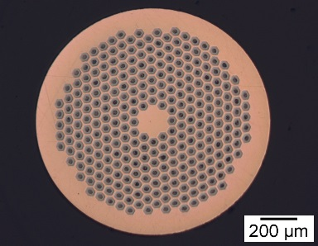
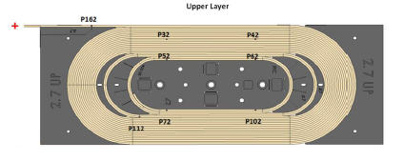
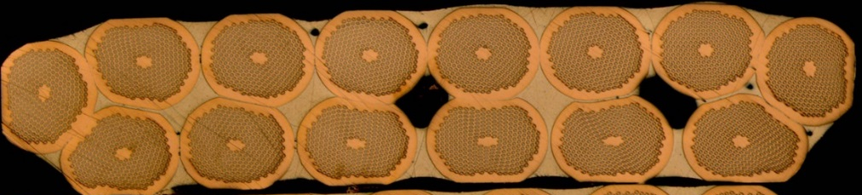
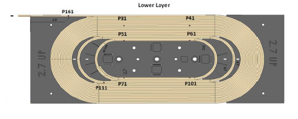
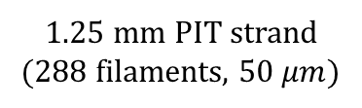
TE-MSC-TF
Scope
Modelling the propagation of a quench in the context of a protection study for Nb3Sn-based magnets foreseen for HL-LHC:
  Hot spot temperature (HST) → 0-D, 2-D, 3-D.
  Quench propagation velocity (QPV) → 3-D Problem.
  Quench heater or spot heater efficiency when the quench is provoked → 3-D Problem.
  Validation of the model with experimental data.
Short Model Coil (SMC) used to test Rutherford cables with PIT strands at high magnetic fields is first addressed in the present study.
14-strand Rutherford cable (10.1 mm x 2.6 mm)
1.25 mm PIT strand
(288 filaments, 50 $μm$)
SMC has two coils, each of them composed by two layers with 21 turns.

Slide 4
TE-MSC-TF
Scope.
Accomplished Activities.
Ongoing Activities.
  Quench Propagation Model.
  Experimental Data Analysis.
  Model Validation.
Planned Actions.

Slide 5
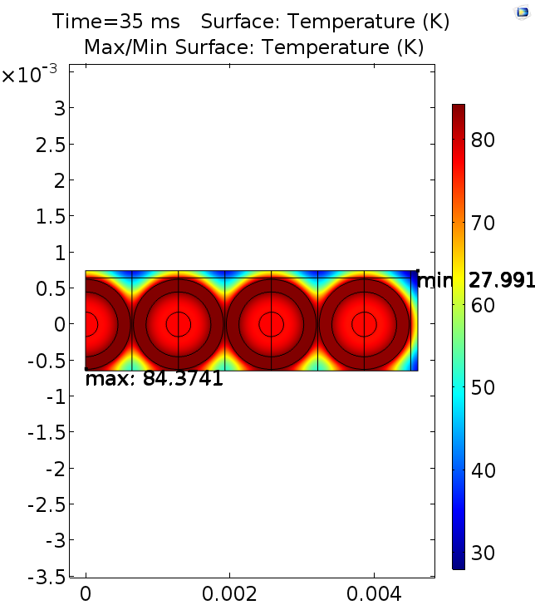
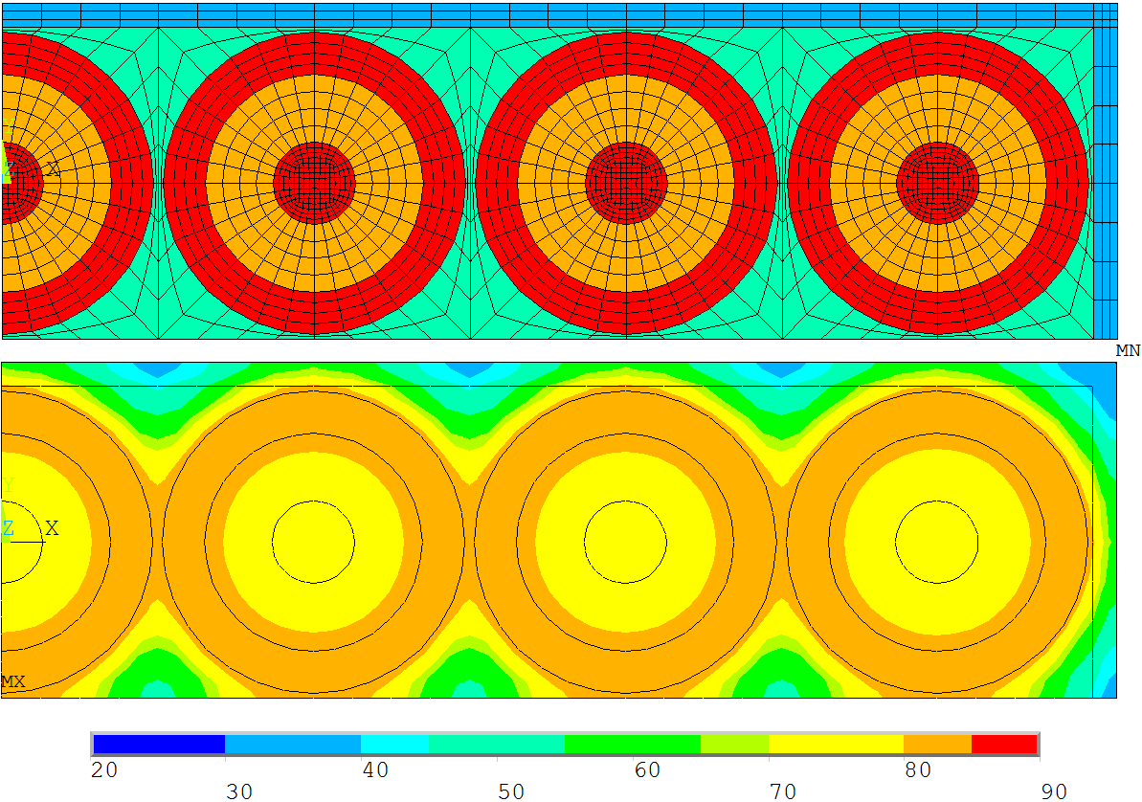
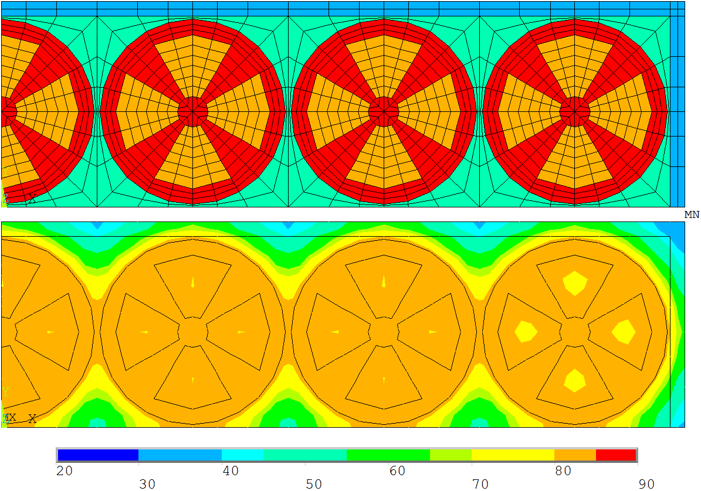
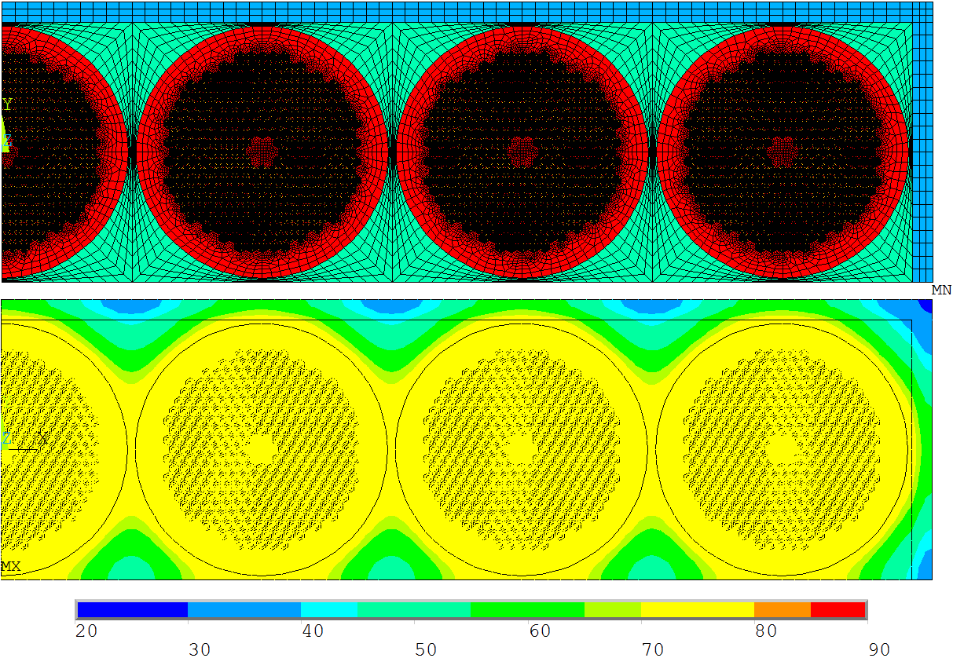
TE-MSC-TF
Hot Spot Temperature Models
Accomplished Activities
  0-D MATLAB model for the hot spot temperature in the cable once the quench has fully propagated.
  2-D Ansys APDL models for the hot spot temperature in the cable section.
Too expensive to simulate quench propagation!
  2-D COMSOL model for the hot spot temperature in the cable section.

Slide 6
TE-MSC-TF
Scope.
Accomplished Activities.
Ongoing Activities.
  Quench Propagation Model.
  Experimental Data Analysis.
  Model Validation.
Planned Actions.

Slide 7
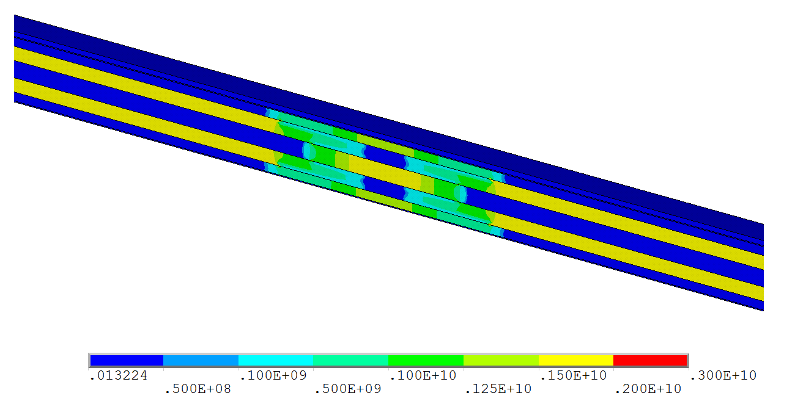
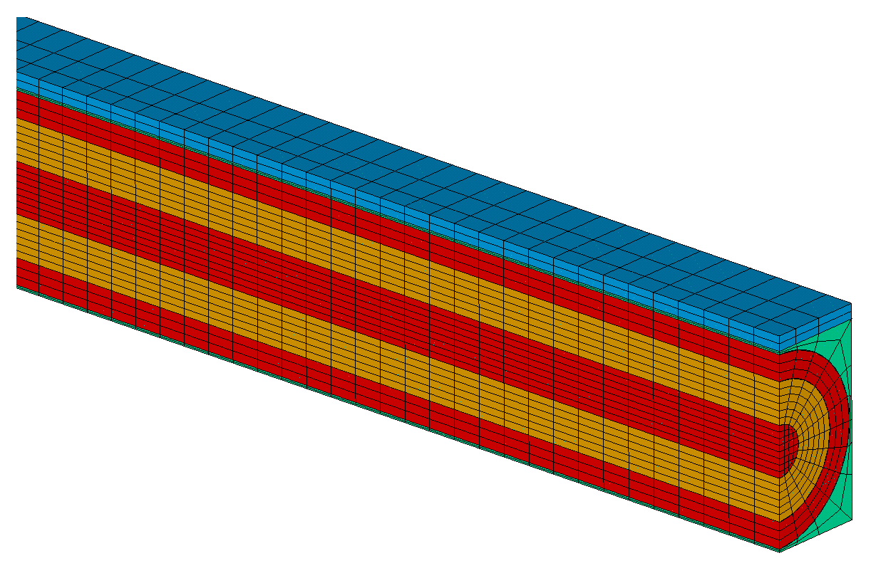
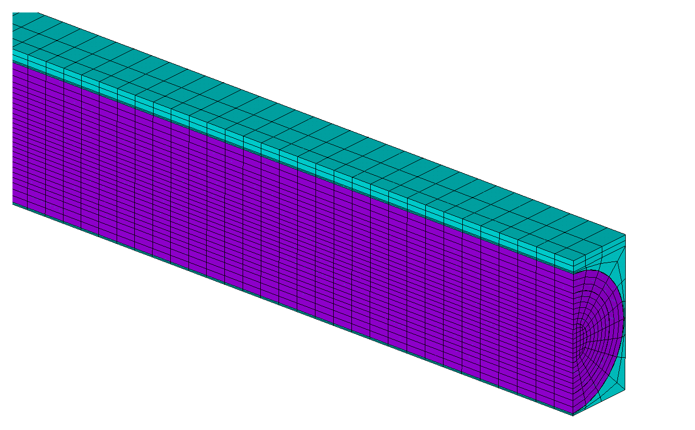
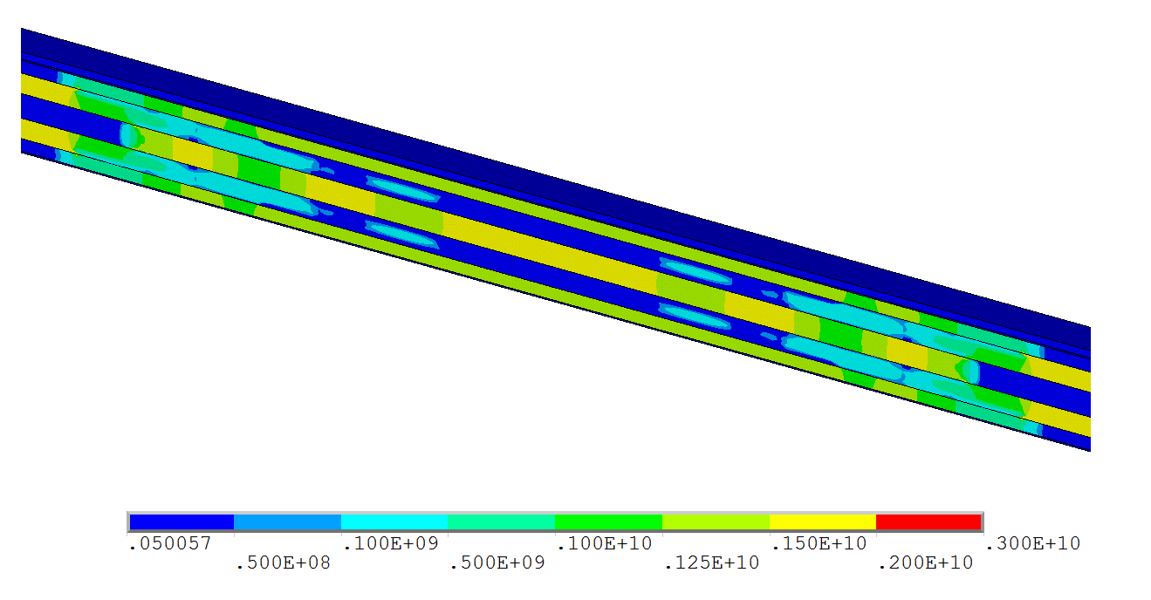






TE-MSC-TF
Quench Propagation Model
Thermal Model
Ongoing Activities:
$$t=0.1 ms$$
  3-D Ansys APDL model for non-provoked quench propagation.
$$ρ_{v}c_{P}\frac{∂T}{∂t}=∇⋅\left(\overset{̿}{K}⋅∇T\right)+ρ_{e}j^{2} over \left\{Ω_{Cu},Ω_{{Nb}_{3}Sn},Ω_{G10},Ω_{S−2}\right\}$$
Electric Model
$$∇⋅\left(\overset{̿}{σ}⋅∇V +ε\frac{∂∇V }{∂t}\right)=0 over \left\{Ω_{Cu},Ω_{{Nb}_{3}Sn}\right\}$$
Current Density (A/m²)
ANSYS SOLID278
3-D 8-Node Thermal Solid
8 nodes 3-D space
DOF: TEMP
$$t=0.3 ms$$
COPPER
Nb₃SN
IMPREGNATION G10
INSULATION S-2
Using just one strand provides with an acceptable approximation for the whole section.
ANSYS SOLID226
3-D 20-Node Coupled-Field Solid
20 nodes 3-D space
DOF: TEMP, VOLT
Current Density (A/m²)

Slide 8
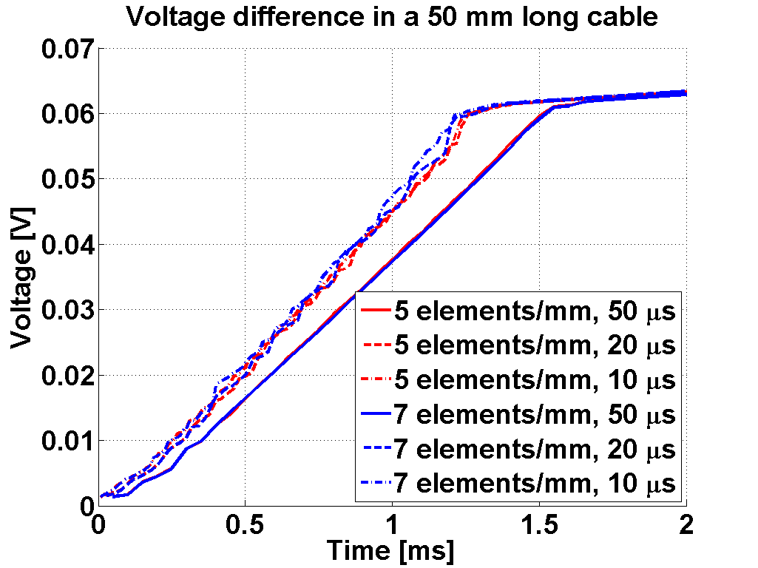
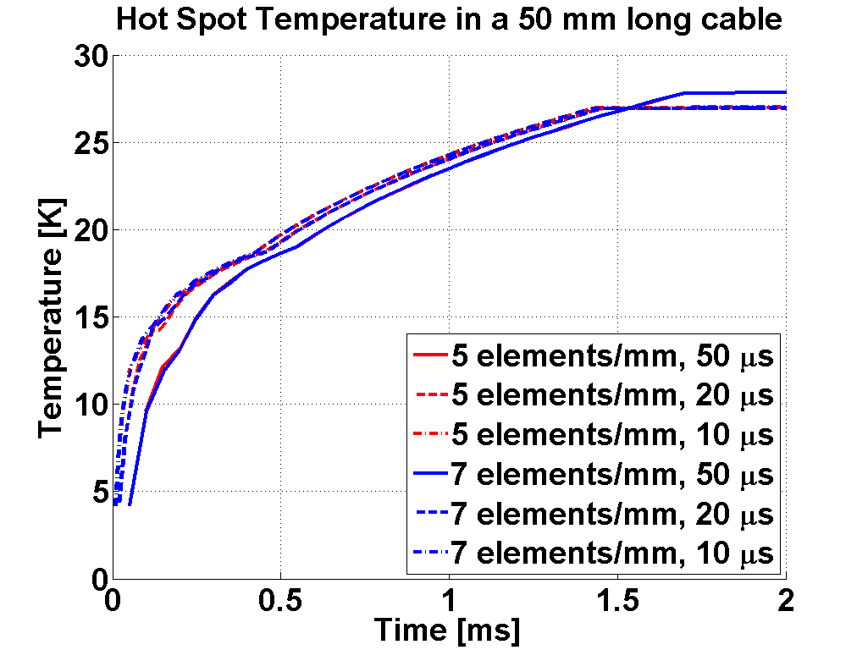
TE-MSC-TF
Quench Propagation Model
Results of interest from simulations are voltage difference between both ends of the cable and hot spot temperature.
The numerical results depends on the problem discretization (mesh density and time step), so that converged solution is reached with 5 elements/mm and 20 μs time step.

Slide 9
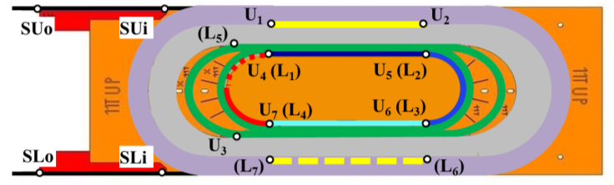

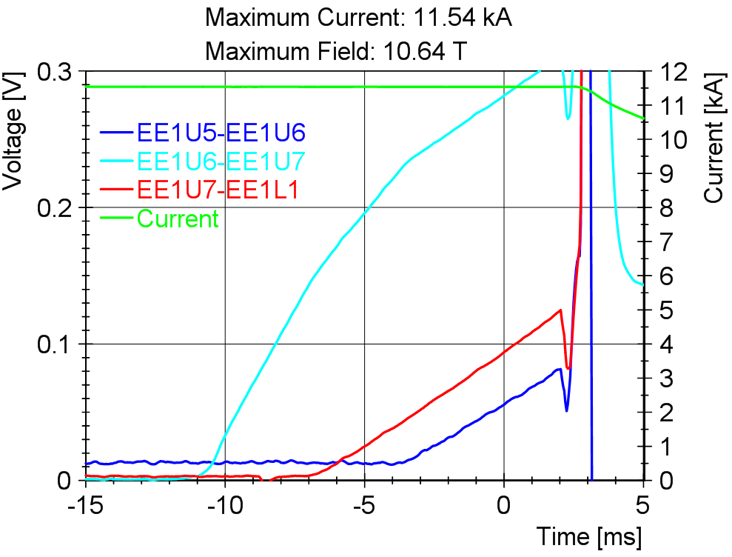
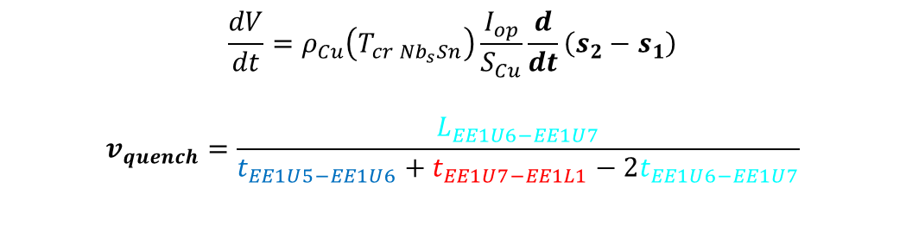
TE-MSC-TF
Experimental Data Analysis
Ongoing Activities:
  Implementation of modules to compute the QPV in the existing SM18 quench analysis software using National Instruments DIAdem.
$$\frac{dV}{dt}=ρ_{Cu}\left(T_{cr {Nb}_{s}Sn}\right)\frac{I_{op}}{S_{Cu}}\frac{d}{dt}\left(s_{2}−s_{1}\right)$$
$$v_{quench}=\frac{L_{EE1U6−EE1U7}}{t_{EE1U5−EE1U6}+t_{EE1U7−EE1L1}−2t_{EE1U6−EE1U7}}$$

Slide 10
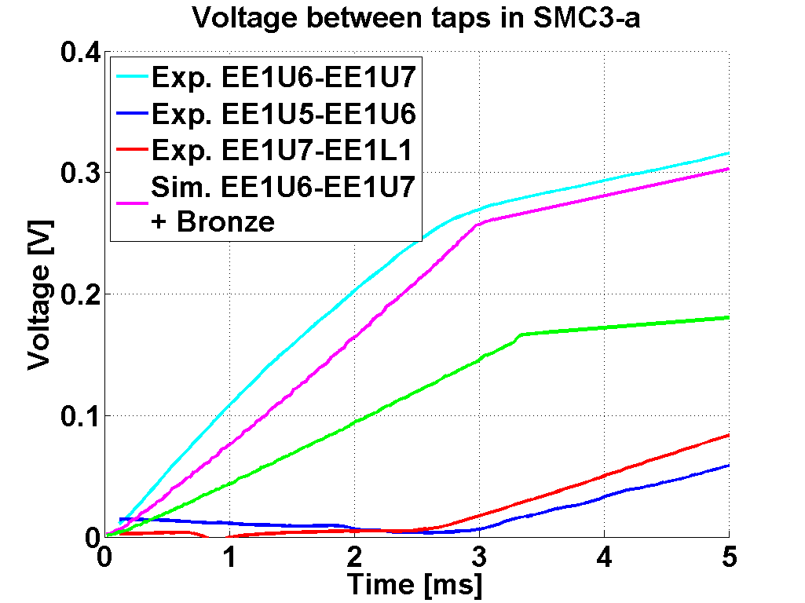
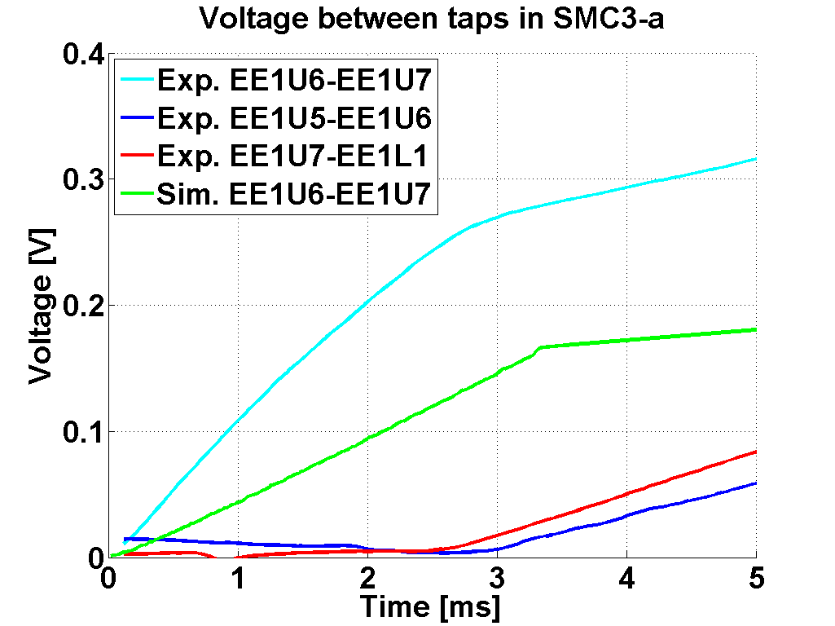
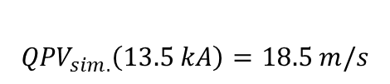



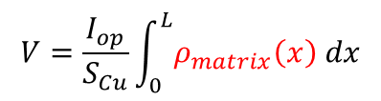
TE-MSC-TF
Model Validation
Validate quench propagation model with experimental data.
$$V_{exp.}=0.27 V$$
$$V_{sim.}=0.16 V$$
$${QPV}_{exp.}\left(13.5 kA\right)=22.5 m/s$$
$${QPV}_{sim.}\left(13.5 kA\right)=18.5 m/s$$
Hypothesis
Because of the high number of filaments in the strand, the copper might have been polluted by tin leakage from broken filaments resulting in some amount of bronze that increases resistivity.
$$V=\frac{I_{op}}{S_{Cu}}\int_{0}^{L}{ρ_{matrix}\left(x\right) dx}$$

Slide 11
TE-MSC-TF
Scope.
Accomplished Activities.
Ongoing Activities.
  Quench Propagation Model.
  Experimental Data Analysis.
  Model Validation.
Planned Actions.

Slide 12
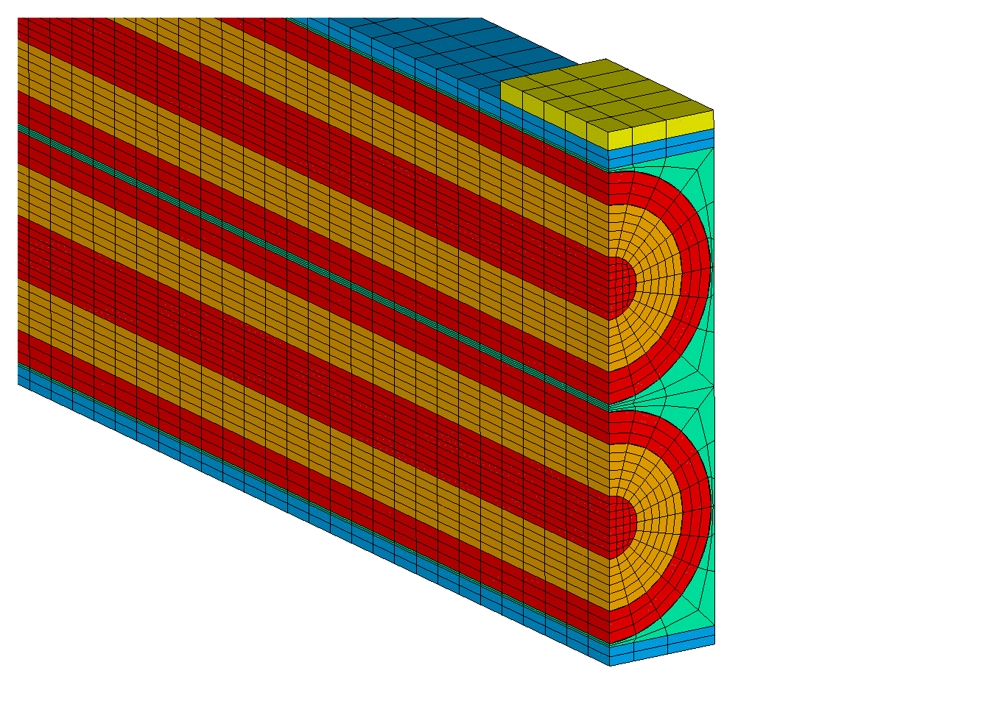
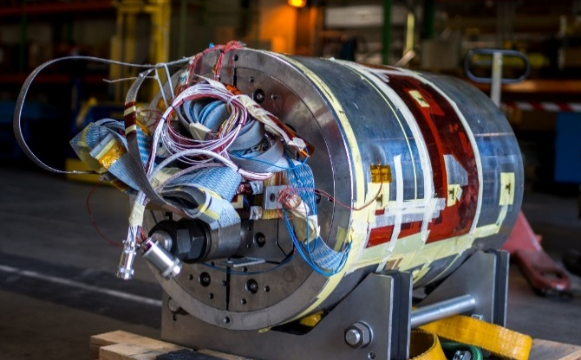
TE-MSC-TF
Planned Actions
Up to now, Boundary Conditions and Mesh are set properly and the quench model works fine.
Moreover, issues regarding numerical parameters and dependence of copper thermal conductivity on magnetic field have been solved.
Main activity in the short term is to study the propagation of a quench provoked by means of a spot heater placed on top of the cable.
  Time for the heater to quench the cable.
  Power needed to start a quench.
Perform a sensitivity analysis of relevant parameters in order to study its influence on QPV and HST.
Try different geometries for the strand section with constant copper/non-copper ratio.
Run simulations on cables models from other Nb₃Sn-based magnets and compare with experimental data:
  SMC11T.
  RMC.
  11T.
  QXF.
COPPER
Nb₃SN
IMPREGNATION G10
INSULATION S-2
SPOT HEATER

Slide 13
TE-MSC-TF
THANK YOU

