Slide 1


Slide 2
TE3530
Development and Optimization of Kicker Systems for LIU-Projects
A. Ferrero, T. Kramer

Slide 3
Reminder- What is a kicker magnet?
Fast pulsed dipole magnet for beam deflection.
Used to kick incoming beam to the circulating orbit (injection kicker);
also used to kick the beam out of an accelerator (extraction kicker);
or to merge two beams into one single line. (recombination kicker).
e.g. injection process

Slide 4
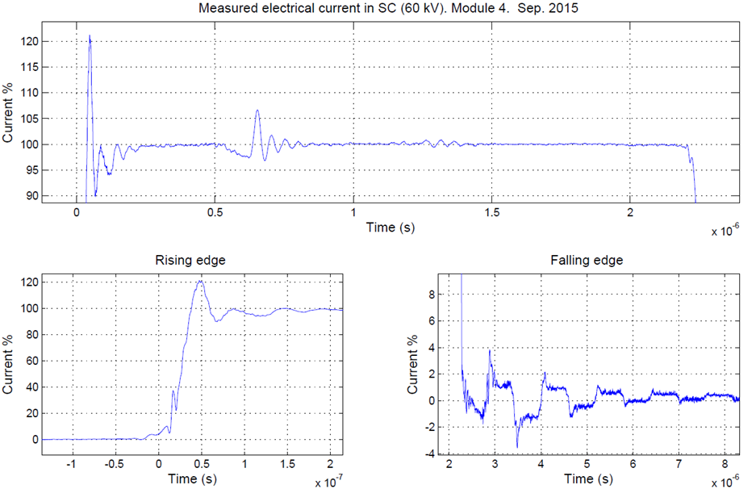
Reminder - Typical limitations and problems with kickers
The magnet filed is switched on only when it is needed to inject, extract or recombine a beam within a particle free gap
Since it is a “fast” pulsed magnet, transmission lines theory must be applied.
Possible issues: Reflections due to line mismatches.
Limitations: Bandwidth defined by system design.

Slide 5
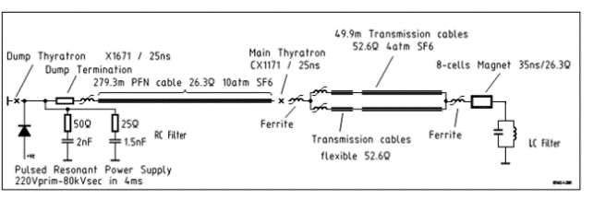
Proton Synchrotron KFA-45 upgrade
Under the LHC Injector Upgrade project, some kicker systems must be upgraded to allow for future 2.0 GeV beam transfer.
More magnetic strength means more ripples and rise time but specification for rise & fall time and maximum system ripples must be respected.
Several improvement possibilities based on simulations were found and presented last time.
Two of them were tested during YETS.

Slide 6
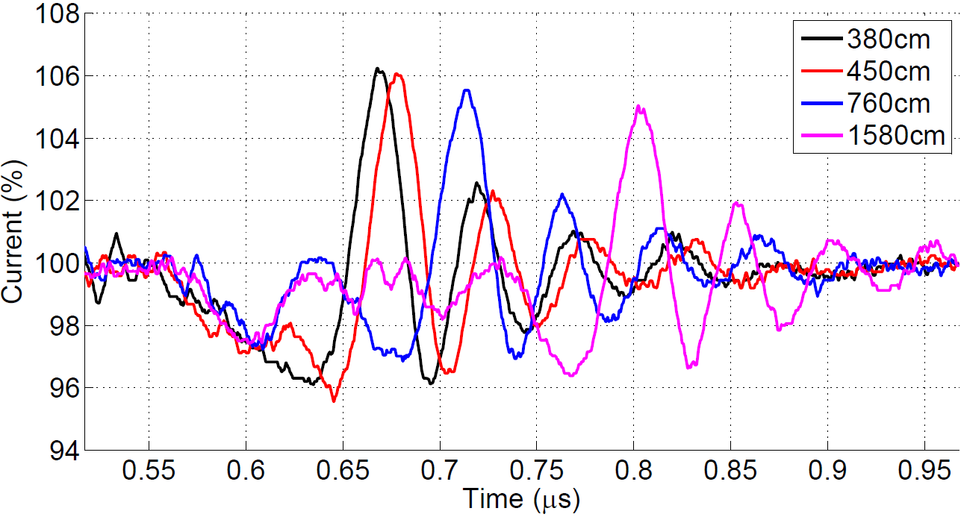
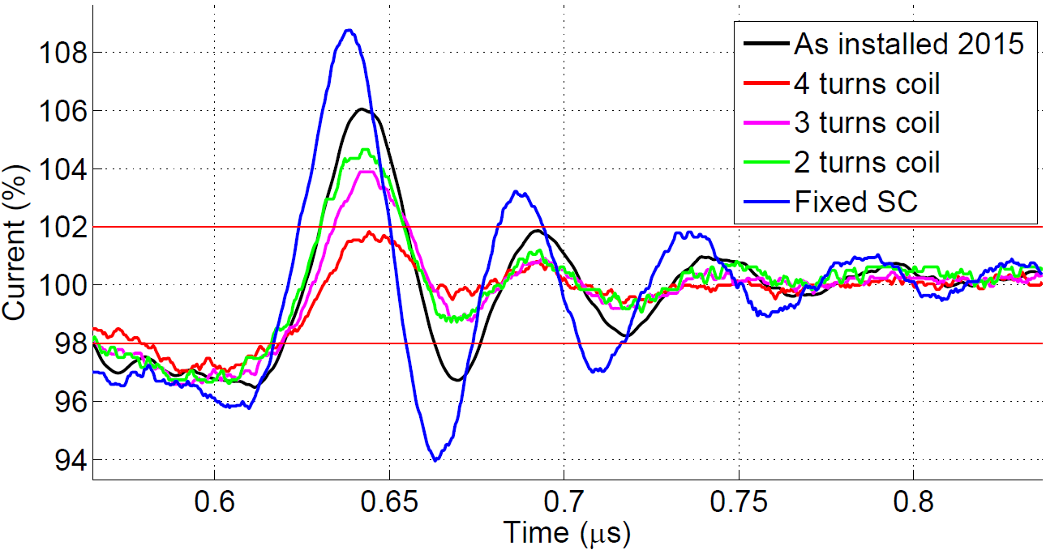
Proton Synchrotron KFA-45 upgrade
Flexible transmission cables mod.
The ripple is shifted in time as predicted by simulations.
Proper configuration of the four generators might cancel out or mitigate oscillations.
LC-filter
Inductance opposes high frequency changes.
Reduction of bandwidth slows down the entire system.
Outcome: Validation of simulation, reduction of ripples from 103.7 to 101.2 %

Slide 7
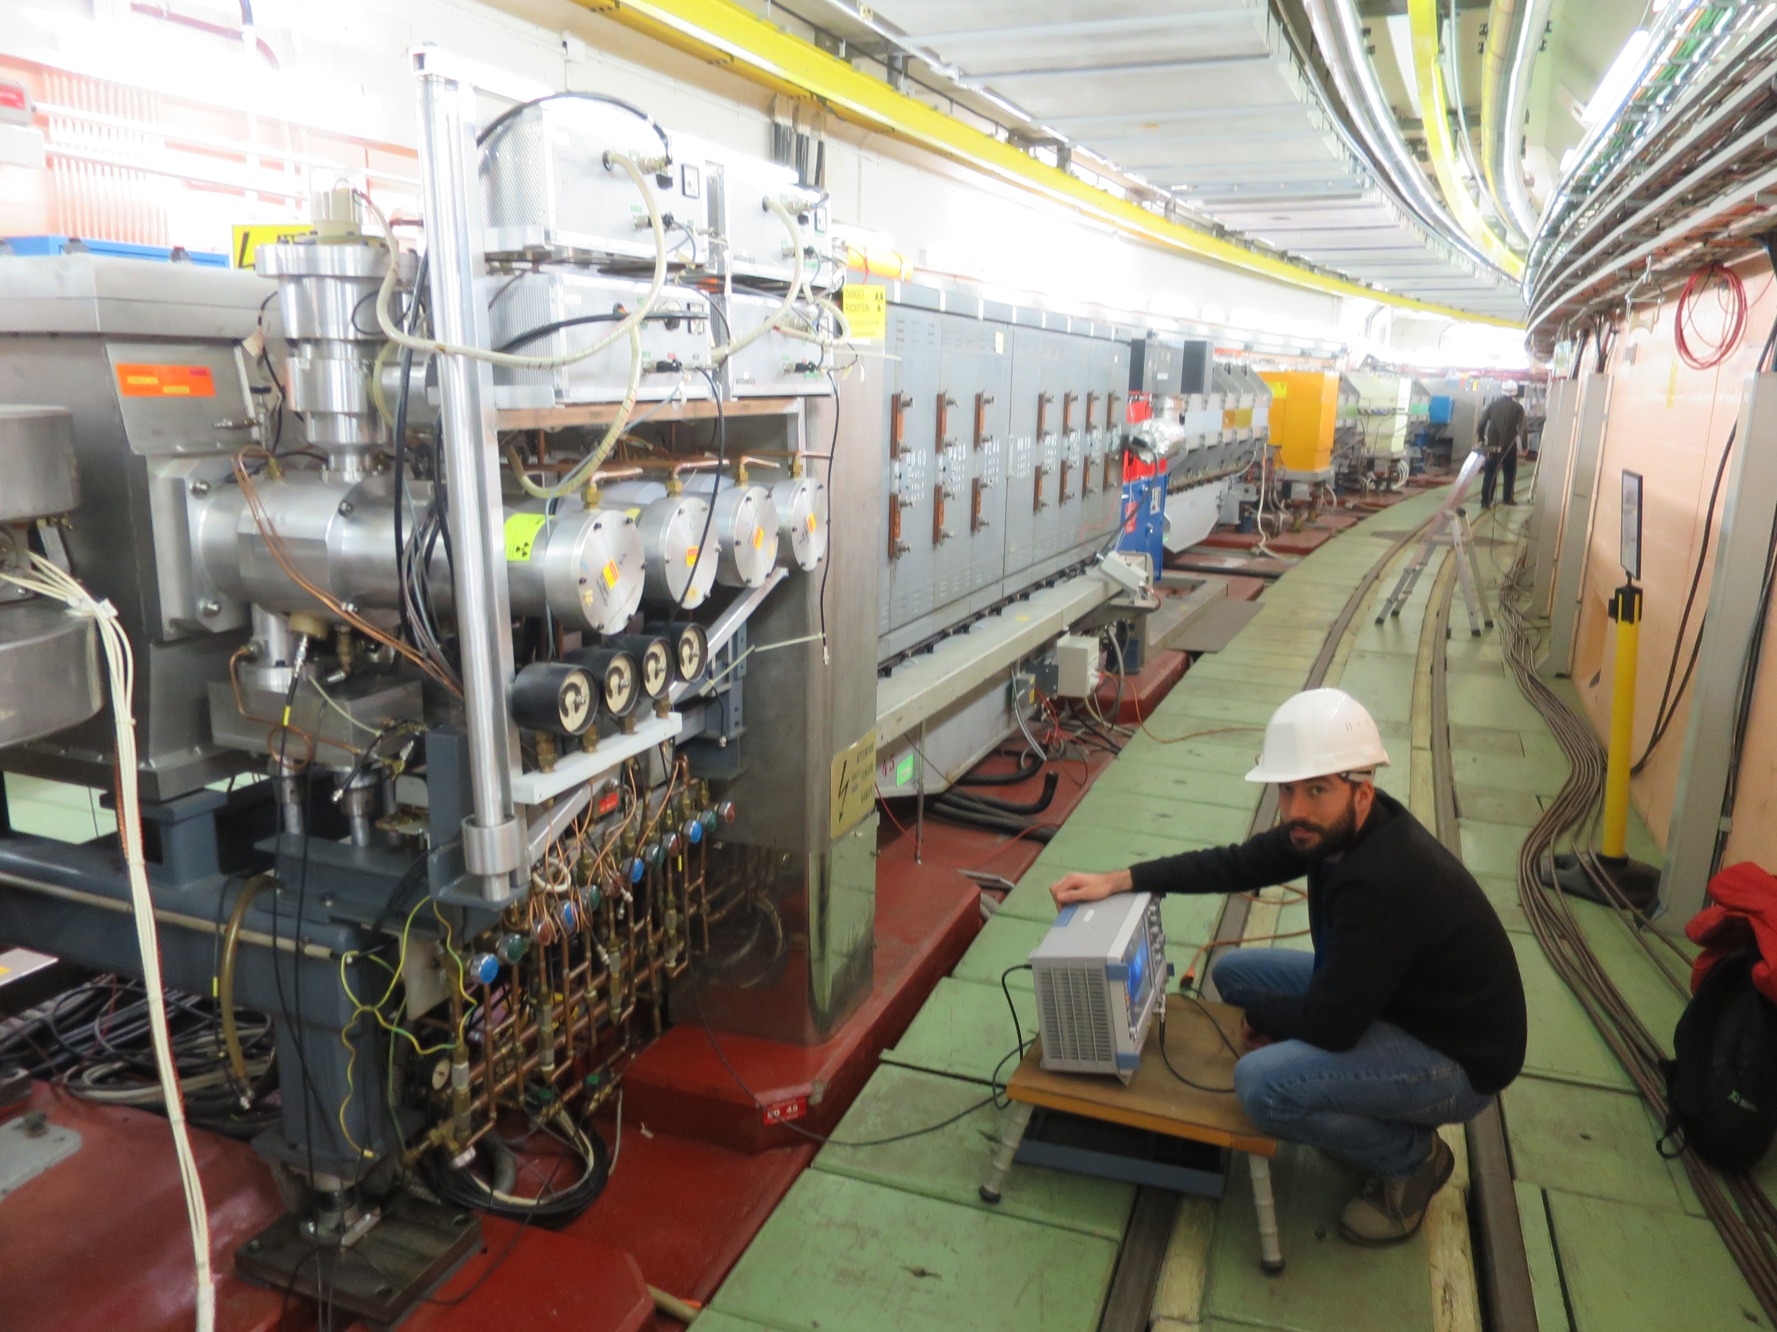
Thyratrons filaments power supply
Magnet
SC-switch replaced by LC Filter
TMR
Hydraulic circuits

Slide 8
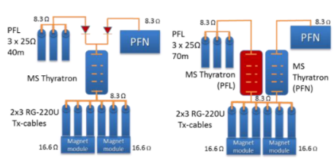
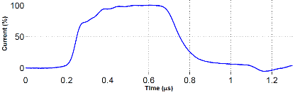
SPS 100ns Ion Injection
Power forming network (PFN) and power forming line (PFL) in parallel.
Two types of interconnection solutions.
Measurements showed slow rising edge.
Outcome:
Simulation model was obtained.
Inductance added by the connection assembly slow down the system.
Low inductive solution need to be developed.
A paper is going to be presented at IPAC conference with all results.

Slide 9
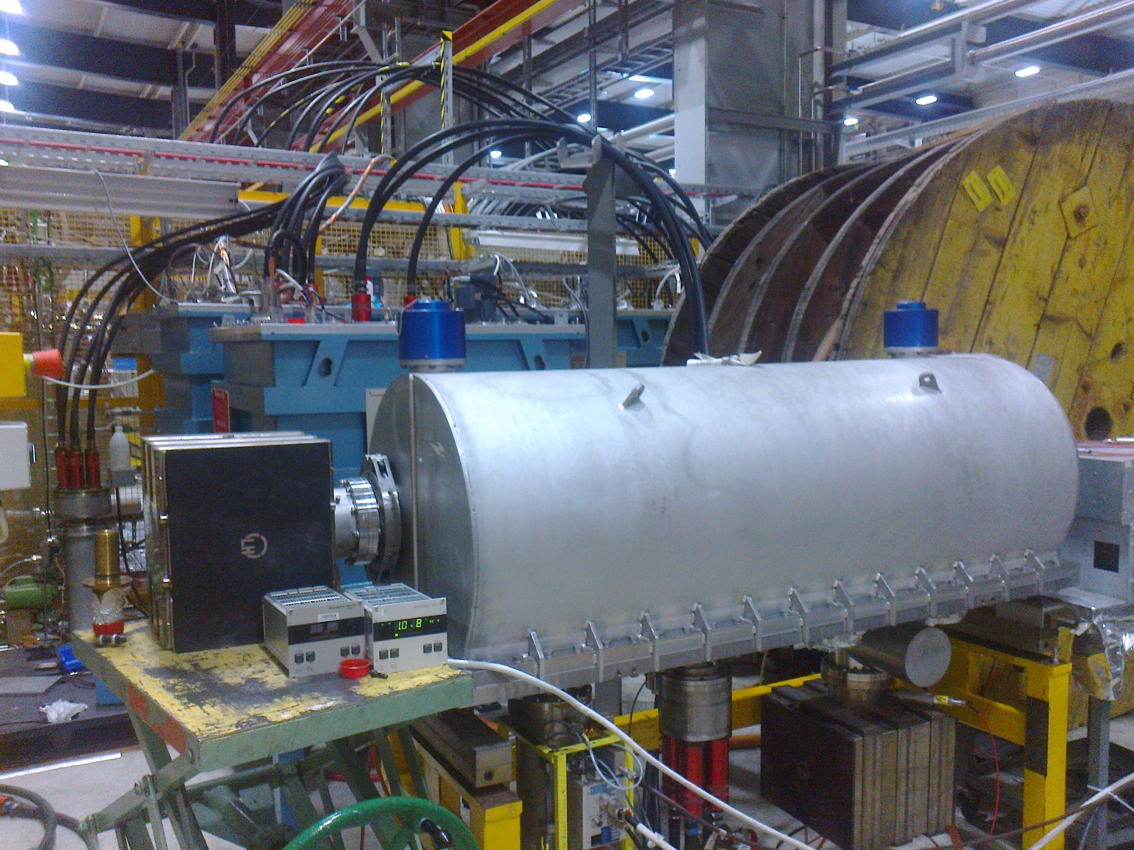
SPS 100ns Ion Injection
Pulse forming line (PFL)
TX cables
MKP switch tank
Magnet tank
Vacuum pumps

Slide 10
Thank you

