Slide 1
Development of redundant components for industrial control systems (EN3444)
Adrian Crestar Santome
Supervisors: Manuel Gonzalez Berges, Jean-Charles Tournier
BE/ICS/SDS 28/04/2016

Slide 2
Table of Contents
Context:
  Typical Control System Architecture
  System availability
  Previous work
Testing software components
What do we need?
Proposed solution
Conclusion & future work

Slide 3
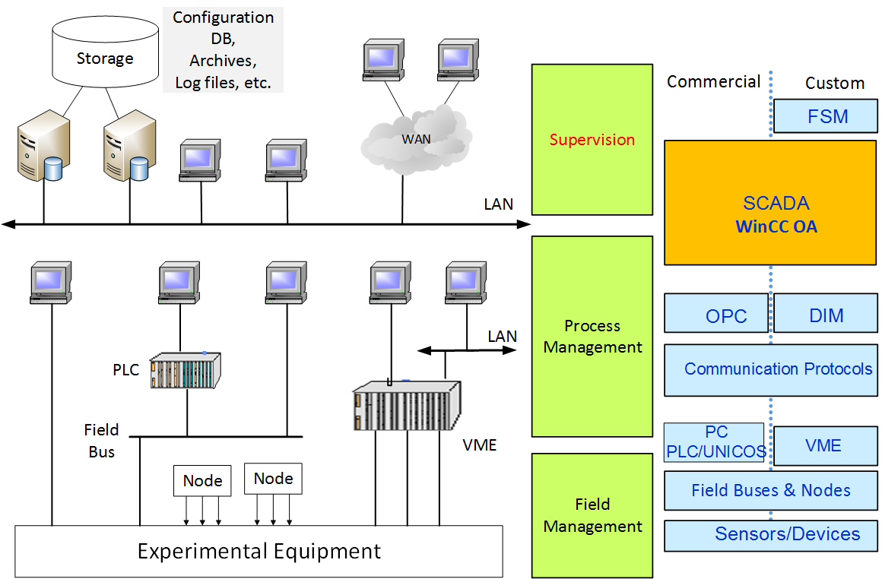
Typical Control System Architecture

Slide 4
System availability
  Two strategies to ensure availability.
  Redundancy: two servers connected to each other, operating permanently, but only one is in an active state.
    If the active server fails the system switches to the passive server.
    Not just a concept. It’s already in use in:
      CMS detector control system
      Electrical network supply.
      Radiation monitoring.
  Disaster recovery: assure that if a system fails, all the operability can be maintained by another system.
    Achieved by a second redundant system assigned to the primary redundant system.

Slide 5
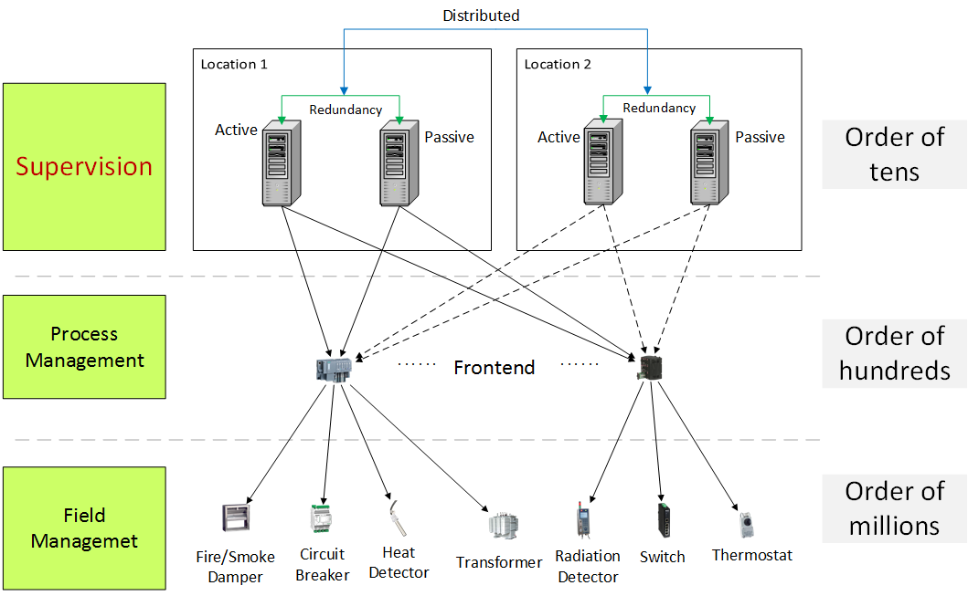
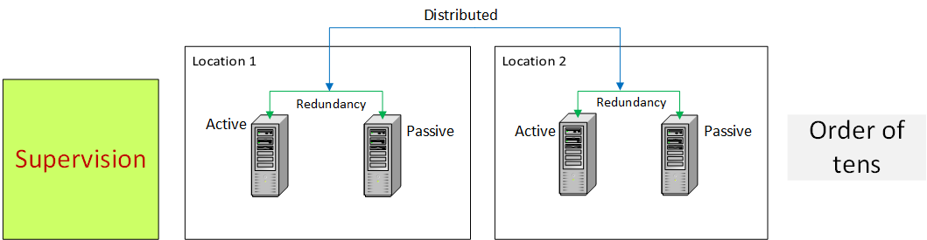
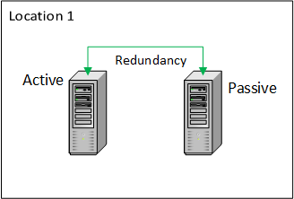
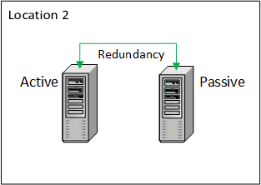
System availability: standard architecture

Slide 6
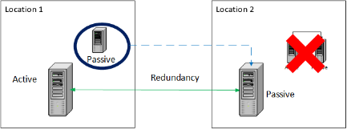
Previous work
Petition from the EN-EL group to come up with a simpler (and less costly) architecture.
But before presenting it, we needed to test the architecture under certain conditions:
  Permanent/transient disconnection.
  Random latency.
What has been done?
  Set up of infrastructure/development of tests.
  Execution of the tests and report with results.

Slide 7
Testing software components
Software is constantly changing and humans make mistakes.
A control system must be guaranteed to work 24/7.
  We must check what we develop!
Testing helps us to find errors and correct them as soon as posible.
But, how to test in a redundant environment?
    Different configurations/situations:
      Redundancy.
      Split mode.
      Permanent/transient disconnection, random latency.
    Setting up the system for a test is not trivial and it’s time consuming!

Slide 8
What do we need?
An automated way of testing our software in a redundant system
  for different configurations
  with the minimum of manual intervention.
With Jenkins:
  Automated software building and testing.
  Already in use in the section.
With Docker:
  Like virtual machines, but more lightweight.
  Simulate a redundant system.
So, let’s mix them together.

Slide 9
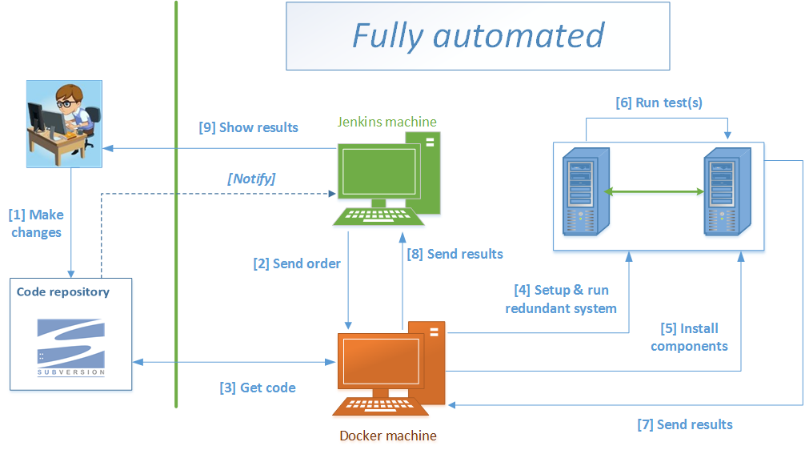
Proposed solution

Slide 10
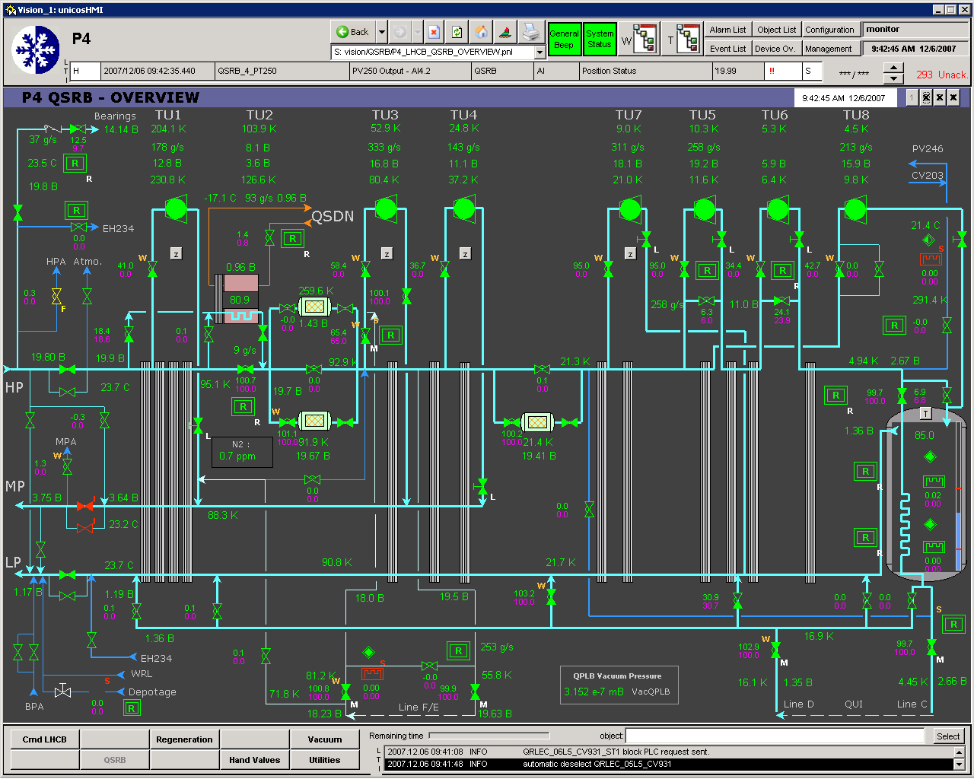
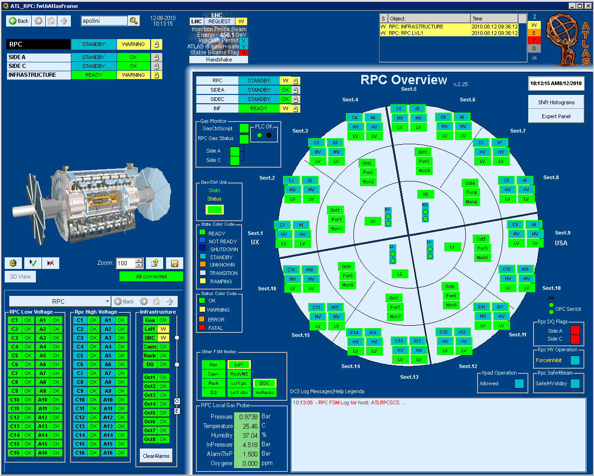
Conclusions & future work
The first version of the environment is
ready to use!
It will make developers more efficient:
  Forget about the set up.
  Test several configurations in one go.
  Completely automated just wait for the results.
Next steps:
  Training session:
    How to use the testing environment.
  Deployment of the proposed disaster recovery architecture for EN-EL.
  Update of existing software components to make them redundant-aware.
  Test bench:
    Real control system with different configurations, physical devices, etc.
    Full scale test.

Slide 11
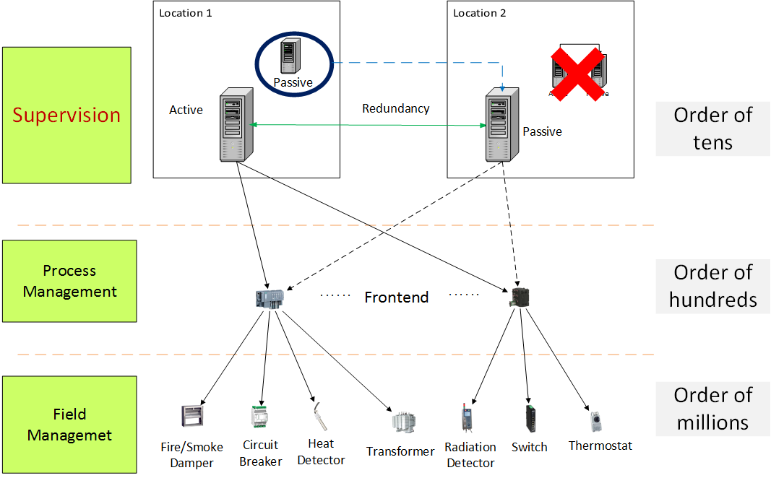
Proposed architecture

Slide 12
Jenkins
Tool for:
  Continuous Integration:
    Changes are immediately tested and reported.
    Detect errors and notify the developer.
  Continuous Delivery:
    Produce software in short cycles.
    Build/test/release faster.
Helps building and testing software projects.

Slide 13
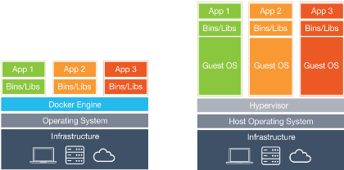
Docker
Building/shipping applications using containers.
Container?
  Provides a complete system that contains everything a software needs to run.
Similar to virtual machines, but:
  not the whole filesystem.
  reuse things.
  provide what’s missing!

Slide 14
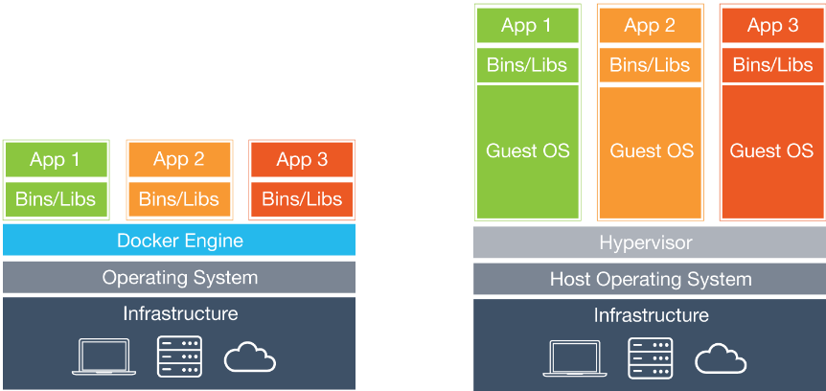
Docker vs Virtual machine

