Slide 1


Slide 2
Optimization of Quadrupole Resonator &
Calibration of High Resolution Phase Shifters
Veronica del Pozo Romano
Supervisor: Frank Gerigk
Group: BE-RF-LRF

Slide 3
QPR Optimization: Overview
Superconducting cavities are generally made of Niobium thin films. Therefore, measuring the RF properties of Niobium and other SC materials is needed.
The Quadrupole Resonator is a four-wire transmission line half-wave. It was constructed in 1997 to measure the surface resistance of niobium samples at 400 MHz, the technology and RF frequency chosen for the LHC.
The Helmholtz Zentrum in Berlin (HZB) has already designed an upgraded version based in CERN’s geometry.
The goal is to optimize the current QPR starting with the enhancements investigated by HZB.

Slide 4
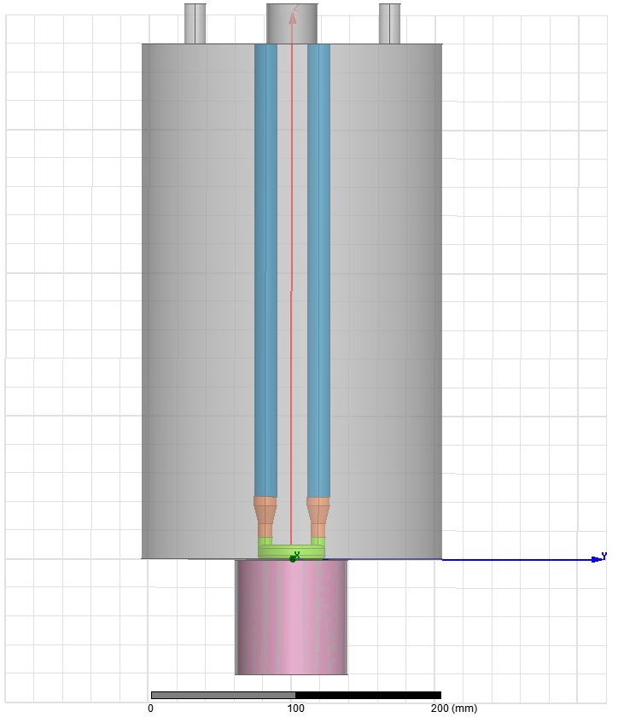
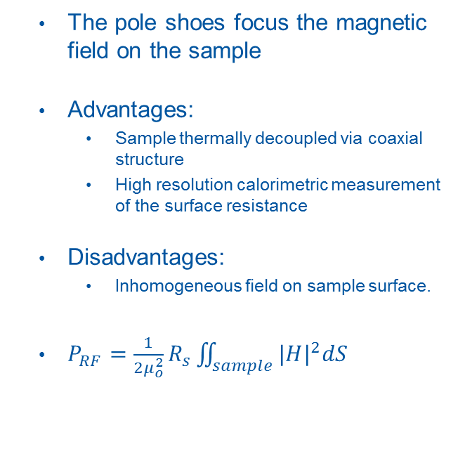
QPR Optimization: Geometry
The pole shoes focus the magnetic field on the sample
Advantages:
  Sample thermally decoupled via coaxial structure
  High resolution calorimetric measurement of the surface resistance
Disadvantages:
  Inhomogeneous field on sample surface.
$P_{RF}=\frac{1}{2μ_{o}^{2}}R_{s}\iint_{sample}{{|H|}^{2}dS}$
Resonator cavity
Hollow rod
Transition piece
Pole shoe
Sample
Calorimeter

Slide 5
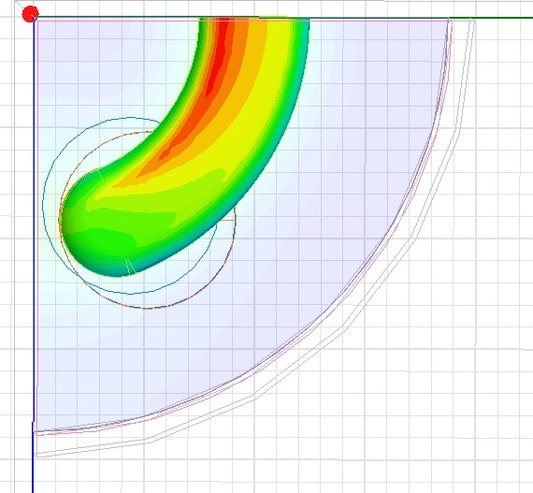
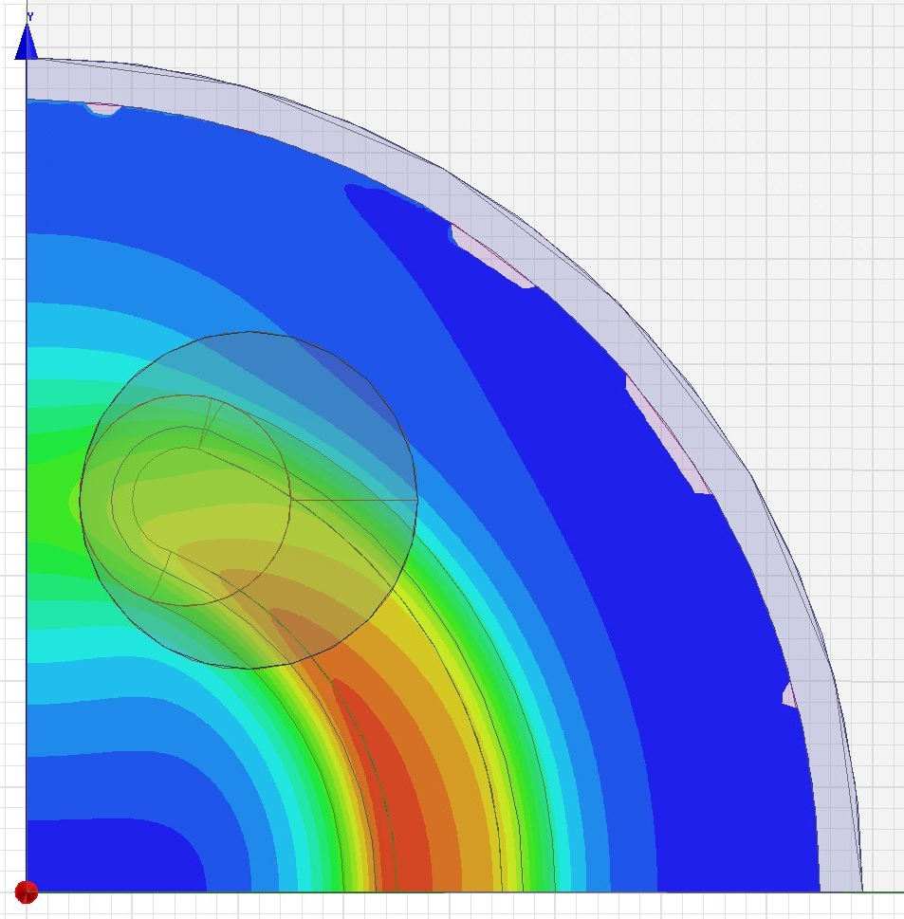
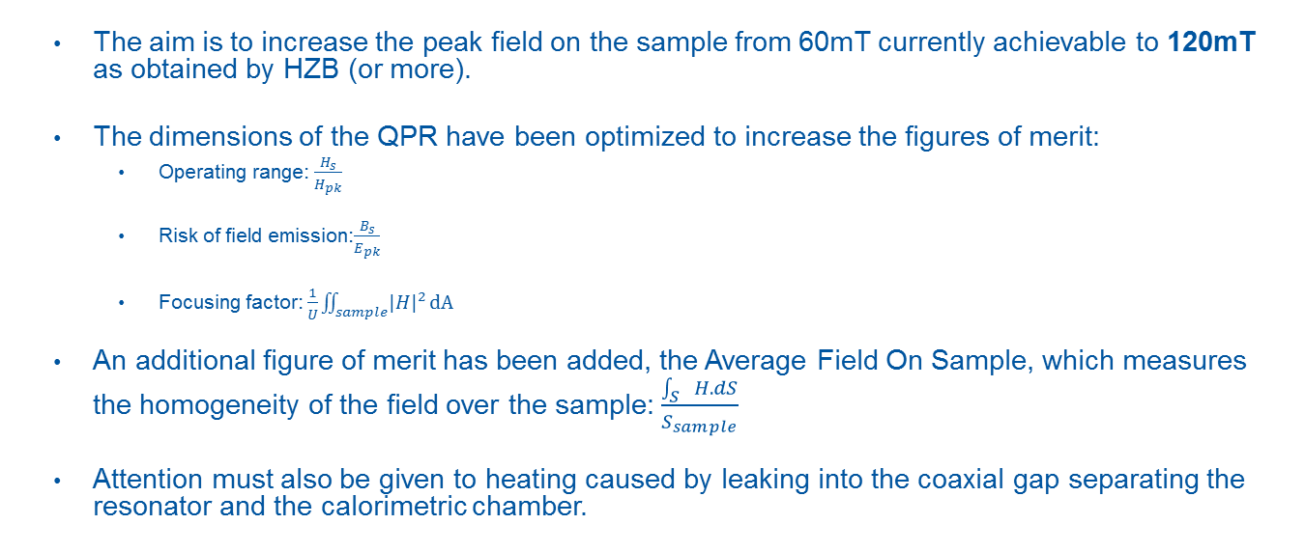
QPR Optimization: RF considerations
The aim is to increase the peak field on the sample from 60mT currently achievable to 120mT as obtained by HZB (or more).
The dimensions of the QPR have been optimized to increase the figures of merit:
  Operating range: $\frac{H_{s}}{H_{pk}}$
  Risk of field emission:$\frac{B_{s}}{E_{pk}}$
  Focusing factor: $\frac{1}{U}\iint_{sample}{{\left|H\right|}^{2}}dA$
An additional figure of merit has been added, the Average Field On Sample, which measures the homogeneity of the field over the sample: $\frac{\int_{S}{H.dS}}{S_{sample}}$
  Attention must also be given to heating caused by leaking into the coaxial gap separating the resonator and the calorimetric chamber.
B field distribution over pole shoe and sample
Normalized to 60mT
Notes:
Ideally the operating range should be high to reach a high field on the sample for the quench field on the QPR.
High Focussing factor means that the magnetic fields in the resonator are concentrated strongly on the sample and thus increases the resolution of the measurement.
The new figure was added because we though the focussing factor was not completely representing the homogeneity of the field over the sample (as the U vary from one geometry to another), which is actually more important if we want to achieve a better resolution.

Slide 6
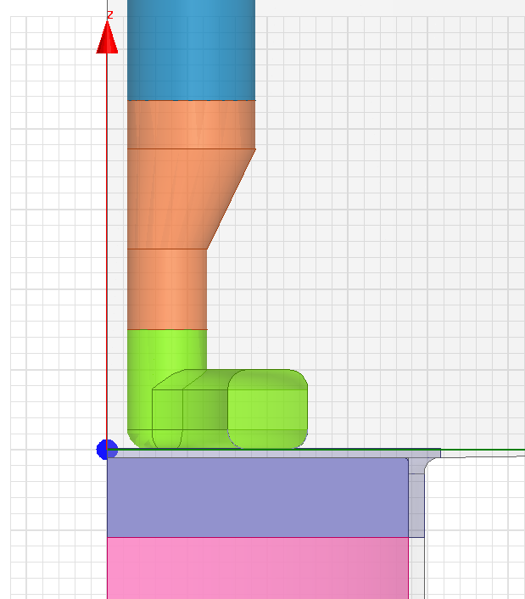
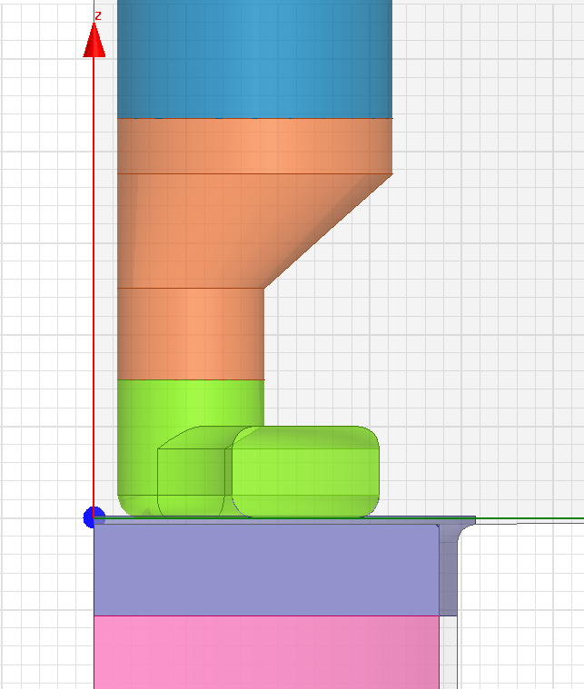
QPR Optimization: Final Design
Full parametrized HFSS model
The parameters that had a noticeable effect on the magnitude of the fields are the gap distance and the rod’s radius.
Modifying the width of the pole shoes improves the field distribution over the sample.
The rods’ height is modified for re-tuning.
3
Parameter | Original | New
1. Pole shoe radius | 20 mm | 23 mm
2. Pole shoe width | 10 mm | 16 mm
3. Rode radius | 8 mm | 15 mm
4. Gap | 1 mm | 0.7 mm
Rods height | 316.5 mm | 310.5 mm
Material | Nb different RRR* | NbRRR300
2
1
4
Original geometry
New geometry
* Residual Resistance Ratio
Notes:
HFSS is the software used for the simulations

Slide 7
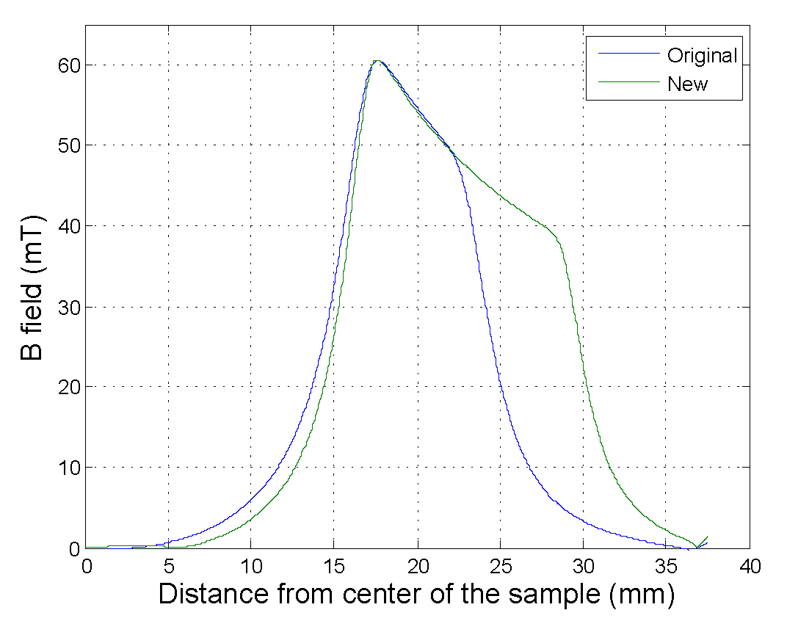
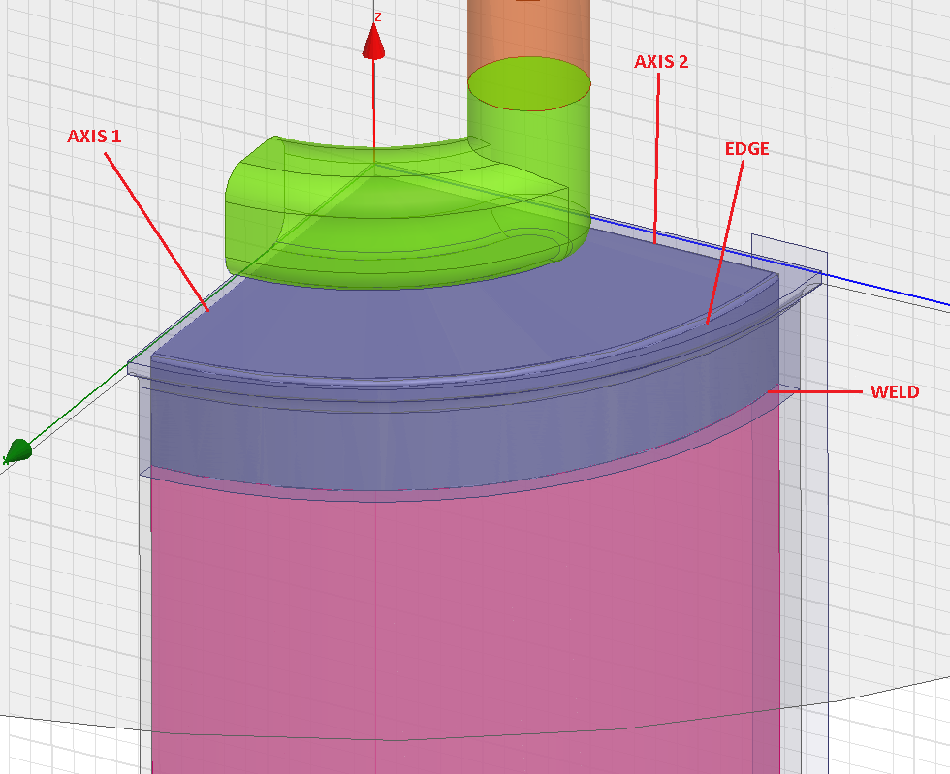
QPR Optimization: Results
B-Field distribution over axis 1
original vs. new pole shoe
Figure of merit | Original design | New design
Resonant frequency [MHz] | 399.7 / 803.3 / 1211 | 398.2 / 806 / 1224
H_{ss}/H_{pk} | 0.87 | 0.91
B_{ss}/E_{pk} [mT/MV/m] | 4.00 / 4.00 / 4.22 | 5.28 / 5.28 / 5.40
Focussing X*10⁻⁷[A²/J] | 4.64 / 4.54 / 4.74 | 6.30 / 5.75 / 5.80
Average field on surface | 16.4mT | 22.5mT
Leak field on the weld | 1.5mT | 2.5mT
All the figures of merit increase.
The field is better distributed over the sample’s surface.
The cavity is tuned within the bandwidth of the amplifiers.
The field on the weld is two times higher than in the original design.
Notes:
The weld is between the copper sputtered with the SC sample and the sample holder, made of niobium.

Slide 8
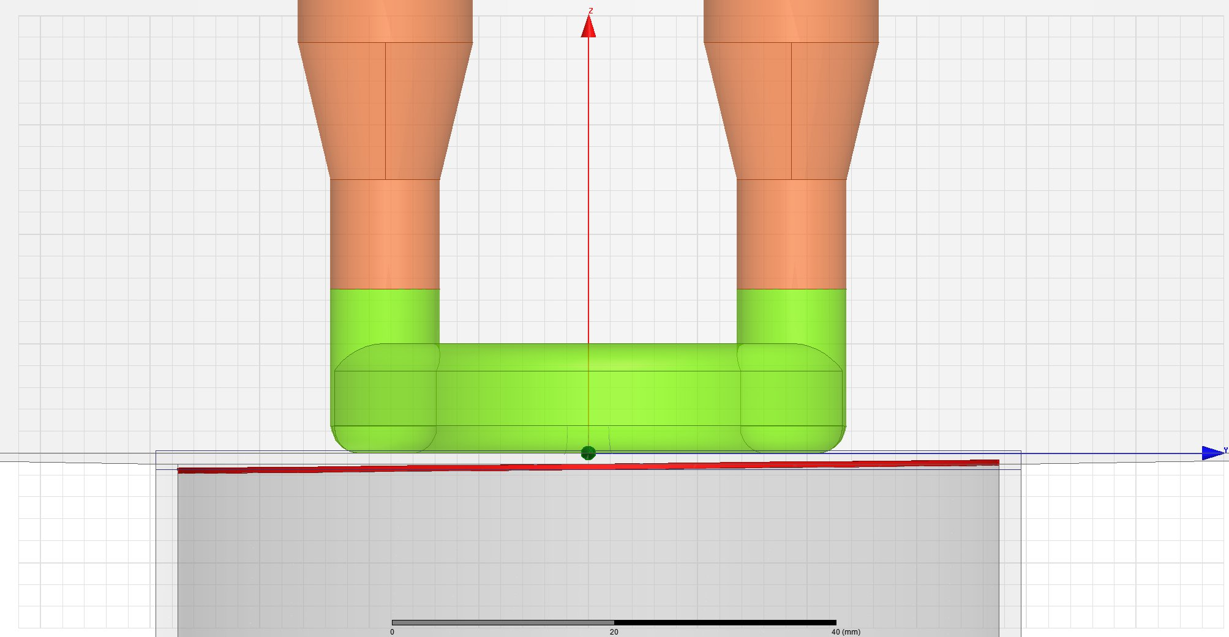
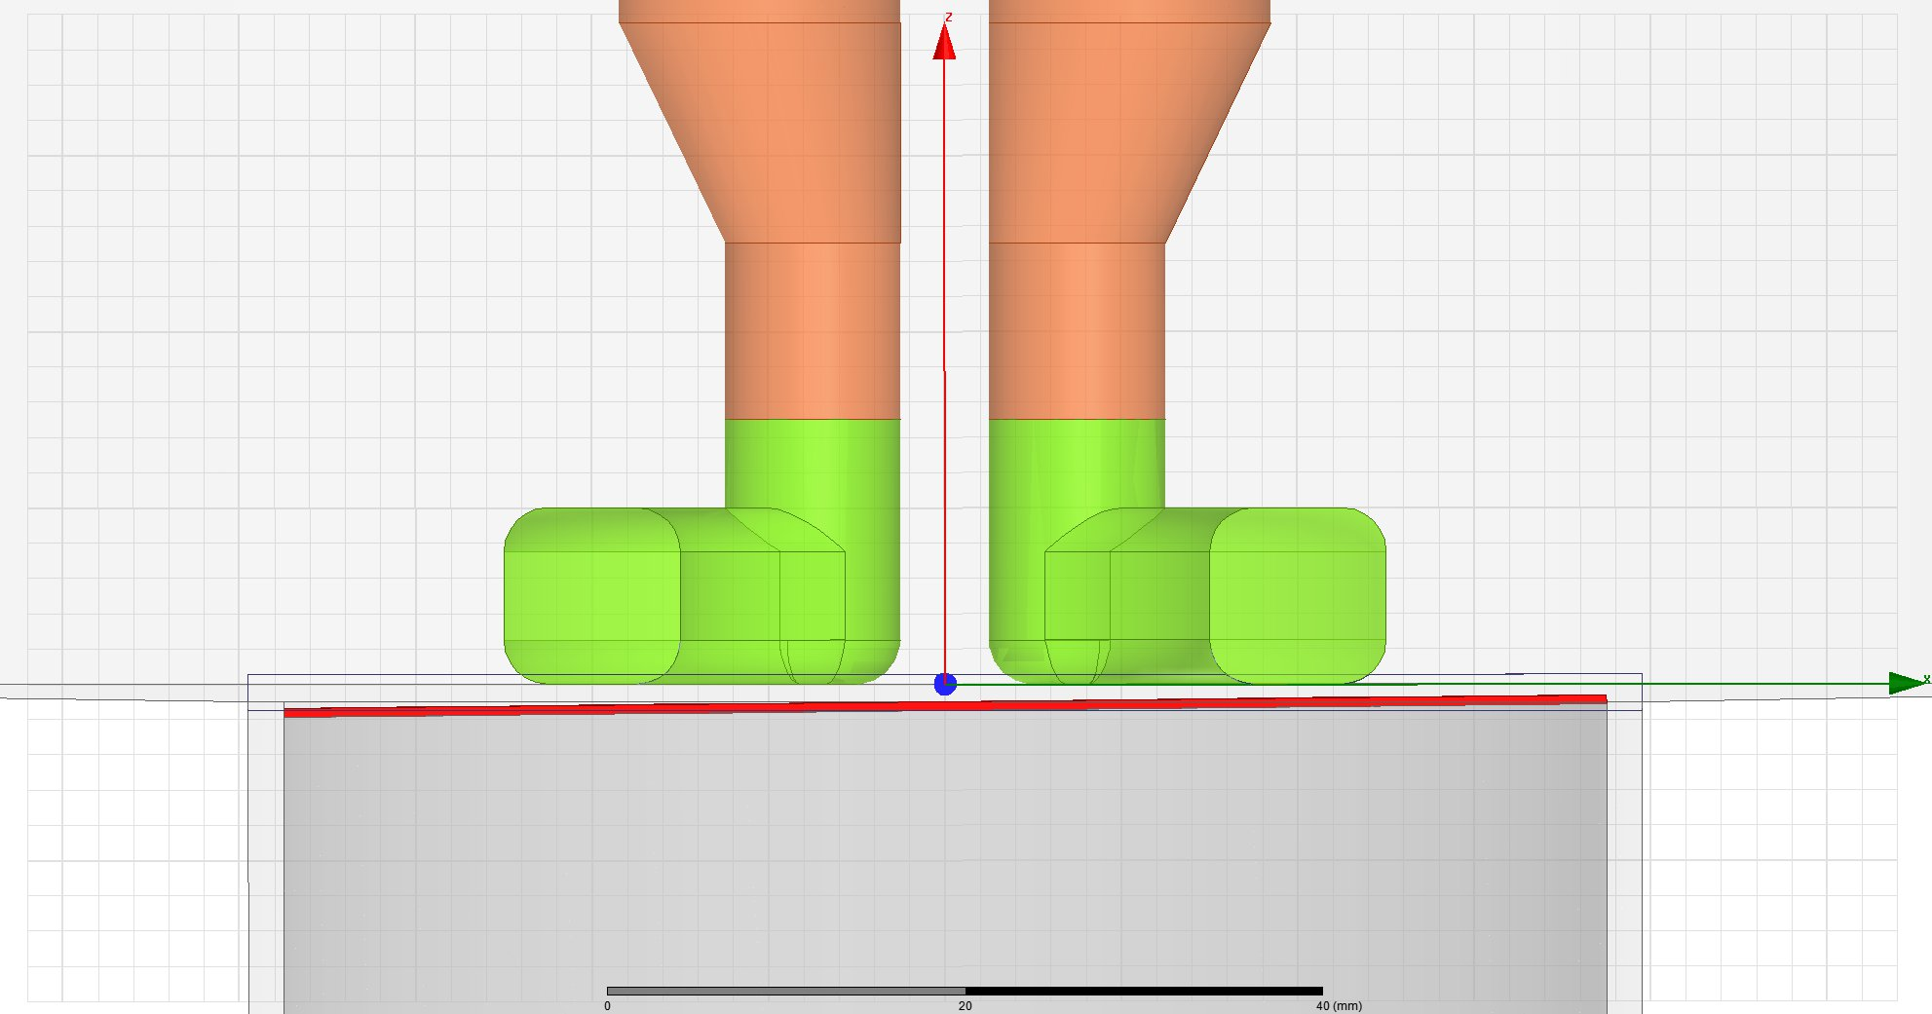
QPR Optimization: Mechanical aspects
The mechanical engineers have already done the first 3D models of the QPR, but in order to build the QPR it is important to know the tolerances for some of the dimensions.
One of the more important issues to be consider is the alignment of the sample with respect to the pole shoes. This alignment could vary every time the sample is changed.
Could this happen?
The alignment measurement campaign showed that the inclination was negligible but the gap was modified in a range of ±100μm
1st mode | 2nd mode | 3rd mode
0.8MHz/100μm | 1.2MHz/100μm | 1.7MHz/100μm
Resonant frequency vs. gap variation

Slide 9
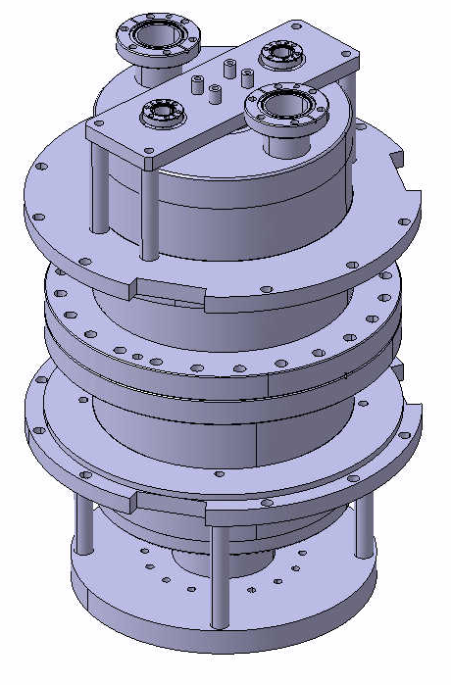
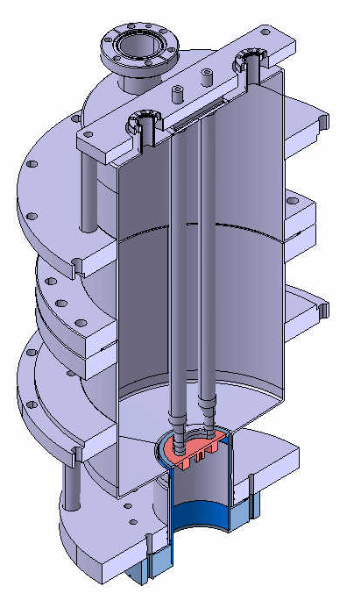
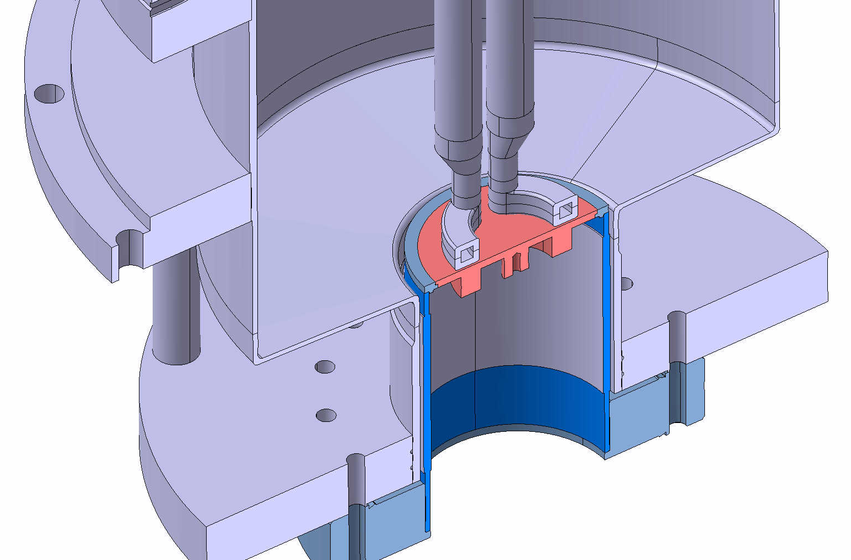
QPR Optimization: 3D images
Courtesy of Ricardo Illan Fiastre (EN/MME)

Slide 10
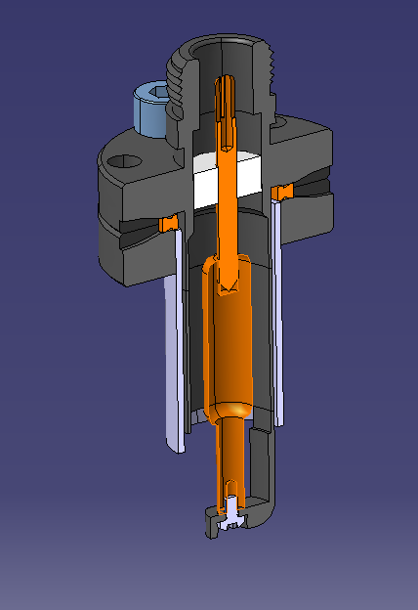
QPR Optimization: Future work
Approval of pole shoe design.
Optimization of the antenna coupling loop.
Inputs from the workshop in charge of the fabrication.
Final mechanical design.
Material purchase and fabrication.
Preliminary design of the antenna coupling loop
Notes:
Some parts will be redesign with the inputs from the workshop in charge of fabrication

Slide 11
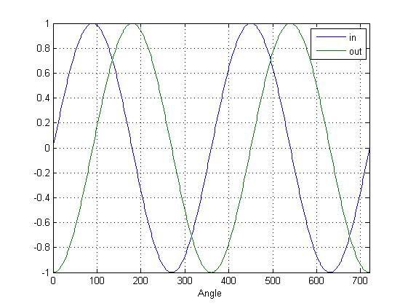
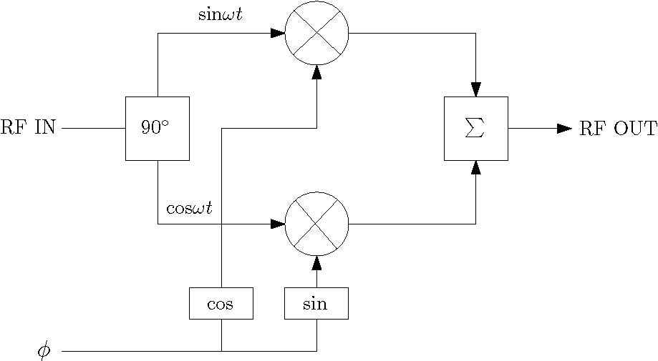
HRPS Calibration: Overview
Phase shifters are used for tuning the phase of the RF frequency before the RF accelerating elements, so that the net effect of the field is accelerating. Used in Linac3.
The HRPS are based on the usual phase shifter scheme:
Phase shift applied electronically.
Two types of HRPS that work at different frequencies: 101.28MHz & 202.56MHz
sin(ωt)
sin(ωt+φ)
Output delayed φ=90º

Slide 12
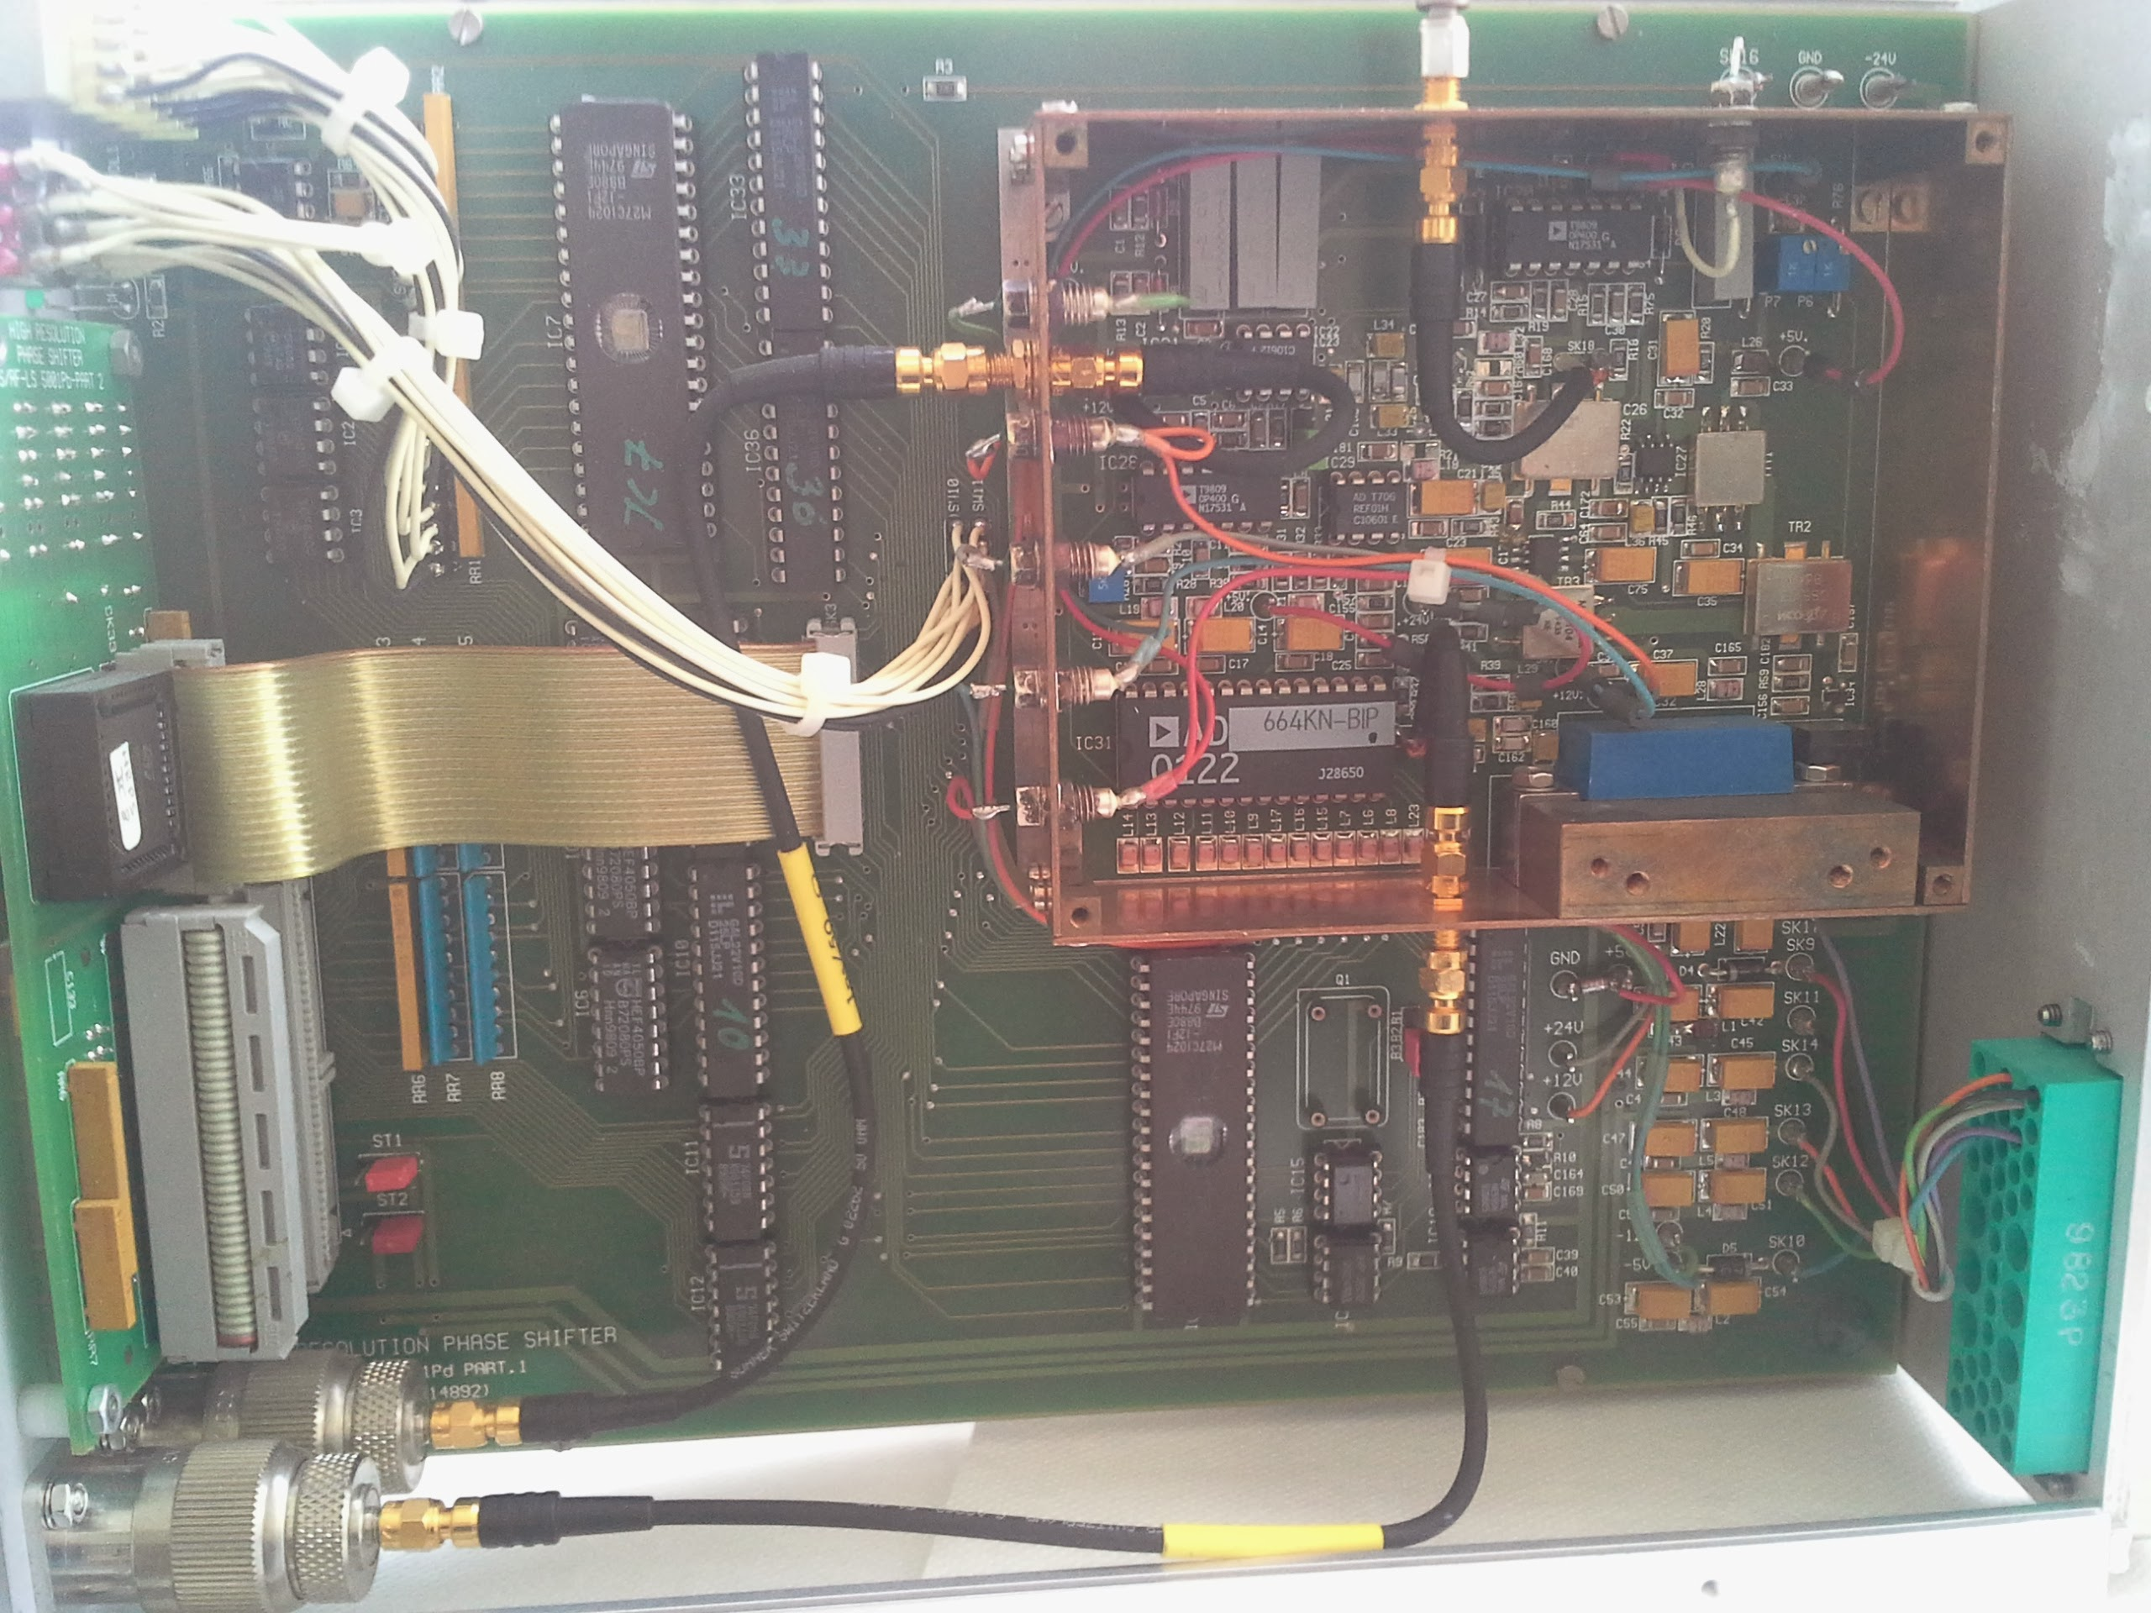
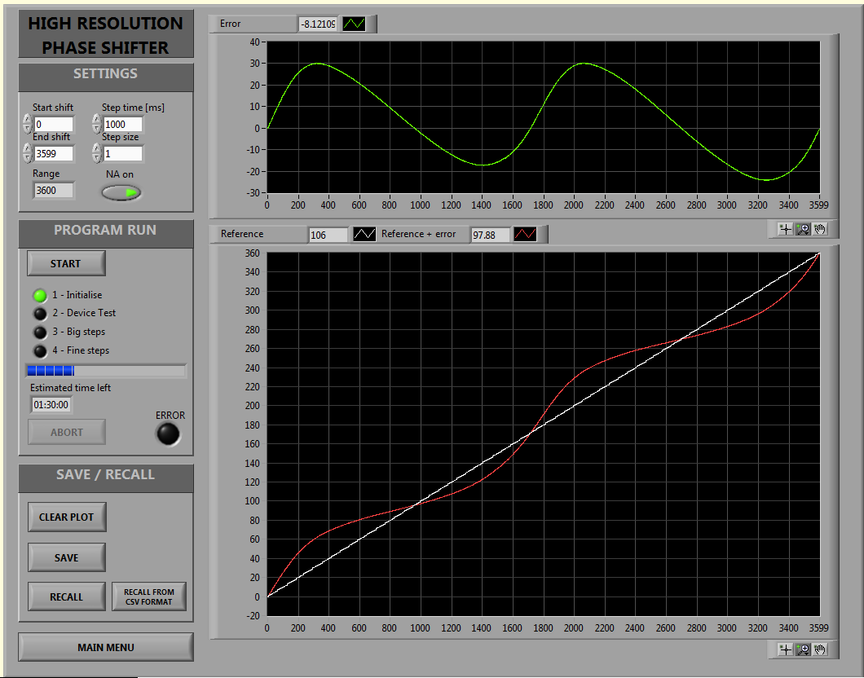
HRPS Calibration: Test and results
Signal generator, oscilloscope and spectrum analyser used for the manual test of the RF part.
Problems found in some of the HRPS:
  The amplifier saturates too soon
  The 12V pin is not connected to the board
  The 90º module is not working
  Broken potenciometer
VNA and LabView software used for the automatic test over the entire phase shift range (0º-360º).
The EPROM contains the cos and sin values of the phase shift. These values can be recalculated and programed in the EPROM for calibration.
5 HRPS have been calibrated and work properly.
3 HRPS need to be fixed.
2 HRPS still under testing.
3 HRPS at 202.56MHz not tested yet.
RF part
Digital part
EPROM

Slide 13
Thank You
Questions?

