Slide 1



Software Developer for Vacuum Control System (BE3528)
Integration Layout information in VacDB-Editor
J. Luis González Arias
Supervisor: André Rocha
28th April 2016

Slide 2
Index
Overview
  Project Description
Status
Challenges
Future work

Slide 3
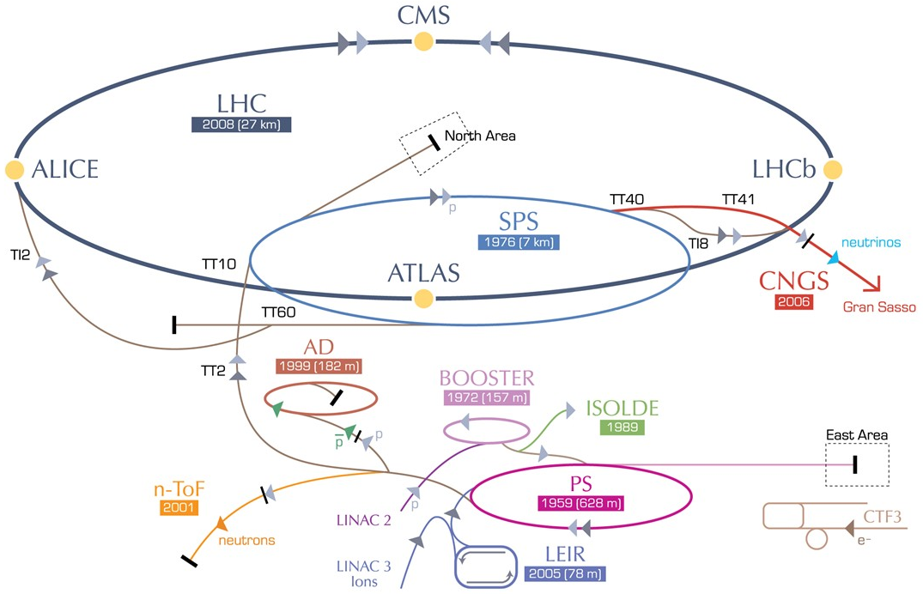
Overview
  Transference to TE-VSC-ICM (January, 2016)
  TE Technology Department
  VSC Vacuum, Surfaces and Coatings Group
  ICM Interlocks, Controls and Monitoring Section
Beam and Insulation vacuum systems
> 128km of vacuum chambers across all accelerators
Pressure range from 10⁻⁴ to 10⁻¹¹ mbar achieved by:
  ~3000 vacuum pumps
  ~3000 vacuum gauges
  ~500 sector valves
How to supervise and control such a large system?
  7 SCADA servers
  ~300 PLCs
  Backboned by vacuum-specific software frameworks

Slide 4
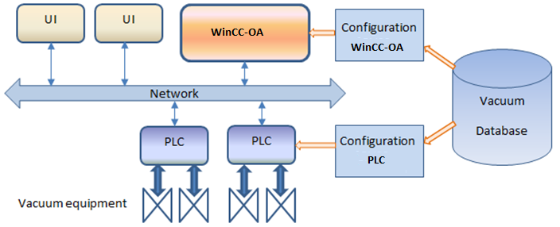



Project description(I)
Motivations
The layout of the control system is currently documented in stand-alone files.
No Hard-links between configuration in DB and these files = prone to inconsistencies
Milestones
Having only one entry point for layout information (vacDB-Editor)
Generating documentation automatically from vacDB (Rack Layout, Layout Diagram, Interlock diagrams)
Requirements
Upgrade the VacDB-Editor so that:
  Layout data can be modified in the database
  Changes in the layout can be tracked
Develop software to generate the documentation
Notes:
Z:\Documentation\Machines\LHC\LHC_Racks

Slide 5

Project description(II)
Tasks:
  Creation of new panels for equipment connections
  Data validation
  Tracking changes in Layout
  Generating automatic documentation
Technology:
  Java
  Jdeveloper
  Swing
  Oracle ADF
  Oracle Database
Methodology:
  Scrum
vacDB-Editor
Master DB
Layout DB
Machine DB
Machine DB

Slide 6
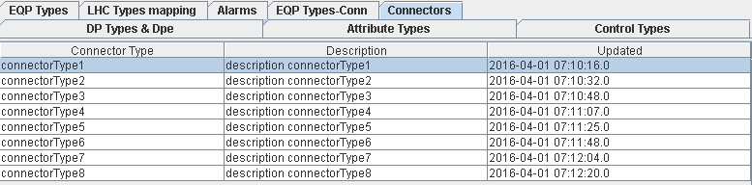
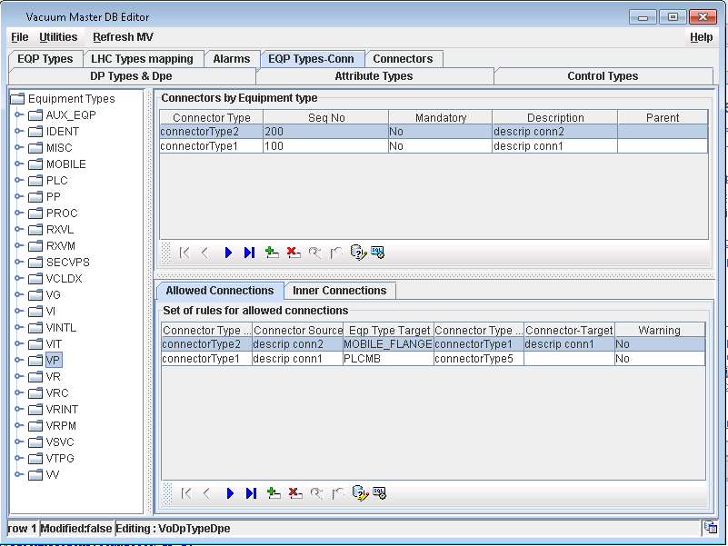
Status(I)
MasterDB Editor

Slide 7
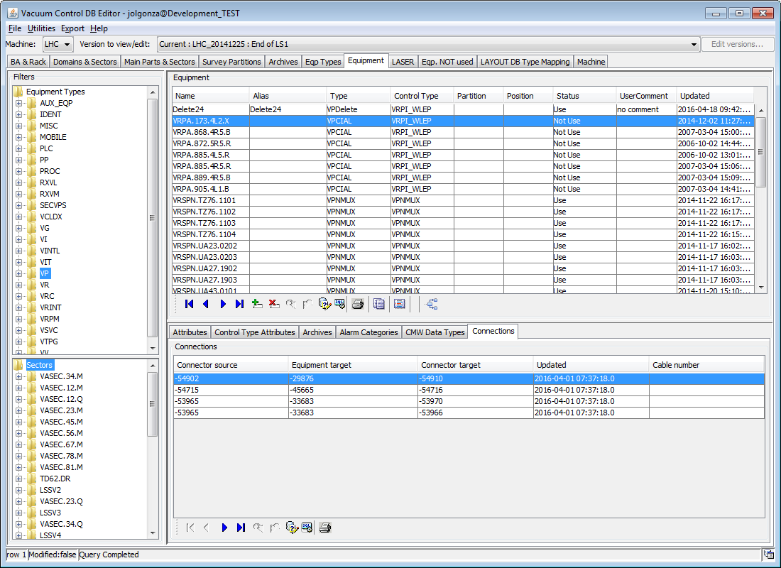
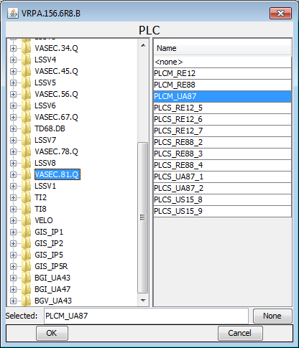
Status(II)
MachineDB Editor

Slide 8

Challenges
Integration with different complex databases
Creating a User-friendly interface
Data validation
Migration between versions
Familiarization with new technologies
Critical environment

Slide 9

Future work
VacDB-Editor
  Finishing all developments to completely integrate the layout information
  Developing a mechanism to track changes.
  Implementing a mechanism to generate automatic documentation.
Other tasks
  Updating the Vacuum Controls Naming Convention, export tool and SCADA faceplates.
  Developing a web interface for VacDB data (extractions & mass configurations).

Slide 10
Thank you for your attention!
Acknowledgements to:
TE-VSC-ICM section

