Slide 1

Radiation hard electronics for ATLAS and CMS pixel detector upgrades
Luis Miguel Jara Casas
Supervisor: Jorgen Christiansen
PH-ESE-ME
Physics department, Electronics Systems for experiments section, Microelectronics group.

Slide 2
Outline
RD53 collaboration
Pixel Readout
Readout cables
Results and status
Next steps

Slide 3
1.RD53 Collaboration:
Present hybrid pixel detector: success, with a new technology on a unprecedented scale. In operation at LHC for tracking the particles.
Extrapolation for the HL-LHC: major challenges for the pixel readout integrated circuits:
  Smaller pixels.
  Higher hit rates (1-3 GHz/cm²).
  Unprecedented radiation tolerance (10MGy)
    10.000 x space electronics.
  Higher output bandwidth.
  Mass and space constraints.
Collaboration to develop the pixel readout chips for the ATLAS and CMS Phase 2 pixel upgrades.
Notes:
Smaller pixels to resolve tracks in boosted jets.
Minimize mass: in order to minimize scattering and energy loss of the particles being measured (not disturb the experiment).

Slide 4
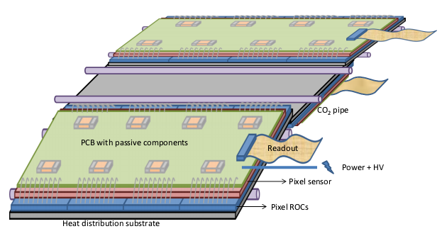
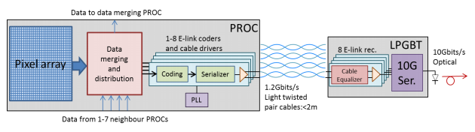
2.Pixel readout:
WHAT WE HAVE:
High read-out rates (factor 100 compared to LHC).
Very high radiation levels.
Significant material contribution.
WHAT WE NEED:
Minimize material (scattering, energy loss)
Signal integrity.
Data must be converted into high rate optical links.
Notes:
Only for the layers L1 and L2, the layers L34 OD have less radiation 1/8.
Unprecedent radiation levels and space constraints make imposible to envisage optical conversion directly on the pixel modules.
Electrical links from the readout chips to the opto conversors in the modules located in the vecinity of the pixel detector. LPGBT to this conversion.

Slide 5
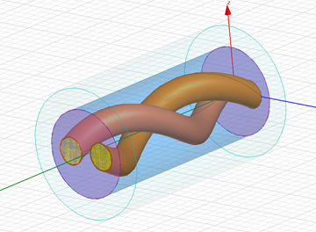
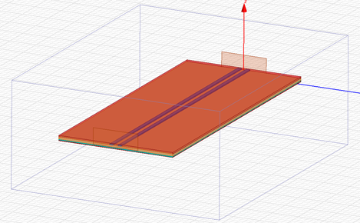
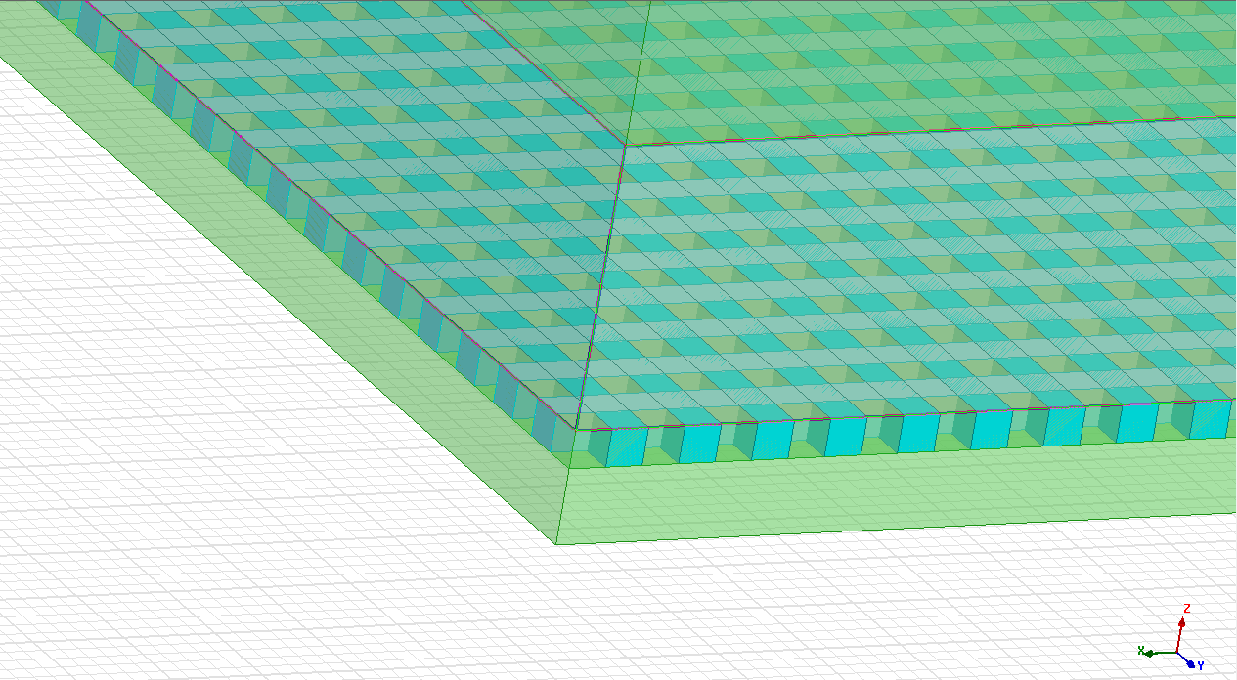
3.Readout cables:
Trying to obtain a balance between mass and signal integrity, taking into account all the constraints (space, radiation, bit rate…)
Several proposals to simulate:
 | Kapton flat cable, Aluminum | Kapton flat cable, Aluminum, meshed ground | Cu cladded Al twisted pair, polymide isolation.
Wire resistance | 11.5Ω | 11.5Ω | 4Ω
Mass (g/m) | 0.29 | 0.14 | 0.1
Mass for 3500 cables | 2.0 kg | 1.0kg | 0.7kg

Slide 6
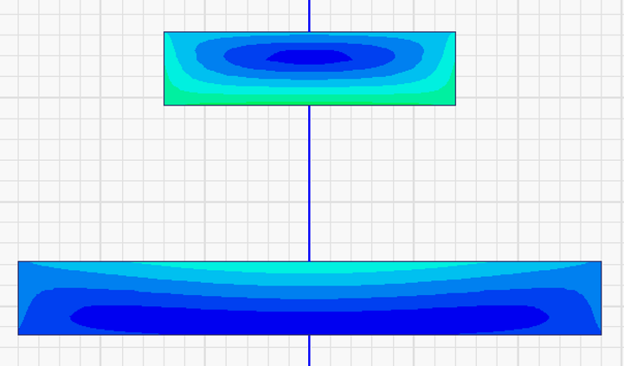
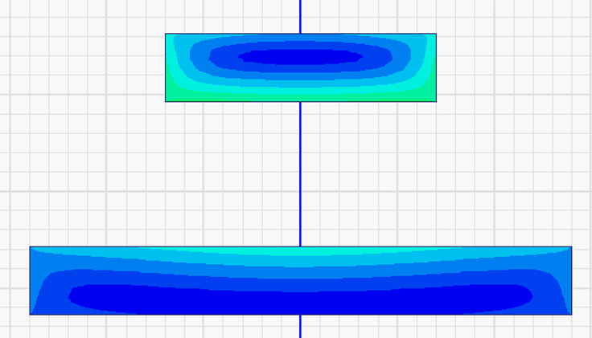
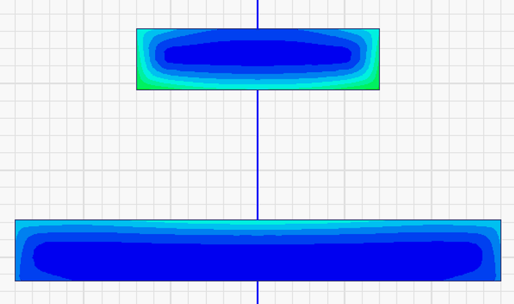
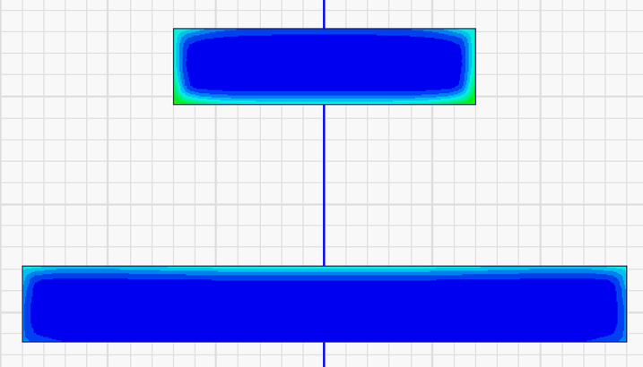
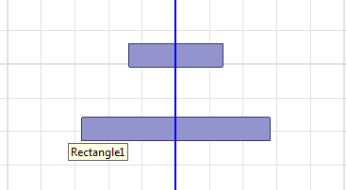
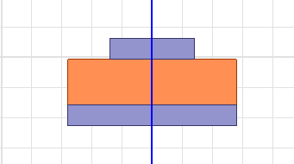
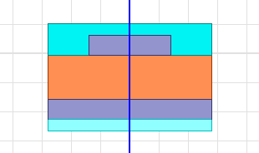
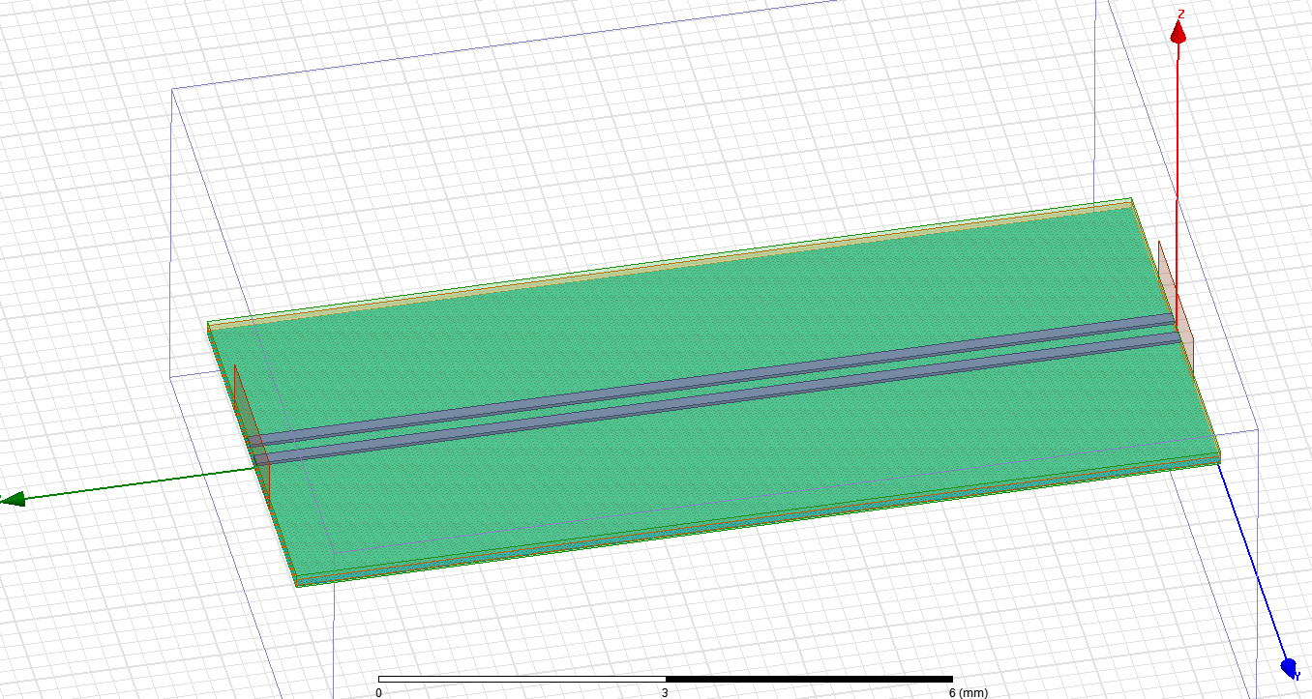
3.Readout cables:
Different loss effects to take into account in simulations:
1.SKIN EFFECT:
Tendency of alternating current to become distributed within a conductor near the surface.
F(Hz)
2.DIELECTRIC LOSS TANGENT:
dissipation of electromagnetic energy (heat) inside the dielectric layer.
3.DC RESISTANCE:
2m cables, dc resistance begins to be an important factor.
 | Conductivity (siemens/m)
Cu | 5.8·10⁷
Al | 3.8·10⁷

Slide 7
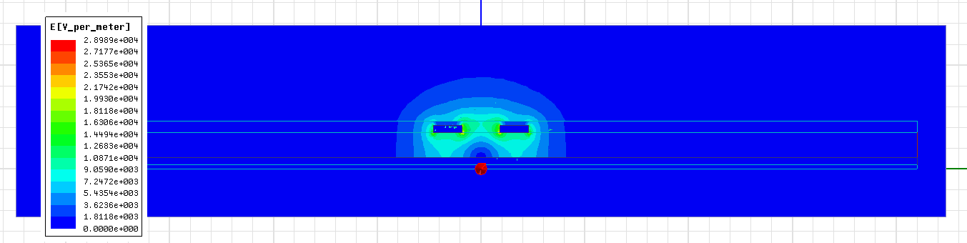
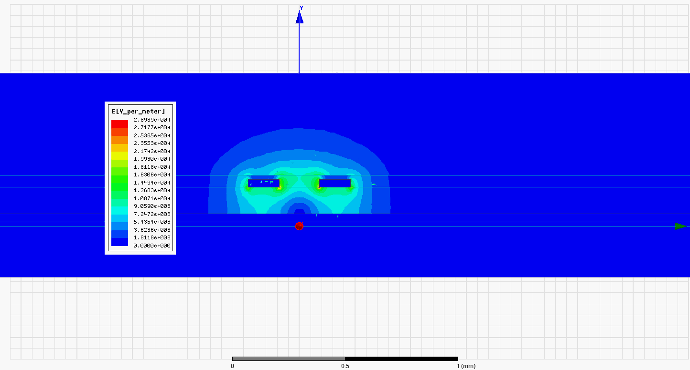
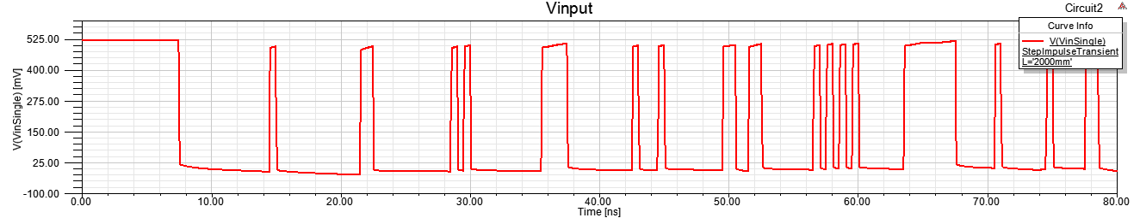
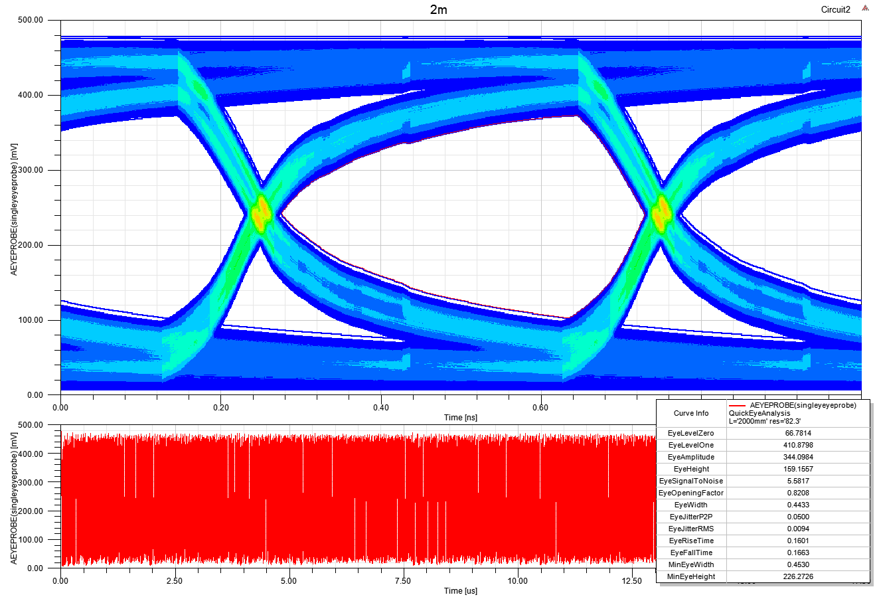
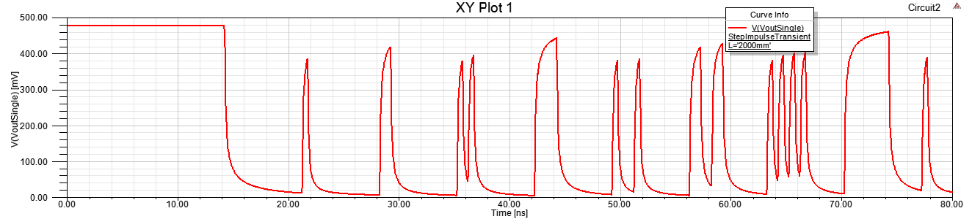

Slide 8
4.Results and status:

Slide 9
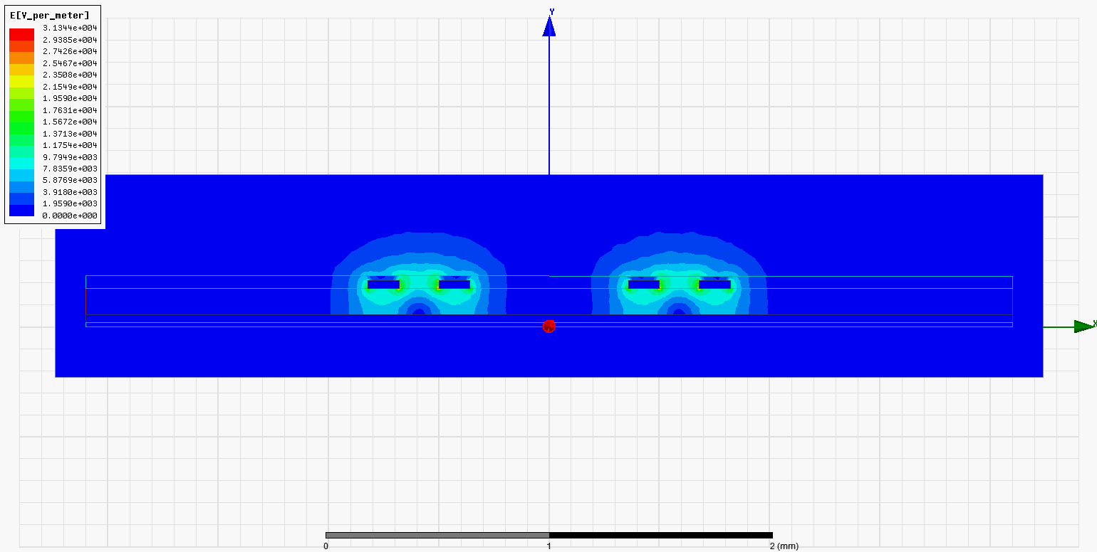
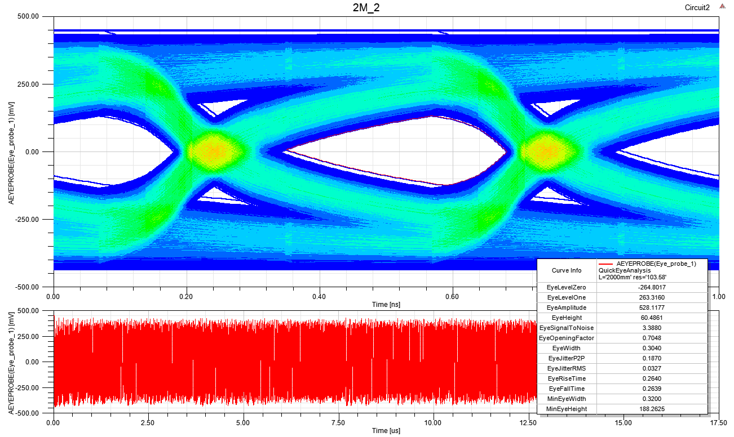
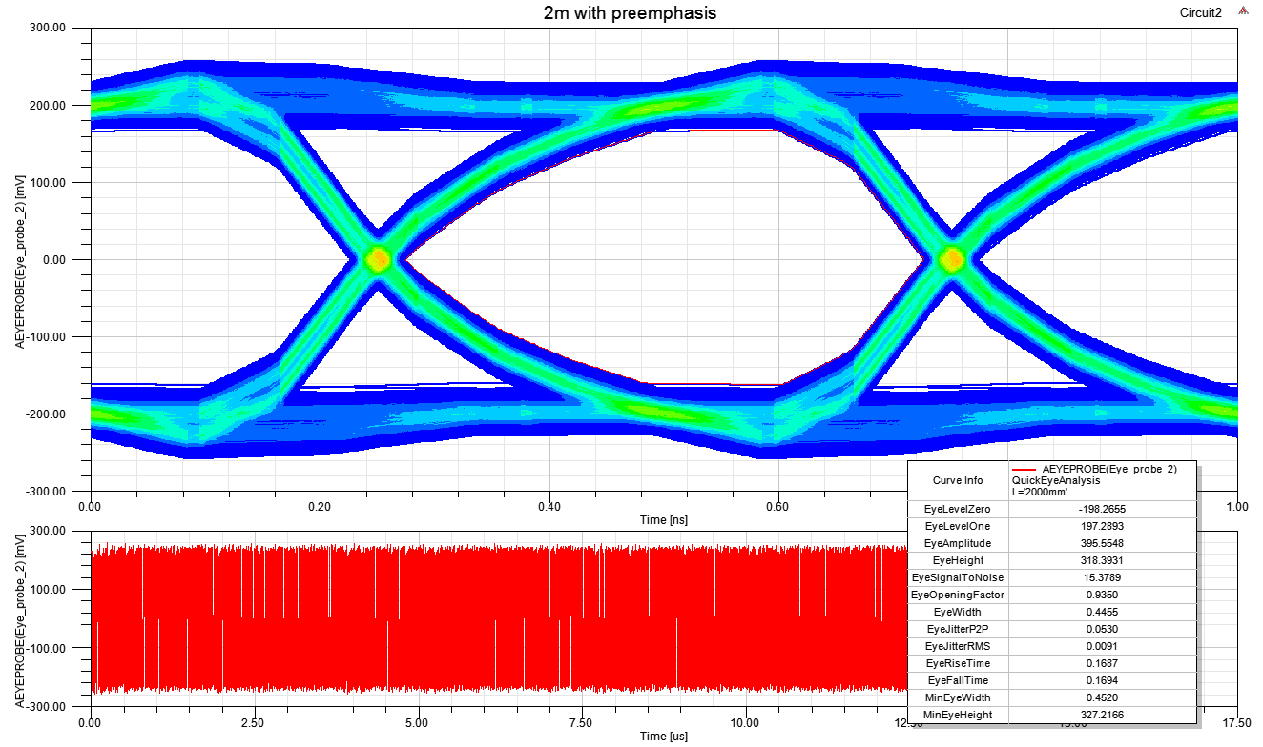
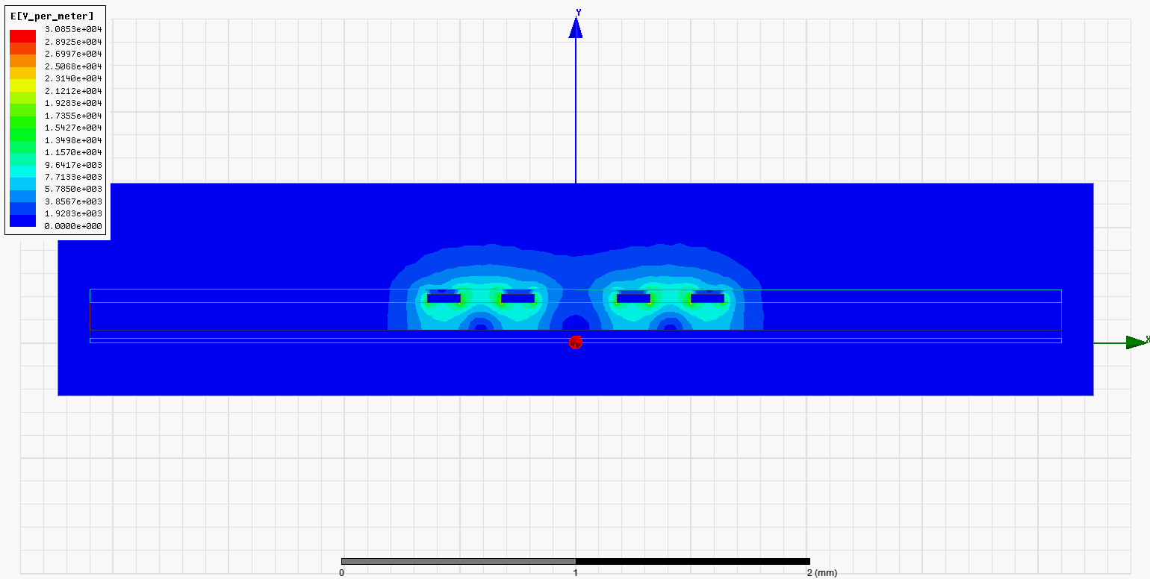
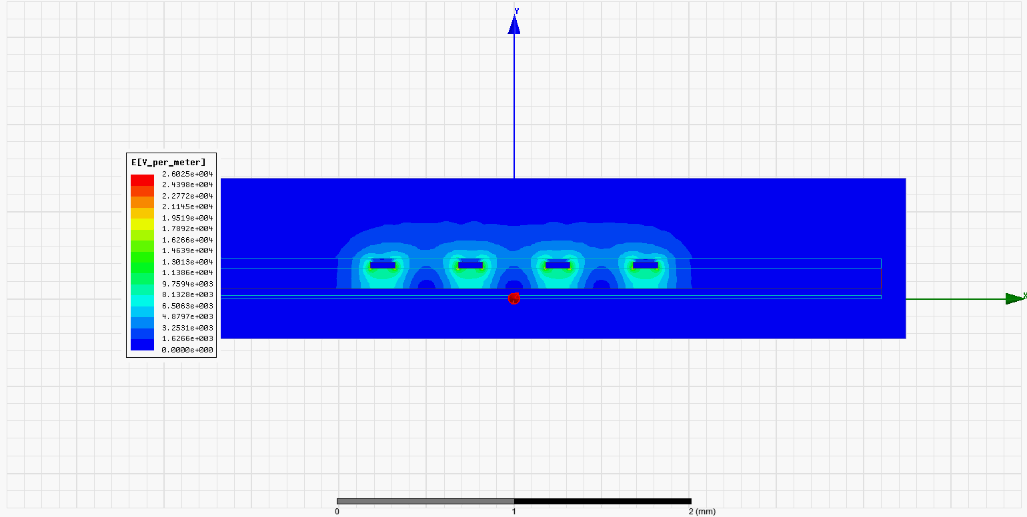
5.Next steps:
Develop simulations for the rest of the models proposed.
Study other effects: crosstalk, wire bundles…
Preemphasis.
Eye diagram before and after preemphasis
Manufacture the better models.
Measure S parameters.
Compare measurements with simulations and improve them.
Crosstalk depending on the distance between differential pairs

Slide 10
Thank you for your attention!

Slide 11
Extra-slides

