Slide 1


Construction and Commissioning of Electronic Test Benches
Medical RFQ
27 October 2015, 1st Workshop of the Spanish Traineeship Programme FTEC 2015
27 October 2015, 1st Workshop of the Spanish Traineeship Programme FTEC 2015
Medical RFQ
eric.montesinos@cern.ch , CERN-BE-RF
josue.rodriguez.diez@cern.ch, CERN-BE-RF-PM
Notes:
Good morning, my name is Josué Rodríguez and I am beginning this presentation about my work at CERN. Constructtion and Commissioning of Electronic Test Benches is my assigned project. More concretely the project that I am working is Medical RFQ.

Slide 2
Index
What is it?
Block Diagram
Design
Layout
27 October 2015, 1st Workshop of the Spanish Traineeship Programme FTEC 2015
Medical RFQ
eric.montesinos@cern.ch , CERN-BE-RF
josue.rodriguez.diez@cern.ch, CERN-BE-RF-PM
Notes:
These are the points we will see in this presentation. First, it is important to know what is and what means Medical RFQ. Then, we will see a very simple diagram to know how it works. To end, we will see some parts of the final design and distribution.

Slide 3
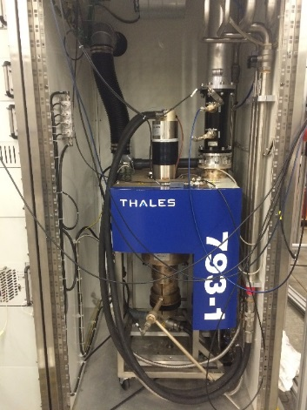
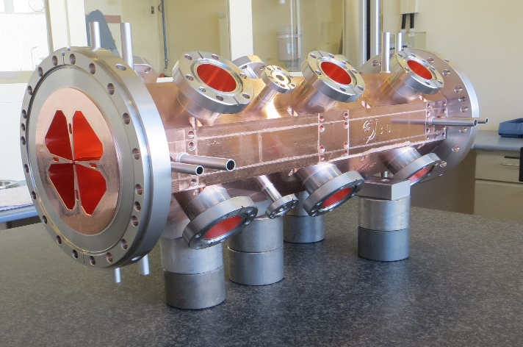
What is it?
RFQ: RadioFrequency Quadrupole
By the existing frequency to 750 MHz, the size of the quadrupole can be reduced
RFQ will produce beams at low speed, after travelling a distance of 2 metres
More compact accelerator created to the best suit installation in a medical facility
Inductive Output Tubes or Solid State Power Amplifiers to be used in the production of the waves used in the acceleration process
27 October 2015, 1st Workshop of the Spanish Traineeship Programme FTEC 2015
Medical RFQ
eric.montesinos@cern.ch , CERN-BE-RF
josue.rodriguez.diez@cern.ch, CERN-BE-RF-PM
Notes:
What is it?
RFQ means Radio Frequency Quadrupole. The idea is use the technology involved in the LHC, specifically, linear accelerator technology and apply to medical aim.
The size of the quadrupole can be reduced by the existing frequency. It permits to use a compact accelerator for medical facilities.
IOT (Inductive Output Tubes) is the technology uses. This technology permits to obtain the best performance.
What type of medical applications? The idea is use subatomic particles on cancerous cells. This facility applies a beam very focus in one point. For this reason, it will permit minimize adverse effects on the body.

Slide 4
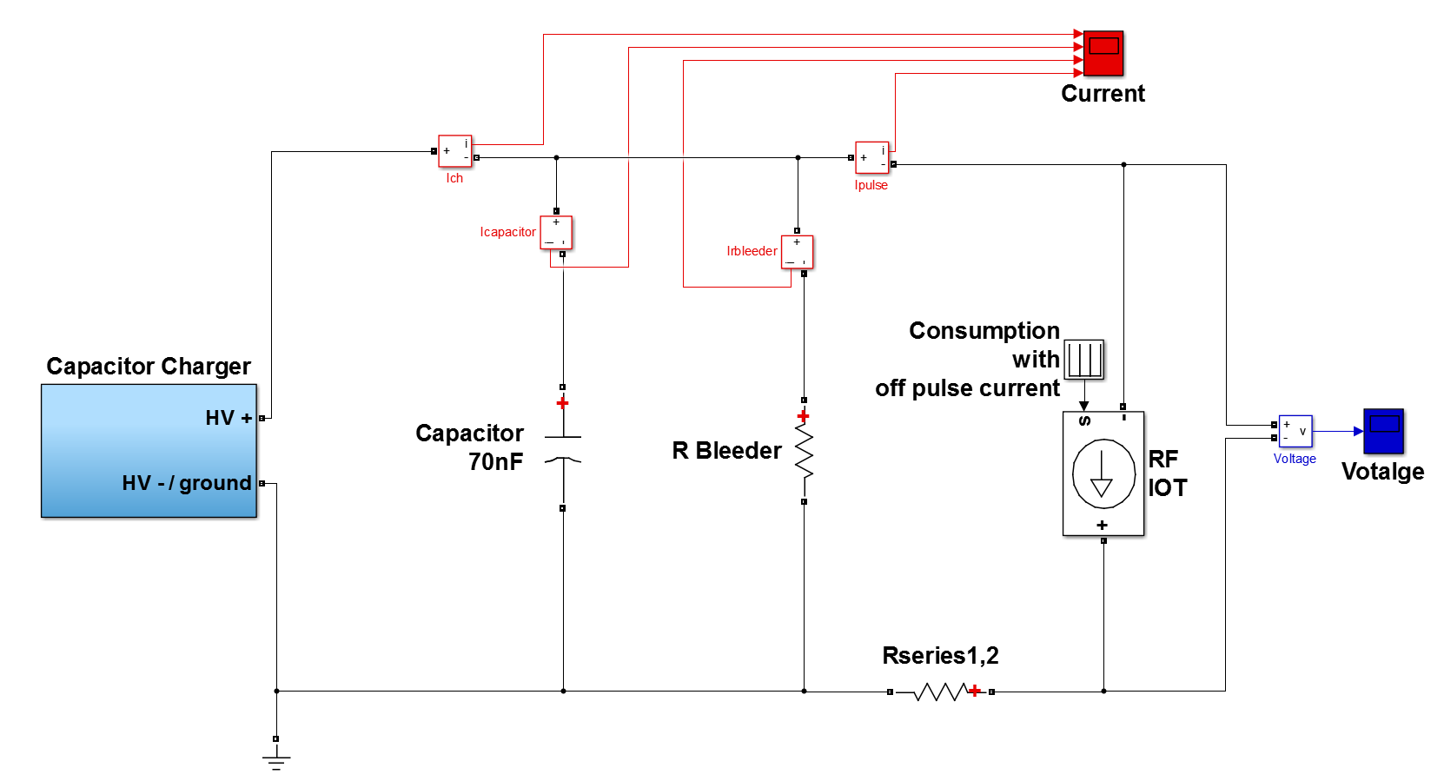
Block Diagram
MATLAB Model
Drivers
IOT
HV
Capacitor Charger
Capacitor Bank
Crowbar
Water
Air
HV-DC
POWER SUPPLY
RF ON/OFF
16A
LVPS
LVPS
CAPACITOR
20µs
200Hz
27 October 2015, 1st Workshop of the Spanish Traineeship Programme FTEC 2015
Medical RFQ
eric.montesinos@cern.ch , CERN-BE-RF
josue.rodriguez.diez@cern.ch, CERN-BE-RF-PM
Notes:
We can see a very simple block diagram about the facility.
This circuit represent a very simple electrical circuit. It will permit to do a Simulink Model. The RFQ have a cycle of 200 Hz with a pulse of 16 A during 20 microseconds. With this characteristics, I could design a model to simulate it. We can obtain the different electrical parameters that permit to know the performanc, the measurements and we can study different conditions.
I calculated and dimensioned the HV Capacitor Charger and the Capacitor Bank. I did all technical specifications about the Low Voltage Power Supplies and the transformer. It provides energy to ITOs (I also did it for the Capacitor Charger and the Capacitors). I did the calculations for the pipes and the blower that the system need. Now, I am working on the driver. We try to find the performance between the power and the temperature.

Slide 5
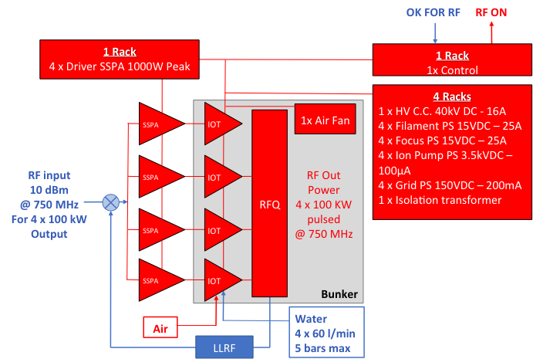
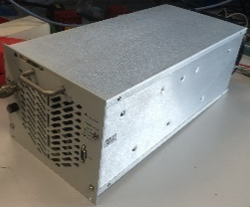
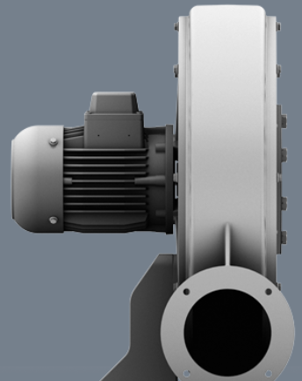
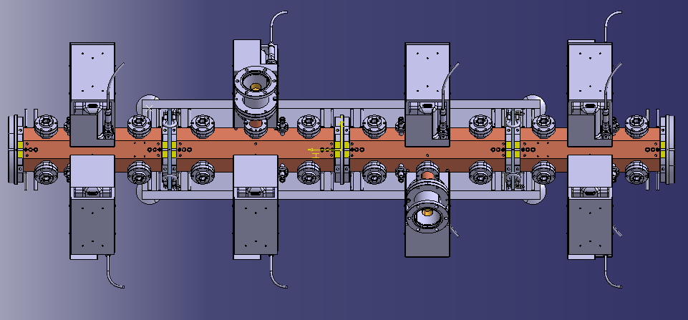
Block Diagram
27 October 2015, 1st Workshop of the Spanish Traineeship Programme FTEC 2015
Medical RFQ
eric.montesinos@cern.ch , CERN-BE-RF
josue.rodriguez.diez@cern.ch, CERN-BE-RF-PM
Notes:
This is more an engineering schematic about Medical RFQ. We can see some signals. I needed to know and to consider the different signals between the different power supplies and the system control. Now, we are working in the control system and all the communications between all devices.
This picture corresponds with us accelerator. It has four modules, and we will connected IOTs on it. This is the shape for the one IOT, and for a driver and this is the fan to provide air to the four IOTs that we need.

Slide 6
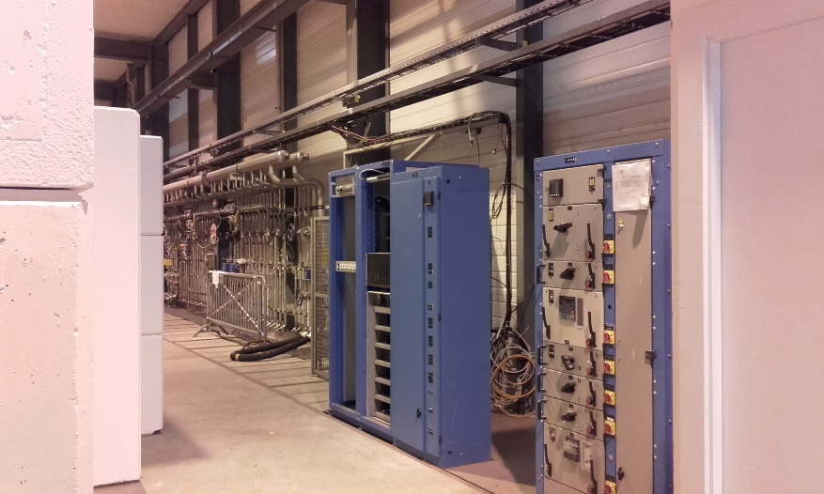
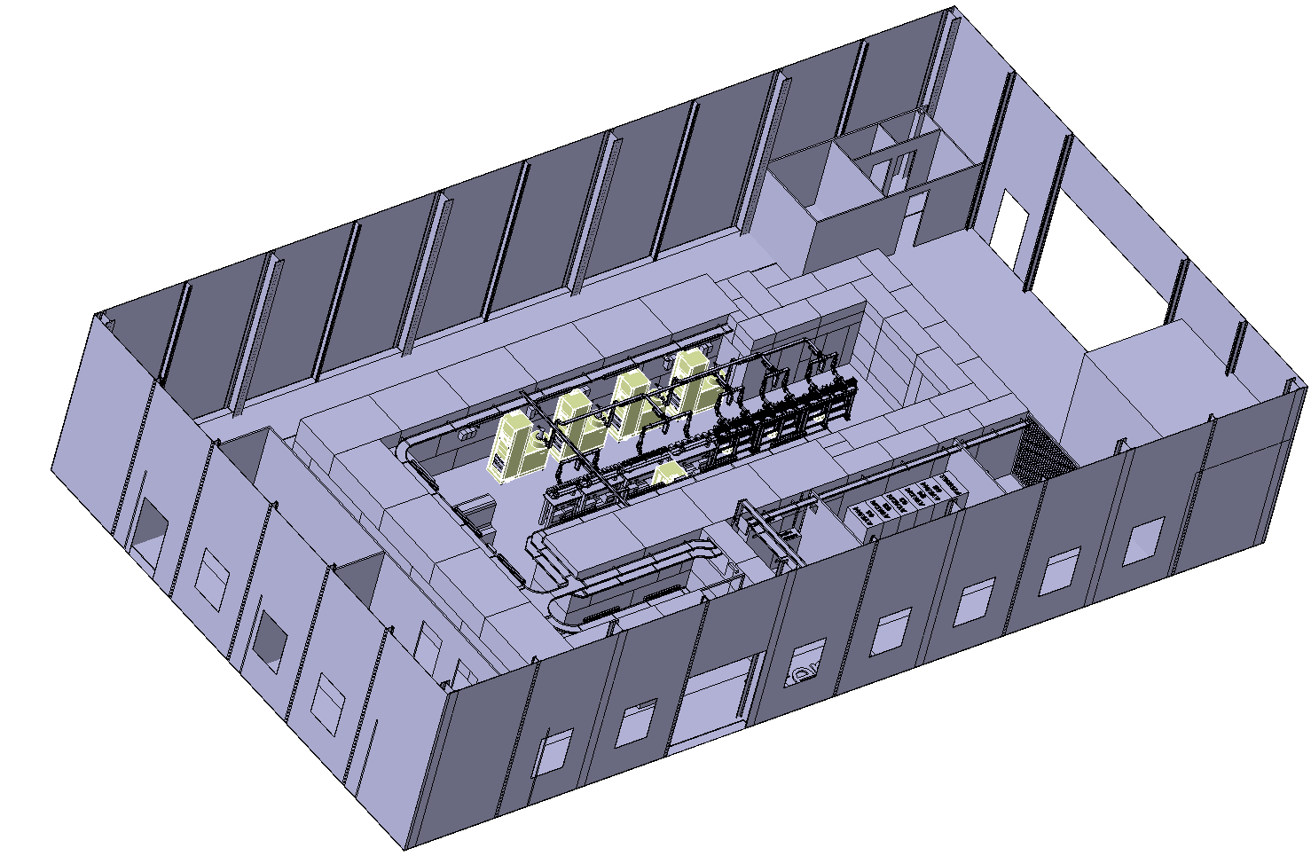
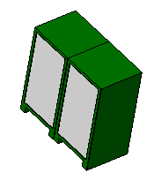
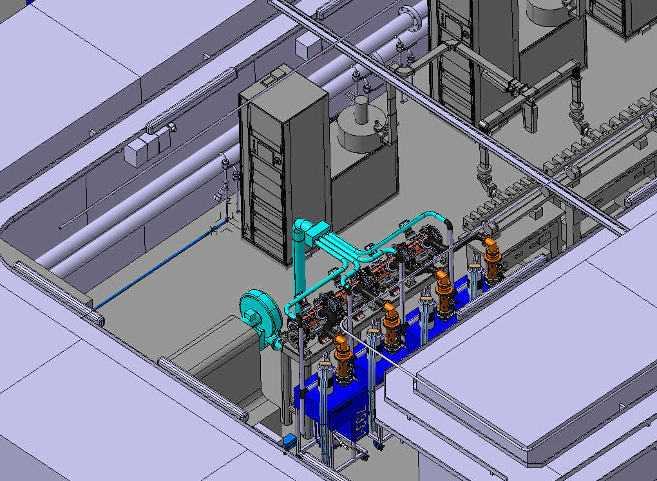
Design & Layout
Isometric View
Control
RACKS
Filament
Grid
Ion Pump
Focus
Driver RF
6 x Racks
Isolation
Transformer
HV
Capacitor
Charger
HOLES
Old Version
Medical RFQ
27 October 2015, 1st Workshop of the Spanish Traineeship Programme FTEC 2015
Medical RFQ
eric.montesinos@cern.ch , CERN-BE-RF
josue.rodriguez.diez@cern.ch, CERN-BE-RF-PM
Notes:
Finally, we can see an idea about the place where the Medical RFQ will be. It is a bunker.
We can see some images take it on the place.
All the devices that we can see before will put in this racks. Now, we are working on how install the cables. We need to calculate the size and I design the lines.
We hope we can begin to test, maybe, on March 2016.
Thank you so much.

