Slide 1
Application engineer, Versatile link Demonstrator board
Ftec 2015 quarterly report ph3464
Raúl Martín lesma
Advisor: Sophie baron

Slide 2
introduction
The PH-ESE group develops electronics for diverse experiments at CERN.
One of its projects is the Radiation Hard Optical Link project.
It aims to supply experiments with a 10 Gbps data link. It will link detector FE and counting rooms.

Slide 3
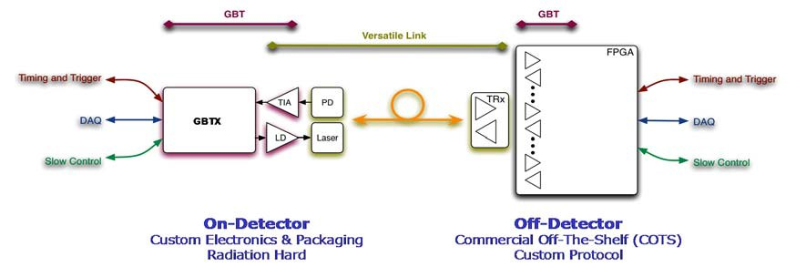
The GBTx
Radiation tolerant ASIC
Manages a high-speed optical link (up to 4.48 Gbps).
Used for:
  Data readout
  Trigger data
  Timing control distribution
  Experiment control and monitoring
Can manage up to 40 electrical links coming from front-end modules.
70,000 GBTx are currently being produced.

Slide 4
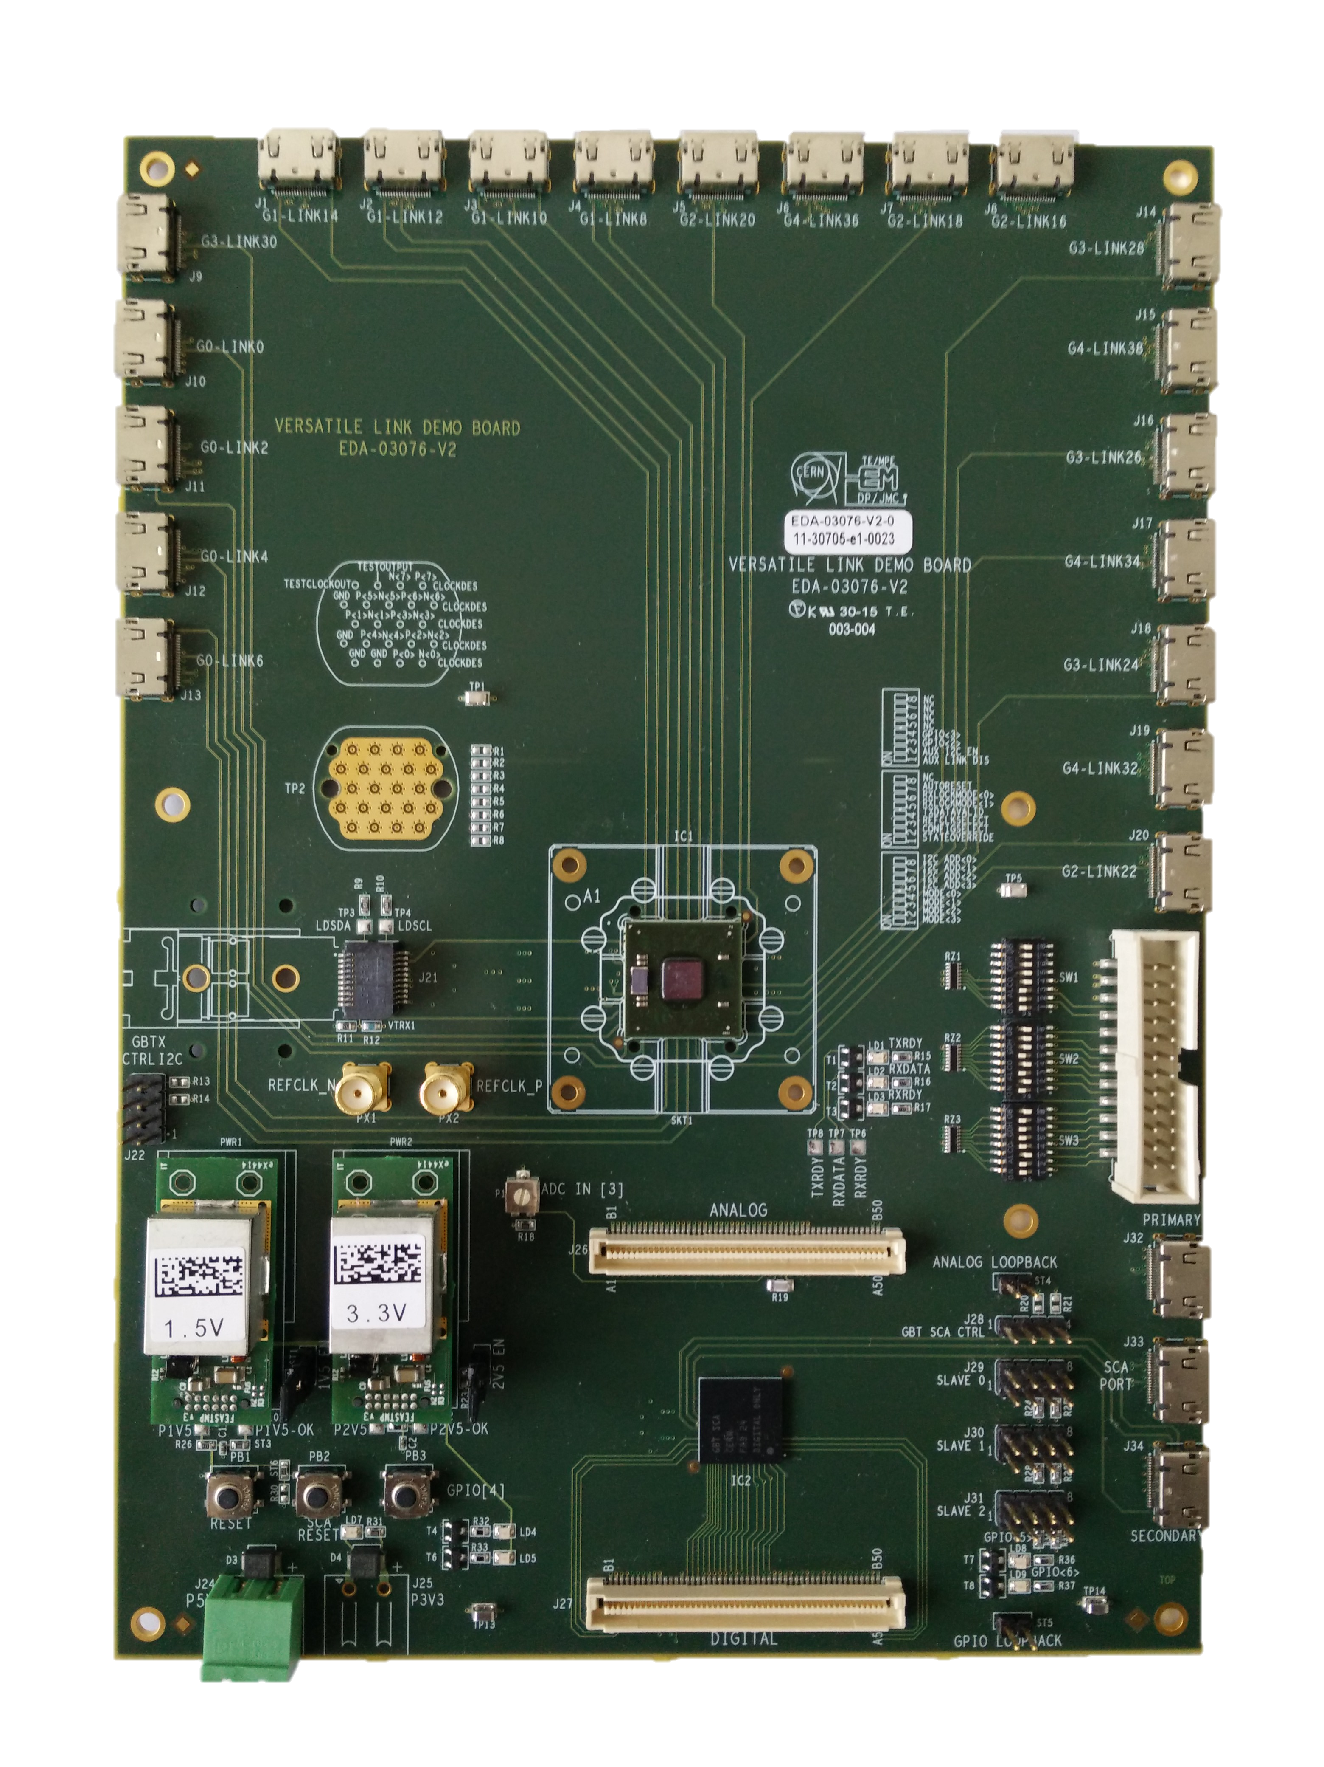
VLDB (Versatile link demonstrator board)
It is a demonstrator board with four custom radiation tolerant components:
  GBTx
  SCA (Slow Control Adapter): FE electronics control and monitoring
  VTRx: Optical transceiver
  DC-DC converters

Slide 5
VLDB (Versatile link demonstrator board)
It is a demonstrator board with four custom radiation tolerant components:
  GBTx
  SCA (Slow Control Adapter): FE electronics control and monitoring
  VTRx: Optical transceiver
  DC-DC converters

Slide 6
VLDB (Versatile link demonstrator board)
It is a demonstrator board with four custom radiation tolerant components:
  GBTx
  SCA (Slow Control Adapter): FE electronics control and monitoring
  VTRx: Optical transceiver
  DC-DC converters

Slide 7
VLDB (Versatile link demonstrator board)
It is a demonstrator board with four custom radiation tolerant components:
  GBTx
  SCA (Slow Control Adapter): FE electronics control and monitoring
  VTRx: Optical transceiver
  DC-DC converters

Slide 8
VLDB (Versatile link demonstrator board)
It is a demonstrator board with four custom radiation tolerant components:
  GBTx
  SCA (Slow Control Adapter): FE electronics control and monitoring
  VTRx: Optical transceiver
  DC-DC converters

Slide 9
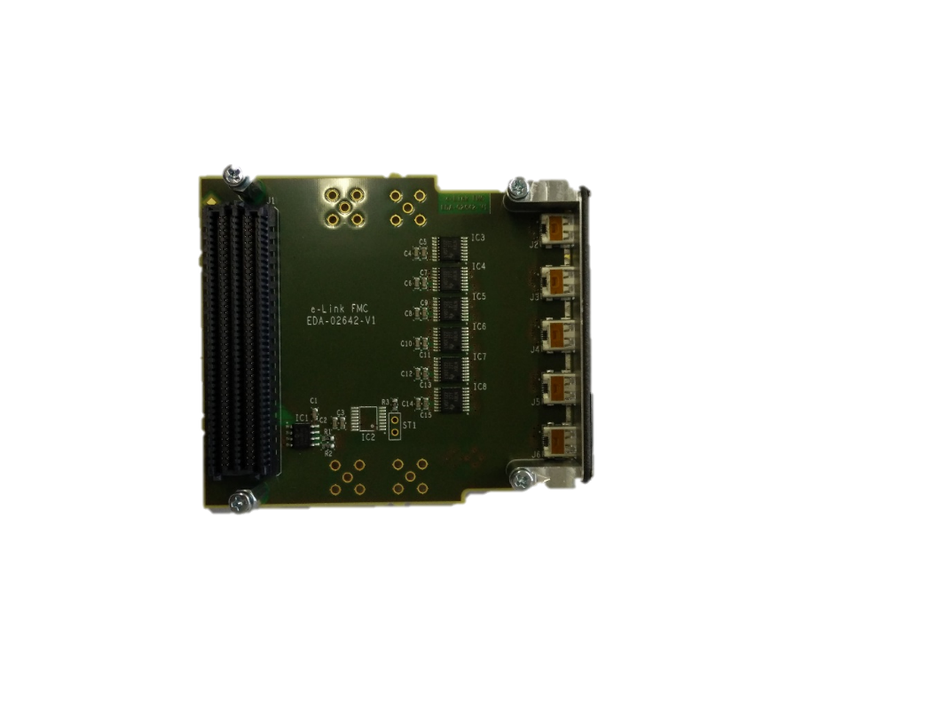
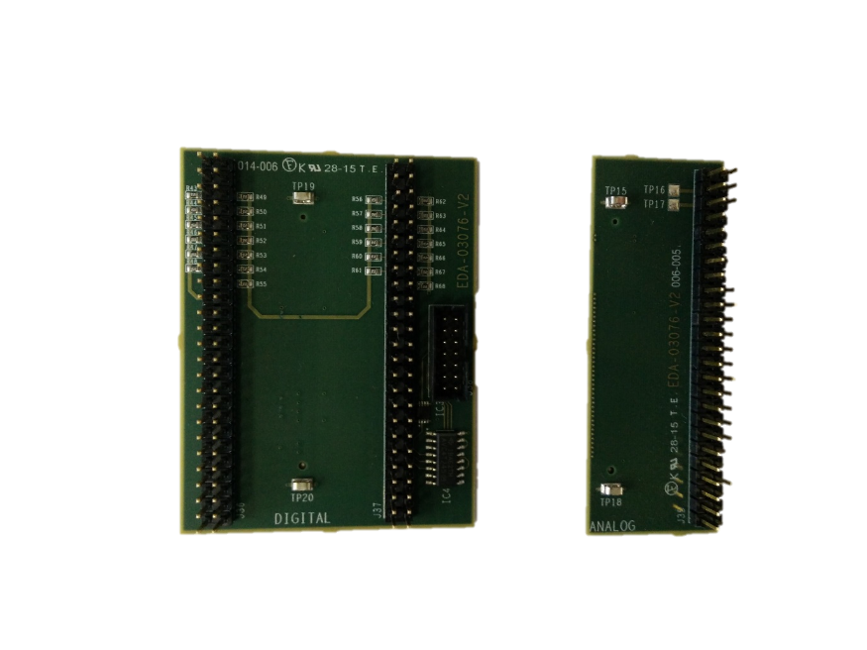
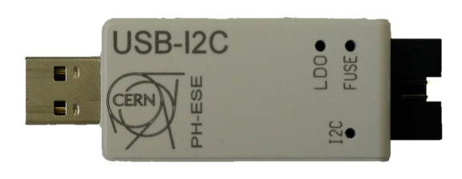
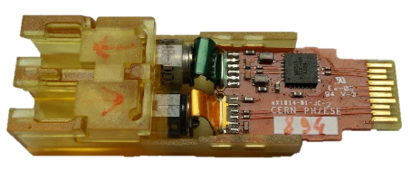
VLDB kit
Daughter boards
E-link FMC board
VTRx
USB-I²C dongle
VLDB

Slide 10
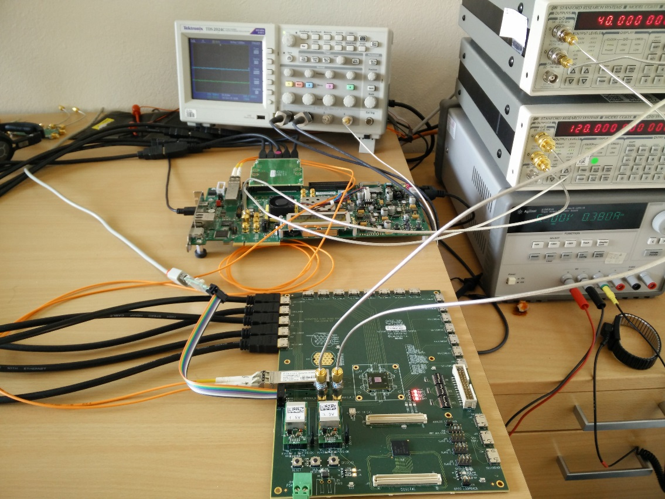
Tasks done (i)
A batch of 60 VLDB Kits were produced.
A VLDB test was developed to test the functionality of the board.
The test involves setting several typical configurations, and then cross check the data on a FPGA.
VLDB kits have started to be delivered to the users. Support is also given for their tests.

Slide 11
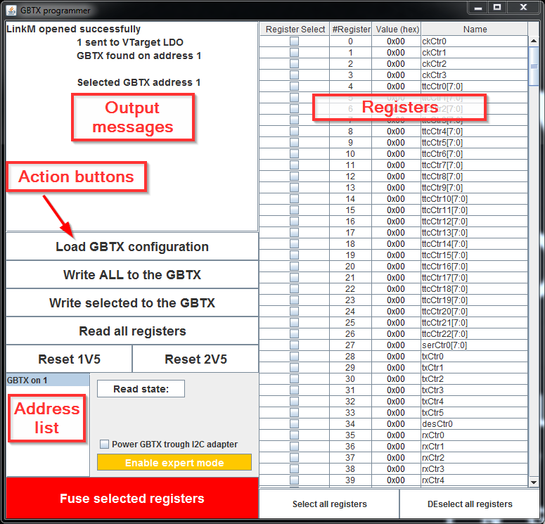
Tasks done (II)
There was a Java programmer for the GBTx which had several bugs related to configuration loading and register reading. They were corrected and new functionality was also added to the program.
The GBTx Configuration website is a tool for the users to download configurations easily. Several configuration problems were solved.
A short user guide was written, and there is work going on to release the program in several platforms.
A python programmer has been developed, so users can perform scripted tests.
Support was given for VLDB temperature tests.

Slide 12
Actions planned for the next three months
Environmental tests will be performed (including radiation tests).
System tests will be done, which will include many-VLDB configurations to resemble real scenarios, including:
  Cascade of VLDB boards
  SCA tests
    JTAG-through FPGA configuration
    ADC read-back
    GPIO control
    SPI
  GBTx configuration from optical link
  GBTx slave configuration from GBTx master on cascade topology from I²C
Training sessions and support will be regularly provided to users.

Slide 13
For more information about the project:
  VLDB website: https://espace.cern.ch/GBT-Project/VLDB
  GBTx configuration website: https://gbtx-configuration.web.cern.ch/gbtx-configuration

Slide 14
  Thank you!
  Questions?

