Slide 2


Magnet Design and Construction
1st Workshop of the Spanish Traineeship Programme FTEC 2015
José Luis Rudeiros Fernández (TE MSC-LMF)
Supervisor: Frédéric Savary (TE MSC-LMF)

Slide 3
Contents
Description and status of the project
Challenges
Actions planned in the short-term

Slide 4
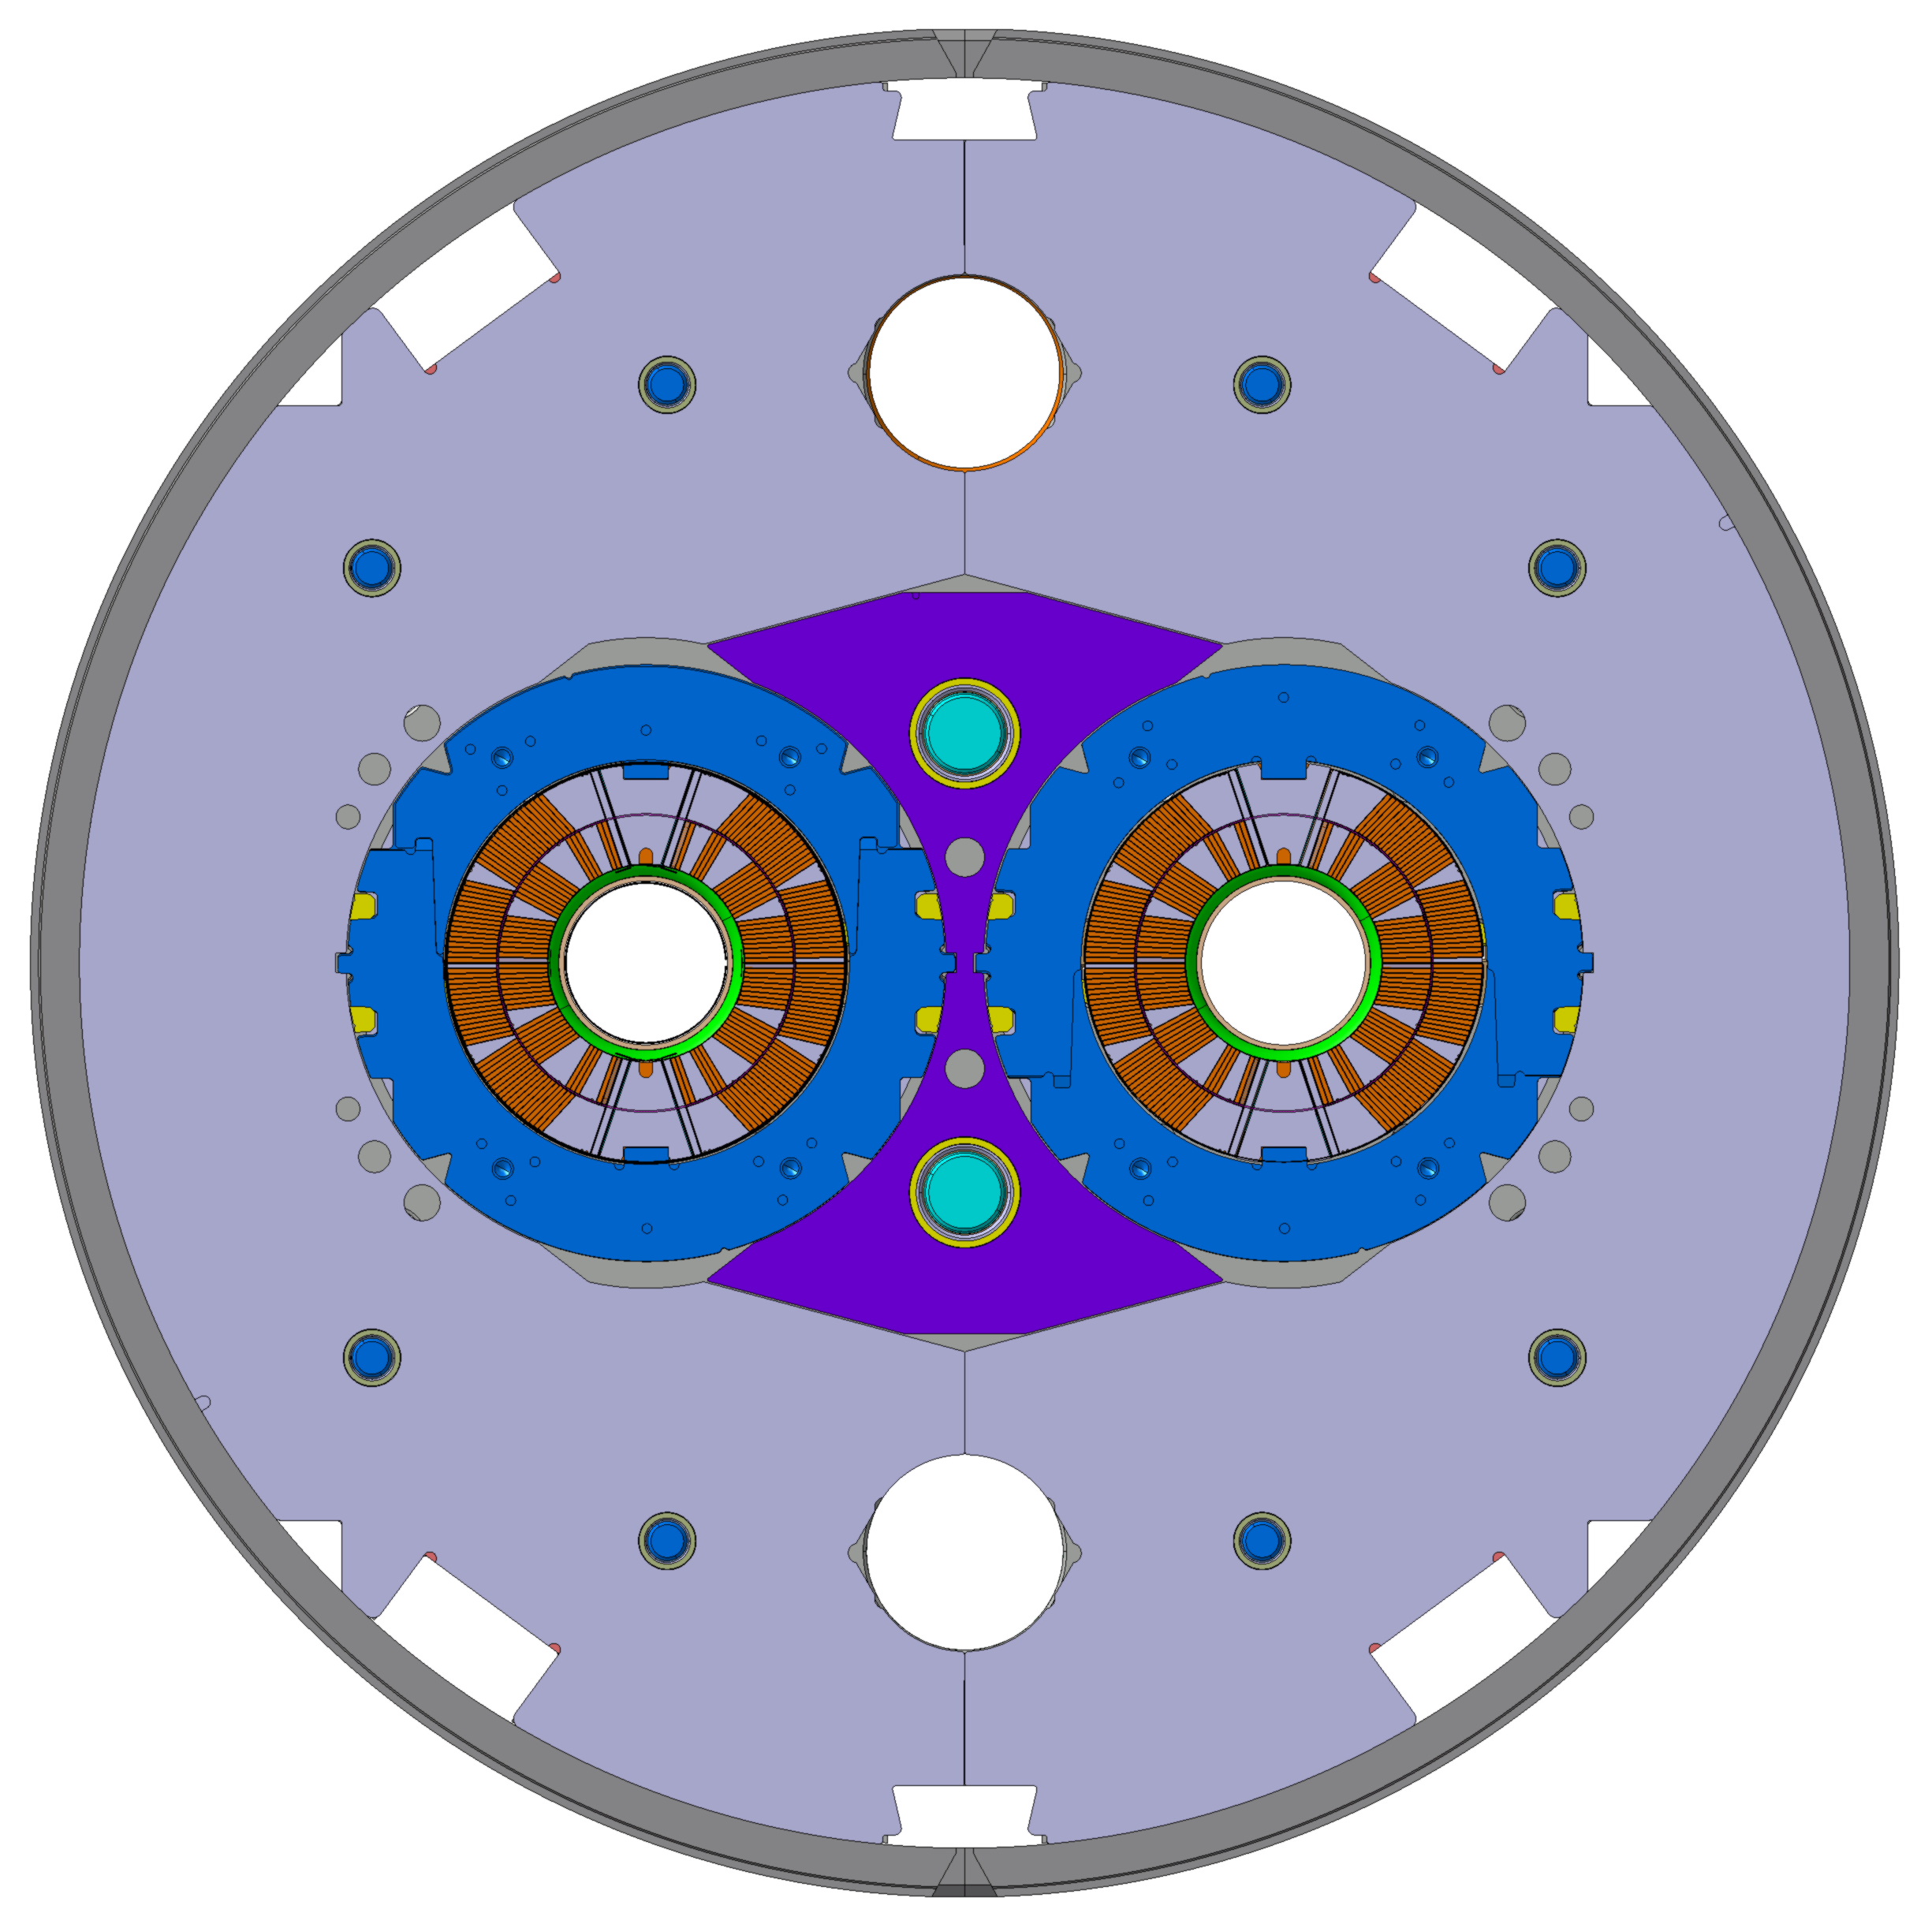
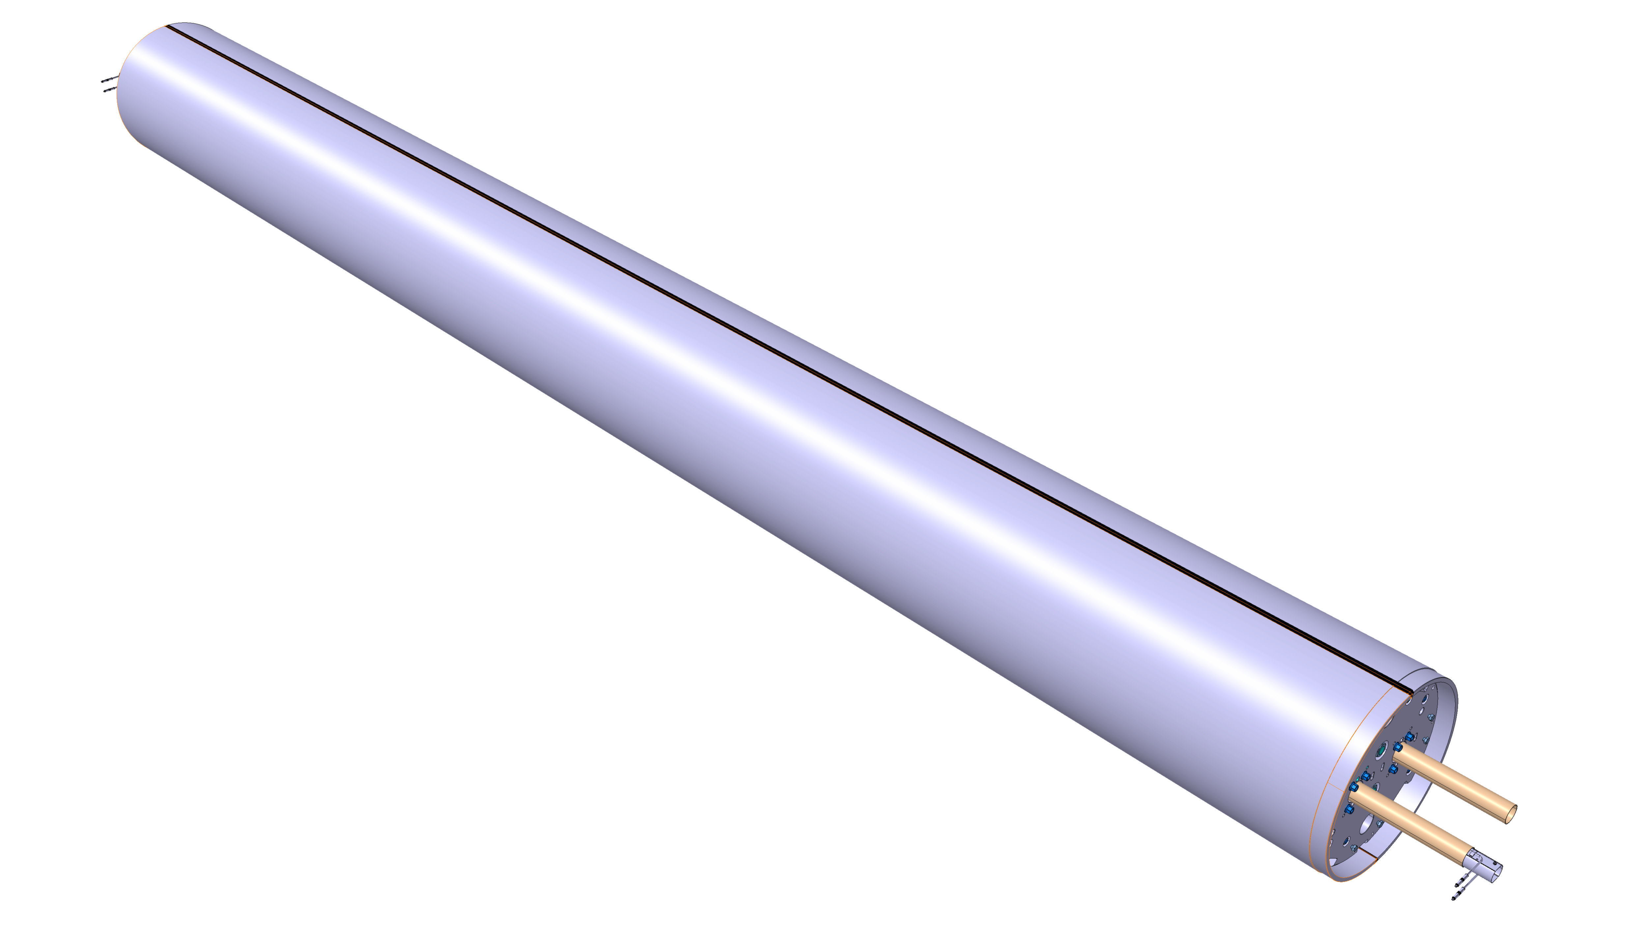
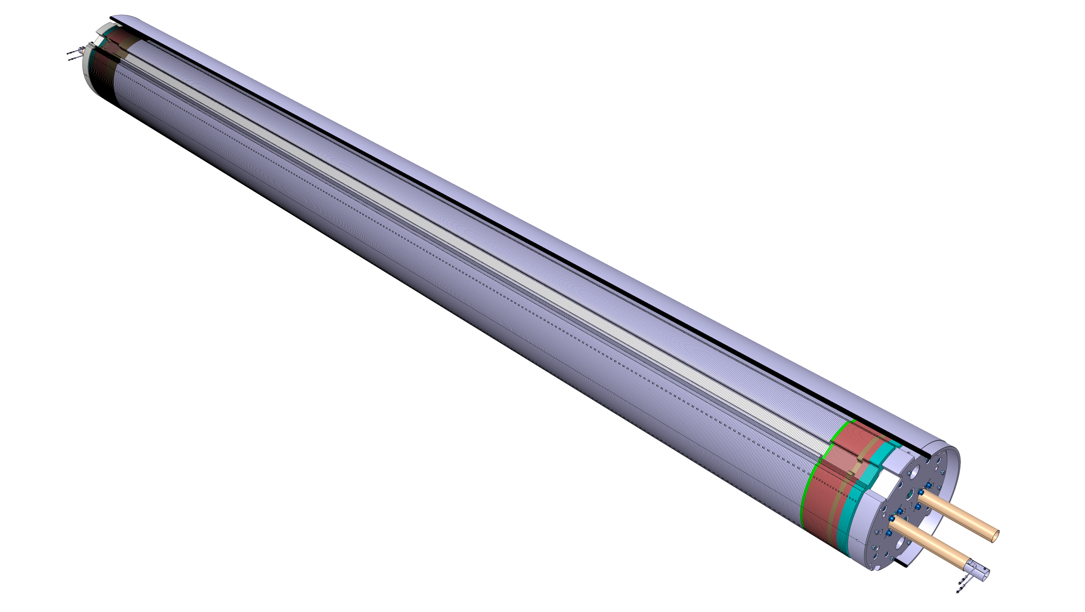
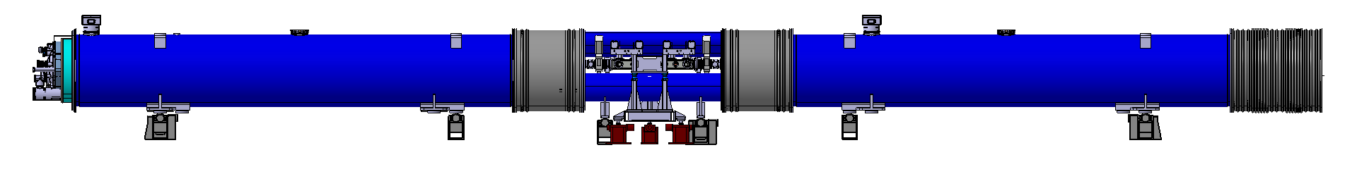
1. Description and Status of the Project
Prototype of the 11T dipole (MBH) for HL-LHC
Procurement process
Shell
Coils
Yoke Lamination
Collars
6500 mm
Central Lamination
15660 mm
11 T dipole cold mass

Slide 5
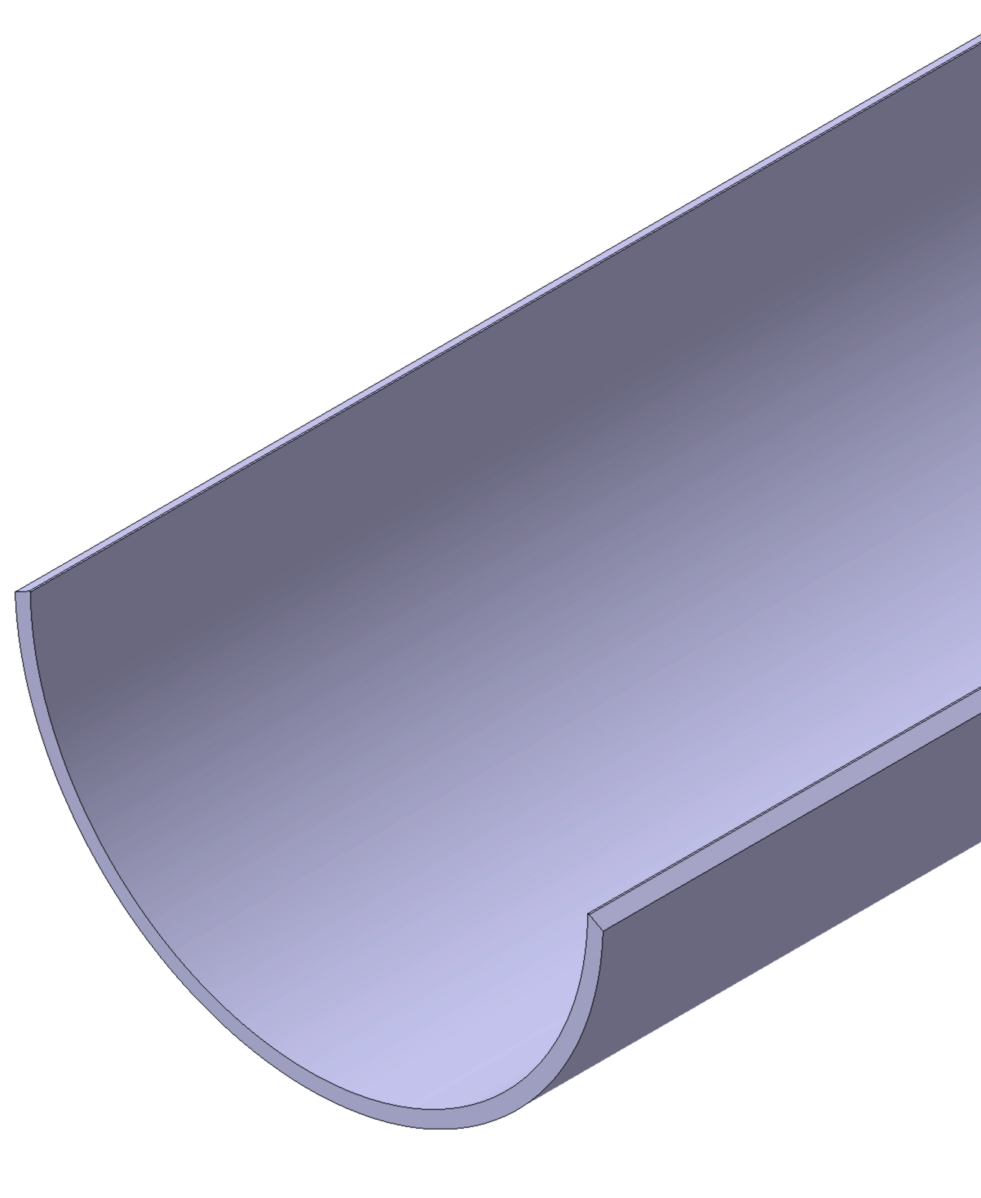
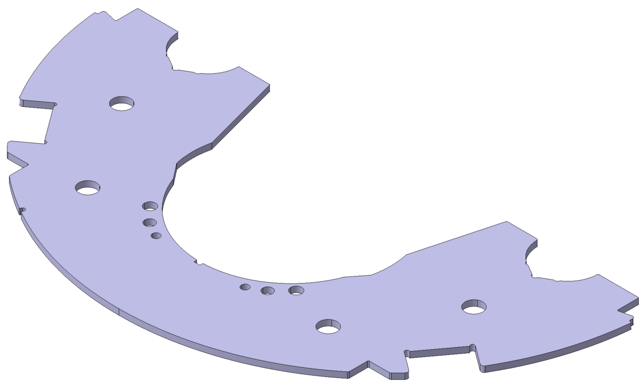
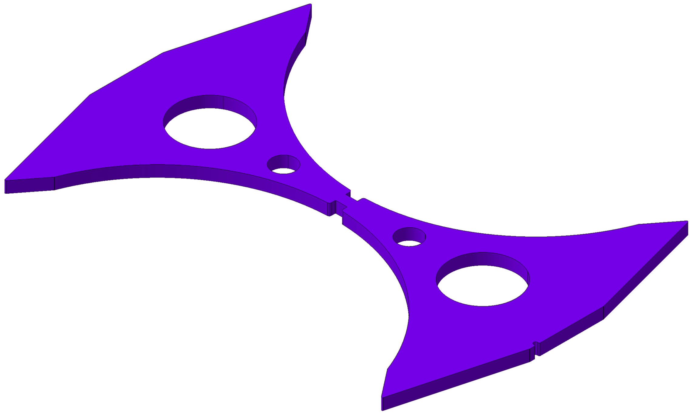
1. Description and Status of the Project
Prototype of the 11T dipole (MBH) for HL-LHC
Procurement process
Technical specifications.
Technical annex to the Tender form.
Departmental requests.
Search for potential bidders
& material suppliers.

Slide 6
1. Description and Status of the Project
Prototype of the 11T dipole (MBH) for HL-LHC
Finite element analysis
Course - ANSYS Workbench advanced:
Non-linear analysis.
Advanced contact – interface.
Advanced materials (e.g. hyperelasticity).
MAPDL integration.

Slide 7
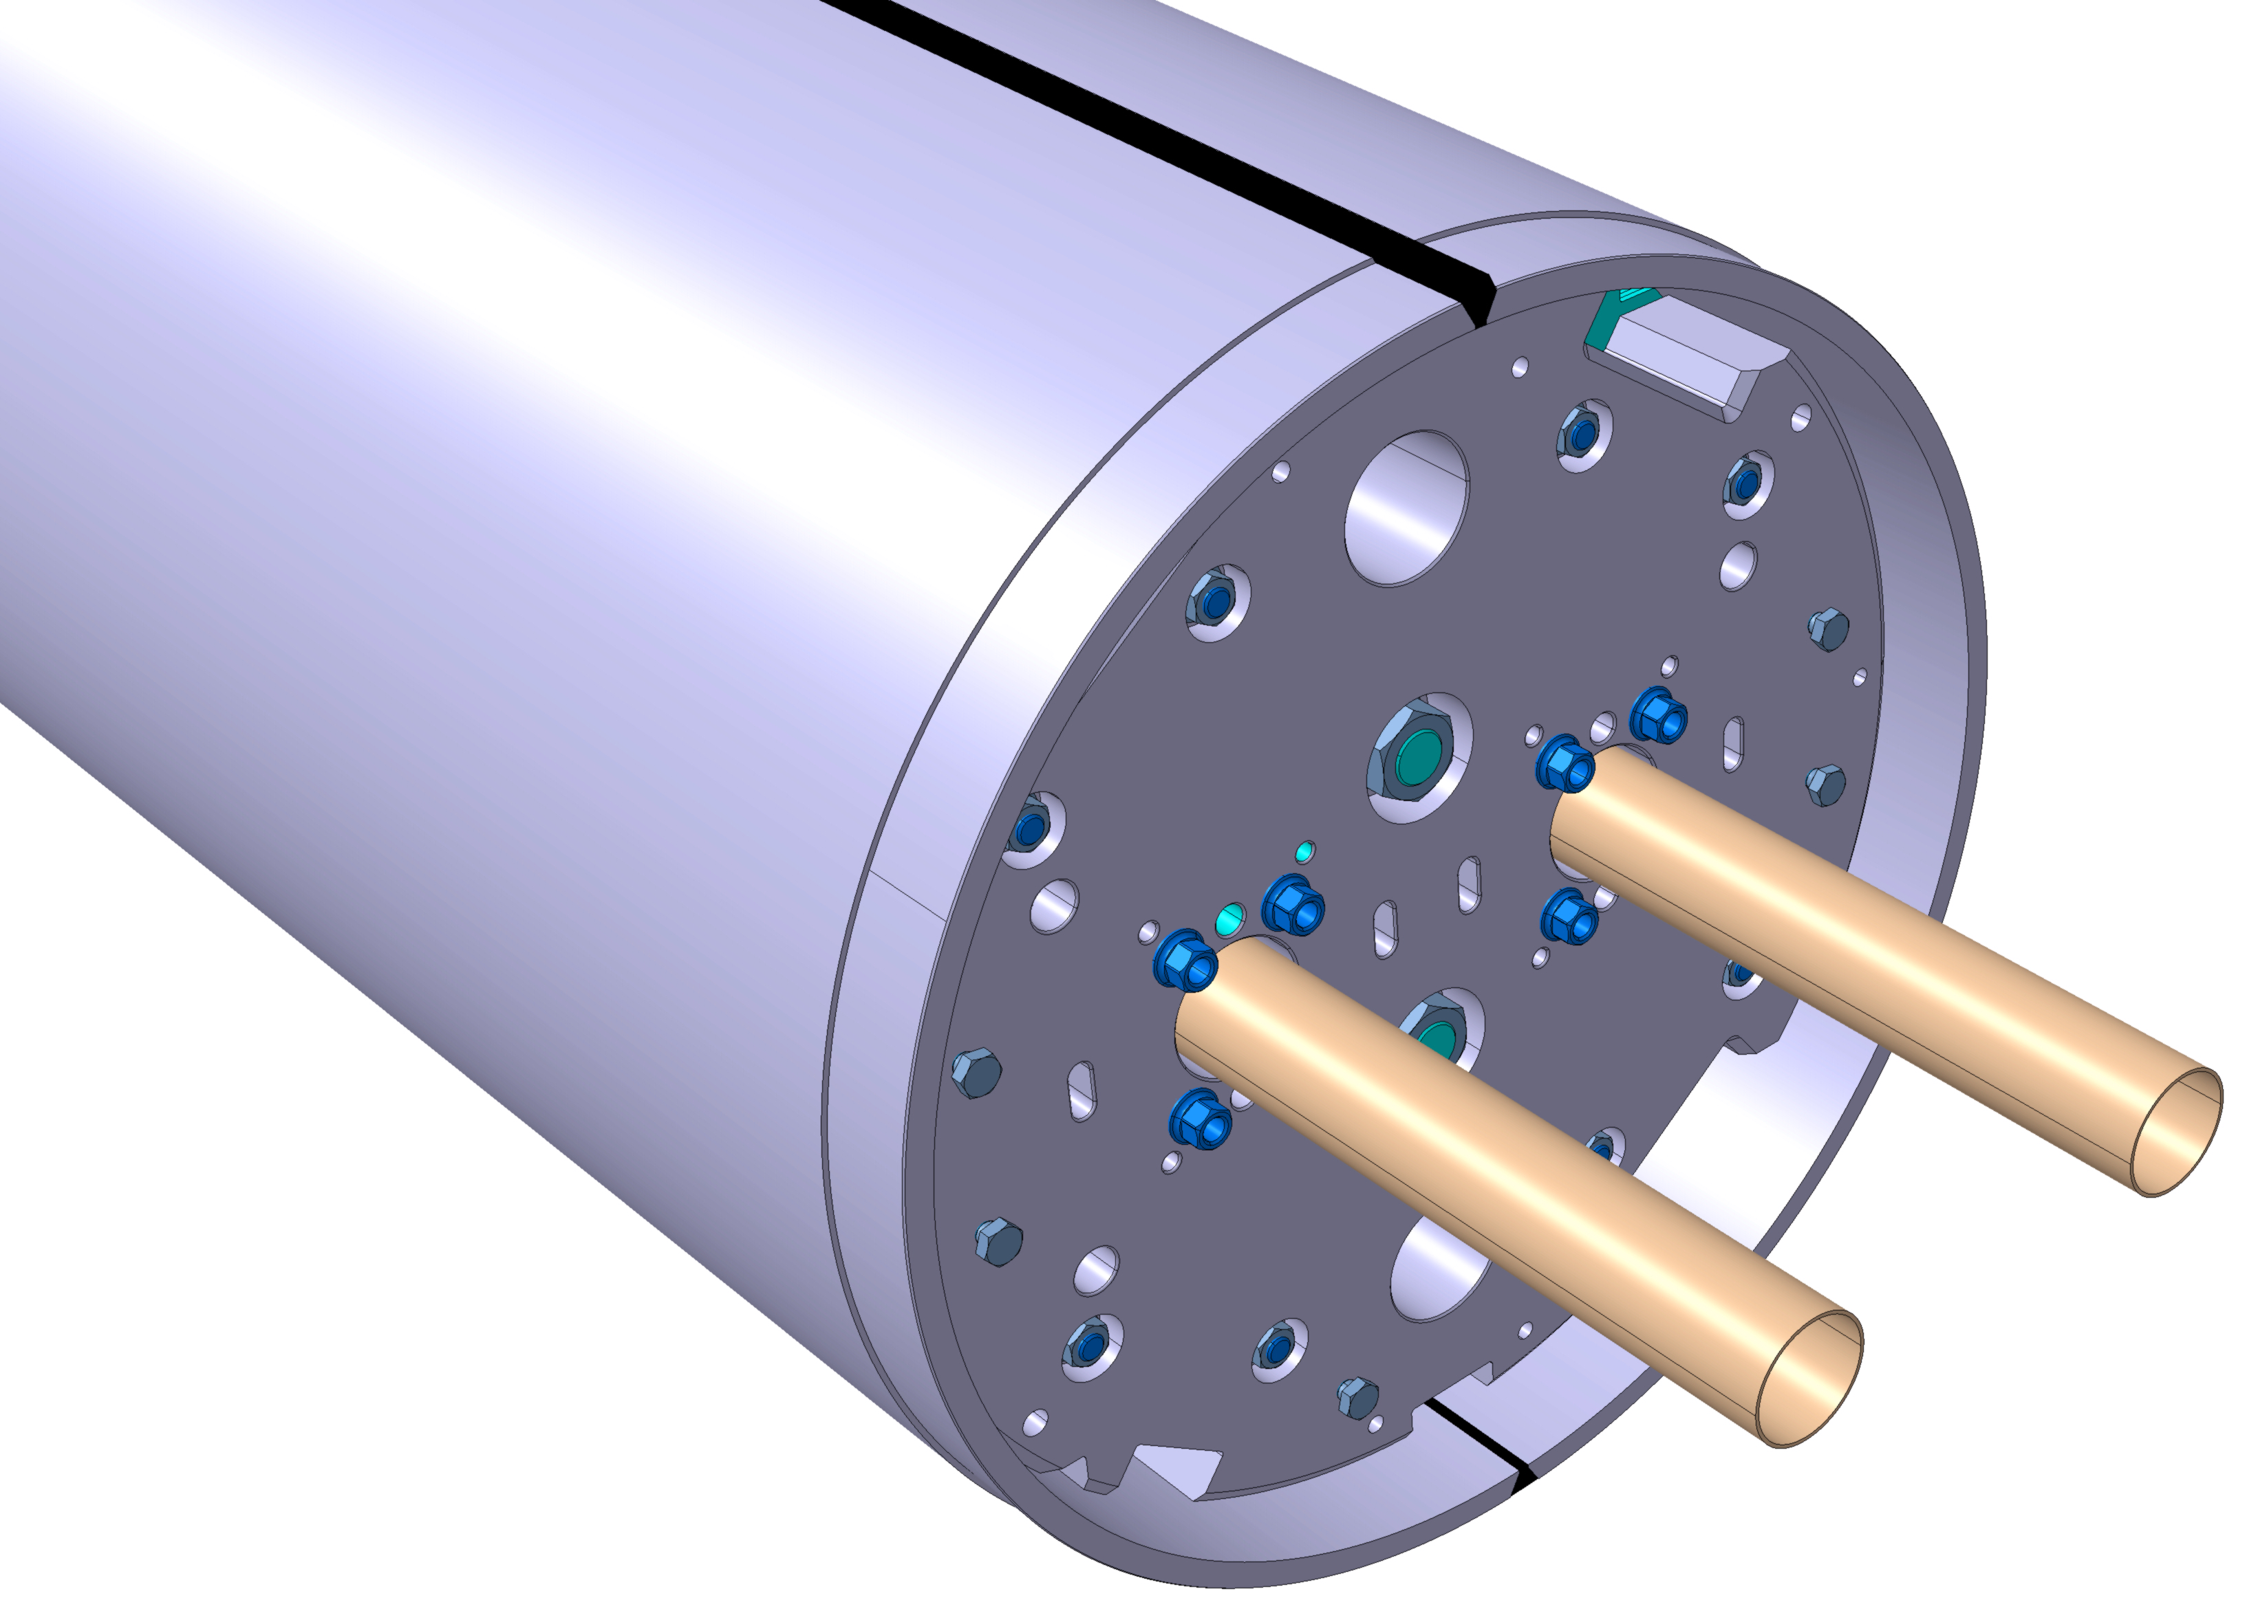
1. Description and Status of the Project
Laser measurement system
y
[x₀,y₀]
x
y
z
x

Slide 8
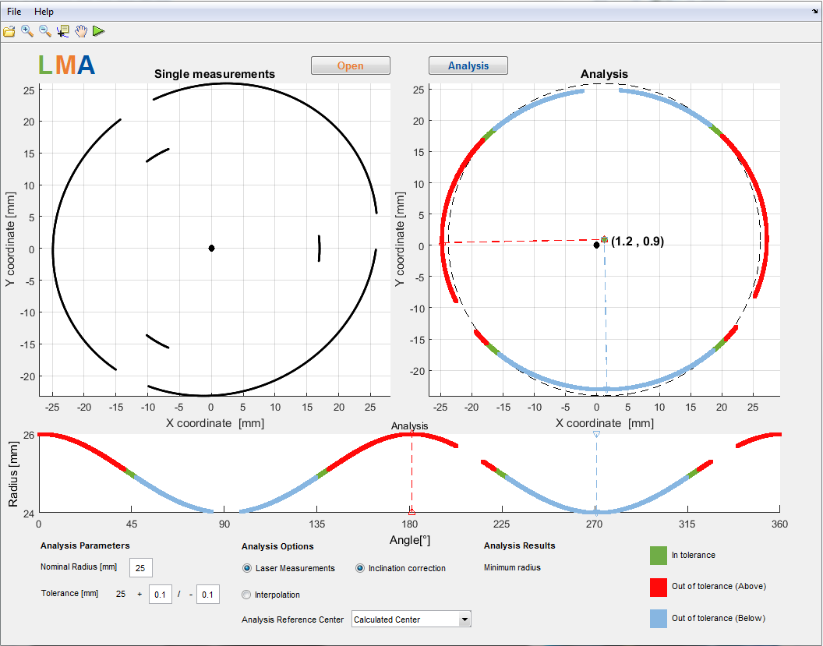
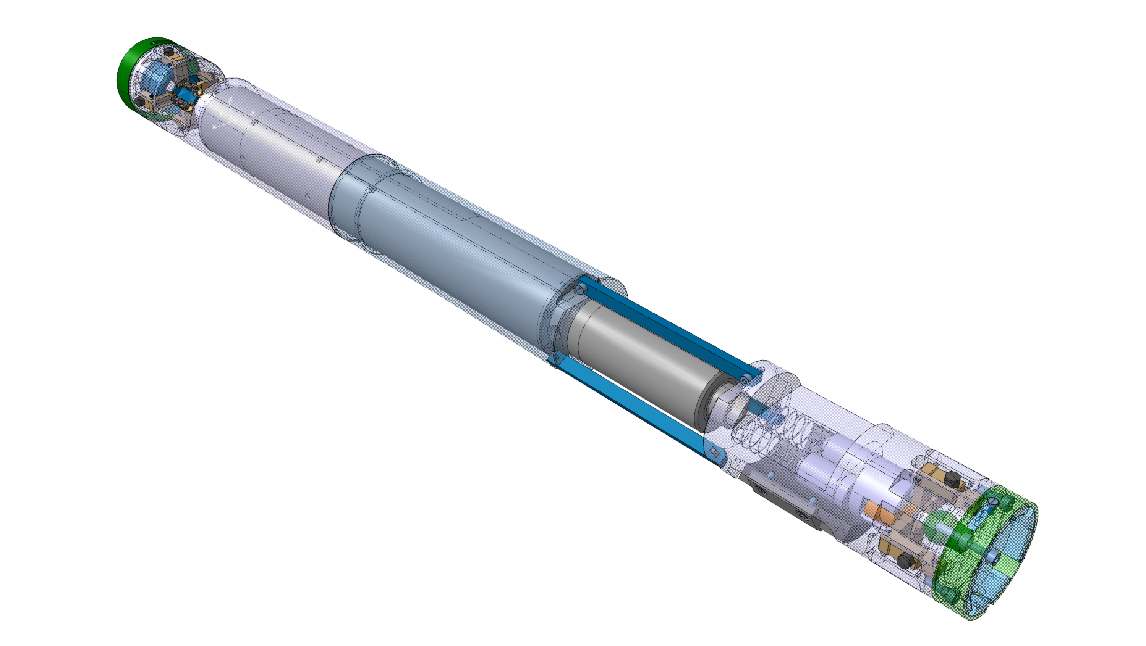
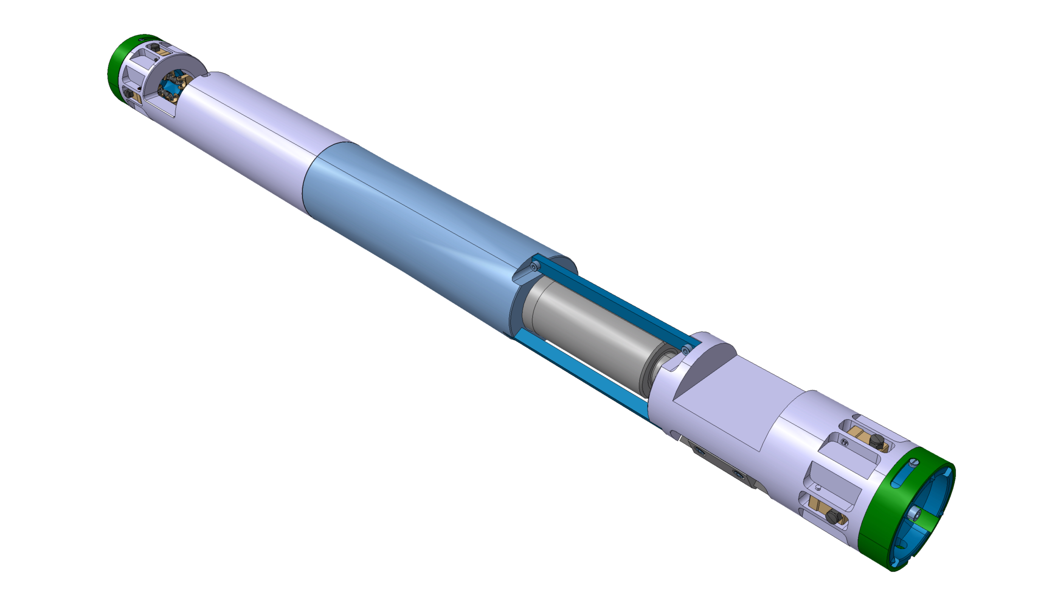
1. Description and Status of the Project
Laser measurement system
Centering
mechanisms
[x_{i},y_{i}]
Laser system
Laser triangulation sensor
Rotating platform
Motor + rotary encoder
Tilt sensor
[z_{i}]
Leica reflector
y
z
x

Slide 9
2. Challenges
Writing technical documents for procurement process.
Specific Technical/Engineering terminology.
Communication in French.

Slide 10
3. Actions plan in short-term
Follow-up on the procurement process.
Follow-up on the Laser measurement system: design changes, manufacturing and assembly.
Further development of LMA software.
Laser calibration and initial testing.
Laser hardware integration with the expansion tooling.
Involvement in activities regarding Finite element analysis.
Course: CATIA-Smarteam Basics.

Slide 11
Thanks!

