Slide 2
Study on heat transfer at low temperatures
TE3542 – FTEC 2015
Upgrade of a Two-stage Cryocooler
Montserrat Bayón Laguna
Advisors: J.Bremer, T. Koettig

Slide 3
Content
Introduction
Objective
Current status
Accomplished activities
Conclusion

Slide 4
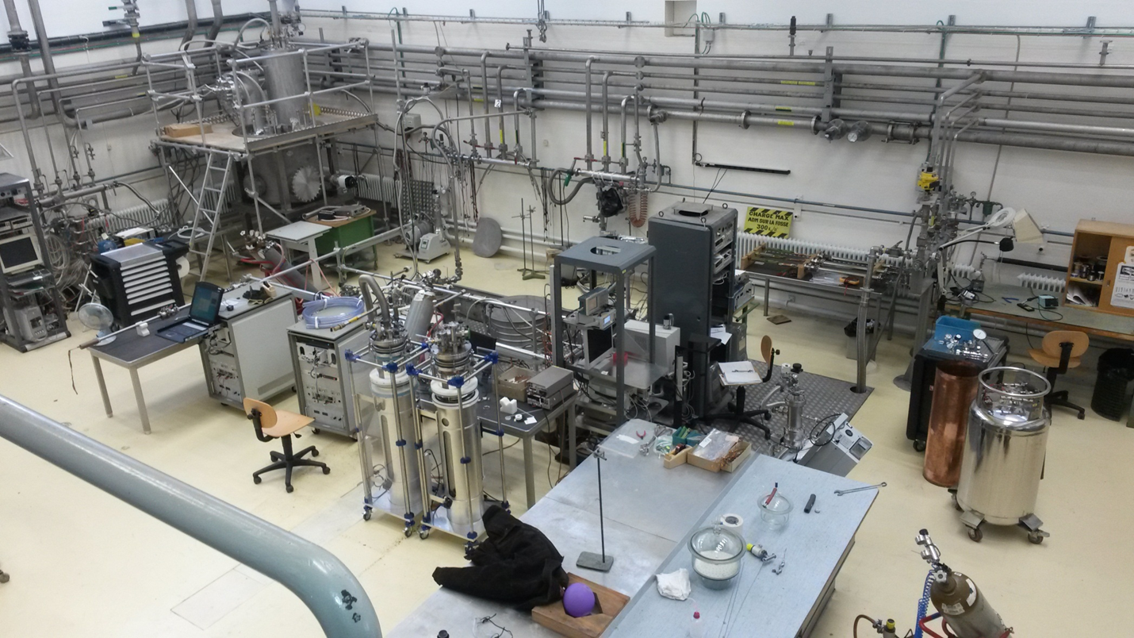
INTRODUCTION
The Central Cryogenic Laboratory
Provides support and
advice for users all over CERN.
Involved in development and testing of components for accelerators and experiments at CERN.
Liquid nitrogen, argon and helium are daily used in experiments.

Slide 5
OBJECTIVE
Upgrade a cryocooler which has currently a lowest reachable temperature (without any external heat load) of 9 K, to a lowest temp of 4 K.
WHY? :
  For small experimental test.
  Calibration of temperature sensors.
HOW? :
  - Integration of an additional He circuit:
    Counter-flow circuit
    Heat exchangers

Slide 6
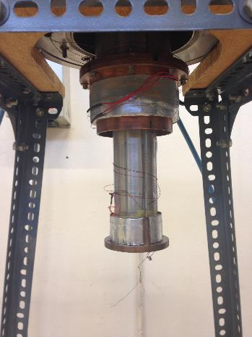
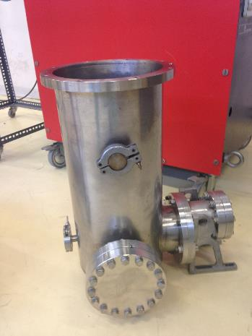
CURRENT STATUS
Internal status
Vacuum vessel
Temperature sensor
1st stage
Heater 1st stage
Heater 2nd stage
2nd stage
Ref. temperature sensor
2nd temperature sensor

Slide 7
ACCOMPLISHED ACTIVITIES
Assembly of the cryocooler/ vacuum chamber system
2nd stage
1st stage
Heat
intercept
@ 50 K
Vacuum
feed-
through
Analysis and implementation of the instrumentation (sensors and heaters).
Design of the radiation shield.
Installation of 2 layers of superinsulation on 2nd stage.
Application of 10 layers MLI on the radiation shield.
Connection of DAQ, multimeters and power supplies.

Slide 8
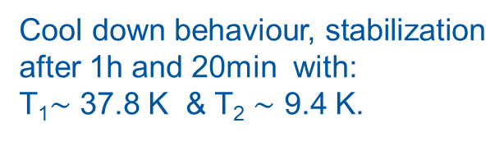
Results / Conclusion
Cryocooler performance applying different heat loads to both stages.
Cool down behaviour, stabilization after 1h and 20min with:
T₁$\sim$ 37.8 K & T₂ $\sim$ 9.4 K.
Available cooling power
for additional He circuit
1 W @ T₂<9.5 K

Slide 10
PLANNED ACTIONS
Calculation of the heat exchangers
293 K
4 bar
? K
58 K
47 K
? K
48 K
12 K
14 K
9.3 K
9.6 K

