Slide 1


FTEC 2015
Elena Barrios Díaz

Slide 2
BE – BI – ML
1
Measurement of all relevant beam parameters
Size
“Cut” through the beam
Location
Quantity
Energy
Variations of the above
Elena Barrios Díaz
27/10/2015

Slide 3
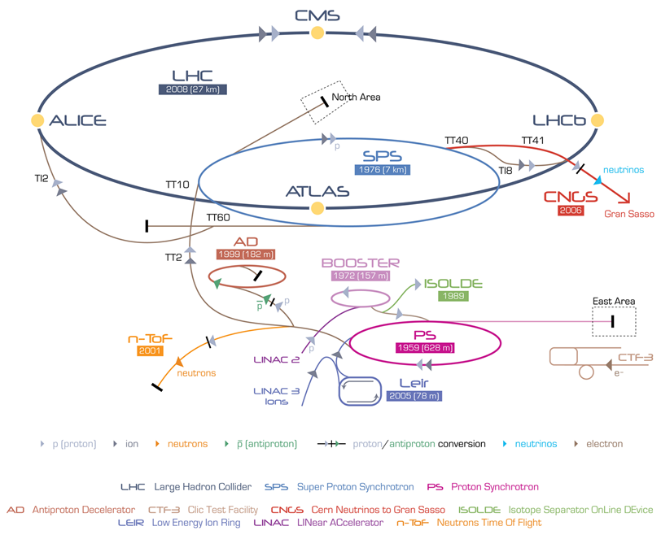
2
Elena Barrios Díaz
27/10/2015

Slide 4
Projects
3
Design and production of a laser emittance meter for LINAC4
Integration and optimization of a supersonic gas jet beam profile monitor for LHC
Elena Barrios Díaz
27/10/2015

Slide 5
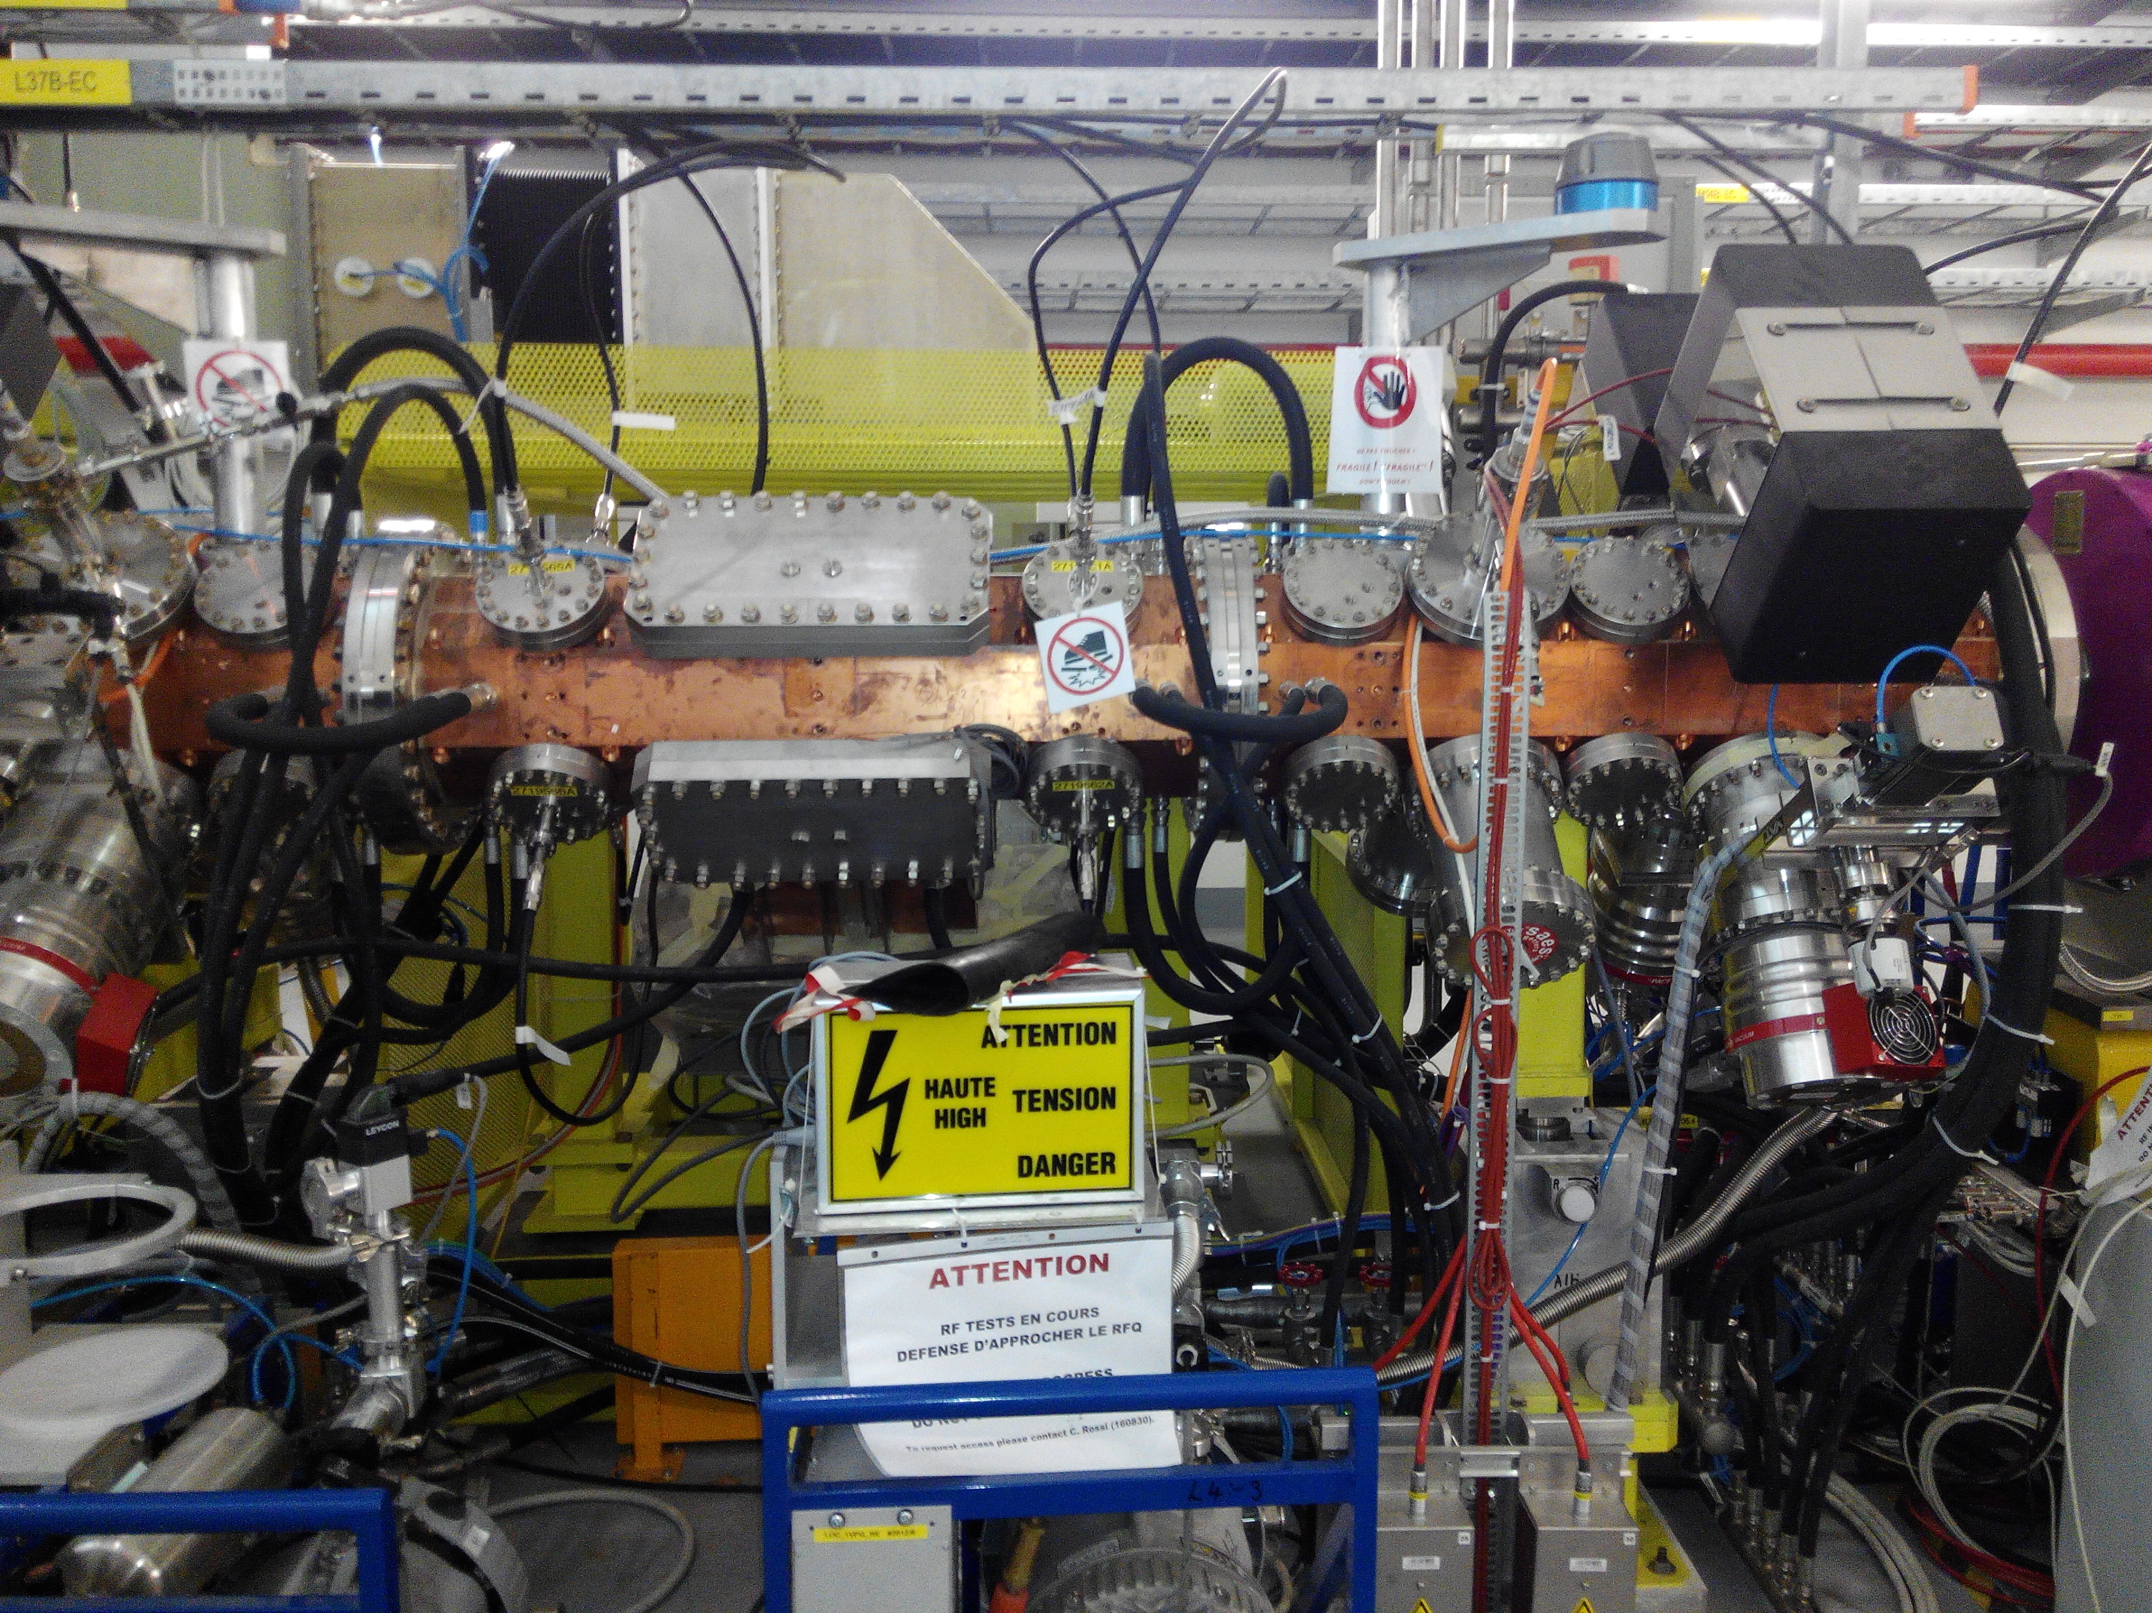
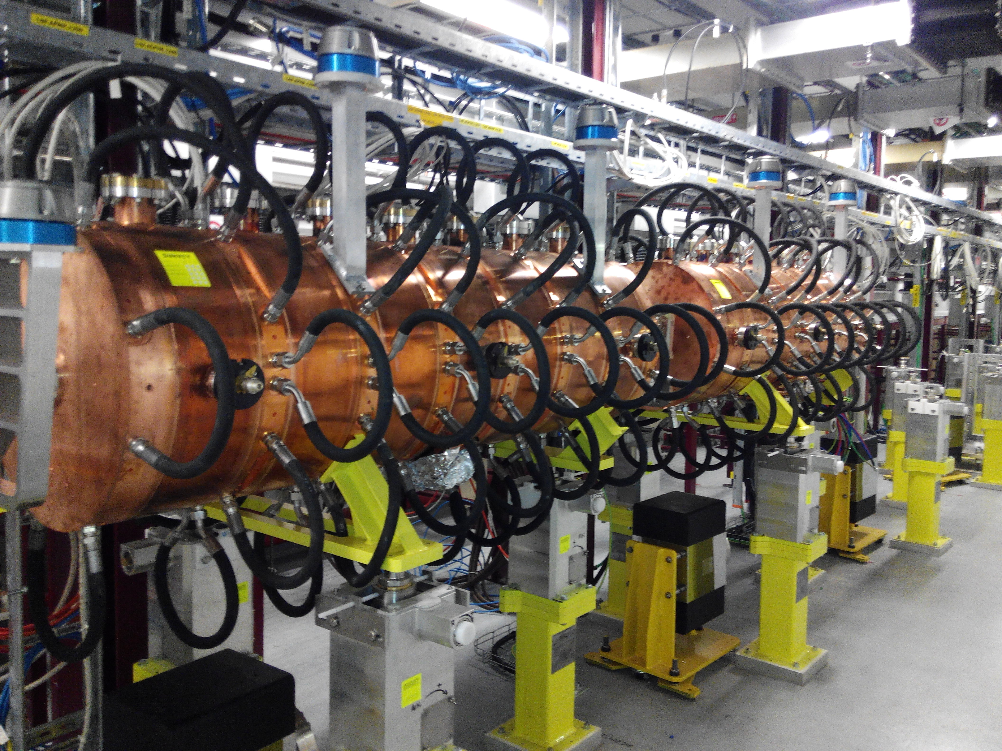
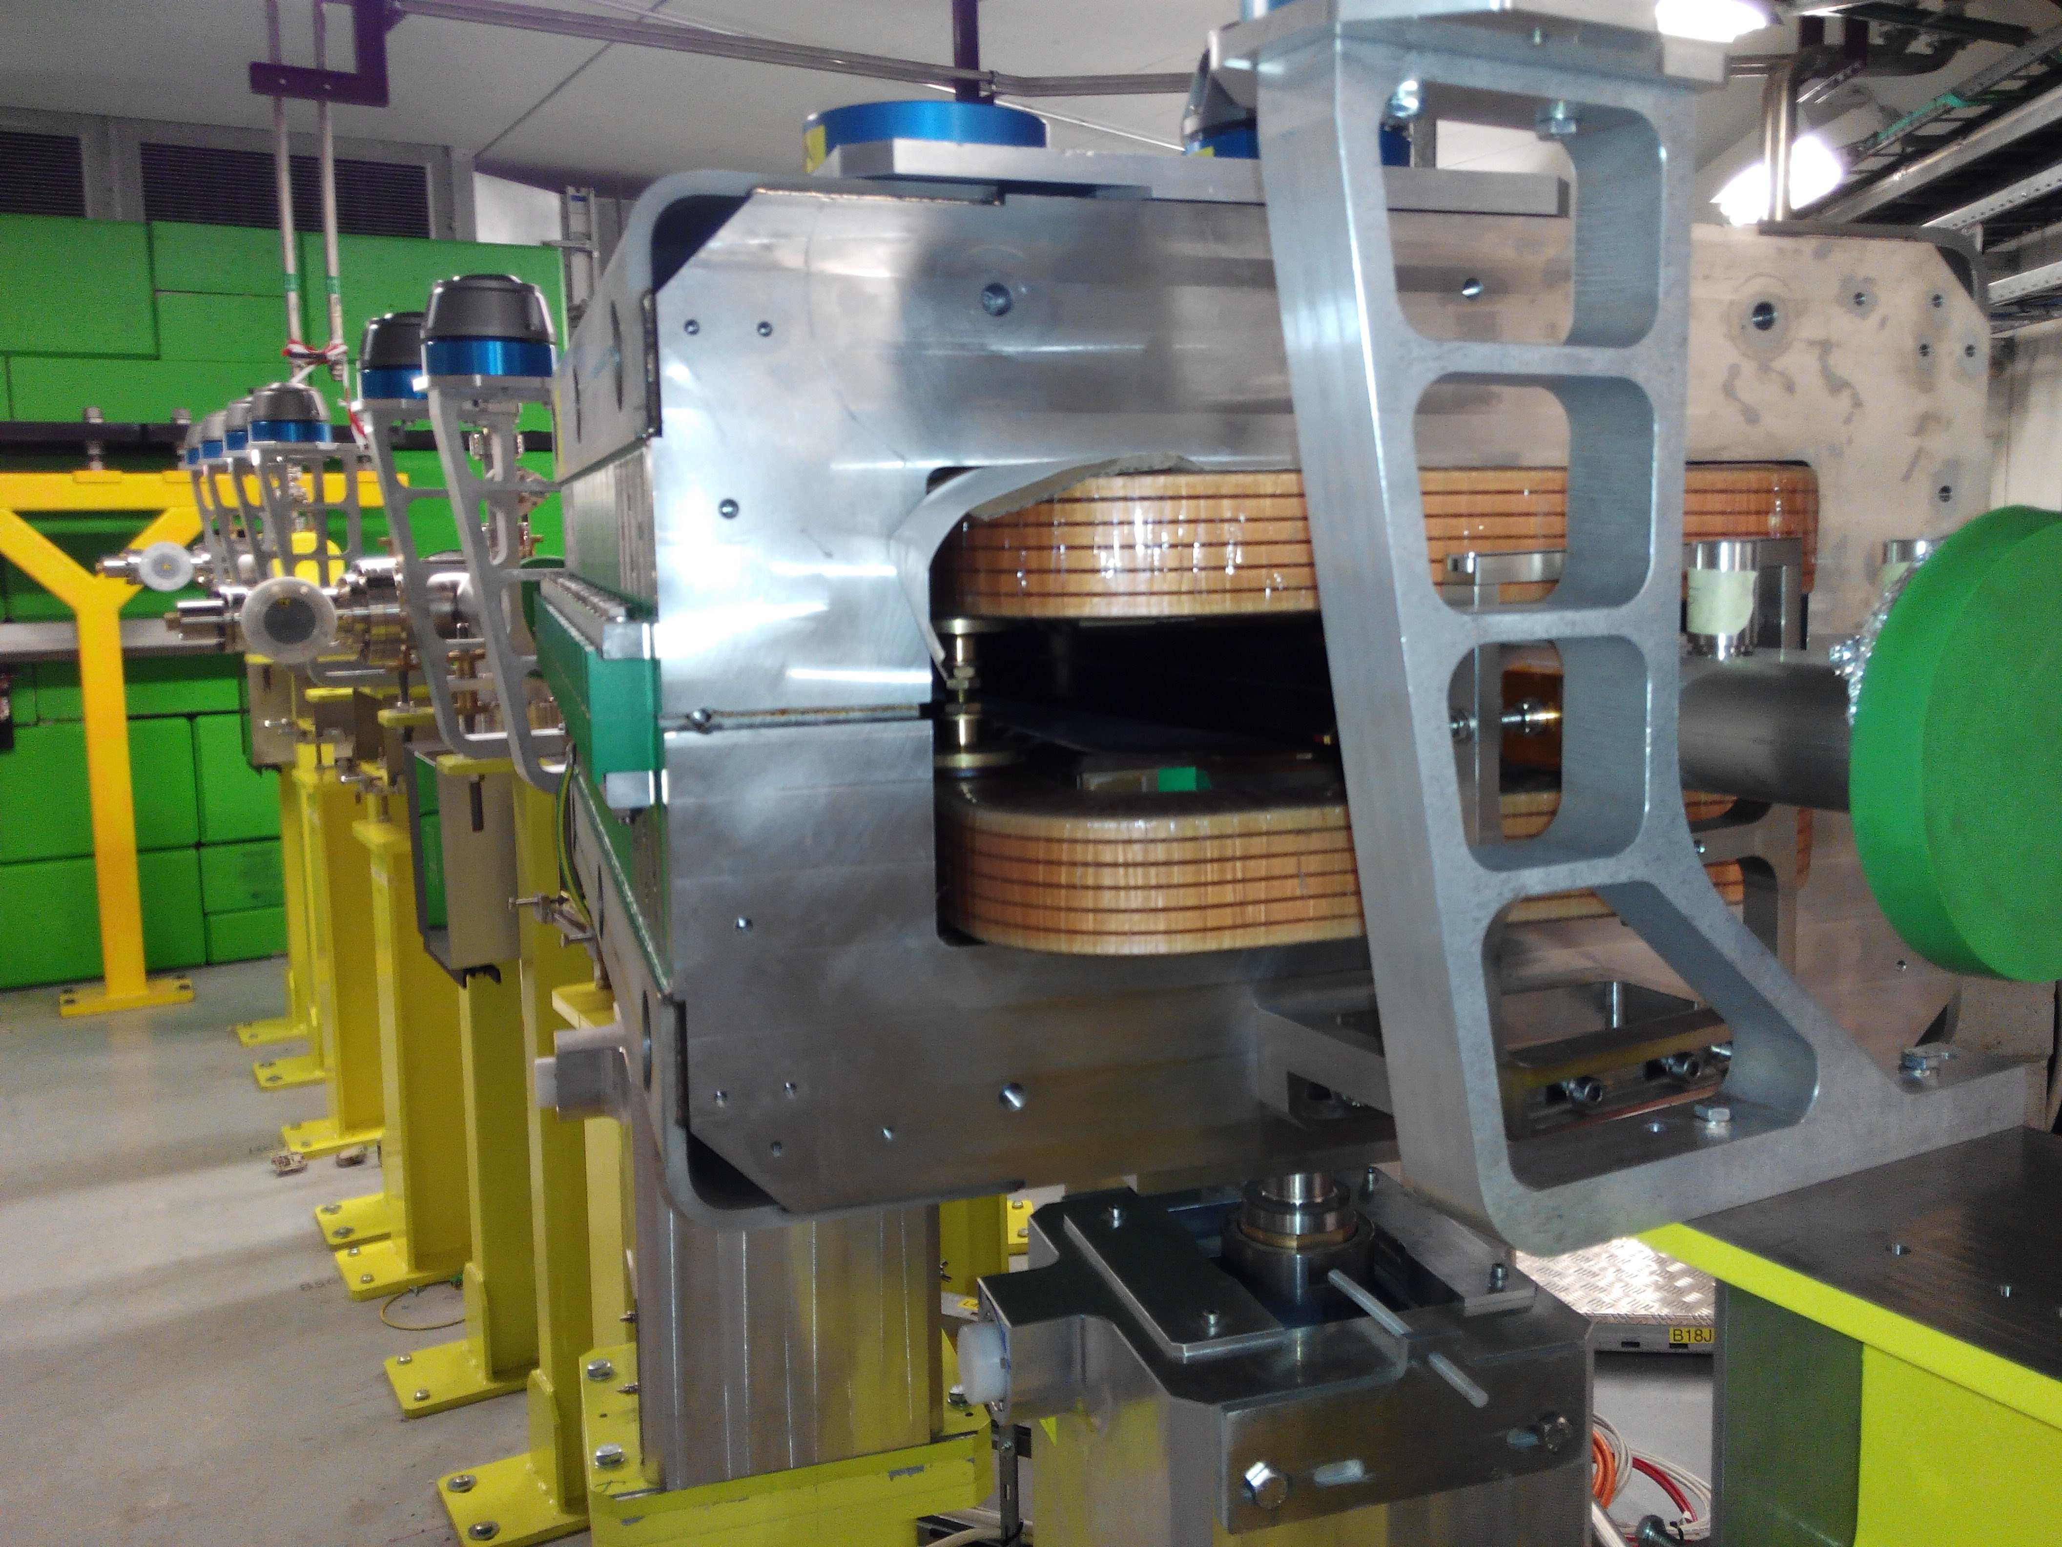
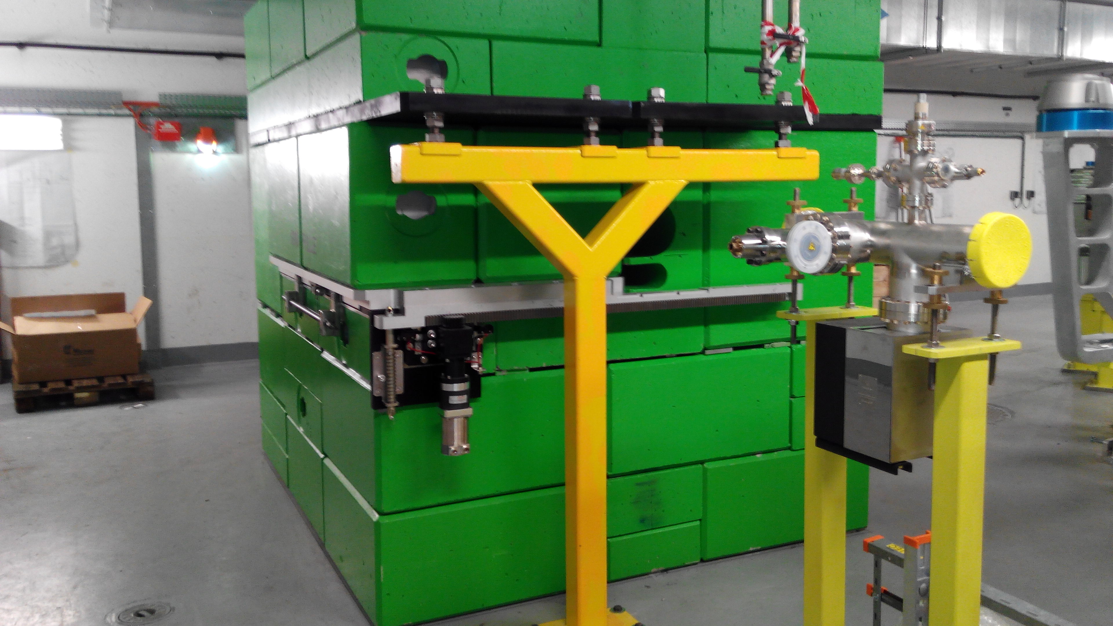
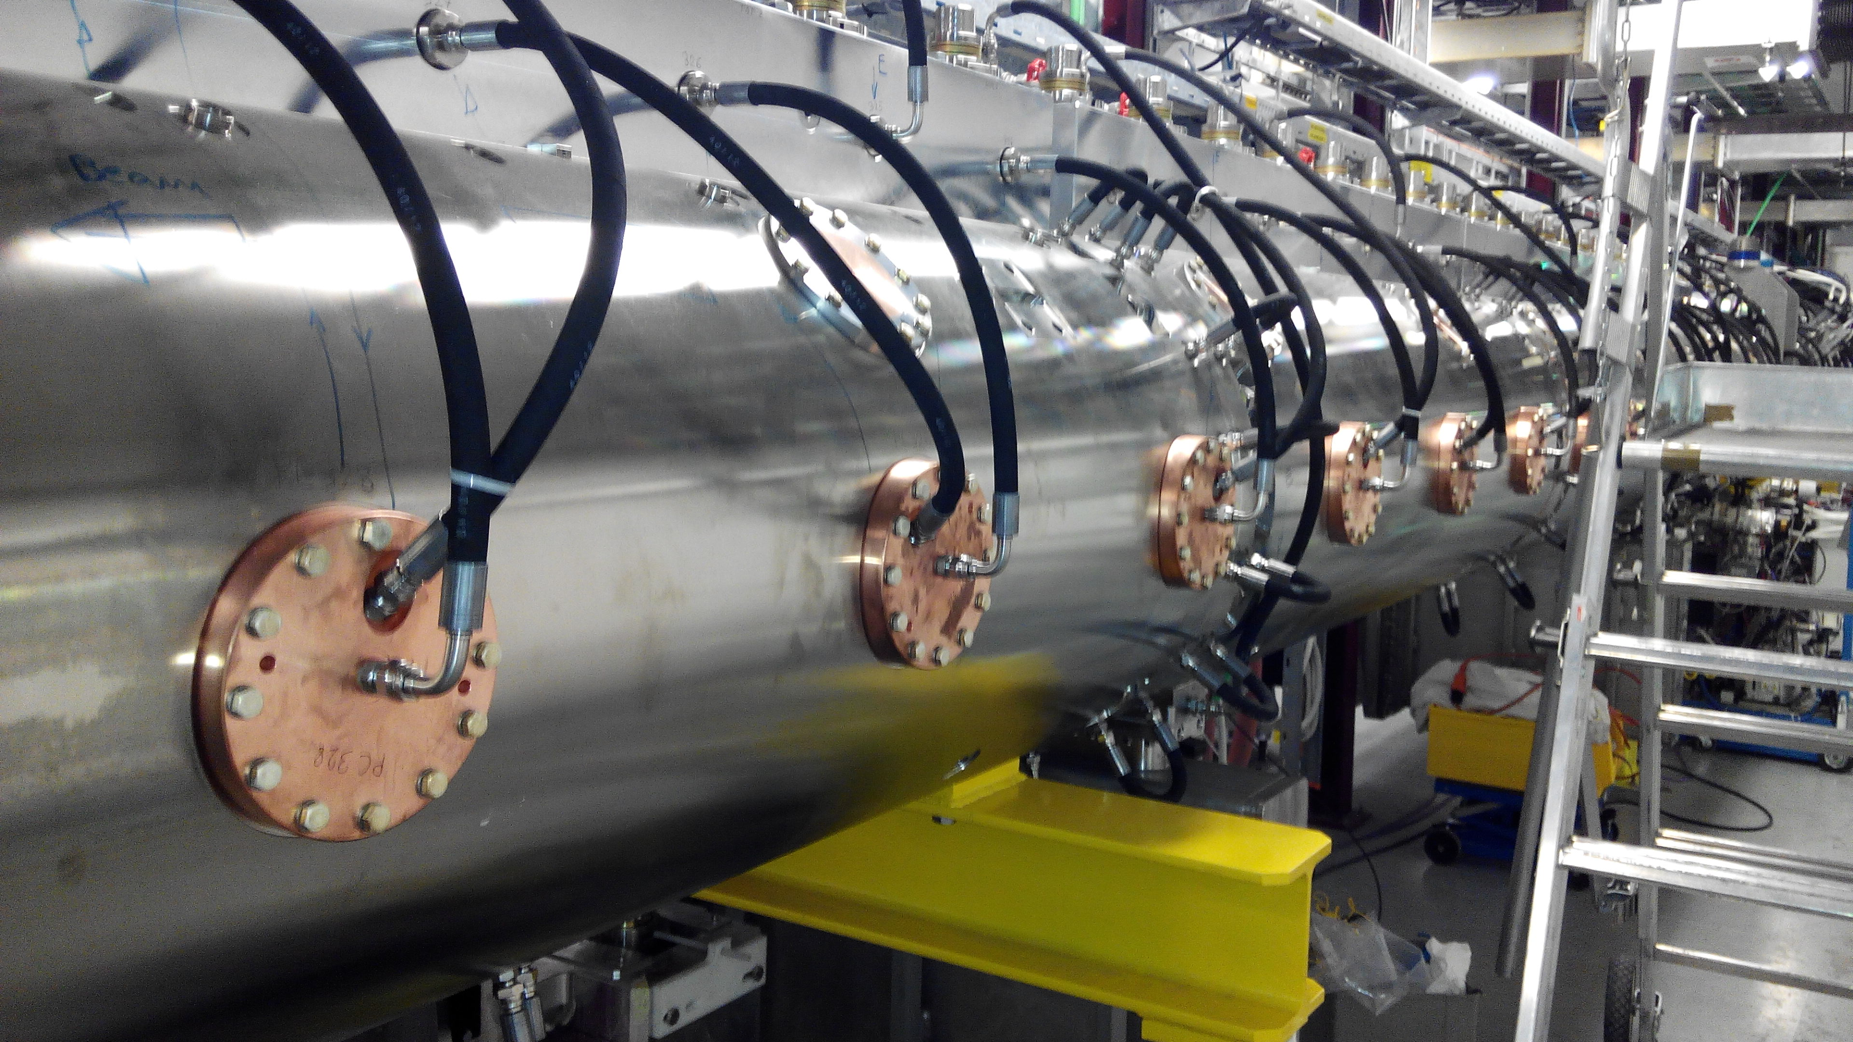
Design and production of a laser emittance meter for LINAC4
4
Elena Barrios Díaz
27/10/2015

Slide 6
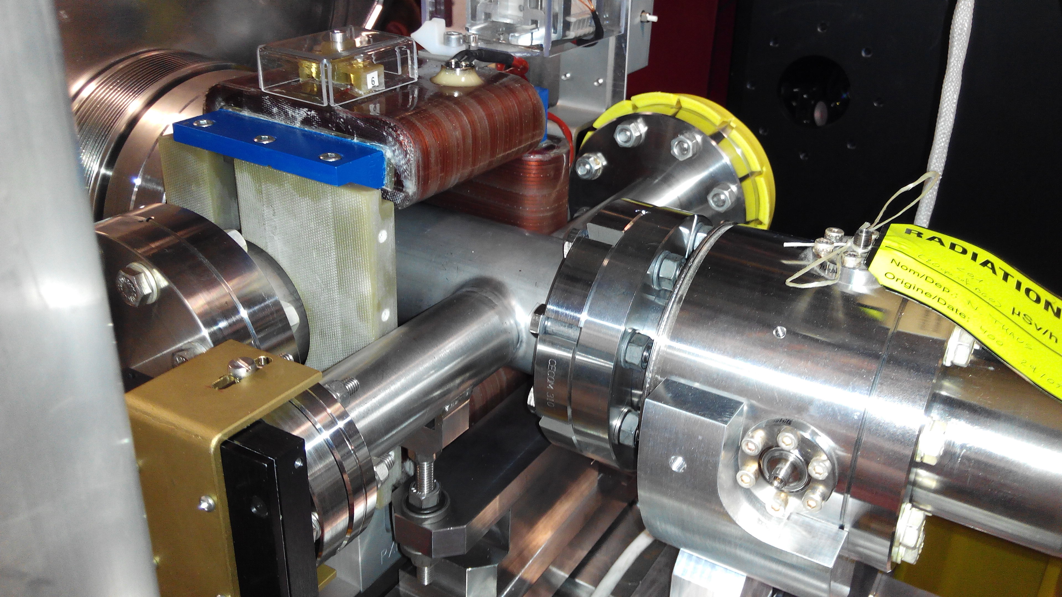
Design and production of a laser emittance meter for LINAC4
4
Elena Barrios Díaz
27/10/2015

Slide 7
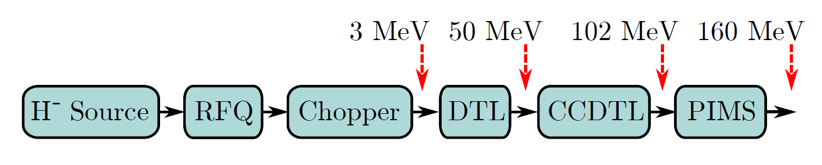
Design and production of a laser emittance meter for LINAC4
5
Elena Barrios Díaz
27/10/2015

Slide 8
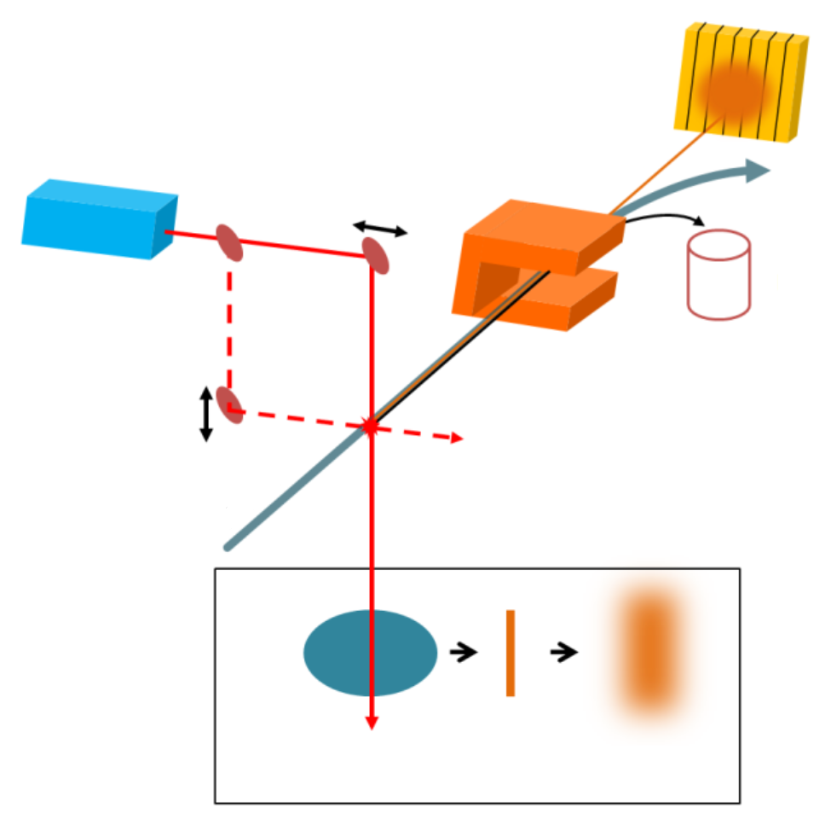
Design and production of a laser emittance meter for LINAC4
6
Detector
Laser
H⁰
H⁻
x-scan
e⁻
Faraday cup
Bending
magnet
y-scan
H⁻ beam
H⁰ beamlet
H⁻ beam
Beamlet after drift
Elena Barrios Díaz
27/10/2015

Slide 9
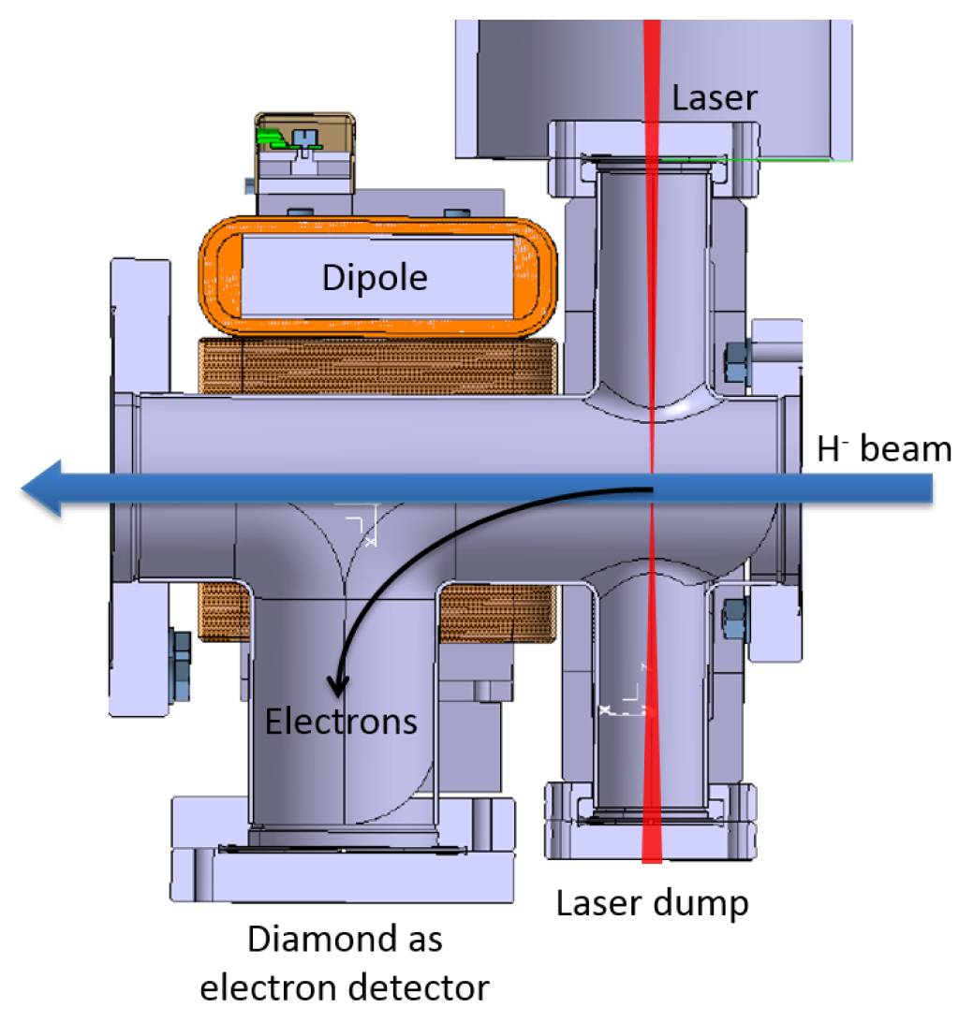
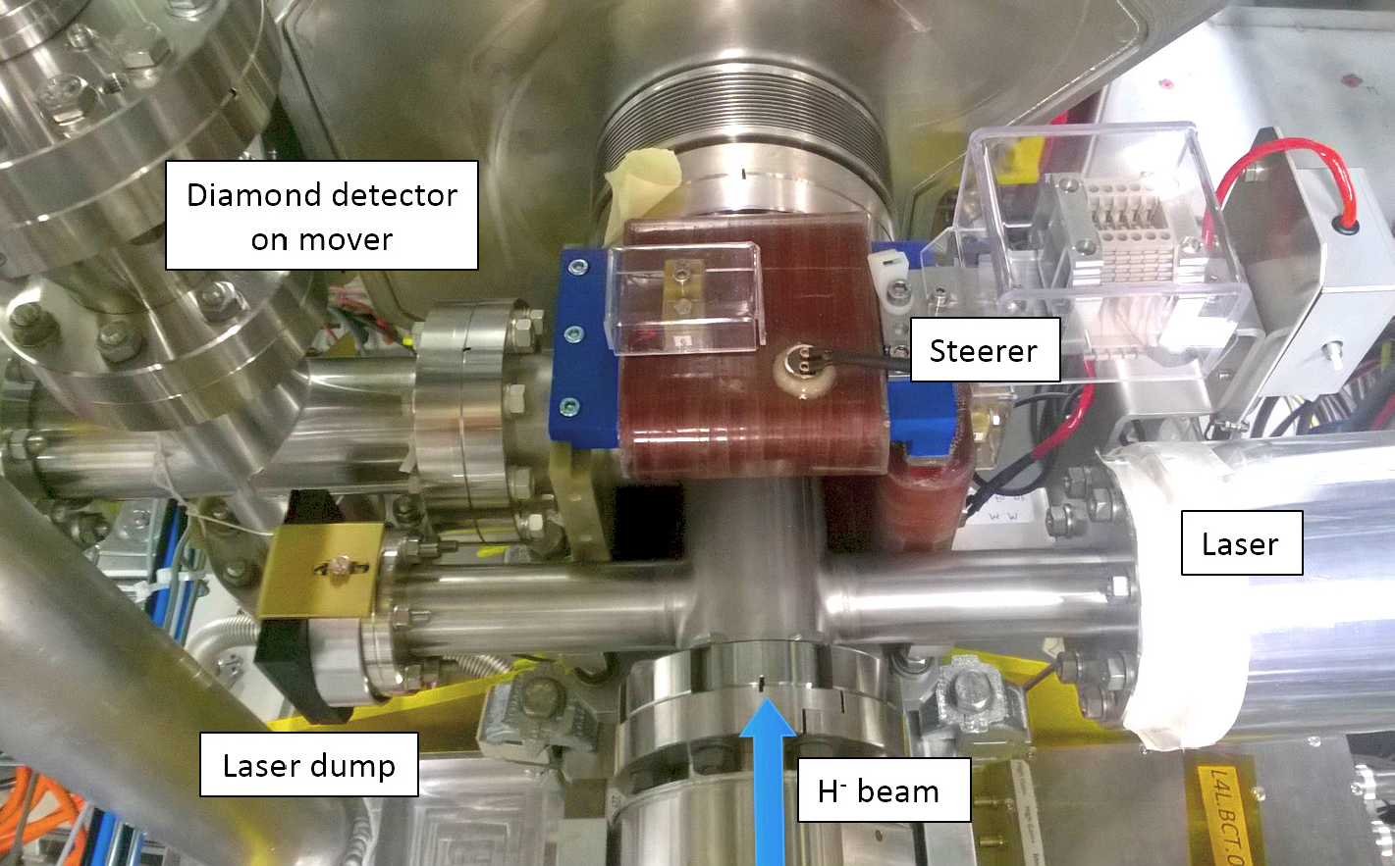
Design and production of a laser emittance meter for LINAC4
7
Elena Barrios Díaz
27/10/2015

Slide 10
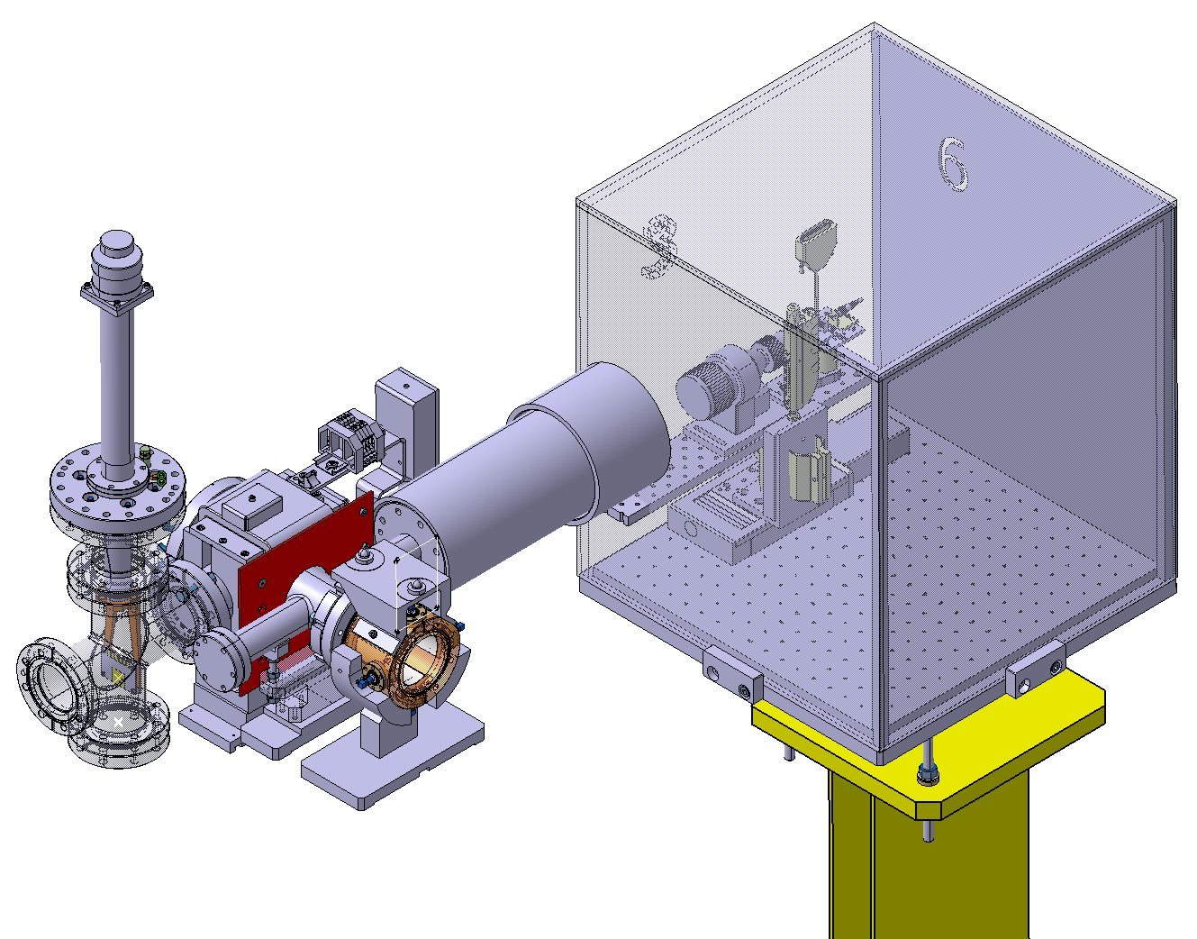
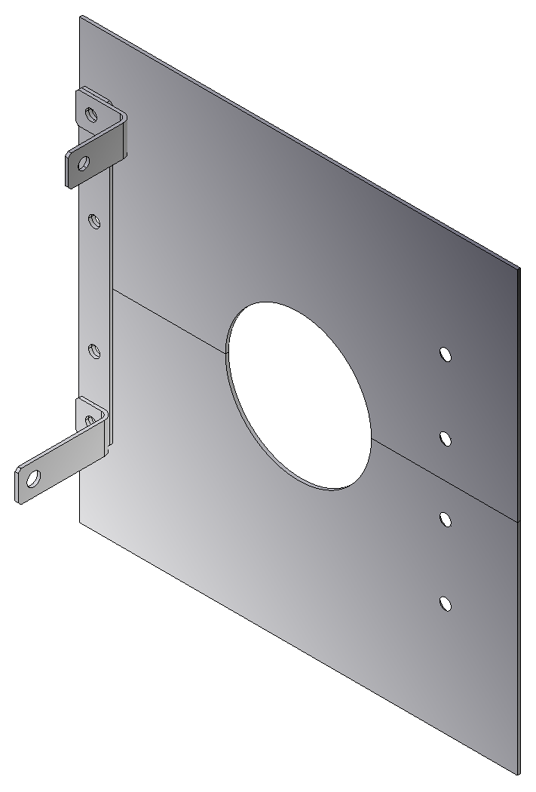
Design and production of a laser emittance meter for LINAC4
8
Elena Barrios Díaz
27/10/2015

Slide 11
Design and production of a laser emittance meter for LINAC4
8
Elena Barrios Díaz
27/10/2015

Slide 12
Projects
9
Design and production of a laser emittance meter for LINAC4
Integration and optimization of a supersonic gas jet beam profile monitor for LHC
Elena Barrios Díaz
27/10/2015

Slide 13
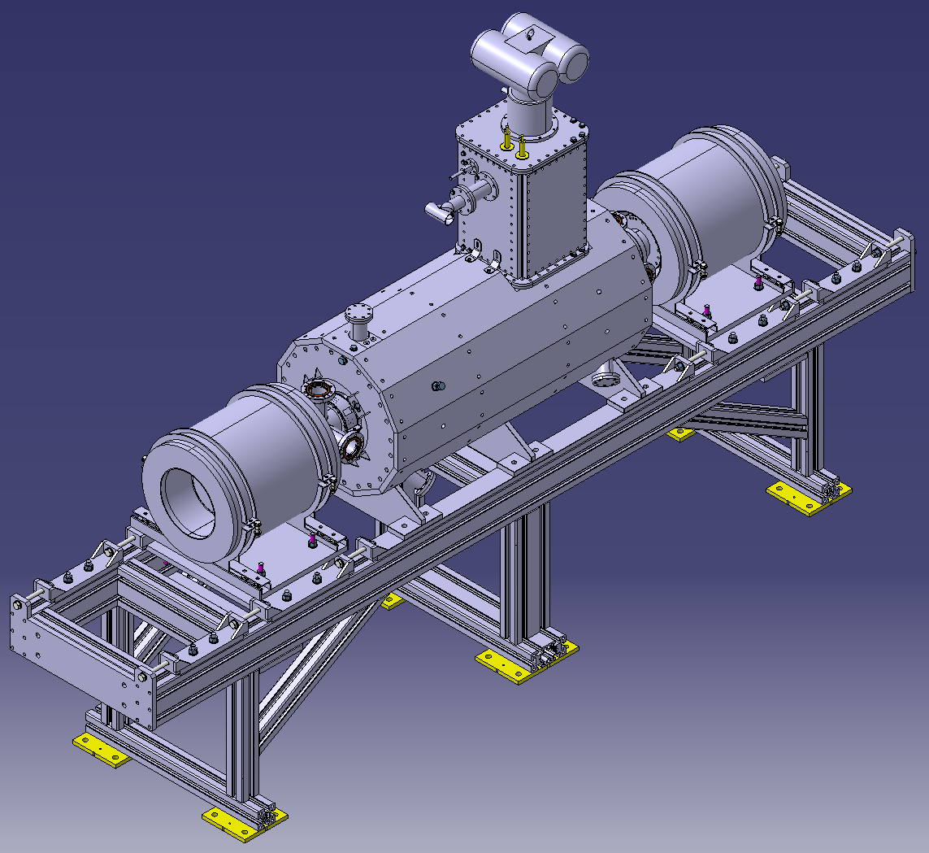
Integration and optimization of a supersonic gas jet beam profile monitor for LHC
10
Electron
Gun
Electron
Collector
Solenoid
Elena Barrios Díaz
27/10/2015

Slide 14
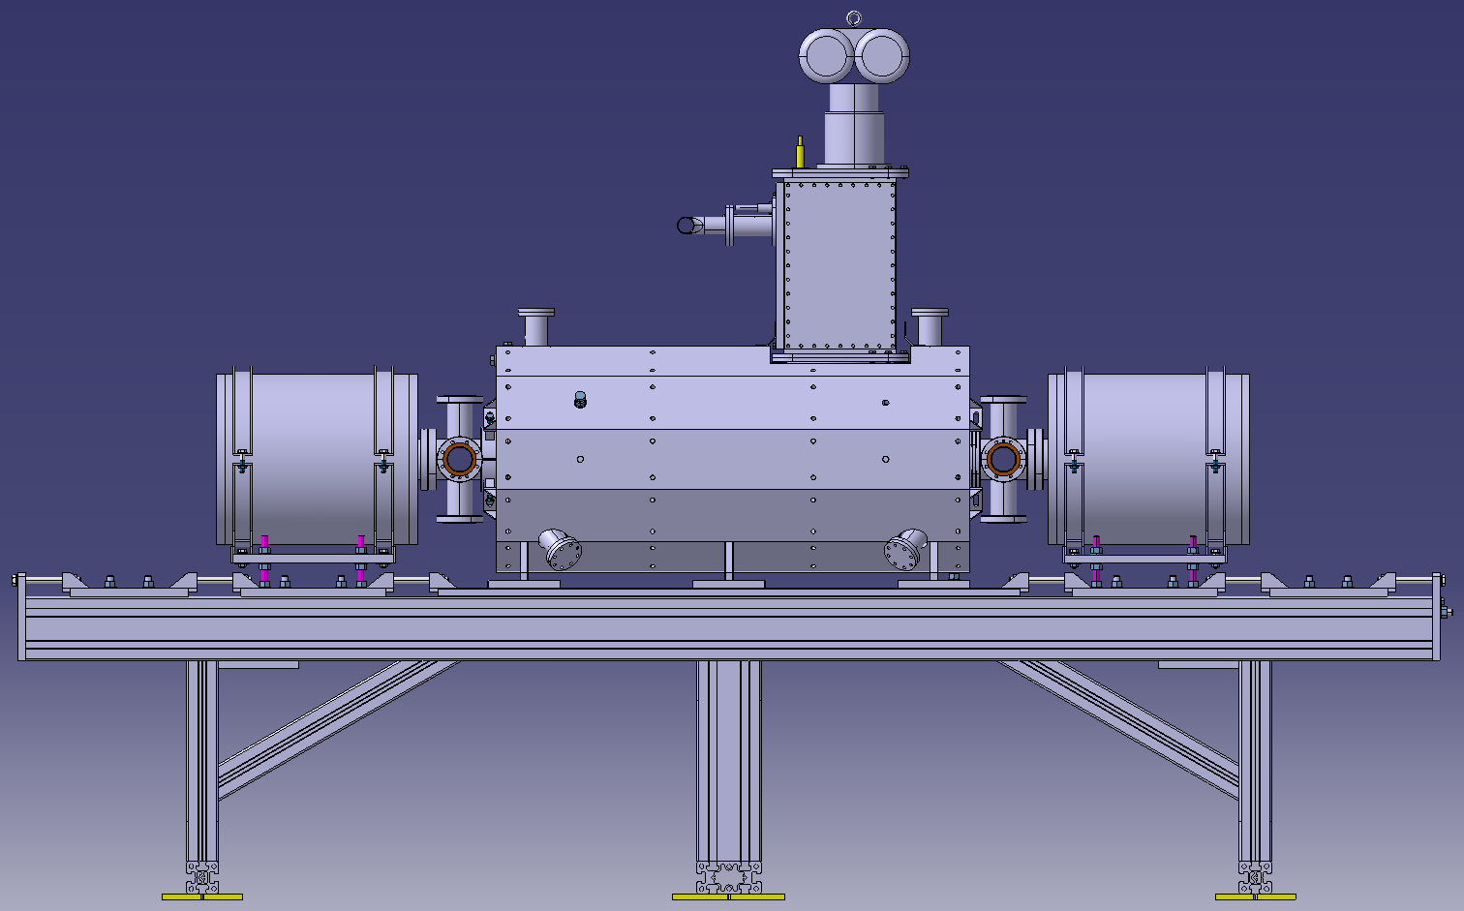
Integration and optimization of a supersonic gas jet beam profile monitor for LHC
11
Electron
Collector
Electron
Gun
Solenoid
Elena Barrios Díaz
27/10/2015

Slide 15
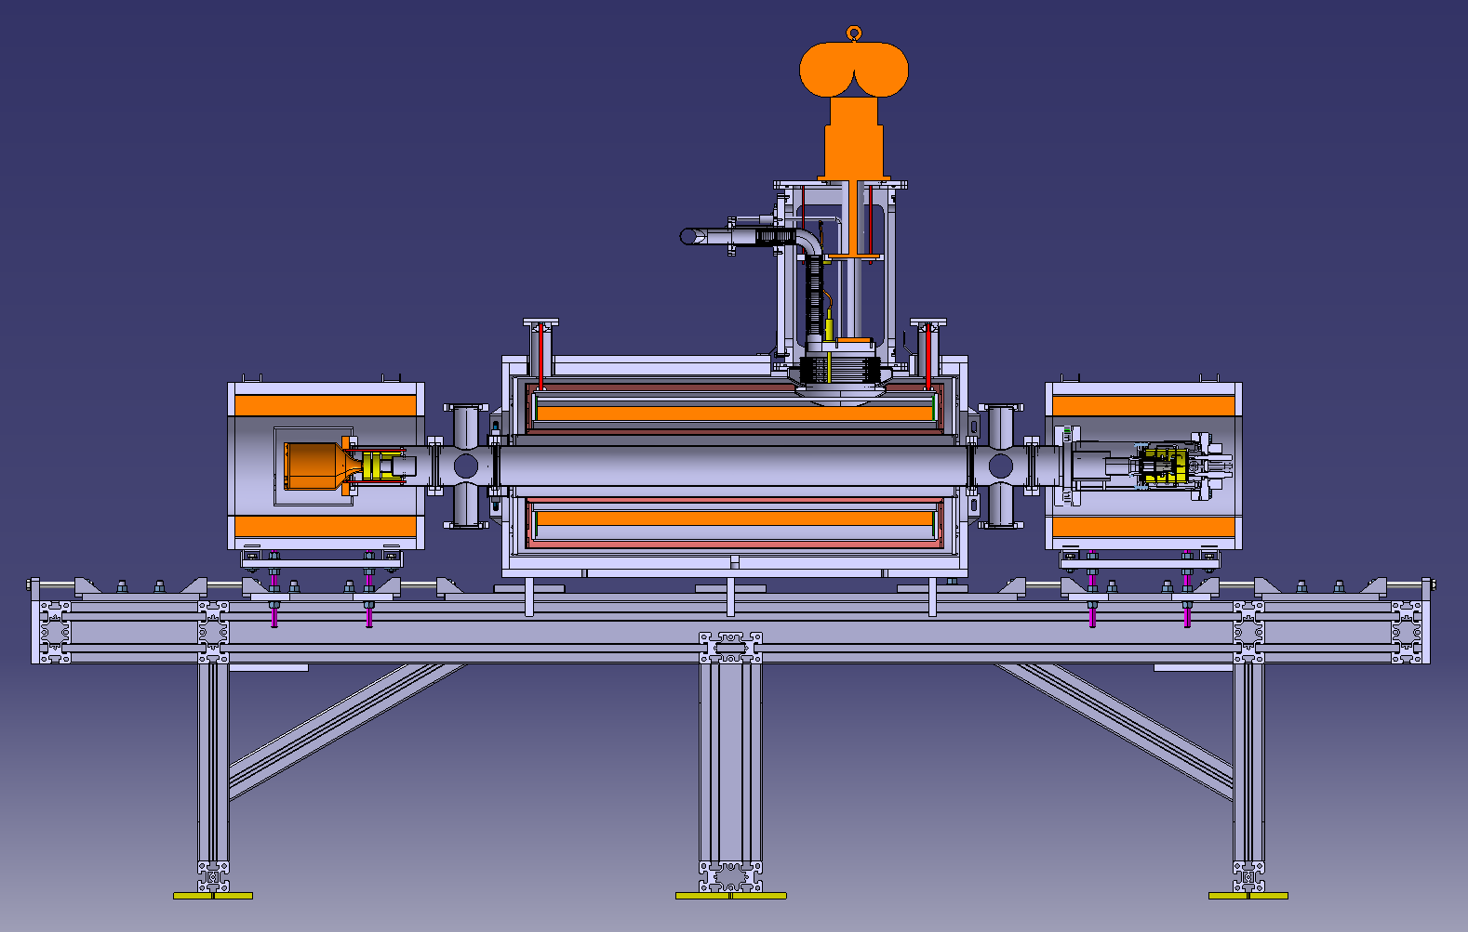
Integration and optimization of a supersonic gas jet beam profile monitor for LHC
12
Electron
Collector
Electron
Gun
Solenoid
Elena Barrios Díaz
27/10/2015

Slide 16
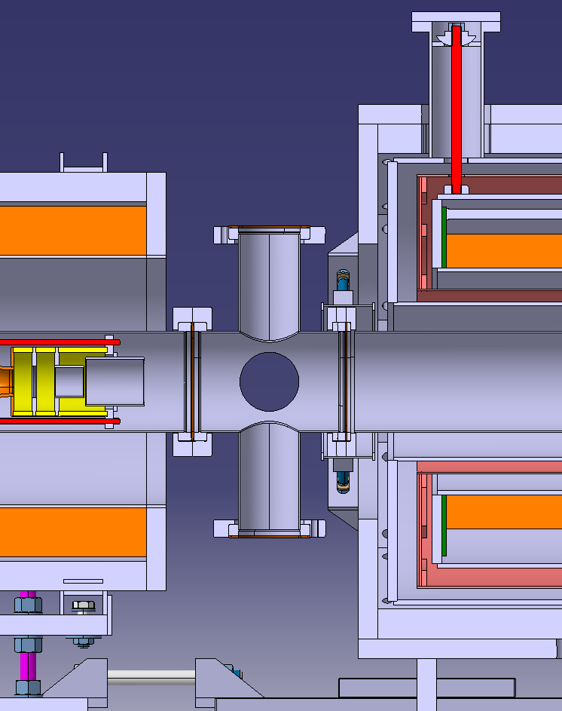
Integration and optimization of a supersonic gas jet beam profile monitor for LHC
12
Elena Barrios Díaz
27/10/2015

Slide 17
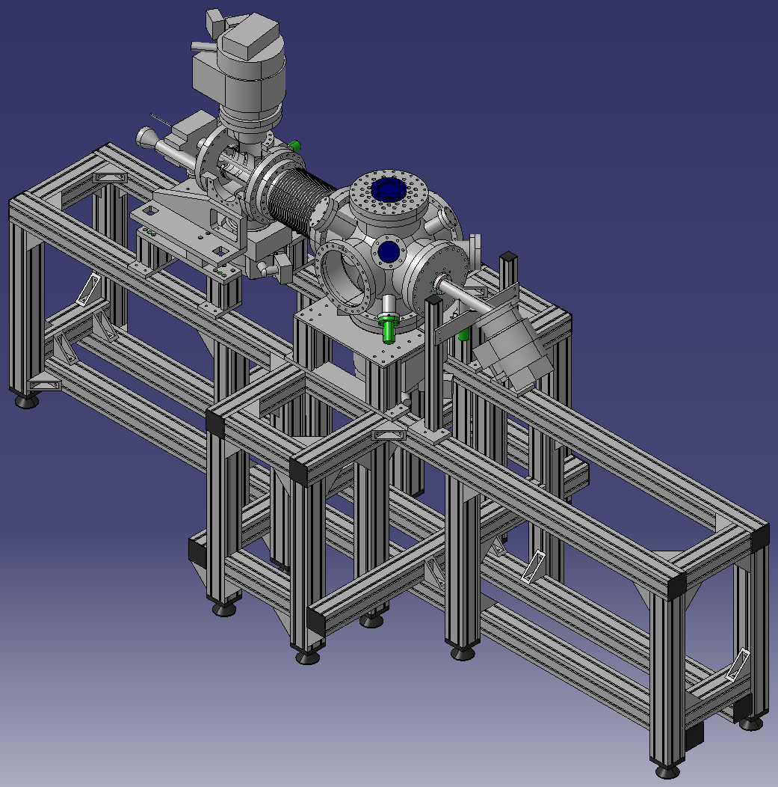
Integration and optimization of a supersonic gas jet beam profile monitor for LHC
13
Nozzle chamber
Interaction chamber
Differential pumping section
Dumping section
0 – 15 mbar
10⁻⁶ – 10⁻⁹ mbar
Elena Barrios Díaz
27/10/2015

Slide 18
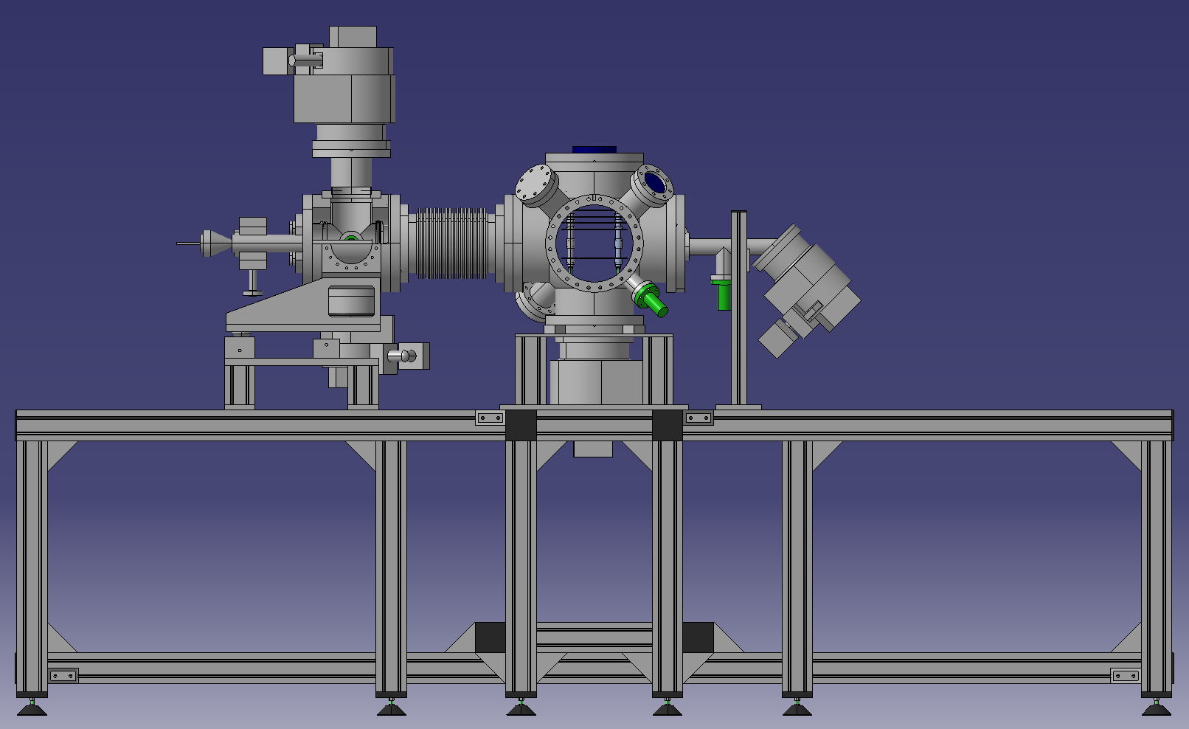
Integration and optimization of a supersonic gas jet beam profile monitor for LHC
14
0 – 15 mbar
10⁻⁶ – 10⁻⁹ mbar
Nozzle chamber
Interaction chamber
Differential pumping section
Dumping section
Elena Barrios Díaz
27/10/2015

Slide 19

Questions
15
Elena Barrios Díaz
27/10/2015

Slide 20

THANK YOU!!!
16
Elena Barrios Díaz
27/10/2015

