Slide 1

TE-MSC-MDT

Slide 2


Activities Report
FTEC CIEMAT-CERN
27/10/2015
Juan Carlos Perez TE-MSC-MDT
Jose Ferradas TE-MSC-MDT

Slide 3
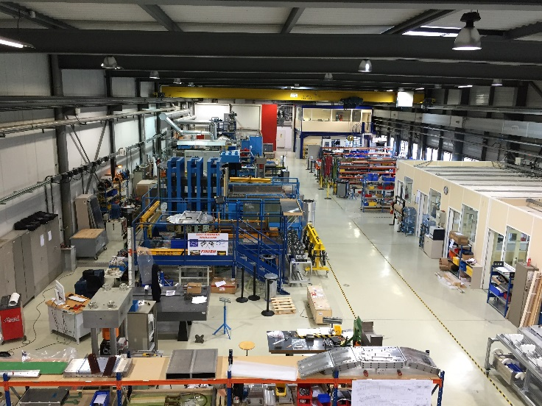
Description and status of the project
1. GENERAL
Project TE3536: Develop dimensional control techniques (using the FARO arm) for short and long Nb₃Sn coils
Mechanical Engineer position at TE-MSC-MDT Section. Laboratory 927
3 months of activities
2 main activities during these 3 months:
  TE3536 Main Project
  MCBXF Orbit Corrector collaboration// CIEMAT – CERN Project

Slide 4
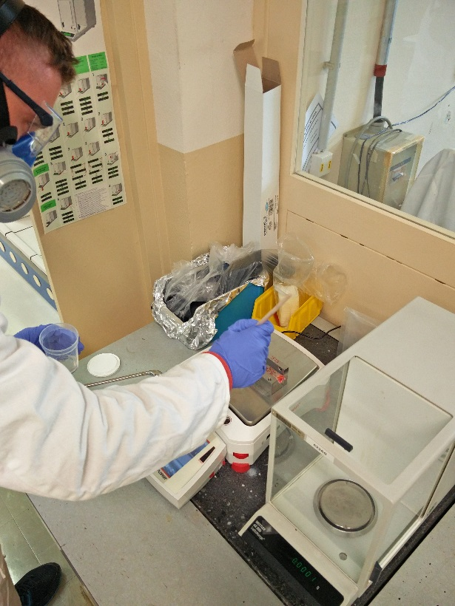
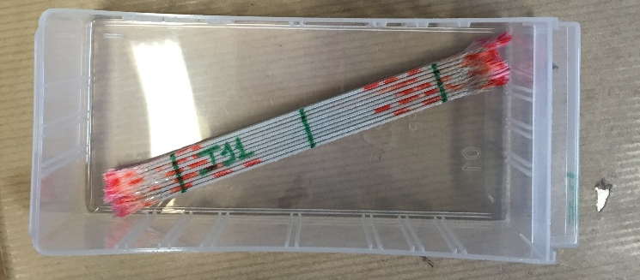
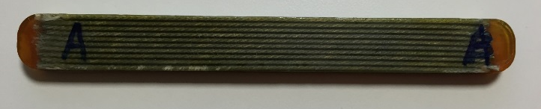
MCBXF Orbit Corrector: CIEMAT - CERN
2.MCBXF
Activities at Polymer Lab (CERN)
  MCBXF Project: Qualification tests for binder application and impregnation
MCBXF Cable: NbTi
  10-Stacks tests
  Coil wounded in steps: Need of suitable binder
Work developed: Binder application and impregnation tests
Result:
  Compatibility resin-binder
  Upcoming tests

Slide 5
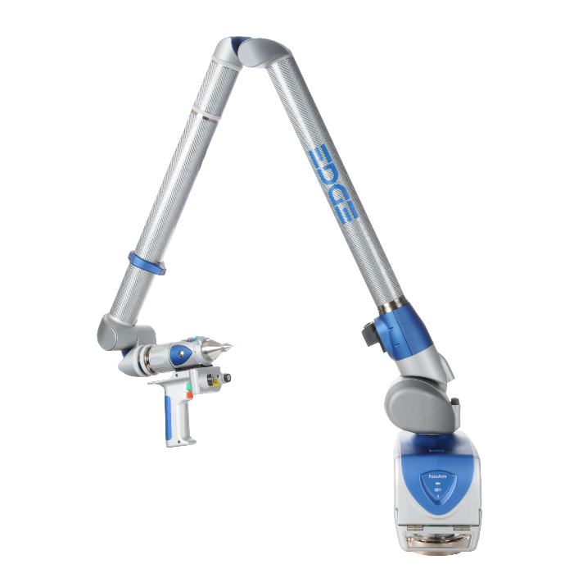
Main Activity: TE3536 at Building 927
3. TE 3536
Supervisor: Juan Carlos Perez
TE-MSC-MDT: Superconducting Magnets Design and Technology
  From functional specifications to the construction of short models
Projects:
  - 11T Dipole – MQXF Project - High Field Magnets R&D (FRESCA2, SMC, RMC)
Work developed:
  Participation in a huge range of activities in the Lab
  In charge of Metrology activities. Check and reports for a huge variety of applications
  Metrology reports for LMF (Large Magnet Facility)
  Participation in meetings inside and outside the section (CIEMAT, LARP (USA), CEA/SACLAY…)
  Contact with suppliers and collaborators

Slide 6
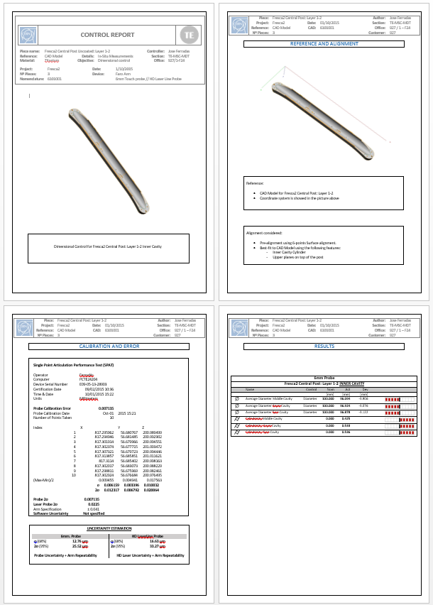
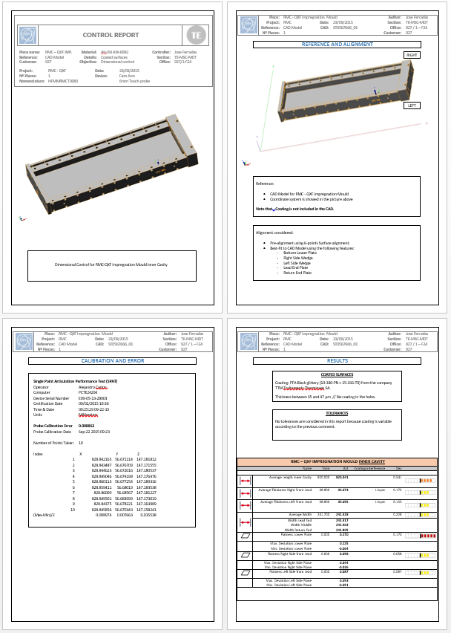
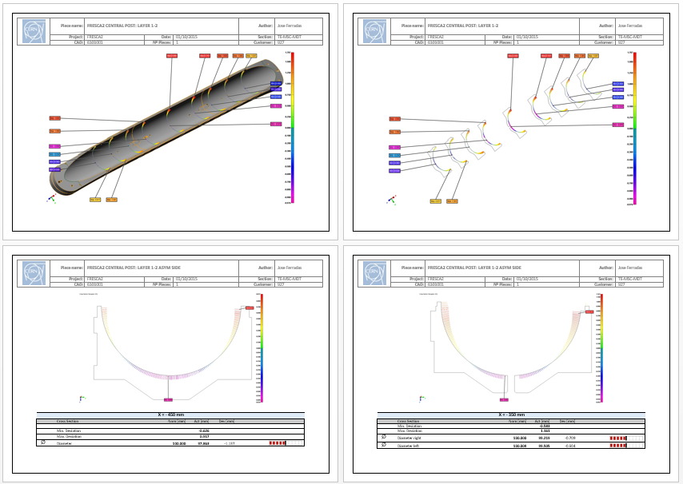
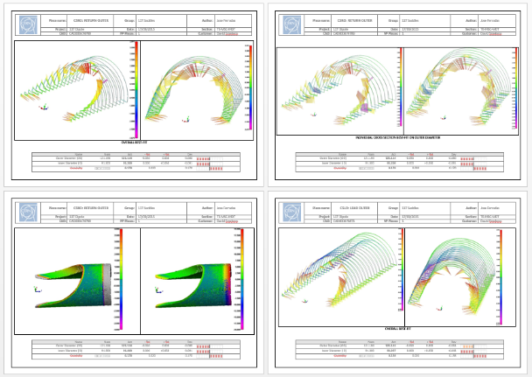
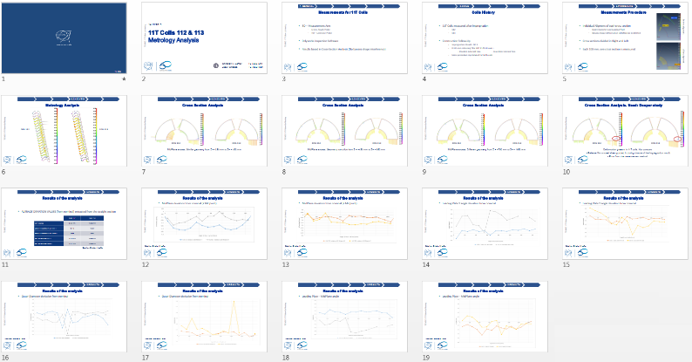
Main Results
4.CHALLENGES
Knowledge acquisition:
  Superconducting Magnets Design and Technology
  Mechanical Engineering and Measurements
  (CMM Coordinate Measurement Machine)
Metrology Reports
Analysis of Results
Magnets Construction / Other activities

Slide 7
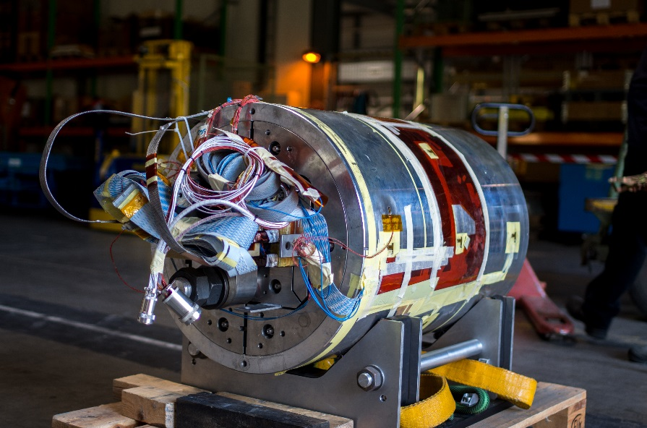
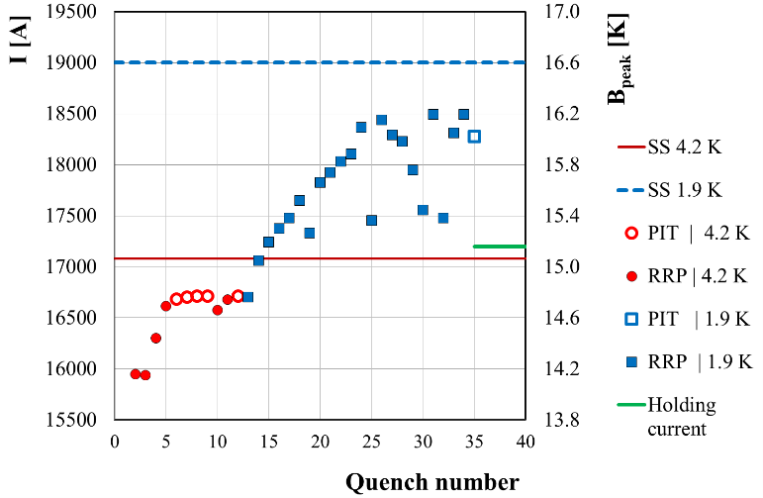
Main Results
4.CHALLENGES
Special mention to RMC_03 Magnet:
  Test bed for magnet construction and fabrication methods
  High Field Magnet program: Nb₃Sn Technology
  Compound by two flat coils
Contribution to RMC_03 Magnet:
  Coils measured and reported
  Shimming plan for coilpack assembly
  Participation in the assembly
Magnet reached a peak field of 16.2T. Corresponding to a current of 18.5kA
Domain of record dipole type fields. Joining LBNL

Slide 8
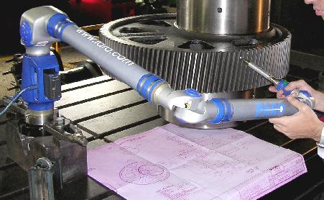
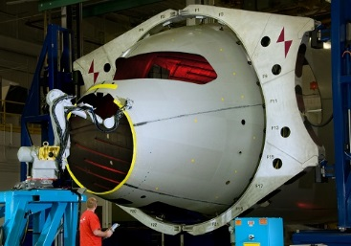
Industry Application (CDTI)
5. NEXT
Planned Actions
Continue with activities concerning TE3536 Project
Analysis of coil geometry for 11T Dipoles production
  Explain coil geometry linked to the tooling geometry and construction steps
Knowledge acquisition in Mechanical Engineering (Magnets Design and Technology)
Metrology and Mechanical Measurements present in huge variety of applications

Slide 9
Thank you
acknowledgment
Juan Carlos Perez TE-MSC-MDT
Jose Ferradas TE-MSC-MDT

