Slide 1


Design, construction follow-up and operation of cold powering test benches
TE-MSC-TF
Thermal Models for Quench Simulation on ${Nb}_{3}Sn$ Cables
H. Bajas
M. Bajko
J. V. Lorenzo
27th October 2015

Slide 2
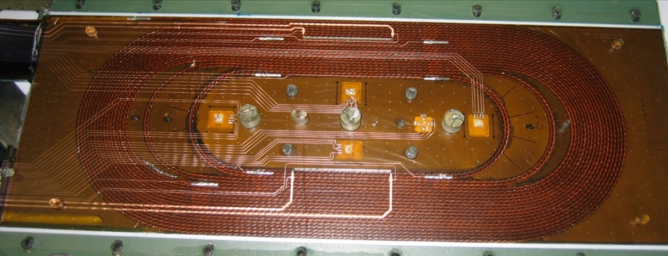
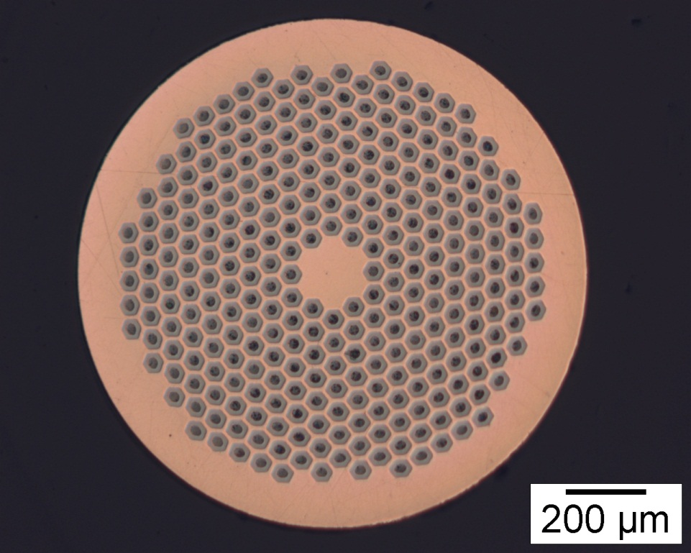
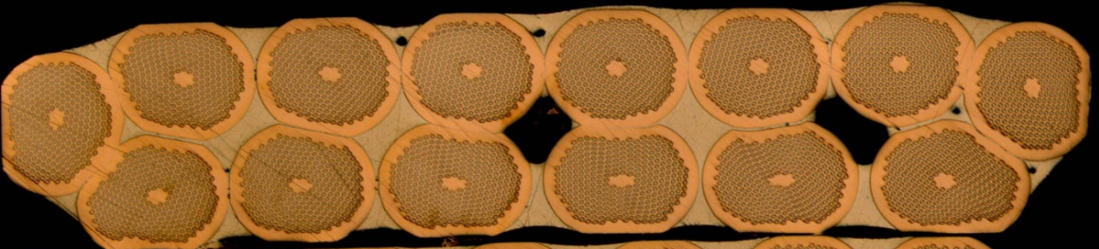

TE-MSC-TF
Cable Geometry
Luminosity upgrade of the LHC (HL-LHC) → Superconducting magnets based on ${Nb}_{3}Sn$ strands
Foreseen cables have been tested in a simplified racetrack coil configuration, the Short Model Coil (SMC)
14-strand Rutherford cable
(10.1 mm x 2.6 mm)
1.25 mm PIT strand
(288 filaments, 50 $μm$)
Ansys model of heat propagation in impregnated ${Nb}_{3}Sn$ cable with nonlinear material properties in order to predict longitudinal and transverse propagation of a quench initiated by a spot heater in SMC.

Slide 3
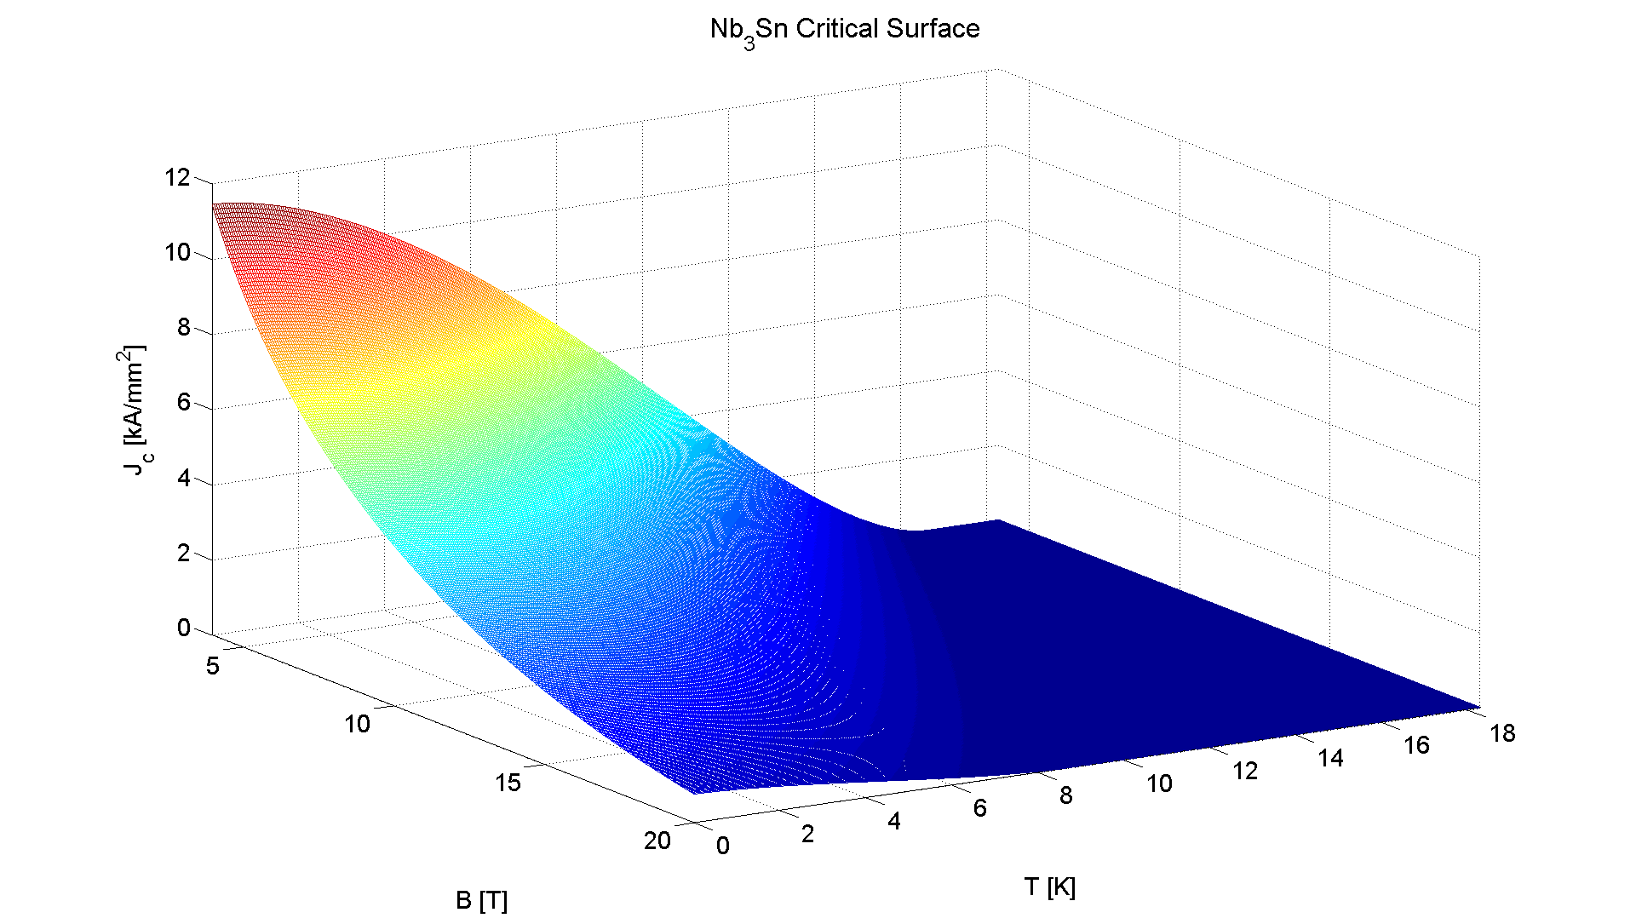
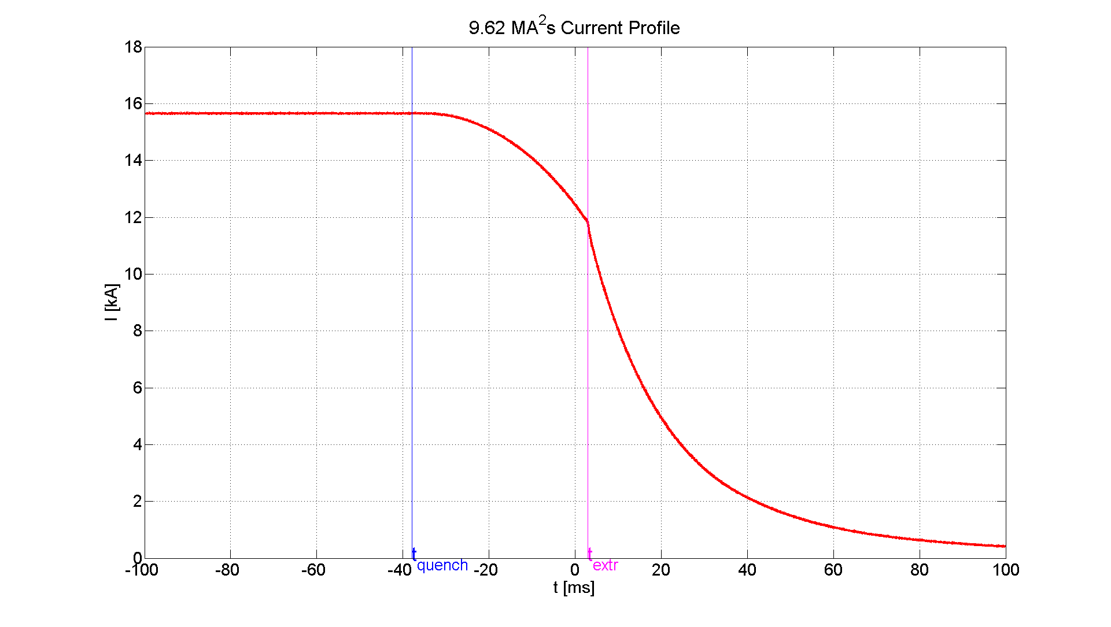
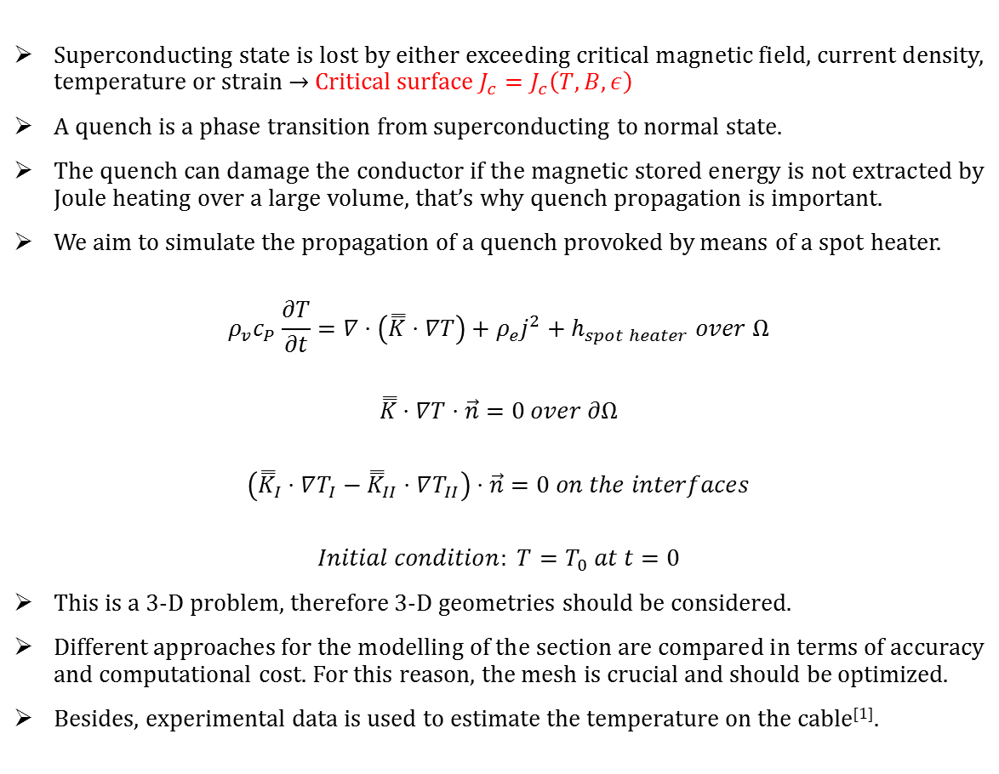
TE-MSC-TF
Quench Propagation
Superconducting state is lost by either exceeding critical magnetic field, current density, temperature or strain → Critical surface $J_{c}=J_{c}\left(T,B,ε\right)$
A quench is a phase transition from superconducting to normal state.
The quench can damage the conductor if the magnetic stored energy is not extracted by Joule heating over a large volume, that’s why quench propagation is important.
We aim to simulate the propagation of a quench provoked by means of a spot heater.
$$ρ_{v}c_{P}\frac{∂T}{∂t}=∇⋅\left(\overset{̿}{K}⋅∇T\right)+ρ_{e}j^{2}+h_{spot heater} over Ω$$
$$\overset{̿}{K}⋅∇T⋅\vec{n}=0 over ∂Ω$$
$$\left({\overset{̿}{K}}_{I}⋅∇T_{I}−{\overset{̿}{K}}_{II}⋅∇T_{II}\right)⋅\vec{n}=0 on the interfaces$$
$$Initial condition: T=T_{0} at t=0$$
This is a 3-D problem, therefore 3-D geometries should be considered.
Different approaches for the modelling of the section are compared in terms of accuracy and computational cost. For this reason, the mesh is crucial and should be optimized.
Besides, experimental data is used to estimate the temperature on the cable^{[1]}.
Current profiles from real tests are used
^{[1]}H. Bajas et al., “Quench analysis of high current density ${Nb}_{3}Sn$ conductors in a racetrack coil configuration”.

Slide 4

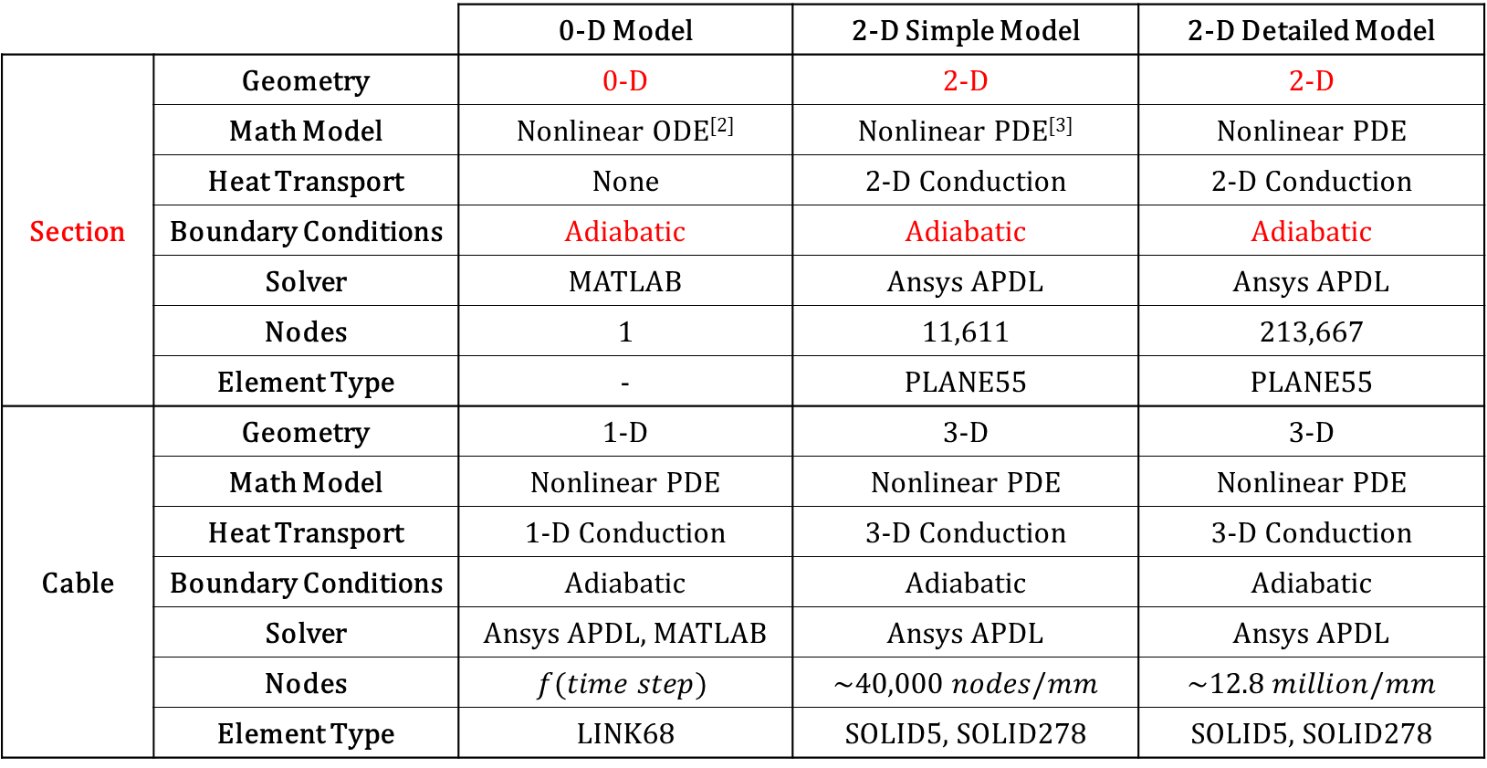
TE-MSC-TF
Contents
Summary
 |  | 0-D Model | 2-D Simple Model | 2-D Detailed Model
Section | Geometry | 0-D | 2-D | 2-D
 | Math Model | Nonlinear ODE^{[2]} | Nonlinear PDE^{[3]} | Nonlinear PDE
 | Heat Transport | None | 2-D Conduction | 2-D Conduction
 | Boundary Conditions | Adiabatic | Adiabatic | Adiabatic
 | Solver | MATLAB | Ansys APDL | Ansys APDL
 | Nodes | 1 | 11,611 | 213,667
 | Element Type | - | PLANE55 | PLANE55
Cable | Geometry | 1-D | 3-D | 3-D
 | Math Model | Nonlinear PDE | Nonlinear PDE | Nonlinear PDE
 | Heat Transport | 1-D Conduction | 3-D Conduction | 3-D Conduction
 | Boundary Conditions | Adiabatic | Adiabatic | Adiabatic
 | Solver | Ansys APDL, MATLAB | Ansys APDL | Ansys APDL
 | Nodes | $$f(time step)$$ | $$\sim 40,000 nodes/mm$$ | $$\sim 12.8 million/mm$$
 | Element Type | LINK68 | SOLID5, SOLID278 | SOLID5, SOLID278
^{[2]} Ordinary Differential Equation
^{[3]} Partial Differential Equation

Slide 5
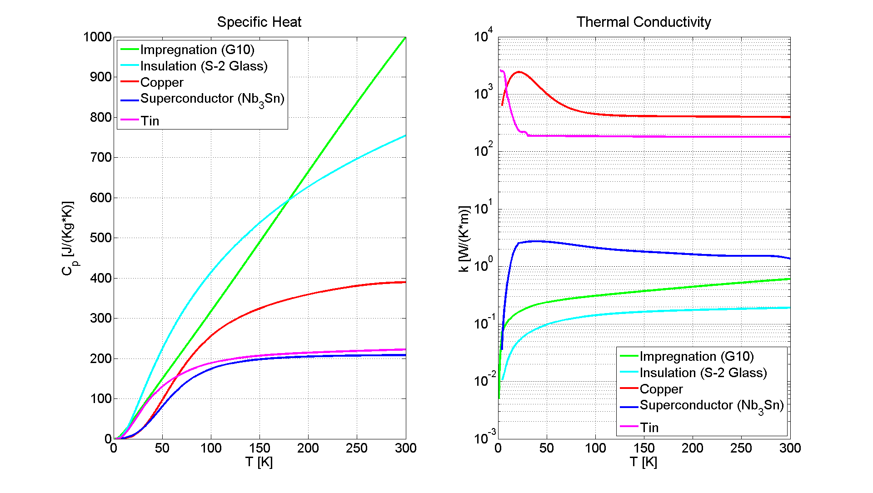
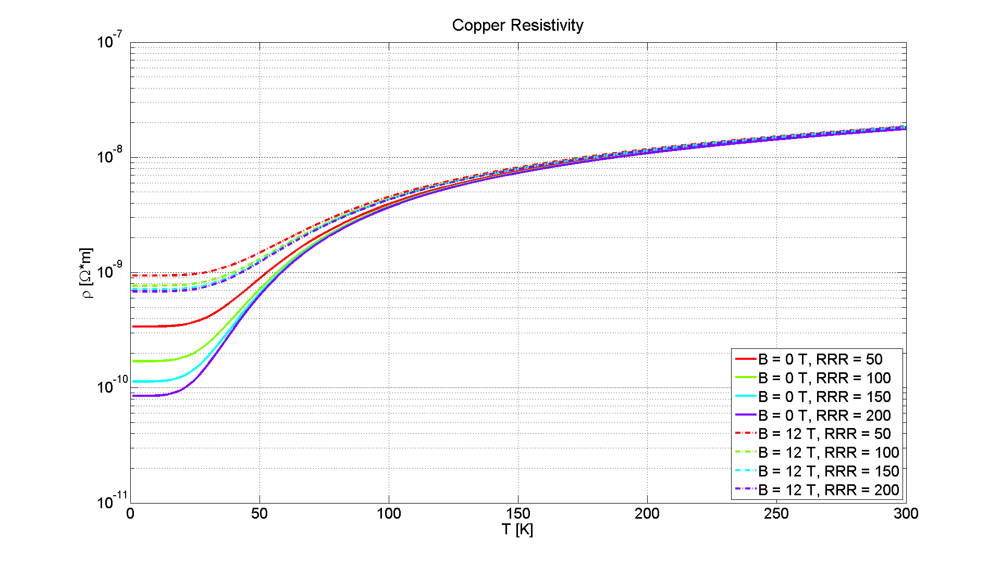

TE-MSC-TF
0-D Model
Results can be compared to those from a simpler model where the temperature is supposed to be uniform over the section, so that thermal diffusion vanishes.
Math model is an ODE which can be easily solved with MATLAB,
$$\frac{dT}{dt}=\frac{{\left[ρ_{e}(B,T)\right]}_{Cu}}{S_{t}S_{Cu}VHC(T)}{I(t)}^{2}$$
$$Volumetric Heat Capacity from mixture law, VHC\left(T\right)=v_{Cu}{\left[ρ_{v}c_{P}\right]}_{Cu}+v_{{Nb}_{3}Sn}{\left[ρ_{v}c_{P}\right]}_{{Nb}_{3}Sn}+v_{G10}{\left[ρ_{v}c_{P}\right]}_{G10}+v_{S−2 glass}{\left[ρ_{v}c_{P}\right]}_{S−2 glass}, v_{i}=\frac{S_{i}}{S_{t}}$$
Material properties are nonlinear temperature-dependent
Only densities are taken to be constant

Slide 6
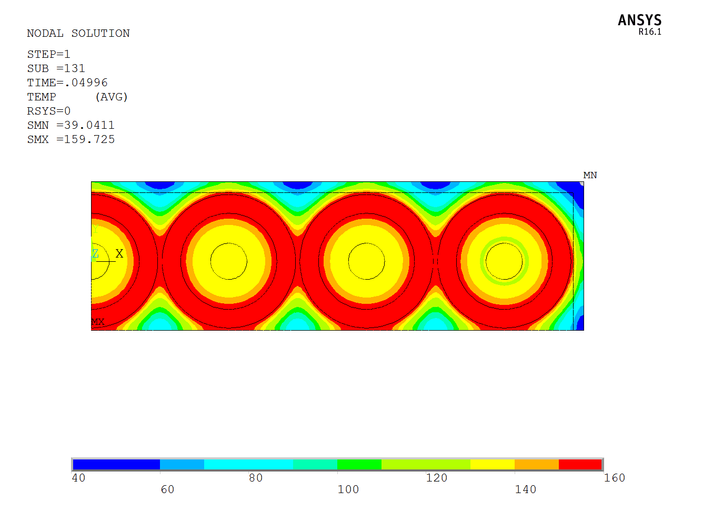
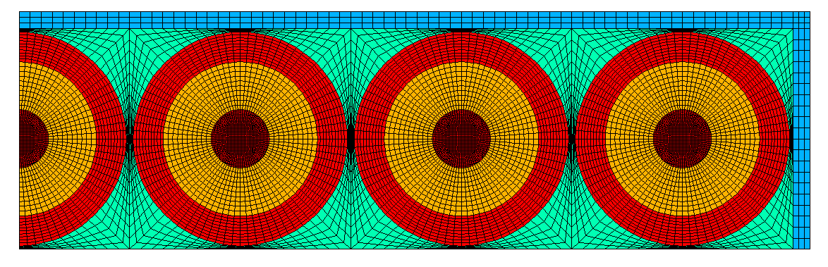
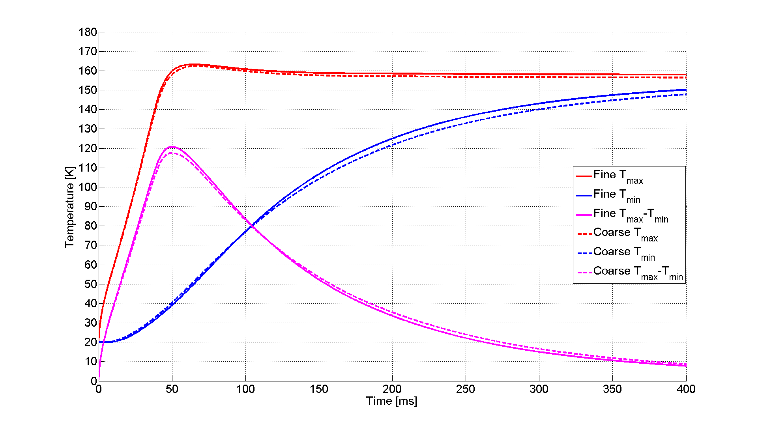
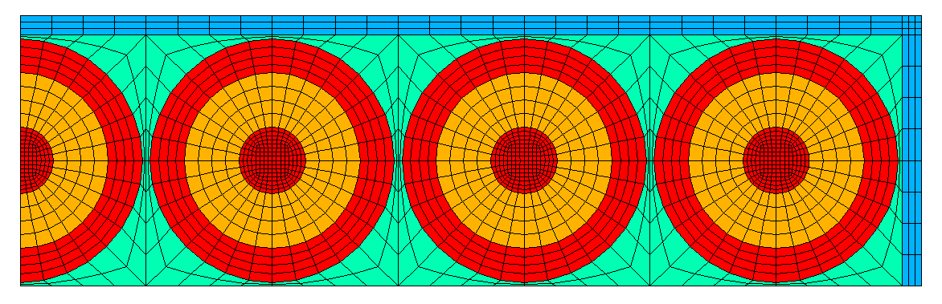

TE-MSC-TF
2-D Simplified Geometry
2-D: $11611 nodes$ → 3-D: $\sim 0.7 million nodes/mm$
However, the number of nodes can be dramatically reduced by coarsening the mesh.
2-D: $1966 nodes$ → 3-D: $\sim 40,000 nodes/mm$

Slide 7
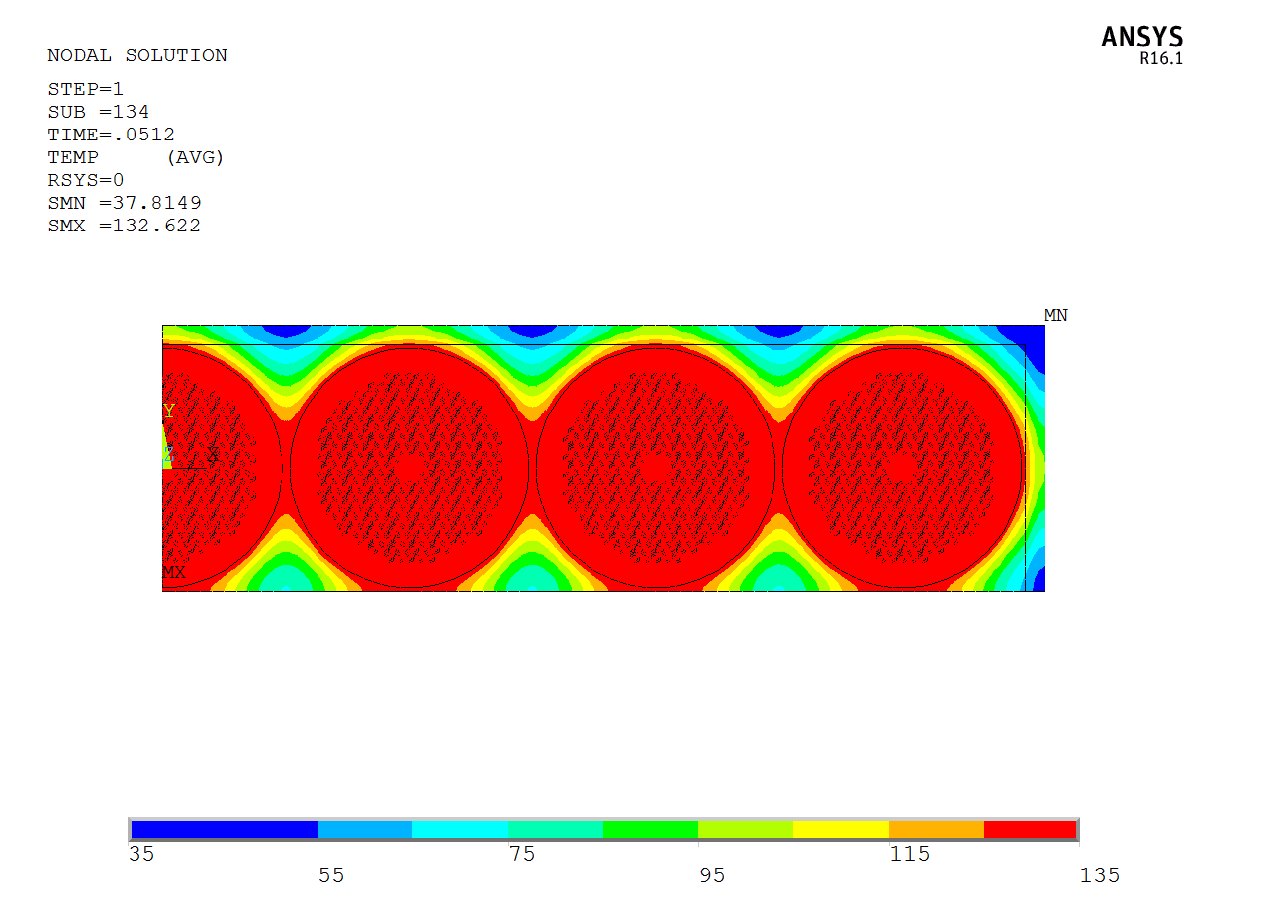
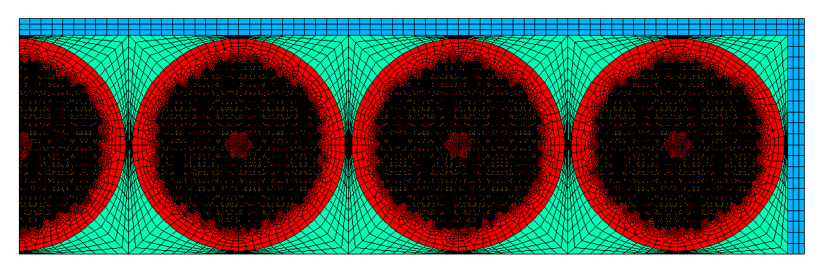
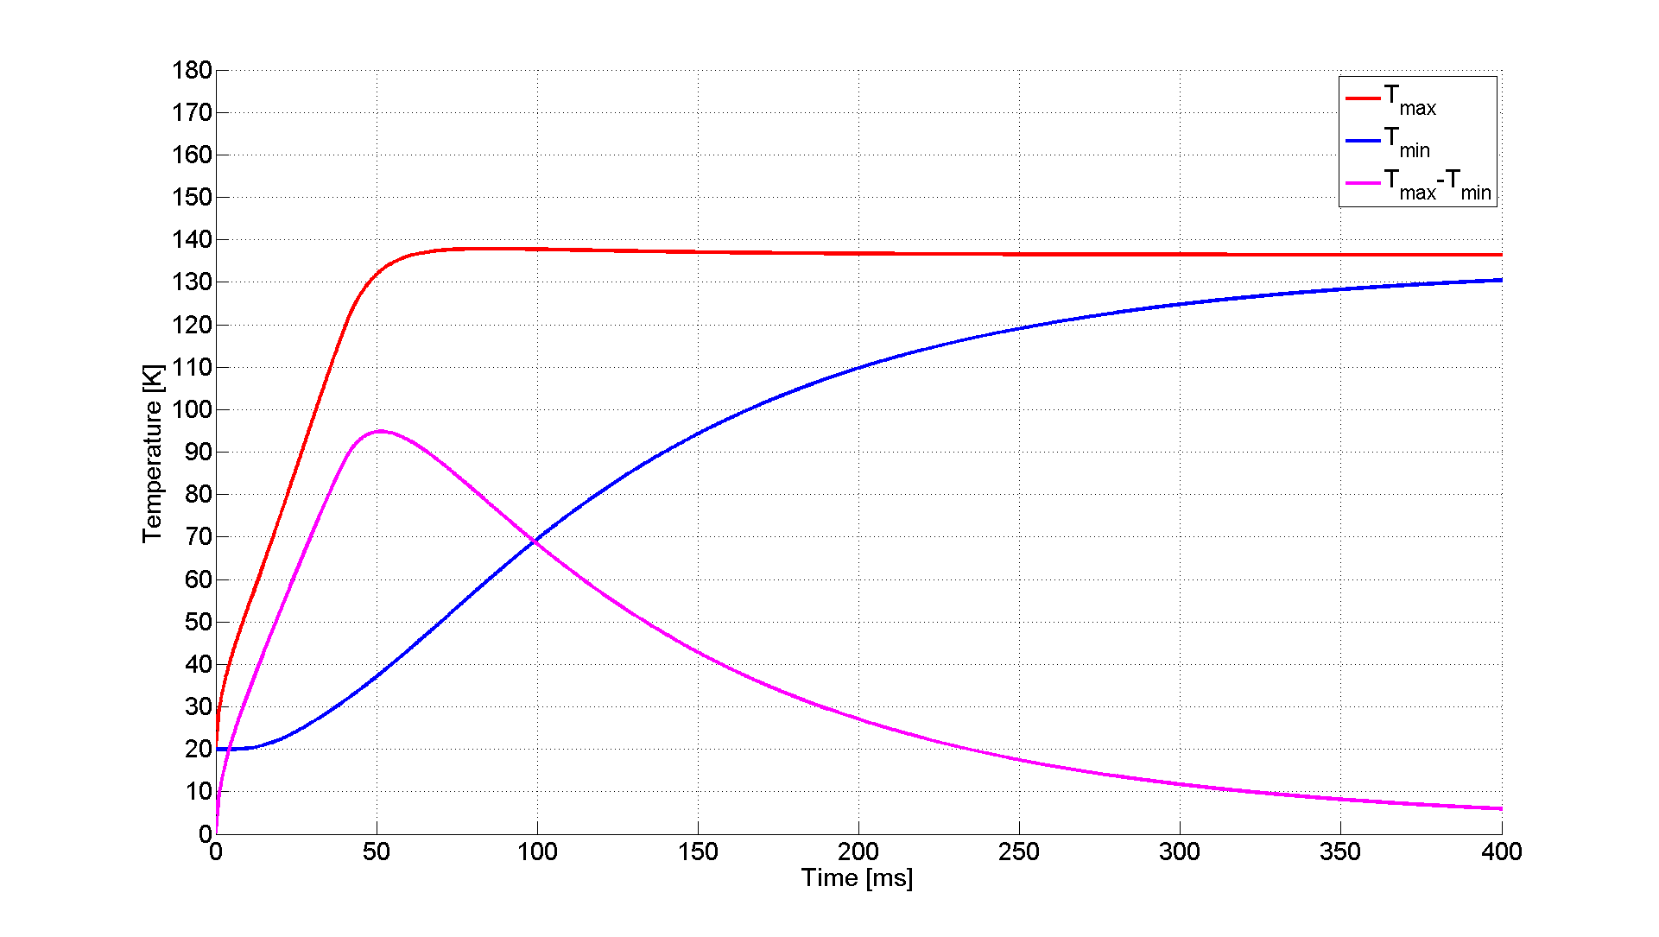
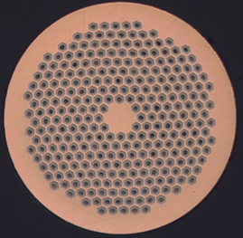
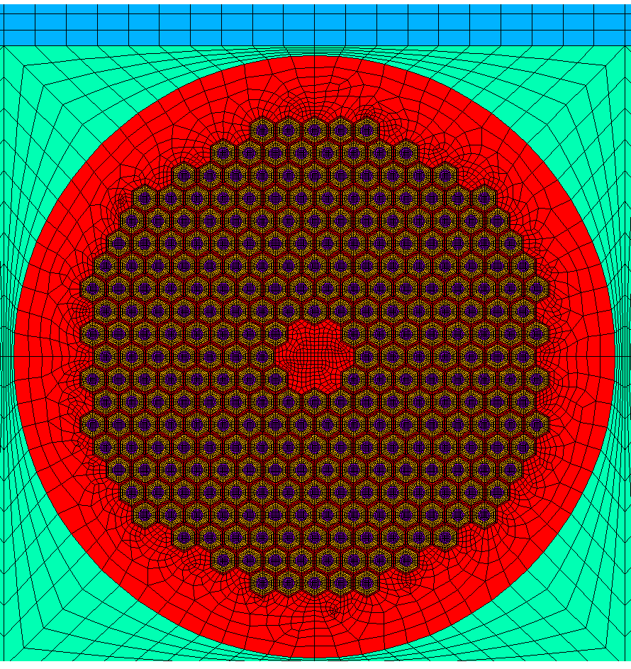

TE-MSC-TF
2-D Detailed Geometry
In this approach we think of exactly reproducing the strands in the cable.
2-D: $213667 nodes$ → 3-D: $\sim 12.8 million nodes/mm$

Slide 8
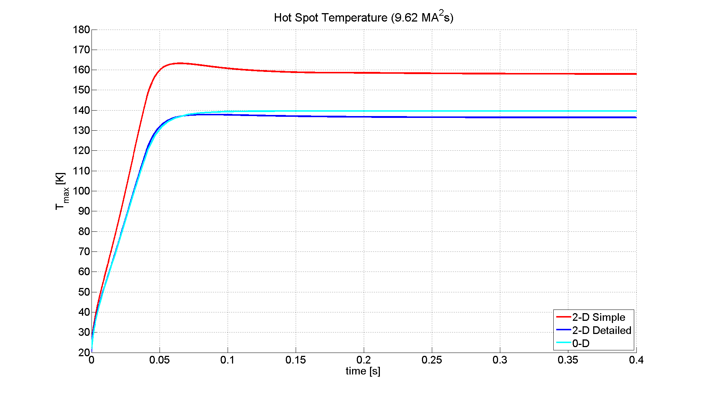
TE-MSC-TF
Results
0-D Model | Too simple A priori estimation
2-D Simple Model | Transversal heat transfer is modelled
2-D Detailed Model | Accurate Too expensive
Results from simplified 2-D geometry slightly overestimate the hot spot temperature, so it turns out to be a conservative approach when working on simpler 3-D models.
It’s interesting to note that both 0-D Model and 2-D Detailed Model provide similar results. This might be due to the fact that in the detailed geometry it’s easier for the heat in copper to diffuse.

Slide 9
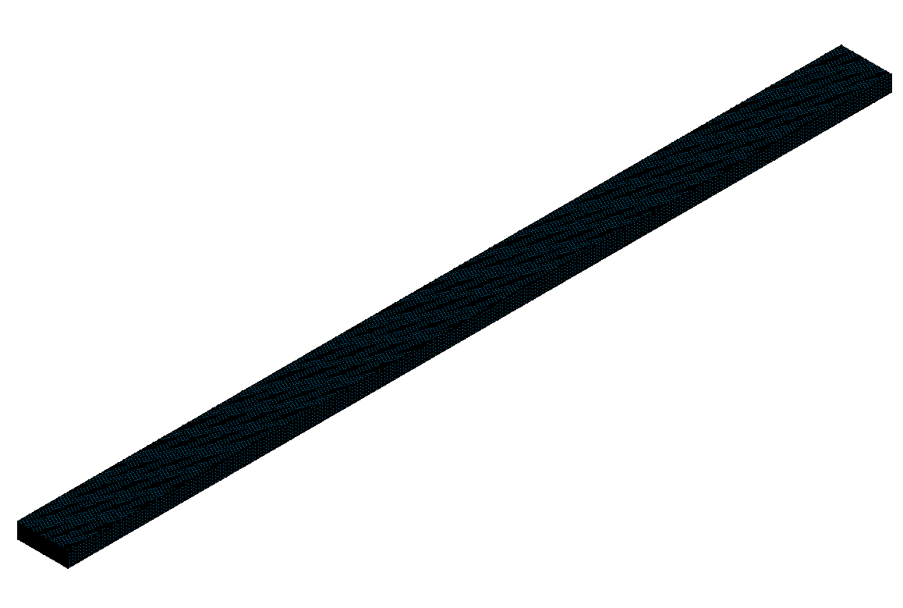
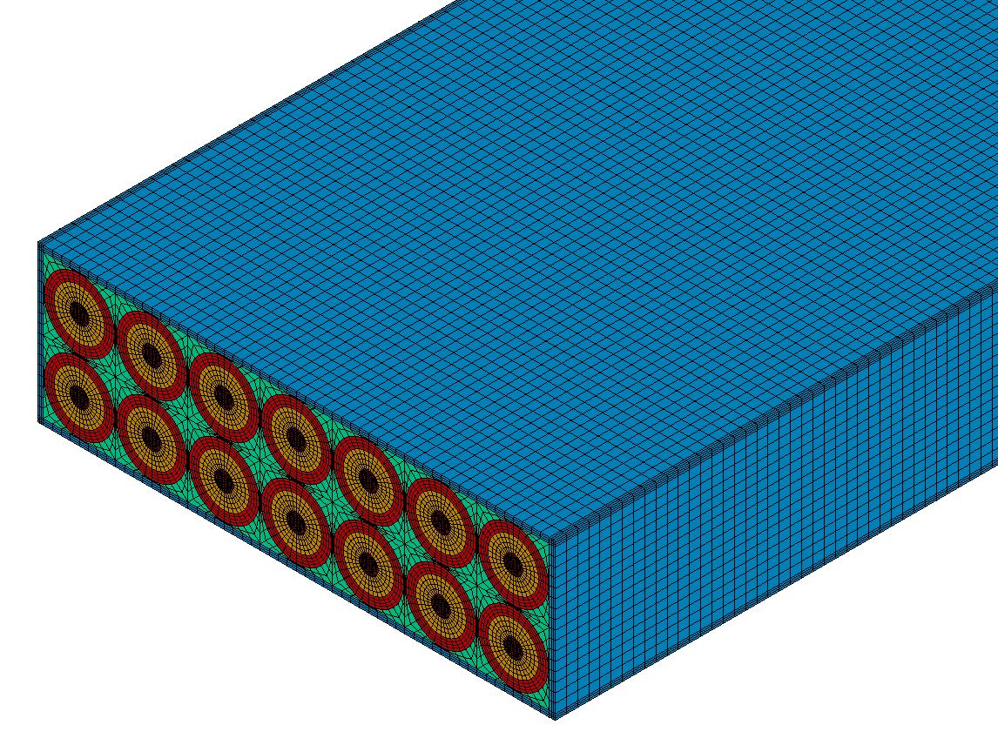
TE-MSC-TF
3-D Geometry
A thermo-electrical model is needed (SOLID5 with TEMP and VOLT degrees of freedom for superconductor and copper).
Quenches are intended to be provoked by a spot heater located somewhere along the 150 mm long straight part of the Short Model Coil.
So, symmetry is lost and the whole cable must be simulated.

Slide 10
TE-MSC-TF
THANK YOU

