Slide 2
TE3530
Development and Optimization of Kicker Systems for LIU-Projects
A. Ferrero, T. Kramer

Slide 3
What is a kicker magnet?
Fast pulsed dipole magnet for beam deflection.
Used to kick incoming beam to the circulating orbit (injection kicker);
also used to kick the beam out of an accelerator (extraction kicker);
or to merge two beams into one single line. (recombination kicker).
e.g. injection process

Slide 4
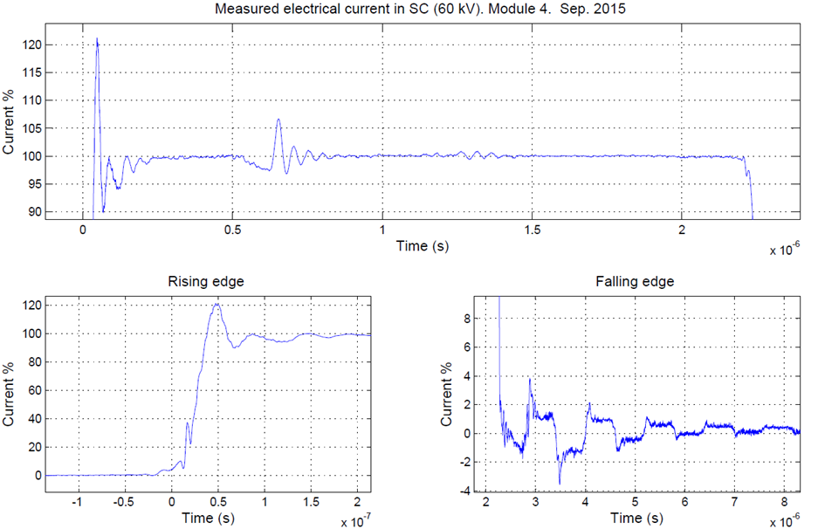
How does a kicker magnet work?
The magnet filed is switched on only when it is needed to inject, extract or recombine a beam within a particle free gap → Pulsed magnet hence important parameters are:
  rise & fall time
  flat top quality
Since it is a “fast” pulsed magnet, transmission lines theory must be applied.
Possible issues: Reflections due to line mismatches.
Limitations: Bandwidth defined by system design.

Slide 5
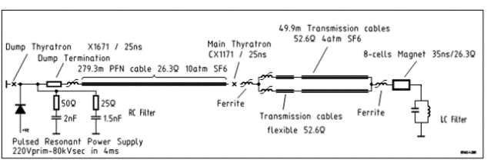
Planned LIU Kicker upgrade
Under the LHC Injector Upgrade project, some kicker systems must be upgraded to allow for future 2.0 GeV beam transfer.
Specification for rise & fall time and maximum system ripples must be respected.
Improvement possibilities had to be identified using analogue circuit simulations.

Slide 6
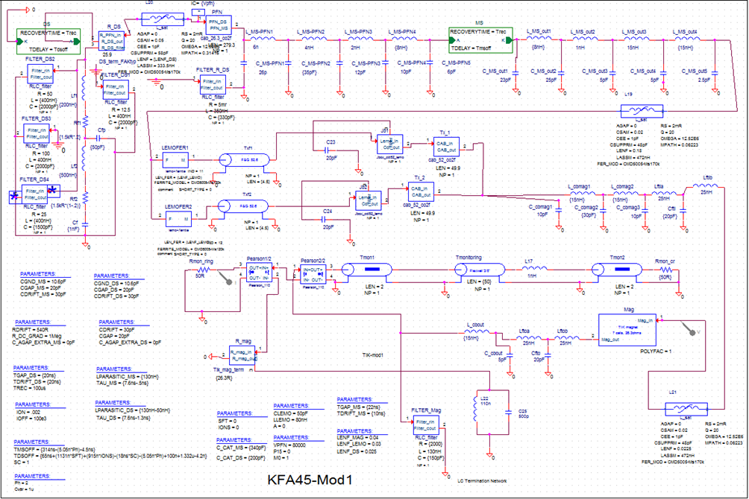
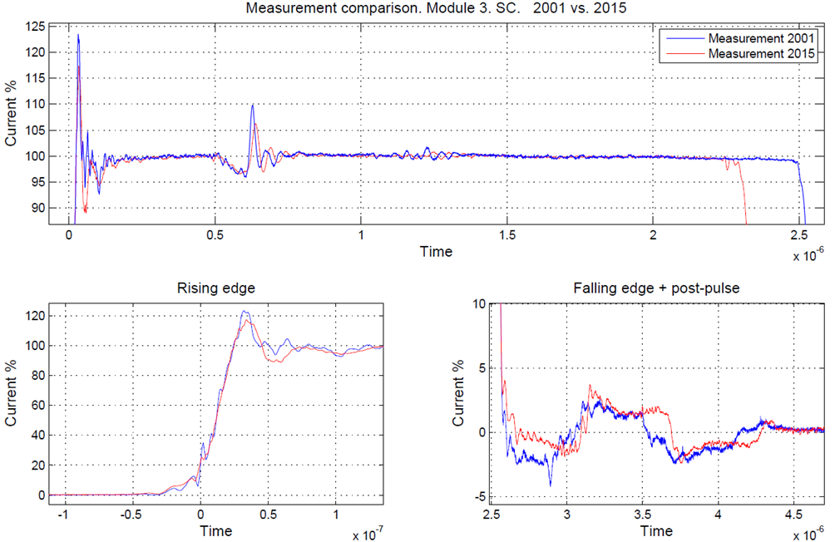
Methodology
Started with brainstorming, interviews of senior engineers (identification of improvement possibilities)
Development and verification by simulation
Validation with real measurements taken in the PS tunnel
Simulations based on Orcad Pspice tool.
Measurements done during technical stop (02/09/15)

Slide 7
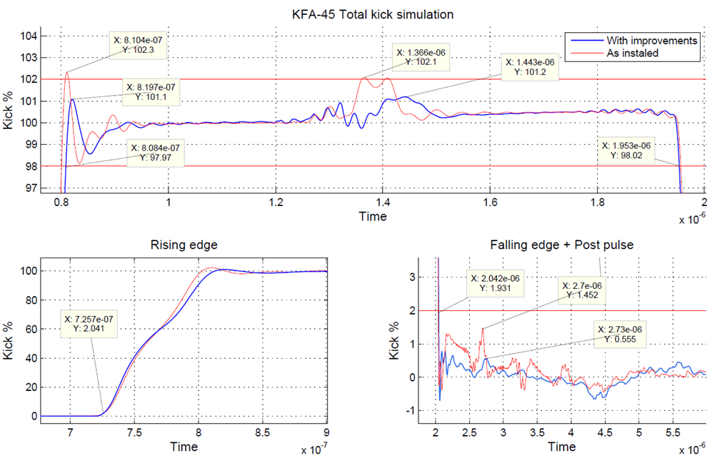
Some results
Less flat top ripple.
Less ringing at the rising edge.
Less post-pulse ripple.

Slide 8
Outlook
Test & measurement campaign foreseen for some of the KFA-45 improvements during upcoming YETS.
Meanwhile started: Optimization of the recombination kicker KFA-10.
Planned: Analysis of fast 100ns MKP-S kicker upgrade (SPS injection).
  Old kicker model obtained.
  Model update and optimization needed.
  Hardware measurements on test stand foreseen.

Slide 9
Thank you

