Slide 1
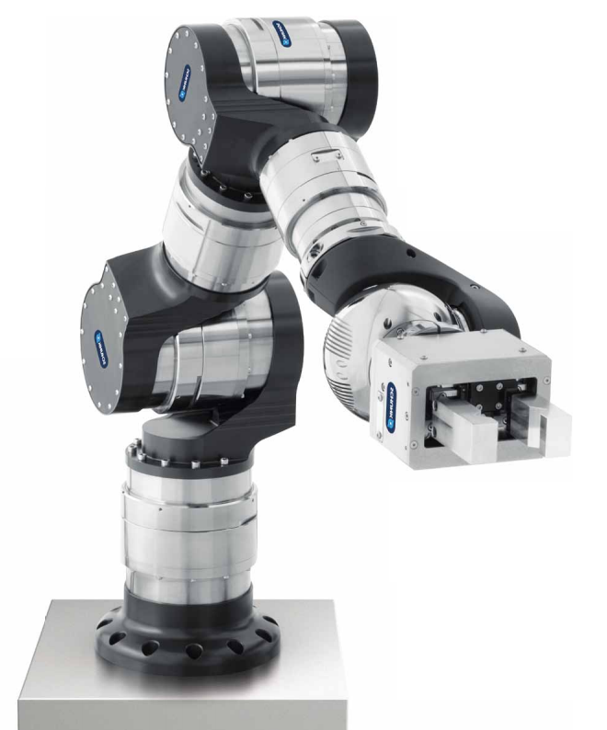
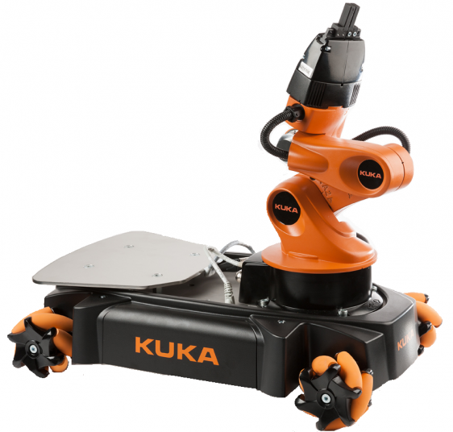
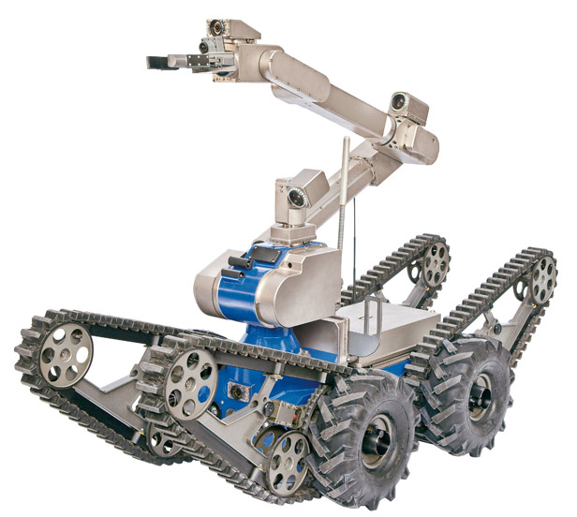
Robotic projects low level control development
1st WORKSHOP FTEC-2015
SPANISH TRAINEESHIP
PROGRAMME
Alejandro Diaz Fontalva
Advisor: Mario Di Castro
Section: EN-STI-ECE
Ref. Number: EN2734

Slide 2
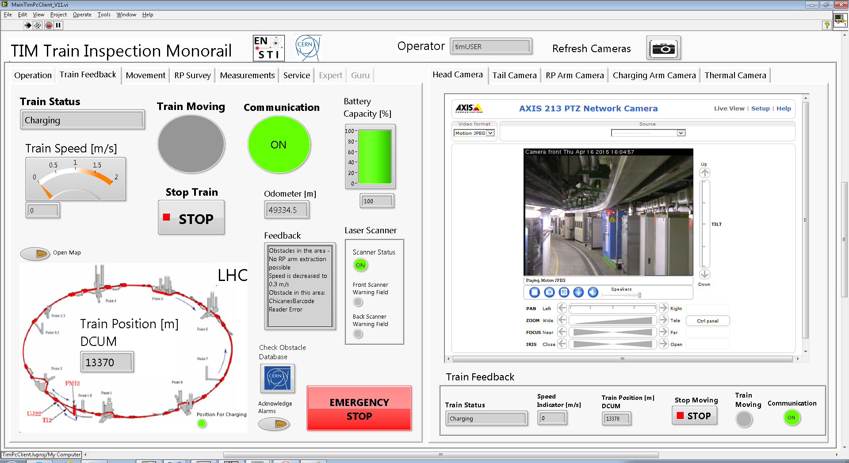
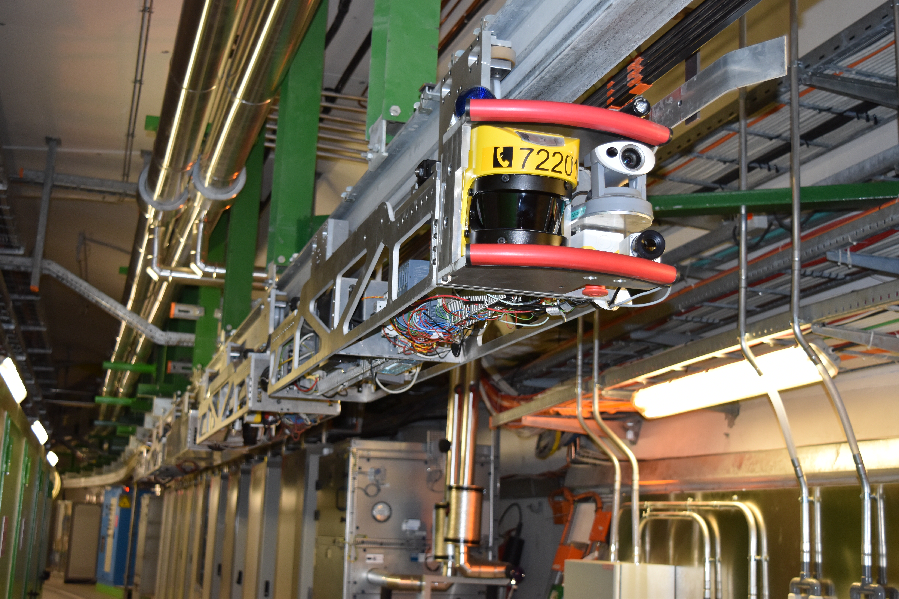



Train Inspection Monorail (TIM)
Goal
  Development of Unmanned tasks along LHC
Features
Attached to ceiling
5 Wagons
3G UMTS / Wi-fi
LabVIEW GUI
Main Tasks
  Checking of collimators displacements.
  Measuring of RP dose and Temperature, TIM position, images, etc.
Mission Data
?
Downstream
Command
Wagon
Battery
Wagon
Motor
Wagon
Payload
Wagon
Reconnaissance
Wagon
Upstream

Slide 3
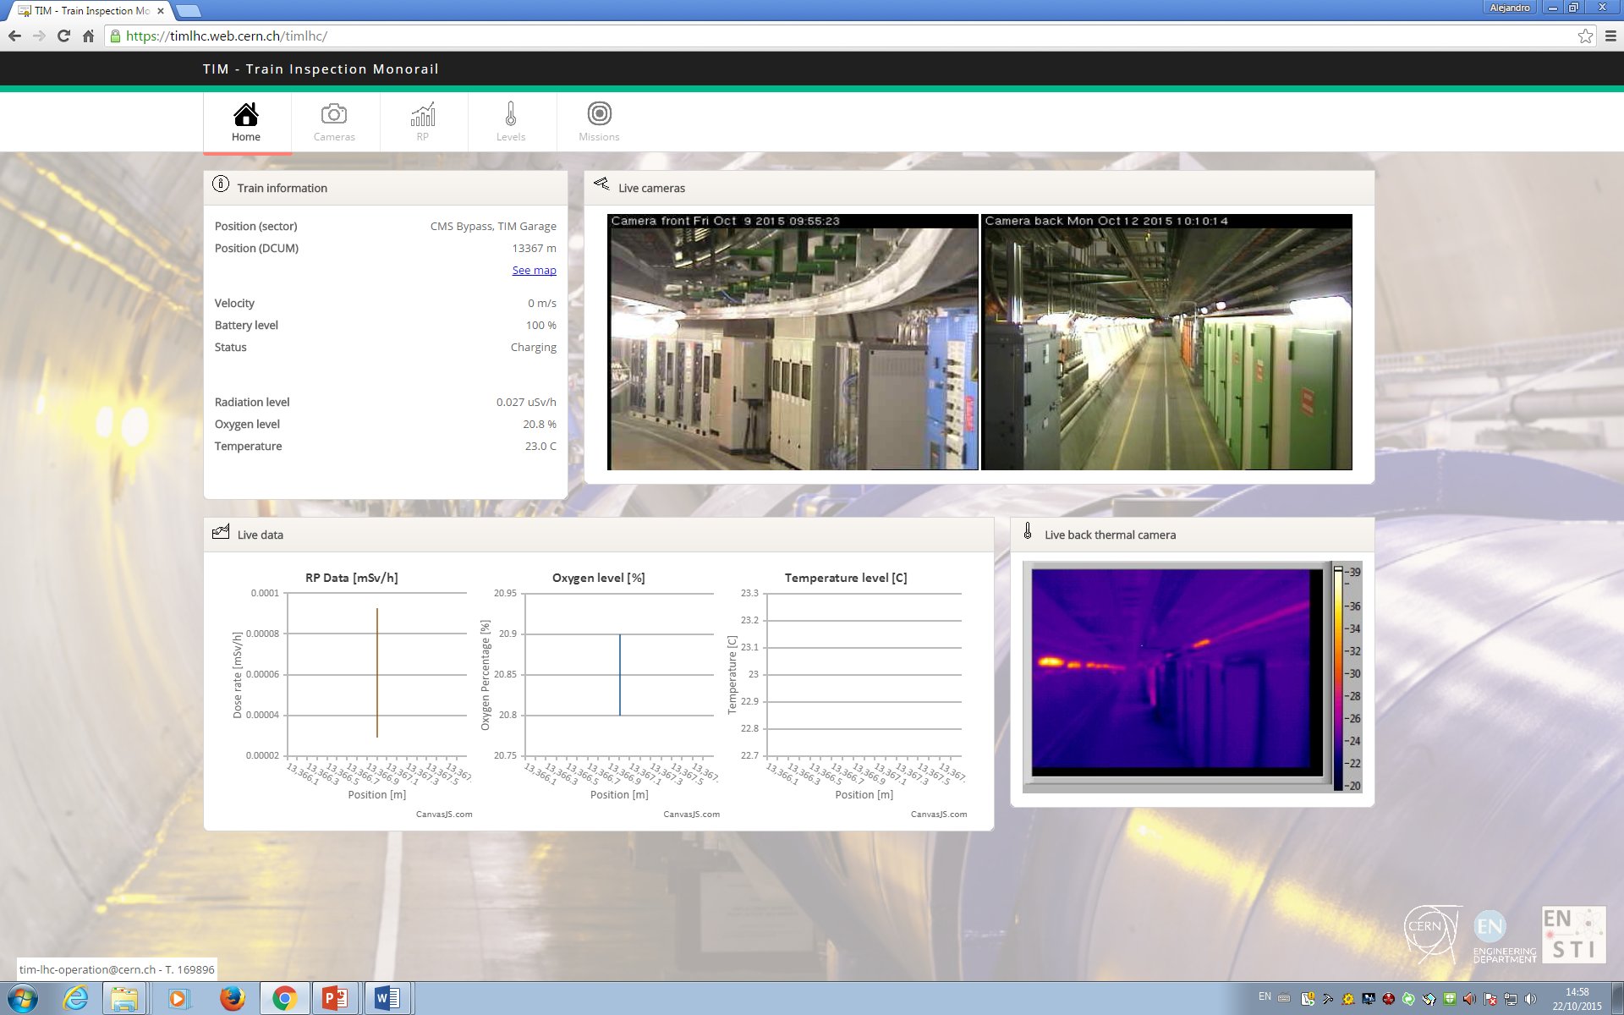
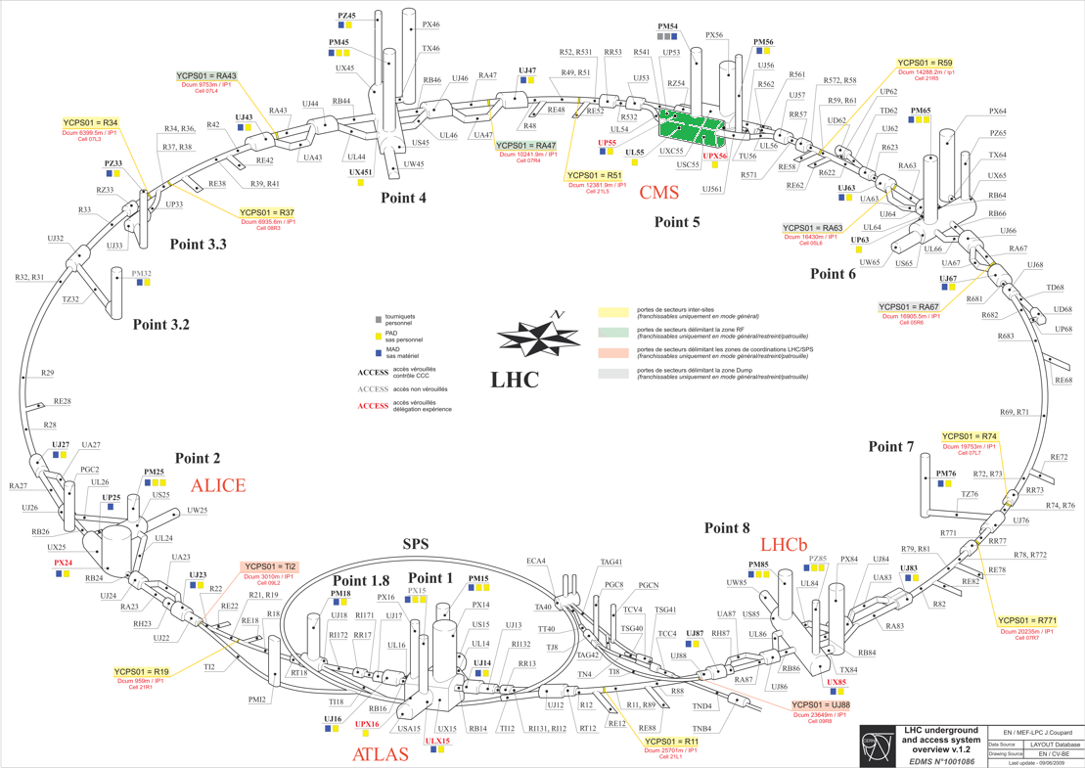

Monitoring and Measurements Treatment
Goals
  Data Management
  Graphical information
  Show images
  Check TIM position
Contribution

Slide 4
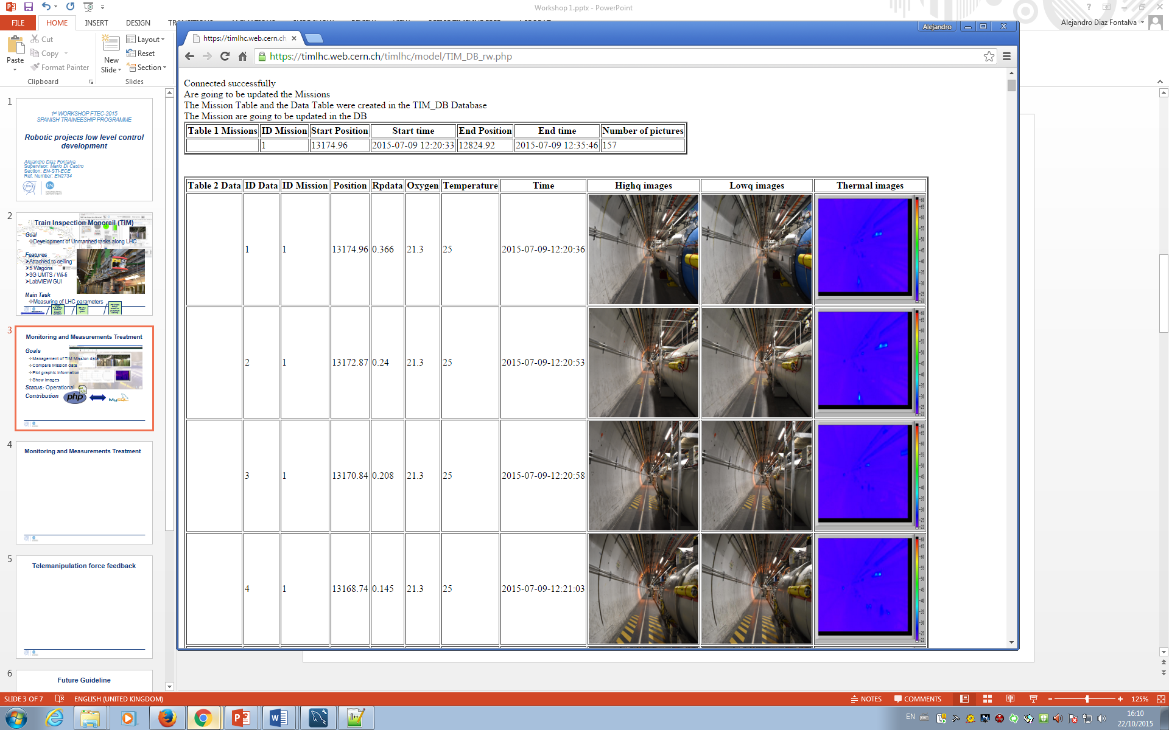
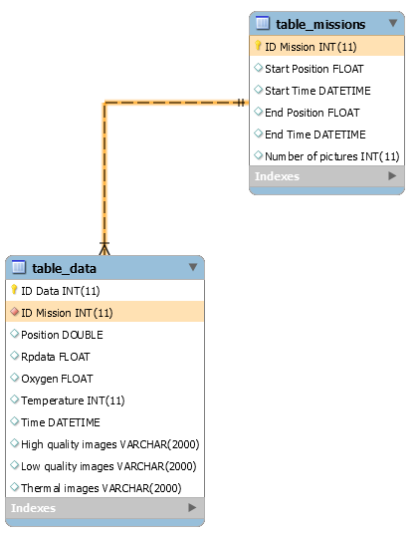

Monitoring and Measurements Treatment
Management options
  Insert new Missions in DB
  Queries to the DB
  Show list of the inserted Missions
2 Tables
  Table Missions
  Table Data
New Requirements
Challenges
  ERROR Uploading Images
Status: Operational
FOREIGN KEYS
PRIMARY KEYS

Slide 5
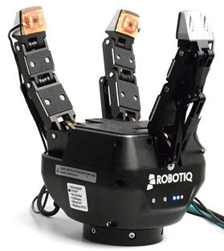
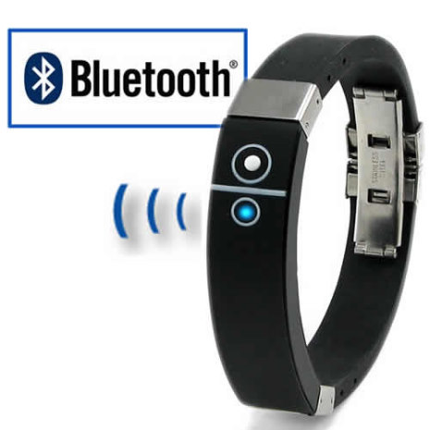
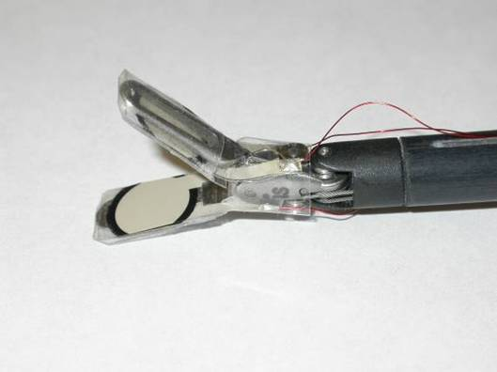
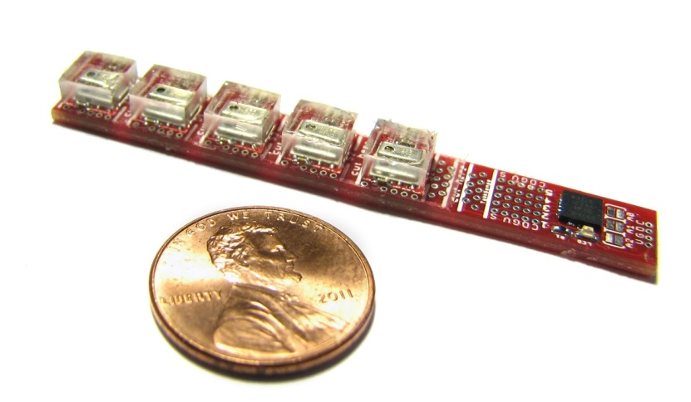
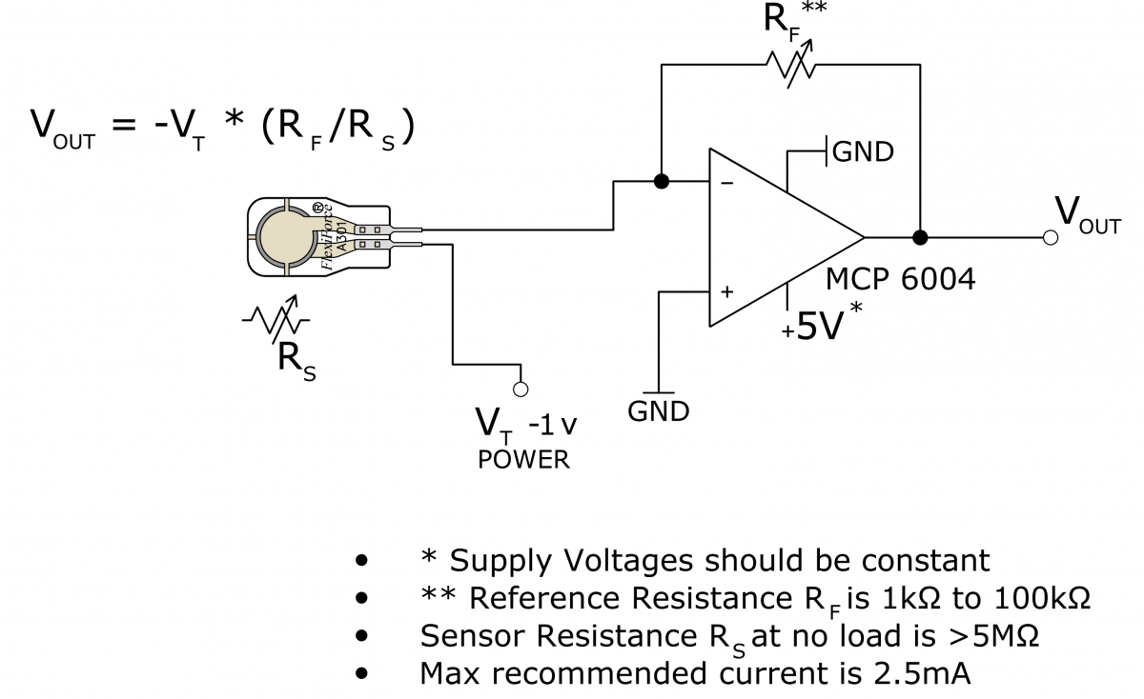
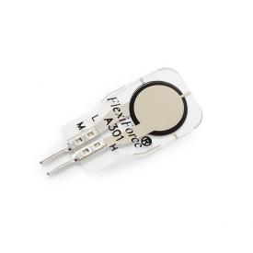
Telemanipulation force feedback
Goal
  Force feedback in telemanipulated robotic arms
Starting idea
  Bracelet user + Sensors in gripper + Wireless Comm.
First tests
  TakkTile sensors
Challenges
  Change TakkTile → Flexiforce
Status: R&D

Slide 6
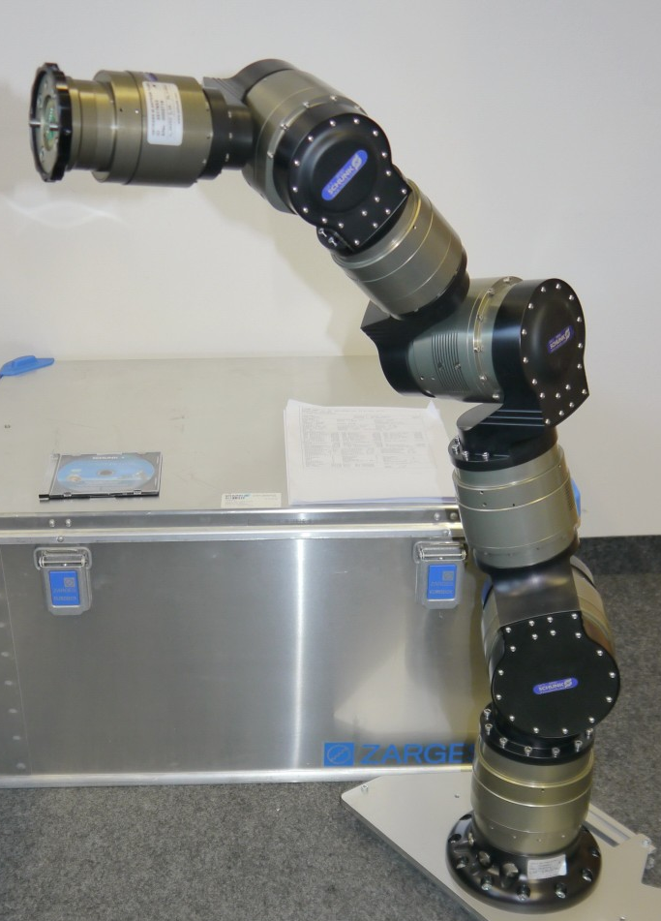
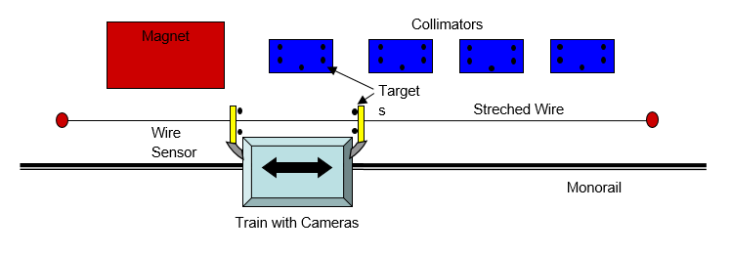
Future Guideline
Continue working on DB and Force Feedback Projects
2 New Projects:
  Integration of Survey Wagon in TIM.
  Reverse Engineering of Robotic arm.

Slide 7
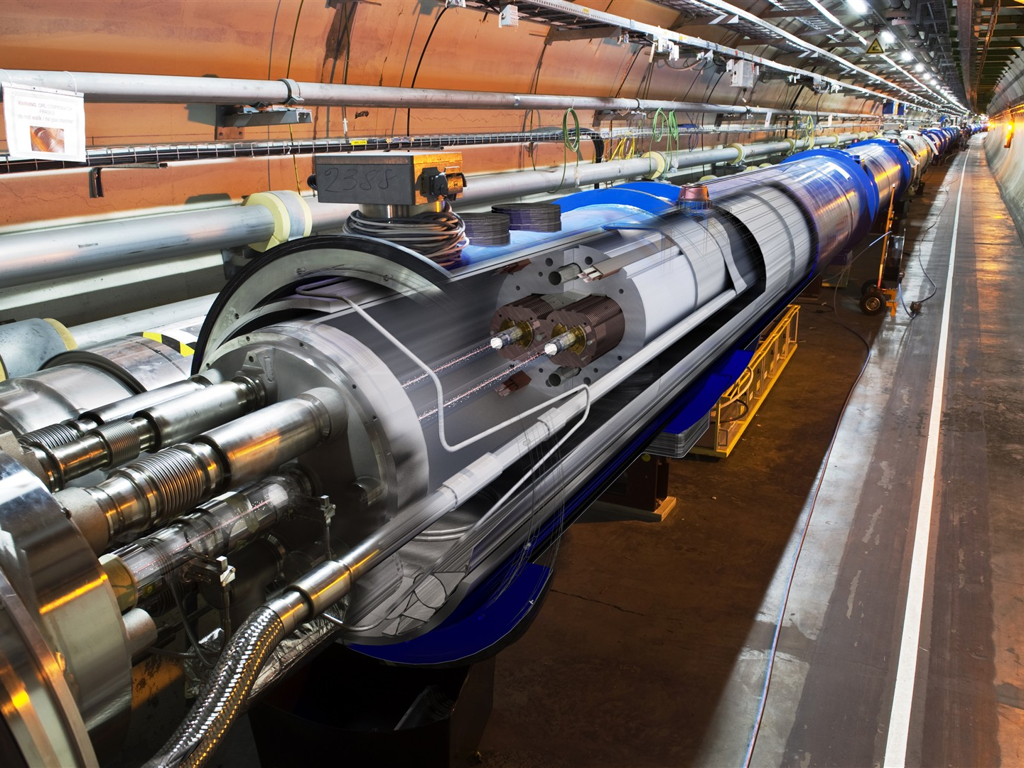



THANK YOU FOR YOUR ATTENTION

