Slide 1


Software Developer for the Accelerator Controls
Configuration Service
Instrumentation of the Controls Configuration Directory Service
J. Luis González Arias
BE3528

Slide 2
Summary
Background
Getting started
Project overview
Project Challenges
Work in Progress and future actions

Slide 3
Background
BE-CO
(Beams controls)
Specification, design, procurement, integration, installation, commissioning and operation of the controls infrastructure for all CERN accelerators
BE-CO-DS
(Beams controls Data Services)
Configuration Data Management
for the accelerator control systems.
Notes:
The control system is data driven, largely based on the data management infrastructure provided by my section – Data Services. In particular, I am working in the domain of Configuration Data Management for the accelerator control systems.

Slide 4

Getting started
First month
  Entrance formalities
  Getting familiar with Work process
  Usage of Different tools (integrating, developing, testing and tracing)
  Learn about several technologies (DB, Monitoring, PL-SQL)
  Fix issues (Support team)

Slide 5
Project overview
Title:
  Instrumentation of the Controls Configuration Directory Service.
Purpose of the Directory Service:
  Provide a mean to Extract data from the Controls Configuration Database
Background of the project:
  Current Directory Service is an important but legacy system
    lots of technical debt
    a bottleneck for evolution
Objectives of the project:
  Clearly establish usage data (Who …? Which particular aspects …?)
  Analyse captured data (Impact of changes, improve the service)
Tasks of the project:
  Instrument the existing Directory Service server-side code
    Logging the usage data in the BE-CO Tracing System (based on Elastic Search)
  Prototype a dashboard to explore the data (based on Kibana)

Slide 6
Project Challenges

Slide 7

Project Challenges
Directory Service
(to be instrumented)

Slide 8

Project Challenges
Directory Service
(to be instrumented)
generate

Slide 9

Project Challenges
Elastic Search
(search and analyze)
Directory Service
(to be instrumented)
generate

Slide 10

Project Challenges
Elastic Search
(search and analyze)
Directory Service
(to be instrumented)
generate
Kibana
(show/explore usage data)

Slide 11
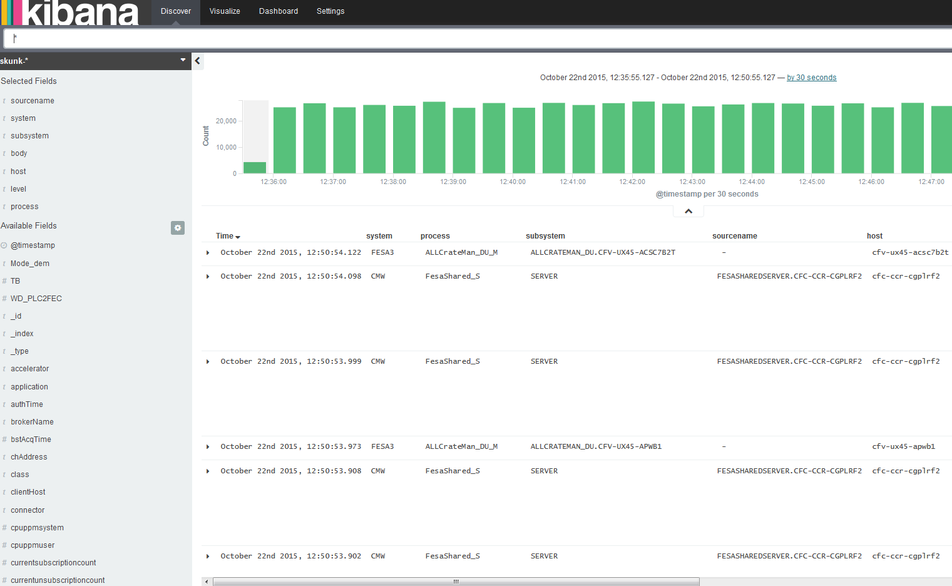
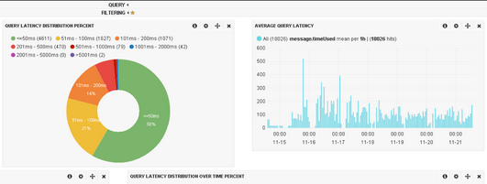
Work in Progress and future actions

Slide 12


Thank you !
J. Luis González Arias
Chris Roderick (Supervisor)

