Slide 1
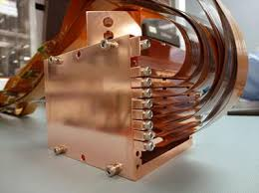

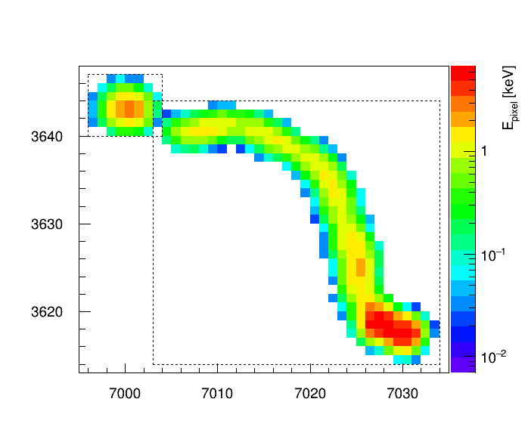

Measurements of radioactive backgrounds in the high-resistivity silicon CCDs of the DAMIC Experiment at SNOLAB
Ariel Matalon for the DAMIC Collaboration
amatalon@uchicago.edu
KICP, UChicago | LPNHE, Sorbonne Université
Low Radioactivity Techniques 2019
May 23, 2019

Slide 2









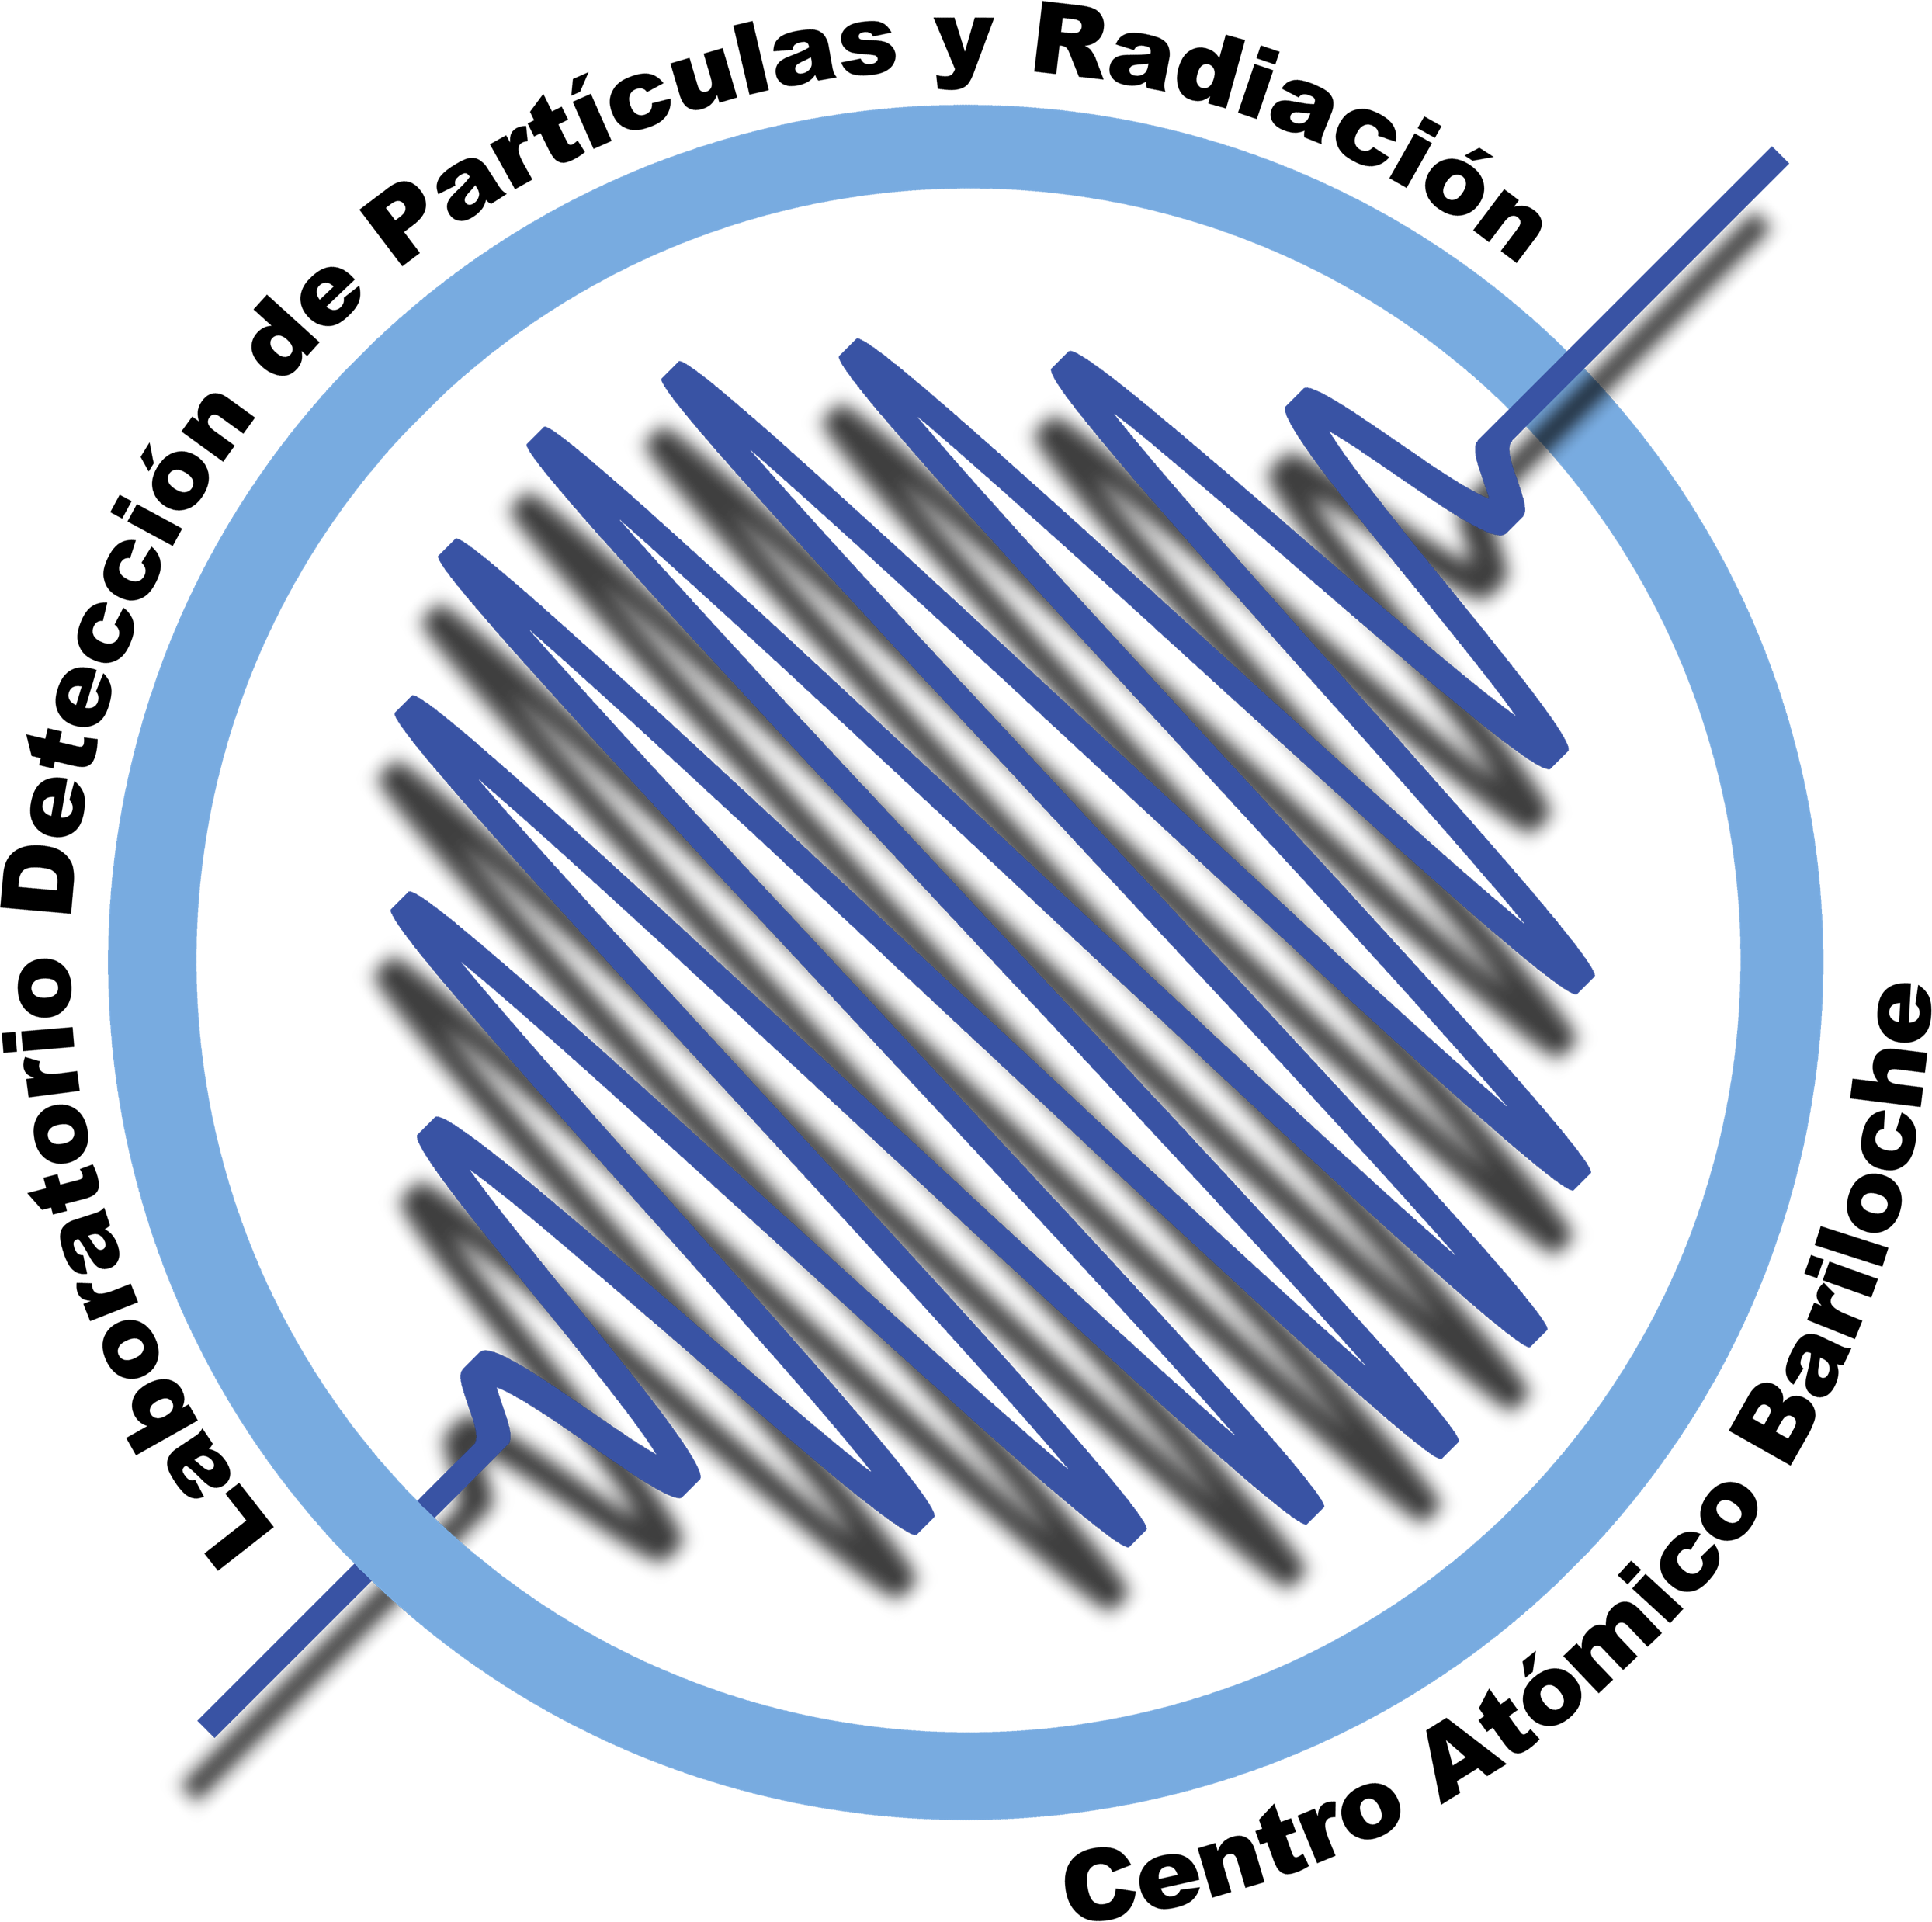
DAMIC Collaboration

Slide 3
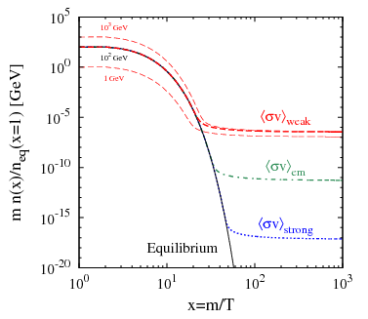
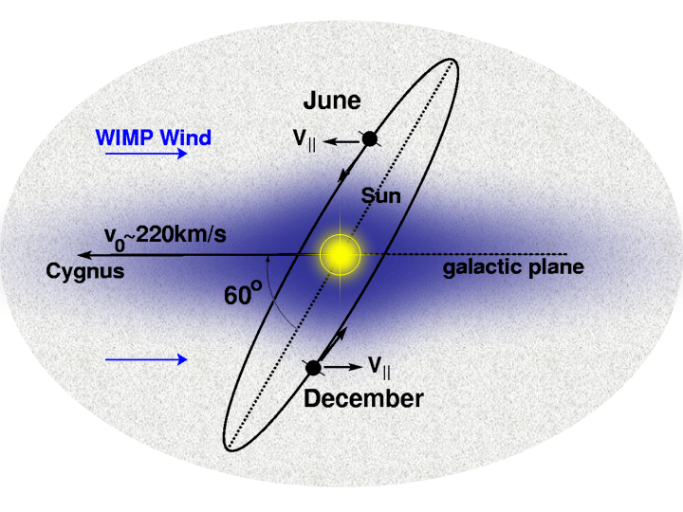
Dark matter remains one of the most important scientific mysteries
Overwhelming astrophysical evidence:
WIMPs, an attractive paradigm for BSM physics:
Created in early universe
Predicted mass O(100 GeV)
Principle of Detection
Recoil interactions O(keV)
Need sub-keV thresholds!
Motivation to probe low-mass WIMPs (< 20 GeV) and dark sector candidates via electron recoils
Dark Matter
Cosmic Structure
31
Notes:
Strategic placement in urban locations; continued investment in new industries

Slide 4
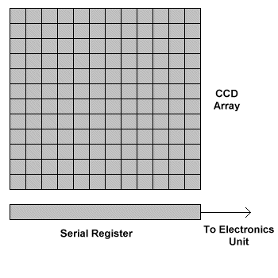
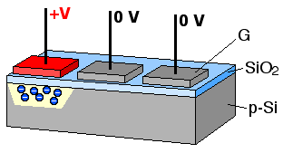
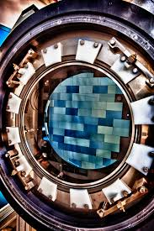
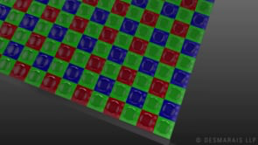
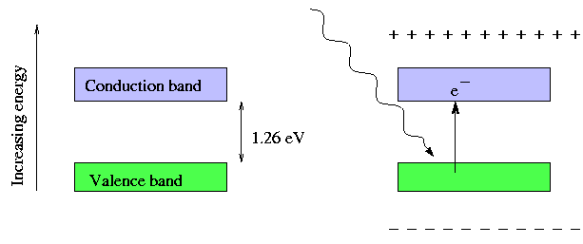
The unique characteristics and principle of operation of modern charge-coupled devices (CCDs) enable particle detection
CCD Operation
CCD Clocking
CCD Technology
Modulation of gate electrodes in order to transfer charge
Developments in CCD design for IR cameras have enabled massive detectors
DECam
42
Notes:
Strategic placement in urban locations; continued investment in new industries

Slide 5
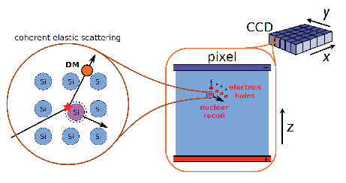
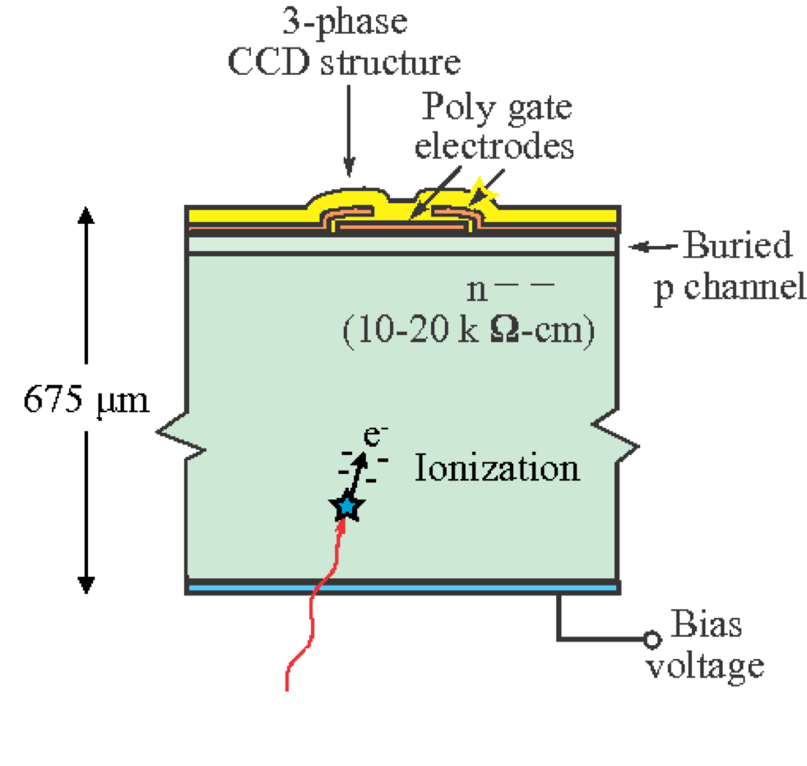
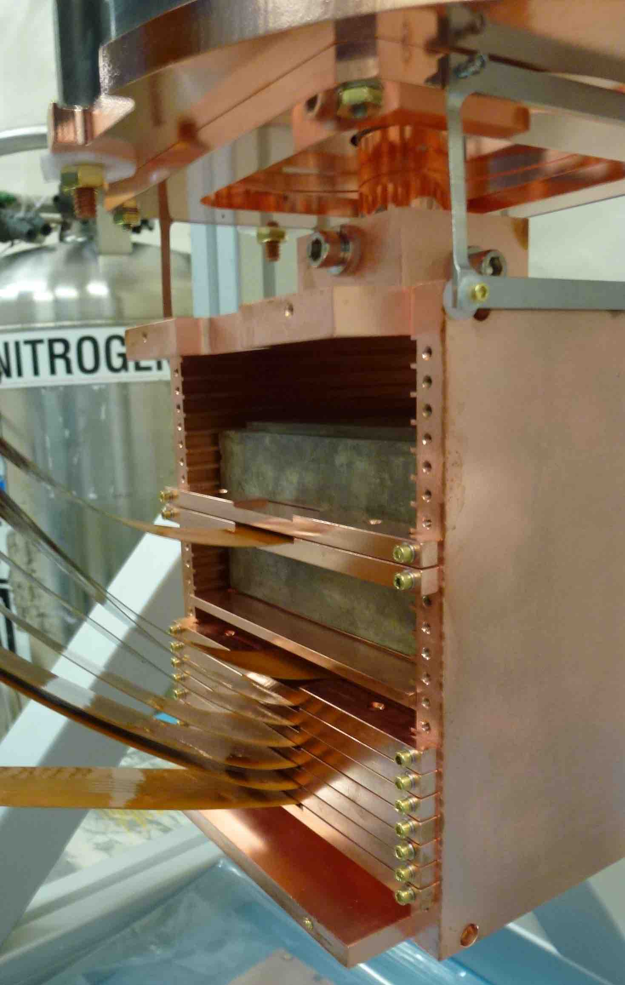
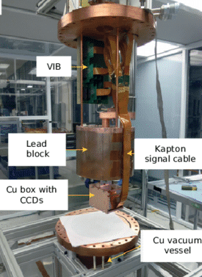
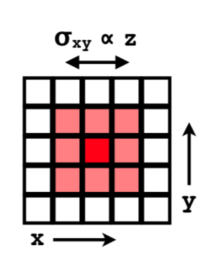
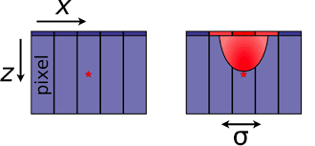
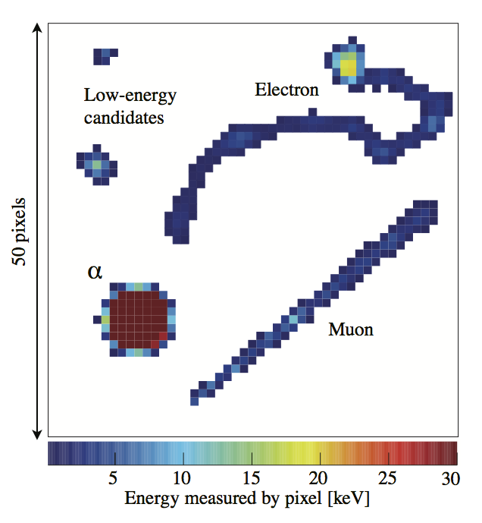
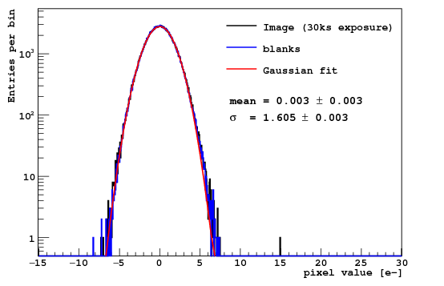
DAMIC employs the bulk-silicon of thick, scientific-grade CCDs to detect DM-nucleus/electron coherent elastic scattering
WIMP Detection Principle in a CCD
MOS Pixel
Setup at SNOLAB
Exquisite Spatial Reconstruction
Particle ID
Excellent Charge Resolution
Pixel charge
r.m.s. < 2e⁻ !
Readout modes: 1x1, (spatial) 1x100 (noise)
Depth of event from diffusion of charge
53
Notes:
Strategic placement in urban locations; continued investment in new industries

Slide 6
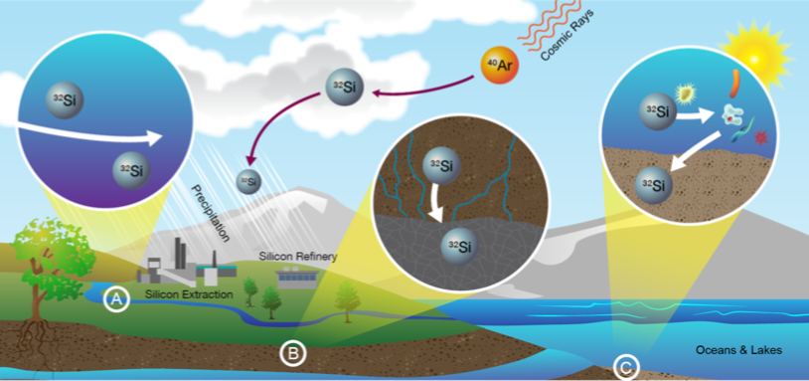
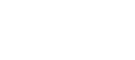
The sensitivity of direct-detection experiments is determined by the ability to identify and mitigate radioactive backgrounds
Cosmogenic isotopes
Natural Radioactivity
²³⁸U
²³²Th
arXiv:1708.00110
Of particular concern…
³²Si, produced by cosmic ray spallation → bulk contamination
²¹⁰Pb, a daughter of radon decay → surface contamination
64
Notes:
Strategic placement in urban locations; continued investment in new industries

Slide 7

DAMIC at SNOLAB acquired background-focused data in order to measure radioactive contamination in CCDs
    200.4 days from 6 active CCDs (35.4 g)
B b
    Images taken in 1x1 readout mode
    LED energy calibration performed at SNOLAB
Notes:
Strategic placement in urban locations; continued investment in new industries

Slide 8
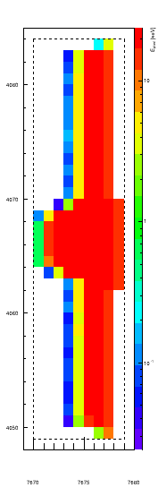
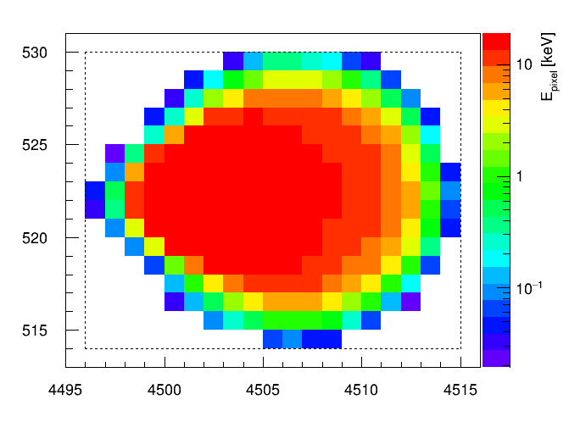
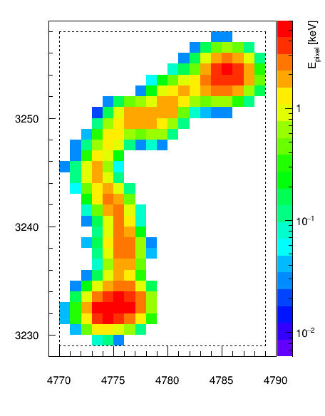
Cluster properties match characteristics of ⍺ and β particles
Bloomed ⍺
Plasma ⍺
β
Circular ⍺’s: bulk or back of CCD, “plasma” effect
Vertical ⍺’s: front of CCD, charge spilling over potential barriers between vertical pixels, i.e. “blooming”
β’s: lower energy and longer tracks
86
Notes:
Strategic placement in urban locations; continued investment in new industries

Slide 9
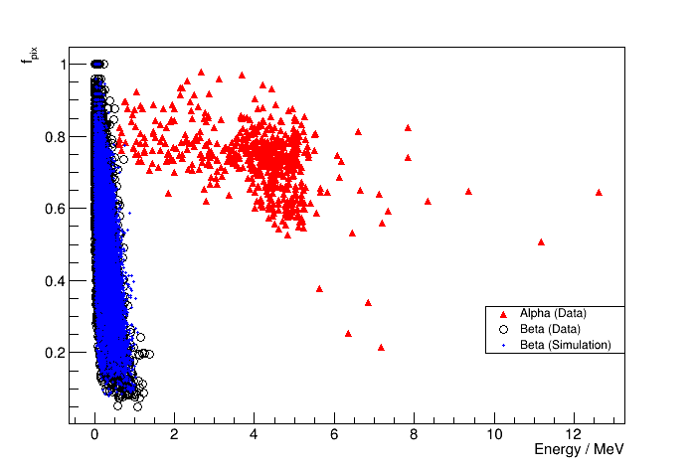
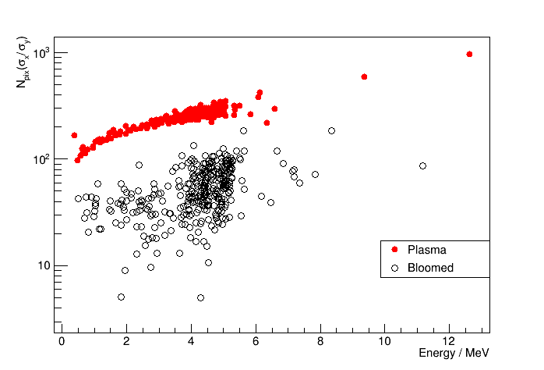
Cluster characteristics subsequently enable successful discrimination between ⍺ and β particles
⍺-β discrimination from energy and f_{pix}, ratio of number of pixels (N_{pix}) to smallest box around cluster
Plasma-bloomed discrimination from N_{pix} and ratio of x:y spatial r.m.s.
97
Notes:
Strategic placement in urban locations; continued investment in new industries

Slide 10
Characteristics of radioactive isotope decays guide searches
Bulk Contamination
Surface Contamination
  ³²Si → ³²P Q = 224.5 keV t_{1/2} = 150 y ³²P → ³²S Q = 1710 keV t_{1/2} = 14.3 d
  ²¹⁰Pb → ²¹⁰Bi Q = 63.5 keV t_{1/2} = 22.3 y
  ²¹⁰Bi → ²¹⁰Po Q = 1161 keV t_{1/2} = 5.01 d
  ²¹⁰Po → ²⁰⁶Po Q = 5407 keV t_{1/2} = 138 d
Searches
Search ID | Relevant Isotope | Decay Sequence | Cluster 1 Energy Cut | Cluster 2 Energy Cut | Cluster Separation Time
1 | ³²Si | β₁-β₂ | E_{β1} > 70 keV | E_{β2} < 230 keV | Δt < 70 d
2*** | ³²Si | β₁-β₂ | E_{β1} > 0.5 keV | E_{β2} < 70 keV | 25 d < Δt < 70 d
3 | ²¹⁰Pb | β₁-β₂ | E_{β1} > 0.5 keV | E_{β2} < 70 keV | Δt < 25 d
4a | ²¹⁰Pb | β₁-⍺ | E_{β1} < 70 keV | E⍺ < 5.4 MeV | Δt < 715 d
4b | ²¹⁰Pb | β₂-⍺ | E_{β2} < 1.2 MeV | E⍺ < 5.4 MeV | Δt < 690 d
5 | ²³⁸U, ²³²Th | ⍺-⍺ | - | - | -
*** Lower bound set on separation time criteria to remove ²¹⁰Pb events within search
108
Notes:
Strategic placement in urban locations; continued investment in new industries

Slide 11
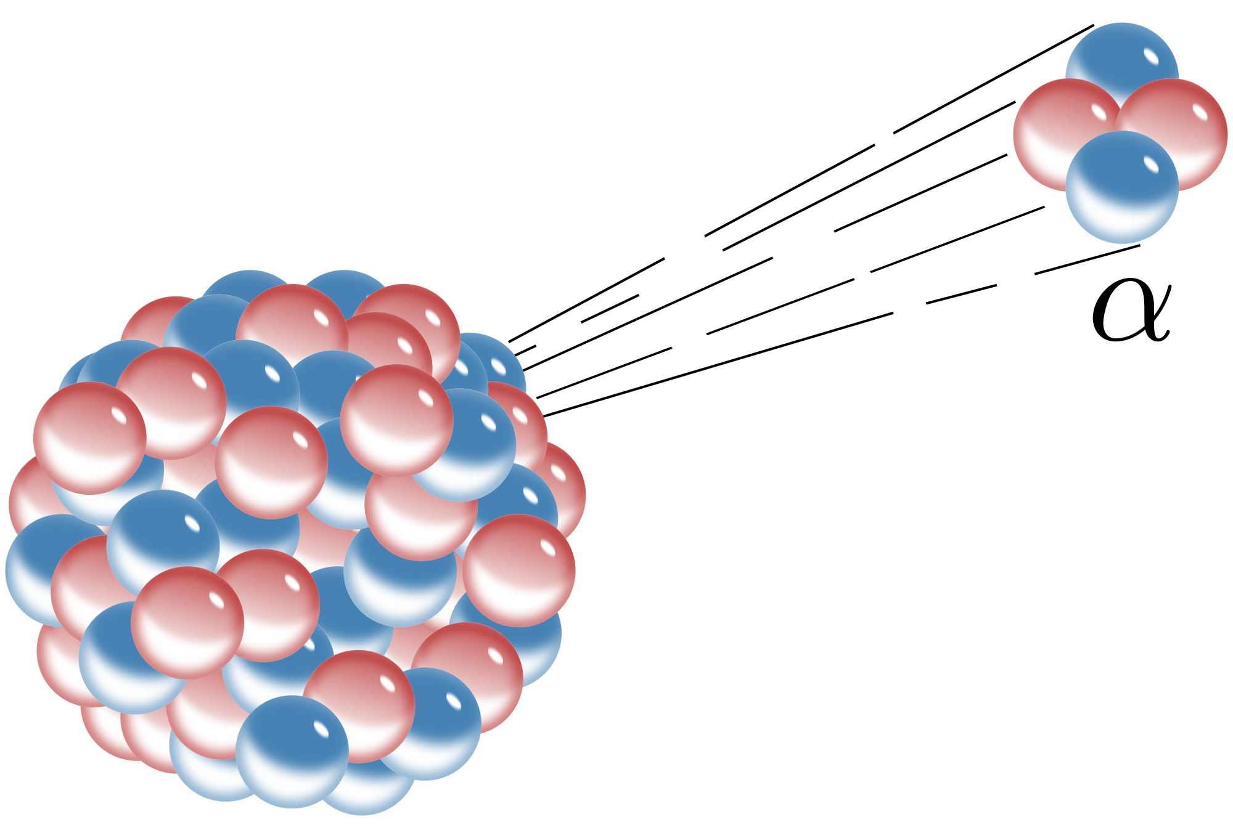
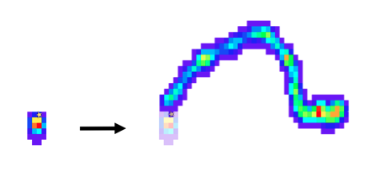

Further constraints are placed for final search criteria
1
2
Events in same CCD; daughters in later images
Correct ⍺ and β classification for decay sequence
3
4
Clusters spatially coinciding, not in masked regions
Sequences fit energy and time cuts from decays
119
Notes:
Strategic placement in urban locations; continued investment in new industries

Slide 12
Spatially-correlated sequences are identified over long periods
³²Si β₁-β₂
²¹⁰Pb β₁-β₂
No sequences match possible decays of ²³⁸U or ²³²Th chains
⍺-⍺
²¹⁰Pb β₁-⍺
E_{β1} = 110 keV
E_{β2} = 361 keV
Δt = 11.7 d
E_{β1} = 57 keV
E_{β2} = 376 keV
Δt = 1.4 d
E_{⍺1} = 4.3 MeV
E_{⍺2} = 3.8 MeV
Δt = 5.2 d
E_{β1} = 717 keV
E⍺ = 3.62 MeV
Δt = 32.3 d
Notes:
Strategic placement in urban locations; continued investment in new industries

Slide 13
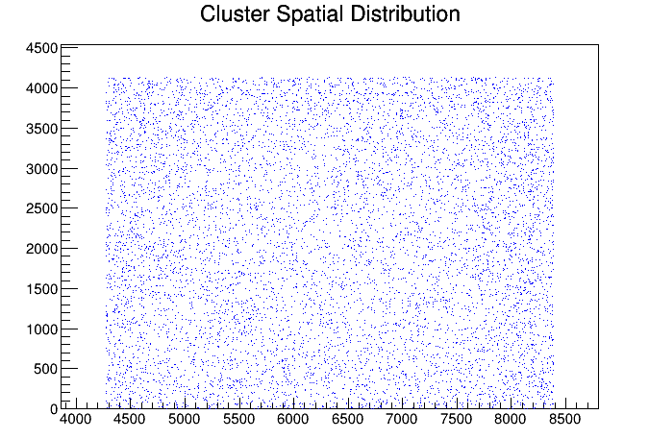
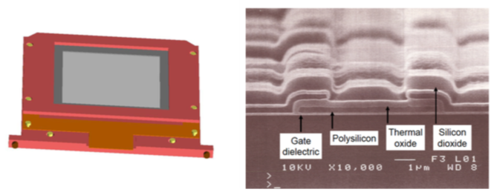
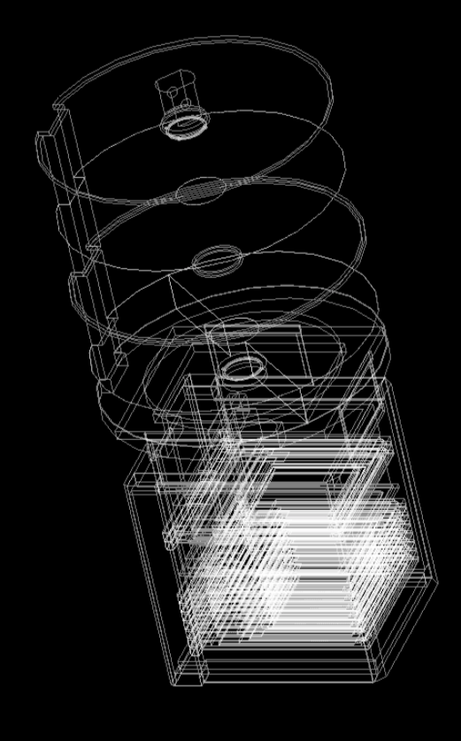
The number of sequences is adjusted for accidentals; Geant4 simulations and probability of seeing decays give search efficiency
CCD top layer
Geant4 geometry
CCD module
Apply search criteria to many iterations of spatially-randomized data in order to estimate accidental events
1311
Notes:
Strategic placement in urban locations; continued investment in new industries

Slide 14
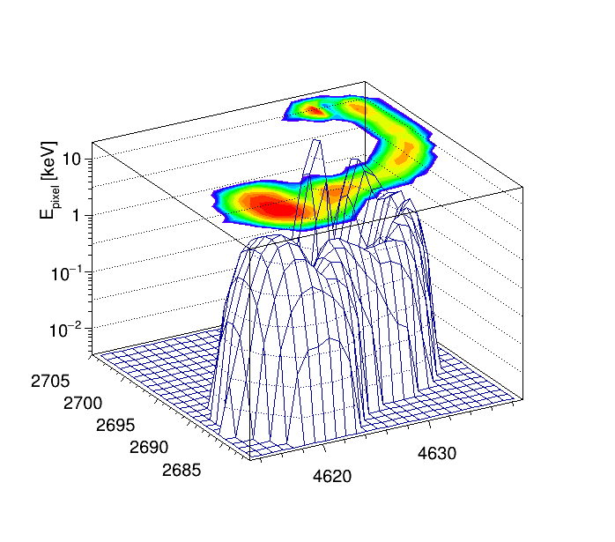
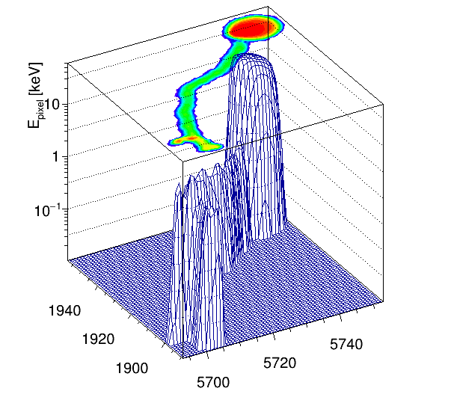
Measured contamination of ²¹⁰Pb and ³²Si (first comparison to previous DAMIC result); limits are placed on ²³⁸U and ²³²Th
This Analysis (preliminary)
DAMIC 2015 R&D result
³²Si
133.3 ± 27.8 μBq/kg
³²Si
925.9 ± 1273 / 752 μBq/kg
²¹⁰Pb
83.1 ± 11.8 nBq/cm²
²¹⁰Pb
902.8 ± 115.8 nBq/cm²
²³⁸U
No ⍺-β sequences
Upper limit:
0.53/kg/day or 1.5 ppt [95%]
²³⁸U
Upper limit: 5/kg/day [95%]
²³²Th
Upper limit: 15/kg/day [95%]
arXiv:1506.02562
²³²Th
No ⍺’s with E = 18.7 MeV
Upper limit:
0.35/kg/day or 1 ppt [95%]
Difference (factor x7) in ³²Si
Notes:
Strategic placement in urban locations; continued investment in new industries

Slide 15
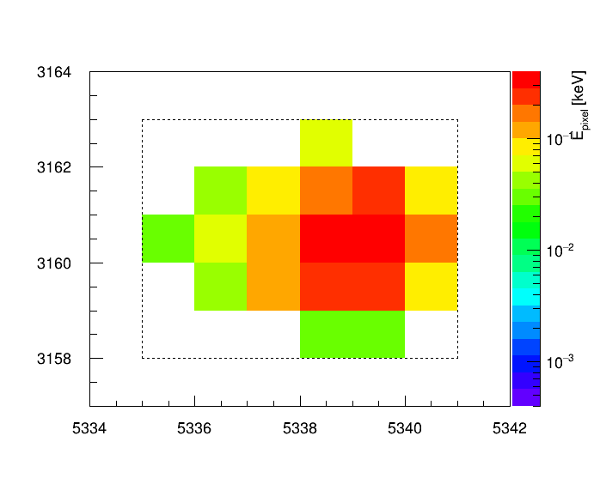
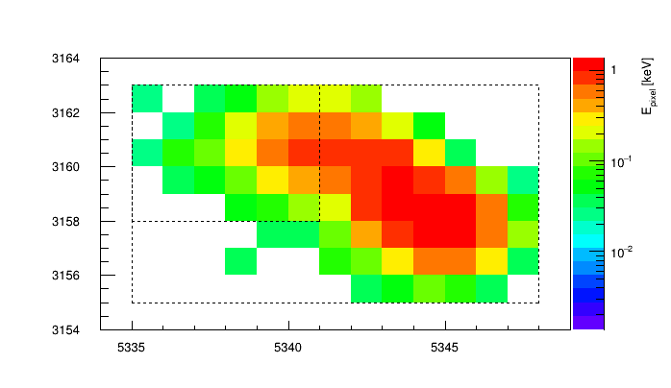
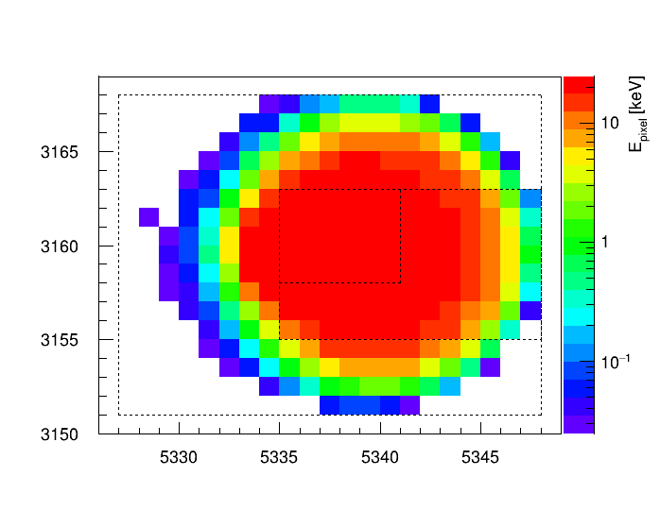
The ⍺’s measured are consistent with the ²¹⁰Pb contamination rate, and ²¹⁰Pb β-β-⍺ sequences are observed
Expected ⍺ (central CCD stack): 276.3 ± 39.2 decays
Observed ⍺ (central CCD stack): 279 decays
CCD Extension | Plasma ⍺ | Bloomed ⍺ | Total ⍺
3 | 25 | 42 | 67
4 | 34 | 35 | 69
6 | 24 | 41 | 65
11 | 34 | 44 | 78
Expected β-β-⍺: 1.9 ± 0.3 decay sequences
Observed β-β-⍺ : 4 decay sequences
N_{CCD} = 6 (4 in central stack)
M = 5.9 g / CCD
t = 200.4 d
A_{CCD} = 36 cm²
E_{β1} = 4.4 keV
E_{β2} = 41.4 keV
Δt = 3.9 d
E_{β2} = 41.4 keV
E⍺ = 4.3 MeV
Δt = 9.6 d
1513
Notes:
Strategic placement in urban locations; continued investment in new industries

Slide 16
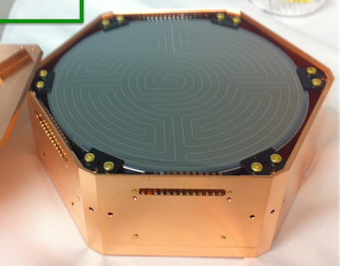
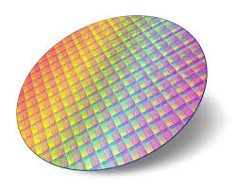
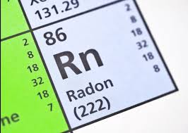
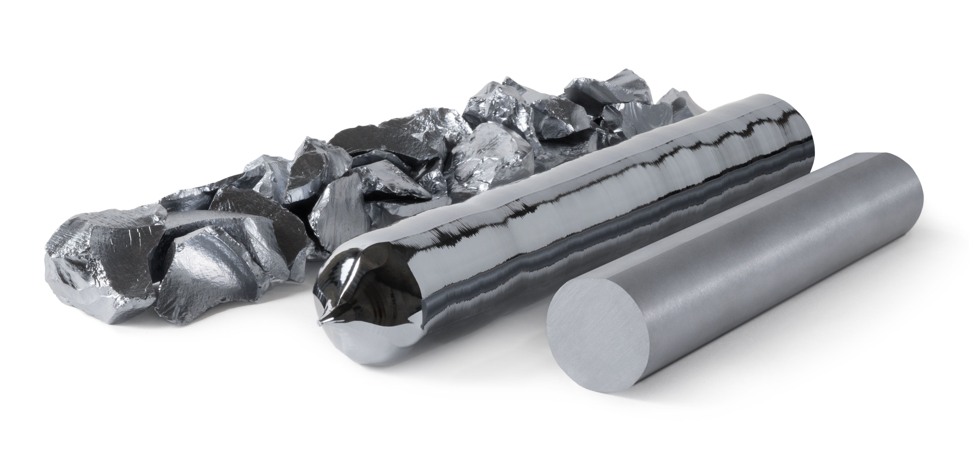
This analysis has major implications for next-generation silicon-based dark matter experiments
DARK MATTER COMMUNITY
STUDIES ON SILICON & ISOTOPES
Other leading silicon-based experiments rely on DAMIC’s measurement of contamination
First comparison to ³²Si level in detector-grade silicon
Confirmation that ³²Si levels vary locally
External
Social
SILICON INGOT SELECTION
RADON CONTROL
Testing contamination in CCDs provides potential to optimize silicon ingot selection
Demonstrable need for lower ²²²Rn levels
Motivation for better CCD packaging and handling protocol
Internal
1614
Notes:
Strategic placement in urban locations; continued investment in new industries

Slide 17
Acknowledgements
This material is based upon work supported by the National Science Foundation Graduate Research Fellowship Program under Grant DGE-1144082, and by the National Science Foundation Graduate Research Opportunities Worldwide Program.
This material is based upon research supported by the Chateaubriand Fellowship of the Office for Science & Technology of the Embassy of France in the United States.
Thank you to the LRT 2019 Local Organizing Committee for the Student Travel Grant that allowed me to attend the workshop.

Slide 18

Cheers!
Normal Matter (5%)
Dark Matter (25%)
4.3% ABV
(Please drink responsibly)
Dark Energy (70%)

Slide 19
Thank you!

Slide 20
Backup

Slide 21
Pairs, accidentals, and efficiency
Bulk Contamination
Surface Contamination
  ³²Si → ³²P Q = 224.5 keV t_{1/2} = 150 y ³²P → ³²S Q = 1710 keV t_{1/2} = 14.3 d
  ²¹⁰Pb → ²¹⁰Bi Q = 63.5 keV t_{1/2} = 22.3 y
  ²¹⁰Bi → ²¹⁰Po Q = 1161 keV t_{1/2} = 5.01 d
  ²¹⁰Po → ²⁰⁶Po Q = 5407 keV t_{1/2} = 138 d
Searches
Search ID | Relevant Isotope | Decay Sequence | N_{pairs} | N_{acc} | 𝝐_{sel} | 𝝐_{t}
1 | ³²Si | β₁-β₂ | 26 | 6.5 | 0.40 | 0.70
2 | ³²Si | β₁-β₂ | 17 | 3.0 | 0.52 | 0.17
3 | ²¹⁰Pb | β₁-β₂ | 69 | 2.5 | 0.08 | 0.75
4a | ²¹⁰Pb | β₁-⍺ | 45 | 2.6 | 0.09 | 0.29
4b | ²¹⁰Pb | β₂-⍺ | 45 | 2.6 | 0.16 | 0.29
5 | ²³⁸U, ²³²Th | ⍺-⍺ | - | - | - | 0.65
*** Lower bound set on separation time criteria to remove ²¹⁰Pb events within search
218
Notes:
Strategic placement in urban locations; continued investment in new industries

Slide 22
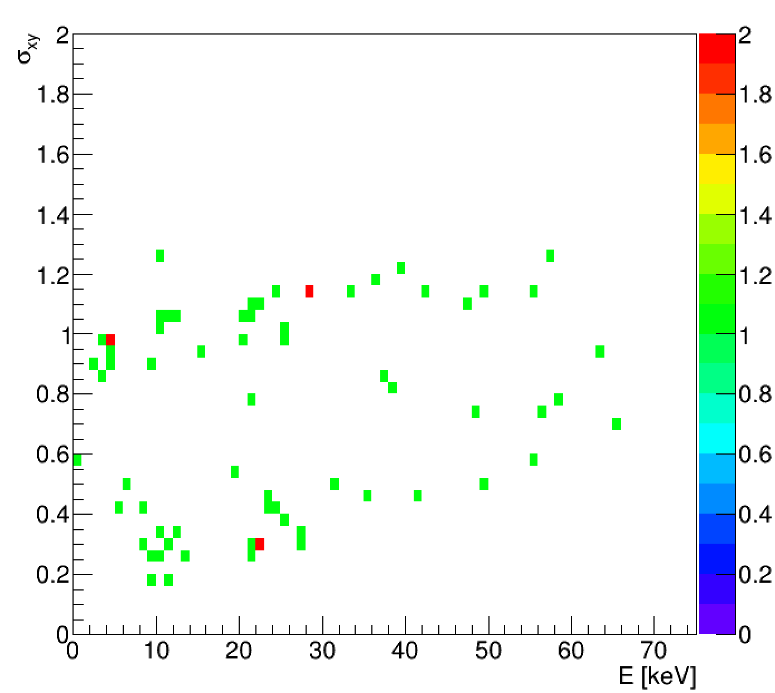
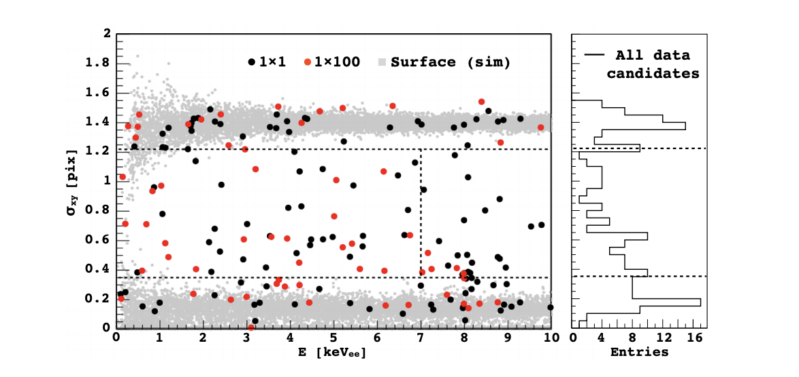
Ongoing efforts to investigate depth profile & diffusion of ²¹⁰Pb
²¹⁰Pb β-β search
Fiducial selection. DAMIC 0.6 kg-day (2016)
Imposed error function with a 50 nm length scale for penetration from surface and inner regions of the CCD (²¹⁰Pb from Rn deposition before/after wafers fabricated into CCDs)
Applied Physical Letters, 103(6):164105 (2013)

