Slide 1
Final results of the CUPID-0 Phase I experiment
Mattia Beretta
On behalf of the CUPID-0 collaboration

Slide 2
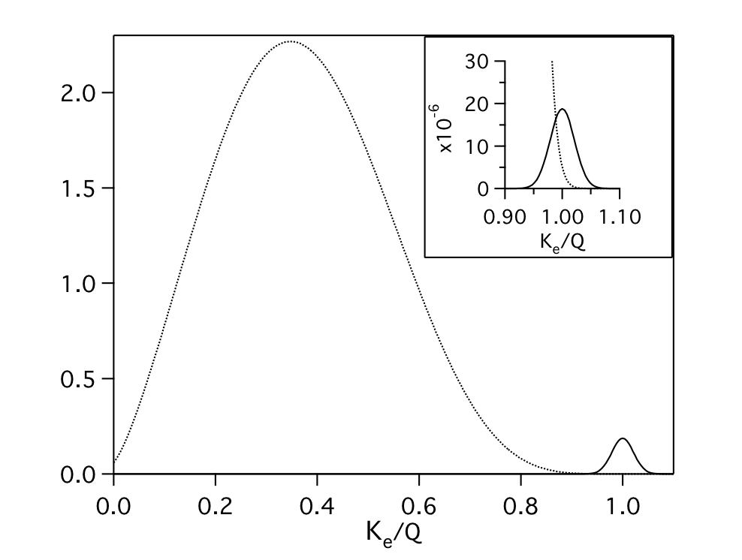
CUPID-0
The first enriched scintillating bolometer ββ experiment
2νββ
⁸²Se
2νββ
Q_{ββ} = (2997±0.3) keV
0νββ:
0νββ
Sum of two e⁻ energy
Performing resolution
At the Q value
Low Background
Few counts expected

Slide 3
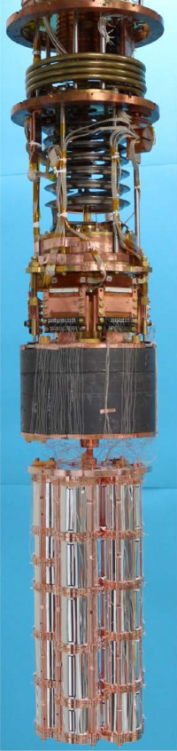
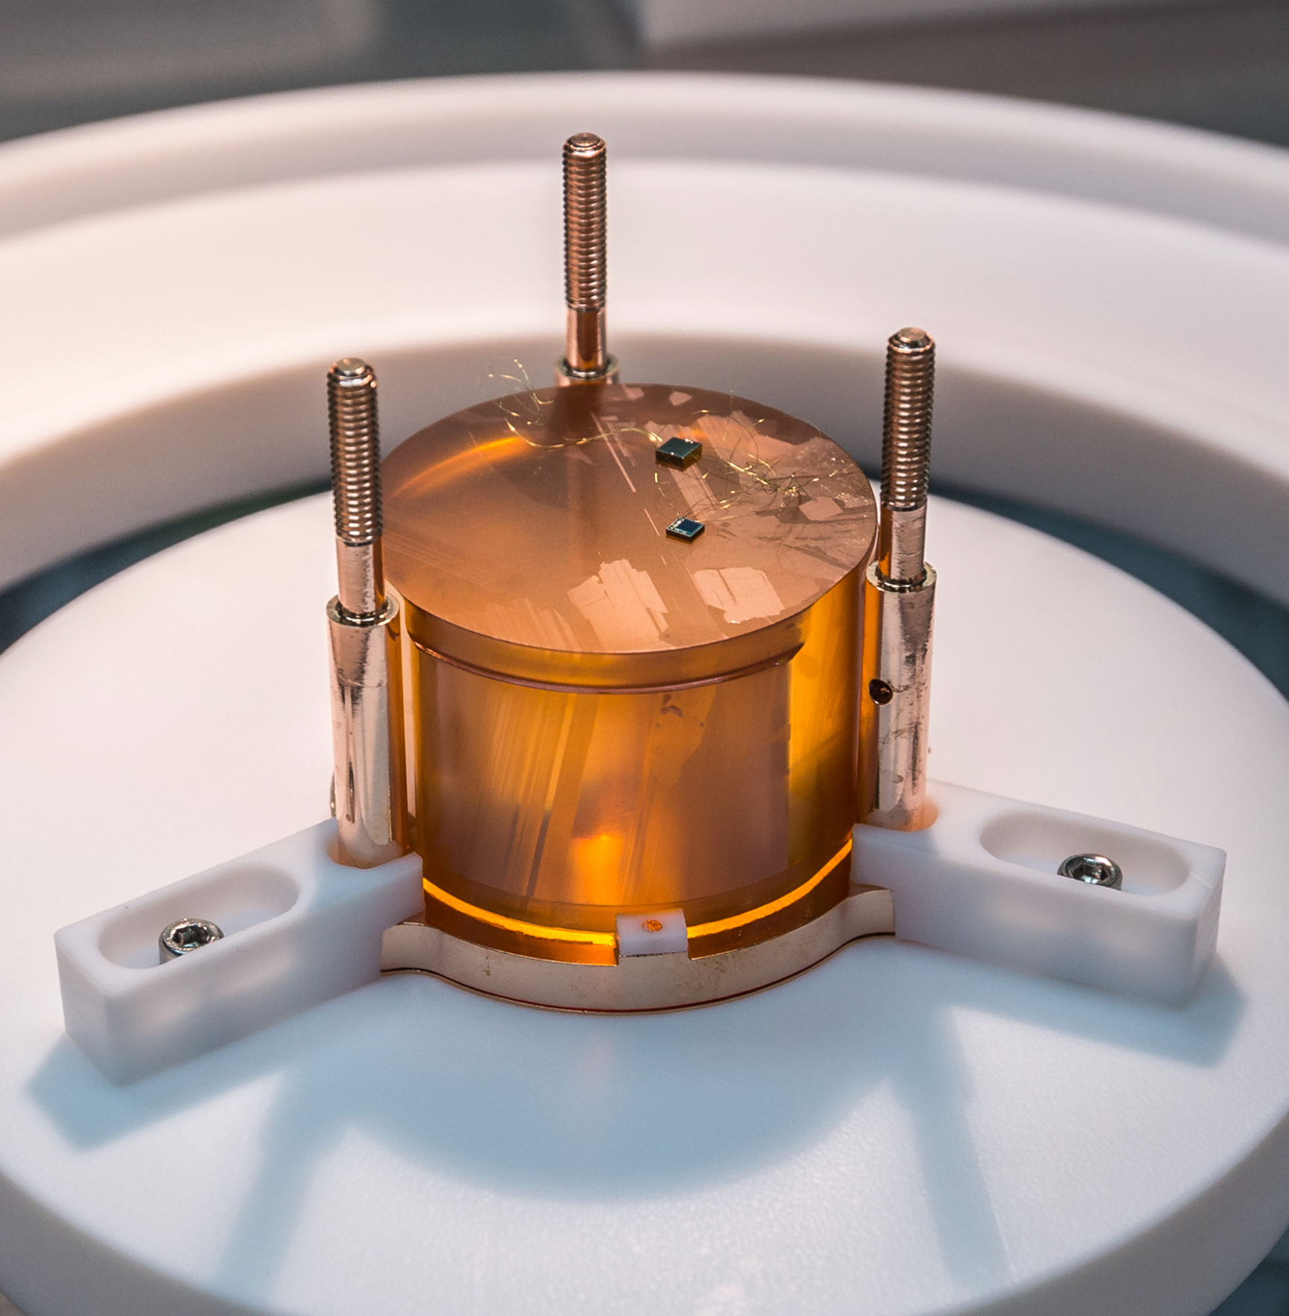
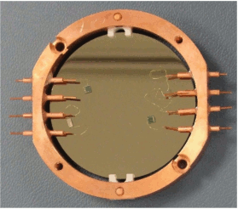
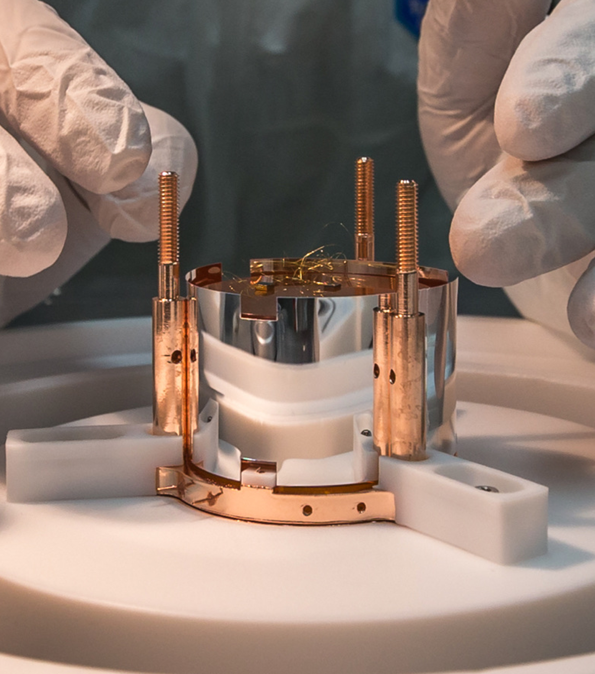
CUPID-0 Detector
Scintillating Zn⁸²Se crystals.
Bolometric Ge Light detectors
Heat signal:
bolometric high resolved output
Light signal:
particle identification
26 ZnSe crystals
  24 enriched in ⁸²Se (95%) + 2 naturals
Total mass= 10.5 kg
  ⁸²Se mass =5.17 kg (3.8∙10²⁵ ββ emitters)
Vikuiti Reflector
More collected light
NOSV Copper
Surface cleaned
O. Azzolini et al. (CUPID), Eur. Phys. J. C 78, 428 (2018), arXiv:1802.06562

Slide 4
CUPID-0 Time-line
2017
June 2017 – December 2018
2019
Phase I
560 d with 74% of livetime
Commissioning
Preparation of Phase II
3%
1%
AmBe source
βγ Shape Characterization in the ROI
⁵⁶Co Energy Calibration
10%
12%
²³²Th Energy Calibration
ββ physics
Exposure: 9.95 kg·y
74%
System manteinance

Slide 5
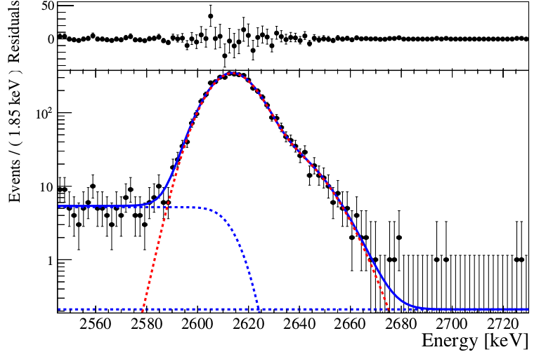
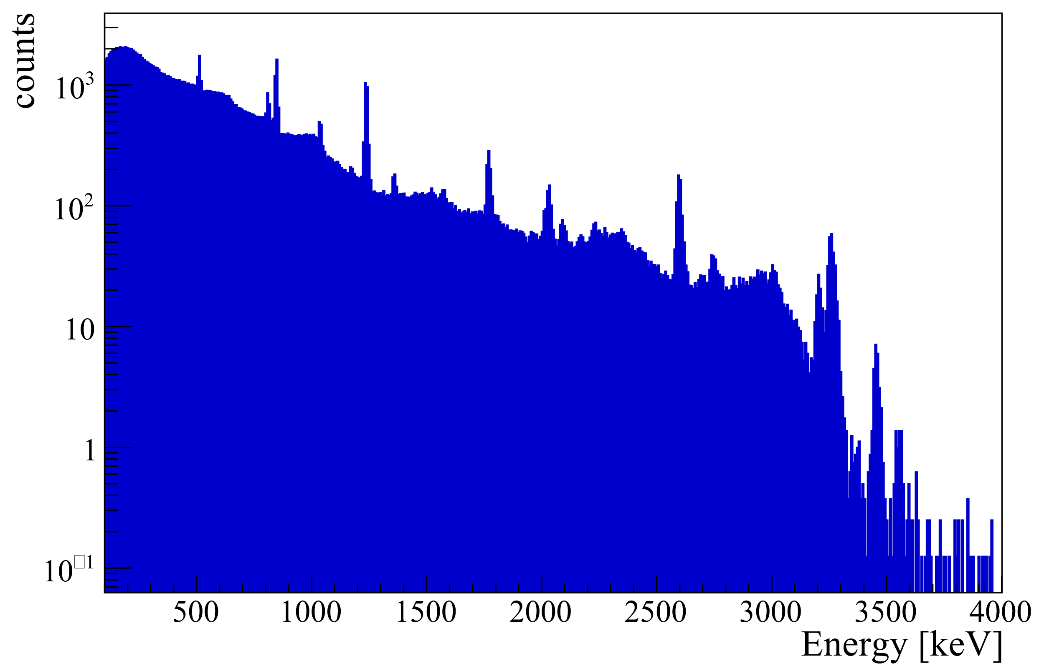
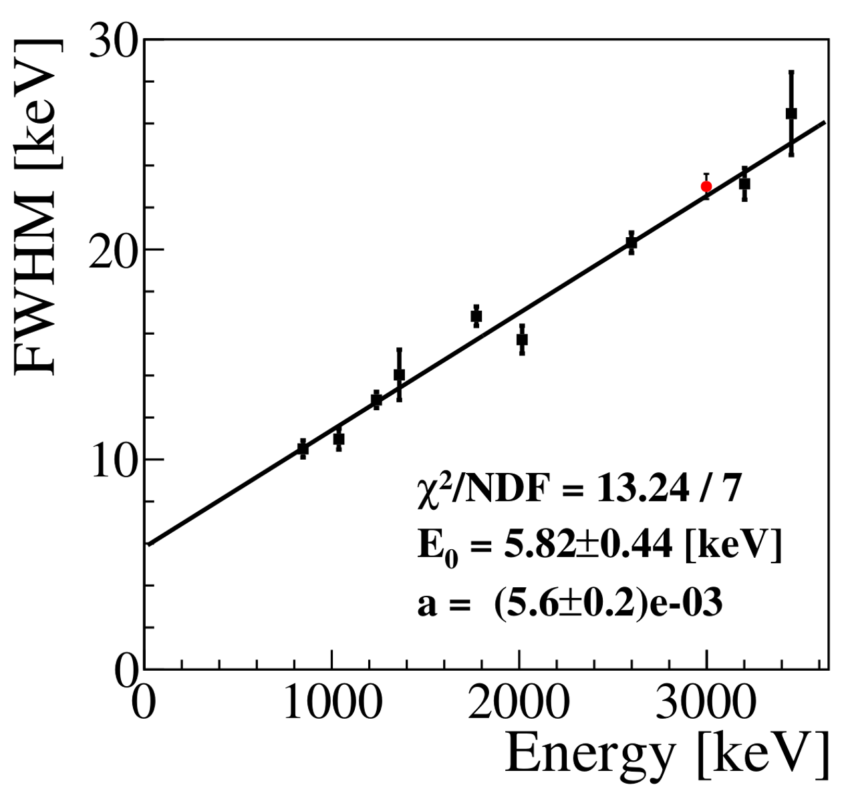
Calibrations
²³²Th Energy Calibration
Periodic Bolometer calibration and light detector intercalibration
Response function: Double Gaussian
  Also observed in other bolometers
⁵⁶Co Energy Calibration
Check of the energy reconstruction
Evaluation of FWHM energy resolution @ ⁸²Se Q
⁸²Se
CUPID-0 Preliminary
FWHM @ Q_{ββ}
(20.0±0.6) keV

Slide 6
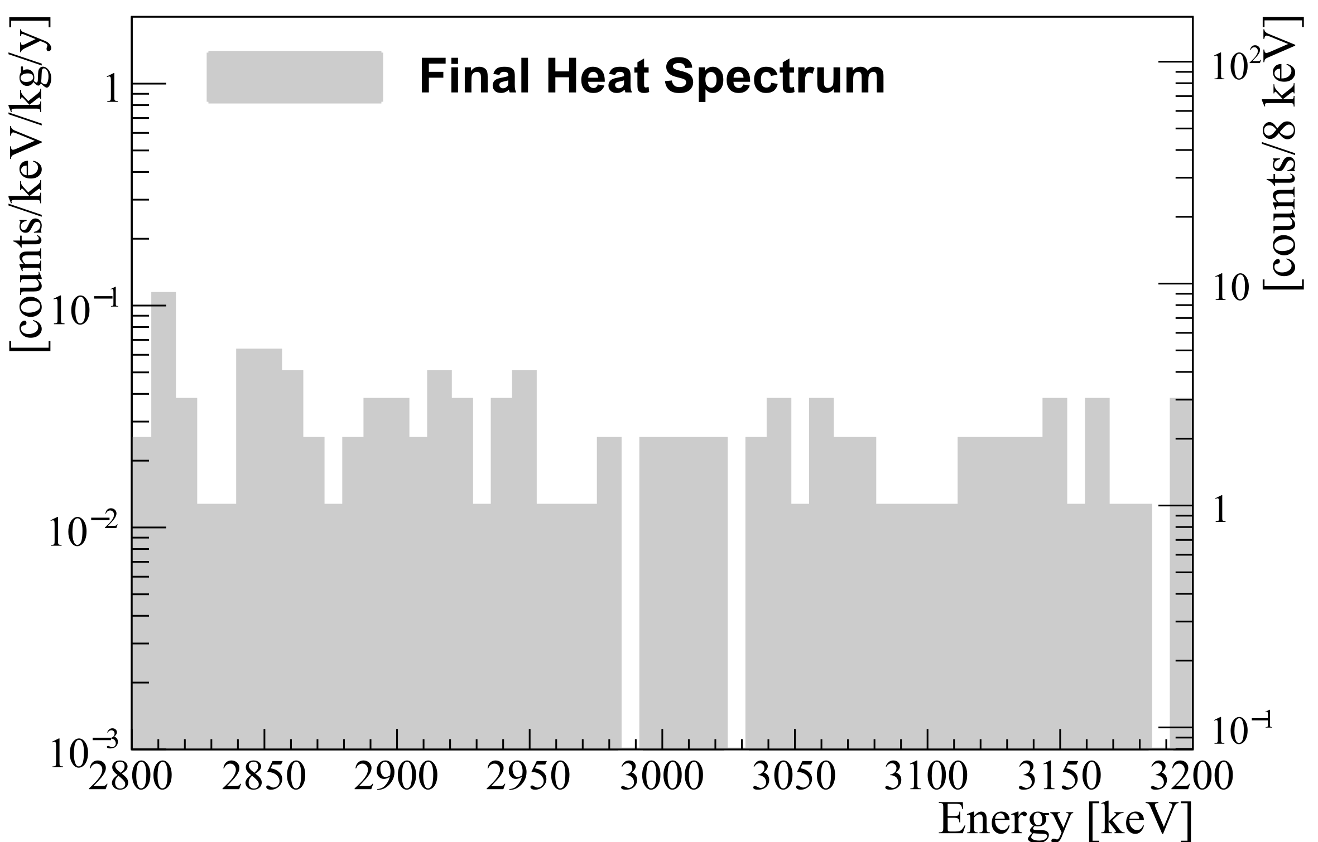
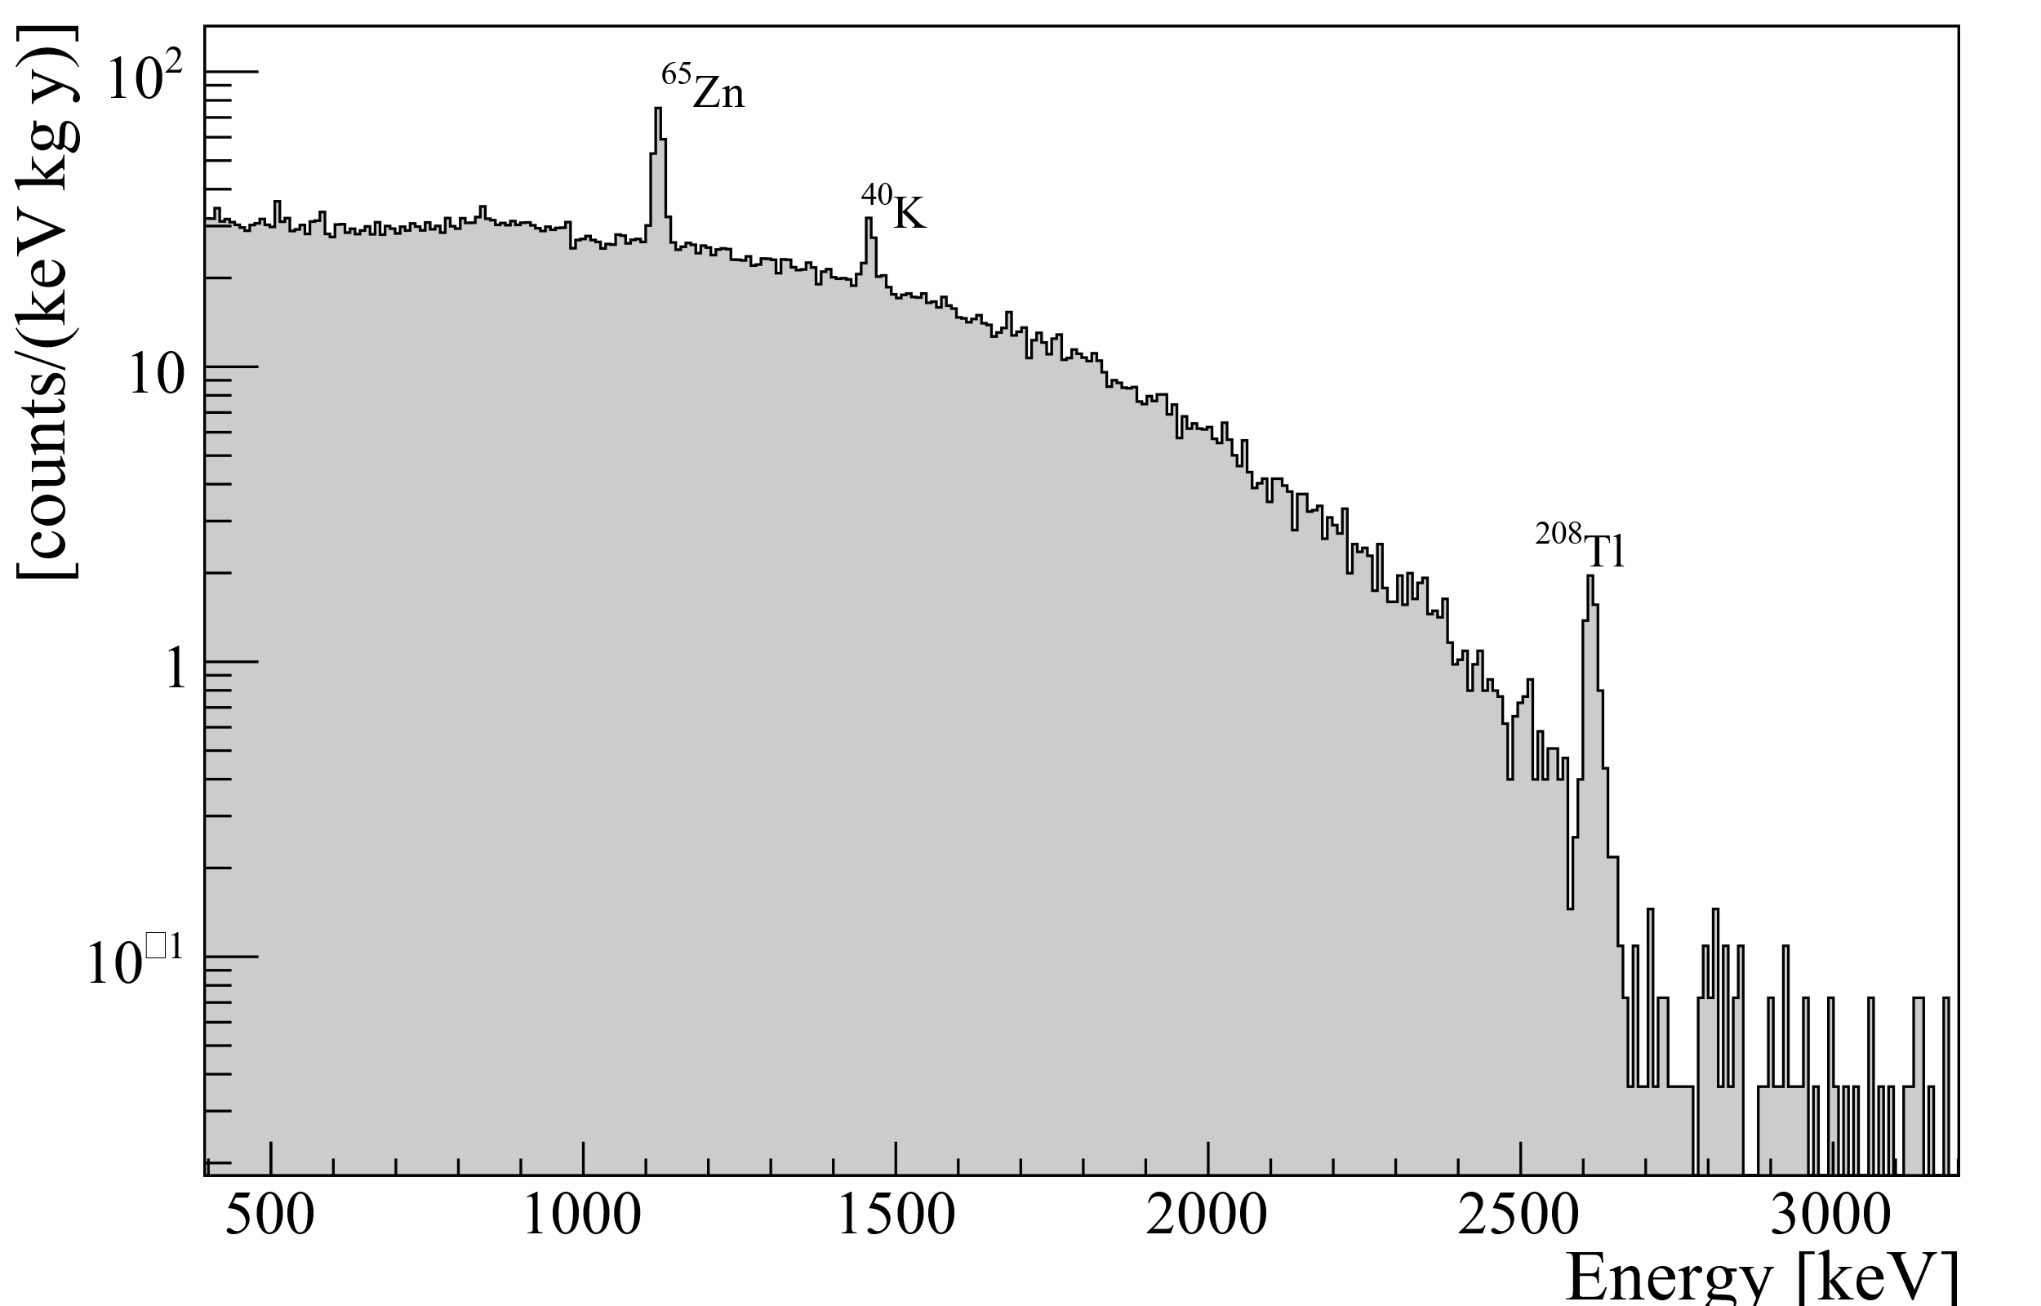
0νββ search
Total Background spectrum
0νββ ROI
CUPID-0 Preliminary
CUPID-0 Preliminary
Basic Selections
Rejection of “non-particle-like” events through pulse shape on thermal pulses
Multiplicity (M)
Anti-coincidence between crystals (ΔT=20ms)

Slide 7
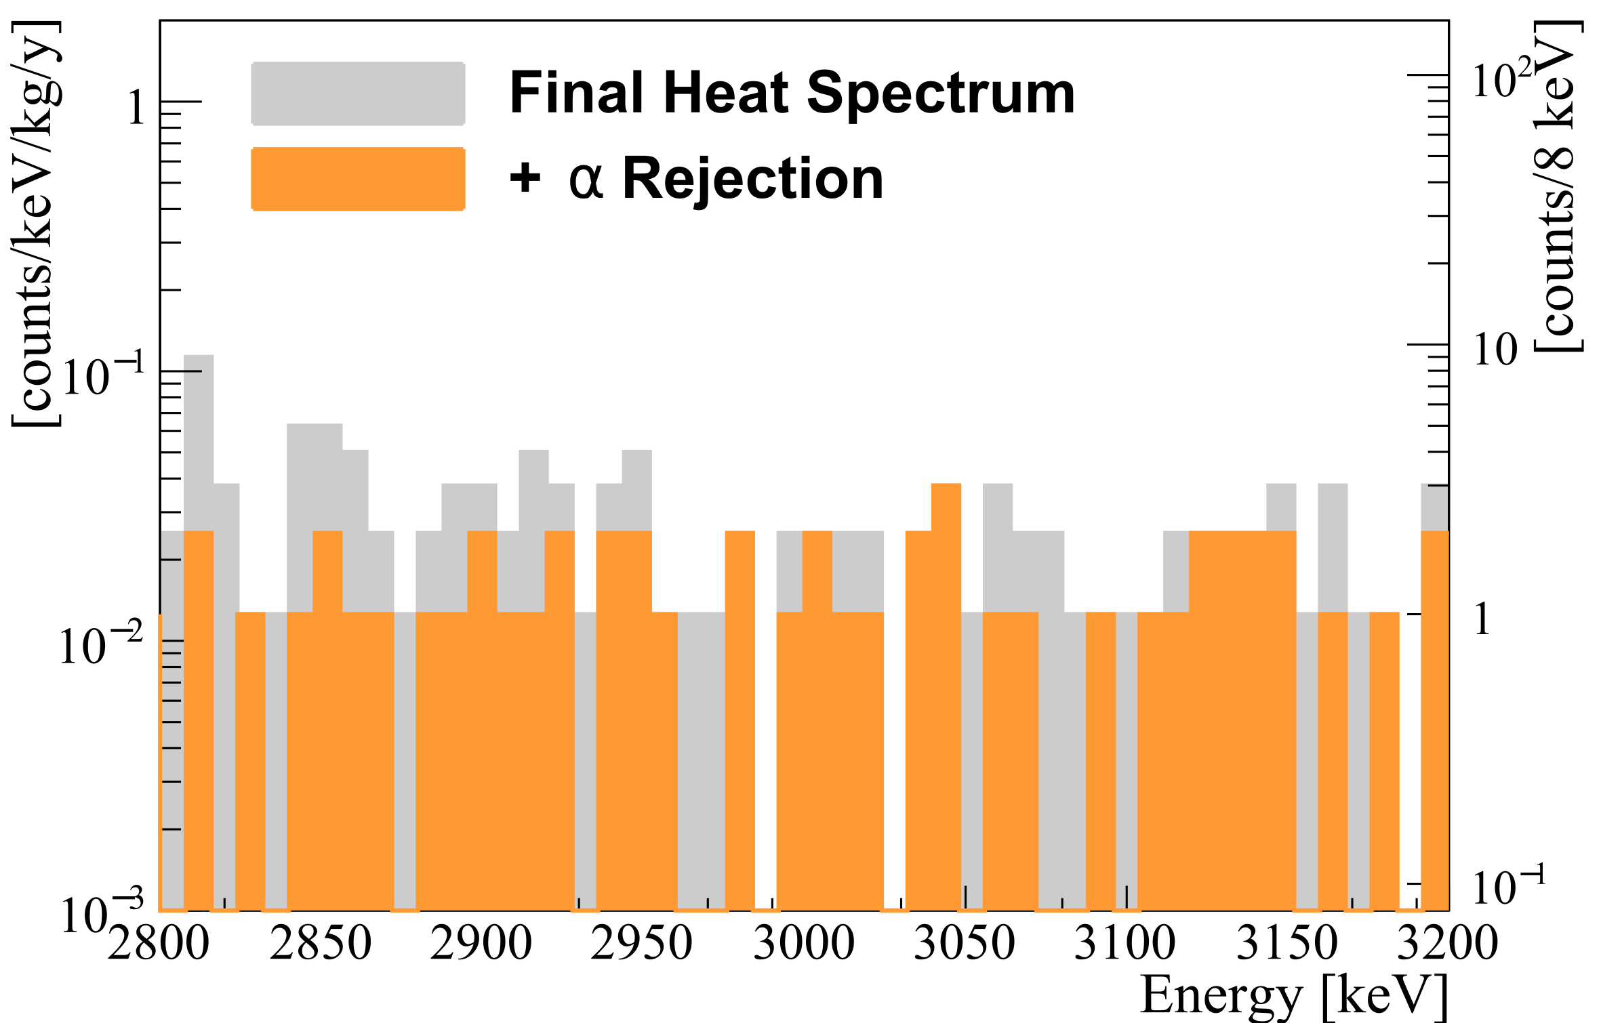
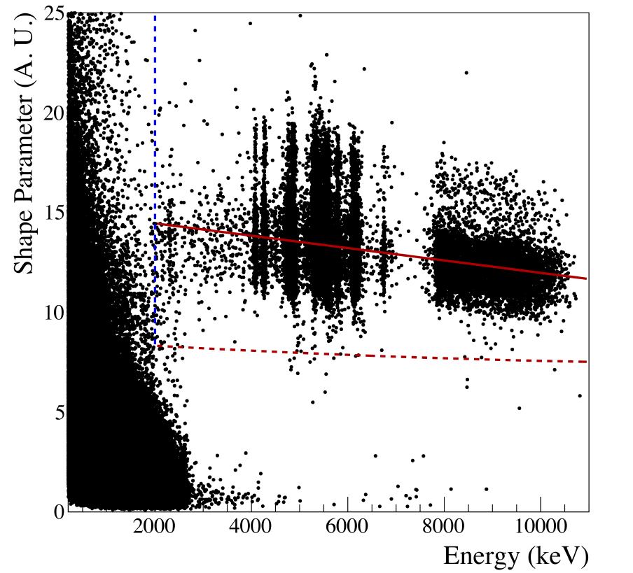
Background – Alpha Rejection
Light Signal depends on particle type
CUPID-0 Preliminary
Selection based on light shape parameter
α events
β/γ events

Slide 8
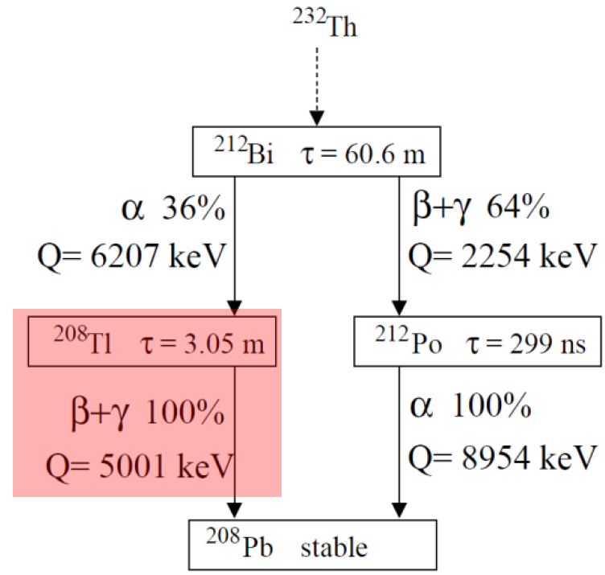
Background – Delayed coincidences rejection
Delayed ²¹²Bi-²⁰⁸Tl (α/β) coincidences
α events
β/γ events
Selection of ²¹²Bi α events
α pulse shape
2.0 MeV<Energy<6.5MeV
  Degraded tag
Veto for 7 half-life

Slide 9
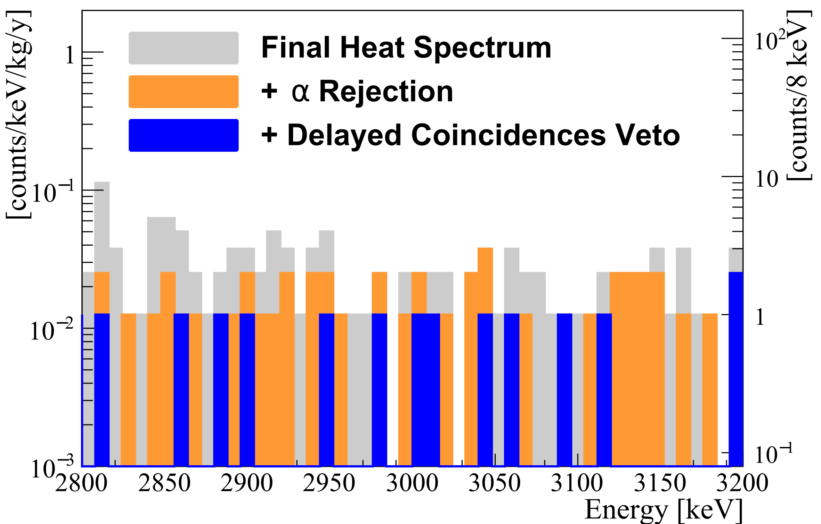
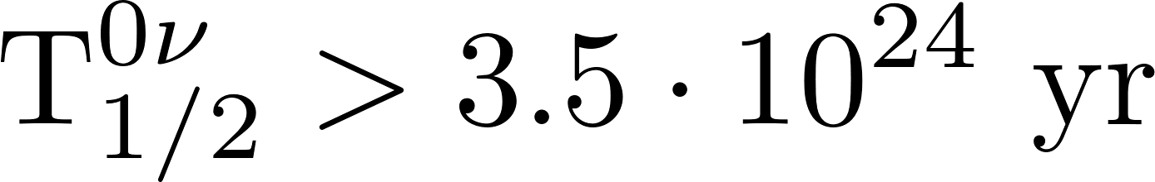
Background – Delayed coincidences rejection
CUPID-0 Preliminary
Lowest background ever measured with a calorimeter
Total cut efficiency:
(86±1)%
No evidence of 0νββ signal
@90% C.I.

Slide 10
Background Model
A complete model of the background sources
EXPERIMENTAL DATA
Analysis
BACKGROUND SOURCES
Bayesian fit to data
Monte Carlo Simulations
Comprehension
Reproduction of measured activity
Predictions
O. Azzolini et al. (CUPID), (2019), arXiv:1904.10397 [nucl-ex].

Slide 11
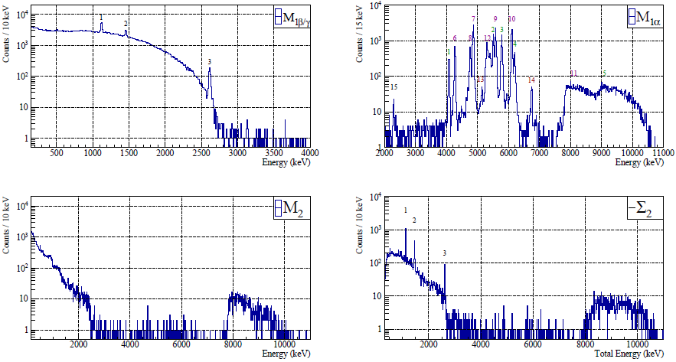
Experimental data for the model
M1 α – β/γ
M2 / M2 sum (Σ2)
M>3 (to constraint Muons)
Divided according to multiplicity and particle type
Multiplicity (M)
Crystals triggered in 20ms
Background source identification
O. Azzolini et al. (CUPID), (2019), arXiv:1904.10397 [nucl-ex].

Slide 12
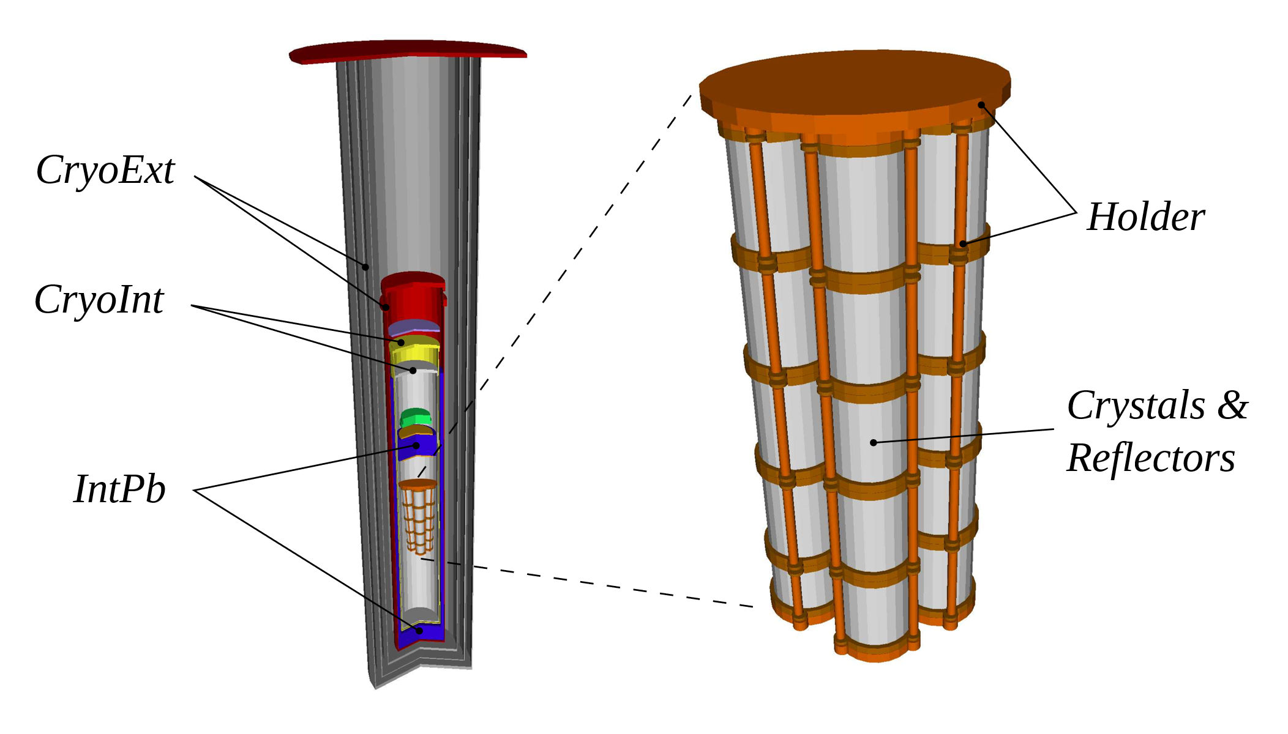
Background sources
Localization in the detector
Radiation type
Natural Chains
Fathers + saecular equilibrium breaking points
Single isotopes
40K, 54Mn, 65Zn, 60Co, ...
Depth of contamination
Muons
Surface
Monte Carlo simulations
Bulk
Exponential profile
Generation
Detection
O. Azzolini et al. (CUPID), (2019), arXiv:1904.10397 [nucl-ex].

Slide 13

Additional informations
O. Azzolini et al. (CUPID), (2019), arXiv:1904.10397 [nucl-ex].
Linear combination
MODEL
33 background sources
Coefficients = Activities
PRIORS
Experimental signatures
  α/α coincidences
Previous contamination measurements
  Reflective foil
²²⁴Rn
τ_{1/2} = 3.66 d
²²²Rn
τ_{1/2} = 3.82 d
α
²²⁰Rn
τ_{1/2} = 3.11 m
Depends on source localization
α
²¹⁸Po
τ_{1/2} = 3.11 m
α
²¹⁶Po
τ_{1/2} = 0.145 s
α
Daughter/parent gives a prior on surface vs bulk contaminations
²¹⁴Pb
τ_{1/2} = 26.8 m
α
²¹²Pb
τ_{1/2} = 10.64 h
²³⁸U (²²⁶Ra →²¹⁰Pb)
²³²Th (²²⁴Ra →²⁰⁸Pb)

Slide 14
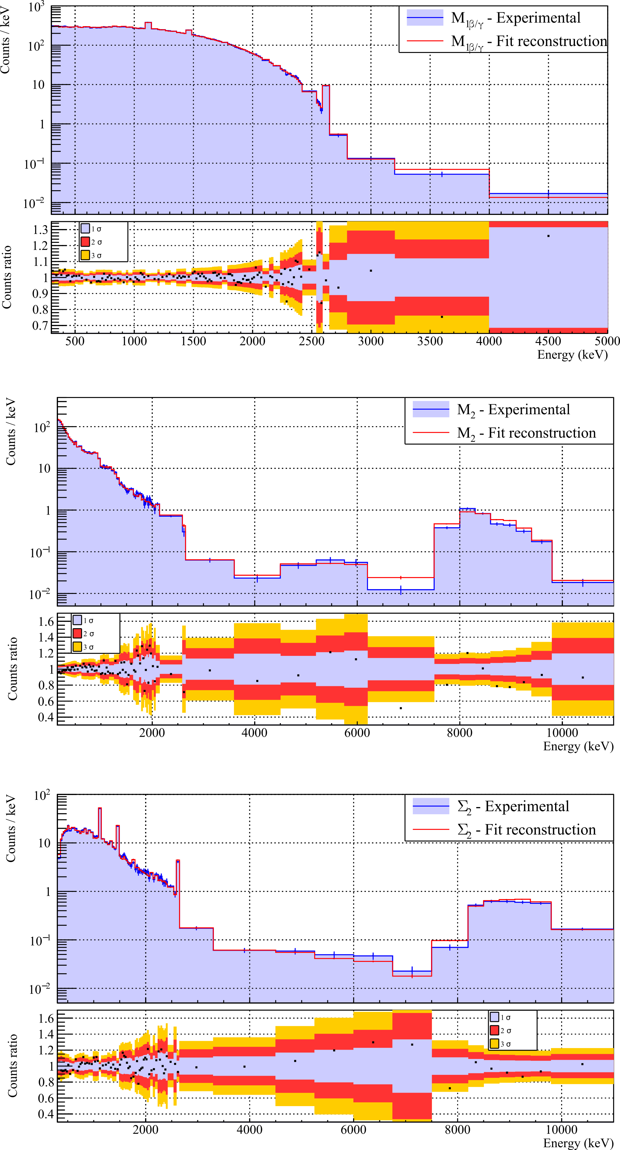
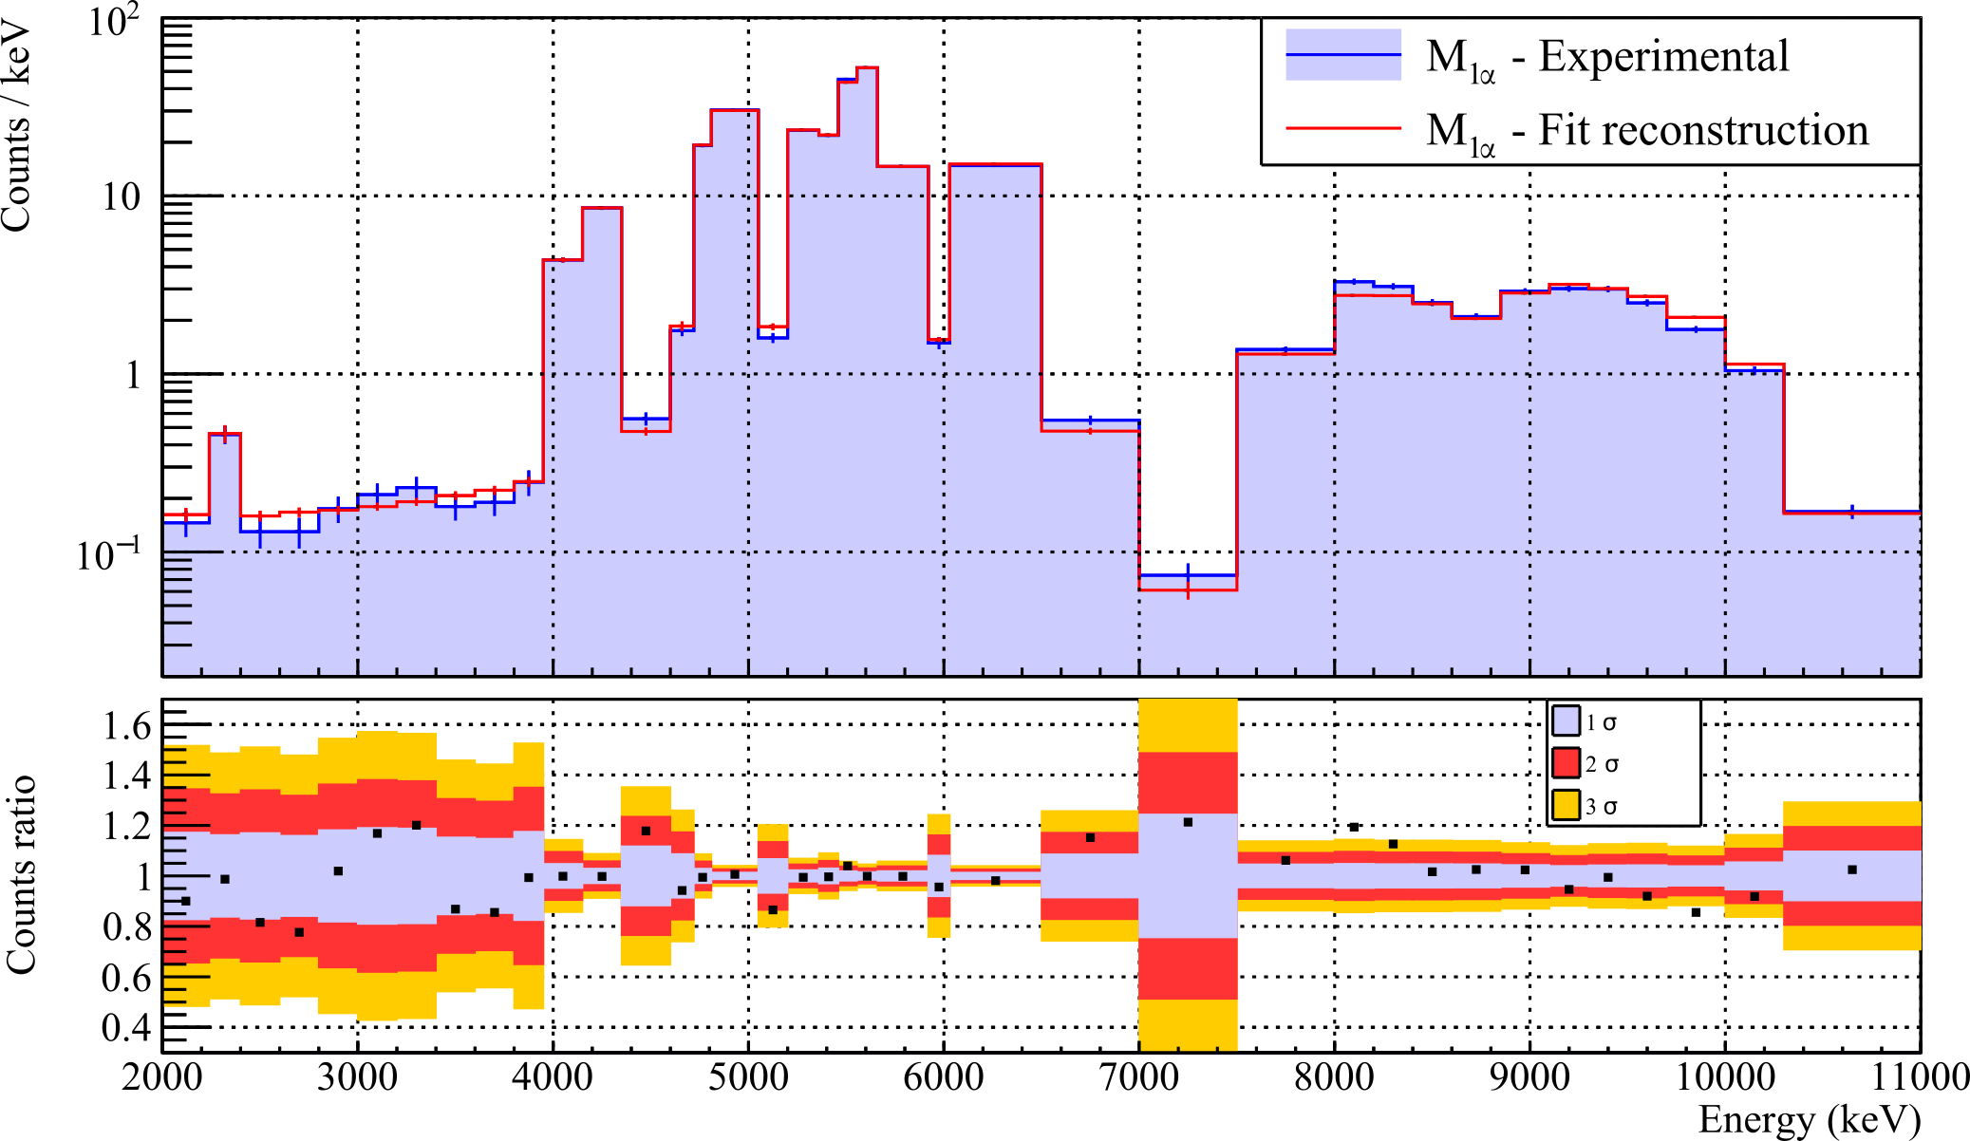
Reconstruction results: M1 Spectra
Full spectrum reconstruction
Peaks and continuum are well modelled
M1 β/γ
M1 α
The α – β/γ separation allows to disentangle the different contributions
O. Azzolini et al. (CUPID), (2019), arXiv:1904.10397 [nucl-ex].

Slide 15
Reconstruction results: M2 spectra
Both α and β/γ regions are well modelled in peaks and continuum
  The surface/bulk prior is a key ingredient
M2
M2 sum (Σ2)
Some differences on the Bi-Po pileup
Imperfect reconstruction of the deposited energy
²¹⁴Bi→²¹⁸Po
²¹²Bi→²¹²Po
O. Azzolini et al. (CUPID), (2019), arXiv:1904.10397 [nucl-ex].
ffff

Slide 16
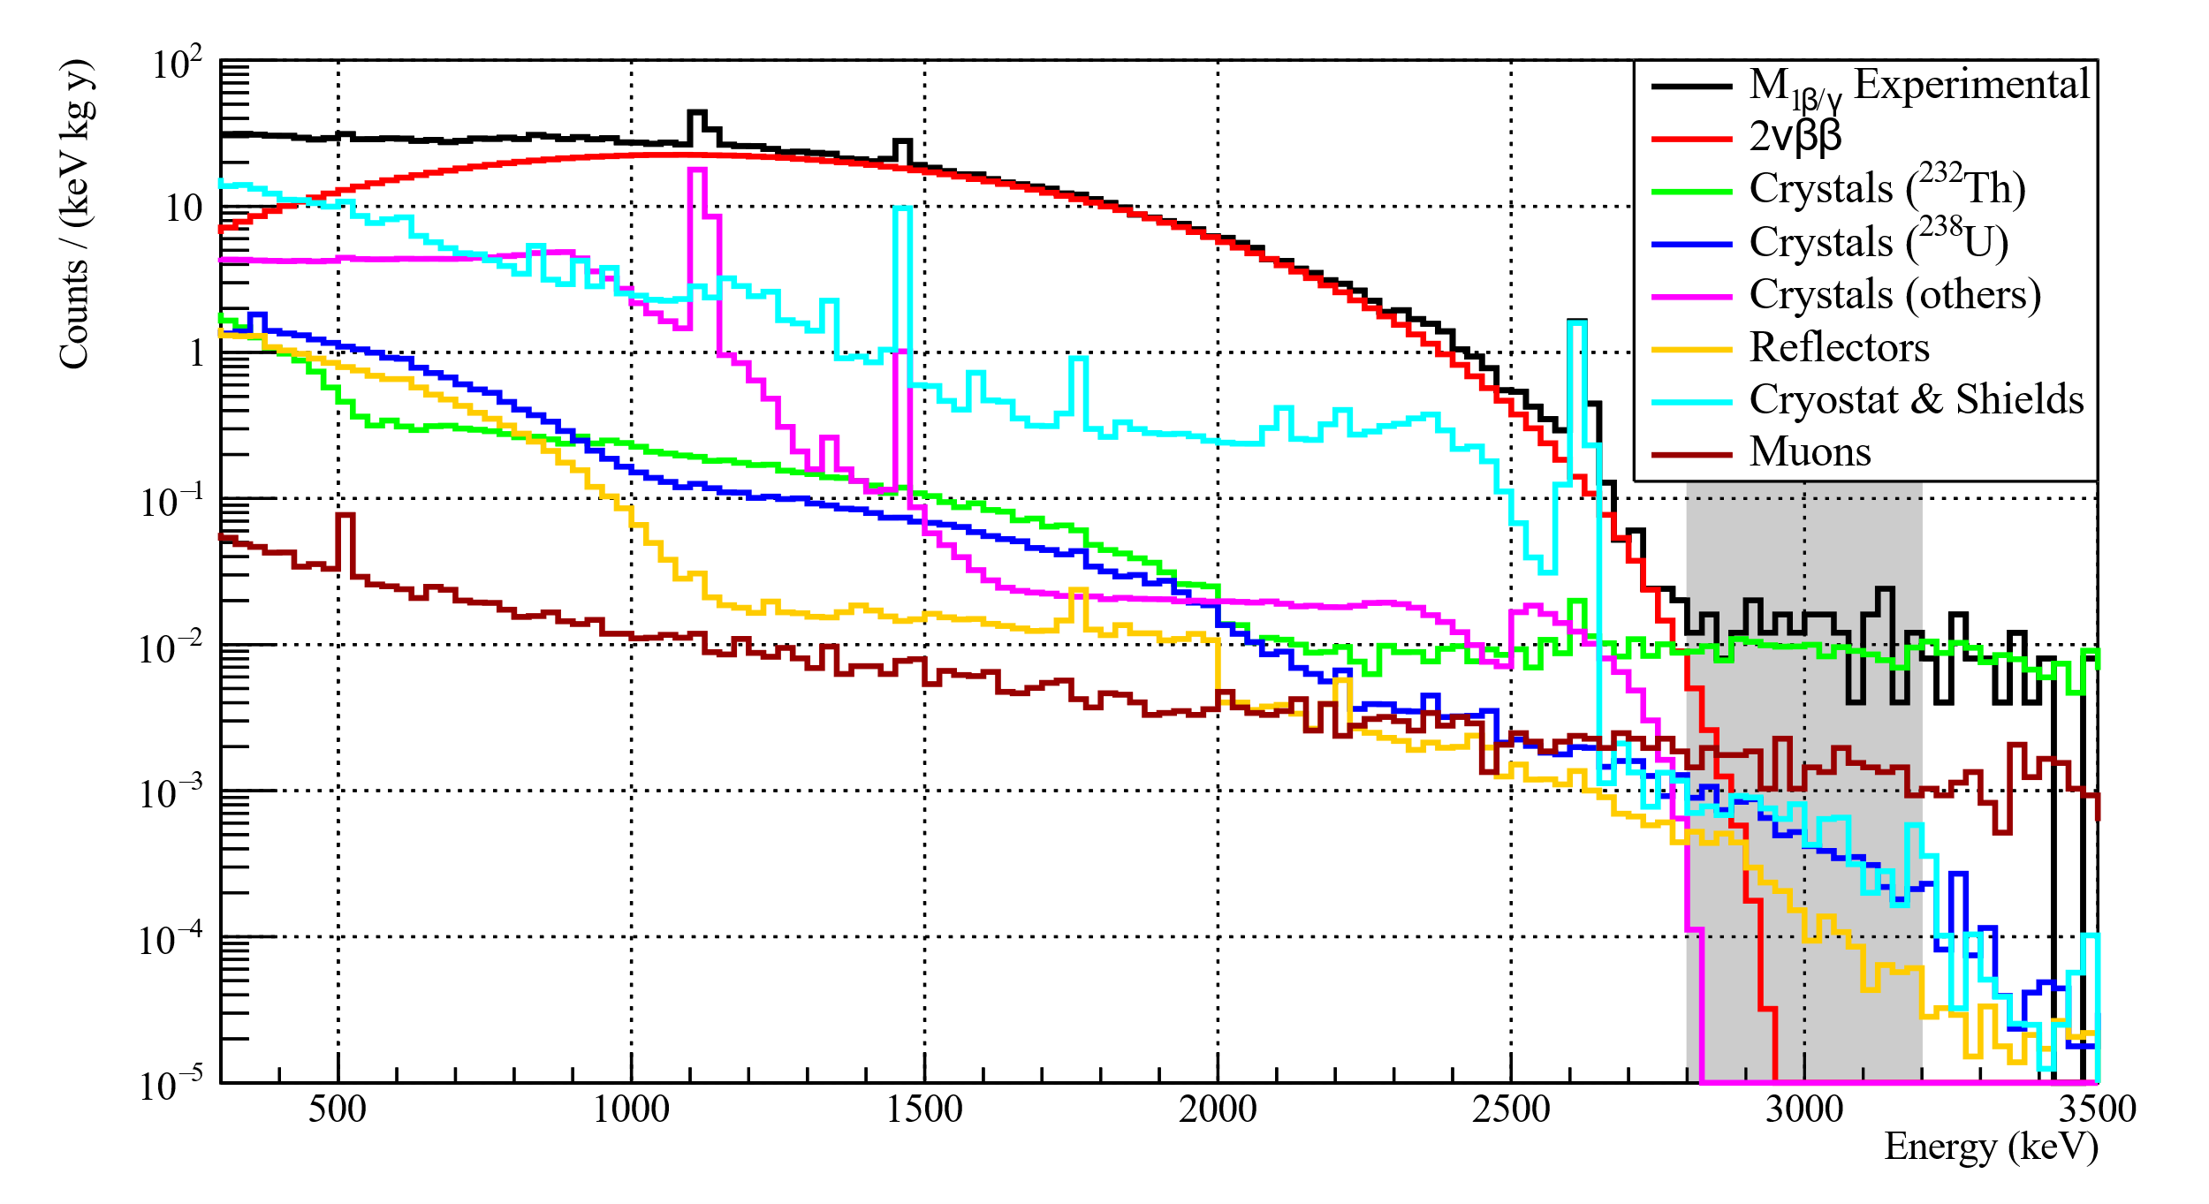
Result: Beta/Gamma spectrum
In the ROI
²³²Th is dominant, because no delayed cut is applied
Delayed coincidences
Muons give 44% of residual background
2νββ is a dominant contribution
Possibility to perform detailed study on this decay
O. Azzolini et al. (CUPID), (2019), arXiv:1904.10397 [nucl-ex].

Slide 17
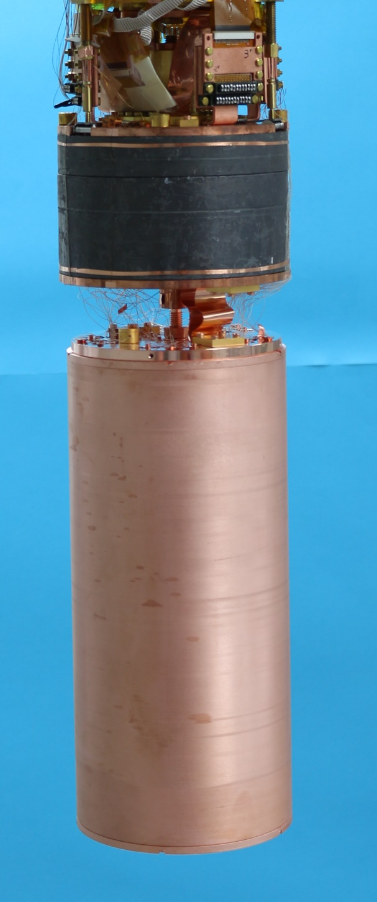
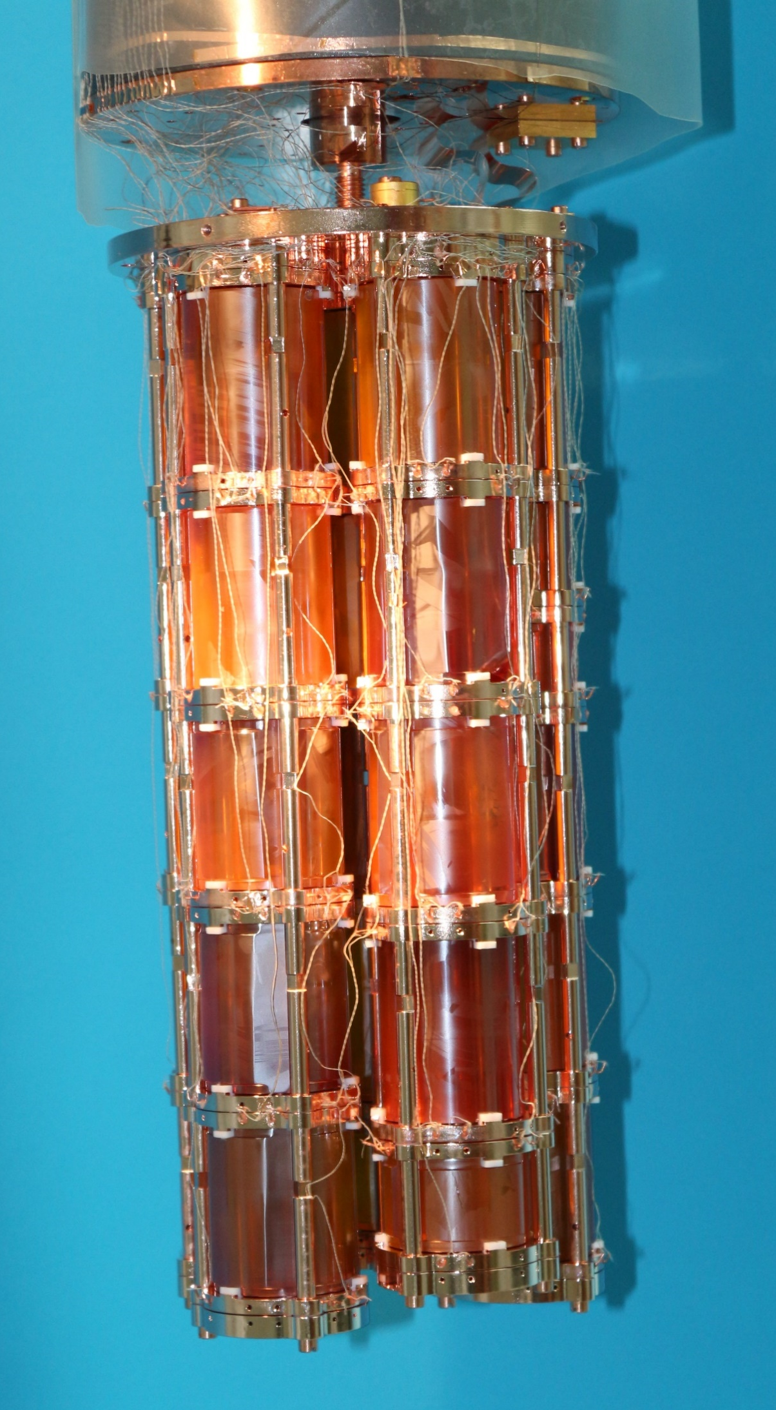
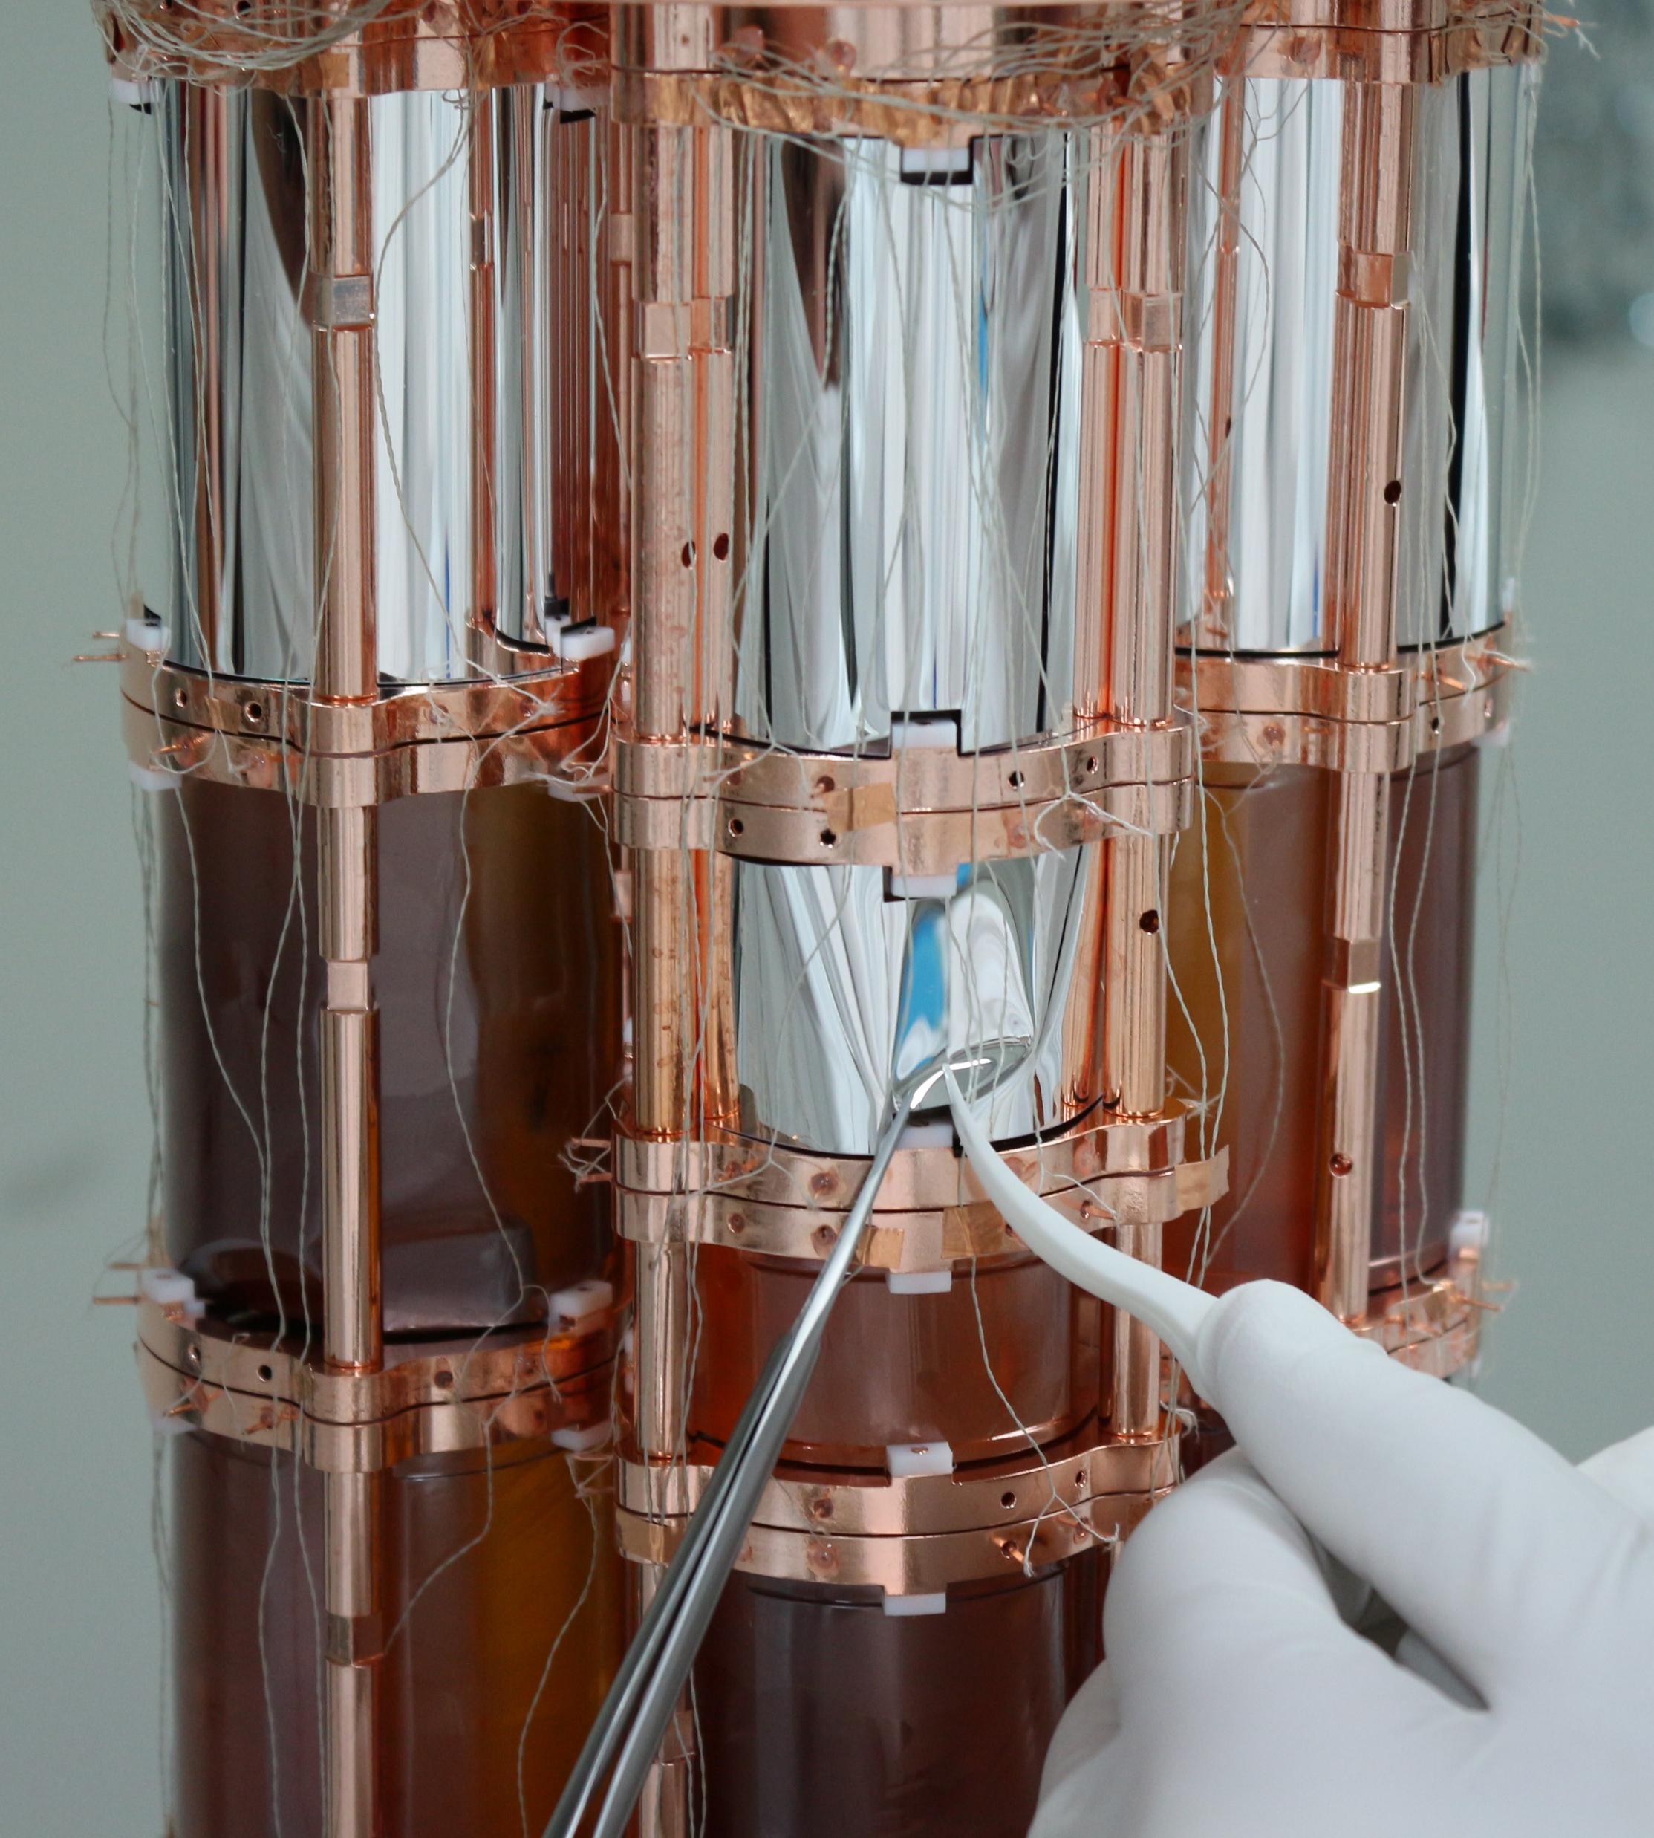
Phase II upgrade
μ are the main residual background
  Installation of μ-veto
New clear Cu Shield
  Thermalization
  Additional shielding
No reflective foil
  Sensitivity to M2 α events
NOW COOLING

Slide 18
CUPID 0: current results and future perspectives
CUPID-0 is the first large array of enriched scintillating bolometers
We reached the lowest background level achieved with bolometric experiments:
A complete background model has been developed
  Major ROI background (²⁰⁸Tl β events) is reduced with delayed cut
  Muons give 44% of residual counts
Phase II upgrade focused on background improvement
  Muon veto installed
  No Reflective foil: M2 alpha events direct tagging
  Additional shielding

Slide 19
BackUp Slides

Slide 20
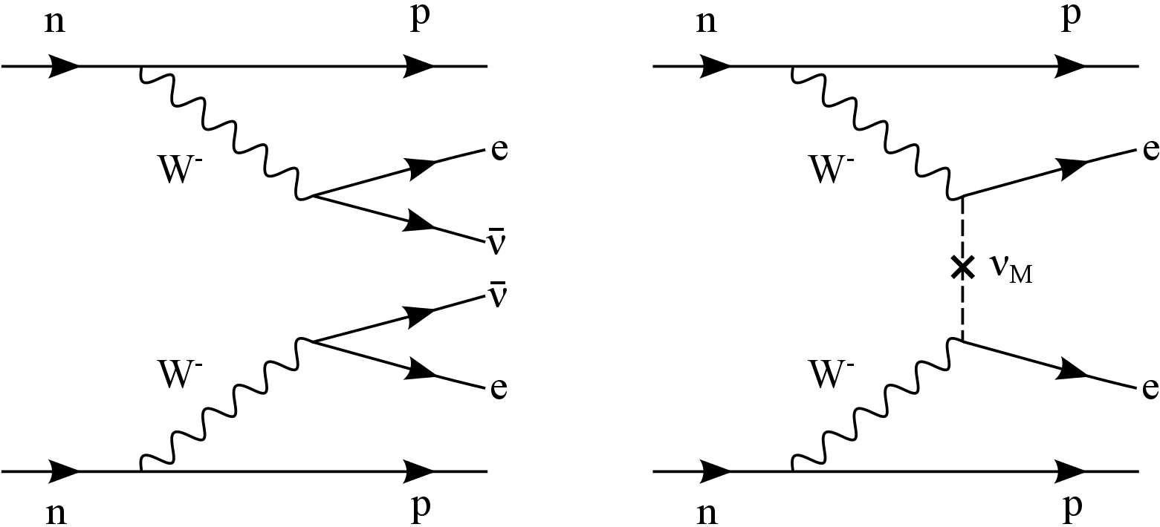
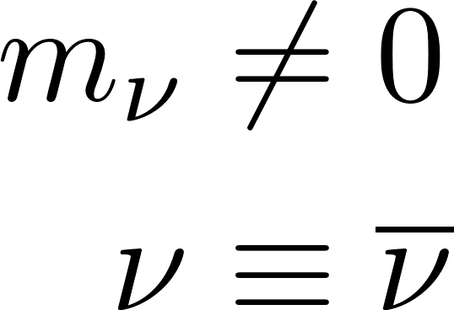
Double beta decay (ββ)
0νββ:
(A,Z) → (A,Z+2) + 2e-
Prohibited in the Standar Model (∆L=2)
Limits: T^{0ν}_{1/2} > 10²⁴ -10²⁵ y
2νββ:
(A,Z) → (A,Z+2) + 2e-+2ν
Predicted and detected
Measuring the two electron energy
2νββ
Performing resolution
At 2-3 MeV (Q_{value} of different isotopes)
0νββ
Low Background
Observing few counts above background

Slide 21
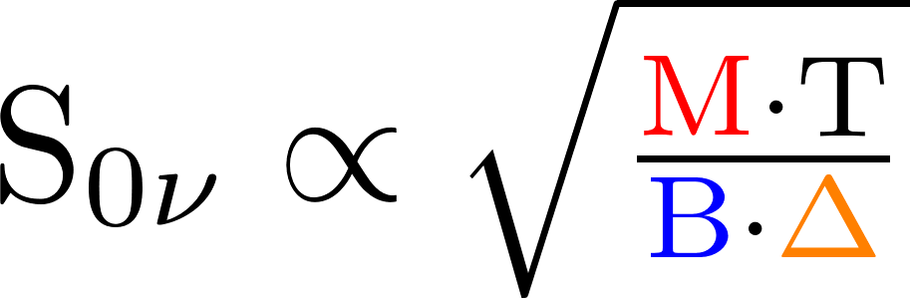
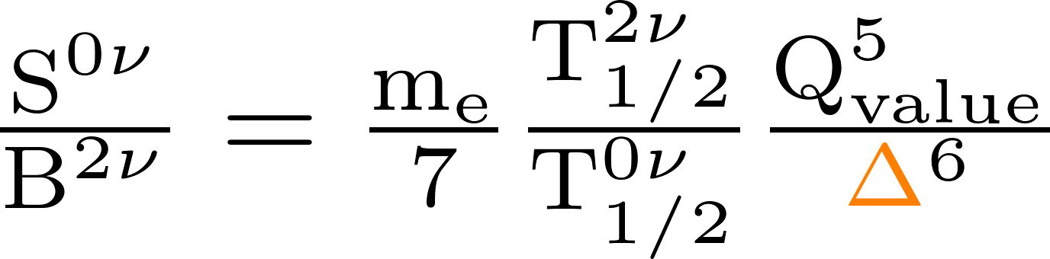
Experimental search for 0νββ
Experimental sensitivity
Maximum measurable half-life at a given C.L.
Crytical experimental parameters:
Isotope Mass (M)
FWHM energy resolution (Δ)
Background (B)
Mass scalability at low cost and high isotopic abundance
High purity materials
(< ppb radioactive contaminations)
Rejection techniques
Δ of few % at Q_{value} to avoid the 2νββ induced background
Ratio 0νββ signal/2νββ background

Slide 22
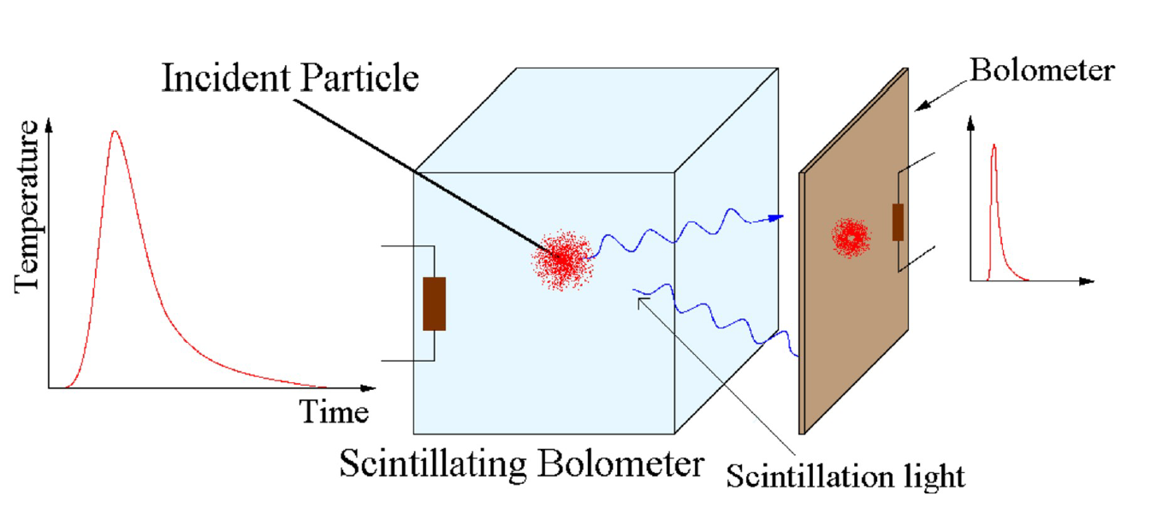
CUPID-0
The first enriched scintillating bolometer ββ experiment
Precision measurements on ⁸²Se ββ
Demonstrating achievable Background rejection
⁸²Se - Q_{ββ} = (2997±0.3) keV
Heat:
bolometric high resolved output
Light:
particle identification

Slide 23
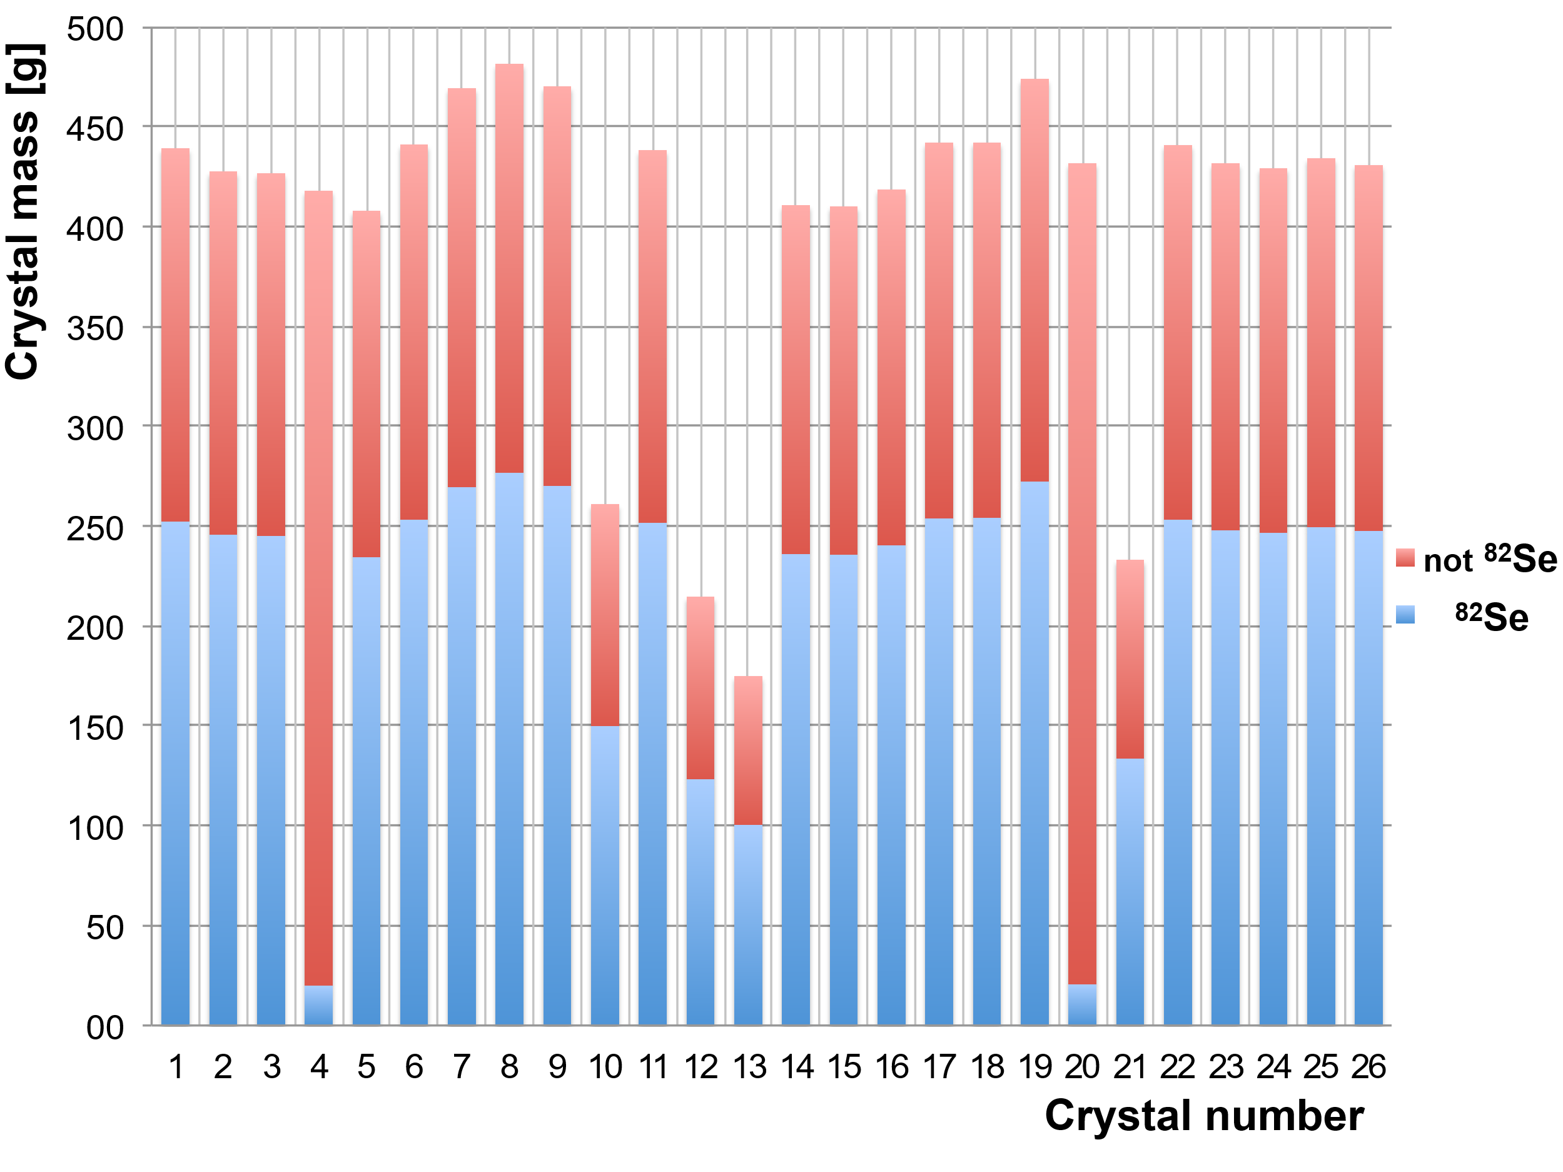
Zn⁸²Se crystals
Fist large mass Zn⁸²Se enriched crystals ever grown.
26 ZnSe crystals
  24 enriched in ⁸²Se (95%) + 2 naturals
Total mass= 10.5 kg
  ⁸²Se mass =5.17 kg
  3.8∙10²⁵ ββ emitters
O. Azzolini et al. (CUPID), Eur. Phys. J. C 78, 428 (2018), arXiv:1802.06562

Slide 24
Material surrounding the crystal
Copper structure
Vikuiti Reflector
NOSV ultra–pure copper
Cleaning procedure vs surface contaminations
Enhances the light output
Low Th/U contaminations measured
Ge Bolometric Light Detector
SiO₂ anti-reflective coating
Sensible to few keV energy deposition
O. Azzolini et al. (CUPID), Eur. Phys. J. C 78, 428 (2018), arXiv:1802.06562

Slide 25
The Cryostat
Oxford 1000 ³He/⁴He diluition cryostat (CUORE-0)
Radially divided by the Roman Lead shield:
  CryoExt, RomanPb, CryoInt
The cryostat contamination have been evaluated from experimental data

Slide 26
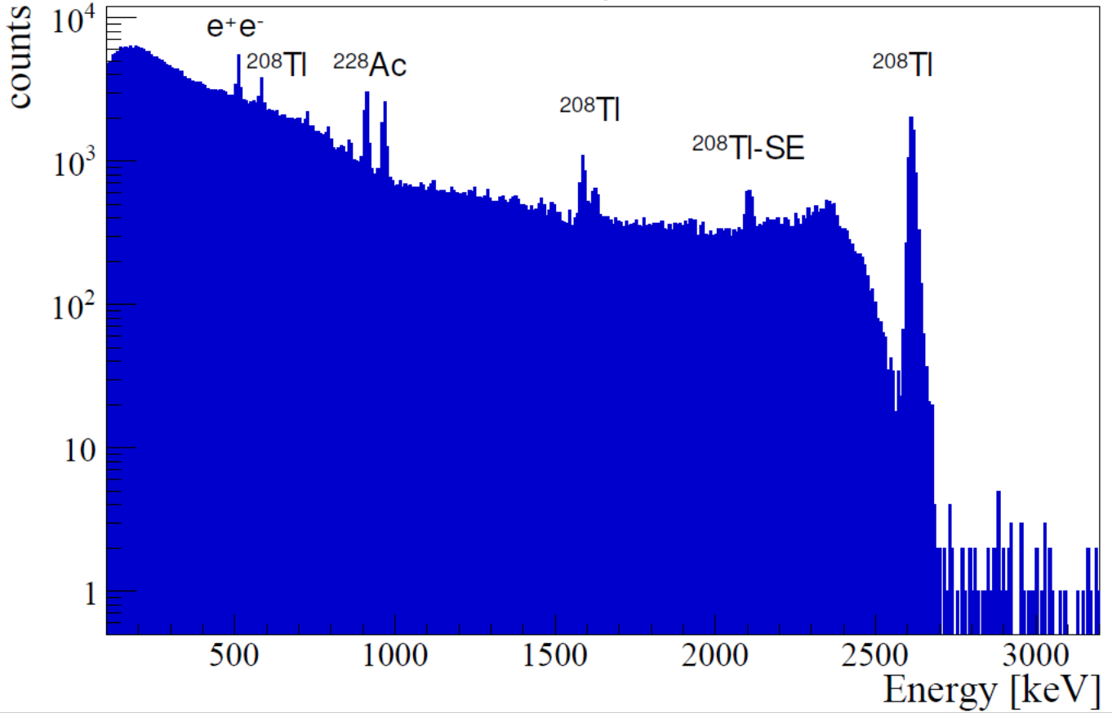
Detector Performances
²³²Th Energy Calibration
Bolometer calibration and light detector intercalibration
Response function evaluation
⁸²Se
Detector response function
Double Gaussian
(deviation from simple gaussian observed in other bolometers)

Slide 27
Detector Performances
⁵⁶Co Energy Calibration
Check of the energy reconstruction
Evaluation of FWHM energy resolution @⁸²Se Q
⁸²Se
FWHM @ Q_{ββ}
(20.0±0.6) keV
Major contribution is the crystal quality
(average baseline FWHM ~5 keV)

Slide 28
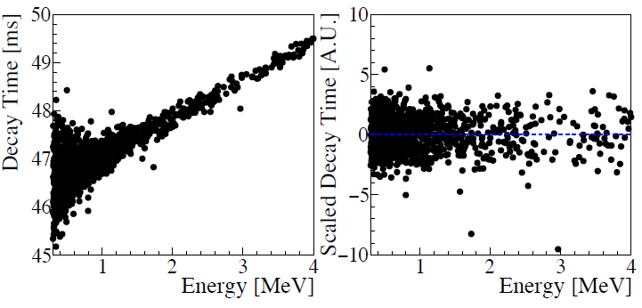
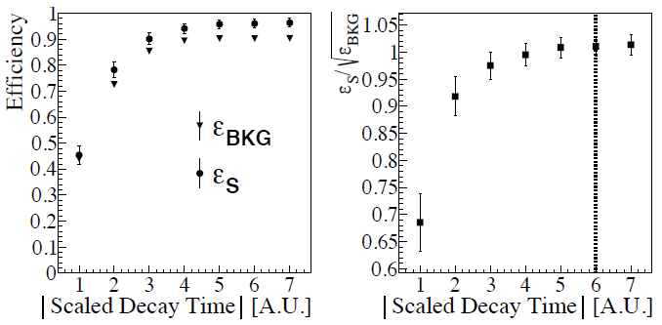
Shape parameters cut
Remove energy-dependency of
the shape parameters for
energy-independent cuts
Efficiency and signal/noise as figure of merit to choose cut level

Slide 29
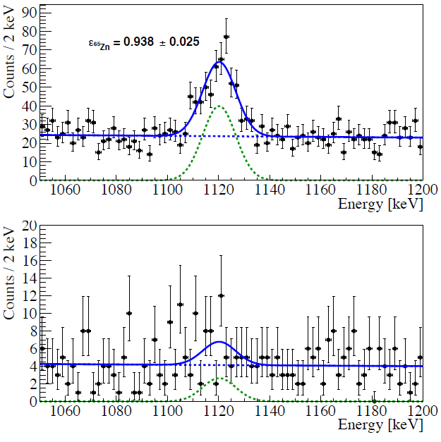
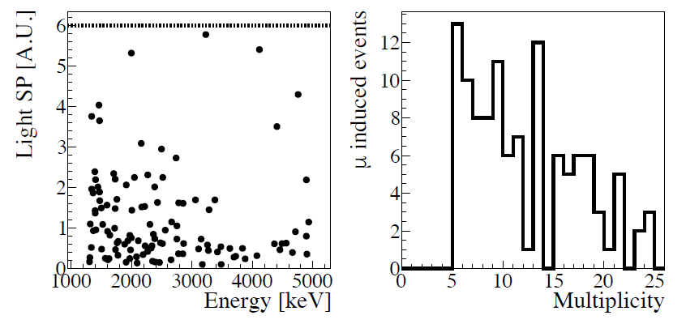
Evaluation of efficiency
Heat
Fit of ⁶⁵Zn Line before/after cuts applied
Light
Cut on events with M>6
  Muonic showers, almost pure beta/gamma sample

Slide 30
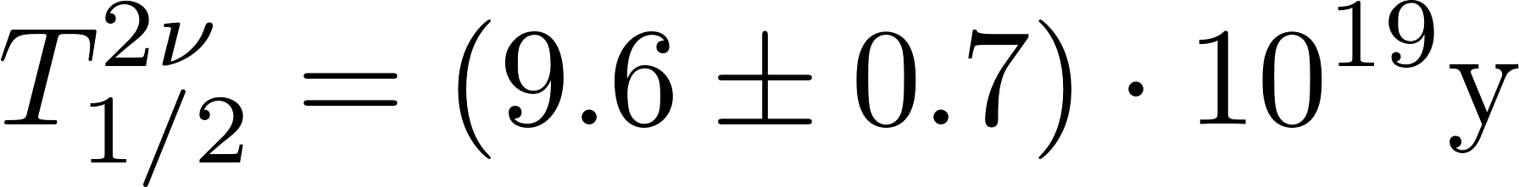
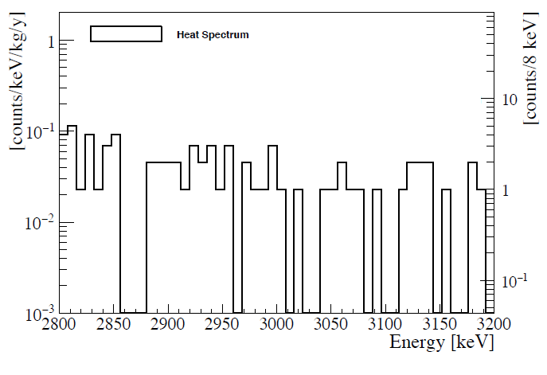
0νββ search
⁶⁵Zn: cosmogenically activated
⁴⁰K and ²⁰⁸Tl: natural radioactivity
2νββ is the dominant background
2νββ
ROI for 0νββ
Basic Selections
Rejection of “non-particle-like” events through pulse shape on thermal pulses
Anti-coincidence between crystals (ΔT=20ms)
  Multiplicity selection

Slide 31
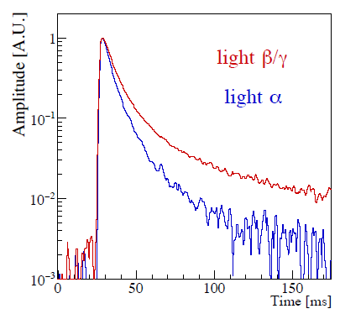
Background – Alpha Rejection
Light Signal depends on particle type
Selection based on light shape parameter
α events
β/γ events

Slide 32
Background – Delayed coincidences rejection
α events
Selection made
Delayed α coincidence ²¹²Bi-²⁰⁸Tl rejection
β/γ events
Veto any event succeeding a ²¹²Bi α event in a 7 half-life window
α pulse shape
2.0 MeV < Energy < 6.5 MeV
  Both peak and surface events

Slide 33
Background model
A full model is needed to undestand the background components
BACKGROUND SOURCES
EXPERIMENTAL DATA
ZnSe crystals
Reflective Foil
Particle type
α events
β/γ events
Bulk
Bulk
Surface
O(10nm)
Surface
O(10mm)
O(10nm)
Multiplicity (M)
Crystals triggered in 20ms
Cryostat
Bulk
Muons
Cu Holder
CryoInt
Roman Lead
Cryo Ext
High Multiplicity
Combined with a Bayesian analysis

Slide 34
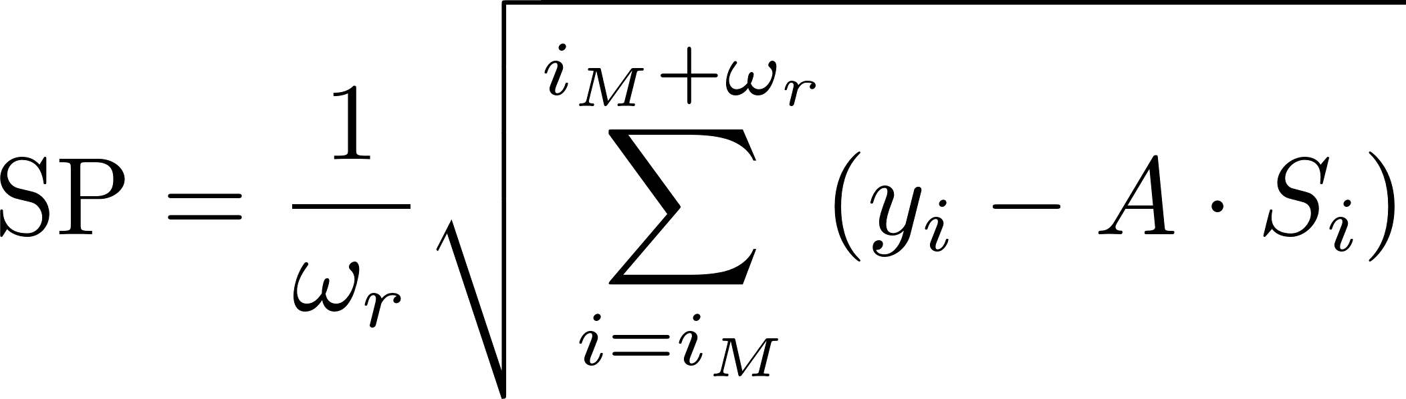
Shape cut for Background Model
α events
yi = filtered light pulse
A = maximum amplitude
Si = filtered average pulse
iM = position of the maximum and
wr = right width at half maximum of Si
Optimized cut:
SP = μ_{α} (E)-3 x σ_{α} (E)
Parameter calculates for SP>6 (pure beta gamma)
β/γ events

Slide 35
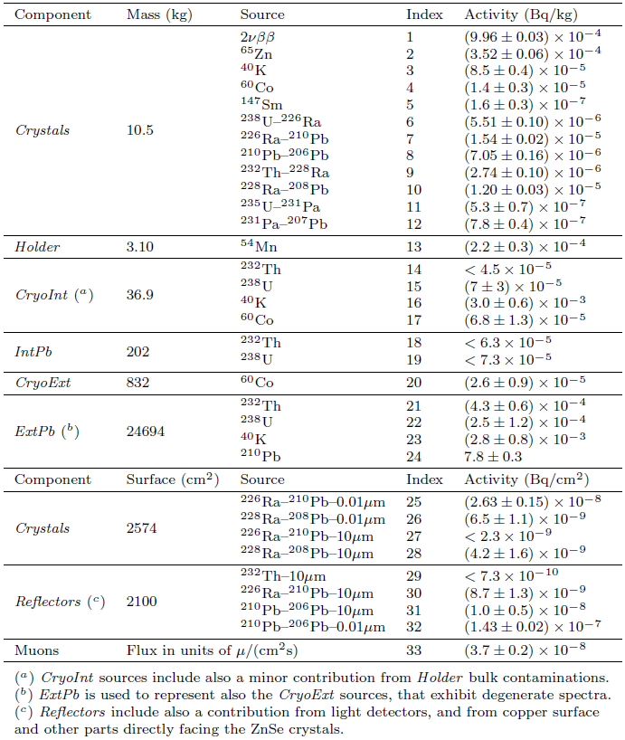
Total Fit Results
Surface
Bulk
Exponential profile

Slide 36
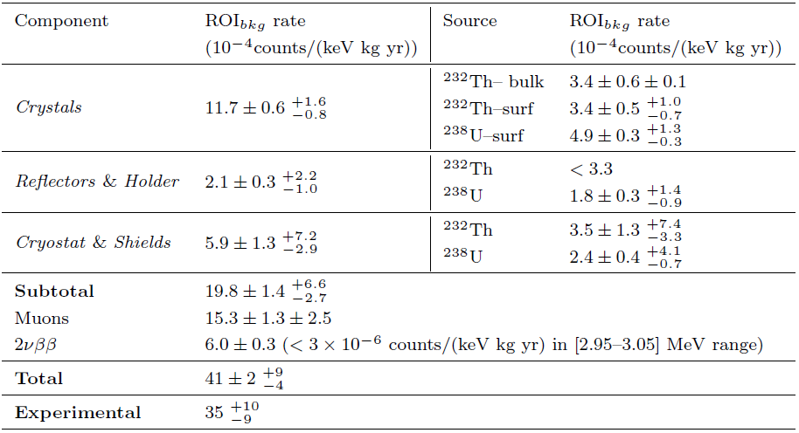
ROI contaminations
After time veto of 7 livetimes

Slide 37
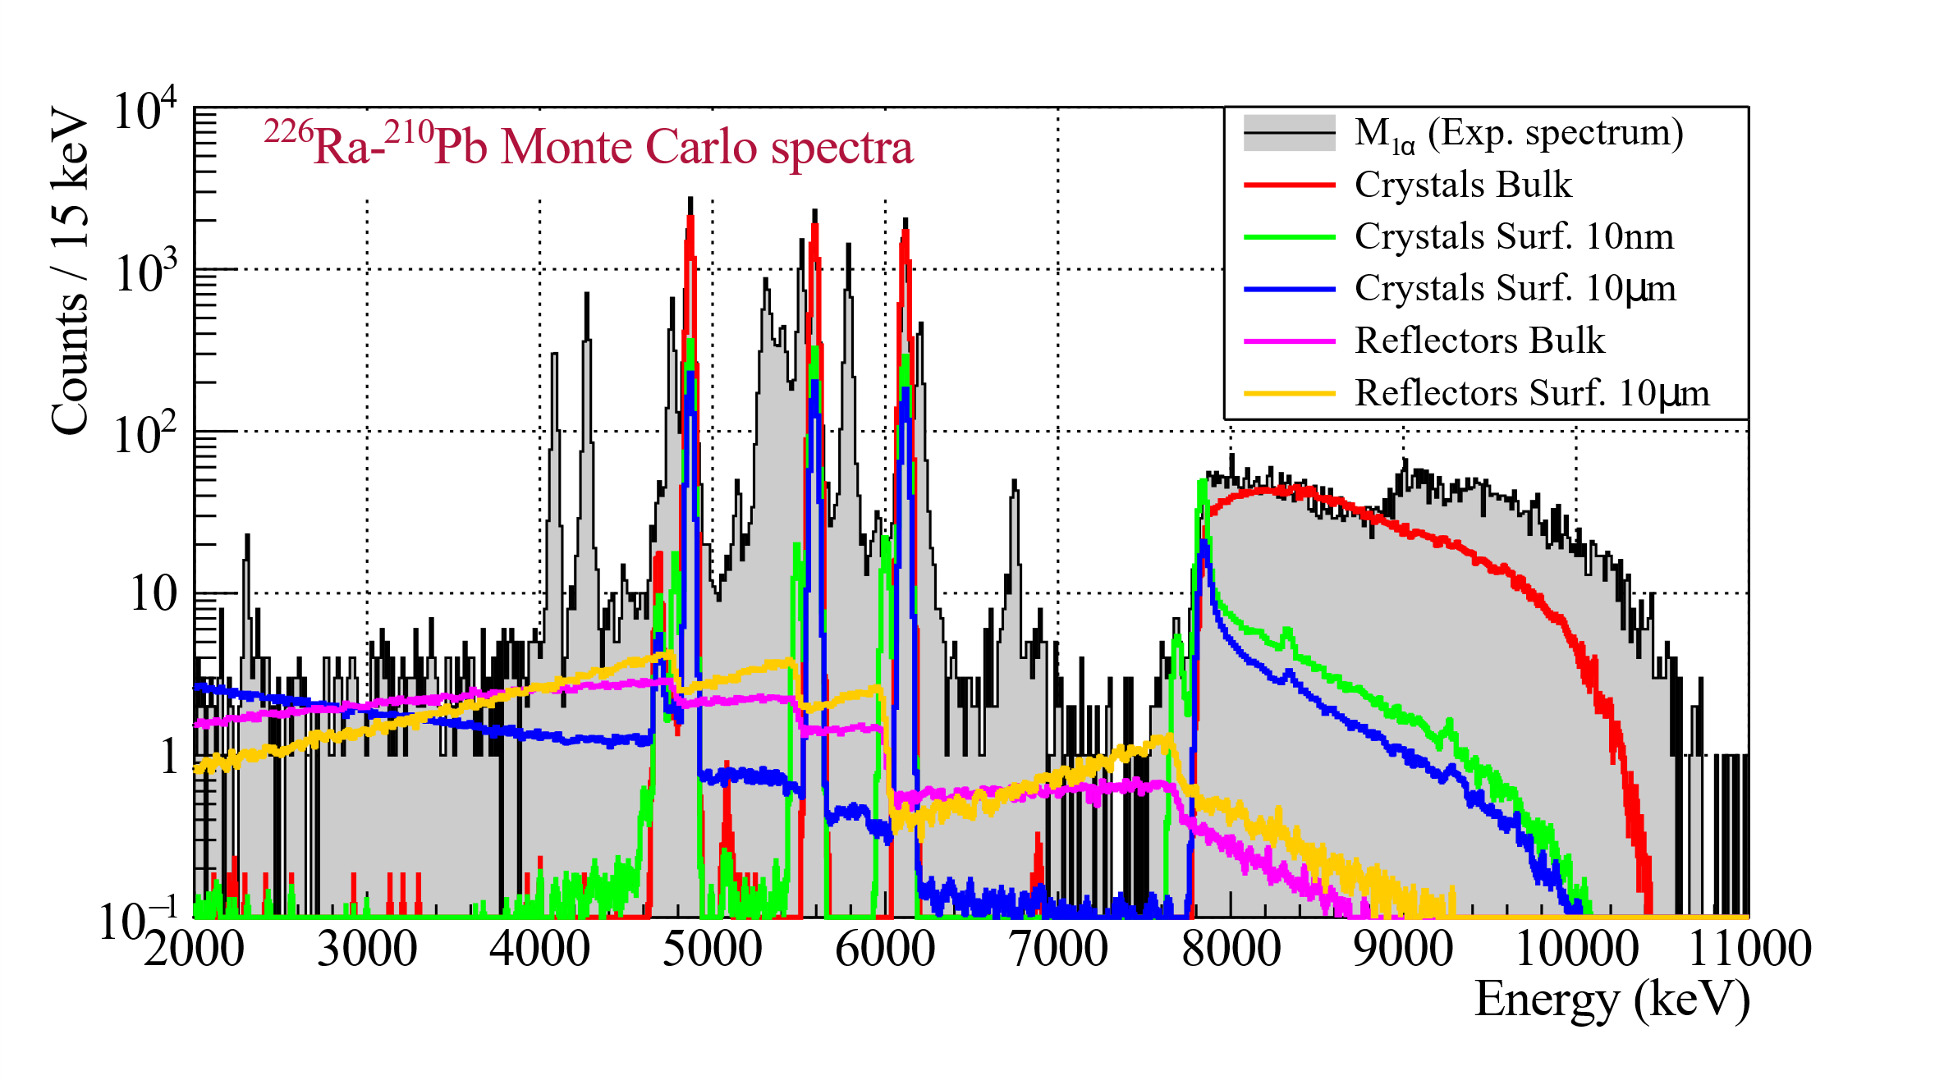
Alpha vs Bulk
Different impact on the continuum

