Slide 1
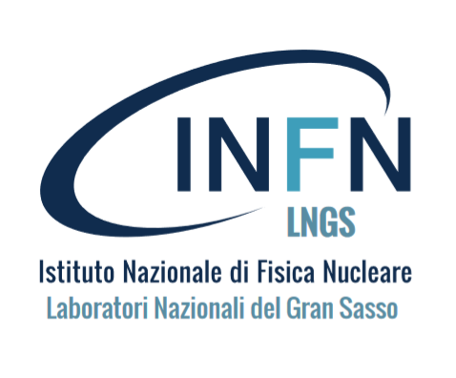



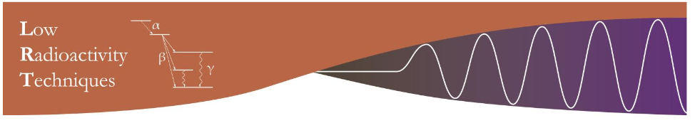
The most modern mechanical technologies and cutting edge radio-analytical techniques merged for extremely low background achievement
S.Nisi, Chemistry Department, Gran Sasso National Laboratory, INFN
D. Orlandi, Advanced Mechanics Service, Gran Sasso National Laboratory, INFN
On behalf of collaboration
20-23May, 2019Jaca, Spain

Slide 2
OUTLINE
Why Low Radioactivity Techniques (LRTs) ?
Additive Manufacturing technologies (AM=“3D printing”)
Aim of this work: new LB Cu components production process
LRTs: tools to ensure the quality control
Conclusions

Slide 3
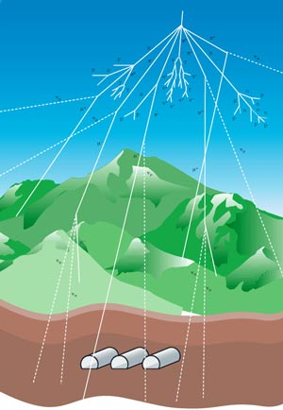
Why Low Radioactivity Technique (LRT) ?
Low Radioactive Techniques are essential to select the materials needed for assembling Low Background (LB) apparata
They are used for screening of semi-finished metal/plastic materials
The final component realization often requires heavy machining
Surface contamination is very critical (often dominant) for LB
Components need final surface treatment and cleaning
NEW APPROACH
LRTs play a fundamental role for production process monitoring
Production of finished components through Additive Manufaturing (AM)

Slide 4
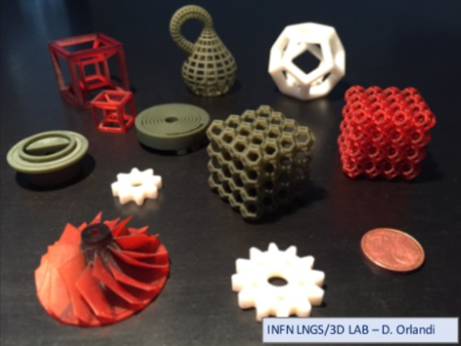
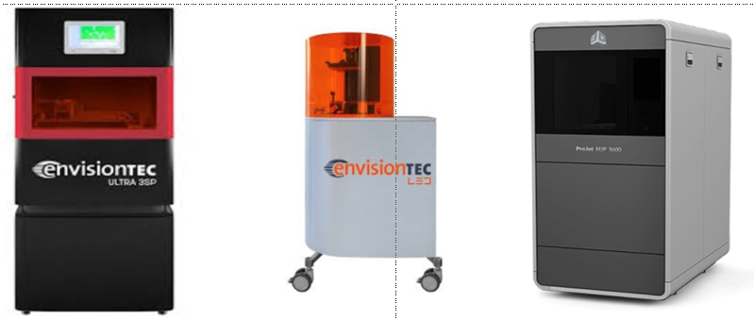
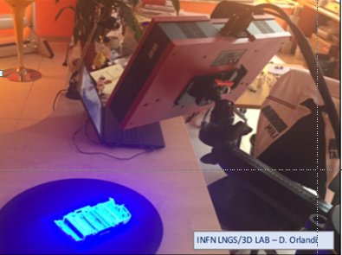
Additive Manufacturing at LNGS
For several years now the Mechanical Workshop is operating 3D printing devices to realize pieces with photo-polymeric and MultiJet Hi-performance thermoplastic resins
Carbon PEEK 3D printing is coming soon
The facility is equipped with a stereoscopic Hi-Res 3D scanning station for quality analysis and reverse engineering

Slide 5
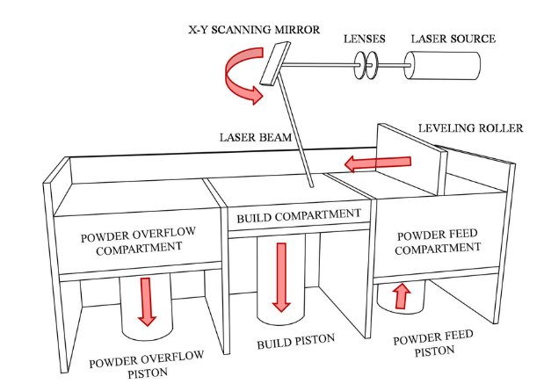
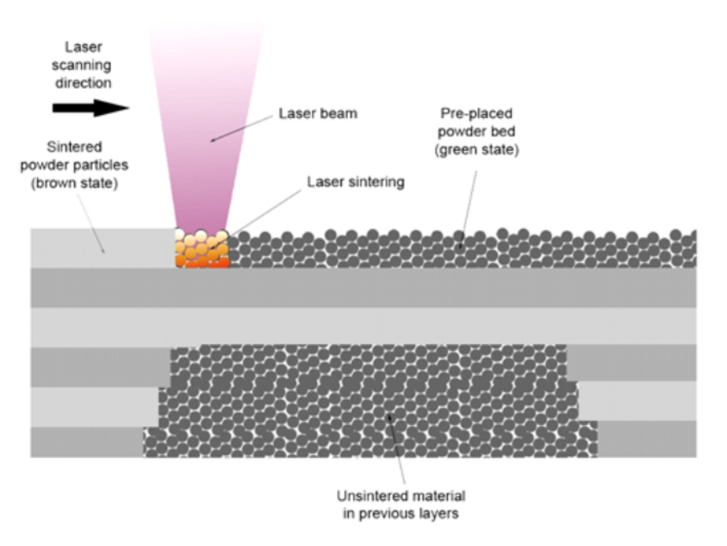
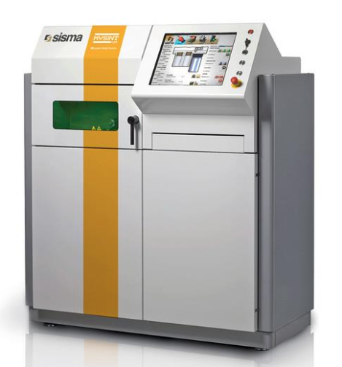
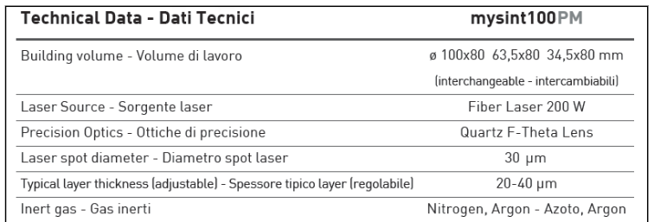
AM: Laser Metal Fusion Technology
Laser beam
scanning
Powder bed
Unsintered material
in previous layers

Slide 6
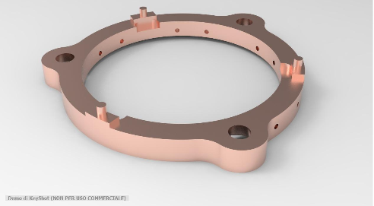
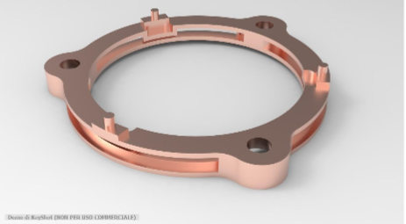
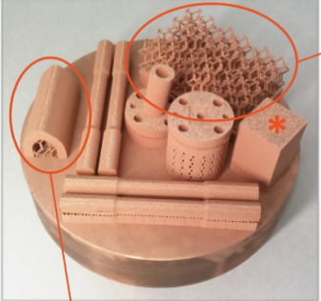
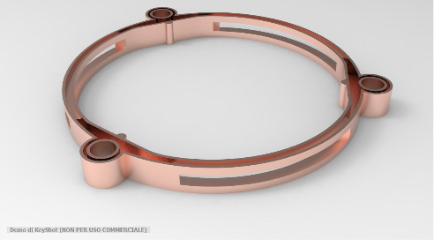
Additive Manufacturing: Future Outlook in Designing Pure Copper Components for particle detectors
AM allows to produce parts:
complex geometries
high Resolution
hollow components
w/o final traditional machining
w/o surface cleaning
mass savings with a factor ≈ 2-3
reduction of number of components
Crystal Holder
Traditional CNC
mass=27g
M/3 !
AM same support
mass=11g
AM new design
mass=9g

Slide 7
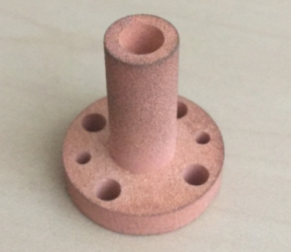
Mechanical and physical properties of pure copper components obtained trough AM
 |  | Raw Cu | Cu AD/Cu Raw
Density (porosity) | gcm⁻³ | 8.93 | 95-97%
Resolution (grain size, laser spot size) | µm | --- | 5-25 µm
Roughness | µm | --- | 5-25 µm
Thermal conductivity Low Temperature | Wm⁻¹k⁻¹ | 390 | 70%
Yield Strengt σ_{0.2} | MPa | 80-120 | 80%
Special post production thermal treatment (HIP:ing at 1000bars at 1150 °C for 120 min) changes the grain size and it enhances the quality of Cu from the mechanical and physical point of view.

Slide 8
Ultrapure Copper component production process
Starting copper
Relatively good quality Cu
is avaible on the market
Copper Electtroforming
EF Purification efficiency has
been already tested
Cu powder production (µm)
Contamination of atomization
has to be investigated but...
STD Cu
Contamination risk
has been preliminary checked
3D printing
Different LRTs are avilable:
ICPMS, ULL-GRS, NAA
Quality control along the flow

Slide 9
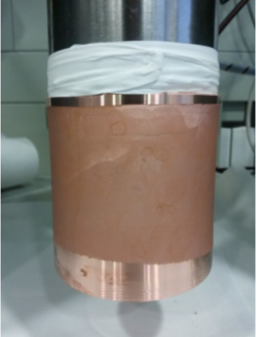
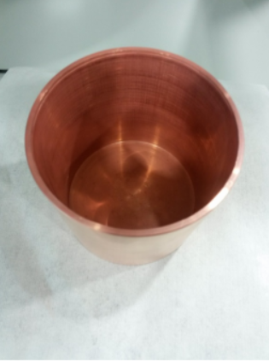
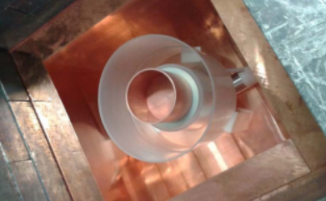
Copper Electroforming facilitiy at LSC
Cu Electroforming allows to produce clean pieces, but relatively simple geometries, it’s time consuming, it needs intermediate and/or final mechanical machining and surface cleaning
EF copper over the mandrel after the first mechanization treatment (left) and the final part (on the right)
EF copper piece over a Marinelli container in the sample cavity a HPGe (GeOroel at LSC)

Slide 10
Purification efficiency of EF at LSC
 |  |  | CURAW2ET.D |  | CUEF2ET.D |  | Removal efficiency
Element | Mass |  | [ ng/g ] |  | [ ng/g ] |  |  | [ % ]
Mn | 55 | ppb | 21 |  | <10 |  | > | 52.38
Fe | 57 | ppb | 13,000 |  | <3000 |  | > | 76.92
Co | 59 | ppb | 1,600 |  | <1 |  | > | 99.94
Ni | 60 | ppb | 26,000 |  | <10 |  | > | 99.96
Zn | 68 | ppb | 70,000 |  | <10 |  | > | 99.99
Ge | 72 | ppb | 5.6 |  | <1 |  | > | 82.14
As | 75 | ppb | 1,300 |  | <100 |  | > | 92.31
Ag | 107 | ppb | 1,000 |  | 240 |  |  | 76.00
Cd | 110 | ppb | 520 |  | <5 |  | > | 99.04
In | 115 | ppb | 75 |  | <2 |  | > | 97.33
Sn | 118 | ppb | 19,000 |  | <5 |  | > | 99.97
Sb | 121 | ppb | 1,900 |  | <5 |  | > | 99.74
Te | 125 | ppb | 66 |  | <5 |  | > | 92.42
Pb | 208 | ppb | 49,000 |  | <50 |  | > | 99.90
Bi | 209 | ppb | 180 |  | <5 |  | > | 97.22
Th | 232 | ppb | <0.010 |  | <0.001 |  |  | ---
U | 238 | ppb | <0.005 |  | <0.001 |  |  | ---
Bulk !

Slide 11
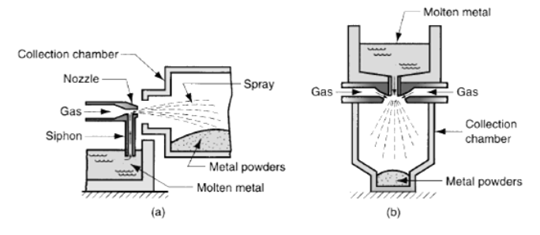
Production of ultrapure Cu powder
by mean atomization technology
Gas technique atomization methods
Atomizer is very expensive outsourcing, but using dedicated pure Cu line

Slide 12
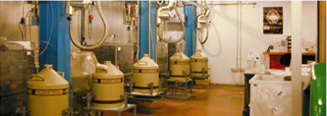
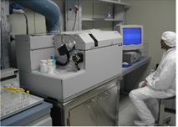
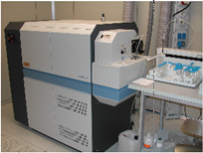
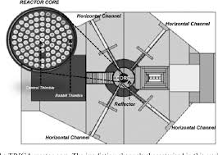
Ultra-low level radioactivity counting facilities
STELLA SubTErranean Low Level Assay
ICP-Mass Spectrometry
ϒ spectrtometry High-Purity Ge Detectors (HPGE)
α spectrometry Silicon PIPS detectors
Liquid scintillation counters
Quadrupole and double focusing ICPMS
ISO 6 Clean room
Regents purification systems
Sample treatment device
Neutron Attivation Anlysis (NAA) Pavia
TRIGA Mark II reactor Pavia University
Radio-Chemical Lab
HPGE at Milan INFN&Univerity
...

Slide 13
LRTs performances comparison
 |  | ICPMS LNGS (LSC) | ULL GRS LNGS (LSC) | ULLGS+NAA Milano-Pavia
 |  | Primordial parents | ϒ emitters | Primordial parents
 |  | Surface/bulk | Bulk | Surface/bulk
Destructive |  | Yes | No | Yes
DL | [ 10⁻¹²g/g ] | Th=0.5 U=0.5 | Th= 10-20 U= 10-20 | Th(²³³Pa)= 0.5 U(²³⁹Np)= 3-5
Sample size | [ g ] | 0.1-10 | 1-10000 | 200
Sample treatment |  | Contamination risk not negligible | Almost free | Hot sample handling Low cont risk
Analysis Time |  | Days | Weeks | Days-week
R&MS are often applied both to check for secular equilibrium of decay chain
ICP-MS allows to perform the quality control of each single part (or lot).
Notes:
In this table the LRTs performances are compared
Cooling time
Pa233=half life 27 days
Np239=half life 2.3 days
Cu66=hal life 5 min
Cu63=half life 12.7 h

Slide 14
Conclusion
AM is a suitable technology to produce complex mechanical components reducing their mass (and background!) up to 70%
AM reduces the risk of contamination during the production process
The purity of Cu powder should improve supplying the atomizer with EF copper
Mechanical and physical properties of the components obtained trough AM are acceptable but they can be improved optimizing the process parameters and applying special post production thermal treatment
The LRTs applied during the production process allow the quality control at sub ppt level (Th, U)
Their sensitivity needs to be further enhanced in order to certify cleaner and cleaner radio-pure material…

Slide 15

... this is the NeverEnding Story (Luckily!)
ppq
ppb
ppqt
ppt
Thank you for your attention !

Slide 17
Abstract
The sensitivity of the experiments, searching for rare and low energy processes which could explain the most fascinating open questions of the modern physic, is limited by the radioactive background of the whole experimental apparatus. Radiometric and non-radiometric cutting edge analytical techniques have already been widely applied for the screening of the materials available on the market. Likely the new frontier of low background experiments requires new materials development, suitably studied, in order to match the thermal, mechanical and radio-purity performances needed in this field of physic.
The recent and rapid diffusion of 3D printing technologies allows producing plastic and metal parts characterized by complex geometry and reduced weight in comparison to the same structural parts obtained by traditional machining. In this project 3D printing, supported by high sensitivity analytical techniques such as ICPMS, ULL-GRS and NAA, will help the achievement of very low background conditions. The monitoring of the purity of the material during the production starting by the metal or polymer to the finished object will be discussed.
HAMMER Hub for Additive Manufacturing, Materials Engineering & Research Donato Orlandi (INFN LNGS) - Valerio Pettinacci (INFN Rome) - Stefano Nisi (INFN LNGS) - Matthias Laubenstein (INFN LNGS)

