Slide 1
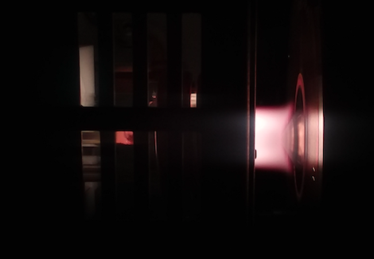
Study of surface contamination on ultralow background (ULB) materials
Maria Laura di Vacri
Low Radioactivity Techniques 2019

Slide 2
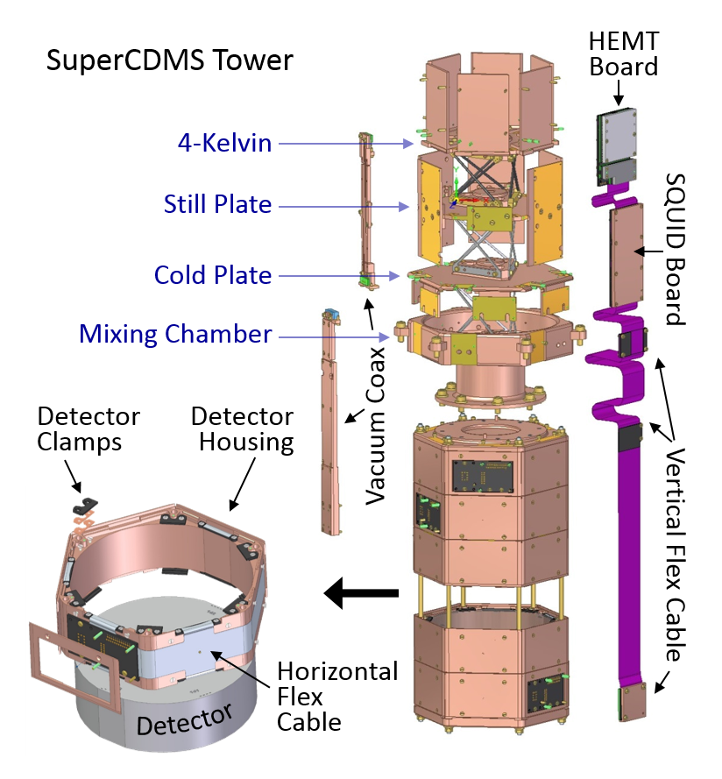
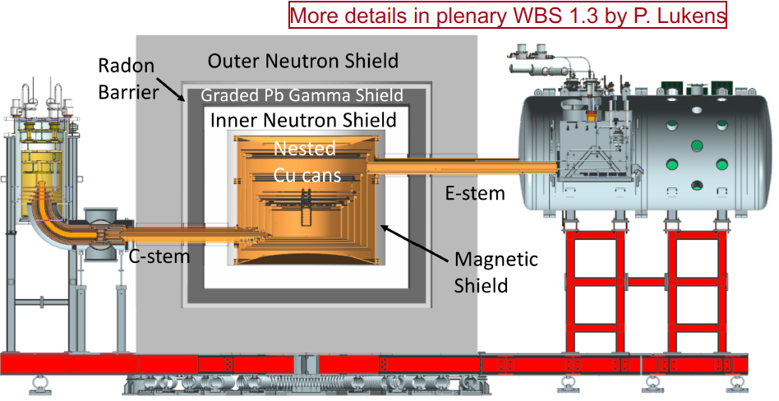
Detector components and surrounding materials:
a significant background source
SuperCDMS SNOLAB detector

Slide 3
The usual suspects
Uranium-238
Thorium-232

Slide 4
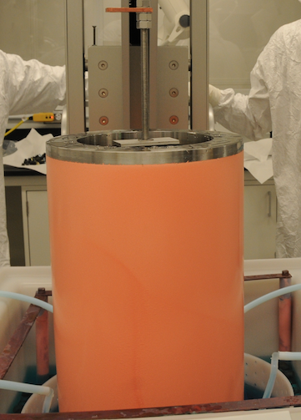
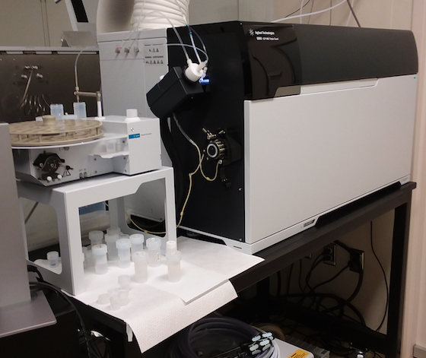
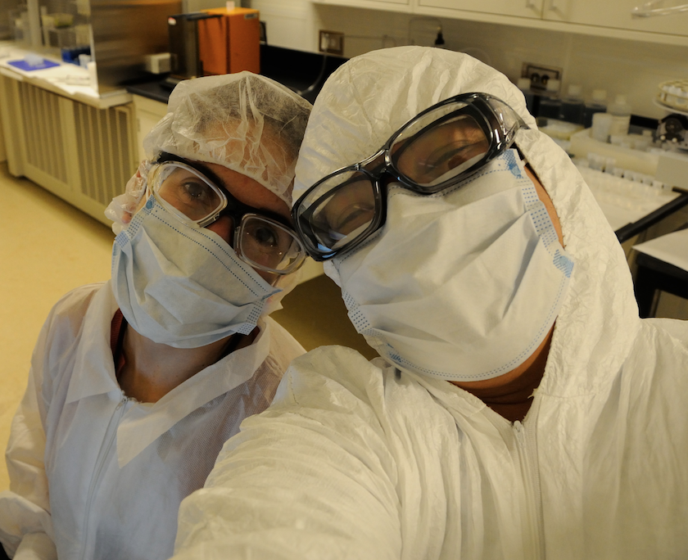
Validation of all materials: a challenging task
→ Extremely stringent radiopurity requirements
μBq/kg
range or lower
For reference:
1 ppt Th = 4.1 μBq ²³²Th/kg
1 ppt U =12.4 μBq ²³⁸U/kg
Meticulously clean analytical procedure specifically developed
R&D to develop ultrapure materials (i.e., electroformed copper)
Ultra sensitive analytical techniques
Dedicated facilities

Slide 5
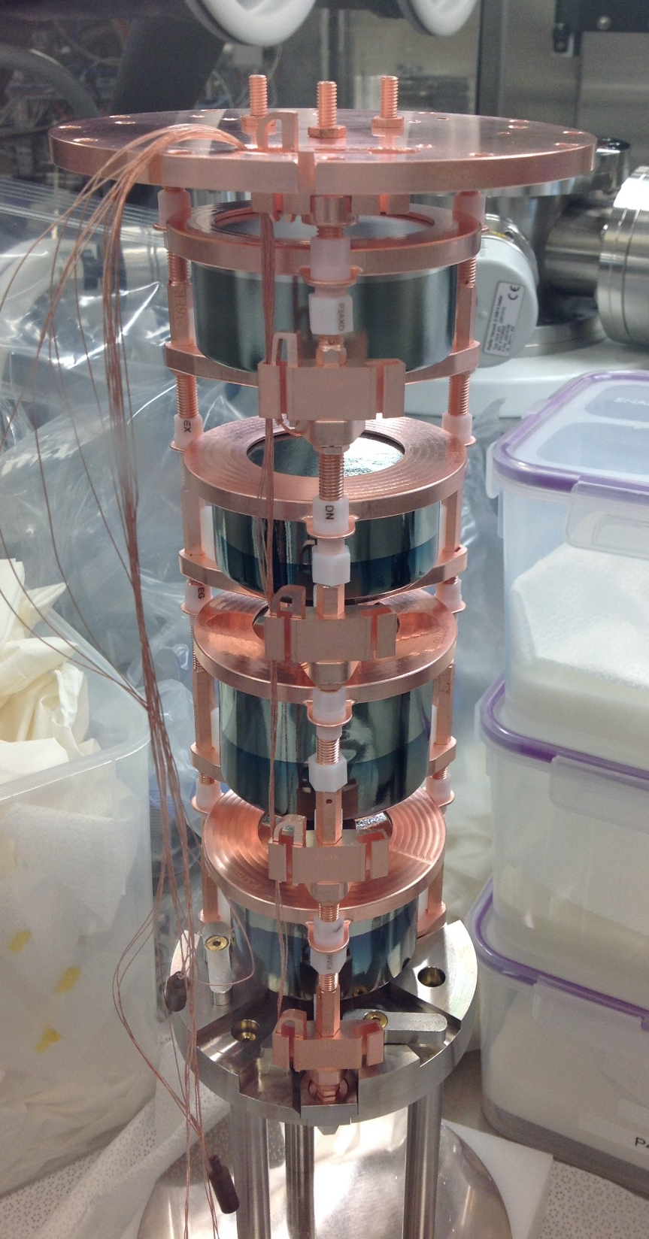
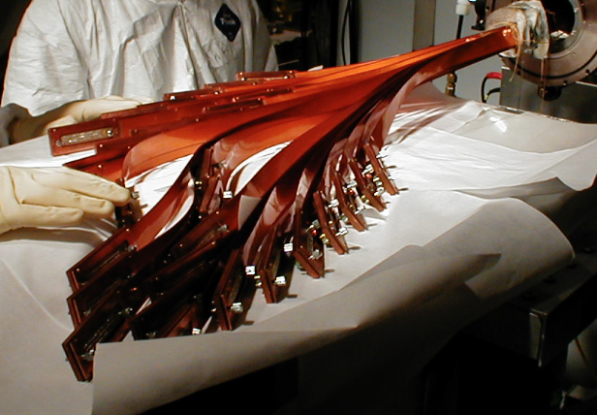
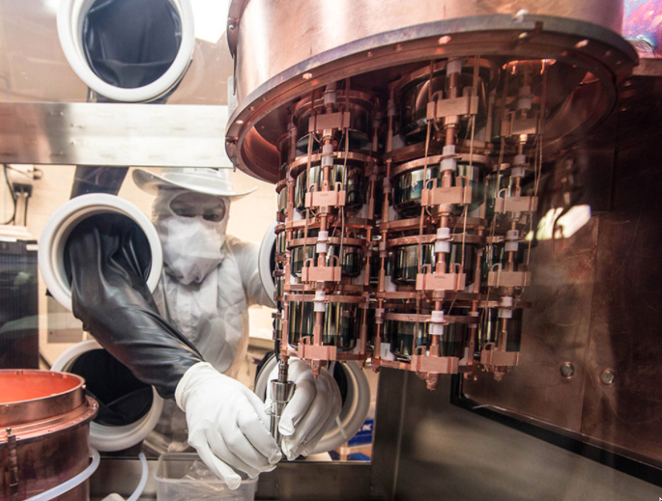
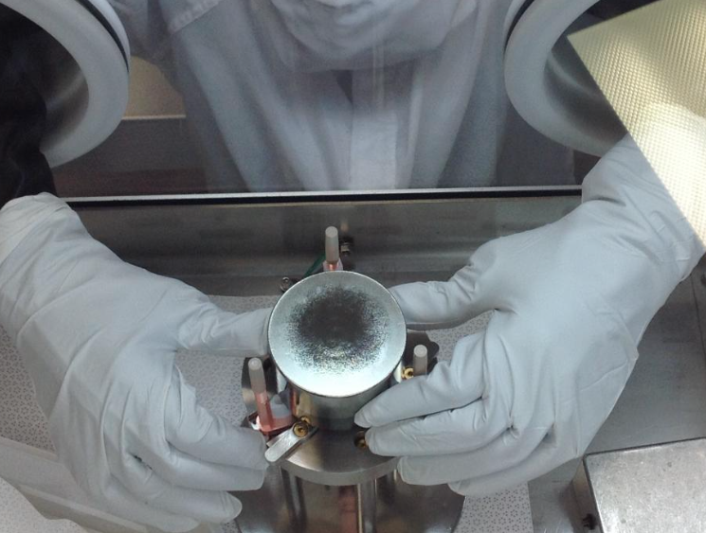
After validation, will materials remain “ultraclean” forever?
Surface contamination!
Manufacturing and processing
Handling for assembly
Machining
Moving and storage
Exposure to dust, even in clean rooms!

Slide 6
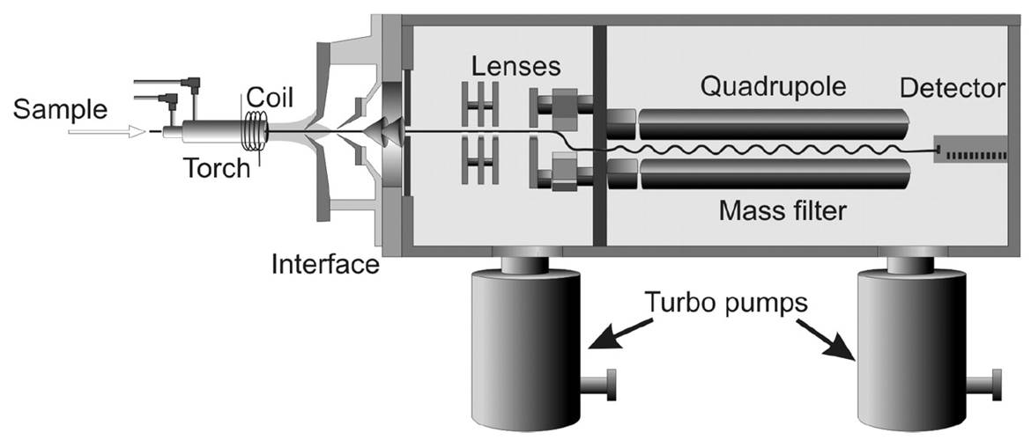
ICP-MS: a powerful tool
Direct, fast, quantitative
Surface and bulk
Understanding
Identifying rather than observing (too late!)
Quantifying and controlling

Slide 7
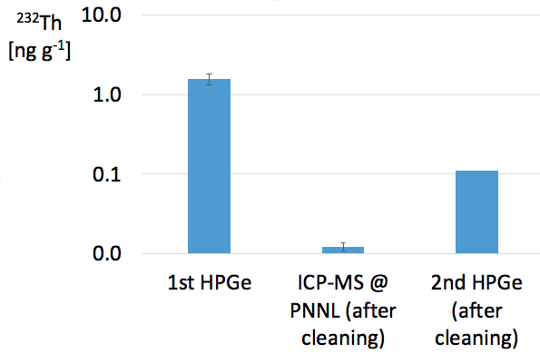
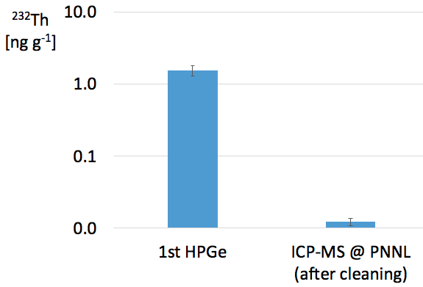
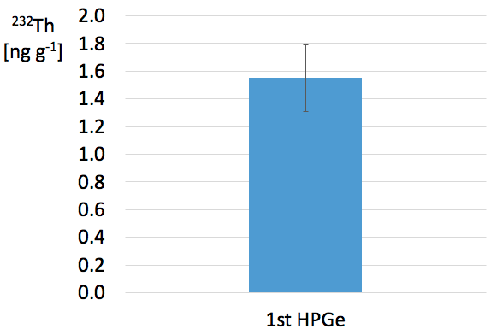
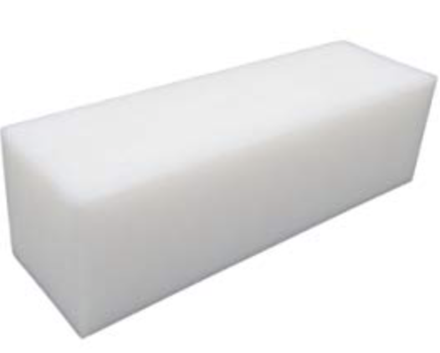
Machining, handling, exposure to dust
2868 ng
22.6 ng
<204 ng
Block of HDPE:
1850 g
1600 cm²
< upper limit
→
2845 ng, or 2.8 μg, of ²³²Th to account for
←

Slide 8
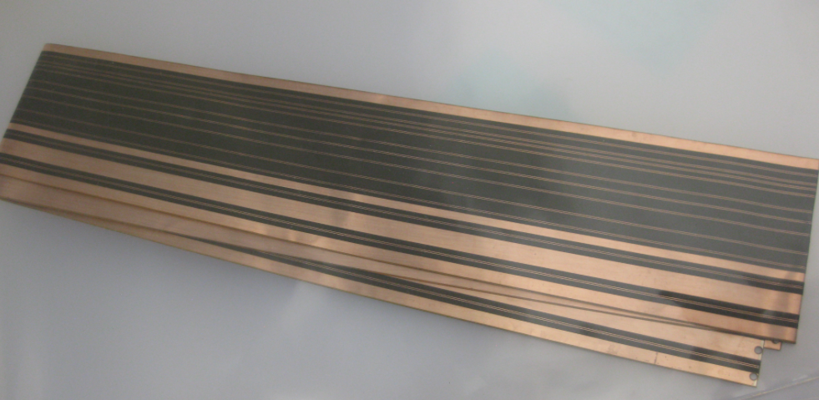
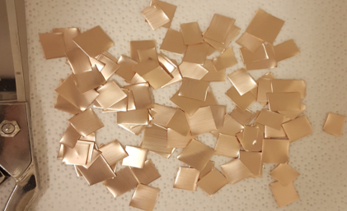
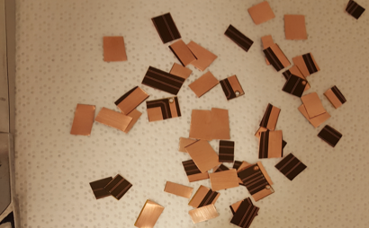
Manufacturing and processing
Flex cable
Polyimide (PI)/Cu laminate
Finished cable
 | ²³²Th | ²³⁸U
 | ppt | ppt
PI/Cu laminate | 8.06 ± 6.30 | 8.72 ± 3.43
Finished cable (whole sample analysis) | 62.8 ±5.2 | 6164 ± 112
2% HNO₃ solution, 30 sec
Leachate analysis, normalized to sample mass
 | ²³²Th | ²³⁸U
 | ppt | ppt
From leach 1 | 40.4 ± 3.0 | 7071 ± 1065
From leach 2 | 2.29 ± 0.13 | 40.2 ± 12.9
From leach 3 | 1.34 ± 0.58 | 16.5 ± 5.8
 | ²³²Th | ²³⁸U
 | ppt | ppt
Leached sample | 35.4 ± 2.9 | 55.1 ± 16.6

Slide 9
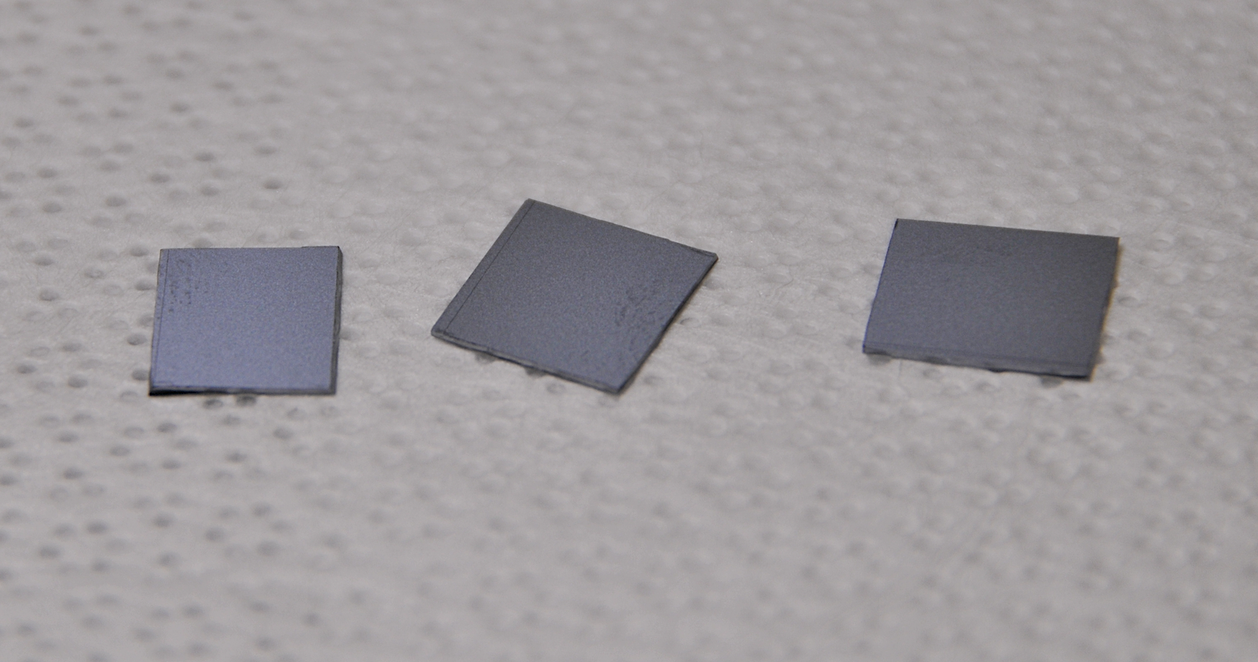
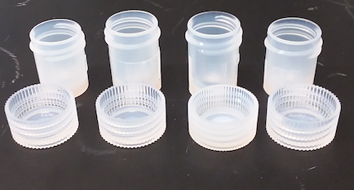
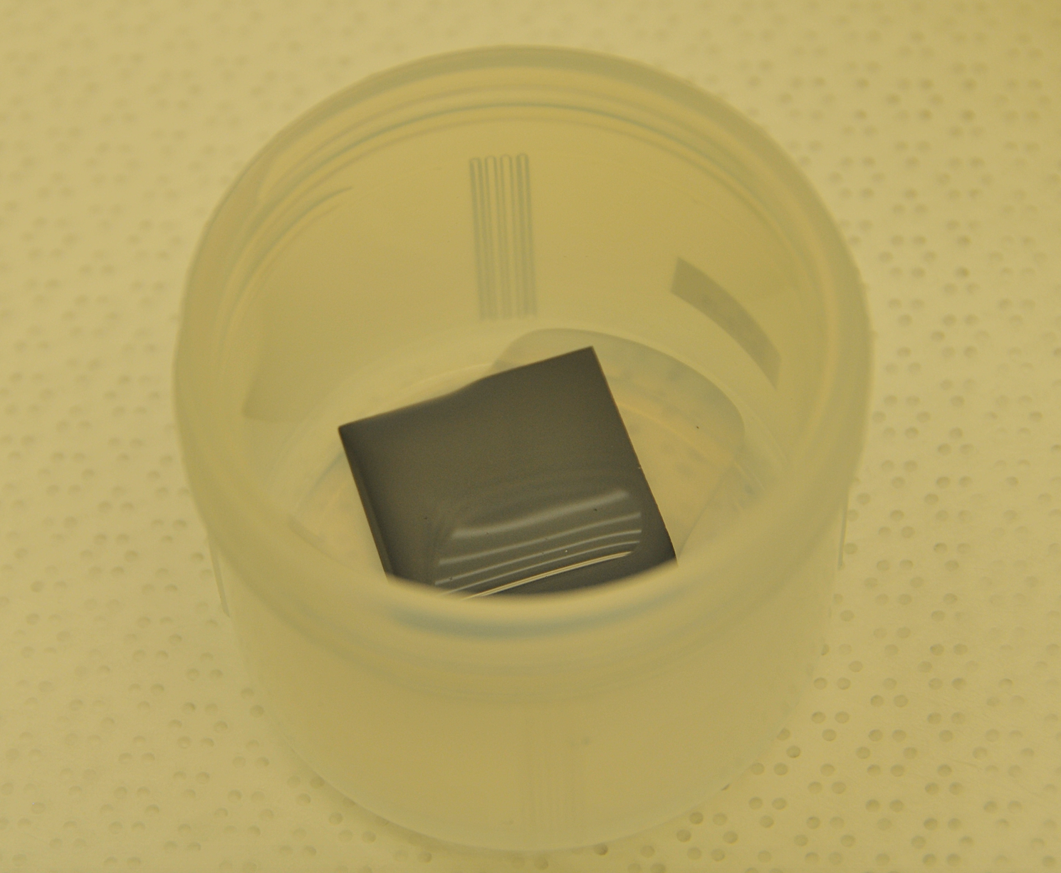
Exposure to dust: direct measurement of dust activity
Surface exposure
Surface leaching
Quantitative analysis
Silicon
PFA (Perfluoroalkoxy alkane)

Slide 10
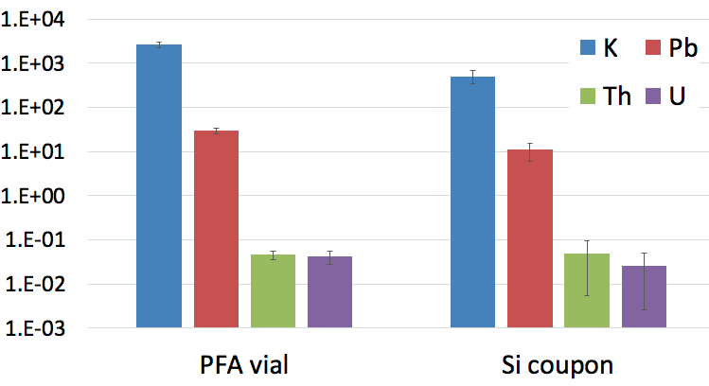
Measured accumulation rate on PFA and Si surfaces
[fg day⁻¹ cm²]
For reference
1 fg = 10⁻¹⁵ g
Class 10000 clean room at PNNL, 29 day exposure

Slide 11
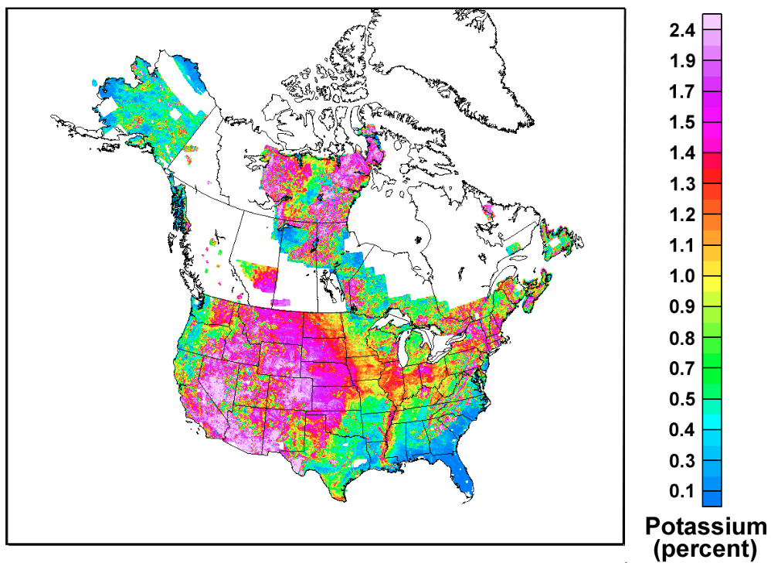

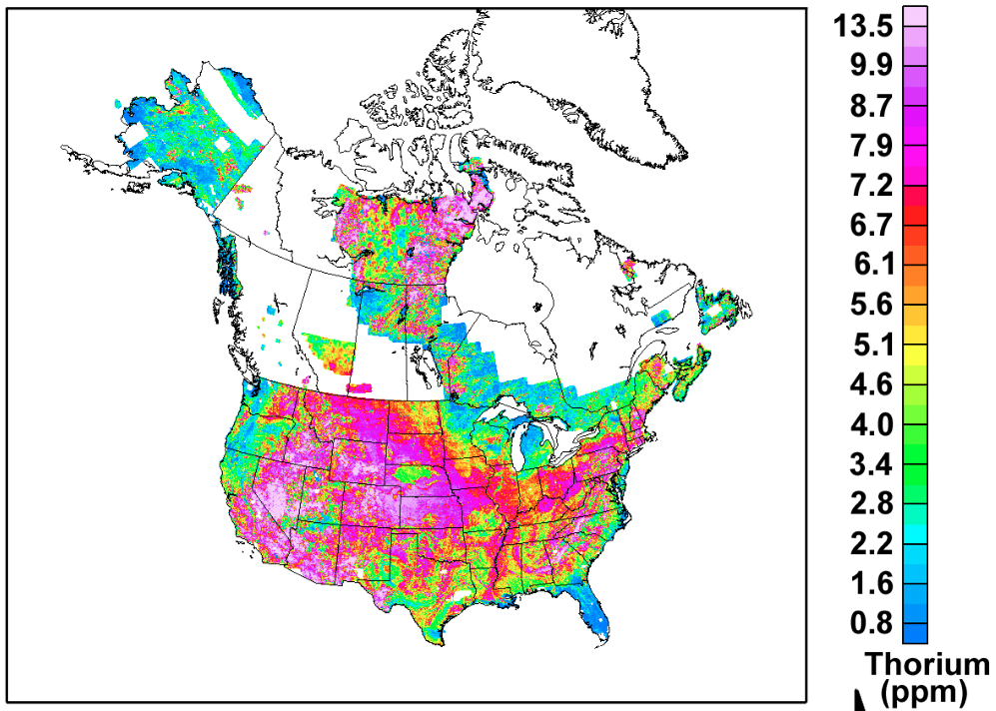
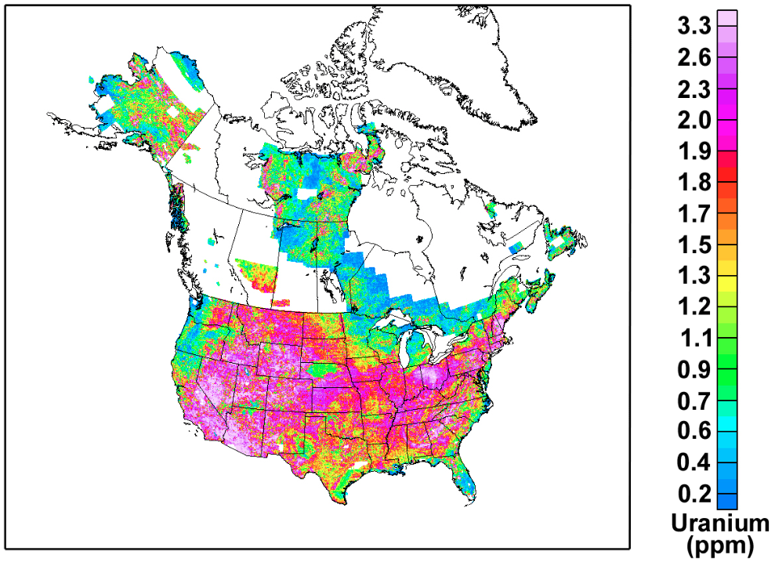
K ~ 1.4 E+4 ppm
Th ~ 7.2 ppm
U ~ 1.2 ppm
PNNL
K ~ 99.94 %
Th ~ 0.051%
U ~ 0.009%
Source: https://pubs.usgs.gov/of/2005/1413/maps.htm
Notes:
US Geological Survey.

Slide 12
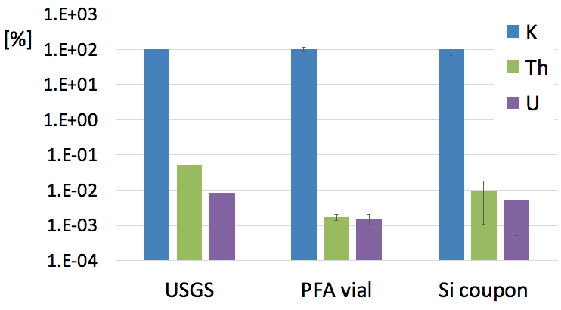
K, Th and U relative content in dust (%)
Notes:
In this plot I have reported a comparison between the measured content of K Th and U in the dust of a 10000 Class clean room (PFA and Si) and the content in the soil of that geographic area reported by the USGS.

Slide 13
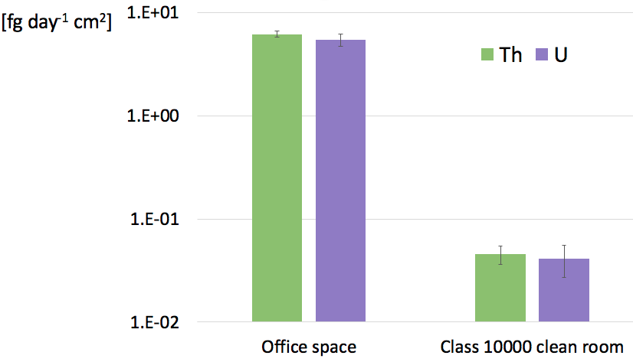
Room air – Class 10000 clean room comparison
Accumulation rate scaling of 100X, as expected
Exposure in a Class 10 area (30 days) : instrumental background level
PFA surface, 30 day exposure
Notes:
I have also compared data obtained from PFA surface exposure in a 10000 Class clean room.

Slide 14
Summary
2.8 μg of ²³²Th (→ ~1g dust???) on HDPE block surface
  Removed with specific cleaning procedure
  ICP-MS → material assay at ppt levels, not an upper limit
~6 ng g⁻¹ of ²³⁸U measured in a flex cable
  Leaching + ICP-MS:
    Identification: ²³⁸U localized on the surface
    Reduction: 1st 30 sec mild leaching pulled out all ²³⁸U surface contamination
ICP-MS: first direct measurement of dust activity
  Relative contribution from K, Th and U
  Deposition rate

Slide 15
In conclusion
Surface contamination: a potentially limiting source of background
How can we support ULB detectors?
ICP-MS: a very powerful technique
  Rapid, direct identification and quantitation
  Developing procedures to control and reduce:
    Cleaning
    Working with manufacturer
Dust activity measurement
  Contribution to contamination from exposure to dust (even in clean rooms!)
  Study of contribution in significant locations
    Valuable for planning assembly and installation of detectors
    Collaboration with underground labs, work in progress for a publication

Slide 16
DOE Detector R&D for High Energy Physics (KA-25)
Sonia Alcantar
Khadouja Harouaka
Notes:
More funding source to thank?

Slide 17
BACK UP SLIDES

Slide 18
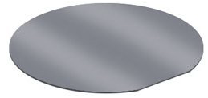
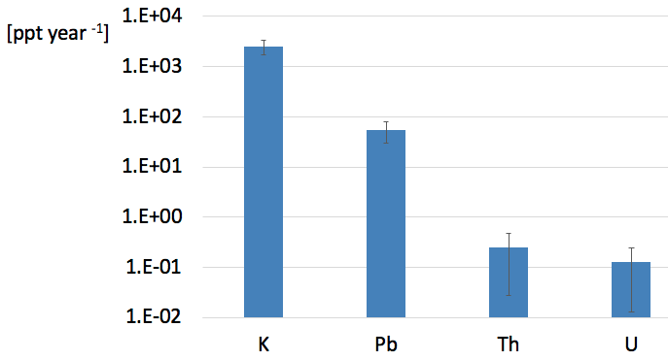
1 year exposure in a Class 10000 clean room
Si wafer
Surface ~ 700 cm²
Thickness 0.77 mm
Density 2.33 g cm⁻³
https://www.svmi.com/silicon-wafers/300mm-wafers/

Slide 19
