Slide 1
Measuring cosmogenic activation rates in active detector material
Richard Saldanha
(Presented by Ariel Matalon)

Slide 2
Cosmogenic Activation
Radioactive isotopes produced by cosmogenic particle interactions in detector materials can be one of the leading sources of backgrounds in rare event searches
Understanding the production rate of these isotopes is extremely important in order to evaluate the total surface residency time, transportation options, and storage requirements for low background detector components
Small production rates and low energy decays of interest for next generation dark matter experiments (tritium, ³⁹Ar) make it difficult to measure sea-level activation without building a full-scale experiment

Slide 3
Measurement Technique
Use high intensity neutron beam to increase production rate compared to sea-level cosmic rays
Irradiate active detector materials and use self-counting techniques to measure low-energy beta decays and x-rays
Extrapolate from measured activity to expected sea-level cosmogenic production rate

Slide 4
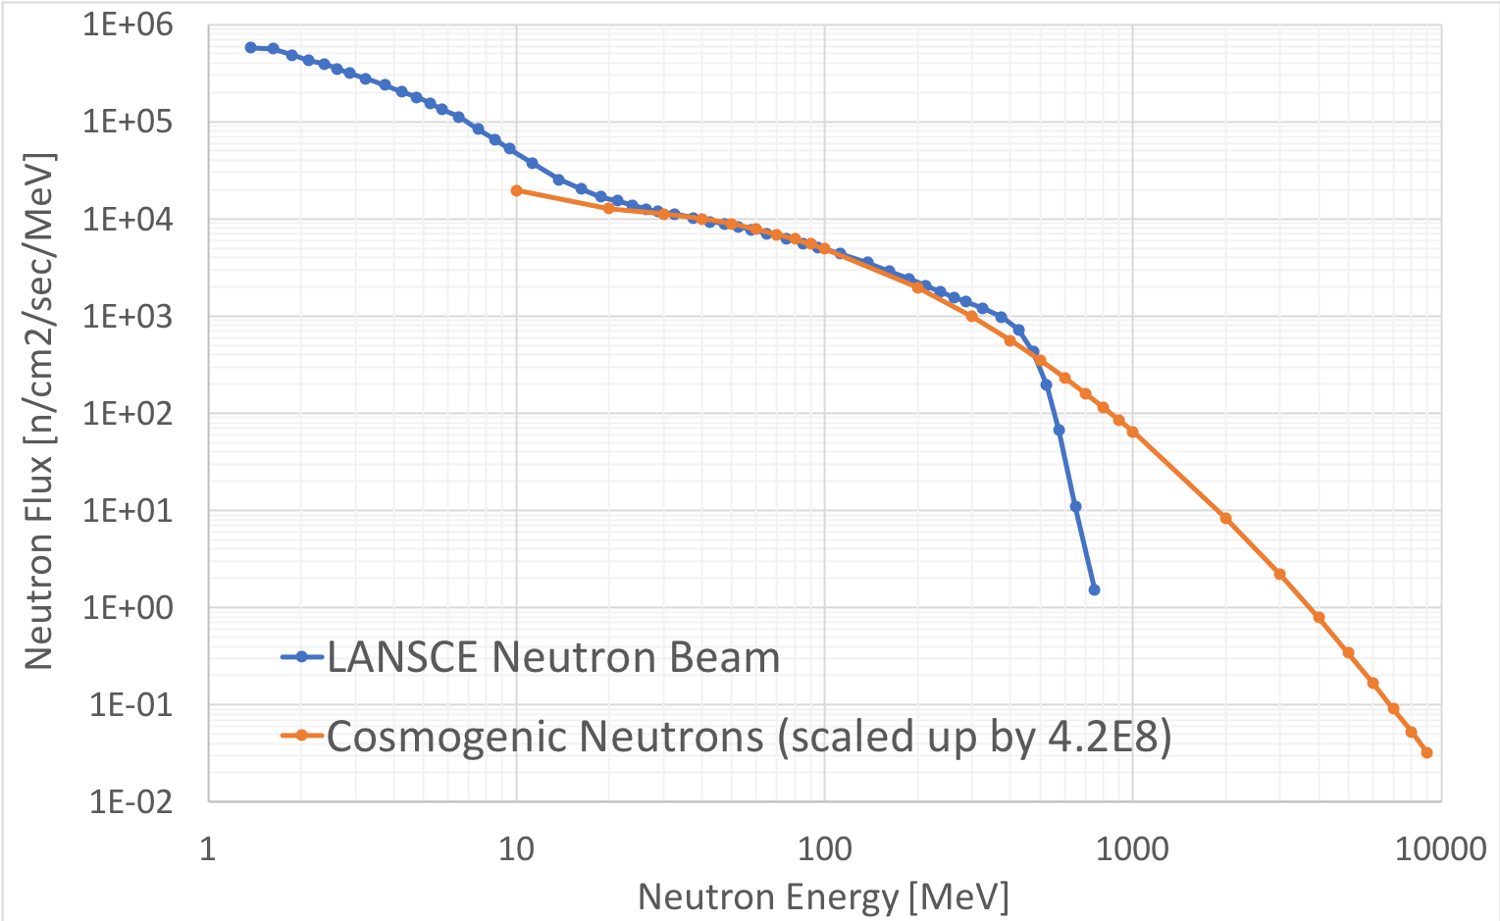
LANSCE ICE-HOUSE Neutron Beam
Los Alamos Neutron Science Center (LANSCE) Weapons Neutron Research (WNR) Facility
has a neutron beam (4FP30R ICE-HOUSE II)
that is very similar in spectral shape to the cosmic ray spectrum
The good agreement in spectral shape between 10–500 MeV allows for low-uncertainty extrapolations to cosmic ray activation rates
The neutron flux is roughly 4.2x10⁸ times larger than the sea-level cosmic neutron flux
1 second on beam
~ 13 years on the surface

Slide 5


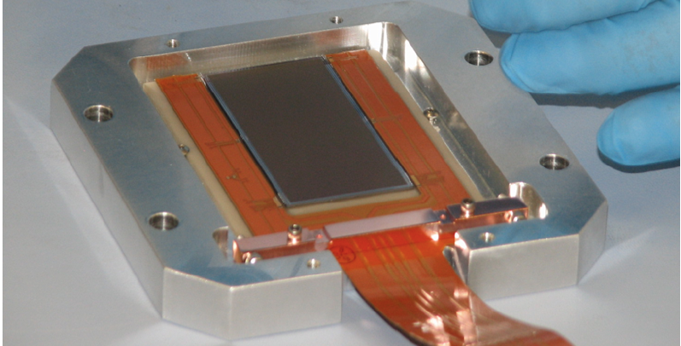
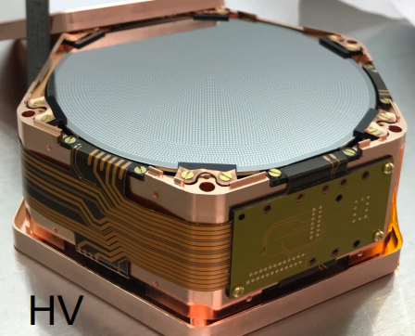
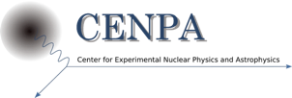

Activation Measurements for
Dark Matter Experiments
³⁹Ar, ³⁷Ar in Argon
³H (Tritium), ⁷Be, ²²Na in Silicon
³H (Tritium), ¹⁰⁹Cd in Sodium Iodide

Slide 6
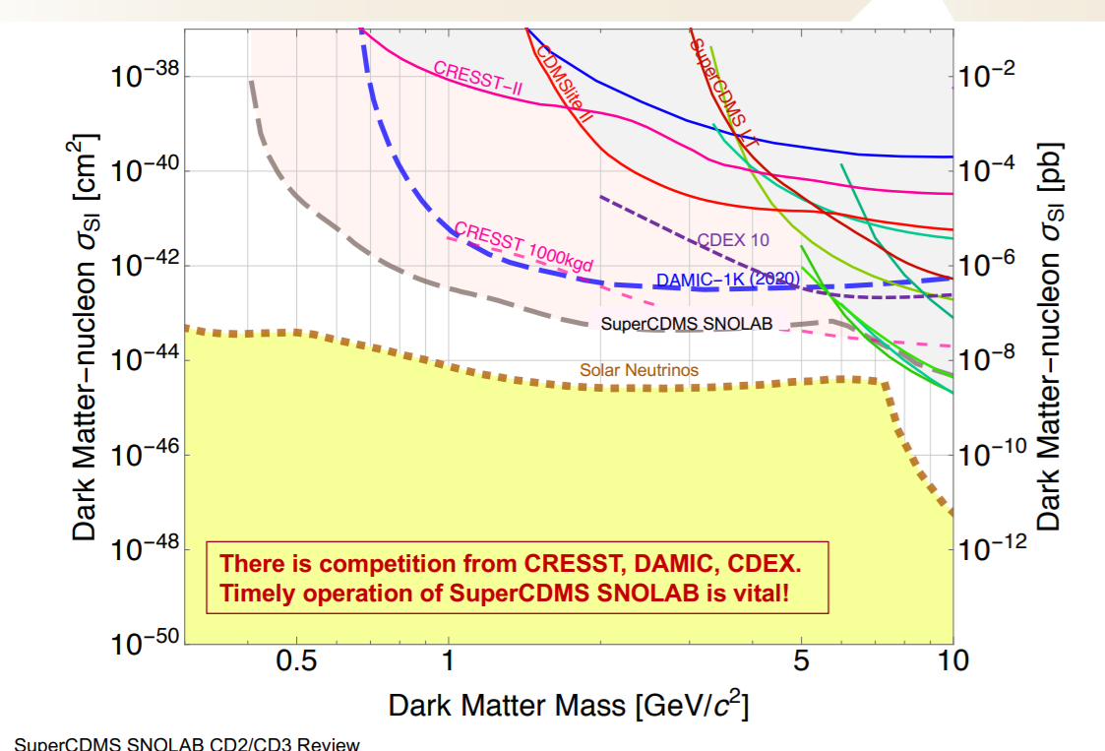
Silicon-Based Dark Matter Detectors
Silicon detectors are poised to make a huge leap in sensitivity
to low mass dark matter
Talk on May 23
15:50-16:10 !
DAMIC CCDs
Dark Matter – Nucleon Cross Section [cm²]
Solid curves = current results
Dashed curves = projected sensitivities
SuperCDMS (phonons)

Slide 7
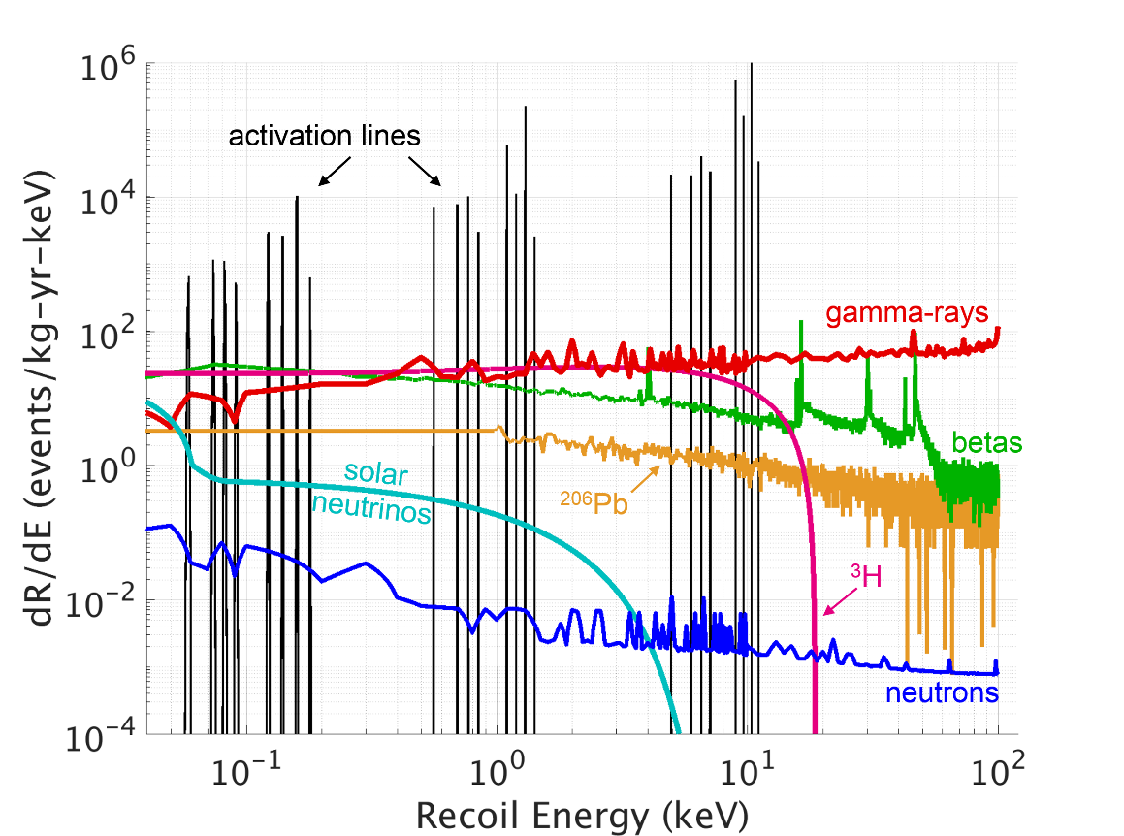

Tritium Background in Silicon
Tritium betas are dominant source of background
in low-energy signal region!
Tritium is spallation product from cosmic-ray neutrons.
Produced in detectors during above-ground detector fabrication prior to installation underground.
New SuperCDMS “High Voltage” detectors and DAMIC CCDs do not reject electron-recoil backgrounds for nuclear-recoil searches.
Possible dark matter signals also in electron-recoil channel.
Spectrum is before analysis cuts;
detector-surface “betas”
rejected by fiducial cuts
Activation lines for
Ge detectors only
Tritium beta decay is a very important background consideration.
²²Na and ⁷Be are also relevant

Slide 8
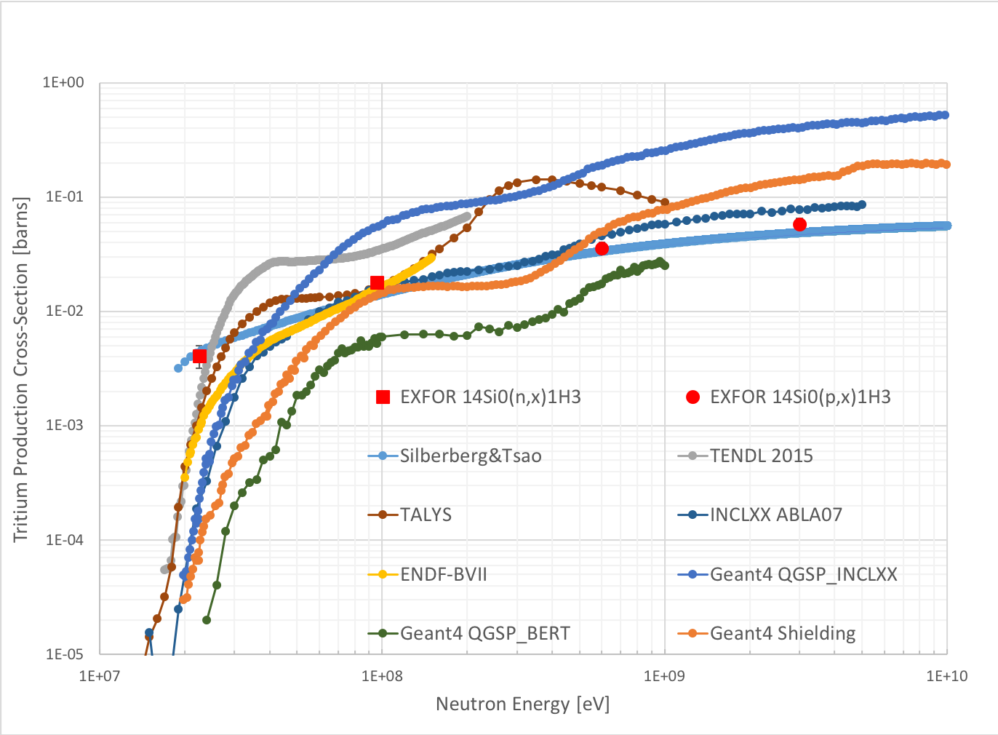
Tritium Production Cross-Sections
Very limited experimental cross-section measurements for tritium production
Estimates from nuclear databases and empirical calculations show significant spread
~8x variation in predicted tritium production rate
Can we directly measure the production rate through detection of low energy (Q = 18.6 keV) tritium beta decays?
Experimental Plan:
Irradiate silicon CCDs on LANSCE neutron beam and then self-count tritium activity in CCD bulk

Slide 9
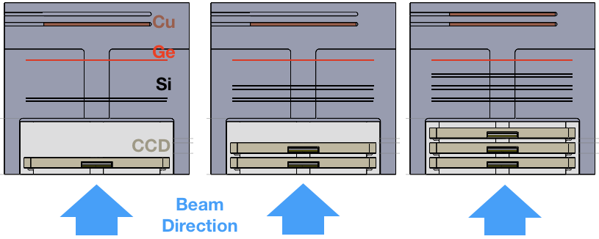
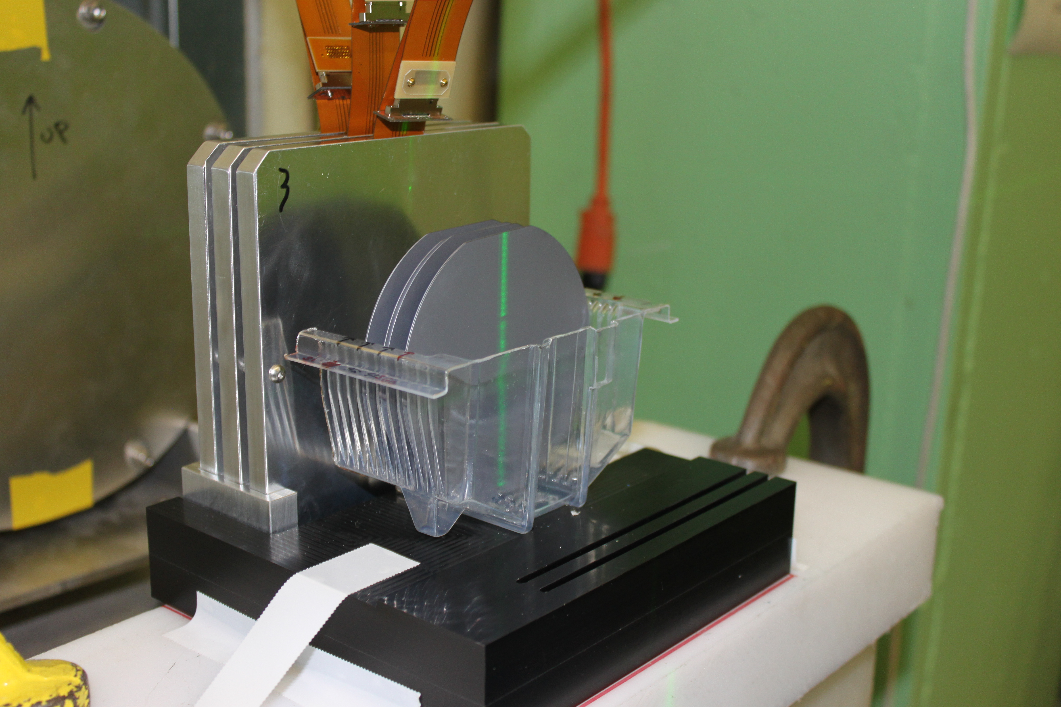
CCD Beam Irradiation
CCD and readout can undergo radiation damage in beam affecting dark current and charge transfer
Based on previous tests with SNAP CCDs* we aimed to keep maximum dose < 2x10⁸ MeV/g
1” beam profile was chosen to minimize irradiation of registers at CCD edges
We used 3 CCDs with staggered exposures to ensure we had at least one CCD that survived

Slide 10
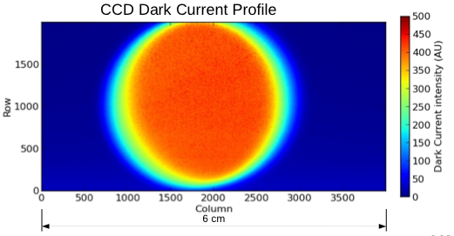
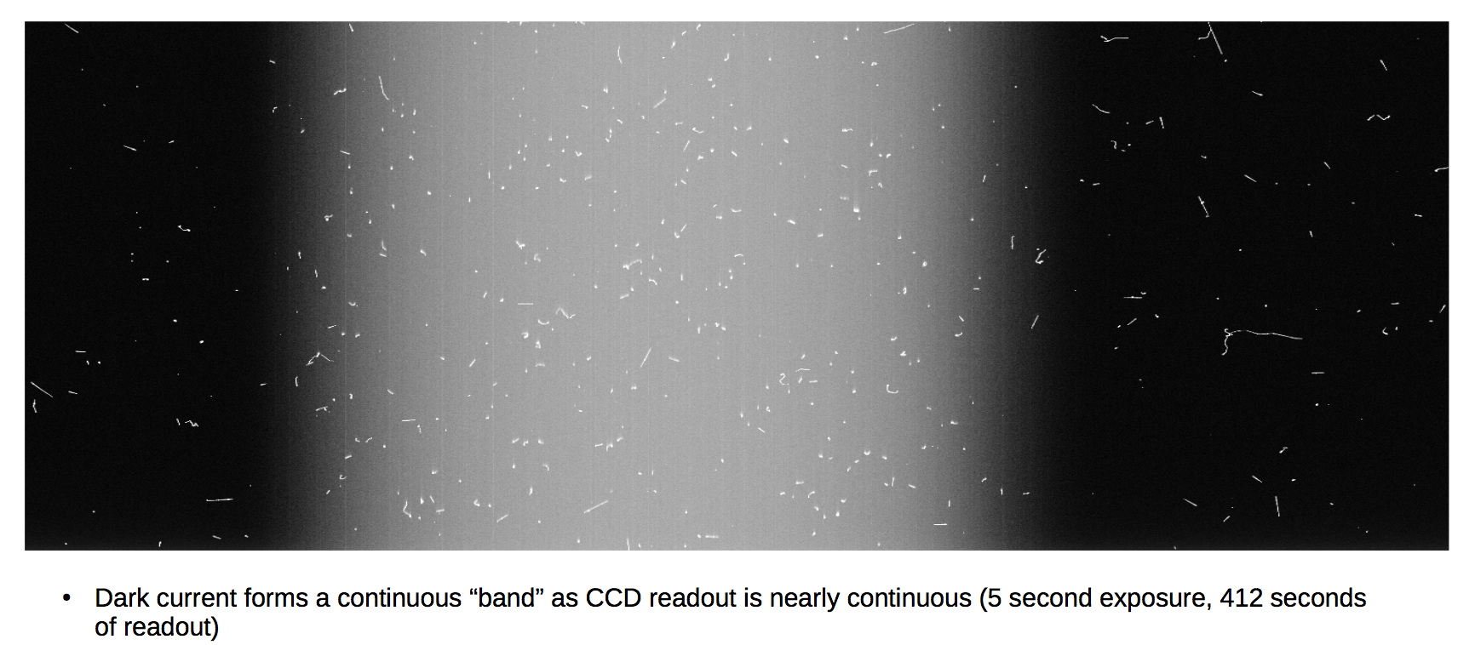
CCD Beam Irradiation
Dark Current matches neutron beam profile
Dark Current
Before Activation: < 3x10⁻⁵ e-/pix/hr
After Activation: ~ 1500-2000 e-/pix/hr
Beam spot region shows higher activity in CCD images
Notes:
Constructed by taking the median dark current value of several 600 second exposures and subtracting off the median of zero-second exposures

Slide 11
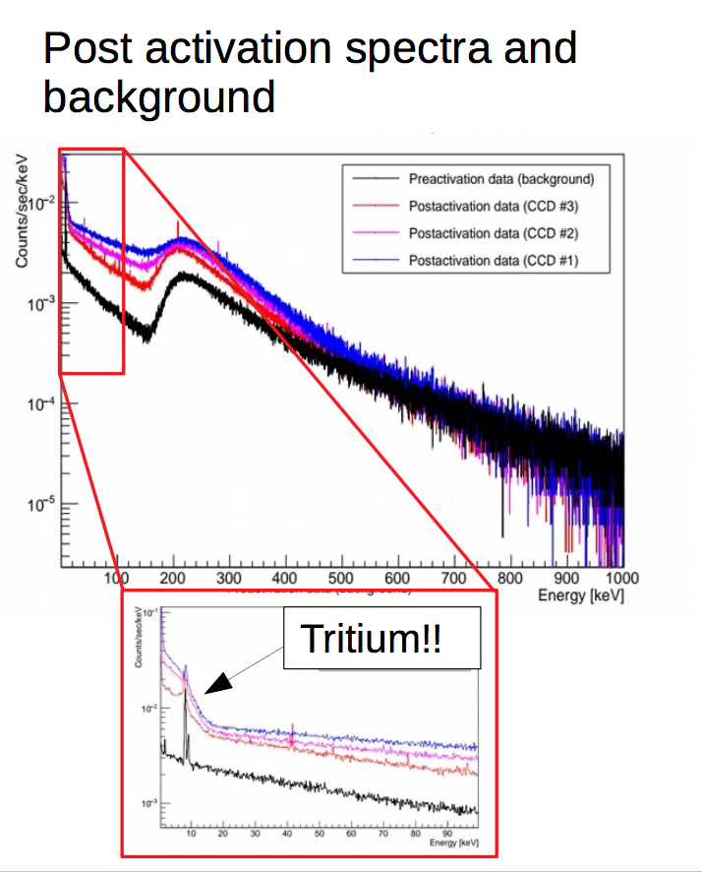
CCD Energy Spectra
PRELIMINARY
Energy spectrum shows clear signs of 18 keV tritium beta spectrum
and 545 keV ²²Na positron spectrum
Detailed analysis and spectral fits to estimates rates is currently underway

Slide 12
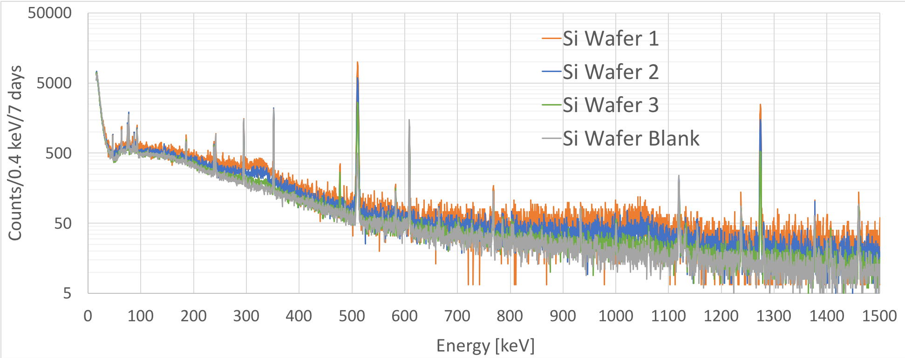
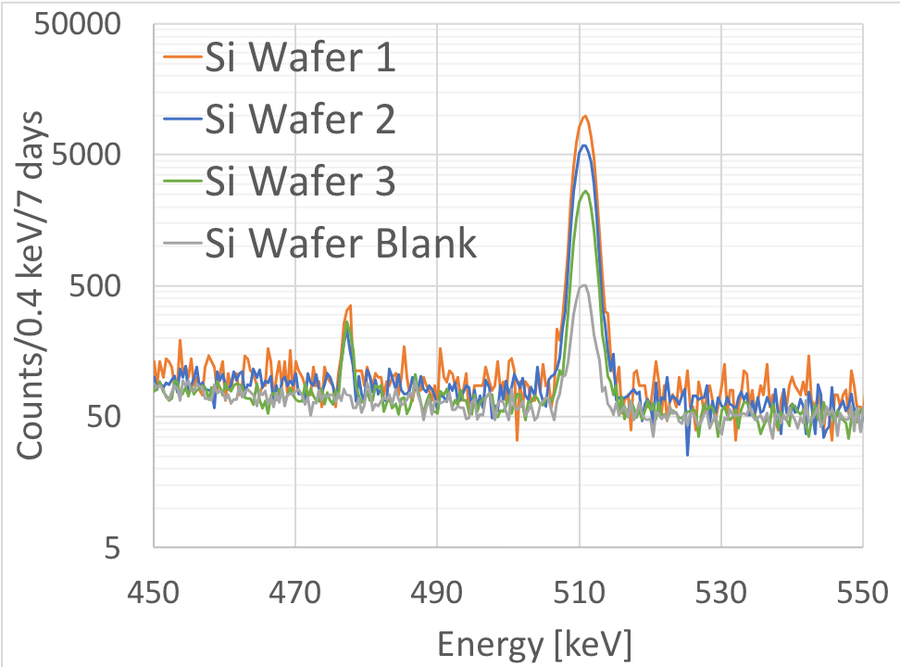
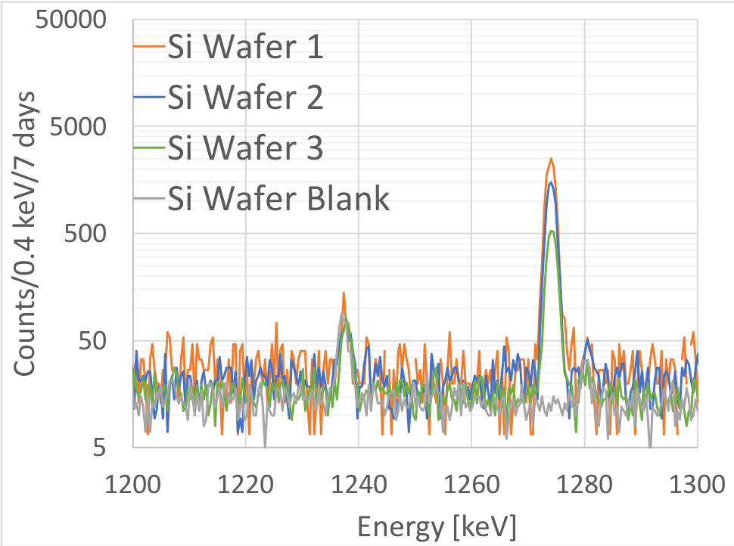
Silicon Wafer Gamma Counting
Along with each CCD a pair of silicon wafers were irradiated with the same exposure in order to measure the ²²Na and ⁷Be activation rates using low background Ge gamma counting
²²Na
1274 keV
⁷Be
478 keV
²²Na
511 keV

Slide 13
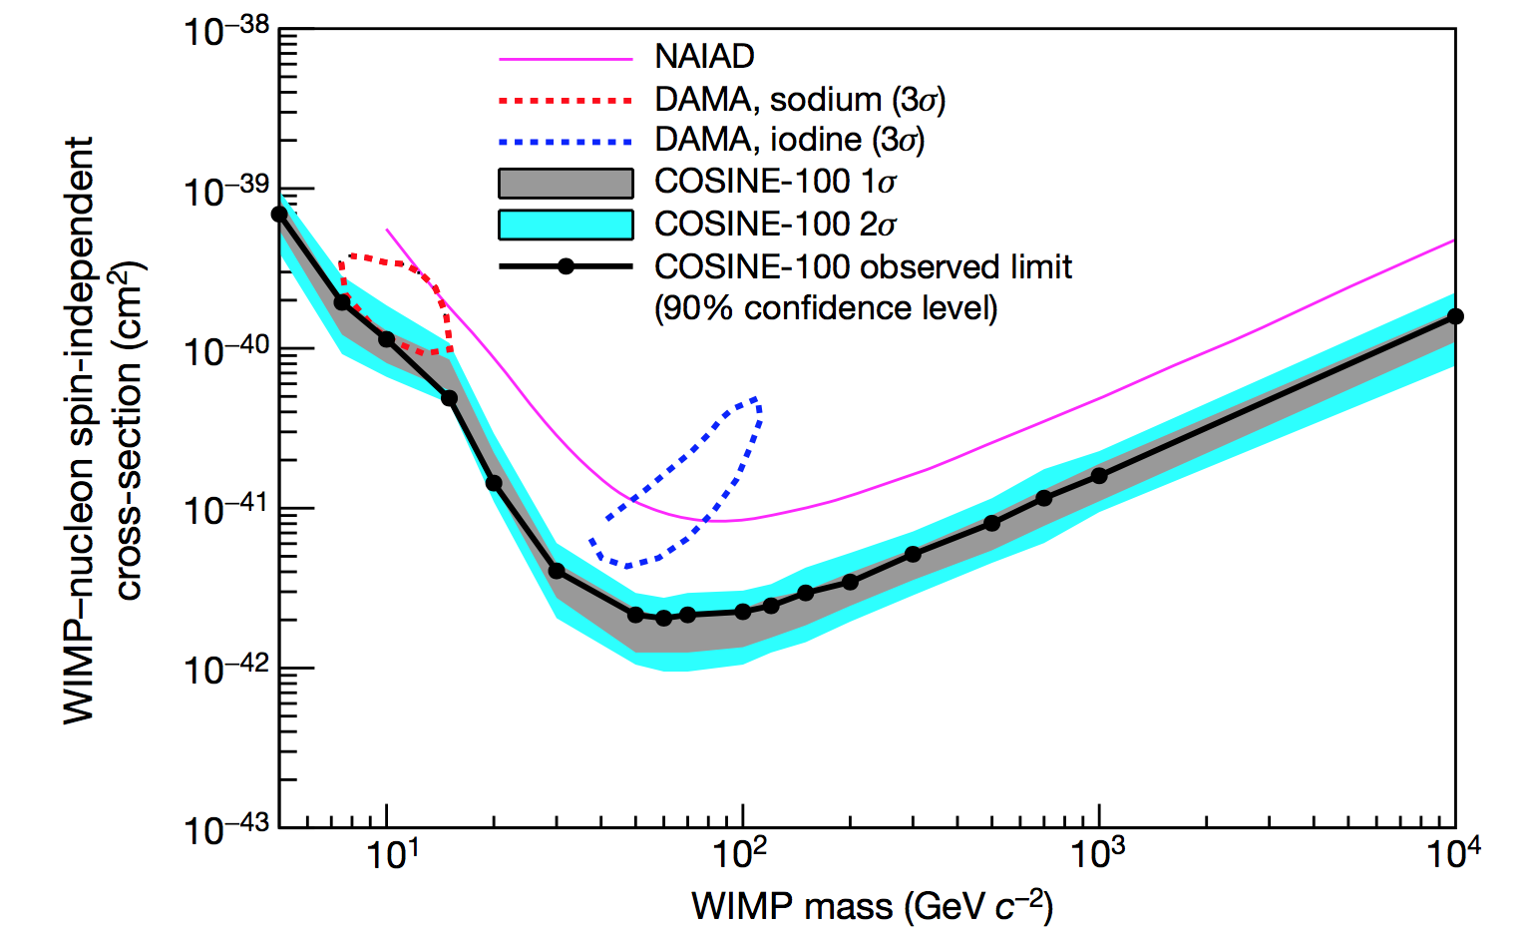
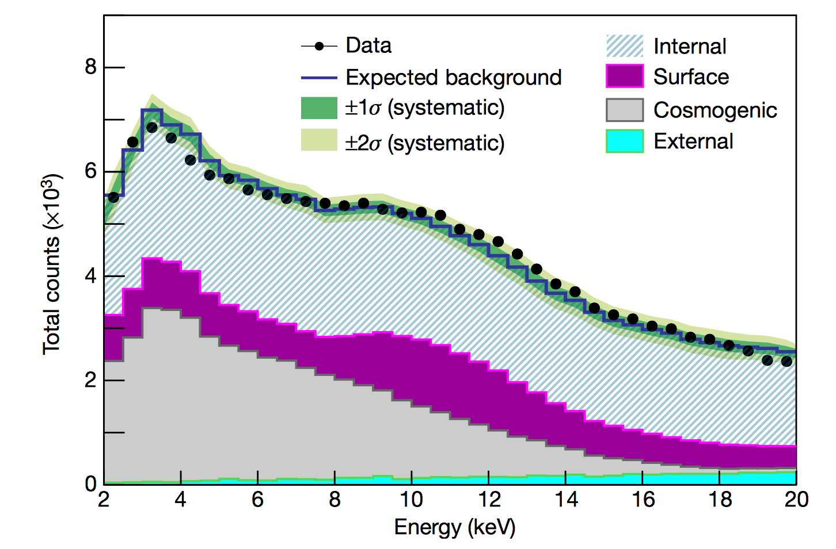
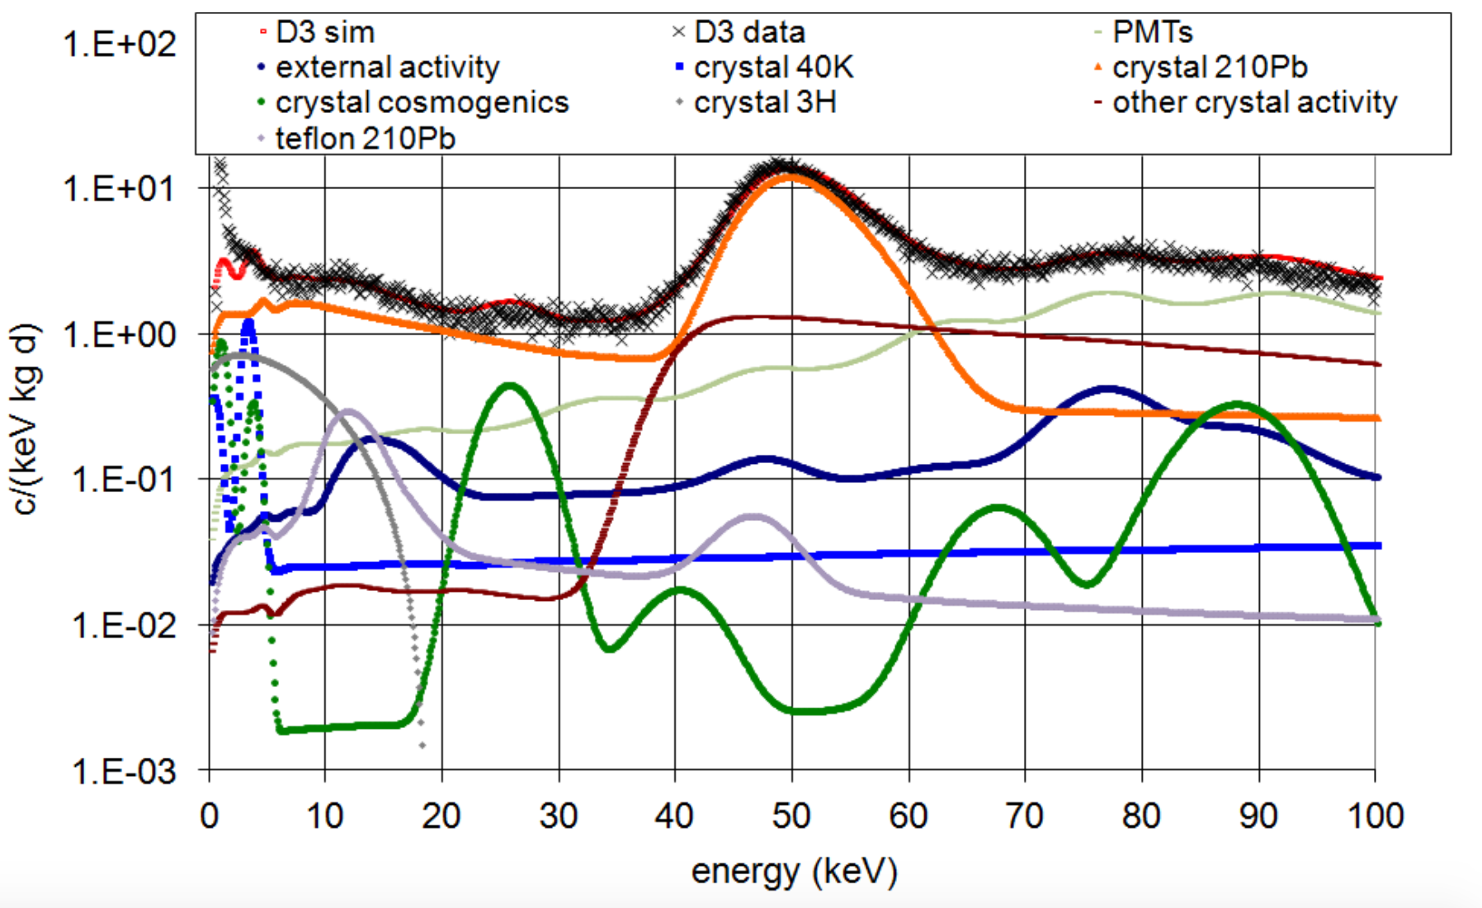
Tritium and ¹⁰⁹Cd Production in NaI
Several NaI-based experiments are currently trying to verify the DAMA-LIBRA dark matter claim
Tritium and ¹⁰⁹Cd are the dominant cosmogenic backgrounds in the energy region of interest (2-6 keV_{ee})
We are setting up to make a measurement of NaI detectors irradiated in the LANSCE beam

Slide 14
Summary
Long-lived cosmogenic isotopes are a significant background for several dark matter experiments
Activation rates of critical isotopes are not well known due to low production rates and low energy of decays
We have used a method of irradiating active detector material in a high energy neutron beam and self-counting the activation products to estimate the production rates
We are in the process of making the first measurement of tritium production in silicon
We are getting ready to try and make the first measurement of tritium production in NaI

Slide 15
Collaboration (Tritium Background in Silicon)

Slide 17
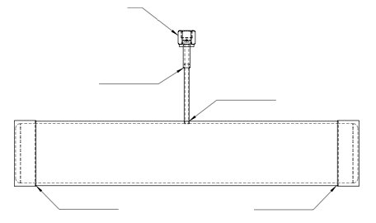
Irradiation Vessel
Double valved for safety
VCR Fitting for leak-tightness
Aluminum to SS transition
Welded pipe
End caps are thinned down to 1.5 mm thick
in the central 2.5" diameter
3"
17.3"
Welded end caps
Weld kept away from thin wall
Aluminium attenuation for 10 MeV neutrons ~ 1% per mm

Slide 18
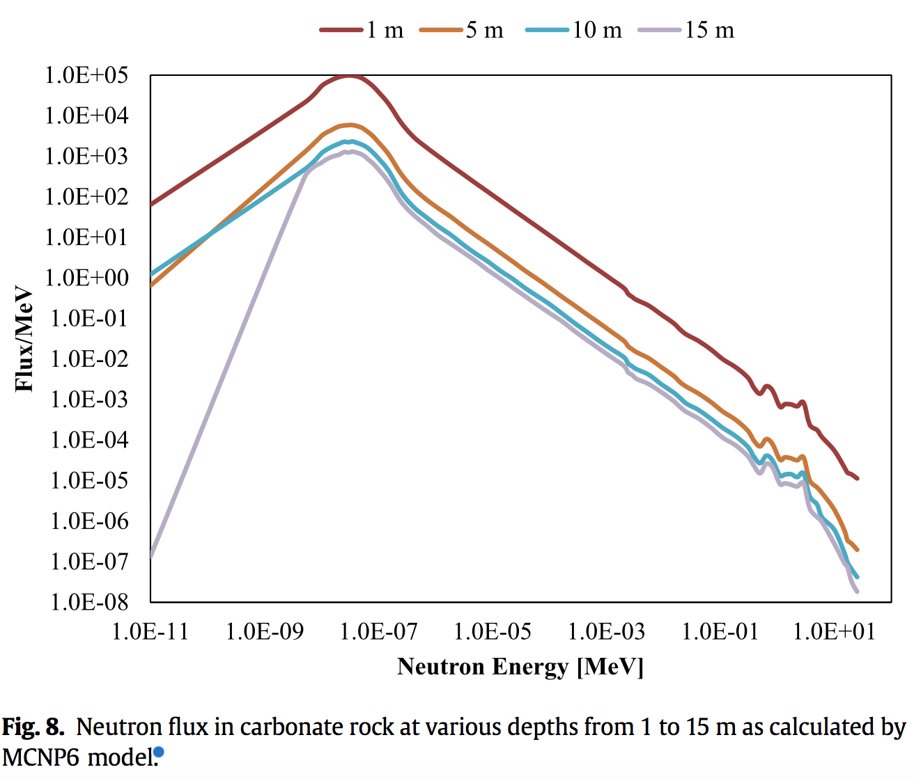
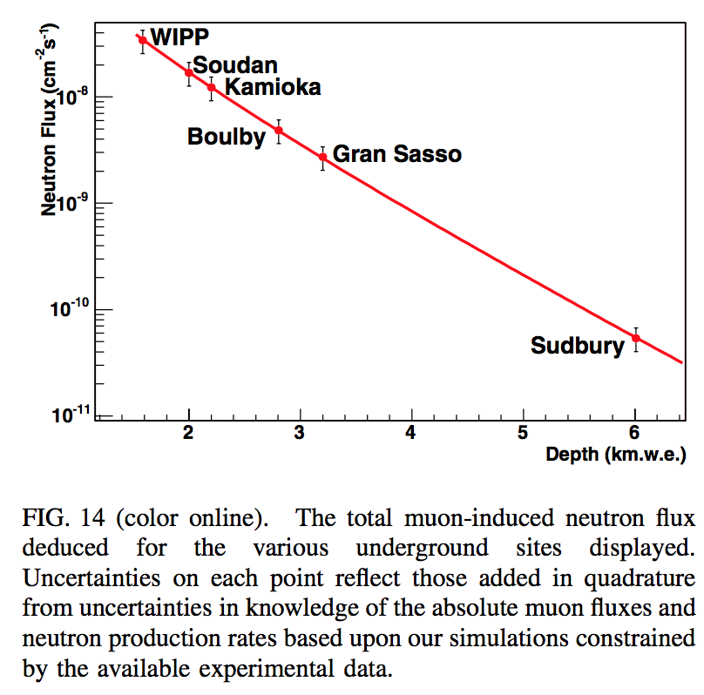
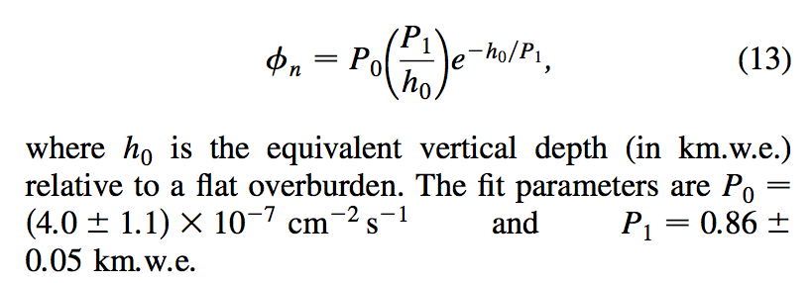
Storage underground - how deep?
Surface Rate
Just 5 m depth reduces the neutron flux by about 2 orders of magnitude
Deep underground, the neutron flux "attenuation length" is about 860 m.w.e

Slide 19
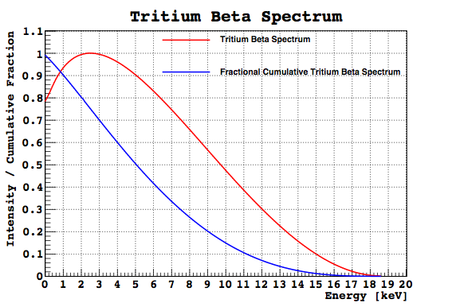
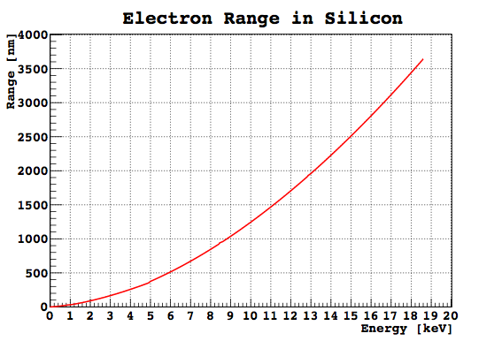
Tritium Beta Decay Spectrum and Range
Lack of tritium cross-section measurement is probably due to the difficulty in measuring tritium,
a pure low-energy beta decay
The low Q-value of the tritium beta decay
and the small range of electrons in silicon,
means that only a small fraction of betas make it to the surface

Slide 20
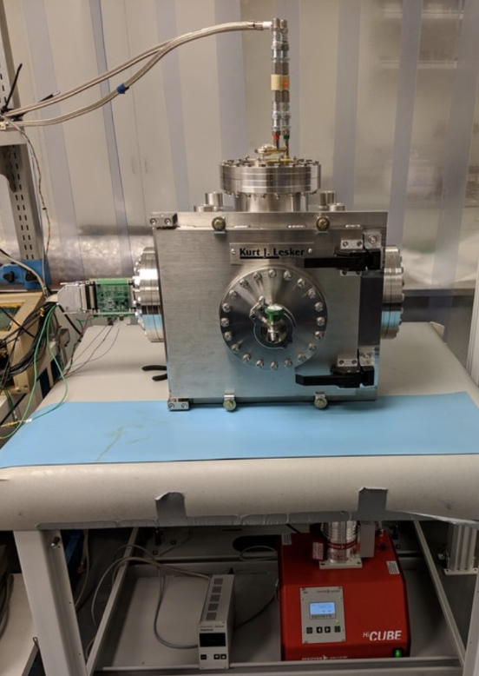
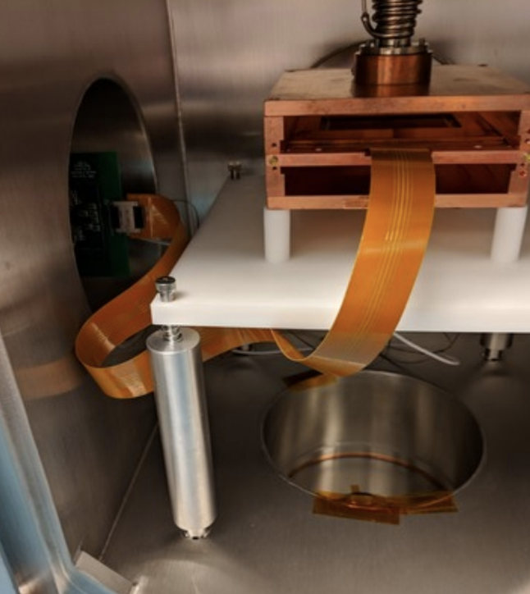
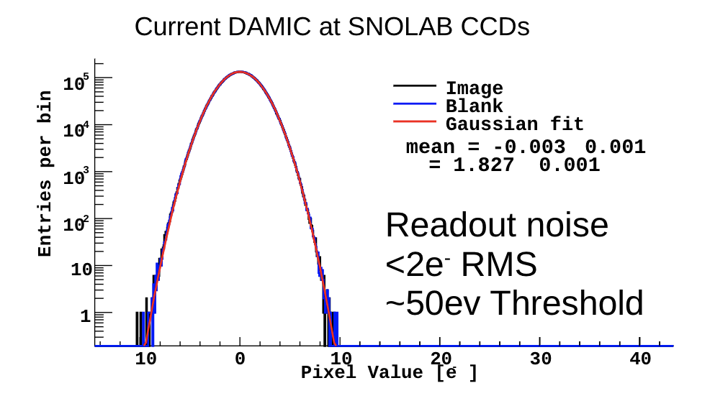
CCD Setup
CCD Test Chamber at the University of Chicago
Remove analog baseline, mask hot pixels; construct profile by taking median dark current of several 600 s exposures and subtracting median of 0 s exposures

Slide 21
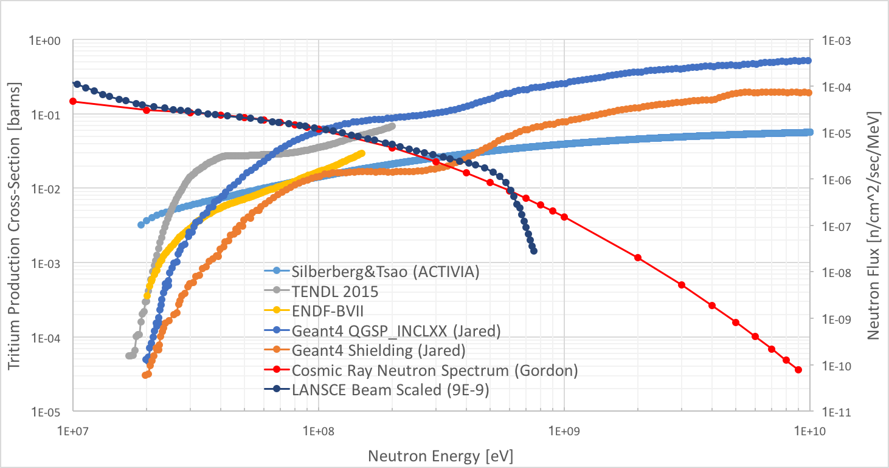
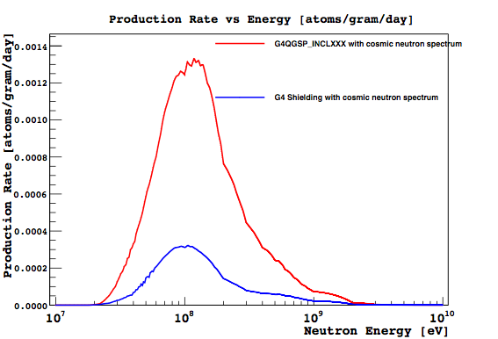
LANSCE Neutron Beam vs Cosmic Ray Neutrons
Does the high energy cut-off matter?
Cross-sections are still rising above 600 MeV,
but the cosmic ray neutron flux is dropping
The production rate depends on the product of the neutron flux and the cross-section
Depending on the cross-section model, the difference between the production rate due to cosmic rays and the LANSCE beam varies between 0-20%

Slide 22
Displacement damage dose
Notes:
E_de: Energy loss due to atomic displacements

Slide 23
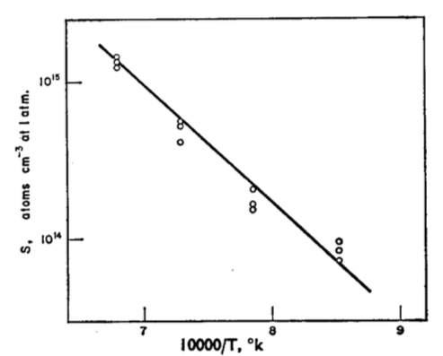
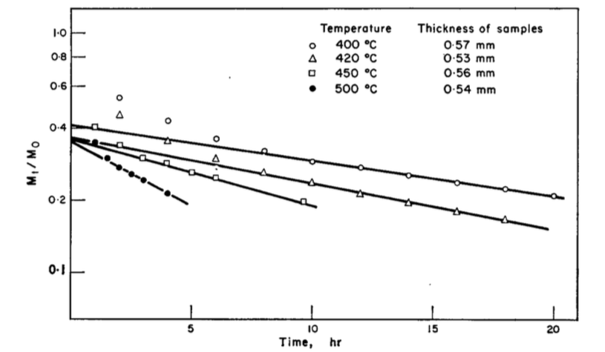
Baking ³H out
Past studies on the solubility and diffusion of tritium in silicon could open the door for further background reduction
Solubility
Relative quantity after baking
Ichimiya, T. et al., The International Journal of Applied Radiation and Isotopes 19.7( 1968) 573-578.

