Slide 1



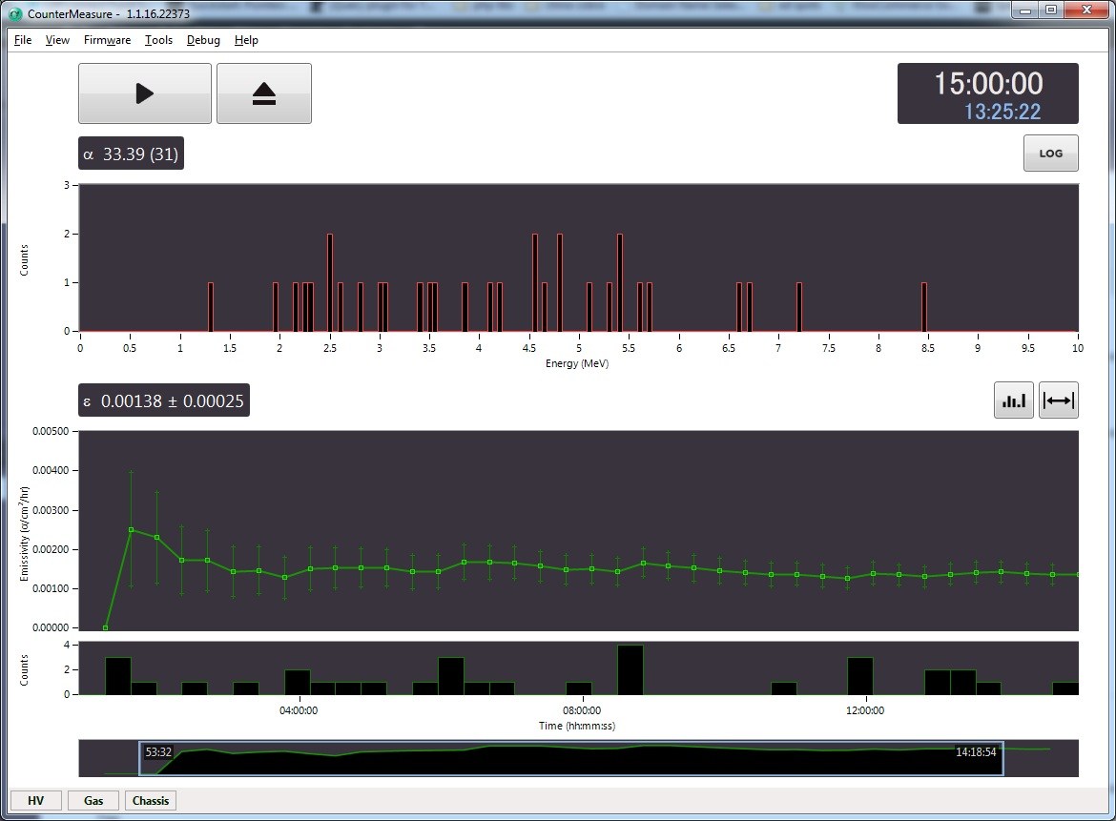
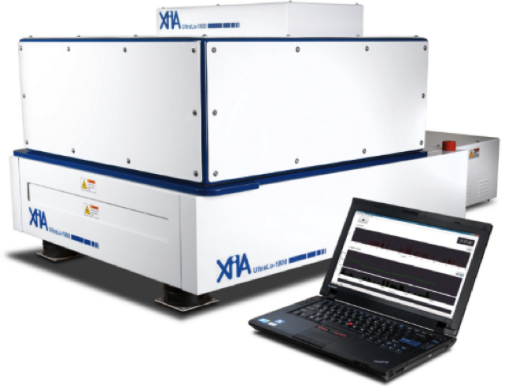
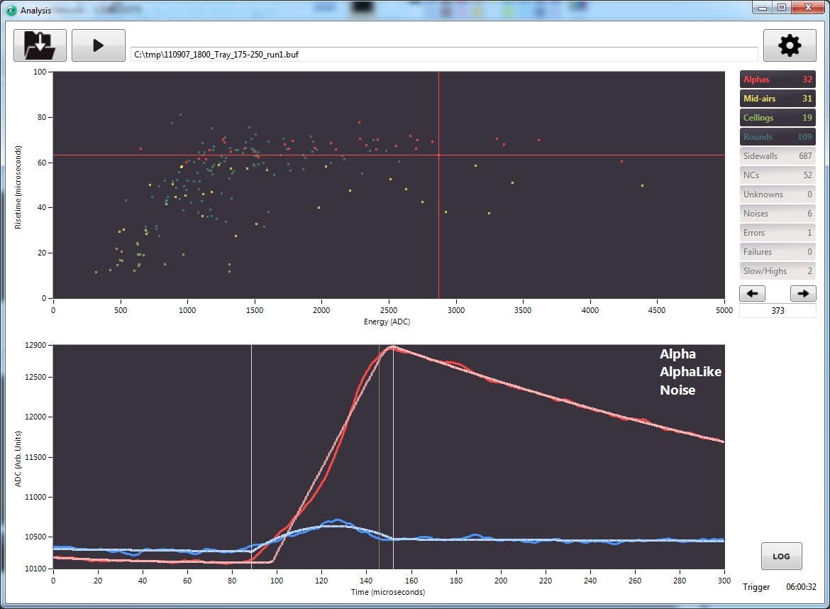



Slide 2
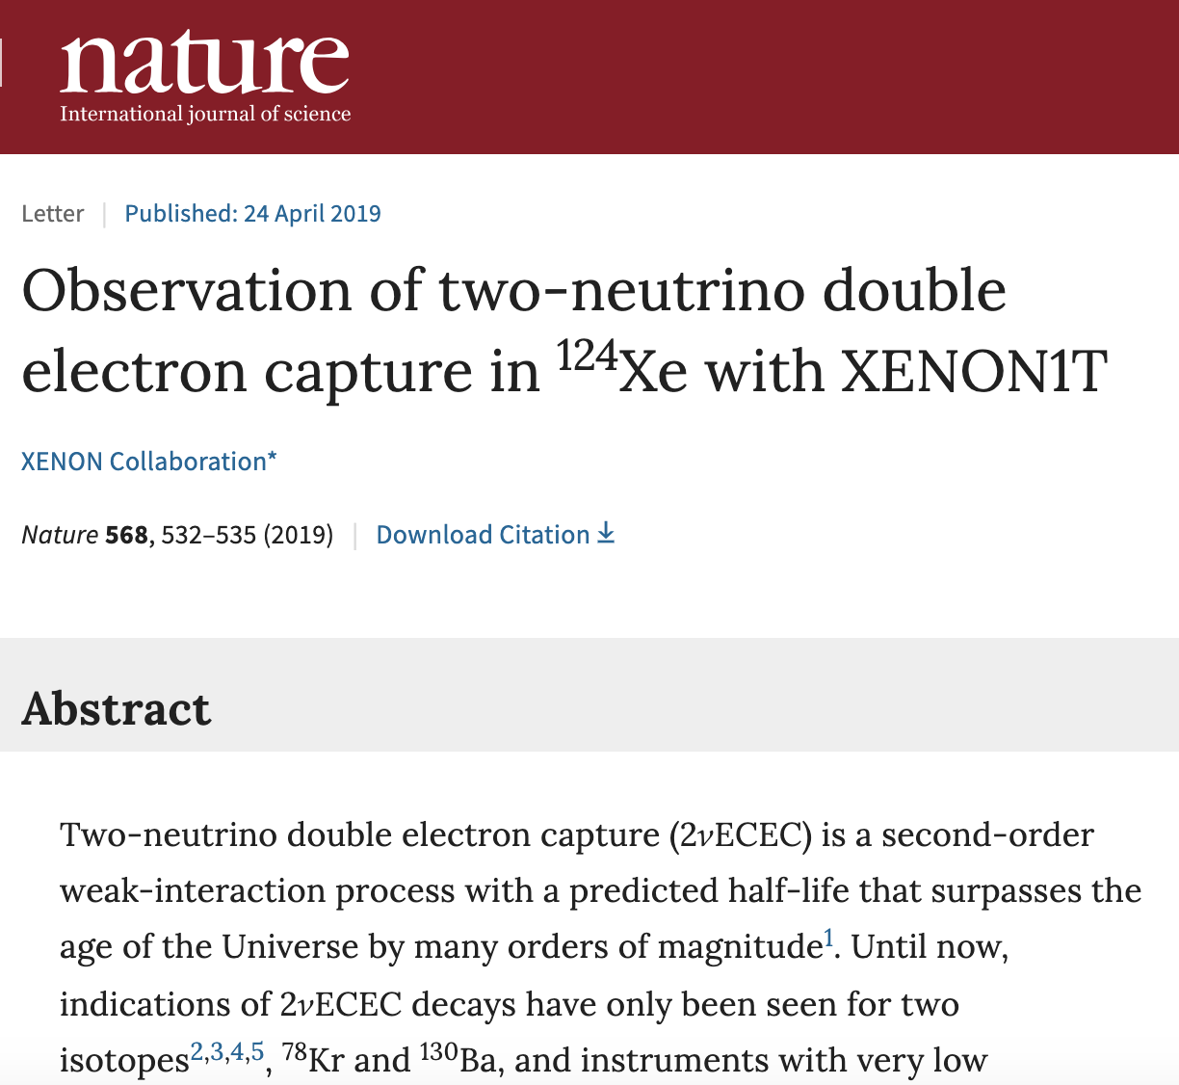

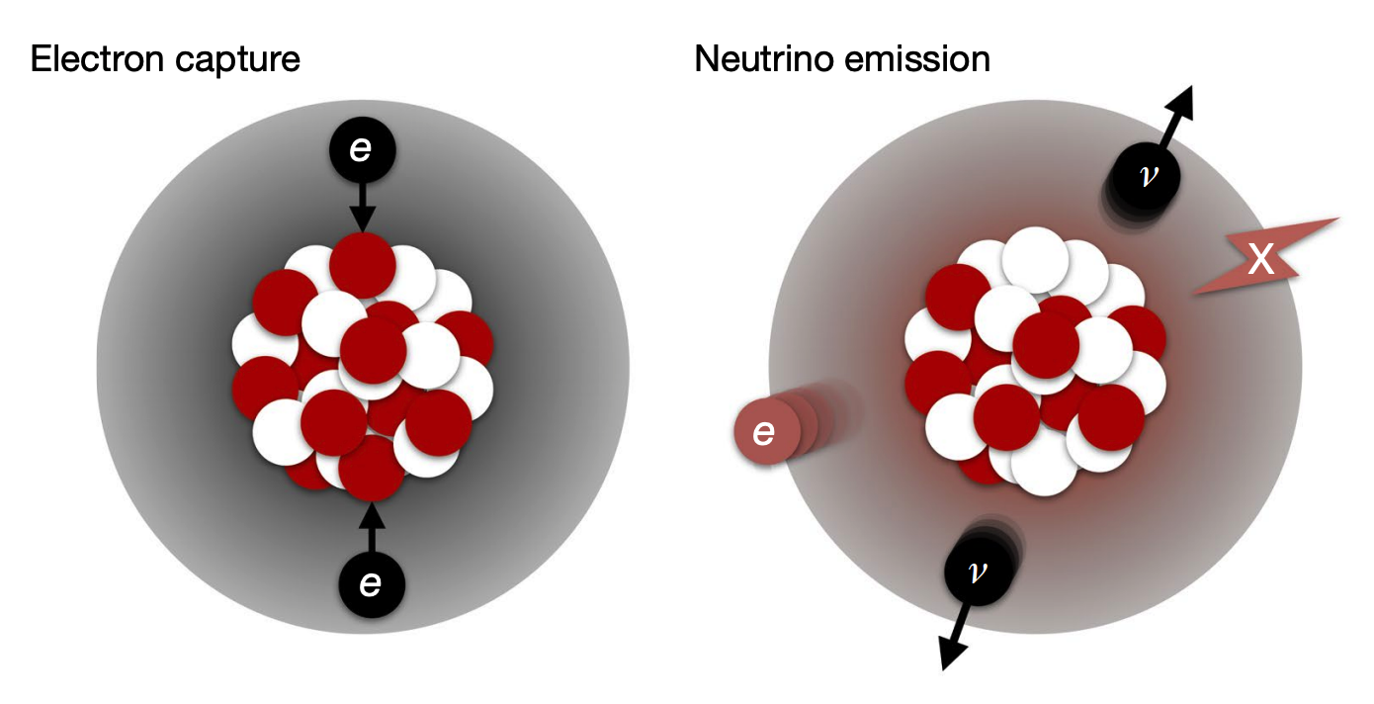
Congratulations
To XENON1T for observing the ‘Rarest Event Ever’!
Two-neutrino double electron capture (2νECEC) is a second-order weak-interaction process with now a measured half-life of 1.8 × 10²² years.

Slide 3
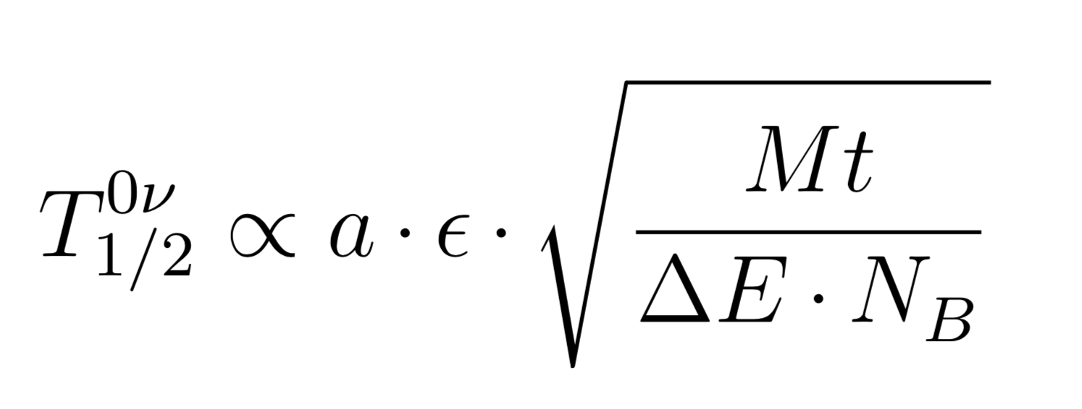
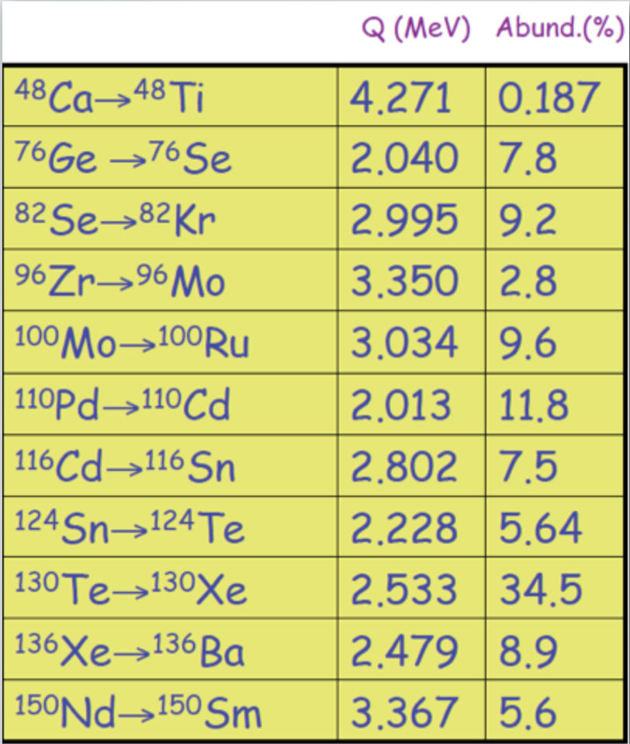
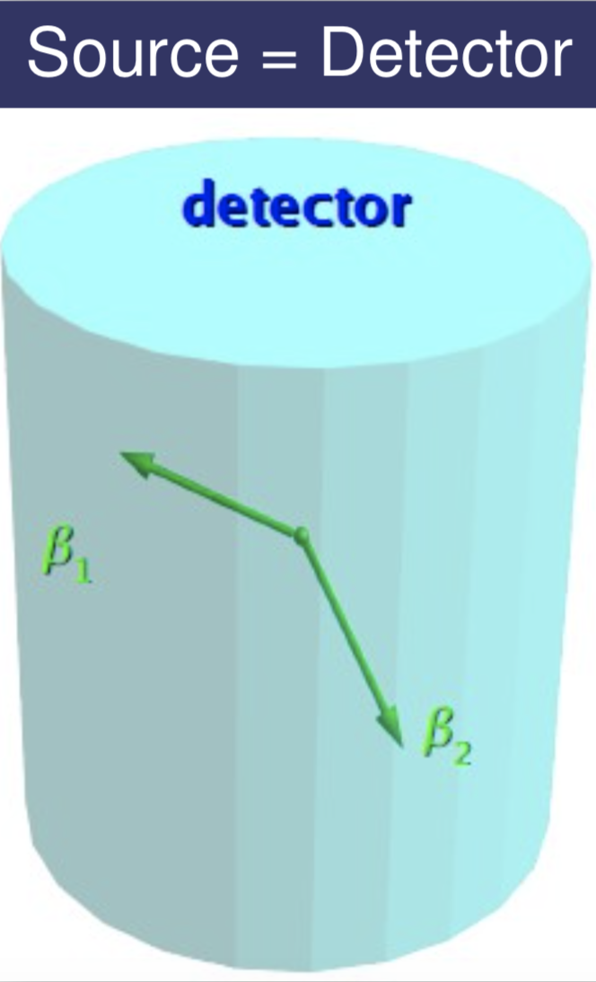
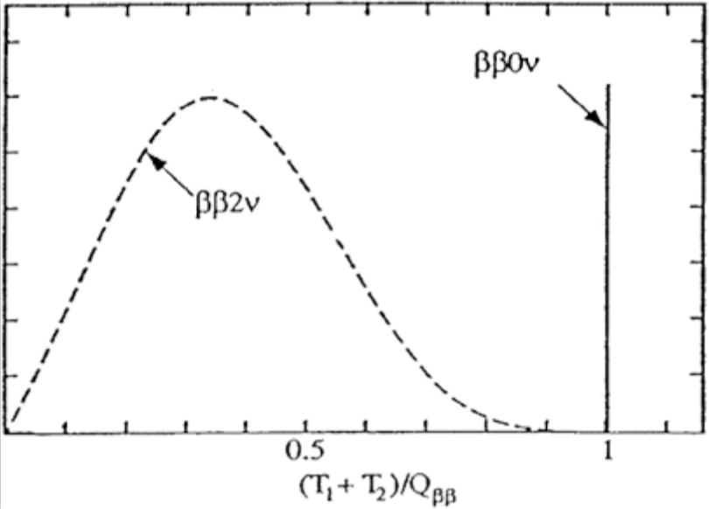


Neutrinoless Double Beta Decay
Detector recipe:
Golden rule: Everything is radioactive, quantify
panic level via screening.

Slide 4
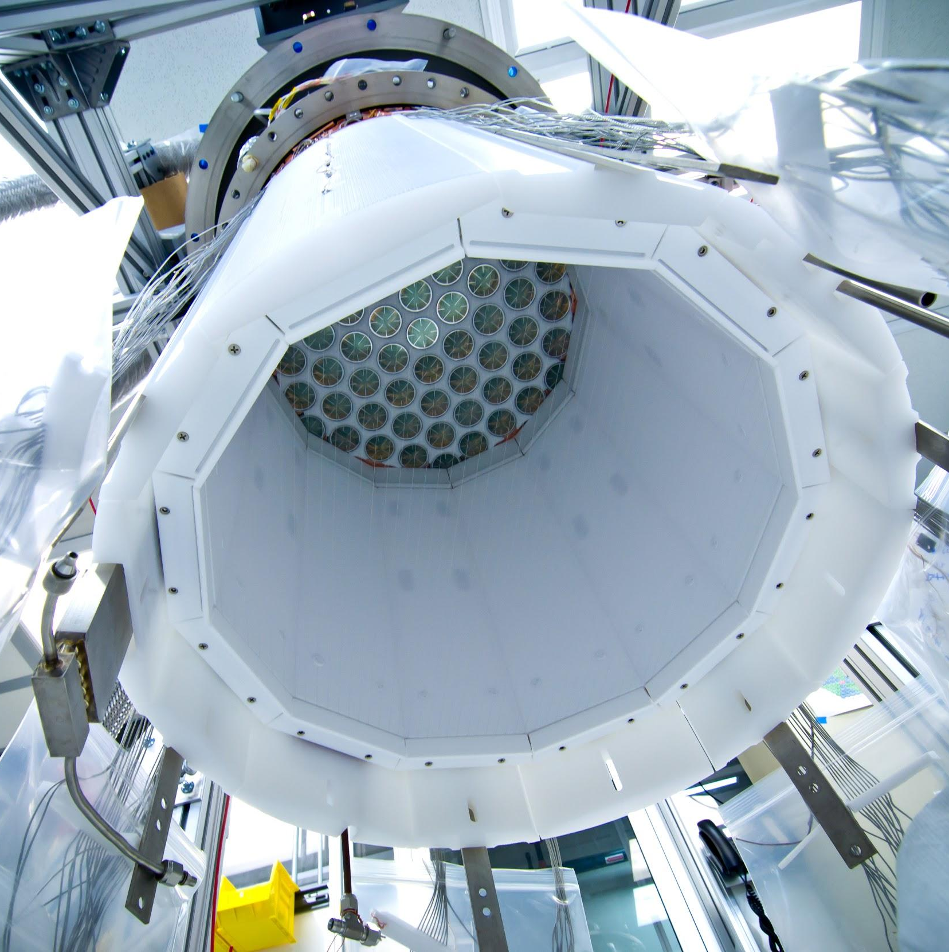
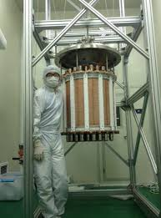
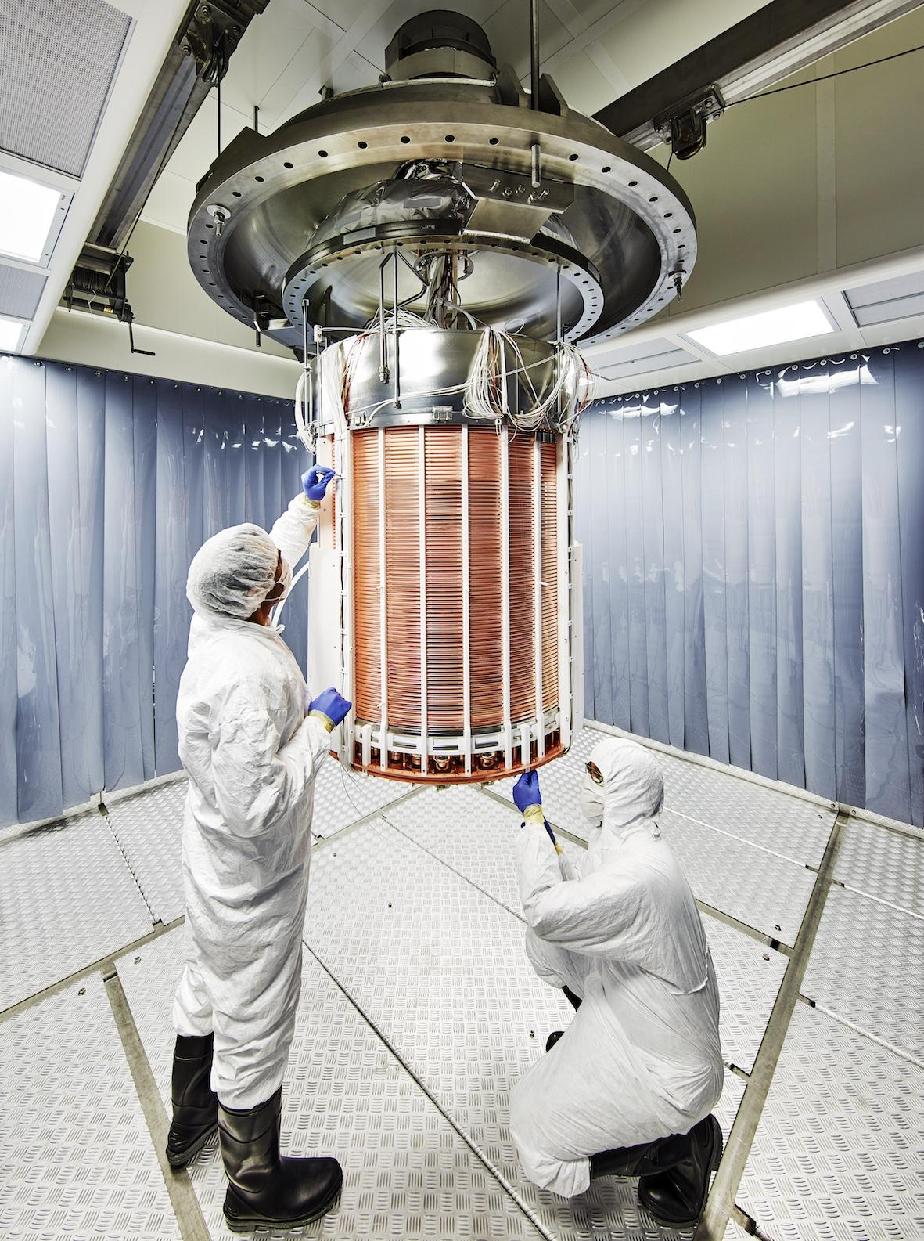
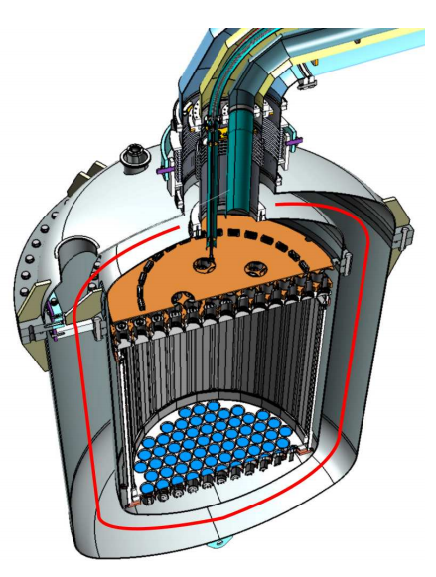
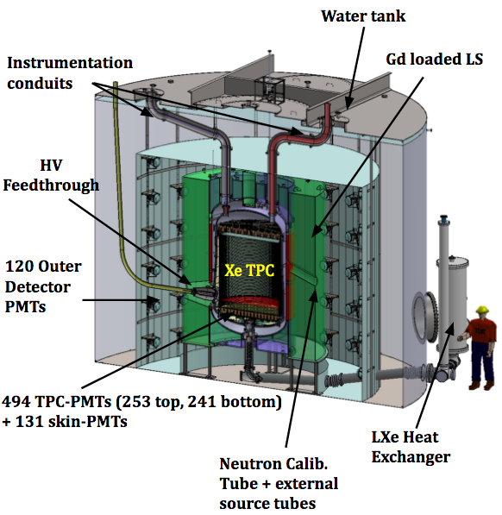
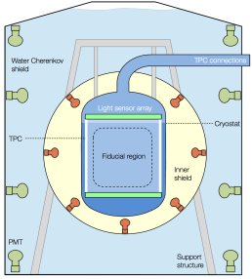
Liquid Xenon TPCs
LUX
PANDAX-II
XENON1T
XENONnT
LZ
250 kg
(100 kg)
580 kg
(362 kg)
2,000 kg
(1,042 kg)
5,900 kg
(4,000 kg)
7,000 kg
(5,600 kg)
2013
2016
2017
2020 + 5 live years
2020 + 3 live years
3.4x10⁻⁴⁶ cm²
2.5x10⁻⁴⁶ cm²
7.7x10⁻⁴⁷ cm²
1.6x10⁻⁴⁸ cm²
1.6x10⁻⁴⁸ cm²
Darwin
Typical detector improvements:
Mass
Detector components
Detection and analysis methods
Improve background
50,000 kg
(40,000 kg)
202X + 7 live years
1x10⁻⁴⁹ cm²
Notes:
Improving backgrounds is constrained by current screening capabilities. Next Generation detector like LZ already push existing detectors to the limit.

Slide 5
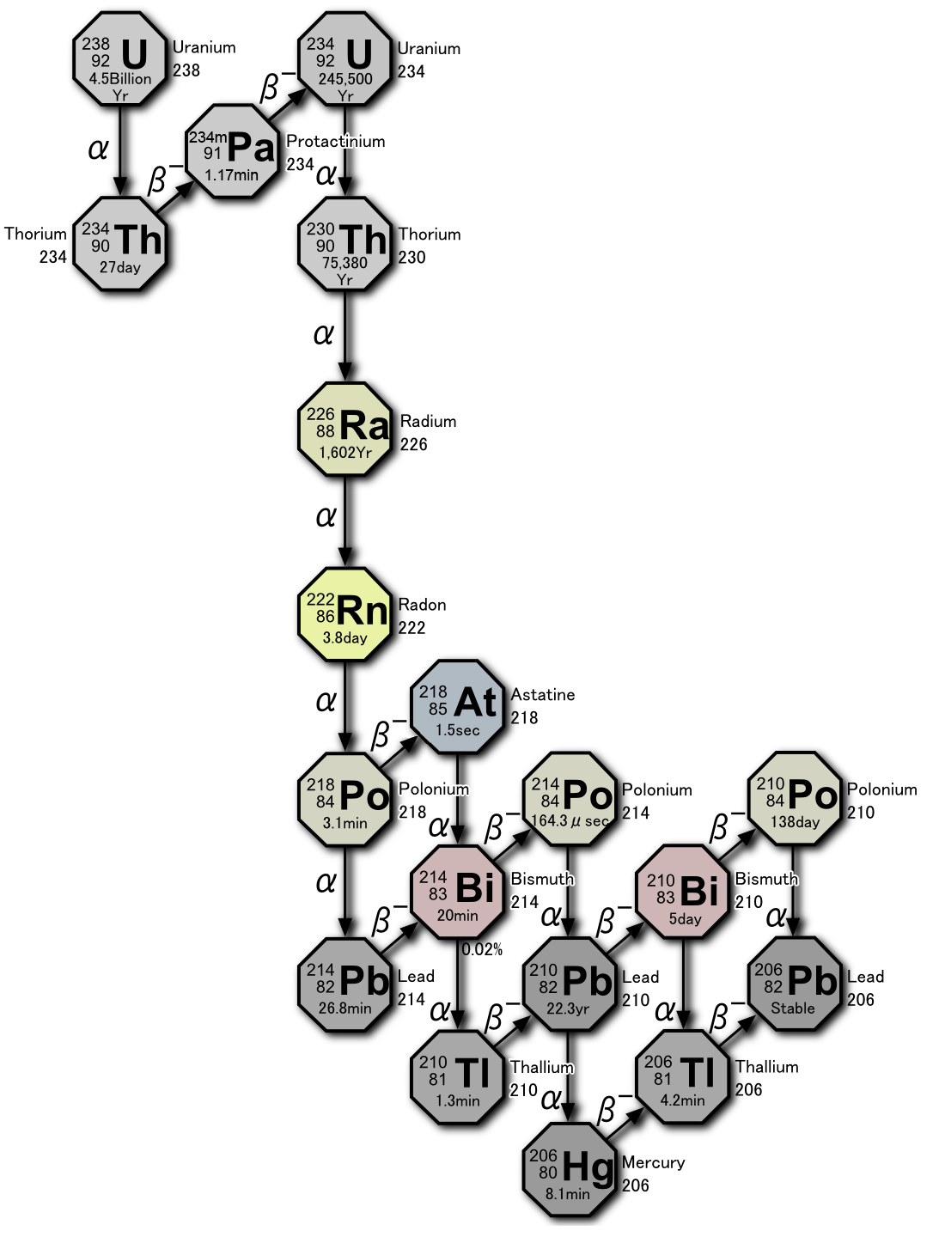
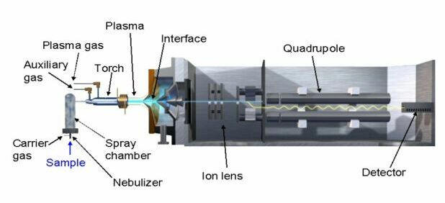
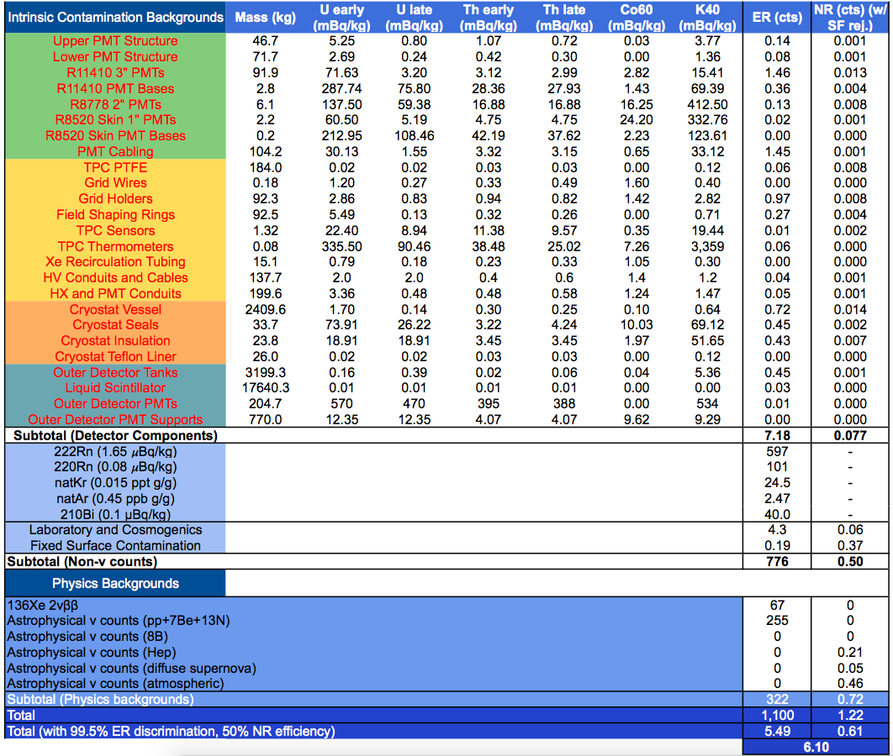
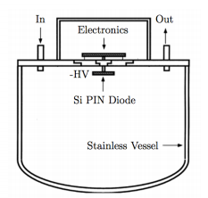
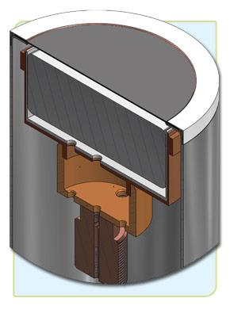
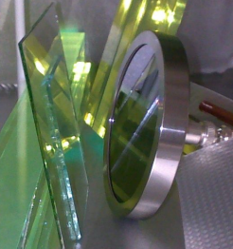
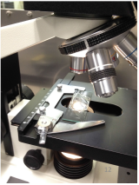
The Challenge
Mass Spectrometry, NAA
Radon Emanation
Gamma-ray Spectroscopy
Alpha detectors
Optical Microscopy

Slide 6
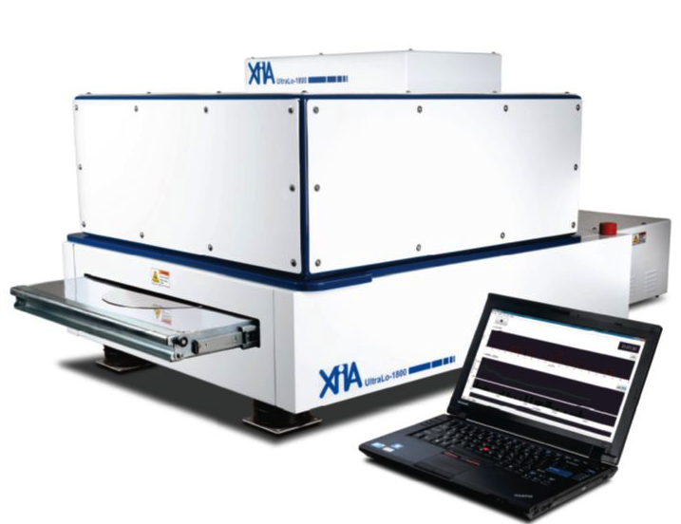
Introduction
The UltraLo-1800 is a low background alpha counter with employs electronic background suppression to achieve background rates of,
0.0001 alphas/cm²/hr
= 4.3 alphas/day (large) or 1.7 alphas/day (small)
= 50 µBq (large) or 20 µBq (small)
The UltraLo (operates in ionisation mode) is a factor 50+ better than conventional proportional counters.
Fast counting time, can measure samples in days rather than weeks/months.

Slide 7
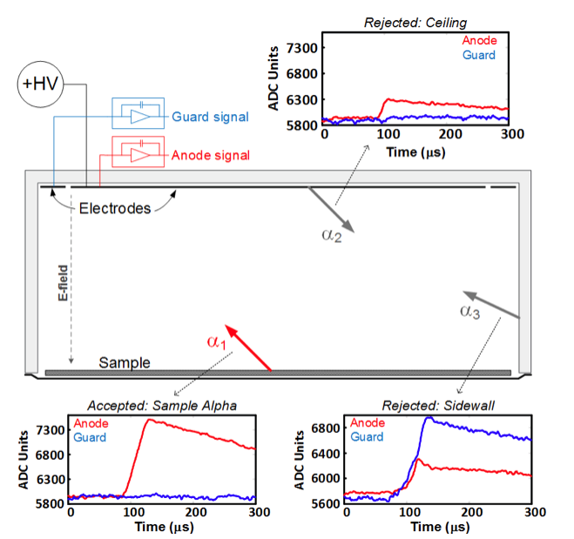
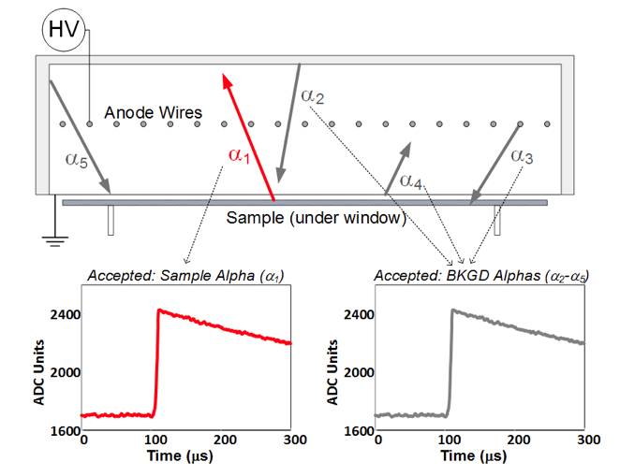
Introduction
The UltraLo is able to distinguish between alpha emitted from the sample to alphas emitted from other parts of the detector using a dual channel pulse-shape-analysis.
UltraLo-1800
Conventional Proportional Counter

Slide 8
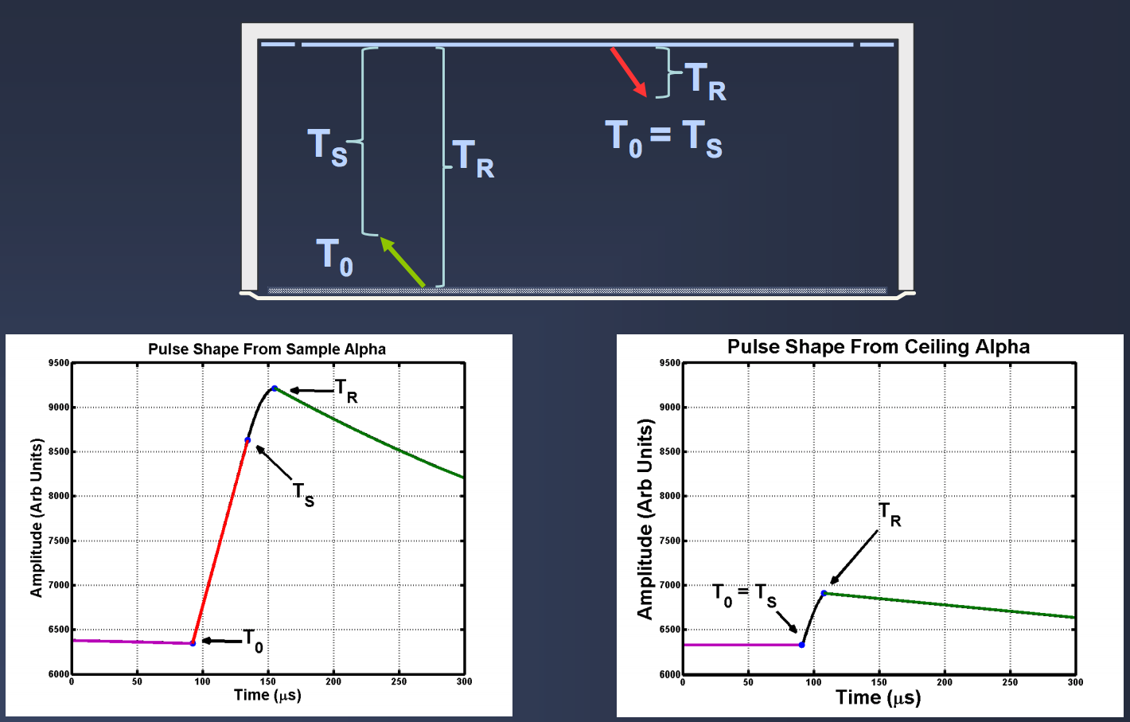
Pulse Shape Analysis

Slide 9
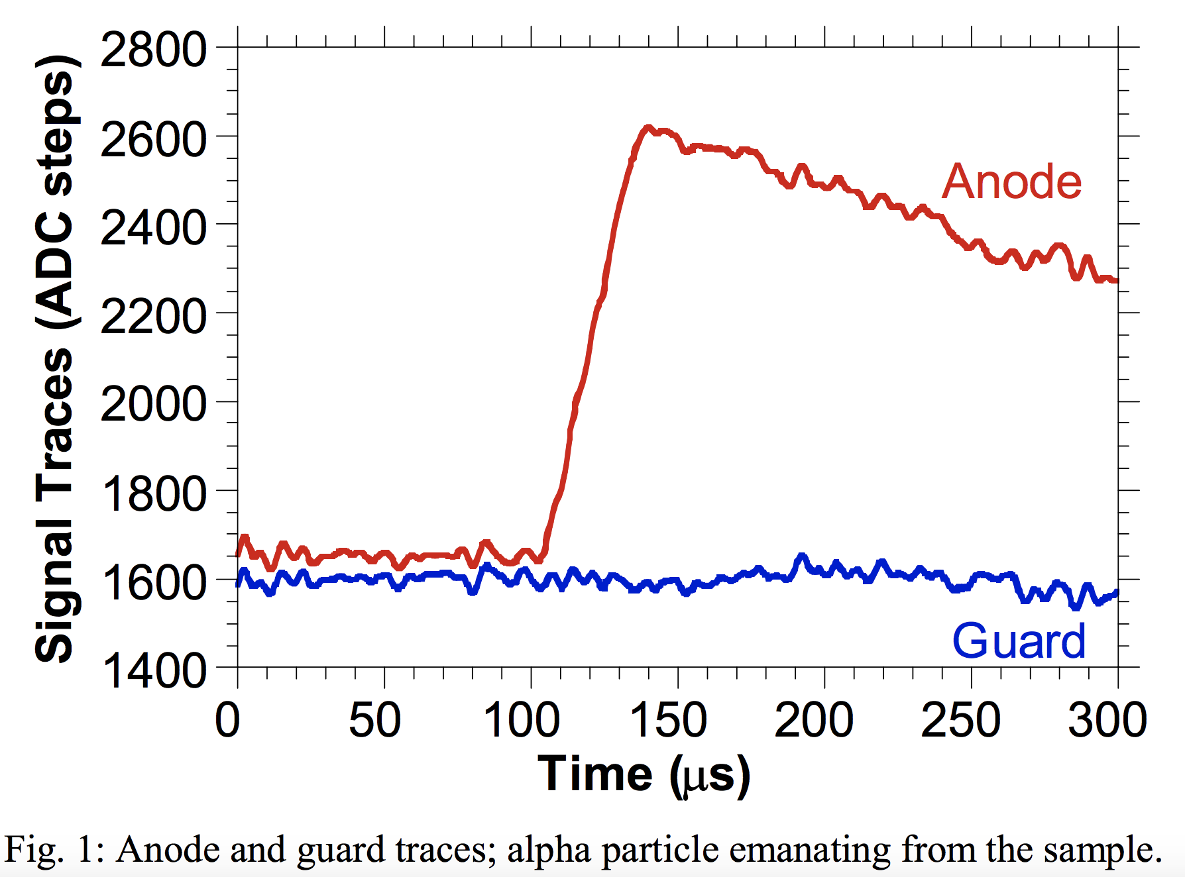
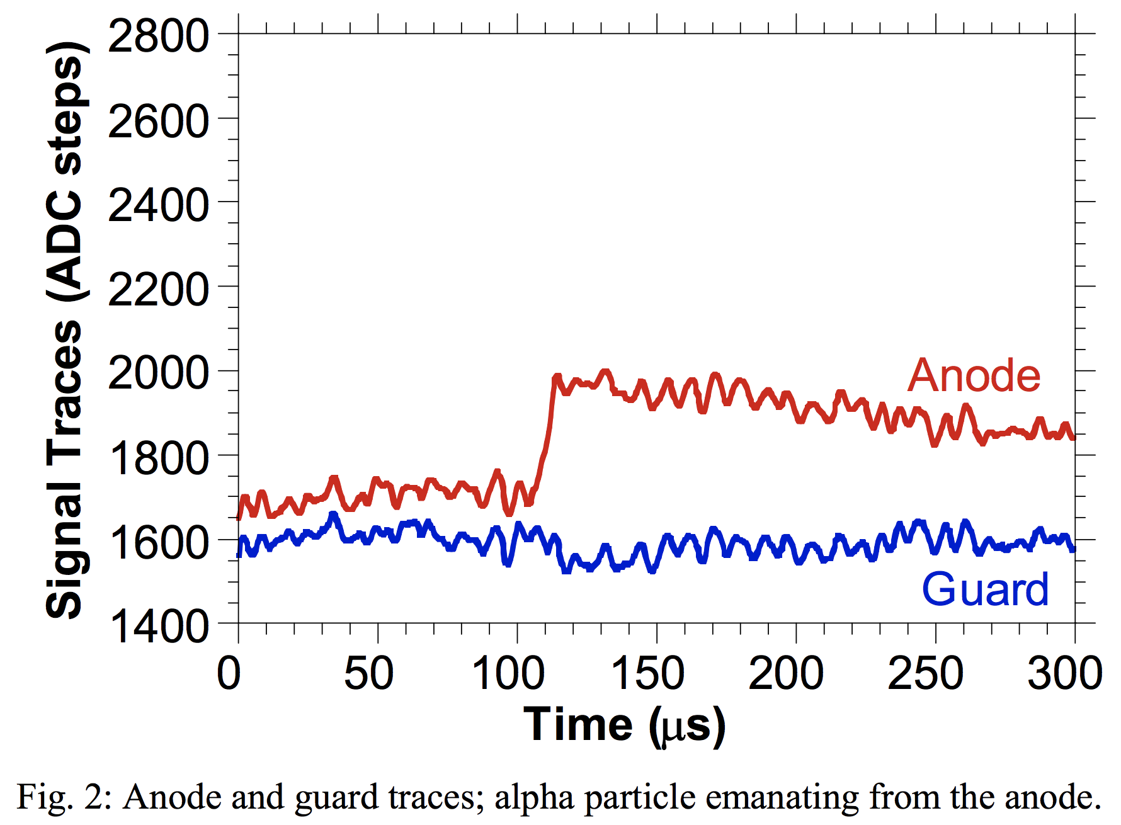
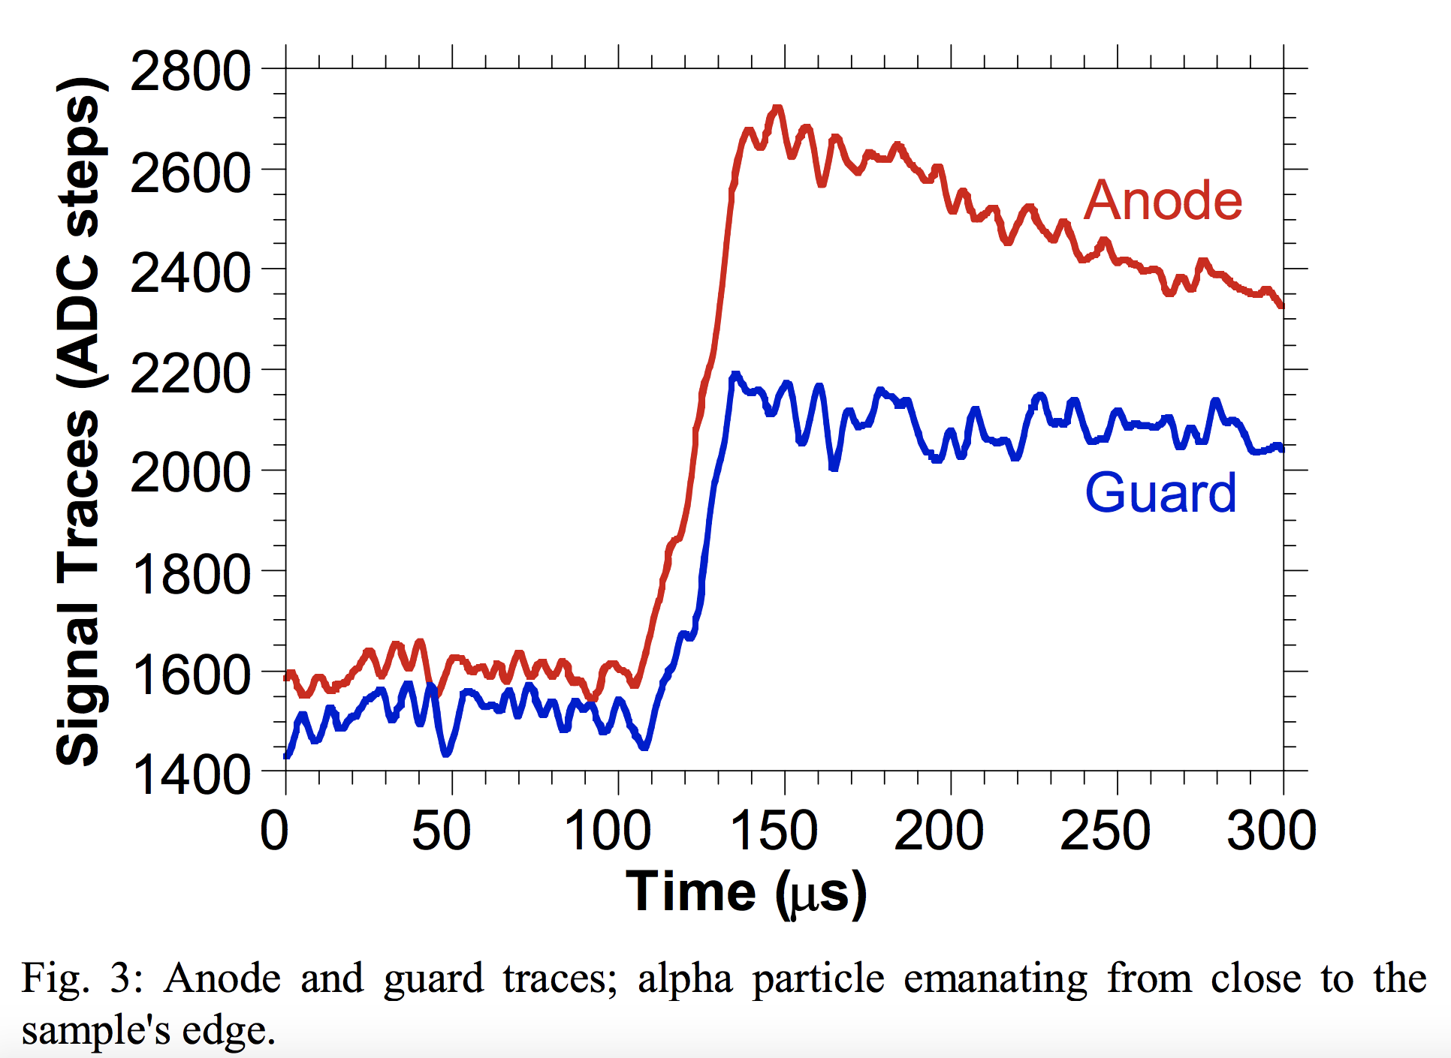
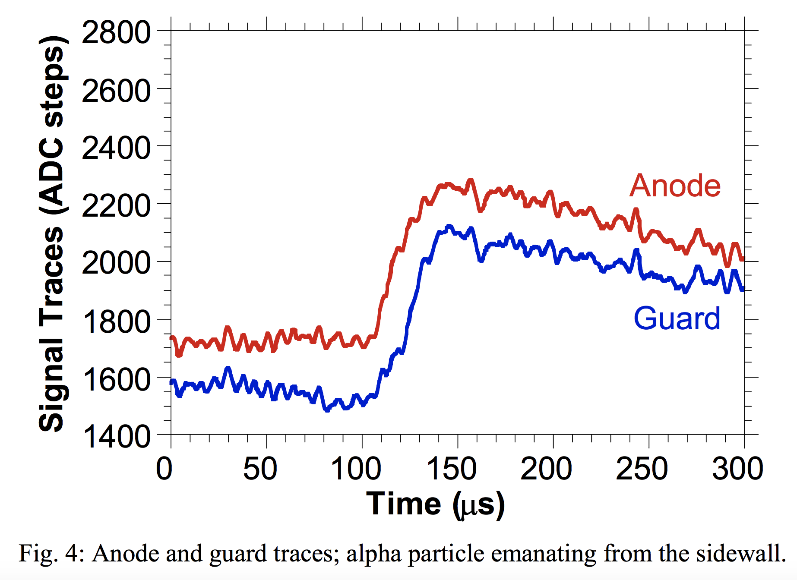
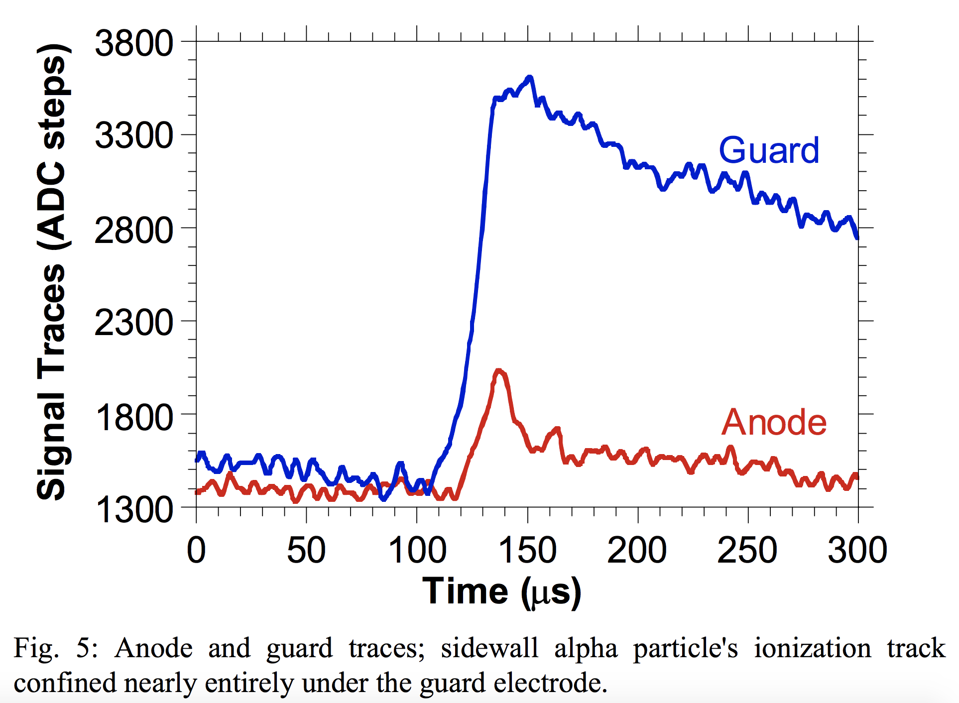
Event Types
Alphas
Ceilings
Edge
Side Walls

Slide 10


Who will measure the Iron Throne?

Slide 11
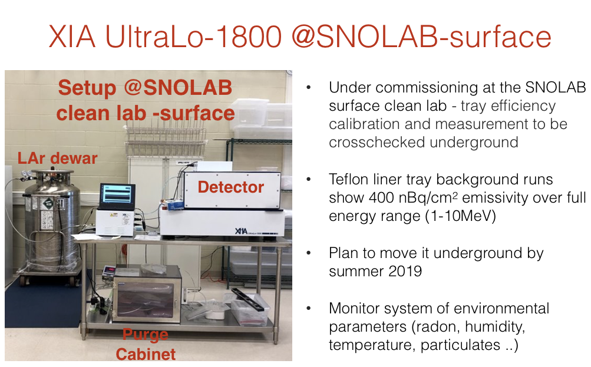
Silvia Scorza
https://arxiv.org/pdf/1708.09476.pdf

Slide 12
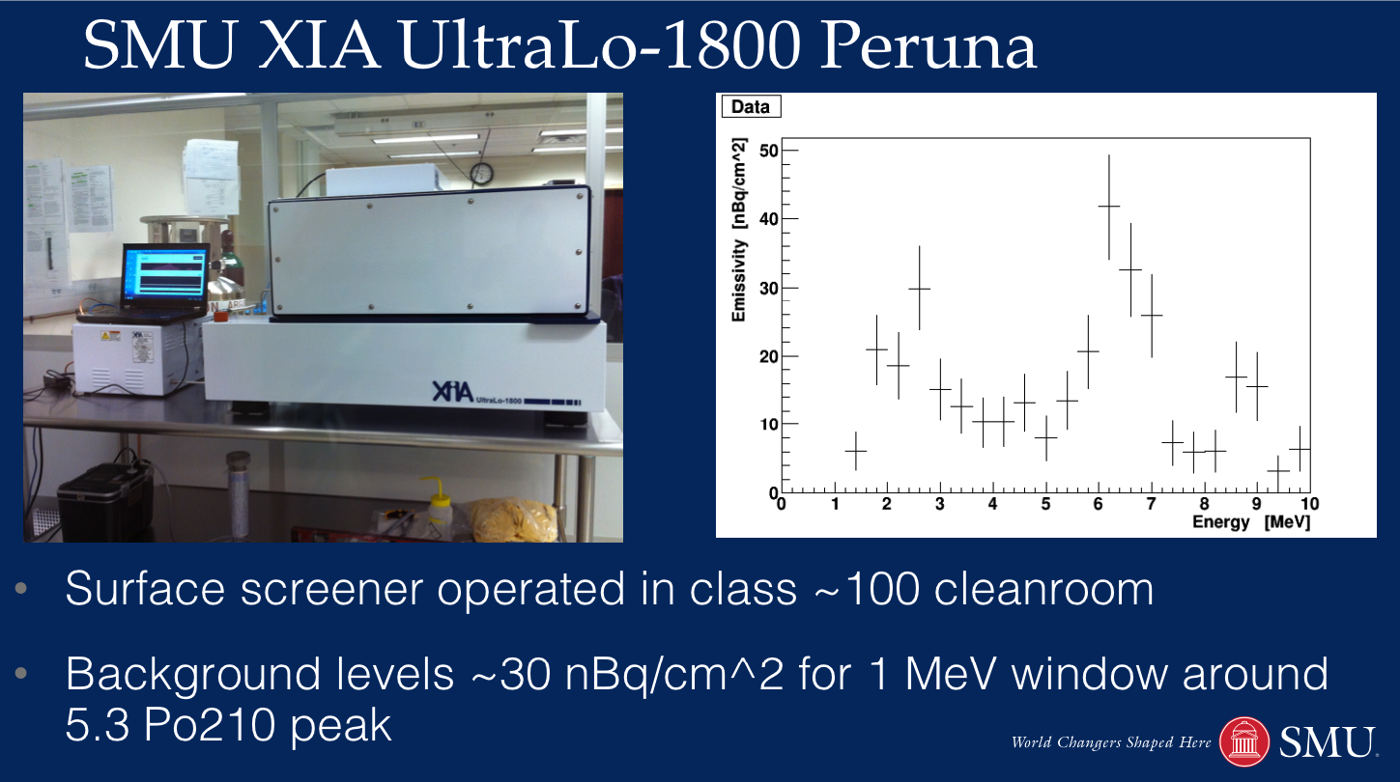
Jodi Cooley
https://arxiv.org/pdf/1506.04050.pdf

Slide 13
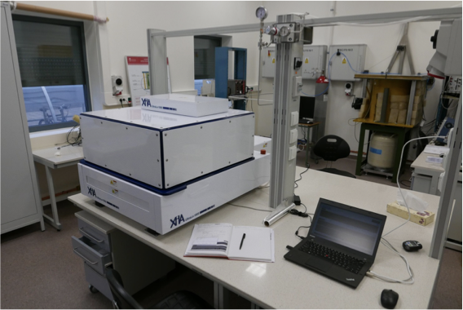
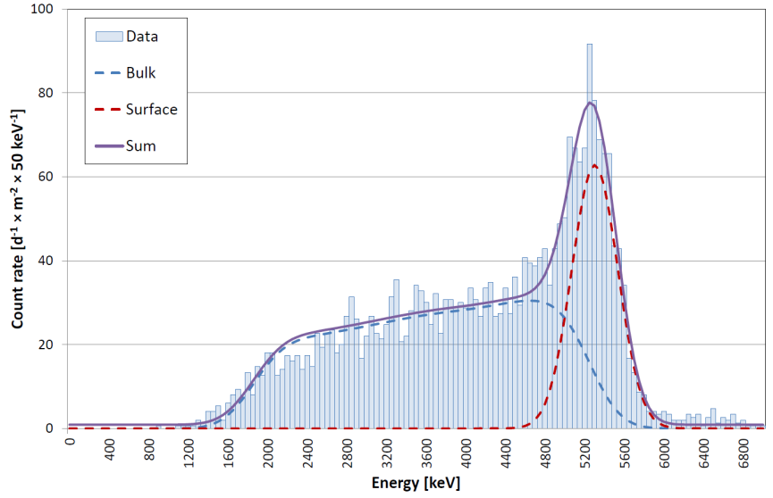
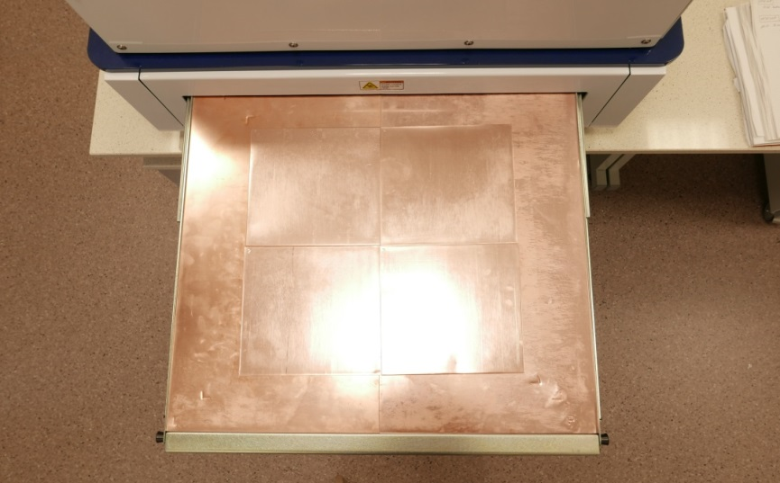
Electroformed copper (LSC)
C_{bulk} ≤ 51 mBq/kg
C_{sf} ≤ 1 mBq/m²
Detector installed on the surface in a clean room.
https://www.sciencedirect.com/science/article/pii/S0969804316305176
See talk tomorrow – 09:00 – 09:25!

Slide 14

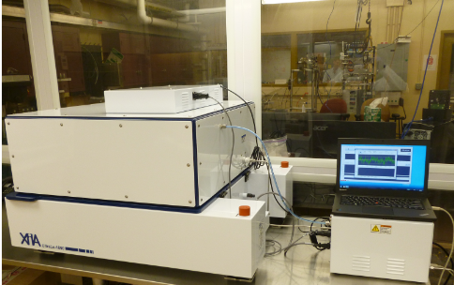
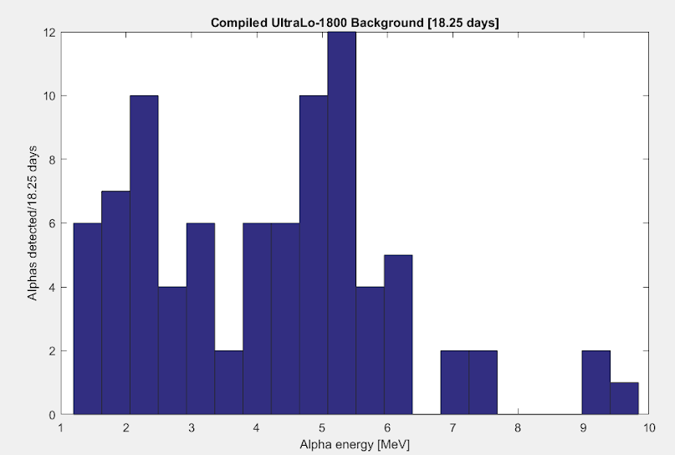
UltraLo-1800 Brown
Chasey Rhye
Compiled significant background data under periods of low activity (18 days, plot below) shows a sharp falloff beyond a 5.3 MeV alpha peak.
  Implies that a significant portion of background is from ²¹⁰Po liner and tray surface contamination
Non-Polonium backgrounds are eliminated via the [4.0 - 5.8 MeV] energy cut, reducing overall background event rate by 1.55 ± 0.07 times.

Slide 15
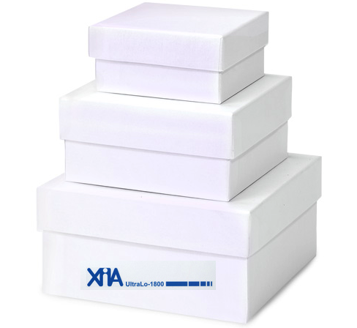
XIA Facility - Kamioka
Kazuyoshi Kobayashi
The alpha particle counter was installed underground at the Kavli Institute, the University of Tokyo.
Established a method to assay 210Pb and 210Po contaminations in the bulk of copper samples using a low-background alpha particle counter.
Achieved sensitivity for the 210Pb and 210Po contaminations reaches a few mBq/kg.
Due to this high sensitivity, the 210Pb and 210Po contaminations in oxygen free copper bulk were identified and measured for the first time. The 210Pb contaminations of our oxygen free copper samples were 17-40 mBq/kg.
https://arxiv.org/pdf/1707.06413.pdf
Operated in class 1000 cleanroom.
See talk tomorrow - 09:25 - 09:45!

Slide 16

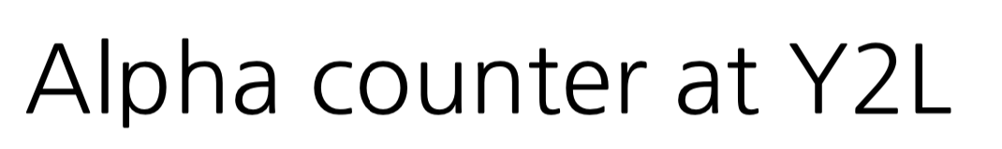
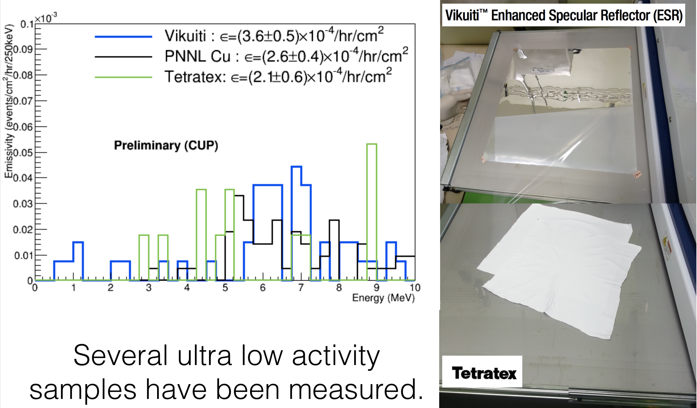
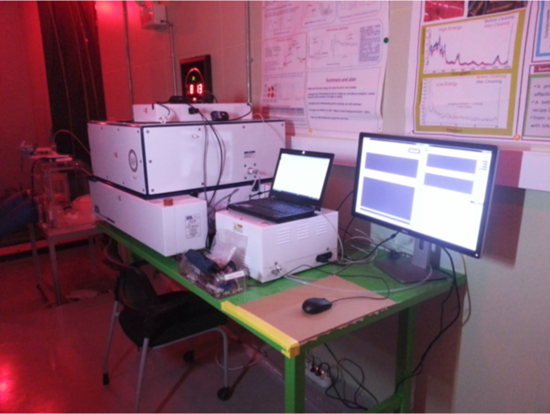
Chang Hyon Ha
A study on how Po-210 is produced helps identify the source of the Pb-210 background in rare event detectors, e.g. COSINE or AMoRE.
Artificial exposure to radon and measure the activities in copper, NaI(Tl) crystal, and Teflon reflector. Exposure to radon and air has been shown to increase Po-210 counts.

Slide 17
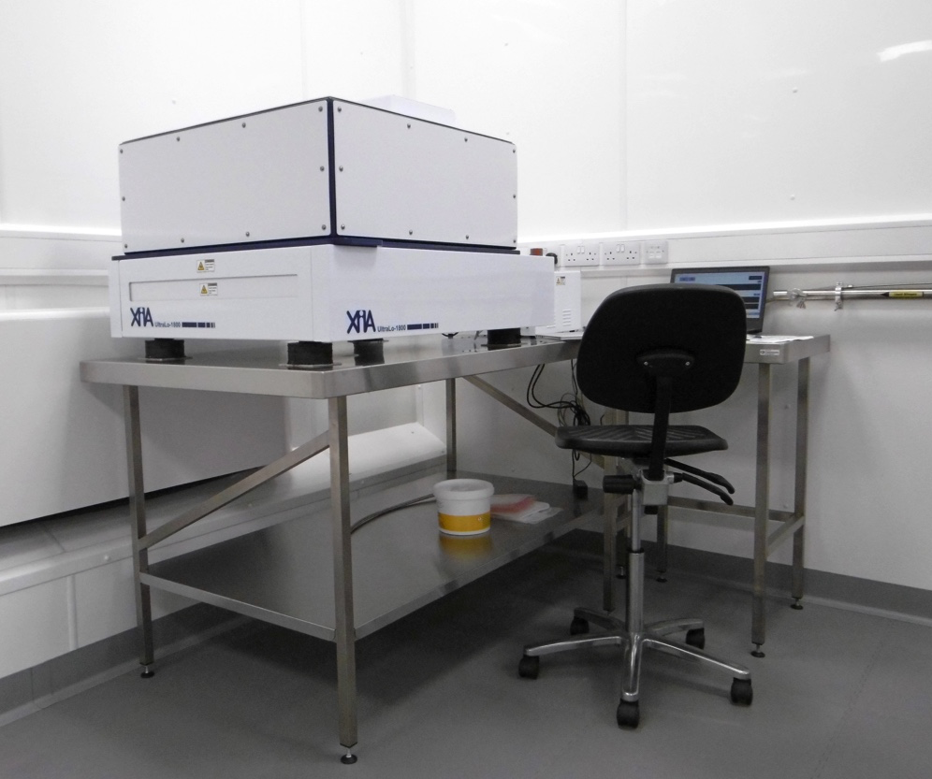
New XIA Facility - Boulby
A UltraLo has been installed at Boulby Underground Laboratory within the “BUGS” cleanroom (Class 1000).
Dedicated argon gas is supplied to the counter via boil off from the 240l dewar. Typical flowrate is 3 lpm during measurement and 15 lpm during purging. The detector is kept under constant gas flow.
Developing material cleaning techniques to complement surface assay capabilities.
Surface measurements of LZ detector components and ultra-pure PNNL copper.
Installed surface linear to reduce detector backgrounds.

Slide 18
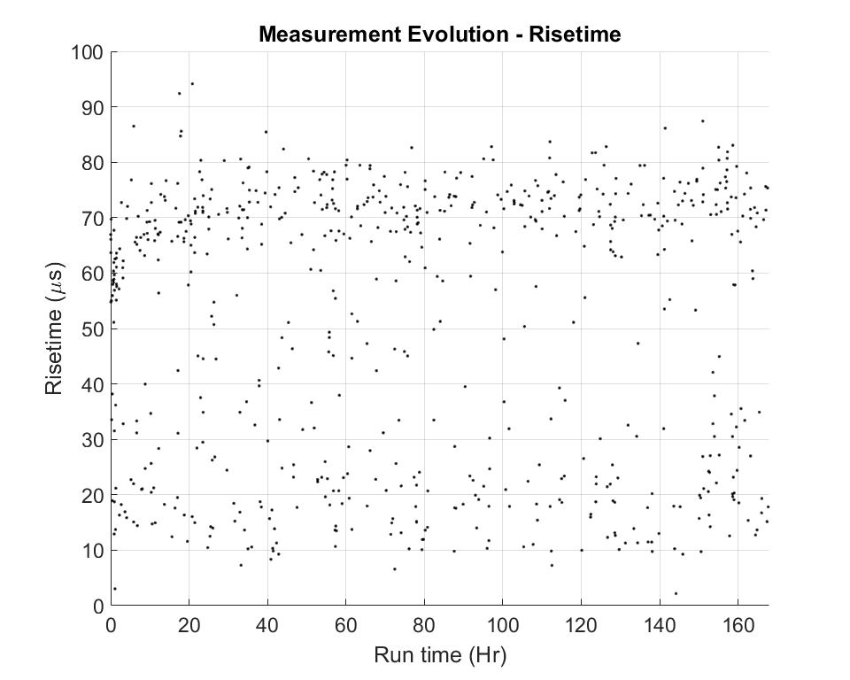
Background Run - Clean Sample Plate
When the XIA is open/closed for sample swap, moisture is introduced into the detector volume.
Typically discard the data from the first 24 hours after sample insertion.
Record the data in two seperate files 24 hours then full sample run.
Moisture related transients at the start of data acquisition.

Slide 19
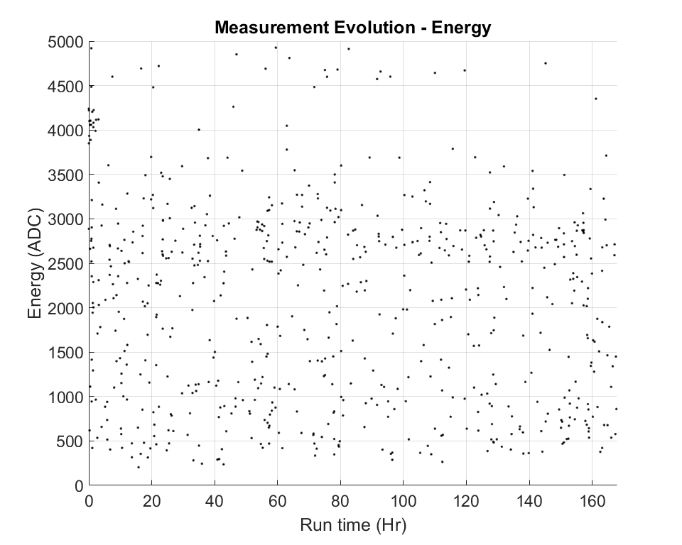
Background Run - Clean Sample Plate
Events falling between 4000-5000 ADC corresponds to alphas with energies 7 - 8 MeV.
When the XIA is open/closed for sample swap, radon is introduced into the detector volume.
These are decays from radon daughters, ²¹⁴Po (7.69 MeV) and ²¹²Po (8.78 MeV), from Radon and Thoron respectively.
Surprised to see the constant radon level. Decided to check plumbing and discovered a leak in the gas line feeding the argon to the XIA.

Slide 20
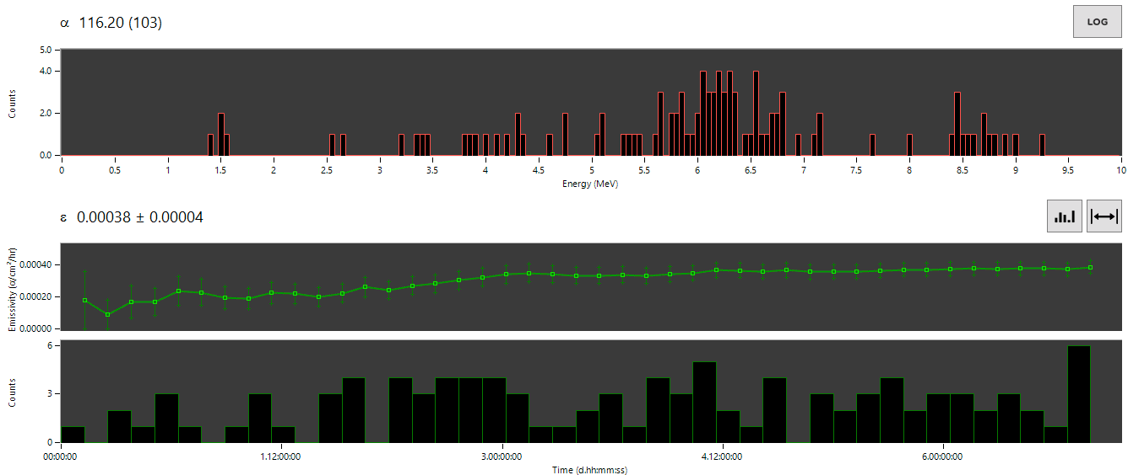
Results - PTFE Liner Background

Slide 21
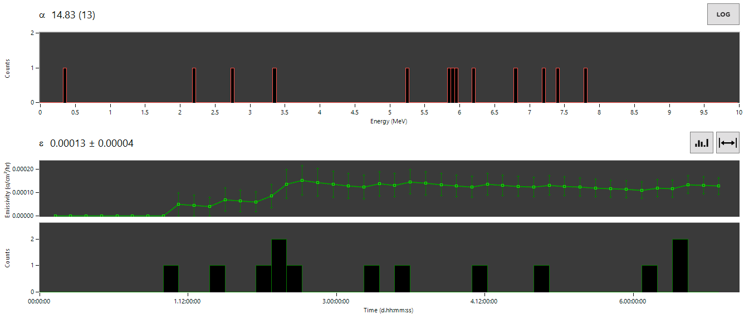
Results - PNNL Copper
Equivalent to 0.72 ± 0.22 mBq/m².

Slide 22
Results
The lowest published measurement so far with XIA is XMASS at LRT2015 where they got 0.14 ± 0.03 ⍺/khr/cm². This is from their low background copper which is comparable to the copper measured at Boulby.
Factor 3 improvement compared to surface lab due to more cosmics which can mimic a background events. Underground detectors are limited by radon in gas decaying very close to the surface of the sample.
Sample | Duration (hrs) | Alphas | Surface Area (cm²) | Emissivity (⍺/khr/cm²) | Activity (mBq/m²)
Background (SS Tray) | 168 | 342 | 1800 | 1.24 ± 0.07 | 6.88 ± 0.38
Background (PTFE Liner) | 168 | 103 | 1800 | 0.38 ± 0.04 | 2.12 ± 0.22
LZ Titanium (IPA) | 168 | 4779 | 707 | 46.65 ± 0.67 | 259.16 ± 3.72
LZ Titanium (Citranox) | 168 | 2302 | 707 | 22.07 ± 0.46 | 122.62 ± 2.56
PNNL Copper | 168 | 13 | 707 | 0.13 ± 0.04 | 0.72 ± 0.22

Slide 23
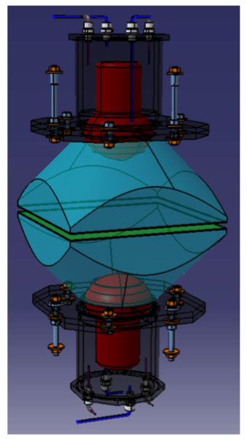
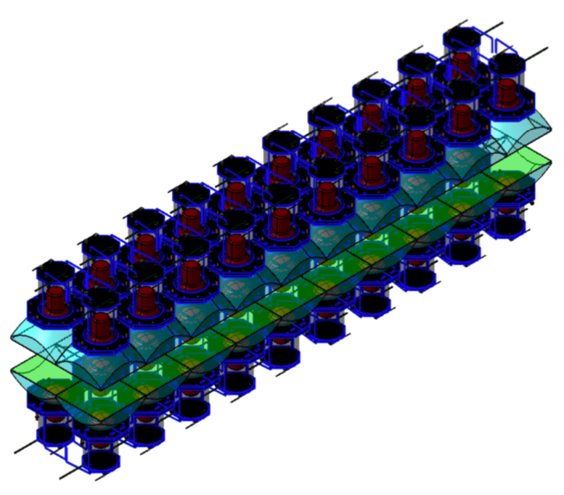
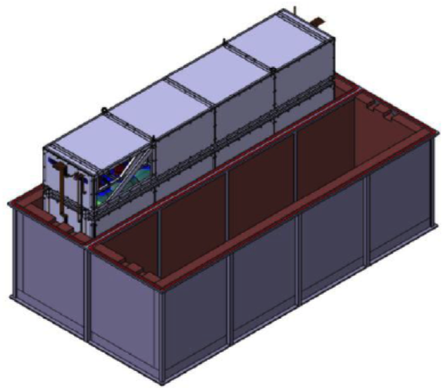

BiPo-3 (SuperNEMO)
Composed of 2 modules
Each module consists of 20 pairs of optical sub-modules
Each optical sub-module consists of a polystyrene-based scintillator plate coupled with a PMMA optical guide to a 5 inches low radioactive PMT.
The total detector surface is 3.6 m2.

Slide 24


BiPo-3
The measurement principle is the detection of an electron followed by a delayed α particle.
The BiPo-3 detector reached sensitivities
A(²⁰⁸Tl) = 0.9 ± 0.2 μBq/m²
A(²¹⁴Bi) = 1.0 ± 0.4 μBq/m²

Slide 25
Summary
XIA UltraLo-1800 provides a fast, reliable way to determine surface and bulk material contamination of Po210 and Pb210.
Complimentary detection technique to understanding full decay chain activities.
Current XIAs have a typical surface measurement sensitivity of order 1 mBq/m² and bulk measurement sensitivity of order 50 mBq/kg.
Working to further improve current detector sensitivity
            - Improve energy cuts to further suppress backgrounds.
  - Modifying the rise time cut to improve radon identification
  without compromising signal efficiency as much.

Slide 26

Thank you for listening!
Any Questions?

Slide 27


BiPo-3 Backgrounds

Slide 28

First Background Run
With stainless steel sample tray.

Slide 29


First Background Run

Slide 30

Results - PNNL Copper

Slide 31

XIA Improvements

