Slide 1


Noble gas purification for LZ and other rare event searches
Eric Miller
LRT – Jaca, Spain
May 20 2019

Slide 2
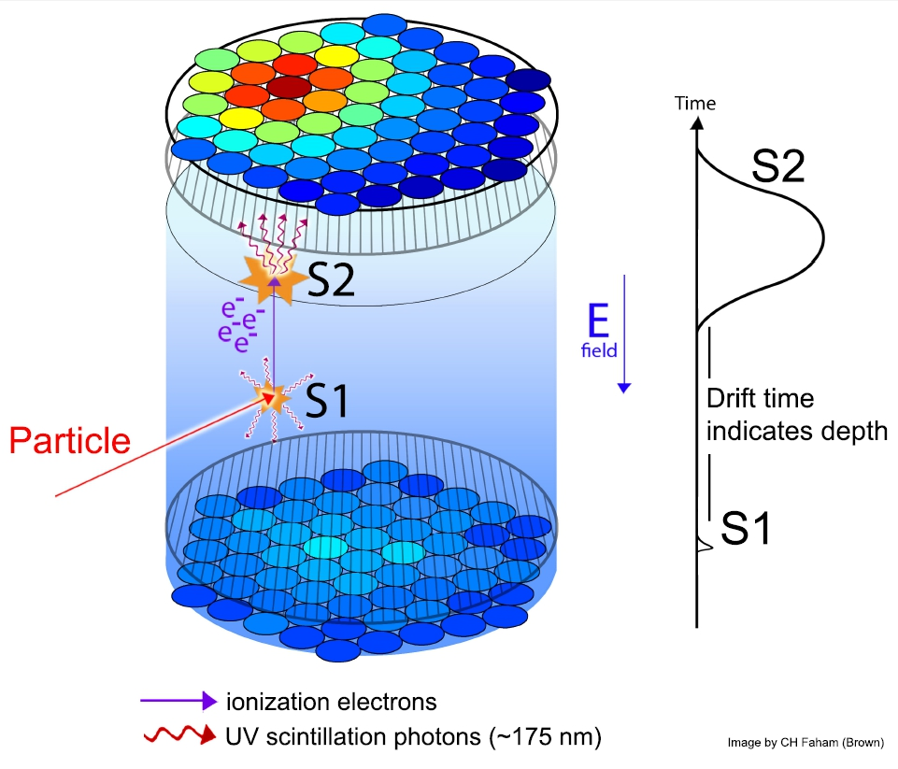
LZ Detector
Z position from S1 – S2 timing
X-Y positions from light pattern
Reject gammas by S2/S1 ratio
Expect > 99.5% rejection
Notes:
Time Projection Chamber

Slide 3
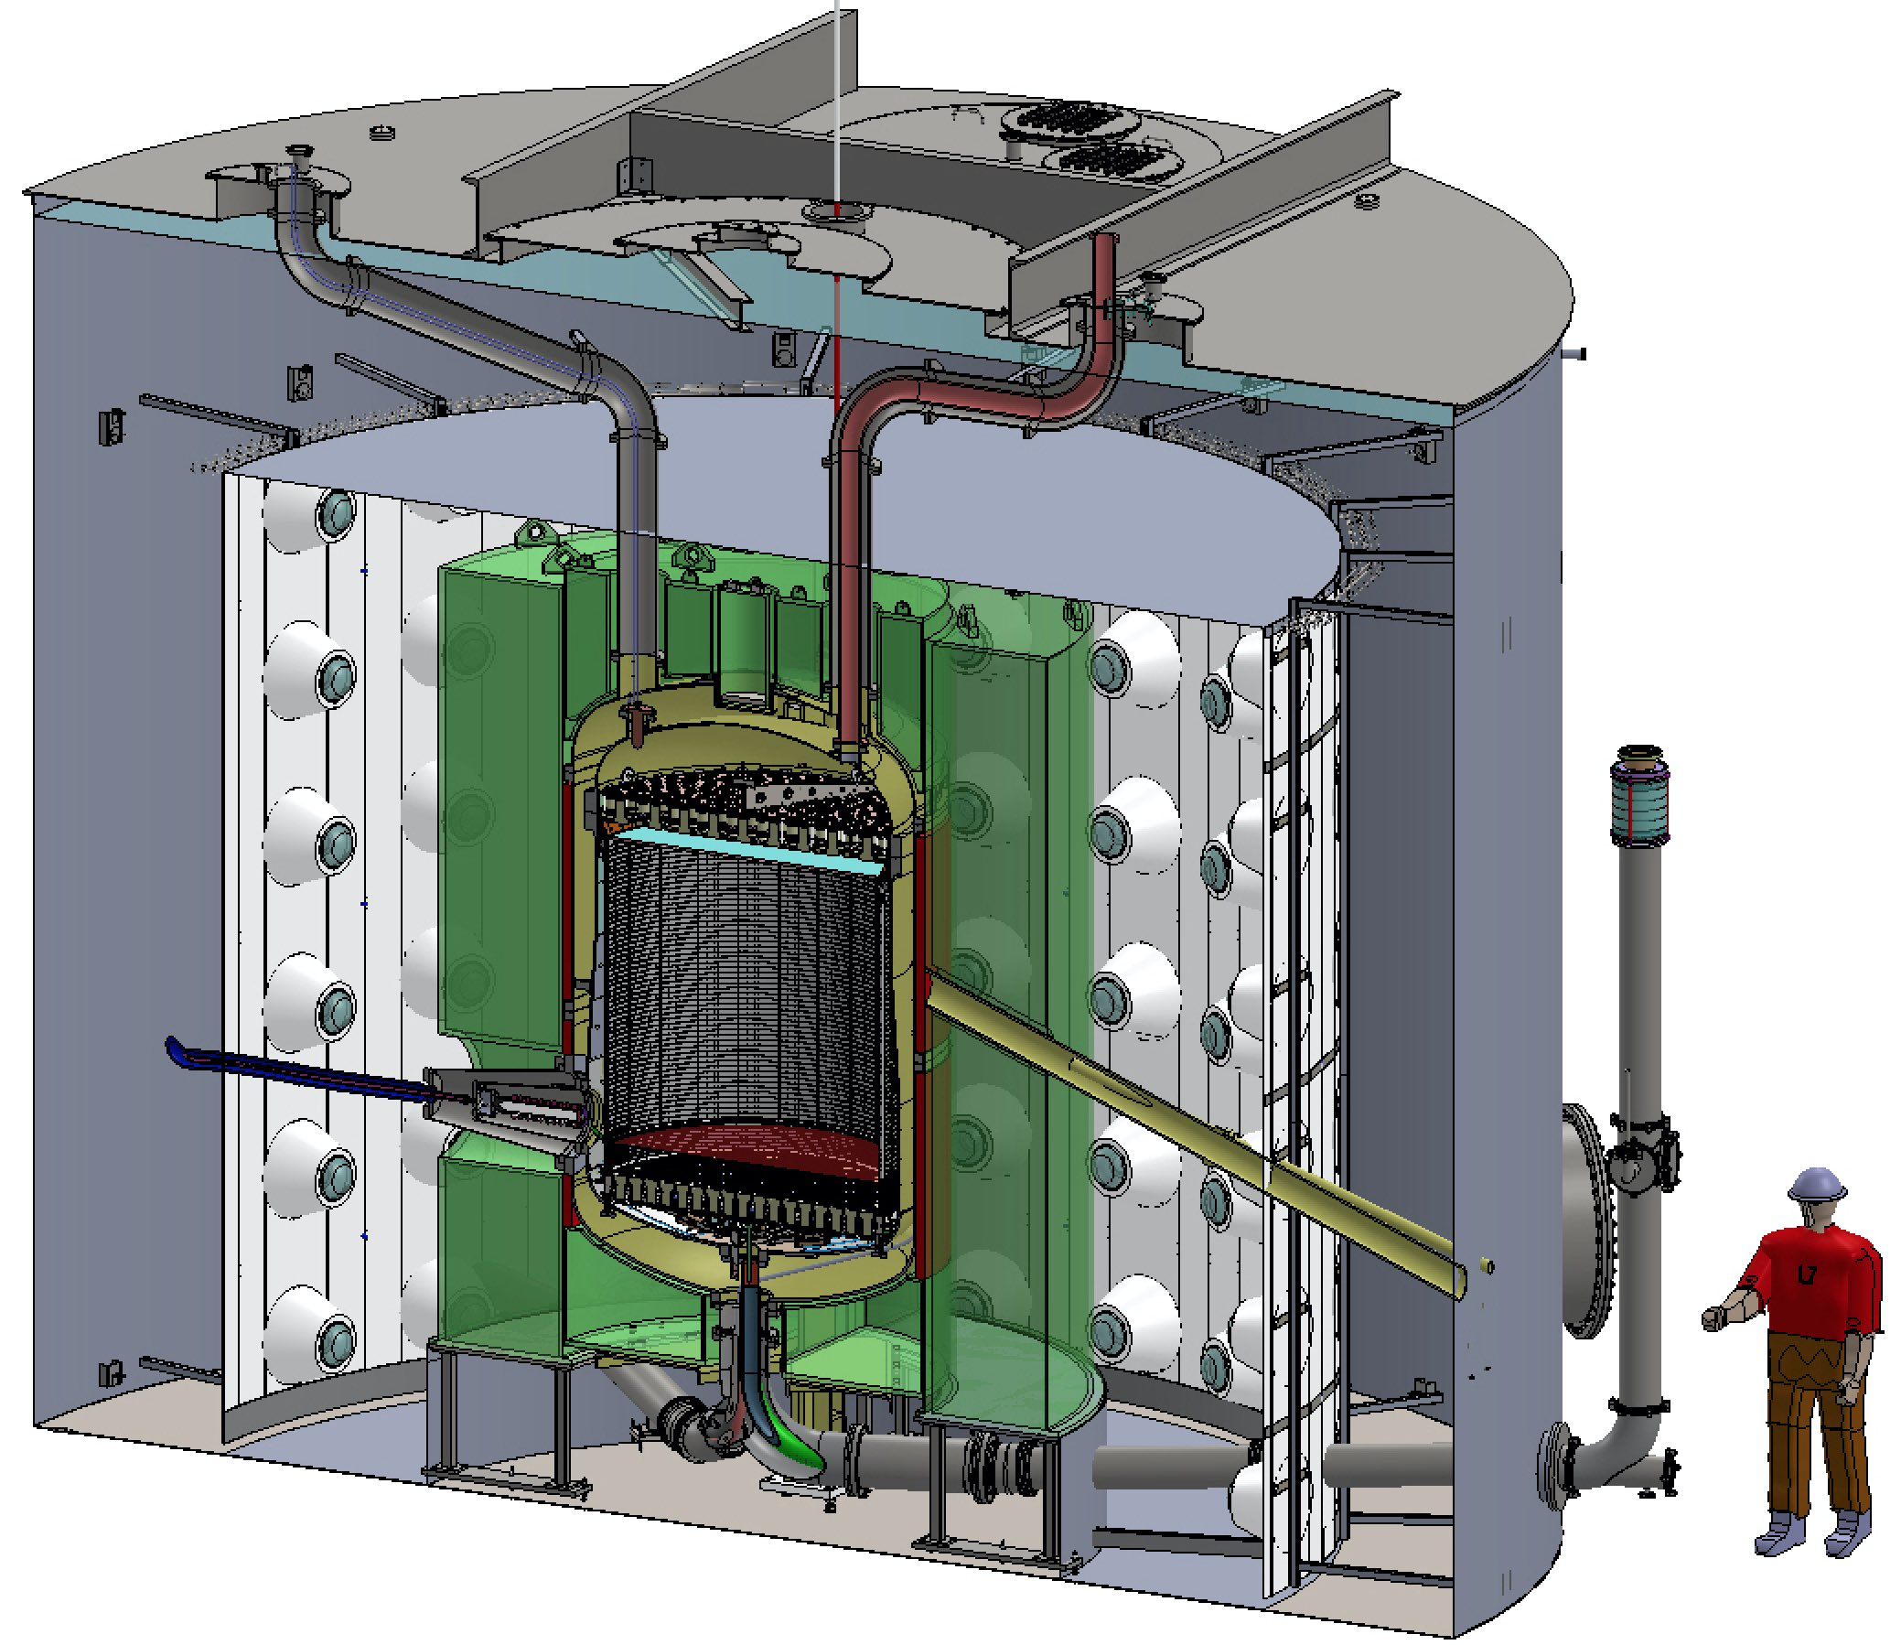
LUX-ZEPLIN (LZ) detector
7.0 T active LXe
5.6T fiducial
Neutron conduit
Instrumented Xe skin detector
50 kV cathode high voltage
17 tonnes Gd-LS Outer Detector
LXe supply & return
Technical Design Report, arXiv:1703.09144.
Lower PMT cable conduit

Slide 4
Backgrounds uniform in LXe
Solar neutrinos
Contamination of the xenon by:
  Non-noble gases, eg ³H
  Long-lived noble gases, eg ⁸⁵Kr, ³⁹Ar
  Short-lived noble gases, eg ²²²Rn

Slide 5
Backgrounds uniform in LXe
Solar neutrinos
Contamination of the xenon by:
  Non-noble gases, eg ³H
  Removed by Getter
  Long-lived noble gases, eg ⁸⁵Kr, ³⁹Ar
  Removed before experiment start
  Short-lived noble gases, eg ²²²Rn
  Mitigated by materials screening
  Removed while experiment is running

Slide 6
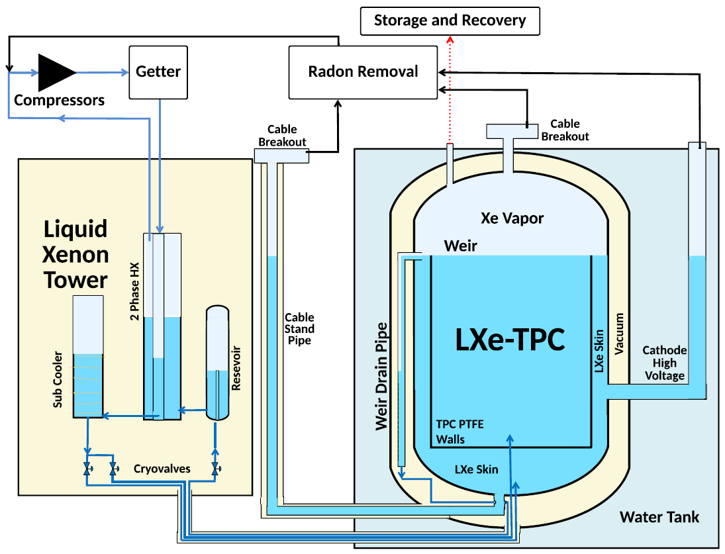
LZ Circulation

Slide 7
Circulation Getter
LZ’s full 10 tonnes purified every 2.3 days
Saes hot zirconium getter removes electronegative impurities
  O₂, N₂, etc.
  Critical for detector performance
Getter also removes ³H
  Eliminates this background

Slide 8
LZ – Radon Control
Radon emanates from materials in contact with Xe
Screening
  Around 100 materials/components screened for LZ
  Warm end of PMT cables potentially significant

Slide 9
LZ – Radon Control
Radon emanates from materials in contact with Xe
Screening
  Around 100 materials/components screened for LZ
  Warm end of PMT cables potentially significant
In-line removal system
  Impractical to purify 500 SLPM circulation
  Practical to purify problematic areas

Slide 10
LZ – Radon Control
Radon emanates from materials in contact with Xe
Screening
  Around 100 materials/components screened for LZ
  Warm end of PMT cables potentially significant
In-line removal system
  Impractical to purify 500 SLPM circulation
  Practical to purify problematic areas
Projected Rn level:
  <2 μBq/kg

Slide 11
LZ Circulation

Slide 12
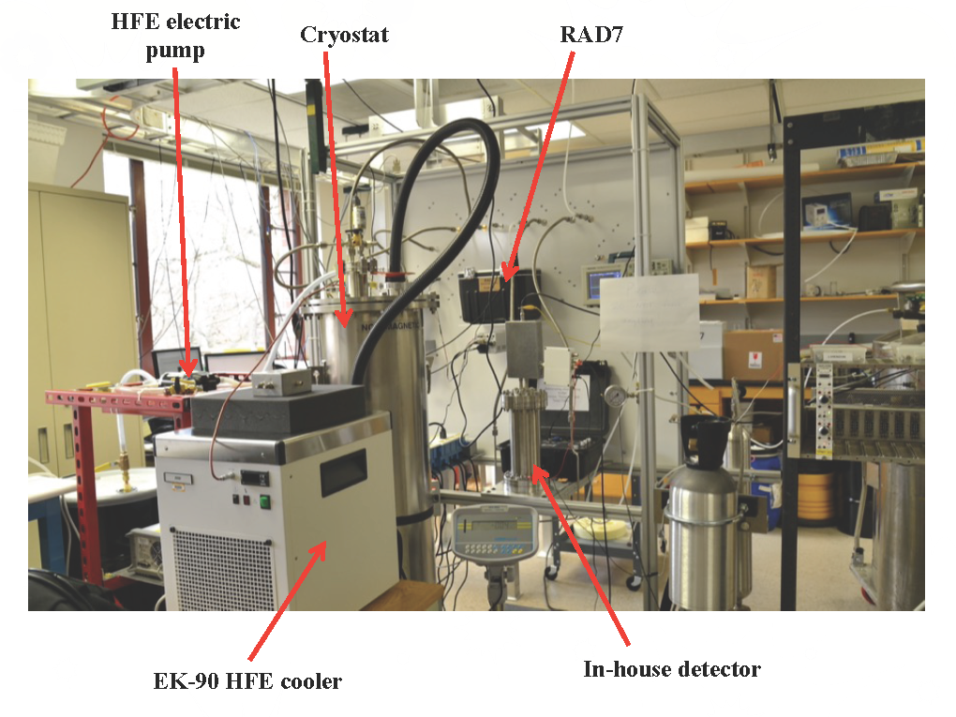
LZ – In-line radon removal
Remove radon from subset of circulation flow
  0.1% of Xe flow, but significant Rn contribution
Strategy: charcoal chromatography
  Radon passes through
  charcoal slower than xenon
  Design system to trap radon
  for many half-lives (3.8 days)
Radon Removal system in
development at the University
of Michigan:

Slide 13
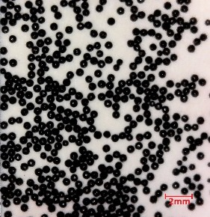
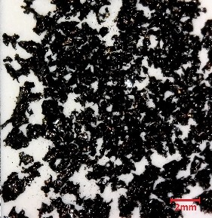
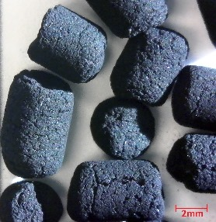
LZ – In-line radon removal
Critical that charcoal remove more radon than it produces!
  Identify low-emanation; high adsorption charcoal
Saratech
CarboAct
Shirasagi
Charcoal | Density (g/cm³) | Surface area (m²/g) | Spec. activity (mBq/kg) | Price ($/kg)
Shirasagi | 0.45 | 1,240 | 101 ± 8 | 27
CarboAct | 0.28 | 1,000 | 0.23 ± 0.19 | 15,000
Saratech | 0.60 | 1,340 | 1.71 ± 0.20 | 35
Saratach (HNO₃) | 0.60 | 1,340 | 0.51 ± 0.09 | 135
provided by Carter Hall

Slide 14
Any worry about cosmic-ray activation of xenon?
Cosmic ray interactions produce radioactive byproducts in xenon cylinders at the Earth’s surface
Many of these are solids, and will not enter experiment
³H will be removed by getter
¹²⁷Xe
  36-day half-life reduces impact
  Production rate too low to be significant background
¹³³Xe
  5.2 day half-life reduces impact
We have the luxury of purifying Xe at the surface
Cosmogenic activation of xenon and copper, Baudis et al., Eur. Phys. J. C (2015) 75: 485

Slide 15
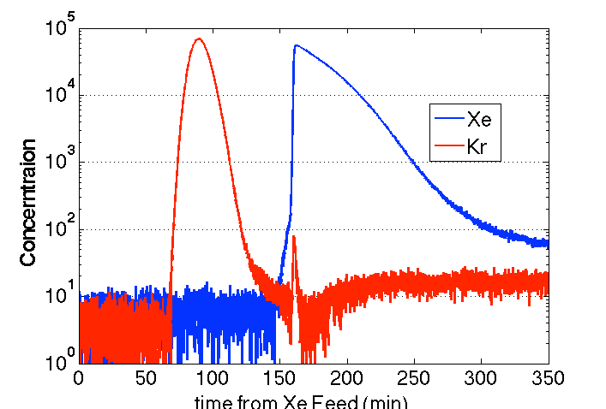
Kr Removal with Chromatography
Remove via gas charcoal chromatography (with helium carrier gas)
  Kr has a faster flow rate through activated charcoal than Xe

Slide 16
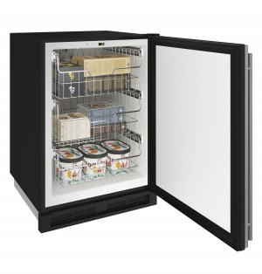
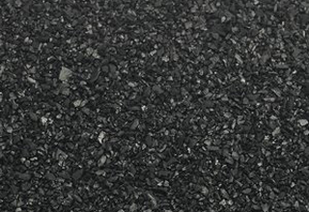
Freezer
Cold
Charcoal
Trap
Storage
Compressor
Circulation
Pump
Vacuum
Pump
Bottles of
Xenon
400 kg Charcoal Column

Slide 17
LZ Kr Removal - Chromatography
Freezer
Clean He
Cold
Charcoal
Trap
Storage
Compressor
Circulation
Pump
Vacuum
Pump
Bottles of
Xenon
400 kg Charcoal Column

Slide 18
LZ Kr Removal - Chromatography
Xenon with ppb Kr
Freezer
Clean He
Cold
Charcoal
Trap
Storage
Compressor
Circulation
Pump
Vacuum
Pump
Bottles of
Xenon
400 kg Charcoal Column

Slide 19
LZ Kr Removal - Recovery
Freezer
Clean He
Cold
Charcoal
Trap
Storage
Compressor
Circulation
Pump
Vacuum
Pump
Bottles of
Xenon
400 kg Charcoal Column

Slide 20
LZ Kr Removal - Storage
Freezer
Ultrapure Xe
Cold
Charcoal
Trap
Storage
Compressor
Circulation
Pump
Vacuum
Pump
Bottles of
Ultrapure
Xenon
400 kg Charcoal Column

Slide 21
LZ – Krypton Removal
Employ 2 columns to clean xenon twice as fast!
LZ system to process 16 kg slugs every two hours
Plan to purify 10 tonnes over 6 months
R&D system reduced Kr content to 0.06 ppt
LZ system designed to achieve 0.015 ppt (15 ppq)
  Subdominant to solar neutrinos
  LZ requires < 0.3 ppt
  Currently commissioning system

Slide 22
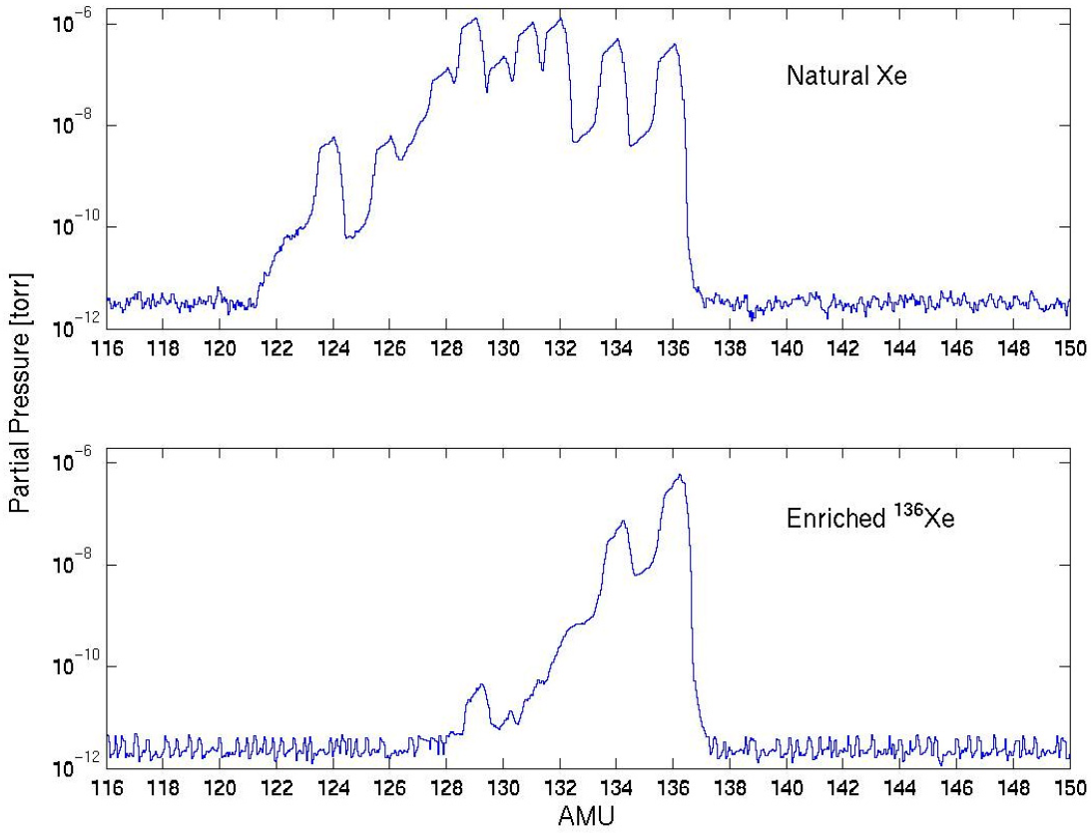
Centrifuge Purification - EXO
Enriched Xenon Observatory (EXO-200) searched for neutrinoless double-beta decay in ¹³⁶Xe
Centrifuges used to enrich heavy isotopes of Xe
  ¹³⁶Xe fraction increased from 8.9% to 80.6%
Other lighter elements also
removed by this process
  Including ⁸⁵Kr and ³⁹Ar
Kr concentration reduced to
16.3 ± 1.9 ppt
The EXO-200 detector, part I: detector design and construction, EXO Collaboration. Journal of Instrumentation 7 (05), P05010, 2012

Slide 23
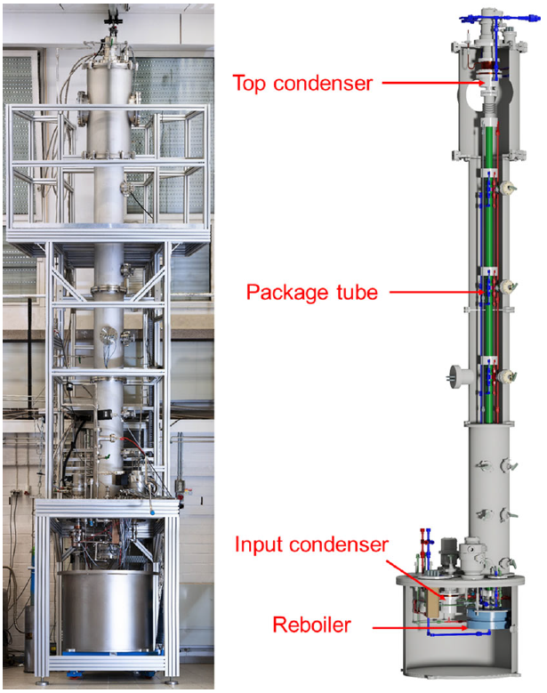
Cryogenic Distillation: Krypton
Employed by XMASS, XENON100, XENON1T, PANDAX…
Distillation tower for XENON1T
Operates at -98 C;
Vapor pressure of Kr is 10.8x
greater than of Xe
High-Kr gas extracted from the top
Low-Kr liquid extracted from bottom
Achieved lowest reported Kr level:
  < 17 ppq
Removing krypton from xenon by cryogenic distillation to the ppq level, XENON Collaboration, Eur. Phys. J. C (2017) 77: 275

Slide 24
Cryogenic Distillation: Radon
Demonstrated on XENON100
  Installed in series
  with circulation system
Operates at -96 C;
Low-Rn gas extracted from the top
Rn decays in liquid at bottom
See also talk by Hardy Simgen later this session!
Online 222Rn removal by cryogenic distillation in the XENON100 experiment, Eur. Phys. J. C (2017) 77: 358

Slide 25
Kr purity achieved
Experiment | Technique | Purity Achieved (ppt g/g)
Panda X | Distillation | <30
XENON1T | Distillation | <0.017
XMASS | Distillation | 2.1 ± 0.7
EXO-200 | Centrifuge | 16.3 ± 1.9
LUX | Chromatography | 3.5
LZ R&D | Chromatography | 0.06
Thanks for listening!

Slide 26
Bonus Slides

Slide 27
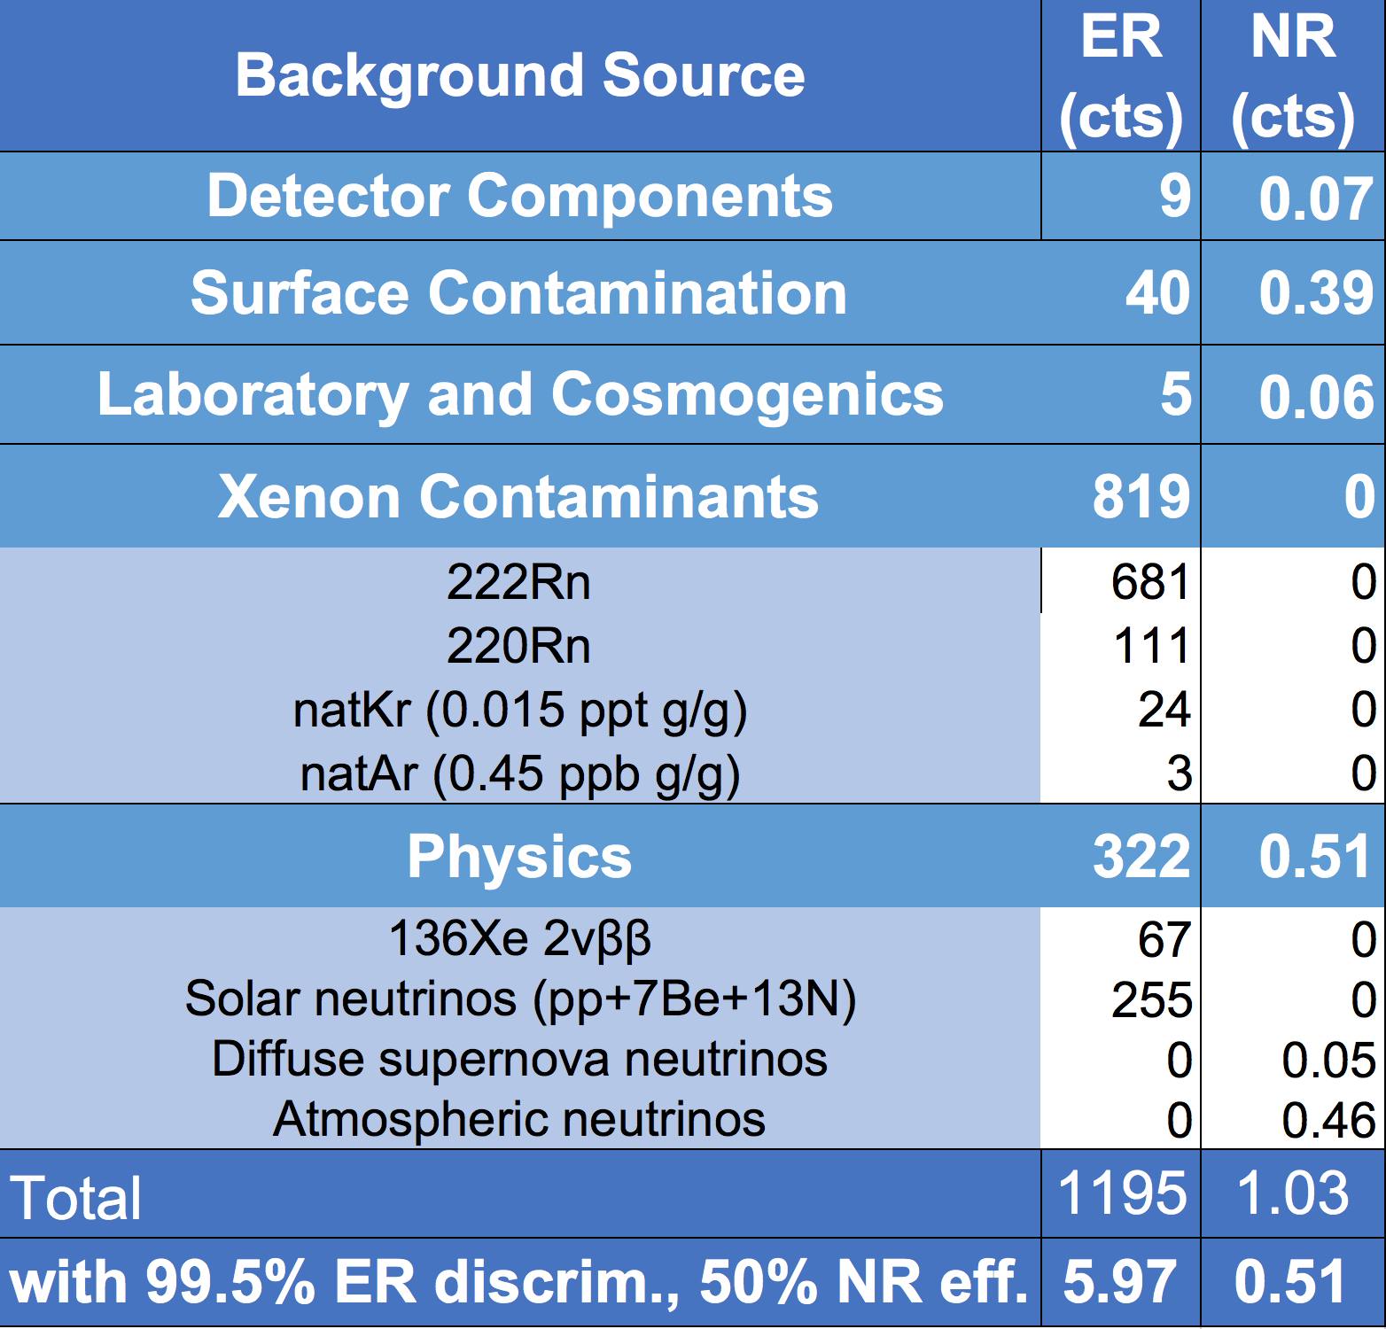
WIMP backgrounds summary
5.6 tonnes x 1000 days; ~1.5 to ~6.5 keV
Projected WIMP Sensitivity of the LUX-ZEPLIN (LZ) Dark Matter Experiment, LZ Collaboration, arXiv:1802.06039, 2018

