Slide 1

Purification of noble liquids: Low-radioactivity argon for DarkSide 20k
Luciano Romero
DarkSide Collaboration
Based on slides from:
M. Simeone, A. Renshaw, R. Tartaglia, P. Garcia-Abia, E. Sanchez, W. Bonivento
LRT 2019 Canfranc 20 May 2019

Slide 2
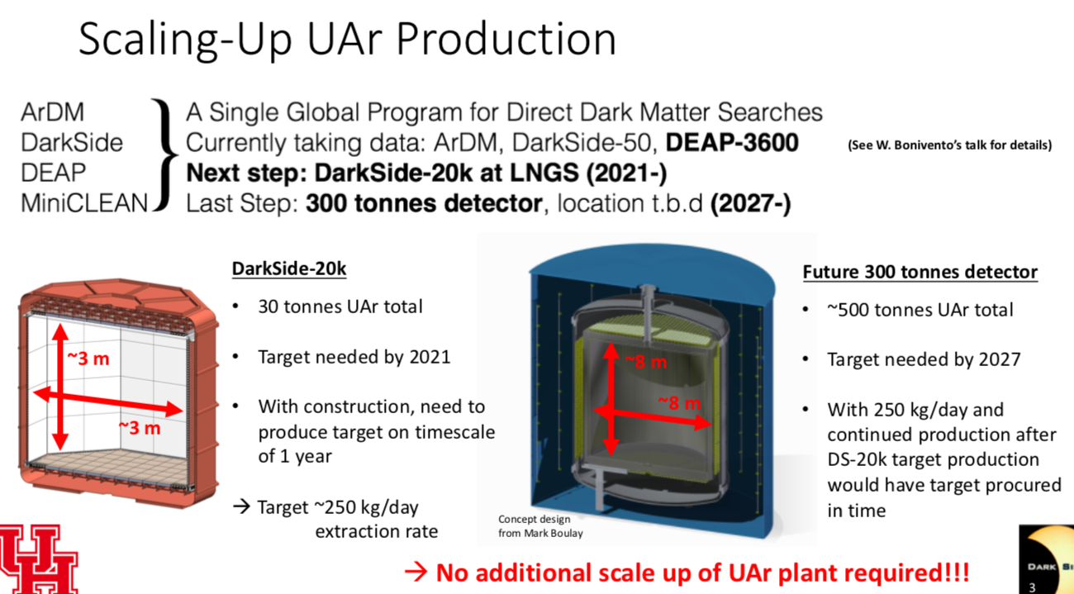
The need for UAr
Next generation direct DM search experiments will operate with liquid UAr to maximize the DM discovery potential.

Slide 3
Low radioactivity UAr in DarkSide
DarkSide 50 liters is an operating LAr detector installed at Gran Sasso underground laboratory.
It is filled with UAr extracted from a well in Cortez (Colorado).
  The concentration and purification of UAr was done using a pilot plant.
    Low production rate.
  DS-50 measured the depletion factor for ³⁹Ar of UAr with respect to AAr.
    The measured depletion factor is 1400.
  It is suspected contamination of UAr with AAr.
DS-20K can fullfill its physics goals with a depletion factor of 1400.
  10⁸ ER events expected in the full 100-200 tonne*year exposure.
  PSD gives a discrimination factor of 10⁻¹⁰ between ER and NR events.
It is required to increment the production rate of UAr. (URANIA)
The UAr would be purified and, eventually, further depleted (ARIA)
It is crucial to measure the depletion factor of ³⁹Ar in UAr. (DArT)
  DarkSide-20k: A 20 tonne two-phase LAr TPC for direct dark matter detection at LNGS. Eur. Phys. J. Plus (2018) 133: 131. DOI 10.1140/epjp/i2018-11973-4

Slide 4
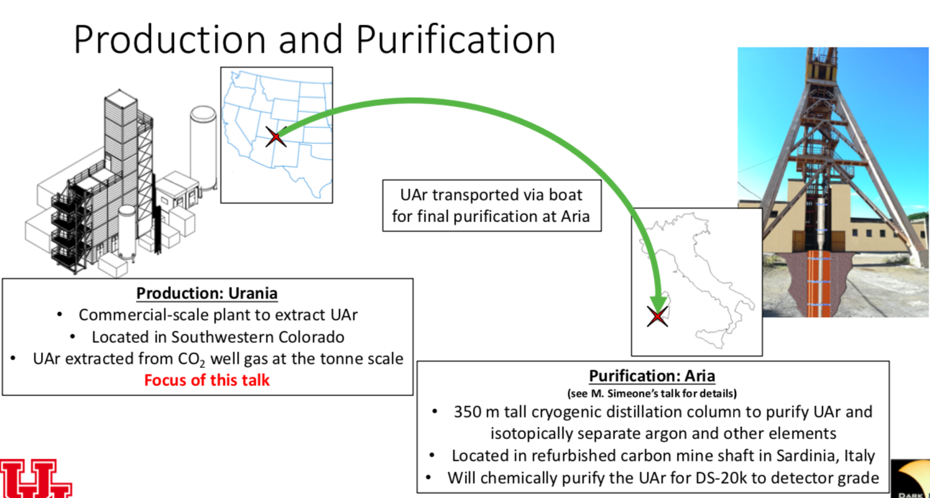

Production and purification
Urania
Aria

Slide 5
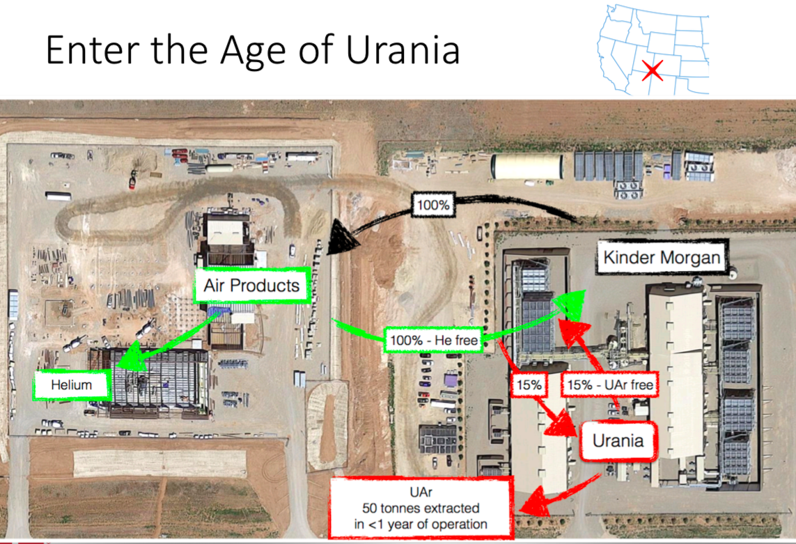
Urania

Slide 6
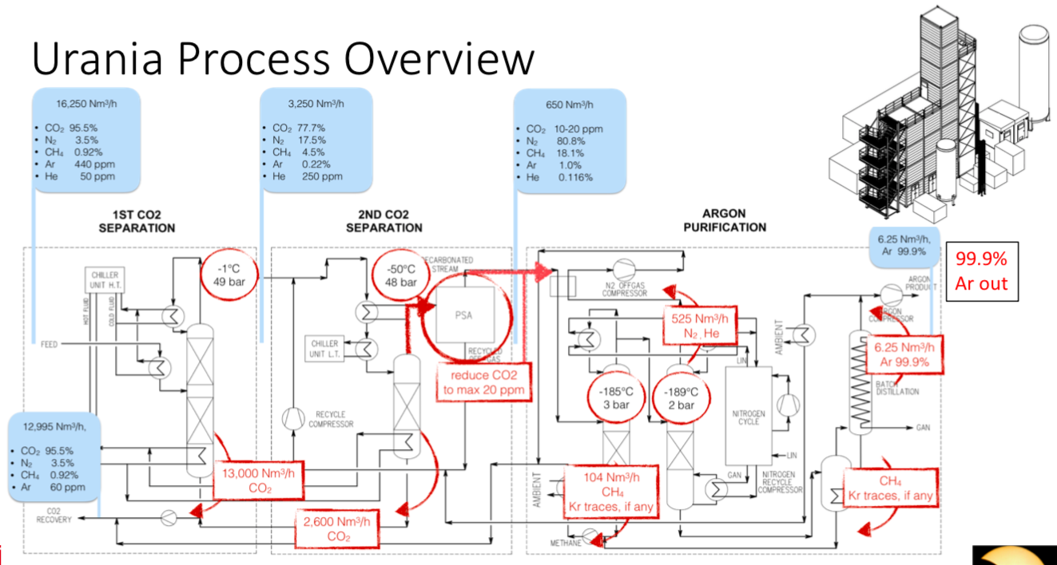
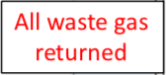
Urania process overview
250 Kg UAr per day

Slide 7
Project timeline

Slide 8
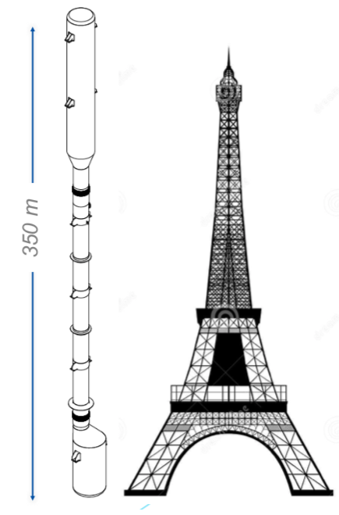
ARIA
Chemical purification of UAr
Will be used for ³⁹Ar depletion.
It is a cryogenic distillation column. To separate components with different volatility.
  The top module is a condenser (7m)
  The bottom module is a reboiler (5m)
  Middle modules (12m)
ARIA is to be installed in a dismissed coal mine shaft in Sardinia (Italy)
  Carbosulcis coal mine.
2 steps in ARIA:
  SERUCI-0: A prototype installed outside the mine.
  SERUCI-1: 28 middle modules.
Production rate with ARIA in chemical purification mode (DarkSide-20k): 1ton/day
Production rate with ARIA in cryogenic distillation mode: 10 Kg/day
Ar recovery close to 100%.
Two cycles are needed for separation of light and heavy components.
The purification will have to follow the URANIA production rate.

Slide 10
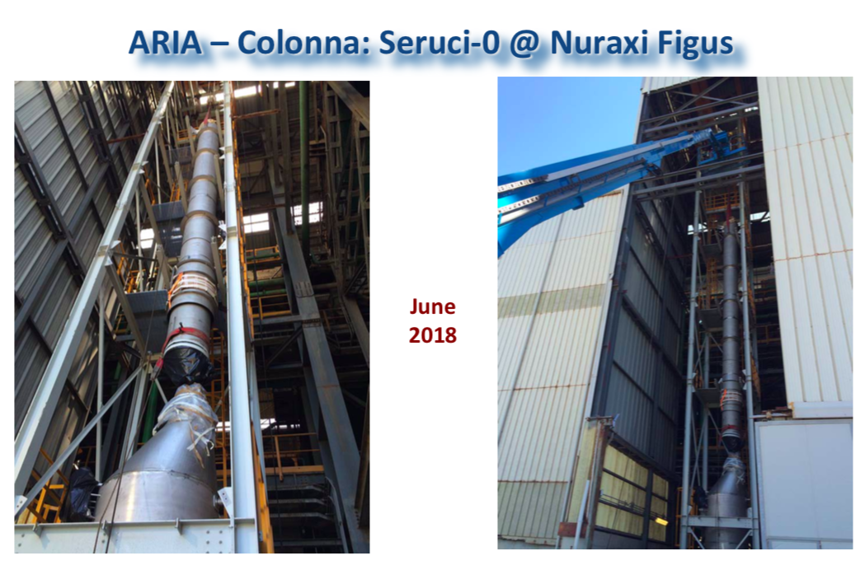
ARIA SERUCI-0

Slide 13
DArT
Measurement of ³⁹Ar in UAr
DArT is a small experiment designed to measure the ³⁹Ar depletion factor of UAr.
Low background detector that will be installed inside ArDM.
ArDM (Argon Dark Matter) is a 850 kg LAr TPC. Currently taking data at LSC (Canfranc, Spain).
ArDM will be used as an active veto.

Slide 14
Experimental set up
DArT is inserted in the middle of ArDM.
ArDM is used as a veto.
ArDM works in single phase mode.

Slide 16
DArT mechanical design
OFC copper vessel ~6.9 kg.
Acrylic cylindrical support structure. ~1.5 kg.
Lateral 3M reflecting foil.
2 SiPM tiles (top+bottom).
Internal volume ~2.6 L.
LAr active volume ~1 L.

Slide 17
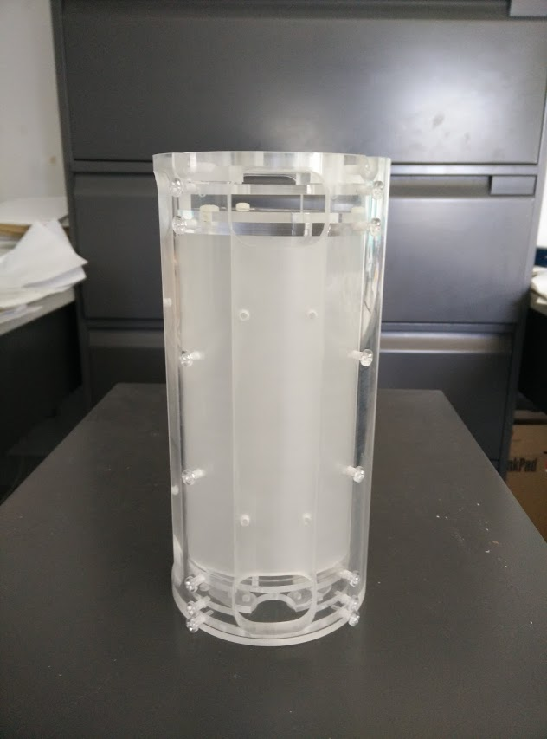
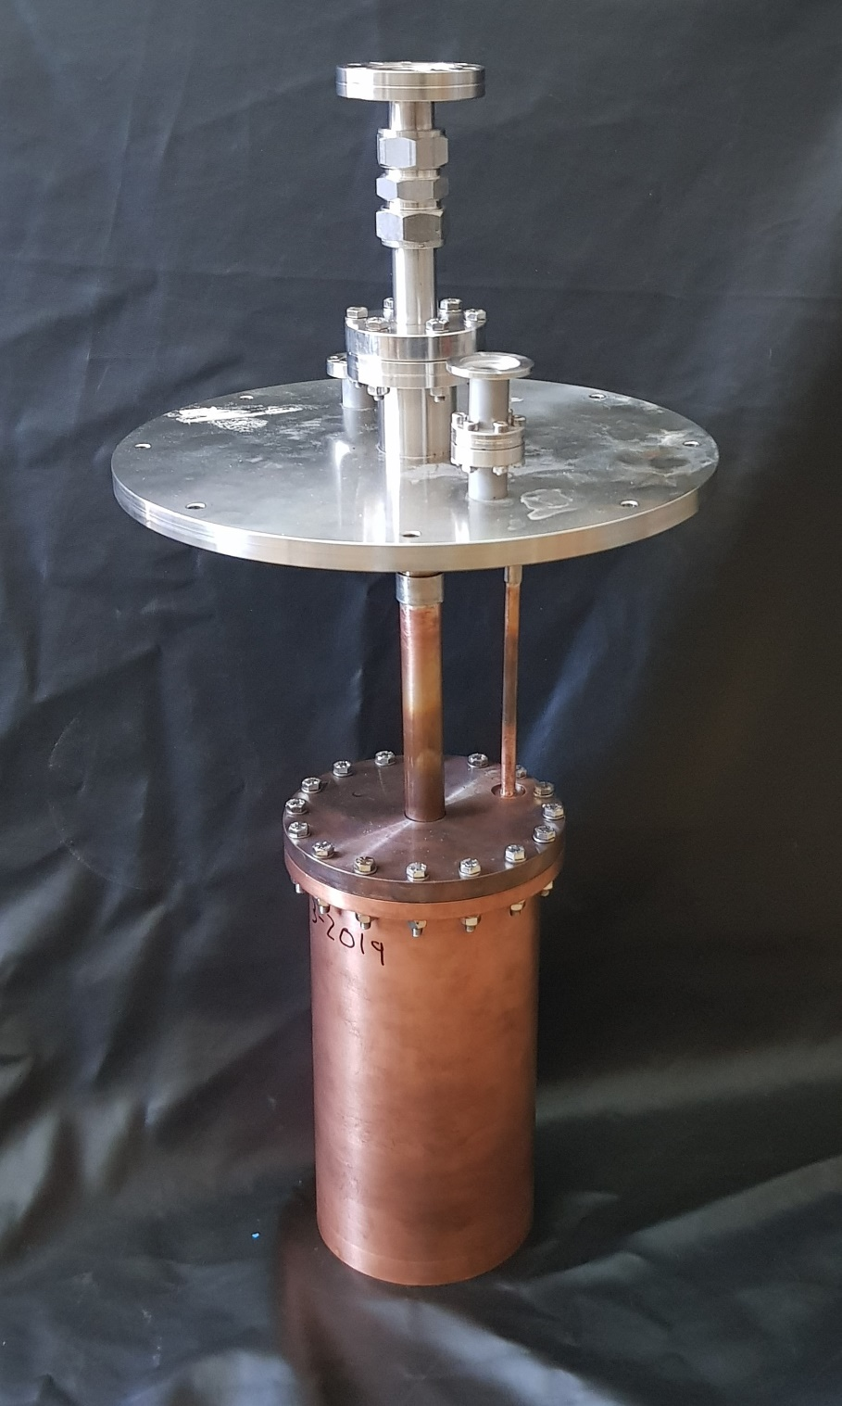
DArT construction status
Acrilic internal structure done in Canada
Testing the vessel at Ciemat

Slide 20
Summary of UAr in DarkSide
Plans for UAr production in Colorado (URANIA) are firmly stablished.
ARIA Prototype SERUCI- 0 is in place.
DArT detector is well advanced.

Slide 21
Backup slides

Slide 22
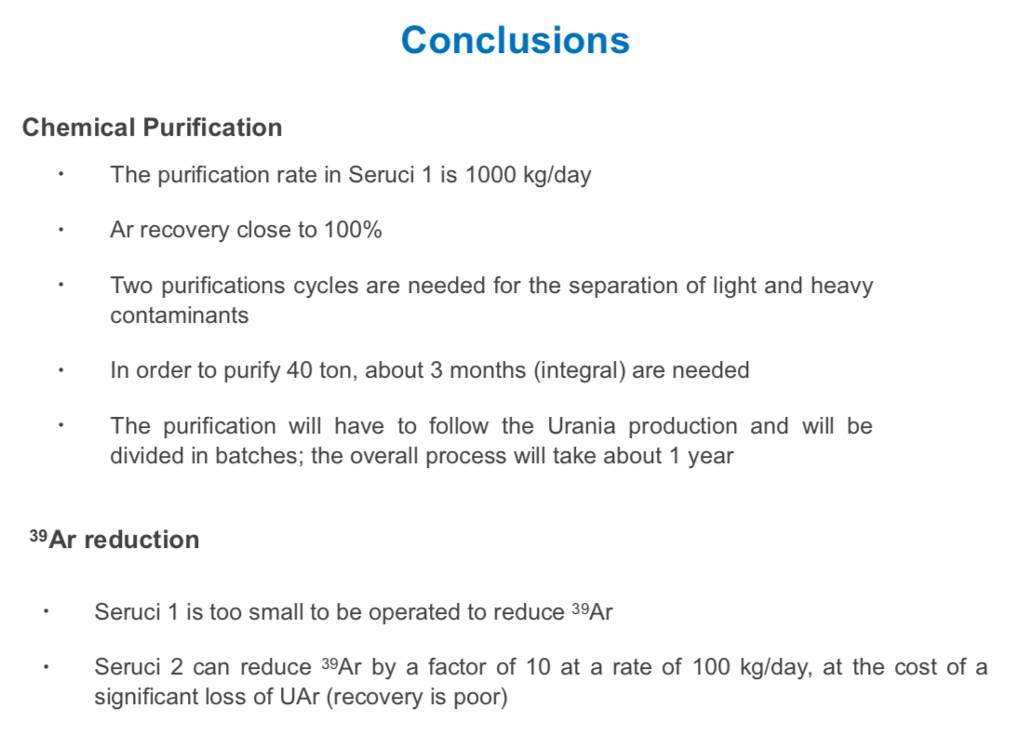
ARIA in a nutshell

Slide 23
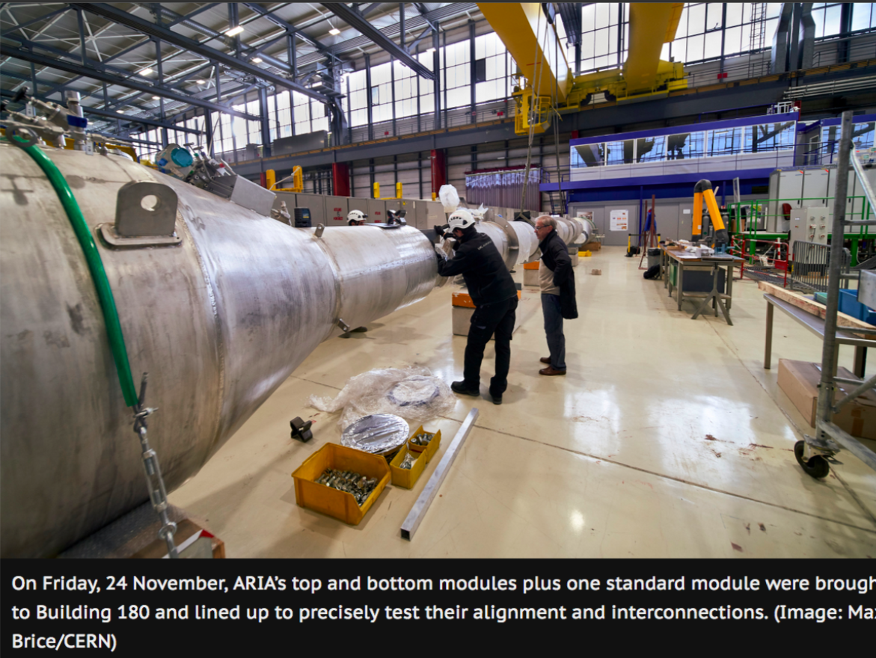
23￼

Slide 24
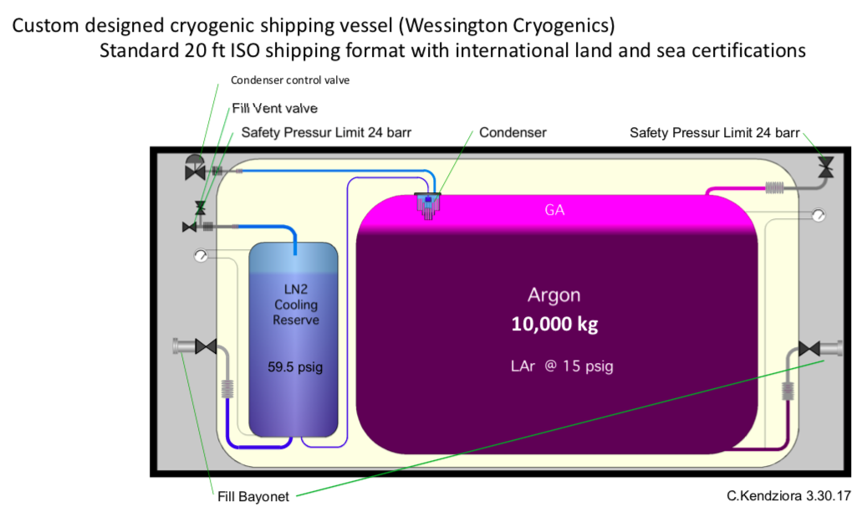
UAr shipping and storage
24￼

Slide 25
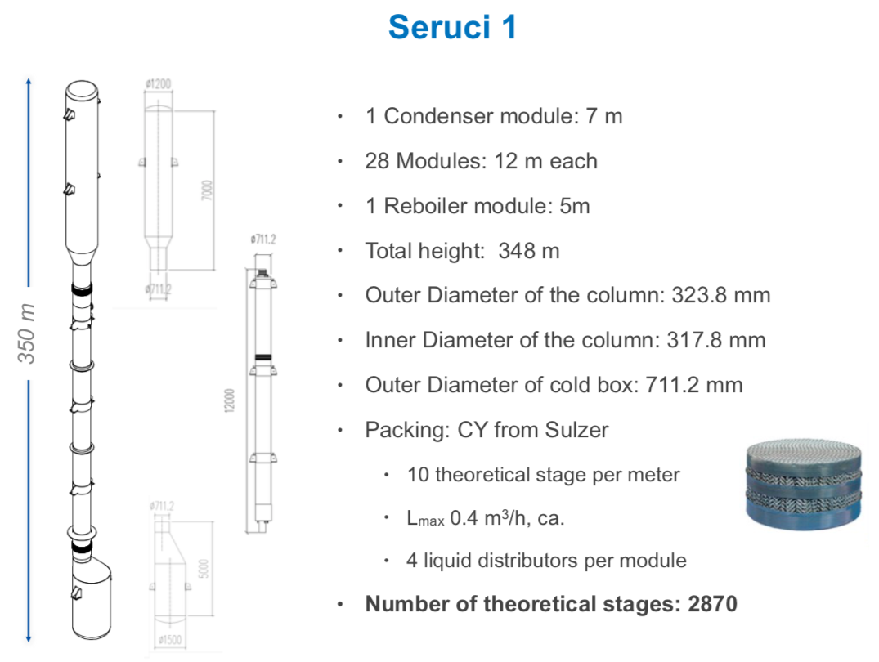

Slide 26
Experimental set up
DArT is inserted in the middle of ArDM.
ArDM is used as a veto.
ArDM works in single phase mode.

