Slide 1
Low background facilities in LSM
Overview of the germaniums and available at LSM

Slide 2
Germanium
Germanium hosted in LSM
Example of detector
Sample management
Partage project
Comparison to mass spectrometry

Slide 3
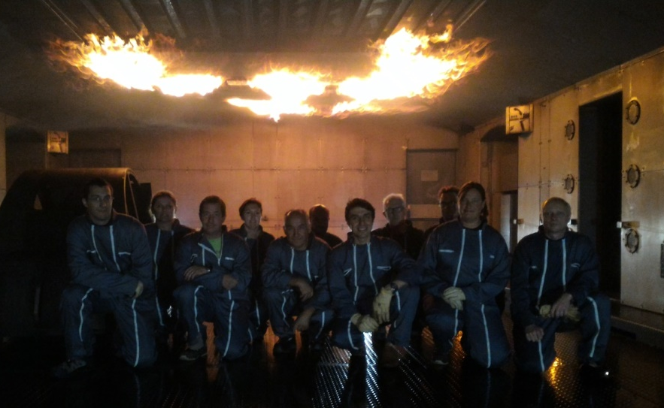


Laboratoire Souterrain de Modane
Located in Modane
12 permanents
1000 visitors days per year
Wide range of interdisciplinary topics
Astroparticles, nuclear physic, environment, electronics, radioactivity measurement, biology

Slide 4

Laboratoire Souterrain de Modane
Merger with Laboratoire de Physique Subatomique & Cosmologie (LPSC-IN2P3) in Grenoble
  70 researchers, 90 Engineers & technicians
  Covering fields in particle & nuclear physics, astroparticle and cosmology
LSM now becomes a « national facility » as labelled by the CNRS
  National facility for IN2P3 / CNRS
LSM as an national experimental facility for :
  Fundamental Physics
    Neutrino property determination
    Direct Dark matter search
  Gamma spectrometry measurement
    14 detectors measuring continuously
    Open to geosciences, materials, biology and medecine
      Actually 1000 samples measured per year
    PARTAGe project to automatize measurments
      Increase significantly the scope of the LSM

Slide 5
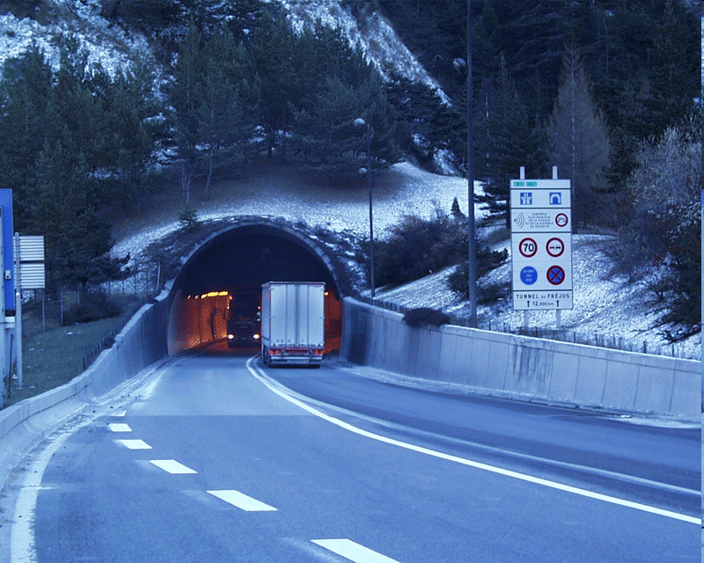
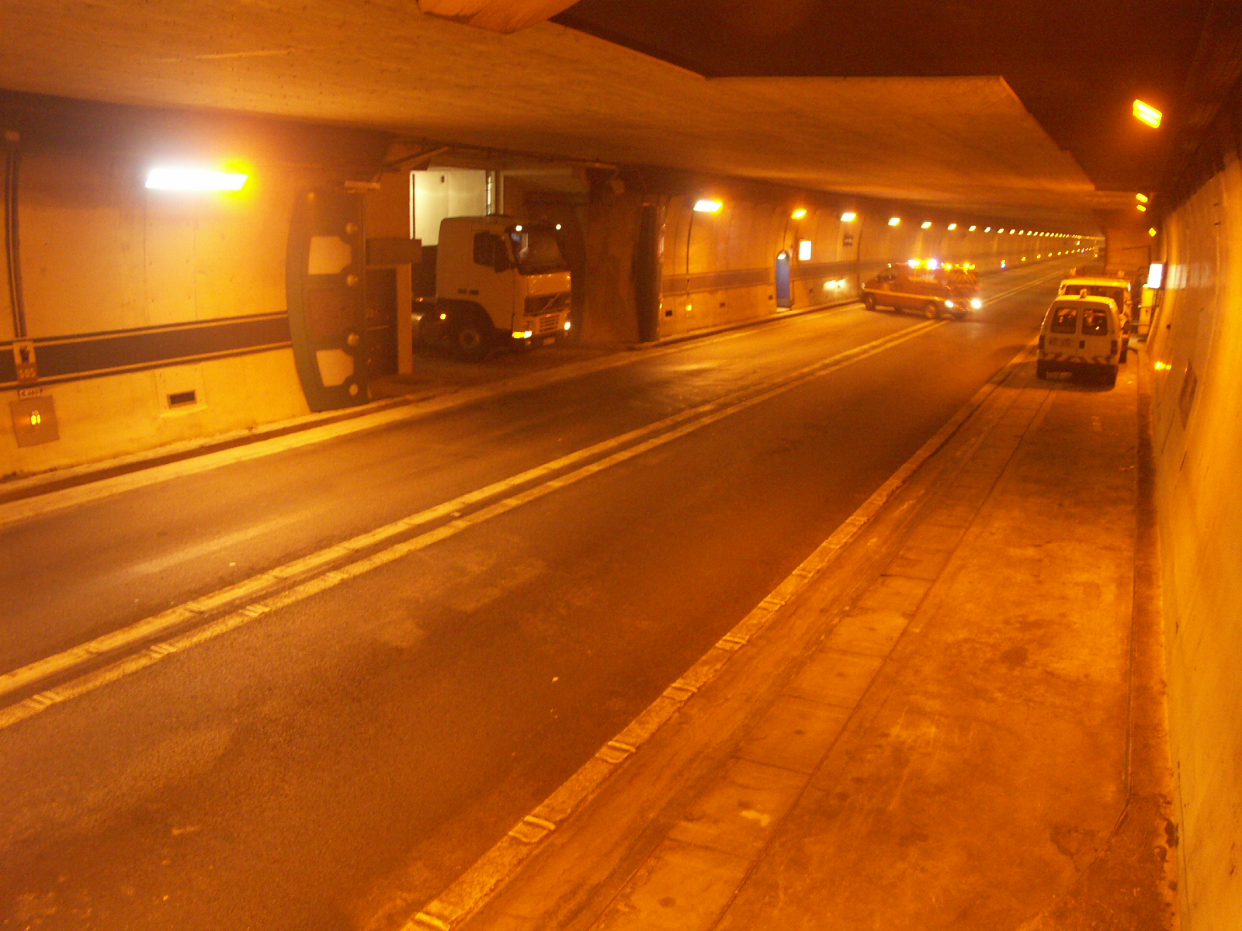
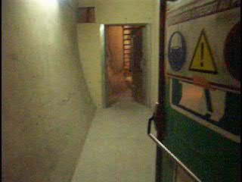
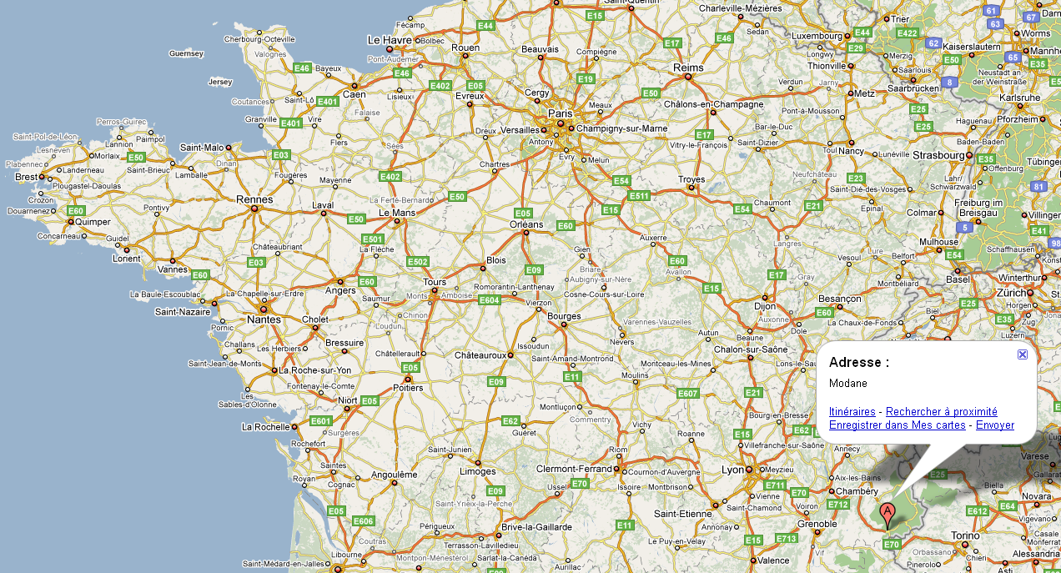
Location and access
4 fire-proof doors
Footmen entrance
LSM
Tunnel Routier du Fréjus

Slide 6
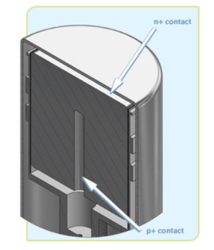
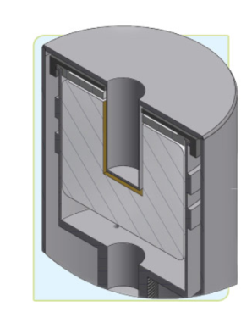
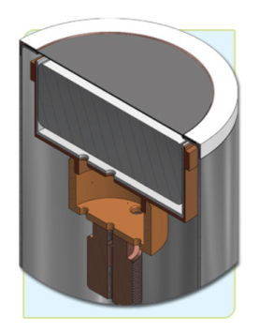
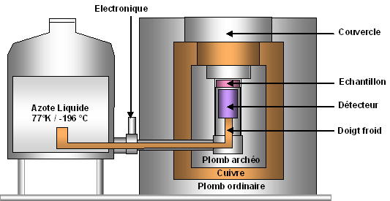
Germanium basics
Sample at room temperature
Sensitive to gammas from 20keV up to 3MeV
Non destructive measurement
Sensitive to muons and cosmic activation
Coax
Well
Planar
Notes:
Quick reminder of the basis of a Germanium detector

Slide 7
Germanium facility
LSM hosts currently 18 ultra low background Germanium this number is expected to grow to 24 in the next years
Different shape and sizes are available.
The detector should be chosen accordingly to the sample nature
The gamma measurement allow to search for contamination (month scale measurement)
Detector fight radons different way. Pure nitrogen, boil off the dewars or radonless air.

Slide 8
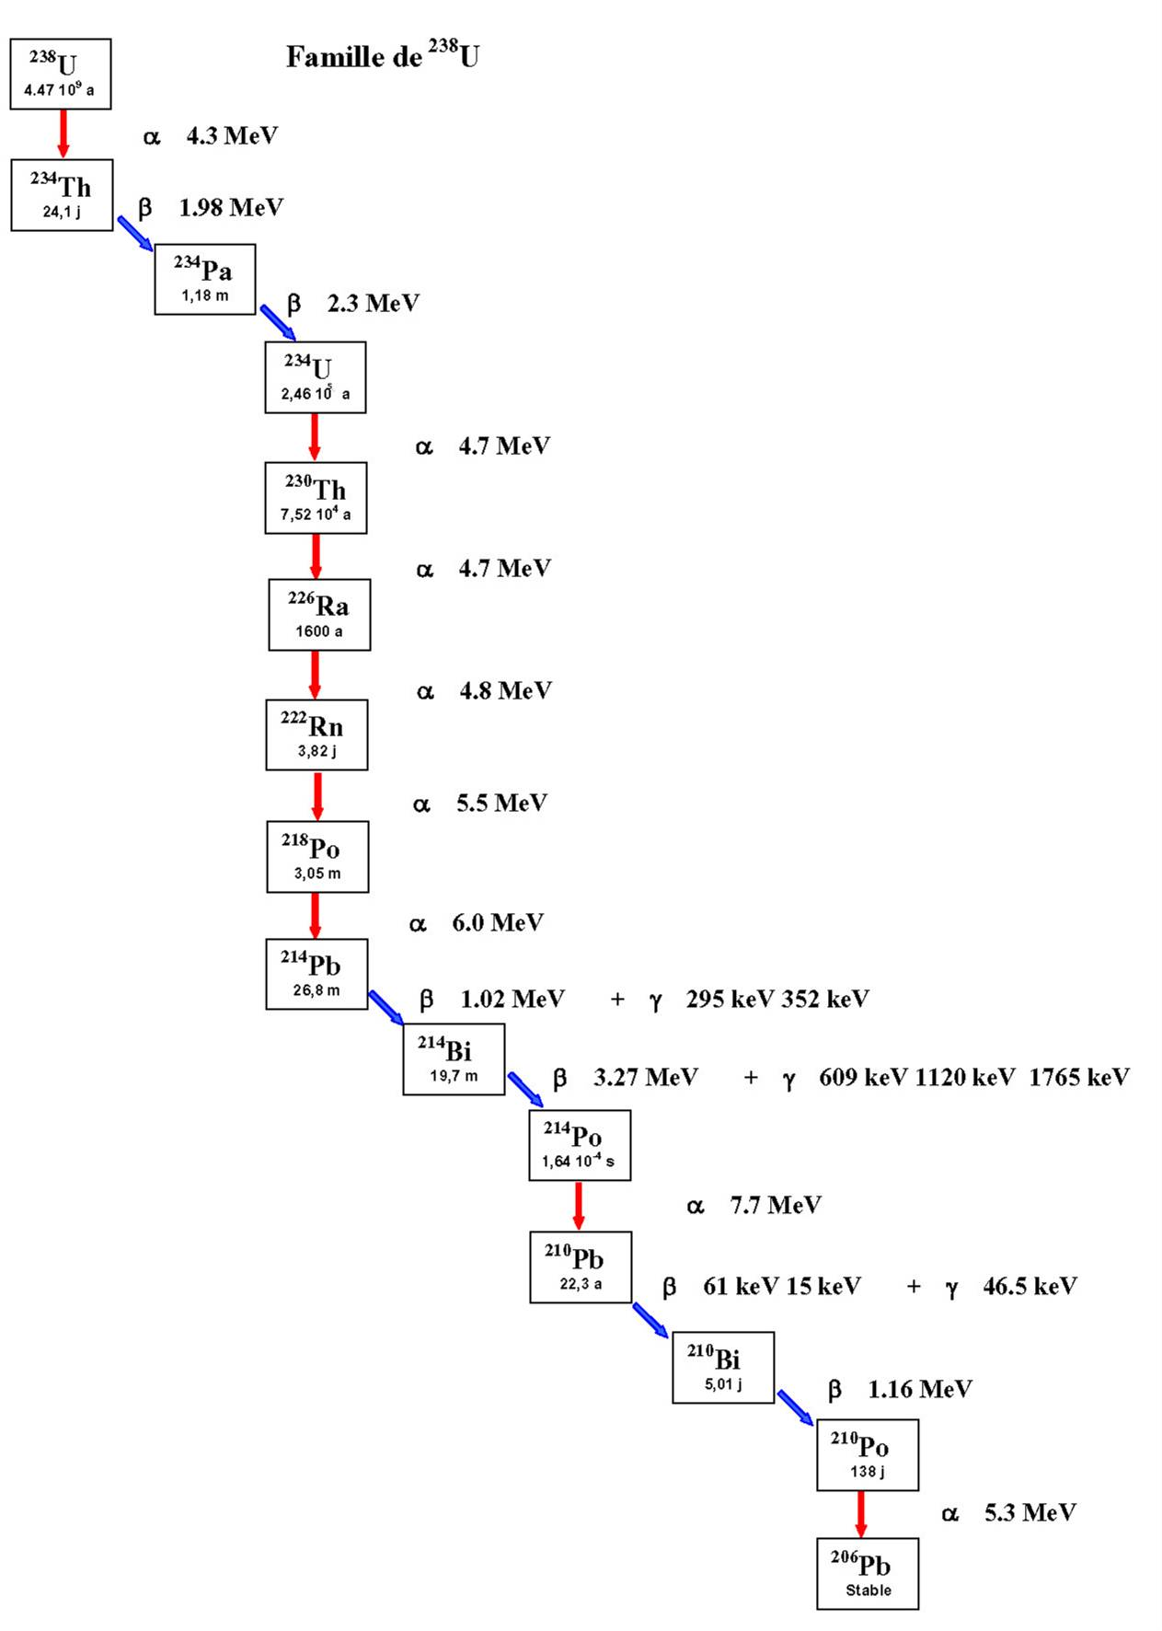
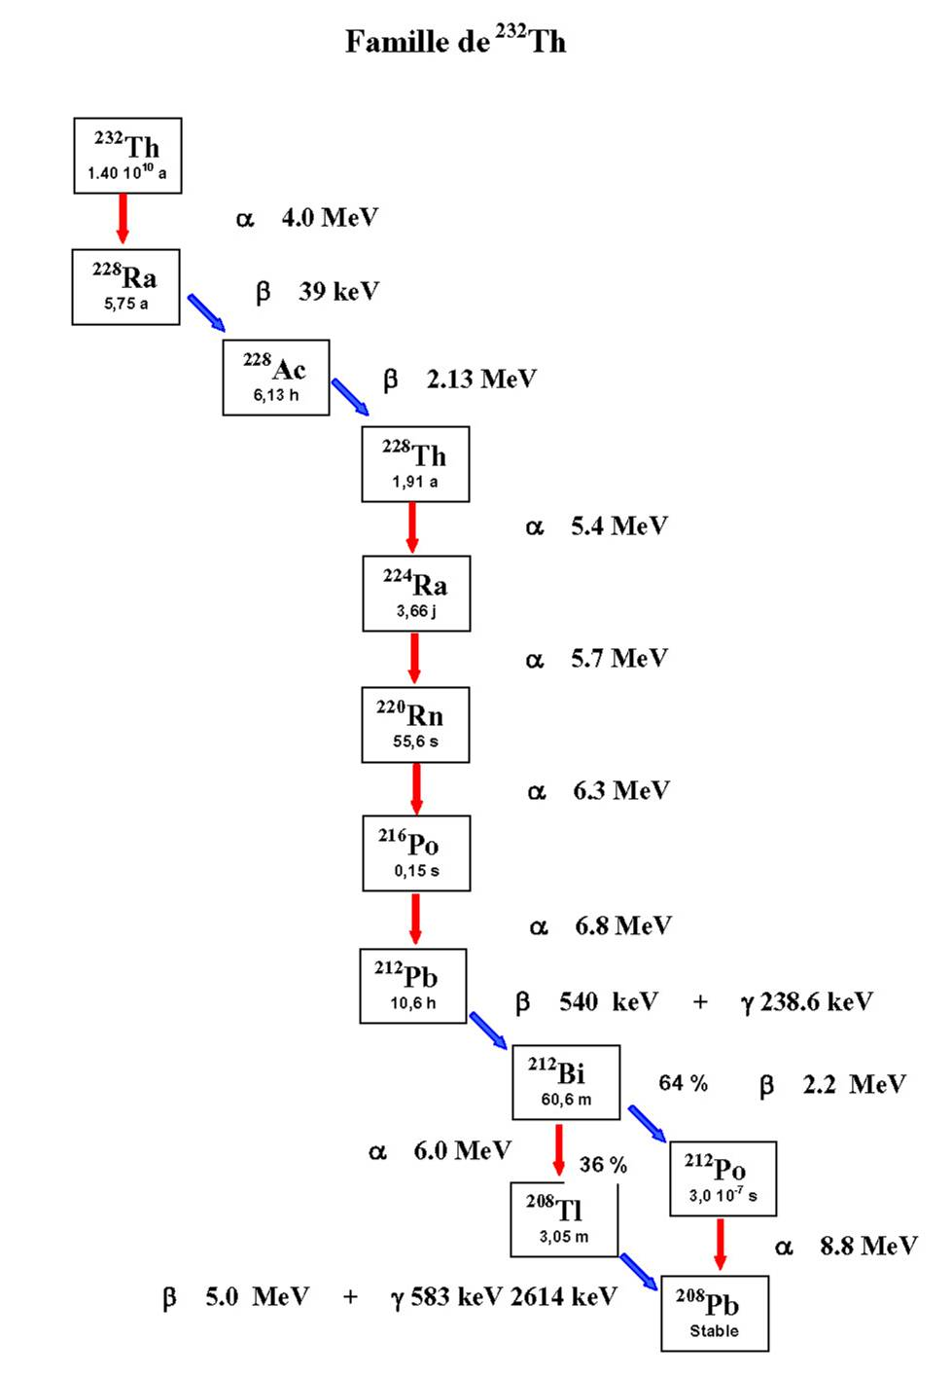
Main contaminants

Slide 9
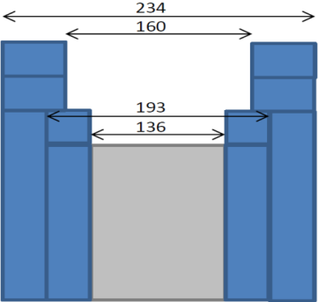
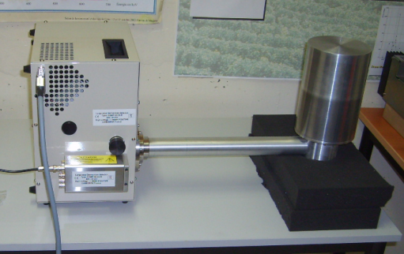
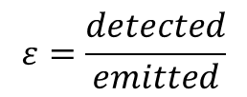

Germanium facility
Example of detection limits
Mafalda : (our swiss army knife)
Size 150 cc – 43,1%
  Φ 80mm h 31,7mm
Resolution
  122 keV 920 eV
  1,33MeV 1,97keV
  Background
    Integral 115±3,5 count/day
    133 c/kg
    Peaks
    46,5 keV 1,49 ± 0,37 c/d [210Pb]
    75 keV 3,6 ± 0,62c/d [Pb]
Shielding
536
Std
Std
ARCH
Silicon wafer measurement
700 000s 650g
limit (Bq)$=\frac{1,43+2,36\sqrt{1,36+bdf×t}}{ε\left(m\right) m t}$
Nucleide |  | Bq/kg
²¹⁰Pb | < | 1,58E-02
²²⁶Ra | < | 1,27E-03
²³⁸U | < | 6,27E-03
²²⁸Ra | < | 3,82E-03
²²⁸Th | < | 8,66E-04
²³⁰Th | < | 1,42E-01
$$ε=\frac{detected}{emitted}$$

Slide 10
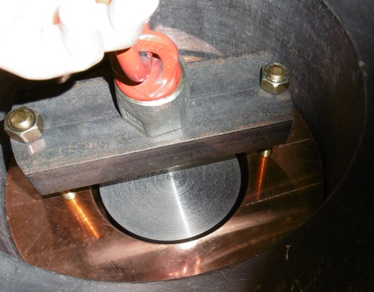
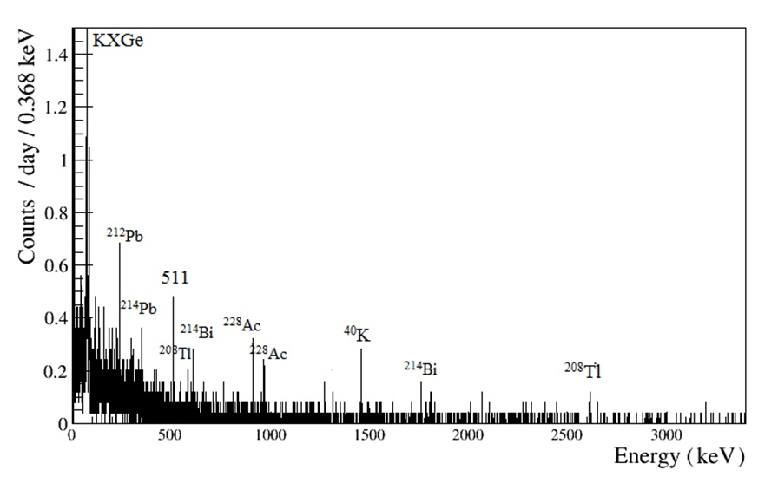
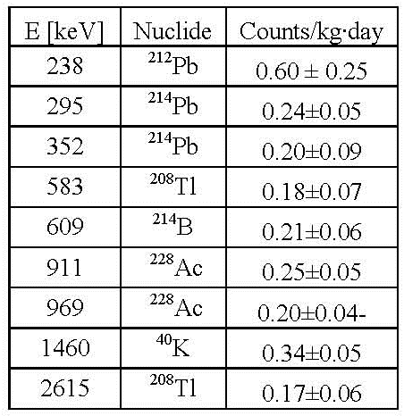
Germanium facility
Improving detection limit :
  Imply choices :
Theoretical sample of 1kg for 500000s
This detector can welcome much bigger sample but the low energy gamma are stopped by the dead layer around the detector.
Obélix :
Size
  600cc-160%
Background
  95 counts/kg.d
Resolution
  122 keV 1,1 keV
  1,33MeV 2keV
Nucleide |  | Bq/kg
210Pb |  | NA
²²⁶Ra | < | 4,96E-4
238U |  | NA
228Ra | < | 1,78E-03
228Th | < | 4,37E-04
Sample Chamber
250 mm
200 mm

Slide 11
Sample management
Priority between measurement and quality checks
Necessity to define the level of contamination aimed for the experiment on every considered nucleides
Necessity to define the nucleides of interest especially 210Pb and 238U
Influence of (α,n) on the background and contamination level associated

Slide 12
Sample management
Database foreseen to agregate the measures?
Modane has its sample management system called BaDGe
Used to centralize measurements and track the samples
Possibility to merge the systems?
Naming rules no space, no special characters less than 16 letters and only upper letter

Slide 13
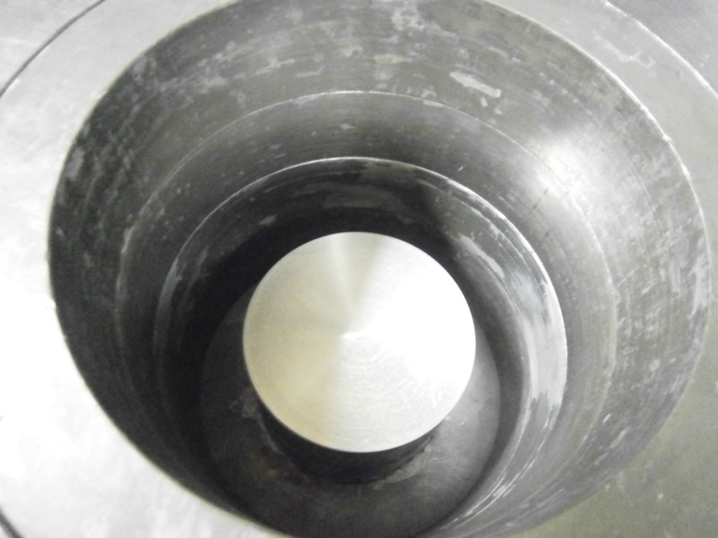
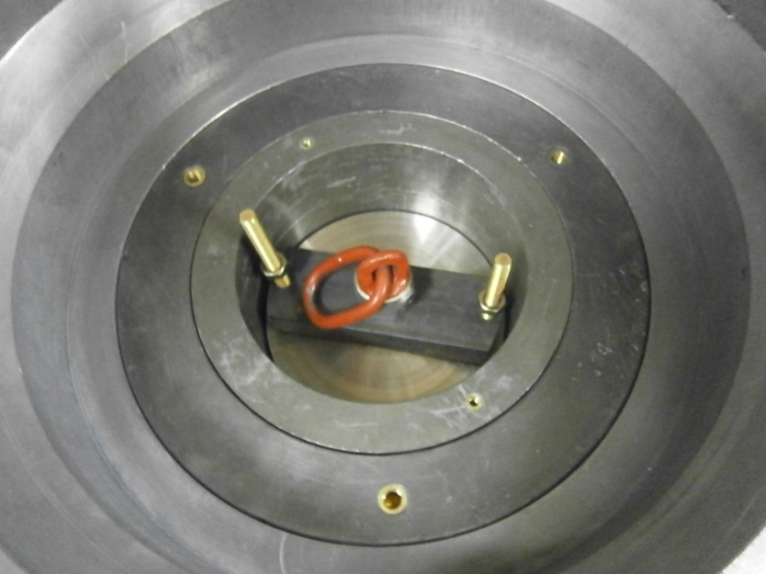
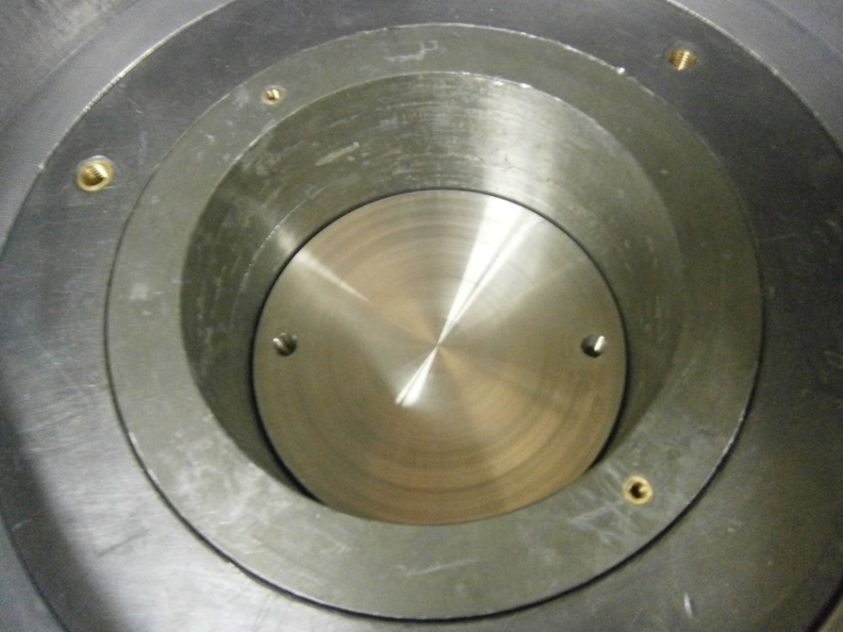
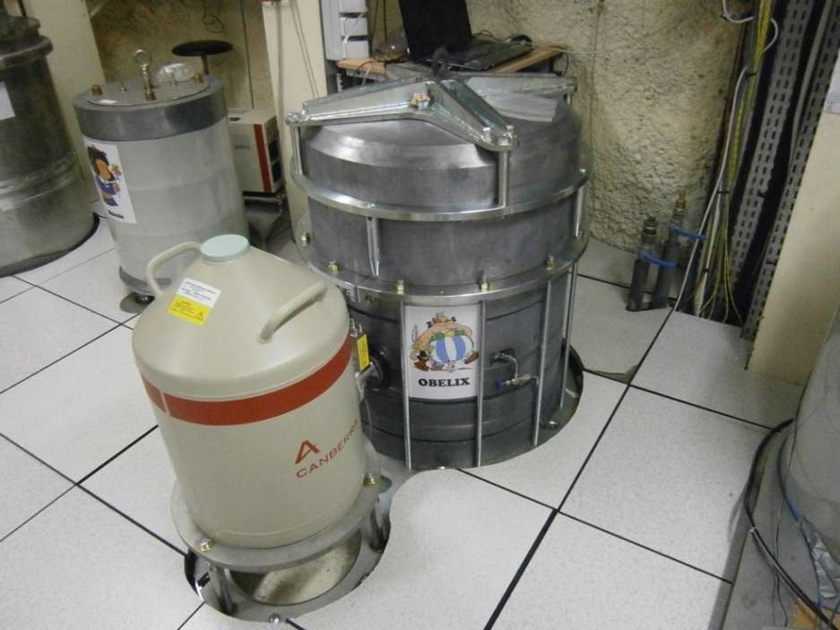
Nickel 58

Slide 14
Partage project
Reduce footprint of Germanium detectors
Free space for more detectors
Keep the same level of shielding
Improve radon mitigation
March toward robotisation

Slide 15
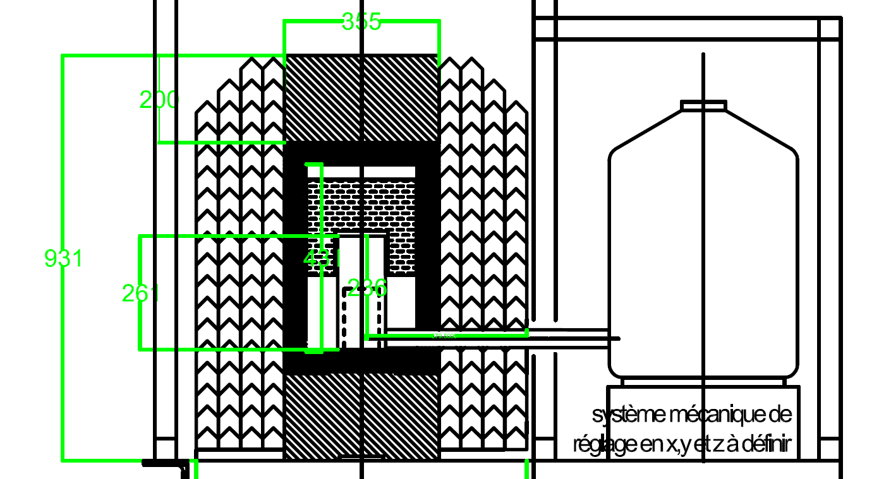
Lead shield for marinelli
Global doctrine : 20 cm standard lead 5cm archeological
No specific design
All shield are
the same
Standard lead removed with crane
Standard bricks
Archeological lead

Slide 16
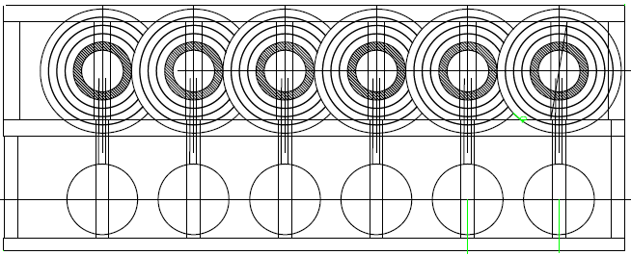
Future of germanium at LSM
PARTAGe project
  Combining shields in common walls
Robotisation
Optimisation of measurement time based on the radiopurity objectives

Slide 17
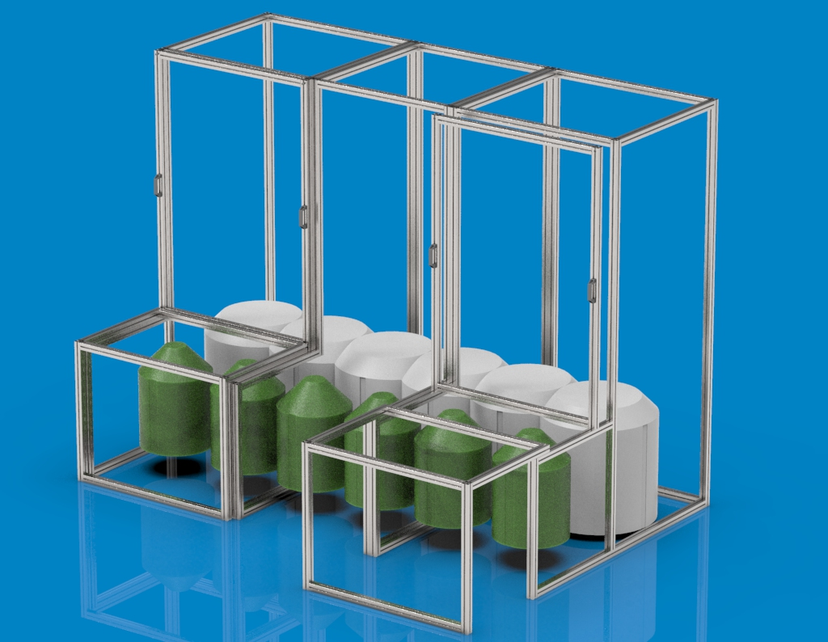
Radon tent
10m3 inlet max
2,1m3 boil off nitrogen <1mBq/m3

Slide 18
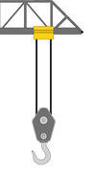

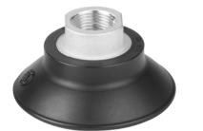
Tent
O-ring
Metalic enveloppe
+ pressure vent

Slide 19
Cosmogenic inside crystal
Detector mafalda
Integral background 0,27/min may 2008
énergie | intégrale | Coups par jour | Identification
46.5 | 51 | 1.7 | Pb210
66.9 | 33 | 1.1 | Th-230
143.8 | 78 | 3.57 | Co-57
238.6 | 20 | 0.57 | Pb-212
1124.5 | 60 | 2.73 | Zn-65
1460 | 7 | 0.36 | K-40
Integral now : 0,086 cnts /min
only 210Pb =1,5 cnts/min
40K =0,47cnts
P.Loiaiza et al

Slide 20
Mass spectrometry
Conversion from mass to activity considering 1 ppt as LD
 | T1/2 | 1ppt en Bq/g | LD en Bq/kg
238U | 4,47E+09 | 1,24E-08 | 1,24E-05
230Th | 7,52E+04 | 7,64E-04 | 7,64E-01
226Ra | 1600 | 3,66E-02 | 3,66E+01
210Pb | 22,3 | 2,82E+00 | 2,82E+03
232Th | 1,40E+10 | 4,07E-09 | 4,07E-06
228Ra | 5,75E+00 | 1,01E+01 | 1,01E+04
228Th | 1,91E+00 | 3,04E+01 | 3,04E+04
Consider analysing a standard lead sample

Slide 21
Conclusions
Deciding the number of sample that must be measured and detection limits required
Choose the right combination of techniques for optimum results (Analyse Pb with ICP-MS)
Germaniums measurements have a life ahead
More demands to put germanium in LSM more fields to explore …

