Slide 1

Status of the muon measurement in LSC
A. Bayo
Laboratorio Subterráneo de Canfranc (LSC)
MUON MONITOR WORKSHOP

Slide 2
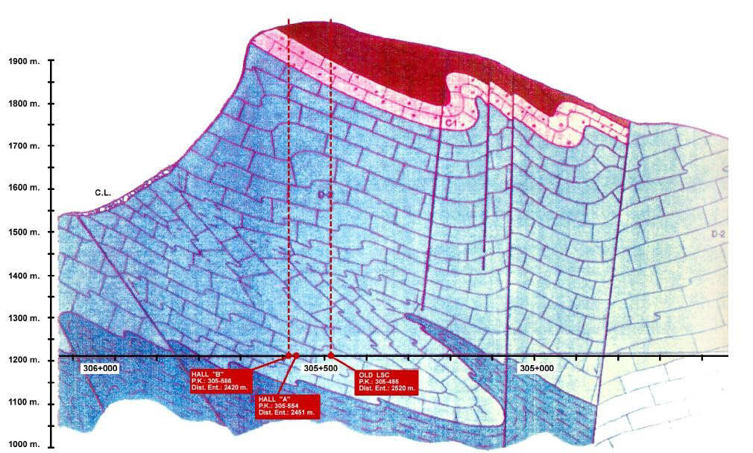
Introduction
Notes:
The outline of the presentation is the following:
First, a short introduction of flux value expected and the glossary used
Secondly, we will see the structure and the first file discrimination rule: the multiplicity. Also we will analyse the “size” (how many modules fired there are in each event) of events.
Next, we have to fix the discrimination rules to obtain the number of muons detected
After that, we will show the detection process of fire forest and power consumption of node.
Finally, the results and conclusions will be analyzed.

Slide 3
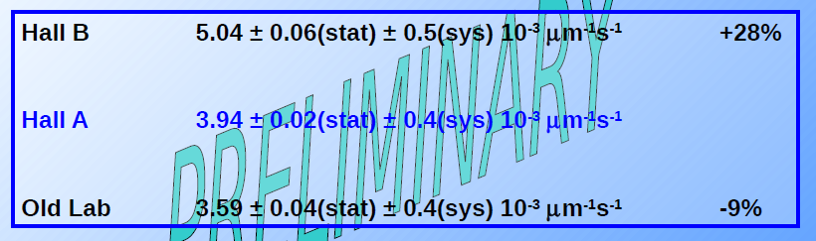
Introduction
Depth (max.): ~ 2450 meters of water equivalent (m.w.e.)
Composition of the rock and average density: limestone, mainly calcium carbonate, ρ~2.7 g/cm³ plus traces of
quartz, ρ~2.6 g/cm³)
Expected Muon flux: φ_{μ}= 2.5 x 10⁻³ μ/m²s
Héctor Gómez Maluenda, University of Zaragoza.
JRA1-N2 Meeting, Zaragoza, Nov 23rd 2007
Notes:
The outline of the presentation is the following:
First, a short introduction of flux value expected and the glossary used
Secondly, we will see the structure and the first file discrimination rule: the multiplicity. Also we will analyse the “size” (how many modules fired there are in each event) of events.
Next, we have to fix the discrimination rules to obtain the number of muons detected
After that, we will show the detection process of fire forest and power consumption of node.
Finally, the results and conclusions will be analyzed.

Slide 4
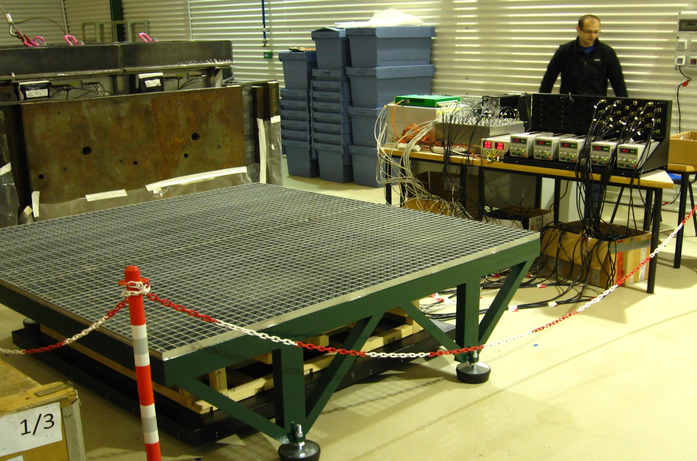
Introduction
LSC, LAB2400 , Hall A
DAQ & power supply

Slide 5
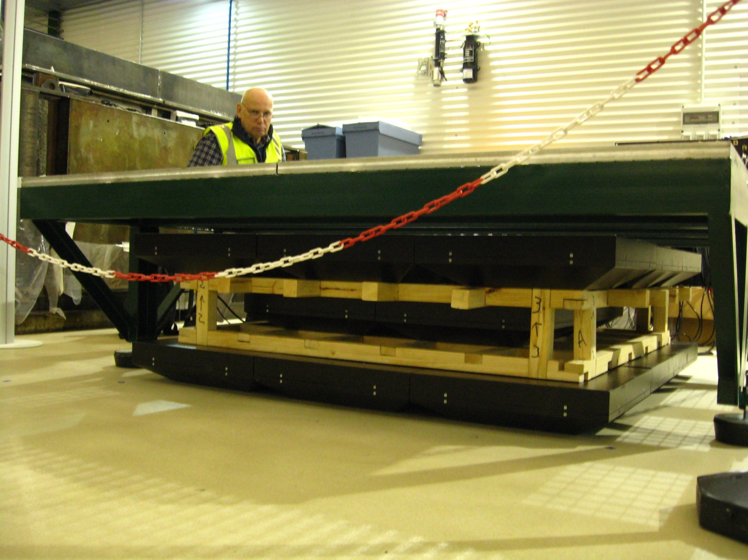
Introduction
3 layers assembly of the SC16 detectors:
3x3=9 SC16s (9x16=144 pixels)
2x2=4 SC16s (4x16=64 pixels)
3x3=9 SC16s (9x16=144 pixels)

Slide 6

Introduction
Top view
Scintillators (pixels) of the 1-st and 3-d layers
Scintillators (pixels) of
the 2-d layer
(marked by the gray)
Size of pixel
122x122x30 mm³
0.5 m
1.5 m
Pixel
Pb bricks
Supporting grid
Steel table
Wooden frame
Muon trajectory
ϴ_{zenith}
120 mm
SC16
SC16
SC16
50 mm
SC16
SC16
SC16
SC16
SC16

Slide 7
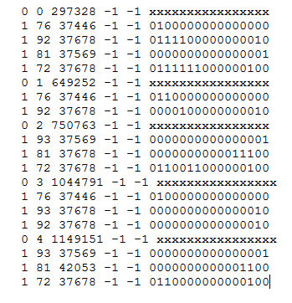
Raw data
Number of detector
Pixel hit map information
px. 0 px.1 …………...px15
0 -> trigger
1 -> module hit
Hit time
(10 ns units)
EVENT

Slide 8
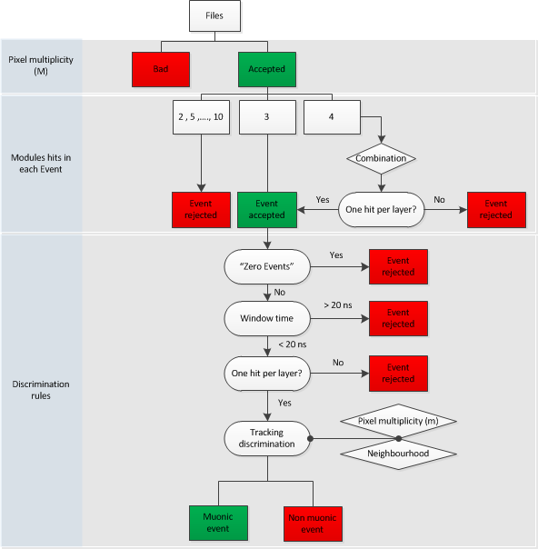
Discrimination rules

Slide 9
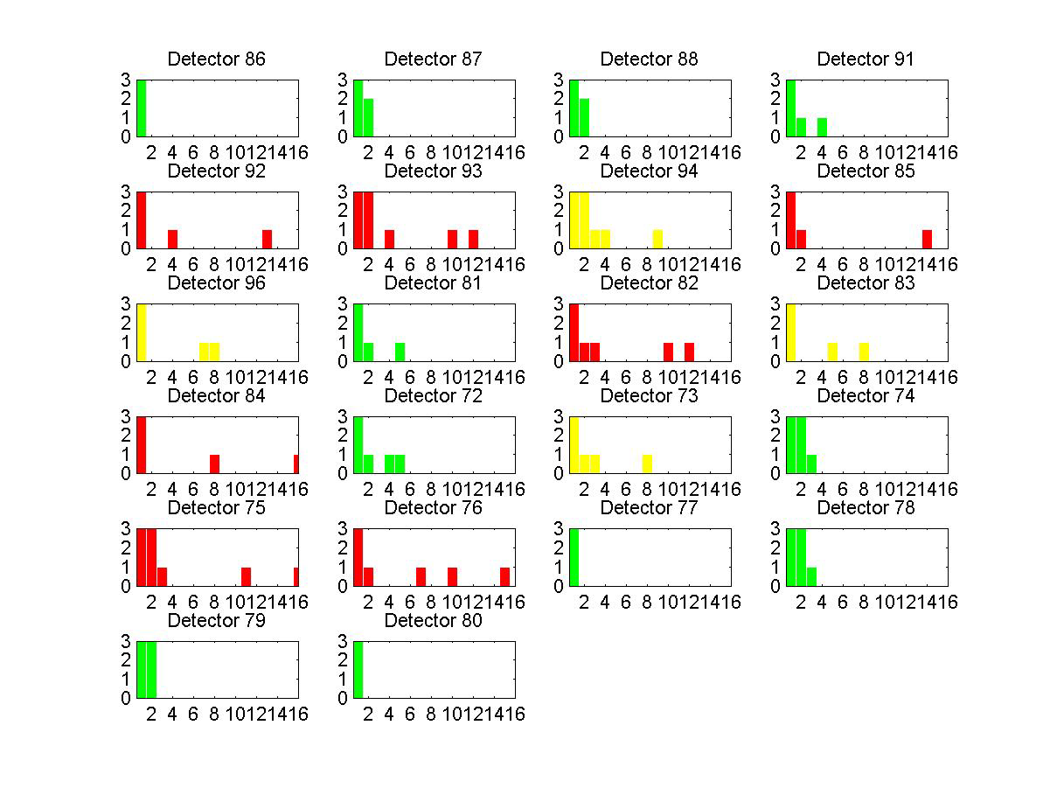
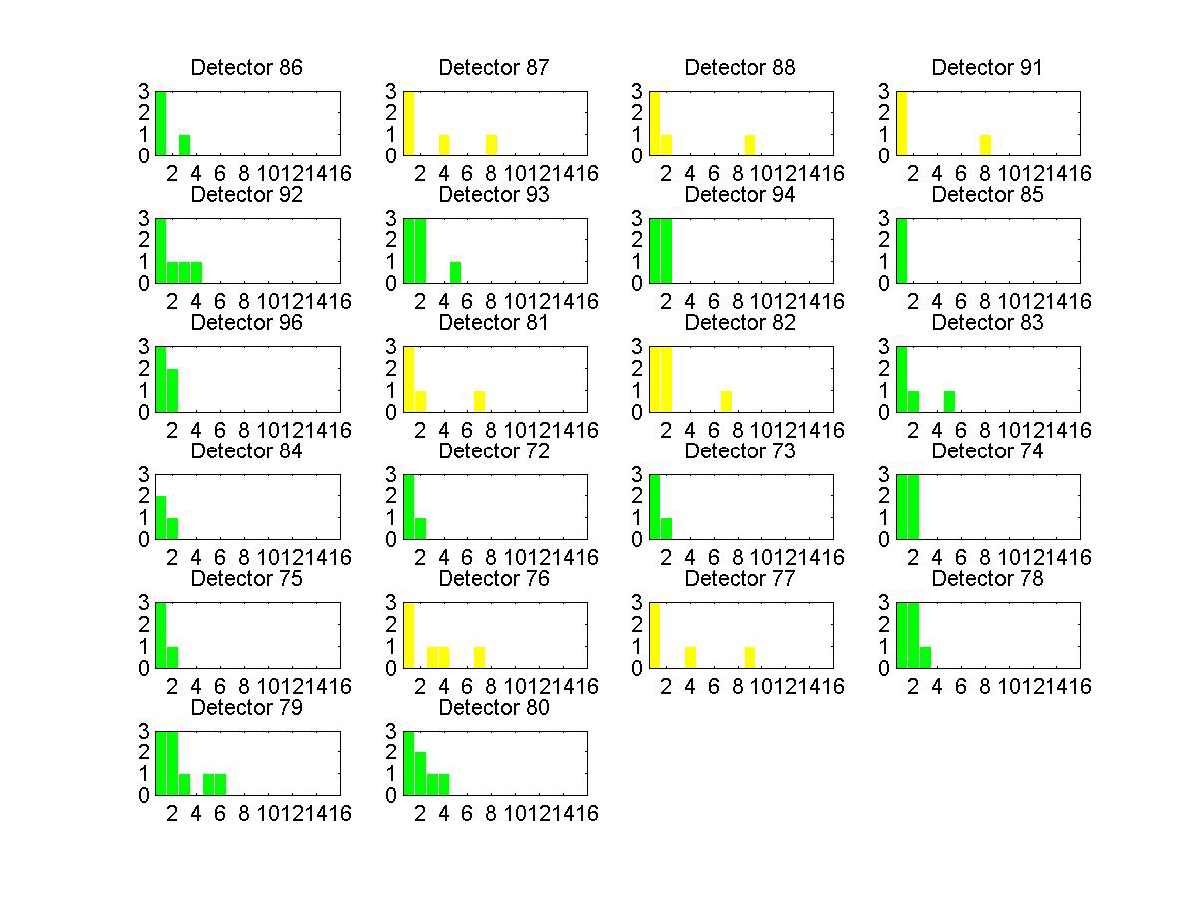
Multiplicity (M)
Pixels multiplicity of one detector(M)
  M < 6 - accepted
  6 < M < 10
    less than 5 detectors - accepted (regular files)
    more than 5 detectors - rejected
  M > 10 - rejected

Slide 10
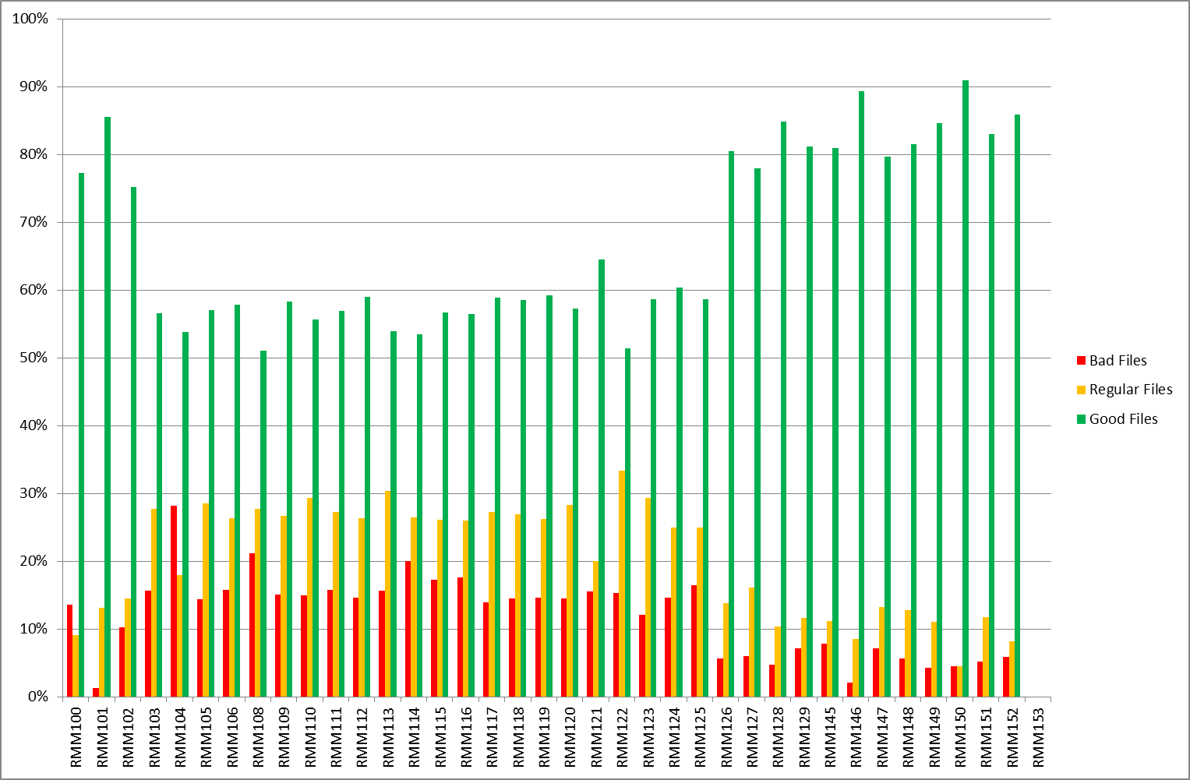
Multiplicity
Without Lead Shield

Slide 11
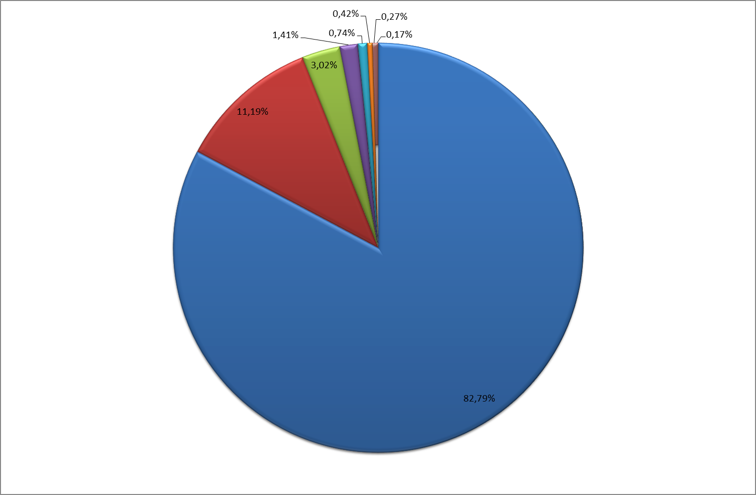
Events groups
RMM100-119
296417 EVENTS

Slide 12
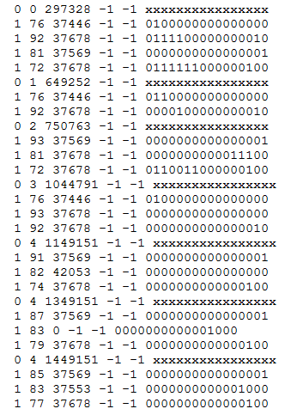
Discrimination rules
“Zero events”
  Pattern info missing
  Time info missing

Slide 13
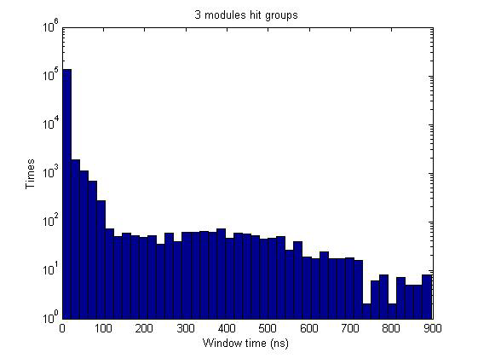
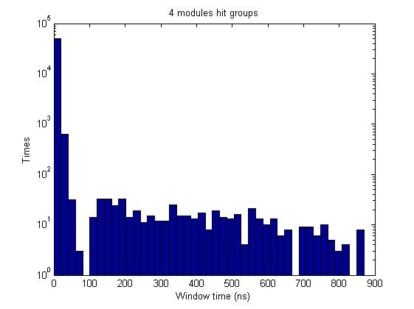
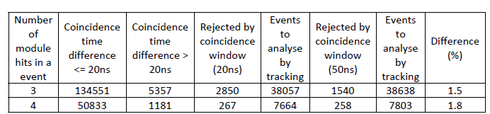
Discrimination rules
Window Time (RMM100-RMM110)
t₂-t₁ t₃-t₂ t₃-t₁

Slide 14
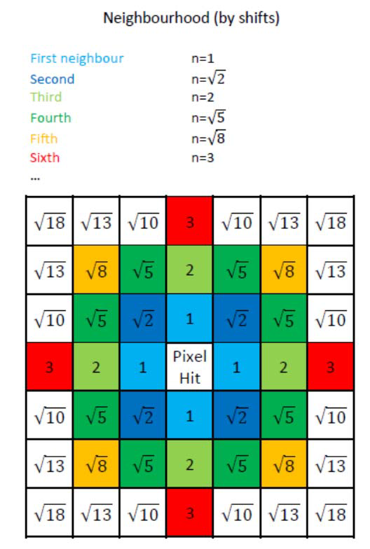
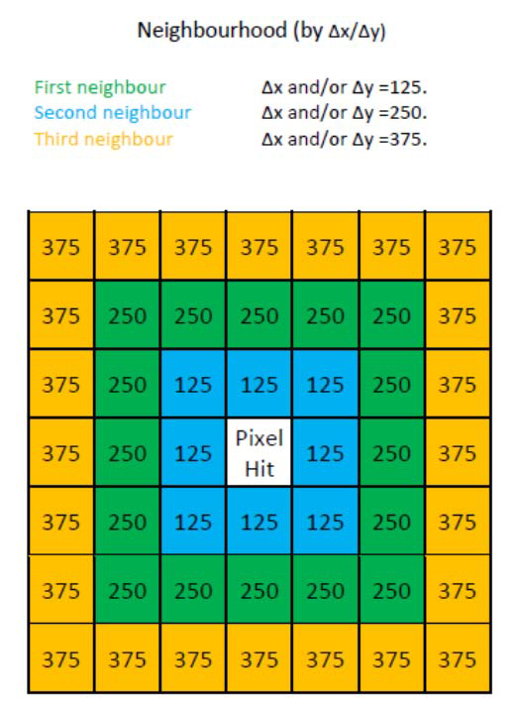
Discrimination rules
Tracking discrimination - neighbourhood

Slide 15
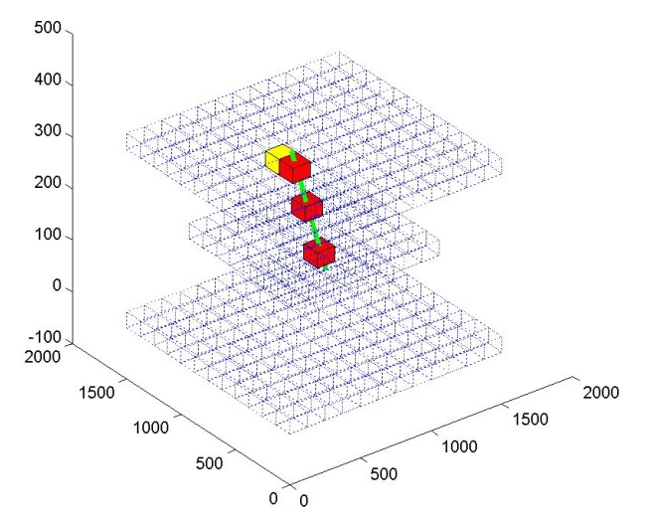
Discrimination rules
Tracking discrimination
  8 straight lines (corner top – corner bottom)
  5 faces of middle layer pixel

Slide 16
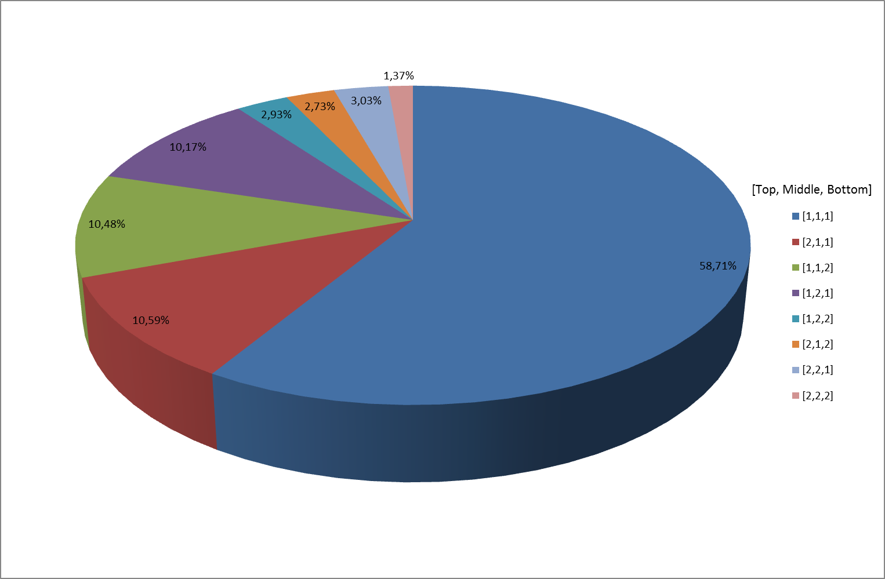
Discrimination rules
Tracking discrimination - multiplicity

Slide 17


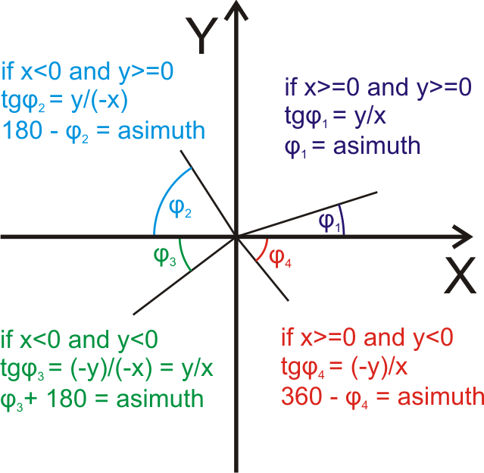
Discrimination rules
Zenith angle
Azimuth angle
We have fixed θ = 0 when:
  x_{top} - x_{bottom} = 0
  x_{top} - x_{middle} = 0
  x_{middle} - x_{bottom} = 0

Slide 18
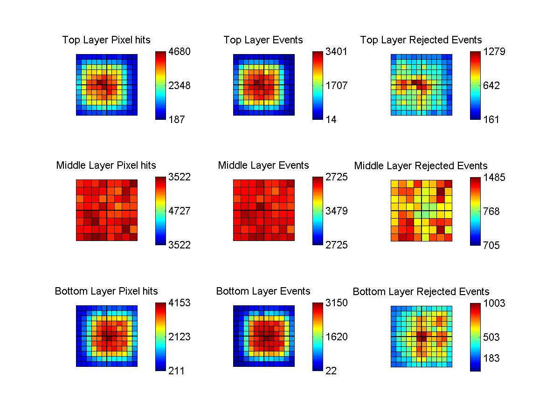
Results – LAB2400

Slide 19
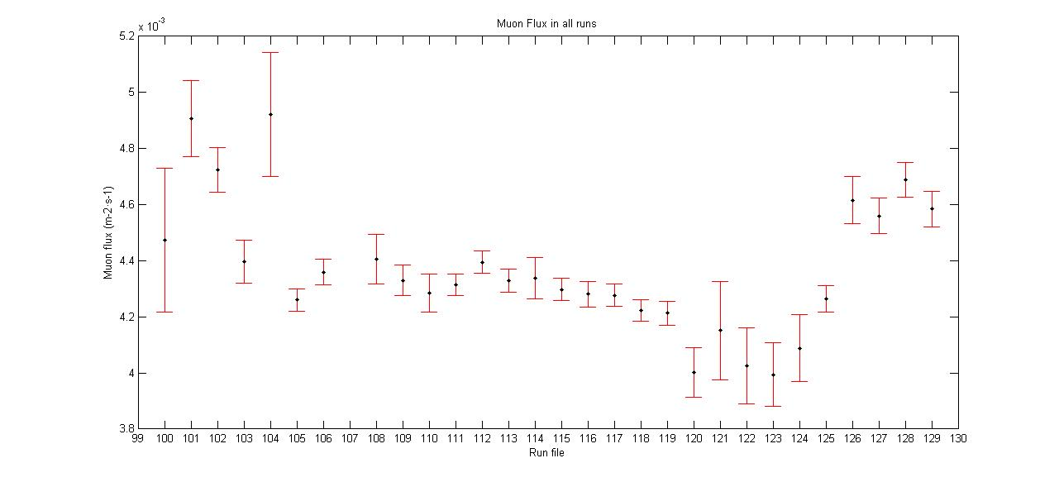
Results – LAB2400
Around 446 days of “good” data

Slide 20
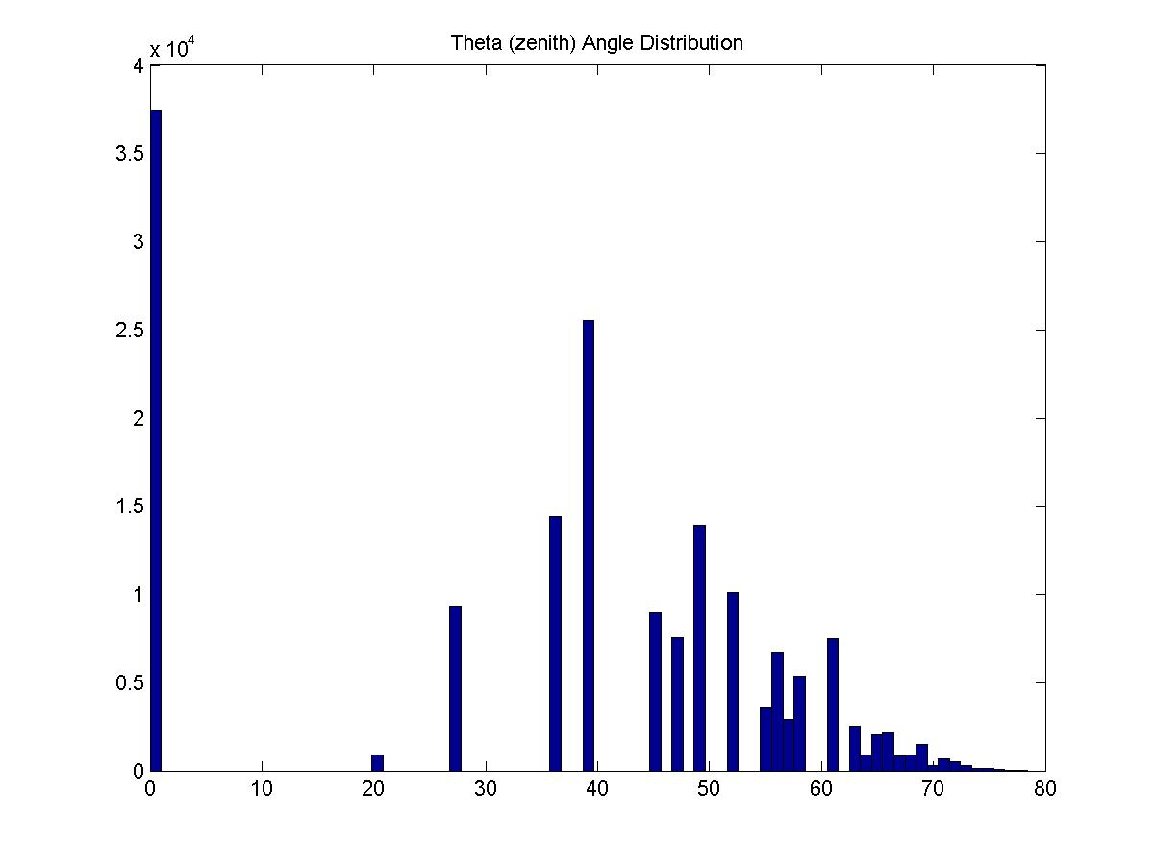
Results – LAB2400

Slide 21
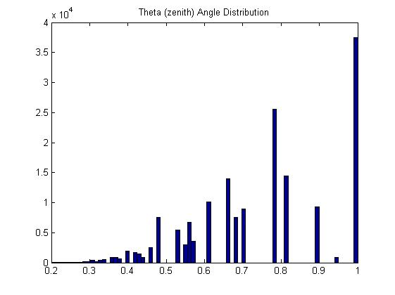
Results – LAB2400

Slide 22
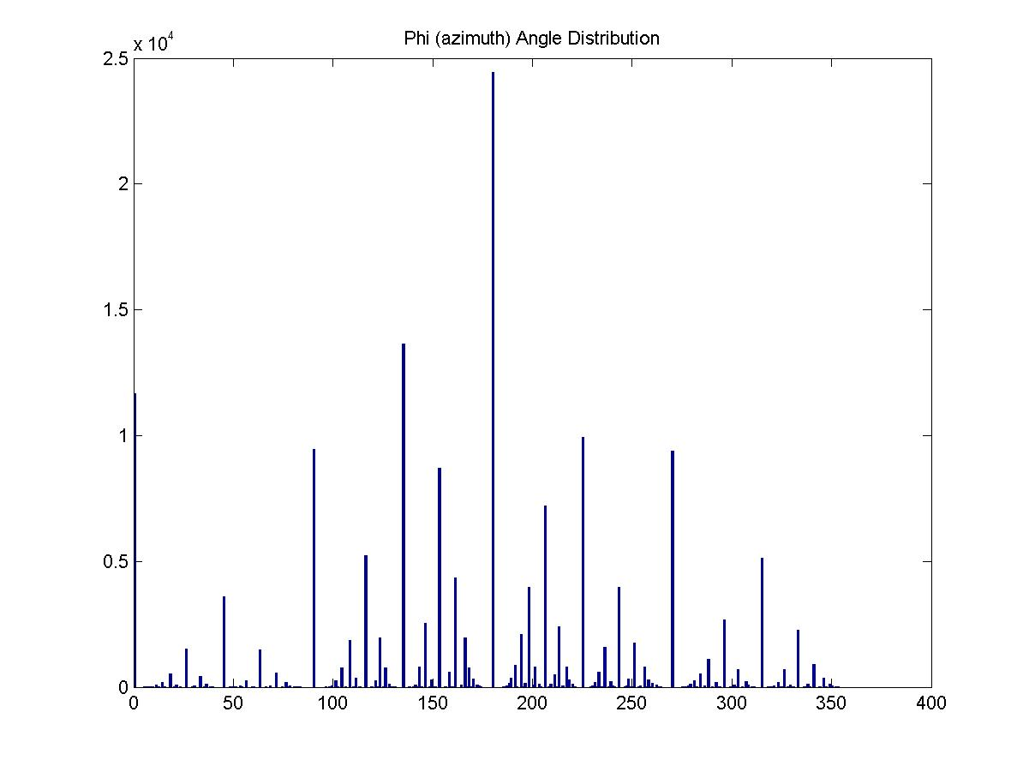
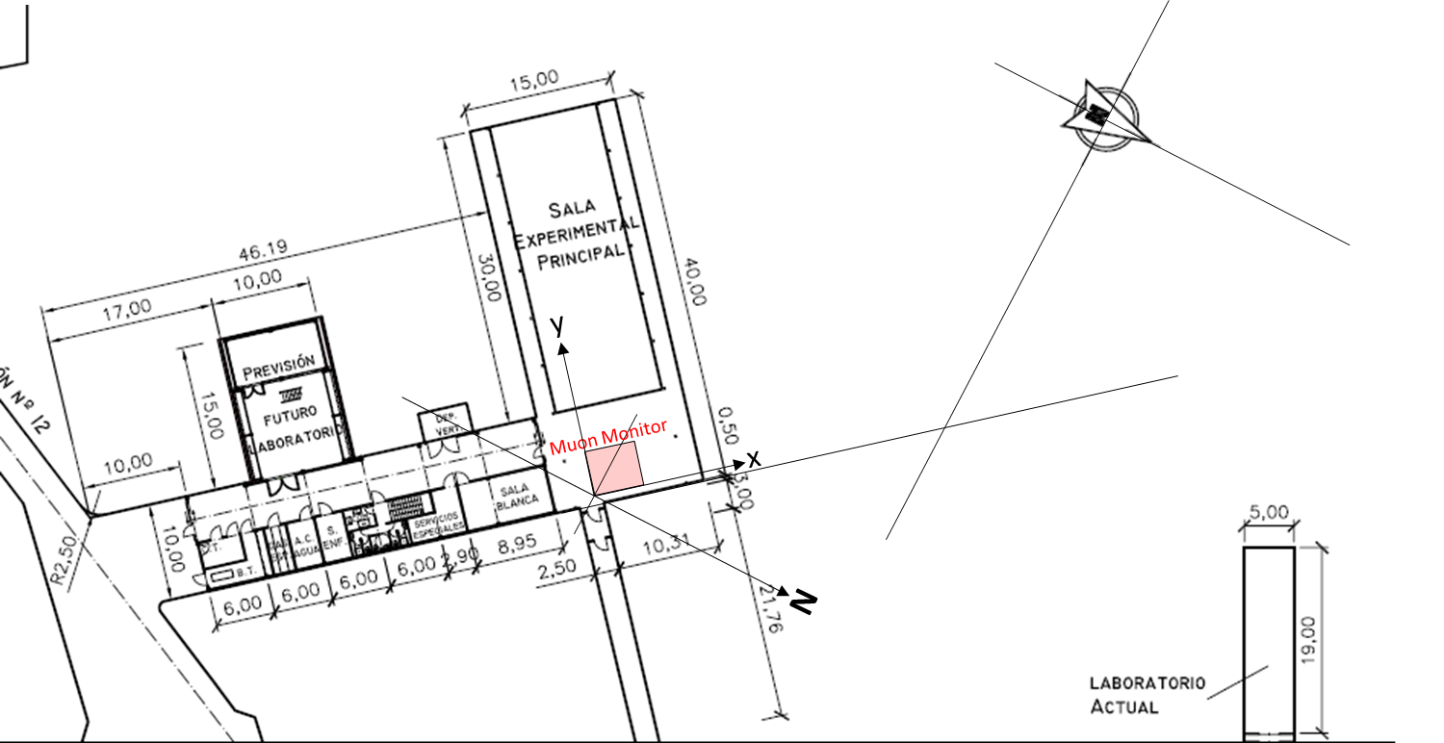
Results – LAB2400
Rioseta Valley
(minimun rock thickness)
ϕ ≈ 180 º

Slide 23
Results – LAB2400

Slide 24
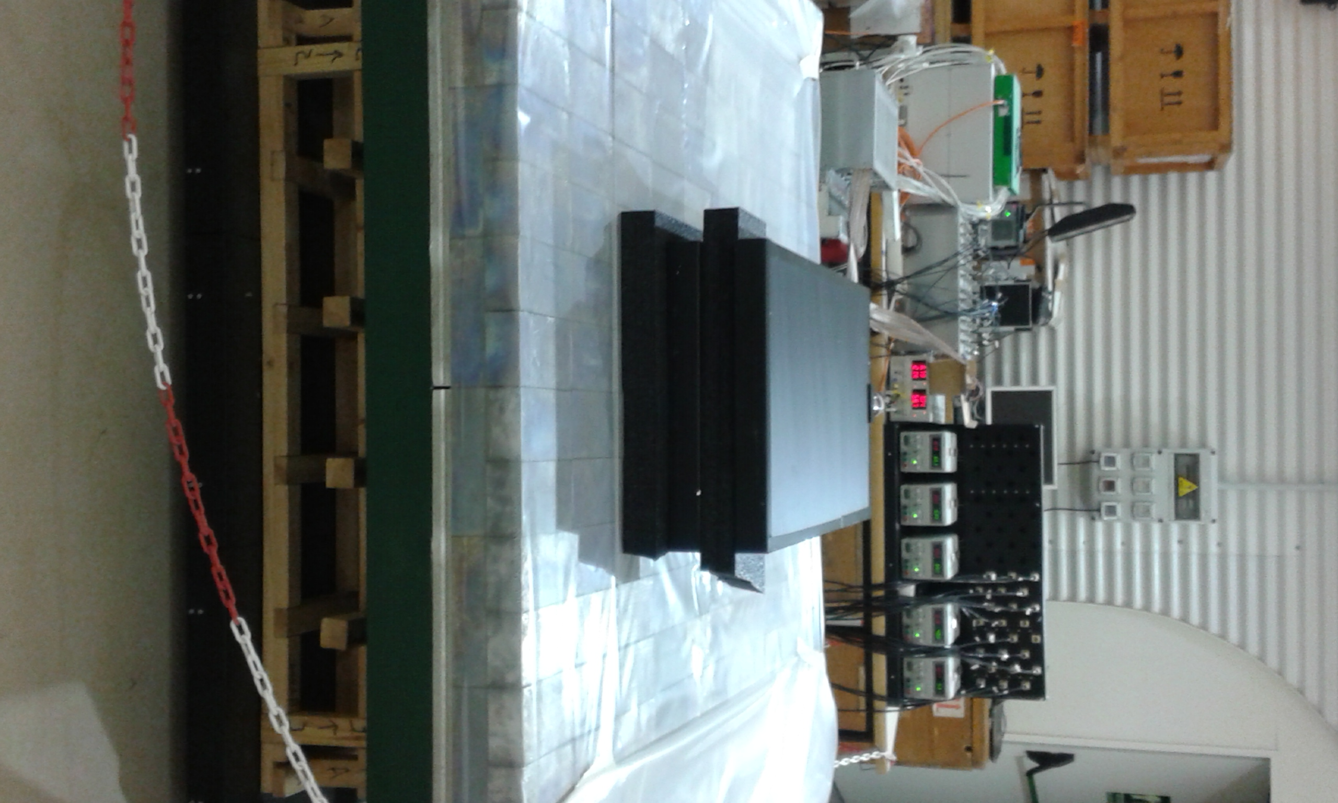
Scintillator plastics
2 SCIONIX detectors (1000 x 500 x 50 mm³)

Slide 25
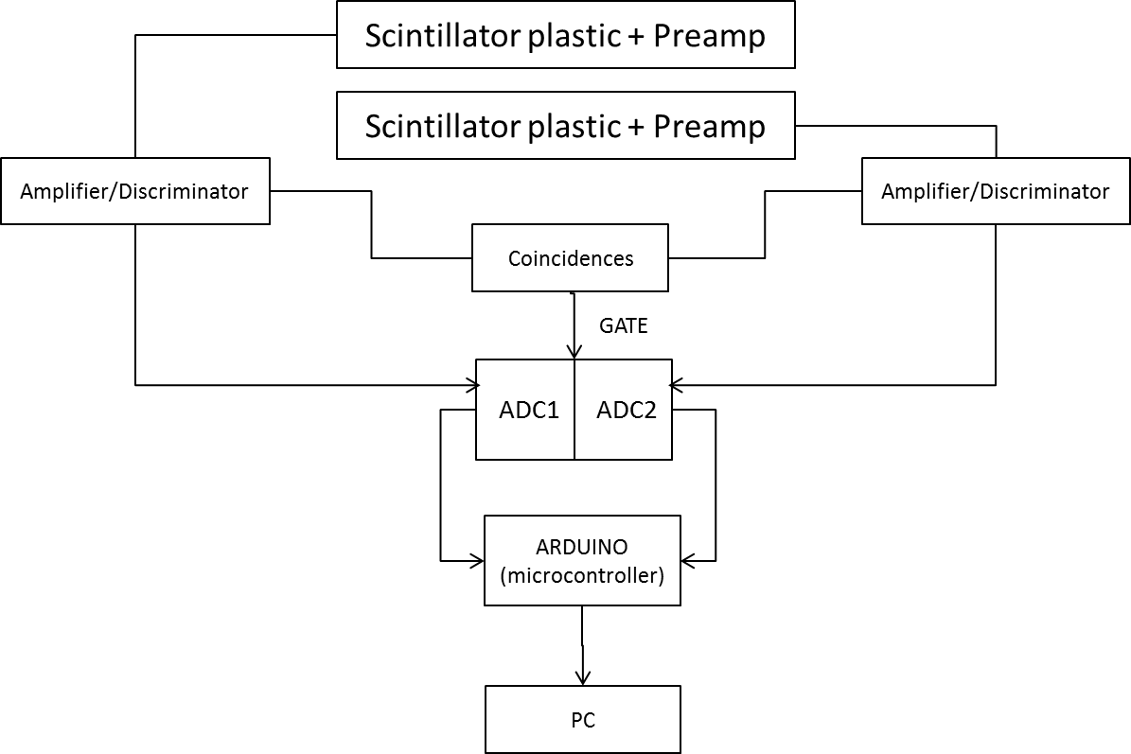
Scintillator plastics

Slide 26
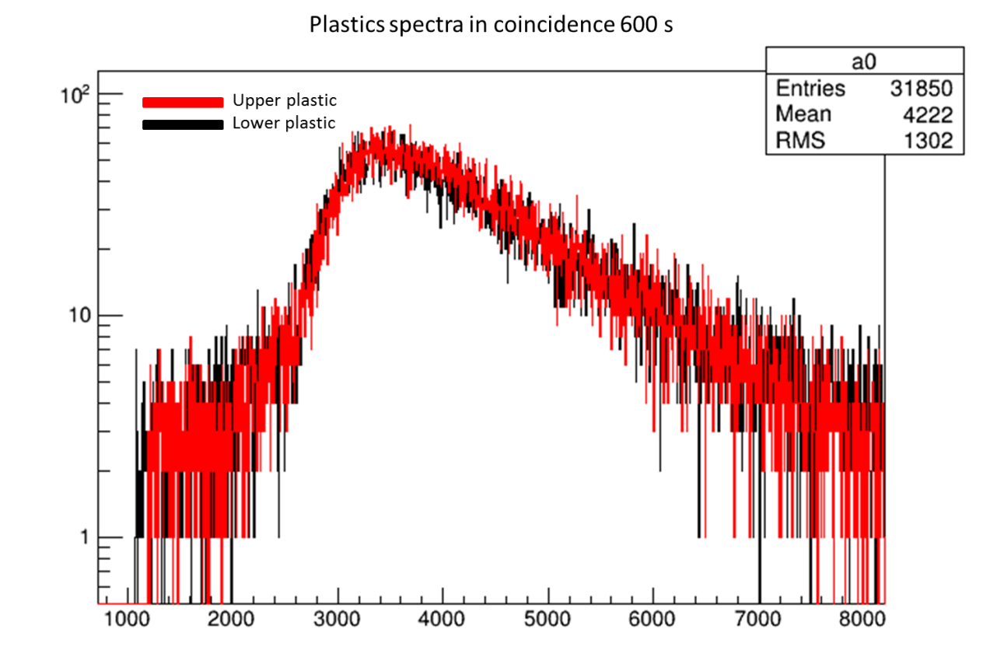
Scintillator plastics

Slide 27
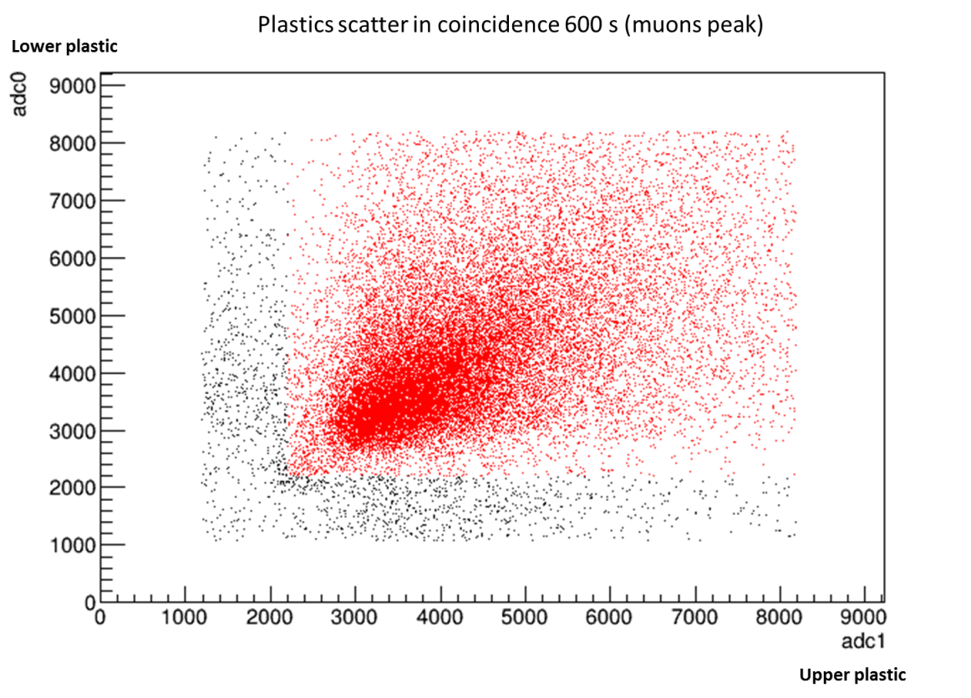
Scintillator plastics

Slide 28
Scintillator plastics
Surface Calibration
Material Attenuation ????
600 mm concrete
200 mm light concrete
100 mm extruded polystyrene
…….
Particle Data Group, Review of Partyicle Physics, Chinese Physics C Vol. 38, No. 9 (2014) 090001

Slide 29
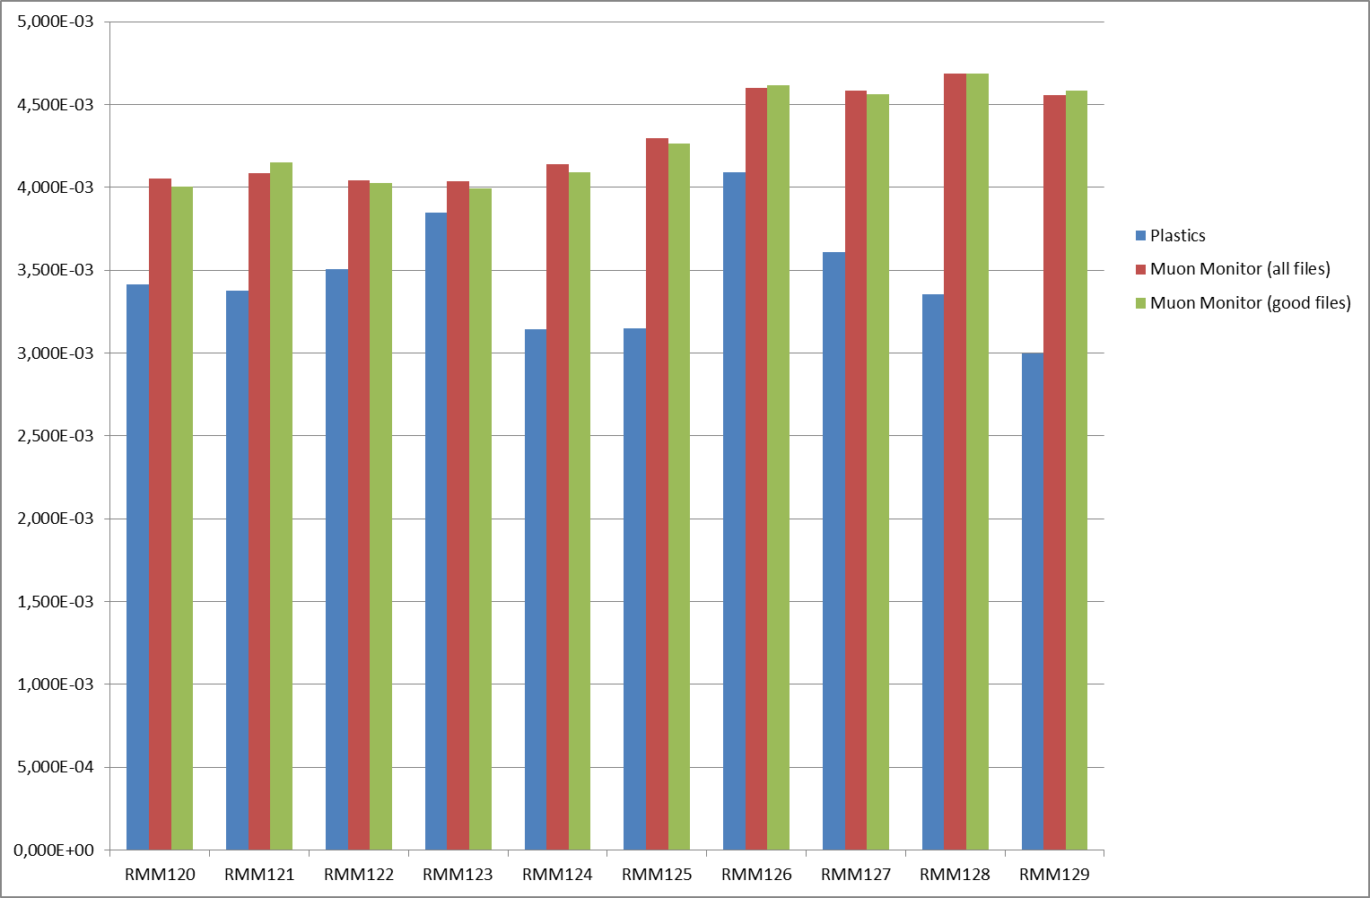
Scintillator plastics
Muon Flux

Slide 30
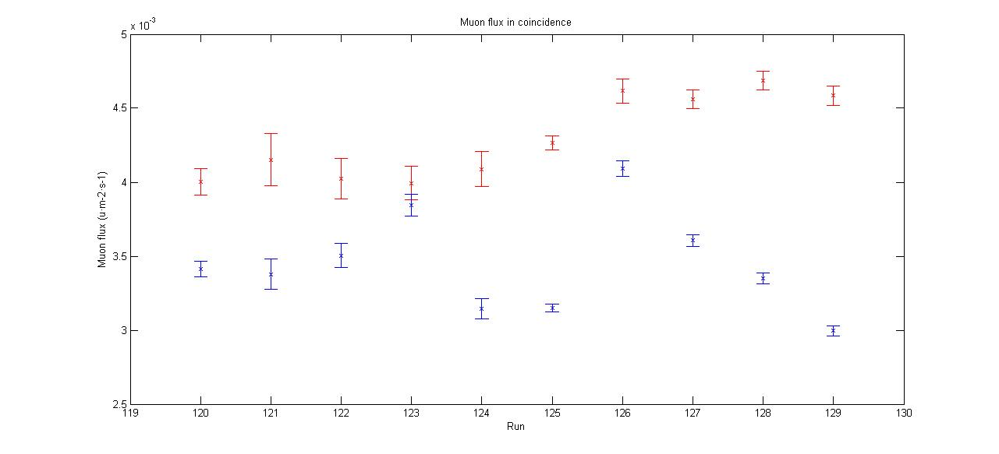
Scintillator plastics
Plastics
Muon monitor

Slide 31
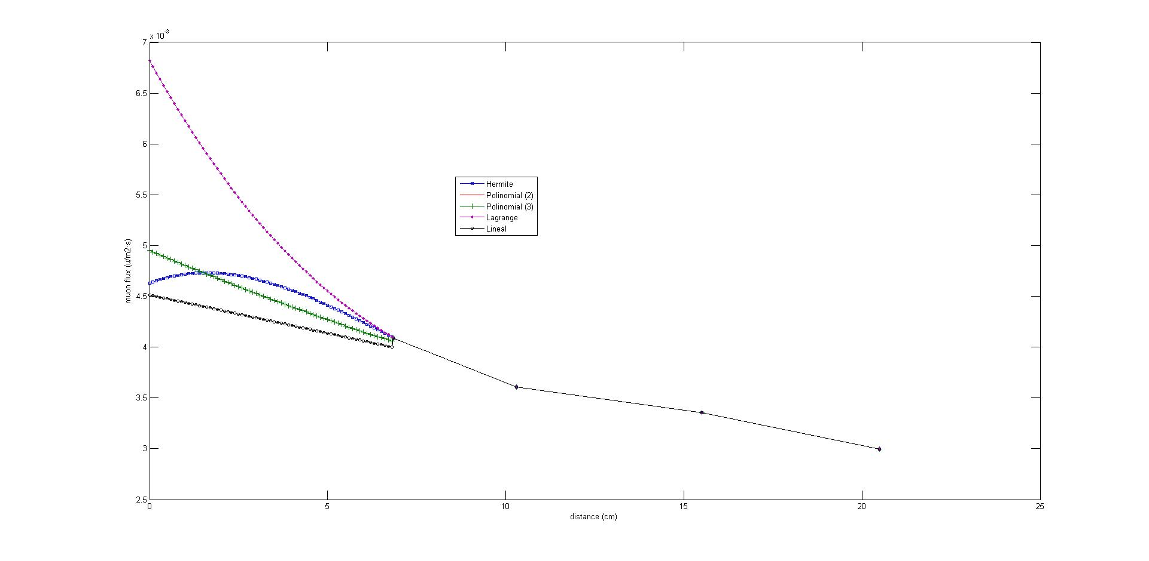
Scintillator plastics
Gap Calibration

Slide 32
Scintillator plastics
Muon track
Top SC16 level
Additional scintillator AS1
Additional scintillator AS2
Mid
SC16 level
PixelT
Bottom SC16 level
PixelM
SC16
PixelB
Measurement of absolute muon efficiency of the SC16 pixels using the additional scintillators. The four-fold coincidence: 2 pixels of 2 different levels + AS1 +AS2 seems to be muon event. If so, we can count absences of fits for the 3-d level pixel which can be hit by muon but has not been.

Slide 33
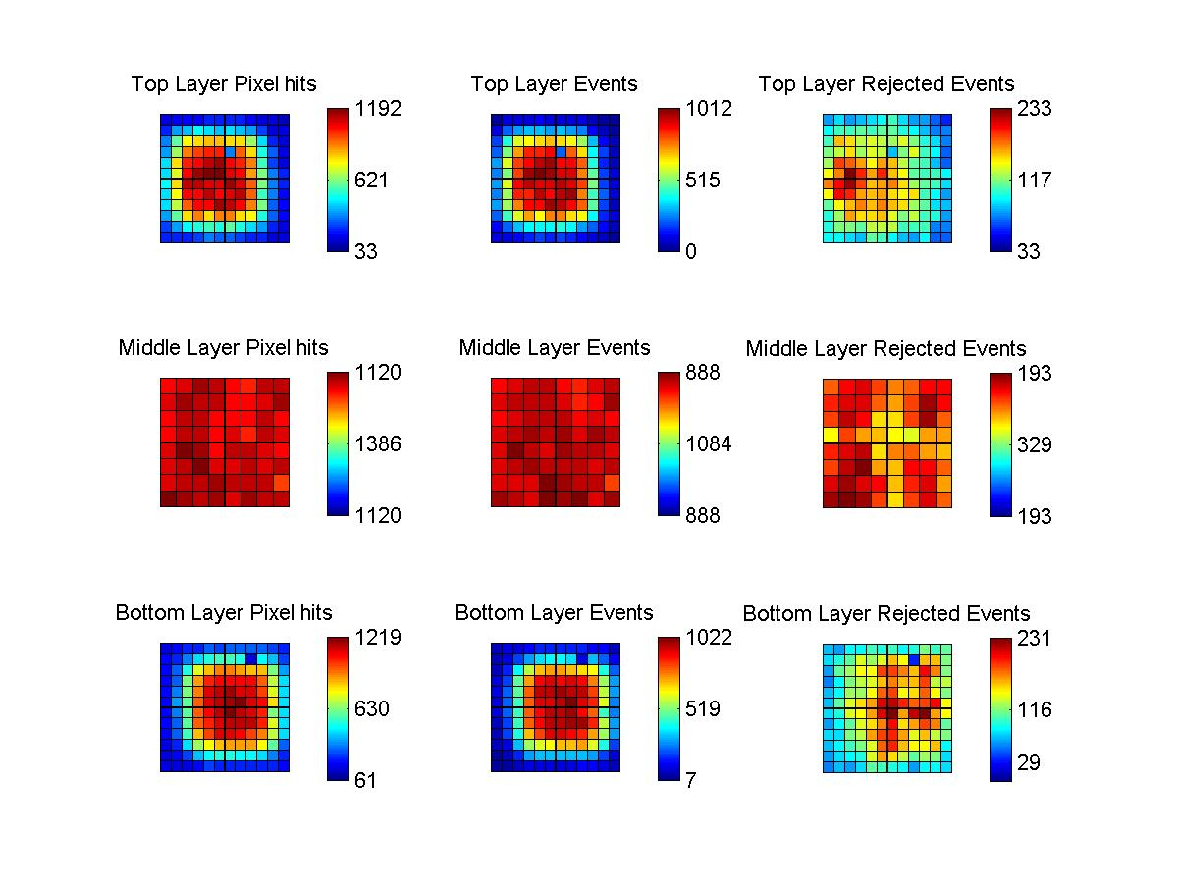
Results – LAB2500

Slide 34
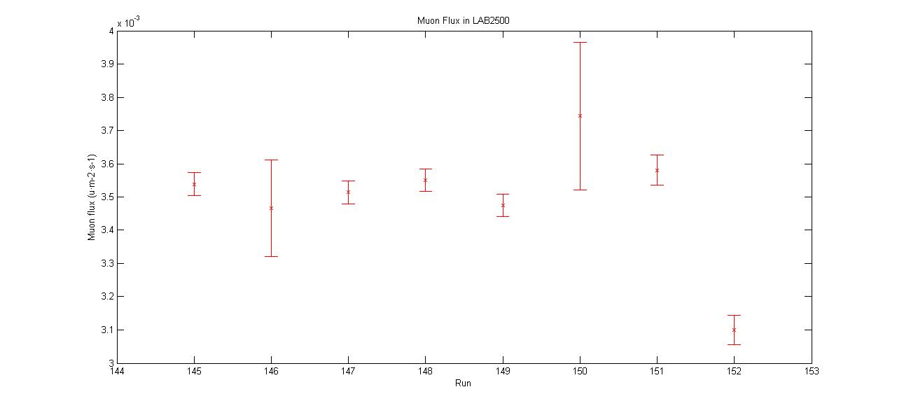
Results – LAB2500
Around 183 days of “good” data

Slide 35
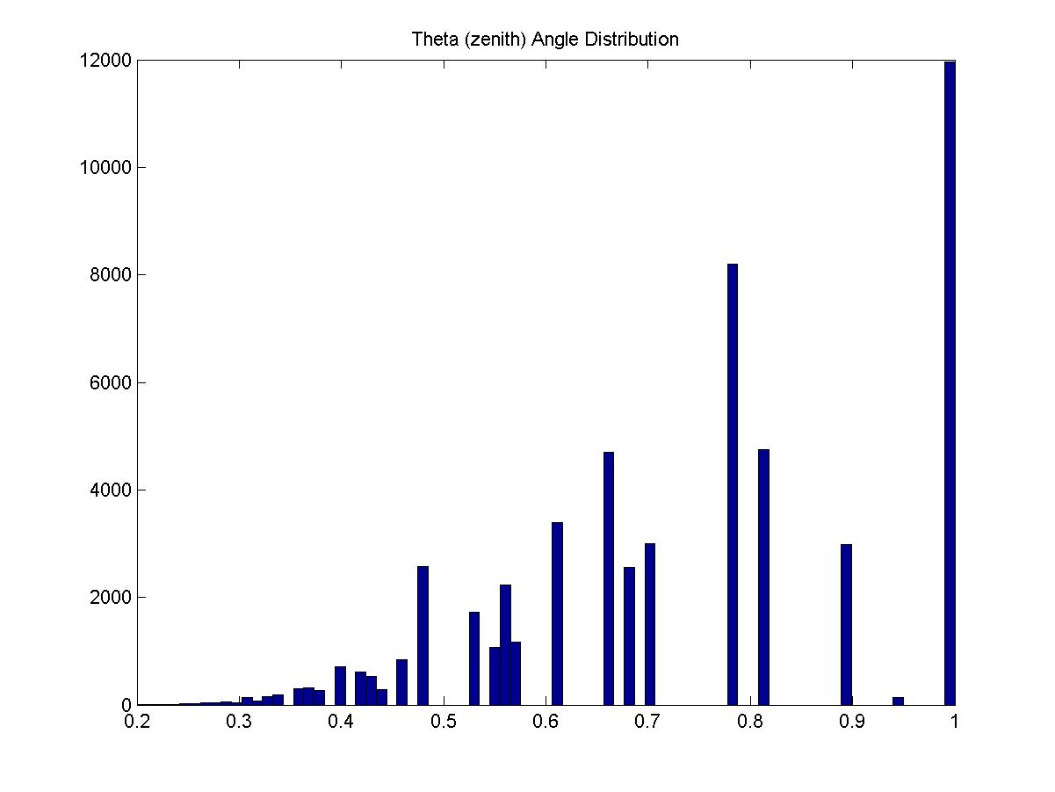
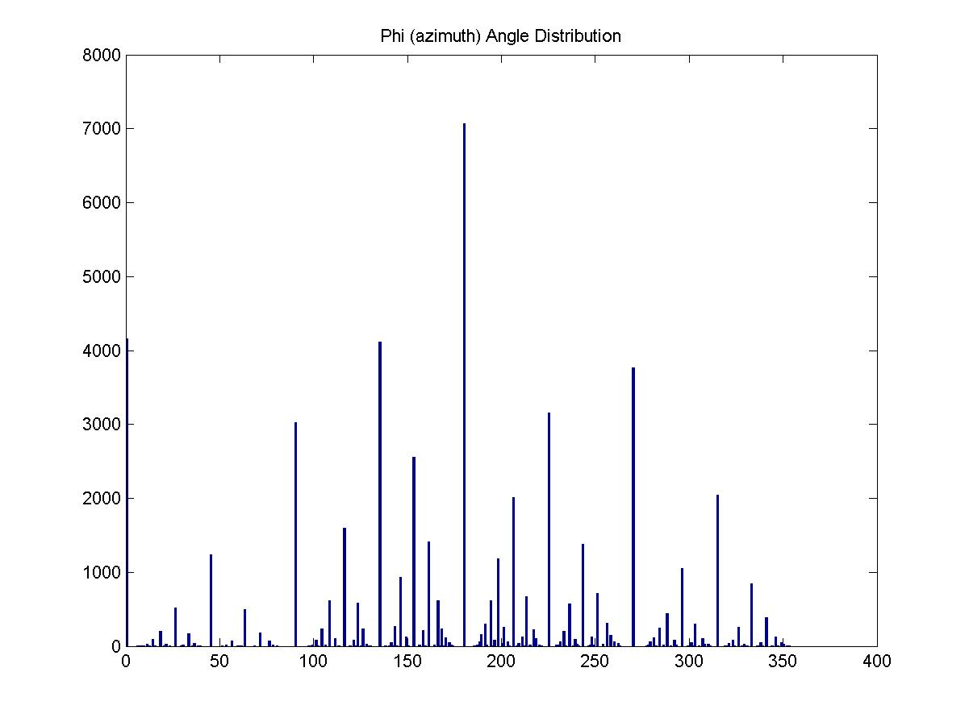
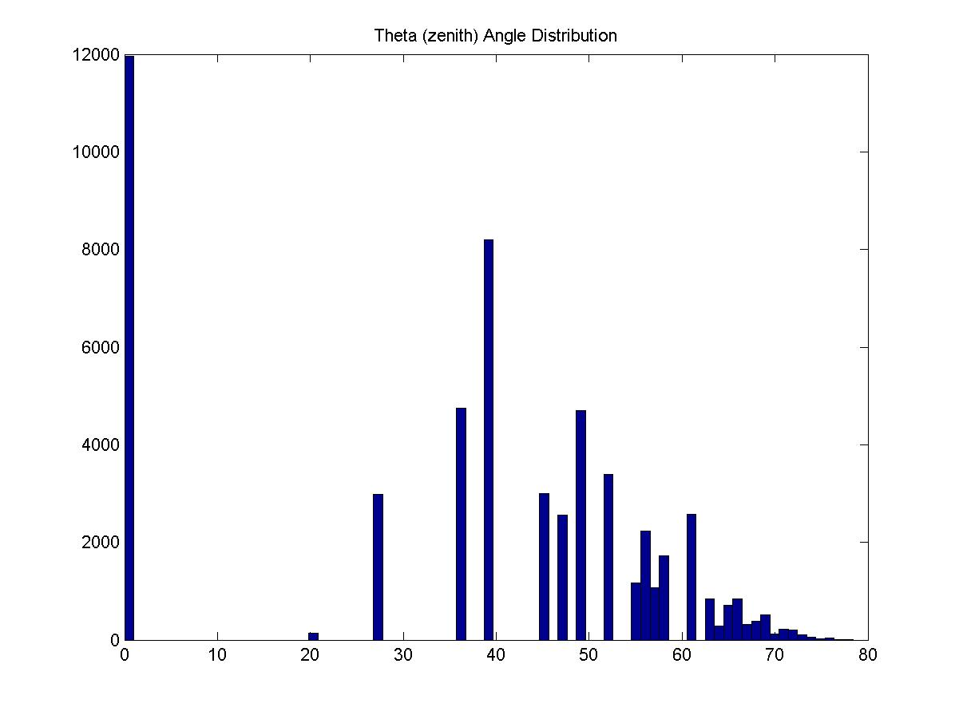
Results – LAB2500

Slide 36
Results – LAB2500

Slide 37
Results – LAB2500

Slide 38
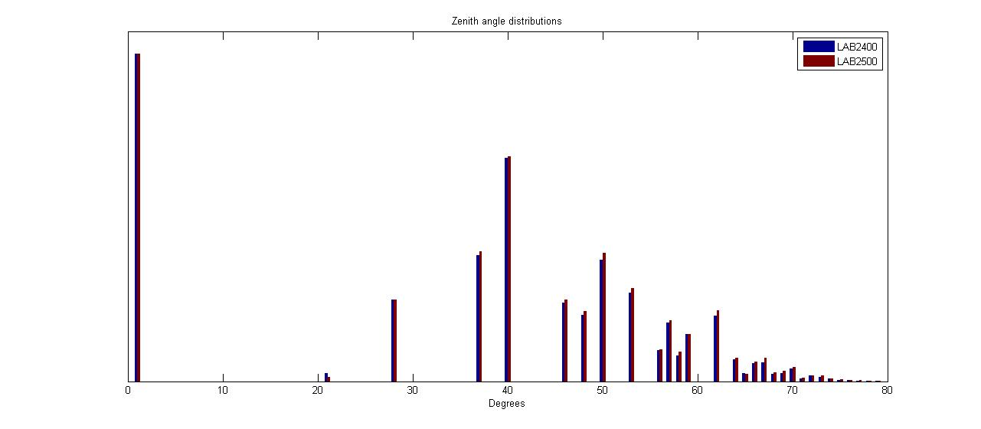
Results

Slide 39
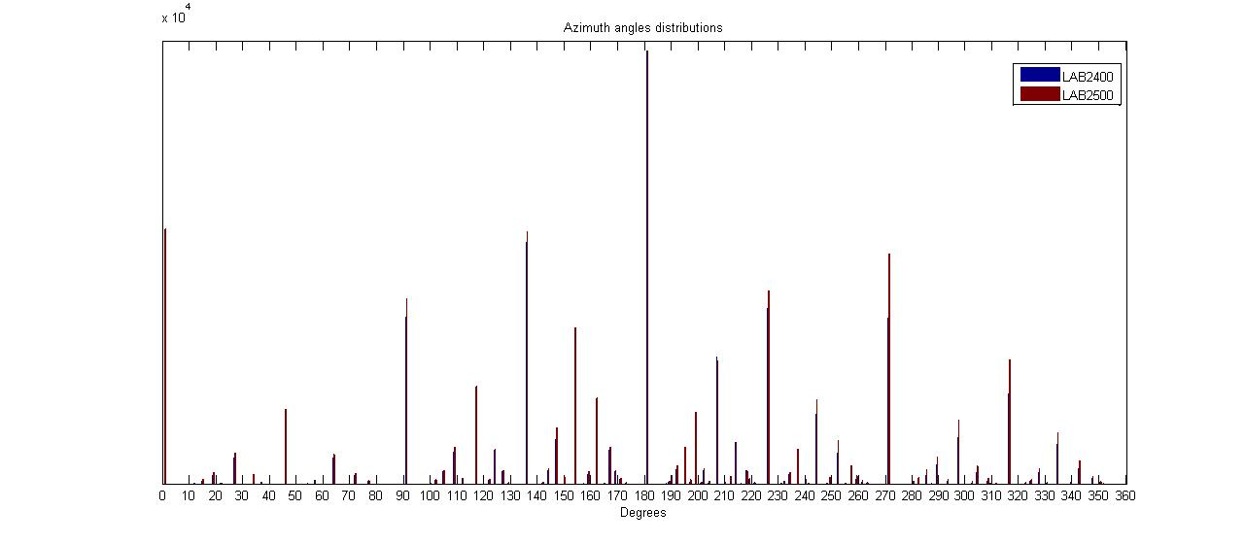
Results

Slide 40
Conclusions
We have made a muon monitor for underground measurement which is sensitive, precise and reliable.
We have enough data to obtain a good statistic value
The value measured is similar to the expected
We observe the dependence between muon flux and mountain profile
The gaps observed in the angles distribution is related with the pixel gap

Slide 41
To do….
Geometry Monte Carlo simulation can correct the final value
This final value must be similar to plastics scintillator corrected (surface and gap calibration) value
We could include the date and time in the program in order to check the modulation
Could be interesting make a program similar to used to check the final values
The monitor data can be applied for tomography of LSC overburden

Slide 42
Status of the muon measurement in LSC
Thank you for attention!!
MUON MONITOR WORKSHOP

