Slide 1
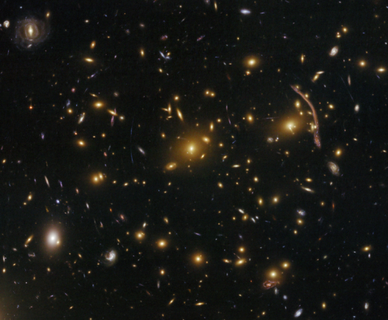
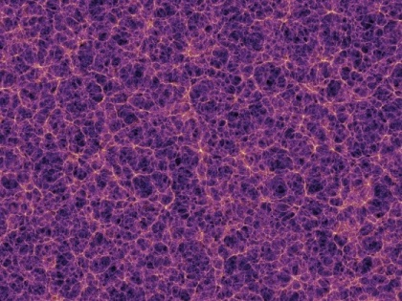
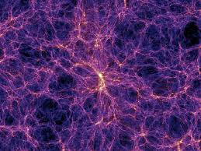
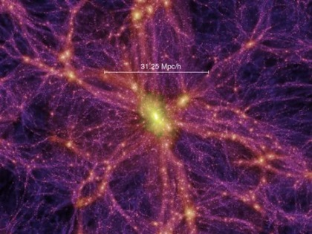
Characterising the most massive GCs of the Universe
z=0
z=10
z=2
What is a Galaxy Cluster?
GCs are the youngest and more massive structures in the Universe, which contain the majority of the DM and where cosmic and galaxy evolution become emphasised
An optical (VIS+IR) observer would say that GCs are accumulations of galaxies
An X-ray/radio astronomer: a gas accumulation
For a theoretical physicist : a DM halo
Multiwavelength analysis is needed

Slide 2
What am I working on?
Characterization of the massive clusters a z=0.25-0.5
Exploring the nature of clusters with cool-core
1) Why massive clusters (at z=0.25-0.5) are so important?
There is only about 100 clusters with M₂₀₀ ̴10¹⁵ Msun in z=0.25-0.5
Massive clusters are important key in the LSS evolution.
As the most massive structures, they show strong lensing efects. So, they can be used to investigate SF at high-z
Explore the Mdyn/Mx (also Mdyn/Msz) at high mass regime.

Slide 3
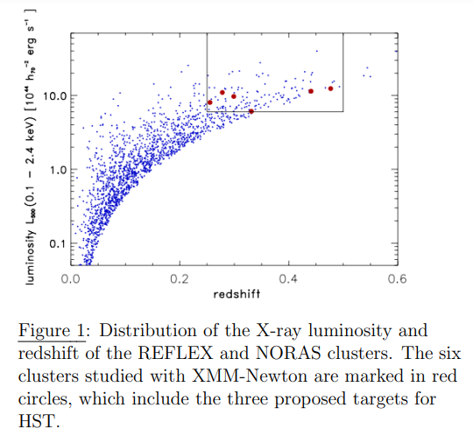
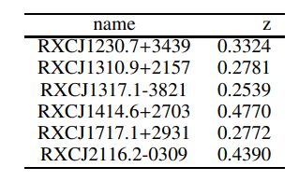
What am I working on?
Characterization of the massive clusters a z=0.25-0.5
Exploring the nature of clusters with cool-core
1) Why massive clusters (at z=0.25-0.5) are so important?
There is only about 100 clusters with M₂₀₀ ̴10¹⁵ Msun in z=0.25-0.5
Massive clusters are important key in the LSS evolution.
As the most massive structures, they show strong lensing efects. So, they can be used to investigate SF at high-z
Explore the Mdyn/Mx (also Mdyn/Msz) at high mass regime.

Slide 4
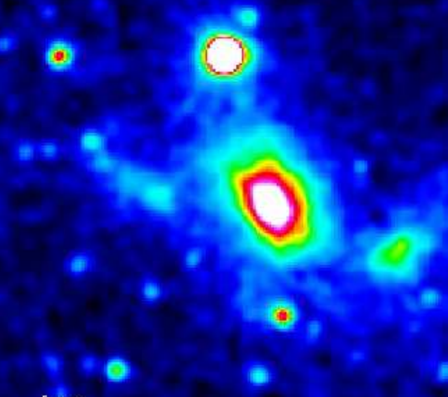
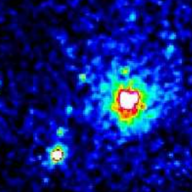
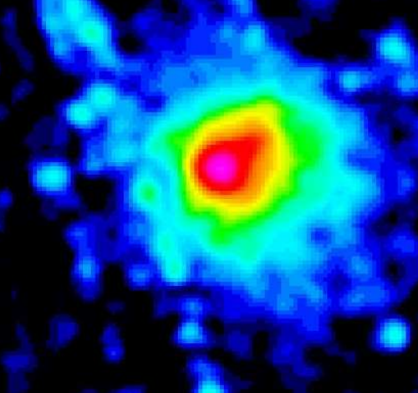
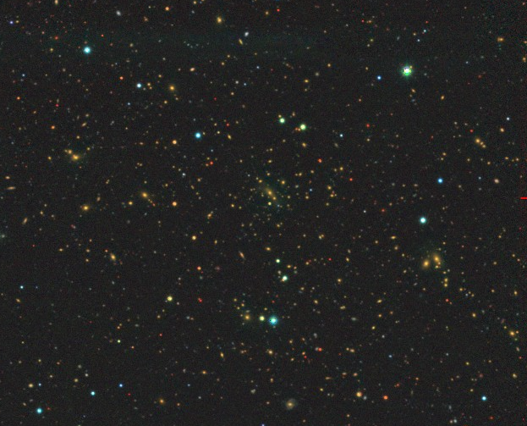
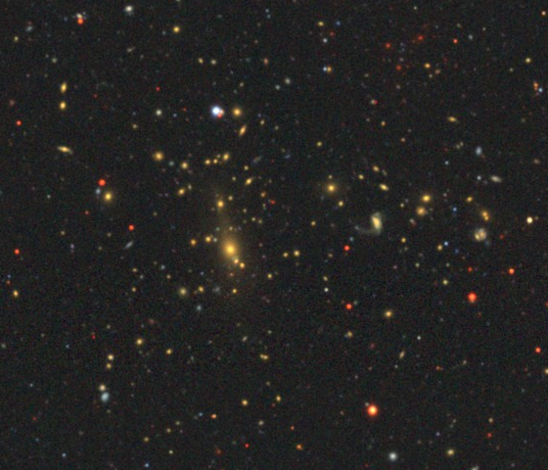
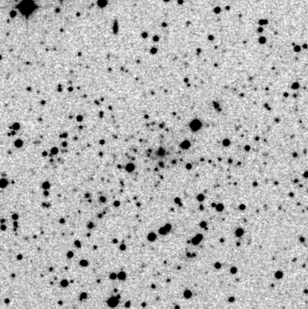
RXCJ1310
RXCJ1230
RXCJ1317
z=0.254
z=0.332
z=0.278

Slide 5
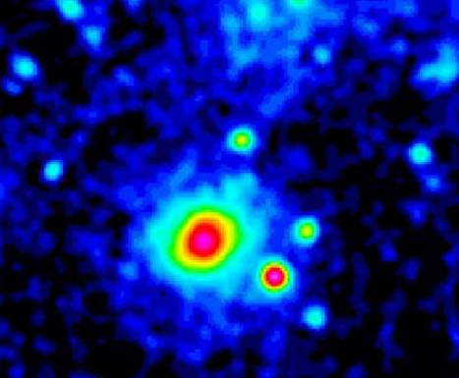
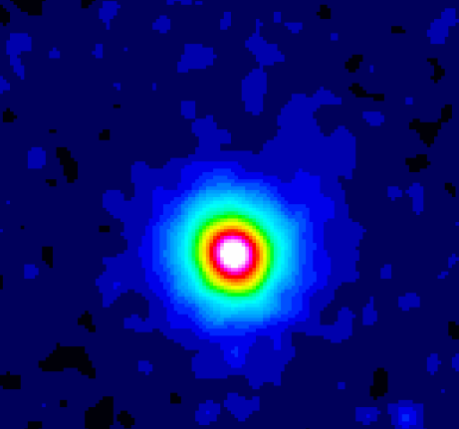
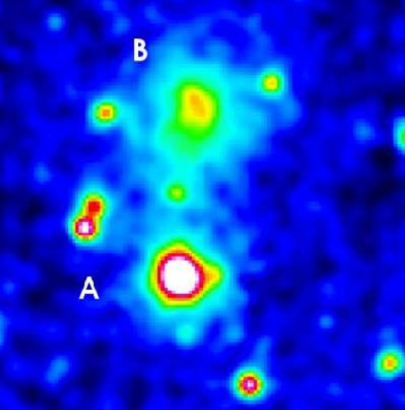
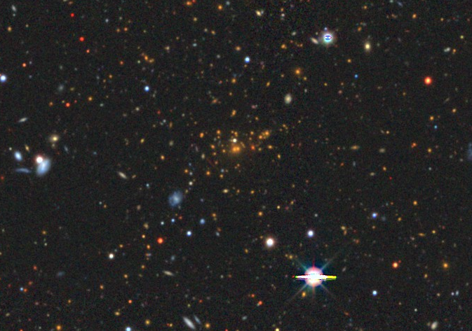
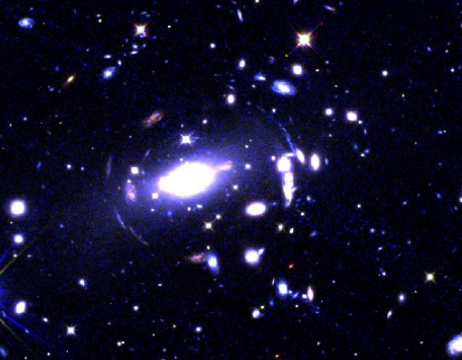
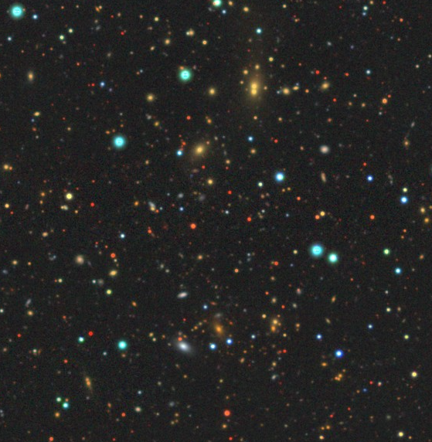
RXCJ1717
RXCJ1414
RXCJ2116
HST
z=0.477
z=0.277
z=0.439

Slide 6
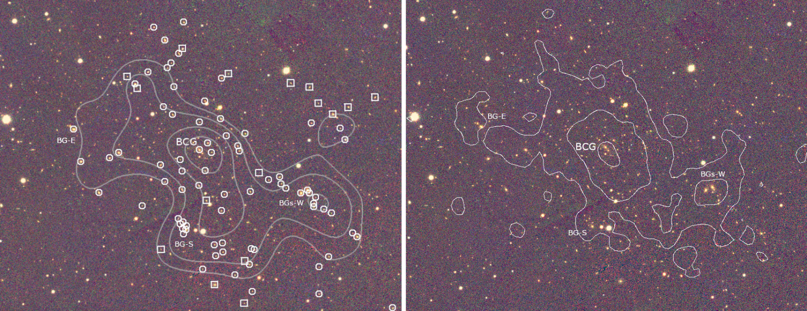
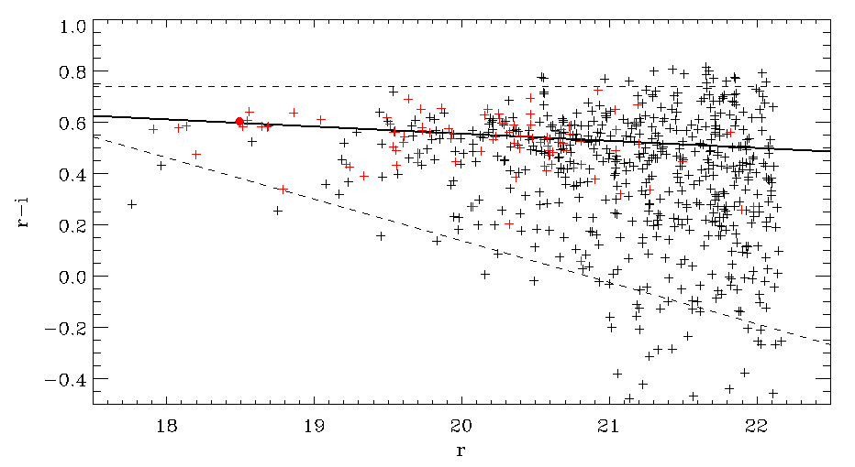
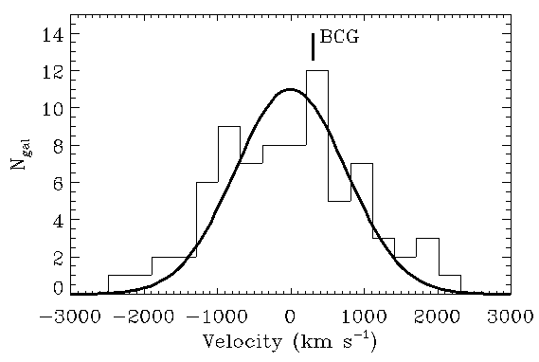
RXCJ1230
(z=0.33)

Slide 7
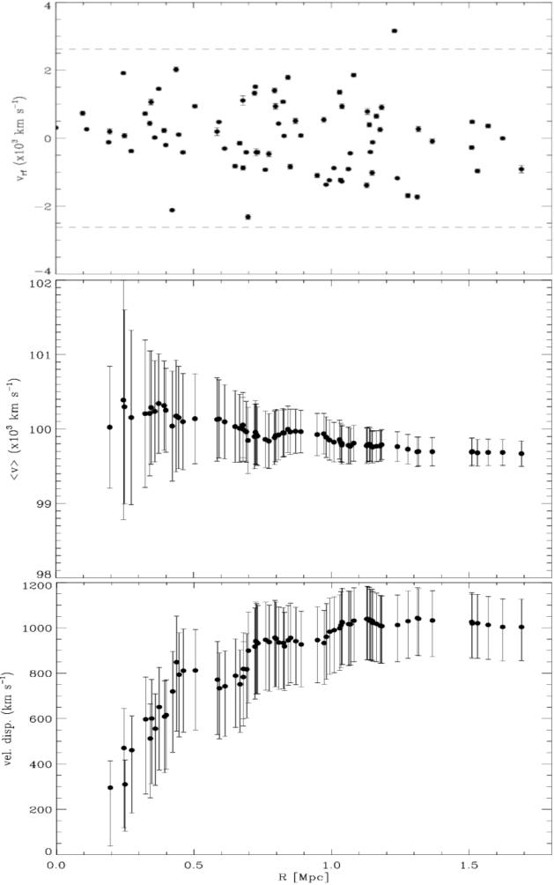
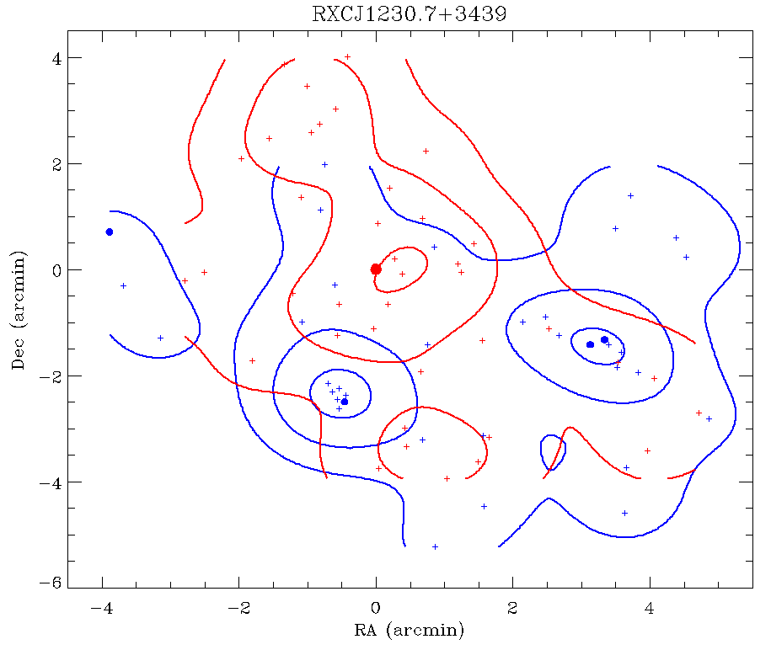
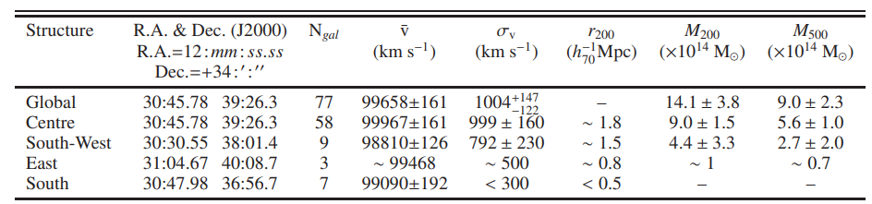

Slide 8
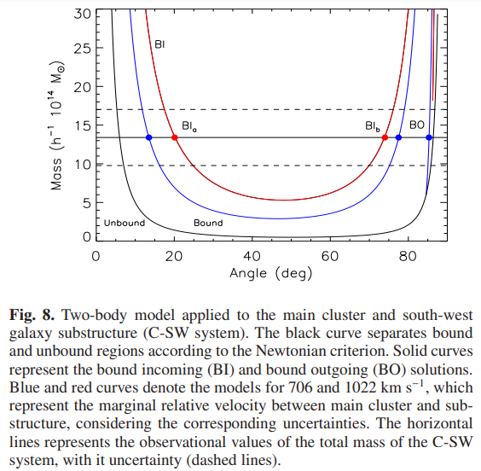

M_{tot} = 1.4 ± 0.4 · 10¹⁵ Msun
Δv_{LOS,rf} = 870 ± 153 km/s
 | <v> (km/s) | M_{500,dyn} (x10¹⁴ M_{o}) | M_{500,X} (x10¹⁴ M_{o}) | T_{X} (keV)
Main body | 99970 ± 160 | 5.6 ± 1.0 | 3.7±0.4 | 4.7 ± 0.4
SW subcl. | 98810 ± 160 | 2.7 ± 2.0 | 2.5±0.3 | 4.4 ± 0.6
E subcl. | - | ̴1.0 | 1.3±0.3
C
E
SW
Most likely angle: α ~ 17º
Mass ratio impact = 2:1
Δv_{rf} = 3000 km/s ; D_{rf} =1 h₇₀⁻¹ Mpc
Merging in about 3 Gyr
This would explain the 1.5 keV excess in SW subcluster.

Slide 9
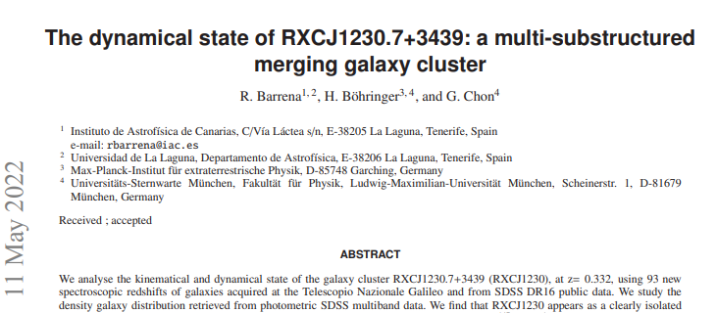
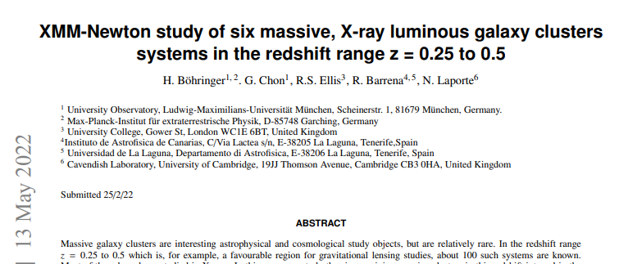

Slide 10
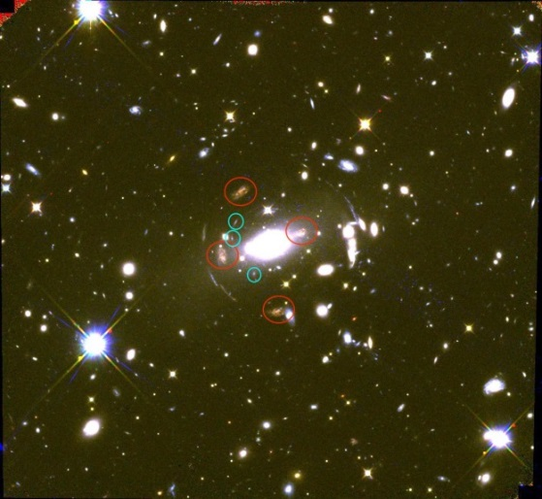
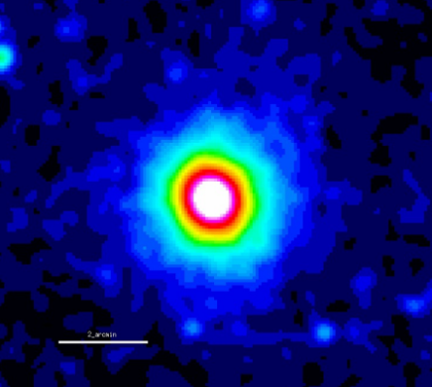
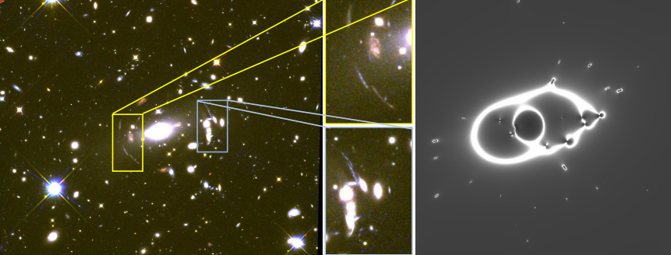
The lensing cluster J1717.1+2931
From F814W, F110W & F160W photometry:
M_{200,X} ~ 1.5 · 10¹⁵ M_{o}
Aim: Use this cluster
As cosmological telescope to
put constraint at the
high-z (3<z<6.5) LF using Ly-α
Multiple image | z_{phot}
Red 1 | 0.57±0.08 (1.6)
Red 2 | 0.46±0.01 (1.6)
Red 3 | 0.32±0.04 (1.6)
Red 4 | 0.25±0.15 (1.6)
Blue 1 | 0.08±0.07 OII (z=1.2)
Blue 2 | 0.11±0.11 OII (z=1.2)
Blue 3 | 0.17±0.14 OII (z=1.2)
z=0.277
XMM
Arc ID | zphot
1 | 0.59±0.04
2 | 0.05±0.04
3 | 0.33±0.03
4 | 0.14±0.13
5 | 0.53±0.06
6 | 1.65±1.22
7 | 0.21±0.05
8 | 0.58±0.08
LensTool
ACS + NICMOS
Preliminary magnification map

Slide 11
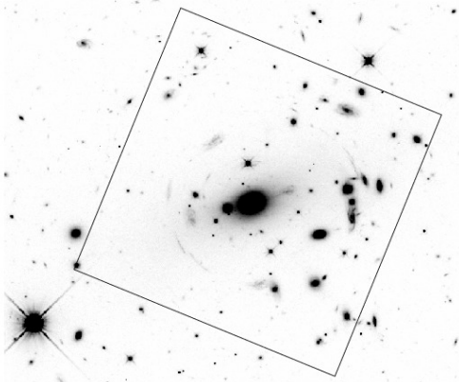
High-z sources
ESO MUSE/VLT proposal
24 pseudo slices
4x1h Texp
m_{z} <22.4
1’x1’ FOV
Redshifts of multiple images, arcs and Lyα emitters
CAT OSIRIS/GTC proposal
90 gals, 60 members
2 masks (PA=0 and 90 deg)
2x2h Texp
i<24
Cluster members
Determine the dynamical mass
Obtain an accurate mass distribution and magnification map in this cluster
Explore the high-z star-forming galaxies

Slide 12
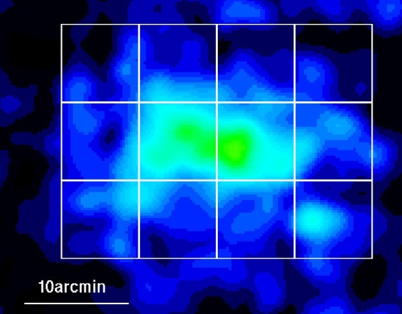
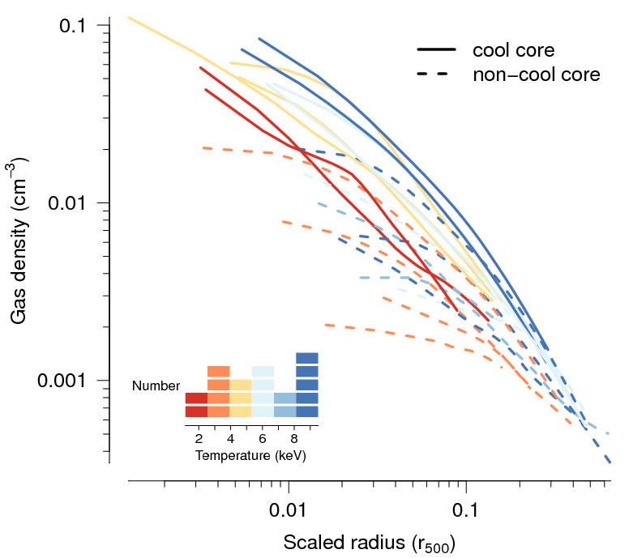
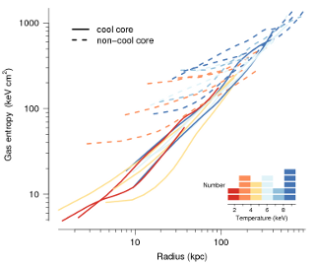
2) Nearby clusters with cool-core
What are these kind of clusters? Unveil the nature of these clusters
Gas vs galaxy clump distribution
Clarify the Mx-Mdyn scaling relation
Density ↑
Entropy and Tx ↓
Abell 76

Slide 13
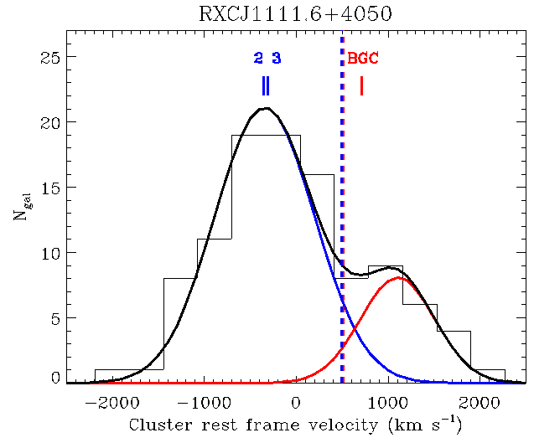
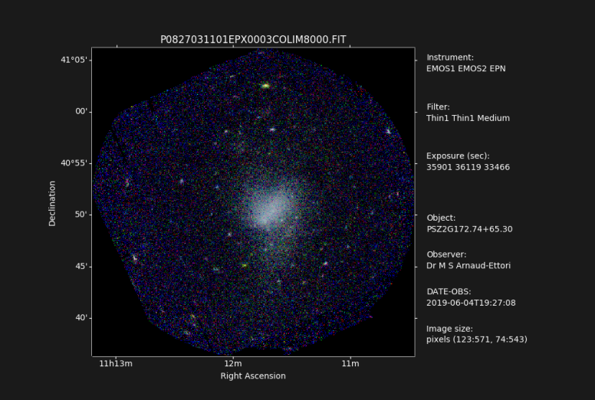
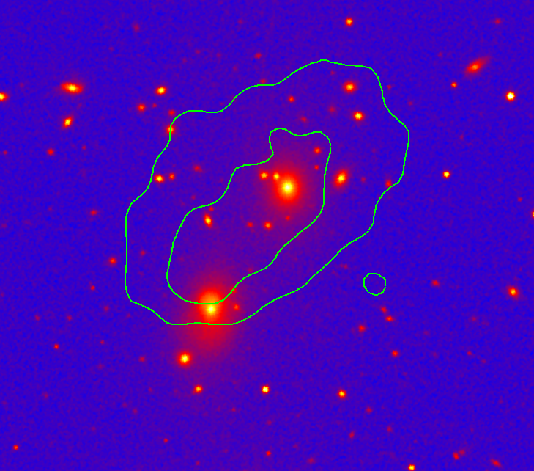
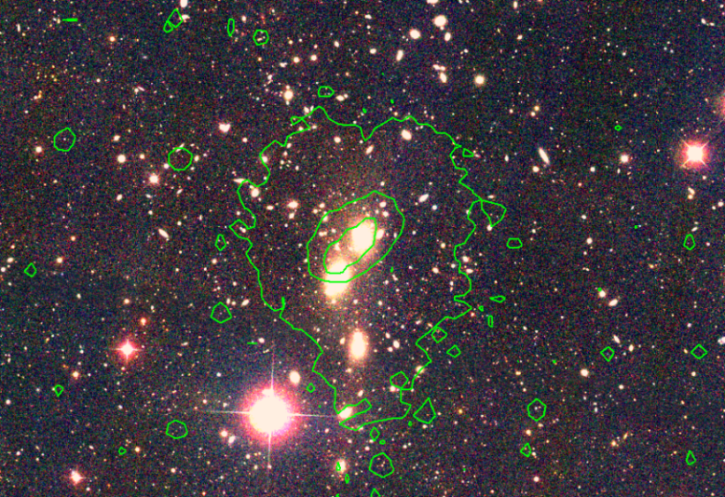
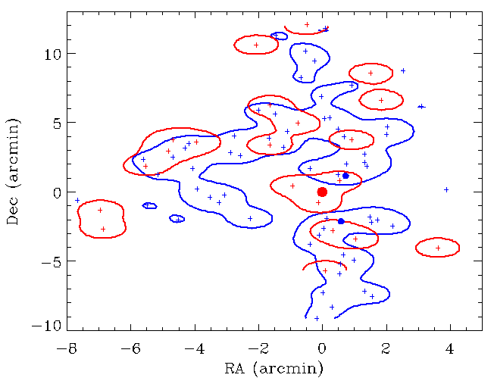
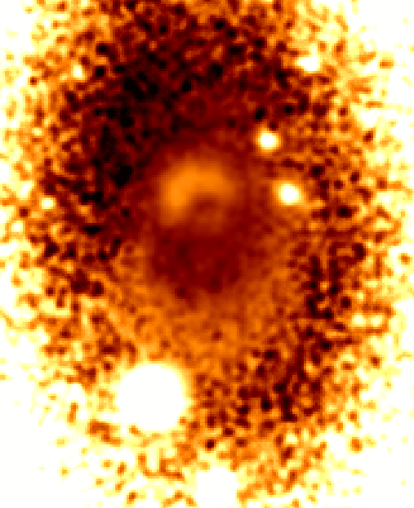
The nearby cluster J1111.6+4050 (z=0.076)
N=103
σv=847+/-98 km/s
M₂₀₀=4.3e14M_{o}

Slide 14
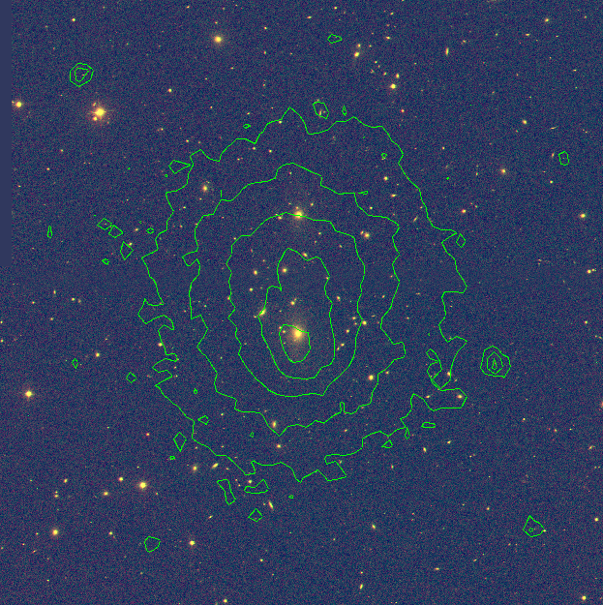
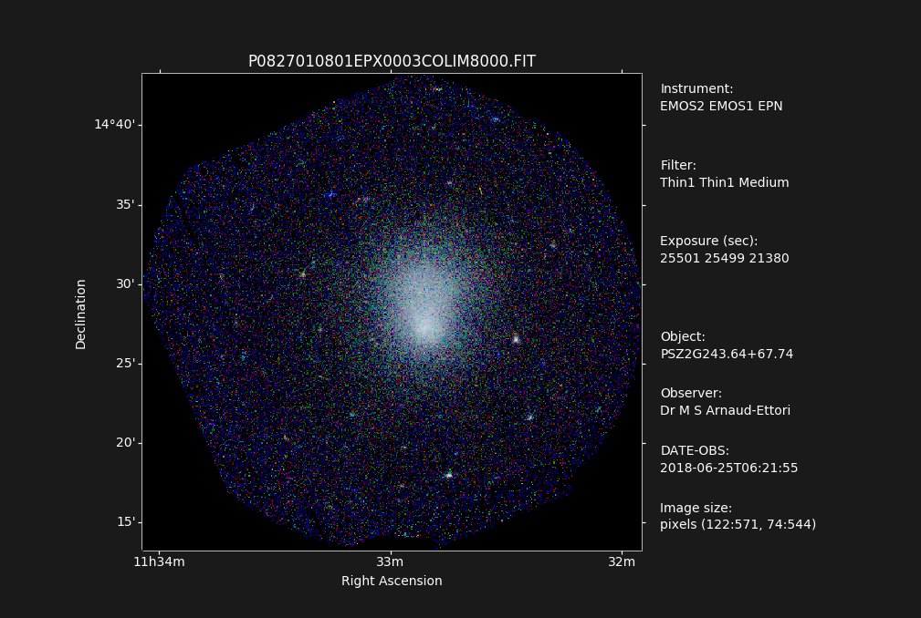
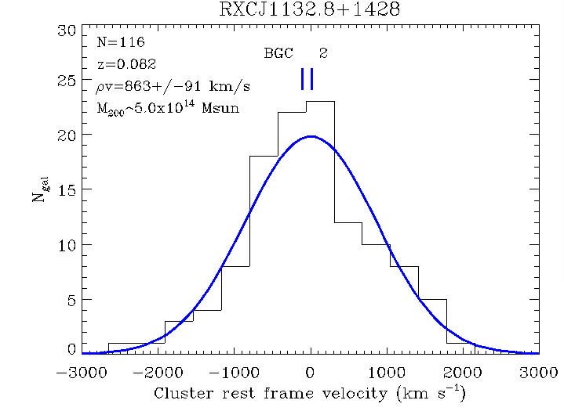
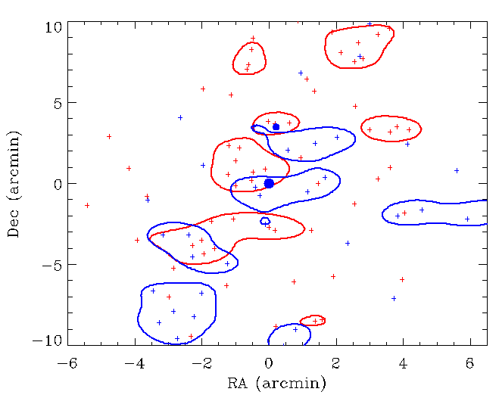
The nearby cluster J1132.8+1428 (z=0.082)

Slide 15
Conclusions
No conclusions yet!!
This is a work in progress.
My suspects …
Even these massive clusters are not completely relaxed and show important mergers.
They gravitational lensing effects. This offers an good opportunity to study the distribution of DM in clusters and use them as cosmological telescopes to explore the universe at high z.
The connection between merger events and cool-core is not clear

