Slide 1
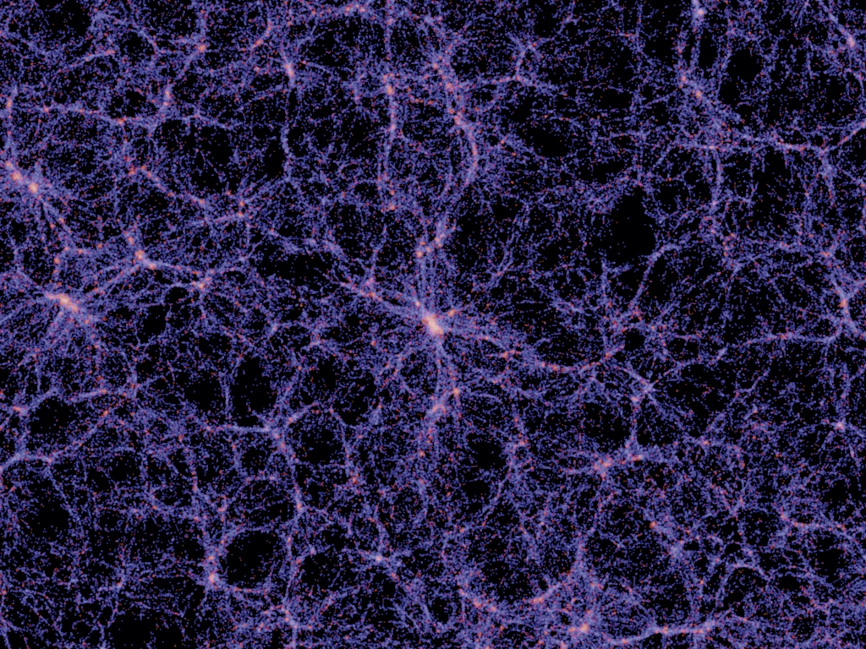
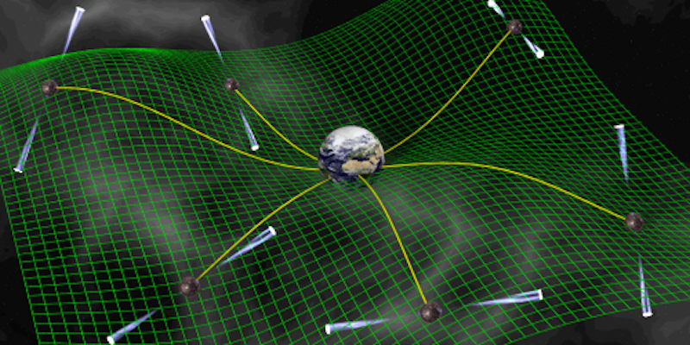
Dark Matter Search with a MeerKAT Pulsar Polarization Array
Michael Sarkis, Stellenbosch University
Collaborators: Zi-Yan Yuwen, Yin-Zhe Ma, Tao Liu, Jing Ren, Patrick Weltevrede, Xiao Xue

Slide 2
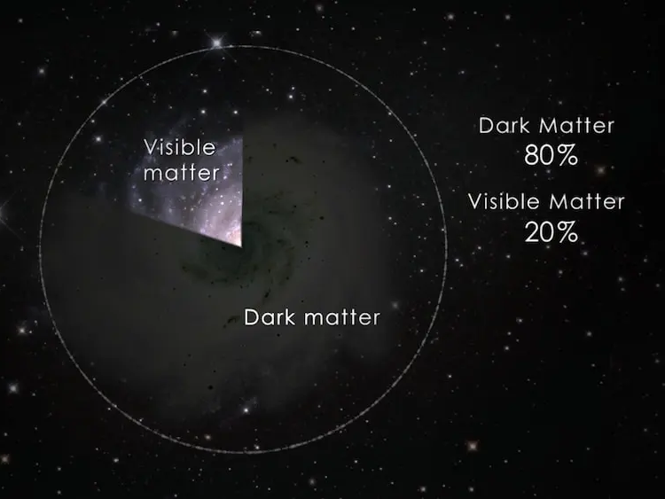
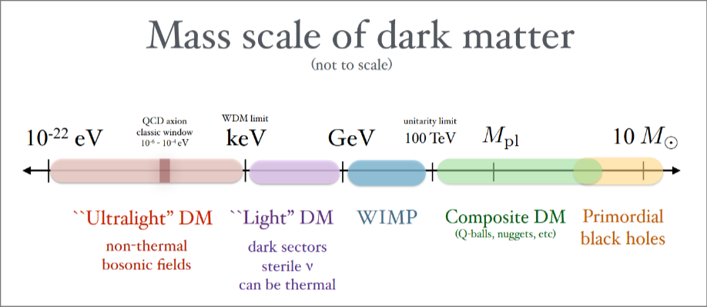



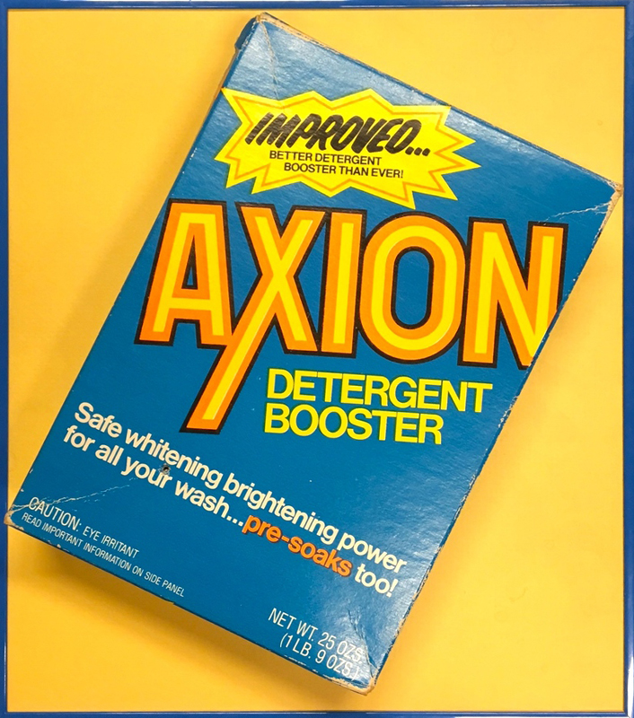
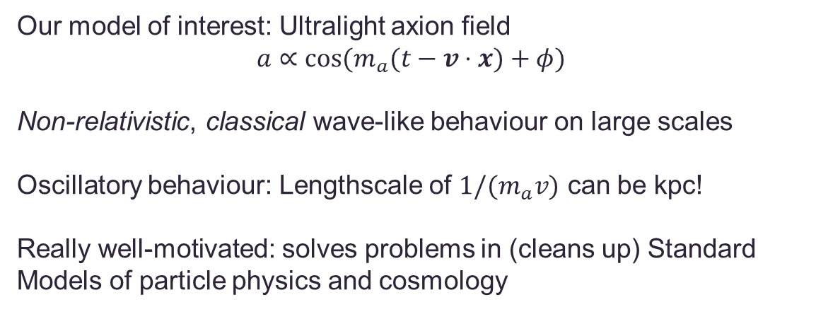
What’s the matter?
Dark matter!
- But what is it?
Our model of interest: Ultralight axion field
$$a∝\cos{(m_{a}(t−v⋅x)+φ)}$$
Non-relativistic, classical wave-like behaviour on large scales
Oscillatory behaviour: Lengthscale of $1/{(m}_{a}v)$ can be kpc!
Really well-motivated: solves problems in (cleans up) Standard Models of particle physics and cosmology
Image credits: T. Lin [1904.07915], symmetrymagazine.org

Slide 3
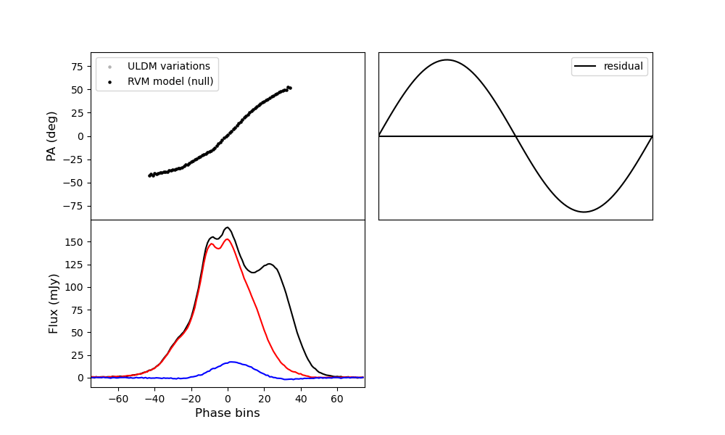
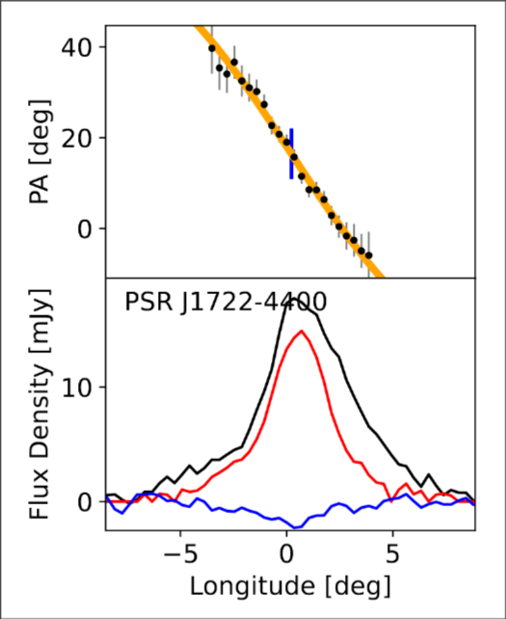
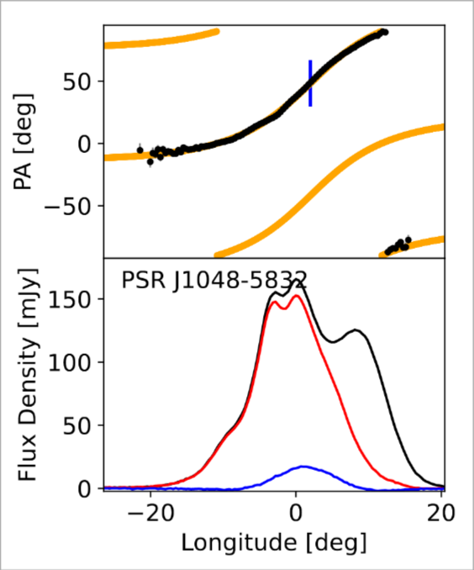
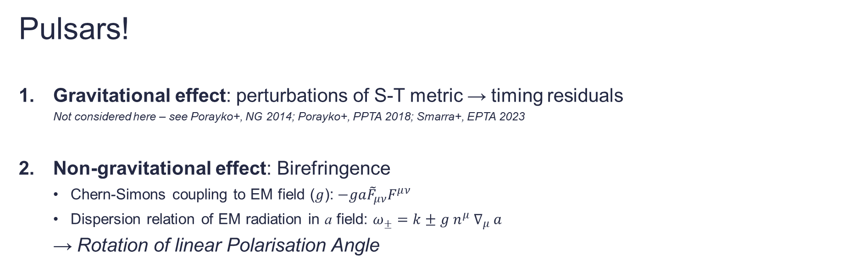
Pulsars!
Gravitational effect: perturbations of S-T metric → timing residuals
Not considered here – see Porayko+, NG 2014; Porayko+, PPTA 2018; Smarra+, EPTA 2023
Non-gravitational effect: Birefringence
Chern-Simons coupling to EM field ($g$):$−ga{\tilde{F}}_{μν}F^{μν}$
Dispersion relation of EM radiation in a field: $ω_{±}=k±g{ n}^{μ} ∇_{μ} a$
→ Rotation of linear Polarisation Angle
Original idea: use RVM model as template, and find residuals
Currently: calculate template from observations
Johnston+, 2023 [2212.03988]

Slide 4
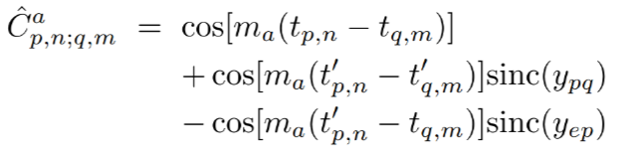
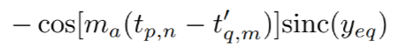
Pulsar Polarisation Arrays
Proposed by T. Liu, X. Lou and J. Ren in PRL 2021 [2111.10615]
Similarity with timing arrays and GW searches:
Looking for correlations in residuals of measurements for many pulsars
Differences:
Polarisation ‘residuals’
Physical distances, not angular separation
Correlation measures (spatial and temporal) can help distinguish signals!
Covariance matrices in likelihood-based analysis
temporal
spatial

Slide 5
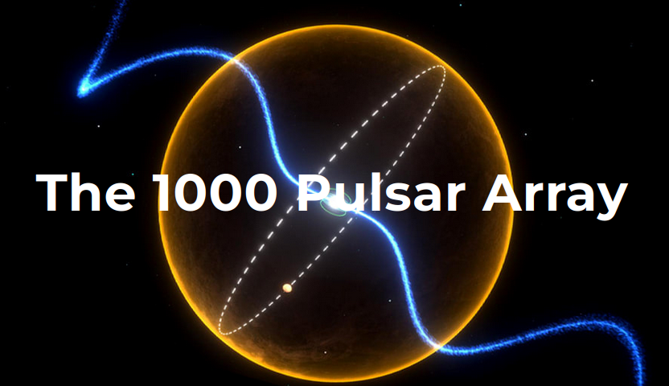
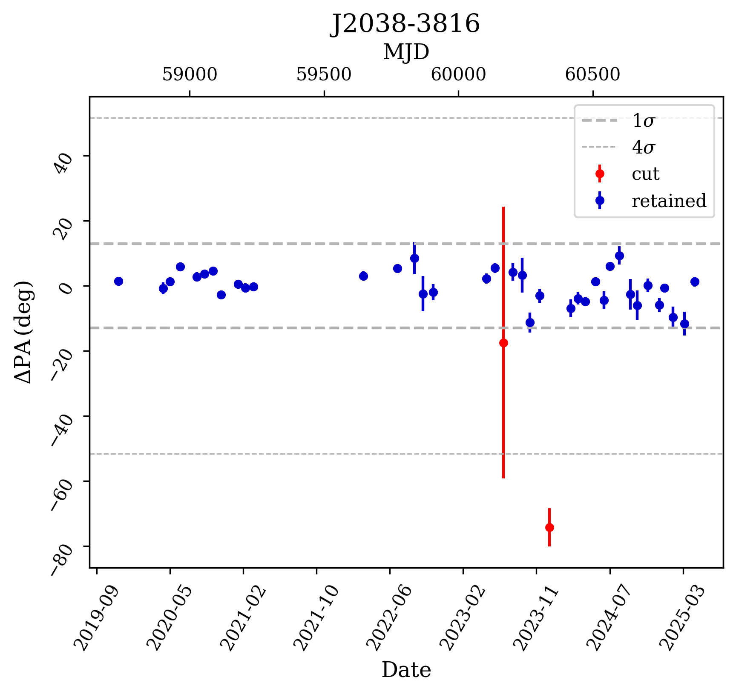
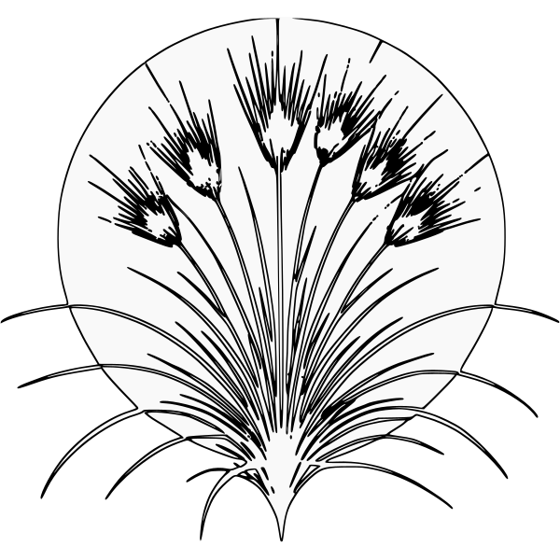
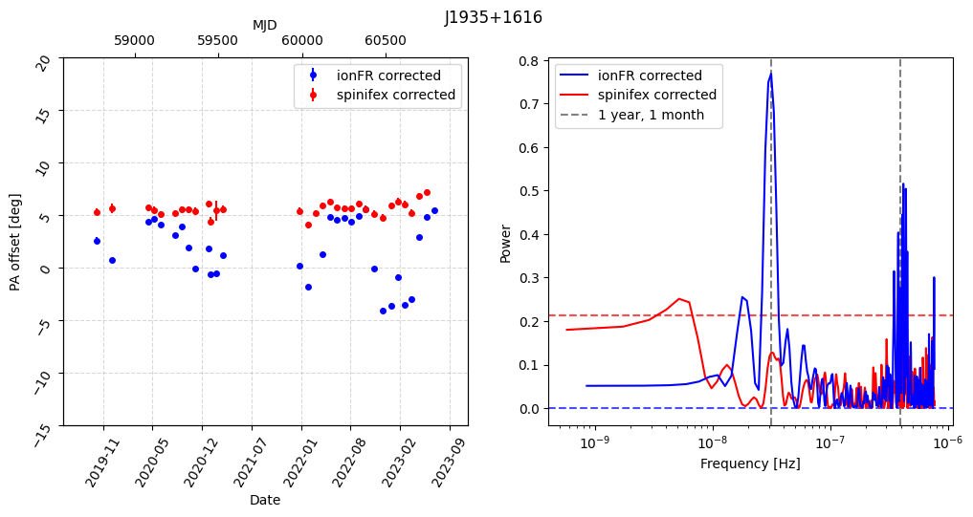

The data
TPA: time series of PA offsets for 1237 pulsars
Basic data cleaning (remove 4σ outliers, minimum observing epochs)
Down to ~ 500 viable pulsars
Ionospheric corrections: ${\text{FR}}_{ion} =\text{RM} λ^{2}$
Not easy to fully account for! (Porayko+, 2018 [1812.01463], 2023 [2023JGeod..97..116P])
Two models: ionFR (https://github.com/csobey/ionFR) and
spinifex (https://git.astron.nl/RD/spinifex)

Slide 6
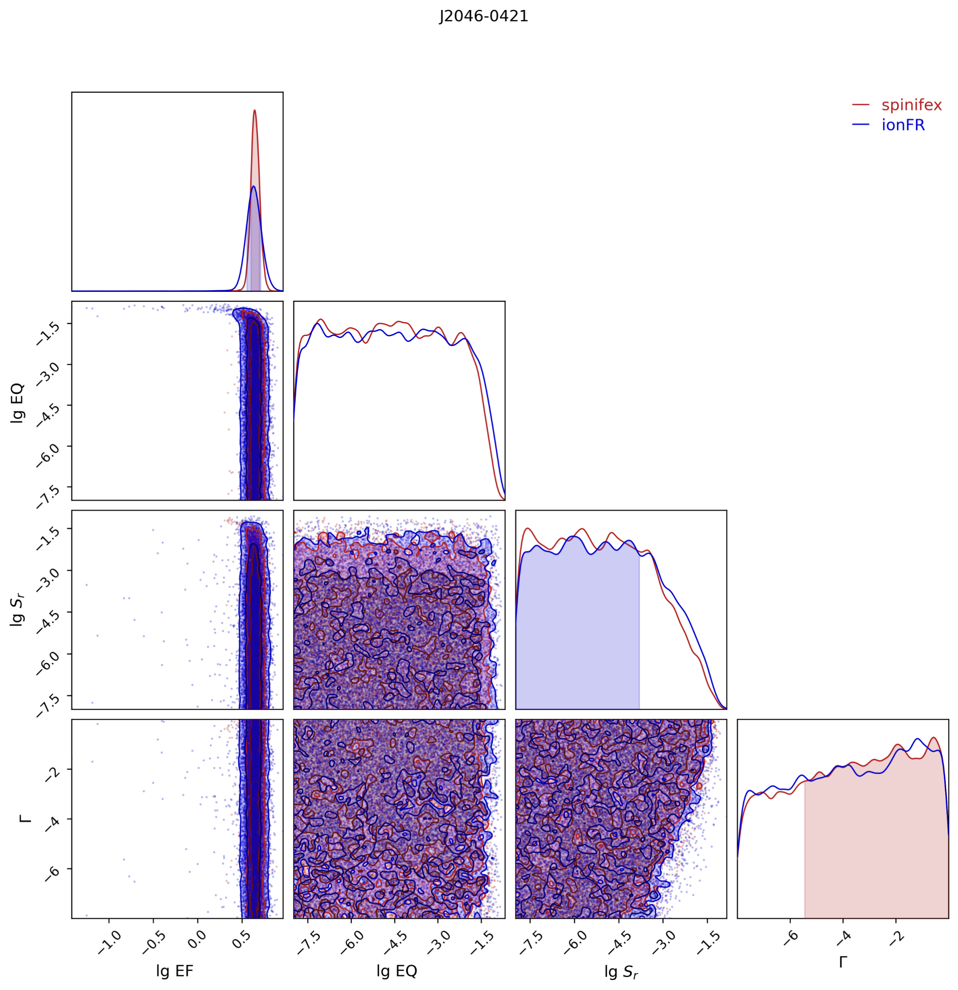
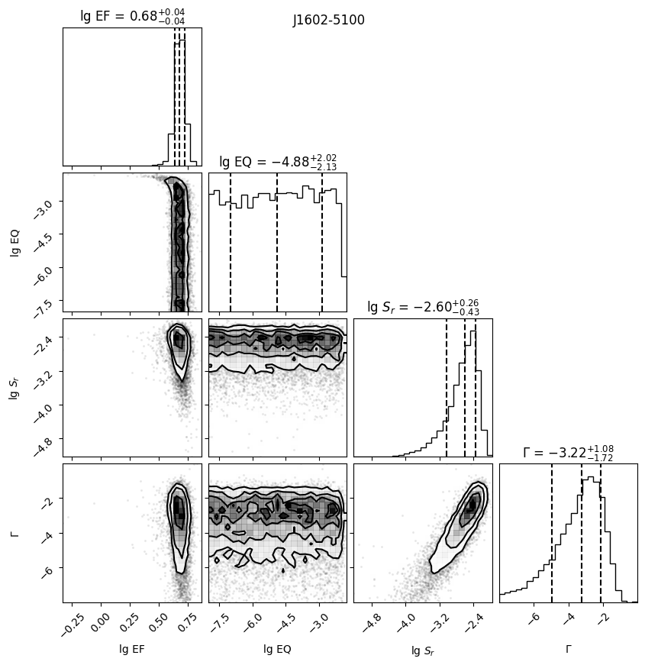
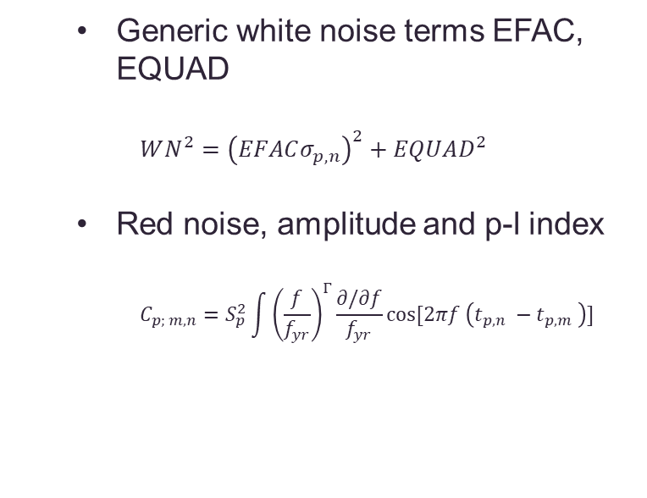
Characterising the polarisation time-series
Noise models similar to (‘vanilla’) pulsar timing analysis
Using code written by X. Xue (https://github.com/XueXiao-Physics/PPA), PTMCMC
Generic white noise terms EFAC, EQUAD
$$WN^{2}={\left(EFACσ_{p,n}\right)}^{2}+EQUAD^{2}$$
Red noise, amplitude and p-l index
$$C_{p; m,n}=S_{p}^{2}\int{{\left(\frac{f}{f_{yr}}\right)}^{Γ}\frac{∂/∂f}{f_{yr}}\cos{[2πf \left(t_{p,n} −t_{p,m} \right)]}}$$

Slide 7
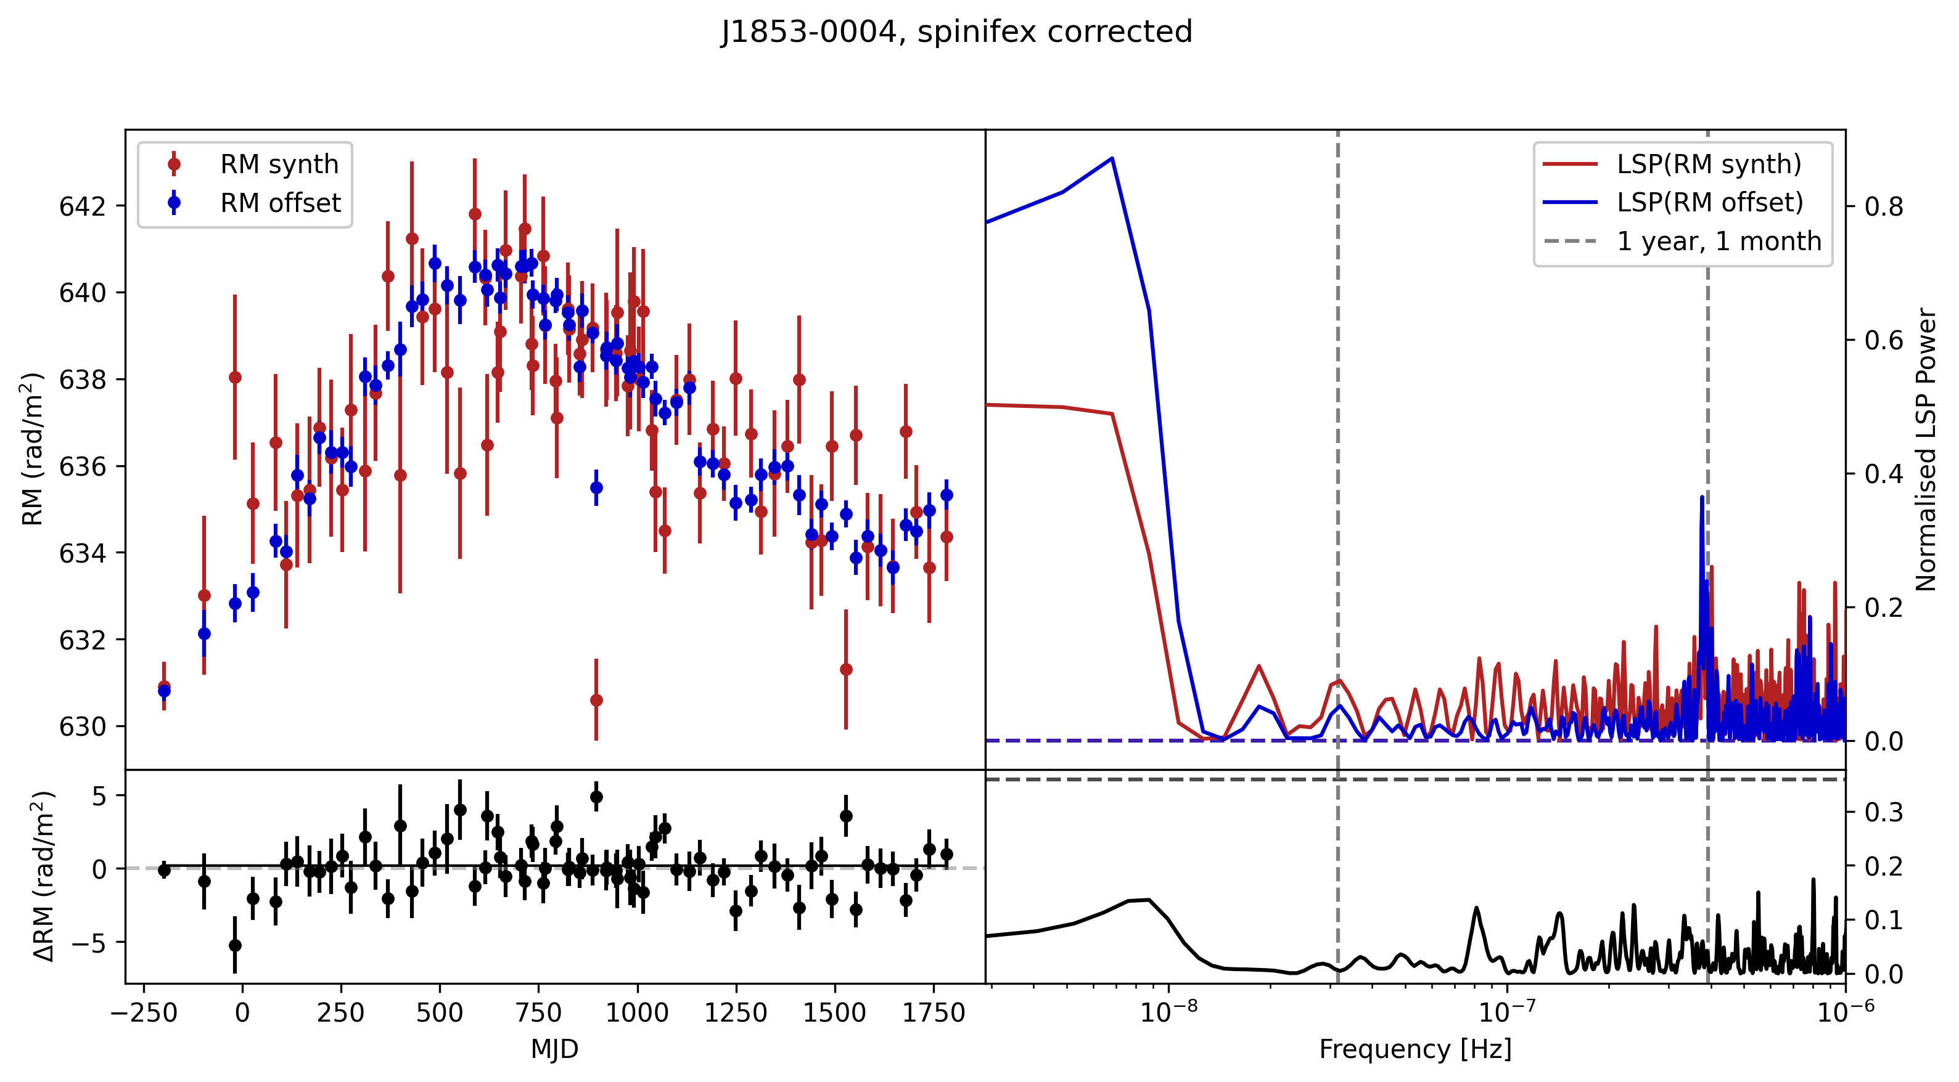
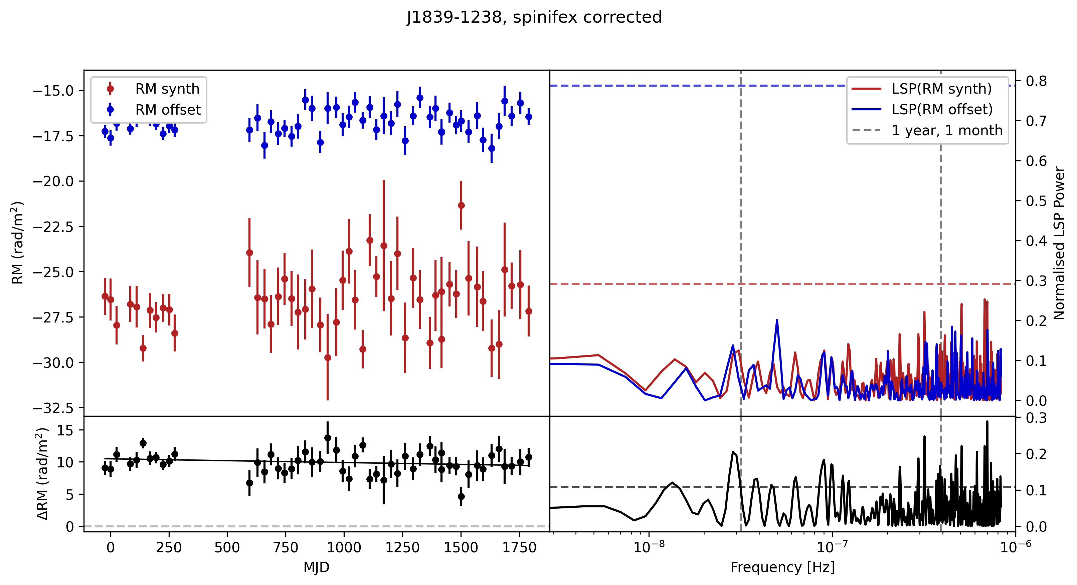
Rotation of PA due to ultralight axion birefringence has a neat property: it’s frequency-independent!
RM is usually found assuming a magnetised plasma – frequency dependent
A distinguishing feature of dark matter-related signals!
Preliminary
Even if we don’t see signs of dark matter, there are strong hints of non-FR like rotation of PA in this population study

Slide 8
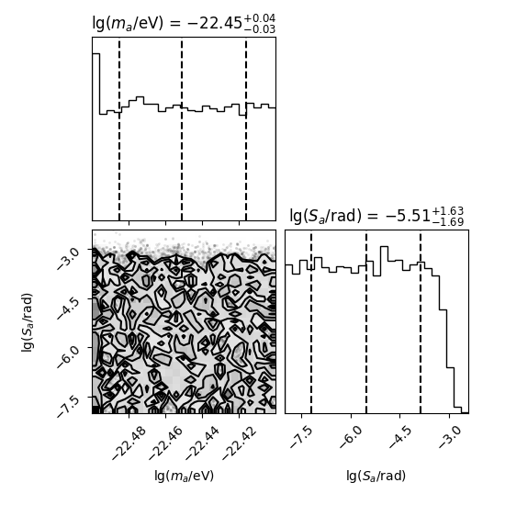
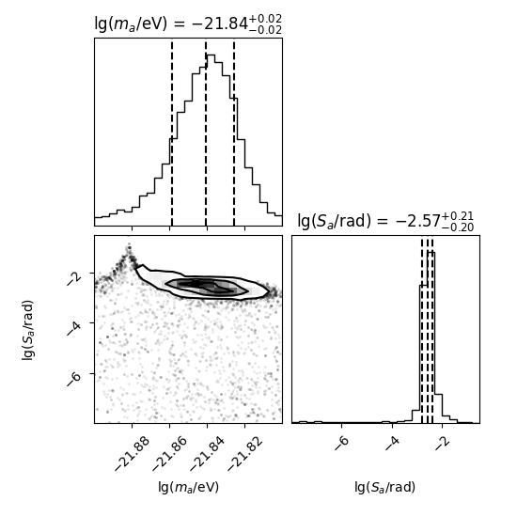

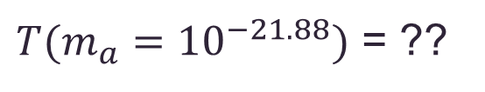
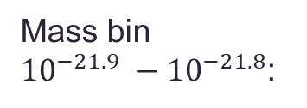
Dark matter search
Two parameters of interest: $\{m_{a}, g_{aγγ}\}$, g proxied by amplitude factor $S_{a}$
Full search with correlations: binned log mass window of (-23, -20) (roughly 6 d – 13 y)
Most mass bins:
Mass bin ${10}^{−21.9} −{10}^{−21.8}$:
$T(m_{a}={10}^{−21.88})$ = ??
0,99 years!

Slide 9
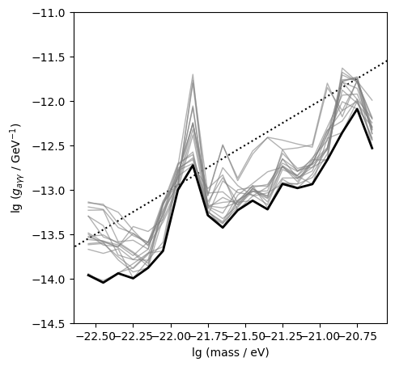
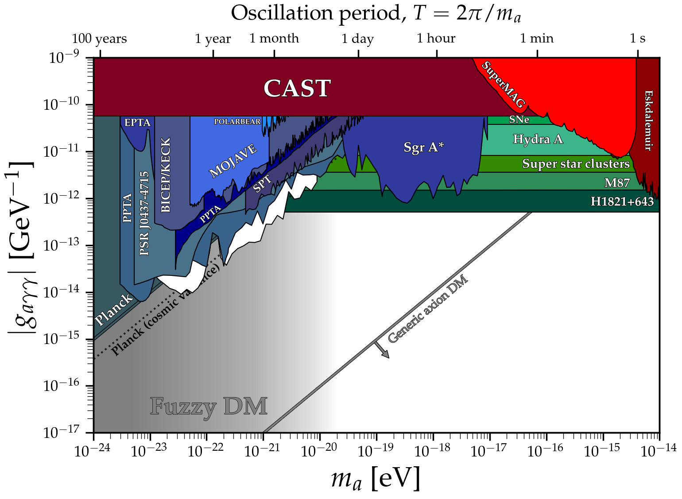
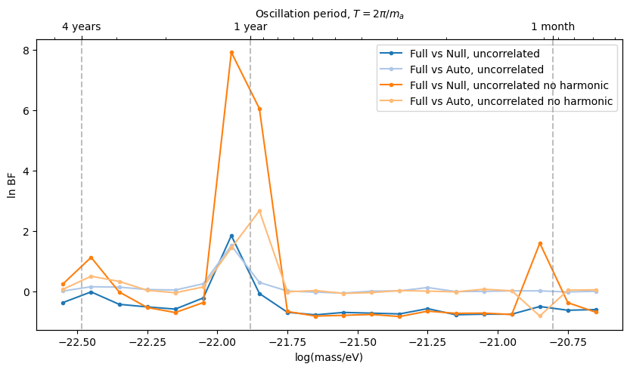
From non-detection: constraints on viable parameter space
10 – 50 pulsar groups, full + auto correlations
Sarkis, Yuwen+, in prep
Notes:
Preliminary – highlight PPTA

Slide 10
Outlook
Bright future for dark matter searches!
Great probe of fuzzy/ultralight DM parameter space
Polarisation array analysis needs to mature
Better noise understanding and characterisation, ionosphere corrections
Multi-frequency
ν-independence of signal allows better noise-signal disentanglement
Timing-polarisation array synergies
New framework development for this: Li X.+, arxiv:2506.04871

Slide 11
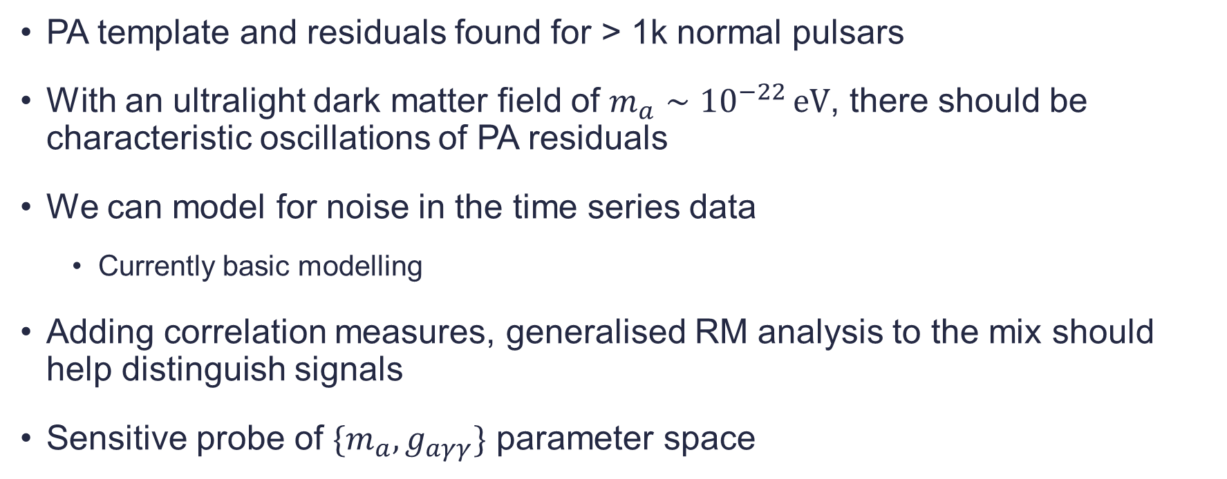
Summary
PA template and residuals found for > 1k normal pulsars
With an ultralight dark matter field of $m_{a}∼{10}^{−22 }\text{eV}$, there should be characteristic oscillations of PA residuals
We can model for noise in the time series data
Currently basic modelling
Adding correlation measures, generalised RM analysis to the mix should help distinguish signals
Sensitive probe of $\{m_{a}, g_{aγγ}\}$ parameter space

Slide 12
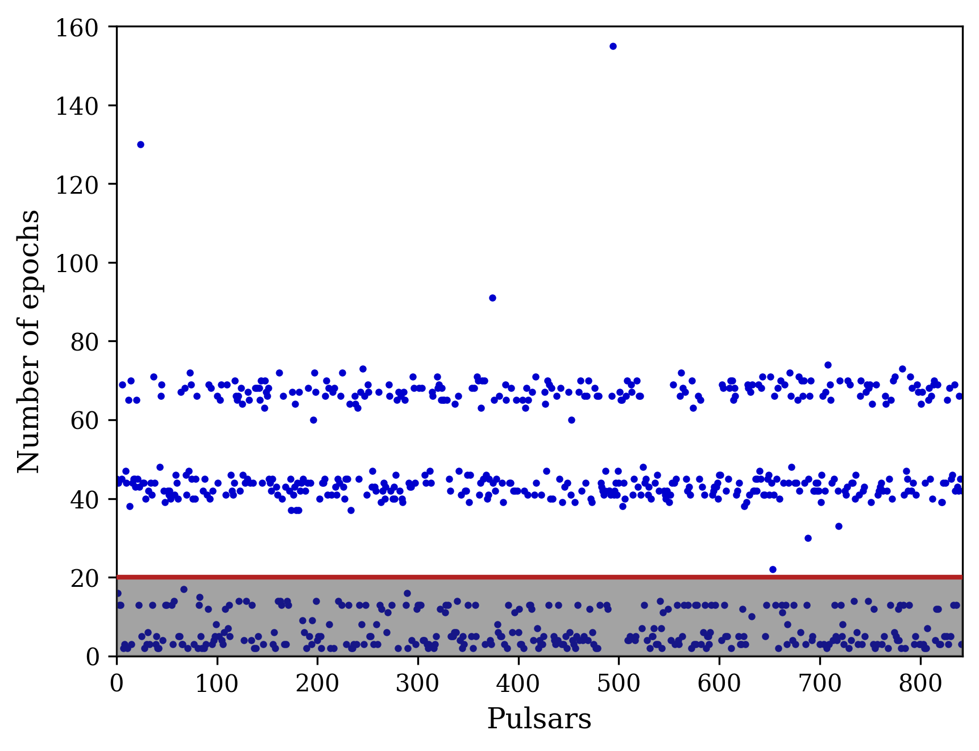
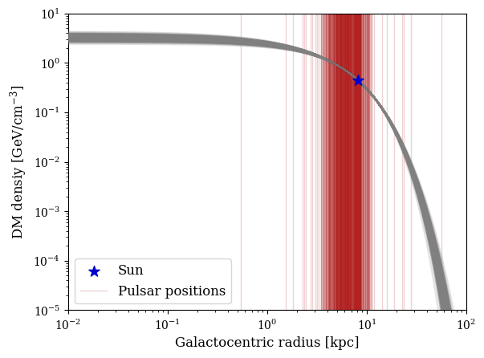
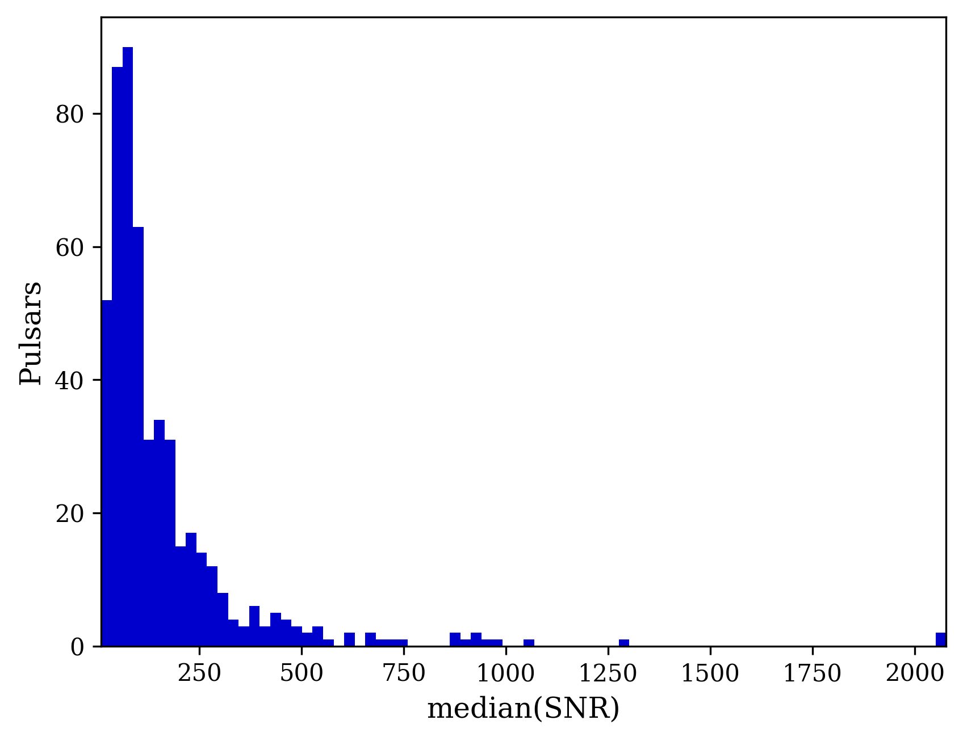
Backups

Slide 13
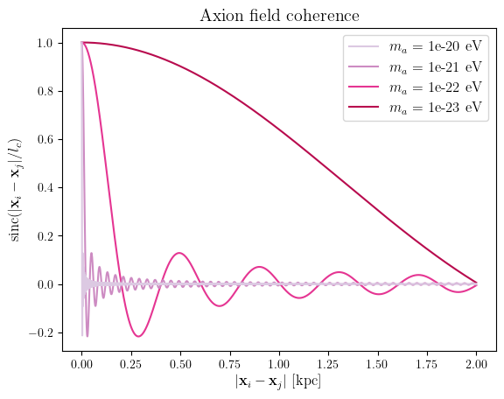
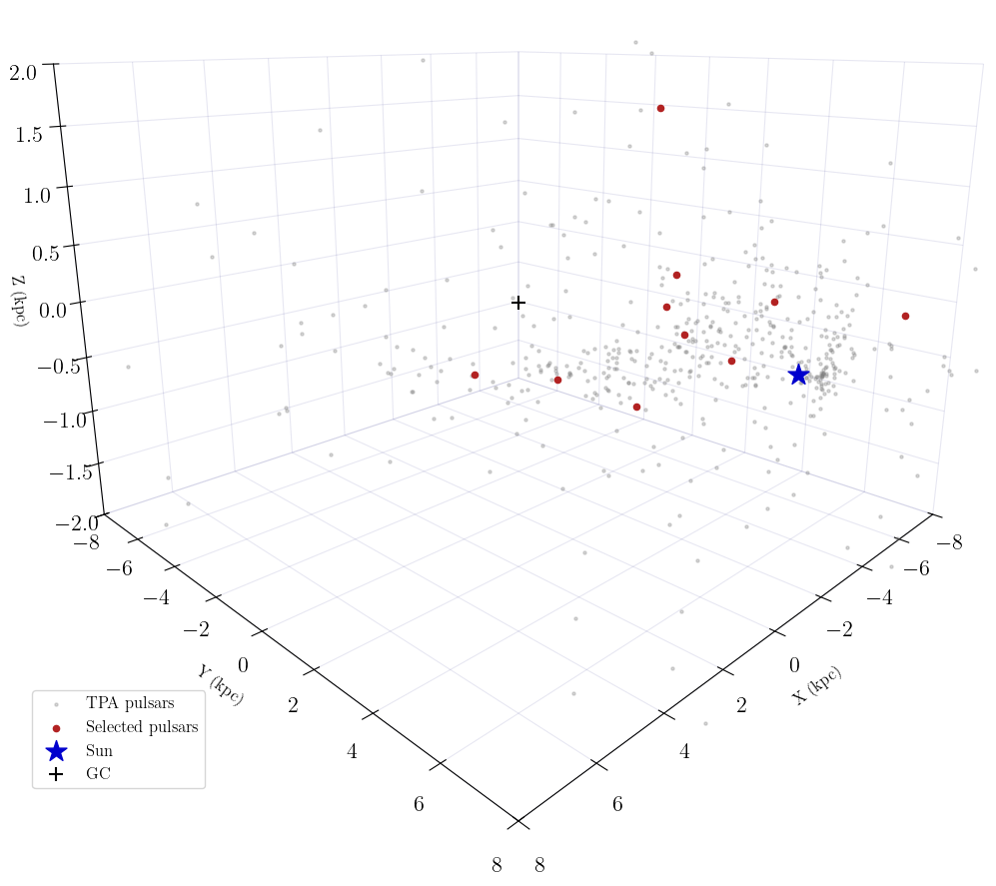
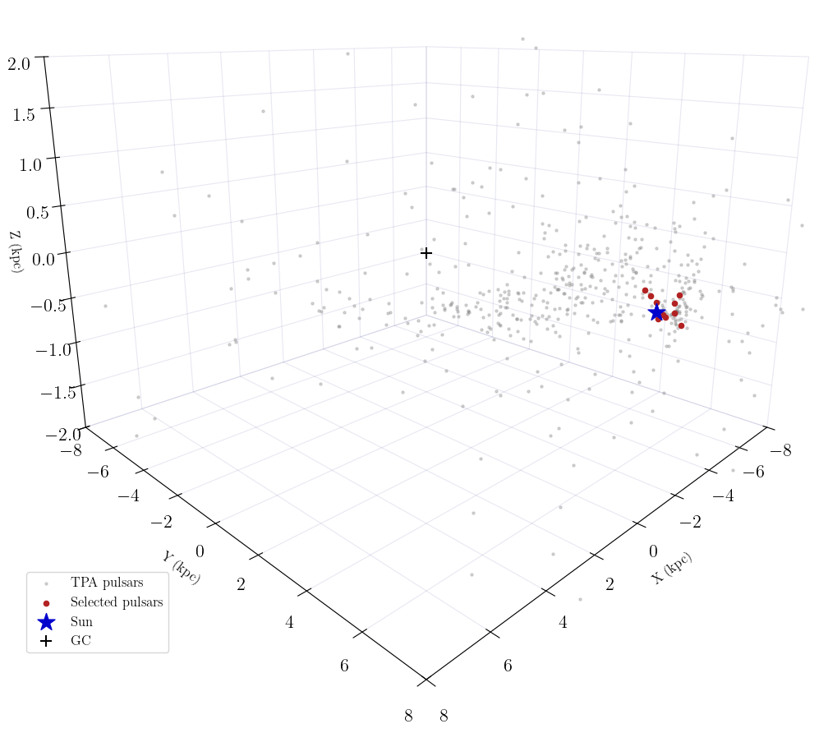
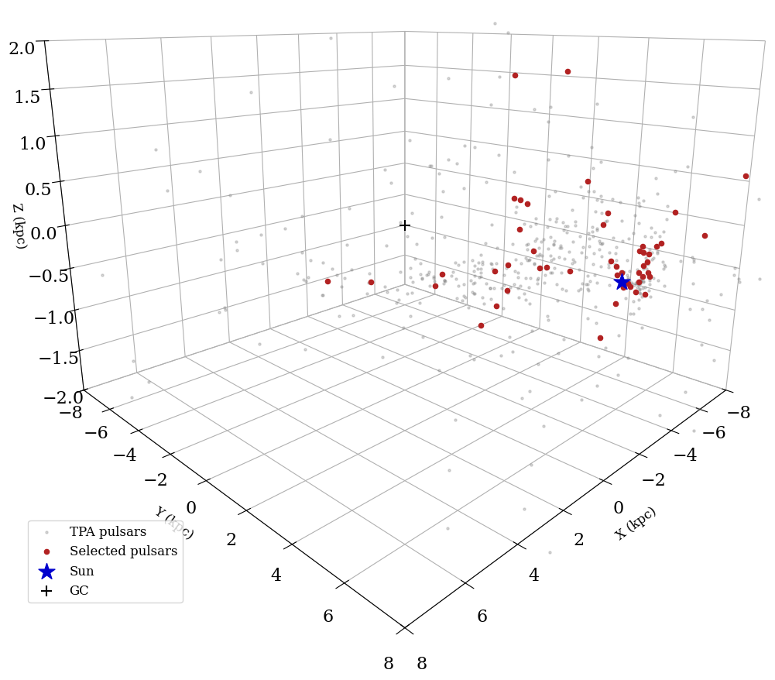
Select subsets of pulsars from full array
‘Correlated’, ‘Uncorrelated’, mixed groups
Can investigate correlations
Necessary for computational resources
Sorted by SNR
Correlated signal
uncorrelated
signal
Notes:
Sky map separations -> absolute positions

Slide 14
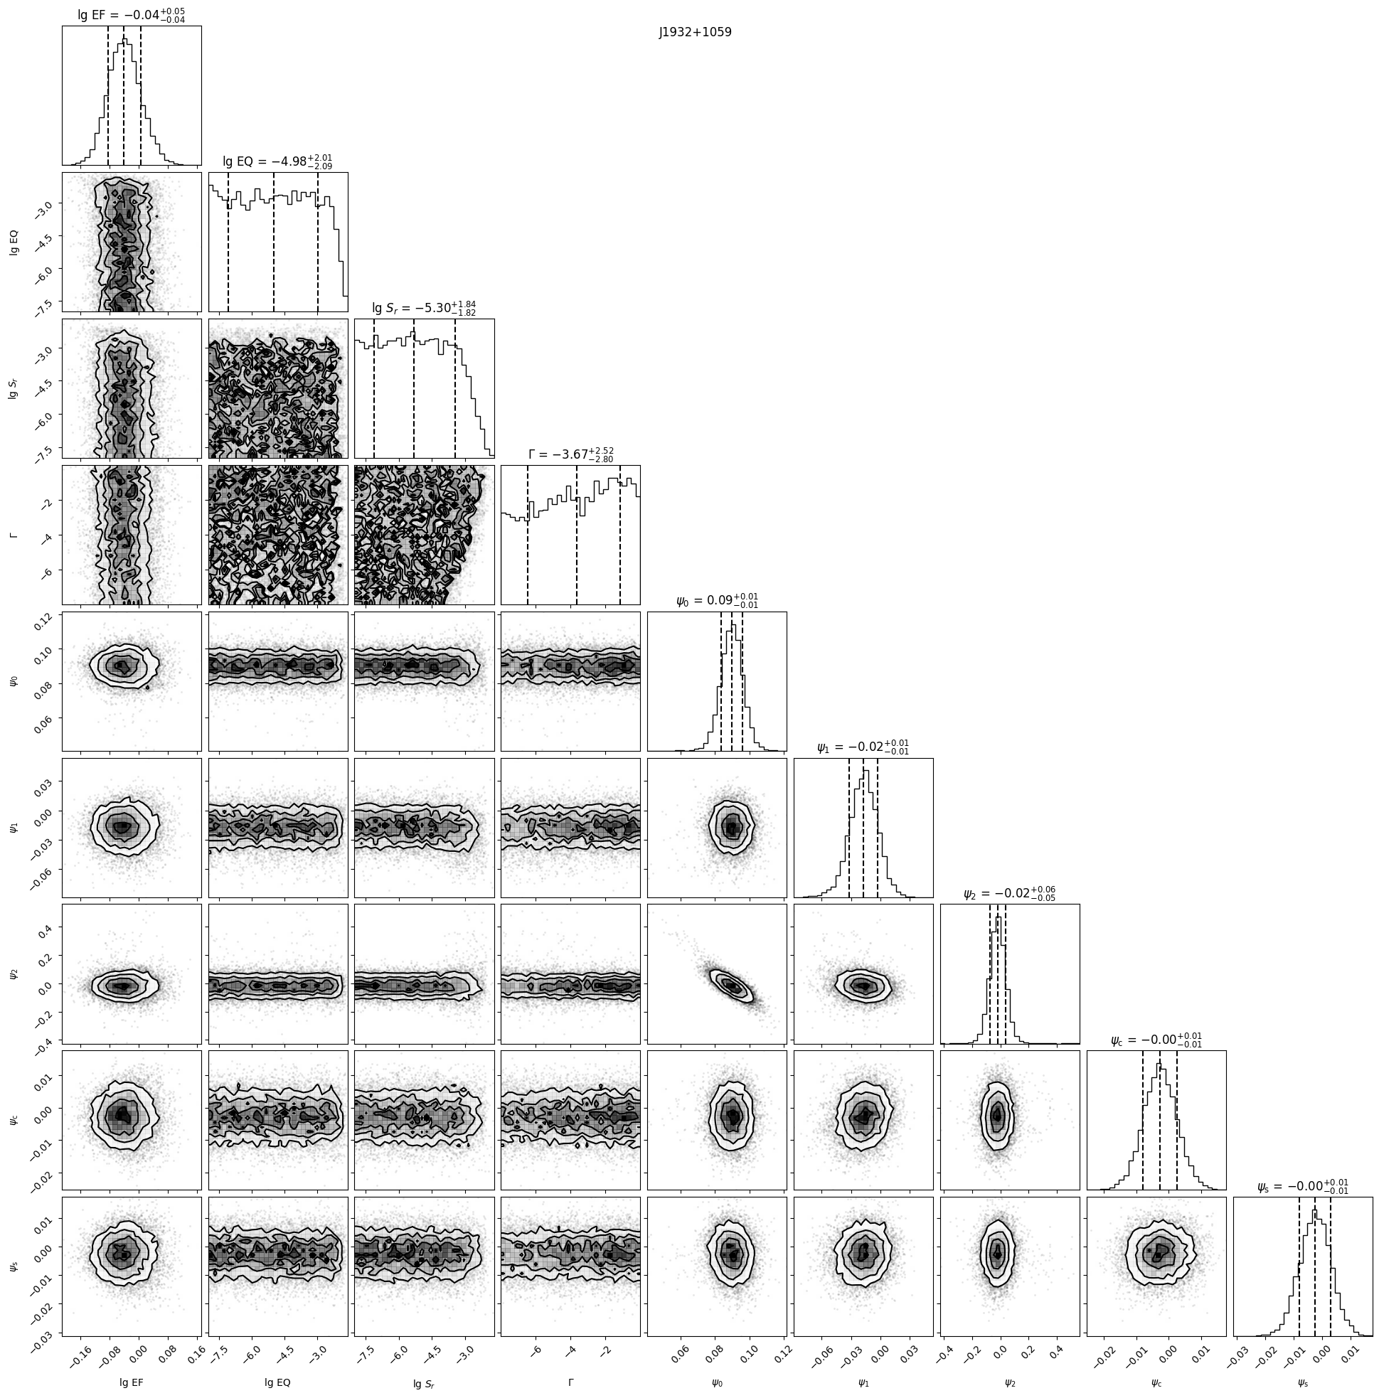
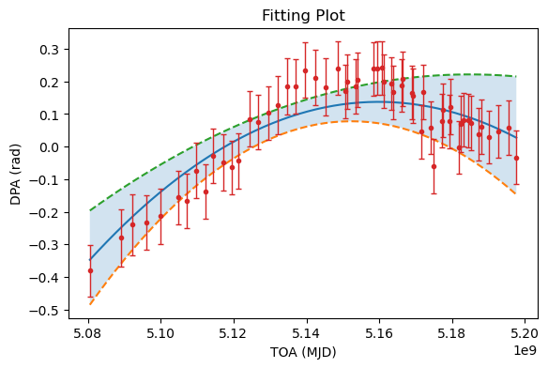
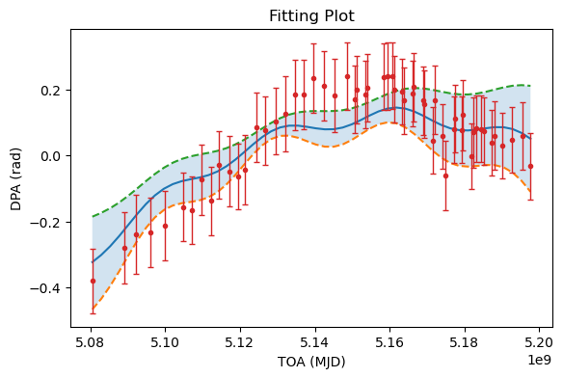
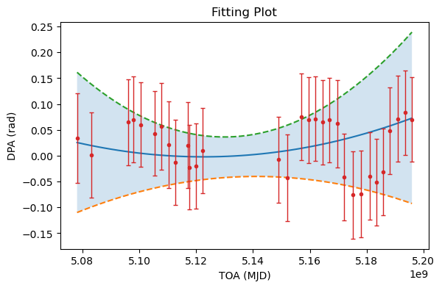
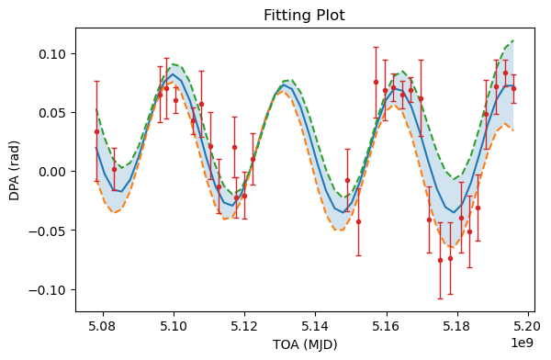
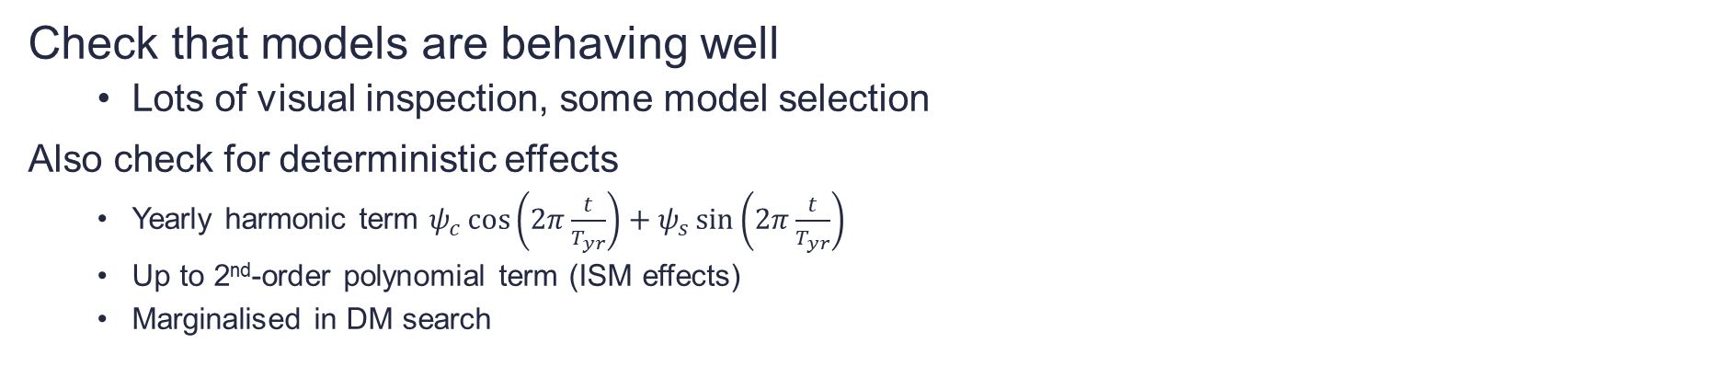
Check that models are behaving well
Lots of visual inspection, some model selection
Also check for deterministic effects
Yearly harmonic term $ψ_{c}\cos\left(2π\frac{t}{T_{yr}}\right)+ψ_{s}\sin\left(2π\frac{t}{T_{yr}}\right)$
Up to 2nd-order polynomial term (ISM effects)
Marginalised in DM search

Slide 15
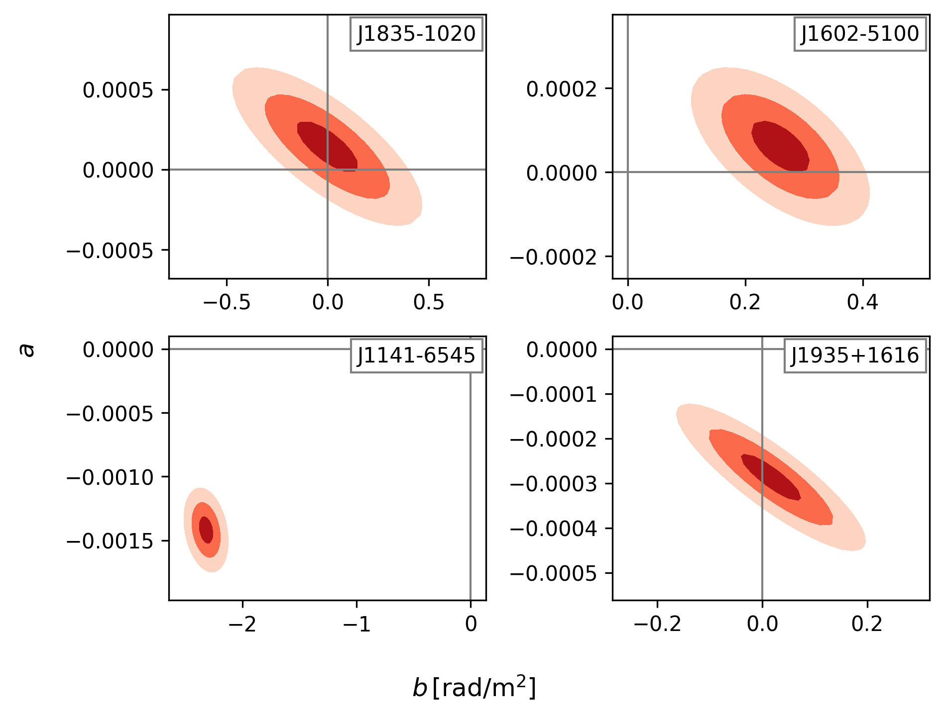
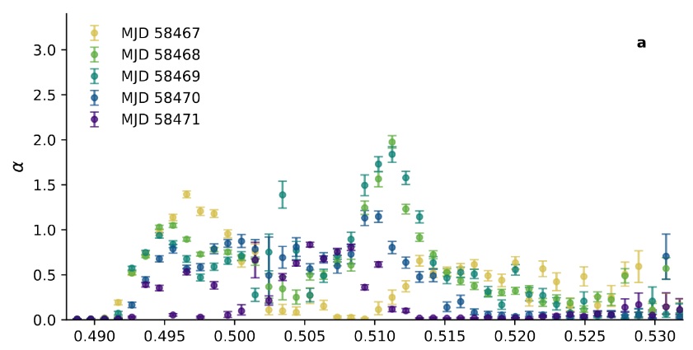
Lower M. et. al. arXiv:2311.04195

Slide 16
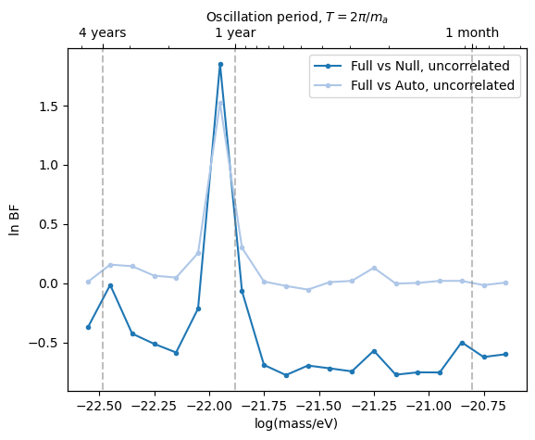
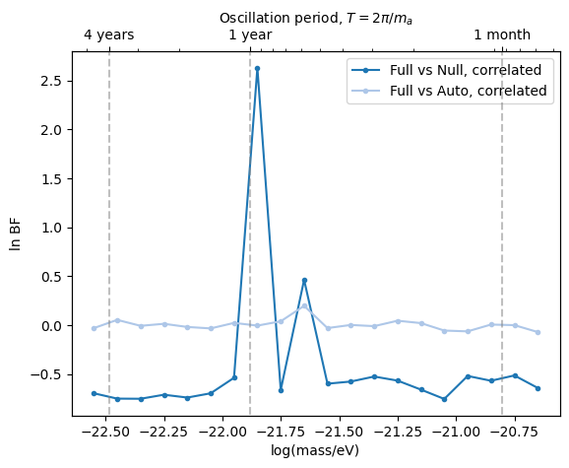

Slide 17
