Slide 1

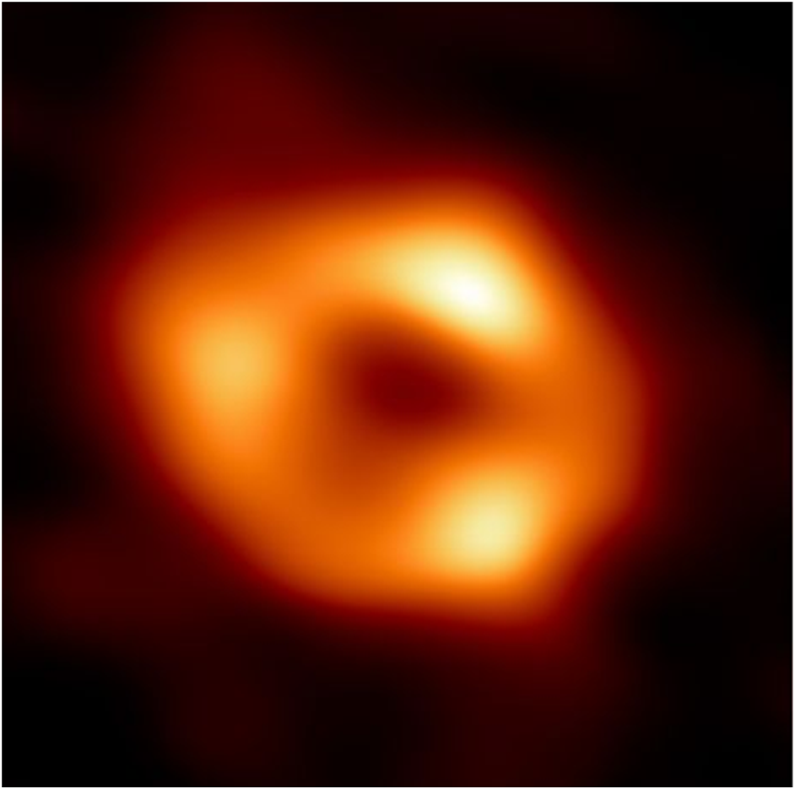
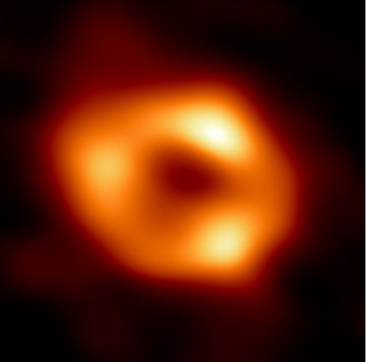
AXION DECAY AROUND SGR A*
By: Javeria Makda
Supervisor: Dr. Geoff Beck

Slide 2
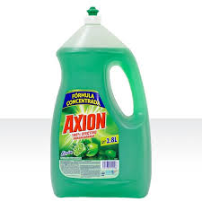
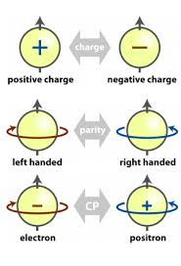
What is an axion?
CP violation and Strong-CP problem
Pseudoscalar boson arising when the Peccei-Quinn symmetry breaks (solution to strong CP problem).
PQ mechanism facilitates a non-thermal production of a large population of non-relativistic particles.
Light particle as a dark matter candidate.

Slide 3
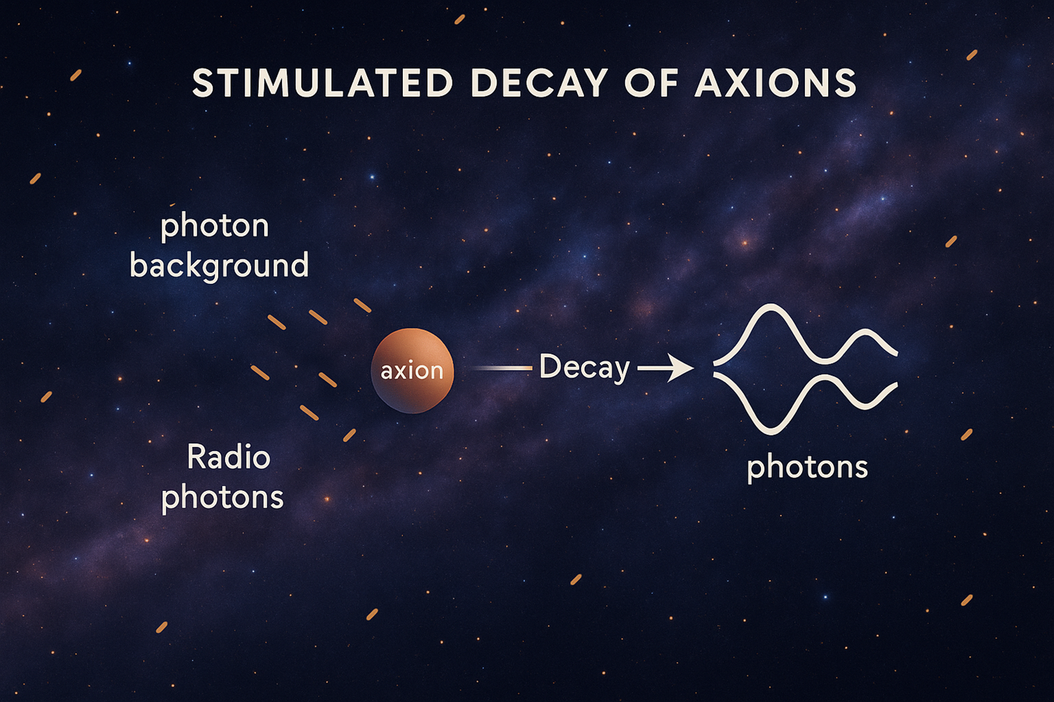

Axions as DM candidates
Non-relativistic (cold) at the time of structure formation.
Axion relic density can match the observed dark matter density.
Interact extremely weakly with ordinary matter and radiation.
Compatibility with current constraints
Usual decay times of axions into photons ~ ${10}^{32 }$years, MUCH larger than the lifetime of the universe!

Slide 4
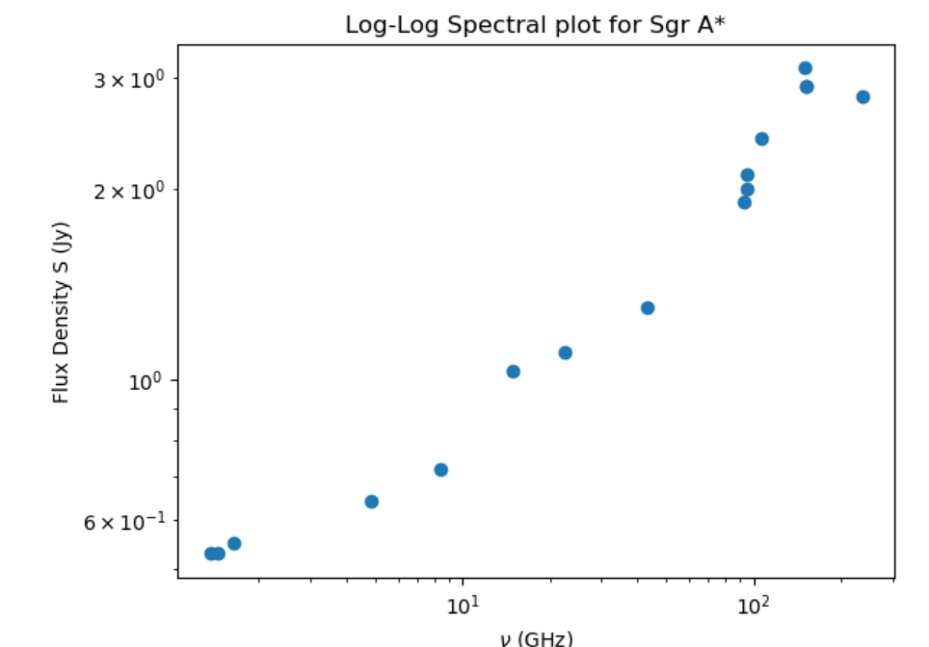


Analysis
$S=2.23{\left(\frac{ν}{100 GHz}\right)}^{0.415}$
photon bath for stimulated decay
Differential photon density:
$$\frac{dρ}{dE}=\frac{r}{Vc}\frac{1}{h}4πd_{L}^{2}S$$

Slide 5
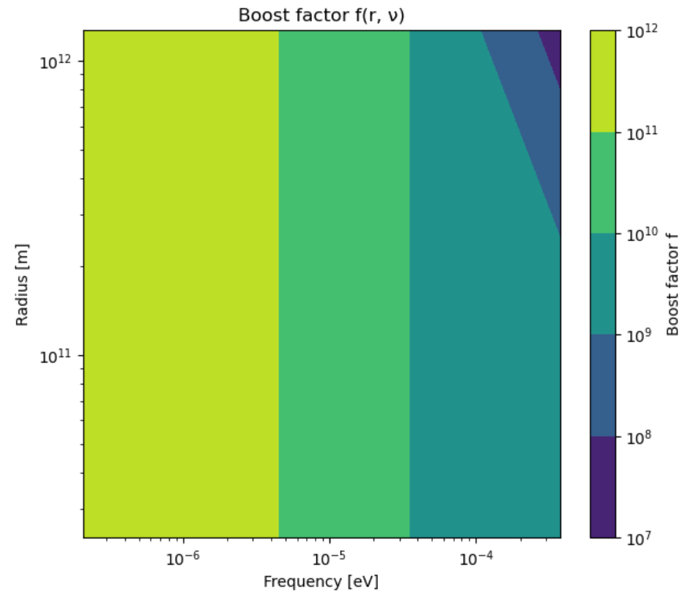
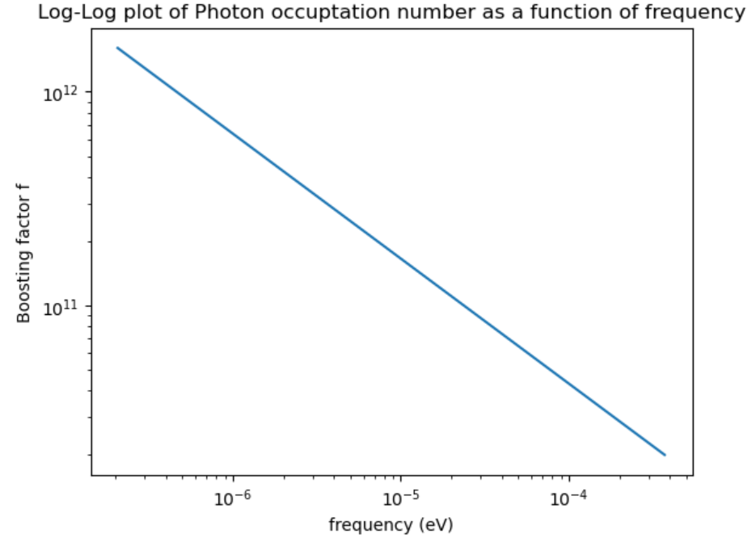


Analysis
Boost factor: $f=\frac{π^{2}}{E^{3}}\frac{dρ}{dE}$
r = 3 Rsc
$$r\left(ν\right)=d_{L}×θ\left(ν\right) \\ θ\left(ν\right)=0.4×\frac{c}{ν}$$

Slide 6



Analysis
Take differential photon density as constant within a certain region where r ≤ r(ν) ; falls off as 1/r² for r > r (ν)
Axion flux: $S_{a}=\frac{Γ}{4πd_{L}^{2}Δν} \int{ρ_{a}\left(1+2f\right) dV}$
$$Δν=ν\frac{σ}{c}$$
Dark matter density around the black hole
Where σ is the velocity dispersion
$Γ=\frac{1}{τ}$ where $τ=\frac{64π}{m_{a}^{3}g_{aγγ}^{2}}$

Slide 7
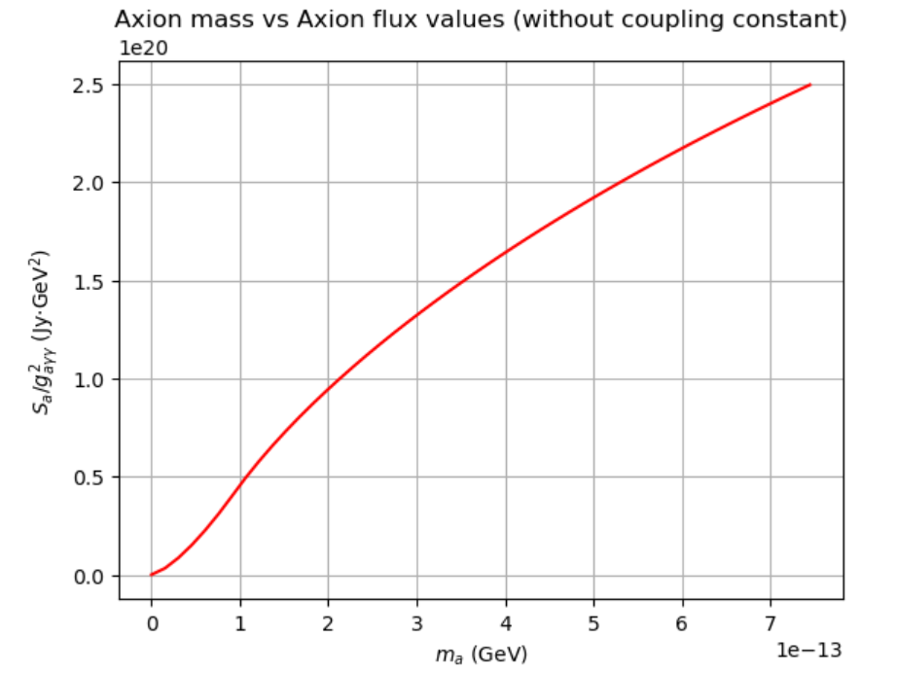

$$S_{a}^{′}=\frac{2S_{a}}{g_{aγγ}^{2}}$$

Slide 8
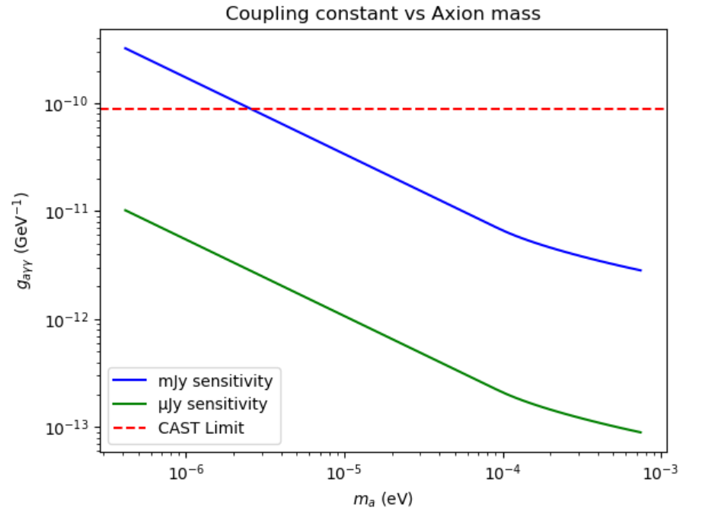

Limits on the axion-photon coupling
Condition for detectability:
$$g_{aγγ}^{2}≥\frac{σ_{T}}{S_{a}′}$$

