Slide 1
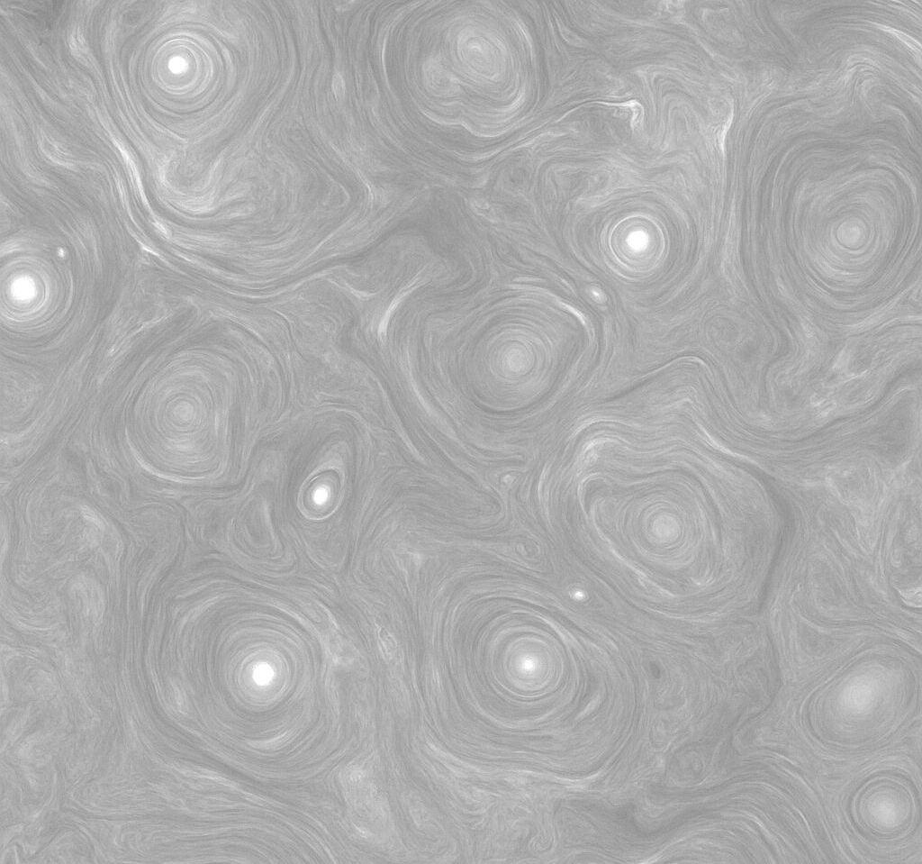
From Fermi to Fractals: Stochastic Particle Acceleration in Strong MHD Turbulence
Frans van der Merwe
frans.h.vandermerwe@gmail.com
Centre for Space Research, North-West University
HEASA 2025 (16 – 20 September)
Supervisor: Prof. Markus Böttcher
Co-supervisor: Dr. Anton Dmytriiev

Slide 2
Outline
Introduction to Fermi’s stochastic acceleration and the more modern approach
First-principles stochastic acceleration model and a brief description of the Monte Carlo simulation
Evolution of the electron spectrum and parameter study
Future work

Slide 3
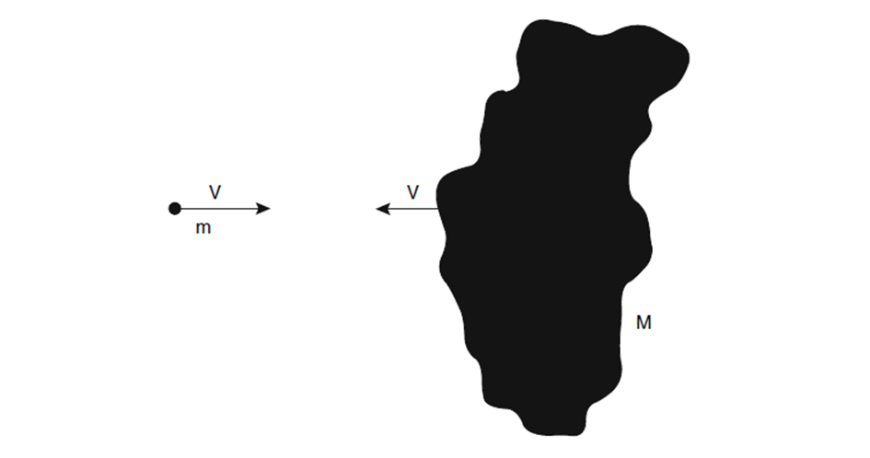
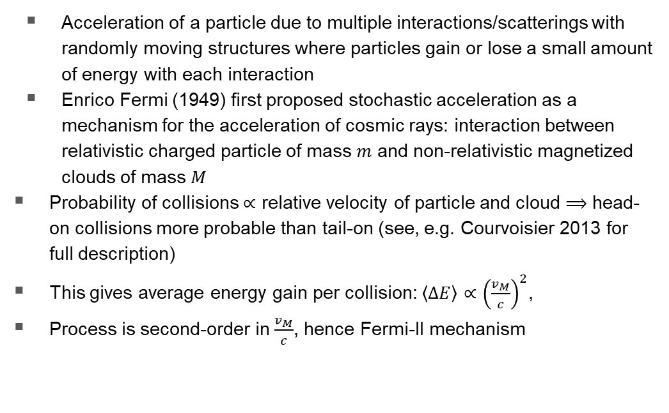
Introduction to stochastic acceleration
Acceleration of a particle due to multiple interactions/scatterings with randomly moving structures where particles gain or lose a small amount of energy with each interaction
Enrico Fermi (1949) first proposed stochastic acceleration as a mechanism for the acceleration of cosmic rays: interaction between relativistic charged particle of mass $m$ and non-relativistic magnetized clouds of mass $M$
Probability of collisions $∝$ relative velocity of particle and cloud $⟹$ head-on collisions more probable than tail-on (see, e.g. Courvoisier 2013 for full description)
This gives average energy gain per collision: $〈ΔE〉∝{\left(\frac{v_{M}}{c}\right)}^{2}$,
Process is second-order in $\frac{v_{M}}{c}$, hence Fermi-II mechanism
Notes:
Stochastic particle accel. (SA) – mechanism by which particle accelerated by multiple scatterings
Fermi proposed stochastic interaction between particles and large magnetic clouds as CR accel mechanism

Slide 4
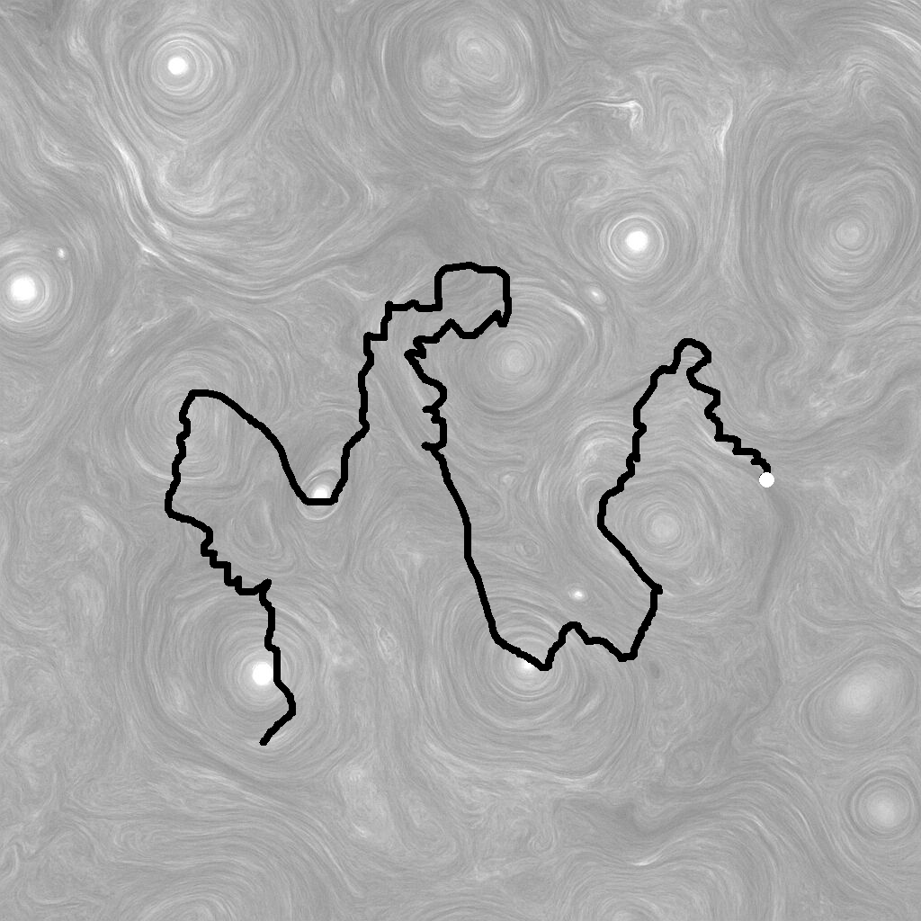
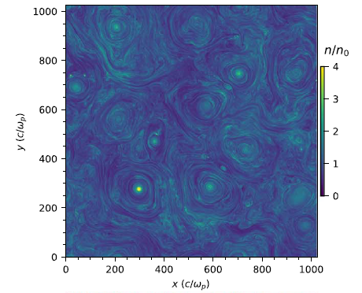
The modern interpretation
Following Fermi’s publication, other scattering agents were proposed: randomly moving magnetic structures due to plasma waves/tubulence
Standard quasi-linear framework of Fermi-II acceleration by MHD turbulence, as described by e.g. Dermer et al., 1996, or Becker et al., 2006, is reasonably accurate in weak/moderate turbulence regimes, but tends to fail in regimes of strong (non-linear) turbulence with plasma amplitudes 𝛿𝐵/𝐵~1.
The situation is more dire due to there being no commonly accepted comprehensive theories of turbulence
Nättillä & Beloborodov, 2021

Slide 5
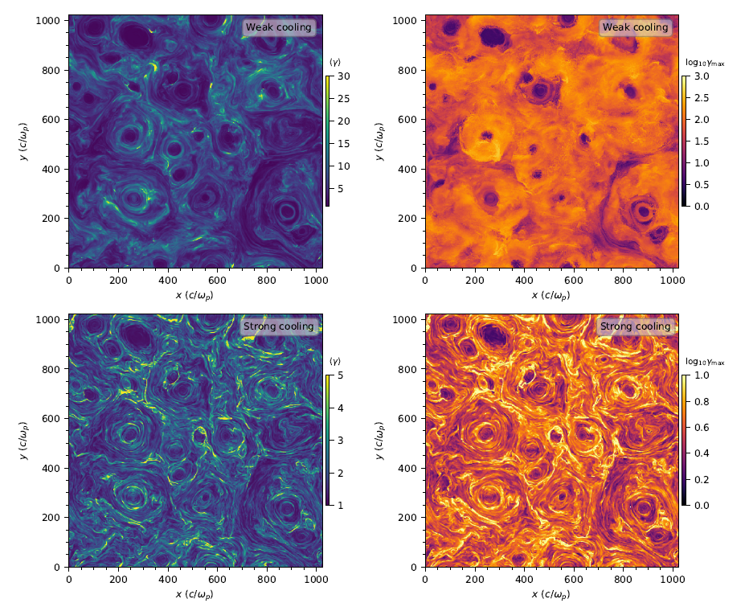
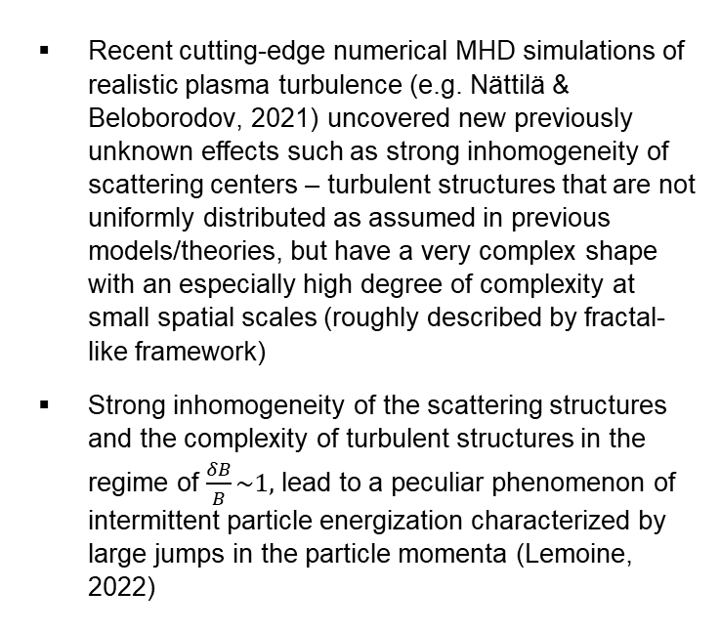
The modern interpretation
Recent cutting-edge numerical MHD simulations of realistic plasma turbulence (e.g. Nättilä & Beloborodov, 2021) uncovered new previously unknown effects such as strong inhomogeneity of scattering centers – turbulent structures that are not uniformly distributed as assumed in previous models/theories, but have a very complex shape with an especially high degree of complexity at small spatial scales (roughly described by fractal-like framework)
Strong inhomogeneity of the scattering structures and the complexity of turbulent structures in the regime of $\frac{δB}{B}\sim 1,$ lead to a peculiar phenomenon of intermittent particle energization characterized by large jumps in the particle momenta (Lemoine, 2022)
(Nättillä & Beloborodov, 2021)

Slide 6
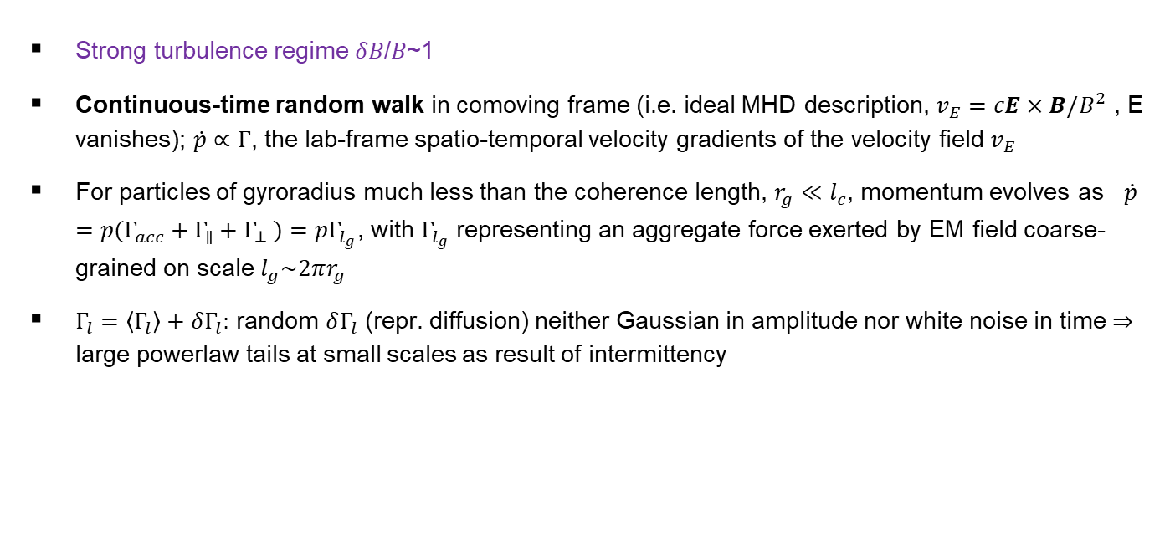
Fermi Acceleration Model (Lemoine,2022)
Strong turbulence regime 𝛿𝐵/𝐵~1
Continuous-time random walk in comoving frame (i.e. ideal MHD description, $v_{E}=cE×B/B^{2}$ , E vanishes); $\dot{p}∝Γ$, the lab-frame spatio-temporal velocity gradients of the velocity field $v_{E}$
For particles of gyroradius much less than the coherence length, $r_{g}≪l_{c}$, momentum evolves as $\dot{p}=p(Γ_{acc}+Γ_{∥}+Γ_{⊥} )=pΓ_{l_{g}}$, with $Γ_{l_{g}}$ representing an aggregate force exerted by EM field coarse-grained on scale $l_{g}\sim 2πr_{g}$
$Γ_{l}=〈Γ_{l}〉+δΓ_{l}:$ random $δΓ_{l}$ (repr. diffusion) neither Gaussian in amplitude nor white noise in time $⇒$ large powerlaw tails at small scales as result of intermittency

Slide 7
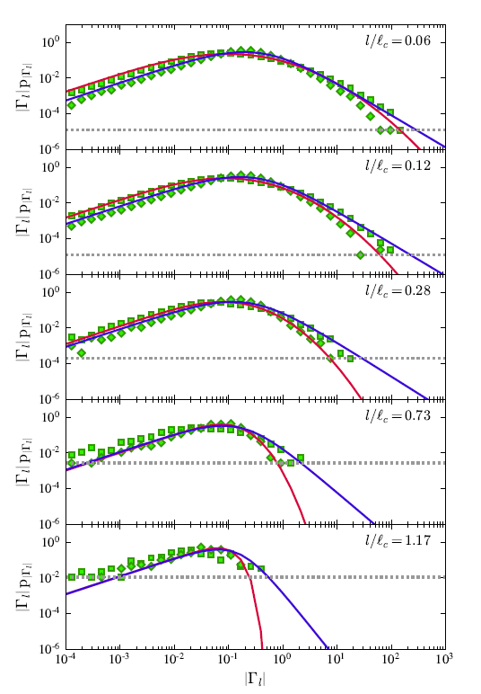
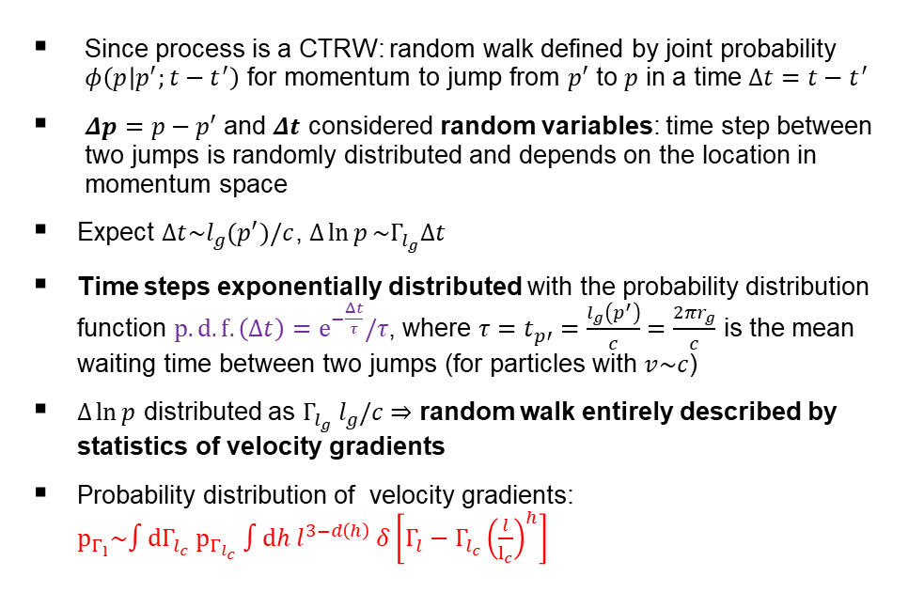

Statistics of the momentum jumps
Since process is a CTRW: random walk defined by joint probability $φ\left(p | p^{′};t−t^{′}\right)$ for momentum to jump from $p′$ to $p$ in a time $Δt=t−t^{′}$
$Δp=p−p′$ and $Δt$ considered random variables: time step between two jumps is randomly distributed and depends on the location in momentum space
Expect $Δt\sim l_{g}(p^{′})/c$, $Δ\ln{p}\sim Γ_{l_{g}}Δt$
Time steps exponentially distributed with the probability distribution function $p.d.f.\left(Δt\right)=e^{−\frac{Δt}{τ}}/τ$, where $τ=t_{p′}=\frac{l_{g}\left(p^{′}\right)}{c}=\frac{2πr_{g}}{c}$ is the mean waiting time between two jumps (for particles with $v\sim c$)
$Δ\ln{p}$ distributed as $Γ_{l_{g}}{ l}_{g}/c$ $⇒$ random walk entirely described by statistics of velocity gradients
Probability distribution of velocity gradients: $p_{Γ_{l}}\sim ∫dΓ_{l_{c}} p_{Γ_{l_{c}}} ∫dh{ l}^{3−d\left(h\right)} δ\left[Γ_{l}−Γ_{l_{c}}{\left(\frac{l}{l_{c}}\right)}^{h}\right]$
${|Γ}_{l}|$ distributions (Lemoine, 2022)

Slide 8
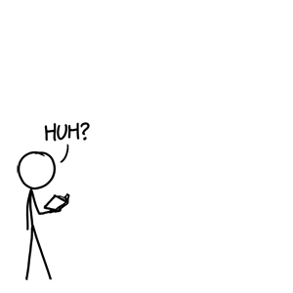


Statistics of the momentum jumps
$p_{Γ_{l}}\sim ∫dΓ_{l_{c}} p_{Γ_{l_{c}}} ∫dh l^{3−d\left(h\right)} δ\left[Γ_{l}−Γ_{l_{c}}{\left(\frac{l}{l_{c}}\right)}^{h}\right]$
${|Γ}_{l}|$ distributions (Lemoine, 2022)
Multifractal analysis:
Each position $x$ ascribed local scaling exponent $h\left(x\right)$ for gradients on coarse-graining scale $l$
$$Γ_{l}\left(x\right){\sim Γ}_{l_{c}}\left(x\right){\left(\frac{l}{l_{c}}\right)}^{h(x)}$$
Describes set of locations $x$ with index $h\left(x\right)$ as a fractal with dimension $d\left(h\right)$, with the spectrum $d(h)$ being log-normal

Slide 9
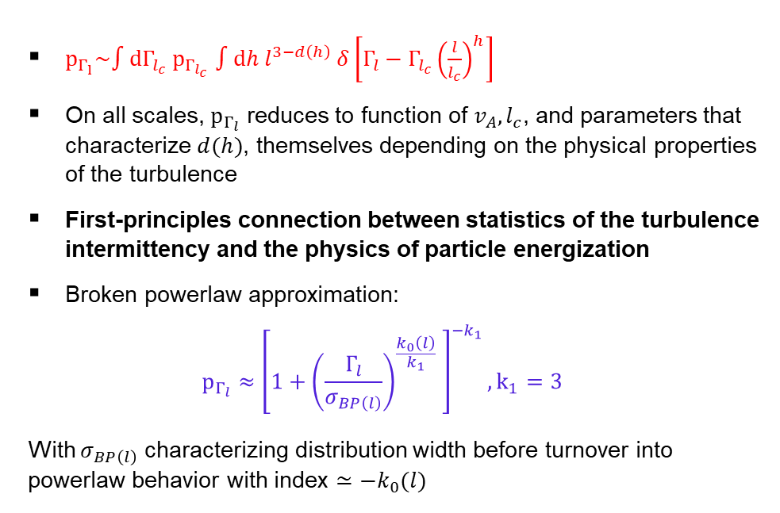
Statistics of the momentum jumps
$p_{Γ_{l}}\sim ∫dΓ_{l_{c}} p_{Γ_{l_{c}}} ∫dh l^{3−d\left(h\right)} δ\left[Γ_{l}−Γ_{l_{c}}{\left(\frac{l}{l_{c}}\right)}^{h}\right]$
On all scales, $p_{Γ_{l}}$ reduces to function of $v_{A}, l_{c}$, and parameters that characterize $d(h)$, themselves depending on the physical properties of the turbulence
First-principles connection between statistics of the turbulence intermittency and the physics of particle energization
Broken powerlaw approximation:
$$p_{Γ_{l}}≈{\left[1+{\left(\frac{Γ_{l}}{σ_{BP\left(l\right)}}\right)}^{\frac{k_{0}\left(l\right)}{k_{1}}} \right]}^{−k_{1}}, k_{1}=3$$
With $σ_{BP\left(l\right)}$ characterizing distribution width before turnover into powerlaw behavior with index $≃{−k}_{0}(l)$
${|Γ}_{l}|$ distributions (Lemoine, 2022)

Slide 10

Statistics of the momentum jumps
Particle experiencing large momentum jumps may escape velocity gradient accelerating it (analogous to Hillas limit). To take this into account multiply p.d.f. by exponential cut-off:
$p_{Γ_{l}}≈{\left[1+{\left(\frac{Γ_{l}}{σ_{BP\left(l\right)}}\right)}^{\frac{k_{0}\left(l\right)}{k_{1}}} \right]}^{−k_{1}}exp\left[−{\left(\frac{Γ_{l}c}{l_{c}}\right)}^{2}Δt\right]$

Slide 11
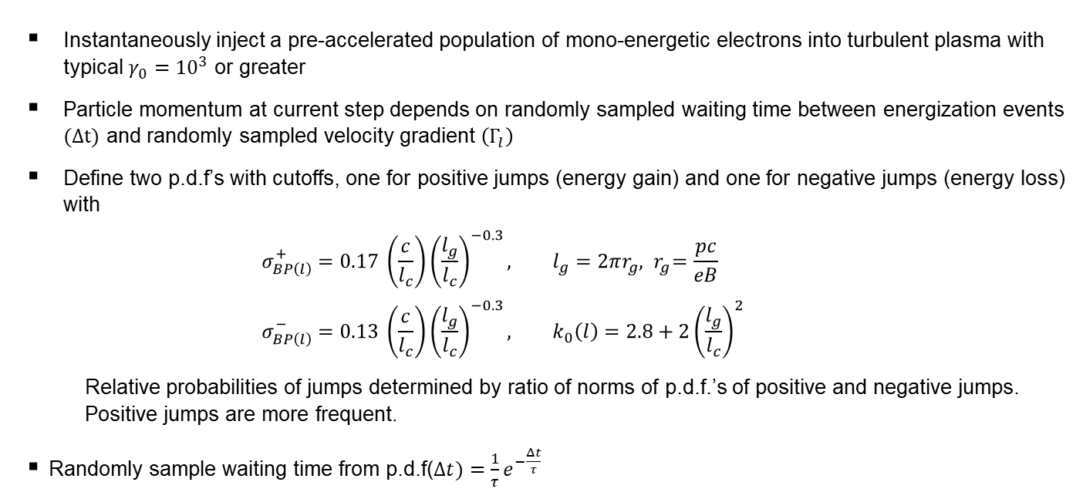

The Monte Carlo Simulation
Instantaneously inject a pre-accelerated population of mono-energetic electrons into turbulent plasma with typical $γ_{0}={10}^{3}$ or greater
Particle momentum at current step depends on randomly sampled waiting time between energization events $(Δt)$ and randomly sampled velocity gradient $\left(Γ_{l}\right)$
Define two p.d.f’s with cutoffs, one for positive jumps (energy gain) and one for negative jumps (energy loss) with
  $$σ_{BP\left(l\right)}^{+}=0.17 \left(\frac{c}{l_{c}}\right){\left(\frac{l_{g}}{l_{c}}\right)}^{−0.3}, l_{g}=2πr_{g}, { r}_{g}=\frac{pc}{eB} \\ σ_{BP\left(l\right)}^{−}=0.13 {\left(\frac{c}{l_{c}}\right)\left(\frac{l_{g}}{l_{c}}\right)}^{−0.3}, k_{0}\left(l\right)=2.8+2{\left(\frac{l_{g}}{l_{c}}\right)}^{2}$$
  Relative probabilities of jumps determined by ratio of norms of p.d.f.’s of positive and negative jumps. Positive jumps are more frequent.
Randomly sample waiting time from p.d.f($Δt)=\frac{1}{τ}e^{−\frac{Δt}{τ}}$
$${σ^{+/−}}_{BP\left(l_{c}\right)}$$

Slide 12
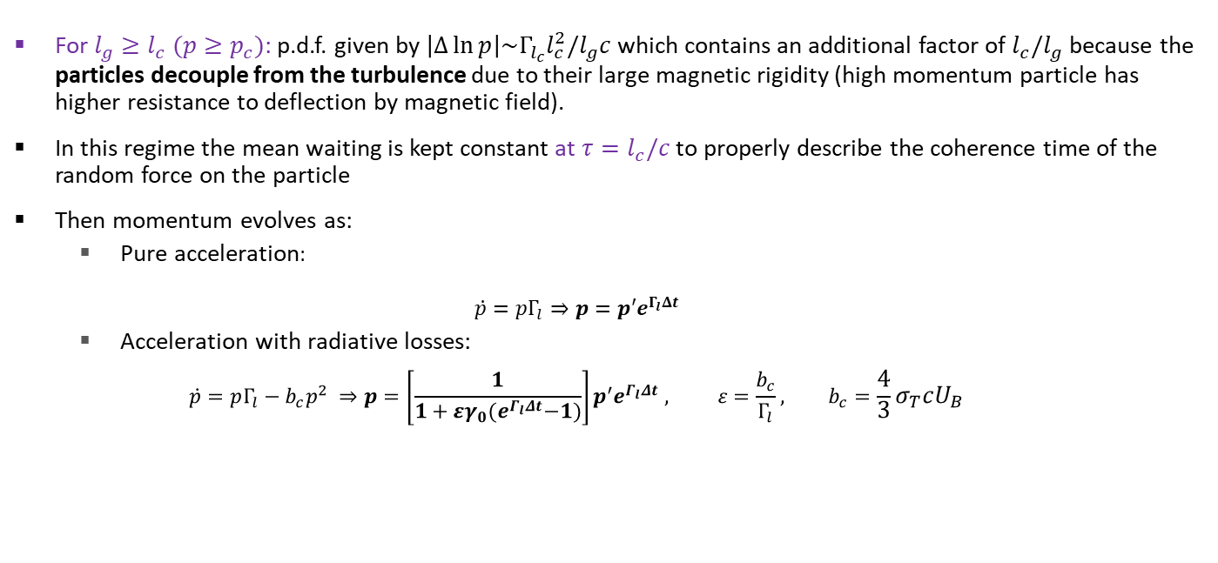
The Monte Carlo Simulation
For $l_{g}≥l_{c} (p≥p_{c})$: p.d.f. given by $\left|Δ\ln{p}\right|\sim Γ_{l_{c}}l_{c}^{2}/l_{g}c$ which contains an additional factor of $l_{c}/l_{g}$ because the particles decouple from the turbulence due to their large magnetic rigidity (high momentum particle has higher resistance to deflection by magnetic field).
In this regime the mean waiting is kept constant at $τ=l_{c}/c$ to properly describe the coherence time of the random force on the particle
Then momentum evolves as:
  Pure acceleration:
  $$\dot{p}=pΓ_{l}⇒p=p′e^{Γ_{l}Δt}$$
  Acceleration with radiative losses:
  $\dot{p}=pΓ_{l}−b_{c}p^{2} ⇒p=\left[\frac{1}{1+εγ_{0}{(e}^{Γ_{l}Δt}−1)}\right]p^{′}e^{Γ_{l}Δt} , ε=\frac{b_{c}}{Γ_{l}}, b_{c}=\frac{4}{3}σ_{T}cU_{B}$

Slide 13
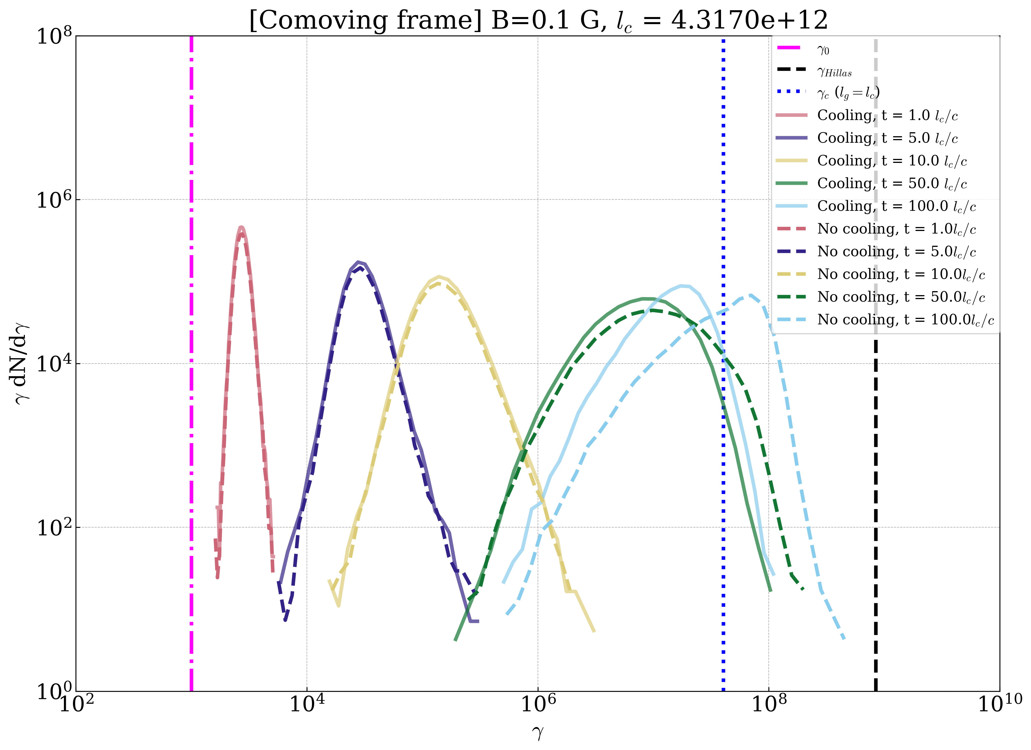
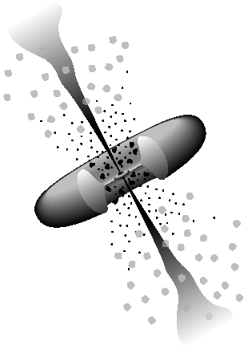



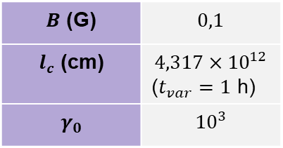

Electron particle spectra (comoving frame)
$B$ (G) | $$0,1$$
$l_{c}$ (cm) | $$4,317×{10}^{12}$$ ($t_{var}=1$ h)
$$γ_{0}$$ | $${10}^{3}$$
Spherical blob
$$R_{blob}=10l_{c}$$
$$z=0,045$$
$d_{L}=200$ Mpc
$$Γ=20$$
$$2°$$
Adapted from Urry, C.M. and Padovani, P., 1995.
Notes:
[high intermittency at early simulation times]
Strong B-field implies higher intermittency (more higher jumps) leading to tail-dominated and narrower distributions.

Slide 14
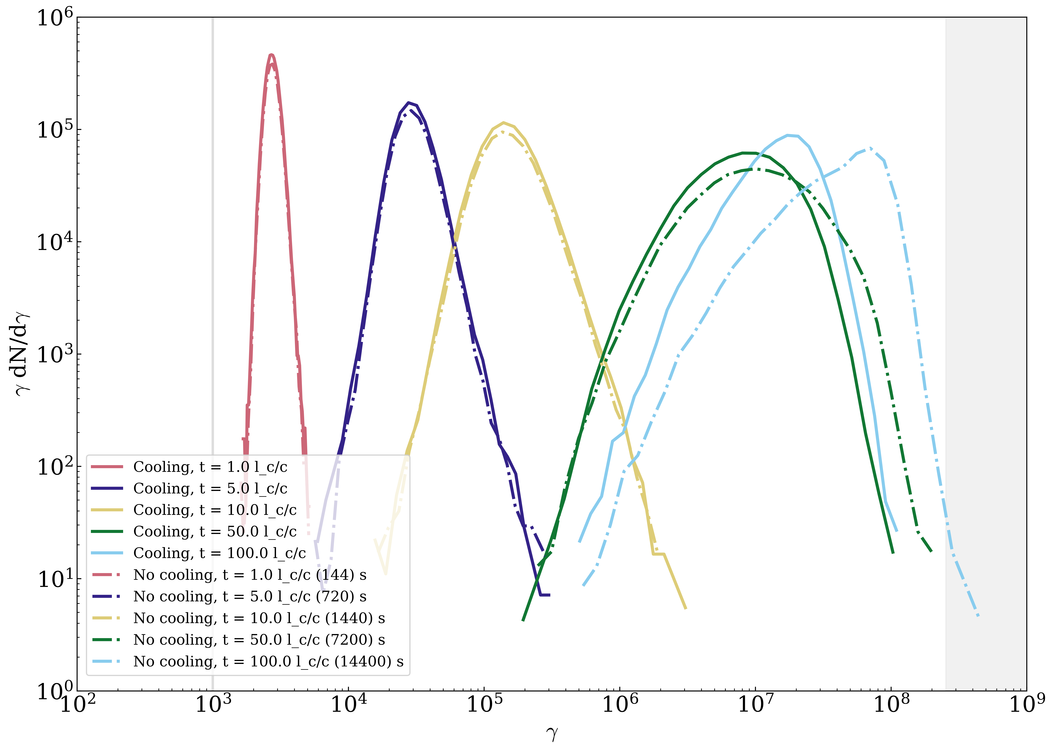
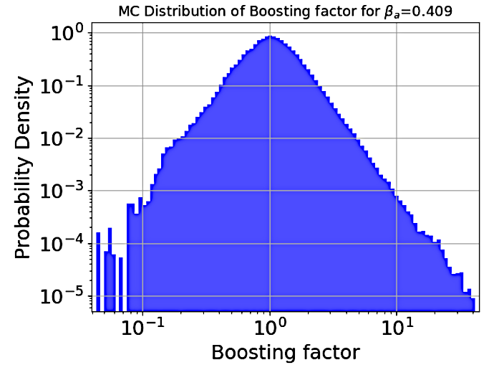
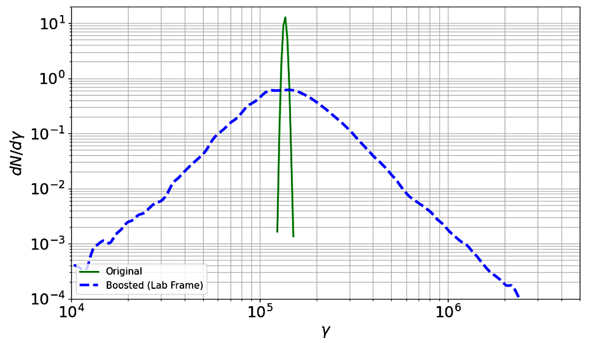
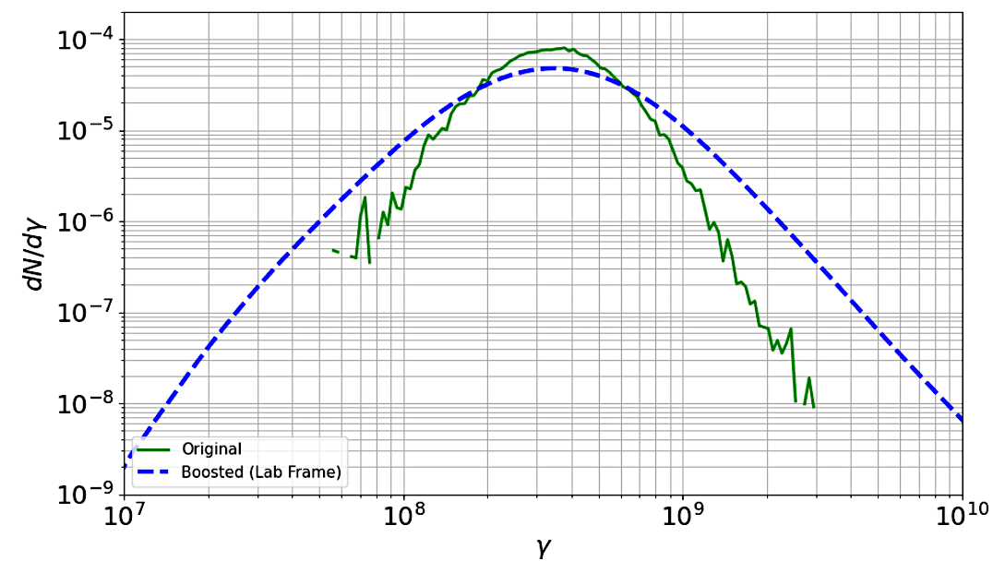


Boosting particle spectra to lab frame
Comoving frame spectra convolved with p.d.f. of boosting factors $(1+μv_{E})/\sqrt{1−v_{E}^{2}/c^{2}}$ where $μ$ is cosine of angle between particle direction and velocity field $v_{E}=|v_{E}|$
Randomly sample $μ$ from uniform distribution; $v_{E_{x}}, v_{E_{y}}, v_{E_{z}}$ randomly sampled from Gaussians
Create boosting factor kernel from above samples, interpolate and convolve with scattering frame spectra
Lab frame spectra are broader and harder
Credit: A. Dmytriiev
Credit: A. Dmytriiev
Notes:
Narrow electron spectra – boosted spectrum resembles the boosting kernel
Other spectra – broader and harder

Slide 15
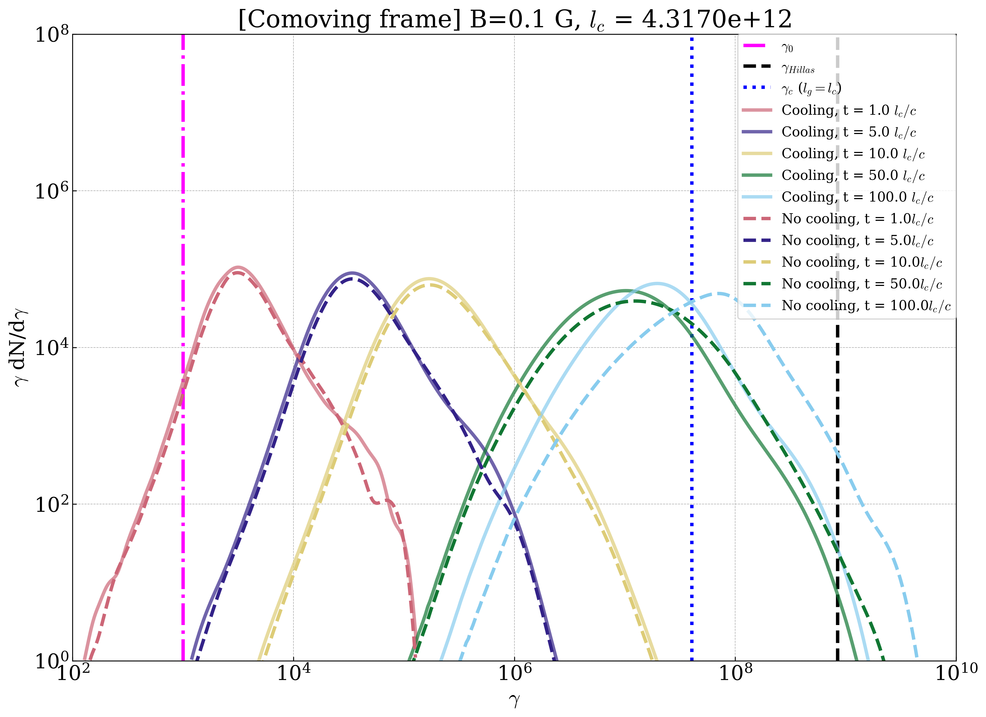

Electron particle spectra
Comoving frame: sharply peaked and narrow spectra
Lab frame: much broader and harder spectra, boosting may extend spectra beyond $γ_{Hillas}$

Slide 16
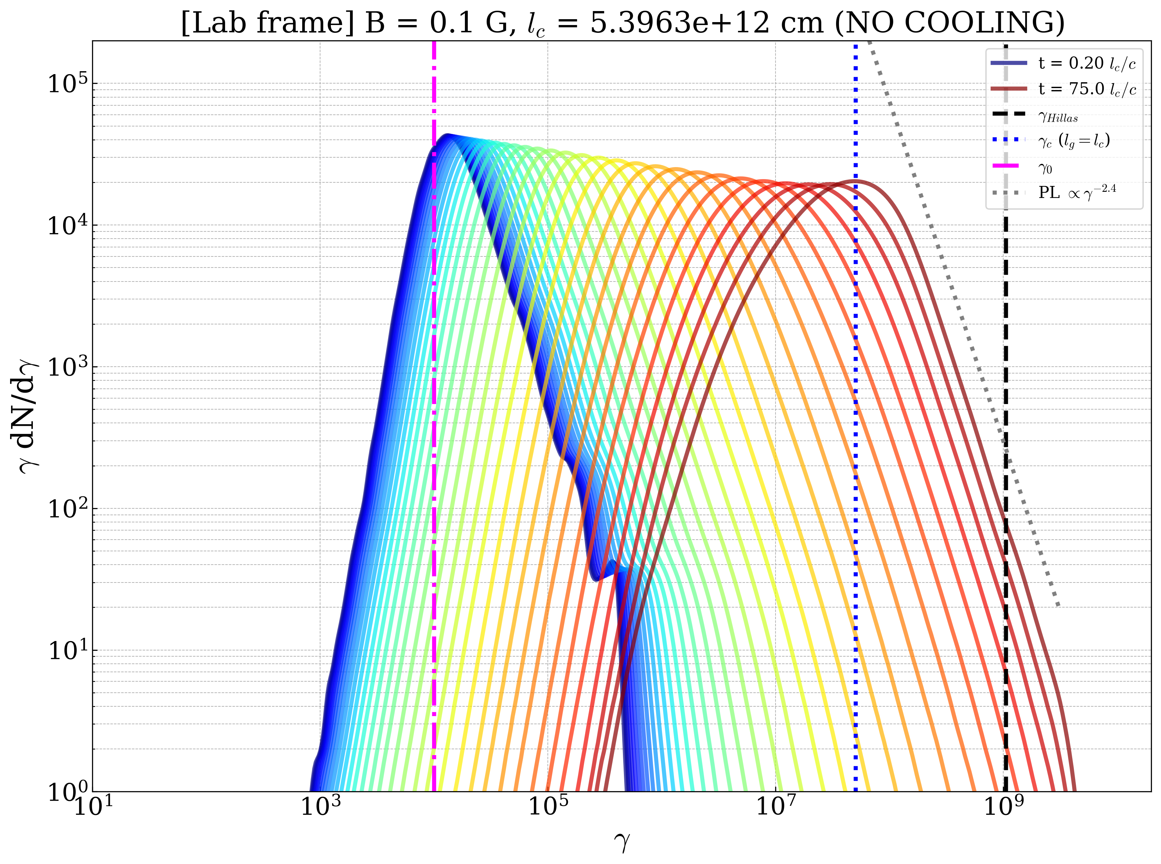
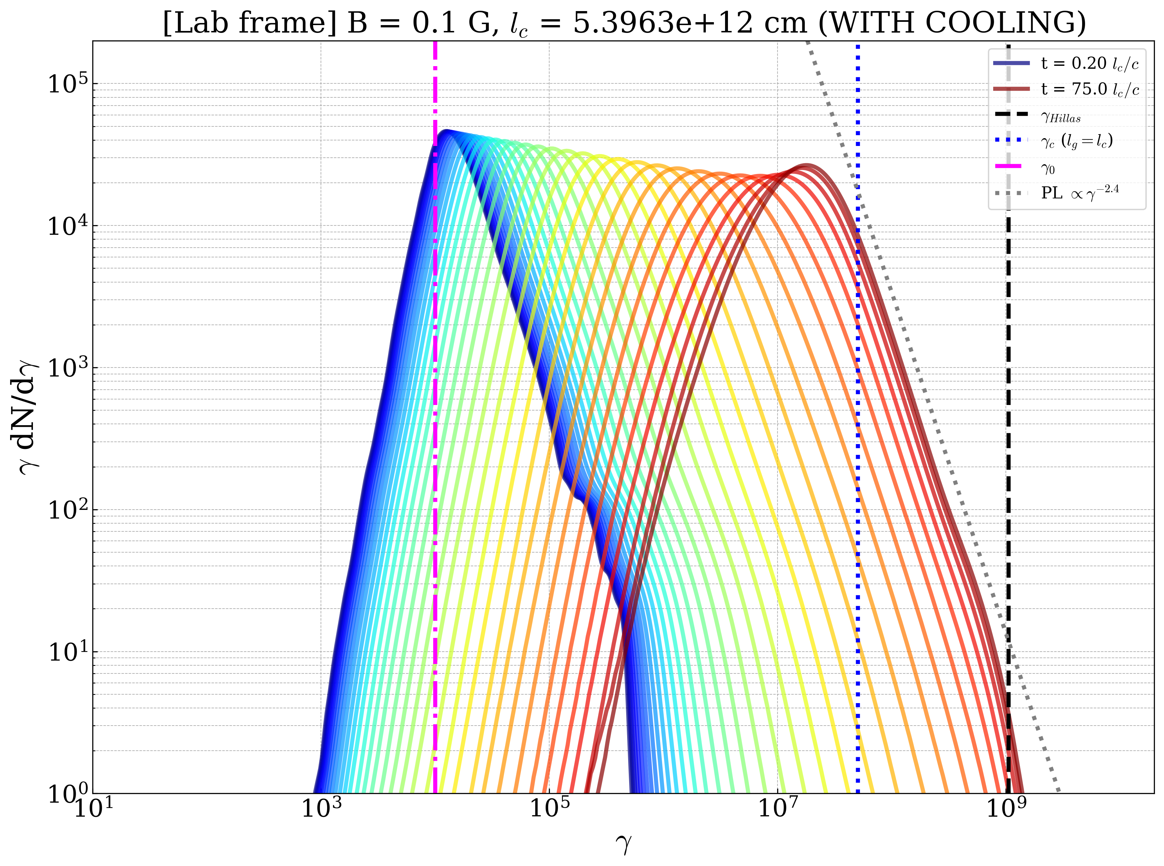
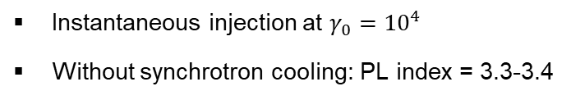

Closer look at spectral evolution
Instantaneous injection at $γ_{0}={10}^{4}$
Without synchrotron cooling: PL index = 3.3-3.4
With synchrotron cooling: PL index of 3.4
Decouple from turbulence at $γ_{c}$
Notes:
.

Slide 17
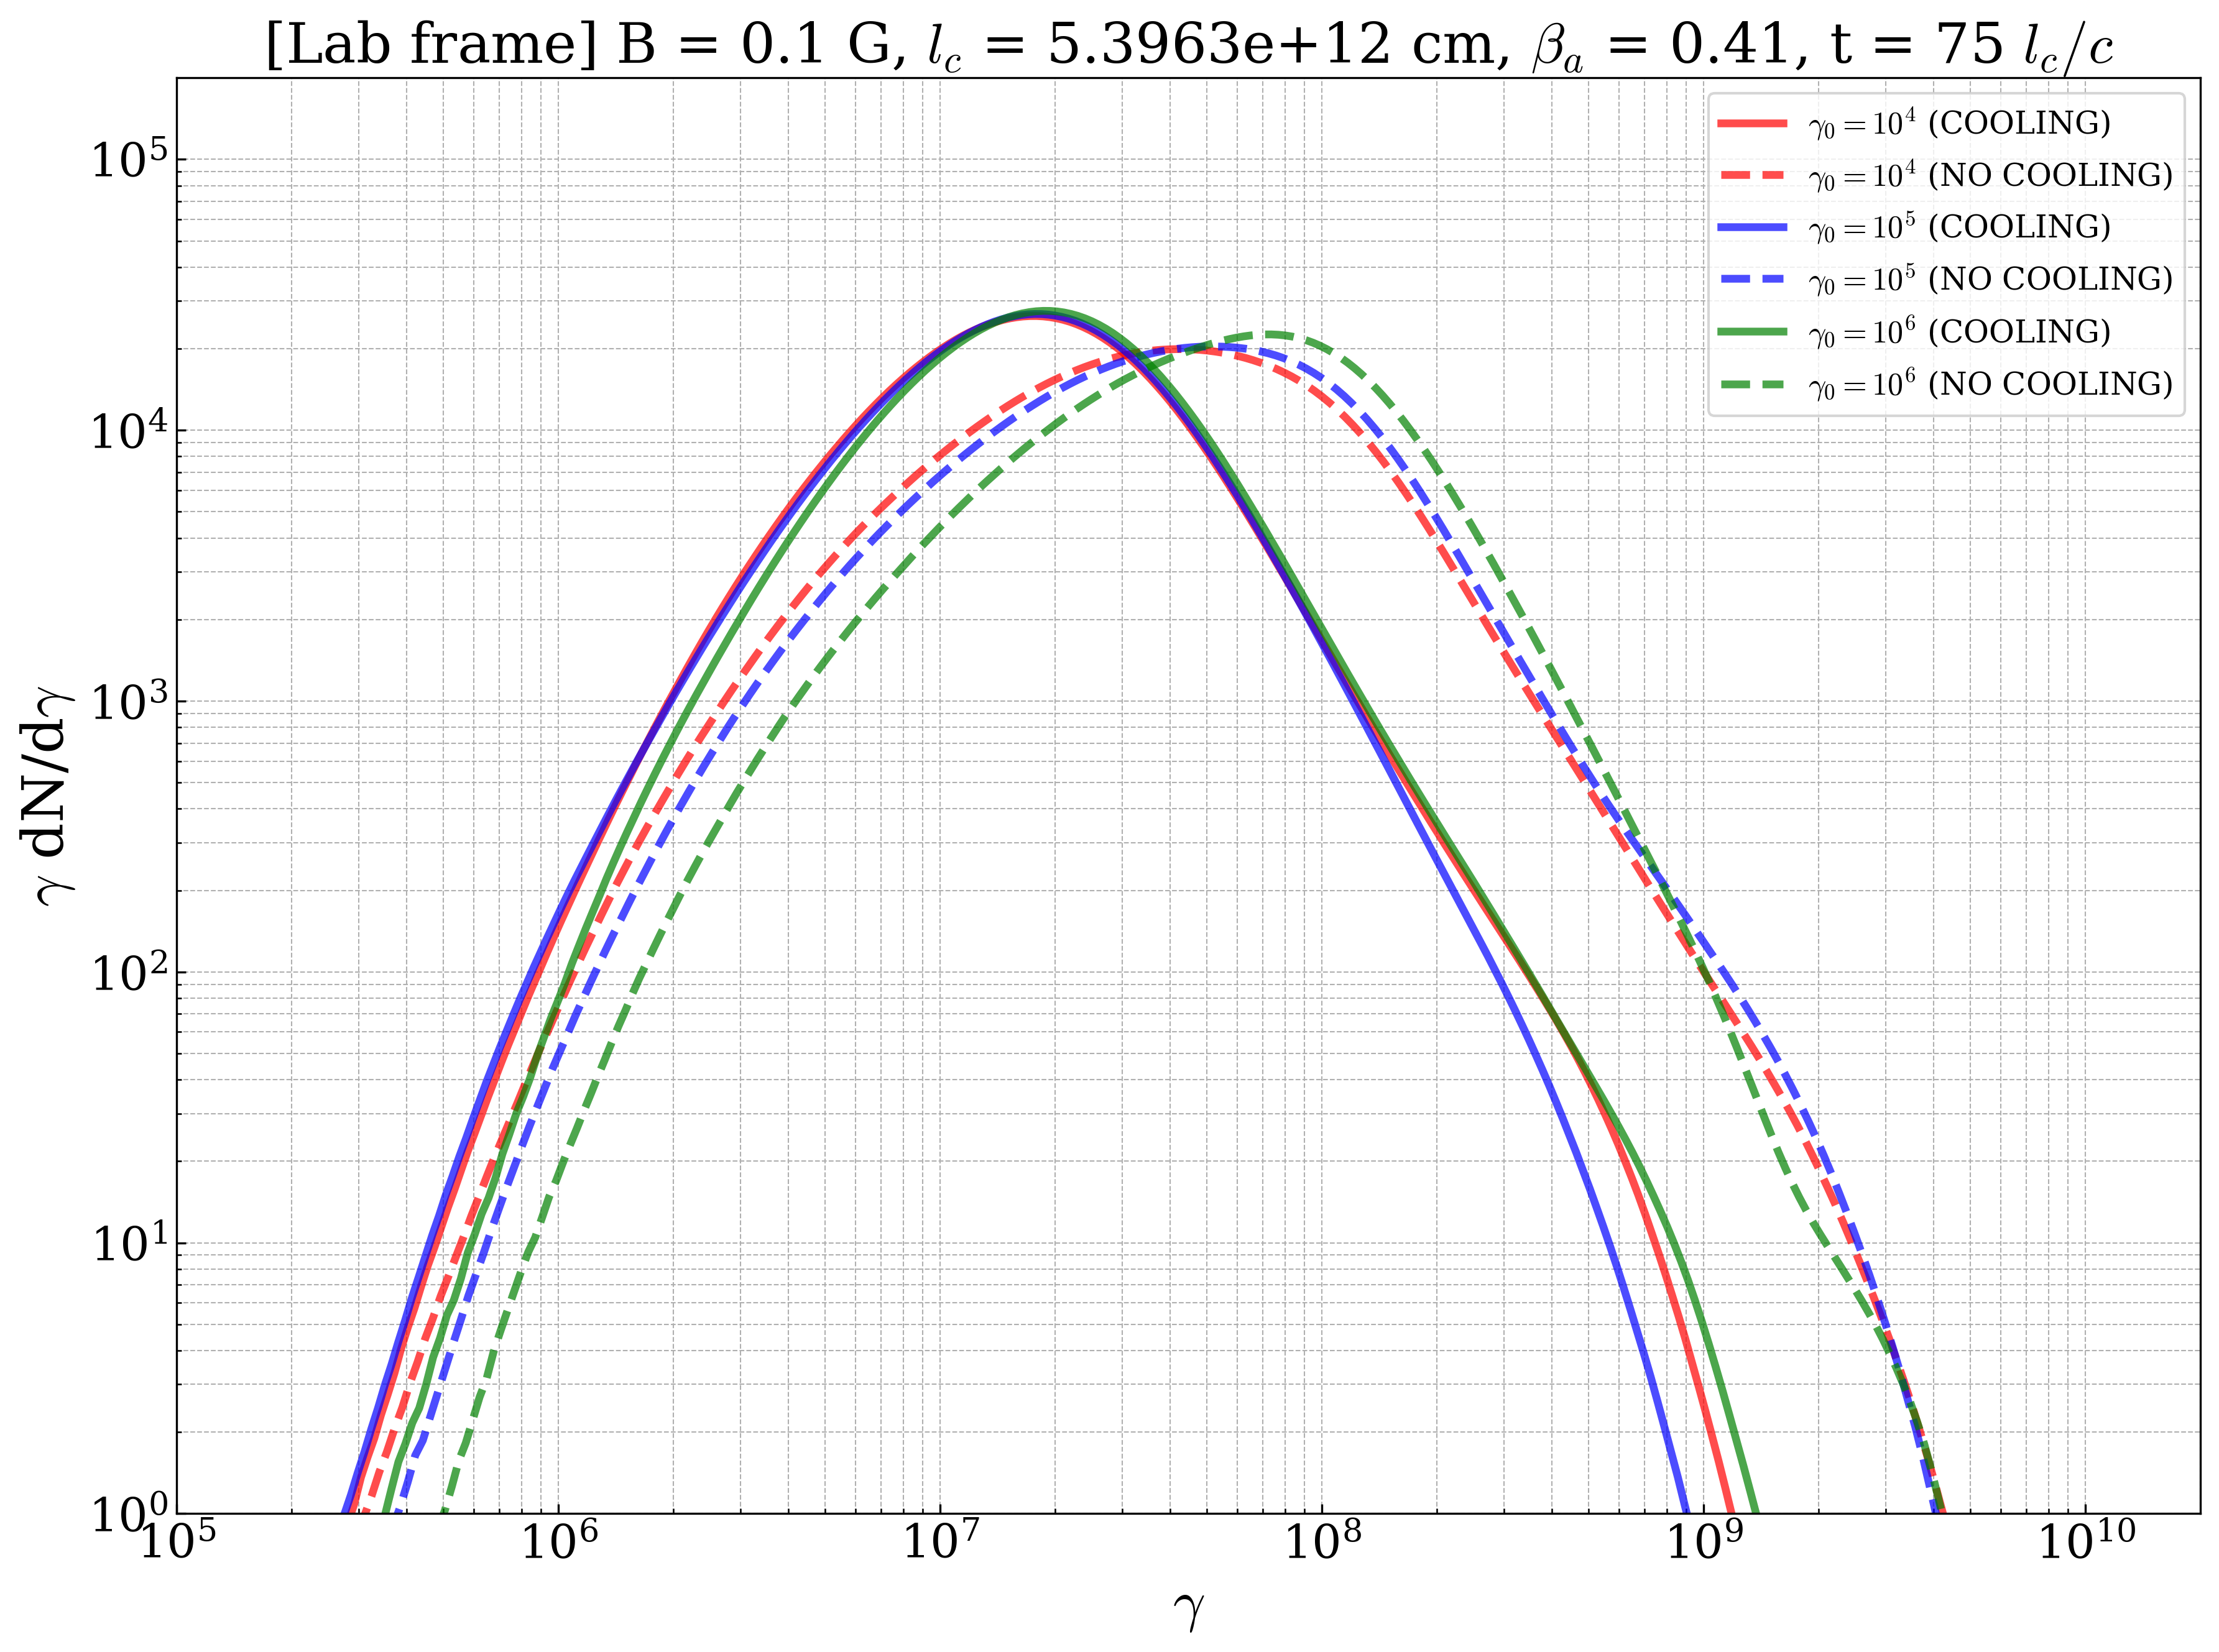

Particle spectra Lorentz factor dependence
Final spectral shape more-or-less independent of choice of initial Lorentz factor
Practical consideration: larger $γ_{0}$speeds up simulation time

Slide 18
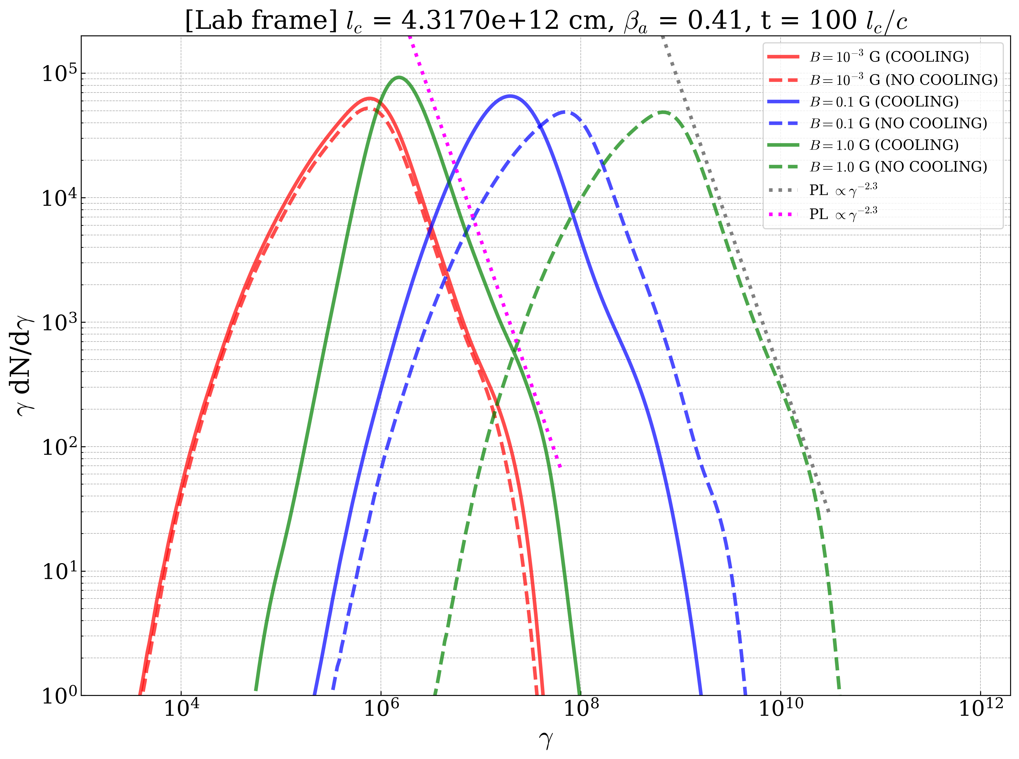
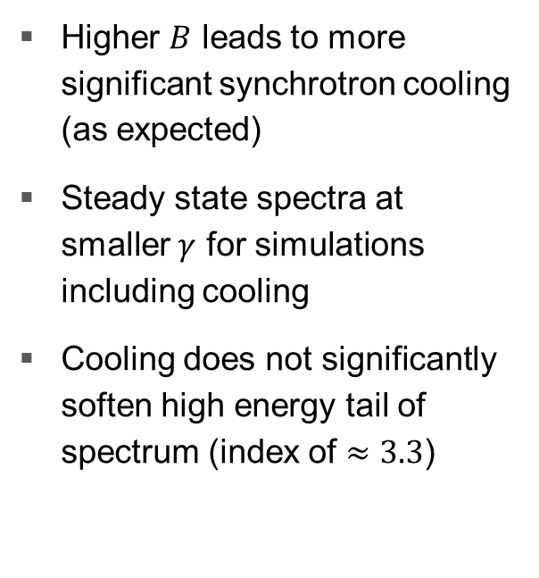
Parameter study: dependence on B
Higher $B$ leads to more significant synchrotron cooling (as expected)
Steady state spectra at smaller $γ$ for simulations including cooling
Cooling does not significantly soften high energy tail of spectrum (index of $≈3.3$)

Slide 19
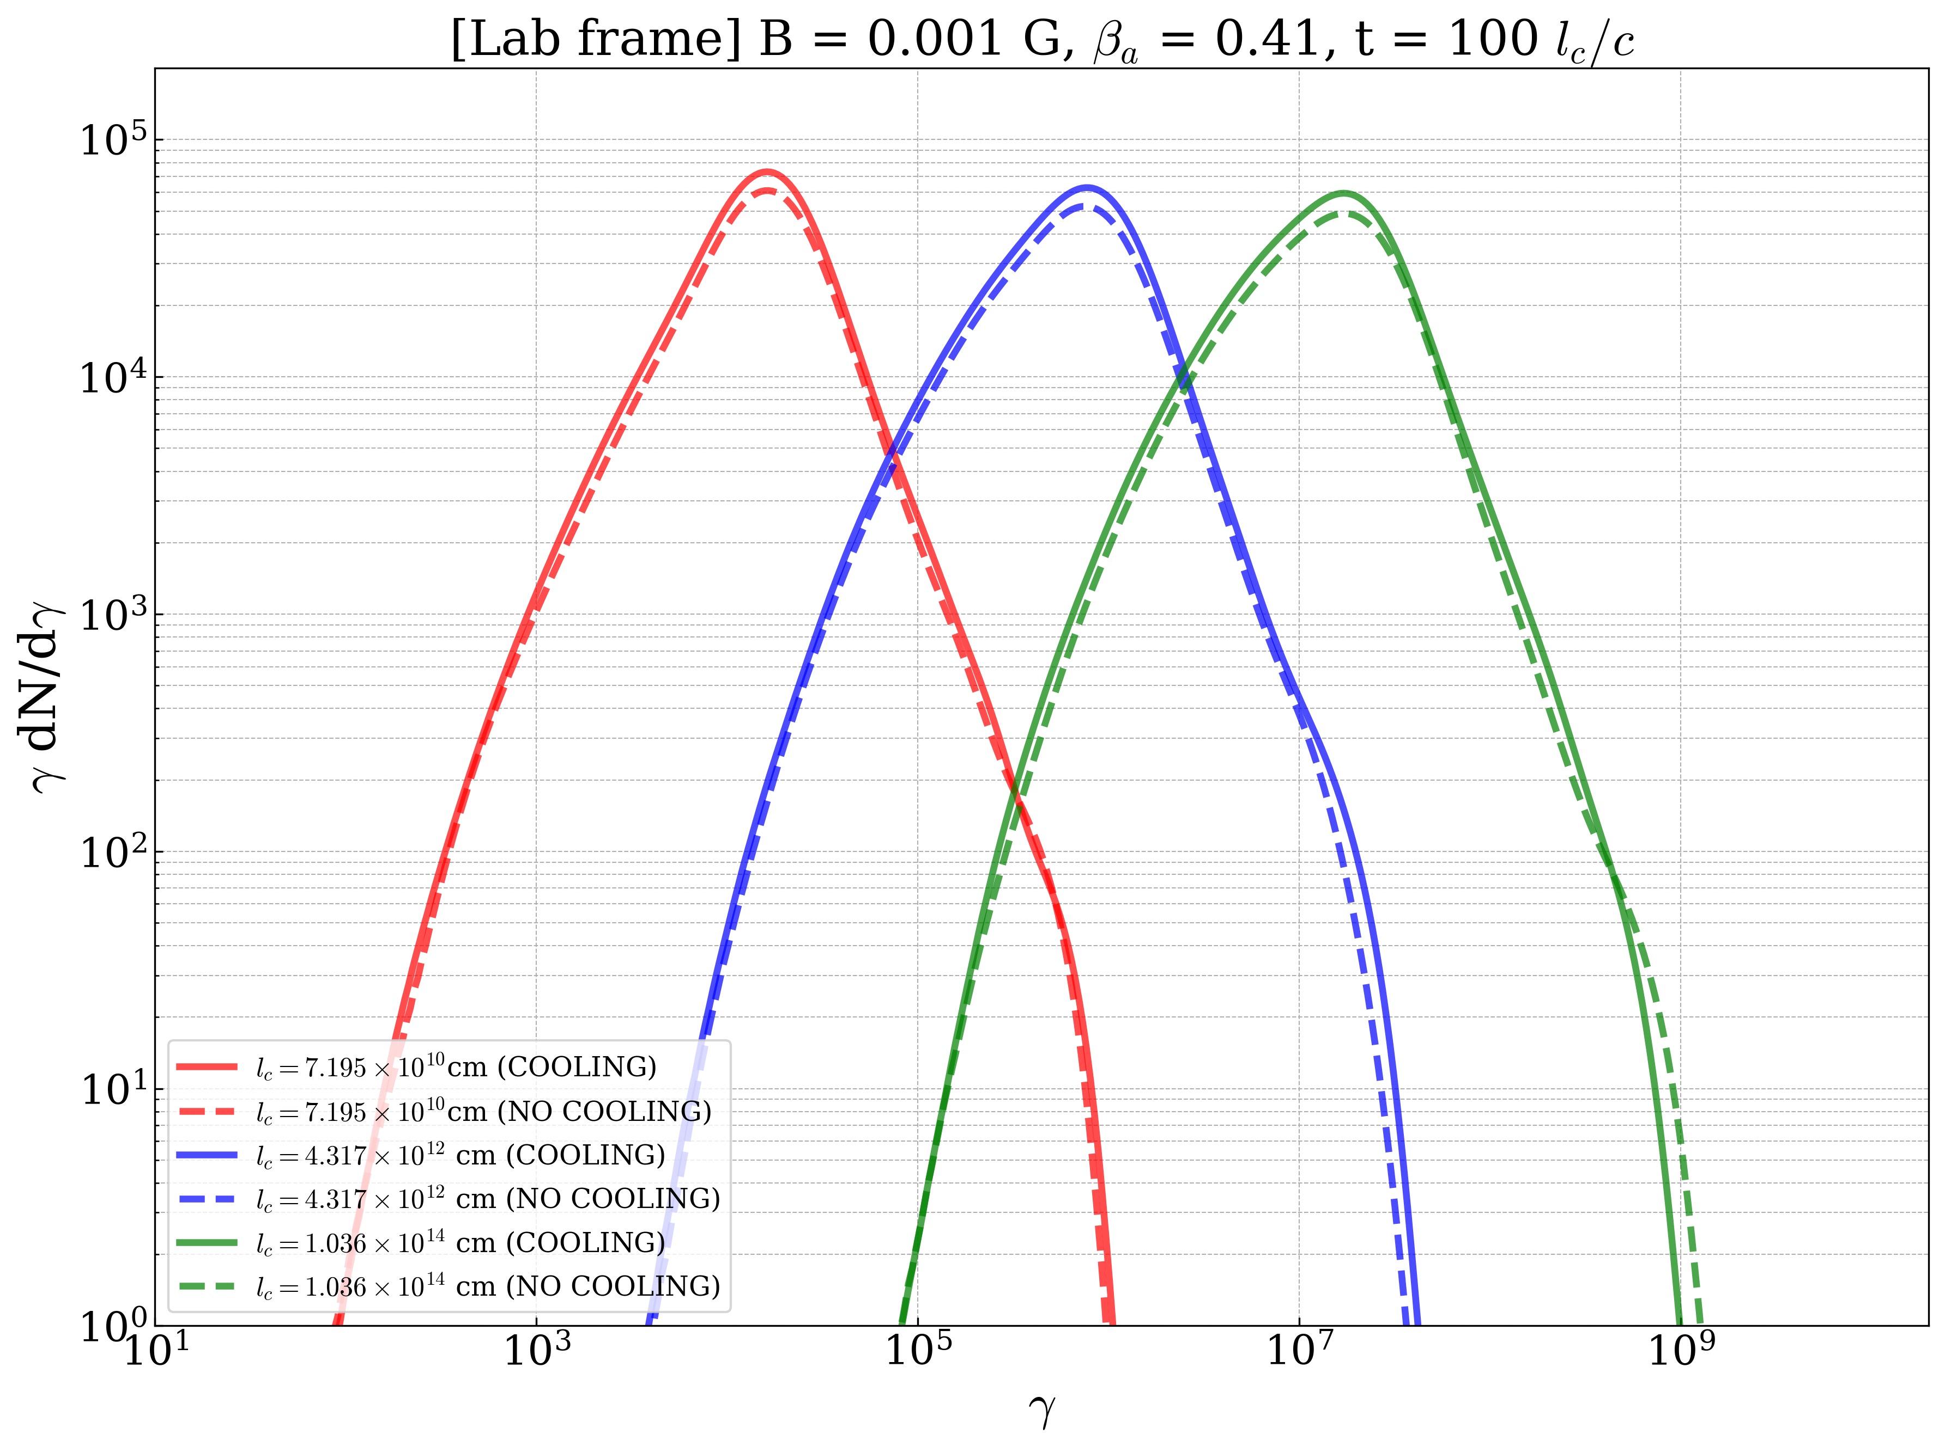

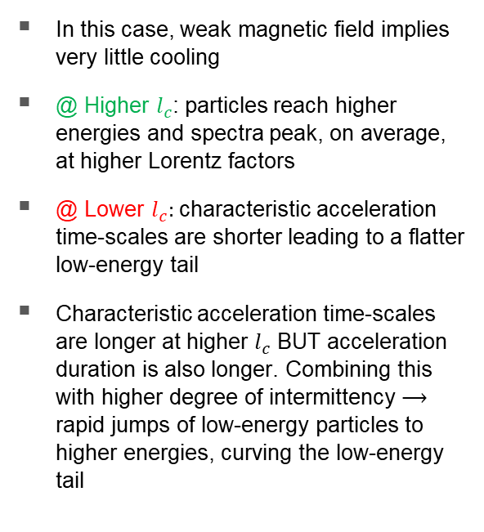
Parameter study: dependence on $l_{c}$
In this case, weak magnetic field implies very little cooling
@ Higher $l_{c}$: particles reach higher energies and spectra peak, on average, at higher Lorentz factors
@ Lower $l_{c}:$ characteristic acceleration time-scales are shorter leading to a flatter low-energy tail
Characteristic acceleration time-scales are longer at higher $l_{c}$ BUT acceleration duration is also longer. Combining this with higher degree of intermittency $⟶$ rapid jumps of low-energy particles to higher energies, curving the low-energy tail
$$l_{c}$$

Slide 20
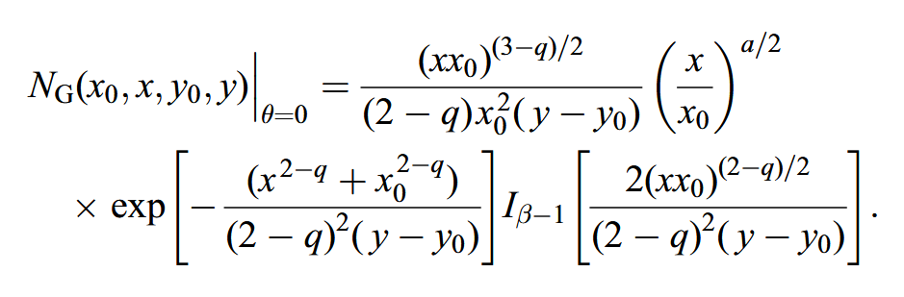
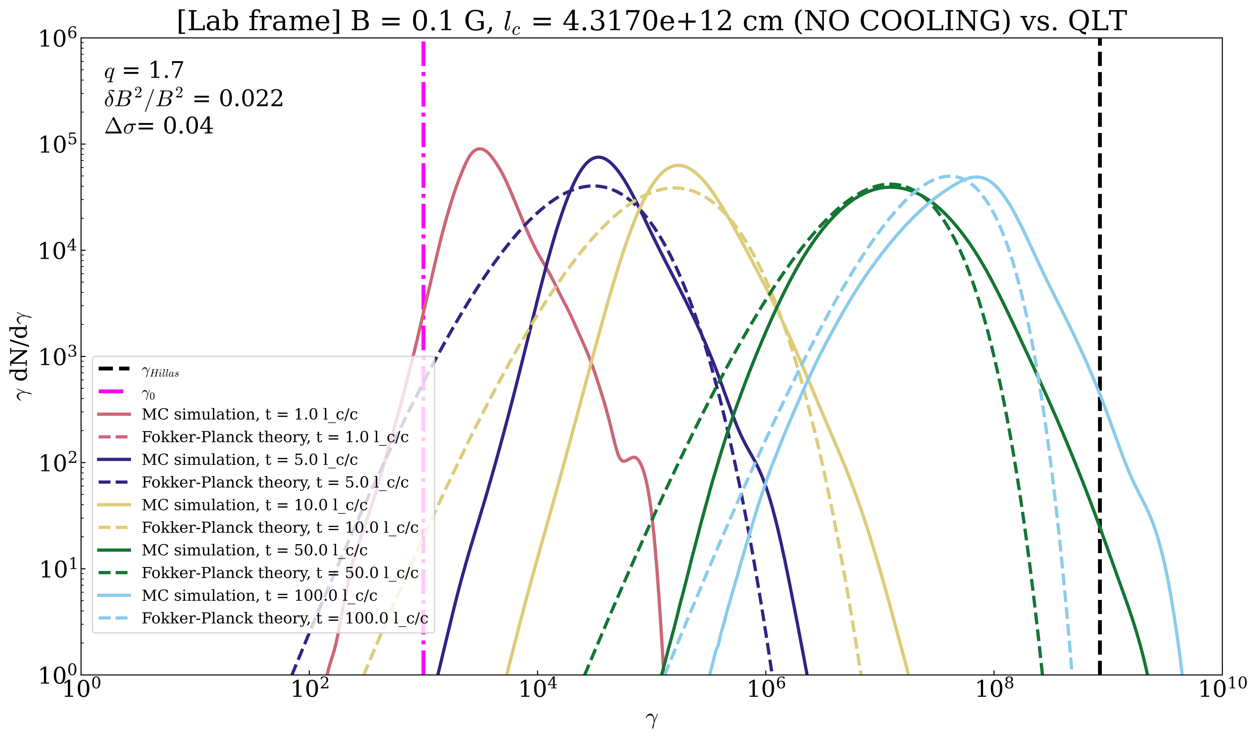
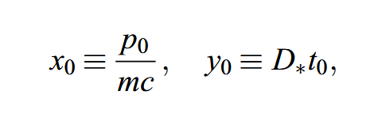
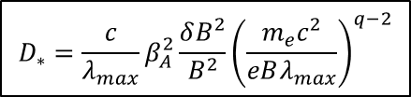
Simulation vs Fokker-Planck Theory
(Becker et al., 2006)
$$D_{∗}=\frac{c}{λ_{max}}β_{A}^{2}\frac{δB^{2}}{B^{2}}{\left(\frac{m_{e}c^{2}}{eBλ_{max}}\right)}^{q−2}$$
NOT REALLY A FAIR COMPARISON!

Slide 21
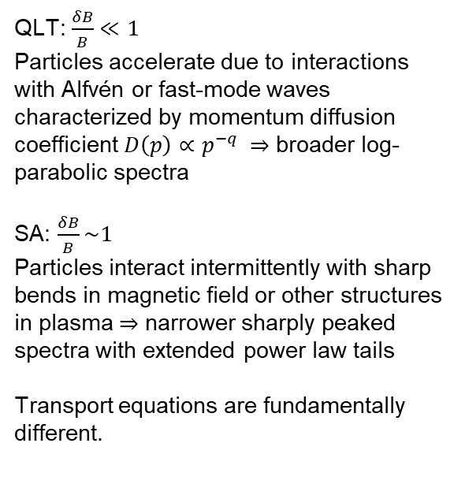
Simulation vs Fokker-Planck Theory
QLT: $\frac{δB}{B}≪1$
Particles accelerate due to interactions with Alfvén or fast-mode waves characterized by momentum diffusion coefficient $D\left(p\right)∝p^{−q} ⇒$ broader log-parabolic spectra
SA: $\frac{δB}{B}\sim 1$
Particles interact intermittently with sharp bends in magnetic field or other structures in plasma $⇒$ narrower sharply peaked spectra with extended power law tails
Transport equations are fundamentally different.
Notes:
Qualitatively shows the difference between our results and spectra predicted by QLT

Slide 22
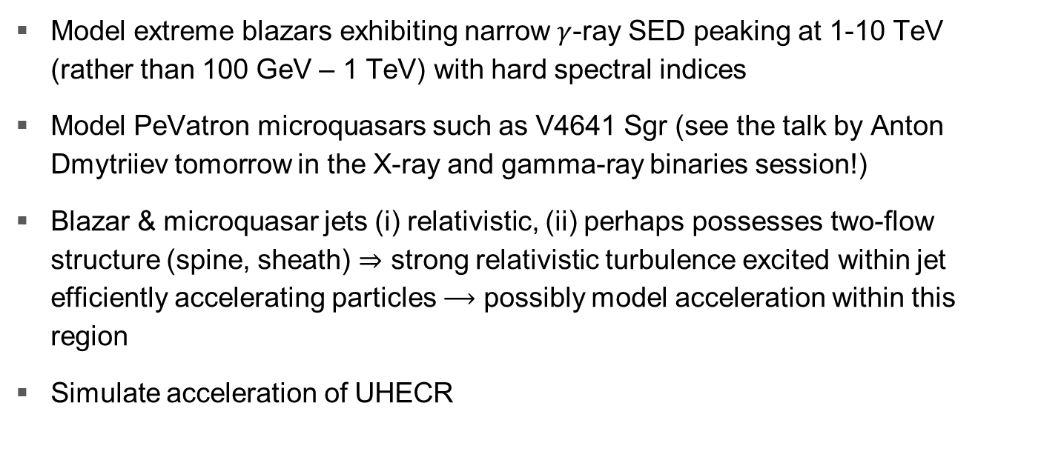
Future work
Model extreme blazars exhibiting narrow $γ$-ray SED peaking at 1-10 TeV (rather than 100 GeV – 1 TeV) with hard spectral indices
Model PeVatron microquasars such as V4641 Sgr (see the talk by Anton Dmytriiev tomorrow in the X-ray and gamma-ray binaries session!)
Blazar & microquasar jets (i) relativistic, (ii) perhaps possesses two-flow structure (spine, sheath) $⇒$ strong relativistic turbulence excited within jet efficiently accelerating particles $⟶$ possibly model acceleration within this region
Simulate acceleration of UHECR

Slide 23
Summary
Introduction
Short overview of Fermi-II acceleration and the modern interpretation in terms of MHD turbulence
Electron particle spectra
Electron particle spectra resulting from our simulations exhibit high- and low-energy powerlaw tails, are sharply peaked, differ significantly from the theoretical spectra, and whose PL indices are weakly dependent on magnetic field and coherence length
First-principles Fermi acceleration in magnetized turbulence
Model stochastic particle acceleration as a continuous-time random walk in terms of the statistical properties of the velocity gradients of the velocity field in the ideal MHD description
Future work
Extreme blazars and PeV microquasars
Acceleration in jets
UHECR
Monte Carlo simulation
MPI parallelized Monte Carlo simulation code in C that models stochastic acceleration with and without synchrotron losses
Thank you!
frans.h.vandermerwe@gmail.com

Slide 24
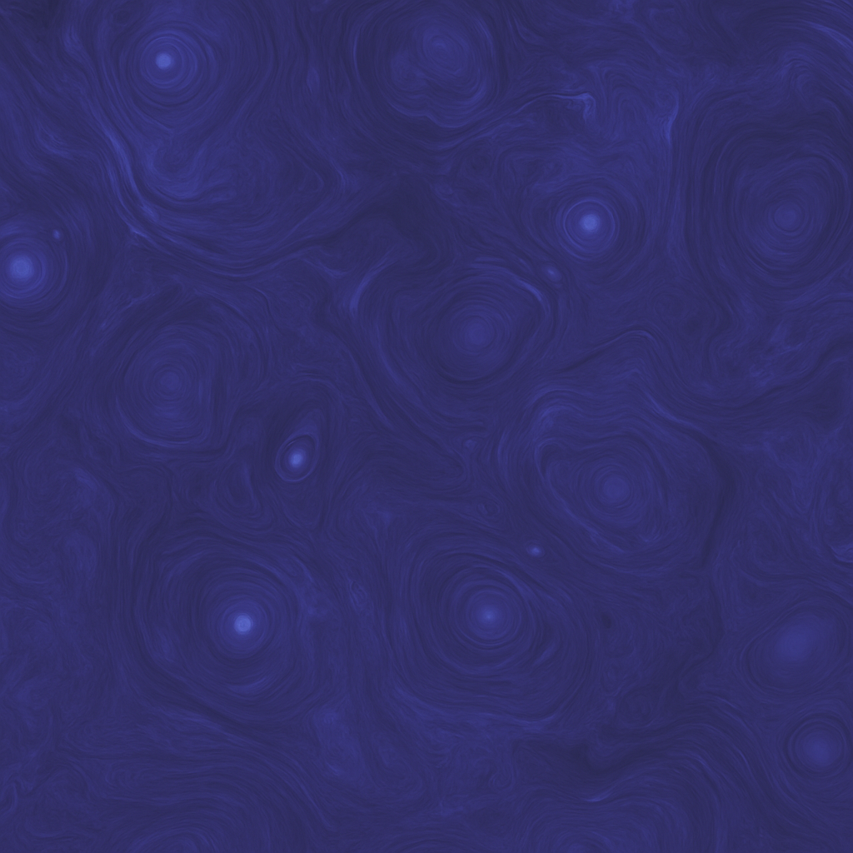
Backup slides

Slide 25
References
Fermi, E., 1949. On the Origin of the Cosmic Radiation. Phys. Rev. 75, 1169–1174. https://doi.org/10.1103/PhysRev.75.1169
Becker, P.A., Le, T., Dermer, C.D., 2006. Time-dependent Stochastic Particle Acceleration in Astrophysical Plasmas: Exact Solutions Including Momentum-dependent Escape. ApJ 647, 539. https://doi.org/10.1086/505319
Lemoine, M., 2022. First-Principles Fermi Acceleration in Magnetized Turbulence. Phys. Rev. Lett. 129, 215101. https://doi.org/10.1103/PhysRevLett.129.215101
Nättilä, J., Beloborodov, A.M., 2021. Radiative turbulent flares in magnetically-dominated plasmas. ApJ 921, 87. https://doi.org/10.3847/1538-4357/ac1c76
Evolution of Special Relativistic Turbulent Plasma, 2023. Video credits: Claudio Meringolo, Alejandro Cruz-Osorio, Luciano Rezzolla and Sergio Servidio. Associated article: Claudio Meringolo et al 2023 ApJ 944 122

Slide 26
References
Cao, Z., Aharonian, F.A., An, Q., Axikegu, Bai, L.X., Bai, Y.X., Bao, Y.W., Bastieri, D., Bi, X.J., Bi, Y.J. and Cai, H., 2021. Ultrahigh-energy photons up to 1.4 petaelectronvolts from 12 γ-ray Galactic sources. Nature, 594(7861), pp.33-36.
Urry, C.M. and Padovani, P., 1995. Unified schemes for radio-loud active galactic nuclei. Publications of the Astronomical Society of the Pacific, 107(715), p.803.

Slide 27
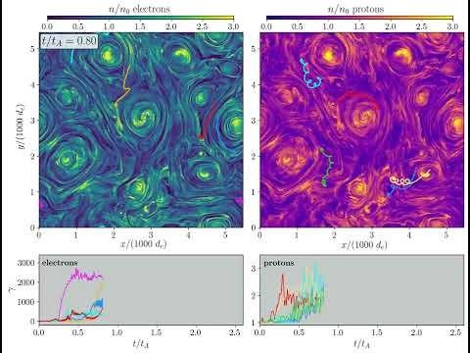
The modern interpretation
Evolution of Special Relativistic Turbulent Plasma, 2023.

