Slide 1
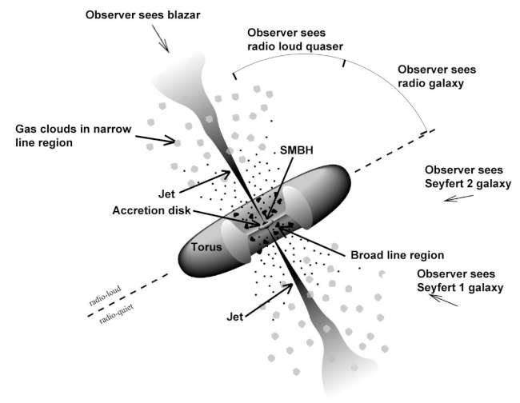

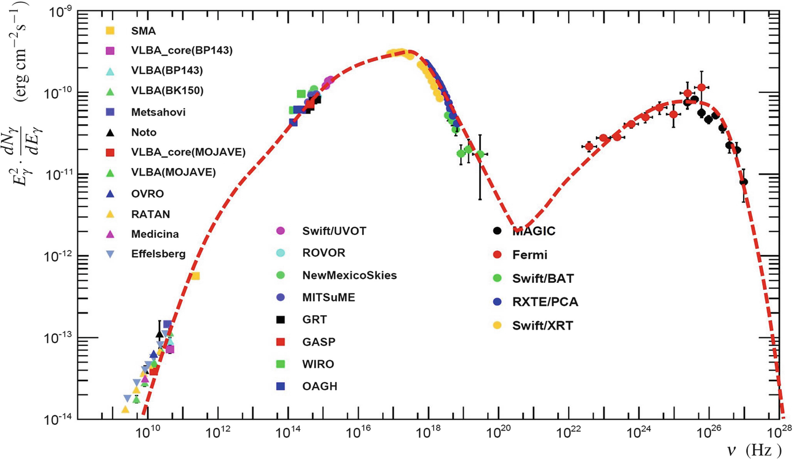
Multi-Messenger study of blazar PKS 0446+11 and Neutrino IC240105A
Rukaiya Khatoon
North-West University, South Africa
Working with Prof. Markus Böttcher
HEASA-2025, University of Johannesburg, South Africa
Broadband SED of Mkn 421 (Abdo et al. 2011)

Slide 2
Overview of Blazar :
Class of AGN for which the relativistic jet is pointed towards the observer.
Blazars include two main categories: Flat Spectrum Radio Quasars (FSRQs), which have strong optical emission lines, and BL Lacertae objects (BL Lacs), which have weak or no optical emission lines.
Blazar properties
Non-thermal spectrum extending from radio to GeV/TeV Gamma rays
Rapid variability - both spectral and flux
Typical double hump spectral energy distribution
Broadband SED of Mkn 421 (Abdo et al. 2011)

Slide 3
Leptonic blazar model :
Radio/Microwave IR optical/UV X-rays Gamma-rays (MeV - TeV)
Relativistic electrons spiraling in magnetic fields, producing synchrotron radiation
Seed photons for inverse Compton scattering originate either from:
Synchrotron emission within the jet itself (Synchrotron Self-Compton – SSC), or
External photon fields, such as from the accretion disk, broad-line region (BLR), or dust torus (External Compton – EC)

Slide 4
Hadronic blazar model :
If protons are accelerated to ultra-relativistic energies, they can:
Radiate via proton synchrotron emission (like electrons, but at higher energies)
Interact with photon fields (internal synchrotron or external disk/BLR/torus photons) through photo-hadronic (p𝛾) interactions
p𝛾 Interaction Pathways:
Neutral pion channel:
p + 𝛾 →p + 𝜋⁰
𝜋⁰ →2𝛾
Produces very high-energy gamma rays
Charged pion channel:
p + 𝛾 →n + 𝜋⁺
𝜋⁺→ 𝜇⁺ + 𝜈_{𝜇}
𝜇⁺ → e⁺ + 𝜈_{e}+ 𝜈_{𝜇}
Produces secondary leptons that can radiate via synchrotron
results in a flux of 𝜈_{𝑒} and 𝜈_{𝜇}

Slide 5
Hadronic blazar model :
The high-energy γ-rays from 𝜋⁰ decay or from synchrotron of secondaries often cannot escape directly.
They interact with low-energy ambient photons via 𝛾𝛾→e⁺ e⁻ pair production.
Electromagnetic Cascades:
These pairs produced in 𝛾𝛾 pair production, 𝜋⁺ decay
can initiate cascade → these pairs emit synchrotron radiation → more high-energy photons → more absorption →electromagnetic cascades
Each step of the cascade lowers the photon energy
The cascade reprocesses the high-energy gamma-ray photons down into the X-ray band or MeV band.

Slide 6
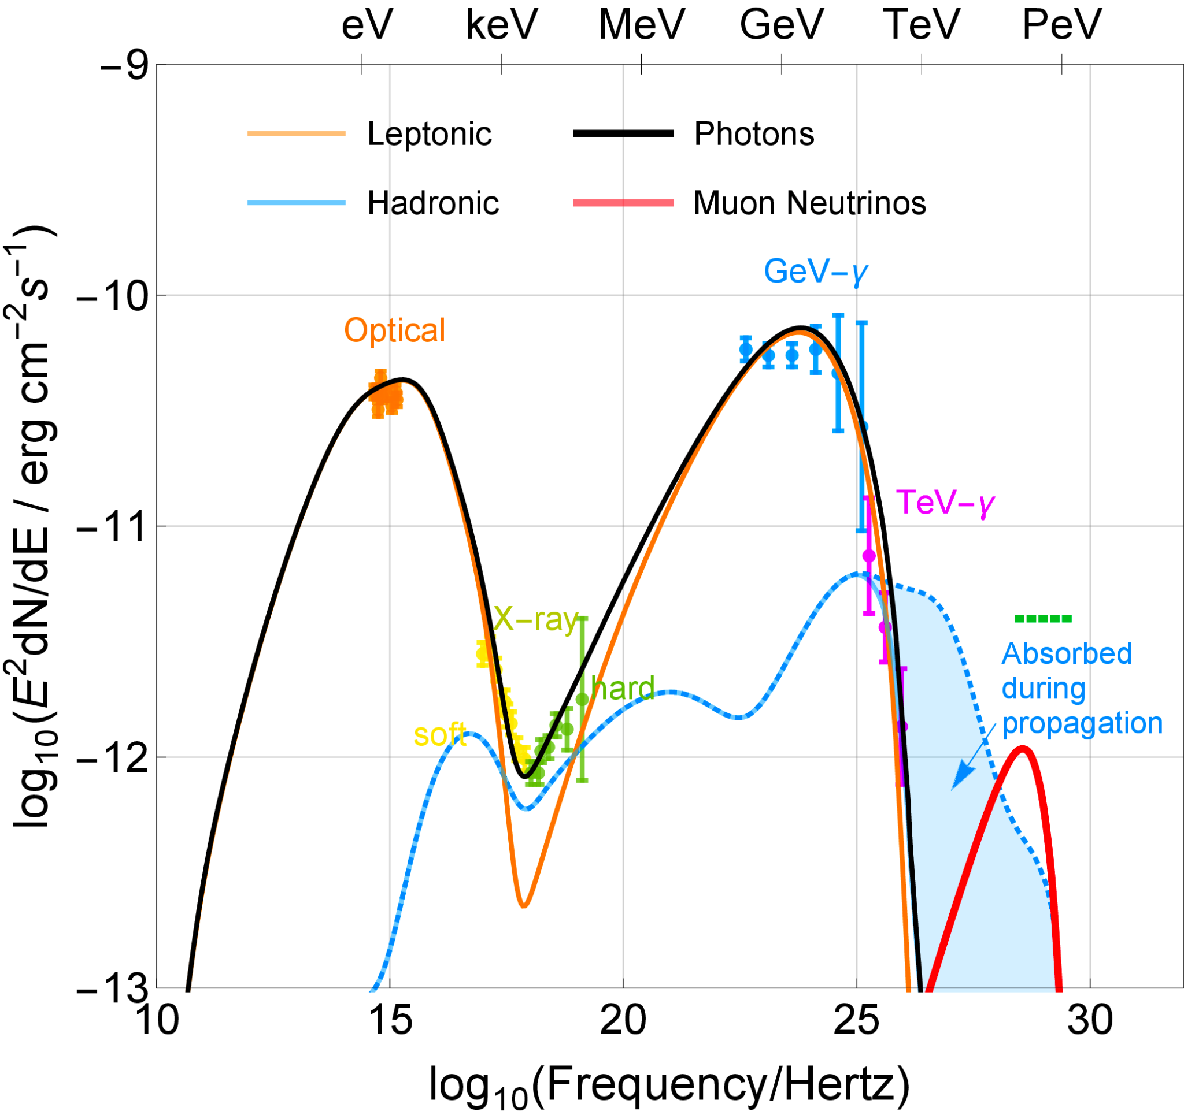
Multi-messenger view :
Energy flux from TXS 0506+056 across the electromagnetic spectrum and for neutrinos. Here the energy spectrum is modeled in the hybrid scenario with both leptonic and hadronic contributions. (Gao et al., 2019)
.
A few more possible associations of blazars with IceCube events are proposed such as PKS 1424+240 (Kadler et al. 2016, Padovani et al. 2022) and PKS 0735+178 (Sahakyan et al. 2023, Acharyya et al. 2023, Prince et al. 2024), etc.

Slide 7
Neutrino IC240105A
IceCube Neutrino Alert — IC240105A (GCN Circular 35485)
Detected by IceCube on 2024-01-05, 12:27:42.57 UT.
Single track-like event — likely a muon neutrino.
Best-fit position: RA = 72.69°, Dec = +11.42° (±1–2° uncertainty)
No significant neutrino excess from the region.

Slide 8
PKS 0446+11 Activity
Fermi-LAT Follow-up (ATel 16398)
Two known gamma-ray sources (4FGL-DR4 catalog) within 90% IceCube error region:
4FGL J0449.1+1121 — FSRQ, PKS 0446+11 (z = 2.15), 0.4° away.
4FGL J0458.0+1152 — Blazar of uncertain type, 1.9° away.
Analyzed all-sky gamma-ray data around T₀ ± 1 day.
Neither source showed >5σ detection in the 1-day window prior to T₀.
1-month integration prior to T₀: only PKS 0446+11 is significantly detected (>5σ )
Flux (E>100 MeV): (1.9 ± 0.3) × 10⁻⁷ ph cm⁻² s⁻¹
3× higher than catalog average

Slide 9
PKS 0446+11 Activity
LAT: Major flare on November 10, 2023 (ATel #16332):
Flux (E>100 MeV): (1.1 ± 0.2) × 10⁻⁶ ph cm⁻² s⁻¹
18× brighter than catalog average
Swift-XRT observations (Jan 06 & 08, 2024, ATel 16397):
Flux (0.3–10 keV): ~4.0–4.4 × 10⁻¹² erg cm⁻² s⁻¹
Archival 2015 value: 2.5 × 10⁻¹³ erg cm⁻² s⁻¹
Harder-when-brighter trend confirmed (Γ ~1.4–1.2)

Slide 10
Motivation
PKS 0446+11 is positionally coincident with IceCube neutrino event (Jan 5, 2024).
Source belongs to VLBI-selected, radio-bright AGN statistically linked with neutrinos (Plavin+ 2023, ATel 16409)
Multiwavelength follow-up triggered after neutrino alert (Sinapius et al. 2024; Eppel et al.
2024; Wani et al. 2024; Garrappa et al. 2024;others); elevated flux state persisted around the neutrino detection (Jan 2024)
γ-rays: Major flare in Nov 2023

Slide 11
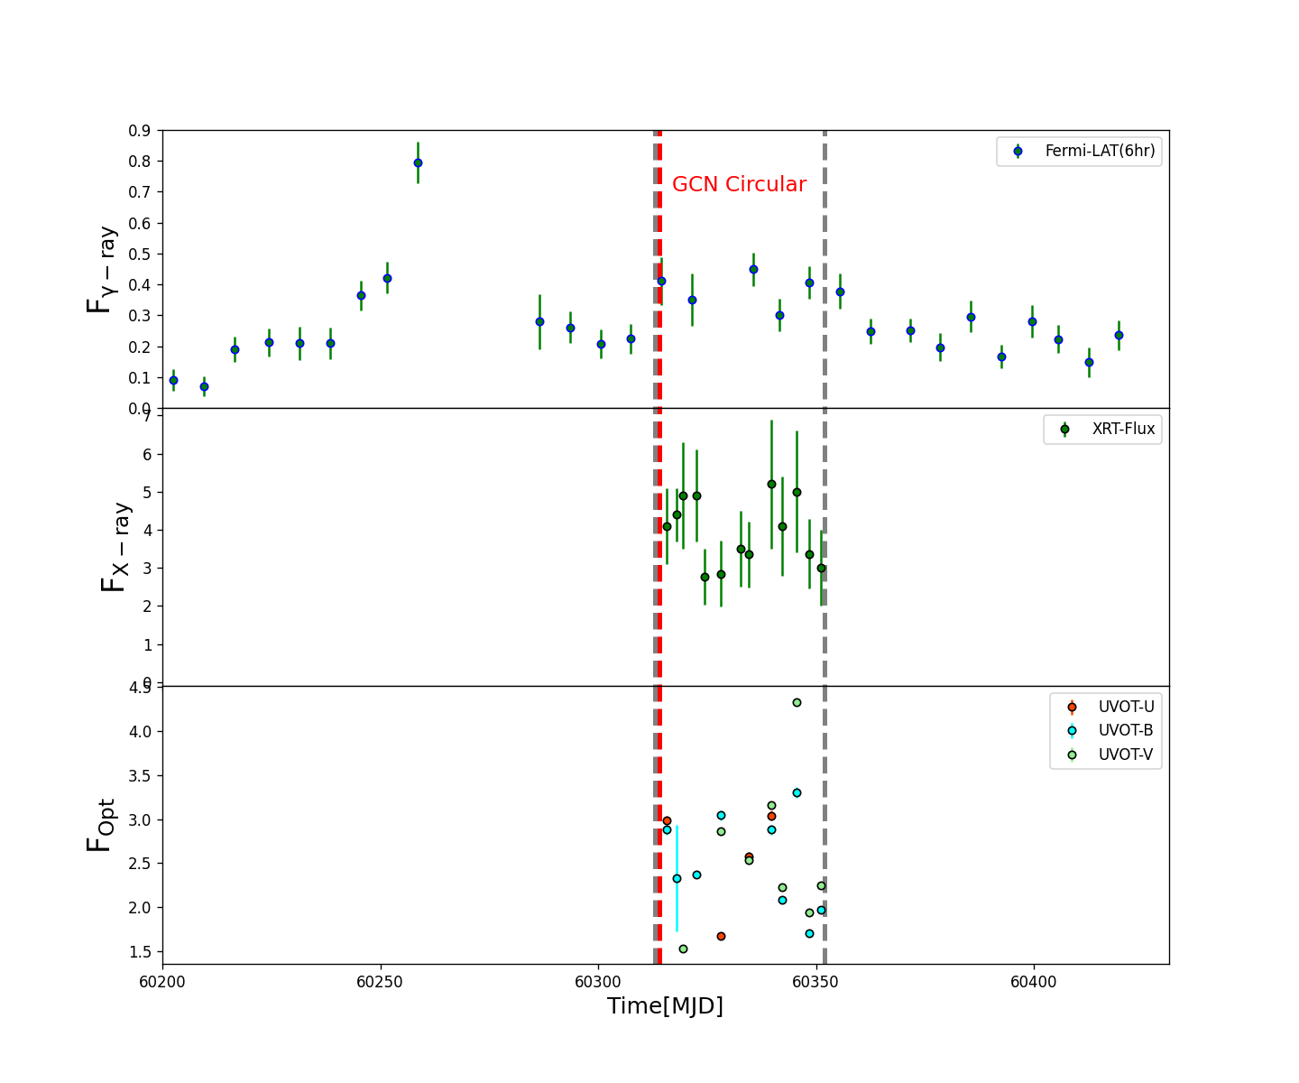
Lightcurve of PKS 0446+11
Multiwavelength light curve of PKS 0446+11 (MJD 60200–60431).
Red dashed line: IceCube neutrino event IC240105A (Jan 5, 2024).
Grey dashed lines: time window for SED modeling (MJD 60315.8–60351).
The γ-ray fluxes are shown in units of 10⁻⁶ ph cm⁻² s⁻¹ , the Swift-XRT fluxes in 10⁻¹² erg cm⁻² s⁻¹, the Swift-UVOT fluxes flux in 10⁻¹²
erg cm⁻² s⁻¹
The weekly binned γ-ray flux is 4.1 × 10⁻⁷ ph cm⁻² s⁻¹ (~6× brighter than catalog average )

Slide 12
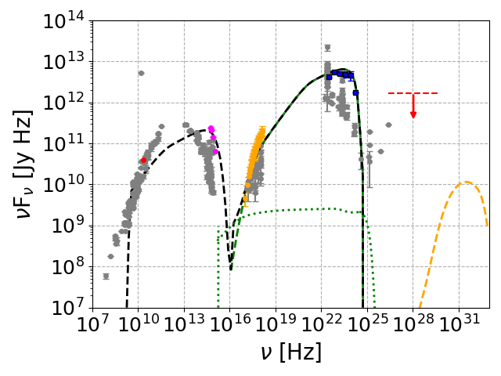
SED modeled with stationary, single-zone leptonic and lepto-hadronic models (Böttcher et.al. 2013)
The black dashed line represents the emission from the leptonic model
The green dotted line represents the cascade emission resulting from hadronic processes
The orange curve illustrates the expected neutrino flux
Dusty torus: T = 1000 K
u_{DT} = 6.8 × 10⁻⁵ erg cm⁻³
BLR: T = 45000 K
u_{BLR} = 1.0 × 10⁻⁵ erg cm⁻³
The red marker indicates flux upper limit (E⁻² assumption)
E² dN​/dE = 5.9×10⁻² GeV cm⁻² (90% CL)
IceCube sensitive range: ~1 TeV to 2 PeV

Slide 13
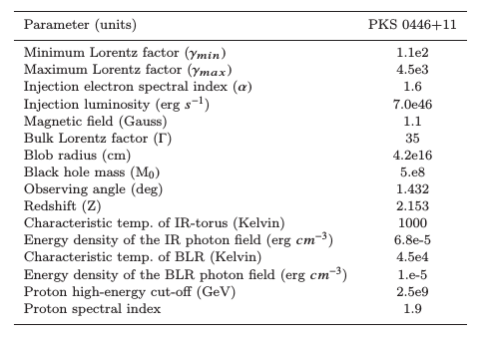
SED model parameters:

Slide 14
Summary & Conclusion:
PKS 0446+11 is positionally consistent with IceCube neutrino IC240105A but shows no strict temporal γ-ray–ν coincidence.
The source was still in an elevated state at the neutrino epoch, highlights the complexity of linking neutrino emission with blazar activity.
SED modeling:
Best explained by leptonic scenario (synchrotron + external Compton from BLR/torus).
Hadronic models underpredict flux and place the ν peak outside IceCube’s most sensitive range.
Implication: PKS 0446+11 unlikely to be dominant source of IC240105A, but remains a key case study for ν–blazar connections.
Future outlook: deeper MeV–X-ray coverage, population studies of high-z blazars, CTA + IceCube-Gen2 essential to constrain hadronic emission and clarify blazars’ role in diffuse astrophysical ν flux.
Thank You !

