Slide 1


Constraints on Cosmological Parameters Using Gamma-Ray Bursts with Measured and Machine Learning Derived Redshifts
Tamador Khalil Mansoor Aldowma
Supervisor
Prof. Soebur Razzaque
HEASA 2025 (16 - 20 September) 2025

Slide 2

1
Introduction
Gamma-Ray Bursts (GRBs).
Phenomenological Correlations.
Outline
2
Machine Learning Model and Data
Machine Learning Models Used.
Estimating GRB Redshifts.
3
Constraints on Cosmological Parameters
Pseudo-Redshift Sample.
Supernova Type Ia (SNe Ia) Sample.
Preliminary results.
4
Summary
1

Slide 3
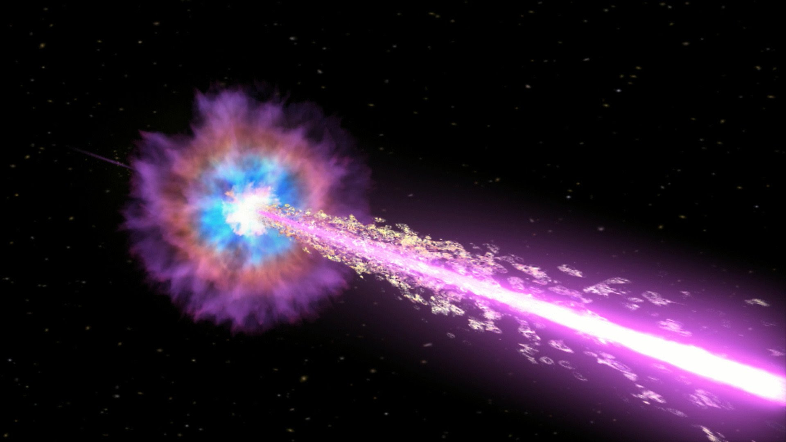
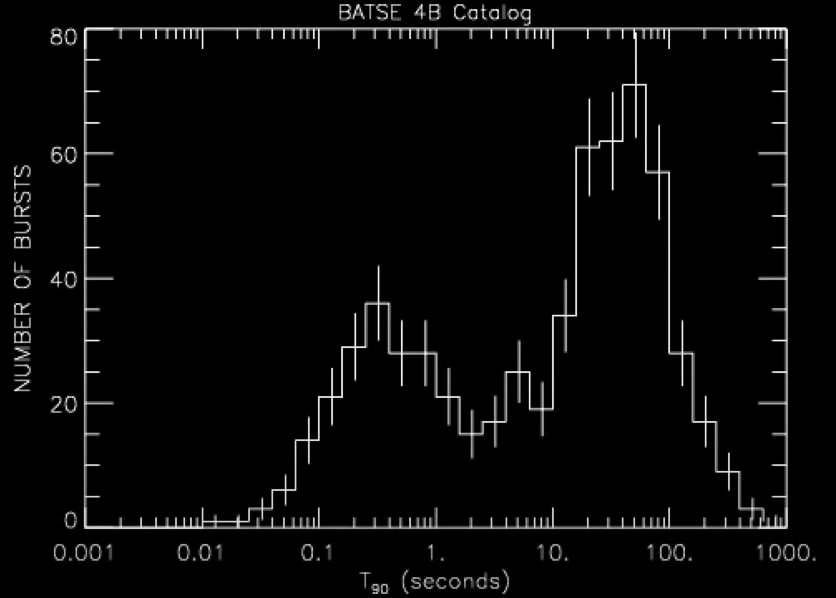
Introduction
Gamma-Ray Bursts (GRBs)
GRBs are the most powerful explosions ever observed in the electromagnetic spectrum.
Emit intense gamma rays in the keV to GeV energy range, and can also be observed in X-ray, and sometimes in optical (Meszaros 2006; Kumar & Zhang 2015).
Duration ranges from less than 1 second to several minutes.
Observed at very high redshifts:
Up to z ≈ 8.2 (Tanvir et al., 2009), from spectroscopic measurement.
Even reaching z ∼ 9.4 GRB 090429B (Cucchiara et al., 2011), from photometric measurement.
Credit: NASA/Swift/Cruz deWilde
2 s
Short GRBs
Long GRBs
Beyond standard assumptions:
GRB plateau emission (X-ray emission) suggest that GRB rates may exceed the cosmic star formation rate (SFR) at low redshifts.
Effects of metallicity evolution in the early universe.
https://gammaray.nsstc.nasa.gov/batse/grb/duration/
Petrosian and Dainotti, 2024.
2

Slide 4
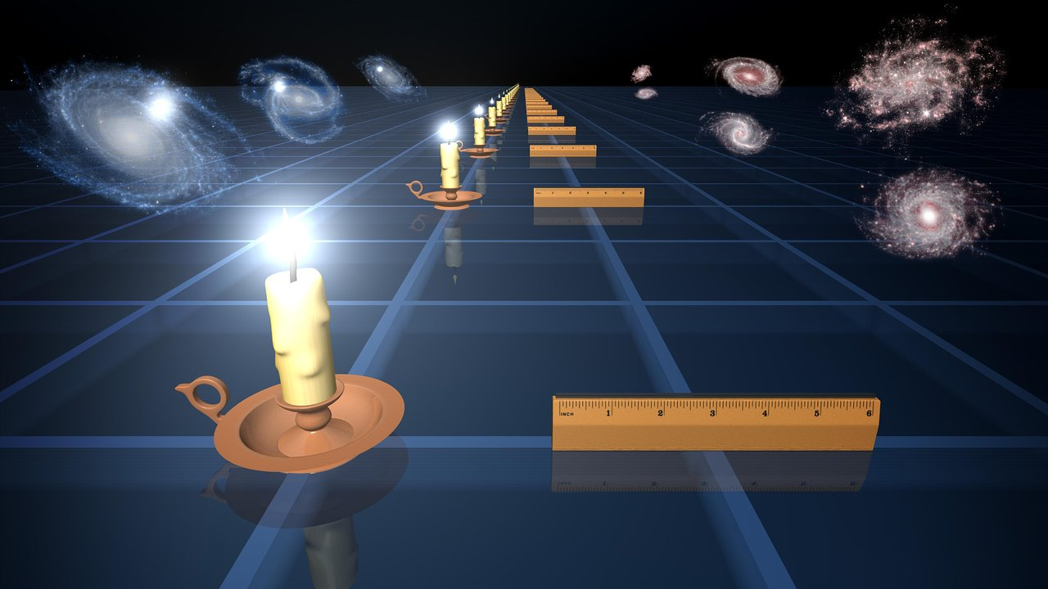
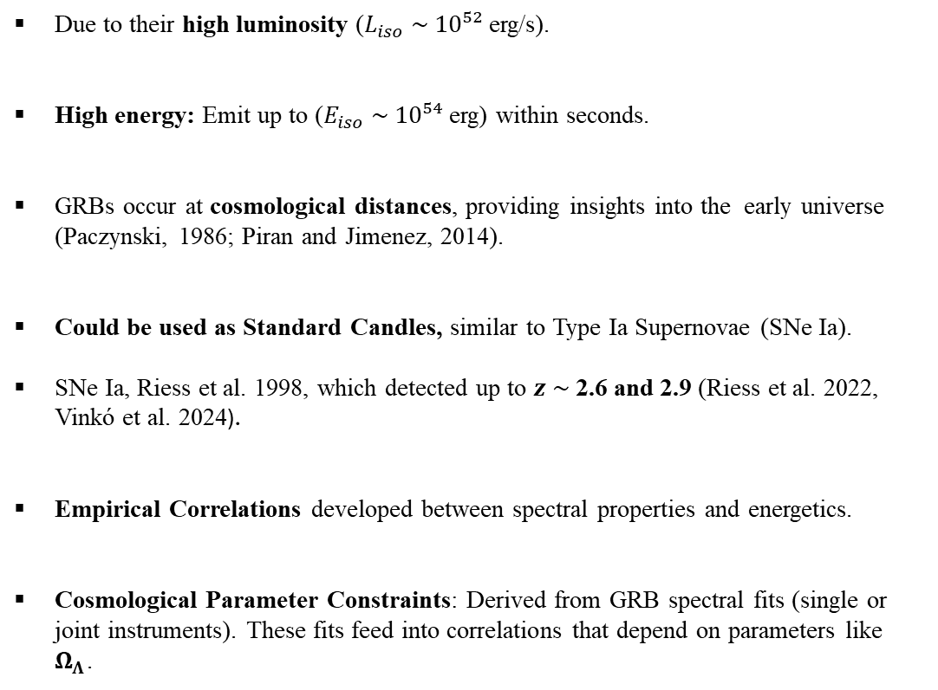
Introduction
GRBs as Cosmological Standard Candles
They have the potential to be used as cosmological standard candles.
Due to their high luminosity ($L_{iso} \sim 10⁵²$erg/s).
High energy: Emit up to ($E_{iso} \sim 10⁵⁴$erg) within seconds.
GRBs occur at cosmological distances, providing insights into the early universe (Paczynski, 1986; Piran and Jimenez, 2014).
Could be used as Standard Candles, similar to Type Ia Supernovae (SNe Ia).
SNe Ia, Riess et al. 1998, which detected up to $z \sim$2.6 and 2.9 (Riess et al. 2022, Vinkó et al. 2024).
Empirical Correlations developed between spectral properties and energetics.
Cosmological Parameter Constraints: Derived from GRB spectral fits (single or joint instruments). These fits feed into correlations that depend on parameters like $Ω_{Λ}$.
Credit: NASA/JPL-Caltech
3

Slide 5
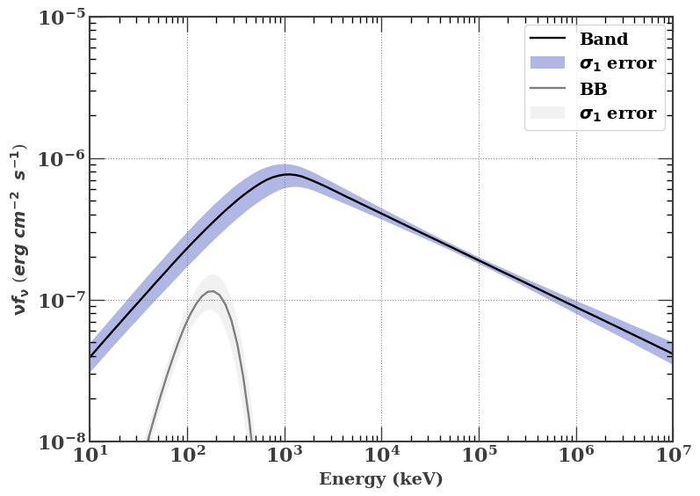
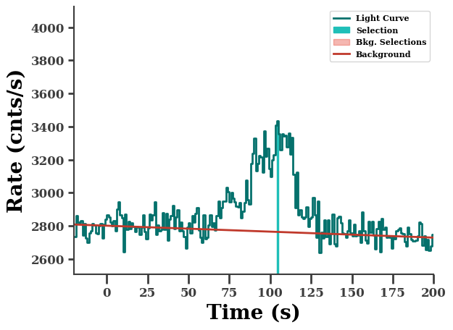
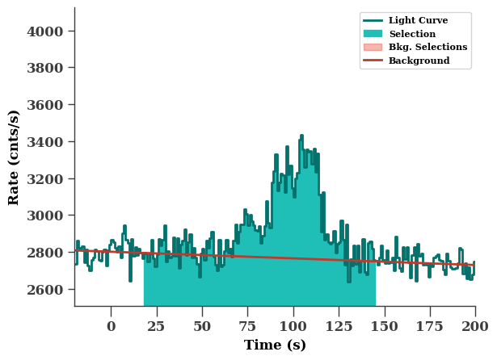

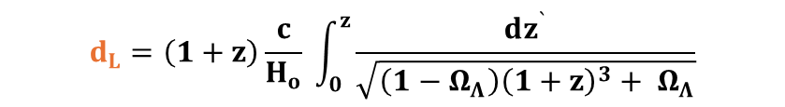

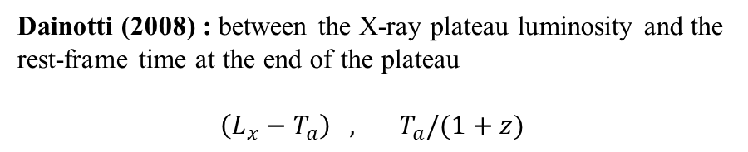



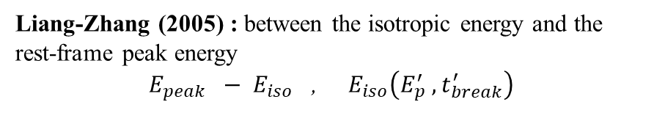
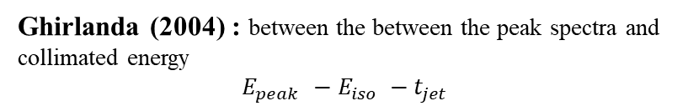


Phenomenological Correlations
Amati (2002): between intrinsic peak energy and isotropic energy
GRB 080916C
$E_{i, peak }−$ $E_{iso}$ ,
$$E_{i, peak }=E_{p}\left(1+z\right)$$
$E_{iso}=\frac{4πd_{L}^{2}}{1+z} S_{bolo}$
Ghirlanda (2004) : between the between the peak spectra and collimated energy
$E_{peak }−E_{iso} −t_{jet}$
Liang-Zhang (2005) : between the isotropic energy and the rest-frame peak energy
$E_{peak} − E_{iso}$ , $E_{iso}\left(E_{p}^{′} , t_{break}^{′}\right)$
One second time interval
*$T_{90}$
Yonetoku (2007): between intrinsic peak energy and isotropic luminosity
$E_{i, peak }−$ $L_{iso}$ ,
$L_{iso}=4πd_{L}^{2} P_{bolo}$
Dainotti (2008) : between the X-ray plateau luminosity and the rest-frame time at the end of the plateau
$\left(L_{x}−T_{a}\right) , T_{a}/(1+z)$
$$d_{L}=\left(1+z\right)\frac{c}{H_{o}} \int_{0}^{z}{\frac{dz^{`}}{\sqrt{\left(1−Ω_{Λ}\right){\left(1+z\right)}^{3}+ Ω_{Λ}}}}$$
$$H_{o }= 67.3 km s^{−1} Mpc^{−1}$$
$Ω_{Λ} = 0.685$(Planck Collaboration et al., 2018)
${∗ T}_{90}$ : the time to detect 90% of GRBs fluence.
4

Slide 6
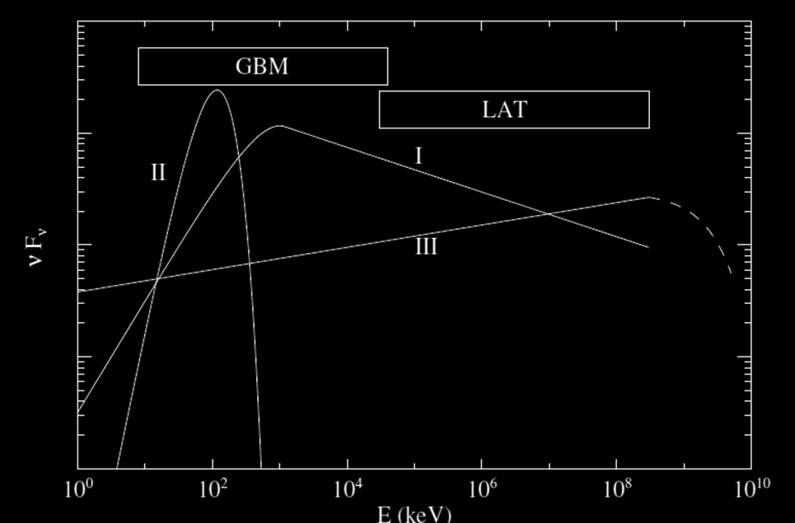
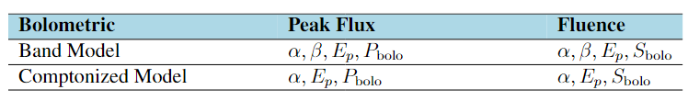
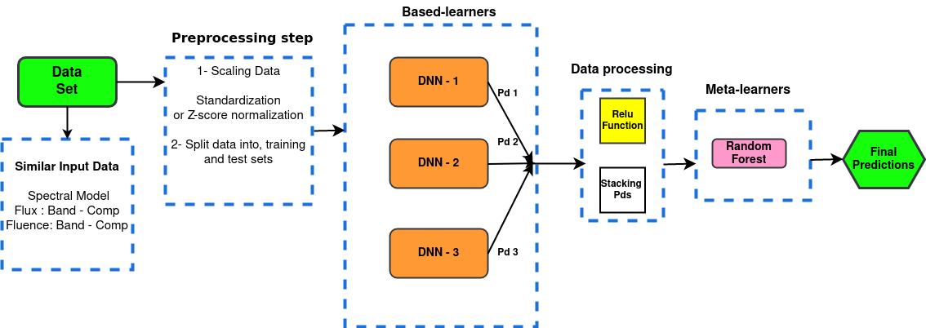
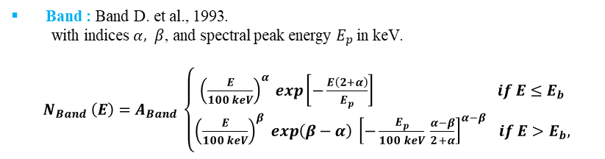
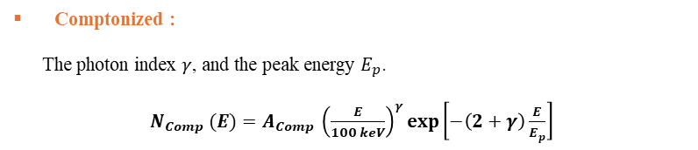
Machine Learning Models and Data
Data from Fermi Gamma-ray Monitor (Fermi-GBM) von Kienlin et al., 2020 catalogue, 128 GRBs (2008-2018) with known redshift.
Kouns-Wind Tsvetkova et al., 2021 catalogue, 338 GRBs (2005-2018) with known redshift.
Figure credit: Zhang et al., 2011.
Aldowma, T., and Razzaque, S., MNRAS, 2024
Ensemble Stacking:
Deep Neural Networks (DNNs) Regressor algorithm in TensorFlow, Géron, A. 2022.
+ Random Forest in Scikit.
Band : Band D. et al., 1993.
with indices $α, β$, and spectral peak energy $E_{p}$in keV.
$N_{Band} \left(E\right)=A_{Band} \left\{\begin{aligned}{\left(\frac{E}{100 keV}\right)}^{α} exp\left[−\frac{E\left(2+α\right)}{E_{p}}\right] if E≤E_{b} \\ {\left(\frac{E}{100 keV}\right)}^{β} exp\left(β−α\right) {\left[−\frac{E_{p}}{100 keV} \frac{α−β}{2+α}\right]}^{α−β } if E>E_{b}, \end{aligned}\right.$
Comptonized :
The photon index $γ$, and the peak energy $E_{p}$.
$N_{Comp} (E)=A_{Comp} {\left(\frac{E}{100 keV}\right)}^{γ}\exp\left[−\left(2+γ\right)\frac{E}{E_{p}}\right]$
Architecture of the Ensemble Stacking
5

Slide 7
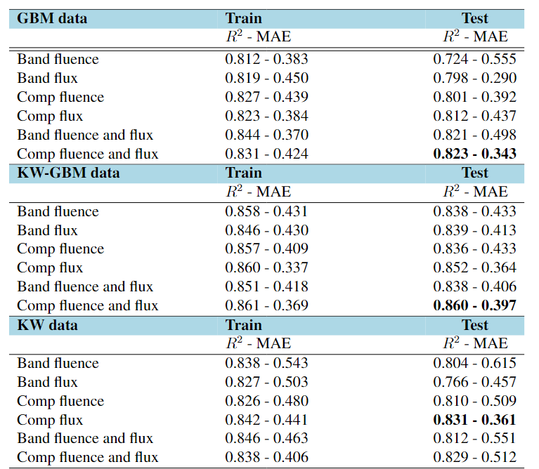
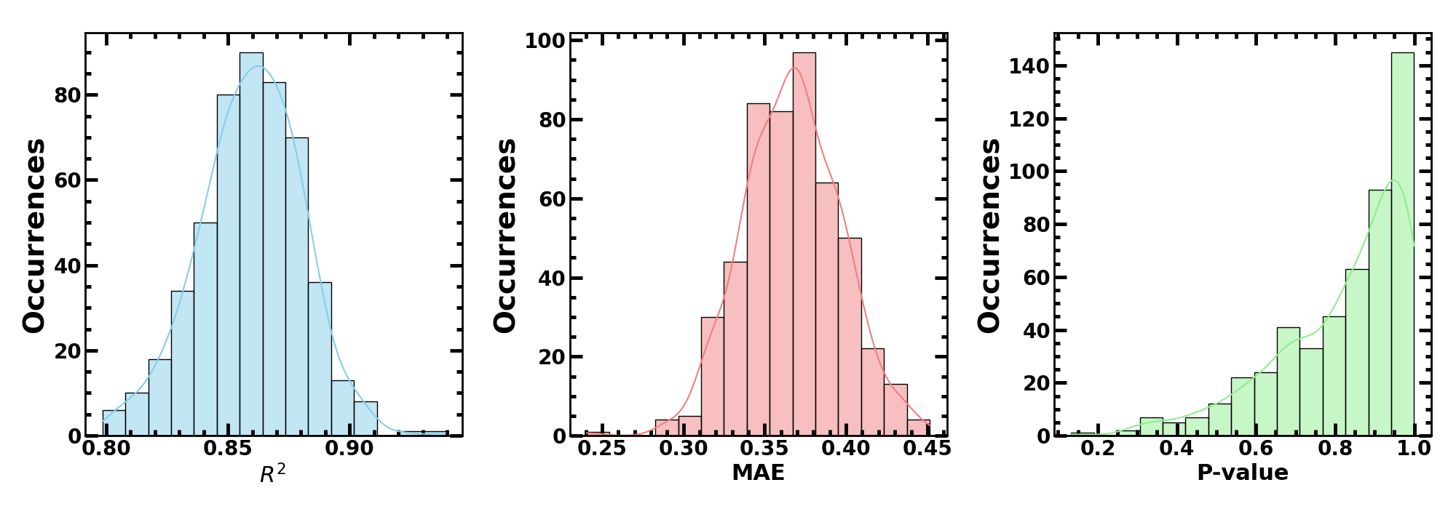
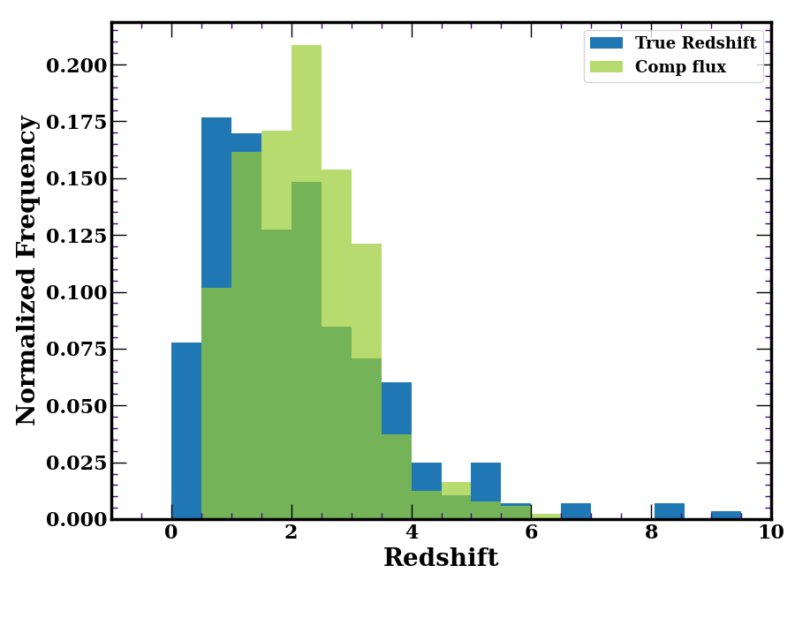
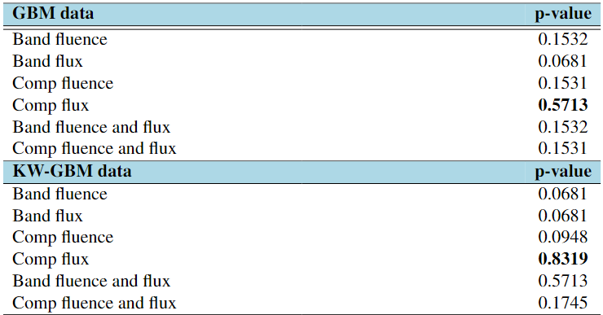
Estimated GRB Redshift
Results from ensemble model with true redshift
High performing model tri-dimensional metric space
Pseudo-redshifts compare with the samples of GRBs with true redshifts
Aldowma, T., and Razzaque, S., MNRAS, 2024
6

Slide 8
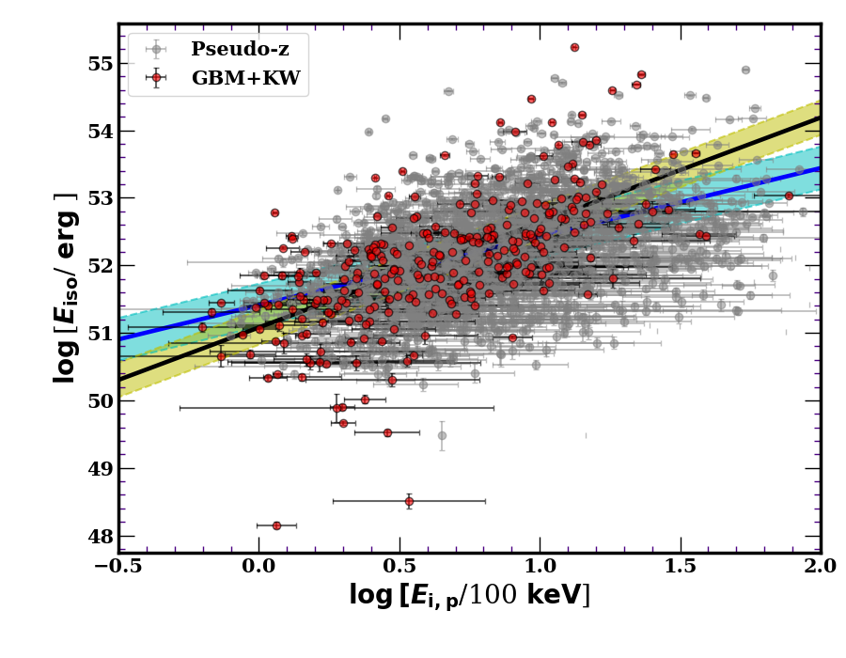
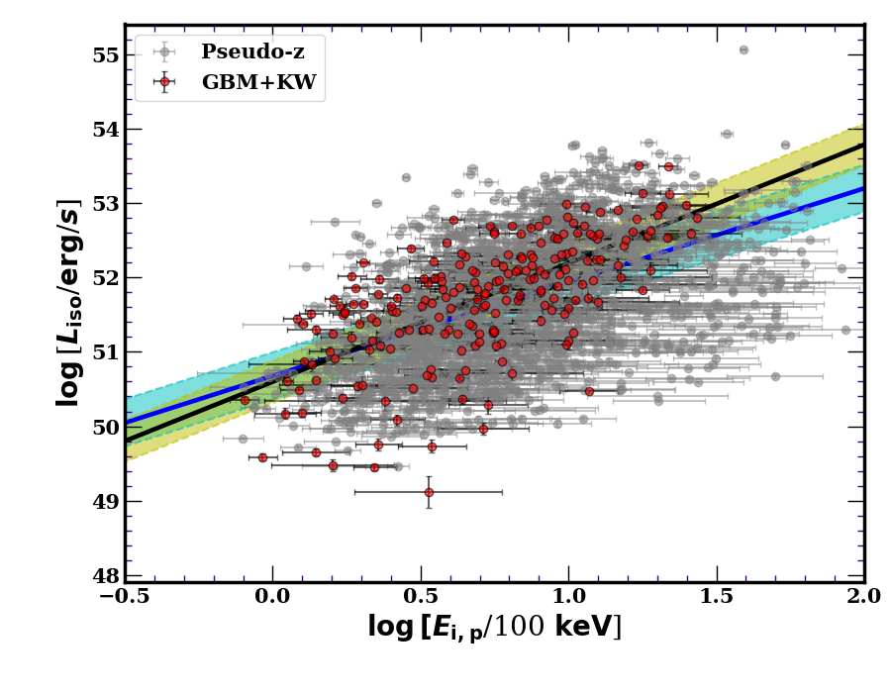
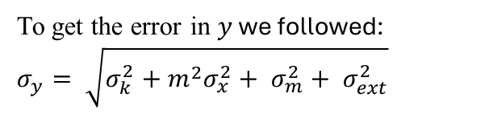
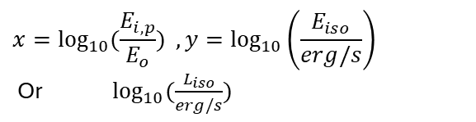
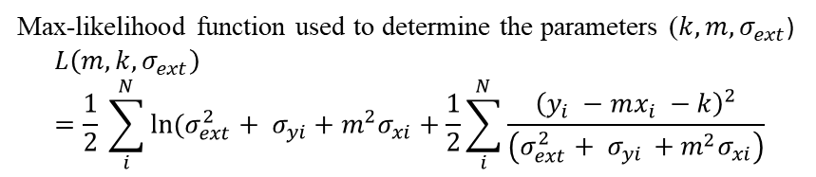
Estimated GRB Redshift
Results of the Amati and Yonetoku correlation fits applied to the KW-GBM samples of GRBs with true redshift and GBM sample of GRBs with pseudo redshift.
$$x=\log_{10}{(\frac{E_{i, p}}{E_{o}})} , y=\log_{10}\left(\frac{E_{iso}}{erg/s}\right)$$
Or $\log_{10}{(\frac{L_{iso}}{erg/s})}$
To get the error in $y$ we followed:
$$σ_{y}= \sqrt{σ_{k}^{2}+m^{2}σ_{x}^{2}+ σ_{m}^{2}+ σ_{ext}^{2}}$$
Max-likelihood function used to determine the parameters ($k, m, σ_{ext}$)
$$L\left(m, k, σ_{ext}\right)=\frac{1}{2} \sum_{i}^{N}{\ln{(σ_{ext}^{2}}}+ σ_{yi}+m^{2}σ_{xi}+\frac{1}{2}\sum_{i}^{N}{\frac{{\left(y_{i} −mx_{i} −k\right)}^{2}}{\left(σ_{ext}^{2}+ σ_{yi }+m^{2}σ_{xi}\right)}}$$
Amati correlation
Yonetoku correlation
The ensemble model used for predicting pseudo redshift is “Comp flux” derived from KW-GBM true-redshift data (KS-test p-value: 0.8319).
7

Slide 9
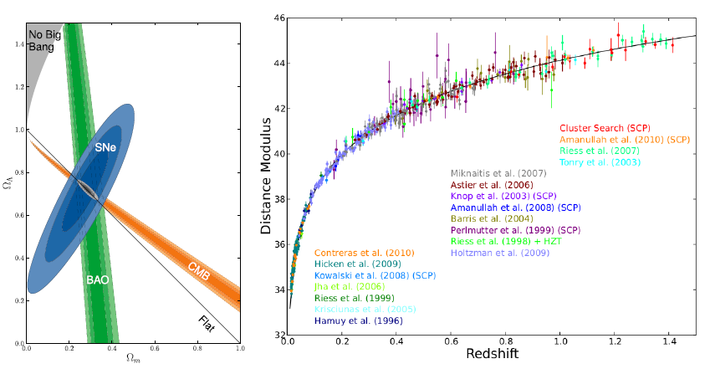
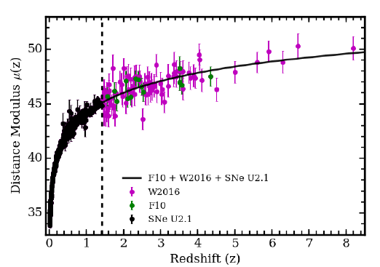
Constraints on cosmological parameters
Supernova Type Ia (SNe Ia):
only up to z = 1.4
GRBs:
up to z = 8.2
Best-fit Amati relation obtained using parameters from the joint spectral analysis of Fermi (LAT+GBM) data.
Combined SNe and GRB Hubble diagram
Suzuki et al., 2012
Dirirsa et al. 2019
In this work
Focusing on the Yonetoku relation, both true and pseudo-redshift GBM data were used to estimate cosmological parameters.
Pseudo-redshift dataset:
is available on the Zenodo website:
https://doi.org/10.5281/zenodo.13695954
8

Slide 10
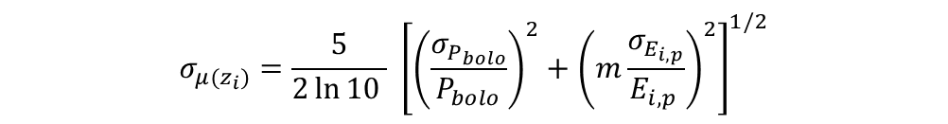
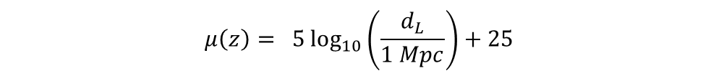
Constraints on cosmological parameters
Using the MCMC method for Fermi-GBM samples with true and pseudo-redshift.
$$μ\left(z\right)= 5\log_{10}\left(\frac{d_{L}}{1 Mpc}\right)+25$$
$μ\left(z_{i}\right)=\frac{5}{2}\log_{10}\left[\frac{1}{4 πP_{bolo}} {\left(\frac{E_{i,p}}{E_{0}}\right)}^{m}\right]+\frac{5}{2}\left(k+51\right) −5\log_{10}\left(1 Mpc\right)+25$
$$σ_{μ(z_{i})}=\frac{5}{2\ln{10 }} {\left[{\left(\frac{σ_{P_{bolo}}}{P_{bolo}}\right)}^{2}+{\left(m\frac{σ_{E_{i,p}}}{E_{i,p }}\right)}^{2}\right]}^{1/2}$$
For the simultaneous fit of cosmological parameters and Yonetoku correlation parameters.
$$χ^{2}\left(H_{0}, Ω_{Λ}, k, m\right)=\sum_{i=1}^{N}{{\left[\frac{μ^{obs}\left(z_{i}, k, m\right)− μ^{th}(z_{i}, H_{0}, Ω_{Λ})}{{σ_{μ}^{2}}_{\left(zi\right)}} \right]}^{2}}+{\left(\frac{k −k^{′}}{σ_{k}}\right)}^{2}+{\left(\frac{m −m^{′}}{σ_{m}}\right)}^{2}$$
9

Slide 11
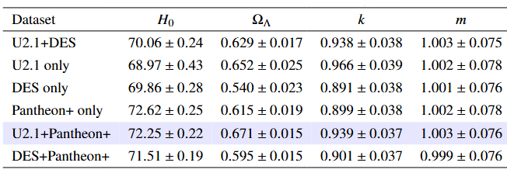
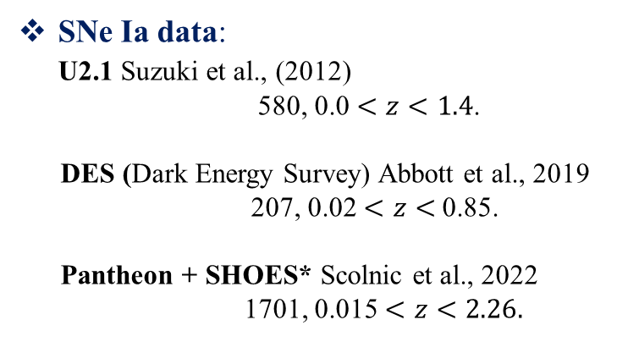
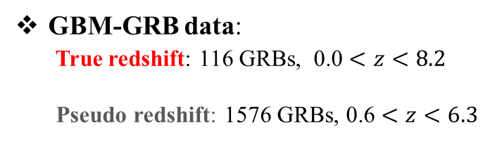
Constraints on cosmological parameters
GBM-GRB data:
True redshift: 116 GRBs, 0.0 $<z<8.2$
Pseudo redshift: 1576 GRBs, 0.6 $<z<6.3$
Preliminary results: Best-fit estimates from the combined GRB and SNe datasets.
SNe Ia data:
U2.1 Suzuki et al., (2012)
580, 0.0 $<z<1.4$.
DES (Dark Energy Survey) Abbott et al., 2019
207, 0.02 $<z<$0.85.
Pantheon + SHOES* Scolnic et al., 2022
1701, 0.015 $<z<2.26.$
* SHOES: Supernova and $H_{0}$ for the Equation of State of dark Energy - (Adam Riess collaboration) project.
10

Slide 12
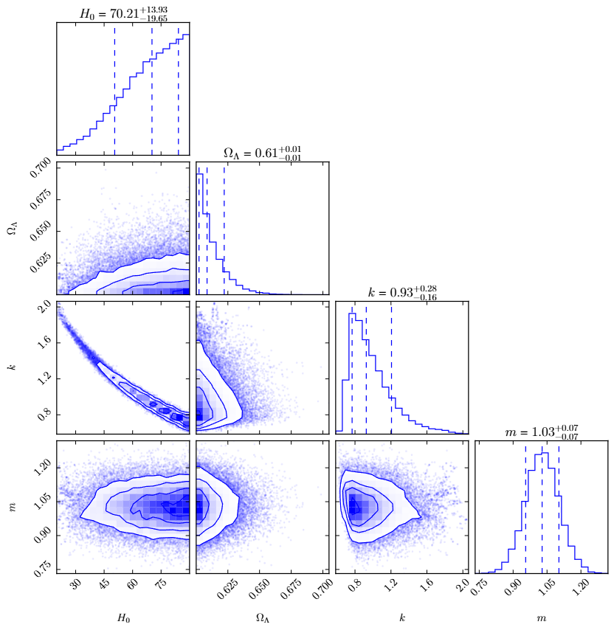
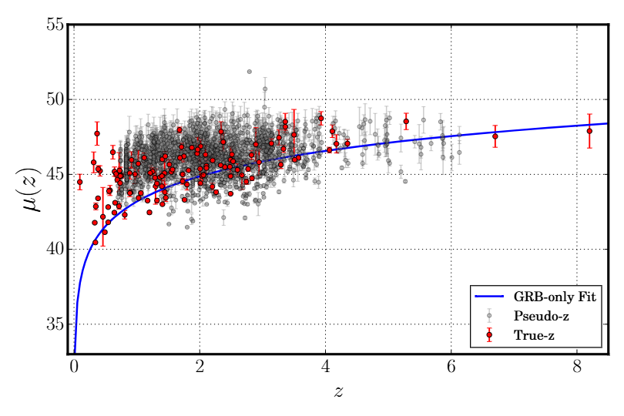
Preliminary results
Perform a joint analysis by combining the true-redshift GRB sample with pseudo-redshift.
GRB (Pseudo + True Redshift)
11

Slide 13
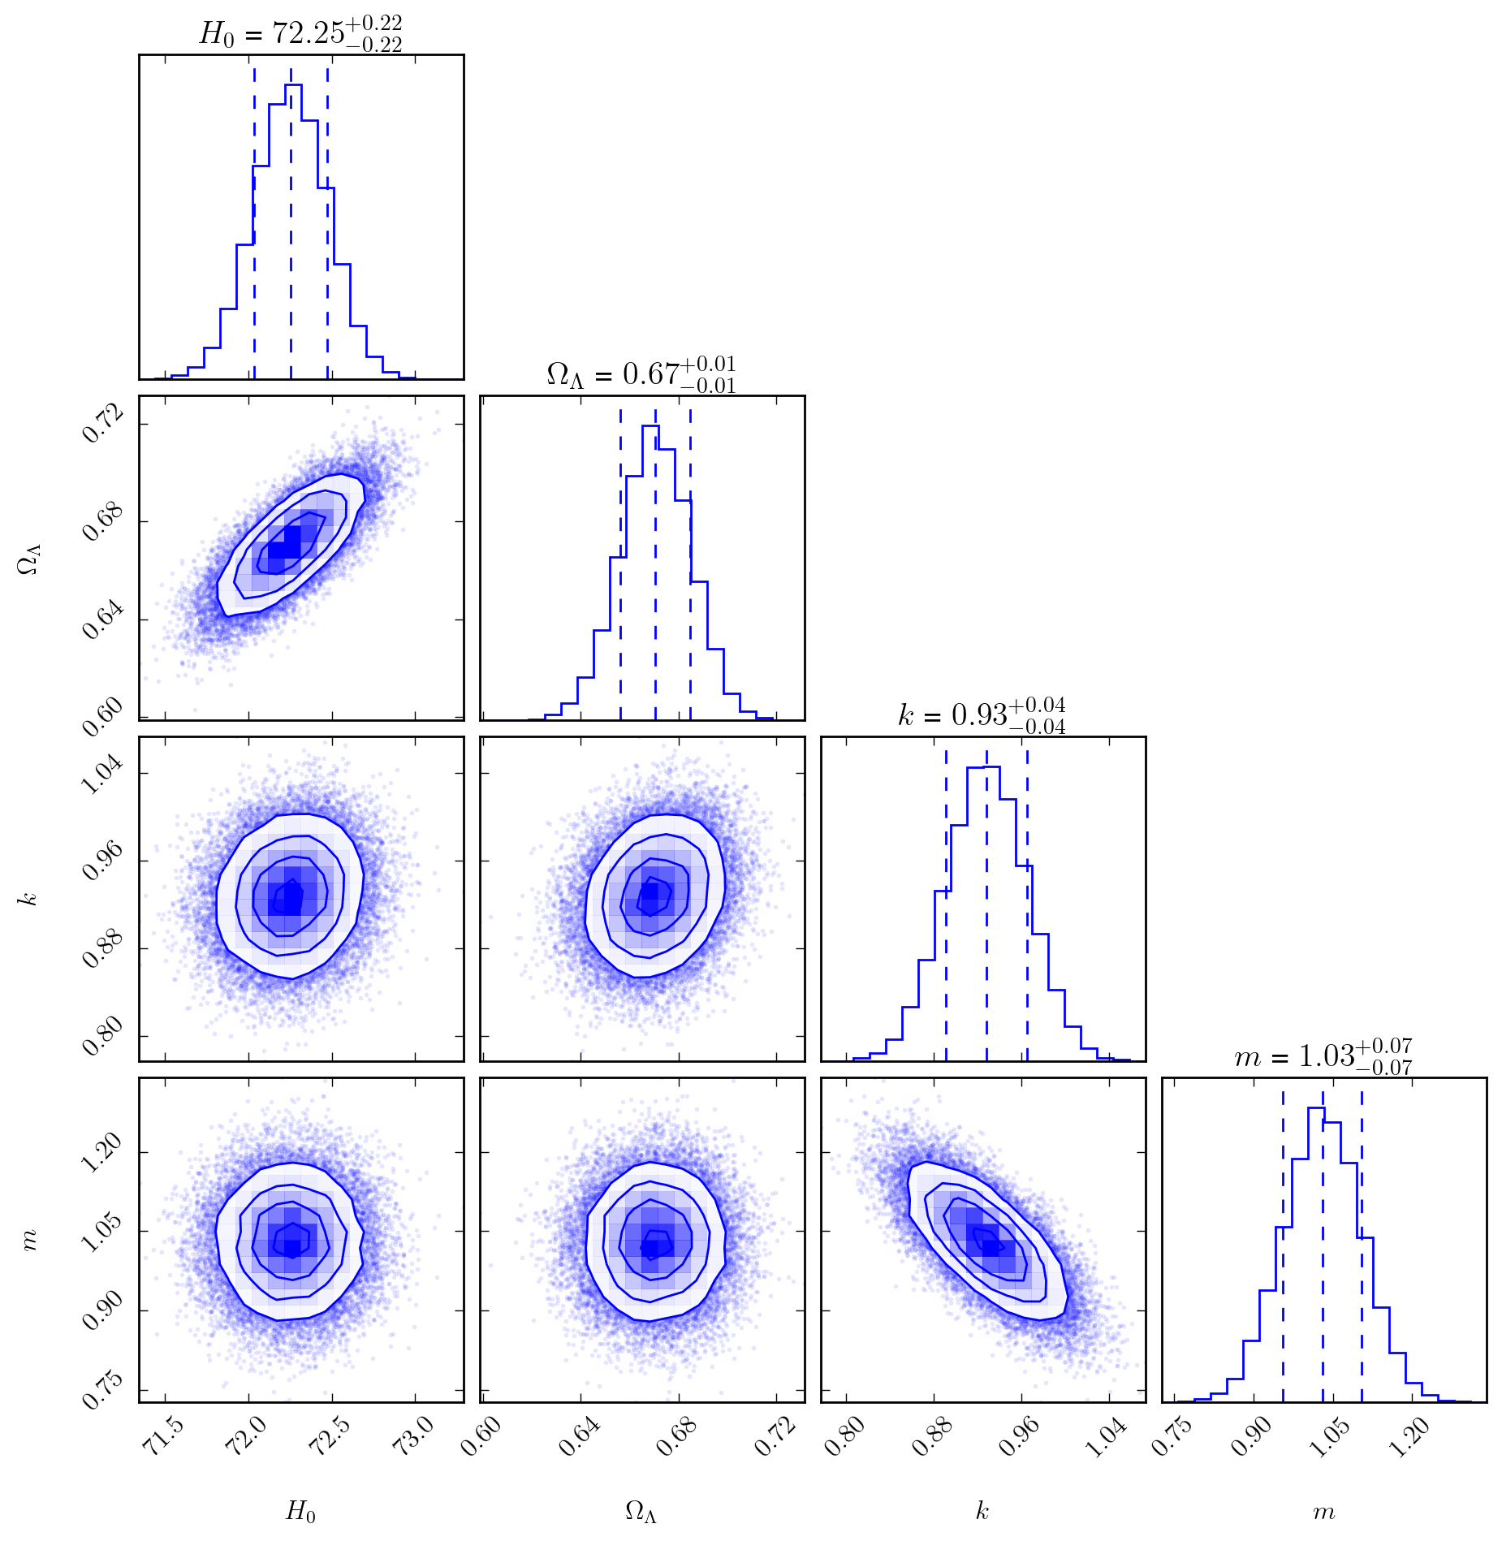
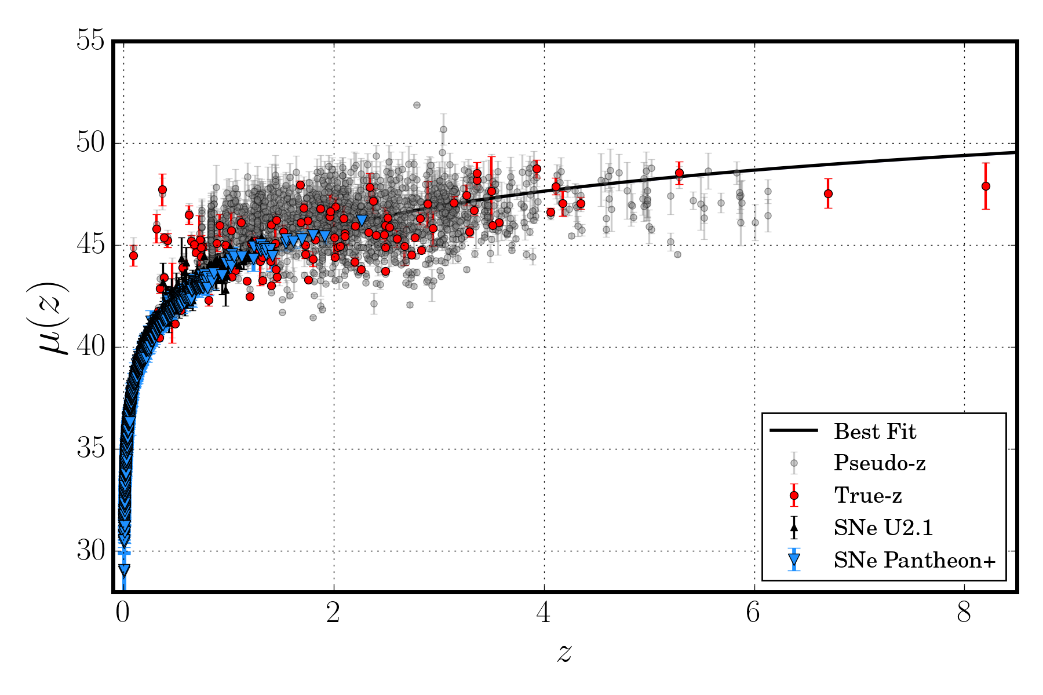
Preliminary results
Perform a joint analysis by combining the true-redshift GRB sample with pseudo-redshift estimates and multiple SNe Ia datasets.
GRB (Pseudo + True Redshift) and SNe (U2.1 + Pantheon+)
12

Slide 14
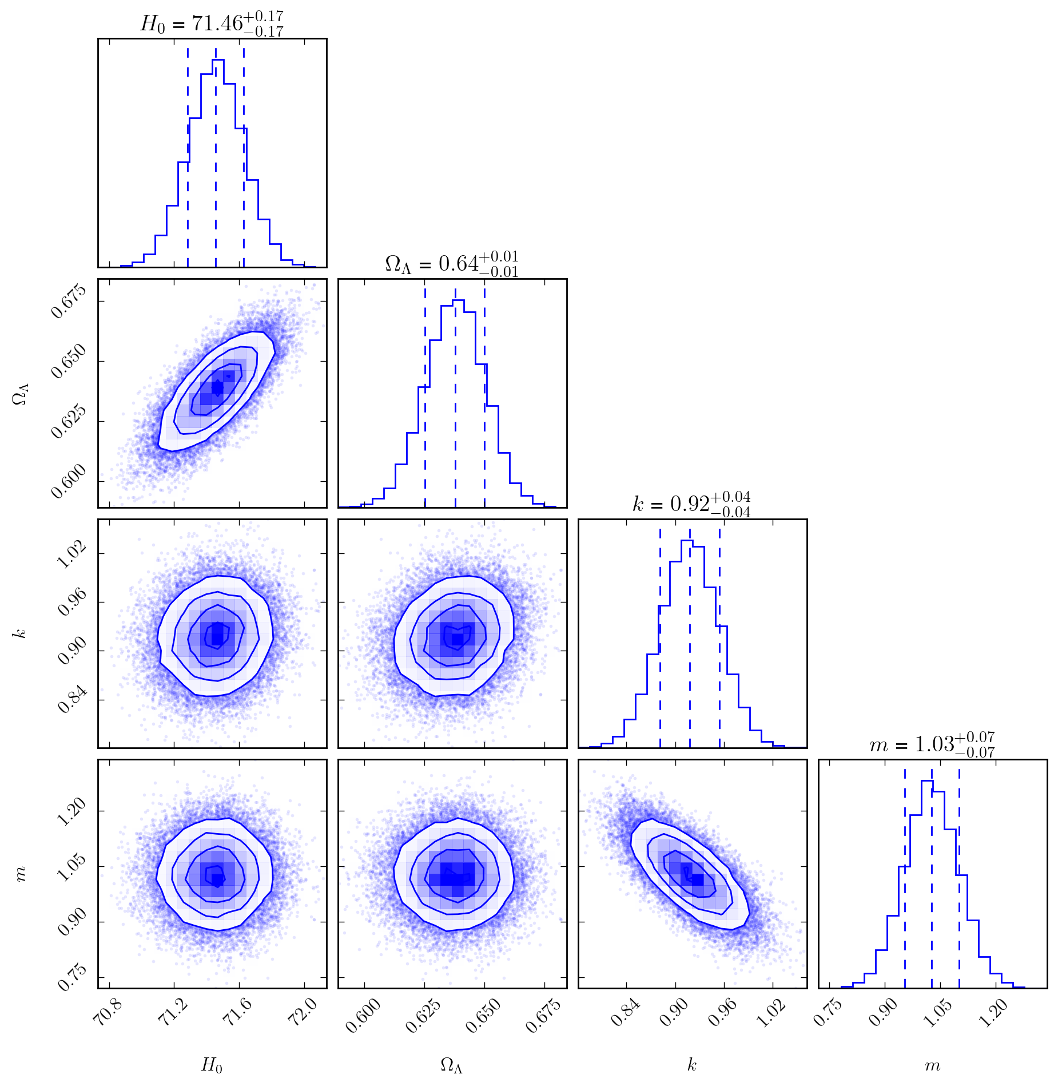

Preliminary results
GRB (Pseudo + True Redshift) and SNe (U2.1 + DES + Pantheon+)
13

Slide 15
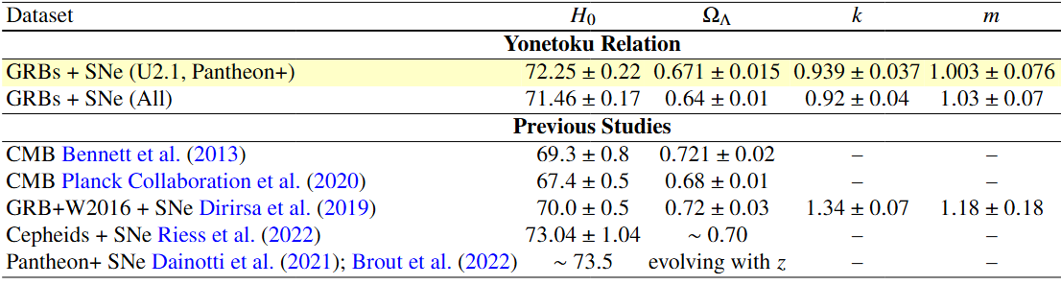
Summary
From GBM Pseudo-Redshift:
→ ML : large pseudo-redshift sample (z ≈ 0.6 to 6.3), extended with the true-redshift sample up to 8.2.
→ Using the best-fit Yonetoku relation to constrain cosmological parameters..
→ Avoiding the circularity problem: we jointly constrained correlation and cosmological parameters
→ GRBs alone are unable to constrain $H_{0},$and$Ω_{Λ}$, because of the degeneracy between $H_{0}$ and the correlation intercept parameters.
→ Combine GRBs with SNe Ia data
Next steps:
→ Simulations & forecasting studies will explore how many GRBs are needed.
→ Goal: achieve cosmological precision comparable to SNe Ia (Dainotti et al. 2022).
14

Slide 16
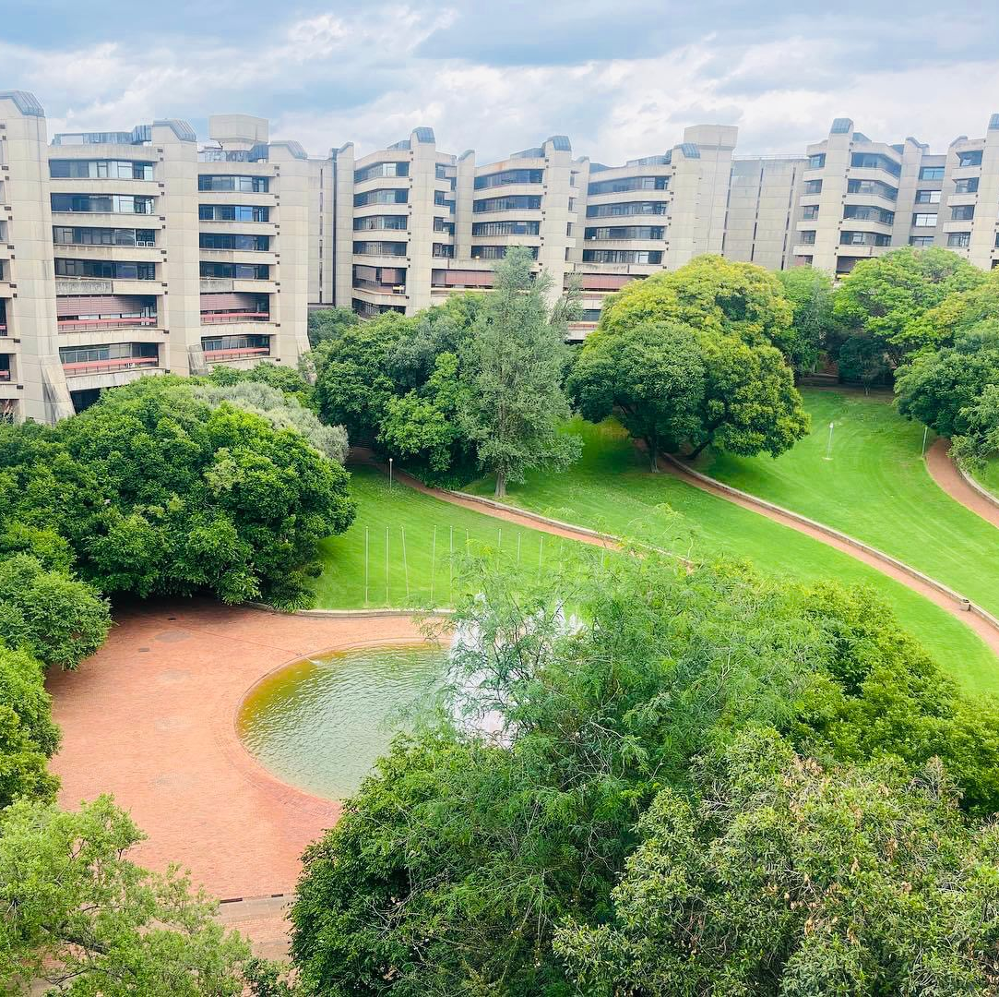

Thank you!

Slide 17
Backup Slides

Slide 18
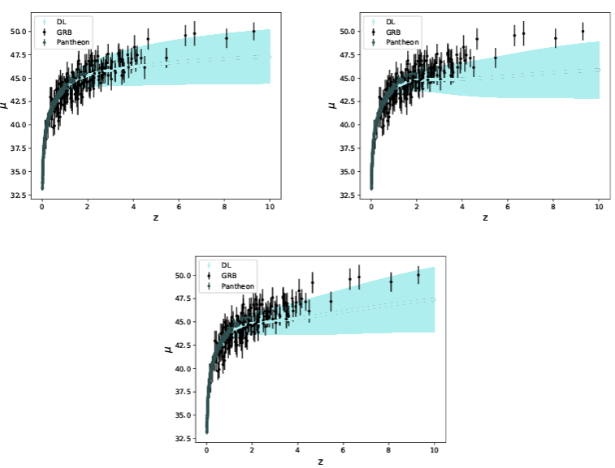
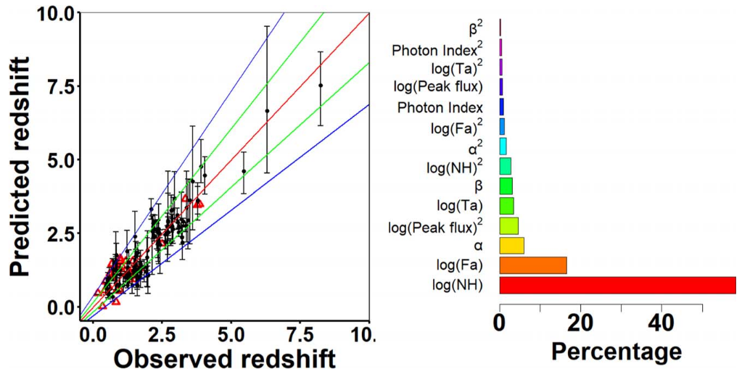
Backup - 1
GRBs and Machine Learning Models
For Examples:
Neural Network:
Recurrent Neural Network (RNN) and a Bayesian Neural Network (BNN) to calibrate observed properties of high redshift GRBs.
SuperLearner:
An ensemble learning technique that improves predictive accuracy by combining the outputs of multiple statistical models. Trains various supervised models.
116 GRBs (z = 0.17 to 8.2 Long GRBs) and Pantheon SNe Ia at low redshift.
Observed redshifts with predicted redshifts for 154 long GRBs.
Samples: are X-ray afterglows
Swift(BAT and XRT).
Estimated redshifts: Pearson coefficient = 0.93.
Used six luminosities correlations, via a maximum likelihood approach.
Escamilla Rivera et al. 2022
Dainotti et al. 2024

Slide 19
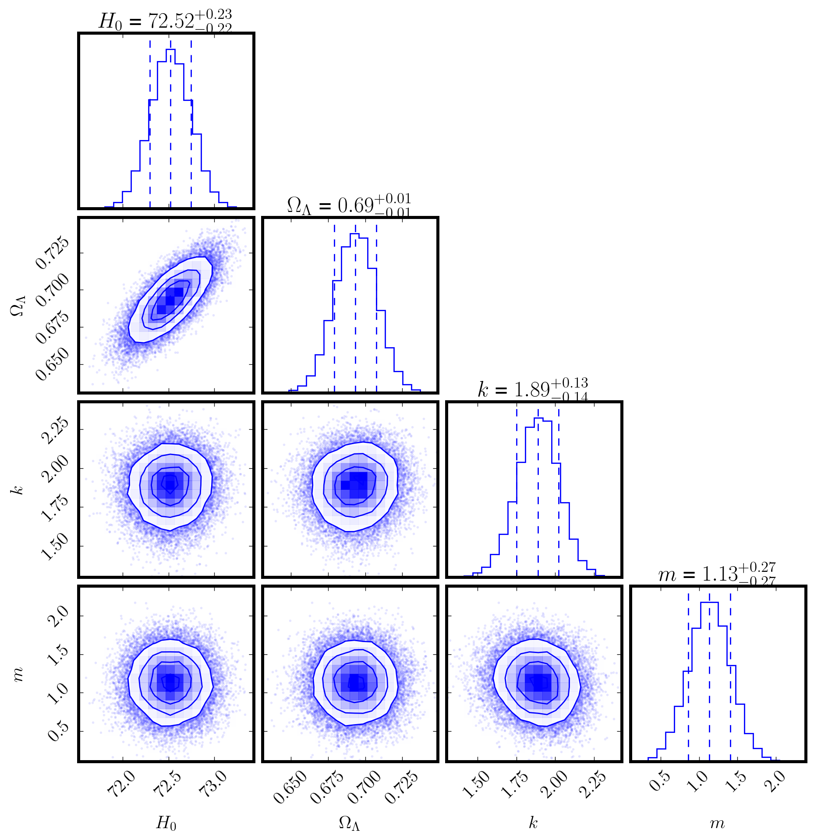
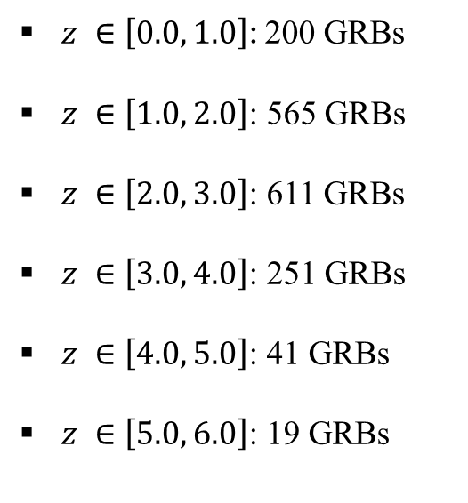
Preliminary results
Backup - 2
Perform a joint analysis by integrating the true-redshift GRB sample with pseudo-redshift data, using redshift bins and multiple SNe Ia datasets.
GRB (Pseudo + True Redshift) and SNe (U2.1 + Pantheon+)
$z ∈\left[0.0, 1.0\right]$: 200 GRBs
$z ∈\left[1.0, 2.0\right]$: 565 GRBs
$z ∈\left[2.0, 3.0\right]$: 611 GRBs
$z ∈\left[3.0, 4.0\right]$: 251 GRBs
$z ∈\left[4.0, 5.0\right]$: 41 GRBs
$z ∈\left[5.0, 6.0\right]$: 19 GRBs

Slide 20
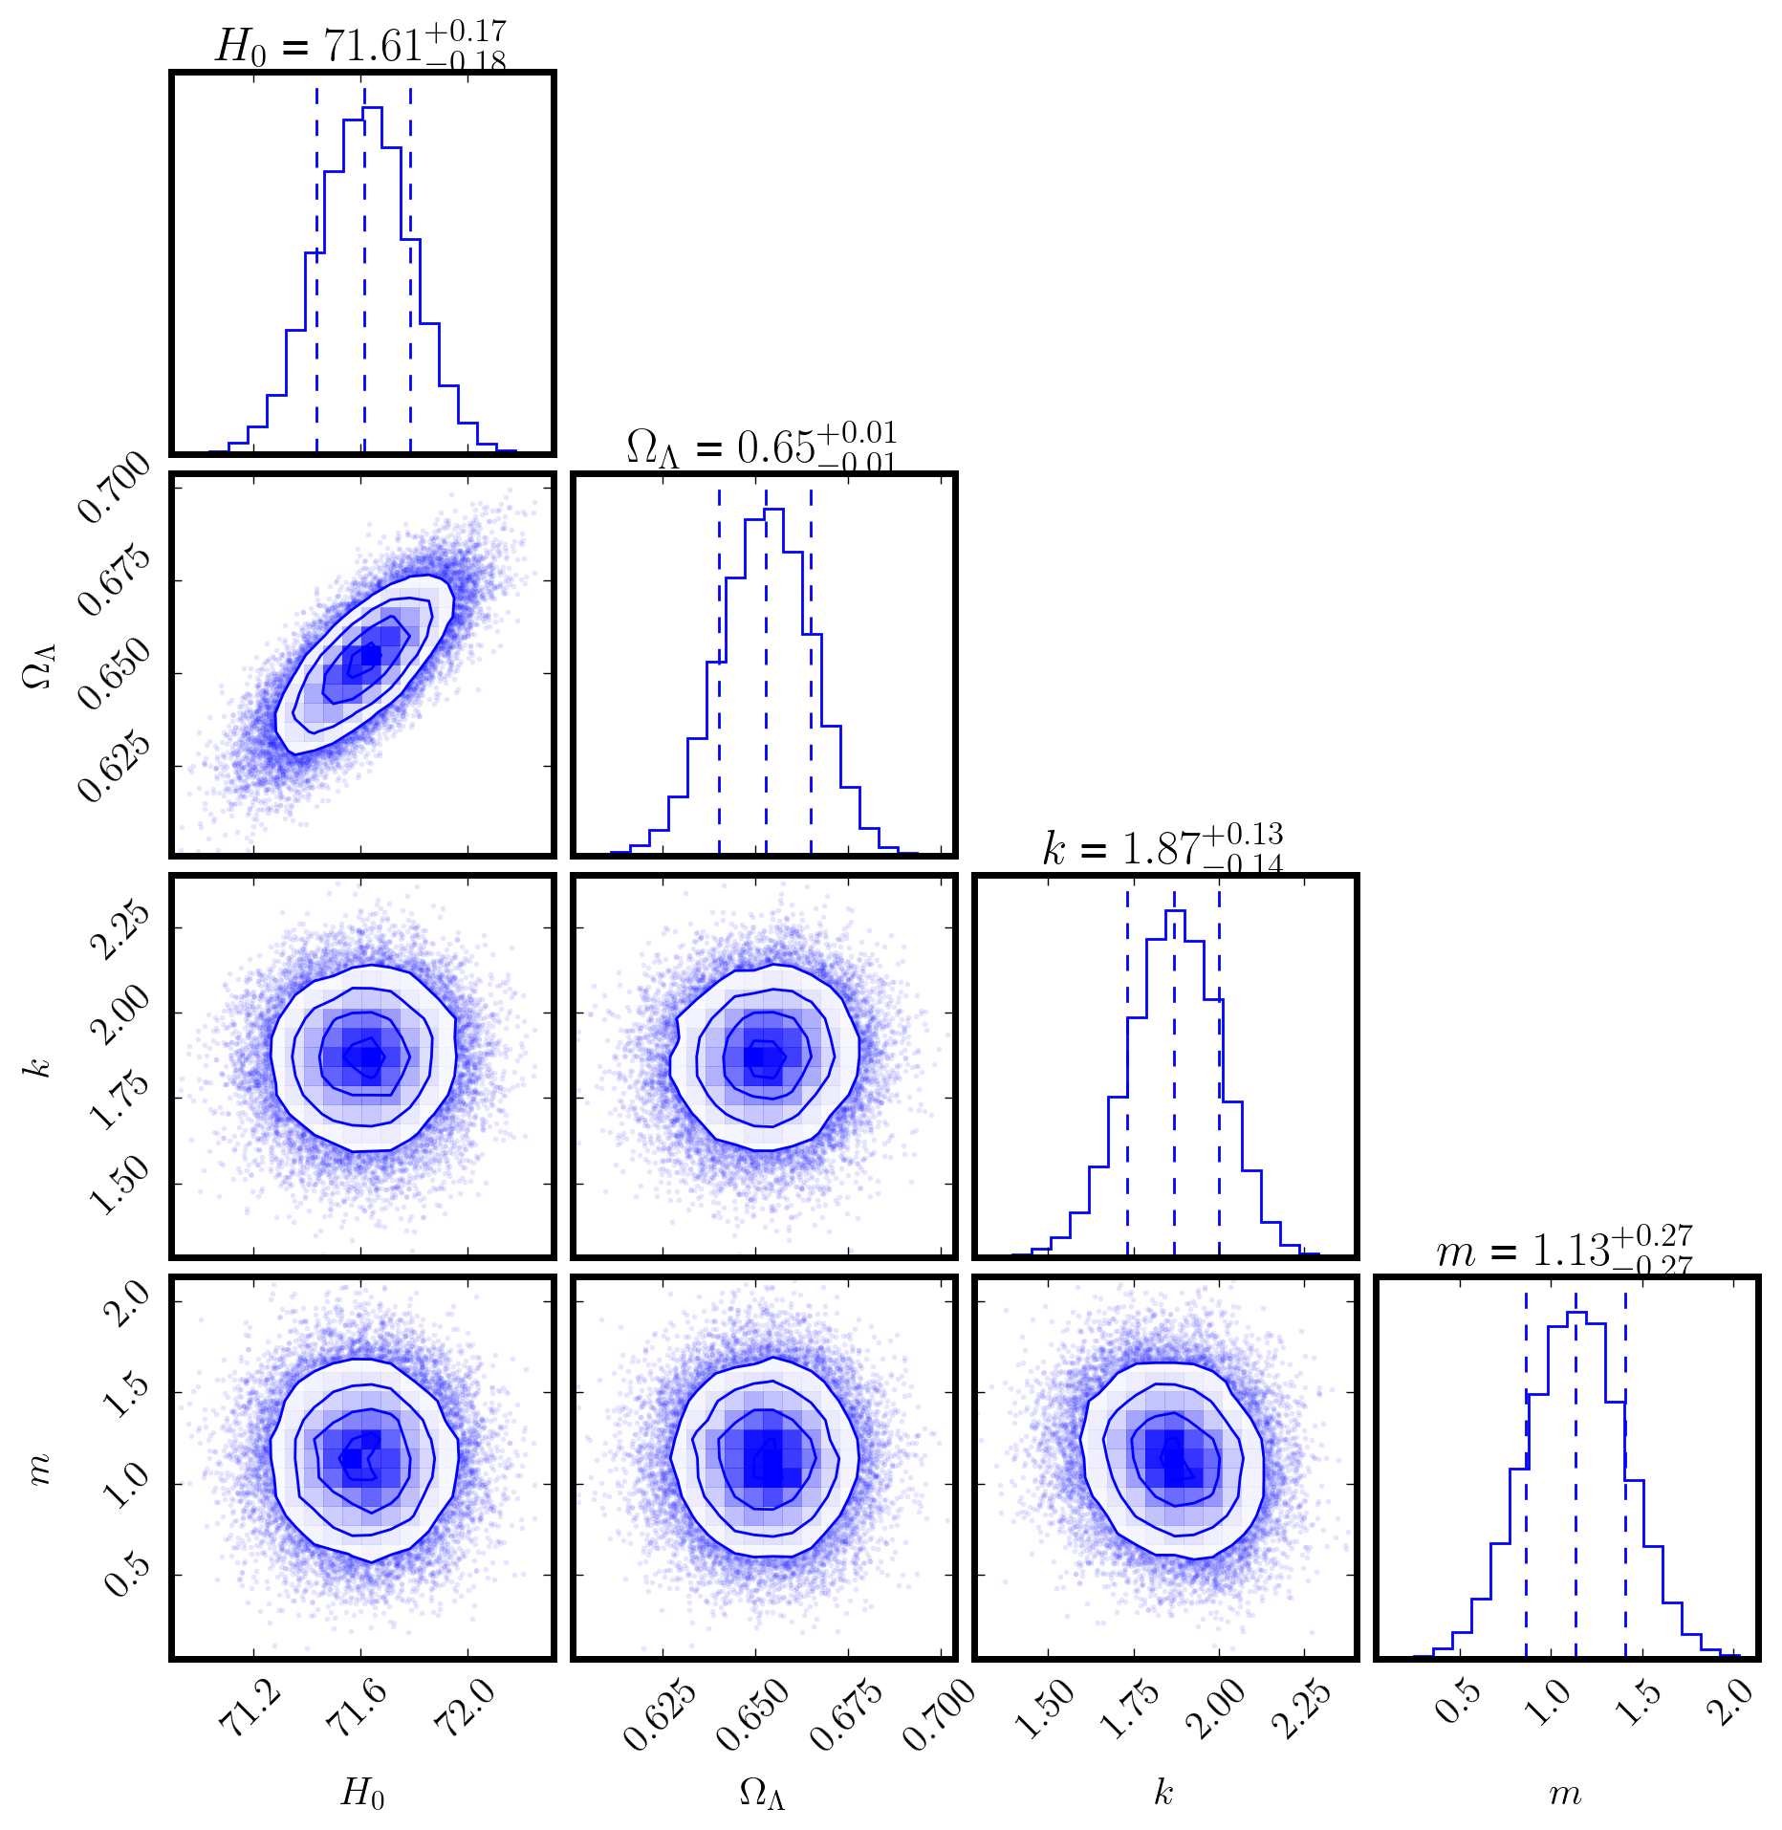
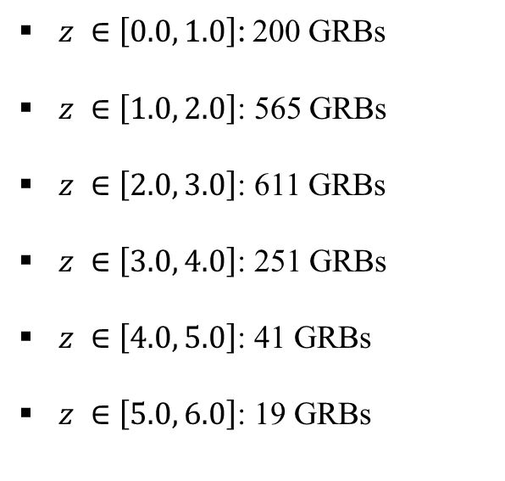
Preliminary results
Backup - 3
GRB (Pseudo + True Redshift) and SNe (U2.1 + DES + Pantheon+)
$z ∈\left[0.0, 1.0\right]$: 200 GRBs
$z ∈\left[1.0, 2.0\right]$: 565 GRBs
$z ∈\left[2.0, 3.0\right]$: 611 GRBs
$z ∈\left[3.0, 4.0\right]$: 251 GRBs
$z ∈\left[4.0, 5.0\right]$: 41 GRBs
$z ∈\left[5.0, 6.0\right]$: 19 GRBs

Slide 21
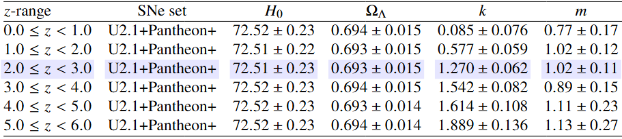
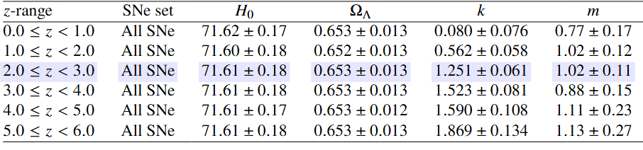
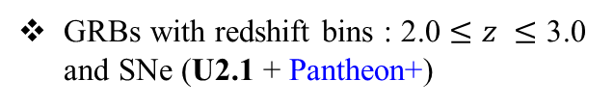
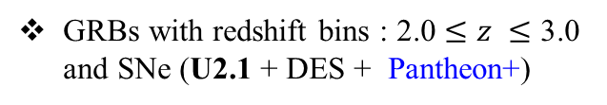
Backup - 4
Preliminary results
GRB with true and pseudo-redshift, using multiple SNe Ia datasets.
GRBs with redshift bins : 2.0 $≤z ≤$ 3.0 and SNe (U2.1 + Pantheon+)
GRBs with redshift bins : 2.0 $≤z ≤$ 3.0 and SNe (U2.1 + DES + Pantheon+)

