Slide 1



Phase-resolved Spectroscopy of Bright Fermi LAT Pulsars
Hend Hamed
Prof. Christo Venter
Prof. Isabelle Grenier
Dr. Alice Harding
Centre for Space Research, North-West University
HEASA 2025, Johannesburg, SA

Slide 2
Table of Contents
Introduction
Motivation
Source Selection
Phase Selection
Fermipy Analysis
Calibration
Spectral Analysis
New Trends
Conclusion
References

Slide 3
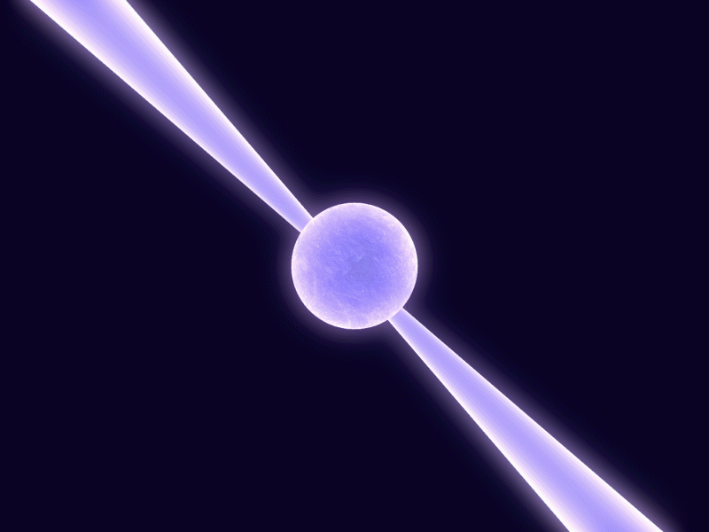
Introduction
P>30 s
Young
Bₛ ~ 10¹²–10¹³ G
Young pulsars
Position on the Galactic Plane
Pulsars
P < 30 s
Old
Bₛ ~ 10⁸–10⁹ G
Millisecond Pulsars (MSPs)
Position on the Galactic Plane

Slide 4

Introduction
Fermi LAT
Gamma-ray satellite
Launch: 2008
Third pulsar catalog (3PC): >290
(Atwood et al., 2008)
Credit: NASA Goddard

Slide 5
Motivation
Larger sample
Longer observation time, higher statistics
Few pulsars with phase-resolved spectroscopy in literature (Abdo et al., 2010d&2010e)

Slide 6
Away from the Galactic Plane
Source Selection
3.Cover different Characteristics
2. Bright Sources

Slide 7
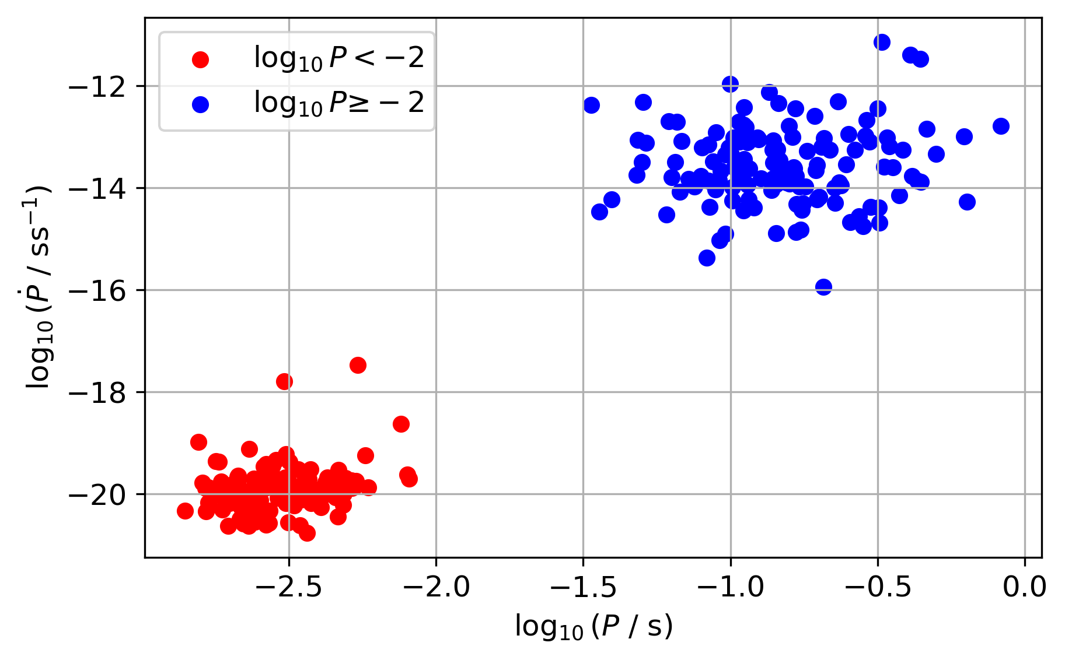
Source Selection
Two Populations
Preliminary results

Slide 8
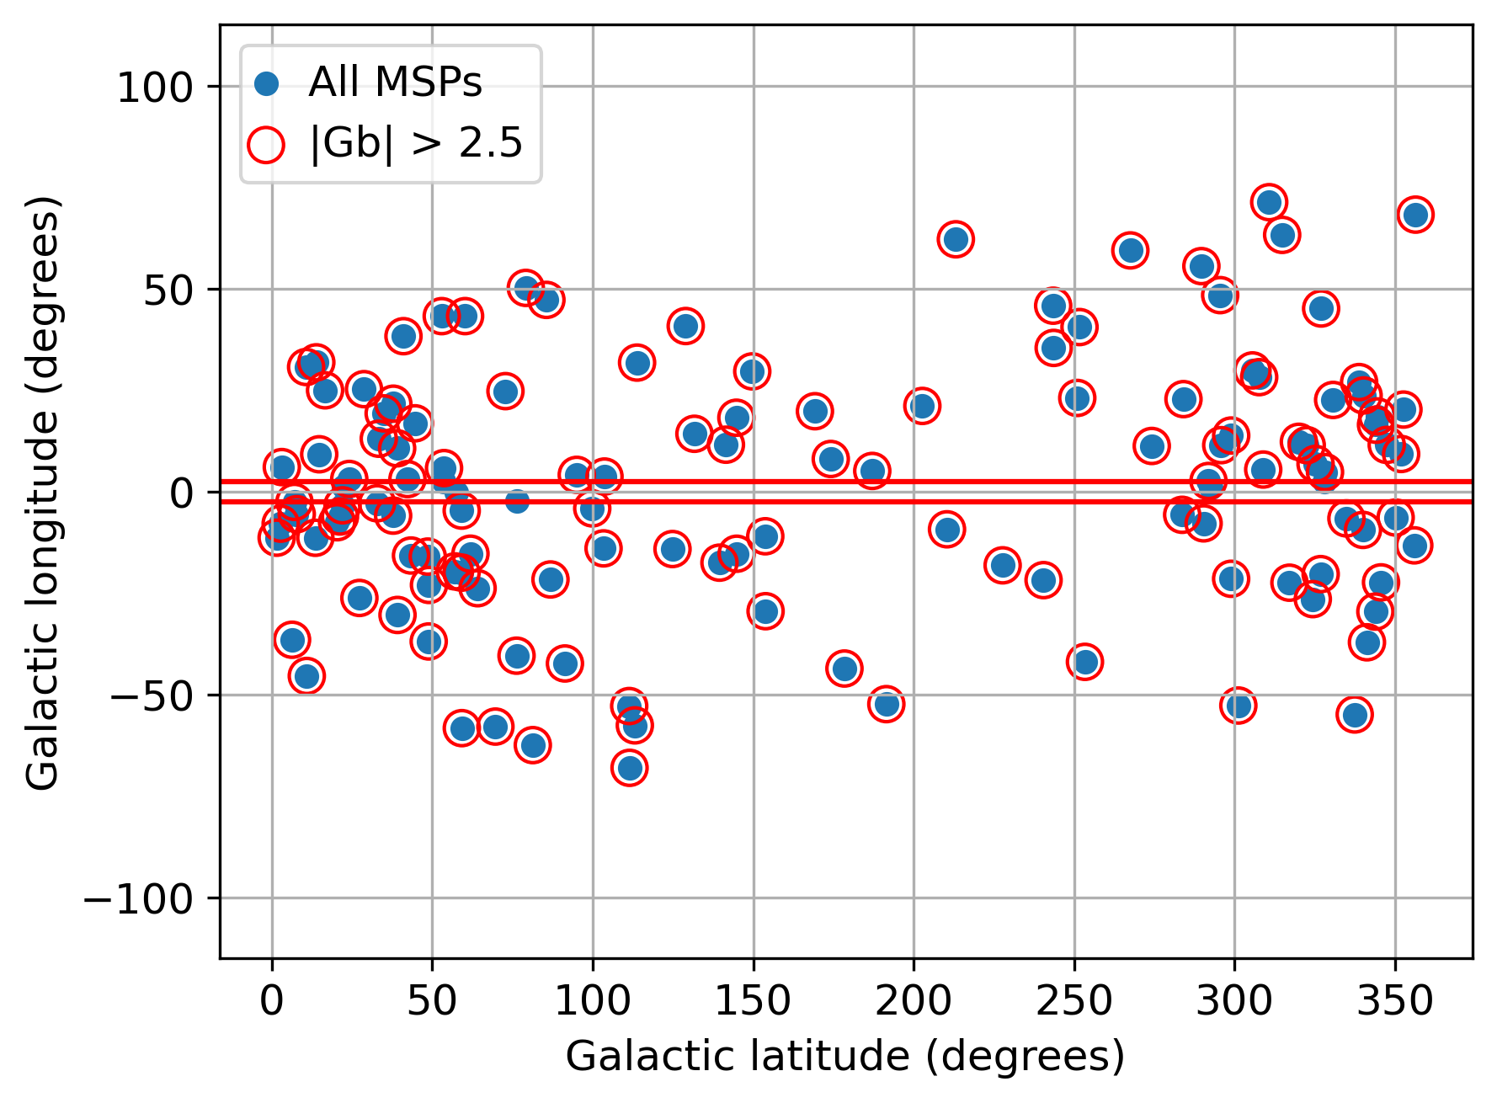
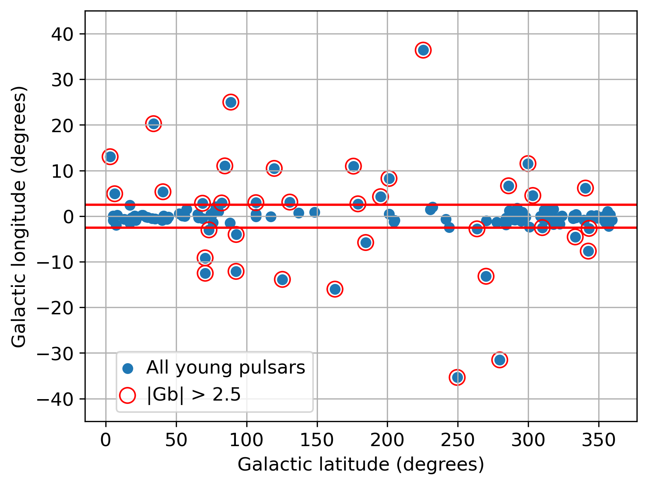
Source Selection
1. Away from the Galactic Plane
Preliminary results
Preliminary results

Slide 9
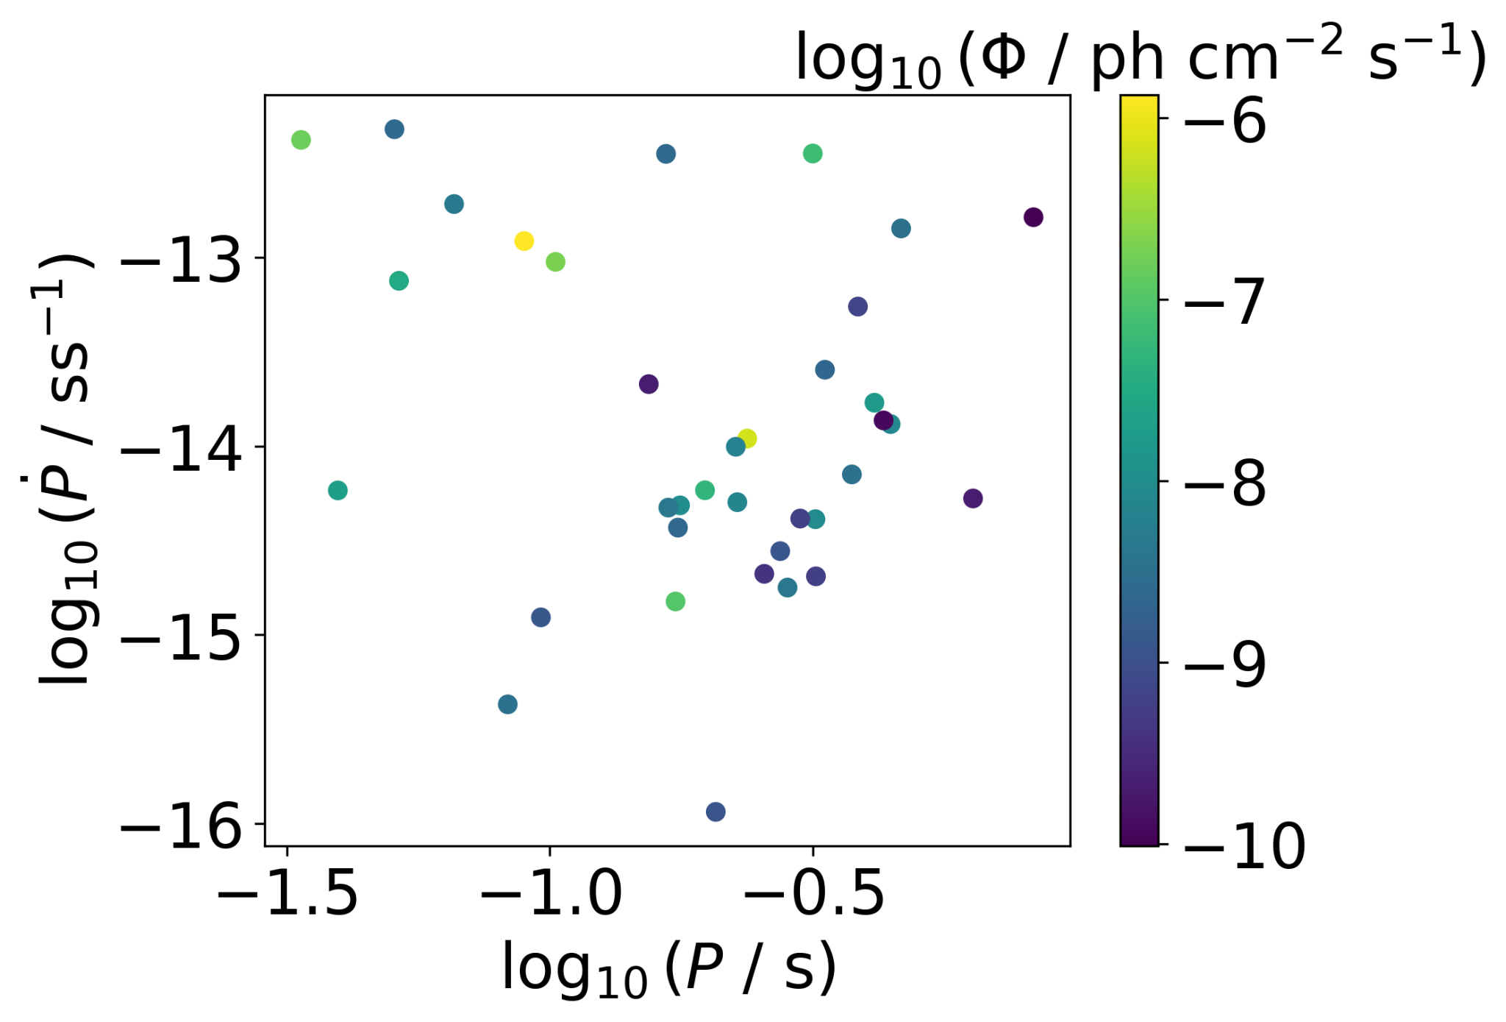
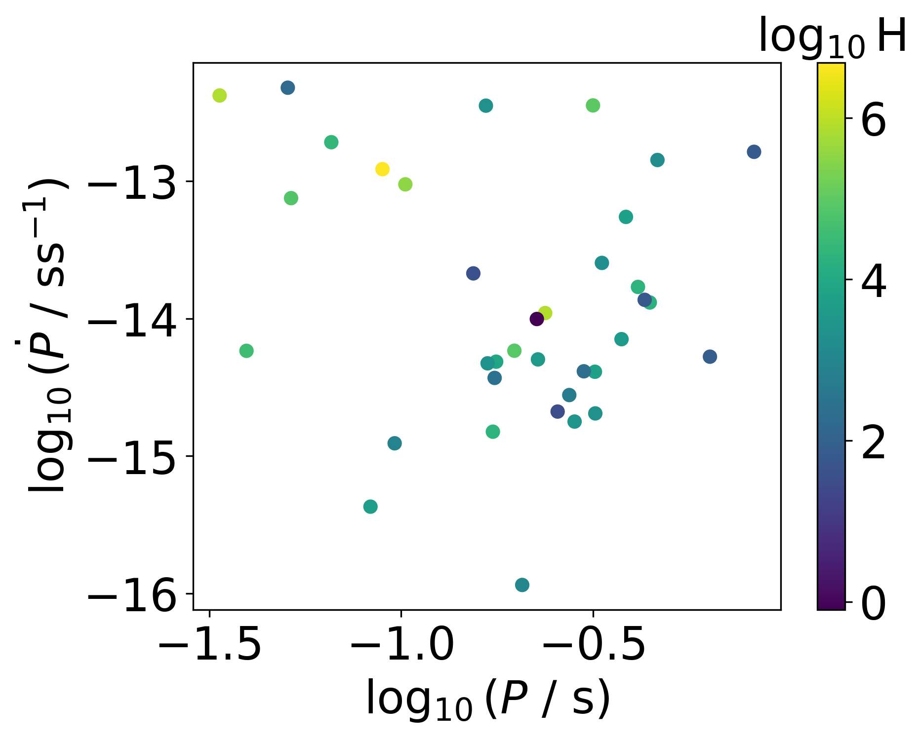
Source Selection
2. Bright Sources

Slide 10
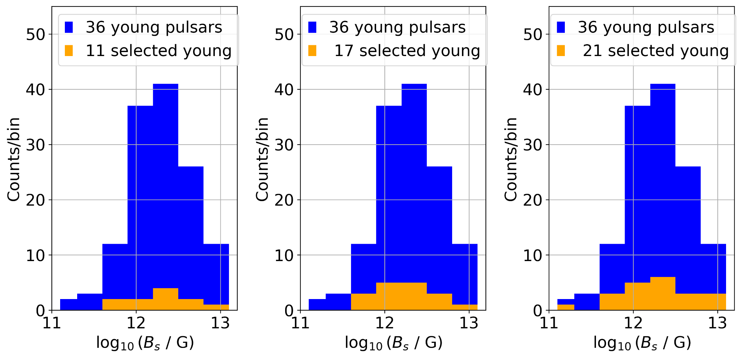
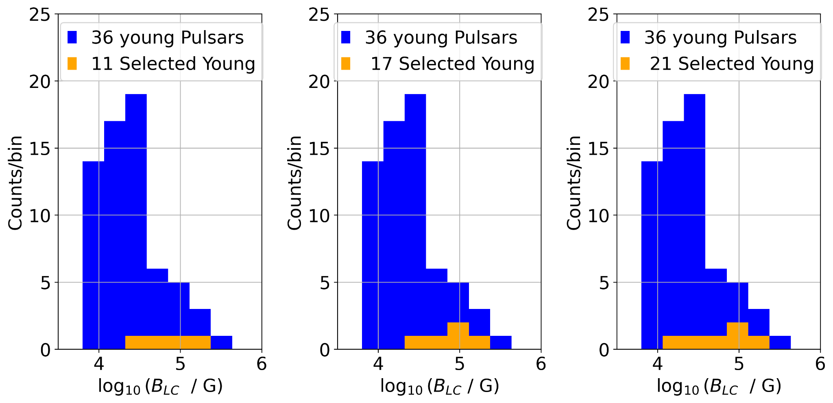
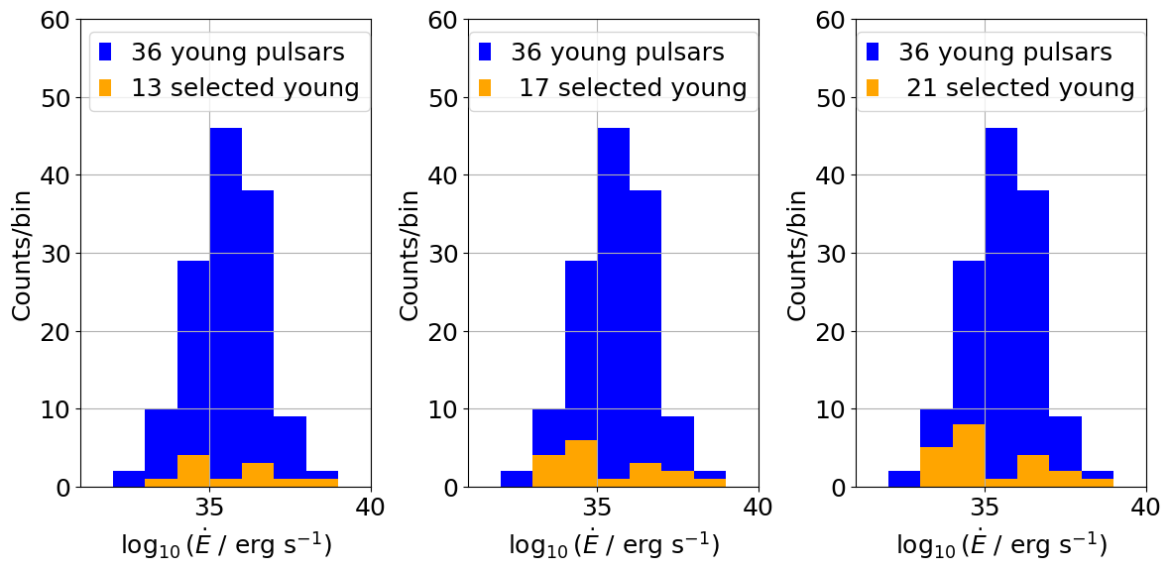
Source Selection
3.Cover different Characteristics
Preliminary

Slide 11
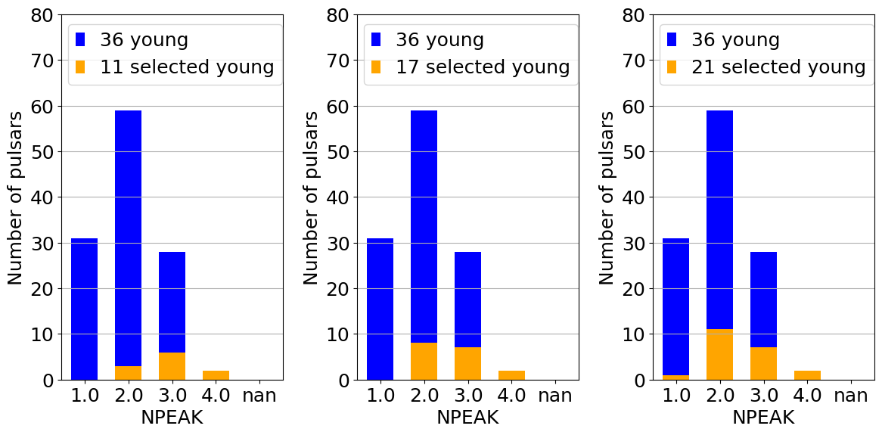
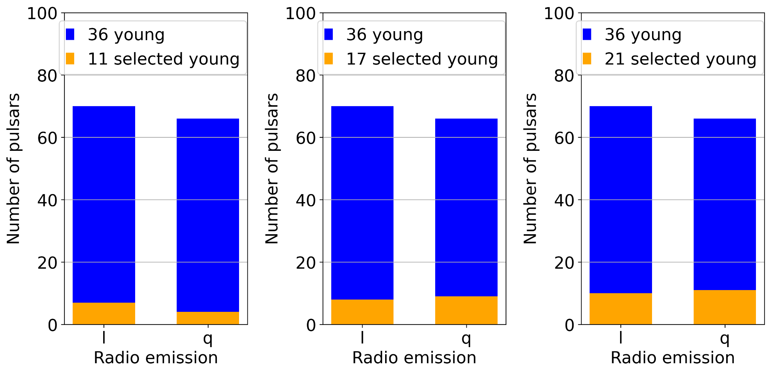
Source Selection
3.Cover different Characteristics
Preliminary

Slide 12
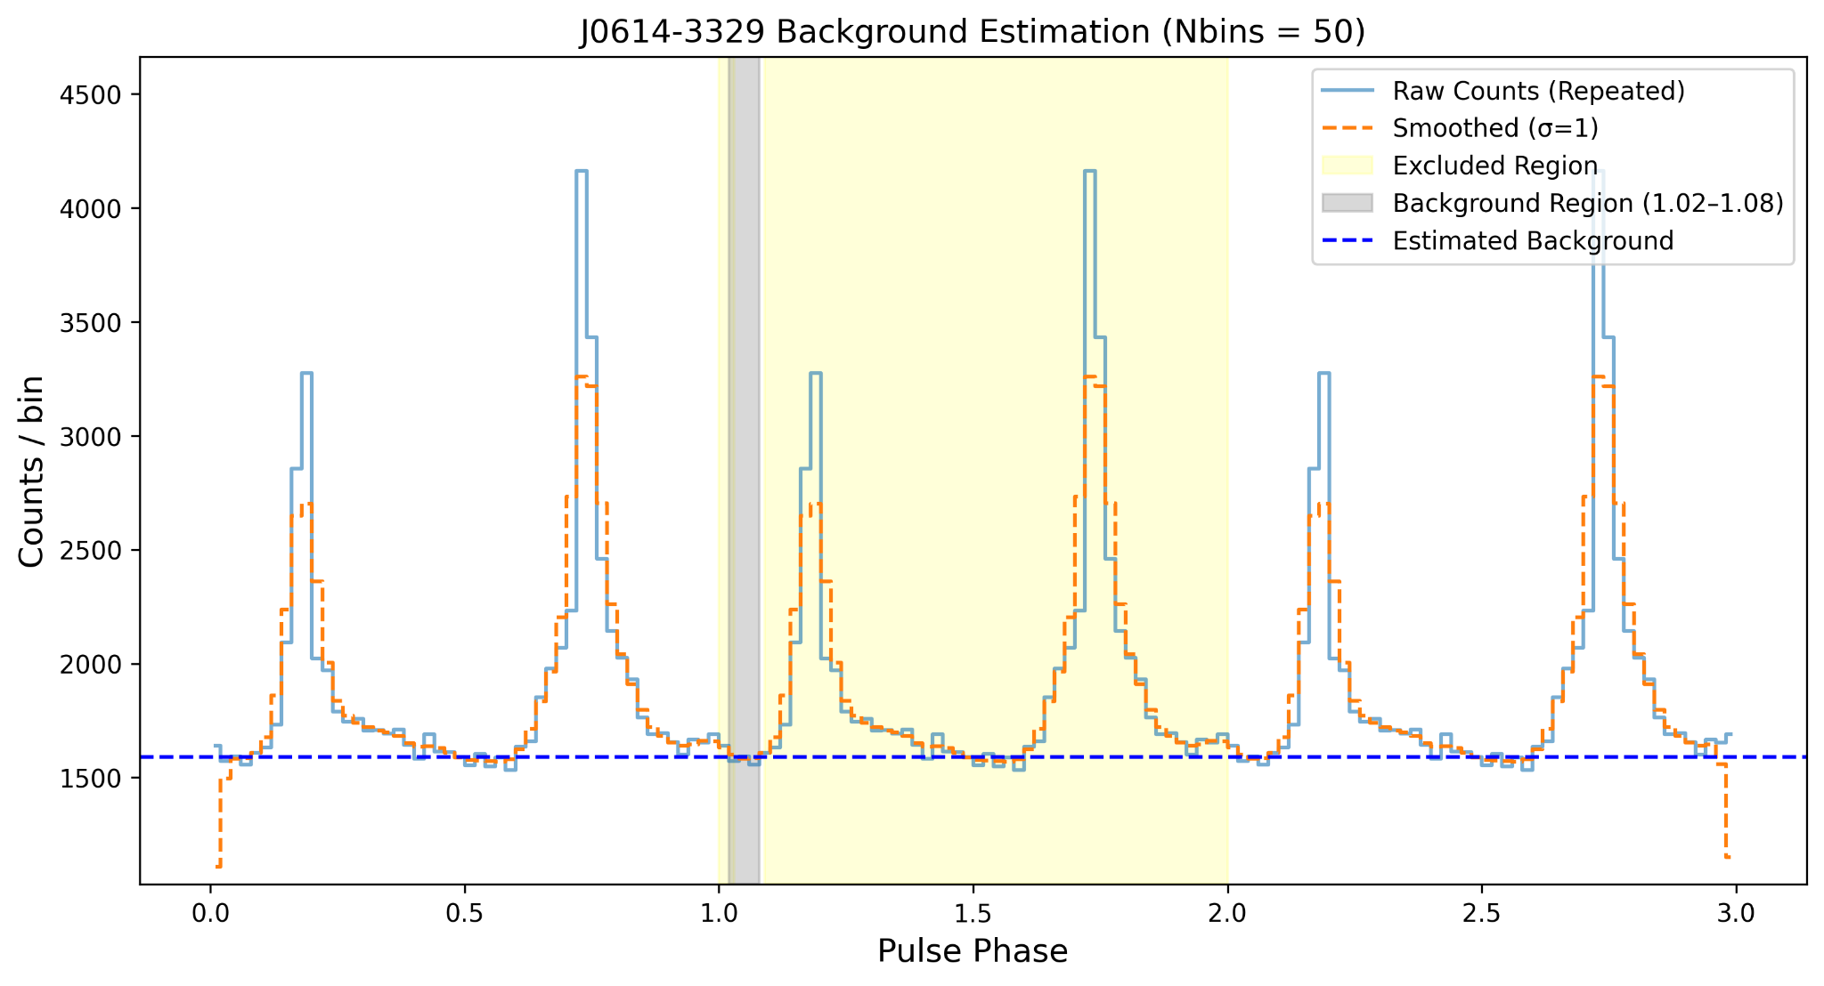
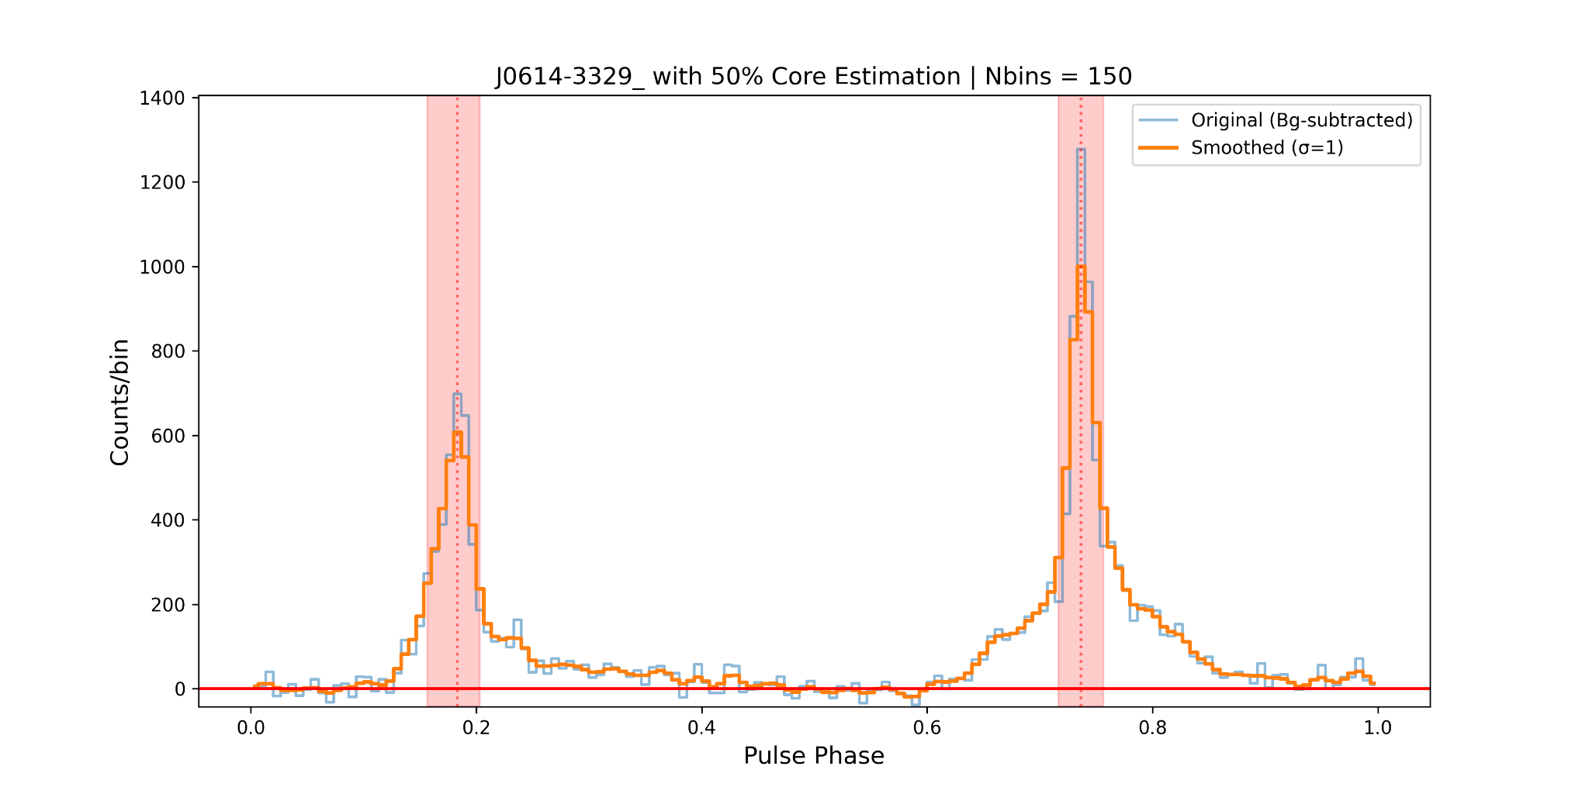
Phase Selection
Preliminary results
Preliminary results
Gaussian Smoothing
Sigma
Nbins
Core width

Slide 13
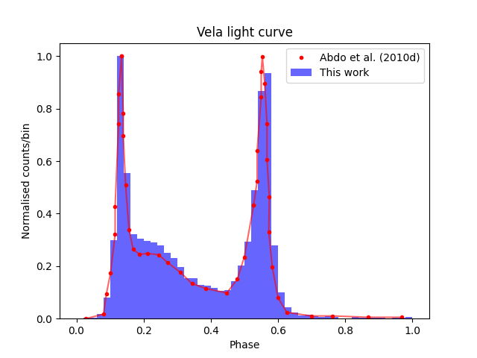
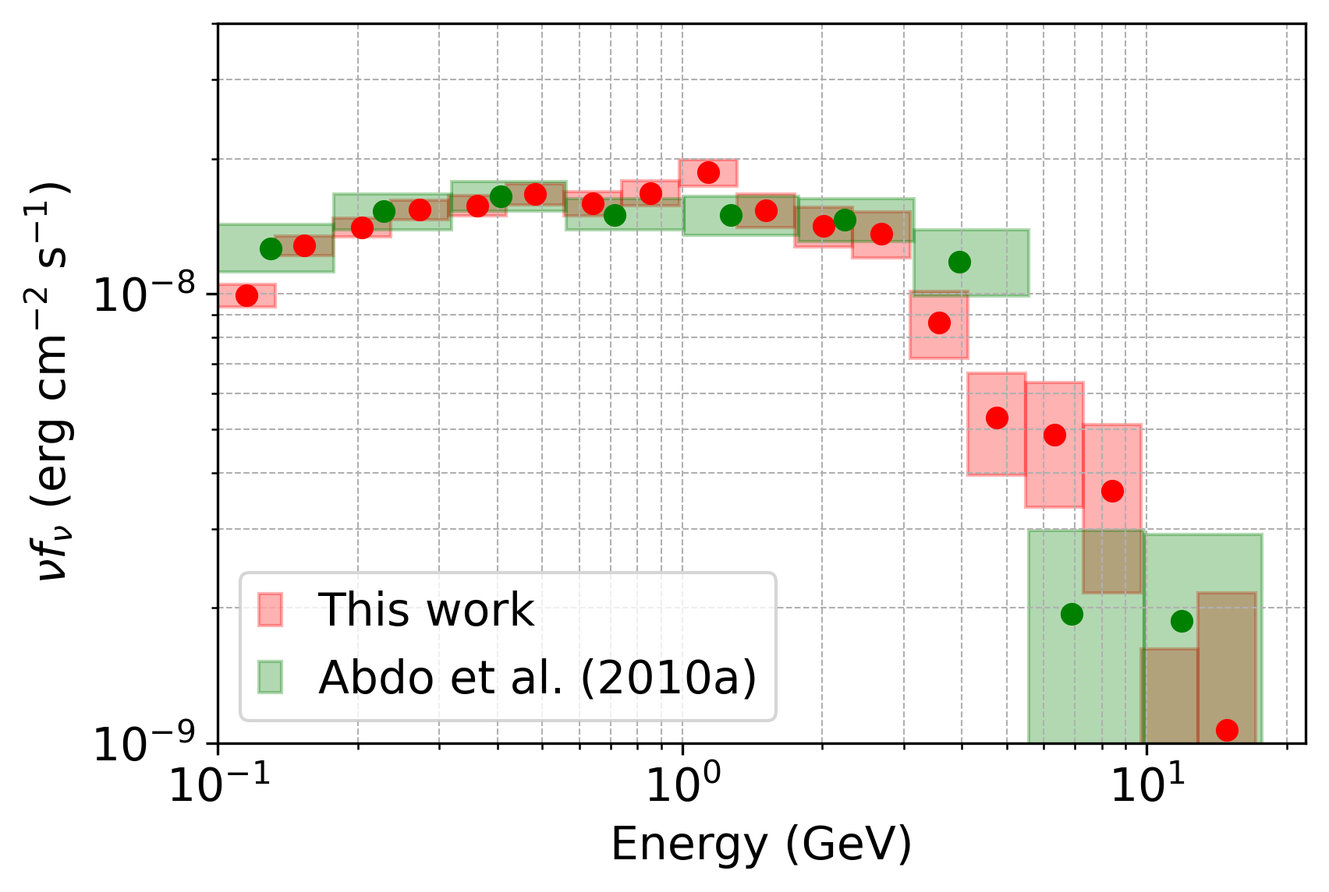
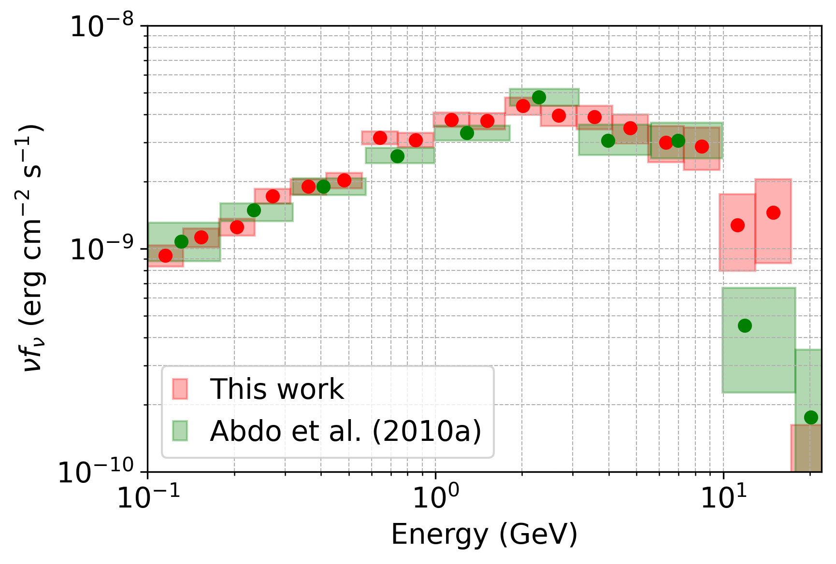
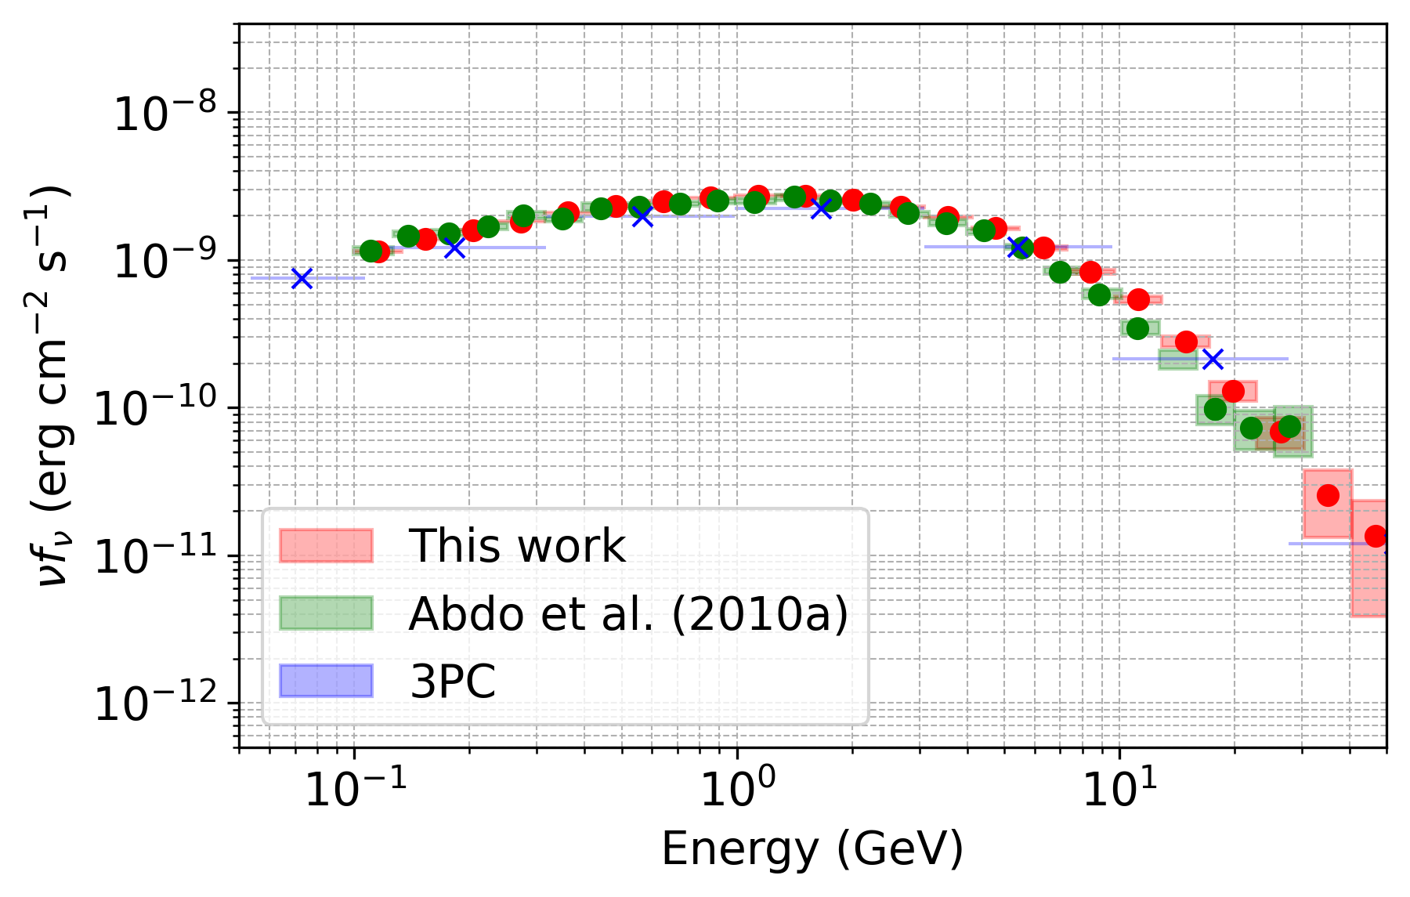
Calibration
Preliminary

Slide 14
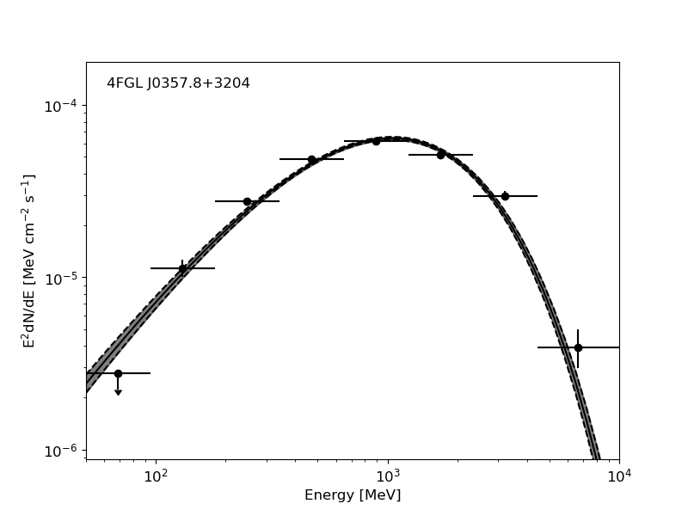
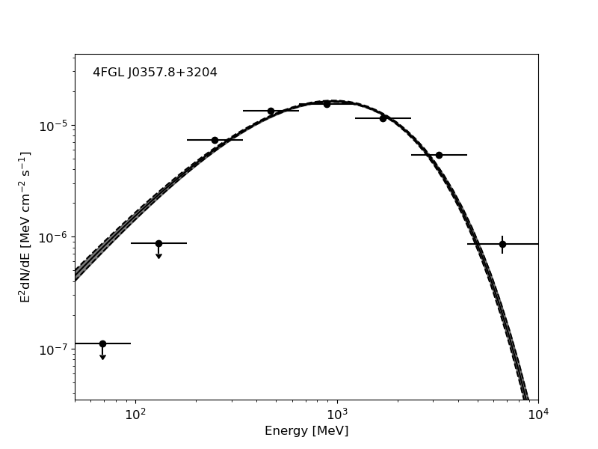
Spectral Analysis
Phase-resolved for the left core of the first peak Phase-averaged

Slide 15
New Trends
Luminosity
LC magnetic field
Spin-down power
Photon Index
E_apex
E_flux
FWHM
(Renault-Tinacci et al., 2015)
(Lei, 2025)
E_cut
Phase

Slide 16
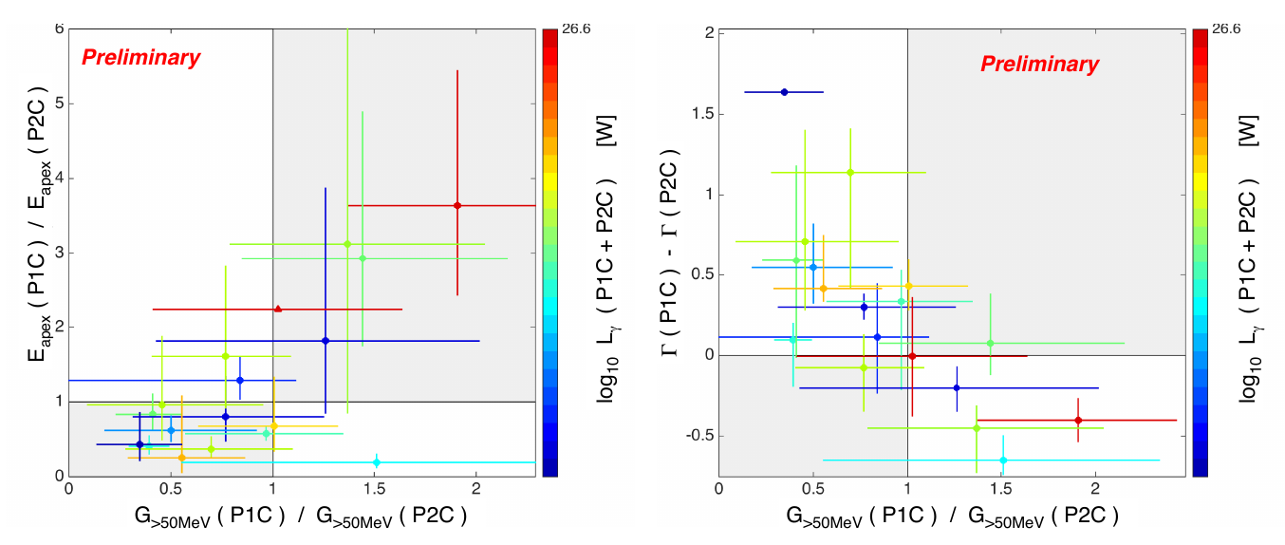
Conclusion
Renault-Tinacci et al. (2015)

Slide 17
References
Atwood, W. B., Abdo, A. A., Ackermann, M., Althouse, et al., 2009, APJ, 697(2), 1071–1102.
Abdo, A. A., Ackermann, M., Ajello, M., Atwood, W. B., Baldini, L., Ballet, J., et al., 2010, APJ, 720(1), 26.
Abdo, A. A., Ackermann, M., Ajello, M., Atwood, W. B., Baldini, L., Ballet, J., et al., 2010, APJ, 710(2), 1721–1735.
Renault-Tinacci, N., Grenier, I., & Harding, A. K., 2015, Proceedings of Science, PoS(ICRC2015), 843.
Lei, M.-Y., Shen, Z.-Q., Xia, Z.-Q., & Huang, X., 2025, doi.org/10.48550/arXiv.2505.01708.

Slide 18
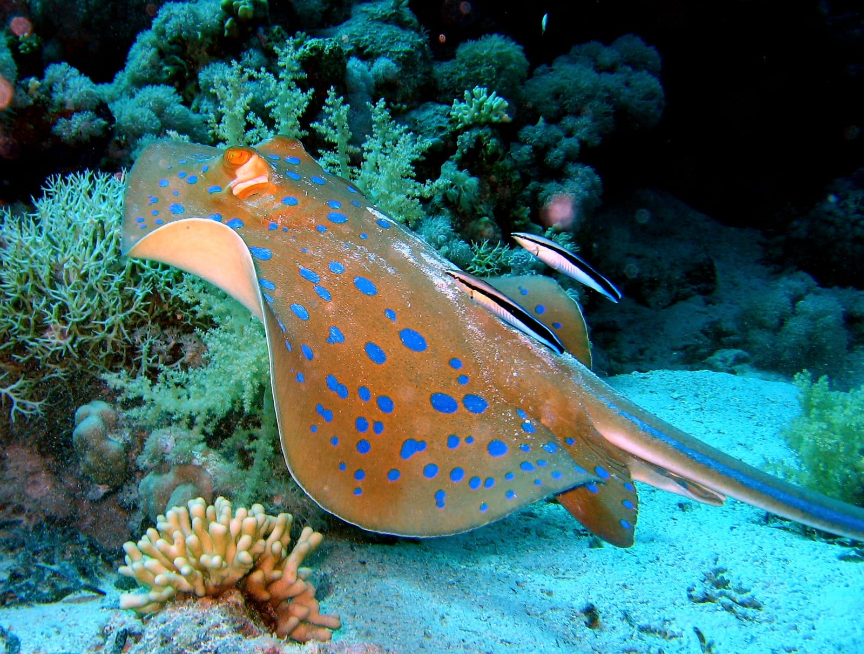
Thank you!
Ras Muhammed protector, Sinai, Egypt

