Slide 1
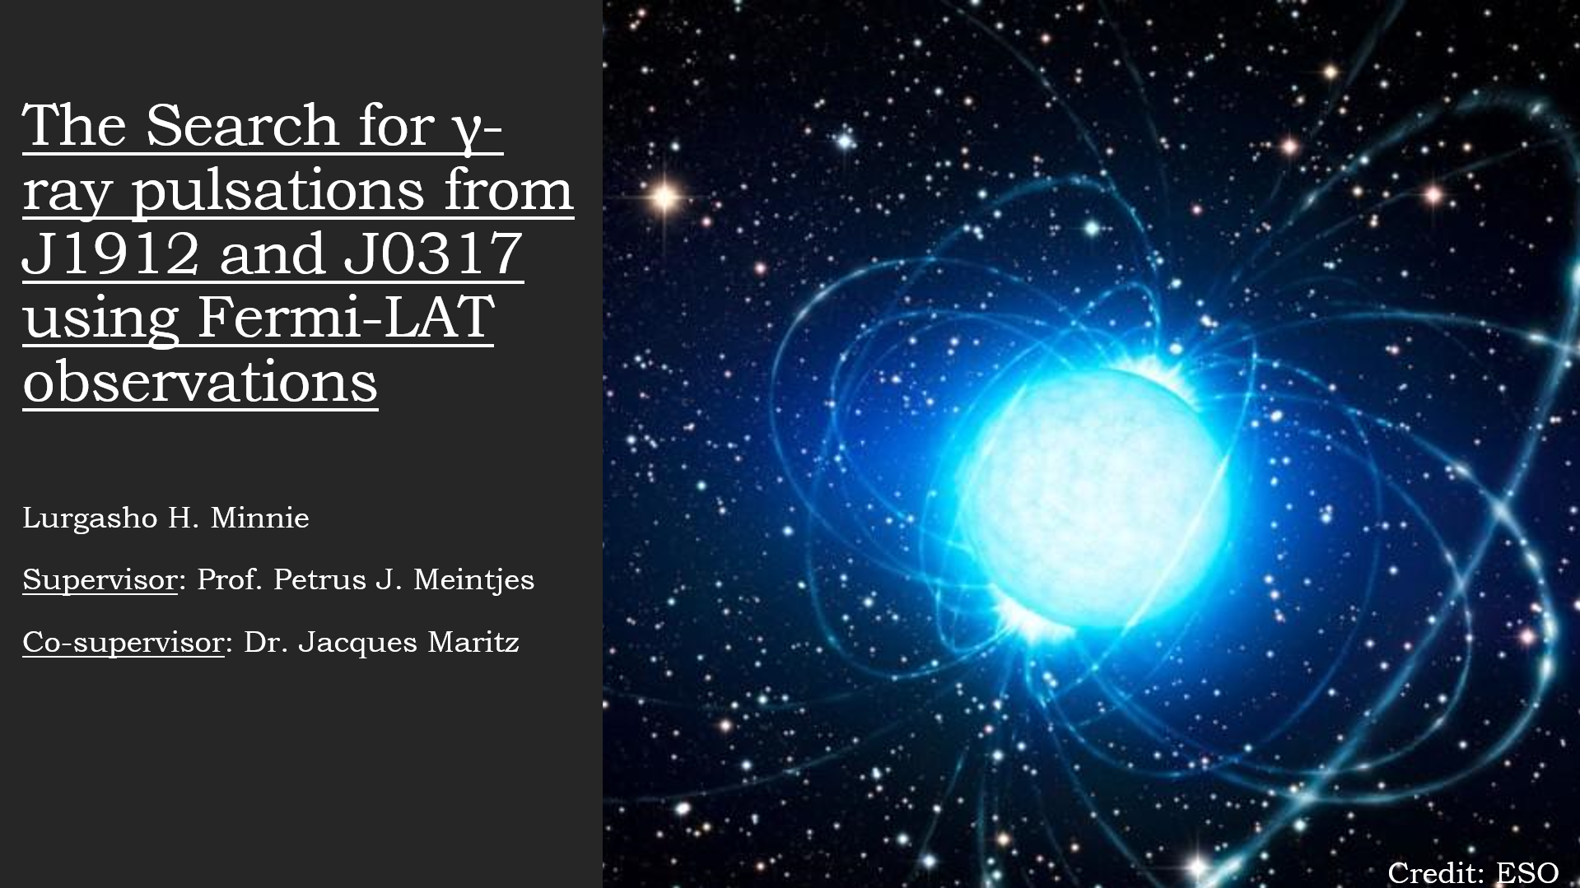

Slide 2
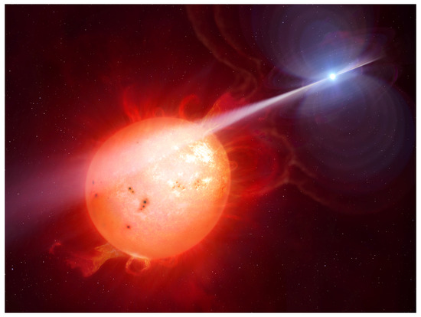
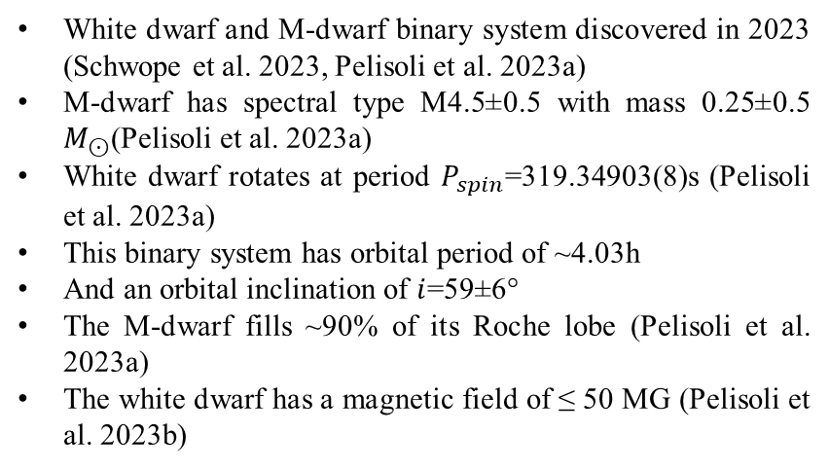
White Dwarf Binary System J1912 (J191213.72−441045.1)
White dwarf and M-dwarf binary system discovered in 2023 (Schwope et al. 2023, Pelisoli et al. 2023a)
M-dwarf has spectral type M4.5±0.5 with mass 0.25±0.5 $M_{⊙}$(Pelisoli et al. 2023a)
White dwarf rotates at period $P_{spin}$=319.34903(8)s (Pelisoli et al. 2023a)
This binary system has orbital period of ~4.03h
And an orbital inclination of $i$=59±6°
The M-dwarf fills ~90% of its Roche lobe (Pelisoli et al. 2023a)
The white dwarf has a magnetic field of ≤ 50 MG (Pelisoli et al. 2023b)
Credit: Mark Garlick, University of Warwick

Slide 3
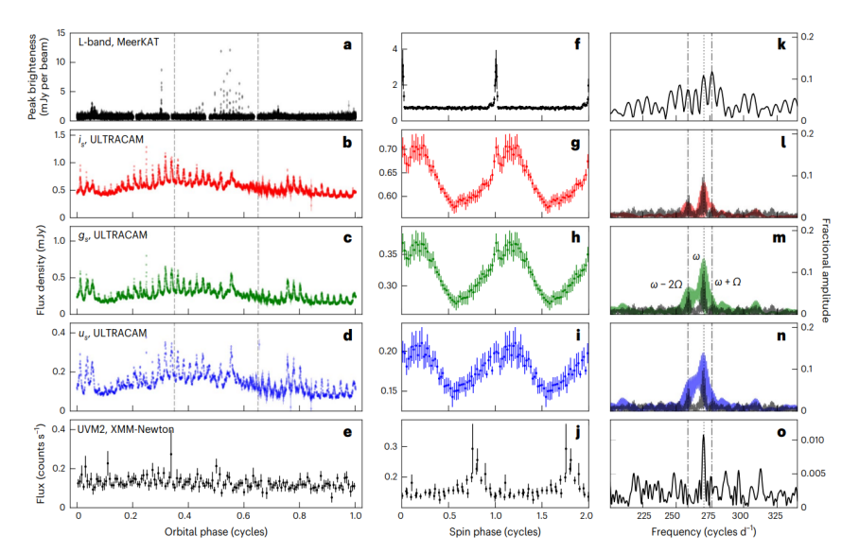
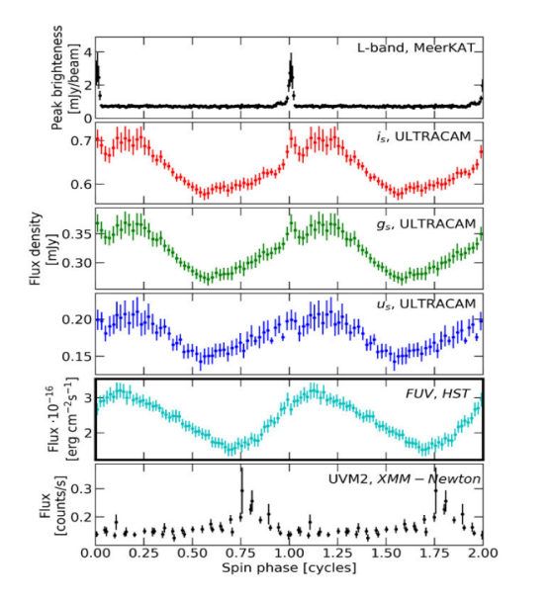
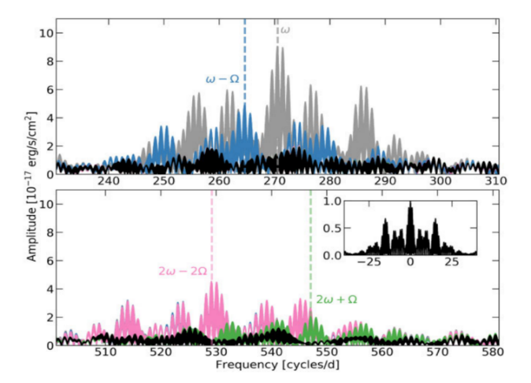
Multi-Wavelength Observations of J1912
Pelisoli et al. 2023b
Pelisoli et al. 2023a

Slide 4
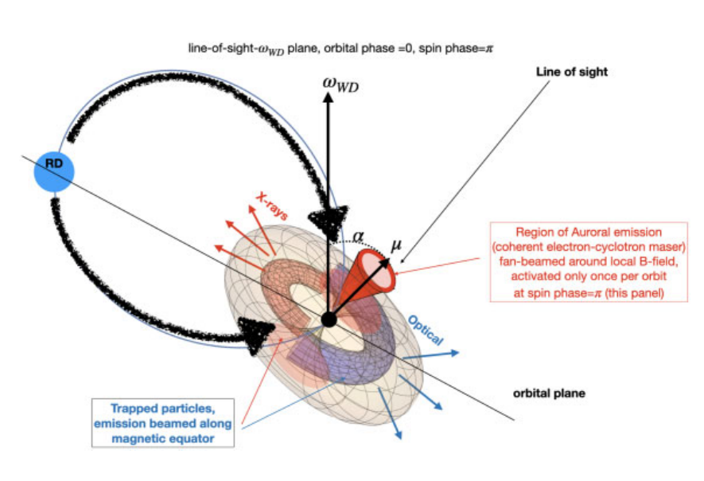
Geometric “Seeding” Model
Pelisoli et al. 2023b

Slide 5
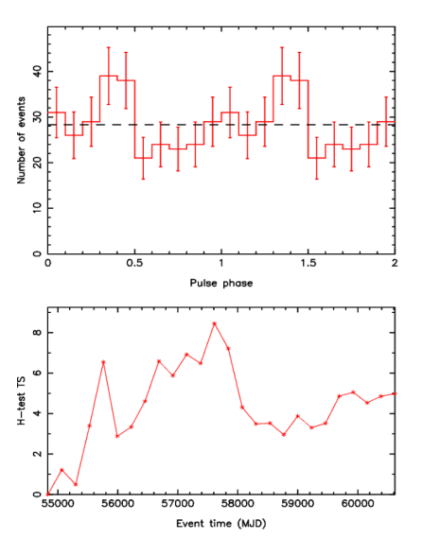
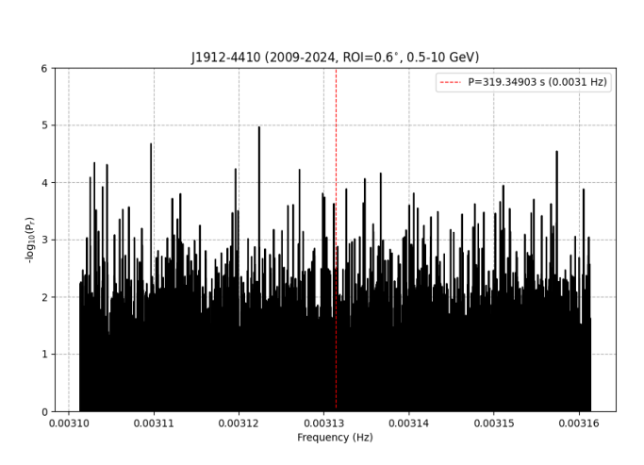
Periodic Analysis of J1912
Focussing on energies 0.5-10 GeV and ROI=0.6°, a Rayleigh Test Periodogram (Mardia 1972) was performed using gtpsearch (FermiScience tool).
Using gtsrcprob, only 80% probability photons from J1912’s ROI are considered
Same spin ephemeris is used for the phase-folded light curve (Pelisoli et al. 2023a)

Slide 6
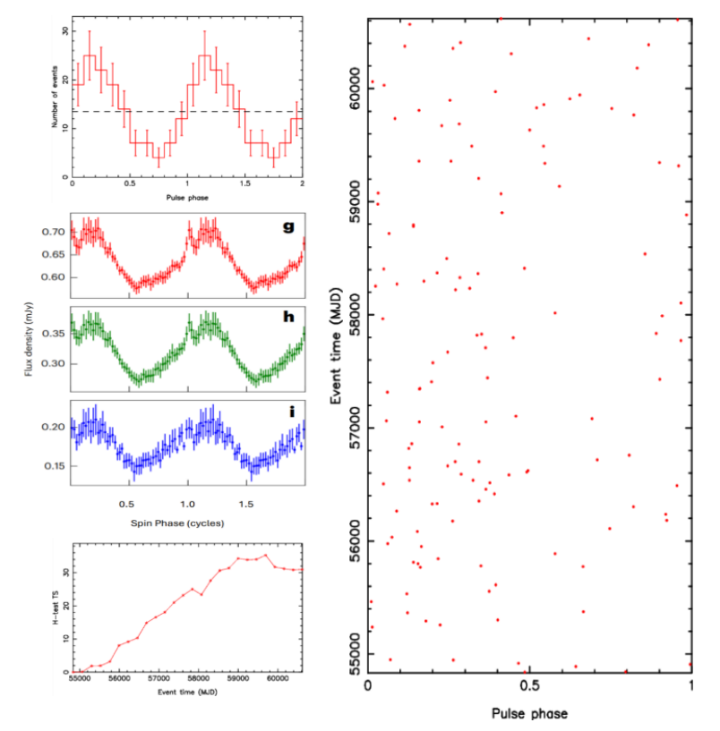
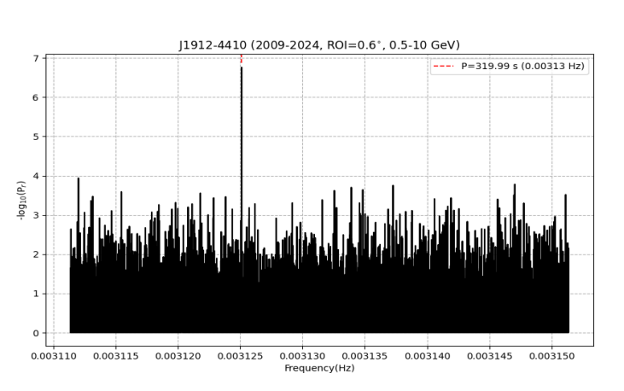
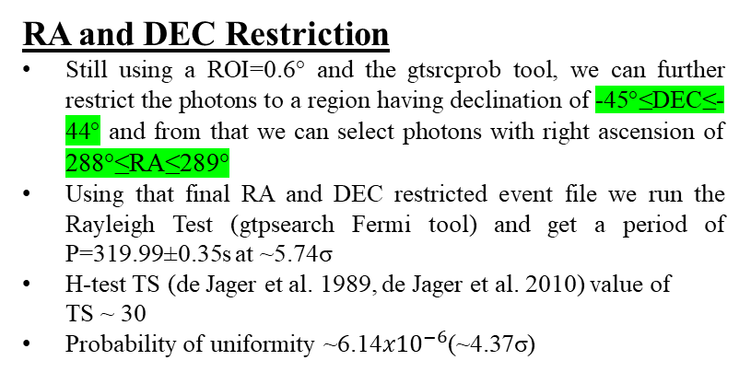
RA and DEC Restriction
Still using a ROI=0.6° and the gtsrcprob tool, we can further restrict the photons to a region having declination of -45°≤DEC≤-44° and from that we can select photons with right ascension of 288°≤RA≤289°
Using that final RA and DEC restricted event file we run the Rayleigh Test (gtpsearch Fermi tool) and get a period of P=319.99±0.35s at ~5.74σ
H-test TS (de Jager et al. 1989, de Jager et al. 2010) value of
TS ~ 30
Probability of uniformity ~6.14${x10}^{−6}$(~4.37σ)

Slide 7
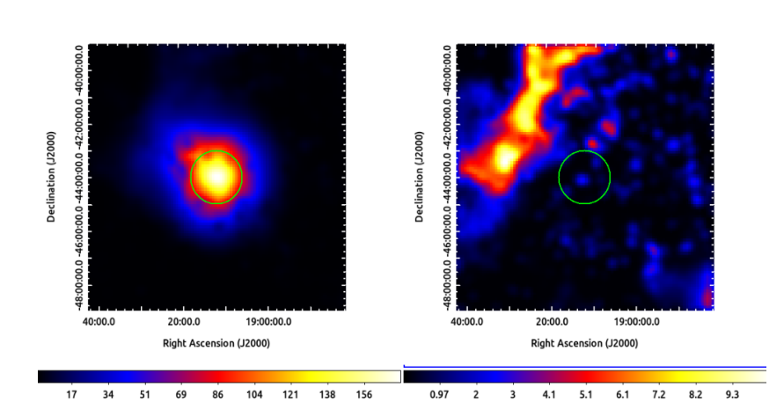
TS gating
In order to increase the visibility in γ-rays we introduce the TS gating method (Madzime et al. 2021, Madzime and Meintjes, 2023)
In the TS gating we only consider time bins with TS>0.
Binned TS and residual maps of J1912

Slide 8
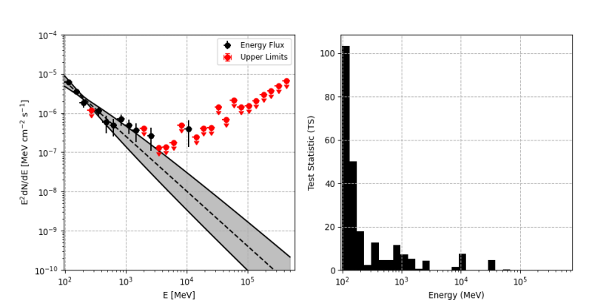
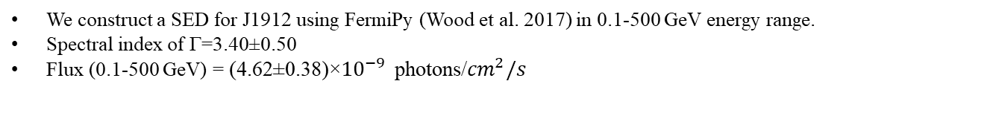
Spectral Energy Distribution (SED) of J1912
We construct a SED for J1912 using FermiPy (Wood et al. 2017) in 0.1-500 GeV energy range.
Spectral index of Γ=3.40±0.50
Flux (0.1-500 GeV) = (4.62±0.38)×${10}^{−9}$ photons/${cm}^{2}/s$

Slide 9
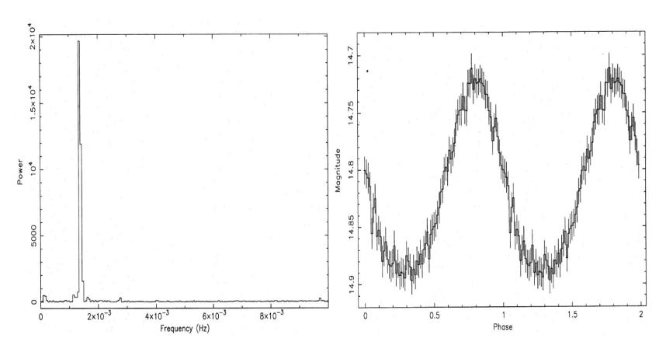
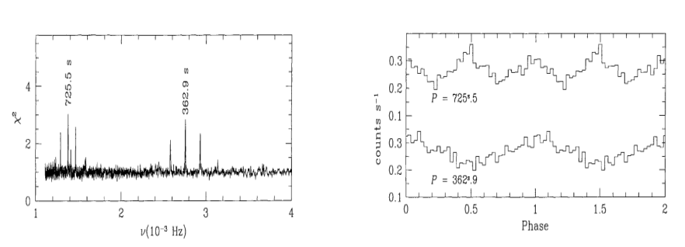
Isolated J0317 (EUVE J0317-855)
Discovered by Barstow et al. (1995) emitting optical pulsed emission at a period of P~725.4s with white dwarf having a B-field of ~340 MG.
Ultraviolet studies done by Ferrario et al. (1997) revealed pulsations at P=725.5±0.8s with B-field of ~450 MG
Ferrario et al. (1997) also detected pulsed emission at the first harmonic of the spin period
Optical Fourier transform and phase folded light curve adopted from Barstow et al. (1995)
FUV power spectrum and phase folded light curves on the spin period and its first harmonic (Ferrario et al. 1997)

Slide 10
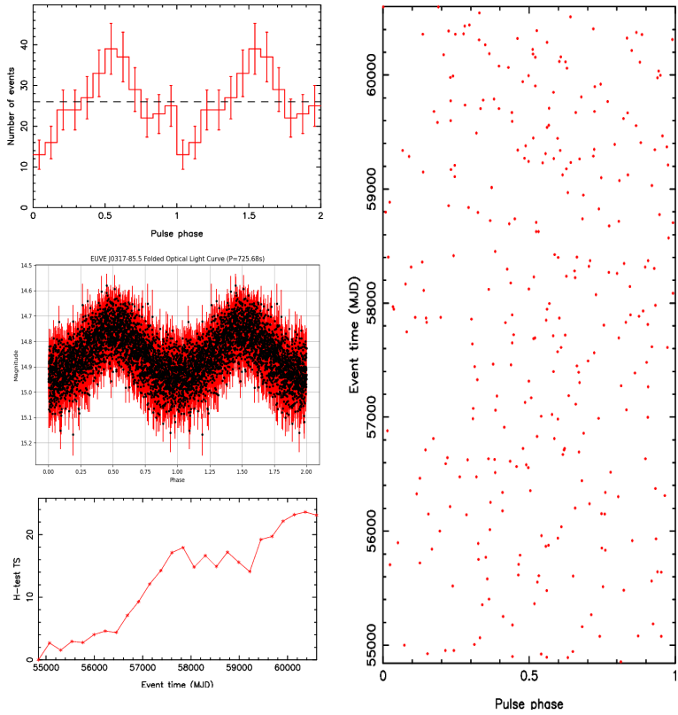
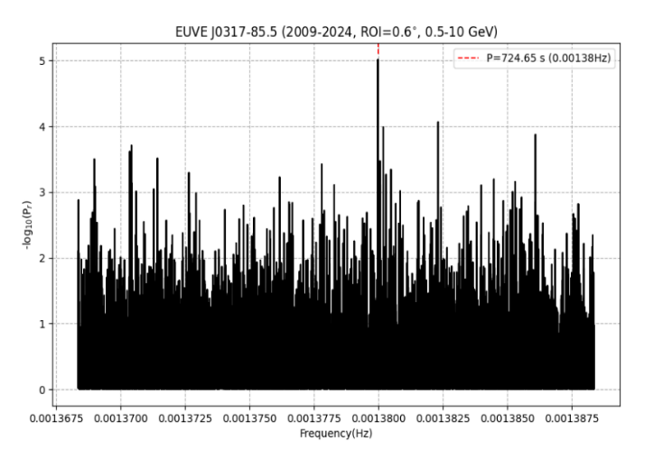
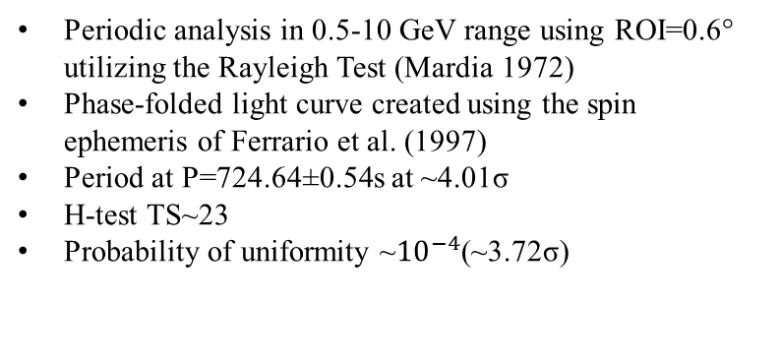
Fermi-LAT Observations of J0317
Periodic analysis in 0.5-10 GeV range using ROI=0.6° utilizing the Rayleigh Test (Mardia 1972)
Phase-folded light curve created using the spin ephemeris of Ferrario et al. (1997)
Period at P=724.64±0.54s at ~4.01σ
H-test TS~23
Probability of uniformity ~${10}^{−4}$(~3.72σ)

Slide 11
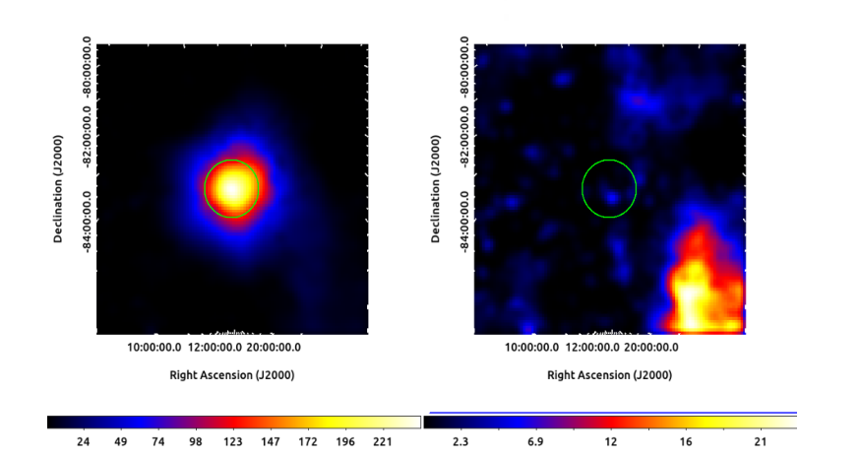
TS Gating
Binned TS map and residual map of J0317 in the 0.1-500 GeV energy range

Slide 12
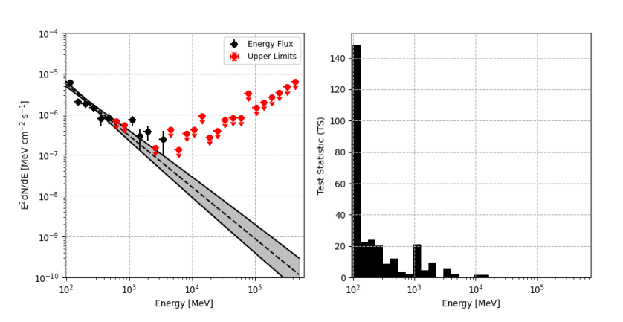
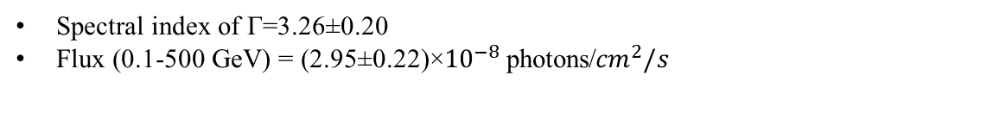
Spectral Energy Distribution (SED)
Spectral index of Γ=3.26±0.20
Flux (0.1-500 GeV) = (2.95±0.22)×${10}^{−8}$ photons/${cm}^{2}/s$

Slide 13
Conclusions
From both the binary J1912 and isolated J0317 white dwarfs we detect possible low-level pulsed γ-ray emission in the 0.5-10 GeV modulated at the spin period of both white dwarfs.
We attribute these possible pulsed γ-ray emission from both fast spinning, highly magnetized white dwarfs to the curvature radiation mechanism (Usov 1988 and references therein)
We don’t exclude ICS in the binary J1912 since there has been detection of residual mass transfer from the secondary.
By using the TS gating method, we aim to increase the visibility of both J1912 and J0317 and confirm that both are well described by a power-law model.
Based on a study by Meintjes et al. (2023) and references therein, these “white dwarf pulsars” can indeed emit low-level pulsed γ-ray emission modulated at their spin period <50 GeV.
Future research will indeed explore more fast rotating, highly magnetized white dwarfs searching for pulsed γ-ray emission modulated at their spin periods using Fermi-LAT observations.

Slide 14
References
M.A. Barstow, S. Jordan, D. O’Donoghue, M.R. Burleigh, R. Napiwotzki and M.K. Harrop-Allin, RE J0317 – 853: the hottest known highly magnetic DA white dwarf, Monthly Notices of the Royal Astronomical Society 277 (1995) 971
L. Ferrario, S. Vennes, D.T. Wickramasinghe, J.A. Bailey and D.J. Christian, EUVE J0317 — 855: a rapidly rotating, high-field magnetic white dwarf, Monthly Notices of the Royal Astronomical Society 292 (1997) 205.
P. Goldreich and W.H. Julian, Pulsar Electrodynamics, 157 (1969) 869
M.A. Ruderman and P.G. Sutherland, Theory of pulsars: polar gaps, sparks, and coherent microwave radiation., 196 (1975) 51
P.J. Meintjes, S.T. Madzime, Q. Kaplan and H.J. van Heerden, Spun-up rotation-powered magnetized white dwarfs in close binaries as possible gamma-ray sources: Signatures of pulsed modulation from ae aquarii and ar scorpii in fermi-lat data, Galaxies 11 (2023)
Madzime, S. T. (2021). The search for pulsed radio and gamma-ray emission from the cataclysmic variable system ae aquarii using meerkat and fermi-lat data (Master’s thesis). University of the Free State.
P.A. Sturrock, A Model of Pulsars, 164 (1971) 529.
D.L. Cáceres, S.M. de Carvalho, J.G. Coelho, R.C.R. de Lima and J.A. Rueda, Thermal X-ray emission from massive, fast rotating, highly magnetized white dwarfs, Monthly Notices of the Royal Astronomical Society 465 (2016) 4434.
J. Trümper, The rosat mission, Advances in Space Research 2 (1982) 241.
Külebi, B., Jordan, S., Nelan, E., Bastian, U. and Altmann, M., Constraints on the origin of the massive, hot, and rapidly rotating magnetic white dwarf rej 0317-853 from an hst parallax measurement, AA 524 (2010) A36
Zechmeister, M. and Kürster, M., The generalised lomb-scargle periodogram - a new formalism for the floating-mean and keplerian periodograms, AA 496 (2009) 577.
N.R. Lomb, Least-squares frequency analysis of unequally spaced data, Astrophysics and space science 39 (1976) 447.
J.D. Scargle, Studies in astronomical time series analysis. I - Modeling random processes in the time domain, 45 (1981) 1.
M. Ackermann, M. Ajello, A. Albert, A. Allafort, W.B. Atwood, M. Axelsson et al., The fermi large area telescope on orbit: Event classification, instrument response functions, and calibration, The Astrophysical Journal Supplement Series 203 (2012) 4.
Usov, V. V. (1988, March). Generation of Gamma-Rays by a Rotating Magnetic White Dwarf. Soviet Astronomy Letters, 14 , 258.
Pelisoli, I., Marsh, T., Buckley, D. A., Heywood, I., Potter, S. B., Schwope, A., . . . others (2023). A 5.3-min-period pulsing white dwarf in a binary detected from radio to x-rays. Nature Astronomy, 7 (8), 931–942. doi: https://doi.org/10.1038/s41550-023-01995-x
Pelisoli, I., Marsh, T. R., Dhillon, V. S., Breedt, E., Brown, A. J., Dyer, M. J., . . . Wild, J. F. (2021, 11). Found: a rapidly spinning white dwarf in lamost j024048.51+195226.9. Monthly Notices of the Royal Astronomical Society: Letters, 509 (1), L31-L36. Retrieved from https://doi.org/ 10.1093/mnrasl/slab116 doi: 10.1093/mnrasl/slab116
Mardia, K. V. (1972). Statistics of directional data. London: Academic Press.
de Jager, O. C., Raubenheimer, B. C., & Swanepoel, J. W. H. (1989, August). A powerful test for weak periodic signals with unknown light curve shape in sparse data. AAP, 221 , 180-190
de Jager, O. C., & B¨usching, I. (2010). The h-test probability distribution revisited: improved sensitivity. A&A, 517 , L9. Retrieved from https://doi.org/10.1051/0004-6361/201014362 doi: 10.1051/0004-6361/201014362

Slide 15
Thank You!

Slide 16
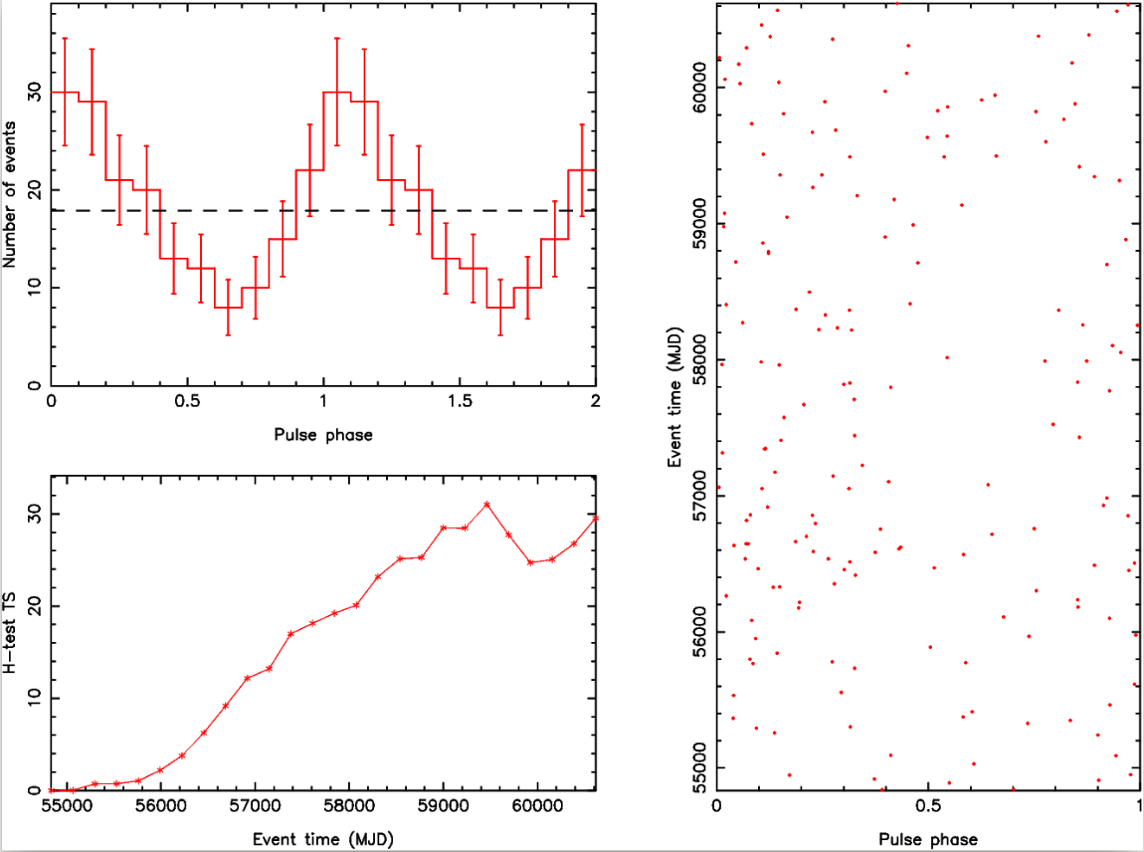
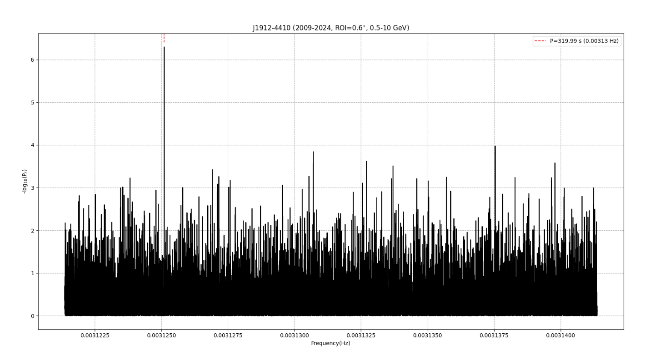
Back-up Slide
Even WITHOUT using the gtsrcprob tool we still get predominant γ-ray pulsations
H-test TS value ~ 30

Slide 17
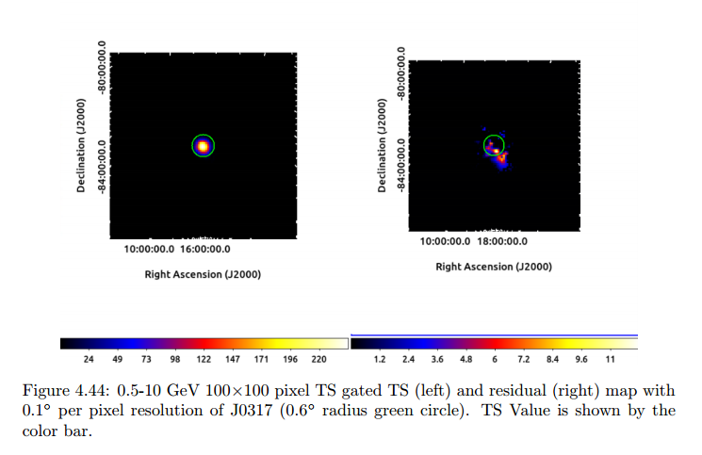
Unbinned TS and Residual Maps J0137

Slide 18
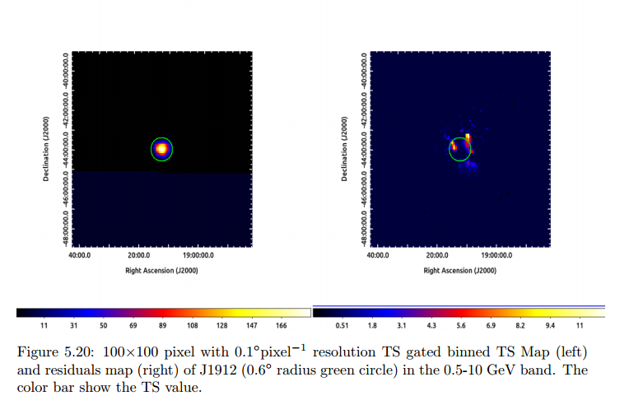
Unbinned TS and Residual Maps J1912

