Slide 1



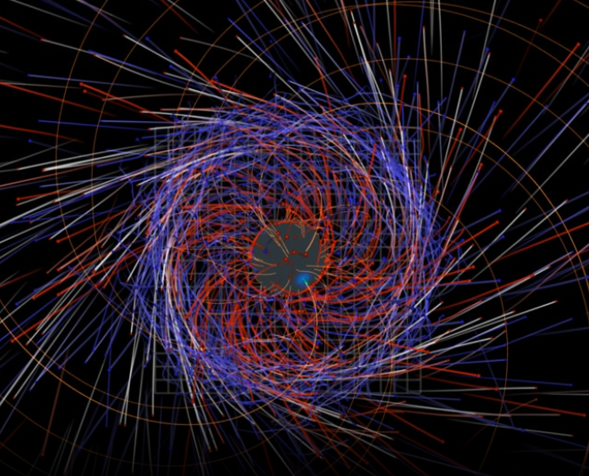
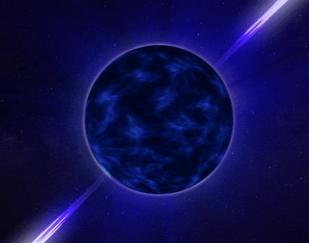
Centre for
Space Research
Modelling γ-ray Pulsar Light Curves using
a Geometric Current Sheet Model
https://svs.gsfc.nasa.gov/4648/
Christo Venter, AK Harding,
C Kalapotharakos, M Barnard
18 September 2025
HEASA, Johannesburg, South Africa
https://svs.gsfc.nasa.gov/14434

Slide 2
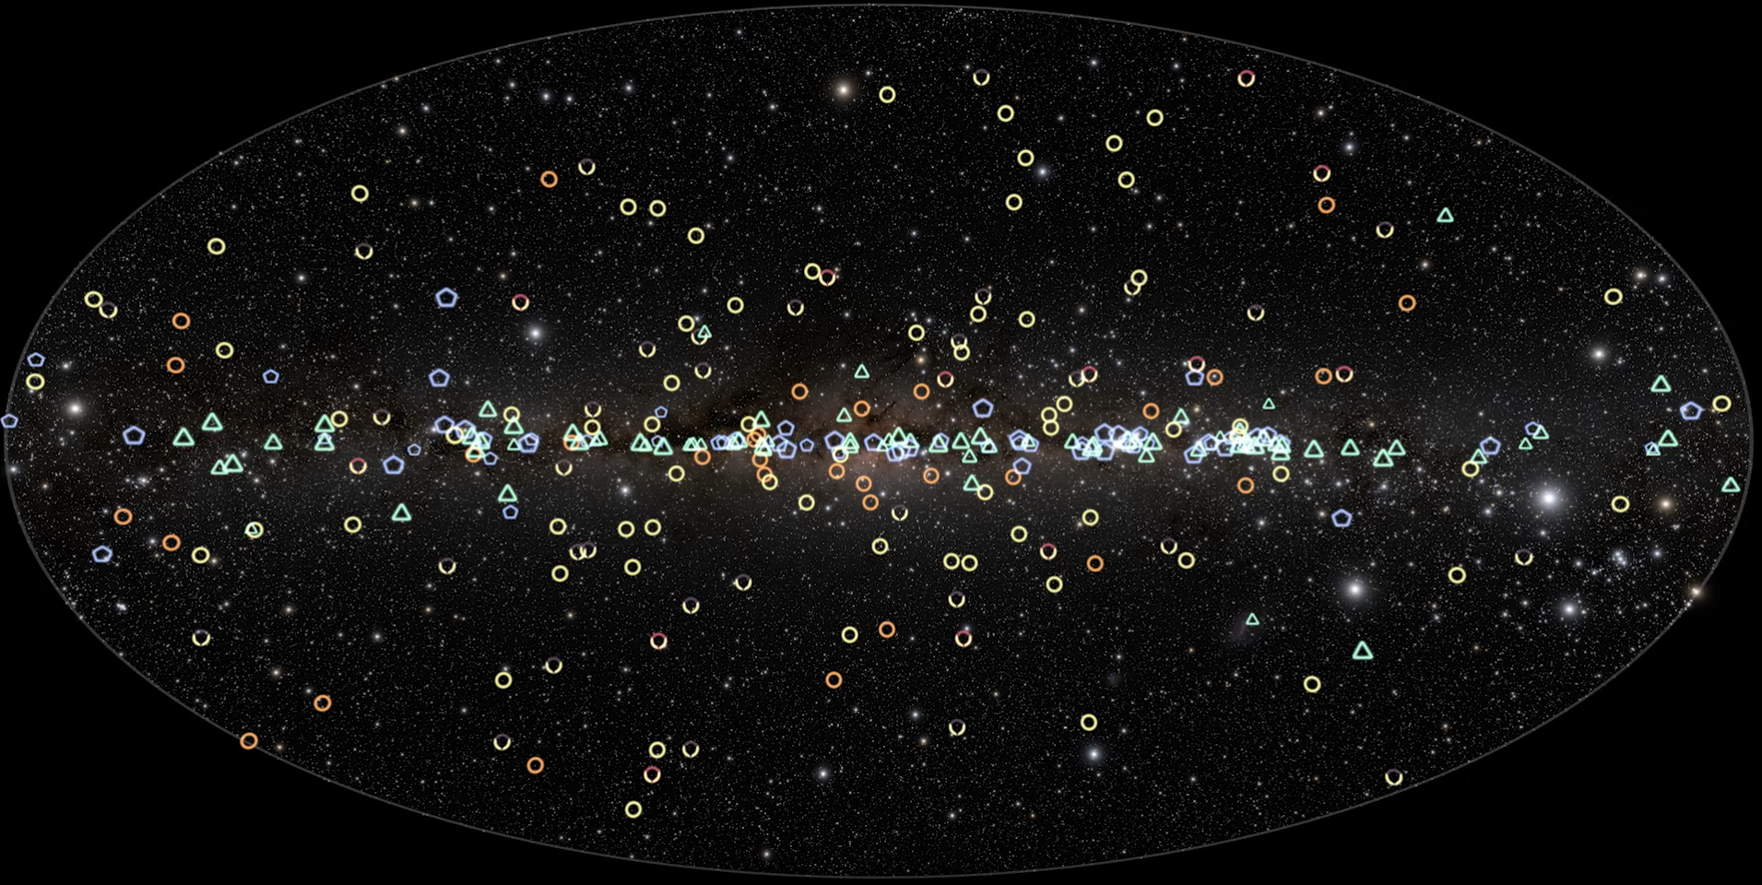
The 3PC Revolution
Smith et al. (2023)
Credit: NASA’s Goddard Space Flight Center
294 gamma-ray pulsars, 33 candidates (radio searches), and 12 optical / X-ray candidates
~ 10 known before Fermi LAT!
Notes:
CR

Slide 3
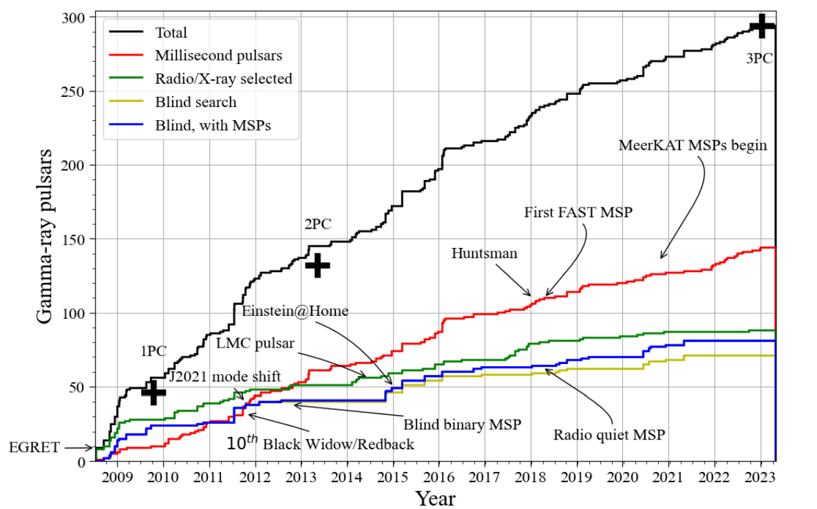
The 3PC Revolution
Smith et al. (2023)
Notes:
CR

Slide 4
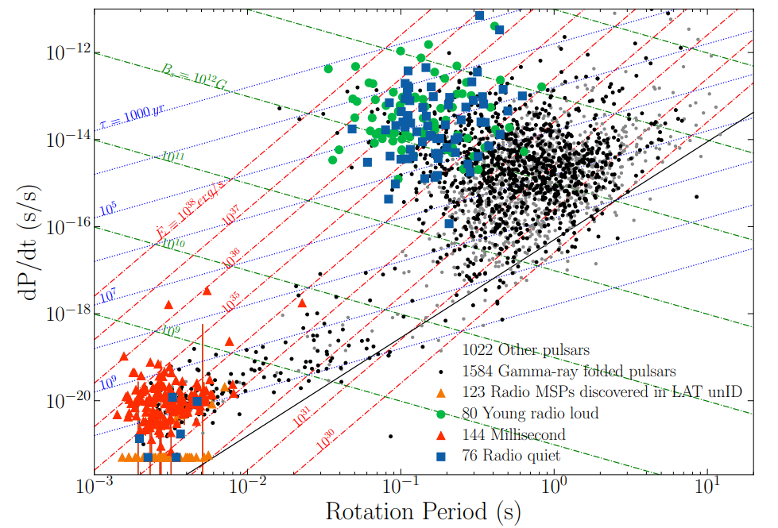
The 3PC Revolution
Smith et al. (2023)
Notes:
CR

Slide 5
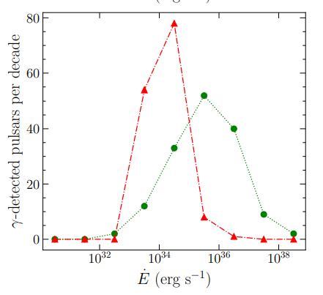

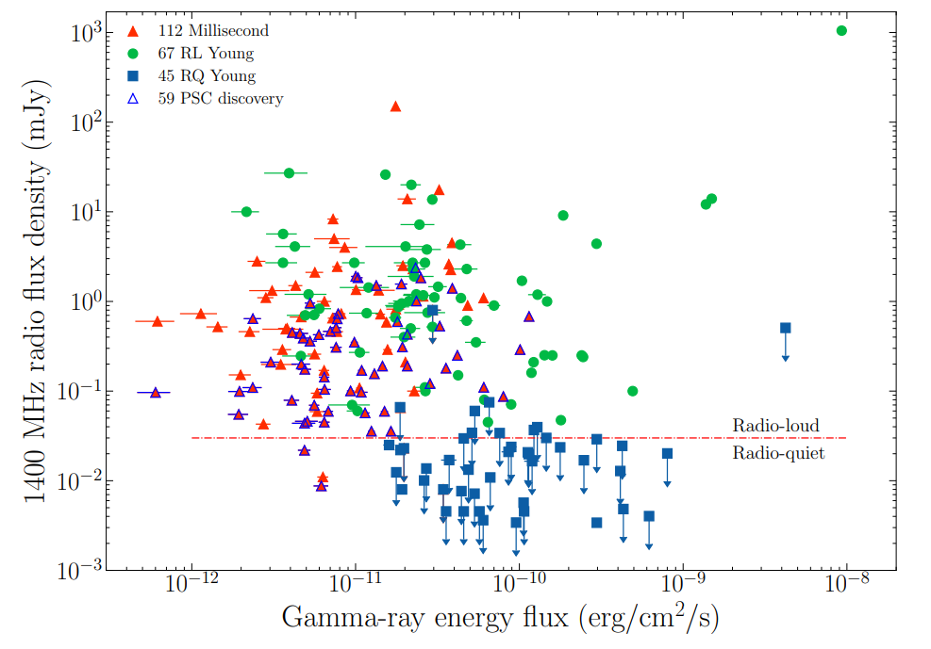
The 3PC Revolution
Smith et al. (2023)
Notes:
CR

Slide 6
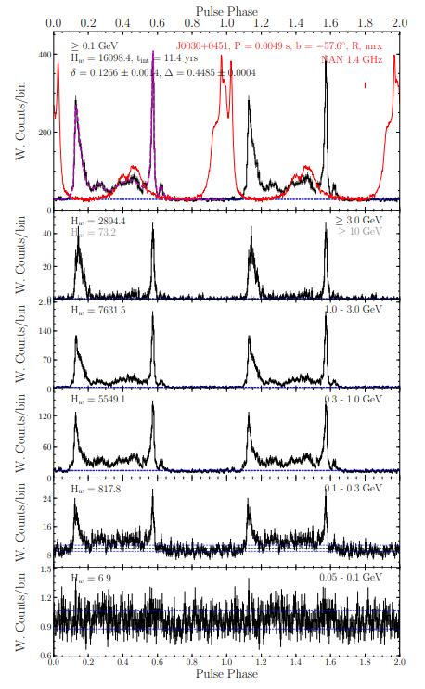
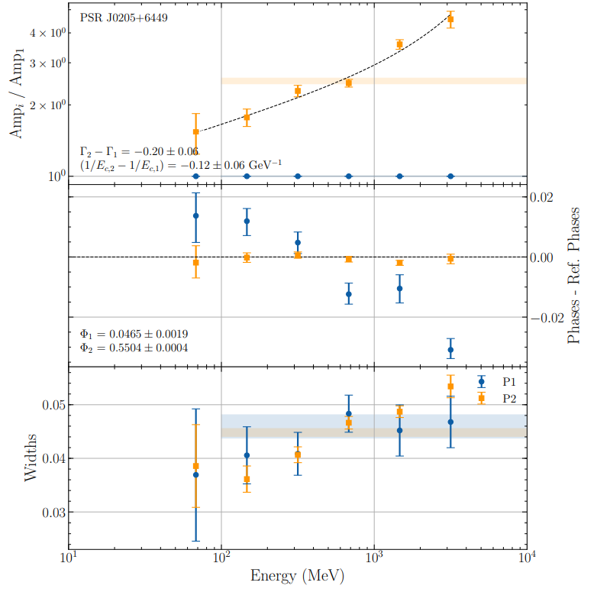
The 3PC Revolution
Smith et al. (2023)
Notes:
CR

Slide 7
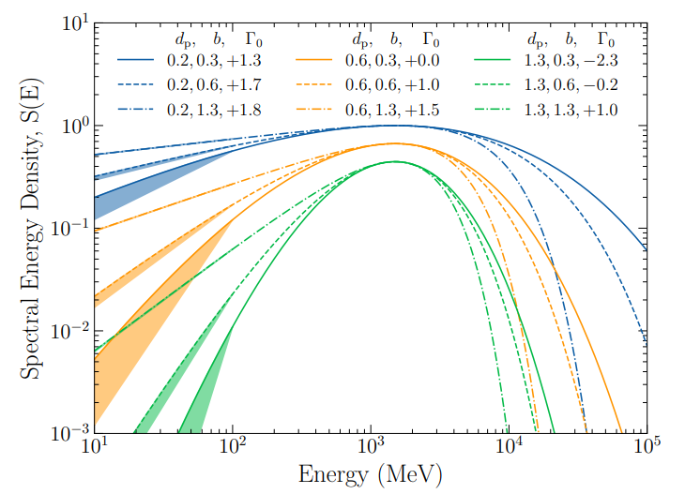
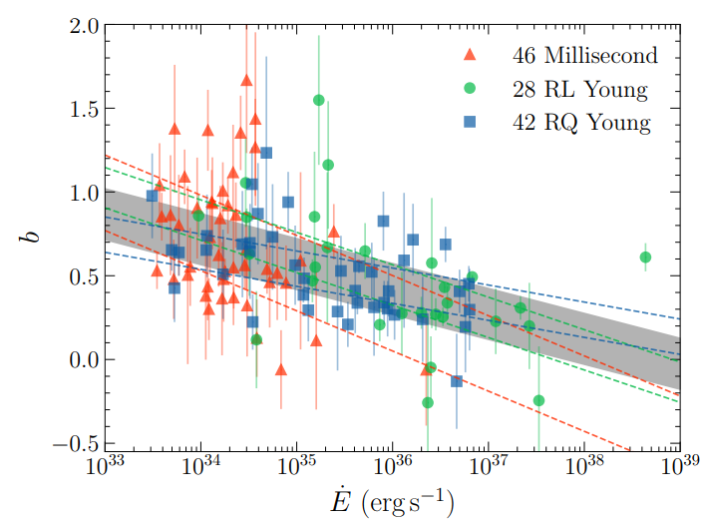
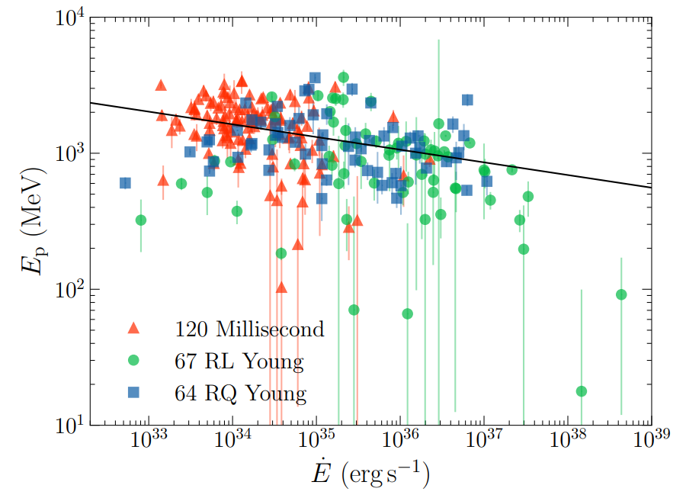
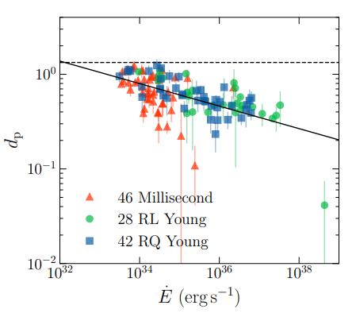
The 3PC Revolution
Smith et al. (2023)
Notes:
CR

Slide 8
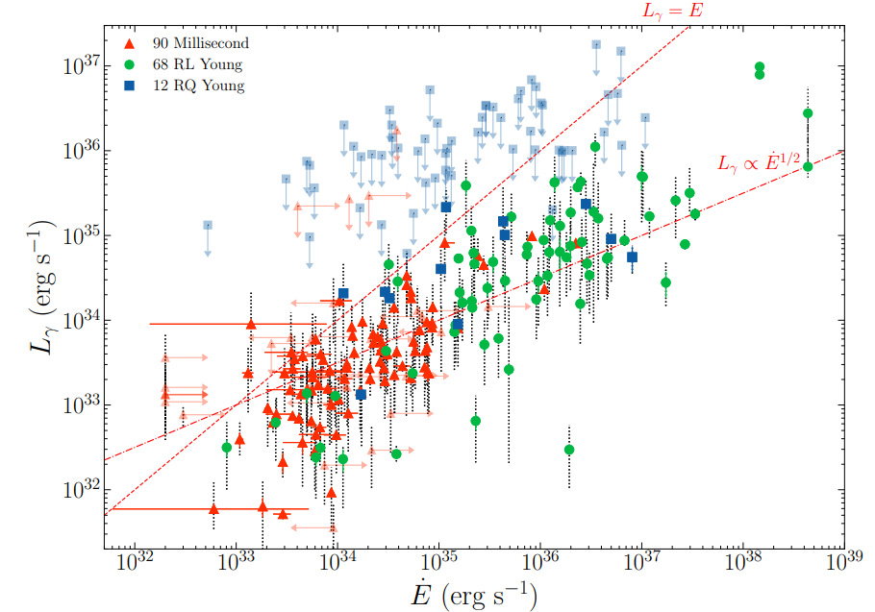
The 3PC Revolution
Smith et al. (2023)
Notes:
CR

Slide 9
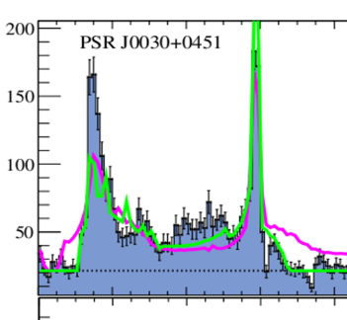
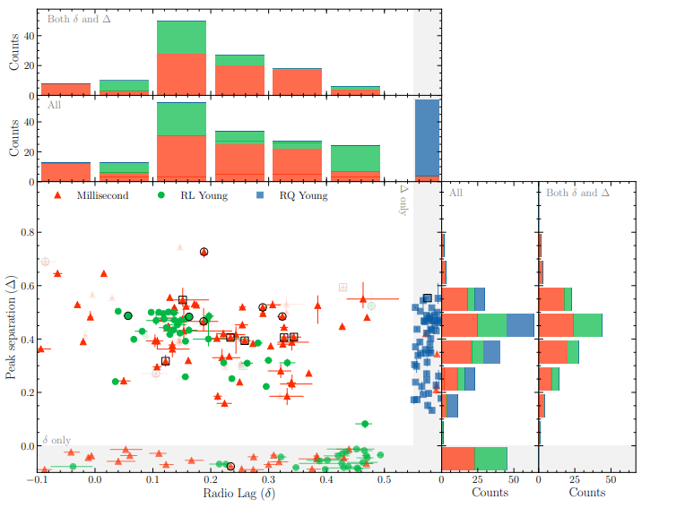
The 3PC Revolution
δ
Δ
Smith et al. (2023)
Notes:
CR

Slide 10
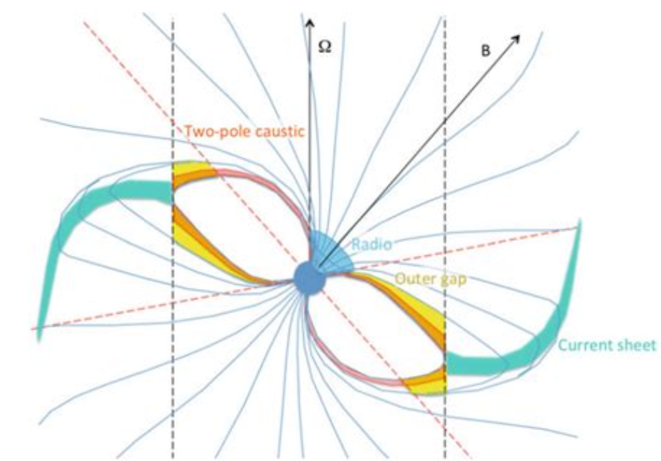
Geometric Models
Harding (2019)

Slide 11
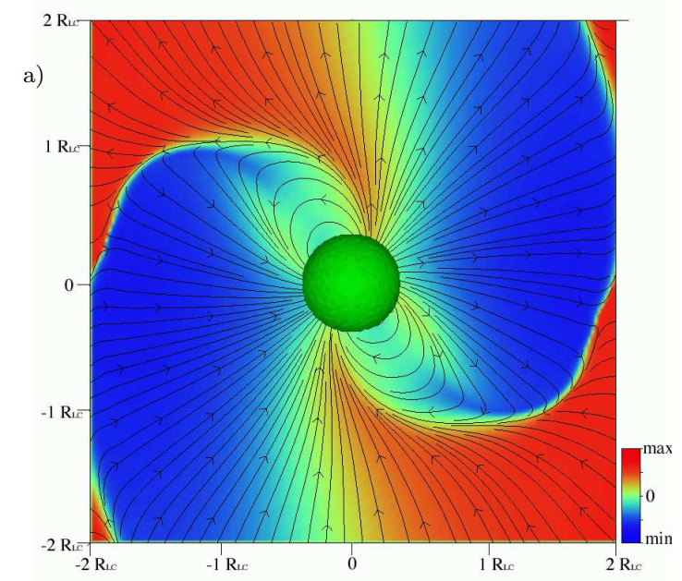
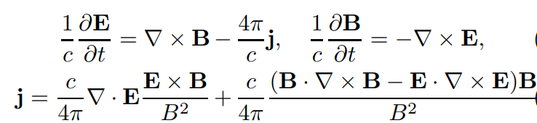

Ideal (FF) MHD
Spitkovsky (2006)

Slide 12
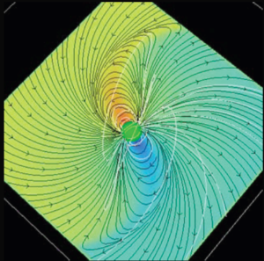
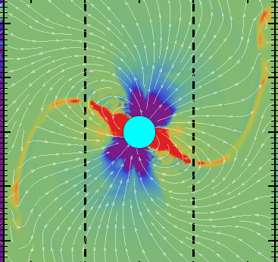
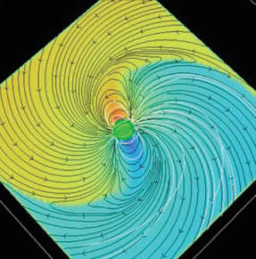



Different Regimes
Vacuum retarded dipole (VRD)
(Deutsch 1955)
No charges, no currents
Force-free magnetosphere
(E.g., Spitkovsky 2006)
No particle acceleration
Non-ideal MHD magnetosphere
(Kalapotharakos et al. 2012, Li et al. 2012)
Charges, currents + acceleration!
Filled with plasma
Credit: AK Harding

Slide 13
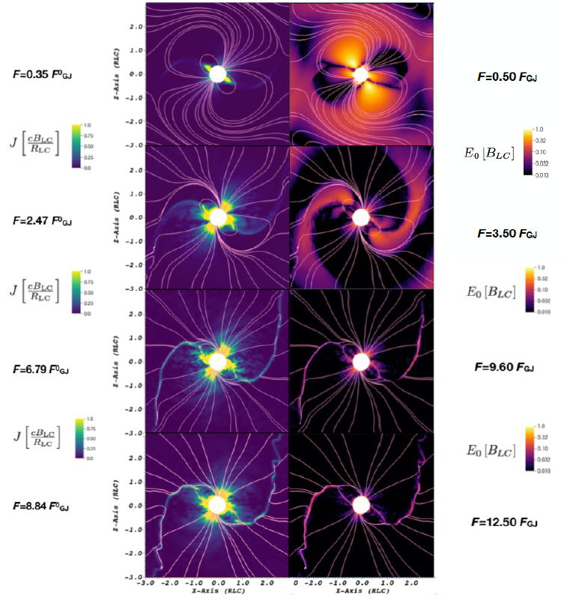
Global PIC Models
Chen & Belodorodov (2014)
Philippov & Spitkovsky (2014, 2018)
Cerutti et al. (2016)
Kalapotharakos et al. (2018, 2023)
Most dissipation takes place near separatrix and CS
E-field shrinks to CS as injection rate increases
Scaling up of
B < 10⁶ G and γ < 10³
[or hybrid models]
HONEST3: The High End of the Pulsar Spectra, 26 – 28 November 2024, Online
Brambilla et al. (2018)
Credit: AK Harding

Slide 14
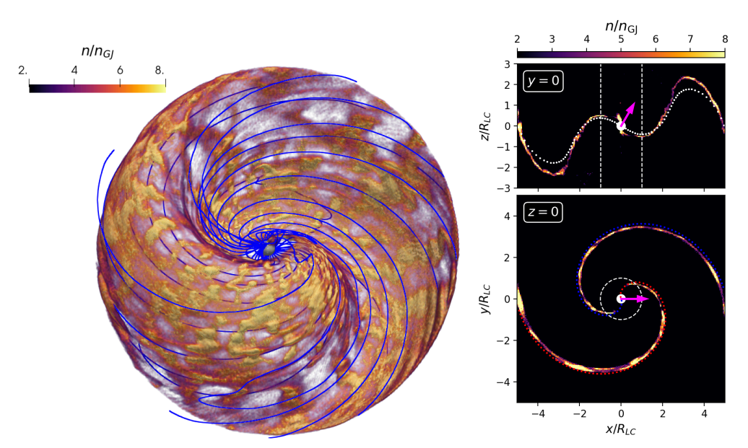
Global PIC Models
Cerutti
et al. (2025)

Slide 15
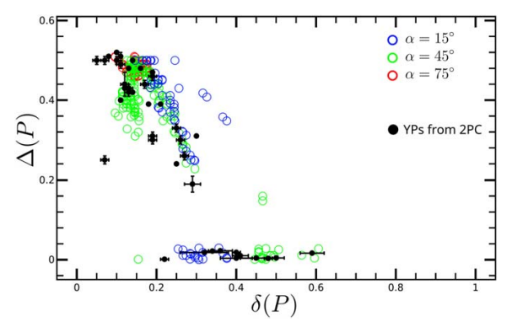
Why the Current Sheet?
Seen as dominant region of emission in dissipative MHD / PIC codes
Ubiquitous double-peak/caustic γ-ray light-curve morphologies
delta–Delta correlation (radio-gamma lag vs gamma peak separation).
Spectra and energetics broadly consistent with observations
FIDO (Kalapotharakos et al. 2014)
Global PIC (Kalapotharakos et al. 2023).
Notes:
CR

Slide 16
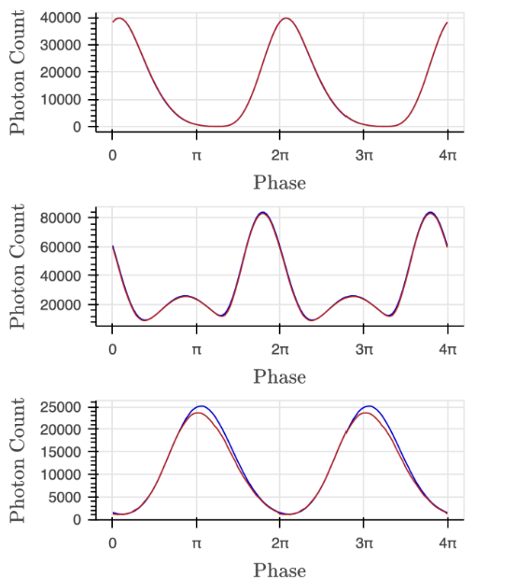
Enter Machine Learning
Computing realistic
global magnetosphere models is computationally prohibitive
Multi-polar fields
X-ray light curves
NN emulator
Speedup x 400 (SVF)
Allows full exploration of parameter space
Olmschenk et al. (2025)
Notes:
CR

Slide 17
Building a Bridge?
Older Geometric Radio / OG / TPC Models
Geometric
CS Model
Emission
Models
Analytic RVD
B-field
Calculations in co-rotating frame
Up to 1 R_{LC}
No emission physics (no spectra)
Lorentz transformation to lab frame
Numerical FF
B-field
Calculations in lab frame
Beyond 1 R_{LC}
No emission physics (no spectra)
Beaming effects
Numerical FF
B-field
Calculations in lab frame
Beyond 1 R_{LC}
FIDO
Emission physics (spectra and energy- dependent LCs)
Beaming effects
Notes:
CR

Slide 18
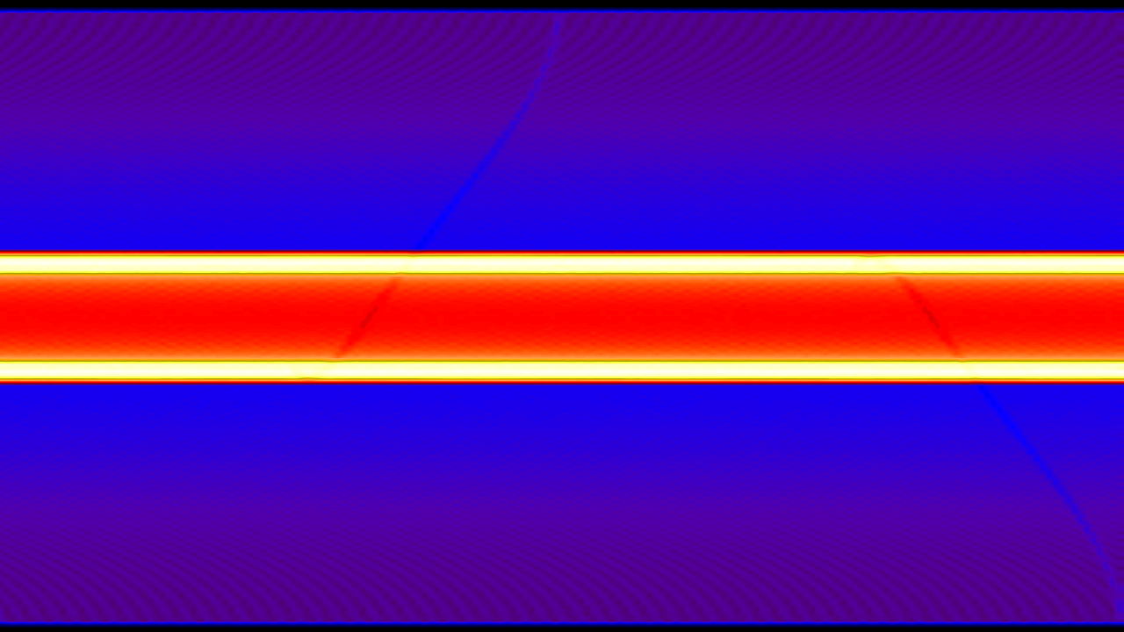
(Old) TPC Phaseplot
Δα = 1º
VRD
Credit: AS Seyffert

Slide 19

TPC Phaseplot
Δα = 15º
FF
ξ_{in} = 0.90
ξ_{out} = 0.96
R_{in} = 0.01R_{LC}
R_{out} = 0.95R_{LC}

Slide 20
Current Sheet Phaseplot
Δα = 15º
FF
ξ_{in} = 0.90
ξ_{out} = 0.96
R_{in} = 1.0R_{LC}
R_{out} = 1.5R_{LC}

Slide 21
Current Sheet Phaseplot
Δα = 15º
FF
ξ_{in} = 0.90
ξ_{out} = 0.96
R_{in} = 1.0R_{LC}
R_{out} = 1.5R_{LC}
log₁₀(F)

Slide 22
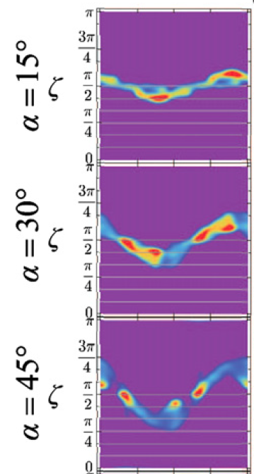
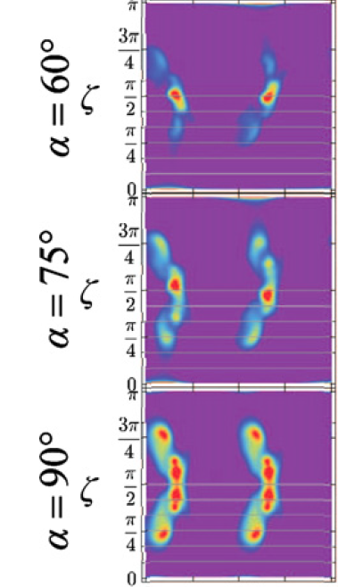
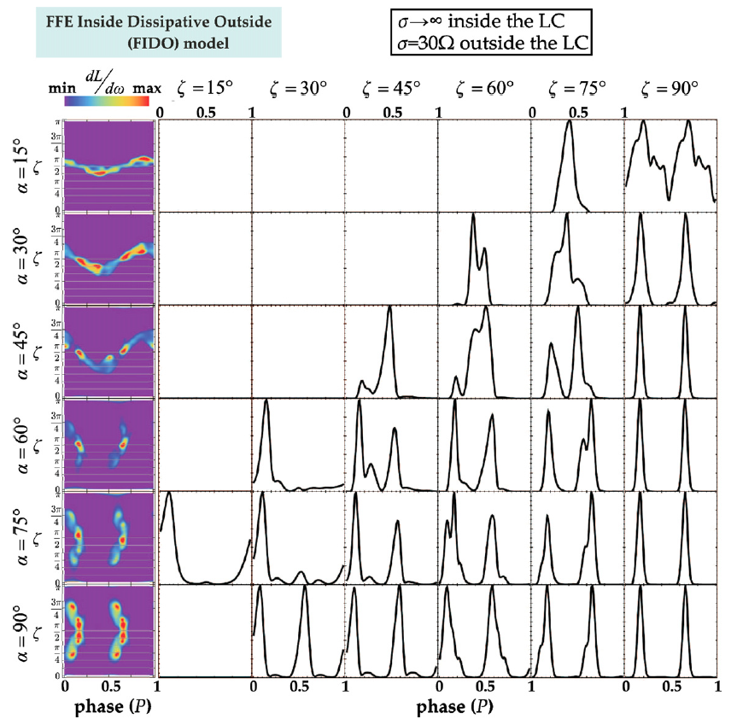
Comparison to Others
Kalapotharakos et al. (2014)
α = 45º

Slide 23
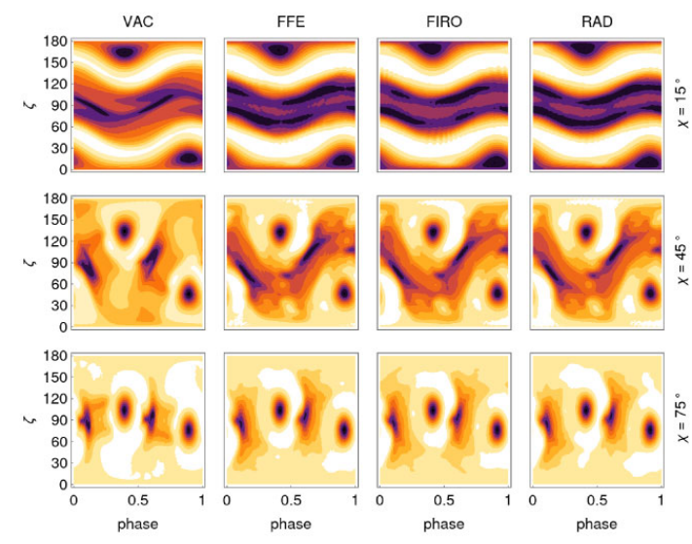
Comparison to Others
VAC
FFE
FIRO
RAD
180
90
0
χ = 15^{ο}
180
90
0
ζ
χ = 45^{ο}
180
90
0
χ = 75^{ο}
φ
Petri (2022)
0
0.5
0
0.5
0
0.5
0.5
1
1
1
0
1

Slide 24
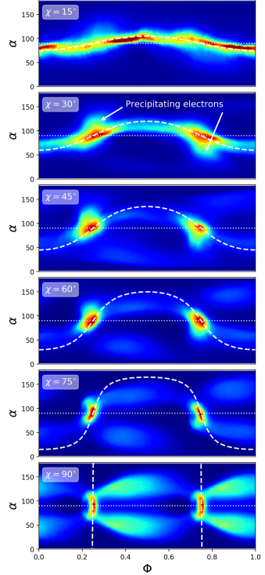
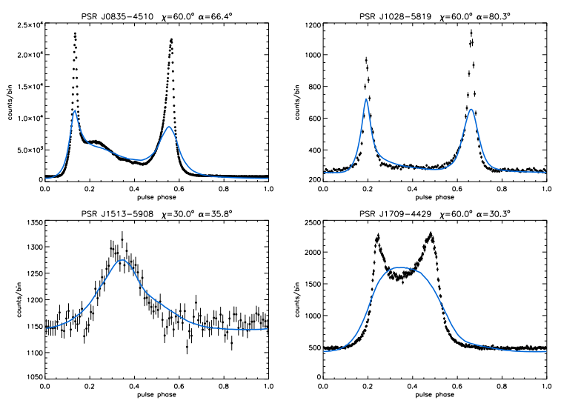
Comparison
to Others
SR
Split monopole
Cerutti et al. (2025)

Slide 25
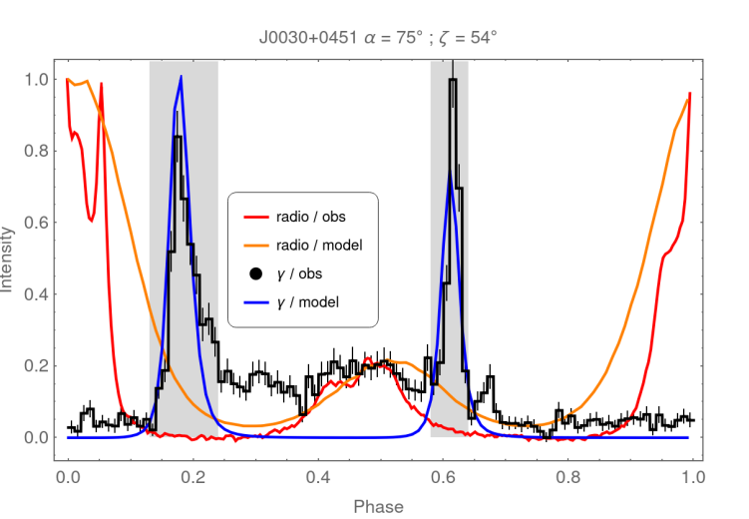
Towards Multi-λ LC Fitting
α = 45º
Petri et al. (2023)

Slide 26
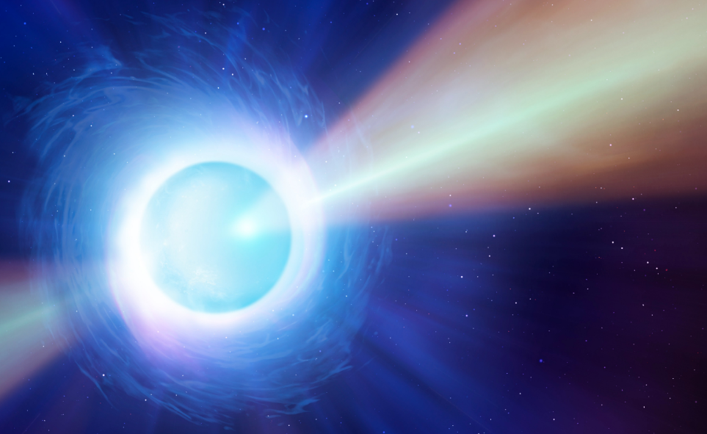
Conclusions
Wealth of new data on γ-ray pulsars
Reaching for an overarching model framework
Decades of model development (different approaches)
Computationally expensive models
Practical implementation for LC fitting: geometric current sheet model
One step in continued model development chain
Future: Machine learning, MHD, PIC, etc.

Slide 27
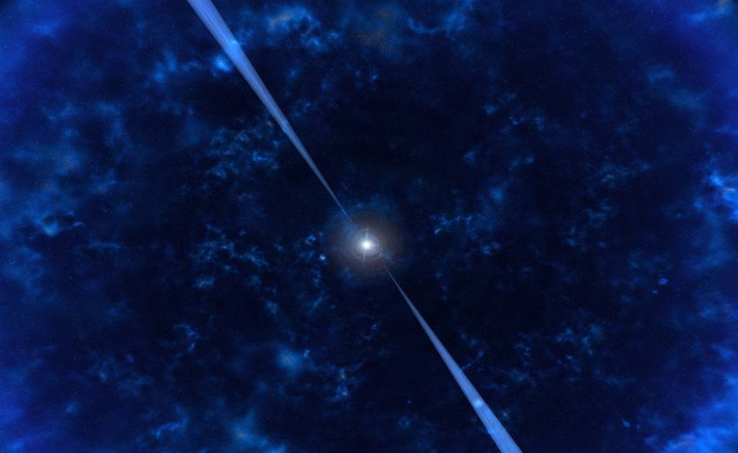




THANK YOU!
This work is based on the research supported wholly/in part by the National Research Foundation (NRF) of South Africa. The grantholder acknowledges that opinions, findings, and conclusions or recommendations expressed in any publication generated by the NRF supported research is that of the author(s), and that the NRF accepts no liability whatsoever in this regard.
“God’s splendour is a tale that is told, written in the stars. Space itself speaks His story
through the marvels of the heavens. His truth is on tour in the starry vault of the sky,
showing His skill in creation’s craftsmanship” (Ps. 19:1 TPT)

