Slide 1





MeerKAT Observations of White Dwarf Pulsars
${\text{Emil} \text{Meintjes}}^{1}$
${\text{Supervisor} \text{: }\text{Prof}\text{.} \text{P} \text{Woudt}}^{1}$
${\text{Co}\text{−}\text{supervisor}\text{ : }\text{Dr}\text{.} \text{M} \text{Geyer} }^{2}$
${}_{}^{1}{\text{University} \text{of} \text{Cape} \text{Town}}$, Astronomy Department
${}_{}^{2}{\text{University} \text{of} \text{Cape} \text{Town}}$, Mathematics and Applied Mathematics Department
High Energy Astrophysics in Southern Africa, 2025

Slide 2

Table of contents
We will discuss the following topics:
What are pulsars?
The discovery of AR Sco and the classification of White Dwarf Pulsars as a class of compact binaries.
What have we learnt from studying AR Sco?
The discovery of J1912-4410 and what makes it particularly special.
What have I been working on?
Preliminary results.
Future work.

Slide 3
01
What are (classical) pulsars?

Slide 4

What are (classical) pulsars?
Rapidly rotating* neutron stars with very strong magnetic fields**.
*millisecond to second long periods
**magnetic field strengths between ${10}^{8} − {10}^{15}$ G.
The creation of the neutron star sets up a magnetic dipole, the rotation of which induces an electric field.
This electric field (~${10}^{10} Vm^{−1}$) is strong enough to strip charged particles from the neutron star, creating a magnetosphere of charged particles.
1 of 15

Slide 5
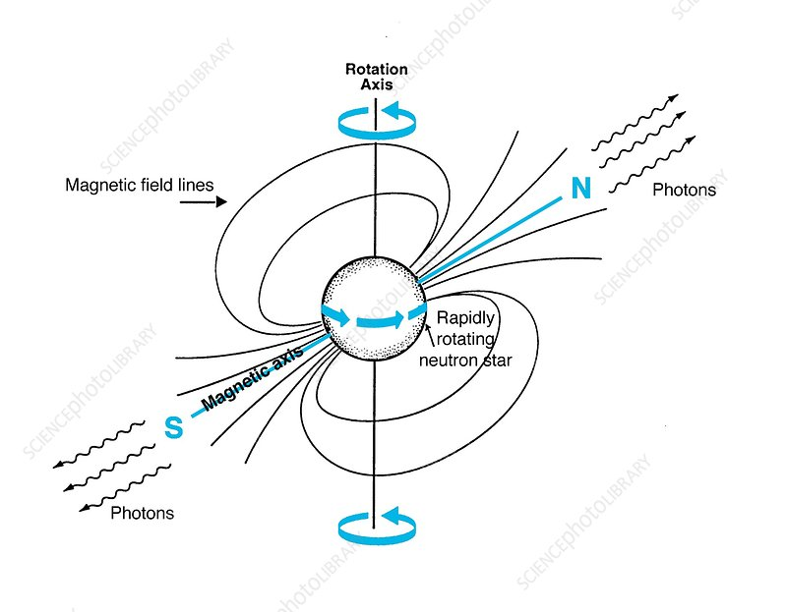

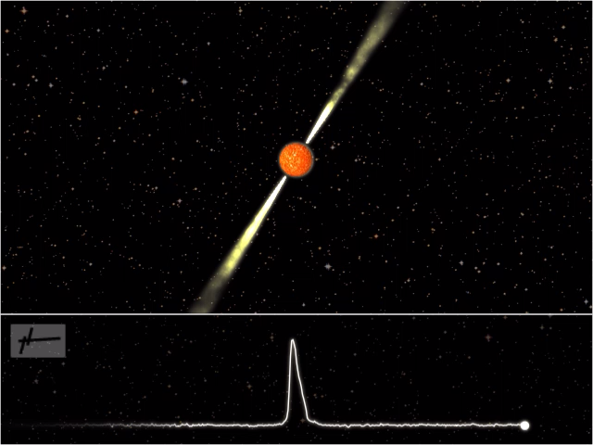
What are (classical) pulsars?
Particles ejected from near the polar regions are accelerated to relativistic speeds and move along the curved magnetic field lines.
This produces a narrow beam of radiation in the instantaneous direction of the charged particle’s travel.
These charged particles continually emit radiation as they travel along magnetic field lines, producing narrow cone of radio emission from the magnetic poles.
These cones sweep through space much like a lighthouse does.
Credit: Jon Lomberg - Science Photo Library
Credit: Joeri van Leeuwen –
https://www.astron.nl/pulsars/animations/
2 of 15

Slide 6
What are (classical) pulsars?
Particles ejected from near the polar regions are accelerated to relativistic speeds and move along the curved magnetic field lines.
This produces radiation in a narrow beam in the instantaneous direction of the charged particle’s travel.
These charged particles continually emit radiation as they travel along magnetic field lines, producing narrow cone of radio emission from the magnetic poles.
These cones sweep through space much like a lighthouse does.
We can extract valuable pieces of information from these pulses:
Time between pulses gives us the neutron star’s spin period.
The period derivative gives an indication of the strength, shape and extent of the neutron star’s magnetic field.
While polarisation gives an indication of the emission mechanisms at play.
2 of 15

Slide 7
02
The discovery of AR Sco

Slide 8
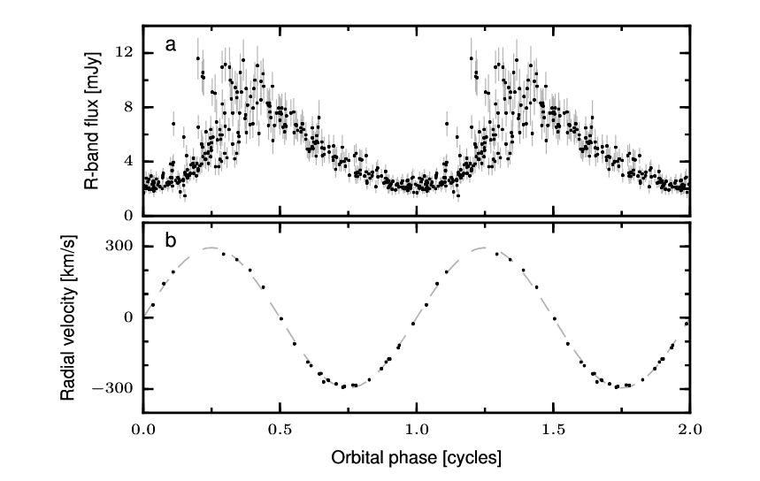
A White Dwarf Pulsar?
Neutron stars were thought to be the only sources of pulsed radio emission.
In 2016 Marsh et al. brought AR Sco to the attention of pulsar astronomers.
T.R. Marsh et al. (2016)
3 of 15

Slide 9
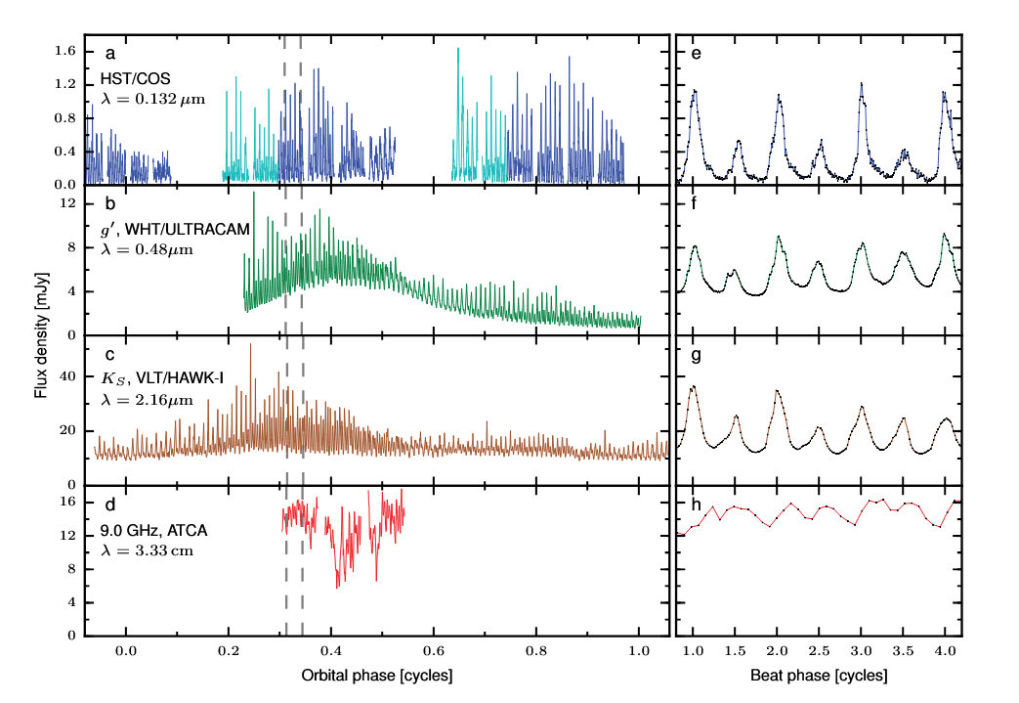
A White Dwarf Pulsar?
The optical photometry of the system suggests a cool M-dwarf and some compact object with an orbital period of 3.56 hours.
Pulsed emission at a fundamental frequency of 1.97 minutes.
Its Spectral Energy Distribution suggests that the compact object is a White Dwarf.
Radio pulsation too!
Thus, classifying AR Sco as the first White Dwarf radio Pulsar (WD pulsar).
T.R. Marsh et al. (2016)
4 of 15

Slide 10
What questions does this raise?
03

Slide 11
What do we know of AR Sco and what are the questions it gives rise to?
We know that WD pulsars must contain strongly magnetic white dwarf.
How did they develop this magnetic field?
Katz et al. (2017) ; Lyutikov et al. (2020) ; Schreiber et al. (2021).
5 of 15

Slide 12
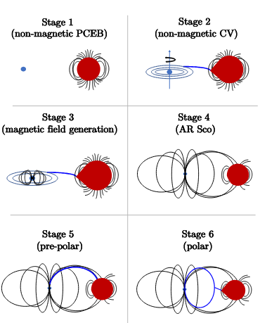
What do we know of AR Sco and what are the questions it gives rise to?
We know of other white dwarf binary systems that are strongly magnetic!
These are AM Her stars (polars) and DQ Her stars (intermediate polars).
So where do WD pulsars sit in the general evolution scheme of mCVs?
Schreiber et al., (2021), Rodriguez, (2025)
What are their connection to Long Period Transients?
?
WD pulsars
6 of 15

Slide 13
The discovery of J1912-4410
04

Slide 14
The discovery of J1912-4410
Pelisoli et al., (2023) performed a target search for white dwarf – M dwarf binary systems with similar observational properties as AR Sco.
Several systems were identified, but one in particular piqued our interest: J1912-4410.
Further observations across the EM spectrum show confirmed pulsations from X-ray to Radio wavelengths.
Confirmed as the second White Dwarf Pulsar!
Thus, firmly establishing White Dwarf Pulsars as a unique, rare class of compact binary system.
7 of 15

Slide 15
What makes J1912-4410 special?
05

Slide 16
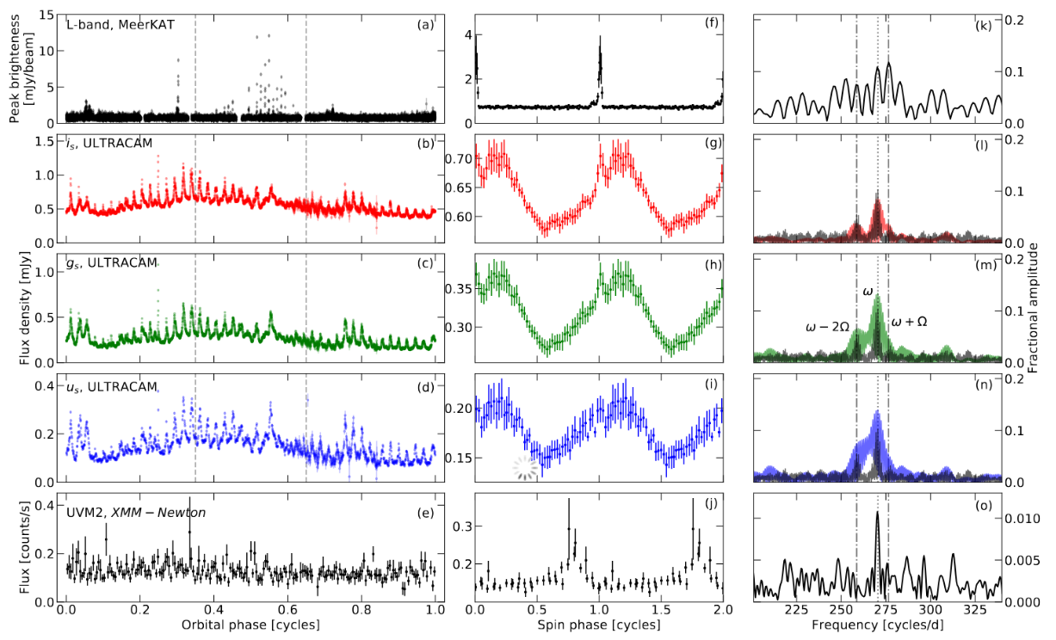
What makes J1912-4410 special?
The radio pulses from AR Sco to originate from the surface of the M-dwarf companion (du Plessis, L. et al. 2022).
NOT directly observed!
The narrow, sharp peaks in J1912-4410’s radio lightcurve suggest that we are seeing the beams directly!
I. Pelisosli (2023) et al.
8 of 15

Slide 17
What makes J1912-4410 special?
The radio pulses from AR Sco to originate from the surface of the M-dwarf companion (du Plessis, L. et al. 2022).
NOT directly observed!
The narrow, sharp peaks in J1912-4410’s radio lightcurve suggest that we are seeing the beams directly!
Studying J1912-4410’s radio pulses will give us unique insight to further constrain formation models and possible emission mechanisms.
MeerKAT’s instantaneous 2-second integrations is perfect for their study!
Furthermore, studies by Pelisoli et al. (2024) suggest contradictions to formation models put forth that the study of AR Sco alone could not reveal.
What makes J1912-4410 special?
The radio pulses from AR Sco to originate from the surface of the M-dwarf companion (du Plessis, L. et al. 2022).
NOT directly observed!
The narrow, sharp peaks in J1912-4410’s radio lightcurve suggest that we are seeing the beams directly!
9 of 15

Slide 18
What have I done so far?
06

Slide 19

What have I done so far?
MeerKAT UHF data collected roughly ~1/month since July 2022.
I have processed our available data from January 2024 to July 2025.
I have produced a radio lightcurve using Stokes I fluxes I extracted from the processed data.
10 of 15

Slide 20
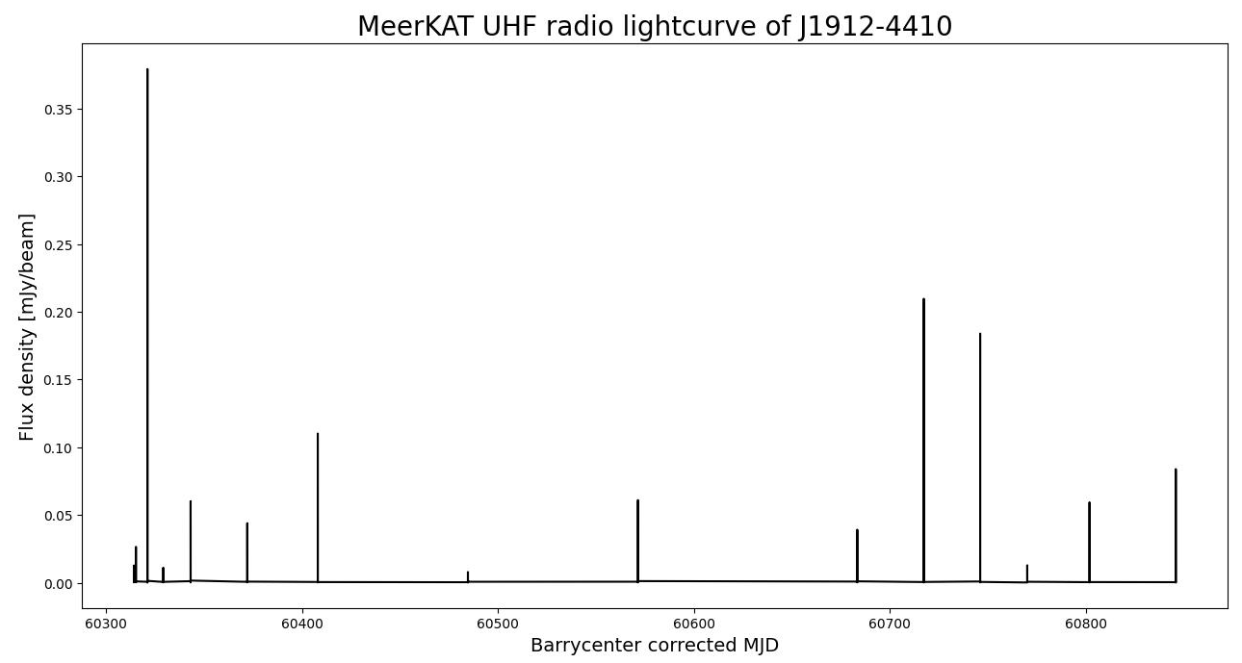
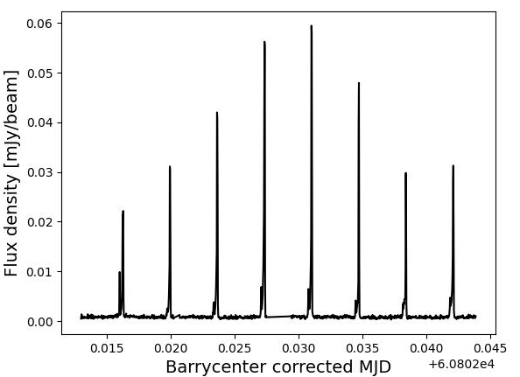

Slide 21
What have I done so far?
I am using Hughes et al. (2025)’s PolKAT pipeline to process the MeerKAT UHF data.
I have processed our available data from January 2024 to July 2025.
I have produced a lightcurve from this data.
I have performed a Lomb-Scargle Fourier analysis on it.
By fitting a Gaussian to the highest peak, I have determined the fundamental frequency of the radio pulses.
10 of 15

Slide 22


Fundamental
$1^{st}$ harmonic
$2^{nd}$ harmonic
$3^{rd}$ harmonic

Slide 23

What have I done so far?
I am using Hughes et al. (2025)’s PolKAT pipeline to process the MeerKAT UHF data.
I have processed our available data from January 2024 to August 2025.
I have produced a lightcurve from this data.
I have performed a Lomb-Scargle Fourier analysis on it.
By fitting a Gaussian to the highest peak, I have determined the fundamental frequency of the radio pulses.
Allows me to calculate its spin period and through standard error propagation, also its uncertainty:
P = $5.32339264± 0.00000040$minutes
10 of 15

Slide 24
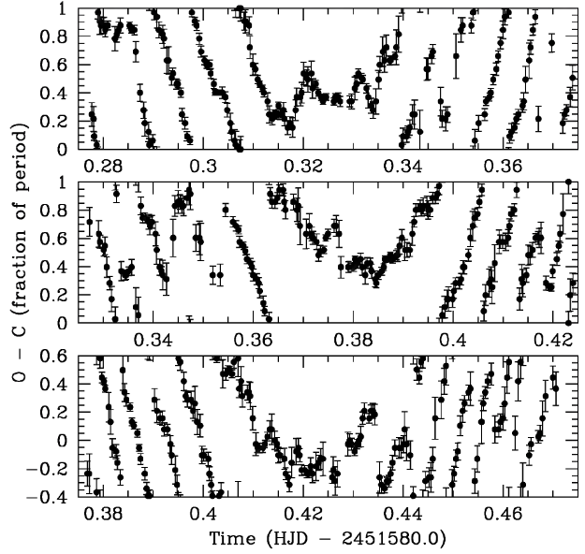
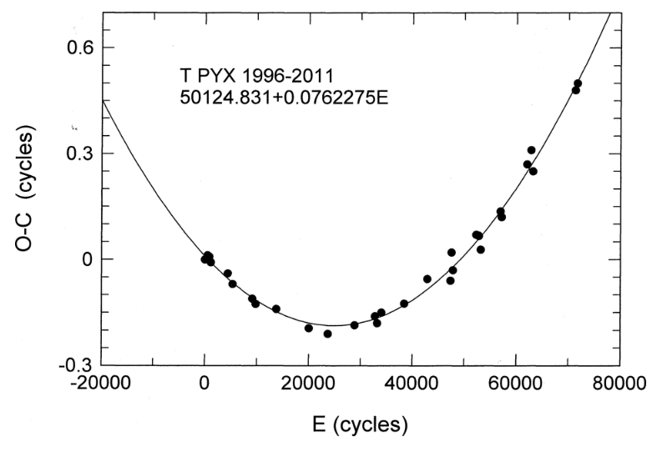
What am I currently working on?
I am working towards constraining the period derivative.
I will do so by constructing an Observed-minus-Computed diagram.
P. Woudt et al. (2002)
J. Patterson et al. (2014)
11 of 15

Slide 25
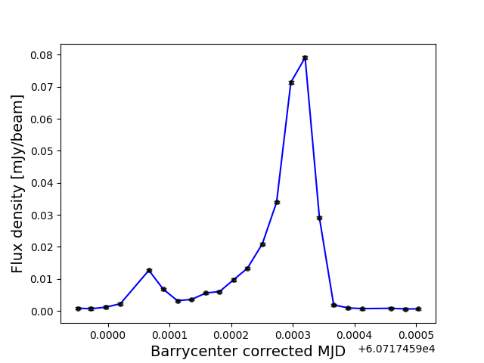
What am I currently working on?
To this end I have starting fitting individual pulses to determine pulse arrival times.
12 of 15

Slide 26
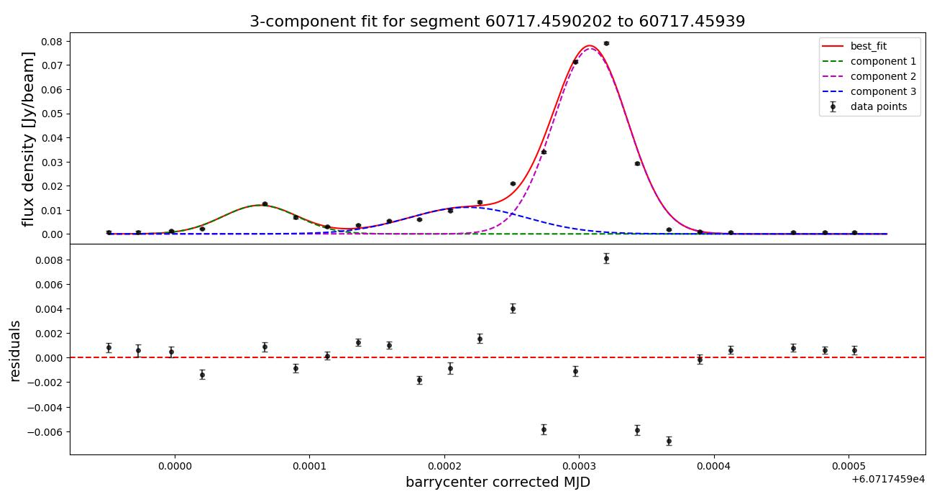
What am I currently working on?
13 of 15

Slide 27
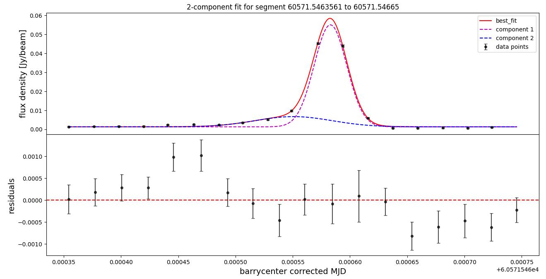
What am I currently working on?
14 of 15

Slide 28
Future work
07

Slide 29
What are my aims for the rest of 2025?
Regarding J1912-4410:
Finalise the (Observed – Calculated ) diagram, and determine the period derivative.
Compare this to the timing solutions we get from folding the PTUSE Beamformer data using PSRCHIVE.
Using PTUSE beamformer data, I aim determine the polarisation of individual pulses.
I aim to stack pulses and non-pulsed emission to investigate intermediate pulse structure across binary’s phase.
I can look at the simultaneous radio and X-ray observation for J1912-4410 have been taken. The team has access to ULTRACAM, SALT spectroscopy, and polarimetry if conditions allow it.
I aim to process the archival data of AR Sco using PolKAT and to compare with J1912-4410.
I aim to process our measurement sets of J2306+2440 and J0317-8532.
15 of 15

Slide 30
Thank you for your time I welcome any questions :)

Slide 31
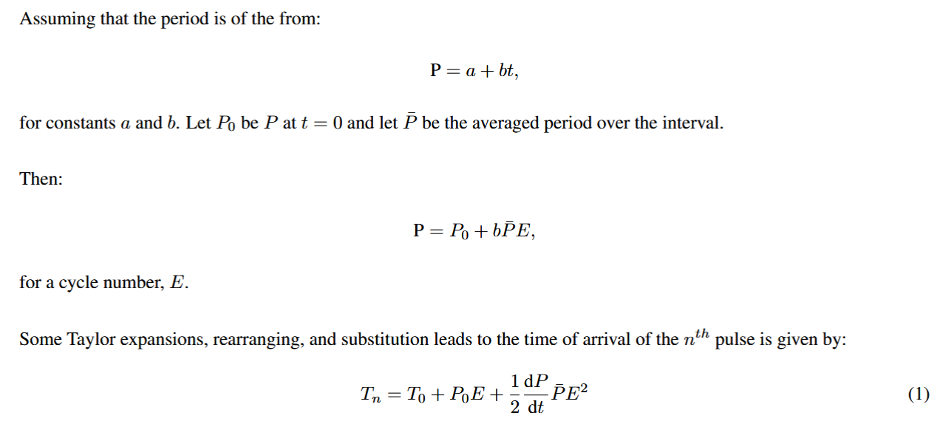
The O-C diagram:

Slide 32
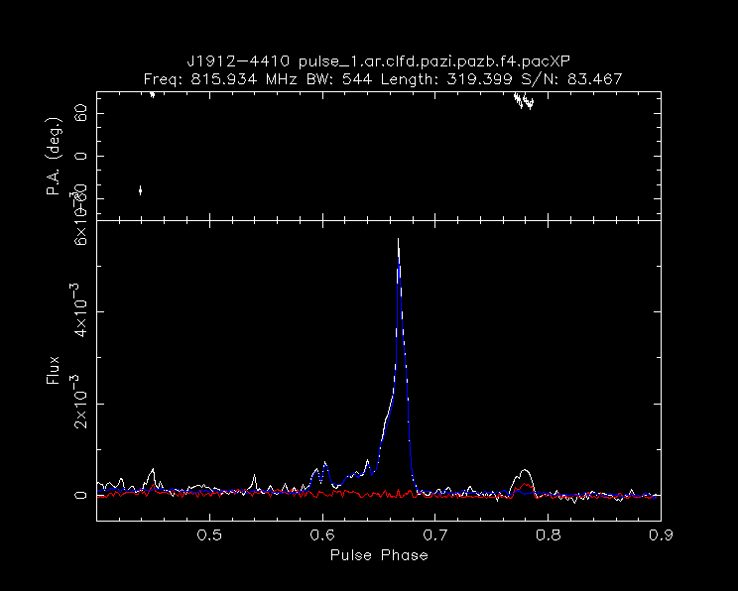
The polarisation of the pulses:

Slide 33
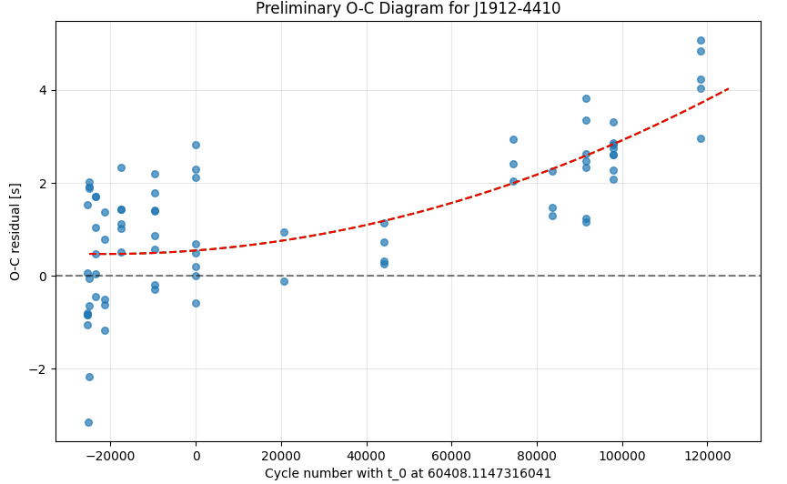
A very preliminary O-C diagram:
$$\dot{P}=\text{1.04164103138558}{×10}^{−12}± {5.4×10}^{−13}$$

