Slide 1

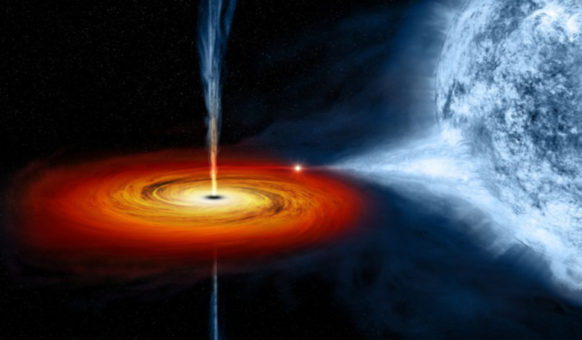



Radiation Signatures of Electron Acceleration in the Decelerating-Blob Model of MAXI J1348-630
HEASA 2025 - High Energy Astrophysics South Africa 2025
16th - 20th September 2025
Aishwarya Sarath
PhD student at Instituto de Estudios Astrofísicos,
Universidad Diego Portales (UDP)
Santiago , Chile
PROF . MARKUS BÖTTCHER
CENTER FOR SPACE RESEARCH,
NORTH-WEST UNIVERSITY, POTCHEFSTROOM, SOUTH AFRICA

Slide 2
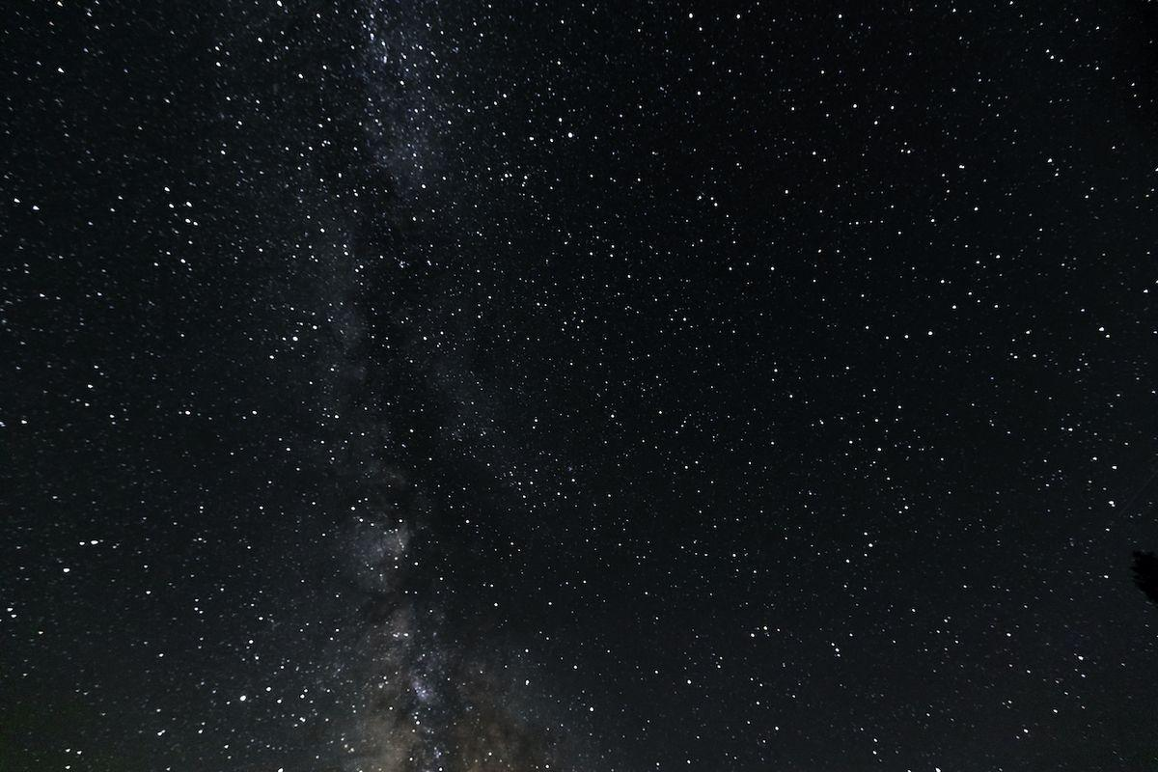
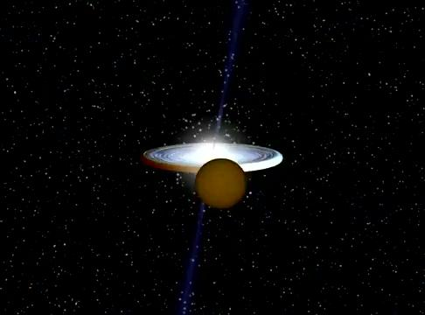
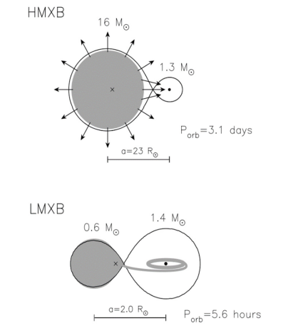
X-Ray Binaries : Microquasars
Fig1:Typical HMXBs and LMXBs with neutron star as the accretion star . (Chengzhuo Tan 2021 J. Phys.: Conf. Ser. 2012 012119)
LMXB Animation Credits :Marc van der Sluys

Slide 3
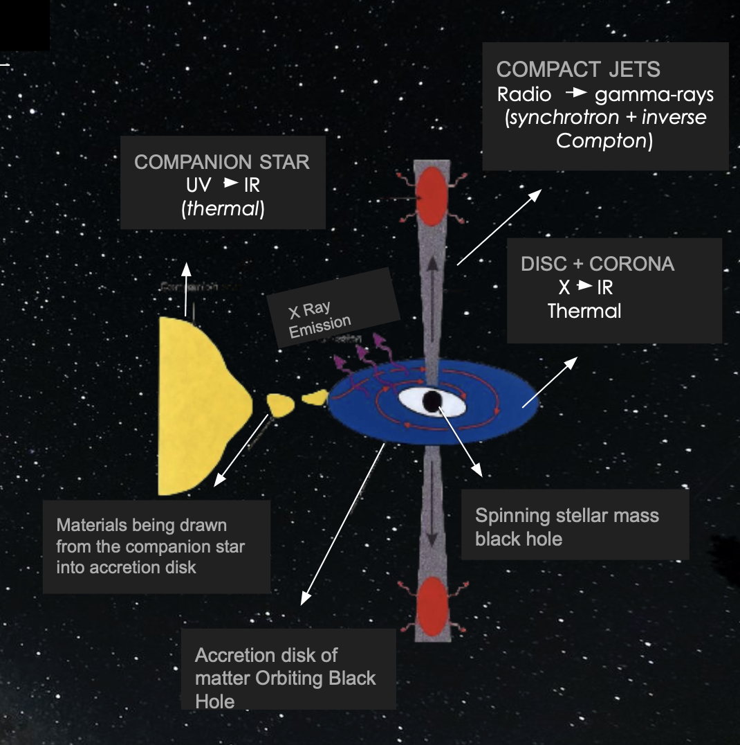
X-Ray Binaries : Microquasars

Slide 4
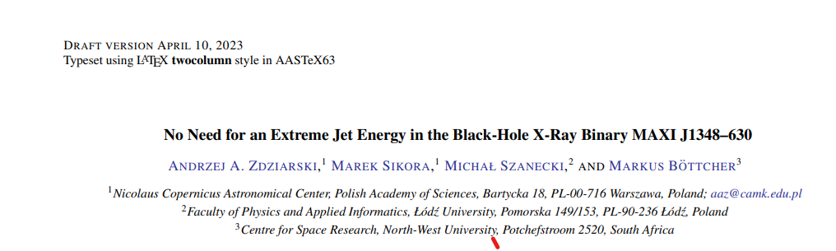
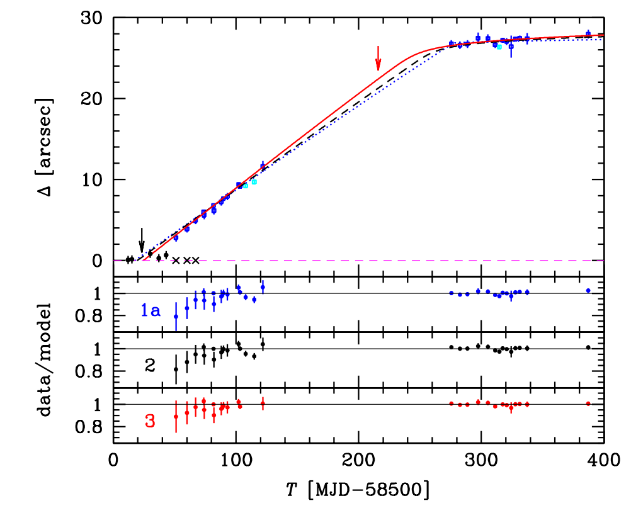
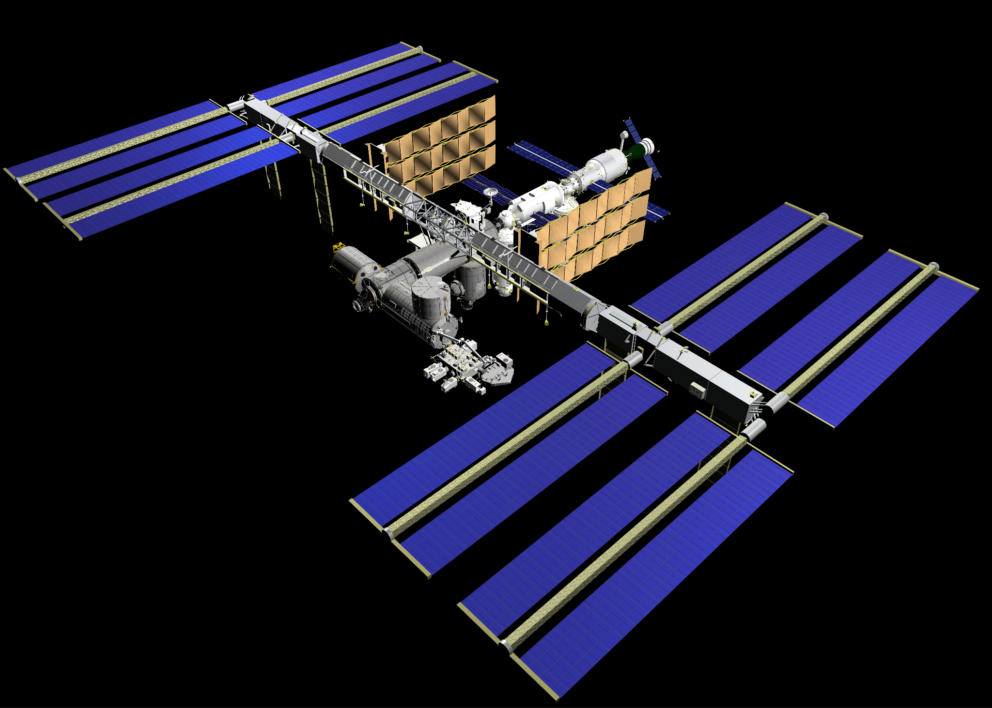
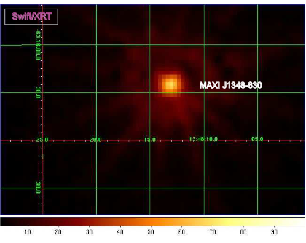
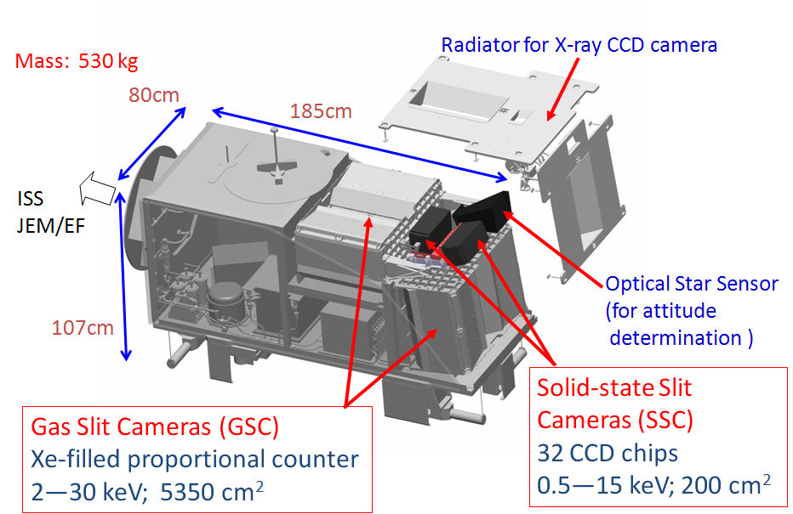
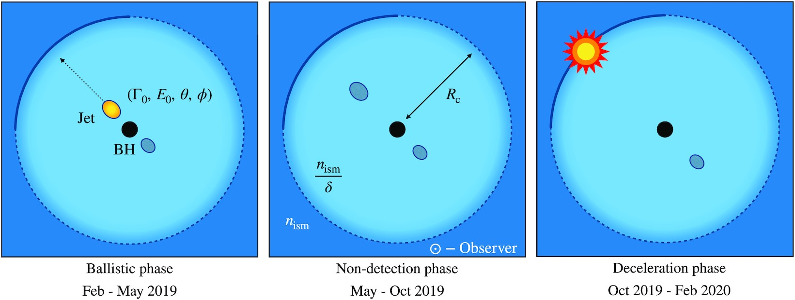
MOTIVATION
Zdziarski et al. 2023
MAXI J1348–630 was discovered as a bright X-ray transient on January 26, 2019, by the MAXI instrument aboard the ISS
Fig 3: Modeling the deceleration of a jet component.
Carotenuto et al (2022)
One main outburst +7 re brightening so far

Slide 5
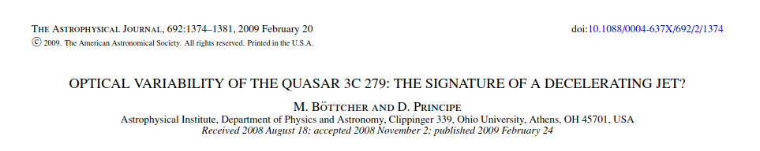
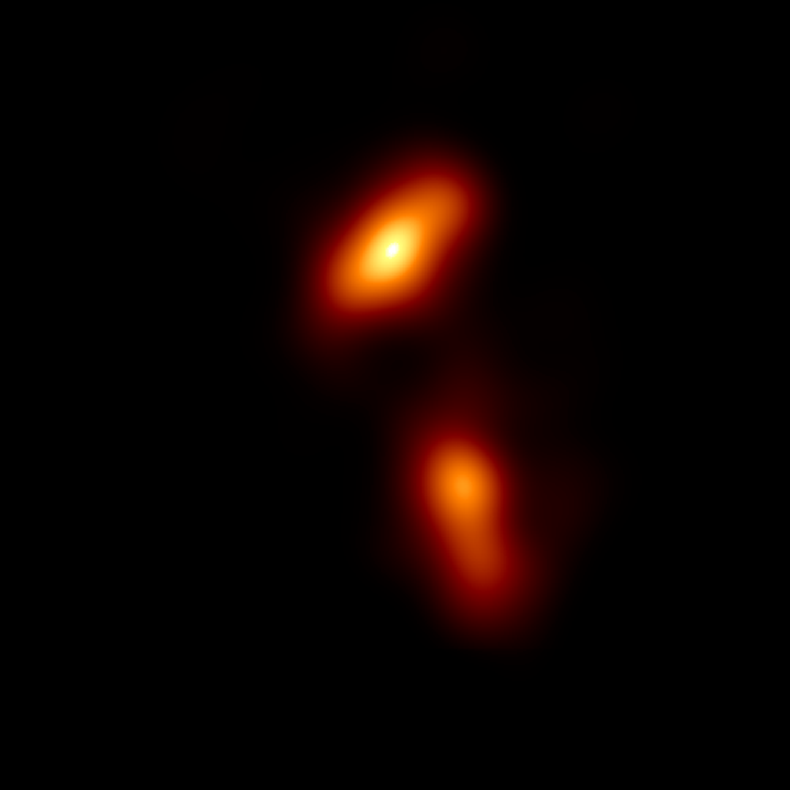
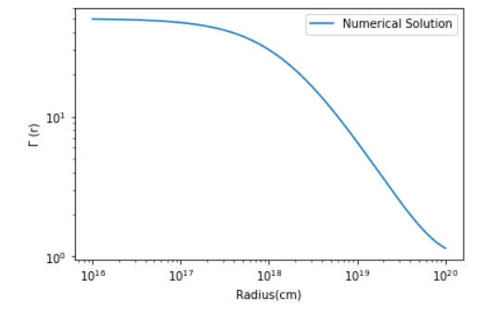
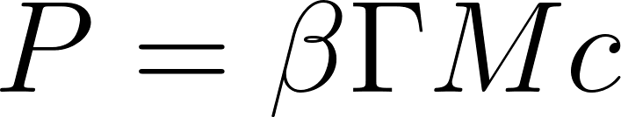
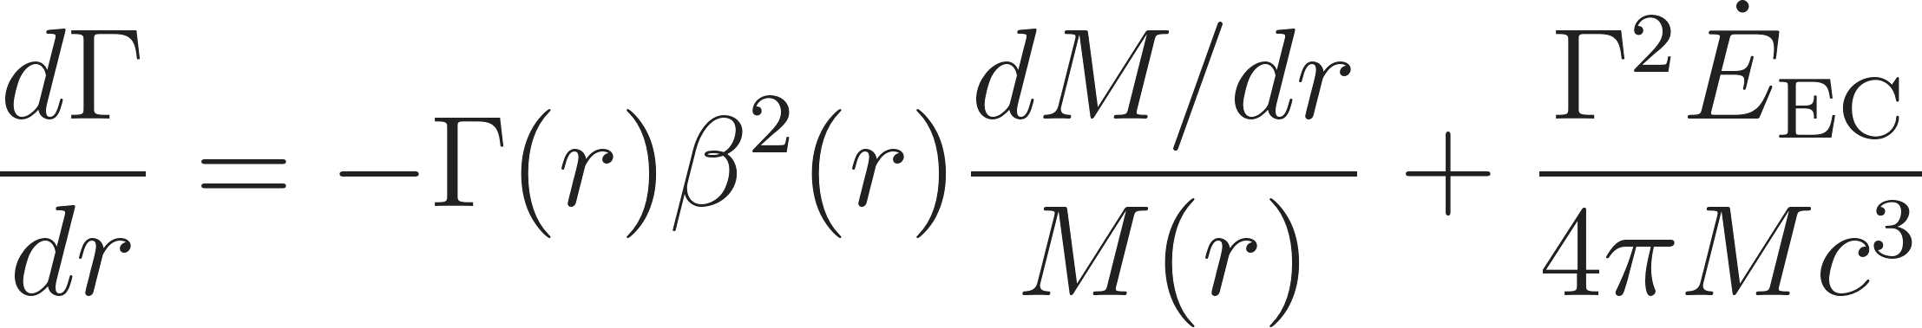
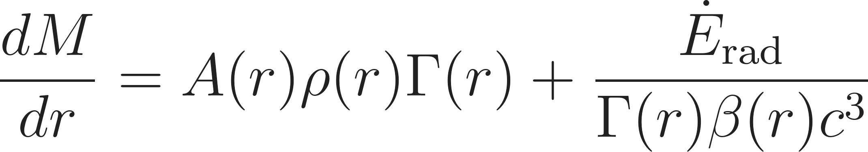
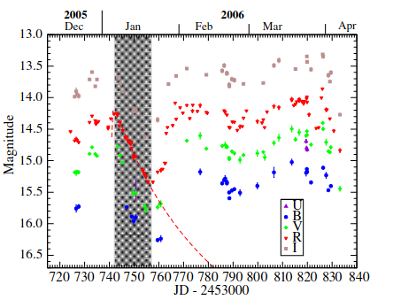
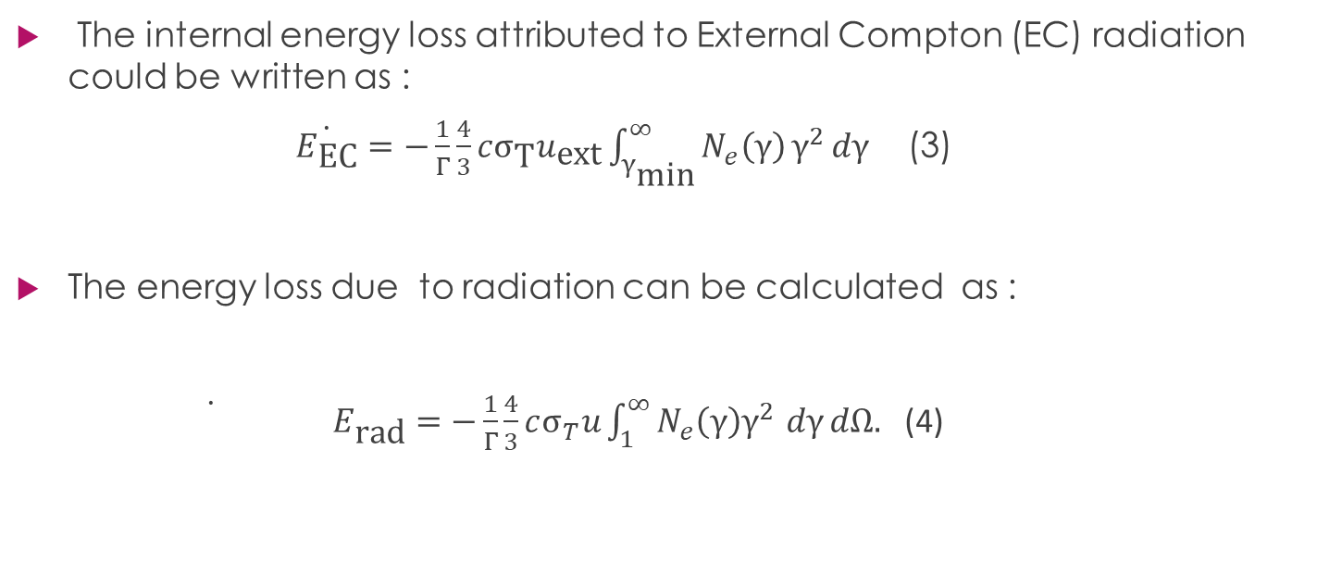
DECELERATING BLOB MODEL
Due to conservation of momentum
(1)
(2)
Boettcher & Principe (2009)

Slide 6
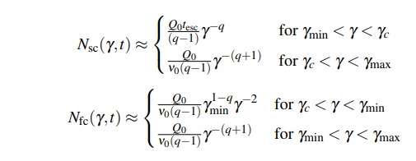




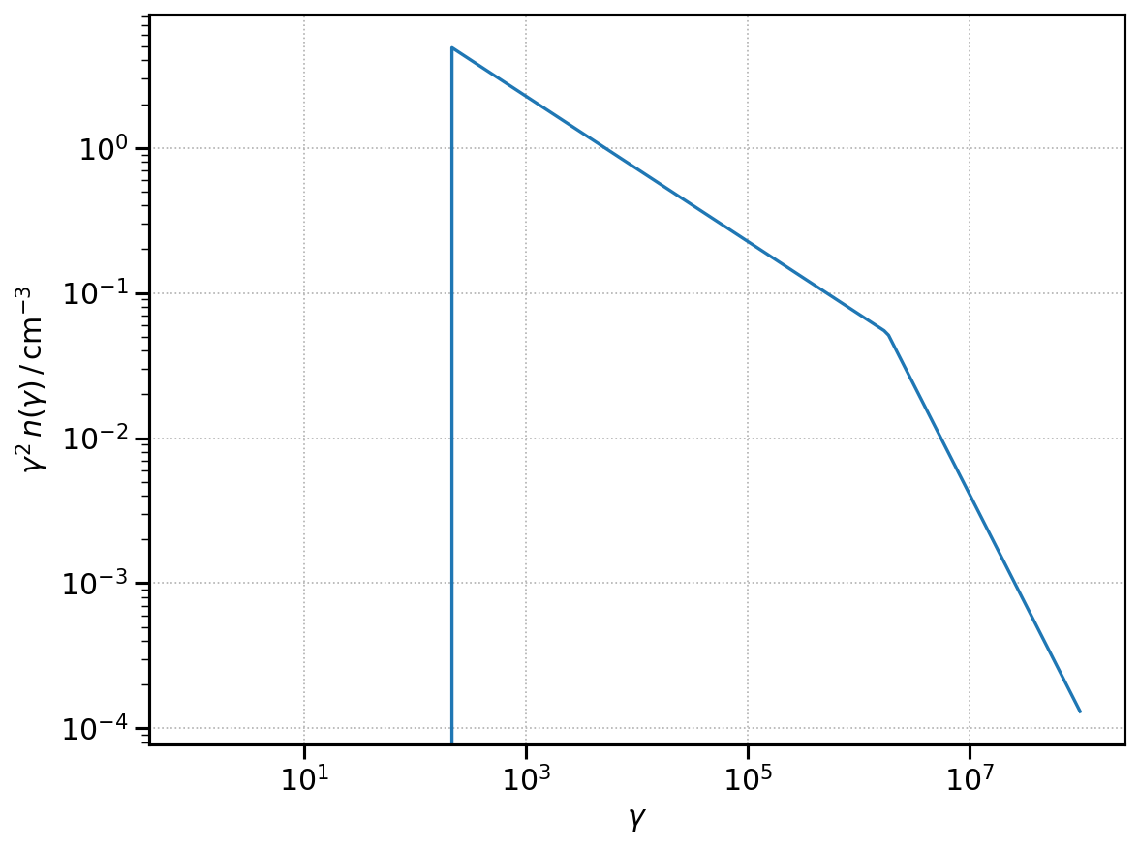


Relativistic Electron Distribution
Slow Cooling and Fast Cooling Regime
When slow cooling regime and is fast cooling regime .
Where : , and
fraction of swept-up power that is transferred
to relativistic electron
Low Energy Cut - Off High Energy Cut - Off
fastest conceivable acceleration timescale = synchrotron loss timescale
fraction of swept-up electrons which is accelerated to ultra relativistic energies.

Slide 7
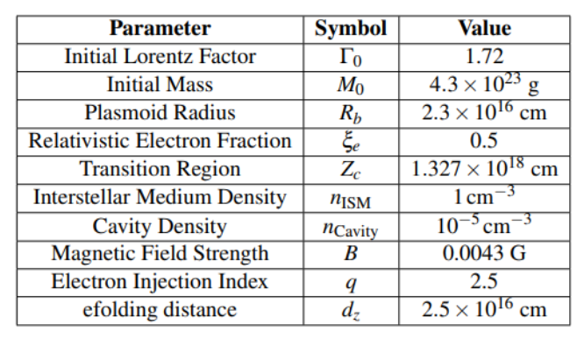
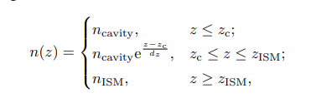
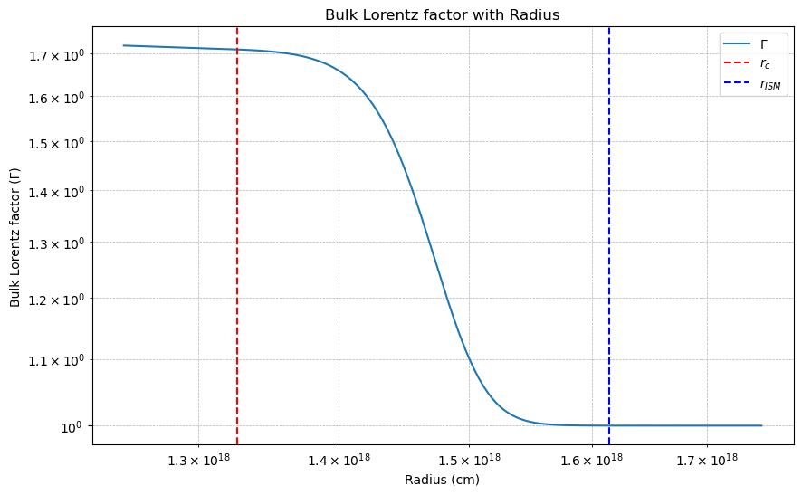
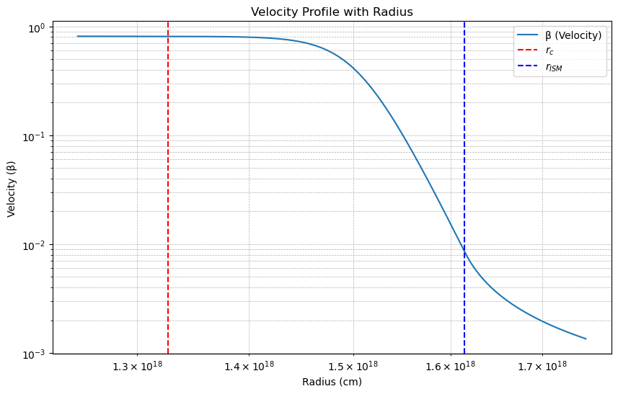
MAXI J1348-630
Sarath et al.(2025)

Slide 8
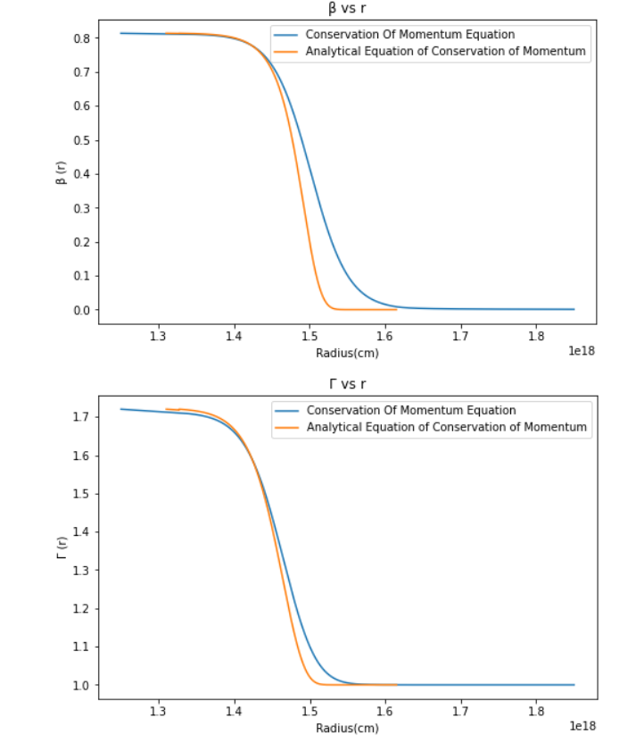
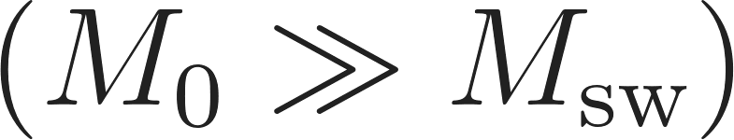
Analytical Solutions
1) Swept-up mass is negligibly small compared to the initial mass , i.e.,
2) The radiative energy and momentum loss terms are negligible .
Sarath et al.(2025)

Slide 9
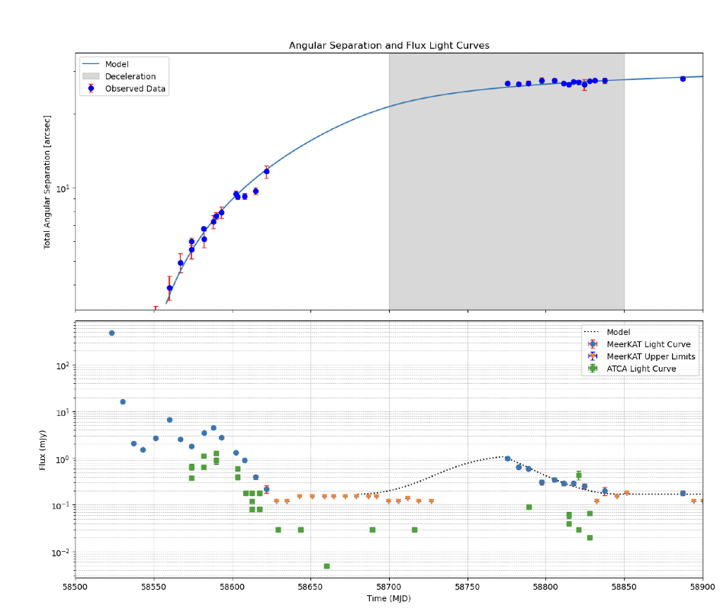
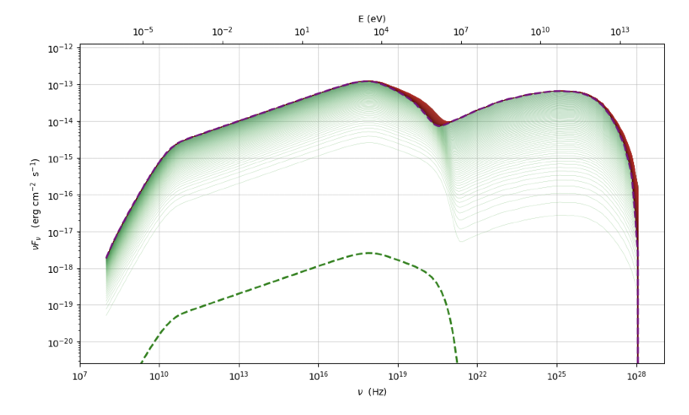
Temporally Evolving SED and Light Curve Fit
Adiabatically expanding
Interaction with ISM
Sarath et al.(2025)

Slide 10
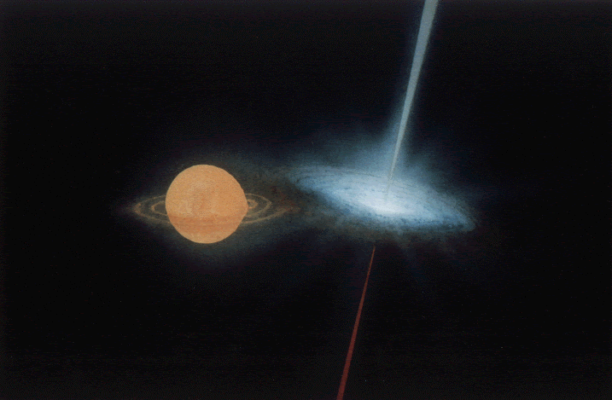
Summary & Future Work
Modeled radio light curve of MAXI J1348-630 during jet deceleration, considering swept-up material, radiation drag, and cooling.
Plasmoid shows coasting → self-similar deceleration, reproducing the RK1 radio light curve (~1 week) with no time delays across wavelengths.
SED predictions: X-ray synchrotron peak (below disk emission) and SSC peak at multi-GeV–TeV γ-rays → potentially detectable.
Approach is consistent with similar models applied to 3C279 and XTE J1550–564, suggesting broader applicability.
Future Work : Apply model to XTE J1550–564 to test if it reproduces radio & X-ray kinematics and light curves.

Slide 11
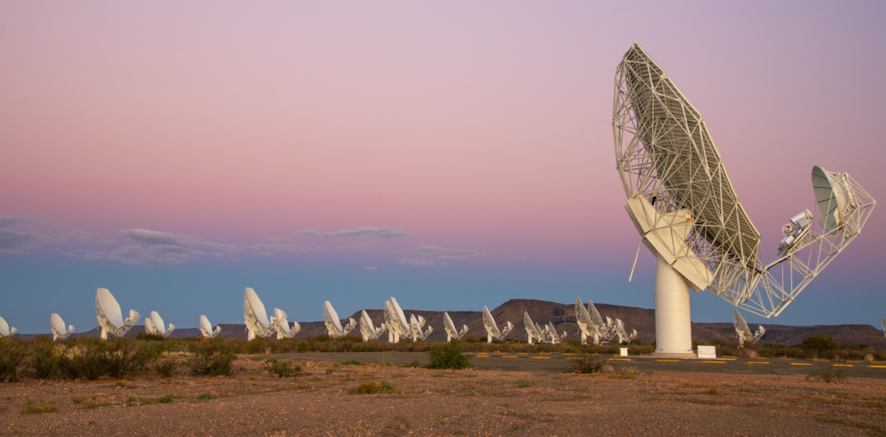
Thank you very much !
Thank You Very Much for the Opportunity !
Credits : SARAO

Slide 12
EXTRA SLIDES

Slide 13


Conservation of Energy Approach – MAXI J1348-630
Wang, X. Y., Dai, Z. G., & Lu, T. (2003). External shock model for the large-scale, relativistic X-ray jets from the microquasar XTE J1550-564. https://doi.org/10.1086/375638
The interaction between the relativistic ejecta and the surrounding medium is analogous to GRB external shock .
A relativistic forward shock expands into the ISM and a reverse shock moves into and heats the original ejecta.
Where,

Slide 14




Conservation of Energy Approach – MAXI J1348-630
We disregarded the radiation drag due to negligible radiation energy
We also considered
Ultra-relativistic shocks : s=6/17 Non – relativistic shocks : s=0.73
We found the equations of motion to be :
(5)
(6)

Slide 15






Analytical Solutions
Conservation of Momentum : and the radiative energy and momentum loss terms are taken to be negligible.
Conical Jet :
Cylindrical Jet :
Motion Inside the cavity : Motion inside the transition zone:

Slide 16

Analytical Solutions
Conservation of Energy :
Extra factor “s”

Slide 17
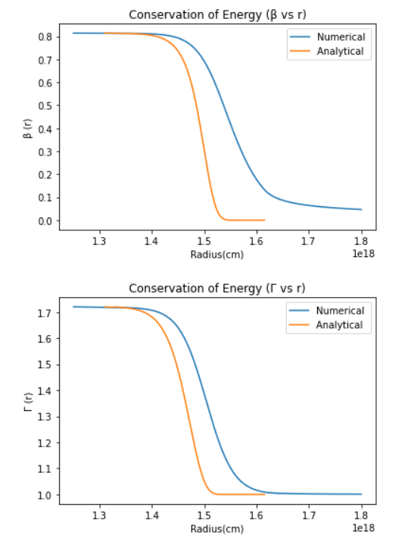
Analytical Solutions with Numerical Solutions

Slide 18
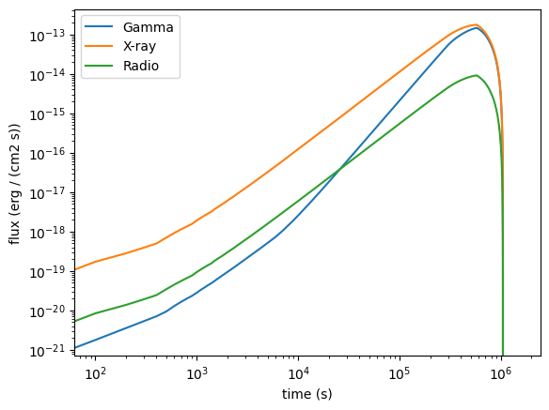
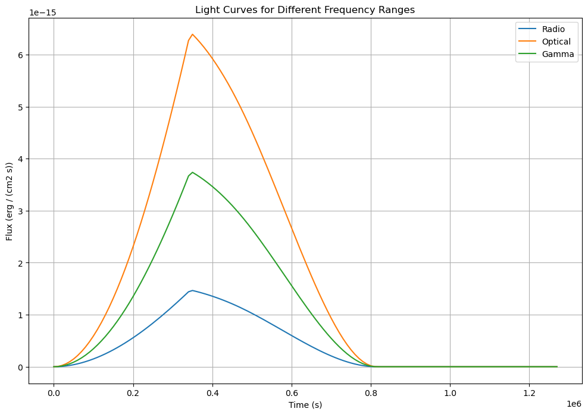
Expected Light Curve

