Slide 1
Radio and Optical Properties of the Blazar PKS 1614+051 at z=3.21
A. Mikhailov, Yu. Sotnikova, V. Vlasyuk, D. Kudryavtsev, M. Khabibullina, T. Mufakharov et al.
Special Astrophysical Observatory, Russia
19 September 2025

Slide 2
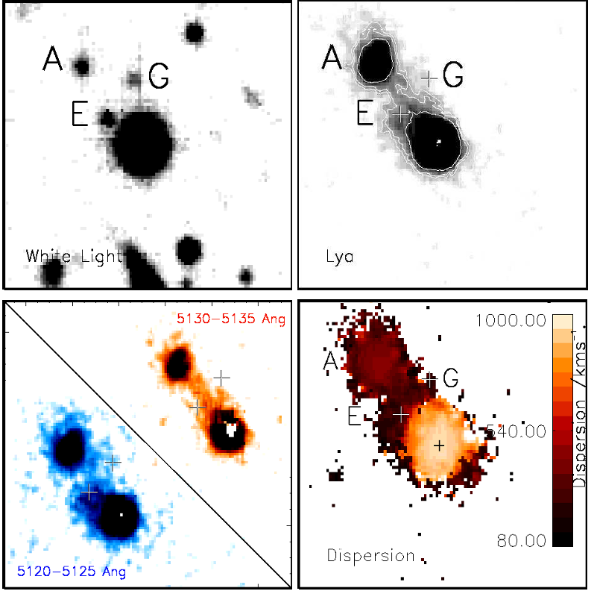
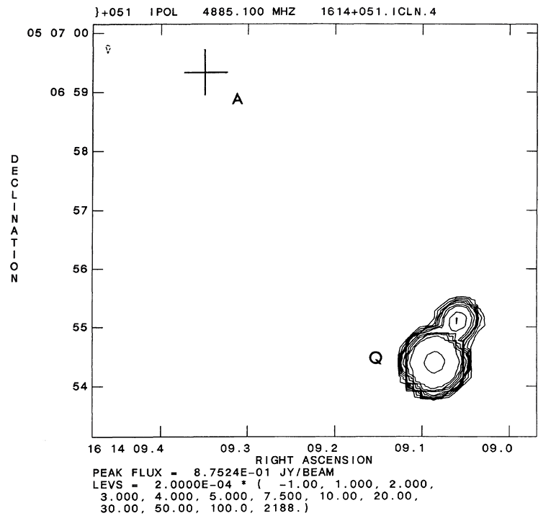
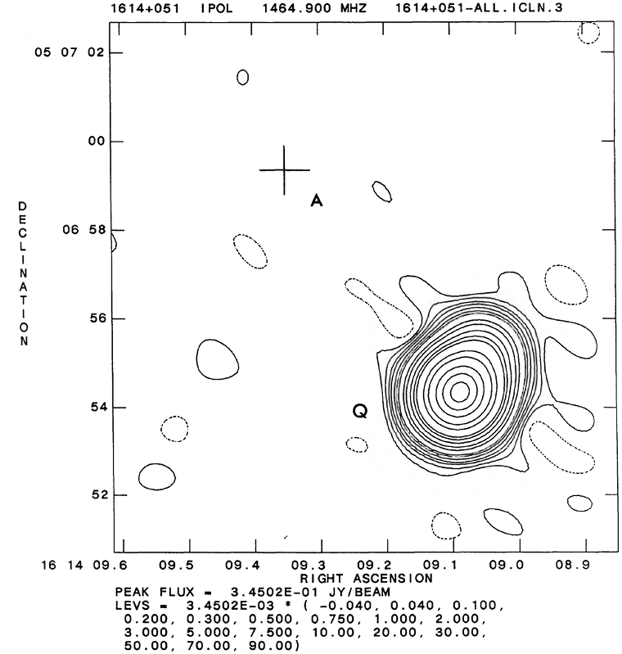
Blazar PKS 1614+051
VLA images, Djorgovski et al. 1987
Husband et al. 2015

Slide 3
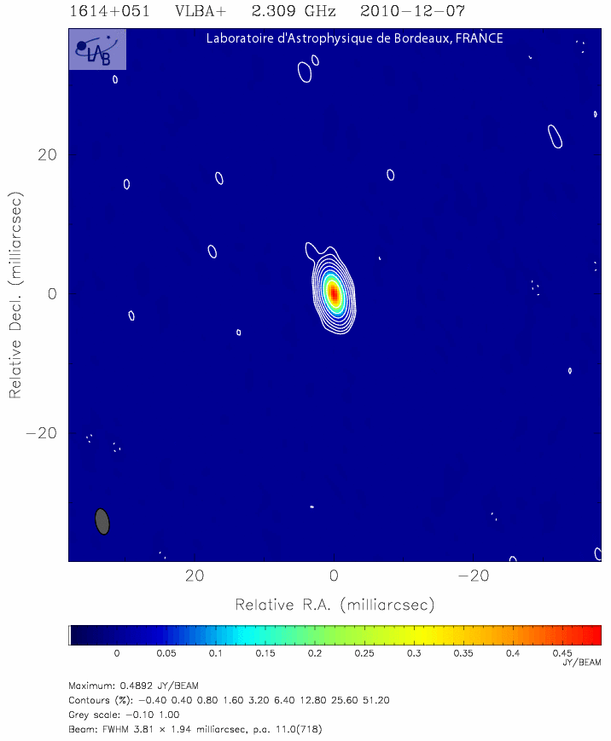
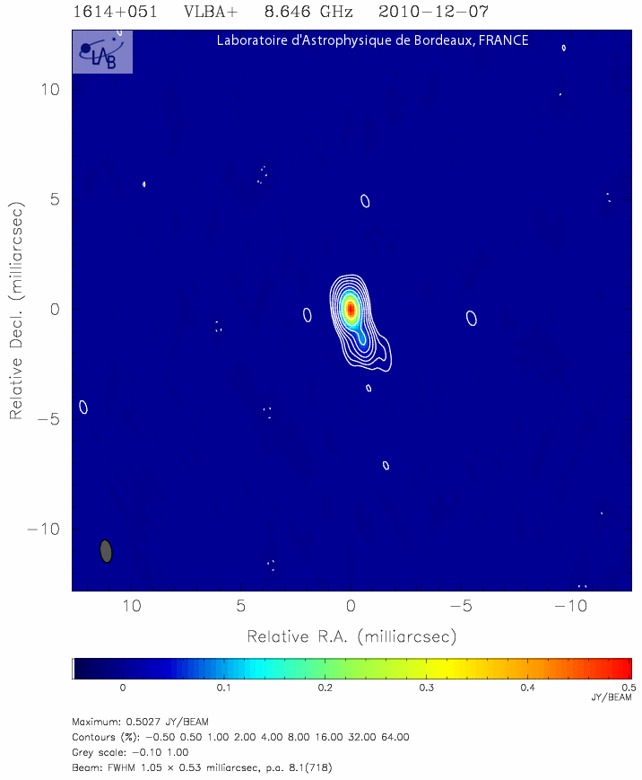
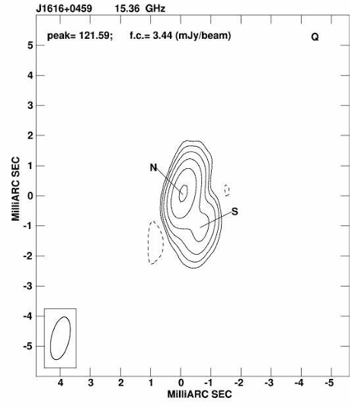
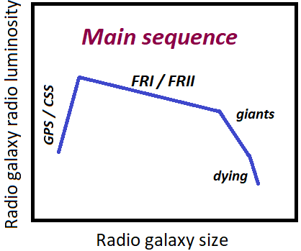
VLBI structure
Orienti et al. 2006
An & Baan 2012
GPS, HFP, CSO candidate (O’Dea 1990, O’Dea et al. 1991, Sotnikova et al. 2021)
Young radio source?

Slide 4
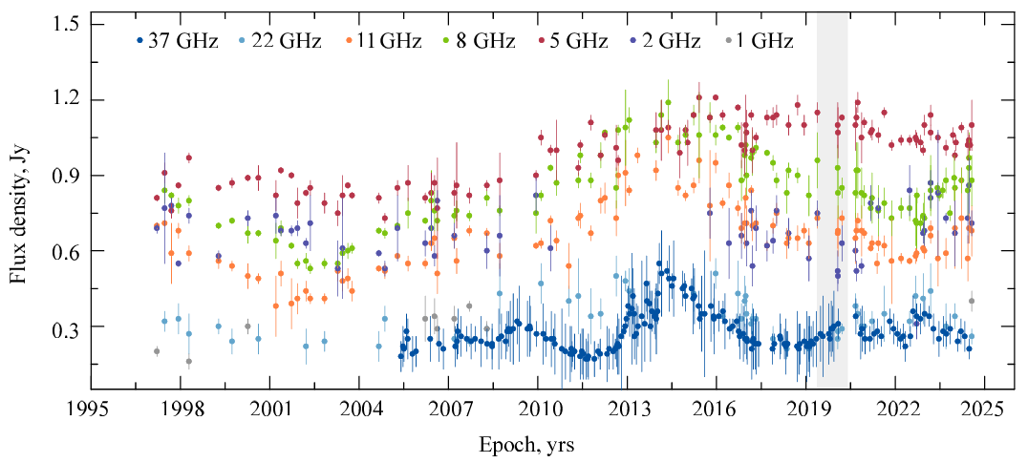
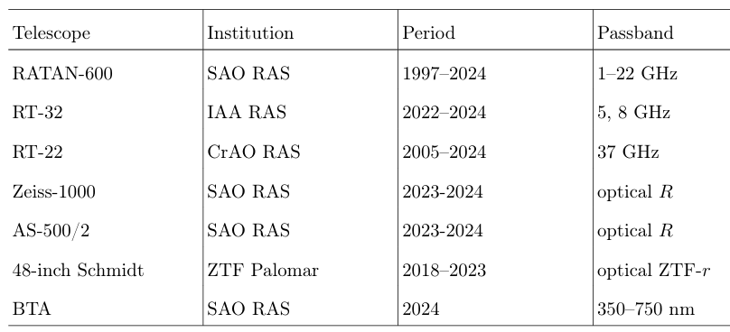
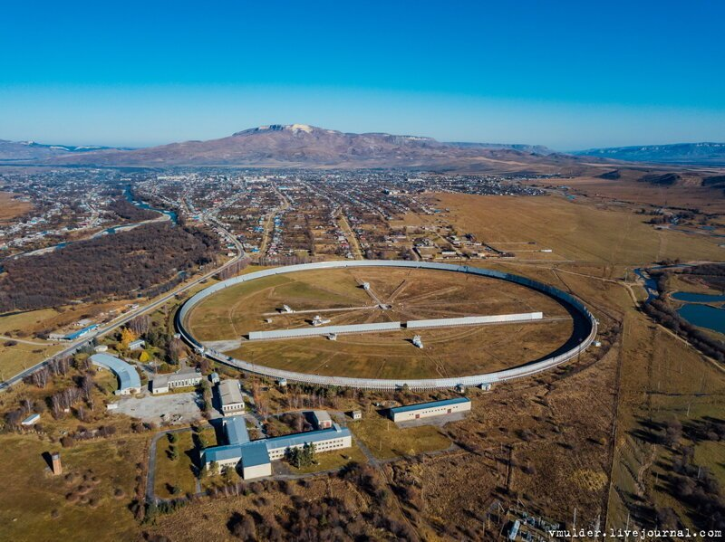
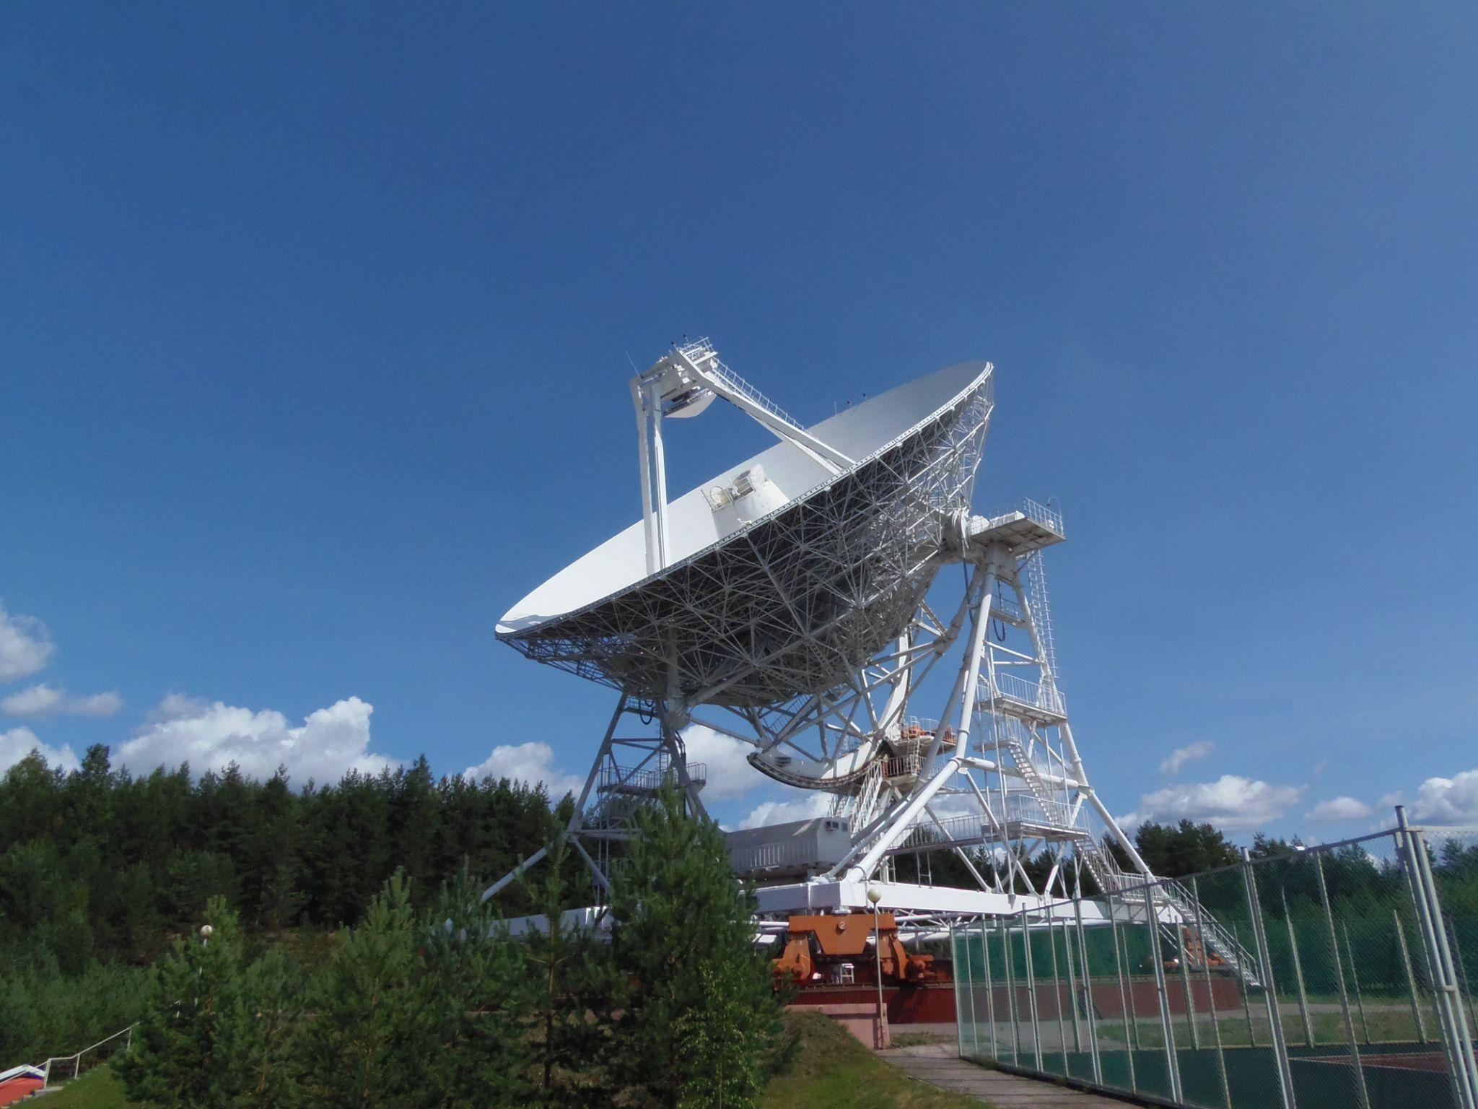
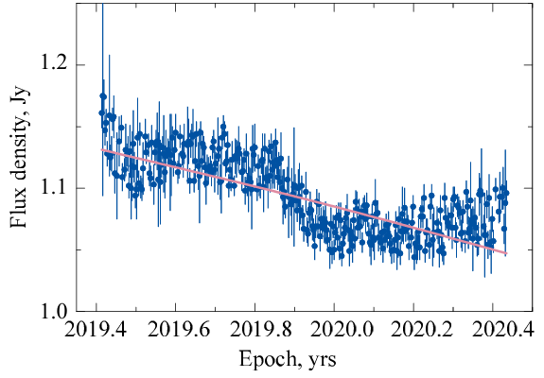
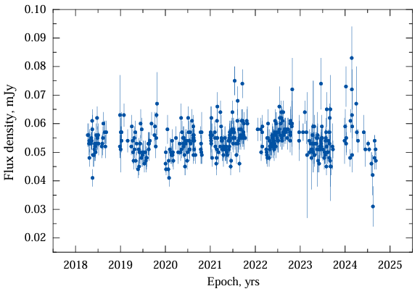
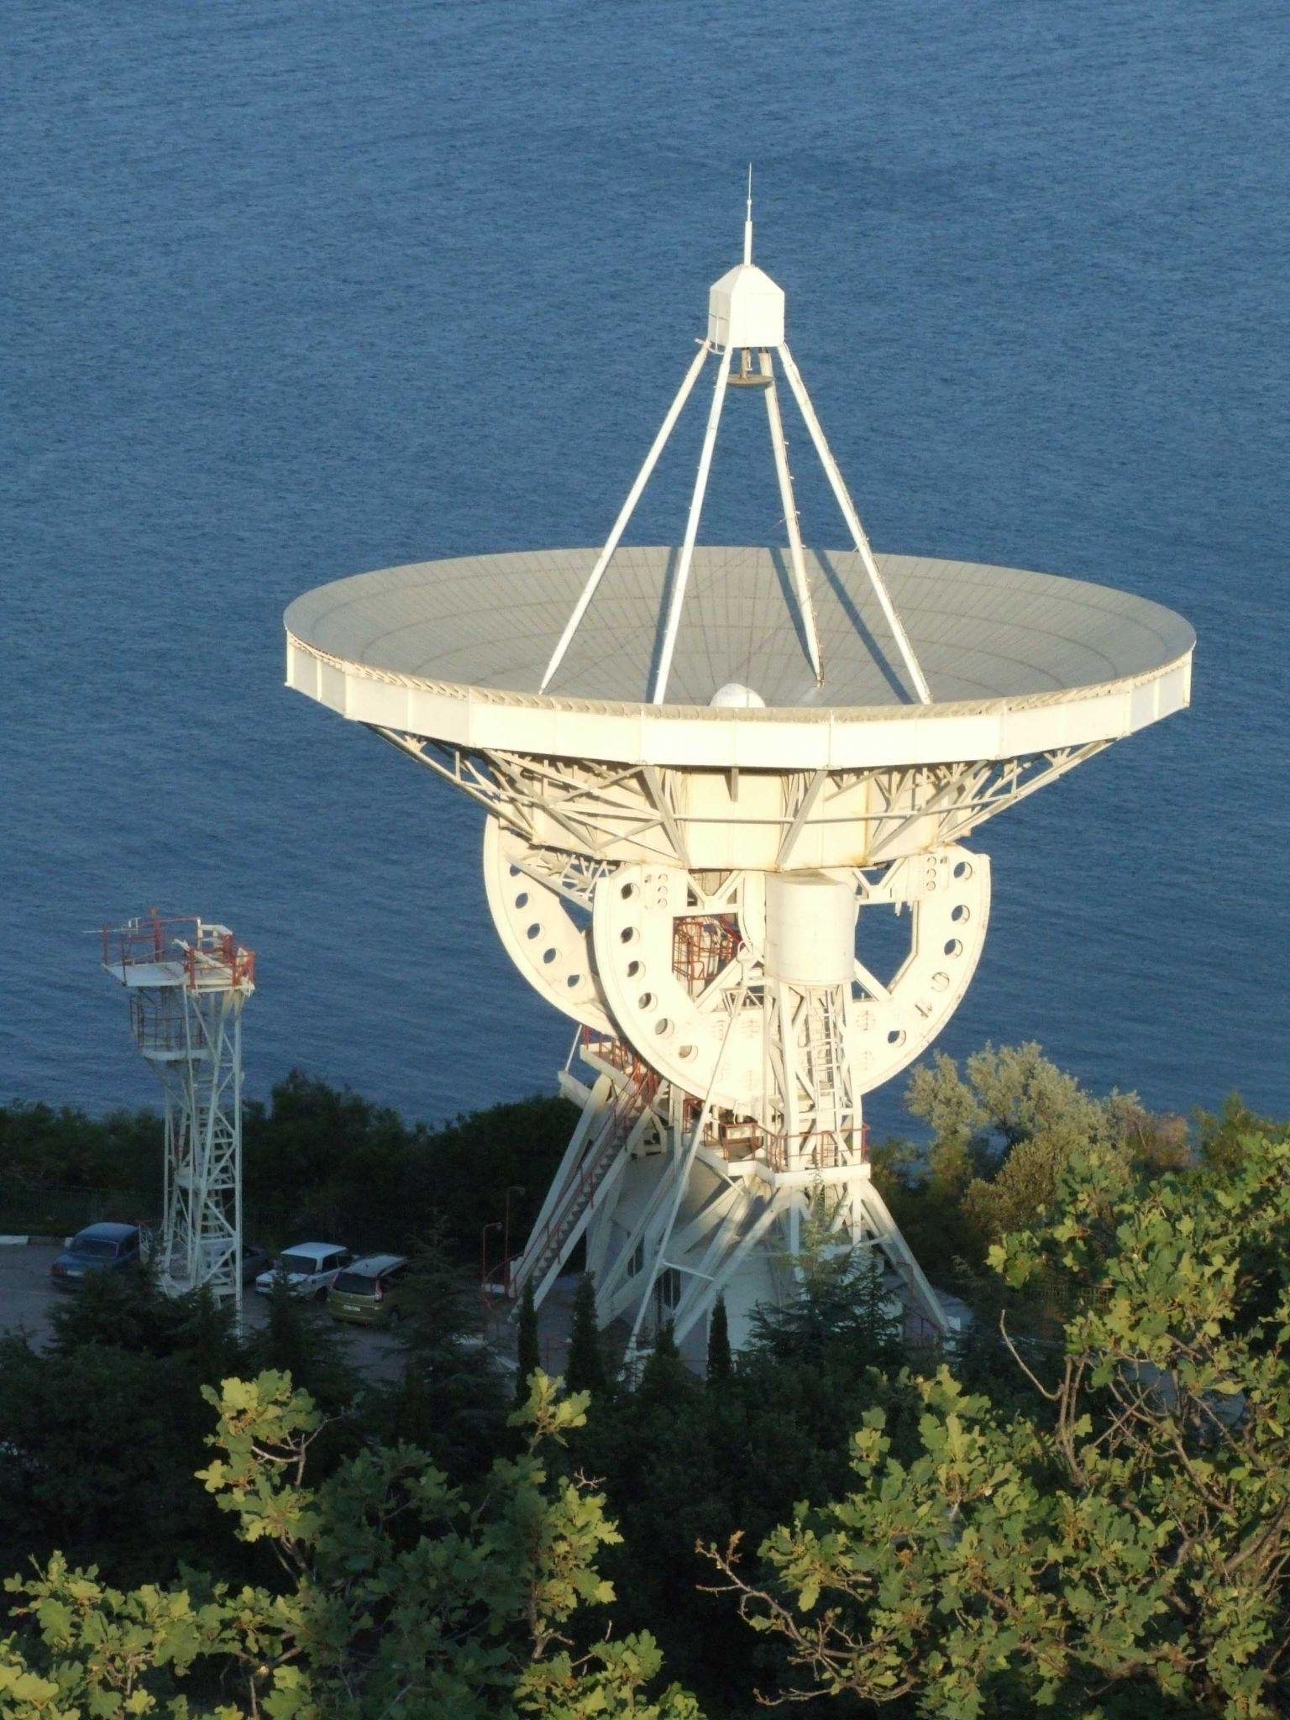
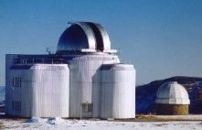
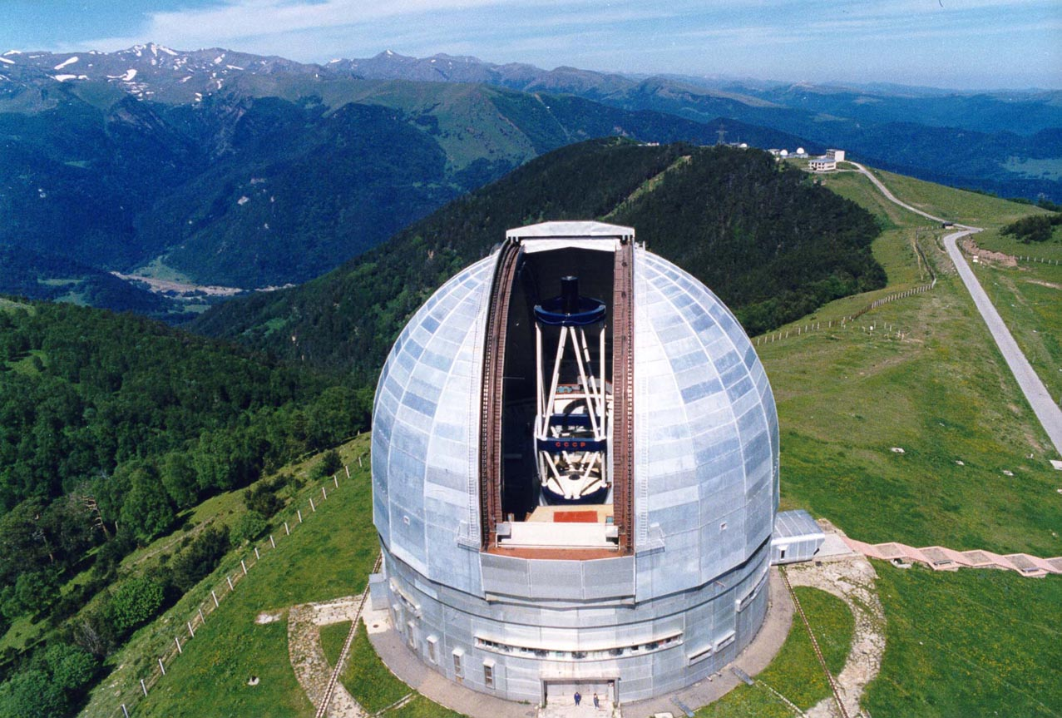
Light curves
Daily light curve at 5 GHz
Optical light curve in R-band

Slide 5
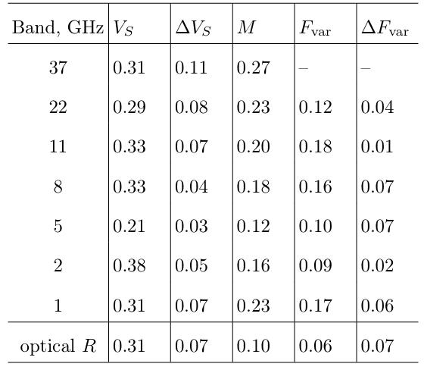





Variability level

Slide 6
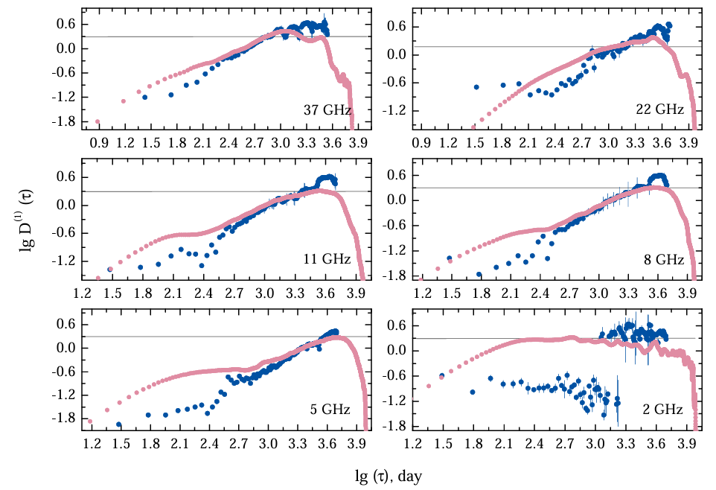
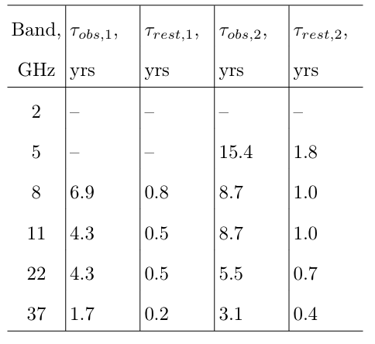

Structure function analysis
Characteristic time scales
Upper limits of emitting region size
0.4-3.5 pc
Method 1: without interpolation (dark blue points)
Method 2: with interpolation (pink points)

Slide 7
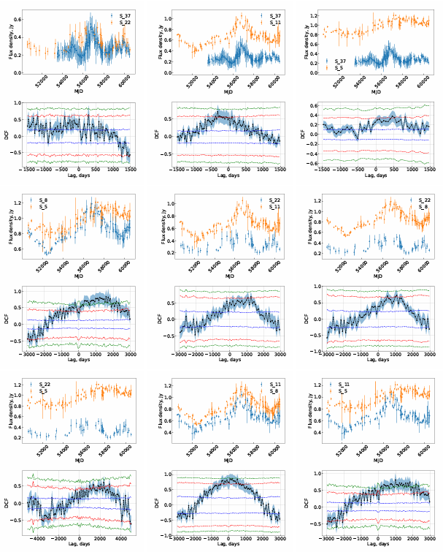
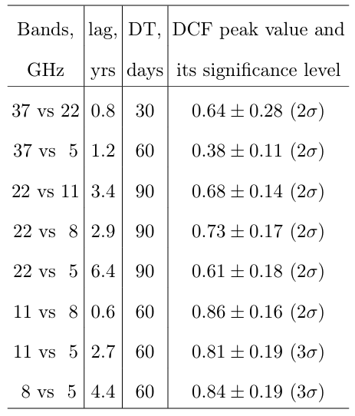
DCF
Lags between frequencies

Slide 8
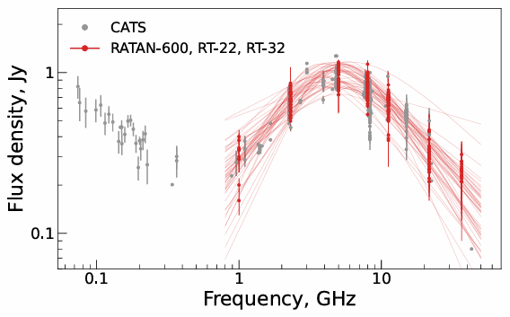
Broadband radio spectra
Low Frequency Component (steep)
+
High Frequency Component (peaked)

Slide 9
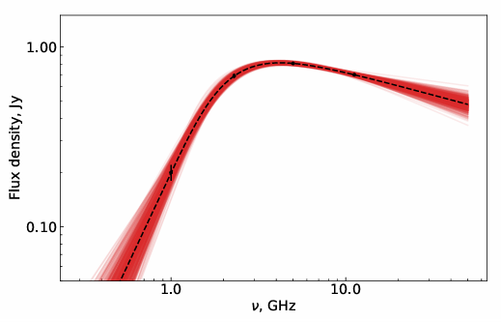

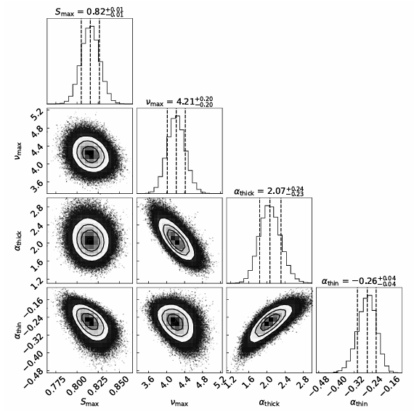

Absorption
An example of MCMC fitting (epoch 1997.21, SSA model)
synchrotron self-absorption
inhomogeneous external free–free absorption
SSA or FFA?
SSA + FFA?

Slide 10
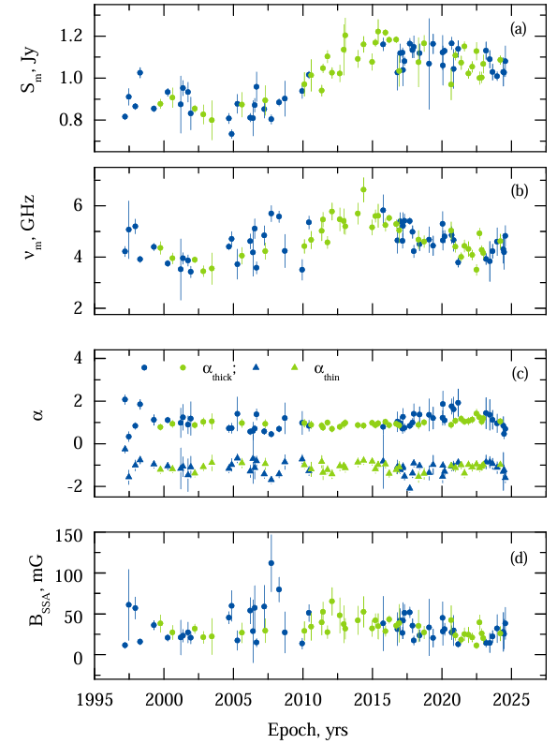

Magnetic field strength

Slide 11
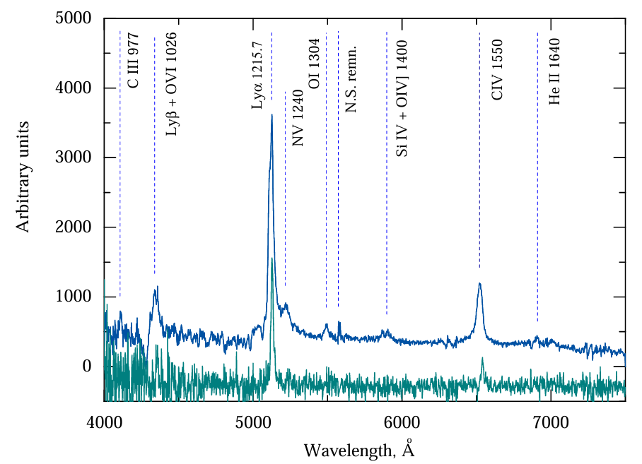
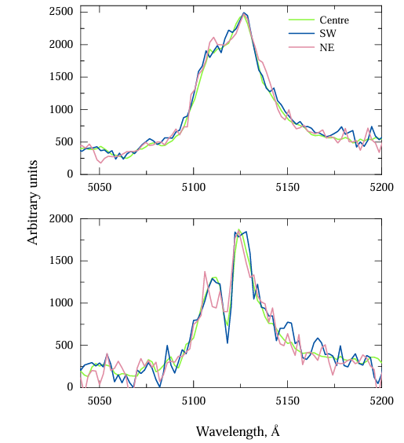
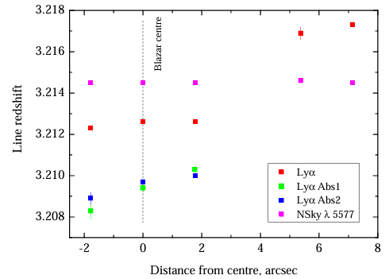
Optical spectroscopy
The redshift of the Lyα-component
Spectrum of PKS 1614+051 (blue) and
a companion galaxy (green)
The spectra of the central region of PKS 1614+051
taken on 14/15 July 2024 (top) and
30 June/1 July 2024 (bottom)

Slide 12
Summary
The PKS 1614+051 is a good probe to study of AGN evolution in early Universe.
The variability level is quite low during monitoring, 0.1-0.3, the spectral shape is constant.
The PKS 1614+051 is a reliable GPS radio source evolving in interacting a host galaxy and a companion galaxy.
Time delays between frequencies range from 0.6 to 6.4 years meaning the greater opacity at lower frequencies; the characteristic time scales of variability are 0.2-1.8 years in the source’s rest frame mening the upper limits of emitting region sizes 0.4-3.5 pc.
We suppose, both the SSA and FFA processes give contribution into the total radio spectrum. The mean magnetic field strength is 30 mG assuming SSA process.
The spectroscopic study has found signs of the regular motion a neutral hydrogen envelope around the blazar center.
The reported results are published in 2024AstBu..79..548S
Thank you for your attention!

