Slide 1
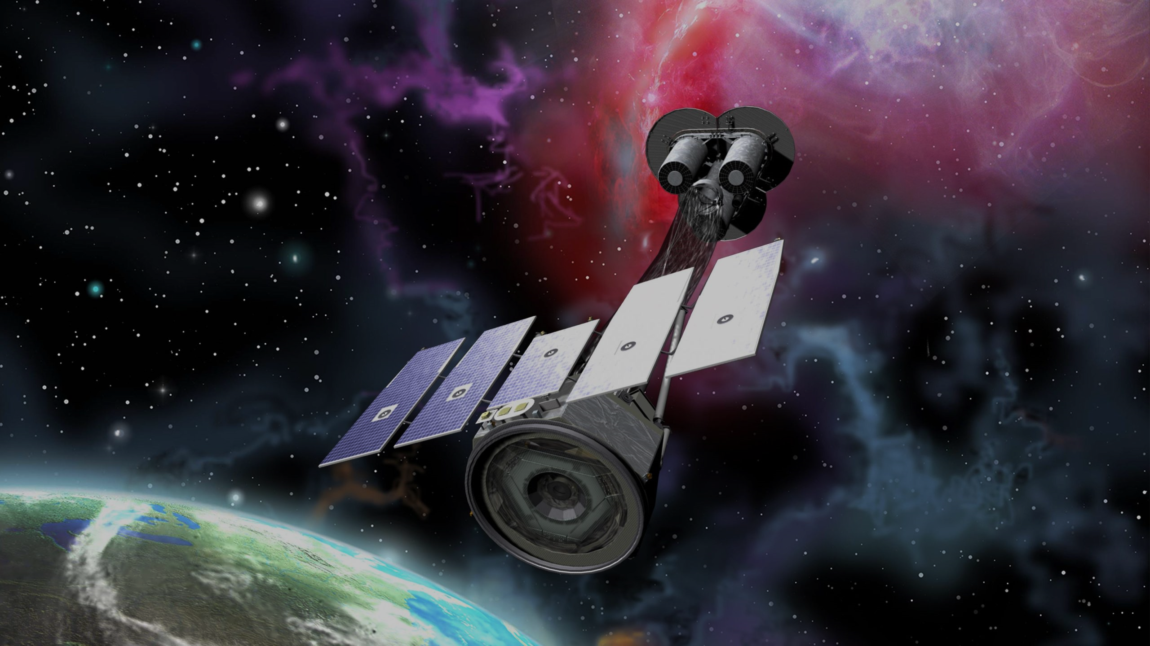




X-Ray Polarization in Blazars
0
Markus Böttcher,
North-West University
Potchefstroom
South Africa

Slide 2
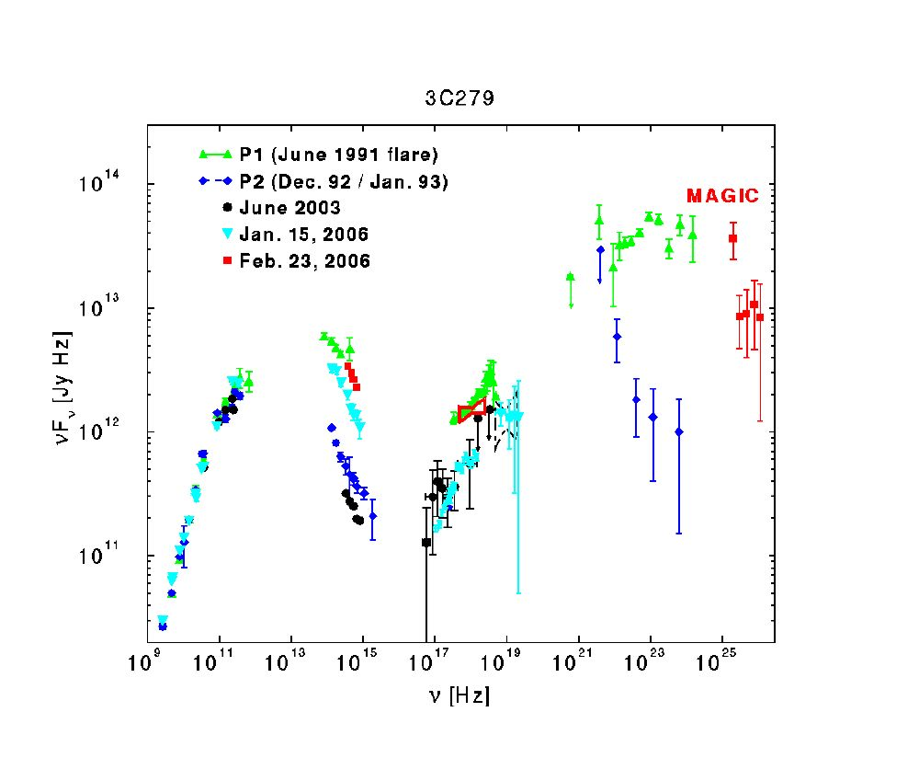
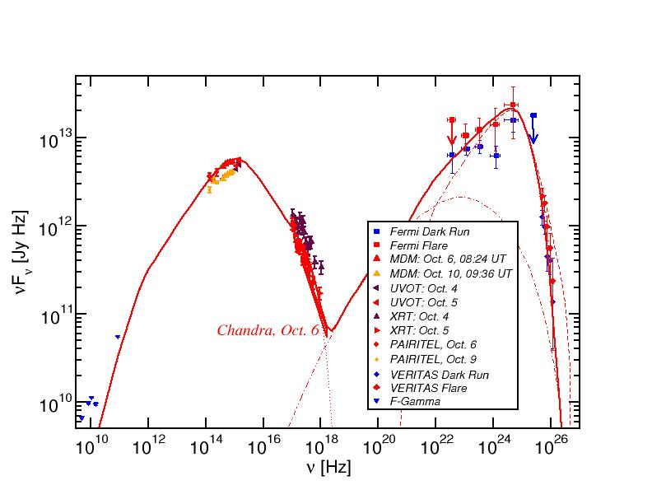
Blazar Spectral Energy Distributions (SEDs)
3C66A
Non-thermal spectra with two broad bumps:
Low-energy (probably synchrotron):
radio-IR-optical(-UV-X-rays)
High-energy (X-ray – γ-rays)

Slide 3
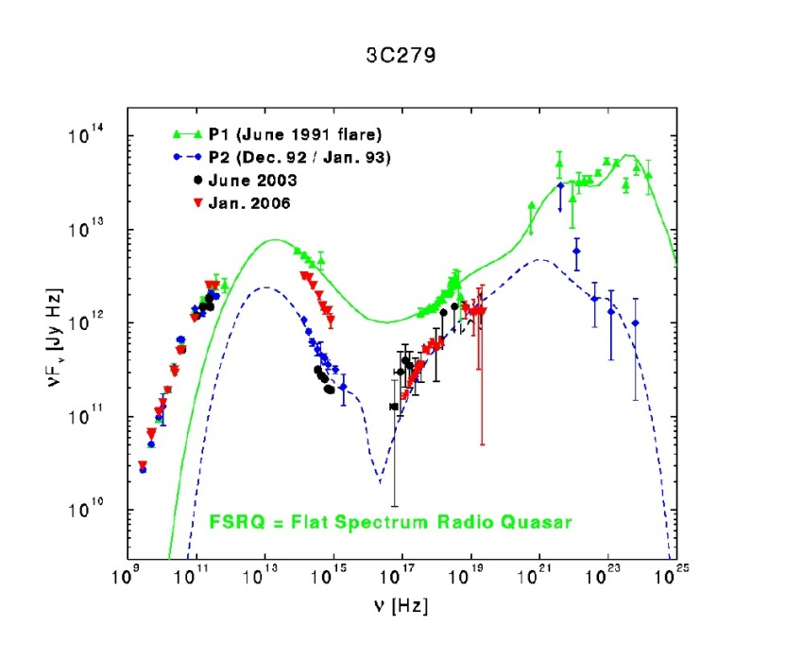
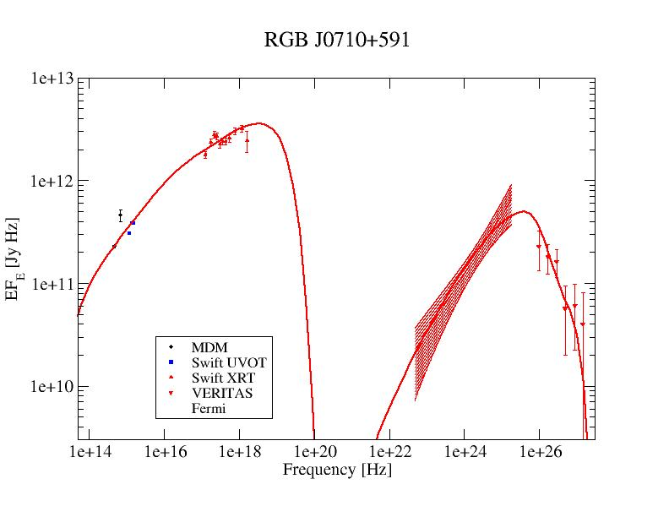
Blazar Classification
0
3C66A
Focus of this talk
Athira (next talk)
(Abdo et al. 2011)
(Acciari et al. 2009)
(Hartman et al. 2000)
High-Synchrotron Peaked (HSP): High-frequency peaked BL Lacs (HBLs):
Low-frequency component from radio to UV/X-rays,
ν_{sy} > 10¹⁵ Hz
often dominating the total power
High-frequency component from hard X-rays to high-energy gamma-rays
Low-Synchrotron Peaked (LSP): Quasars (FSRQs)/ Low-frequency peaked BL Lac Objects (LBLs)
Low-frequency component from radio to optical/UV,
ν_{sy} ≤ 10¹⁴ Hz
High-frequency component from X-rays to γ-rays, often dominating total power
Intermediate-Synchrotron Peaked (ISP): Intermediate BL Lacs (IBLs):
Peak frequencies at IR/Optical and GeV gamma-rays,
10¹⁴ Hz < ν_{sy} ≤ 10¹⁵ Hz
Intermediate overall luminosity
Sometimes γ-ray dominated

Slide 4
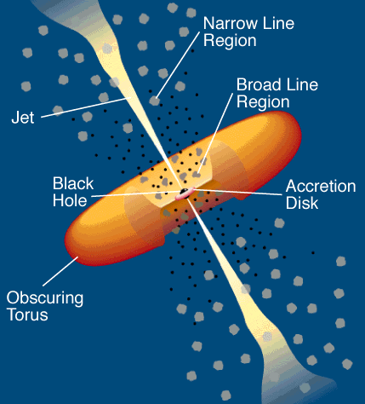
Leptonic Blazar Model
0
Synchrotron emission
Injection, acceleration of ultrarelativistic electrons
Relativistic jet outflow with Γ ≈ 10
νF_{ν}
Q_{e} (γ,t)
γ^{-q}
ν
γ₁
γ₂
γ
Compton emission
Radiative cooling ↔ escape =>
νF_{ν}
γ^{-q} or γ⁻²
Q_{e} (γ,t)
ν
γ^{-(q+1)}
Seed photons:
Synchrotron (within same region [SSC] or external sources, e.g., accretion disk, BLR, dust torus (EC = External Compton)
γ₁
γ_{b}
γ₂
γ
γ_{b}:
τ_{cool}(γ_{b}) = τ_{esc}
γ_{b}
γ₁
γ₂

Slide 5
Hadronic Blazar Models
0
Injection, acceleration of ultrarelativistic electrons and protons
Proton-induced radiation mechanisms:
Relativistic jet outflow with Γ ≈ 10
νF_{ν}
γ^{-q}
ν
Q_{e,p} (γ,t)
Proton synchrotron
γ₁
γ₂
γ
pγ → pπ⁰ π⁰ → 2γ
Synchrotron emission of primary e⁻
pγ → nπ⁺ ; π⁺ → μ⁺ν_{μ}
μ⁺ → e⁺ν_{e}ν_{μ}
νF_{ν}
→ secondary μ-, e-synchrotron
ν
Cascades …

Slide 6
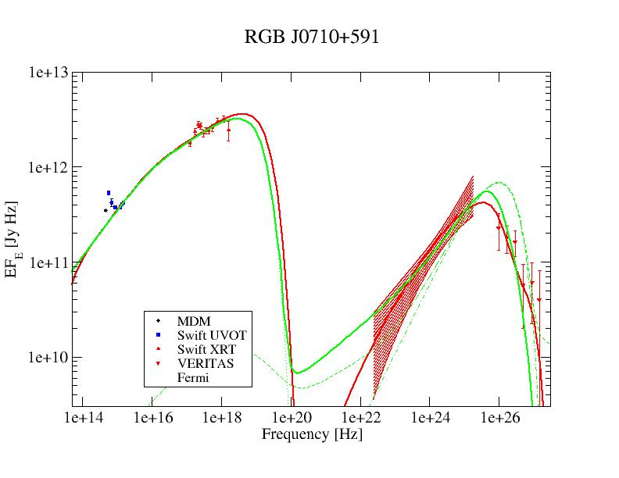
Leptonic vs. Hadronic Model Fits to Blazar SEDs
(HBL)
Red = leptonic
Green = lepto-hadronic
In many cases, leptonic and hadronic models can produce equally good fits to the SEDs.
Possible Diagnostics to distinguish:
Neutrinos
Variability
Polarization

Slide 7


Polarization Mechanisms
Synchrotron Polarization
For synchrotron radiation from a power-law distribution of electrons with n_{e} (γ) ~ γ^{-p} → F_{ν} ~ ν^{−α} with α = (p−1)/2.
In a perfectly ordered magnetic field:
Sy,max
= $\frac{p+1}{p+7/3}$
= $\frac{α+1}{α+5/3}$
Π_{PL}
In a turbulent multi-zone scenario (e.g., Marscher 2014: ApJ, 780, 87) with N cells:
Π^{Sy} =
Sy,max
Π /√N

Slide 8
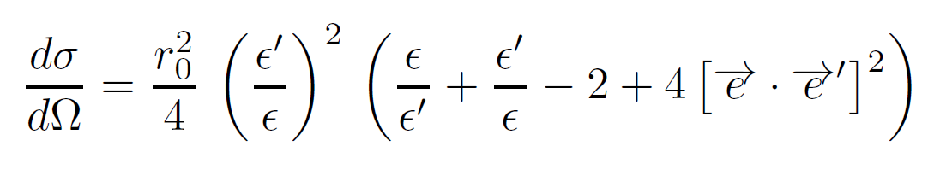
Compton Polarization
Compton cross section is polarization-dependent:
= hν/(m_{e}c²): before scattering
ε’: after scatt.
Thomson regime: ε ≈ ε’
dσ/dΩ = 0 if e∙e’ = 0
Scattering preferentially in the plane perpendicular to e!
Preferred polarization direction is preserved.
p
e
k
p’
e’
k’

Slide 9
Compton Polarization
Compton scattering of an anisotropic radiation field by non-relativistic electrons induces polarization perpendicular to the plane of scattering.
k
e
e’
k’
e⁻
Observer

Slide 10
Compton Scattering by Relativistic Electrons
Relativistic aberration => approx. axisymmetric radiation field in co-moving frame of e⁻
Unpolarized target photons (EC emission) → Unpolarized
Polarized target photons (SSC) → SSC polarization ~ ½ of target (synchrotron) photon polarization in a single zone with ordered magnetic field.
e⁻ (γ)
1/γ

Slide 11
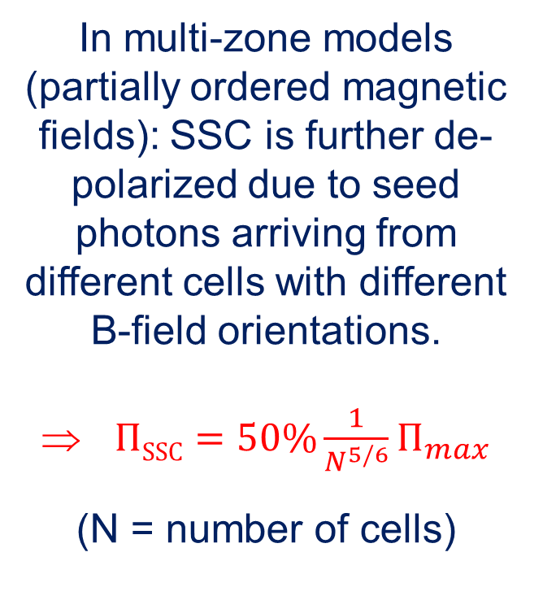
Double Depolarization of SSC
In multi-zone models (partially ordered magnetic fields): SSC is further de-polarized due to seed photons arriving from different cells with different B-field orientations.
$ΠSSC=50\%\frac{1}{N^{5/6}}Π_{max}$
(N = number of cells)
B
C
(Peirson & Romani 2019: ApJ 885, 76;
Zhang, MB, & Liodakis 2024: ApJ 976, 93)

Slide 12
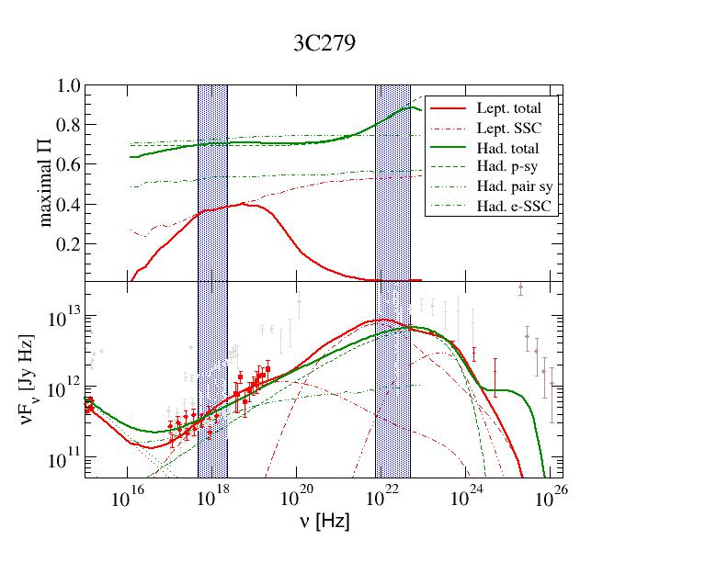
X-Ray and Gamma-Ray Polarization in LSP blazars
Hadronic model: Synchrotron dominated => High Π, generally increasing with energy (SSC contrib. in X-rays).
Leptonic model:
X-rays SSC dominated:
~ 20 – 40 %;
γ-rays EC dominated
=> Negligible Π.
(Zhang & Bӧttcher, 2013, ApJ 774, 18)

Slide 13
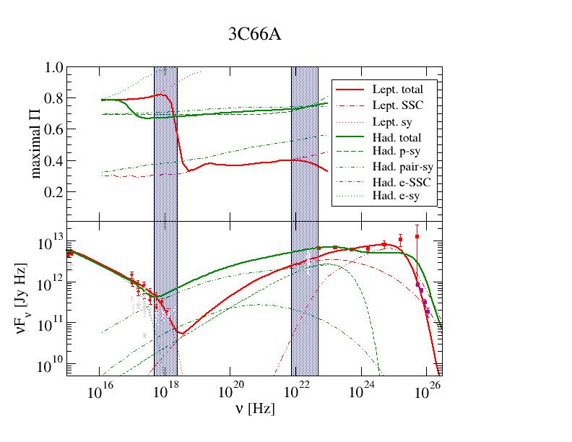
X-Ray and Gamma-Ray Polarization in ISP blazars
Hadronic model:
Synchrotron dominated => High Π, throughout X-rays and γ-rays
Leptonic model:
X-rays sy. Dominated => High Π, rapidly decreasing with energy;
γ-rays SSC/EC dominated
=> Small Π.
(Zhang & Bӧttcher, 2013: ApJ 774, 18)

Slide 14
Simulated MWL polarization in ISP blazars – IXPE predictions
Synchrotron (low-energy) X-ray polarization possibly detectable within 300 – 500 ksec, but not SSC polarization.
(Peirson et al. 2022: ApJ 931, 59)

Slide 15
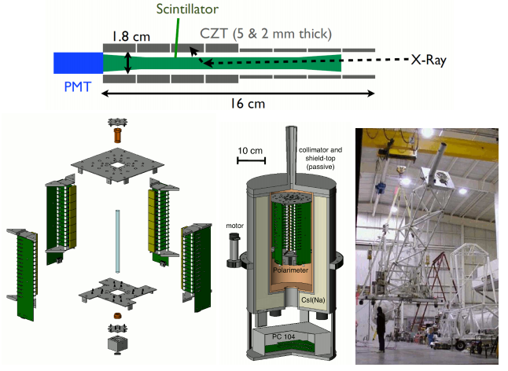
X-Ray Polarimeters (I)
Single Compton scattering
B
Pol. Direction e
Look for angular modulation of scattered X-rays

Slide 16
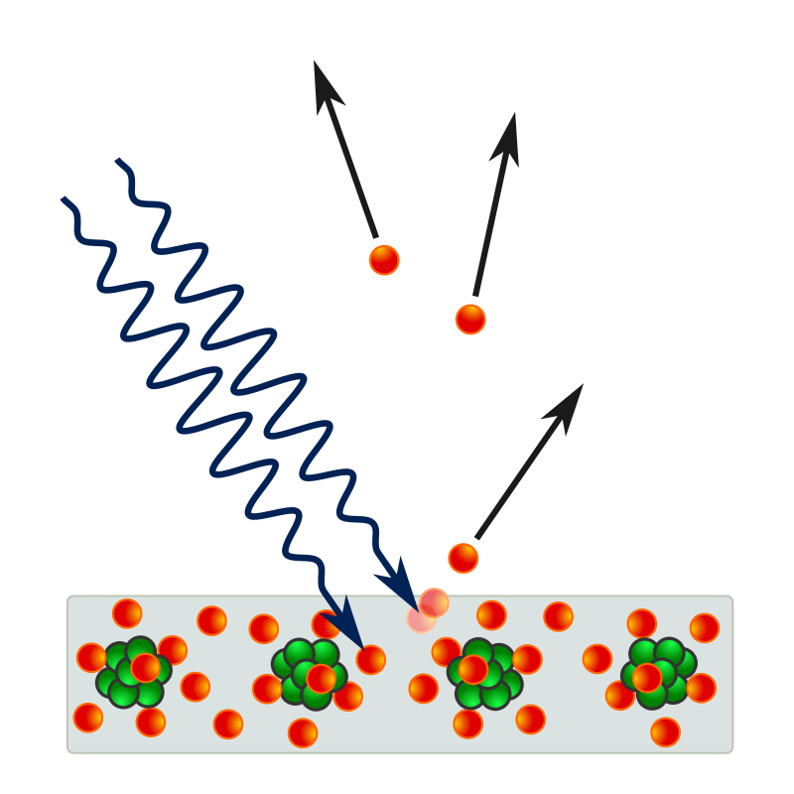
X-Ray Polarimeters (II)
Photo-electric effect: Electrons ejected preferentially in the plane of polarization and propagation vectors
e
Look for angular modulation of ejected electrons
B

Slide 17

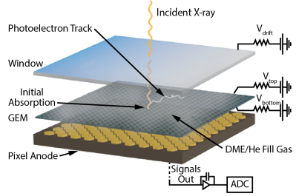
The Imaging X-Ray Polarimetry Explorer (IXPE)
Launched 9 December 2021
Exploits polarization-dependence of the photoelectric effect
2 – 8 keV

Slide 18
IXPE Observations of BL Lacertae
LSP/ISP blazar
=> X-rays dominated by SSC or hadronic emission
2 IXPE observations in May and June 2022.
Only upper limits in Π_{x} measured.
Π_{x} < Π_{optical} for both observations
=> Support for leptonic (SSC) X-ray emission.
(Middei et al. 2023, ApJ, 942, L10)

Slide 19
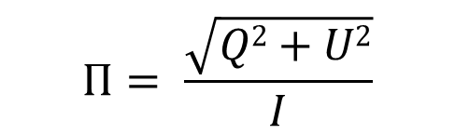
IXPE Observations of LSP blazars
$$Π= \frac{\sqrt{Q2+U2}}{I}$$
All consistent with 0 polarization;
Π_{x} < Π_{opt}
Support for leptonic SSC / EC X-ray emission.
(Marshall et al. 2024: ApJ 972, 74)

Slide 20
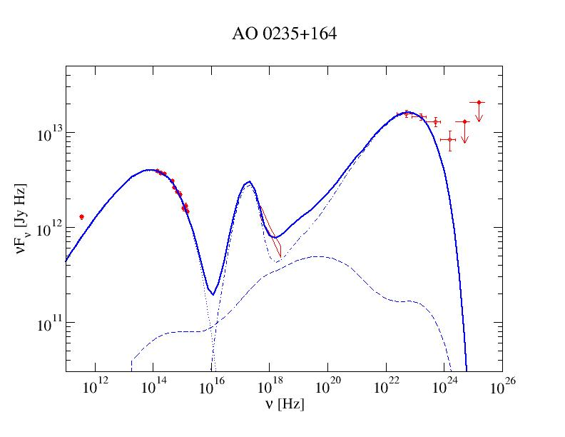
The “Big Blue Bump”
UV / soft X-ray excess seen in the SEDs of several blazars
Baring, MB, & Summerlin (2017: MNRAS 464, 4875):
Monte-Carlo simulatons of Diffusive Shock Acceleration (thermal + non-thermal electron distributions);
BBB from Comptonization of external radiation field by thermal electrons
Accretion disk + Corona? → Unpolarized
Additional synchrotron component? → Moderately polarized
Bulk Compton scattering of external radiation field by thermal electrons (Sikora et al. 1994) → Potentially highly polarized

Slide 21

Monte-Carlo Simulations of Polarization-Dependent Compton Scattering
The MAPPIES (Monte-Carlo Applications for Partially Polarized Inverse External Compton Scattering) code (Dreyer & Böttcher 2021a: ApJ, 906, 18):
Arbitrary electron distributions in a relativistically moving emission region
Arbitrary target photon distributions (unpolarized or polarized)
Polarization-dependent Compton scattering based on techniques developed by Matt et al. (1996)
BBB in AO 0235+164:
Up to ~ 50 % polarized in soft X-rays
IXPE energy range slightly too high.
(Dreyer & Böttcher 2021b: ApJ, 910, 2)

Slide 22
Polarization of the BBB due to bulk Comptonization
(Dreyer & Böttcher 2021b: ApJ, 910, 2)
PD is maximum when the jet is viewed at θ_{obs} = 1/Γ, corresponding to 90º scattering in the co-moving frame.
PA is perpendicular to the jet axis.

Slide 23
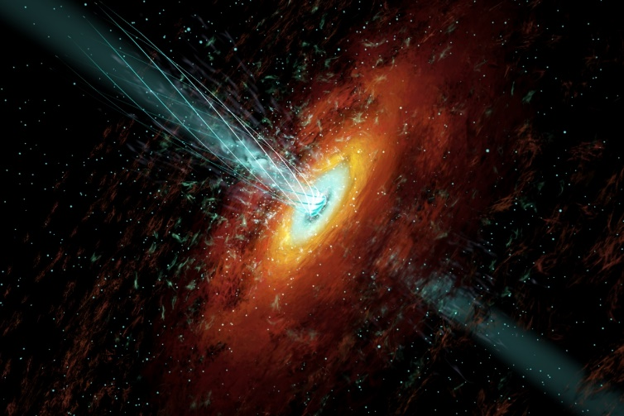



Summary
0
IXPE has opened a new window of X-ray polarimetry.
All IBLs / LBLs observed by IXPE: No X-ray polarization detected → Consistent with leptonic SSC / EC high-energy emission; disfavouring hadronically dominated X-ray / γ-ray emission scenarios.
Soft X-ray polarization of the Big Blue Bump feature can diagnose its nature: Bulk Compton BBB may be highly polarized.

Slide 24

Thank you!

Slide 25
Backup Slides

Slide 26
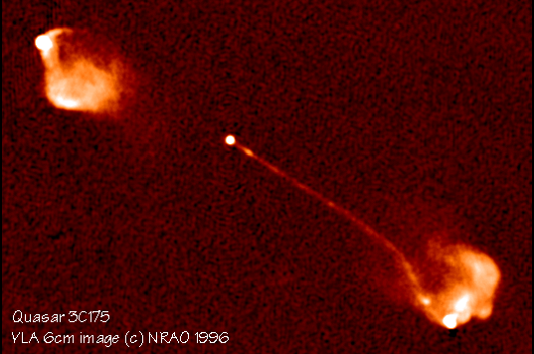
Blazars
0
Class of AGN consisting of BL Lac objects and gamma-ray bright quasars with relativistic jets pointing close to our line of sight
Rapidly (often intra-day) variable
Strong gamma-ray sources
Radio knots often with superluminal motion
Radio and optical (and X-ray?) polarization

Slide 27
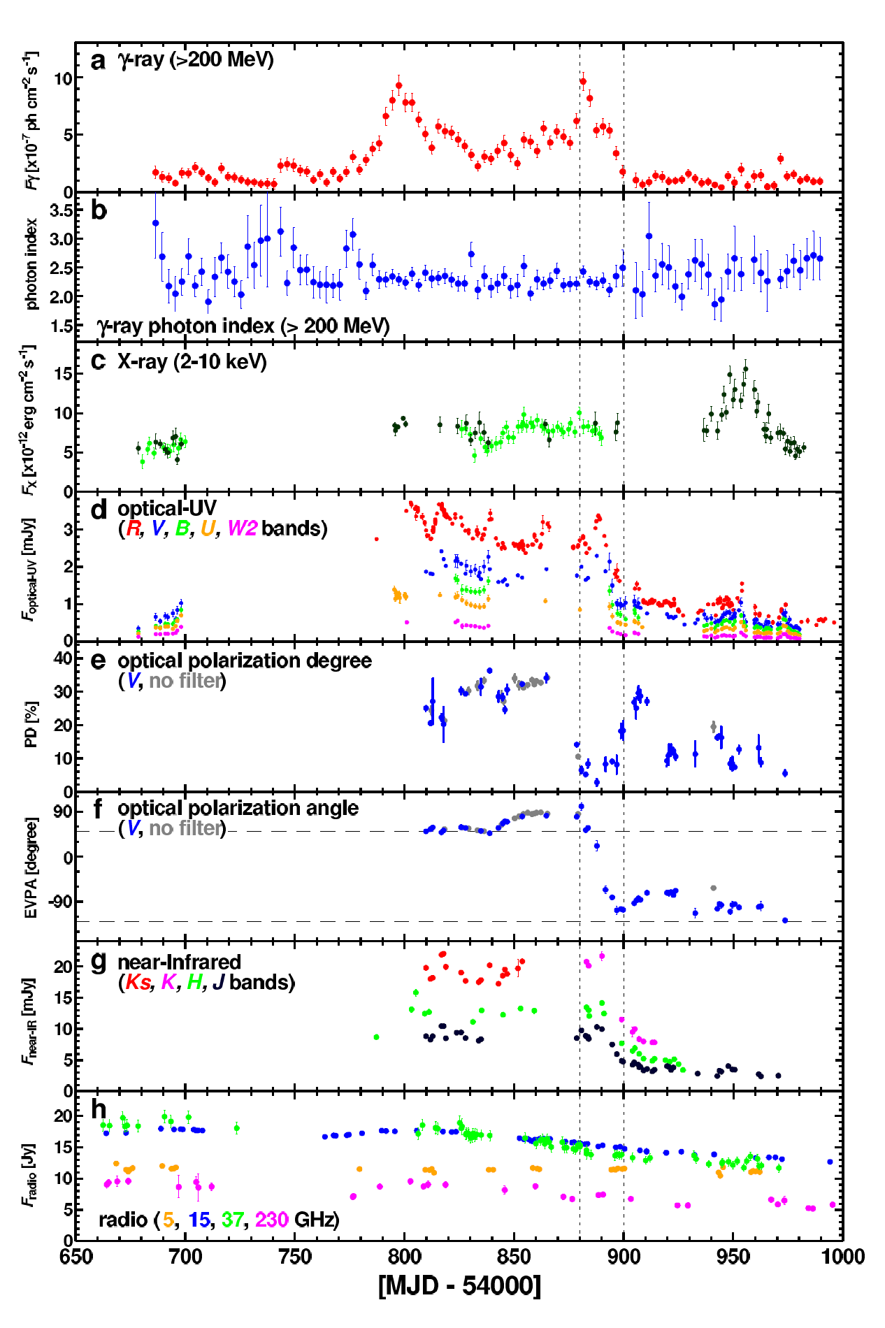
Flux and Polarization Variability
Multi-wavelength variability on various time scales (months – minutes)
Sometimes correlated, sometimes not
Observed optical polarization degrees
Π_{opt} <~ 30 %
Both degree of polarization and polarization angles vary.
Swings in polarization angle sometimes associated with high-energy flares!
(3C279: Abdo et al. 2010)

Slide 28
Open Physics Questions
Source of Jet Power (Blandford-Znajek / Blandford-Payne?)
Physics of jet launching / collimation / acceleration – role / topology of magnetic fields
Composition of jets (e⁻-p or e⁺-e⁻ plasma?) – leptonic or hadronic high-energy emission?
Mode of particle acceleration (shocks / shear layers / magnetic reconnection?) - role of magnetic fields
Location of the energy dissipation / gamma-ray emission region

Slide 29
Multiwavelength Polarization of Blazars
40
IXPE
COSI
30
PD [%]
20
10
0
accretion disk
dust torus
e⁻ synchrotron
νF_{ν} [Jy Hz]
SSC
EC
leptonic total
p synchrotron
pγ cascades
10¹⁰
10¹²
10¹⁴
10¹⁶
10¹⁸
10²⁰
10²²
10²⁴
hadronic total
ν [Hz]

Slide 30
The “Big Blue Bump”
In Baring et al. (2017: MNRAS, 464, 4875):
Self-consistent thermal + non-thermal electron distributions from diffusive shock acceleration (Summerlin & Baring 2012)
BBB resulting from Comptonization of external (dust torus) radiation field by the thermal electrons.
Tight constraints on plasma parameters (total density, magnetization, …)

