Slide 1
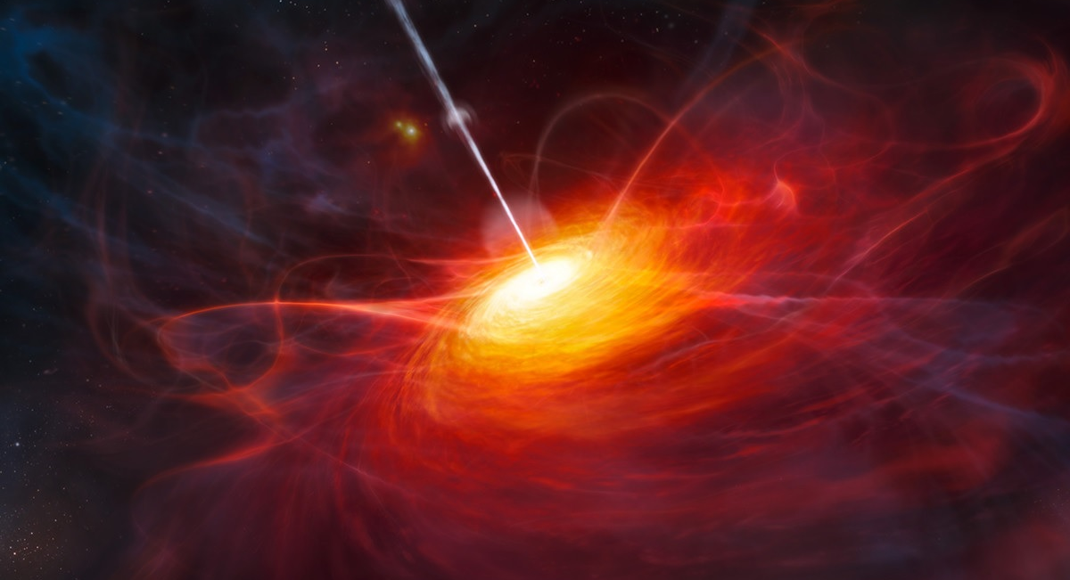


Two-zone (leptonic) modelling of 3C 279 - Motivations
Anna Luashvili, Markus Boettcher
North-West University, CSR
Credits: ESO/M. Kornmesser

Slide 2
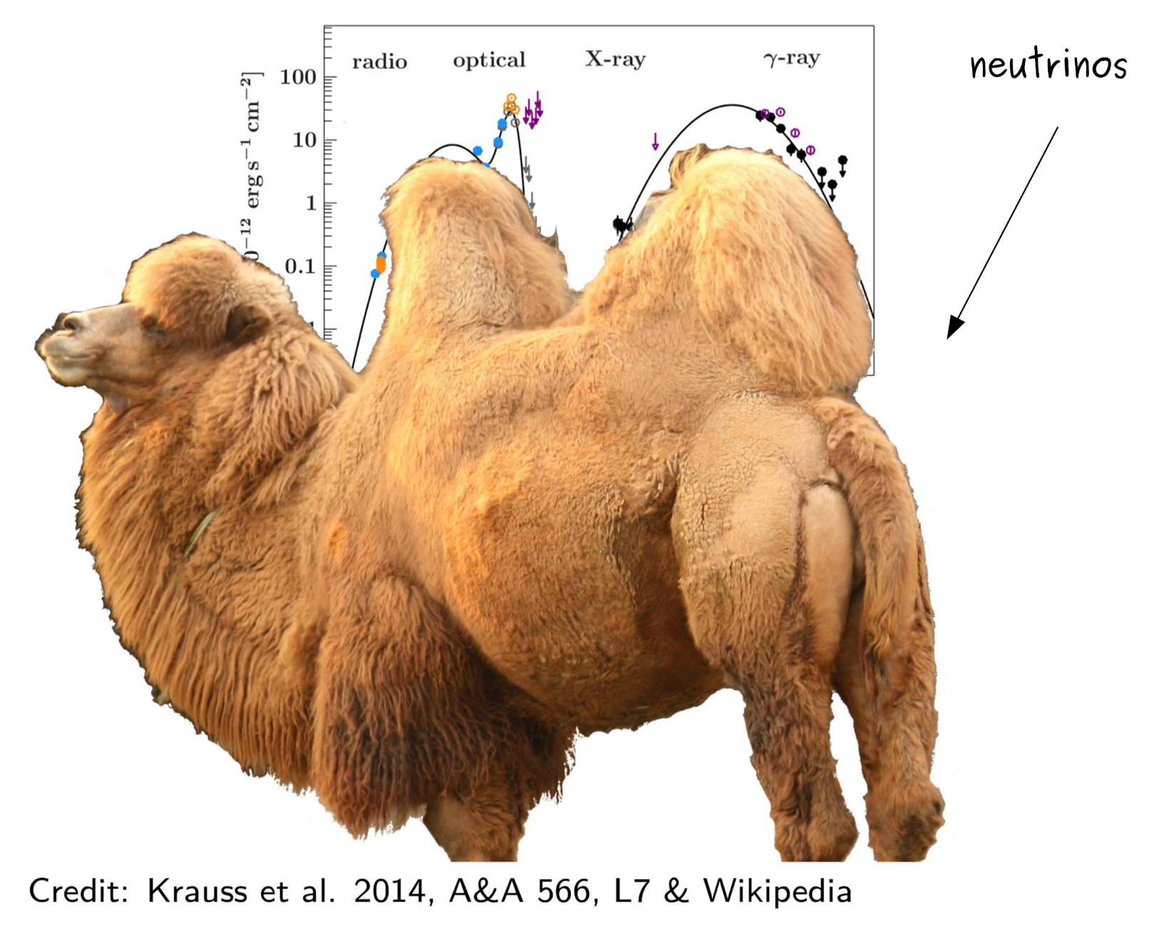
  ‘Cosmic camels’
Marina Manganaro
HEASA 2025 Anna Luashvili 18 September 2025 1

Slide 3
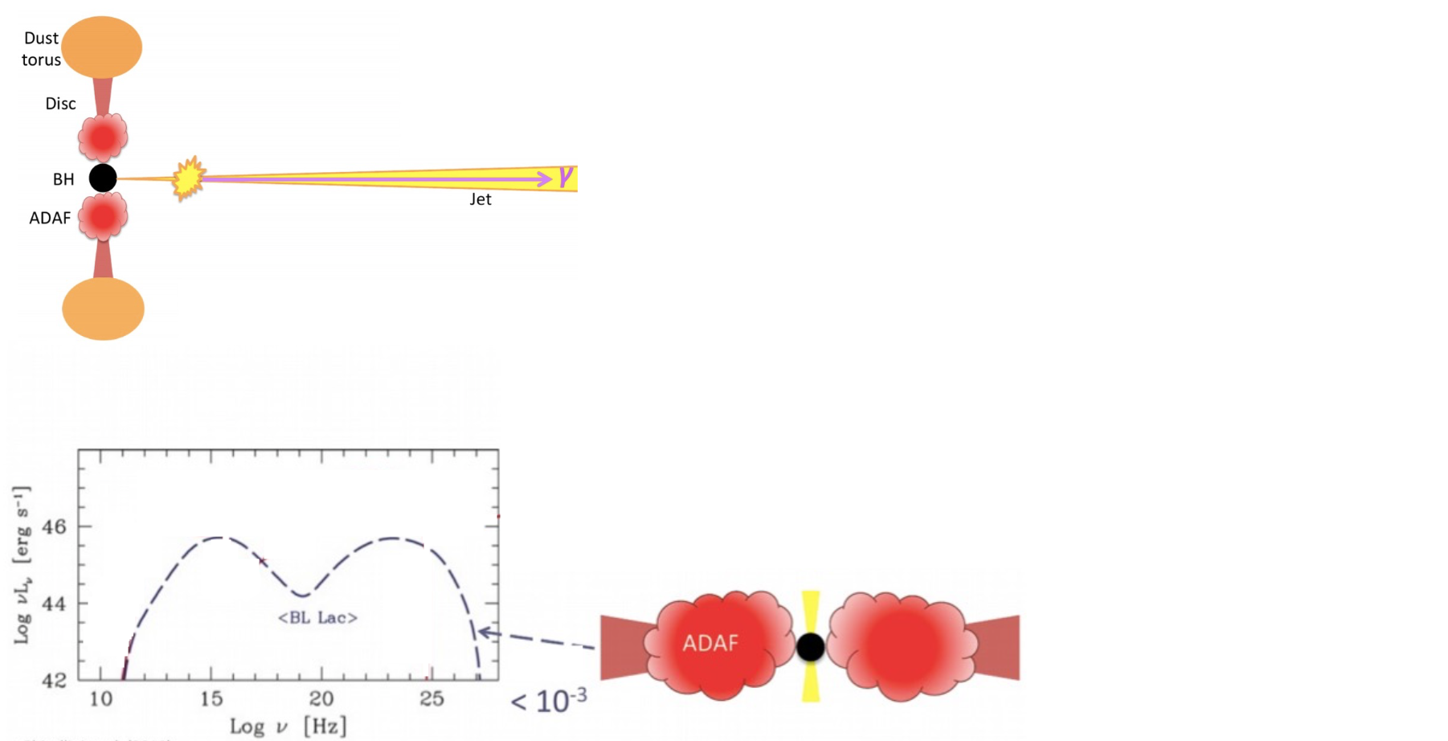
  Blazar sub-classes - Reminder
SSC (Synchrotron self Compton)
BL Lac
Credit: D. Kynoch
Ghisellini et al. 2010
HEASA 2025 Anna Luashvili 18 September 2025 2

Slide 4
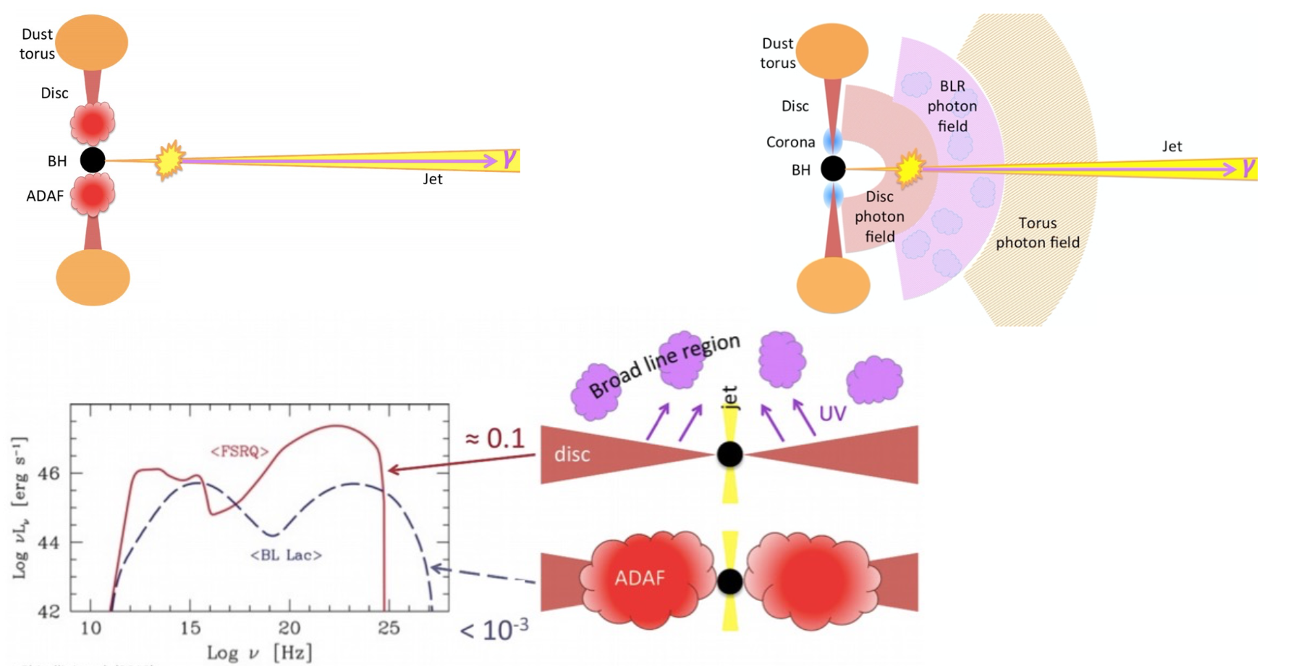
  Blazar sub-classes - Reminder
SSC (Synchrotron self Compton)
SSC + external photon field interactions
BL Lac
FSRQ
Credit: D. Kynoch
Ghisellini et al. 2010
HEASA 2025 Anna Luashvili 18 September 2025 2

Slide 5
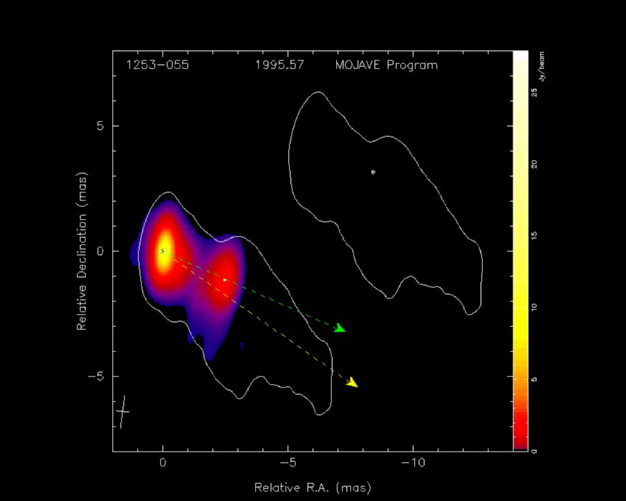
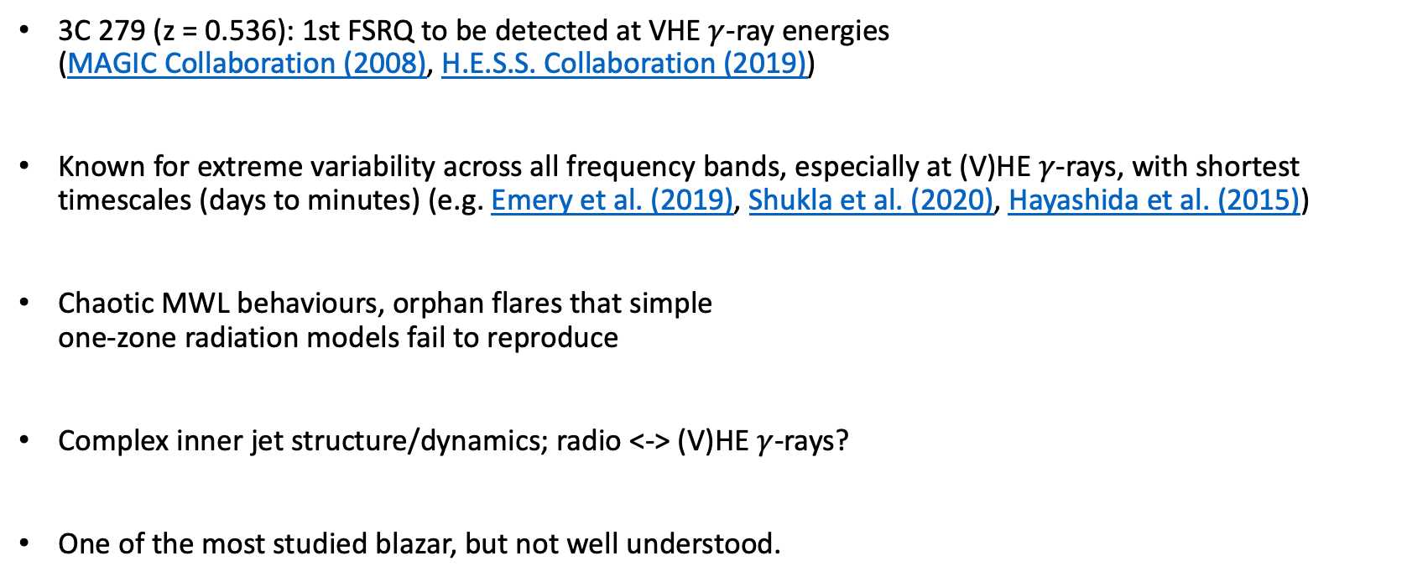
About 3C 279
3C 279 (z = 0.536): 1st FSRQ to be detected at VHE $γ$-ray energies
(MAGIC Collaboration (2008), H.E.S.S. Collaboration (2019))
Known for extreme variability across all frequency bands, especially at (V)HE $γ$-rays, with shortest timescales (days to minutes) (e.g. Emery et al. (2019), Shukla et al. (2020), Hayashida et al. (2015))
Chaotic MWL behaviours, orphan flares that simple
one-zone radiation models fail to reproduce
Complex inner jet structure/dynamics; radio <-> (V)HE $γ$-rays?
One of the most studied blazar, but not well understood.
MOJAVE program
Homan et al., 2003
HEASA 2025 Anna Luashvili 18 September 2025 3

Slide 6
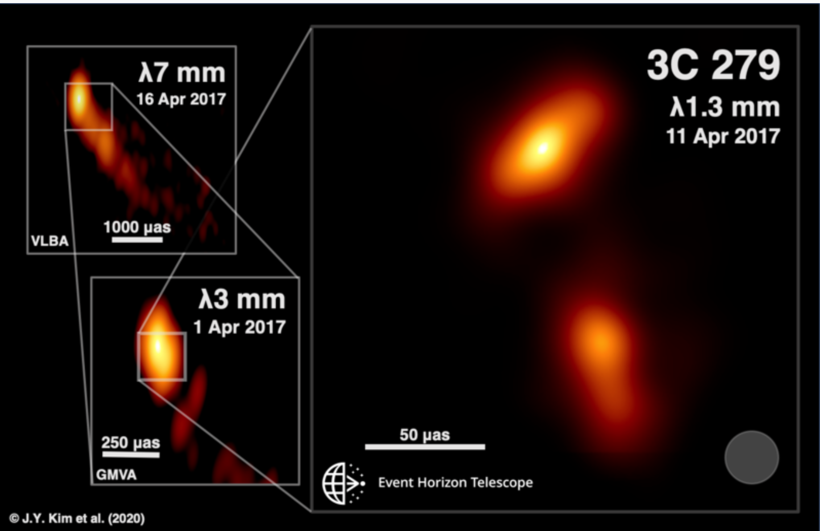
3C 279 – EHT target
2017 April observations
Kim + 2020:
”20 μas (at a redshift of z = 0.536 this corresponds to ∼0.13 pc
∼ 1700 Schwarzschild radii with a black hole mass M_BH = 8 × 10^8 M_sun.”
Perpendicular inner jet components moving at app. speeds ~15c and 20c.
Innermost jet regions – where one expects the rapidly variable HE&VHE gamma-ray emission to be produced.
HEASA 2025 Anna Luashvili 18 September 2025 4

Slide 7
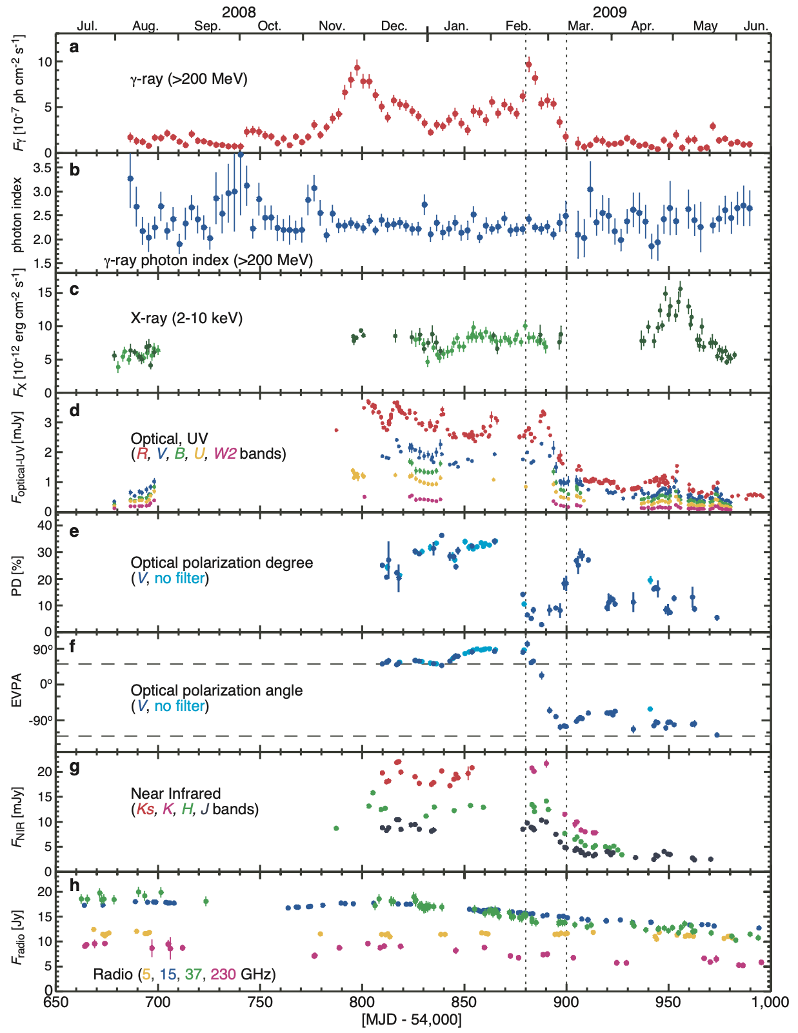
  Need for two emission zones in 3C 279?
Abdo et al. 2010
HEASA 2025 Anna Luashvili 18 September 2025 5

Slide 8
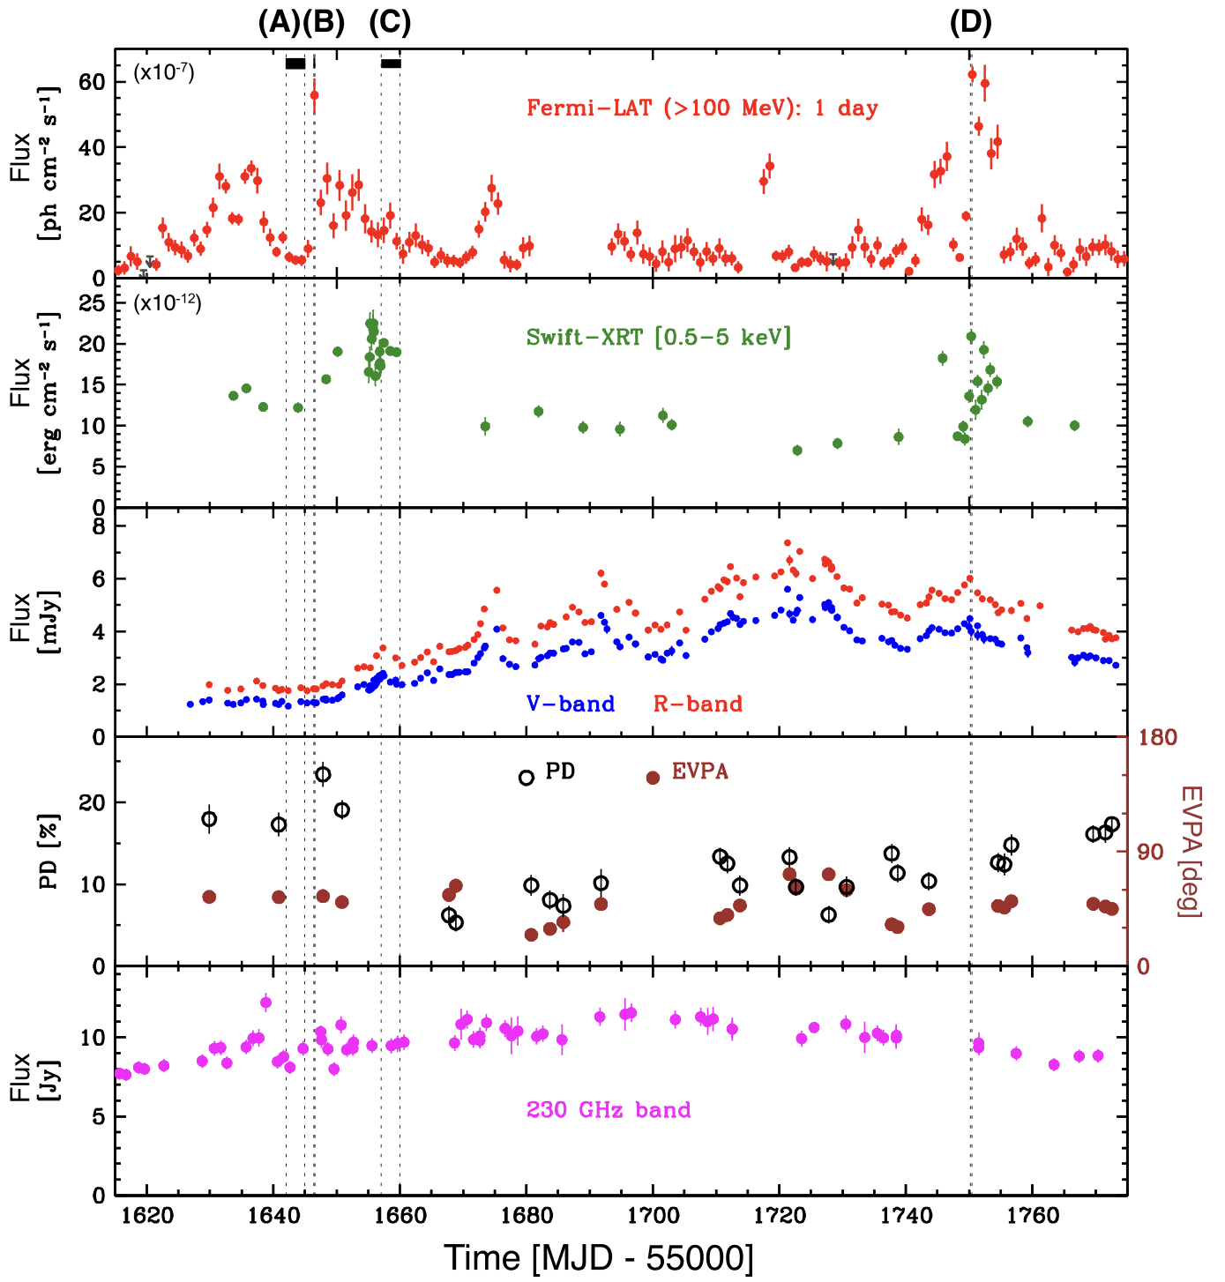
  Need for two emission zones in 3C 279?
Hayashida et al. 2015
Abdo et al. 2010
HEASA 2025 Anna Luashvili 18 September 2025 5

Slide 9
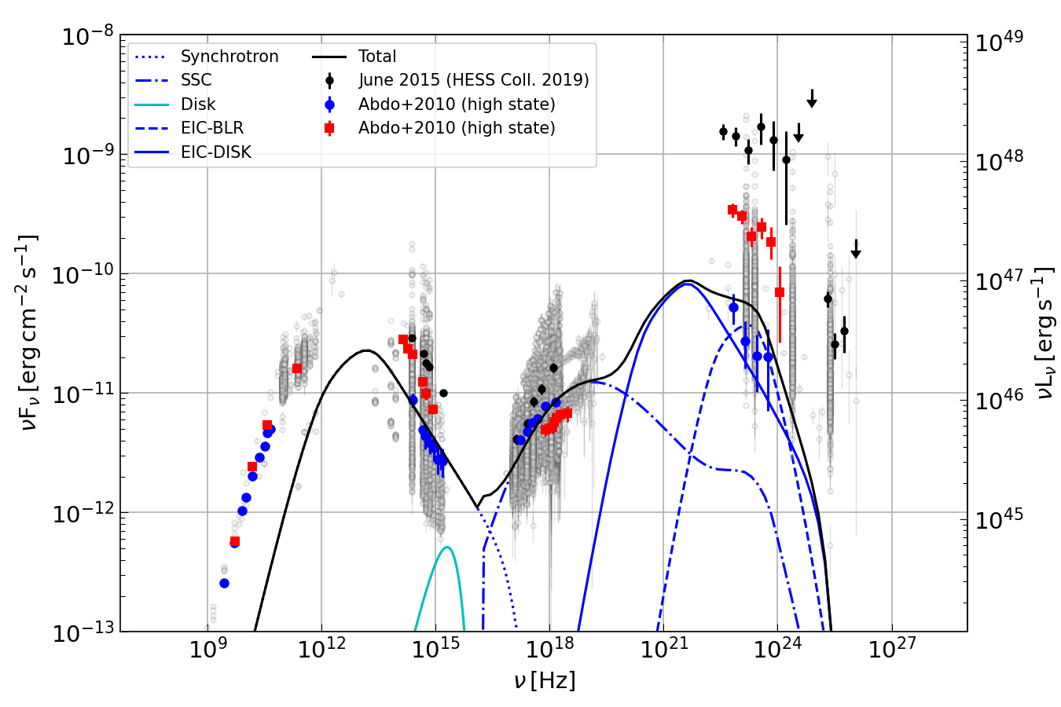
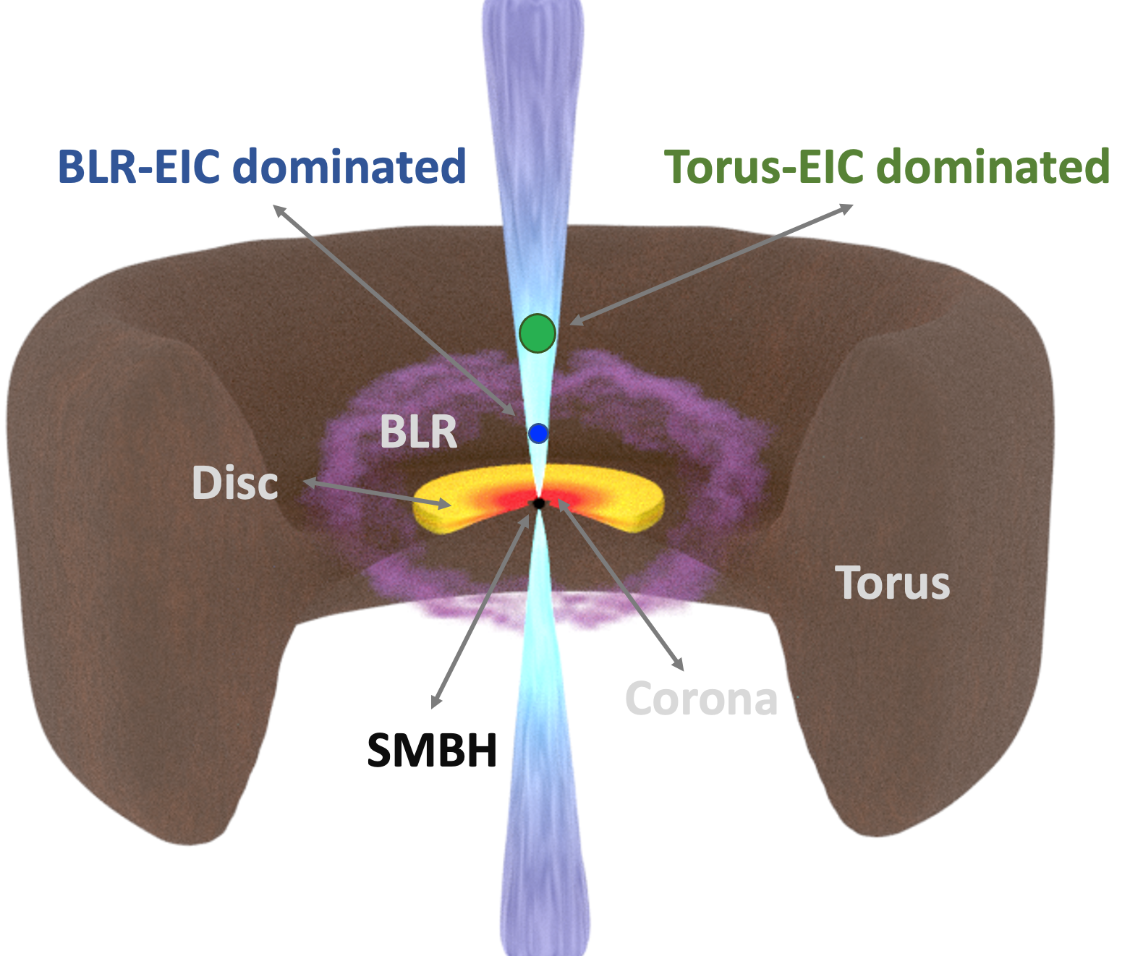
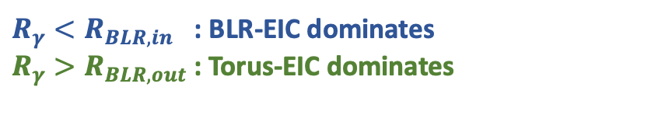
  Two-zone leptonic scenario
$R_{γ}<R_{BLR,in}$ : BLR-EIC dominates
$R_{γ}>R_{BLR,out}$: Torus-EIC dominates
PRELIMINARY
Boettcher + 2013 stationary lepto-hadronic code (only leptonic part here)
Inner blob << R_BLR
HEASA 2025 Anna Luashvili 18 September 2025 6

Slide 10
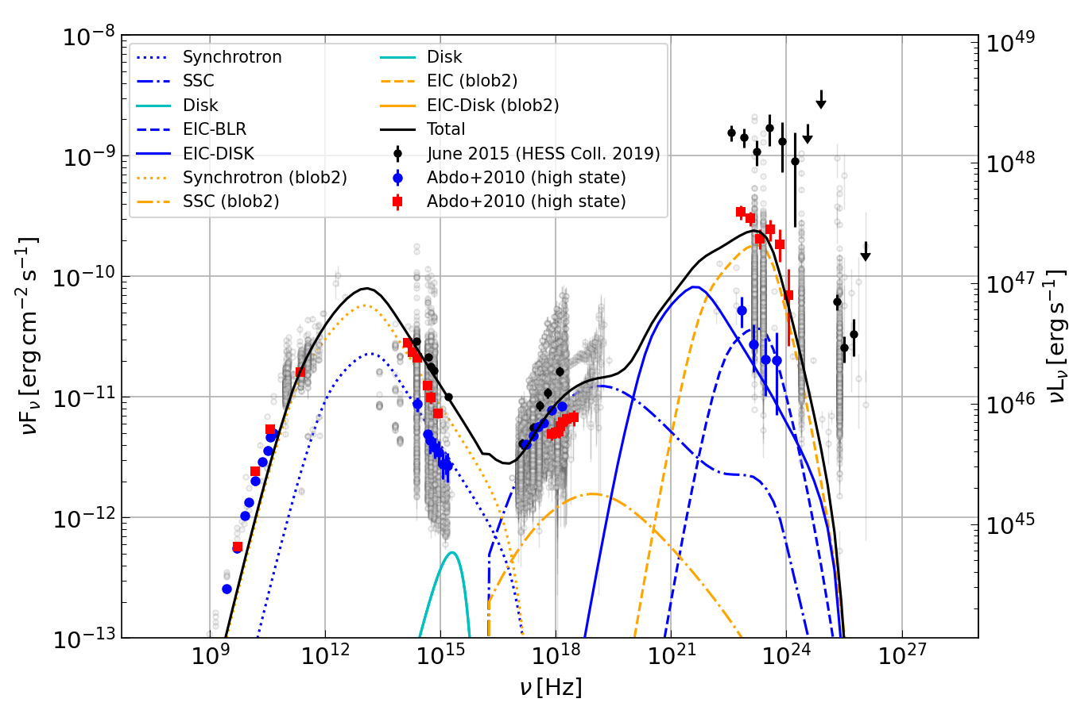
  Two-zone leptonic scenario
$R_{γ}<R_{BLR,in}$ : BLR-EIC dominates
$R_{γ}>R_{BLR,out}$: Torus-EIC dominates
PRELIMINARY
Boettcher + 2013 stationary lepto-hadronic code (only leptonic part here)
Inner blob << R_BLR
Far blob > R_BLR
HEASA 2025 Anna Luashvili 18 September 2025 7

Slide 11
Conclusion/outlook
One-zone models usually reproduce well blazar SEDs, but some sources at specific epochs point towards more complex scenarios.
+ One-zone lepto-hadronic models failed to reproduce the MWL behavior of 3C 279 (2015 flare,
H.E.S.S. Collaboration (2019))
Two-zone model applied to 3C 279 during periods of drastic MWL changes
+ Optical polarization - very preliminary!
Similar behaviors in other sources of the same class?
Ex: PKS 1510-089
Time-dependent approach and in-depth radio constraints need to be investigated.
HEASA 2025 Anna Luashvili 18 September 2025 8

Slide 12

Thank you!
Rick and Morty (S2, Ep. 2)

Slide 13
BACK-UP slides

Slide 14
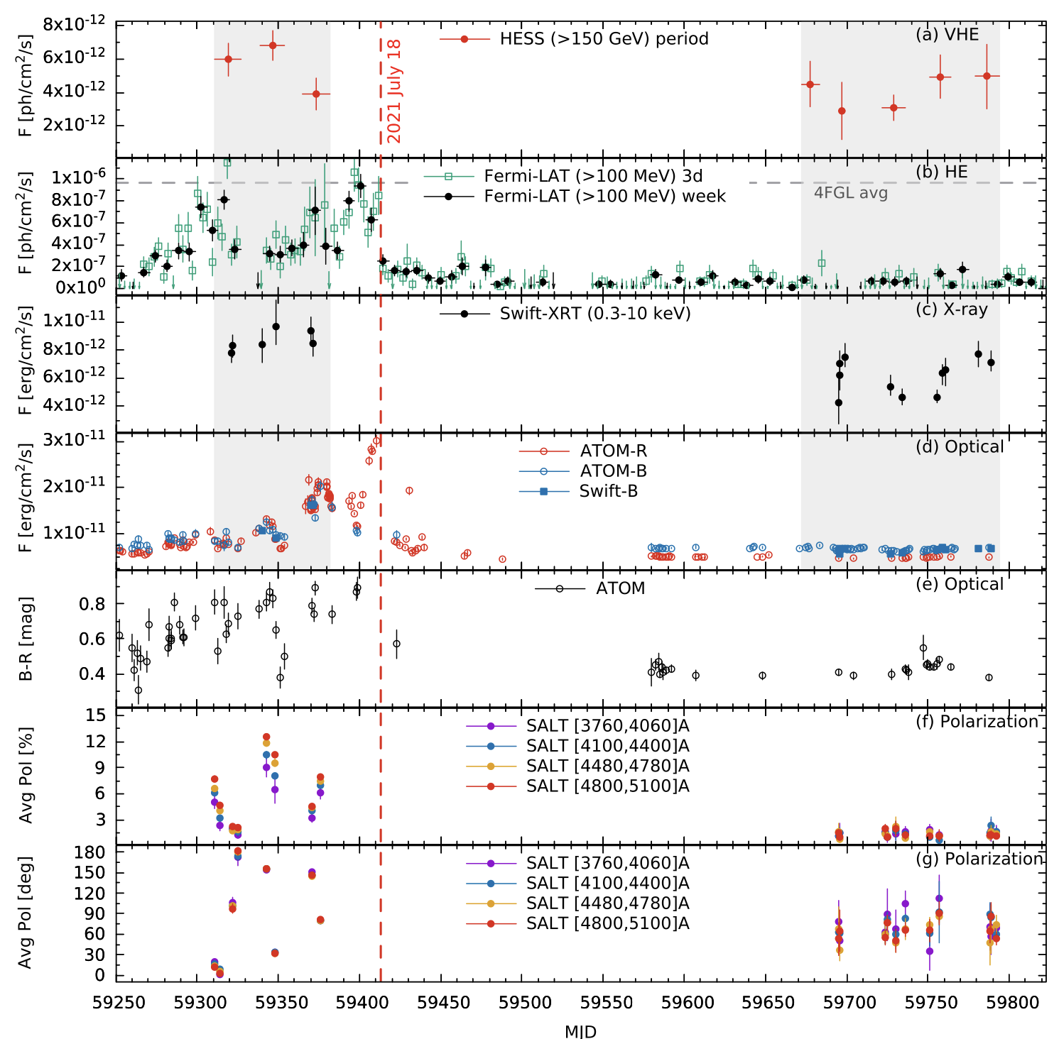
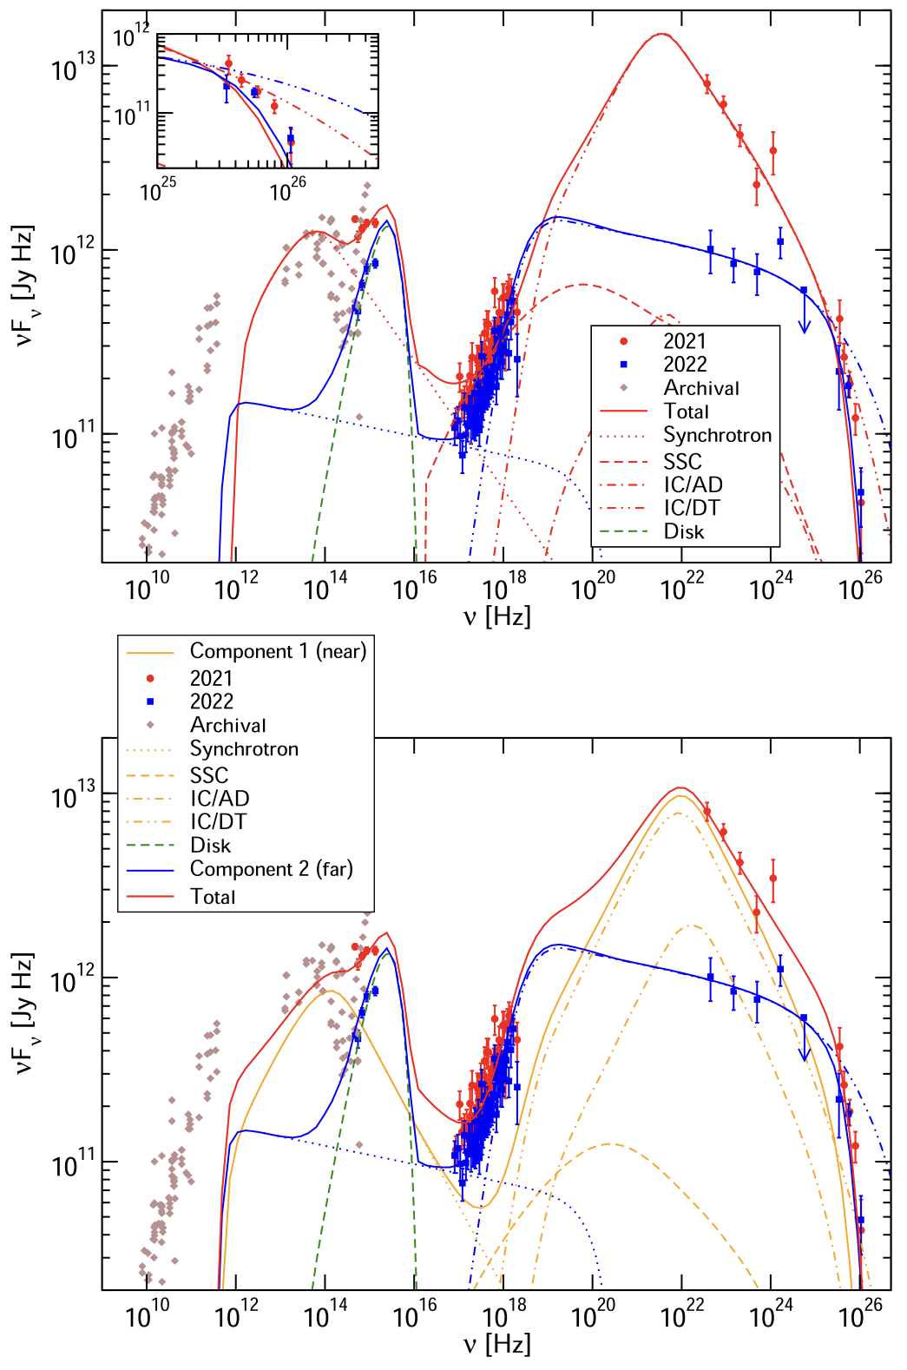
PKS 1510-089 example
H.E.S.S. Collaboration (2023)

Slide 15
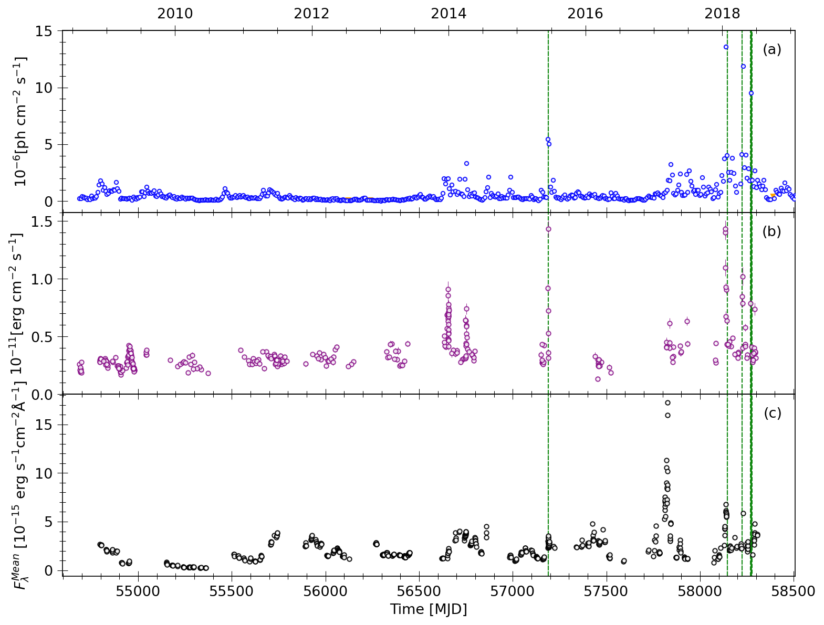


Long-term view
Fermi-LAT (>100 MeV)
Fermi LC Repository (weekly bins)
$F_{var}≈$(164 ± 1)%
Swift-XRT (@1 keV)
Giommi+2021 data
$F_{var}≈$(49.4 ± 0.4)%
Steward Observatory
$F_{var}≈$73%

Slide 16
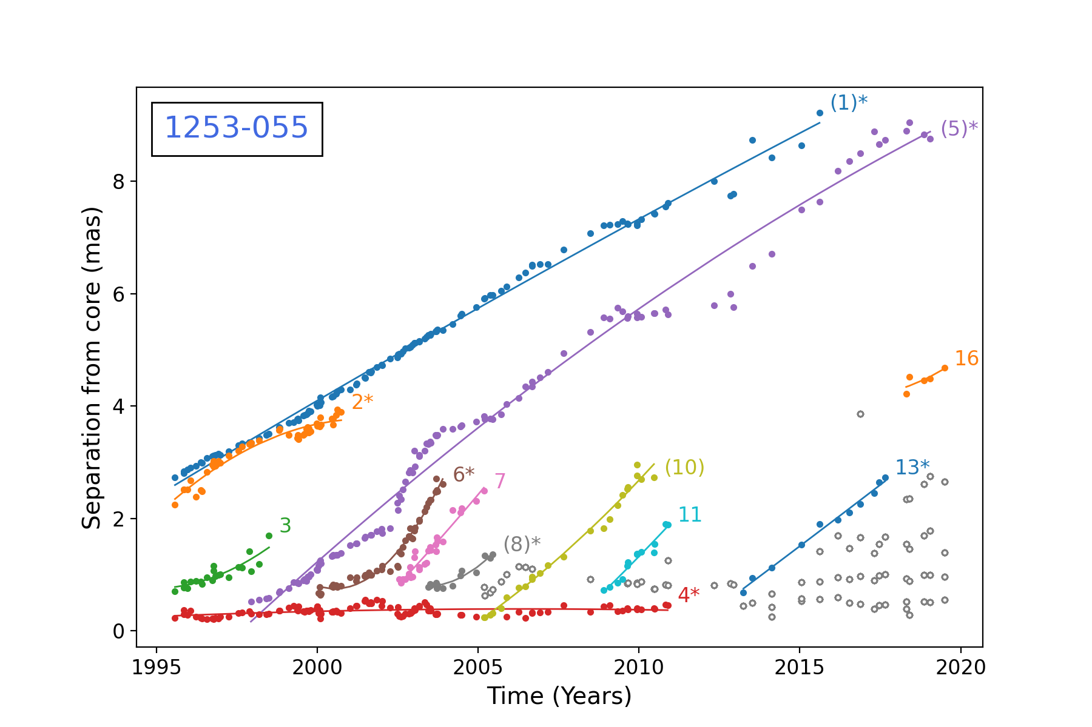
Complex inner jet dynamics
MOJAVE observations of 3C 279
Multiple superluminal radio
components seen @ 15 GHz
MOJAVE program
Lister et al., 2019 & 2021

Slide 17
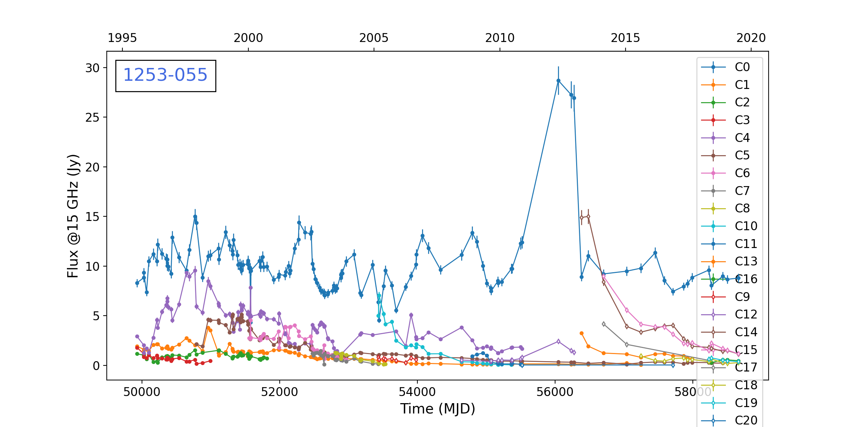
Complex inner jet dynamics
MOJAVE observations of 3C 279
Multiple superluminal radio
components seen @ 15 GHz
MOJAVE program
Lister et al., 2019 & 2021
MOJAVE program
Lister et al., 2019 & 2021

