Slide 1

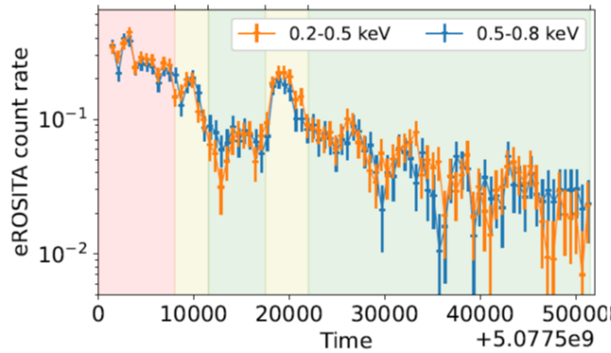
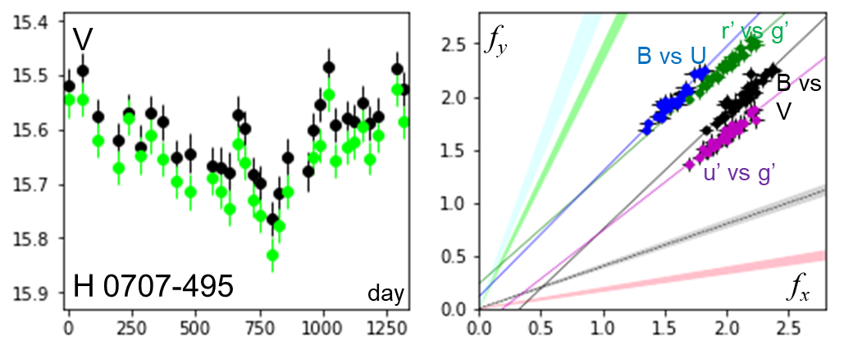



The I Zw 1 type AGN: busy in X-rays but optically quiet
Hartmut Winkler
Department of Physics
University of Johannesburg
HEASA 2025
Muldersdrift
17 Sep 2025
H Winkler, U. Johannesburg, HEASA2025, Muldersdrift, Sep 2025

Slide 2
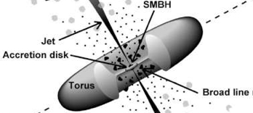
Variability as a probe of the central engine and its surroundings
Numerous components contribute to the (optical) nuclear luminosity – how do these all vary?
Intermediate line region?
from fermi.gsfc.nasa.gov
Inner torus?
These potential nuclear components are not equally represented in all AGN. Some components are particularly strong in specific subclasses
H Winkler, U. Johannesburg, HEASA2025, Muldersdrift, Sep 2025

Slide 3
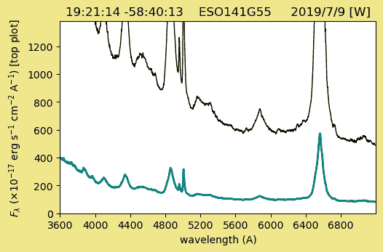
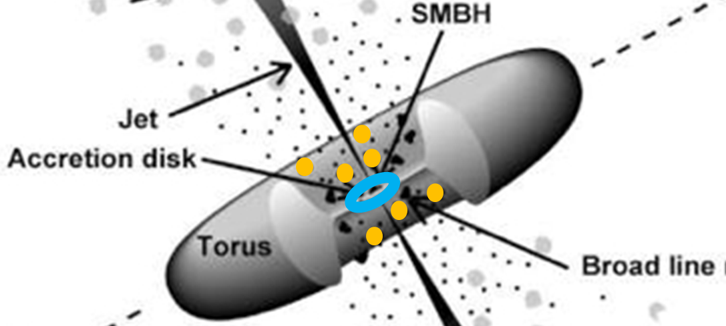
A ‘normal’ Seyfert 1 galaxy spectrum
A typical Seyfert 1 galaxy exhibits a blue continuum from the accretion disk and spectral lines from both broad and narrow line regions
When Fe II lines are present, they are generally also broad and can seldom be resolved
Fe II
H I
Fe II
He I
H I
H I
[O III]
H Winkler, U. Johannesburg, HEASA2025, Muldersdrift, Sep 2025

Slide 4
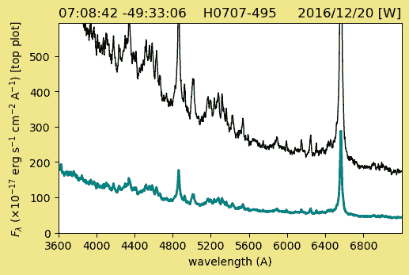
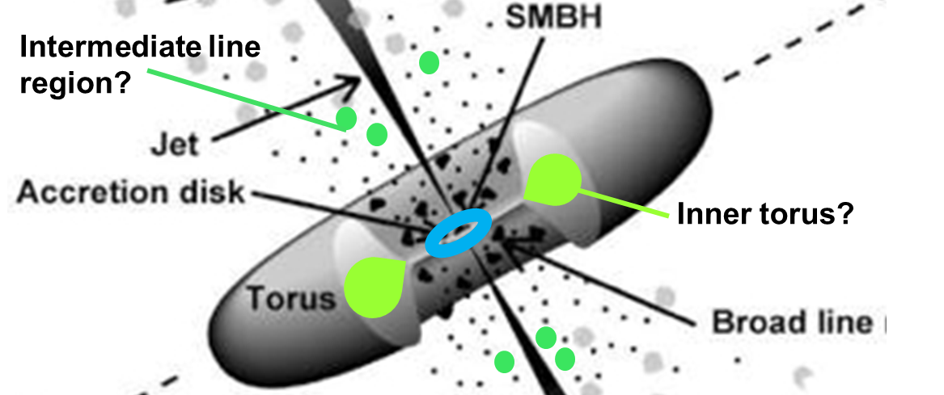
Narrow line Seyfert 1 galaxies with strong Fe II emission – prototype: I Zw 1
While traditional broad and narrow-line spectra are present, such AGN display rich emission features of intermediate width, especially Fe II – not yet clear where this region is located
Fe II
Fe II
H Winkler, U. Johannesburg, HEASA2025, Muldersdrift, Sep 2025

Slide 5
Interpretation of the broad-line width and Fe II strength
Low
Eddington
ratio
High
Eddington
ratio
Shen & Ho 2014
H Winkler, U. Johannesburg, HEASA2025, Muldersdrift, Sep 2025

Slide 6
Dramatic X-ray fluctuations in some I Zw 1 type AGN
X-ray missions have frequently reported fairly dramatic flux changes in this wavelength regime. One might expect that such events would be accompanied by similar brightening or fadingat other wavelengths
Short-term light curve
Long-term light curve
Both plots are for H 0707–495 and
come from Boller et al (2021)
Note the logarithmic scale!
H Winkler, U. Johannesburg, HEASA2025, Muldersdrift, Sep 2025

Slide 7
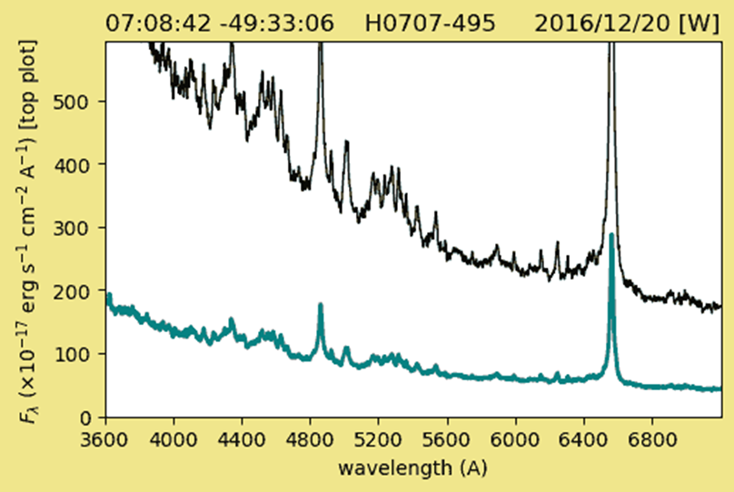
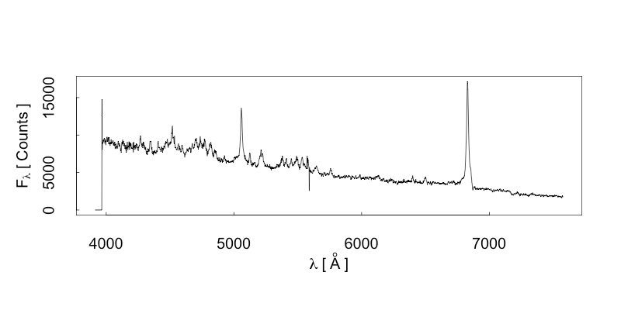
Optical spectral Changes
Remillard et al (1986)
Jones et al (2009)
When comparing the optical spectra from different epochs, almost no changes are detectable
Paul PhD (2022)
H Winkler, U. Johannesburg, HEASA2025, Muldersdrift, Sep 2025

Slide 8
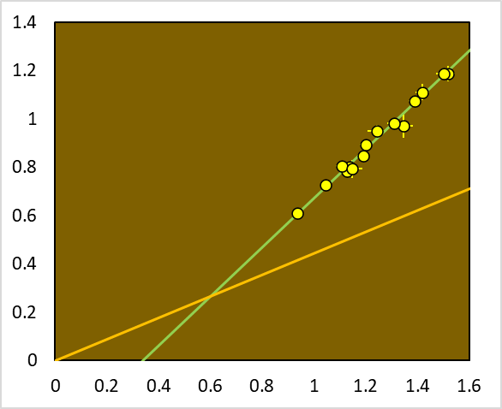
Extracting the variability measure of the nuclear component
As in other AGN, plotting flux vs flux in different filters yields a tight linear relationship showing a varying but constant colour nucleus superimposed on a constant host galaxy
(Choloniewski, 1981, Winkler et al, 1992, Winkler, 1997)
f_{B}
f_{V,n}
The degree of nuclear variability σf_{B,n} is here defined by means of the ratio (given as a percentage) between the standard deviation of f_{B,n} and f_{B,n}
nuclear
colour
±σf_{B,n}
f_{B,n}
f_{V,g}
host galaxy
colour
f_{B,g}
f_{V}
H Winkler, U. Johannesburg, HEASA2025, Muldersdrift, Sep 2025

Slide 9
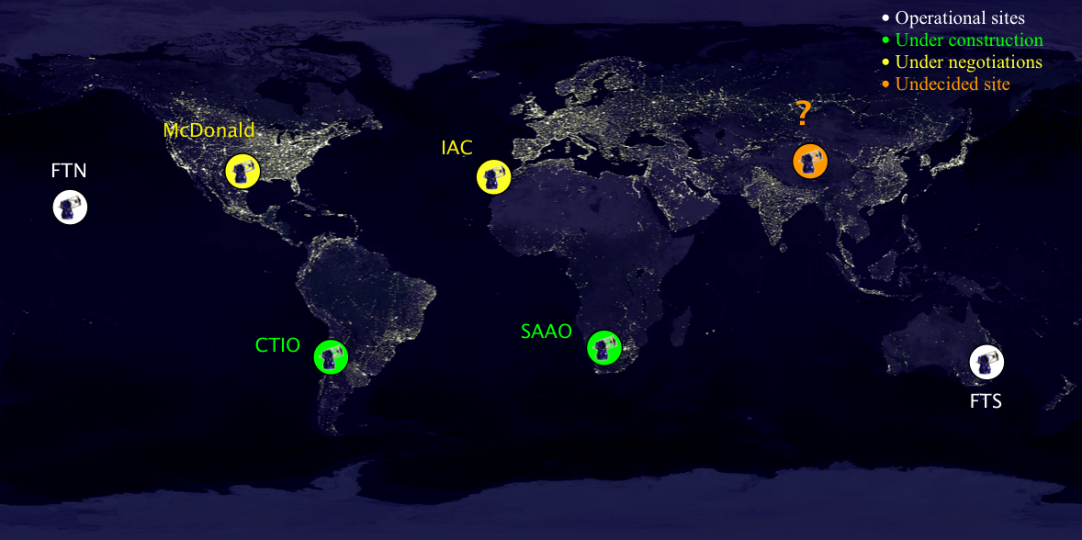
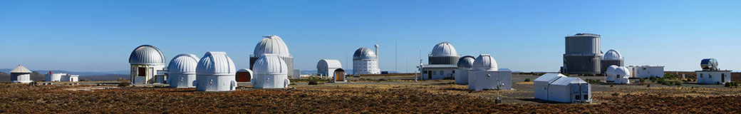
Las Cumbres Observatory (LCO) robotic telescope network
Teide
Haleakala
Siding Spring
1.0m & 0.4m
networks
SAAO Sutherland
H Winkler, U. Johannesburg, HEASA2025, Muldersdrift, Sep 2025

Slide 10
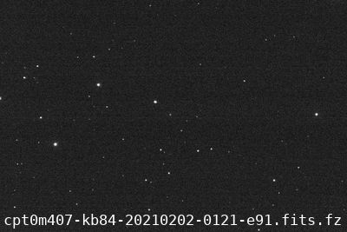
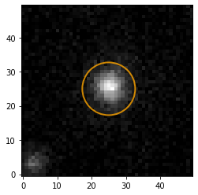
Photometry with LCO
AGN
(U)BV(u’)g’r’ filters
2x images in each filter
Observations carried out at roughly monthly intervals
3 arcsec radius aperture
Photometric calibration
using the multitude of
stars in each image that
have magnitudes in the
APASS database (NB: doesn’t have U, u’ mags)
3” radius
aperture
2”-3” annulus used to deter-mine host galaxy colour
H Winkler, U. Johannesburg, HEASA2025, Muldersdrift, Sep 2025

Slide 11
The sample and observing programme
Programme started in August 2020, ongoing
To date there have been ~420 h of observations with the 1.0m network and ~790 h with the 0.4m network
141 AGN have been observed photometrically between 10 time (for recently added objects) and ~35 times. Of these:
19 were NLSy1 with strong Fe II (i.e. I Zw 1 type)
The other 69 were ordinary Seyfert 1 galaxies, some chosen to better enable photometric calibration
53 belonged to other AGN subclasses (e.g. BL Lac, Changing Look AGN), and are not considered in this presentation
H Winkler, U. Johannesburg, HEASA2025, Muldersdrift, Sep 2025

Slide 12
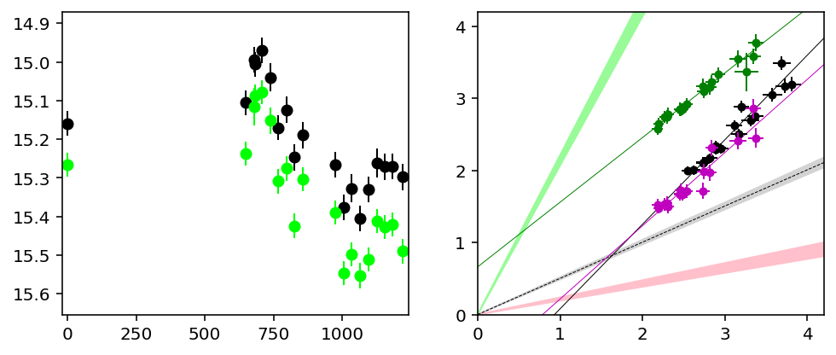
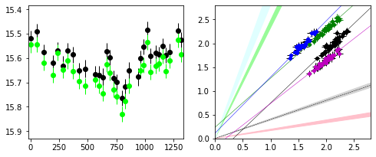
Comparing the flux changes a typical ‘normal’ Seyfert 1 with a I Zw 1 type object
f_{y}
r’ vs g’
V
σf_{B,n} = 25%
B vs V
u’ vs g’
g’
VII Zw 118
day
f_{x}
V
f_{y}
r’ vs g’
I Zw 1 type
B vs U
B vs
V
σf_{B,n} = 8%
u’ vs g’
H 0707-495
day
f_{x}
H Winkler, U. Johannesburg, HEASA2025, Muldersdrift, Sep 2025

Slide 13
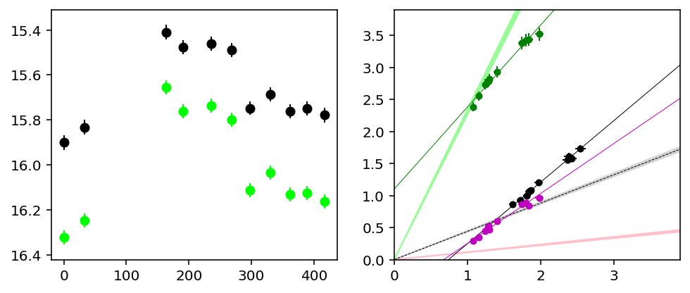

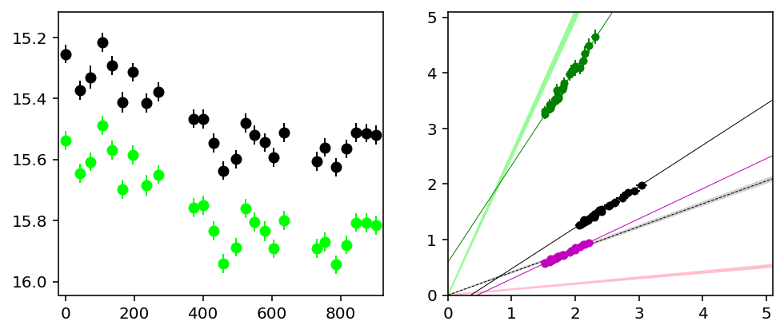
Two more examples
Mkn 50
f_{y}
r’ vs g’
Normal
Seyfert
V
g’
day
u’ vs g’
f_{x}
RX 1741+0348
f_{y}
V
r’ vs g’
I Zw 1
type
B vs V
g’
u’ vs g’
f_{x}
day
H Winkler, U. Johannesburg, HEASA2025, Muldersdrift, Sep 2025

Slide 14
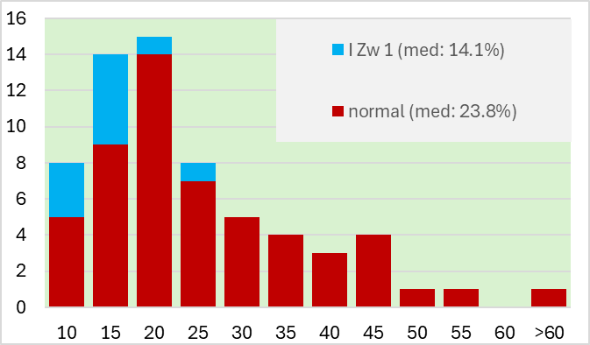
Comparing the relative variability of different Seyfert sub-classes
The average nuclear variability range for ‘normal’ Seyfert 1 galaxies appears to be of the order of 25%
I Zw 1 type AGN (high Eddington ratios?) have significantly lower nuclear variability amplitudes of ~15%
H Winkler, U. Johannesburg, HEASA2025, Muldersdrift, Sep 2025

Slide 15
Summary – preliminary findings of study
Otherwise ‘normal’ Seyfert galaxies have a nuclear variability σf_{B,n} of about 25%
I Zw 1 type objects have lower variability ranges (~15%)
This could signify that for an as yet undetermined reason the nuclear component of I Zw 1 type objects is only weakly variable
Alternatively, the nuclear flux in I Zw 1 type AGN could include a large fraction due to a second component; this might be generated in a region that is far removed from the black hole and this might be the same region where the Fe II bands are formed
Finalisation of programme in January next year; optimized calibration followed by a re-evaluation of the results
Thanks to: i) SAAO for allocating telescope time; ii) LCO for use of their robotic telescope network and technical support; iii) SA-GAMMA for funding HEASA meetings
H Winkler, U. Johannesburg, HEASA2025, Muldersdrift, Sep 2025

