Slide 1

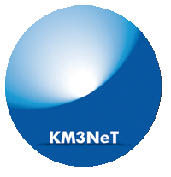


https://antares.in2p3.fr
https://www.km3net.org
From ANTARES to KM3NeT: The Adventure of Neutrino Detection in the Mediterranean Sea
Antoine Kouchner
for the ANTARES and KM3NeT collaborations
HAESA 2024, October 2 - 4 Wits Rural Facility, South Africa

Slide 2
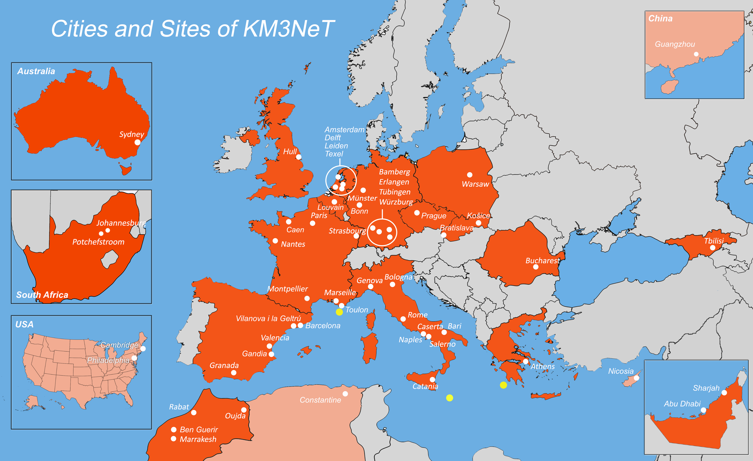
ANTARES and KM3NeT Collaborations
2
ANTARES Collaboration
Paris
Marseille
Clermont-Ferrand
Strasbourg
Nice
Oujda
Rabat
Valence
Amsterdam
Leyde
Rome
Gênes
Bologne
Catane
Pise
Naples
Bari
Erlangen
Wurtzbourg
Bamberg
Bucarest
Bentley

Slide 3
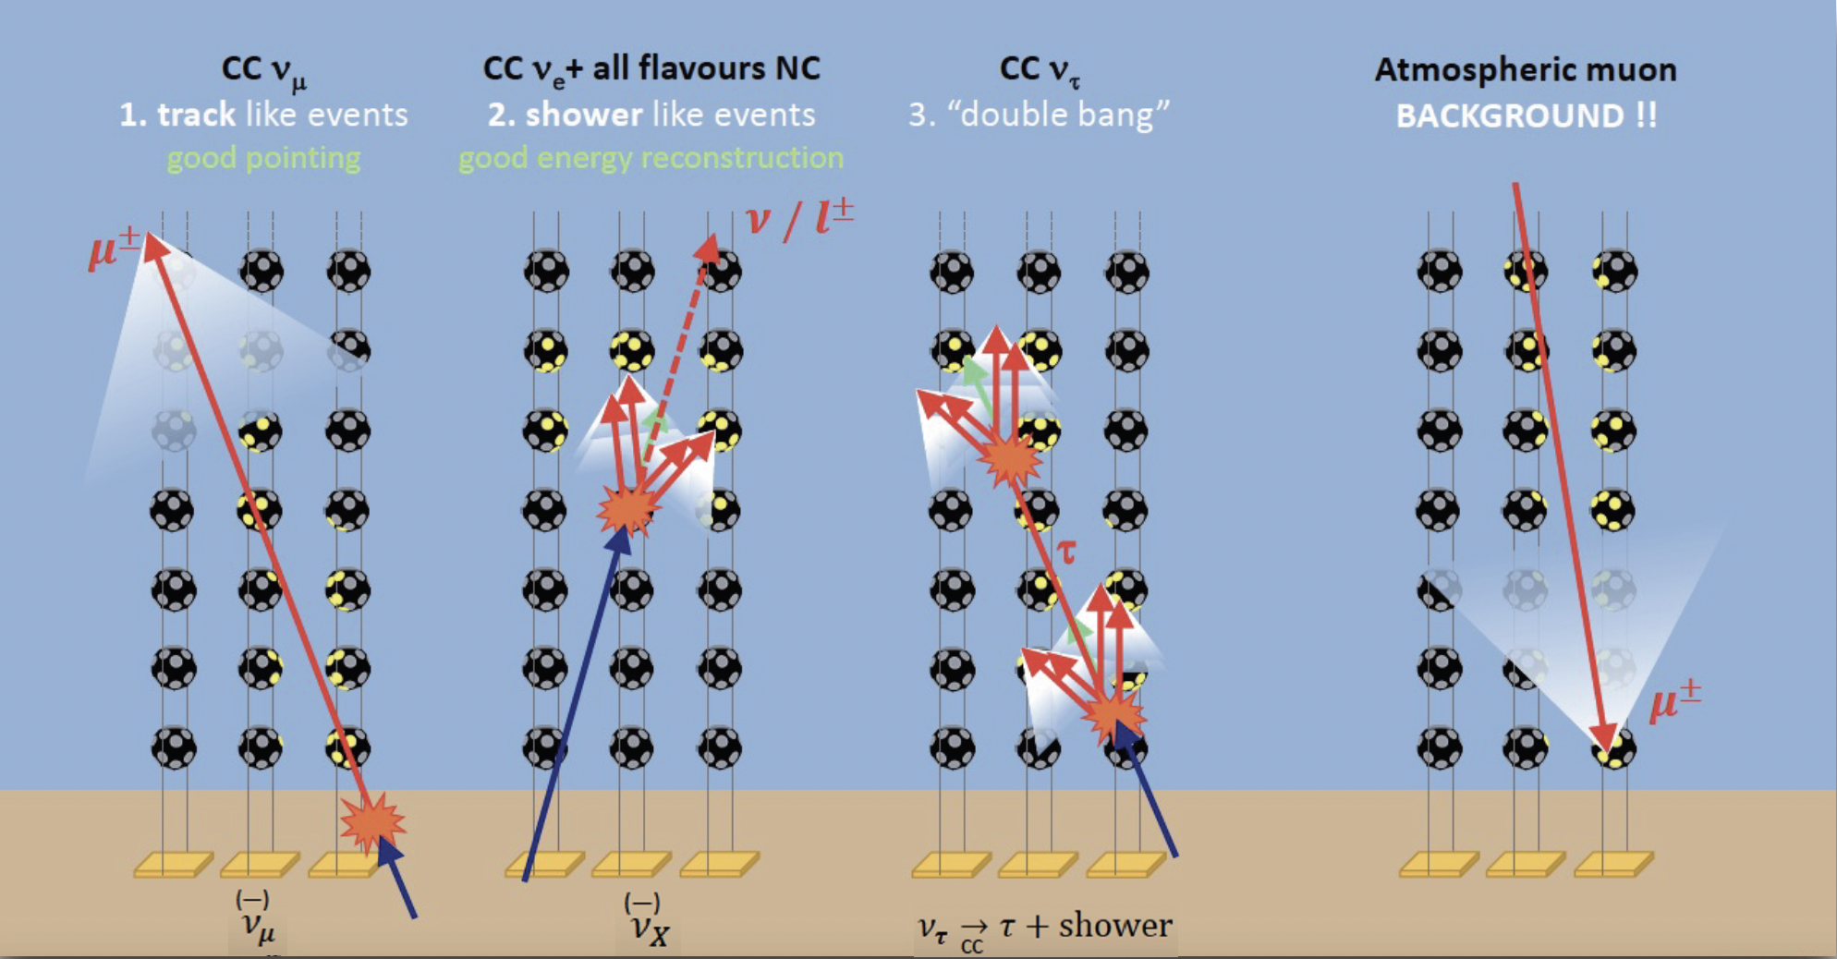
Detection Principle in a nutshell
3
Deep-sea waters offer long effective scattering length – Homogeneous medium
Tracks: median ang. res. can drop below 0.1◦ above 100 TeV, factor 2 energy estimate
Showers : median angular resolution can reach 1◦ at 100 TeV, 10% energy resolution
Notes:
On peut mettre les resolution ici dans l’eau de mer et virer le slide 17

Slide 4
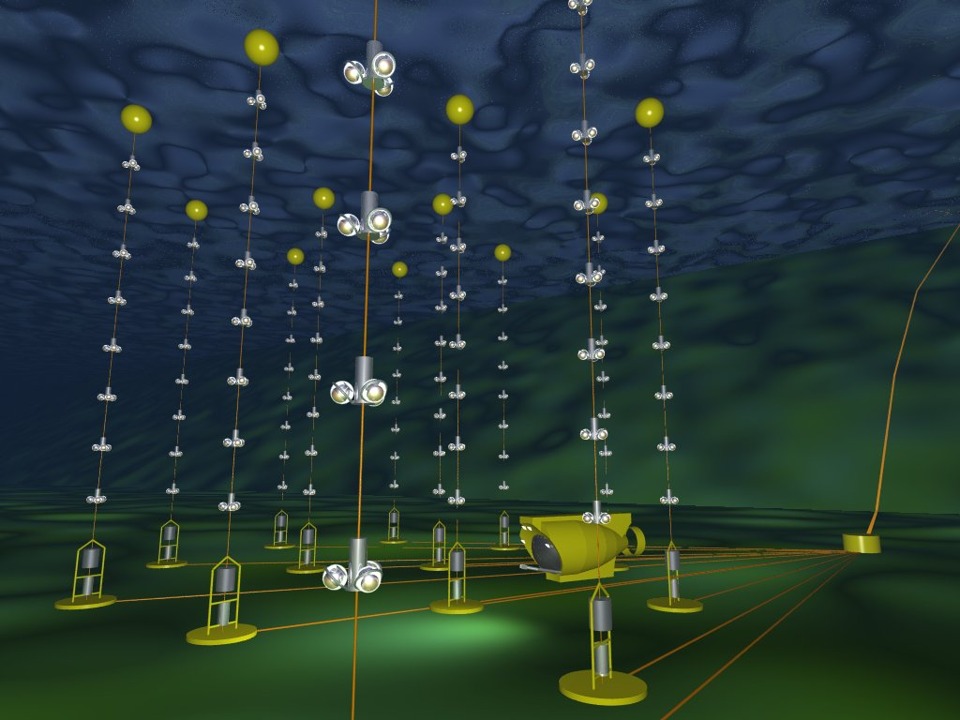
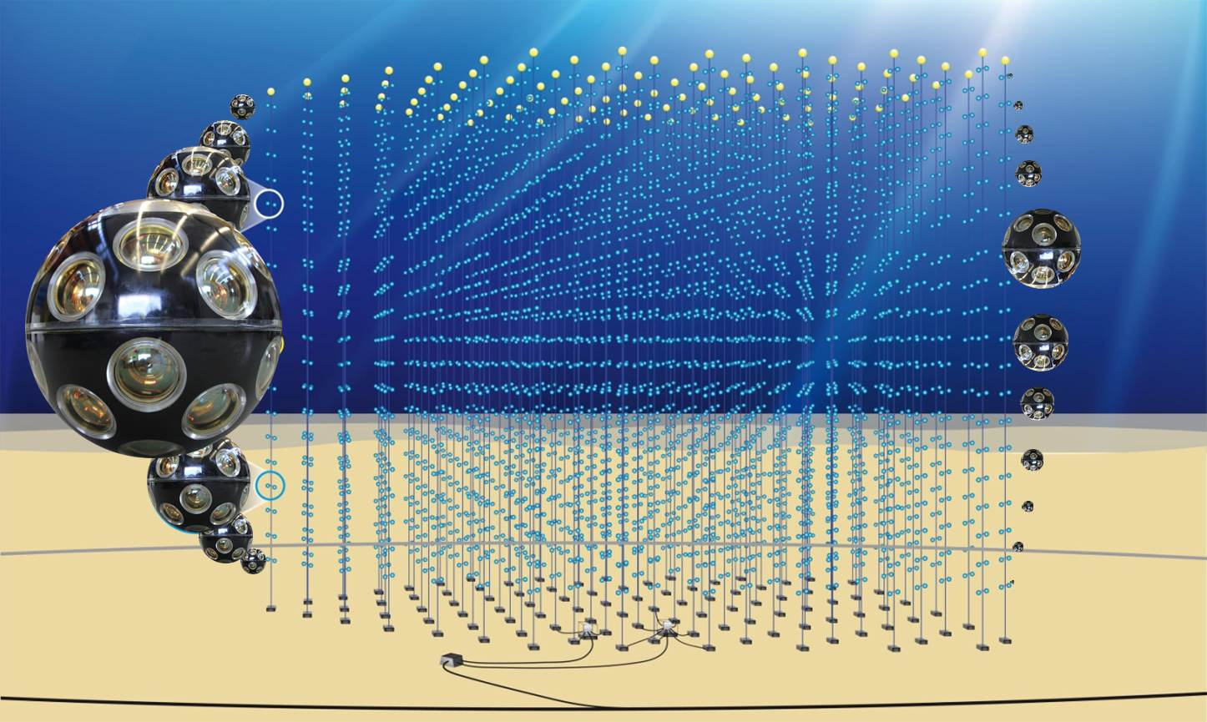
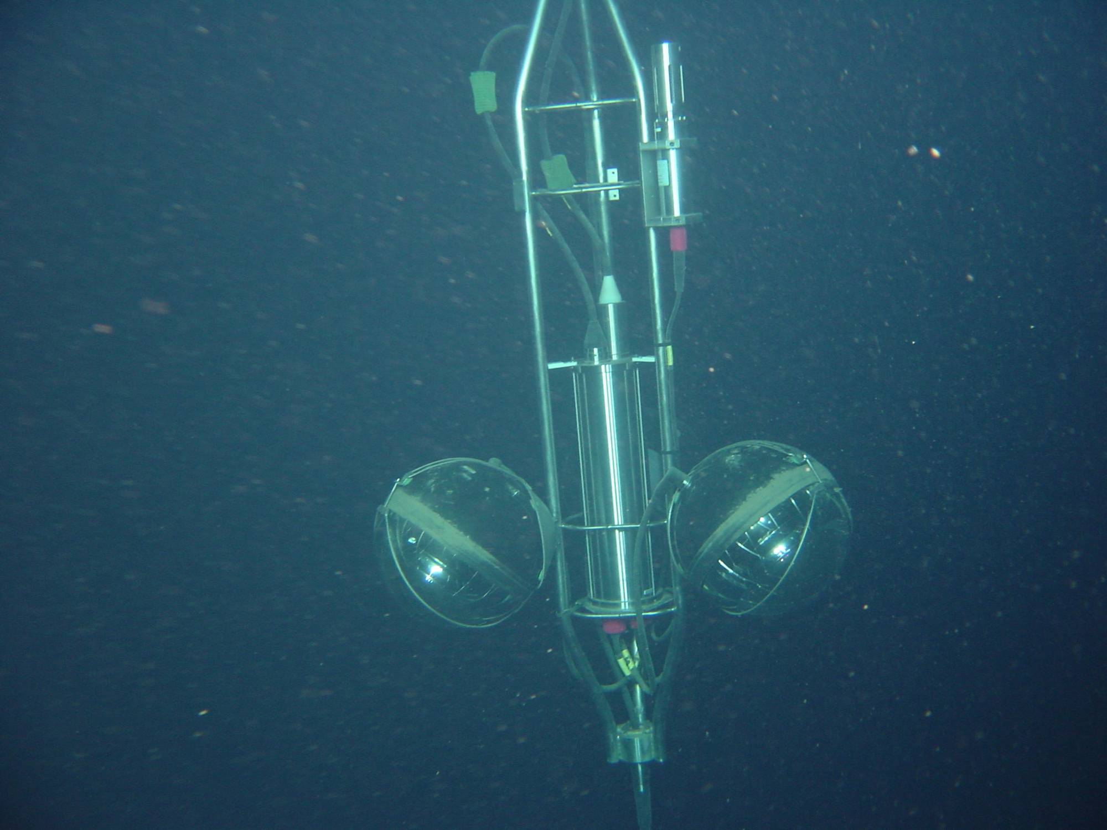
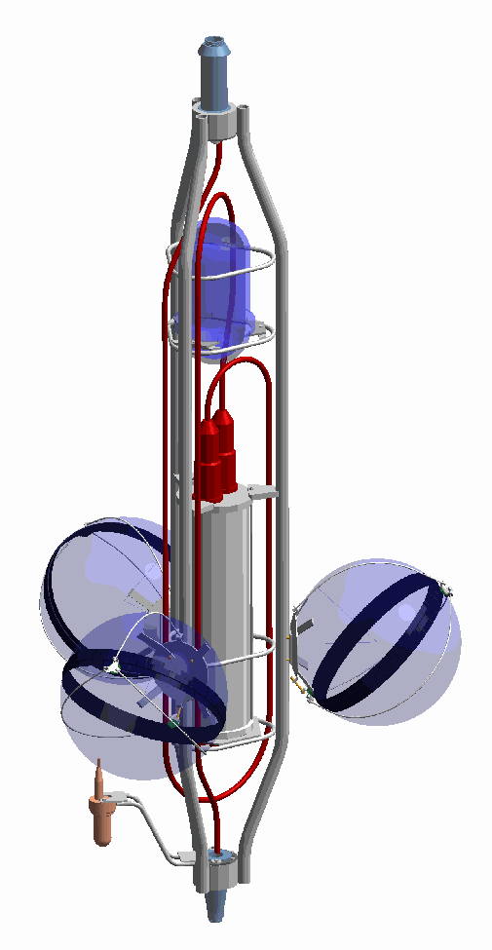
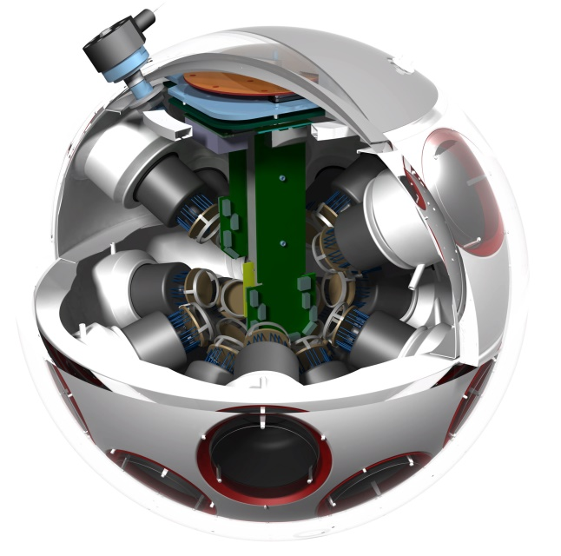
Mediterranean Detectors
4
ANTARES complete 2008 - 2022
KM3NeT Under Construction
~20m/90m
25 storeys / line
3 PMTs / storey
900 PMTs
18 storeys / line
1 DOM / storey
~200 000 PMTs
350 m
14.5 m
~200m/~650m
100 m
~70 m
~10 Mton
230 ARCA + 115 ORCA lines New Generation
12 lines First Generation
First line in 2006
~1 Gton ~7 Mton
Same size (43cm)
DOM: 31 3” PMTs
Digital photon counting
Directional information
Wide angle of view
Cost reduction wrt Antares
 NIM A 656 (2011)
Compact
Notes:
Cost reduction?

Slide 5
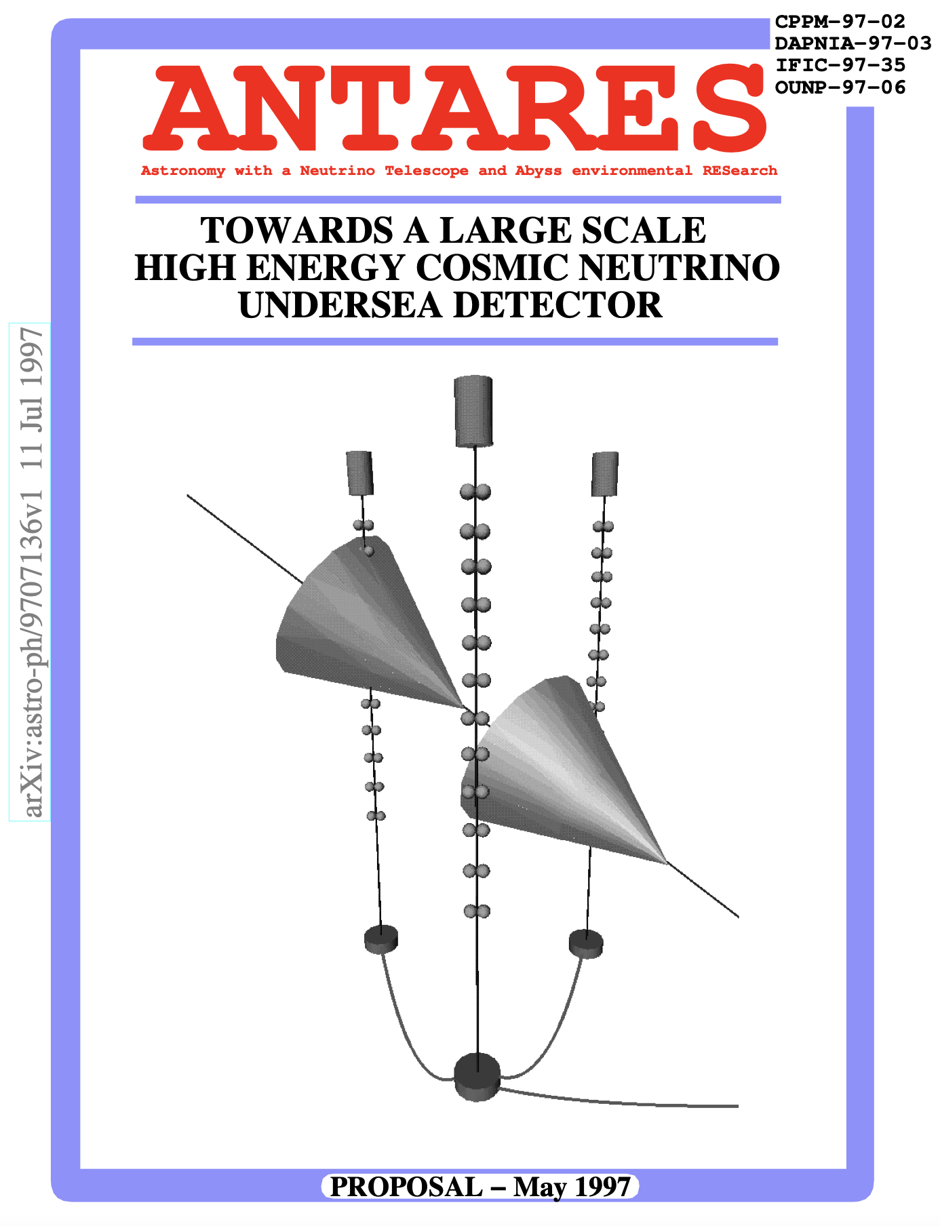
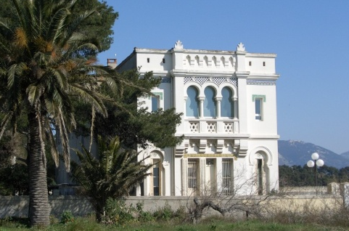
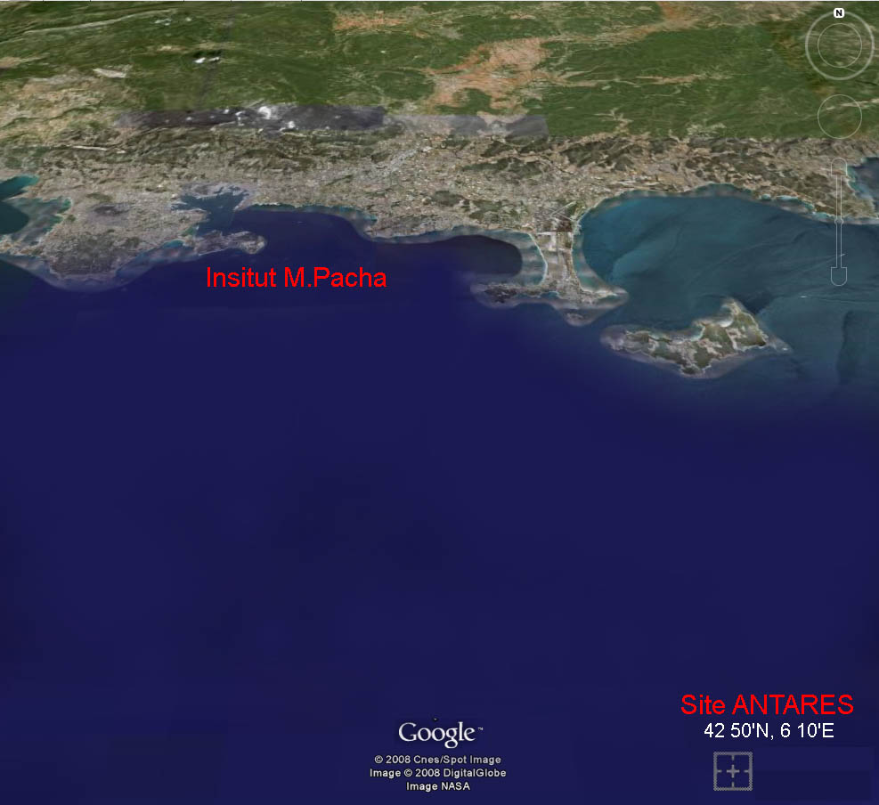
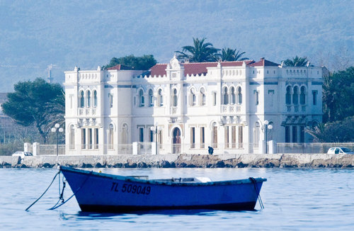
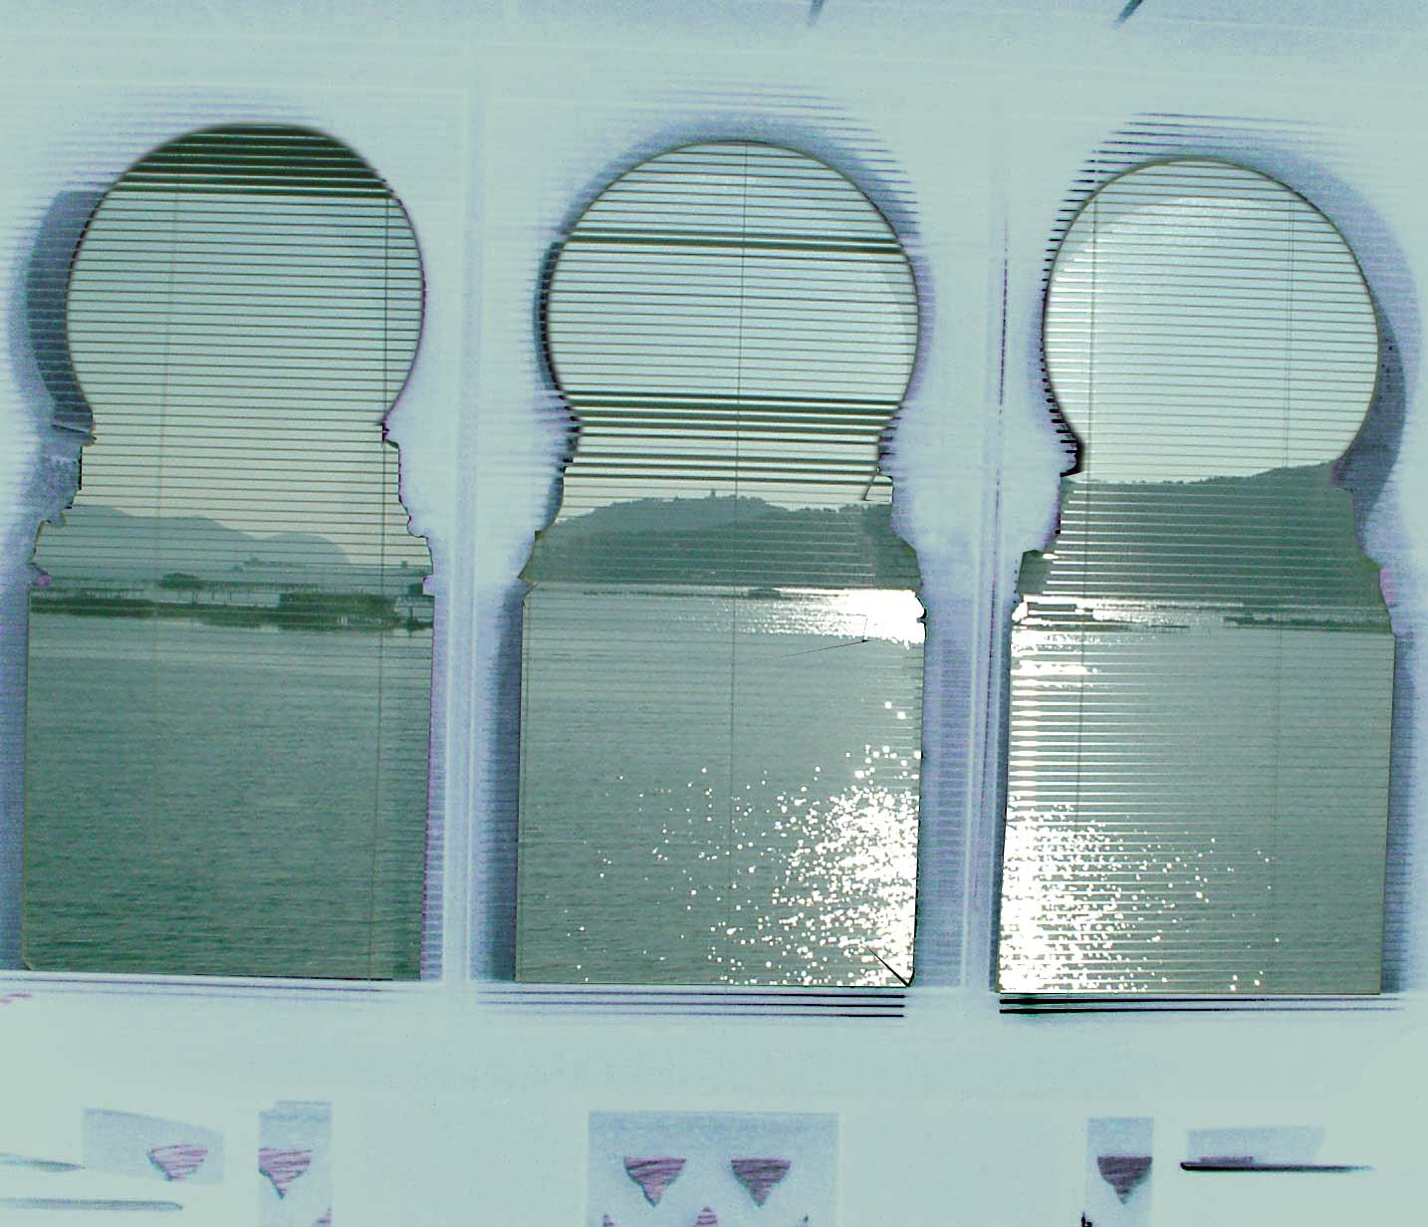
The ANTARES Endeavor
5
Institute Michel Pacha
Electro-Optical
Cable of
40 km

Slide 6
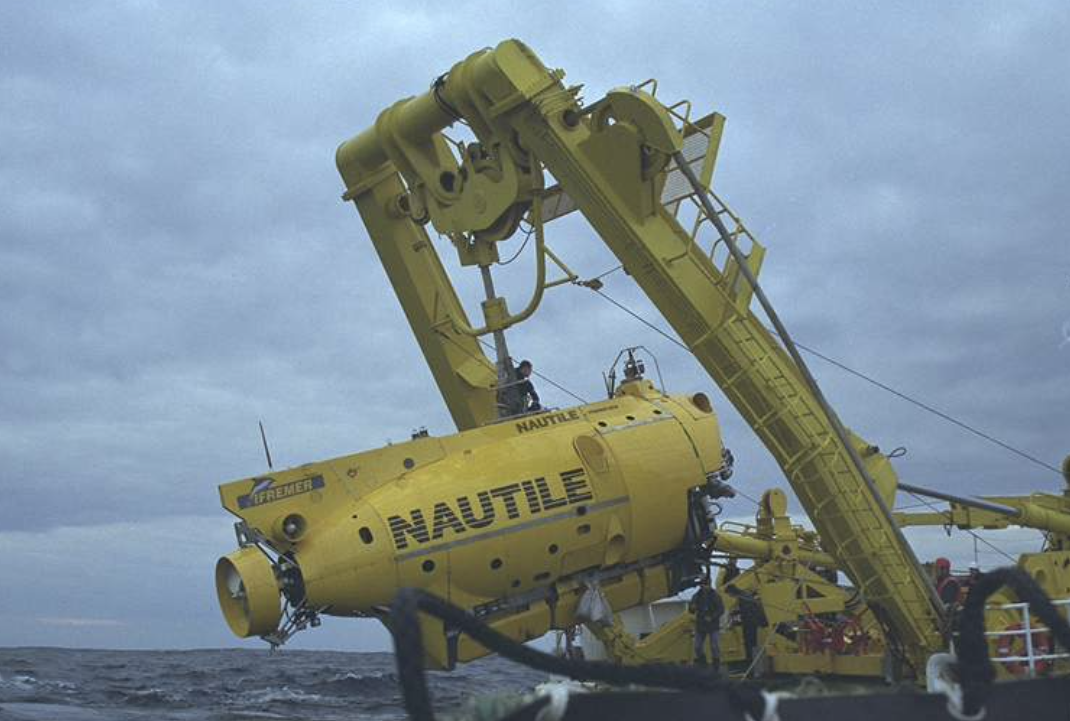
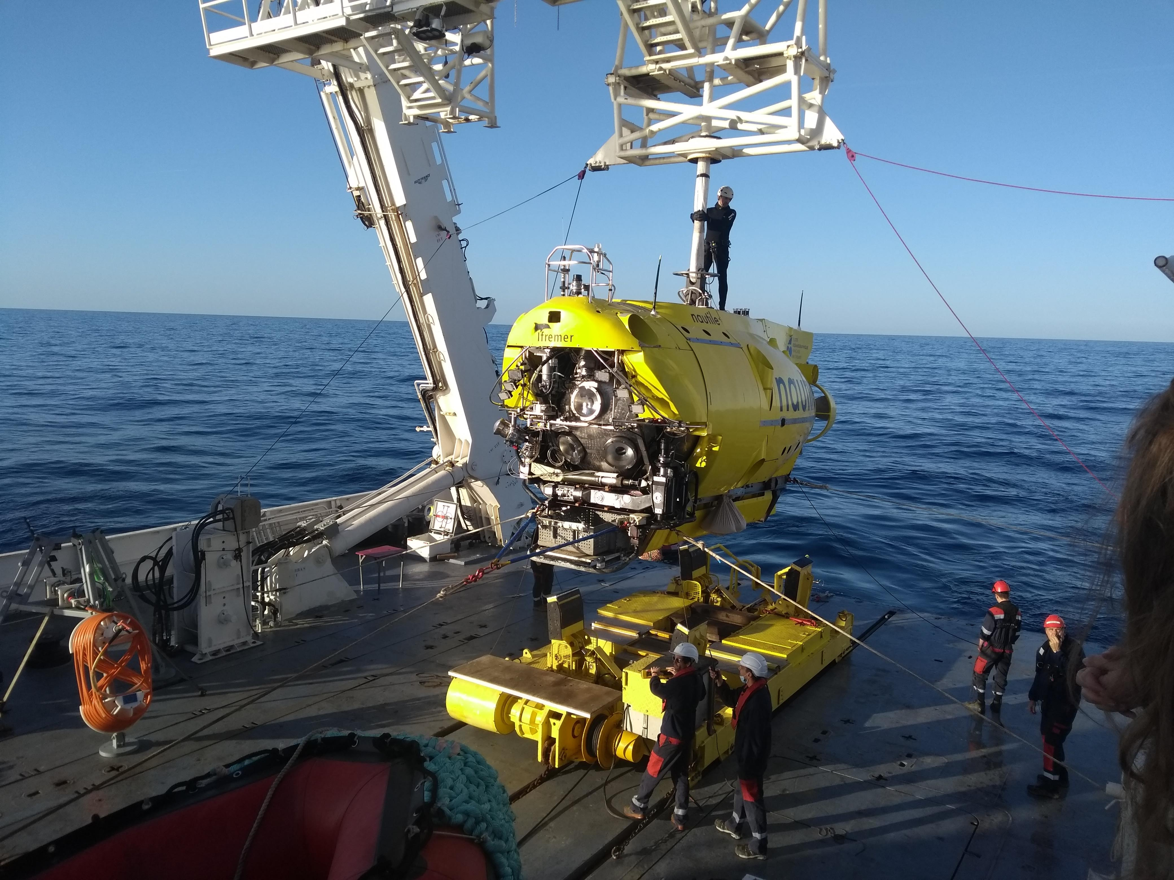
ANTARES 2001-2022
6
6
2001
2022
2001 2002 2003 2004 2005 2006 2007 2008… 2016 …2022
Main
Electro-Optical Cable
Prototype
Sector line
First line
Running
(almost)
without common fund
Mini Instrumentation Line with OMs
Completion
End of
data taking
Recovery
Junction
Box

Slide 7
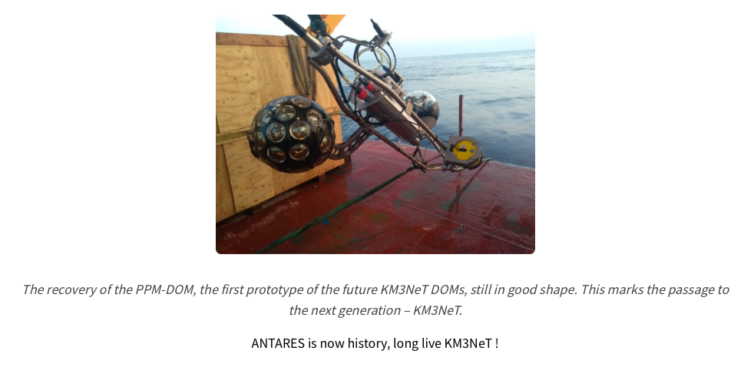
ANTARES: A key step towards KM3NeT
7
News item on ANTARES (new) web site, published on June 23rd, 2022

Slide 8
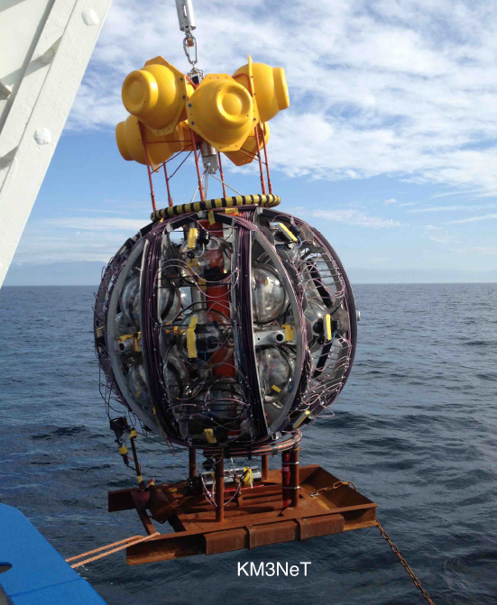
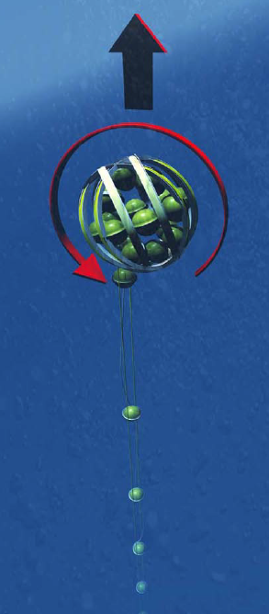
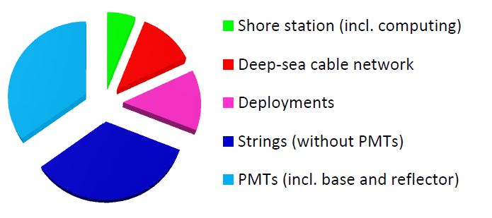

KM3NeT Construction
8
28 (23) strings deployed in ARCA (ORCA)
ANTARES’ online acceptance overcome (> ✕3 )
Data taking on the fly
Total KM3NeT cost: 320 M€
rapid deployment
autonomous unfurling
recoverable
Flagship Experiment
ARCA 47 DUs
ORCA 28 DUs
https://www.youtube.com/watch?v=tR8jwgG6uzk
2020
2021
2022
2023
2024
2025
2026
2027
2028
2029
ANTARES
decommissioning
ANTARES
legacy papers
ORCA & ARCA
completions

Slide 9
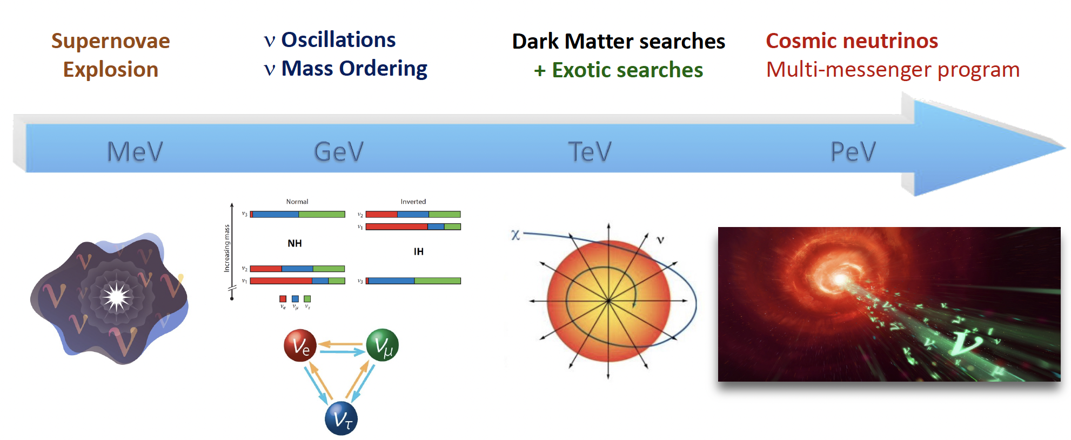
Physics Studies
9
Supernovae
Explosion
Neutrino
Physics
Dark Matter
& Exotic searches
Cosmic neutrinos
Multi-messenger program
(See backup)
KM3NeT(-ORCA) ANTARES KM3NeT(-ARCA)

Slide 10
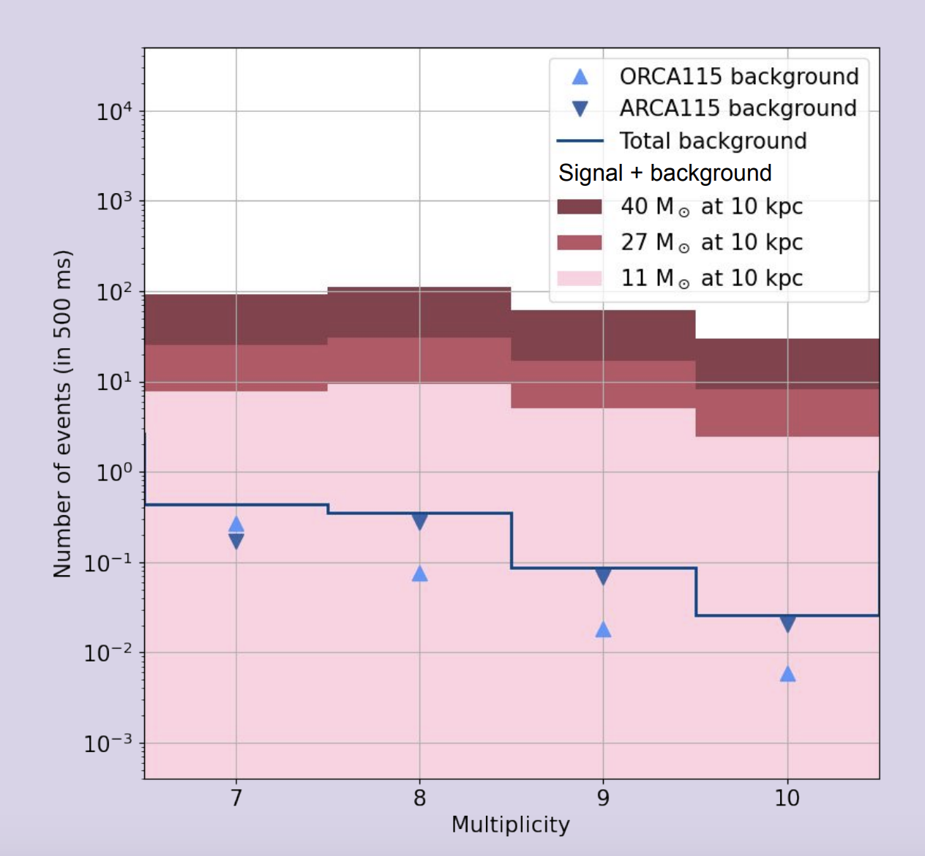
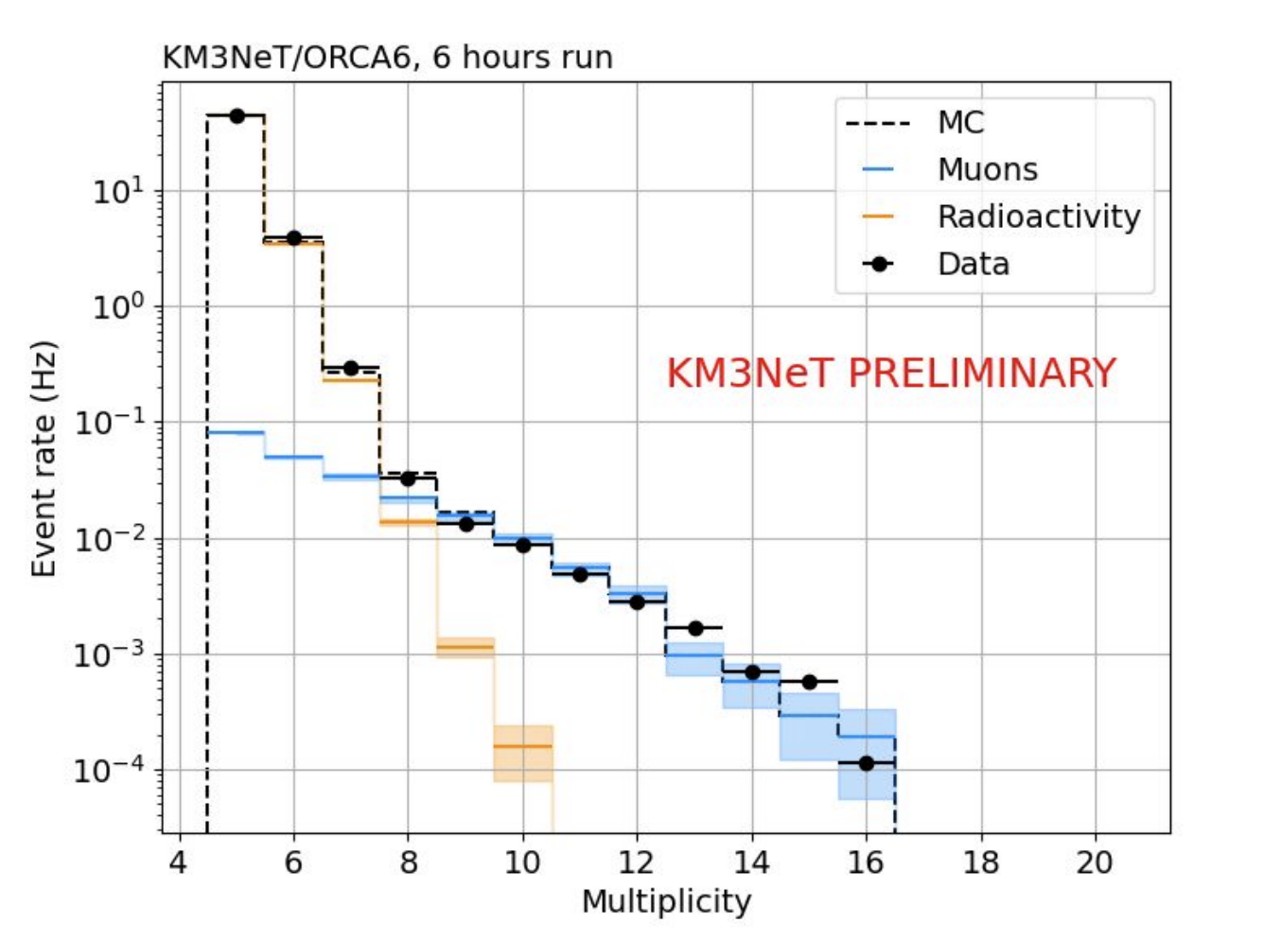
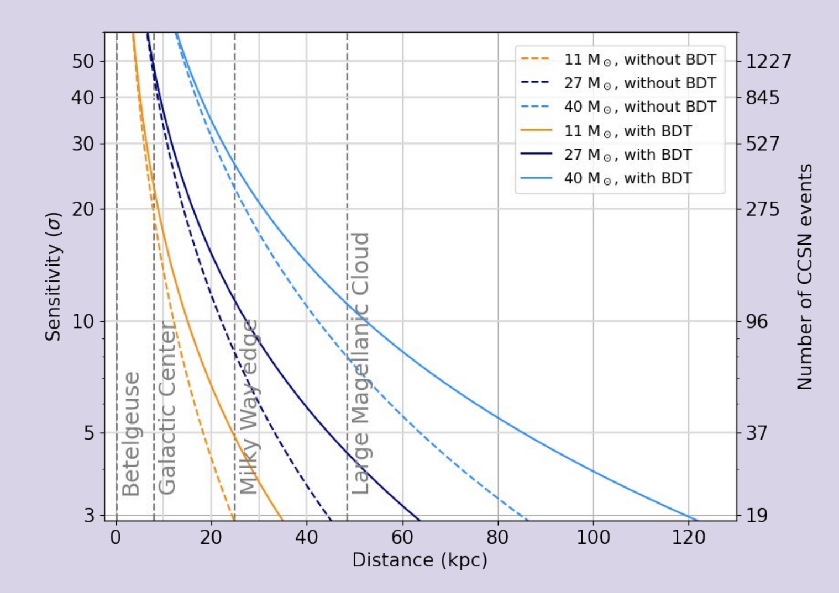
Supernova Physics
10
A DOM as a single detector
Muon background rejection improved
PMT multiplicity plot
Signal expected above background
Significance
ARCA28+ORCA24
>5σ for ARCA+ORCA for 27M☉ at distance <50kpc
An on-line alert system for CCSN already implemented
Integrated in SNEWS

Slide 11
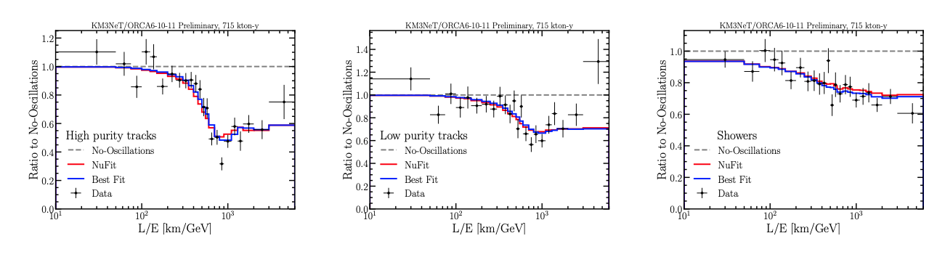
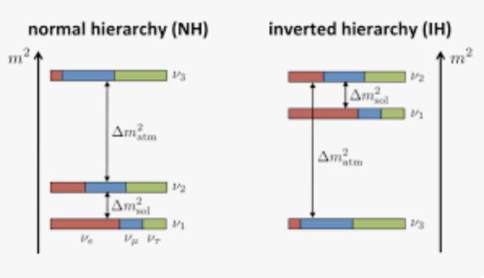
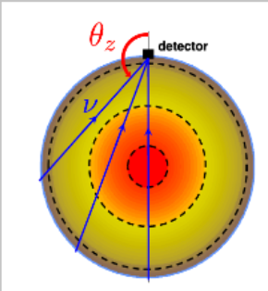
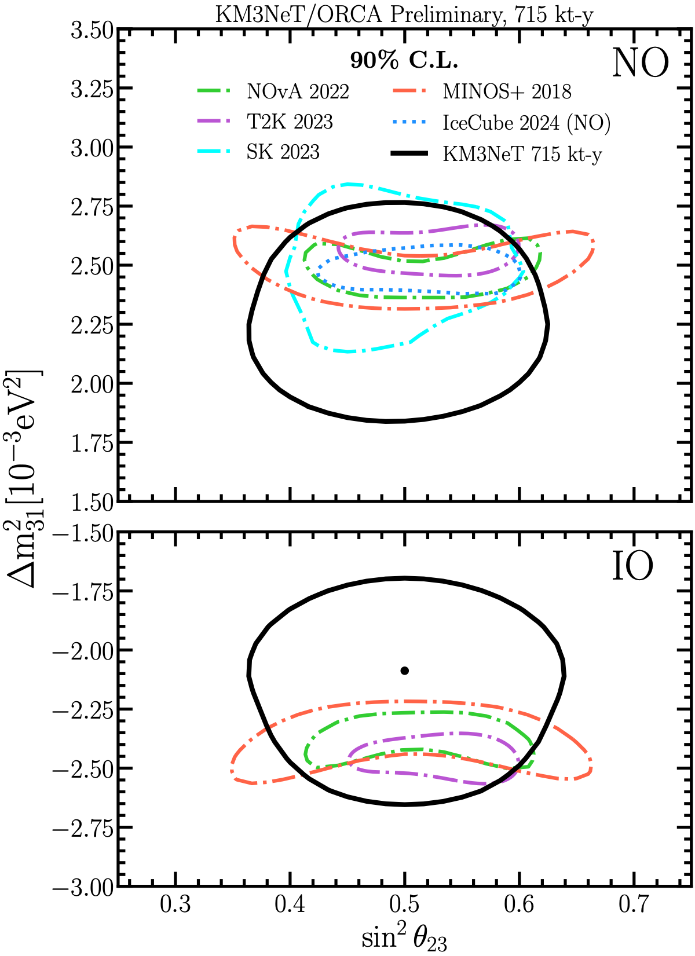
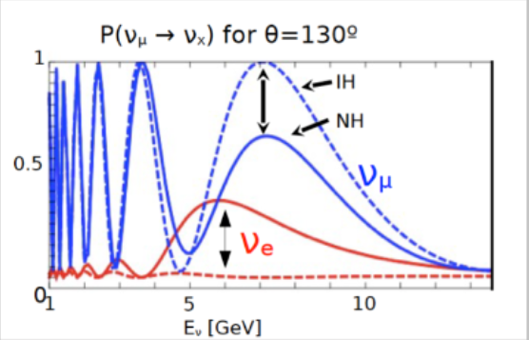
Neutrino Oscillations
11
Neutrino Mass Ordering measuring atmospheric neutrinos crossing the Earth
ORCA6-10-11 data
Oscillations clearly seen both in track and shower events
Baseline from 50 to 12800 km
Energy range of interest 5-15 GeV
Notes:
OK

Slide 12
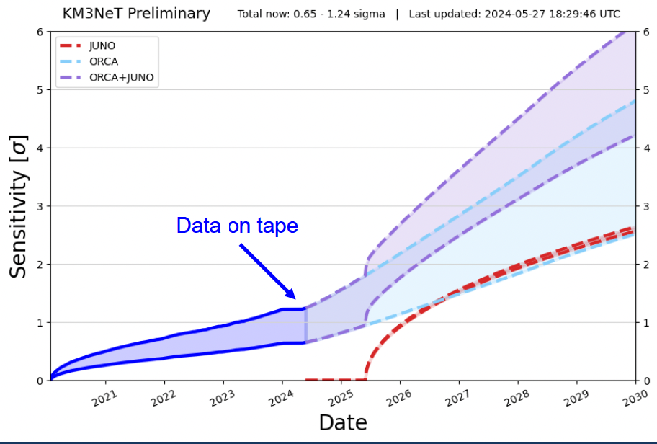
Neutrino Mass Ordering
12
Predictions based on the current construction plan.
 Eur. Phys. J. C 82, 26 (2022)
 J. High Energ. Phys. 2022, 55 (2022)
→ Exploiting synergies with reactor experiments can boost the measurement
5σ can be reached in the next 5-6 years if combined with Juno

Slide 13
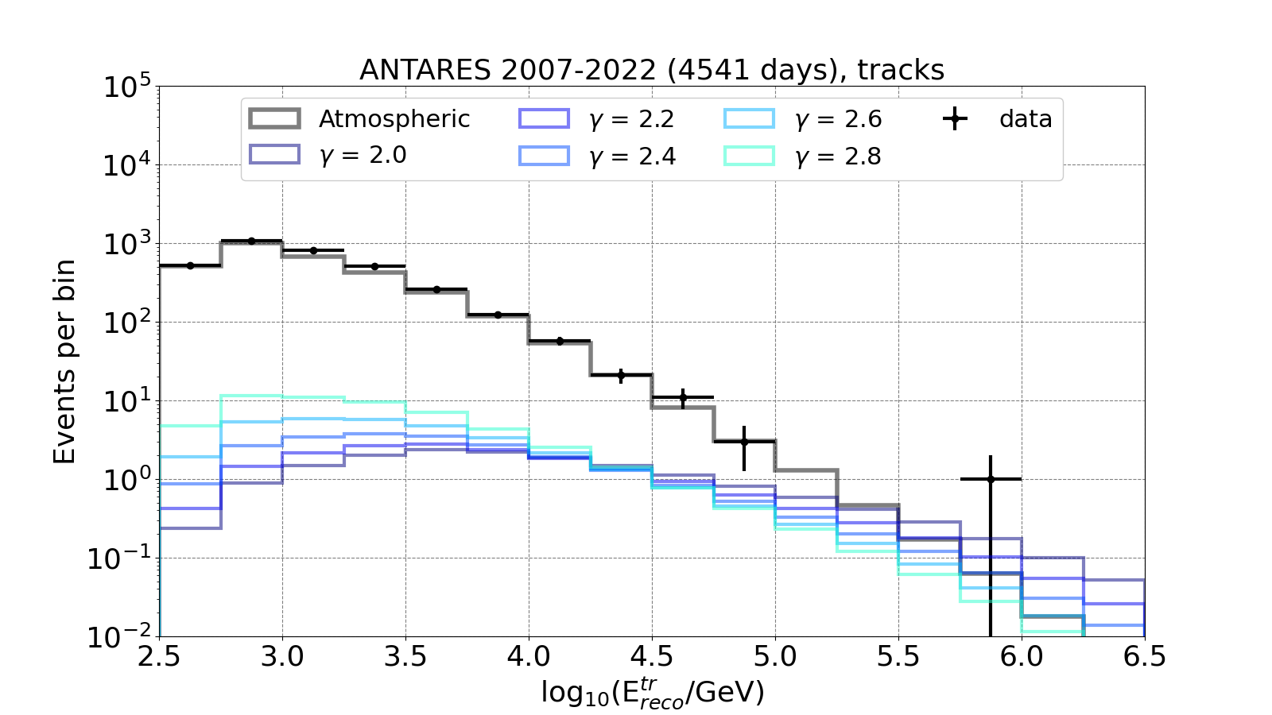
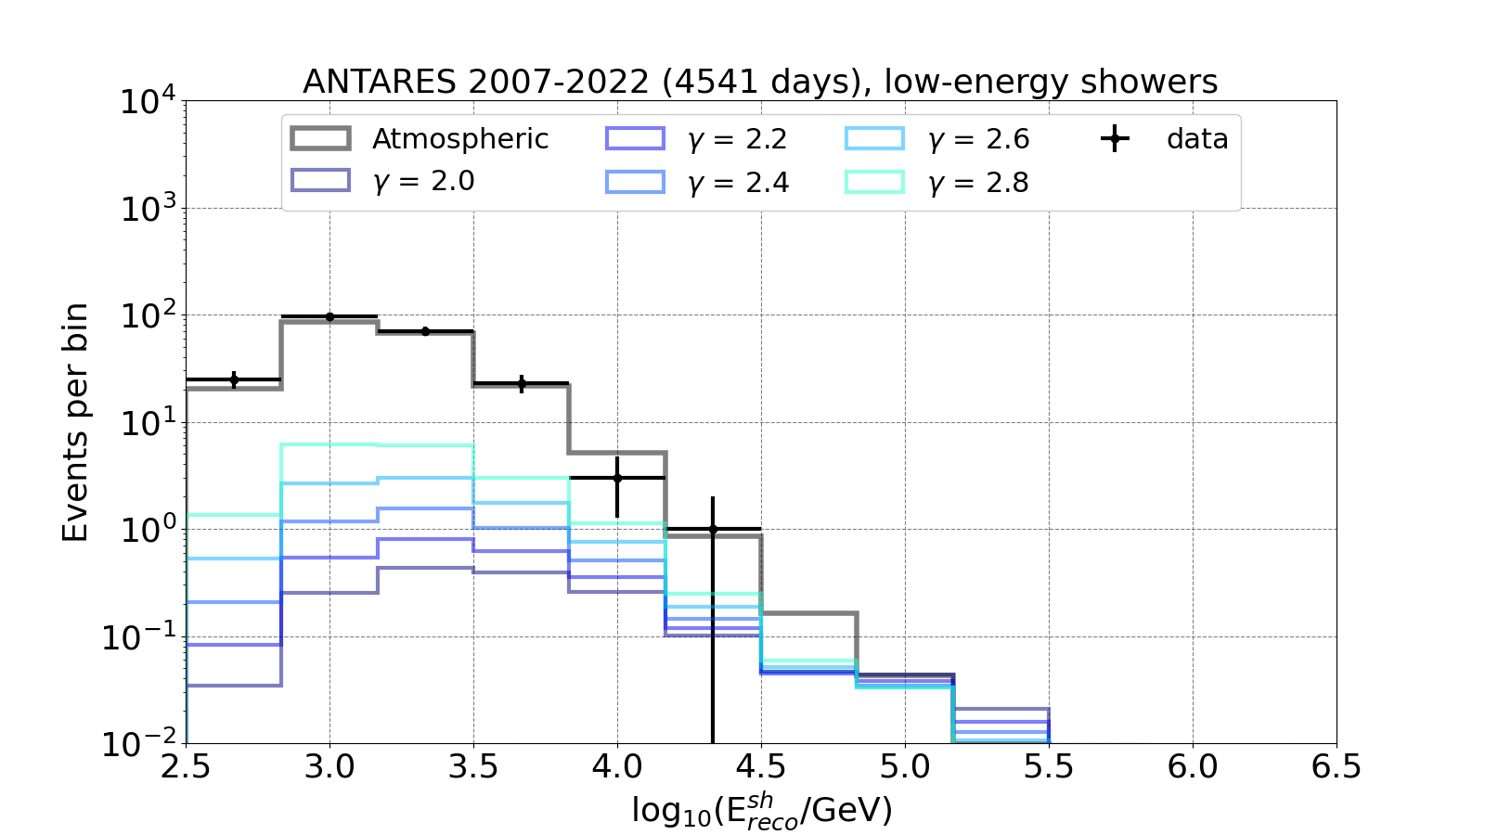
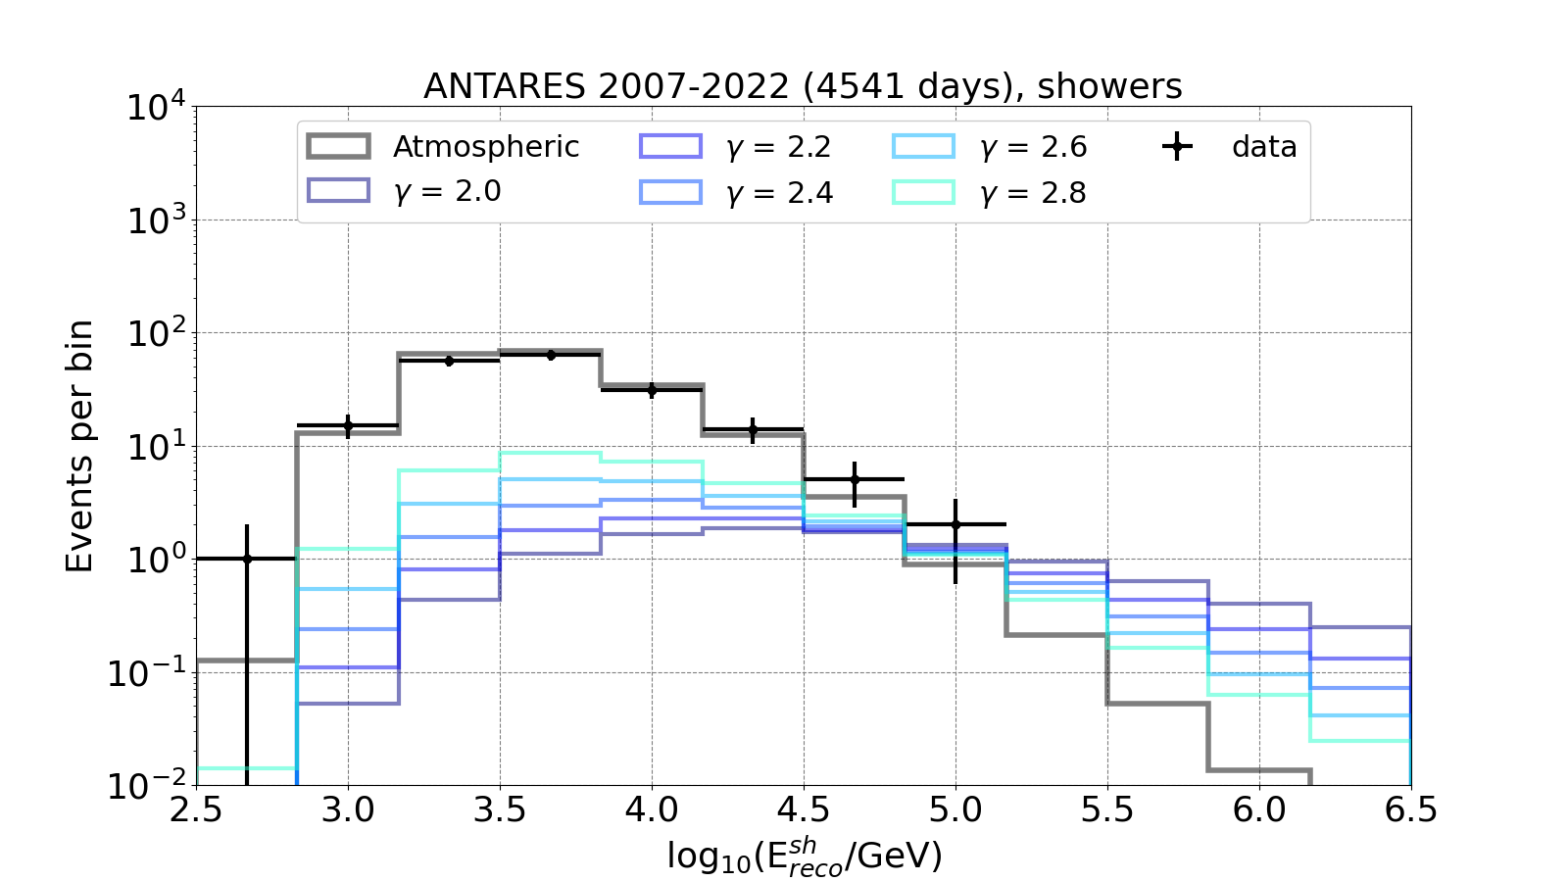
Antares Final Diffuse Flux Search
13
ANTARES data from 2007 to 2022 (4541 days) All-sky / All-flavor neutrino search
  Selection cuts optimized with Model Rejection Factor procedure (spectral index Γ = 2.5)
  Look for excess above a given energy threshold
Three high-purity samples (Tracks, Showers, LE showers)
Showers provide most of the sensitivity
 arXiv:2407.00328
No significant excess of events is observed

Slide 14
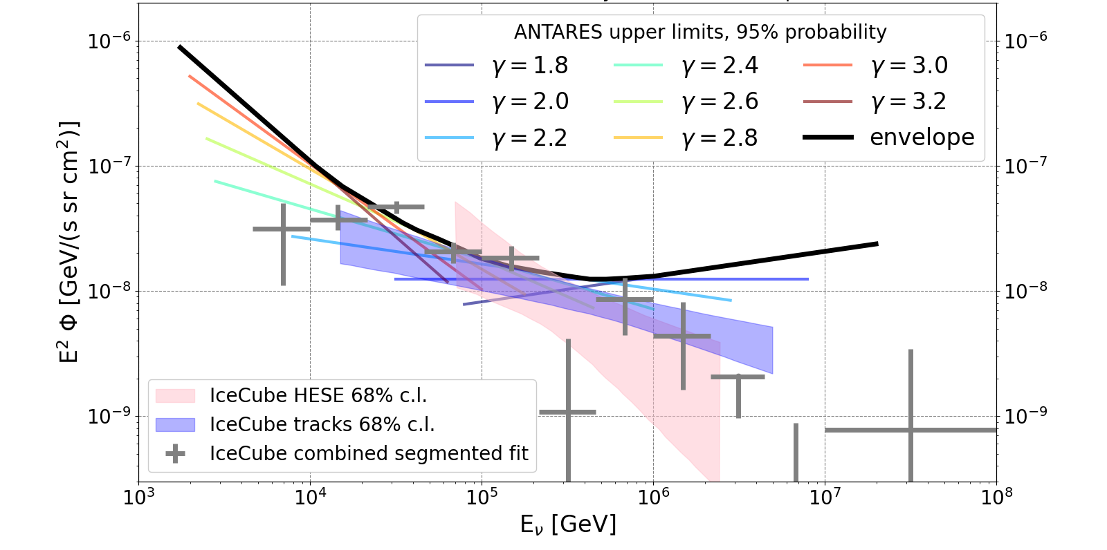
Antares Final Diffuse Flux Search
14
ANTARES data from 2007 to 2022 (4541 days) All-sky / All-flavor neutrino search
  Upper limits can be extracted from the non-observation of a clear signal
  Mostly relevant below 100 TeV
 arXiv:2407.00328
Notes:
The ANTARES 15-years 95% probability upper limits for different spectral indexes (coloured lines in the legend) are reported in the figure. The envelope of the limits (black) is taken as the least restrictive limit at every energy. The shaded areas represent the 68% confidence level intervals for the measurements obtained with the IceCube HESE sample [8] in pink and the IceCube track sample [9] in blue. The results from the E−2 segmented fit of the IceCube combined samples [11]
are also shown in grey.

Slide 15
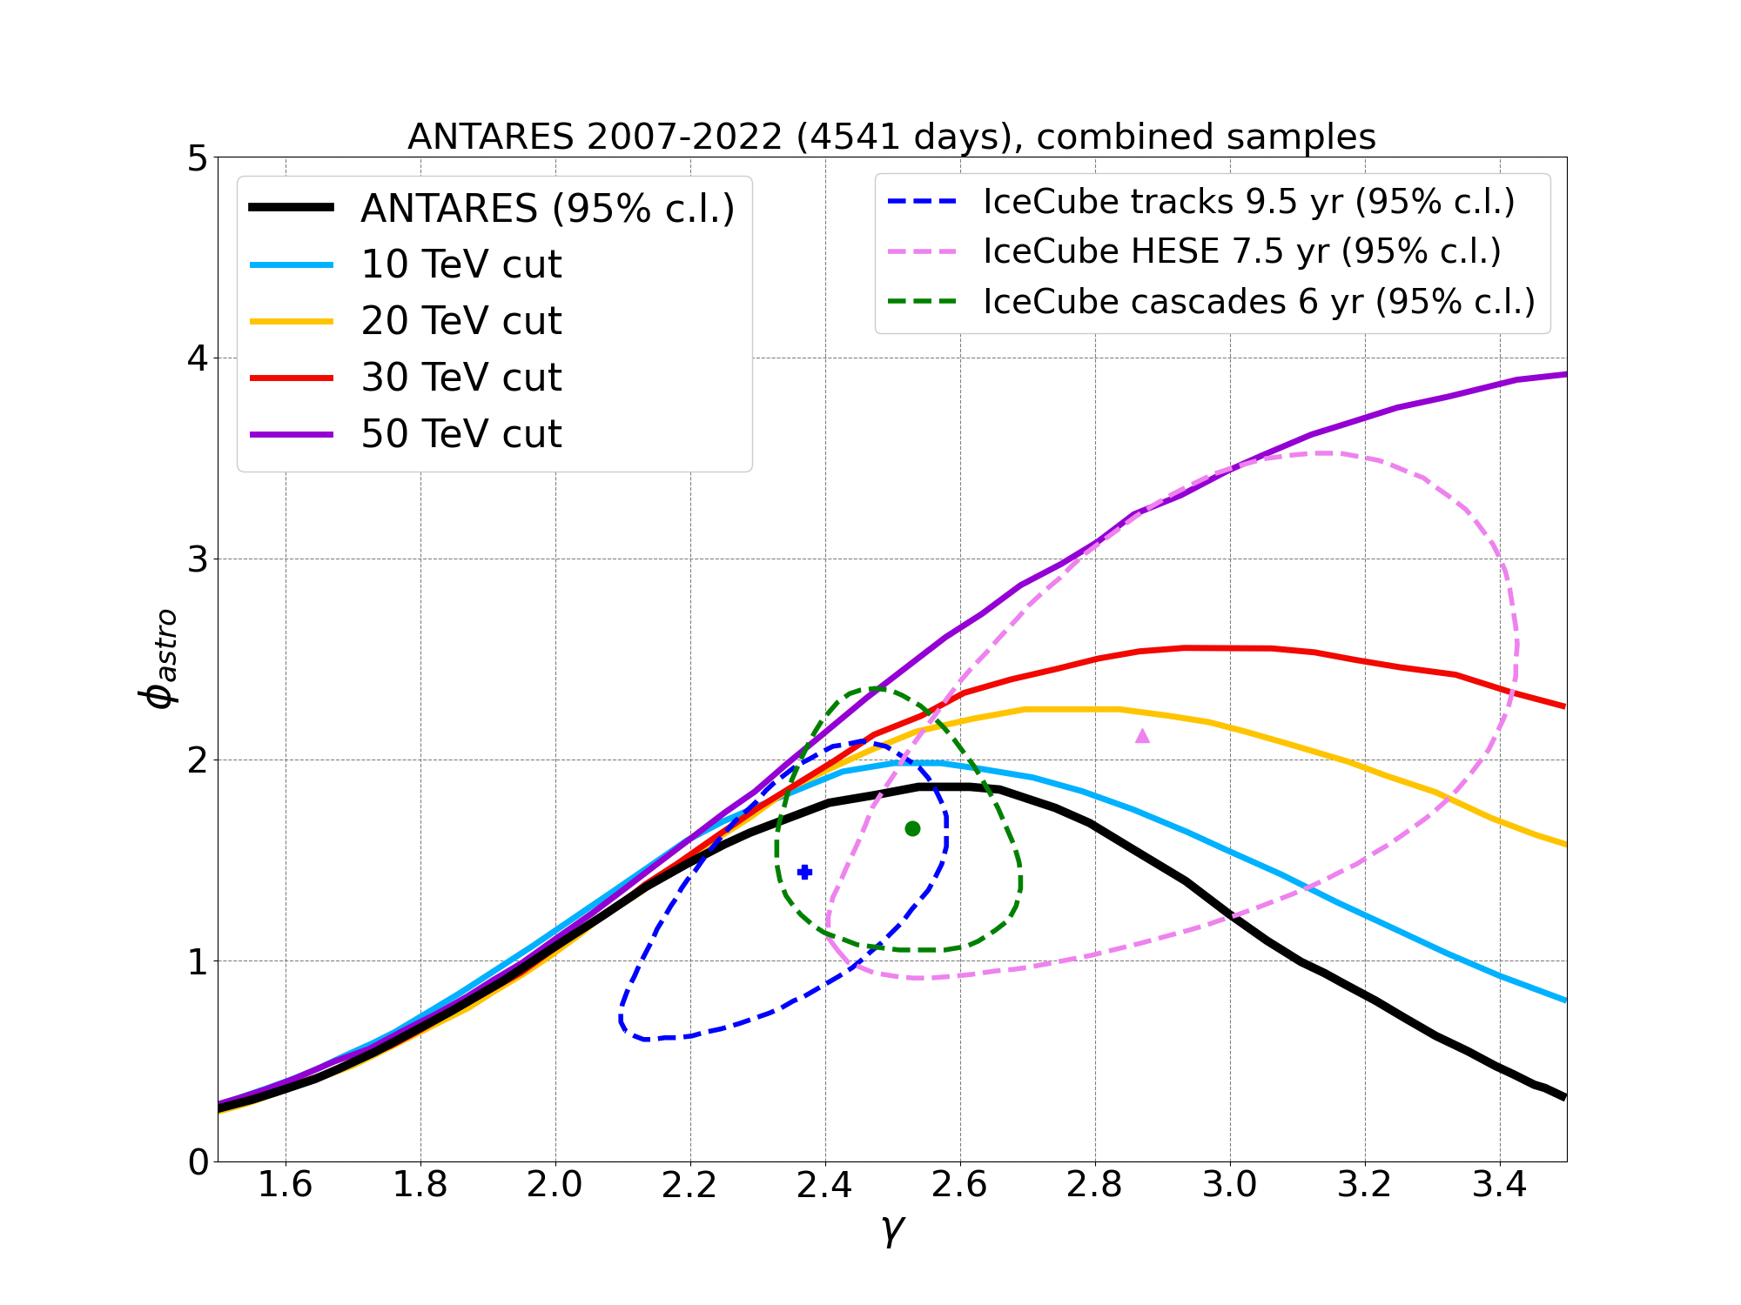
Antares Final Diffuse Flux Search
15
ANTARES sensitivity optimal in the 10-50 TeV range
  Study hypothesis of single unbroken power-law at low energies
  Soft spectra fits of the IceCube signal become admissible (2 σ) only with spectral break
Legacy paper:
JCAP 08 (2024) 038
Notes:
The 95% posterior probability credible areas obtained from the ANTARES fit assuming the single unbroken power-law hypothesis (black) and adding a low-energy cut in the spectrum from 10 to 50 TeV (coloured lines as in the legend) are compared to the 95% confidence limit contours from the IceCube HESE (pink), tracks (blue) and cascades (green) samples, shown as dashed lines together with their respective best-fit point.

Slide 16
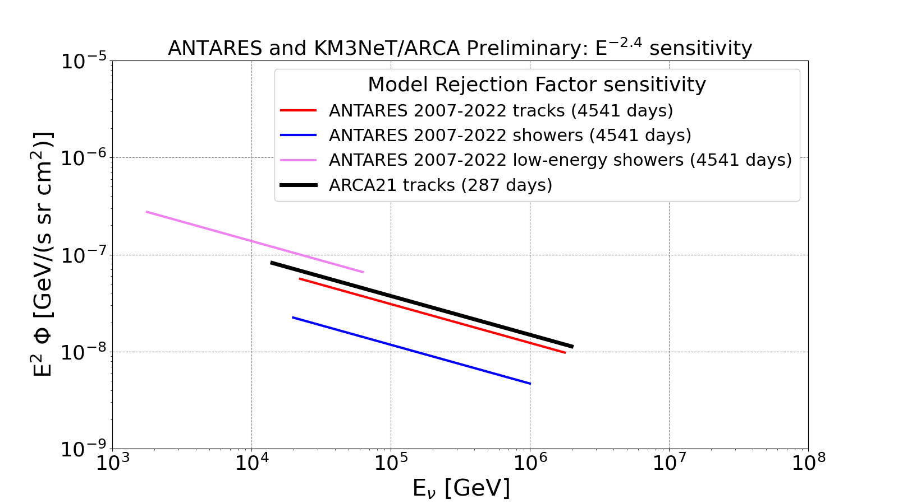
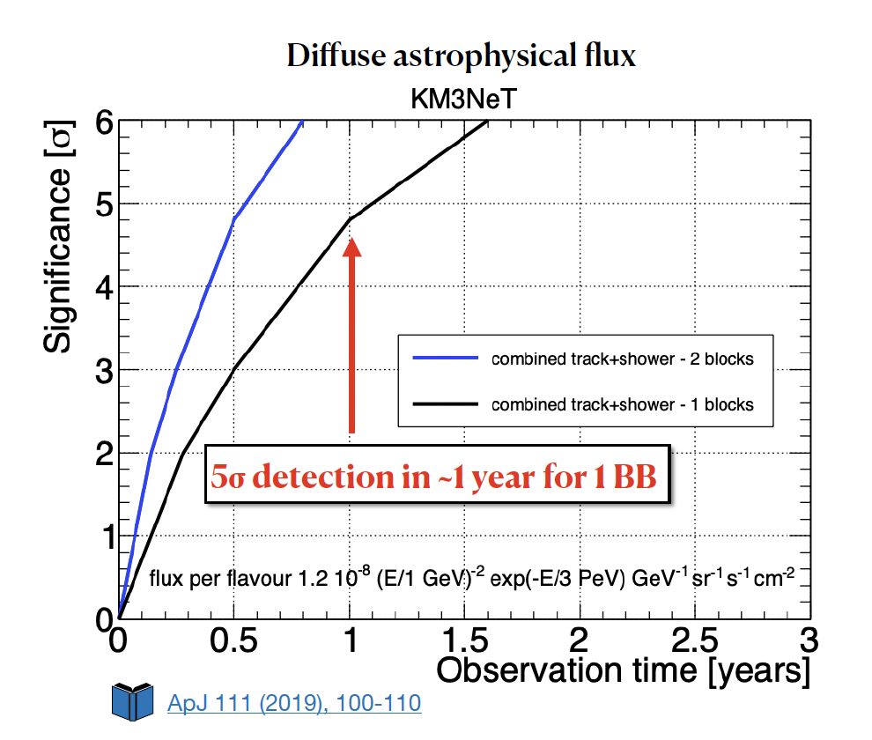
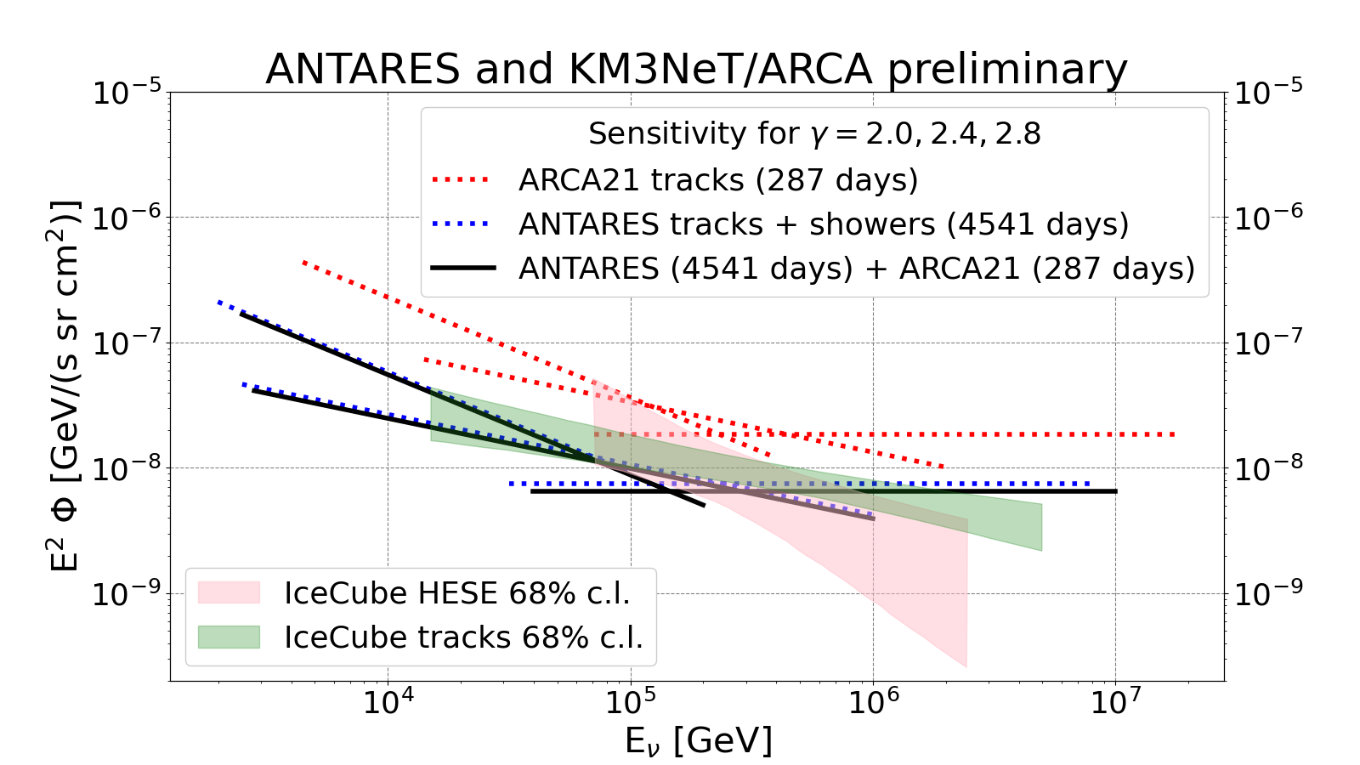
Diffuse flux – Towards a confirmation of IC
16
ANTARES and ARCA21 (tracks) : first combination
Independent confirmation with KM3NeT

Slide 17
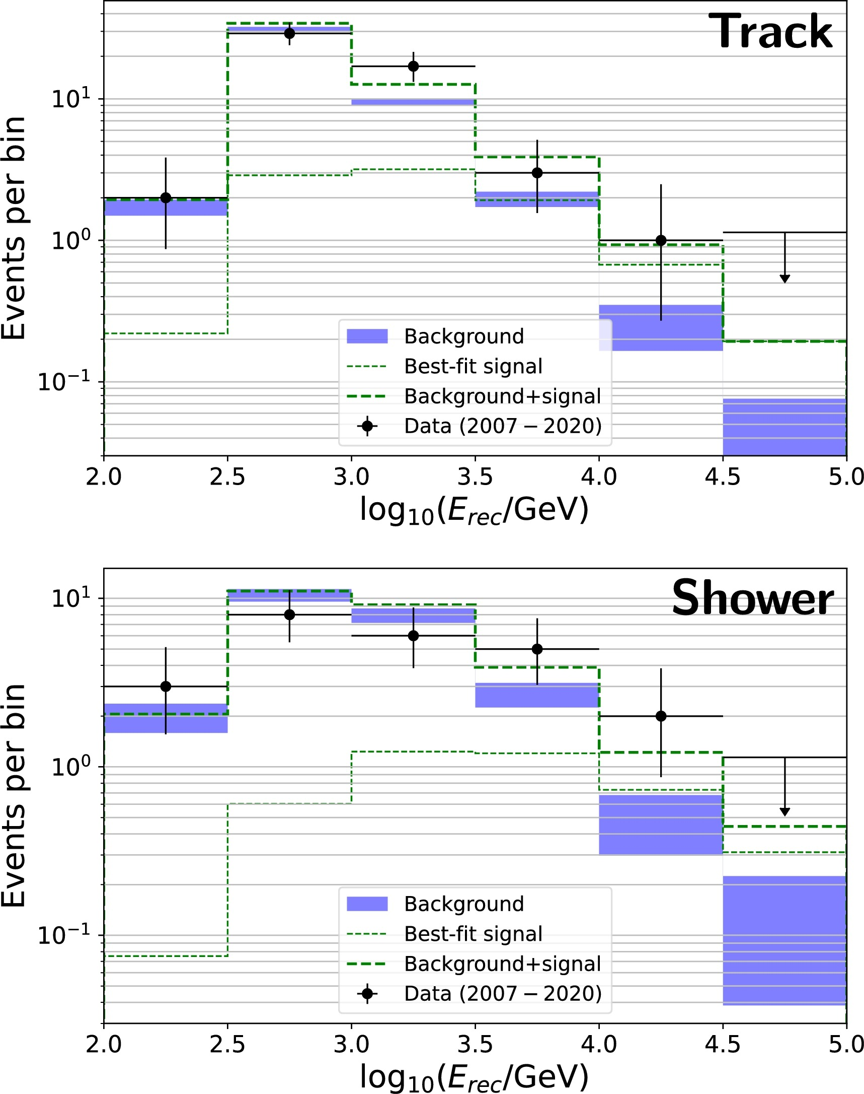
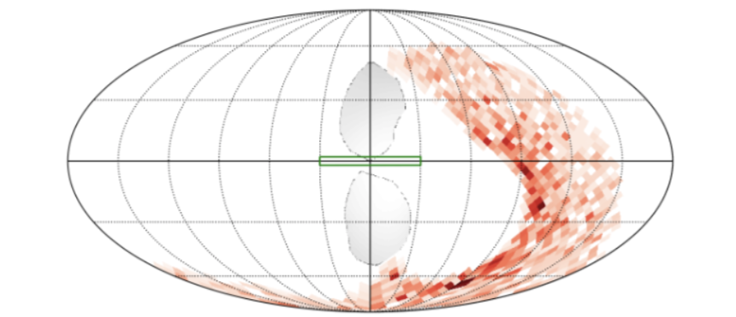
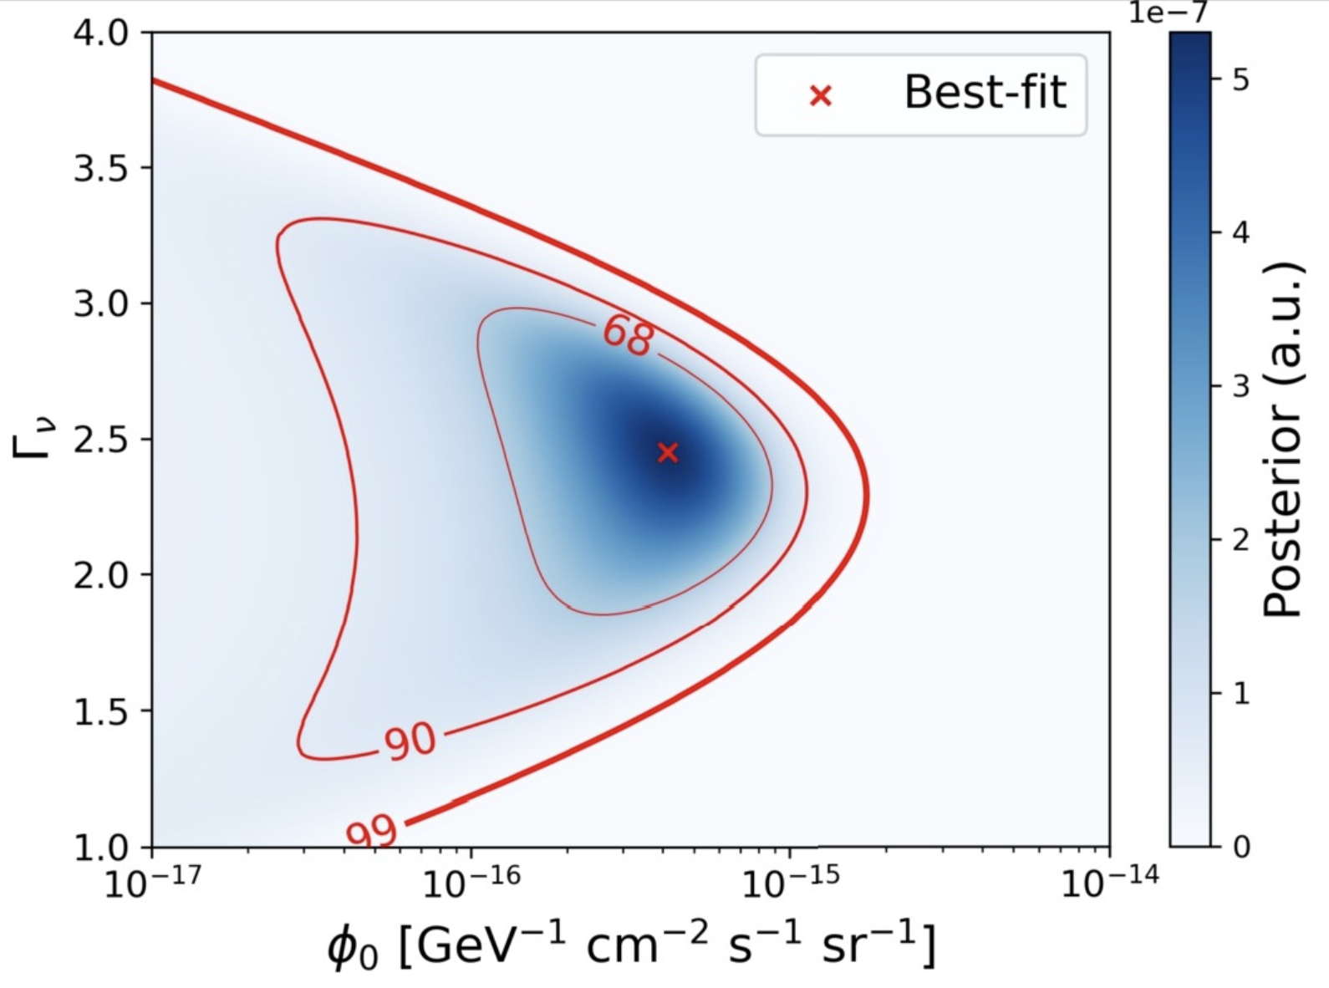
Search for Diffuse Galactic Emission
17
17
More robust analyses: background measured from OFF regions of same local acceptance
Phys. Lett. B 841 (2023) 137951
96% C.L. hint of a galactic signal – Compatible with IceCube

Slide 18
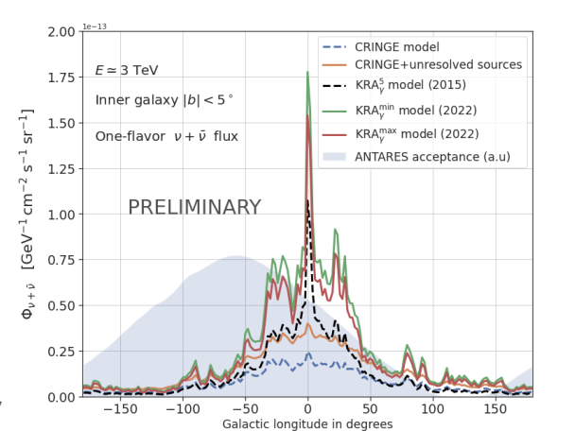
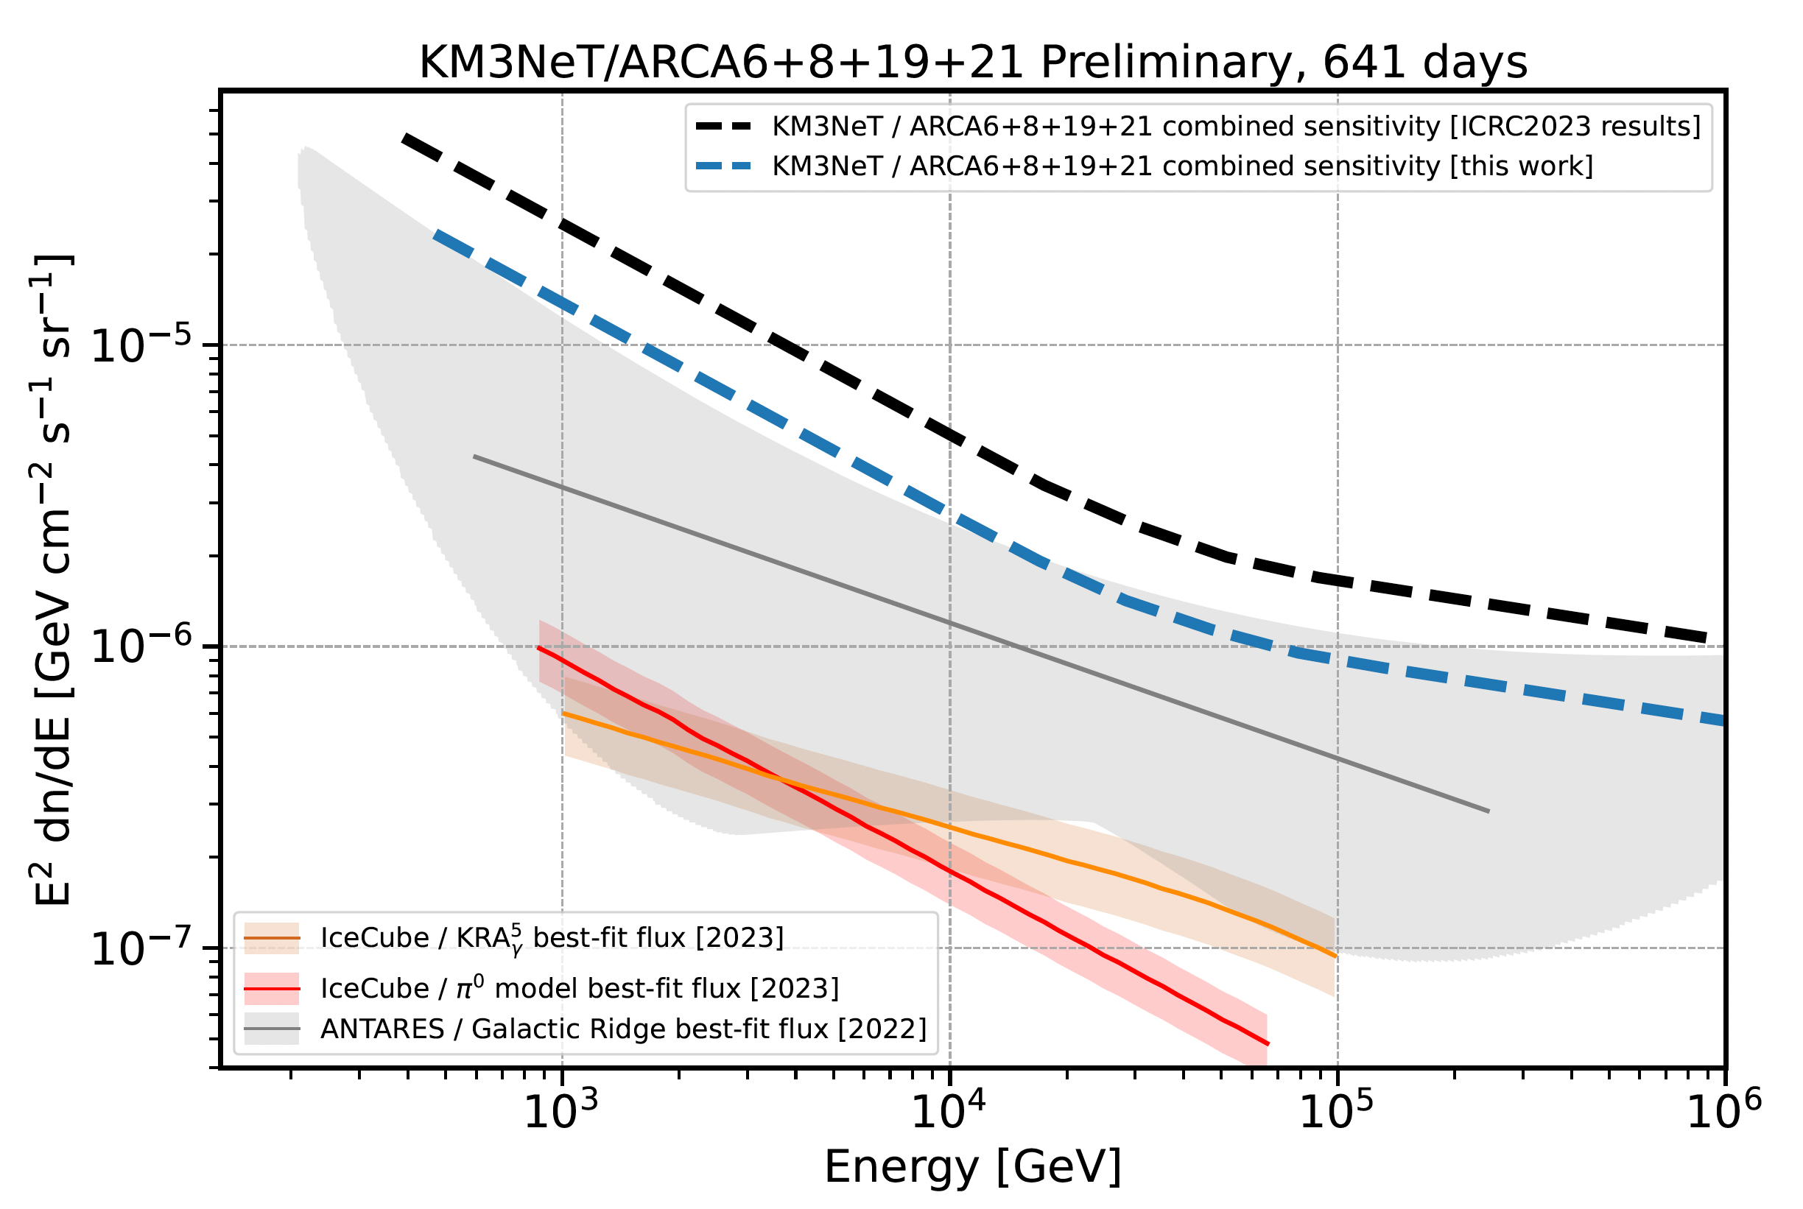
Search for Diffuse Galactic Emission
18
KM3NeT
|l| < 31° and |b| < 5° for KM3NeT/ARCA6-8 and
|l| < 31° and |b| < 4° for KM3NeT/ARCA19-21
Comparison with template studies (full sky not trivial)
On-Off zone analysis
ARCA6 & ARCA8 & ARCA19 fully analyzed
ARCA21 partially analyzed (until December 2022)
ARCA6+8+19+21 upper limits (432d)
A. Neronov, et al, Phys. Rev. D 108, 103044 (2023)
ARCA6+8+19+21 sensitivity (641d)
IceCube
π⁰ model best-fit flux
ANTARES
best -fit flux
IceCube
KRA_{γ}⁵ best-fit flux
Next : identify sources with KM3NeT
Notes:
Consistent pion decay emission produced by a power-law distribution of protons with a slope Γ ≃ 2.5, harder than locally observed
→ variability of the spectrum of cosmic- rays across the Galactic disk

Slide 19
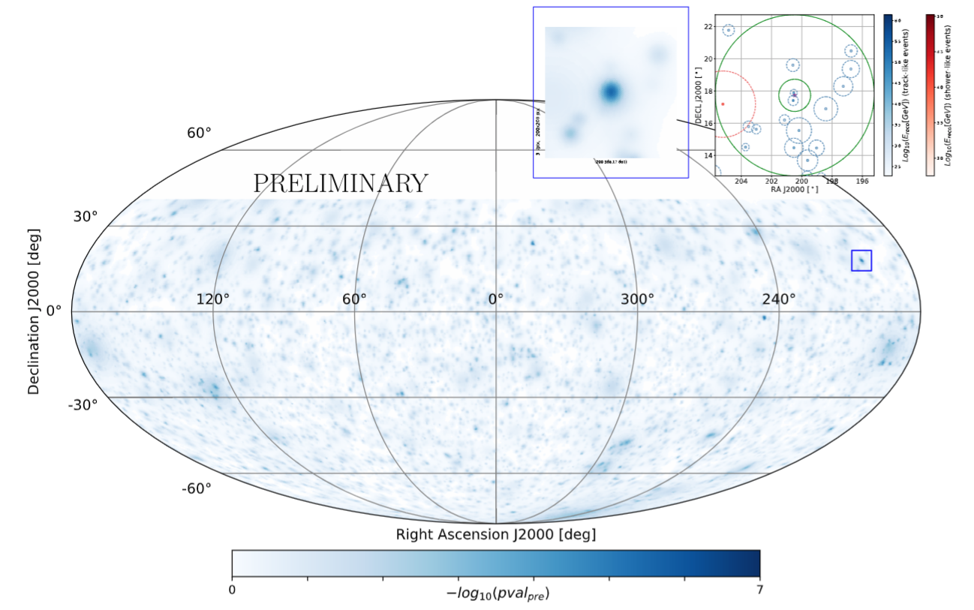
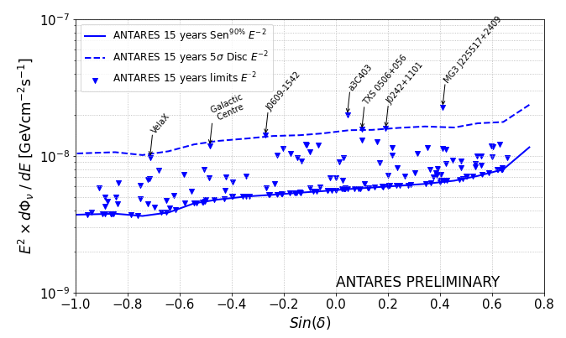
Search for Point Sources
19
ANTARES 2007-2022 sample: 11029 tracks and 200 showers
Hottest spot (𝛿, RA) = (17.7, 200.5)
Pre(post)-trial significance 4.5𝜎 (0.29𝜎)
World best limit on the Southern sky
below hundreds of TeV.
Candidate-list search
Most significant:
MG3 J225517+2409
Pre(post)-trial
3.6𝜎 (1.8𝜎)

Slide 20
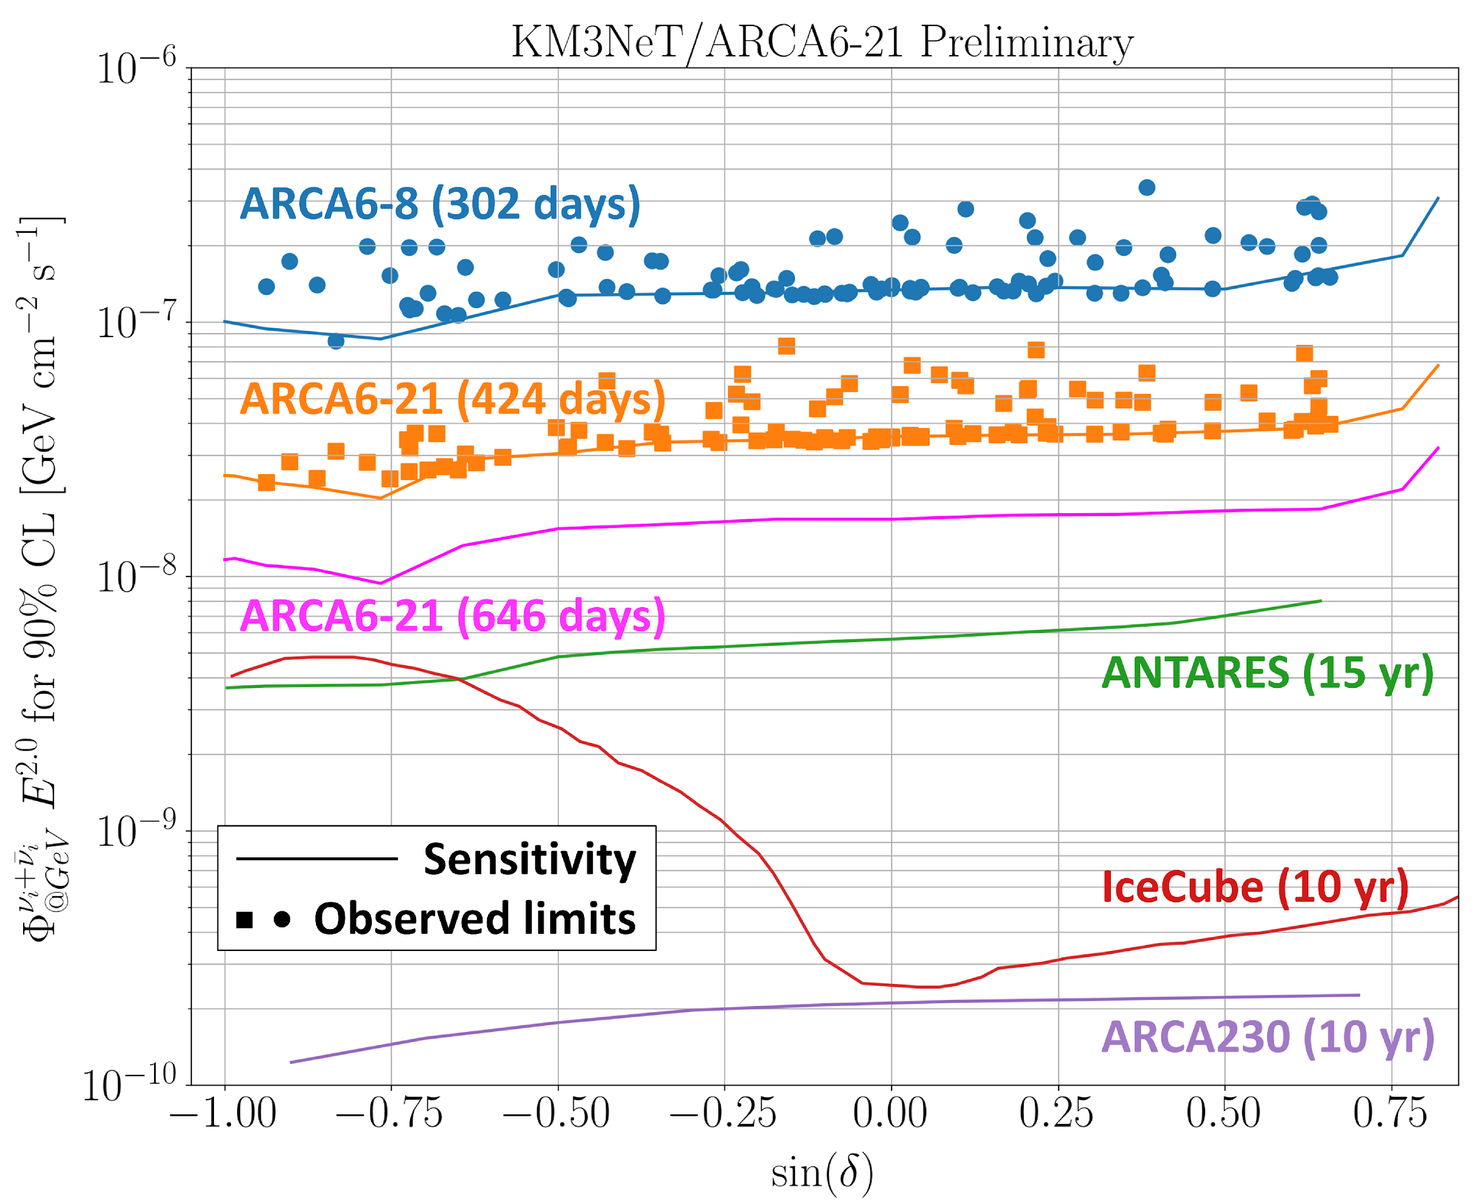
Search for Point Sources
20
Remarkable sources
TXS 0506+056 p-value 0.007 n_{signal} = 2.2
3C403 (3.3σ)
J0242+1101 (2.1σ)
J0609-1542 (2.3σ)
Galactic Centre (2.1σ)
No signal seen from NGC1068 (as expected)
Improved sensitivity (for equivalent exposure) & sky coverage wrt IceCube
☞ PoS(ICRC2023)1018 & 1075
Large improvement is expected in the next year:
+ ARCA28 from sept 2023 + ARCA48 from sept 2024

Slide 21
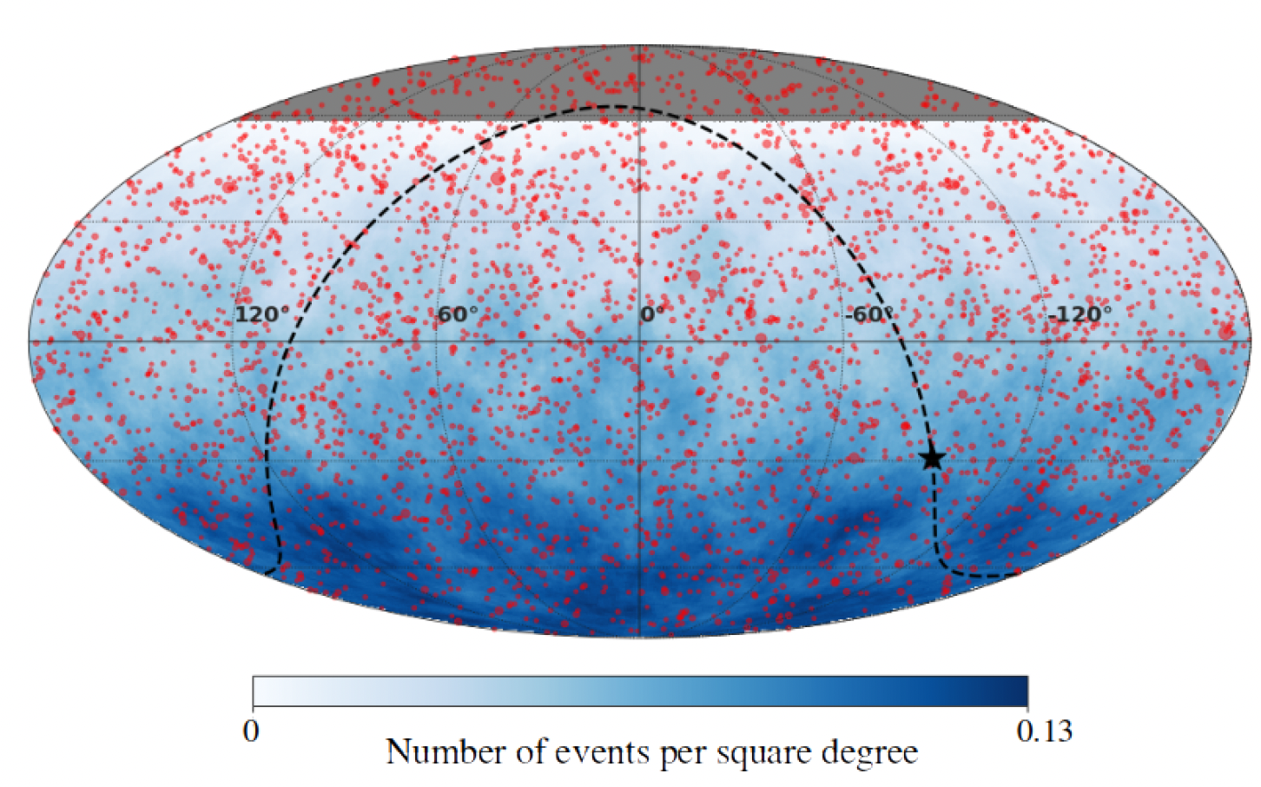
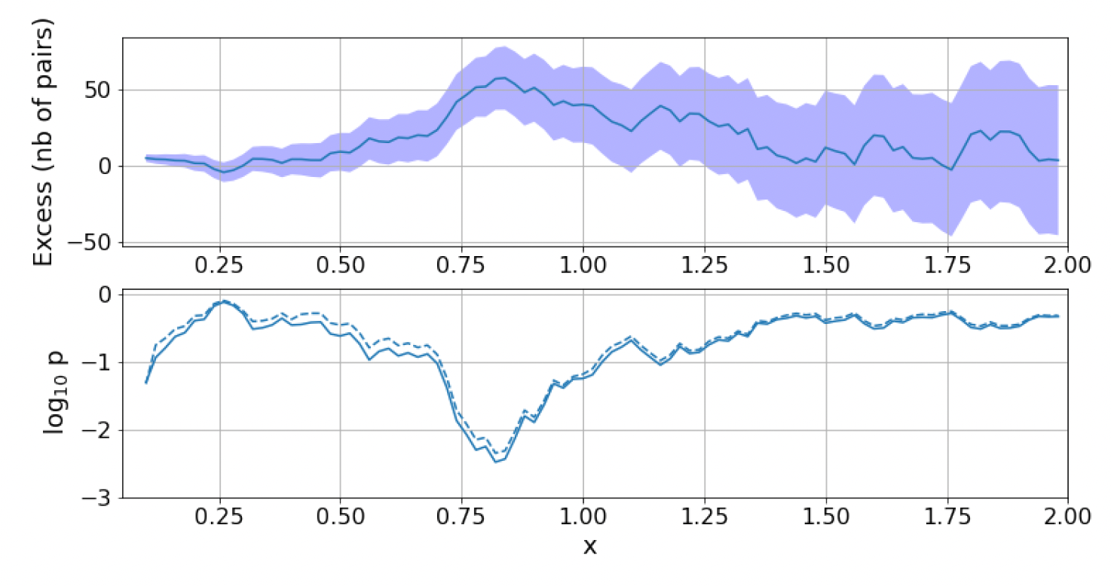
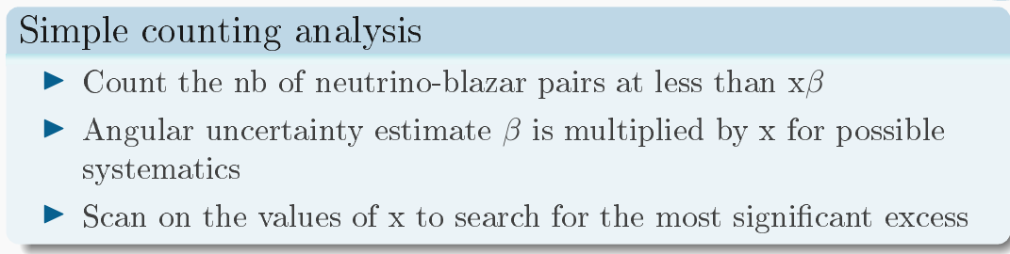
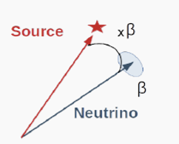
Catalog-based Searches
21
VLBI blazars (red dots)
Plavin et al., Astrophys. J. 908 no. 2, (2021) 527 157
ANTARES between January 29, 2007 and February 29, 2020 (3845 day live time)
Astrophys.J. 964 (2024) 1, 3
--- w/o blazars with S > 3,68 Jy
Only accounting for a 1D scan in x gives post-trial p-value = 0.03 (2.2 σ)
A. Albert et al 2024 ApJ 964 3

Slide 22
The multi-messenger program
22
22
Legacy paper:
A. Albert et al., JCAP 08 (2023) 072
1st approach:
Time dependent searches
GRB
Microquasar
Gamma-ray binaries
Blazars
Supernovae Ib,c
Fast Radio Bursts
Neutrino Telescopes
can guide optical follow-up
Eur. Phys. J. C 80, 487 (2020)
ApJ 870 (2019) 2
ApJL 848 L12 (2017)
ApJL 850 L35 (2017)
Phys. Rev. D 96 (2017) 022005
Phys. Rev. D 93 (2016) 122010
JCAP06(2013)008

Slide 23
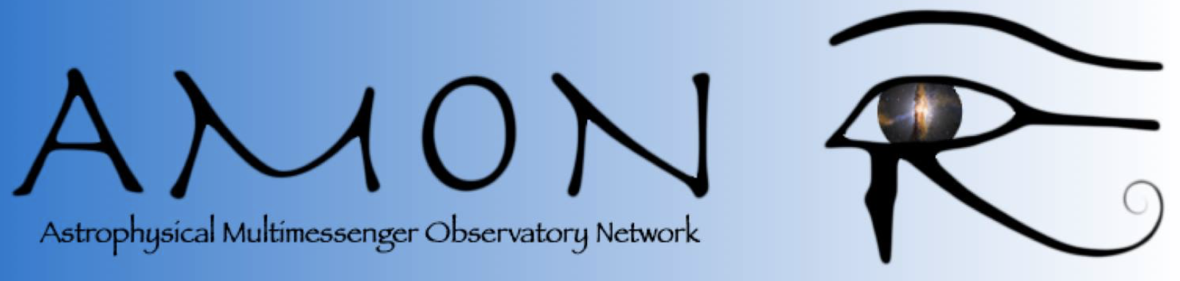
The multi-messenger program: TAToO
23
Telescope-Antares Target of Opportunity
Legacy paper :
A. Albert et al., JCAP 09 (2024) 042
2nd approach:
Alert
triggering
Real-time analysis
+ …
- Time to send an alert: ~5 s
- First optical image < 20 s
- Median angular resolution: ~0.3°
- Triggers: single HE event, preferred direction, multiplets

Slide 24


KM3NeT taking up the torch online
24
Several thousands of alerts received and analyzed in real time
👉 so far no significant excess found in any of the observed alerts

Slide 25

The Highest Energetic Neutrino Event ?
25
ARCA21

Slide 26

The Highest Energetic Neutrino Event ?
26
The event is well reconstructed as a track (cf. time residuals)
1° above the horizon
ARCA21

Slide 27


The Highest Energetic Neutrino Event ?
27
With a deposited energy above 10 PeV !
ARCA21
Huge amount of light detected 👉 35% of the total number of PMTs were triggered
KM3NeT Preliminary
MC simulation
KM3NeT Preliminary

Slide 28


The Highest Energetic Neutrino Event ?
28
ARCA21
From the track and shower reconstructions
👇
A muon track and three showers detected
DOM number
Hit times are fully consistent with photons from Cherenkov emission
DOM number

Slide 29

The Highest Energetic Neutrino Event ?
29
Hit times consistent with the emission from three points along the track 👉 stochastic light emission
ARCA21

Slide 30

30
30
An answer to the Horizon Europe 2023 call for Research Infrastructures

Slide 31


31
31
Astrophysics Centre for Multimessenger studies in Europe
Objective: ACME is set up to realize an ambitious coordinated European-wide optimization of the accessibility and cohesion between multiple leading RI, offering access to instruments, data and expertise, focused on the new science of multi-messenger astrophysics.
Coordinator: Prof. Antoine Kouchner – APC Laboratory (CNRS/Université Paris Cité)

Slide 32


32
32
Astrophysics Centre for Multimessenger studies in Europe
Consortium: 40 partners, 15 countries, over 30 research infrastructures (observatories and detectors, cyberinfrastructures and expertise centers) from Astronomy and Astroparticle domains, covering GW, Gamma & X-rays, neutrinos, CR, radio, optical.
Suppported by:
AstroParticle Physics European Consortium APPEC
A planning and advisory Network for European astronomy ASTRONET
The ACME project coordinator Prof. Antoine Kouchner (CNRS/Université Paris Cité), and co-coordinator Paolo D’Avanzo (INAF), represent each community to ensure balance and drive cross-domain collaboration.

Slide 33
ACME
33
33
Astrophysics Centre for Multimessenger studies in Europe
Objectives: The Astronomy and Astroparticle physics research infrastructures involved in this proposal will lay the foundations for building a new ecosystem for a deepened, stronger and long-term vision collaboration with the aim to:
1. implement the European roadmaps’ recommendations and act as a pathfinder to broaden, improve and align the accesses to the respective RI services and data
2. provide a harmonized transnational and virtual access to world-class RIs
3. develop centers of expertise
4. improve the science data products management
5. develop and improve interoperable cyberinfrastructures for alert sending and better manage coordinated observations
6. provide training for a new generation of scientists and engineers
7. open the astrophysics data sets to other disciplines and increase citizen engagement in scientific research
7 Work Packages (WP) corresponding to the objectives above
ACME objectives are to implement the Astroparticle Physics European Consortium’s (APPEC) and the Planning and Advisory Network for European Astronomy’s (ASTRONET) roadmaps’ recommendations
https://www.appec.org/roadmap/ https://www.astronet-eu.org/?page_id=521

Slide 34

34
Astrophysics Centre for Multimessenger studies in Europe
Kick-Off meeting September 16-17, 2024
Now hiring a technical coordinator part time on SVOM (GRBs)
https://emploi.cnrs.fr/Offres/CDD/UMR7164-KEVVEL-029/Default.aspx

Slide 35
Summary
ANTARES: first undersea Cherenkov detector
  Excellent angular resolution, view of Southern sky, competitive sensitivities
  Constraints on the origin of the IceCube signal
  Hint of a Galactic neutrino diffuse emission
  A rejuvenated web page is online
  Last results and legacy program by mid-2025.
KM3NeT: phased approach to next-generation neutrino telescope by 2028
  Deployment of detection units on good pace.
  Instantaneous sensitivity exceeds that of ANTARES
  Likely detection of the most energetic cosmic muon neutrino
  ORCA and ARCA combine a rich neutrino physics and astrophysics scientific scope, from MeV to PeV energies, in addition to a unique multidisciplinary program.
ANTARES and KM3NeT are both part of the novel ACME endeavor

Slide 36


Indirect search for Dark Matter (GC)
36
Improved results with respect to JCAP 10 (2015) 068
Results depend on density profile
Particle physics
Astrophysics
New !
2007 – 2013 dataset
Track channel only
Single and multi-line events
Extended likelihood function
New Dark Matter density profile NFW
(same parameters as IceCube)
Best limit from a Neutrino Telescope
Also limits from the Earth [P4.005]
Notes:
IC has not limits from Dwarf?
What did HESS b bbar channel producing gamma.
The old HESS excess was for e+e-
FERMI stacked analysis with b-bbar channel from dwarf galaxies and the GC_NFW and Galactic Halo.
Dark Matter rather expected to be low mass, rarely higher than 10^4GeV
FERMI and HESS typically used something quite similar to our new NFW (more concentrated close to the center.)
We use Cerilli for the estimate on neutrino flux

Slide 37



Indirect Search for Dark Matter
37
Relic WIMPs gravitationally bound / elastic collisions
(Sun, Earth, Galactic Center)
χ
Earth
χ
χ
χ
ν
χ
<E_{ν}> ~ M_{χ}/3
ANTARES
Full ANTARES (4532.16 days) & ARCA8+19+21 (328 days)
 Earth
Physics of the Dark Universe, 16 (2017) 41–48
Sun
Phys.Lett. B759 2016
JCAP 05 (2016) 016
JCAP11 (2013) 032
 Galactic Center
JCAP 06 (2022) 06, 028 (secluded DM)
Phys. Lett. B 805 135439 (2020).
Phys. Rev. D 102, 082002 (2020)
Phys. Let. B 769 (2017) 249
JCAP 10 (2015) 068
Improvement expected with
single line reconstruction
☞ PoS(ICRC2023)1443
Notes:
Assuming NFW halo
profile with 100%
branching ratio for each
annihilation channel

Slide 38

Indirect Search for Dark Matter
38
Relic WIMPs gravitationally bound / elastic collisions
(Sun, Earth, Galactic Center)
χ
Earth
χ
χ
χ
ν
χ
<E_{ν}> ~ M_{χ}/3
ANTARES
 Earth
Physics of the Dark Universe, 16 (2017) 41–48
Sun
Phys.Lett. B759 2016
JCAP 05 (2016) 016
JCAP11 (2013) 032
 Galactic Center
JCAP 06 (2022) 06, 028 (secluded DM)
Phys. Lett. B 805 135439 (2020).
Phys. Rev. D 102, 082002 (2020)
Phys. Let. B 769 (2017) 249
JCAP 10 (2015) 068
ORCA offers better
sensitivity to low WIMP masses
Final ANTARES limits being produced
☞ PoS(ICRC2023)1406,

Slide 39




Example of Indirect Search for Dark Matter
39
Search for WIMPs annihilating
Mass range: 300 GeV/c² ÷ 100 TeV/c²
Channels: μ⁺μ⁻, τ⁺τ⁻, bb, νμνμ,WW
Sources:
Galactic centre
Sun core
χ
χ
χ
ν
ν
ν
χ
ν

Slide 40





Reconstruction Performances
40
ANTARES
μ
ν
90%
Angular resolution [◦]
Angular resolution [◦]
1σ
< 0.4 ° E_{ν}>10 TeV
Tracks (CC νμ ντ)
< 0.1° E_{ν}>100 TeV
←0.35 Log(Eμ) Resolution 0.27→
☞ PoS(ICRC2023) 1074
Angular resolution [◦]
90%
Angular resolution [◦]
1σ
Cascades (CC νe ντ − NC)
←10% Energy Resolution 5%→

Slide 41





Calibration procedures & monitoring
41
 Eur. Phys. J. C (2018) 78: 669
Time offset
⁴⁰K KM3NeT
Up to 150 Cherenkov γ
per decay; stable ⁴⁰K
concentration
Efficiency
2-fold coincidence rate [Hz]
Time spread
⁴⁰Ca
^{γ}
e
⁴⁰K (β decay)
Time difference [ns]
Regular tunings
Only ~20% efficiency loss
Complemented by:
Scattered photons
Direct photons
Nanobeacon
μ
Cross-calibration with muons
Notes:
Cost reduction?

Slide 42





Absolute Pointing
42
42
 Eur.Phys.J. C78 (2018) no.12, 1006
ANTARES Moon (3,5 σ)
2007-2016
1σ, 2σ, 3σ
contours
ANTARES Sun (3.7σ)
2007-2017
 S. Aiello et al., Eur. Phys. J. C 83, 344 (2023)
 Phys. Rev. D 102, 122007 (2020)
42

Slide 43


Multidisciplinary Observatories
43
A dedicated program on
French KM3NeT Site
  Deep-Sea Research I 58 (2011) 875–884
  Acoustic and optical variations during rapid downward
  motion episodes in the deep North Western Mediterranean
   PLoS ONE 8 (7) 2013
  Deep-sea bioluminescence blooms after dense water formation at the ocean surface
Oceanography
Biology
  Ocean Dynamics, April 2014, 64, 4, 507-517
  High-frequency internal wave motions at the ANTARES site in the deep Western Mediterranean
  J of Geophysical Research: Oceans, 122, 3, 2017
  Deep sediment resuspension and thick nepheloid layer
  generation by open-ocean convection
  Sci. Rep. 7 (2017) 45517
  Sperm whale diel behaviour revealed by ANTARES, a deep-sea neutrino telescope
  https://arxiv.org/abs/2107.08063
  Studying Bioluminescence Flashes with the ANTARES Deep Sea Neutrino Telescope
+ Citizen science
Seismology
Bioacoustics…

