Slide 1


Locating the gamma-ray emission regions in the relativistic jet of 3C 279.
Tekano Mbonani, Brian van Soelen & Richard Britto
Department of Physics
University of the Free State
High Energy Astrophysics in Southern Africa 2024
2 – 4 October 2024
mbonanits@ufs.ac.za | www.ufs.ac.za

Slide 2


Outline
Introduction: 3C 279
Optical and Gamma-ray Data
Results:
  The z-transformed discrete cross-correlation functions: Time-lags
  Gamma-ray flux temporal profiling
  Physical Constraints: Doppler factors, emission region radii and distance from the SMBH.
  Gamma-ray SED: spectral energy breaks
Discussion

Slide 3
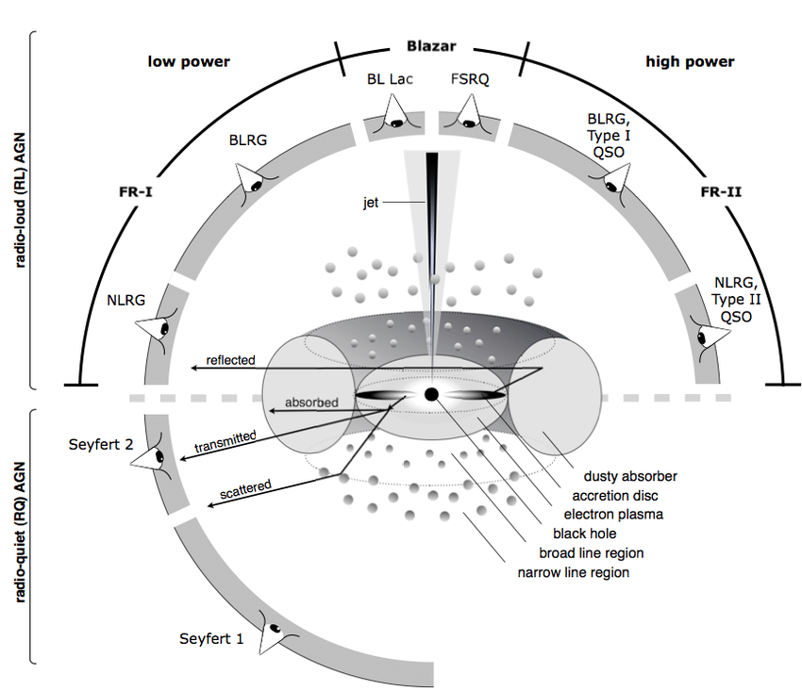
Introduction: 3C 279
Active Galactic Nucleus (AGNs)
Blazars – relativistic jet aligned close to the line of sight of the observer [1].
Blazar Subclass:
  Flat Spectrum Radio Quasars (FSRQ).
  BL Lacertae (BL Lac).
Target 3C 279 Characteristics:
  FSRQ.
  Multiwavelength variability on all timescales [2].
  Inconsistent multi-wavelength correlation [2].
2. Patel, S.R., 2021. Broadband modelling of Orphan gamma ray flares. Journal of High Energy Astrophysics, 29, pp.31-39.
1. Beckmann, V. & Shrader, C. (2013), Active galactic nuclei, John Wiley & Sons

Slide 4
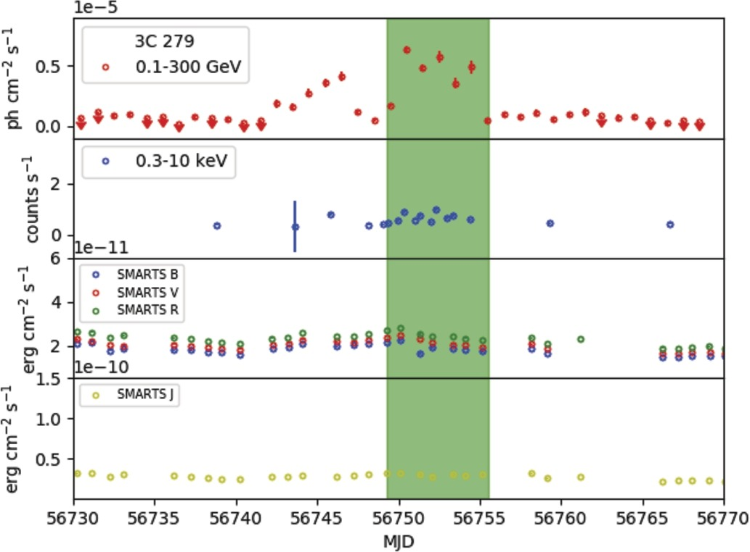
Introduction: 3C 279
Orphan Gamma-ray
Flare
Gamma-rays
Active Galactic Nucleus (AGNs)
Blazars – relativistic jet aligned close to the line of sight of the observer.
Blazar Subclass:
  Flat Spectrum Radio Quasars (FSRQ).
  BL Lacertae (BL Lac).
Target 3C 279 Characteristics:
  FSRQ.
  Multiwavelength variability on all timescales [1].
  Inconsistent multi-wavelength correlation [1].
X - rays
Optical
Near IR
1. Patel, S.R., 2021. Broadband modelling of Orphan gamma ray flares. Journal of High Energy Astrophysics, 29, pp.31-39.

Slide 5
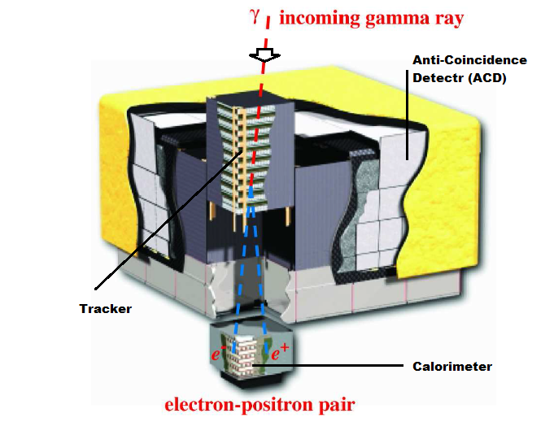
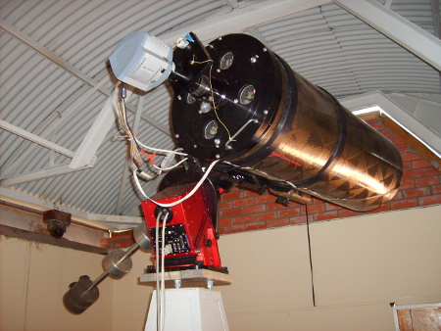
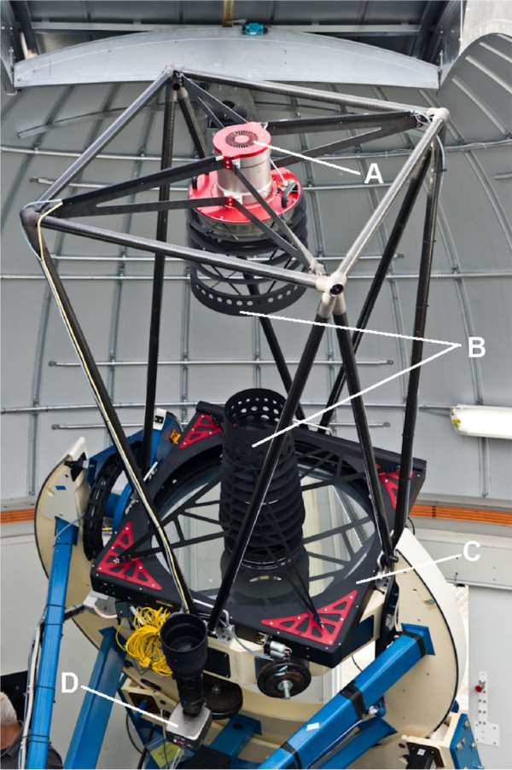
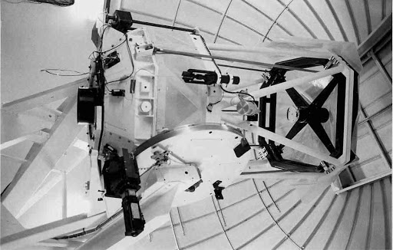
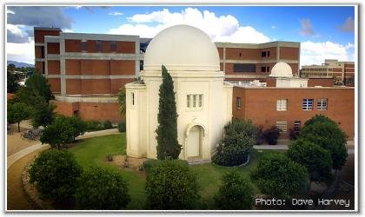
Gamma-ray and Optical Correlations
Fermi-LAT
Watcher
40-cm Telescope
z-transformed Discrete Cross-Correlation Functions (ZDCF) [1].
  Variability time-lags
  To probe the number of emission zones in the jet during flares
The Fermi Large Area Telescope (LAT): Gamma-rays 0.1 – 300 GeV [2].
  Light-curves
  Spectral Energy Distributions (SEDs)
Optical Photometry:
  Boyden Observatory: Watcher Telescope
  Las Cumbres Observatory (LCO)
  Steward Observatory
  Small and Moderate Aperture Research Telescope System (SMARTS)
SMARTS
1.3-m Telescope
Steward
Observatory
Alexander, T. (2013), ‘Improved agn light curve analysis with the z-transformed discrete correlation function’, arXiv preprint arXiv:1302.1508.
Atwood, W. (2009), ‘The large area telescope on the fermi gamma-ray space telescope mission’, The Astrophysical Journal 697(2), 1071.
LCO 1.0-m Telescope

Slide 6
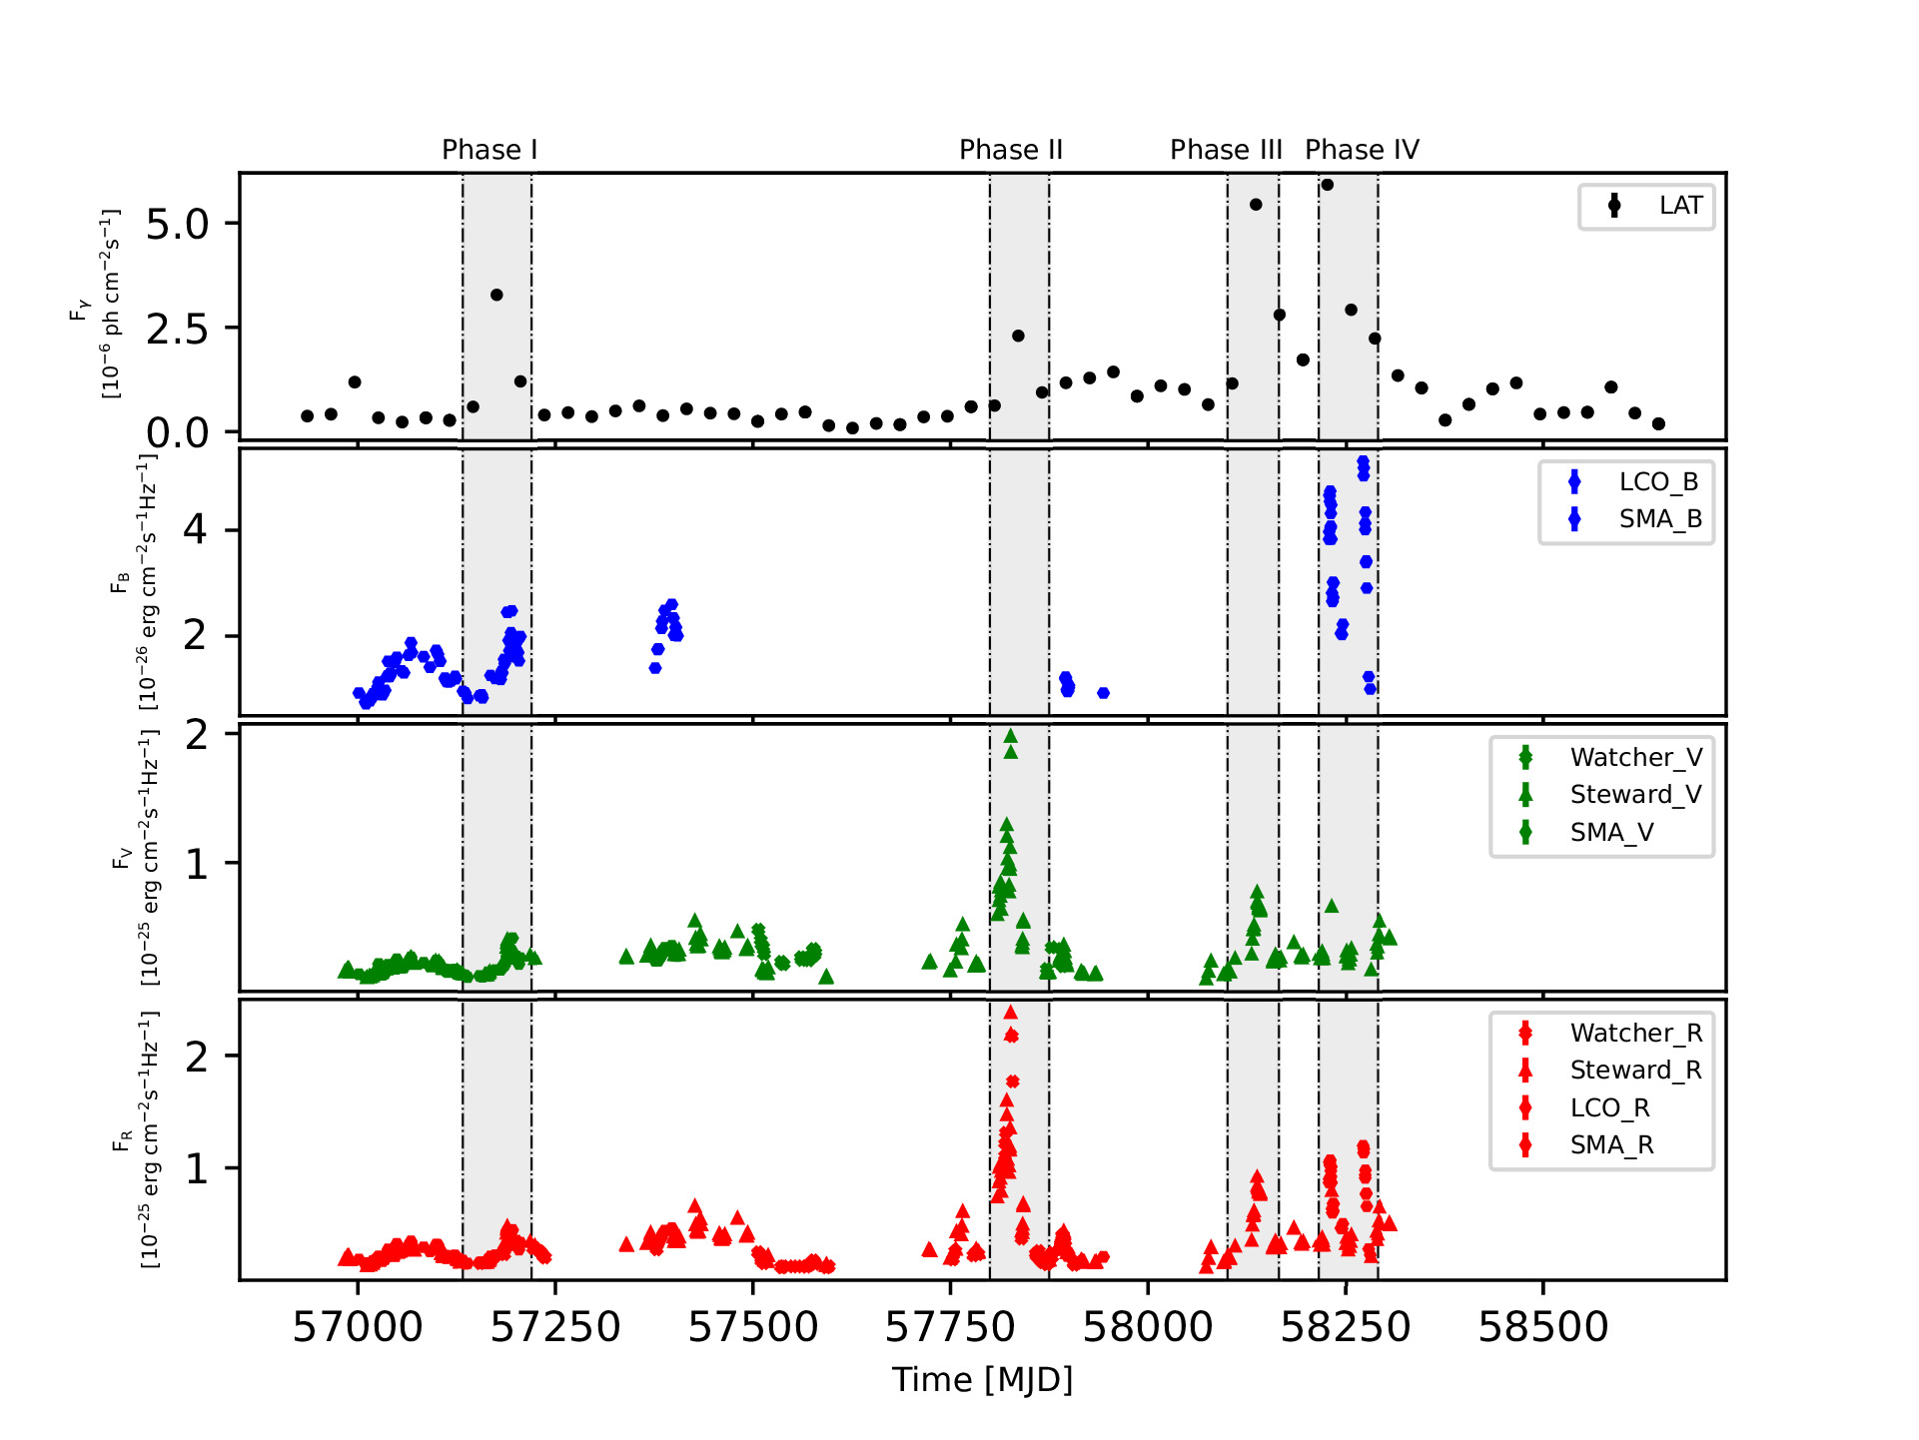

3C 279: Optical & Gamma-ray Variability
$$Fvar= \sqrt{\frac{(S^{2} −f2err)}{f2avg}}$$
S² is the flux variance, f²_{err} the mean square flux error and f²_{avg} is the mean square flux [1].
Table 1. Observational dates and the flux variability amplitudes of the flaring phases.
(1)
Phase | MJD | Year | F_{var}
I | 57180 - 57196 | 2015 | 0.96±0.02
II | 57800 - 57865 | 2017 | 0.54±0.01
III | 58100 - 58160 | 2017 | 0.97±0.01
IV | 58216 - 58250 | 2018 | 0.69±0.05
Figure 1: The gamma-ray [photon.cm⁻².s⁻¹] and optical [erg.cm⁻².s⁻¹.Hz⁻¹] light-curves of 3C 279 between 2014 – 2019.
1. Vaughan, S., (2003), ‘On characterizing the variability properties of x-ray light curves from active galaxies’, Monthly Notices of the Royal Astronomical Society 345(4), 1271–1284.

Slide 7
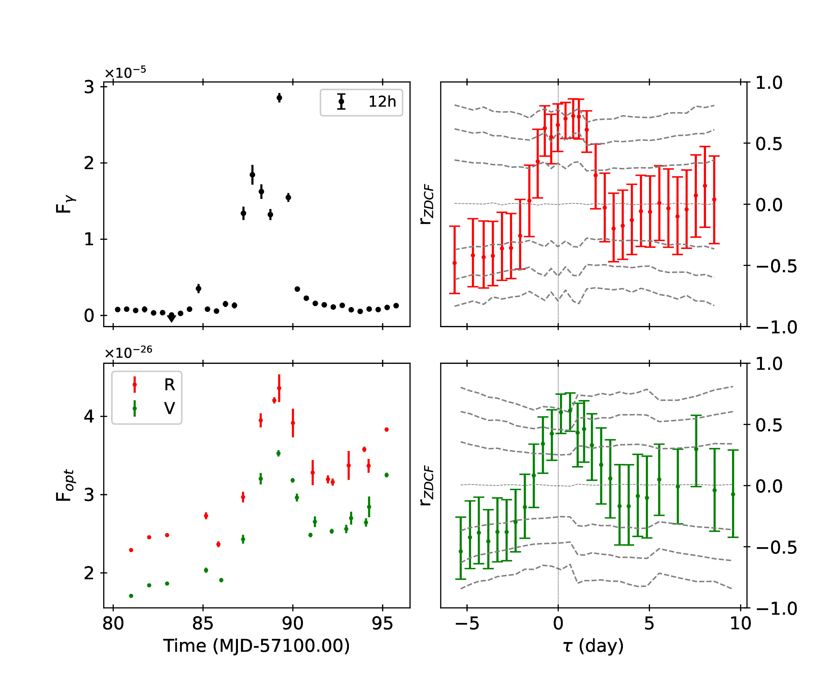
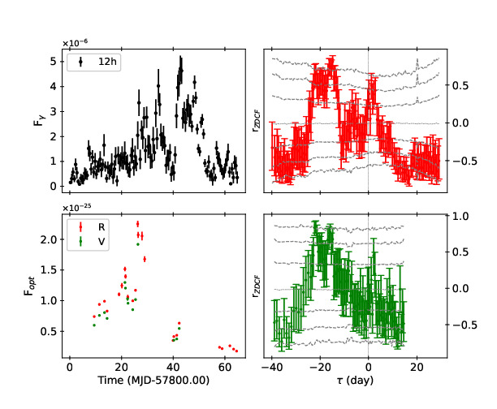

Optical and Gamma-ray Correlations
Phase I: ZDCF
Phase II: ZDCF
Gamma-ray/Optical R
Gamma-ray/Optical V
Data Gaps
Table 2. z-transformed Discrete Cross-Correlation Functions and time-lags from Phase I and II.
r_{ZDCF} peak $≥$ 2σ C.L.
Phase I:
  The gamma-ray leads the optical (𝛕 > 0).
  𝛕 $<1$ day, i.e. near zero time-lags.
Phase II:
  The gamma-ray lags the optical (𝛕 < 0).
  Two to three weeks delays (𝛕).
Light-curves | _{Phase I} |  | _{Phase II}
 | r_{ZDCF} | 𝛕 (days) | r_{ZDCF} | 𝛕 (days)
Gamma-ray/Optical V | 0.61±0.14 | 0.65±0.11 | 0.86±0.07 | -21.85±0.03
Gamma-ray/Optical R | 0.72±0.18 | 0.82±0.14 | 0.81±0.08 | -14.82±0.09

Slide 8
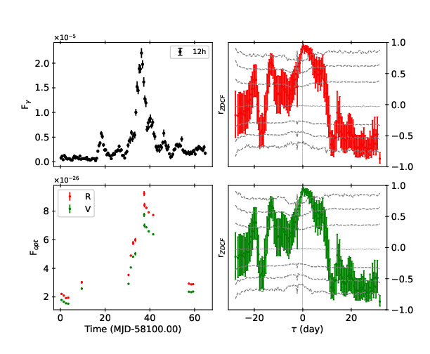
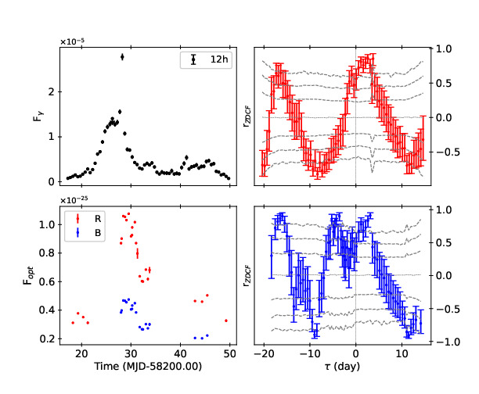

Optical and Gamma-ray Correlations
Phase III
Phase IV
Gamma-ray/Optical R
Data Gaps
Gamma-ray/Optical V
Data Gaps
Table 3. z-transformed Discrete Cross-Correlation Functions and time-lags from Phase III and IV.
r_{ZDCF} peak $≥$ 3σ C.L.
Phase III:
  The gamma-ray leads the optical (𝛕 > 0).
  𝛕 $\sim 0$ day, i.e. near zero time-lags.
Phase IV:
  The gamma-ray leads the optical (𝛕 > 0).
  𝛕 $\sim 3−4$ days, i.e. near zero time-lags.
Light-curves | _{Phase III} |  | _{Phase IV}
 | r_{ZDCF} | 𝛕 (days) | r_{ZDCF} | 𝛕 (days)
Gamma-ray/Optical B | - | - | 0.91±0.05 | 3.12±0.11
Gamma-ray/Optical V | 0.94±0.03 | 0.23±0.02 | - | -
Gamma-ray/Optical R | 0.94±0.03 | 0.23±0.02 | 0.85±0.07 | 3.73±0.05

Slide 9
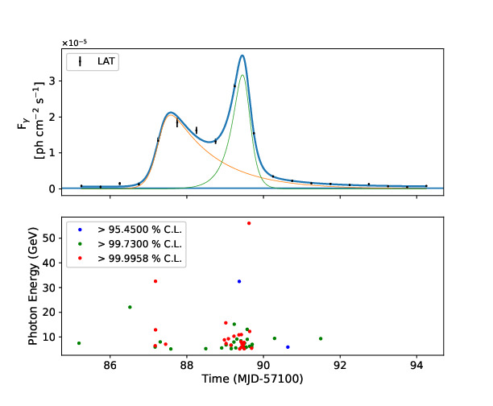
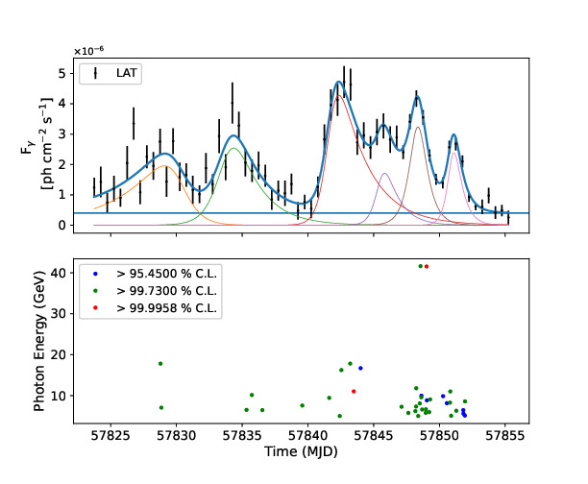
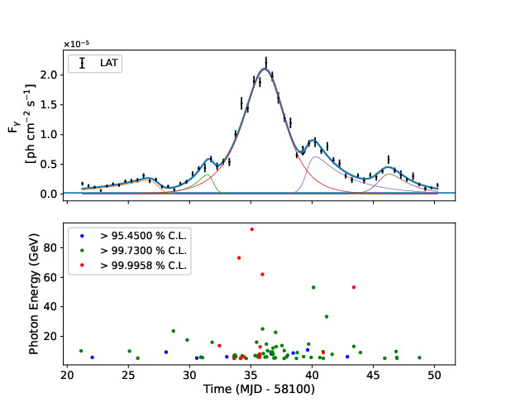
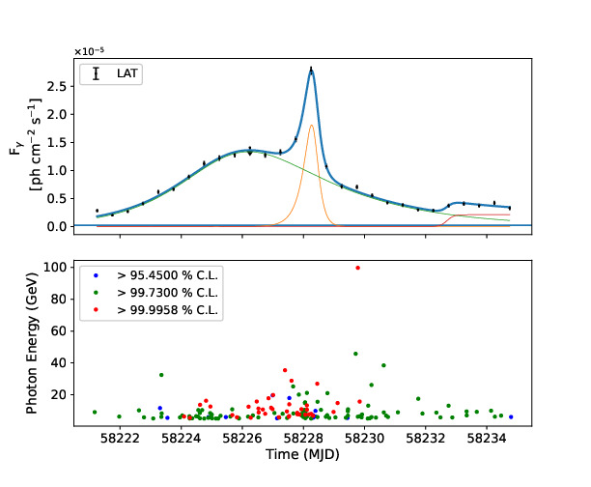
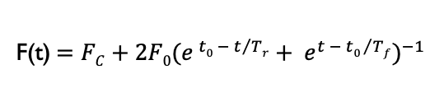


The Gamma-ray Flux Temporal Profiling & Photon Energies
Phase I
Phase II
Phase III
Phase IV
Fastest T_{r}
Fastest T_{r}
Fastest T_{r}
Fastest T_{r}
F(t)$=FC+2F0({e^{{ t0 − t}/{Tr}}+ e^{{t − t0 }/{Tf}})}^{−1}$
(2)
F₀ is the flare amplitude
F_{c} is the constant baseline flux
t₀ is the approximate time at F₀
T_{r} is the flux rise timescale
T_{f} is the flux decay timescale
Table 4. The gamma-ray flux temporal profiling & high energy
photons from the most rapid flares during Phases I – IV.
Asymmetric flaring profiles.
Faster flux rise than decay times T_{r} < T_{f} , Phases I – III.
Faster decay than rise times T_{r} > T_{f} , Phases IV.
Intra-day variability (IDV), i.e. t_{d} $≤$ 24 hours.
t_{d} are comparable within error (2σ).
High energy photons.
 | T_{r} (days) | T_{f} (days) | t_{d} (hours) | E_{ɣ} _{(GeV)}
I | 0.16±0.02 | 1.18±0.07 | 2.66±0.33 | 56.00
II | 0.36±0.15 | 0.61±0.16 | 5.99±2.50 | 41.61
III | 0.32±0.13 | 2.99±0.81 | 5.32±2.16 | 92.22
IV | 0.29±0.12 | 0.15±0.08 | 4.82±2.00 | 99.76
$td= \ln{2 × Tr }$
(3)
t_{d} is the flux doubling time, i.e., the time it takes the observed flux to increase by a factor two [1].
1. Abdo, A. et al. (2010), ‘Gamma-ray light curves and variability of bright fermi- detected blazars’, The Astrophysical Journal 722(1), 520

Slide 10
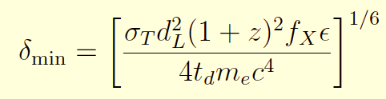










Relativistic Beaming
Emission Region: Size & Location
Assuming the optical depth of a high energy photon with energy 𝜖 = E_{ɣ}/m_{e}c² to interact with a low energy photon in photon-photon absorption is $τ$(𝜖) = 1, we determined the minimum Doppler factors [1]:
By assuming the geometry of the emission regions to be spherical, we can determine their radii (r) and distances (R) relative to the SMBH [2]:
$δ$_{min} = $\left[\frac{σTd2L\left(1+ z\right)2fXε}{4tdmec4}\right]\frac{1}{6}$
(4)
r$≤ \frac{δ\min{td c}}{(1+z)}$
(5)
σ_{T} is the Thomson scattering cross-section.
d_{L} is the luminosity distance.
z is the cosmological redshift.
f_{X} is the X-ray flux at 𝜖 = ${Eɣ}/{mec2}$.
R$≥ \frac{2δ2\min{td c}}{(1+z)}$
(6)
1. Paliya, V. S. (2015), ‘Fermi-large area telescope observations of the exceptional gamma-ray flare from 3c 279 in 2015 june’, The Astrophysical Journal Letters 808(2), L48
2. Rani et al, B. (2013), ‘Radio to gamma-ray variability study of blazar s5 0716+714’, Astronomy & Astrophysics 552, A11
R $\sim$10¹⁶ cm
R $\sim$10¹⁷ cm
Accretion disk
SMBH
Emission region
BLR
Jet

Slide 11

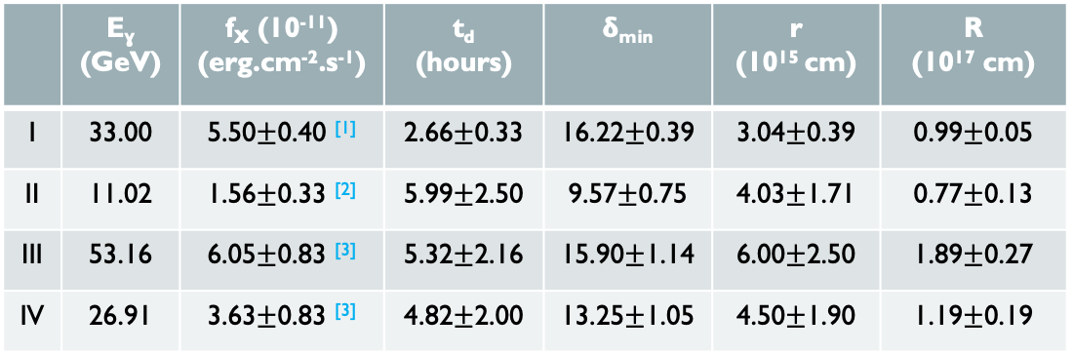
Phase I
Phase II
Phase III
Phase IV
Table 5. The minimum Doppler factors, the emission region radii and distances from the SMBH.
 | E_{ɣ} (GeV) | f_{X} (10⁻¹¹) (erg.cm⁻².s⁻¹) | t_{d} (hours) | 𝝳_{min} | r (10¹⁵ cm) | R (10¹⁷ cm)
I | 33.00 | 5.50$±$0.40 ^{[1]} | 2.66$±$0.33 | 16.22$±$0.39 | 3.04$±$0.39 | 0.99$±$0.05
II | 11.02 | 1.56$±$0.33 ^{[2]} | 5.99$±$2.50 | 9.57$±$0.75 | 4.03$±$1.71 | 0.77$±$0.13
III | 53.16 | 6.05$±$0.83 ^{[3]} | 5.32$±$2.16 | 15.90$±$1.14 | 6.00$±$2.50 | 1.89$±$0.27
IV | 26.91 | 3.63$±$0.83 ^{[3]} | 4.82$±$2.00 | 13.25$±$1.05 | 4.50$±$1.90 | 1.19$±$0.19
Phases I, III and IV have similar relativistic beaming 𝝳_{min} within error (2σ).
Consistent radii r (within 1σ) for all phases.
R is comparable with the size of the BLR, i.e., R_{BRL} $\sim$ 2.30 $×$10¹⁷ cm [4].
Pittori, C. (2015), ‘Update on swift follow-up observations of the gev flaring blazar 3c 279’, The Astronomer’s Telegram 7668, 1.
Yoo, S. & An, H. (2020), ‘Spectral variability of the blazar 3c 279 in the optical to x-ray band during 2009–2018’, The Astrophysical Journal 902(1), 2.
Prince, R. (2020), ‘Broadband variability and correlation study of 3c 279 during flares of 2017–2018’, The Astrophysical Journal 890(2), 164.
Böttcher, M. & Els, P. (2016), ‘Gamma–gamma absorption in the broad line region radiation fields of gamma-ray blazars’, The Astrophysical Journal 821(2), 102

Slide 12
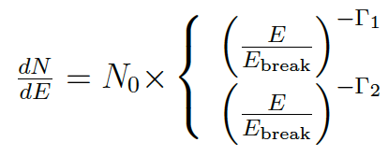
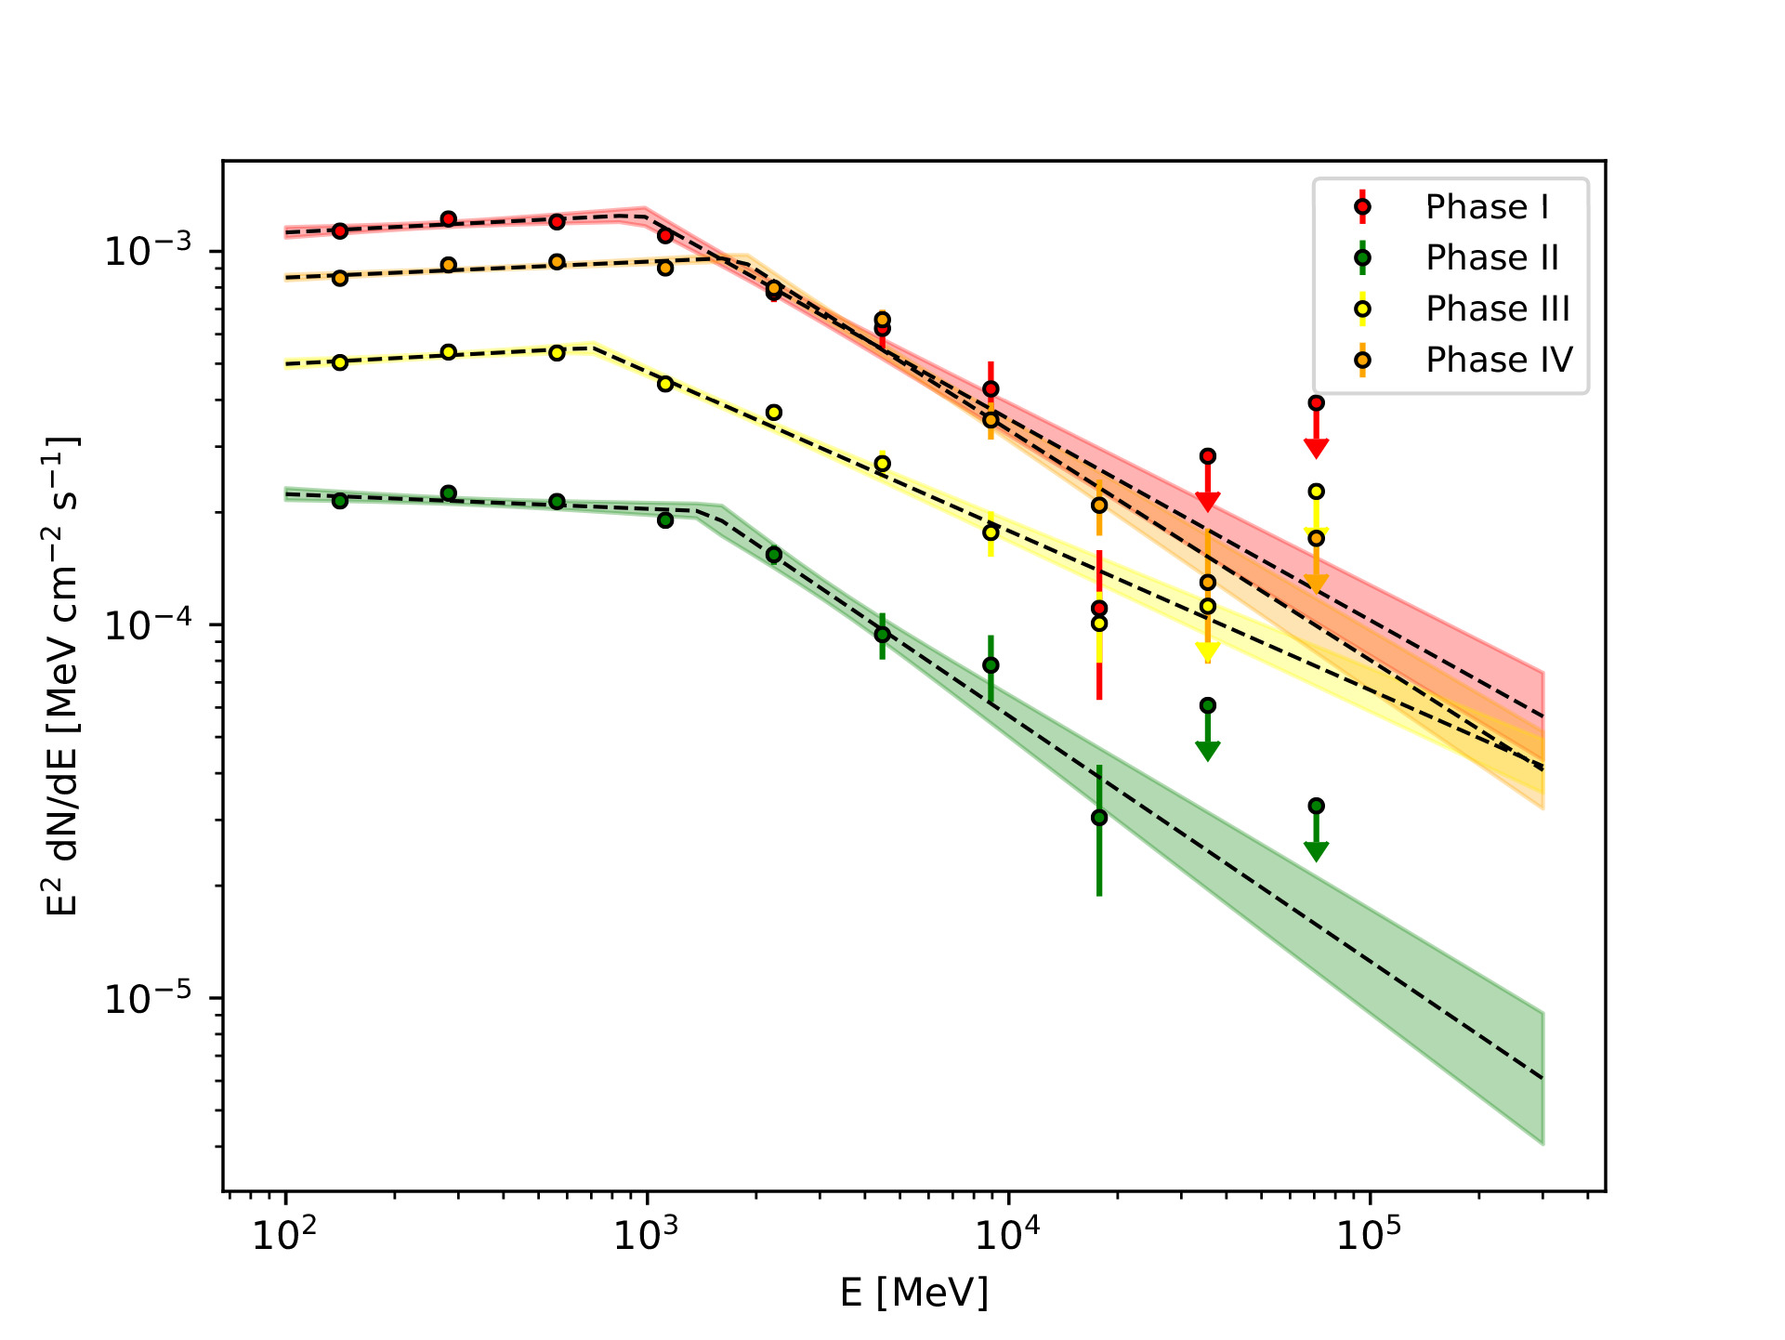



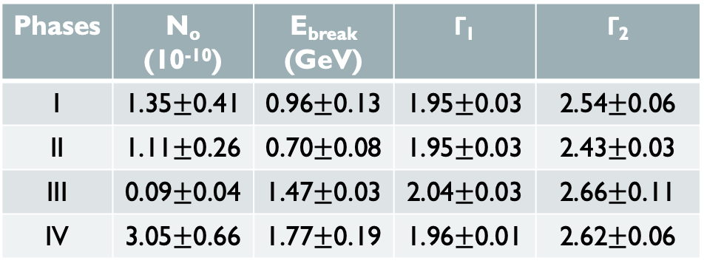
Gamma-ray Spectral Energy Distributions (SEDs)
$\frac{dN}{dE}$ $=N0 × \left(\frac{E}{Ebreak}\right)−Γi$
(7)
$Γ$ = Γ₁, E $≤$ E_{break}
Γ = Γ₂, E $>$ E_{break}
Prefactor N₀ is in units of MeV⁻¹cm⁻²s⁻¹.
E_{break} is the break in the spectral energy
Γ_{i} is the photon index below and above E_{break}.
Table 6. Broken Power-law (BPL) likelihood fit parameters.
Phases | N_{o} (10⁻¹⁰) | E_{break} (GeV) | Γ₁ | Γ₂
I | 1.35$±$0.41 | 0.96$±$0.13 | 1.95$±$0.03 | 2.54$±$0.06
II | 1.11$±$0.26 | 0.70$±$0.08 | 1.95$±$0.03 | 2.43$±$0.03
III | 0.09$±$0.04 | 1.47$±$0.03 | 2.04$±$0.03 | 2.66$±$0.11
IV | 3.05$±$0.66 | 1.77$±$0.19 | 1.96$±$0.01 | 2.62$±$0.06
The spectra is hard below E_{break} and softens above E_{break}.
Phases have comparable spectral parameters.
  Γ_{i} is the same within 2σ error.
  E_{break} comparable within 3σ error.

Slide 13




Discussion: Emission from 3C 279
Variable Phase
Near zero time-lags implies that the flares were produced co-spatially by a single population of non-thermal particles.
The emission were produced in similar emission regions, located at similar distances from the SMBH, i.e., near the outer
edges of the BLR.
Previous studies estimate external Compton cooling times in the range 7 – 27 minutes, significantly shorter than our decay times [1, 2].
The flux rise and fall times suggest the emission were produced through interactions with standing shocks within the jet:
  The faster rise (T_{r}) than decay time are consistent with the rapid injection of accelerated electrons in the emission regions at the shock front.
  The slower decay (T_{f}) can be attributed to a combination of a continued injection of accelerated electrons and radiative cooling as the emission region propagates beyond the shock (Phases I, II & III).
  The slower rise than decay observed in Phase IV could be attributed to a slow injection rate of accelerated electrons (T_{r}), followed by continued injection and efficient electron cooling (T_{f}).
R₁ $\sim$10¹⁶ cm
R₂ $\sim$10¹⁷ cm
Accretion disk
Shock
SMBH
BLR
Emission region
Paliya, V. S. (2015), ‘Fermi-large area telescope observations of the exceptional gamma-ray flare from 3c 279 in 2015 june’, The Astrophysical Journal Letters 808(2), L48.
Wang, G., Fan, J., Xiao, H. & Cai, J. (2022), ‘Variability and spectral behavior of gamma-ray flares of 3c 279’, Publications of the Astronomical Society of the Pacific 134(1040), 104101
t₁
t₂

Slide 14
Thank You.

