Slide 1
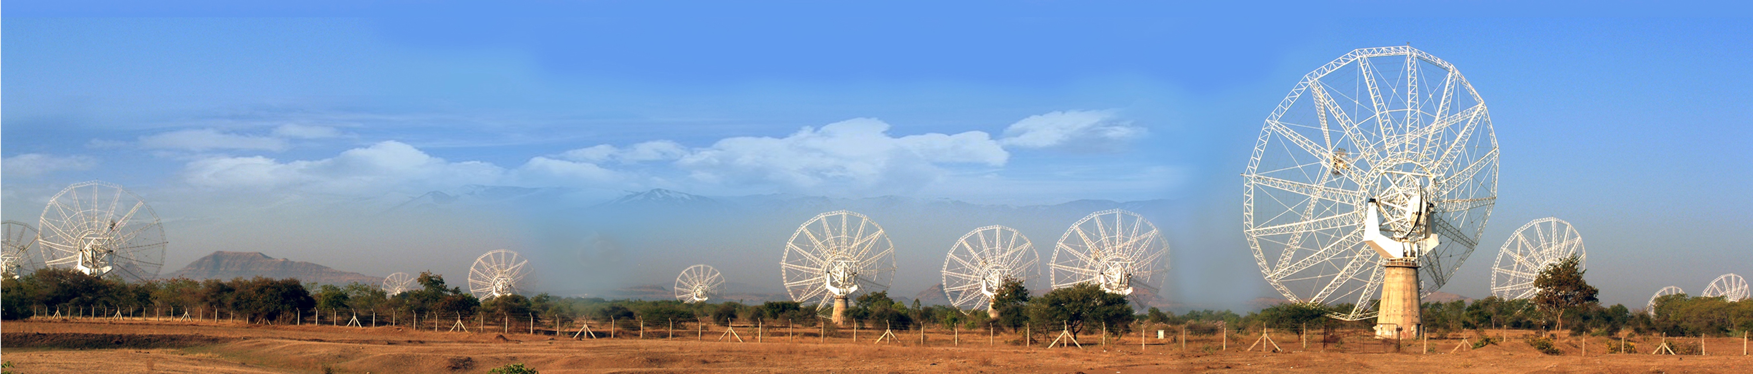
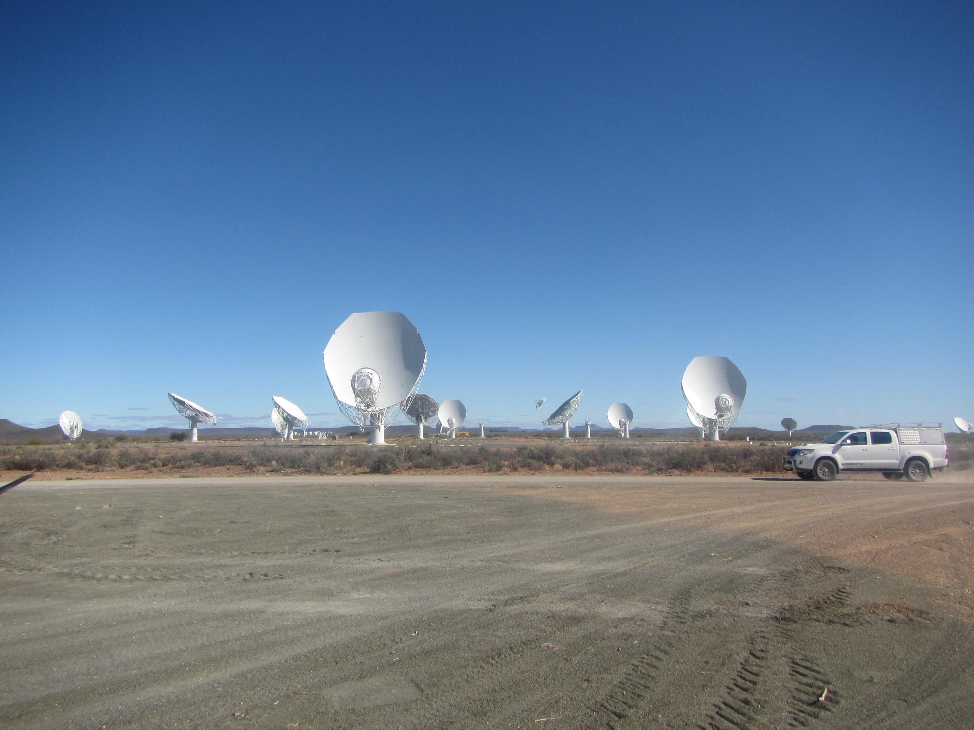





The radiative origins of radio emission in galaxies
Sthabile Kolwa
The University of Johannesburg
High Energy Astrophysics in South Africa (2 – 5 October 2024)
Wits Rural Facility, Mpumalanga
In collaboration with MIGHTEE and colleagues at several institutes…

Slide 2
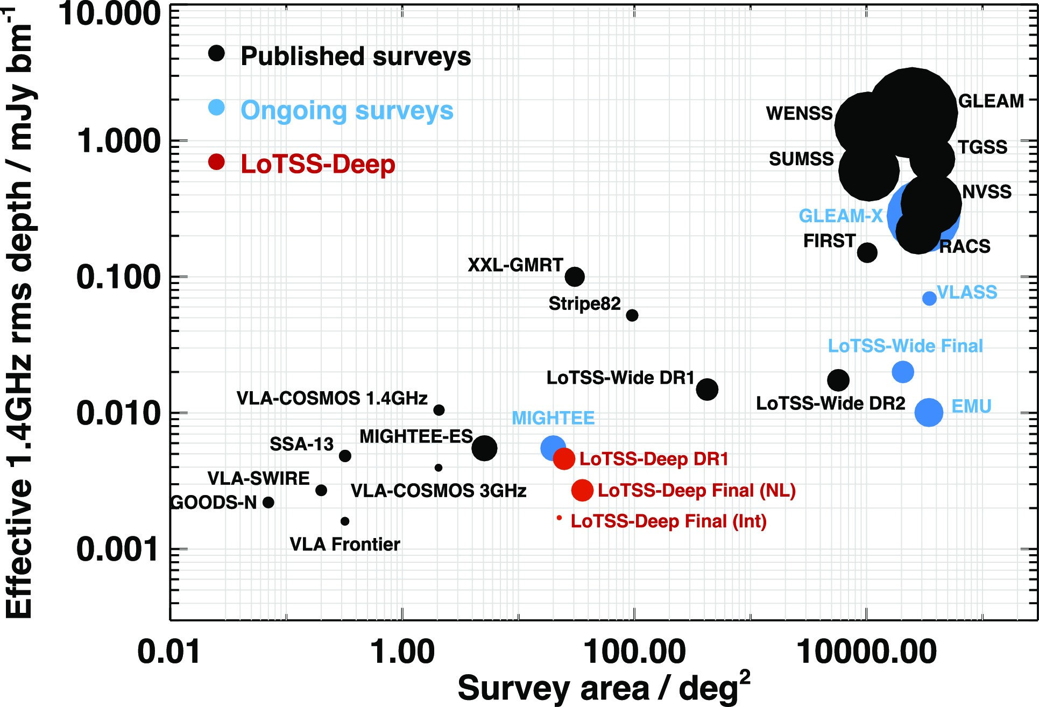
Probing the distant Universe in the radio continuum
Benefits of deep radio continuum surveys to galaxy evolution:
Detections of wide samples of star-forming galaxies, radio-quiet quasars as well as low-luminosity radio galaxies (Best + 2023) i.e. the faint radio source population
Probe the evolution of nuclear activity and star-formation through cosmic time (Jarvis+ 2016)
MIGHTEE Early Science data release (Heywood+ 2022)
→ rms=2 μJy/beam and up to 3.5 deg² field L-band
MIGHTEE DR1 (Hale+ in prep.) to extend survey area coverage to 20 deg² on target MIGHTEE fields (Jarvis+ 2016)
The upgraded Giant Metrewave Radio Telescope (uGMRT)
(Taylor, Lal+ in prep.)
→ 5 arcsec and rms =5 μJy/beam at band-3 (390 MHz) and band-4 (650 MHz)
HEASA-2024 – Wits Rural Facility, Mpumalanga

Slide 3
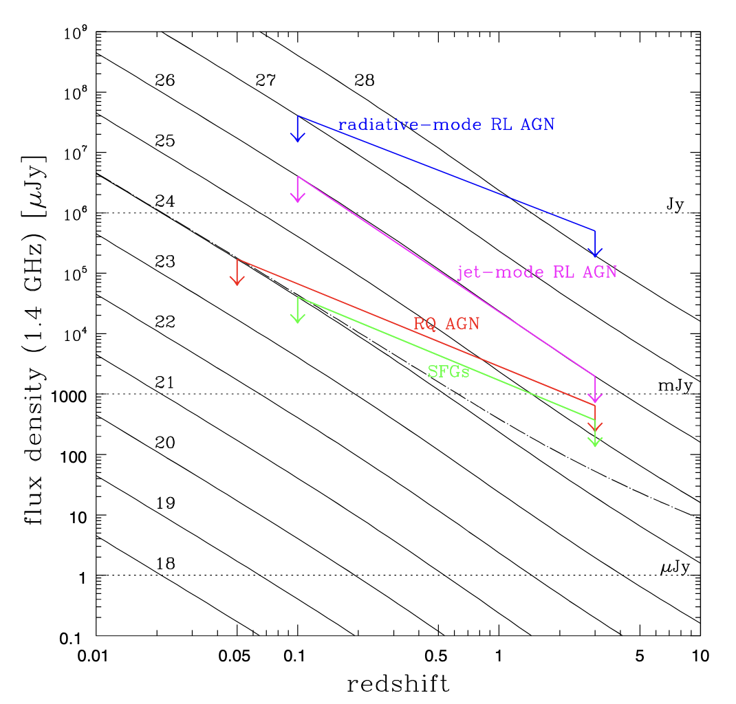
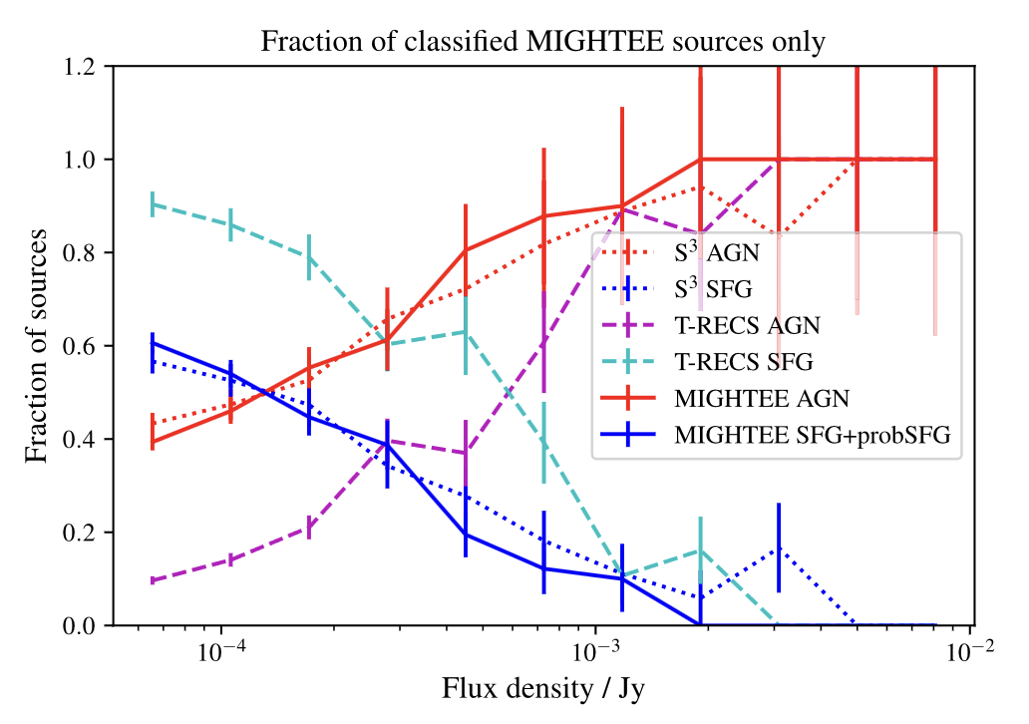
The faint radio source population
Classically, radio source divided into two groups
AGN where radio emission is primarily nuclear
Star-forming galaxies (SFGs) where radio emission originates from SF regions
Deeper radio continuum surveys revealed:
The faint (sub-mJy) radio source population is dominated by star-forming galaxies (SFGs) and radio-quiet (non-jetted) AGN
Questions remain:
  Which radiative processes power non-jetted AGN?
  Are non-thermal processes responsible for the flattening of radio spectra at
    Low flux densities (<0.5 mJy)
    Low frequencies (< 1 GHz observed)
Padovani+ 2016
→ Fractions of AGN and SFGs as a function of radio flux density:
Gruppioni+ 1999, Magliocchetti+ 2000, Prandoni+ 2001
Whittam+ 2024
HEASA-2024 – Wits Rural Facility, Mpumalanga

Slide 4
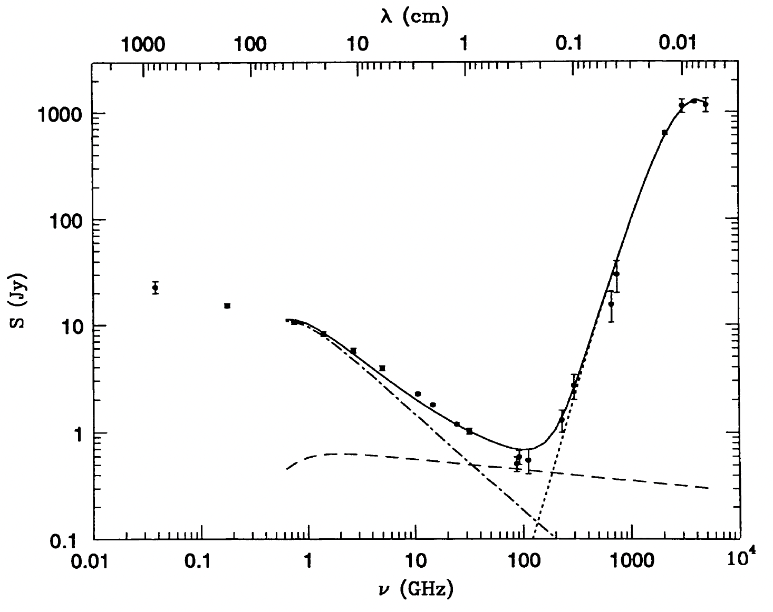
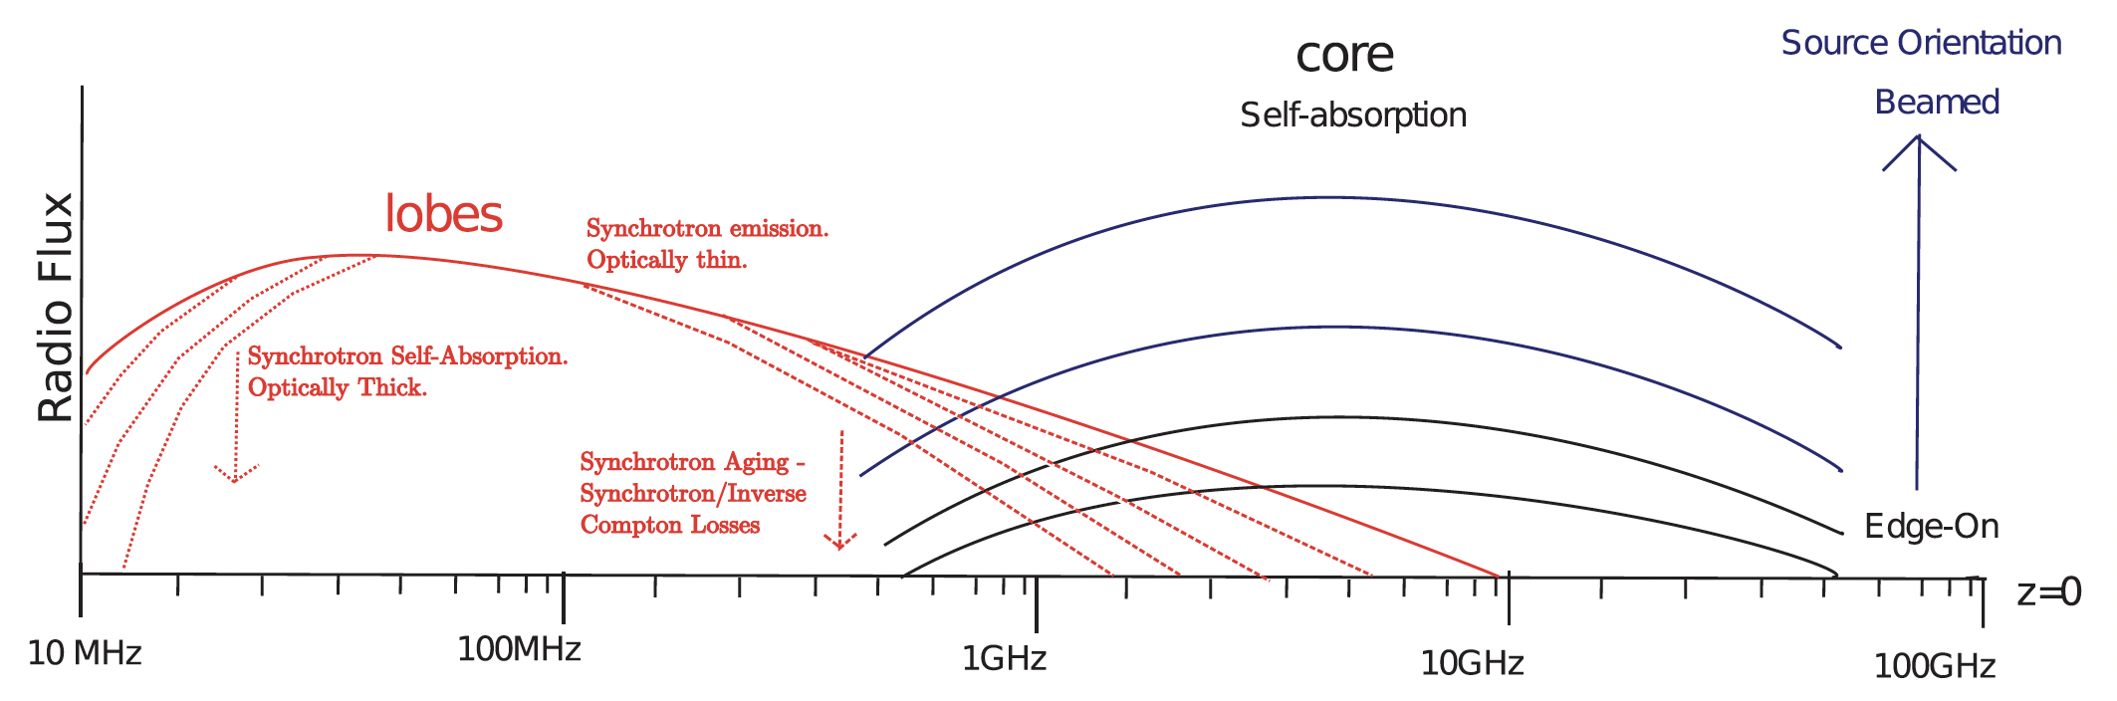

The Radio Spectra of AGN and SFGs
  Radio spectral shapes can be constrained by a power-law:
  S_{ν} ∝ ν⍺
  ⇒ $α_{1}^{2}$ = log(S_{ν2}/S_{ν1}) / log(ν₂/ν₁)
Main Goals:
-Infer the radiative processes powering (and absorbing) radio emission
-Investigate the link between radio emission and host galaxy properties
-Determine whether spectral flattening occurs at <1 GHz (observed) for the faint sub-mJy population
Flux density
Frequency
jets or
synchrotron
dust
thermal
Condon 1992 – SFG radio spectrum
Ker+ 2012 – AGN radio spectrum
HEASA-2024 – Wits Rural Facility, Mpumalanga

Slide 5
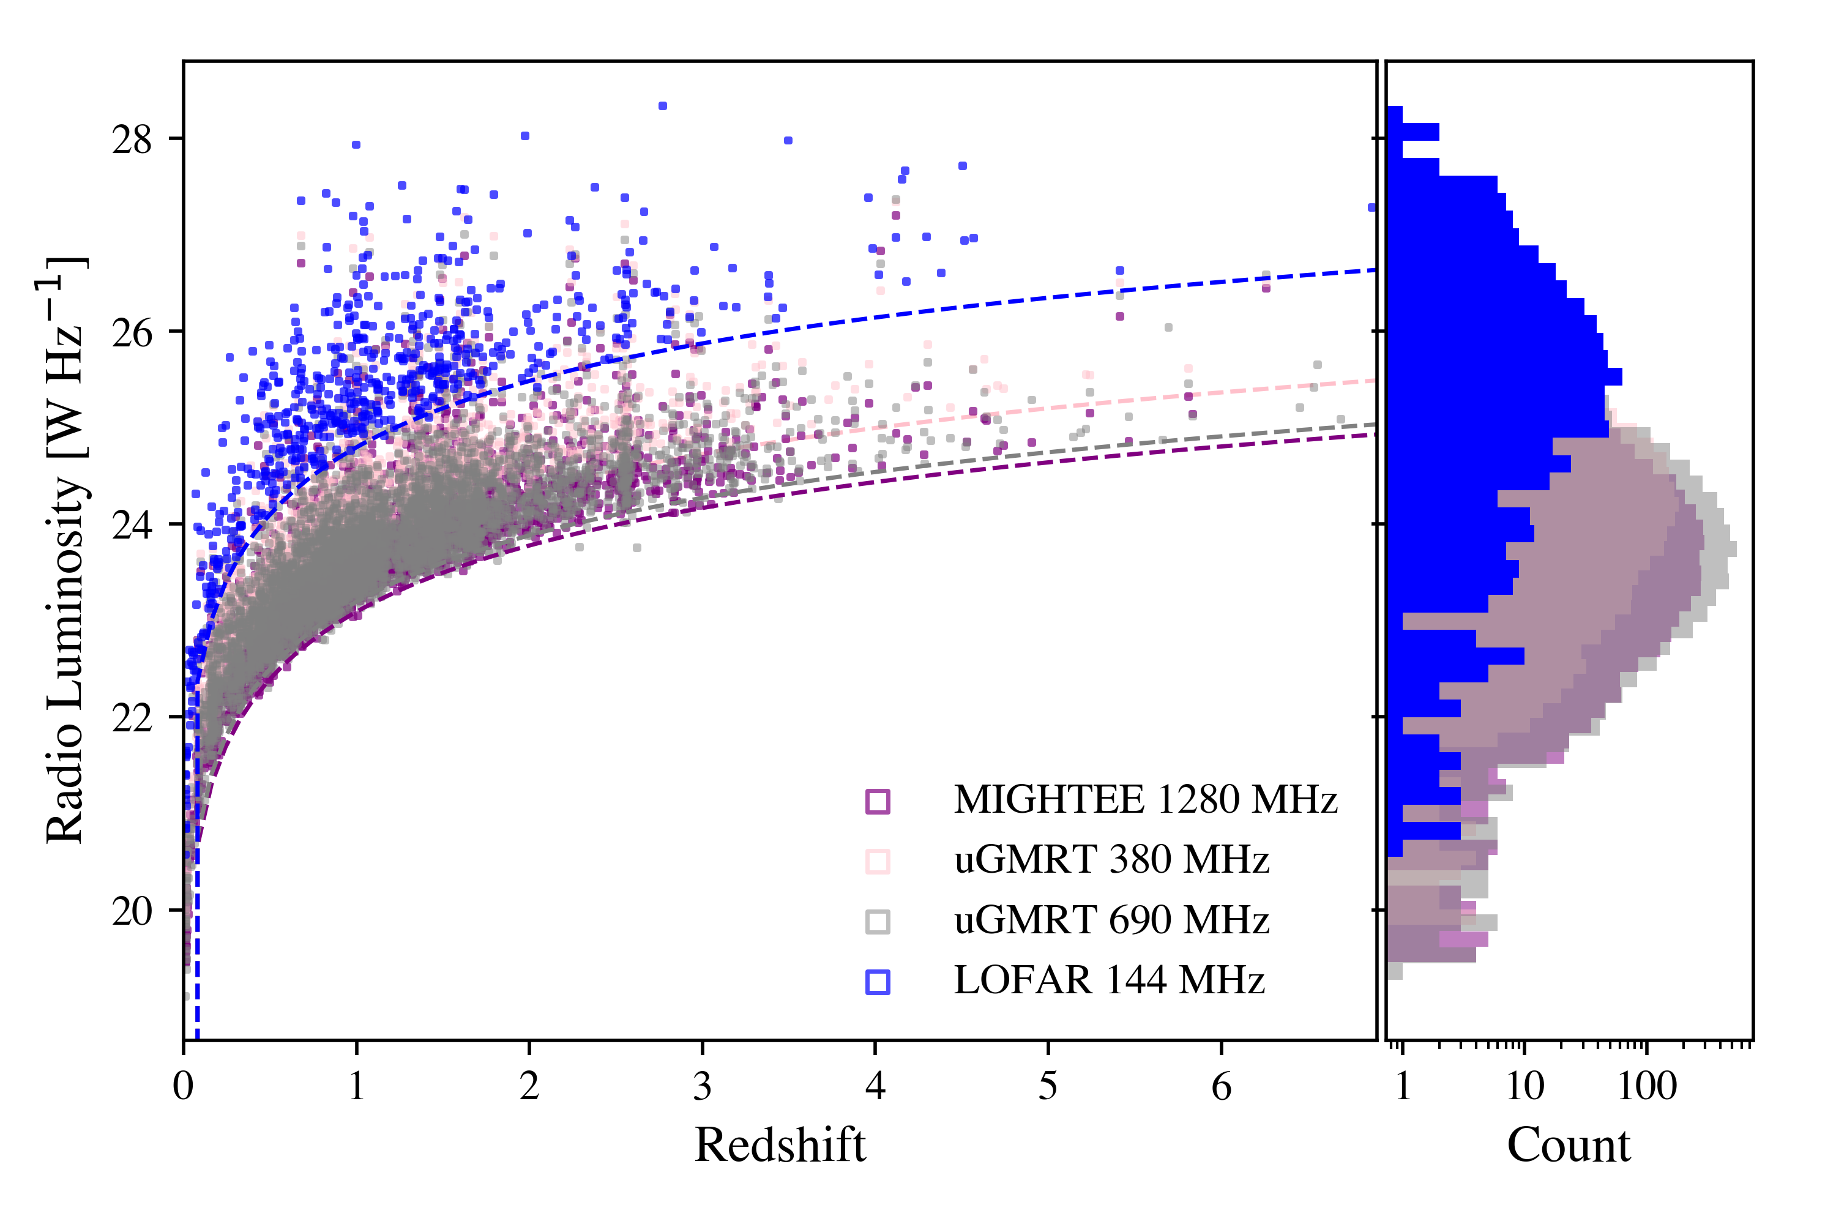
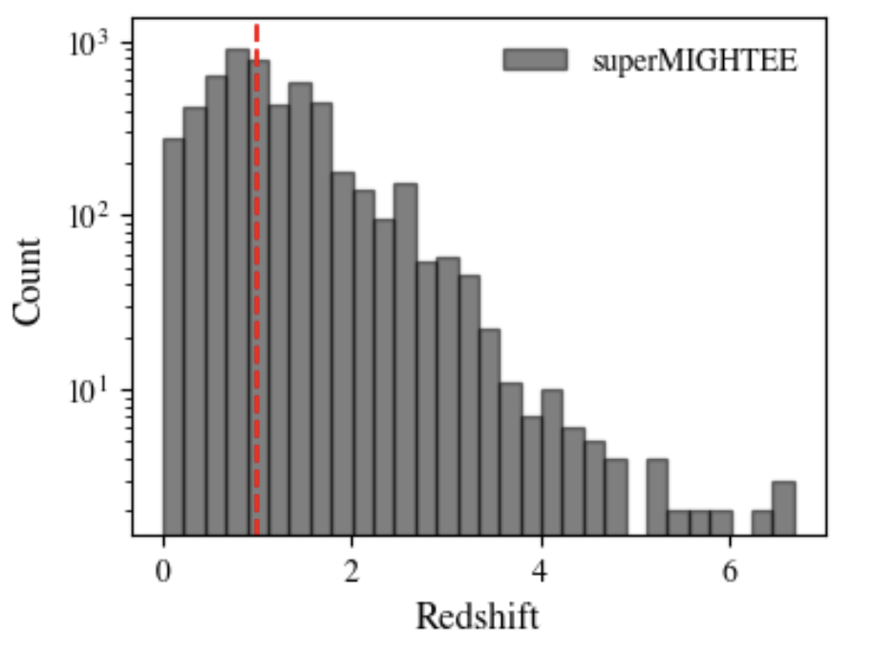
superMIGHTEE: the radio source population in XMM-LSS
Source-finding on uGMRT and MIGHTEE mosaics with PyBDSF (Mohan & Rafferty 2014)
7241 uGMRT band-4 (690 MHz) radio sources cross-identified with band-3 (380 MHz) and with MIGHTEE L-band (1280 MHz; resolution-optimized at 5 arcsec)
  2551 matches in B3; 35.2 % complete
  4073 matches in MK; 56.2 % complete
Optical/near-infrared ancillary data (Mehta+ 2018, Bowler+ 2020)
  Subaru/HSC (Aihara+ 2018)
  CFHT VIDEO/VISTA (Jarvis+ 2013
  Spitzer/IRAC (Mauduit+ 2012)
superMIGHTEE: rms = 2 μJy/beam (~ 100x lower in rms depth than existing LOFAR 144 MHz XMM-LSS observations)
HEASA-2024 – Wits Rural Facility, Mpumalanga

Slide 6
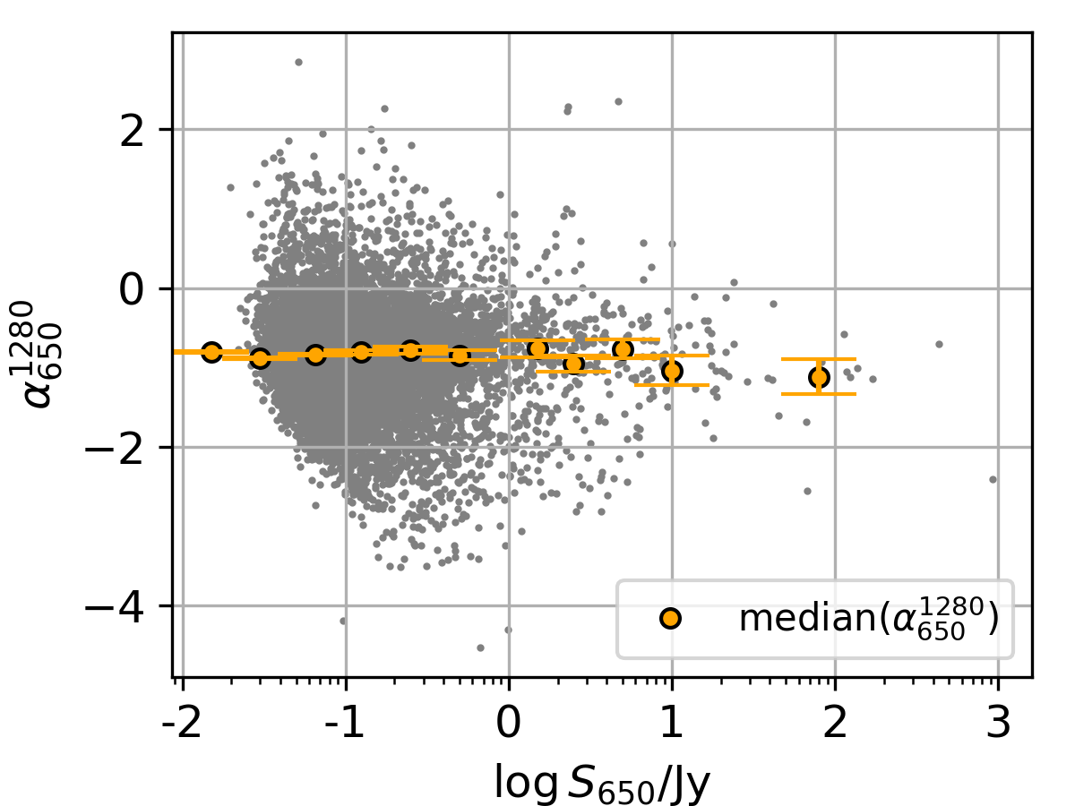
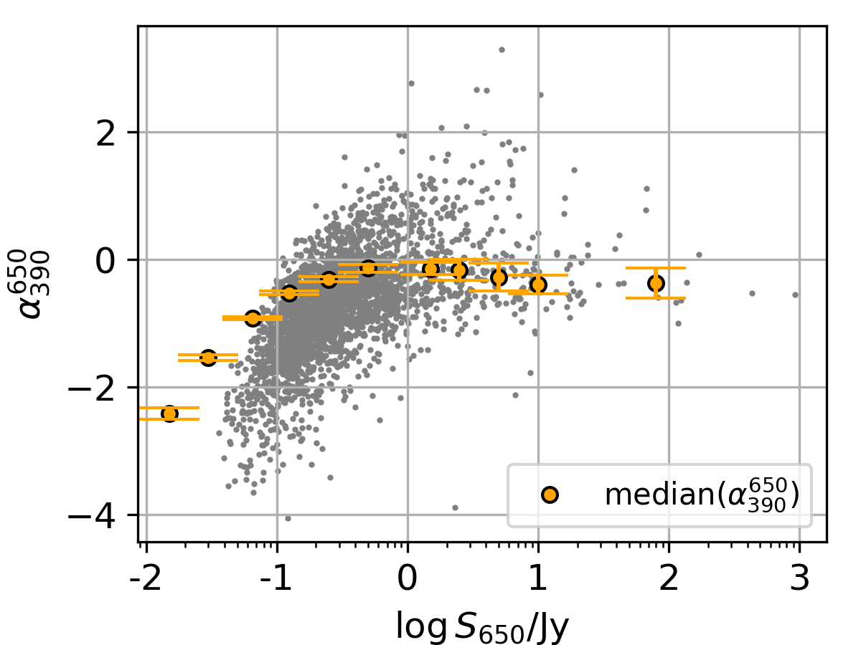
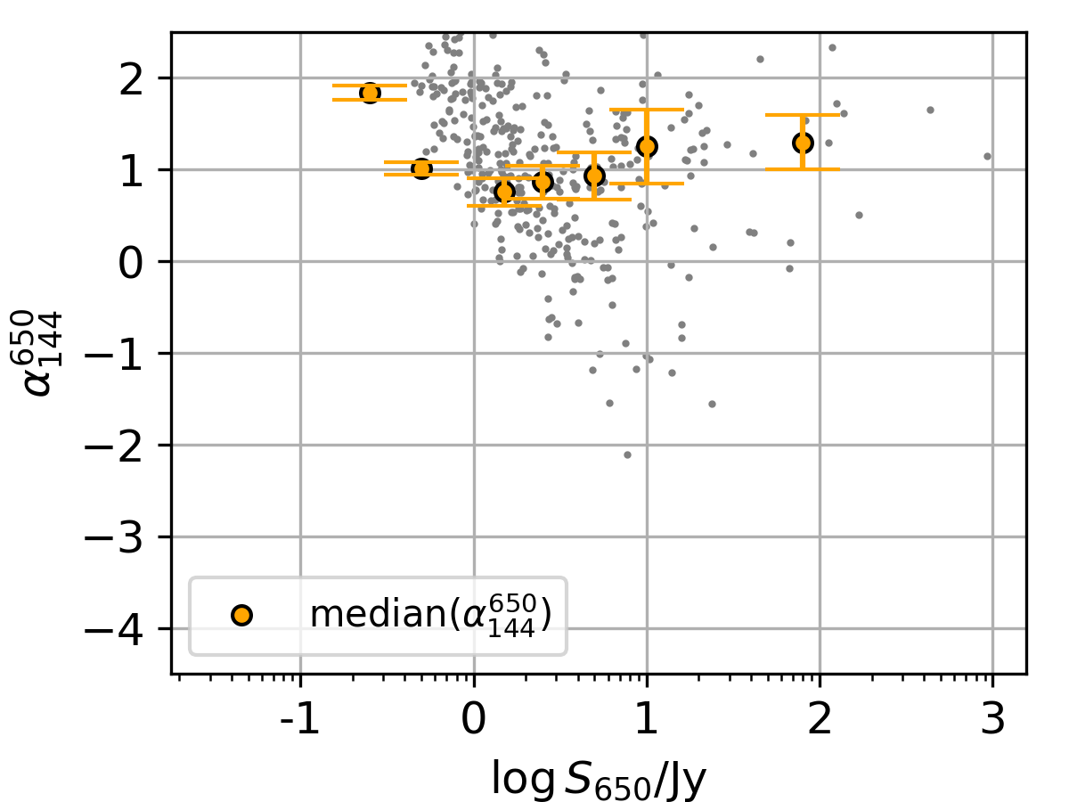
Connecting spectral index to source brightness
uGMRT band-4 flux density (S₆₉₀) lower flux cuts imposed per flux density bin:
  Flattening of ɑ(1280 – 650) with decreasing flux cut
    Free-free absorption and thermal emission in SFGs
  Steepening of ɑ(650 – 390) with decreasing flux cut
    Synchrotron ageing in low-power radio-AGN (also observed at z < 0.3 in Sabater+ 2021)
  Consistently positive (or rising) ɑ(144 – 650)
    Synchrotron self-absorption in optically thick plasma
CAVEATS:
Upper-limits from non-detections not shown
Comparison to Monte-Carlo simulations of unbiased simulations needed
Kolwa+ in prep.
HEASA-2024 – Wits Rural Facility, Mpumalanga

Slide 7
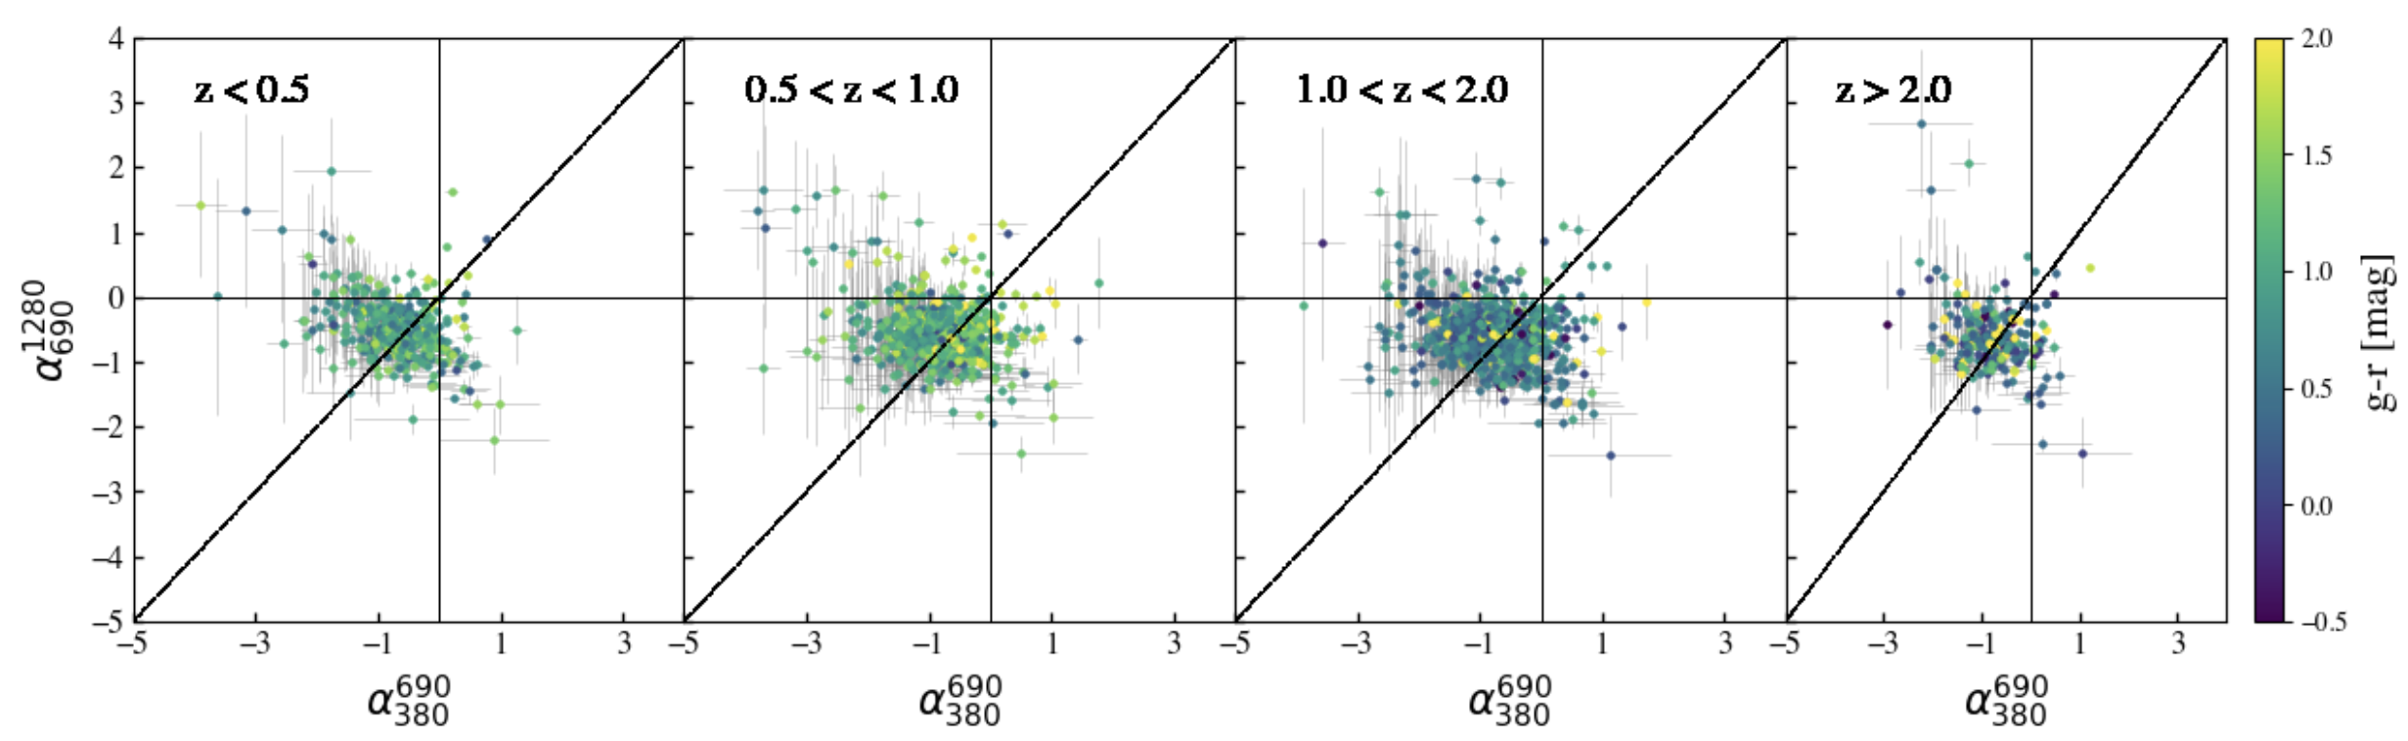
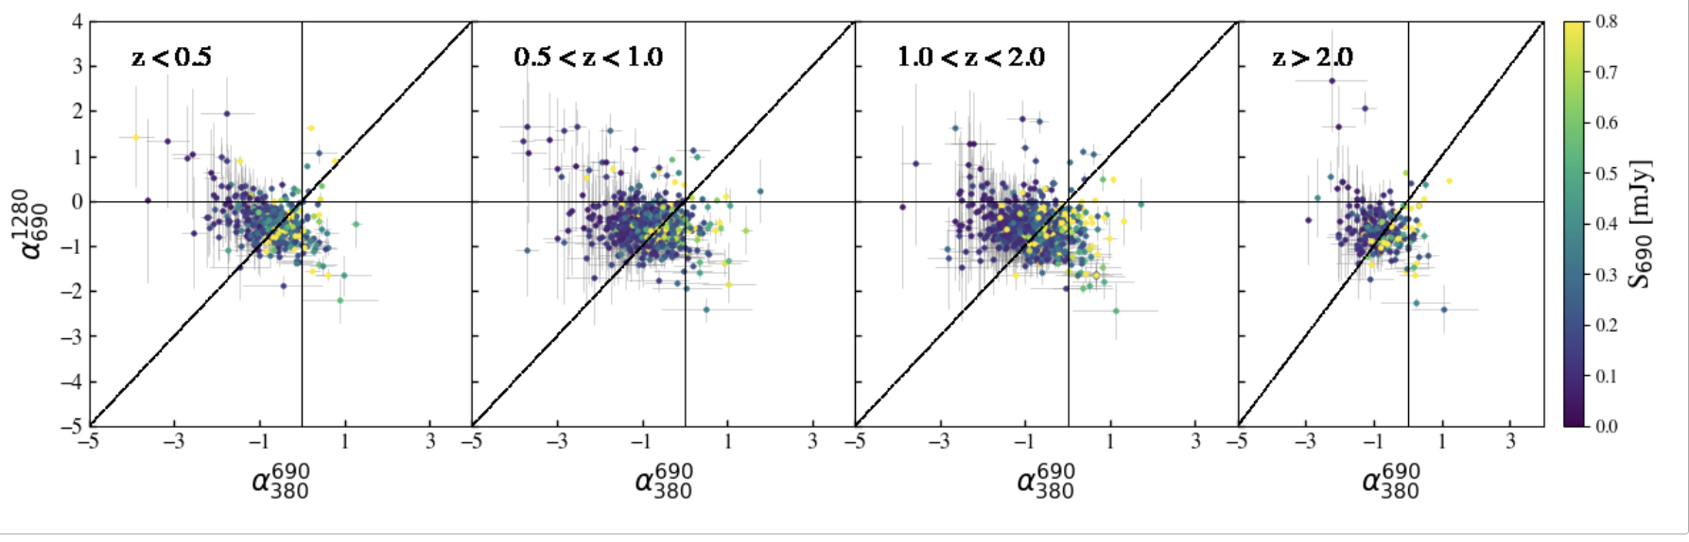
Connecting spectral shape to the observed properties
Radio spectral curvatures indicate:
Steepened for 81% of the population:
→ Synchrotron emission (SE) at ν_{rest} > 1 GHz
Peaked for 9% of the population
→ Synchrotron self-absorption (SSA) at
ν_{rest} < 1 GHz in addition to SE
Rising sources and inverted sources comprise ~1% and ~7% of the population respectively
Observed trends in flux density
(bottom panel):
Brighter sources (>0.2 mJy) -> radio-AGN
→ majority peaked (due to SSA and SE from lobes)
Fainter sources (<0.2 mJy) -> SFG
→ majority steep and some are downturned (due to dominance of thermal emission in SED).
Kolwa+ in prep.
HEASA-2024 – Wits Rural Facility, Mpumalanga

Slide 8
Summary:
A pilot radio spectral study with superMIGHTEE
uGMRT and MIGHTEE Early Science observations provide a glimpse into the faint radio source and high-redshift galaxy population (up to z~6) when cross-matched with optical/NIR survey data
With these observations, we conduct a multi-frequency spectral shape analysis over 380 MHz, 690 MHz and 1280 MHz
We find statistical evidence for spectral flattening towards low flux densities <100 μJy at high observed frequencies (650 – 1280 MHz) indicative of thermal emission and absorption processes at ν_{rest} < 1 GHz in star-forming galaxies and non-jetted AGN
At high flux densities and lower observed frequencies (390 – 650 MHz) , synchrotron processes steepen radio spectra in powerful radio galaxies with extended lobes

