Slide 1
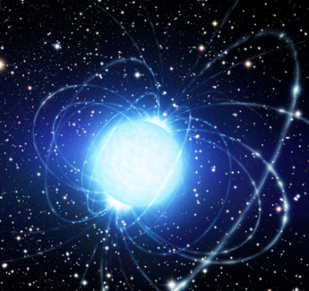
The possible detection of γ-ray pulsations from J1912-4410 and J0317-855 using Fermi-LAT observations.
Lurgasho H. Minnie
Supervisor: Prof. Petrus J. Meintjes
Co-Supervisor: Dr. Jacques Maritz
Image Credit: ESO/L.Calcada

Slide 2
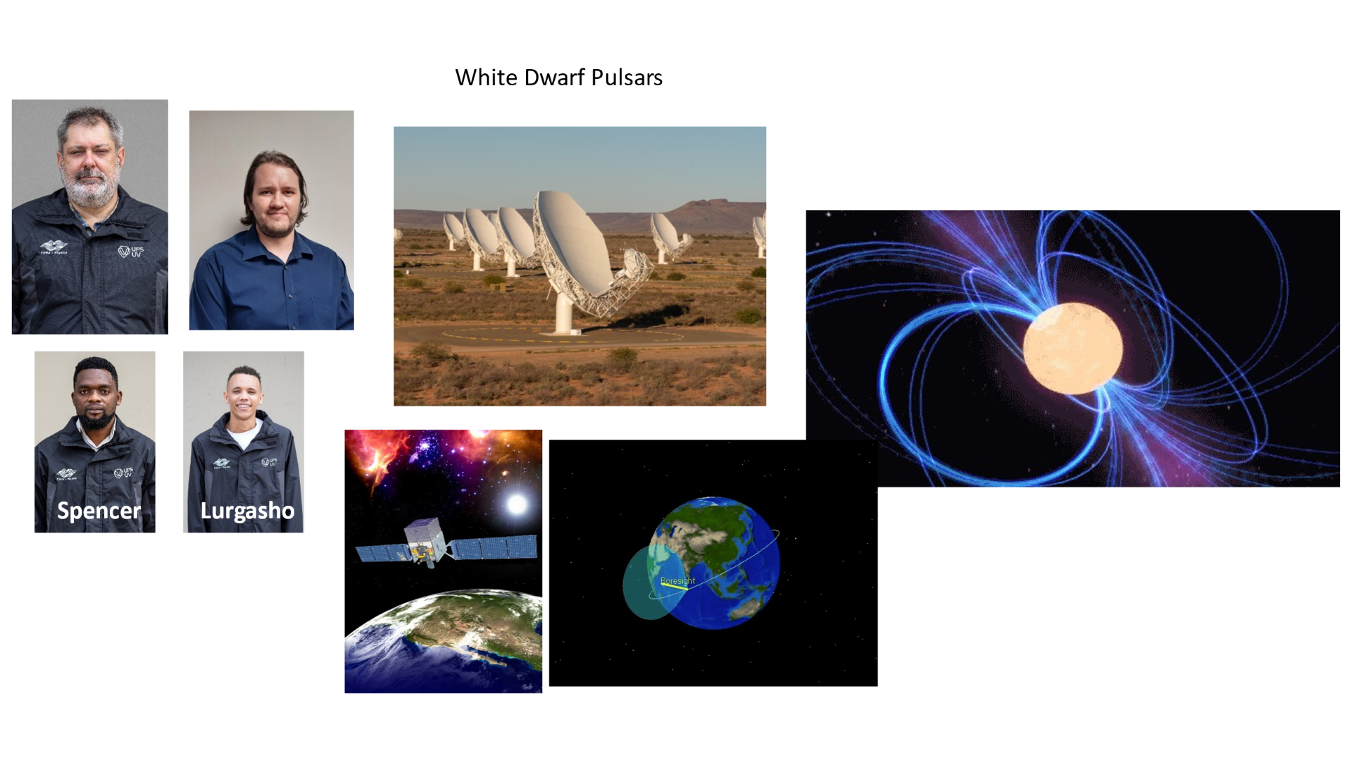

Slide 3
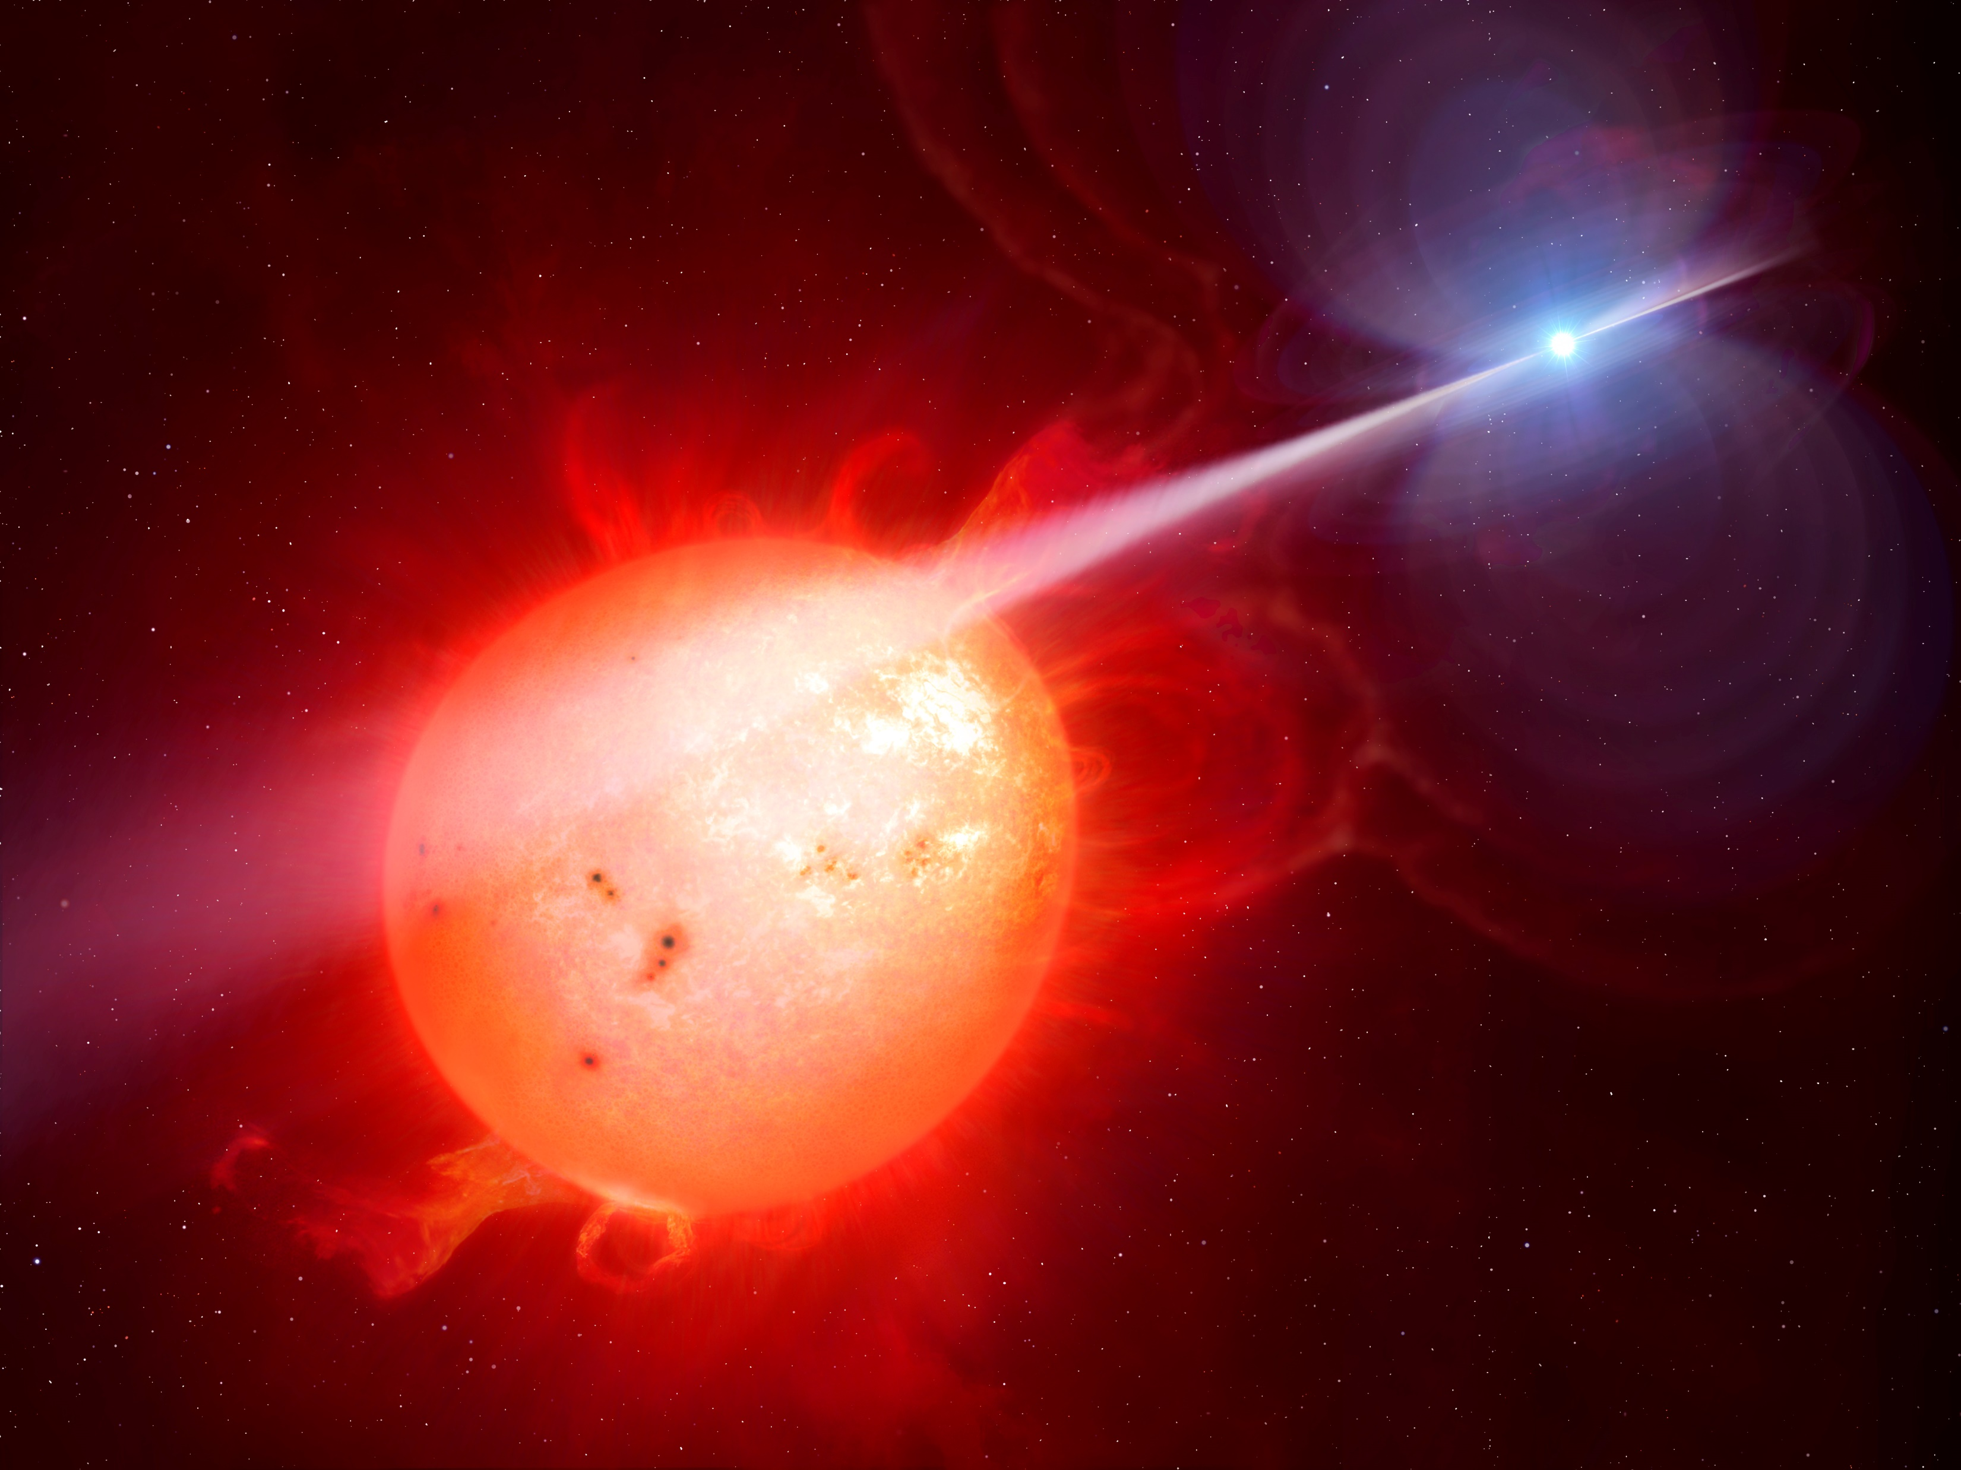
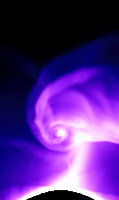
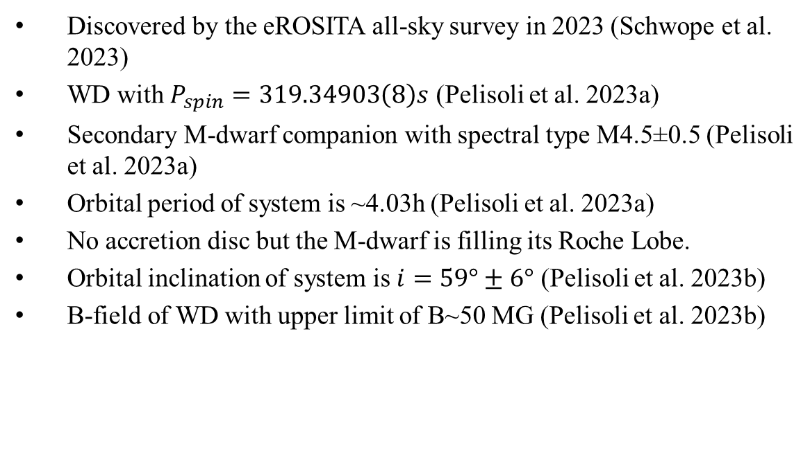
Binary System J1912-4410
Discovered by the eROSITA all-sky survey in 2023 (Schwope et al. 2023)
WD with $P_{spin}=319.34903\left(8\right)s$ (Pelisoli et al. 2023a)
Secondary M-dwarf companion with spectral type M4.5±0.5 (Pelisoli et al. 2023a)
Orbital period of system is ~4.03h (Pelisoli et al. 2023a)
No accretion disc but the M-dwarf is filling its Roche Lobe.
Orbital inclination of system is $i=59°±6°$ (Pelisoli et al. 2023b)
B-field of WD with upper limit of B~50 MG (Pelisoli et al. 2023b)
Artistic illustration of WD pulsar. Credit: Mark Garlick

Slide 4
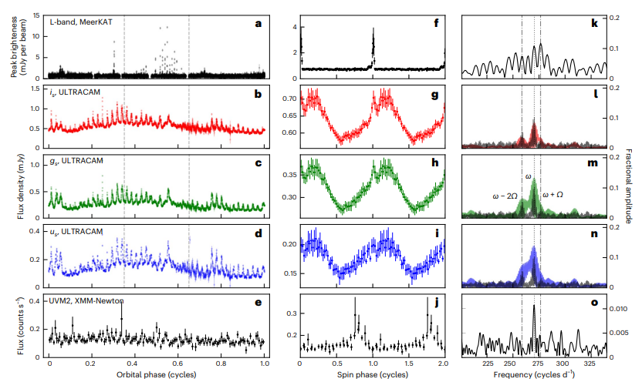
Multi-wavelength study of J1912
Figure 1: 1st column shows light curve as a function of orbital phase, 2nd column shows the folded light curve on spin period (spin ephemeris BJD(TDB) = 2459772.142522(24) + 0.0036961693(10)E) and 3rd column shows the Fourier Transform for the respective wavebands (Pelisoli et al. 2023a)

Slide 5
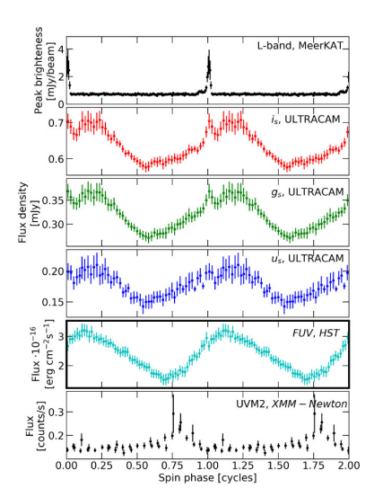
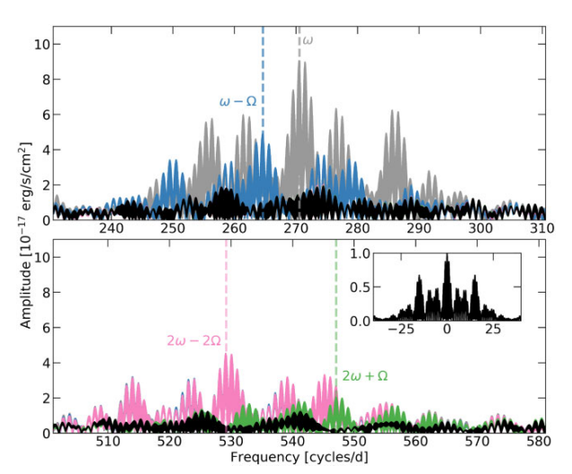
Far Ultraviolet Observations (Hubble Space Telescope)
Figure 3: Fourier Transforms of FUV data showing the spin period and orbital sideband frequencies. Inset shows the window function at the cadence of HST observations (Pelisoli et al. 2023b)
Figure 2: Folded light curves with the additional FUV (HST) folded light curve shown in cyan (Pelisoli et al. 2023b)

Slide 6
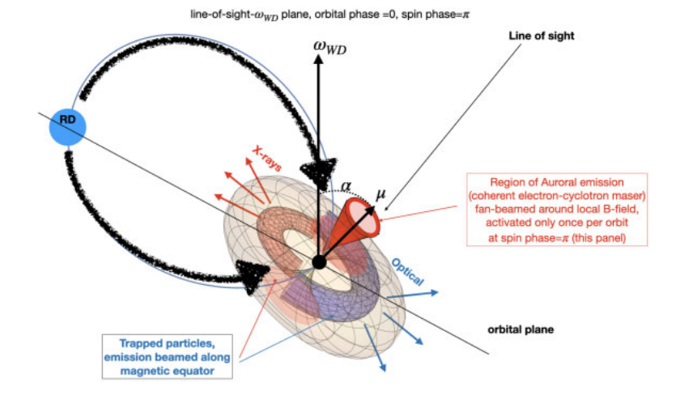
Geometric “Seeding” Model
Figure 4: Geometric model to explain the multiwavelength pulsed emission observed from J1912 (Pelisoli et al. 2023b)

Slide 7
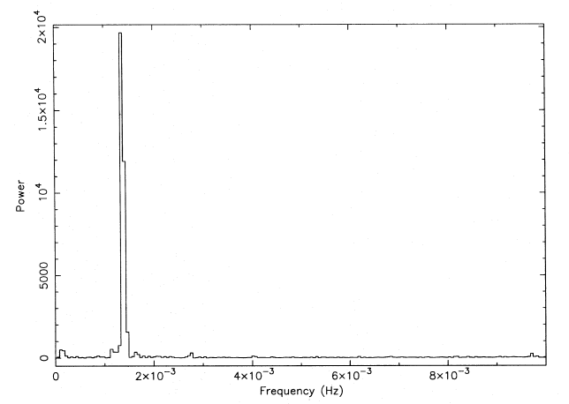
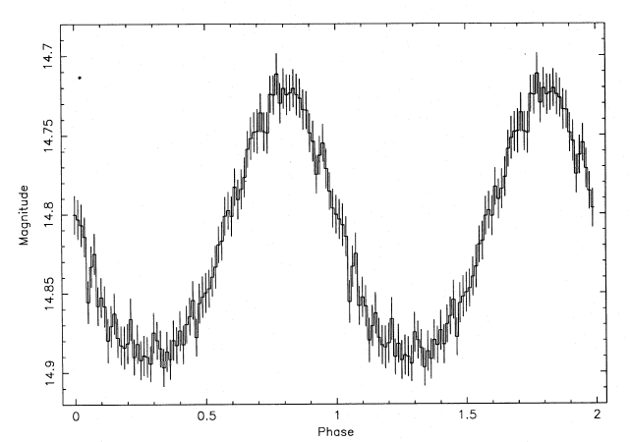
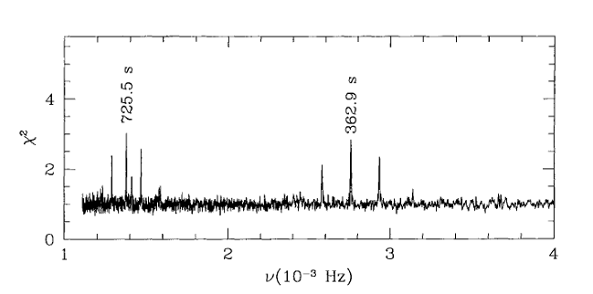
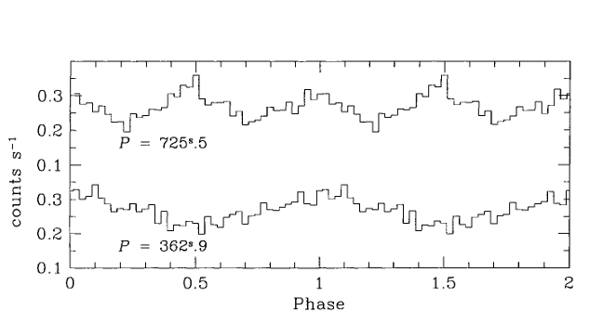
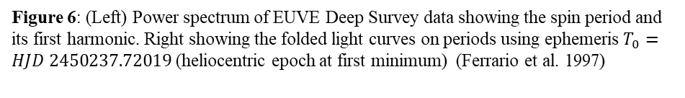
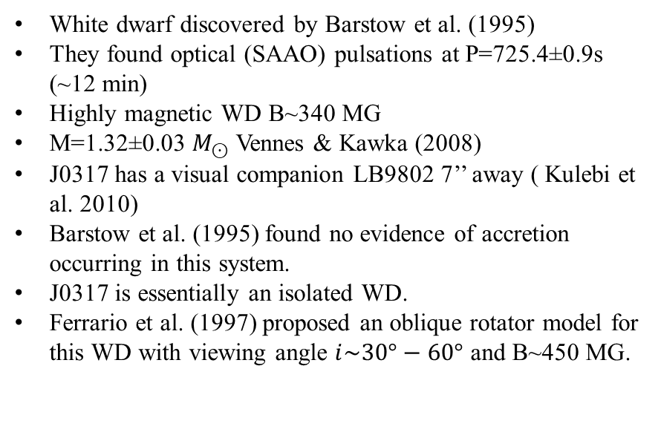
Isolated White Dwarf J0317
White dwarf discovered by Barstow et al. (1995)
They found optical (SAAO) pulsations at P=725.4±0.9s (~12 min)
Highly magnetic WD B~340 MG
M=1.32±0.03 $M_{⊙}$Vennes & Kawka (2008)
J0317 has a visual companion LB9802 7’’ away ( Kulebi et al. 2010)
Barstow et al. (1995) found no evidence of accretion occurring in this system.
J0317 is essentially an isolated WD.
Ferrario et al. (1997) proposed an oblique rotator model for this WD with viewing angle $i\sim 30°−60°$ and B~450 MG.
Figure 5: (Left) Fourier transform of 1994 Nov 12/13 optical light curve and on the right showing the optical light curve folded on P=725.4s taking HJD=2449669 as epoch of phase zero. Barstow et al. (1995)
Figure 6: (Left) Power spectrum of EUVE Deep Survey data showing the spin period and its first harmonic. Right showing the folded light curves on periods using ephemeris $T_{0}=HJD 2450237.72019$(heliocentric epoch at first minimum) (Ferrario et al. 1997)

Slide 8
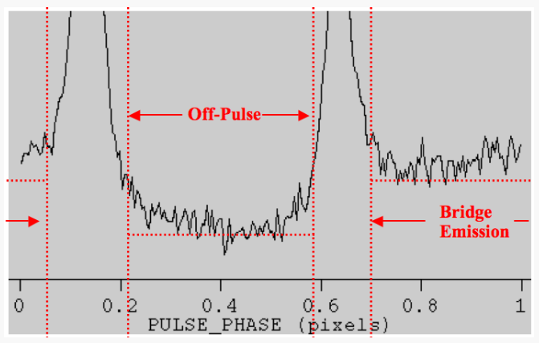
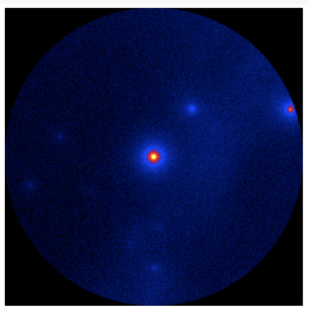
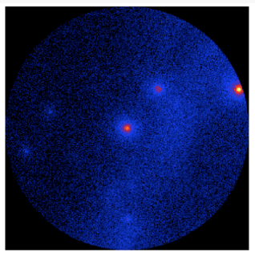
Fermi-LAT Data Analysis
Test Statistic (TS) Gating
Standard Fermi-LAT analyses does not reveal much about faint sources.
TS gating (Madzime and Meintjes, 2023) is analogous to pulsar gating.
Data set divided into 5-day bins and an unbinned likelihood analysis was performed on those sets.
Only time bins with TS>0 are considered.
Then, a binned likelihood analysis was performed on the TS-gated data.
Figure 7: (Top) Geminga off-pulse selection. Bottom shows Geminga before (left) and after (right) pulsar gating. Credit: NASA

Slide 9
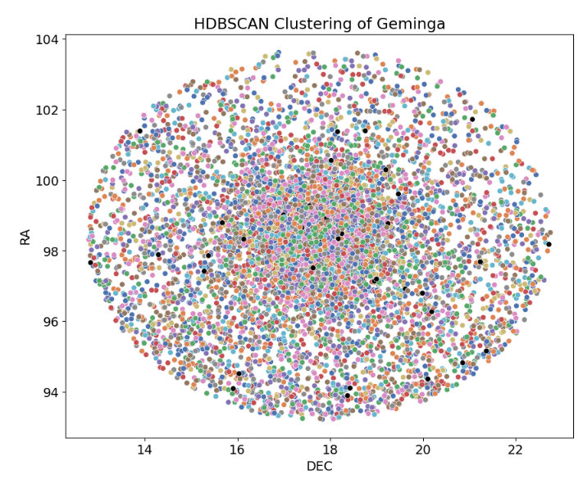
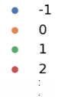

HDBSCAN Clustering
Tempo2 (Hobbs et al. 2006) was then used to calculate the phase of the arrival times of the obtained TS-gated event file.
Hierarchical Density-Based Spatial Clustering of Application with Noise (HDBSCAN, Campello et al. 2013) was utilized to cluster photons together.
Folded light curves of these clusters were then obtained.
Clusters that showed structure in their light curves were selected and combined resulting in a final event file.
This event file was then used to search for periodicity using the Rayleigh test (gtpsearch)
Clusters
Figure 8: Clusters of Geminga region (ROI=5°)

Slide 10
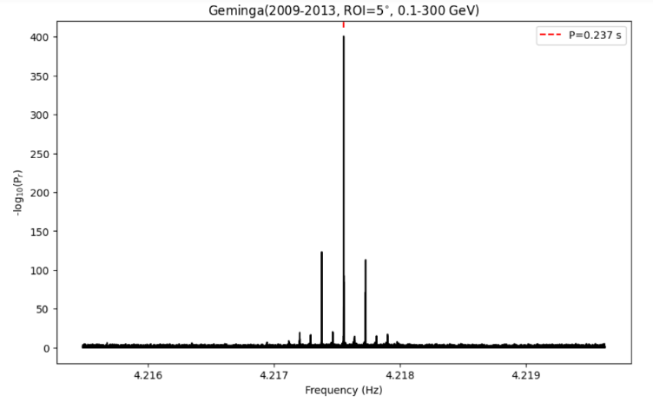
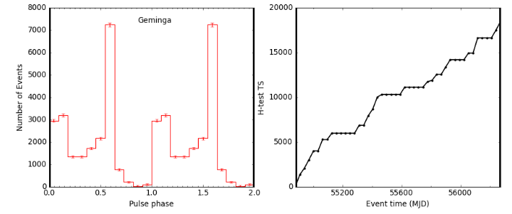
Sanity Check!
Figure 9: (Left) Rayleigh Periodogram for Geminga (after TS-gating & HDBSCAN) , (middle) folded γ-ray light curve (0.1-300 GeV) and right figure showing the H-test (de Jager et al. 1989)

Slide 11
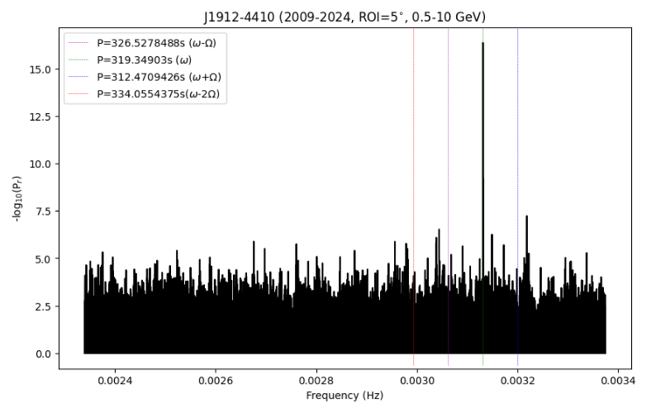
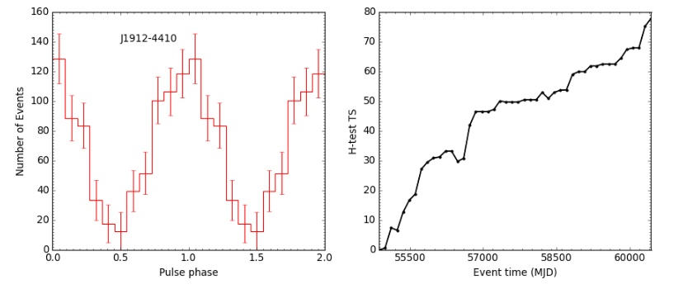
Results
J1912-4410 (0.5-10 GeV)
γ-ray pulsations at $P_{spin}=319.34903\left(3\right)s$ (~10.52σ)
γ-ray folded light curve (spin ephemeris BJD(TDB) = 2459772.142522(24) + 0.0036961693(10)E, Pelisoli et al. 2023) is in aligned with the MeerKAT radio light curve!

Slide 12
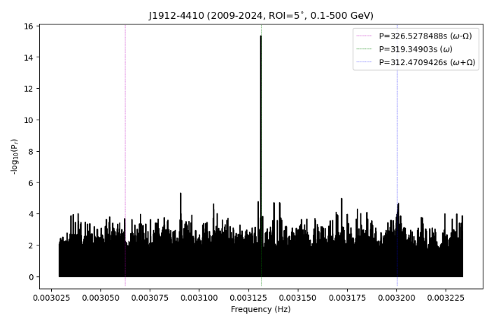
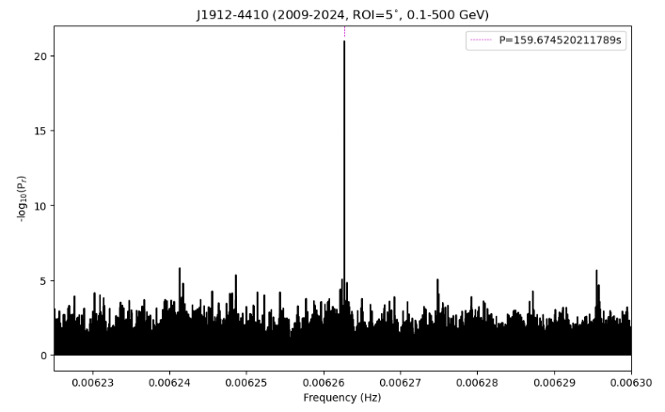
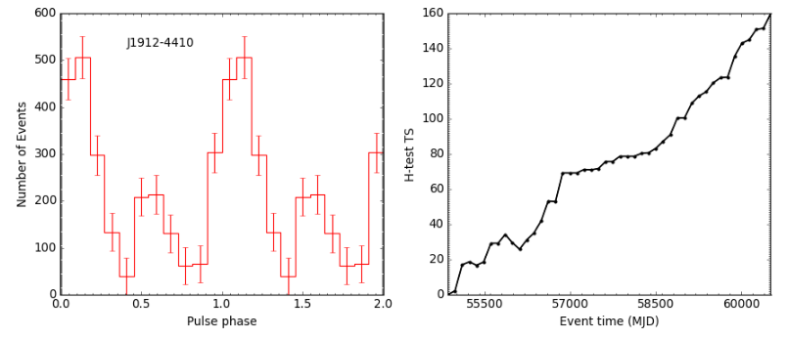
J1912-4410 (0.1-500 GeV)
Preliminary
Pulsations at the spin period ($P_{spin}=319.349±0.003s, \sim 10.37σ$) and the first harmonic ($P=159.675±0.001s, \sim 15.75σ$)
Light curve is double-peaked in 0.1-500 GeV energy range contrary to 0.5-10GeV!

Slide 13
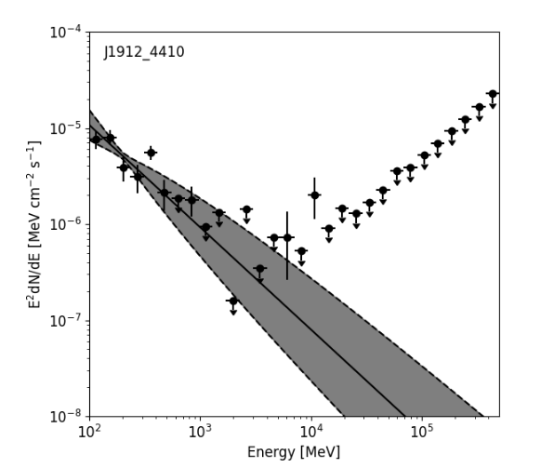
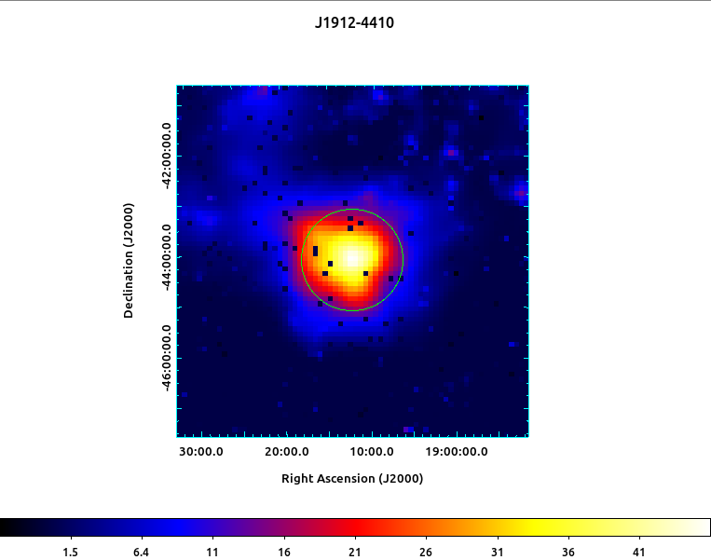
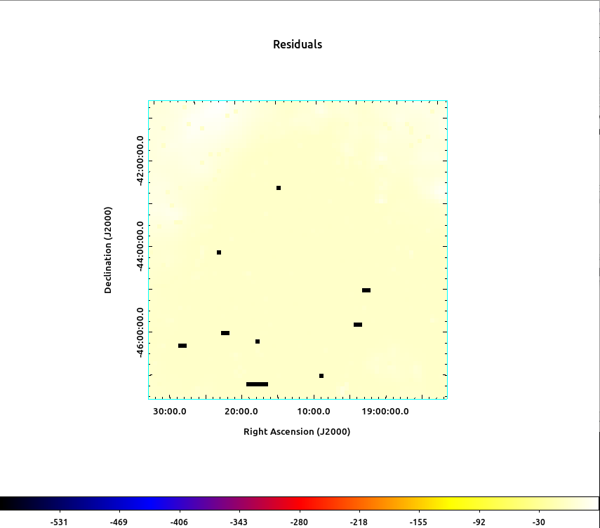
SED of J1912-4410 (0.1-500 GeV)
Figure 10 : (Left) SED of J1912 produced using FermiPy (Wood et al. 2017), (middle) Test Statistic (TS) Map of J1912 and right showing the residuals
TS~46 with significance of ~6.78σ
Flux (0.1-500 GeV) = (8.517±0.003)$x{10}^{−11}$ $photons {cm}^{−2}s^{−1}$
Spectral index = -(3.06±0.62)

Slide 14
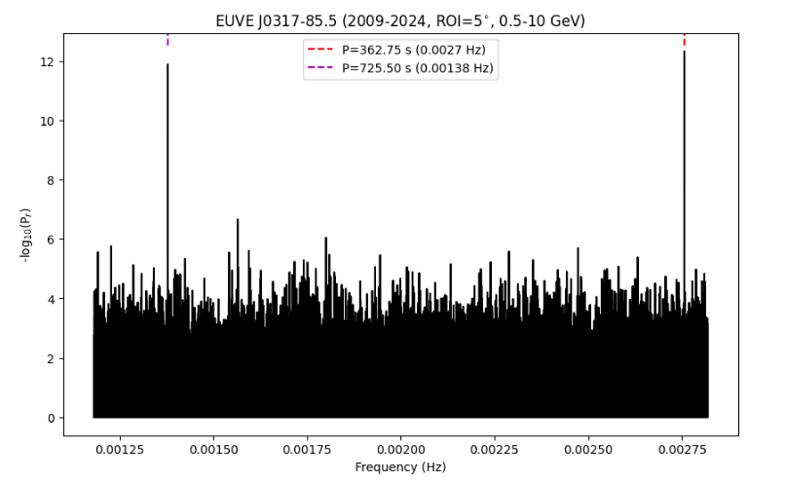
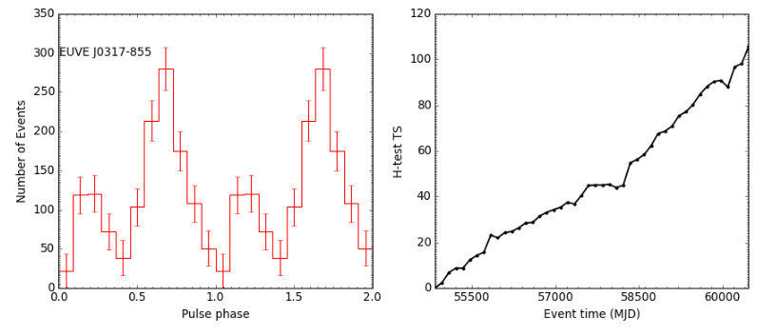
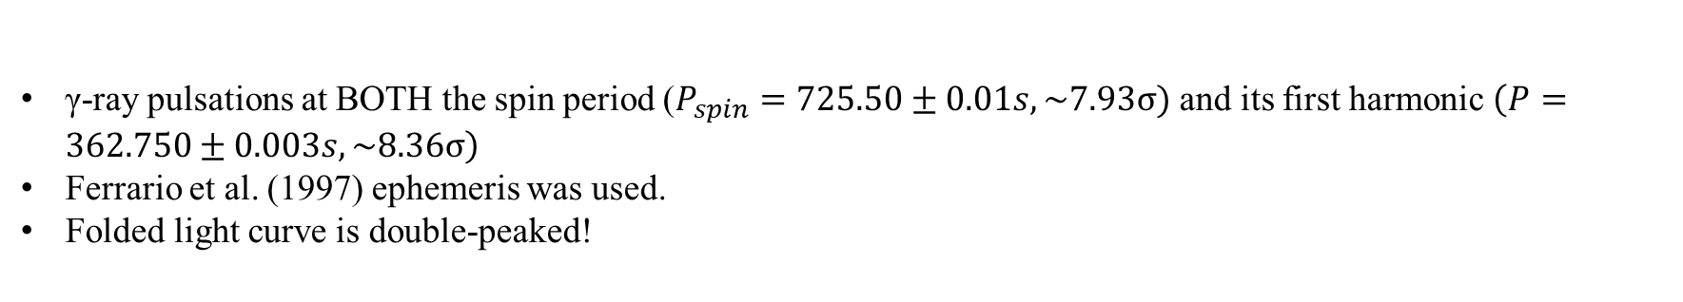
J0317 (0.5-10 GeV)
γ-ray pulsations at BOTH the spin period ($P_{spin}=725.50±0.01s, \sim 7.93σ)$ and its first harmonic $\left(P=362.750±0.003s, \sim 8.36σ\right)$
Ferrario et al. (1997) ephemeris was used.
Folded light curve is double-peaked!

Slide 15
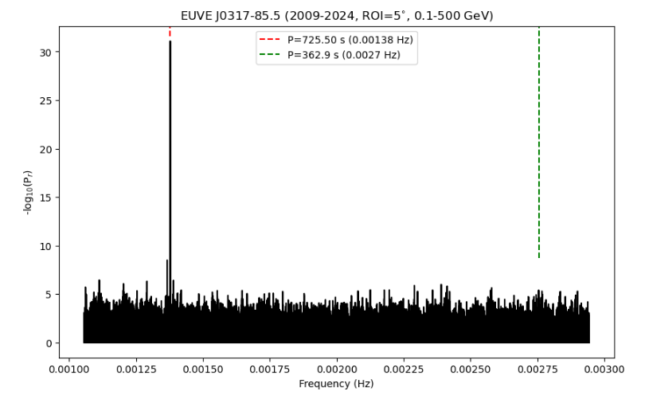
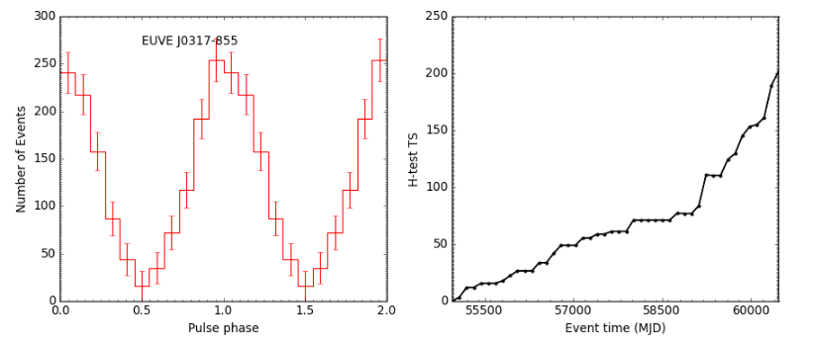

J0317 (0.1-500 GeV)
Preliminary
More dominant pulsations at spin period $P_{spin}=725.500±0.003s(\sim 24.13σ)$
First harmonic not visible!
Single-peaked folded light curve at higher energies!

Slide 16
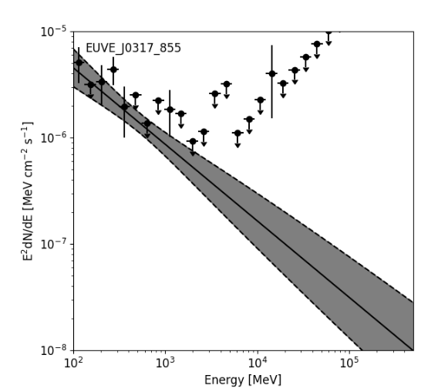
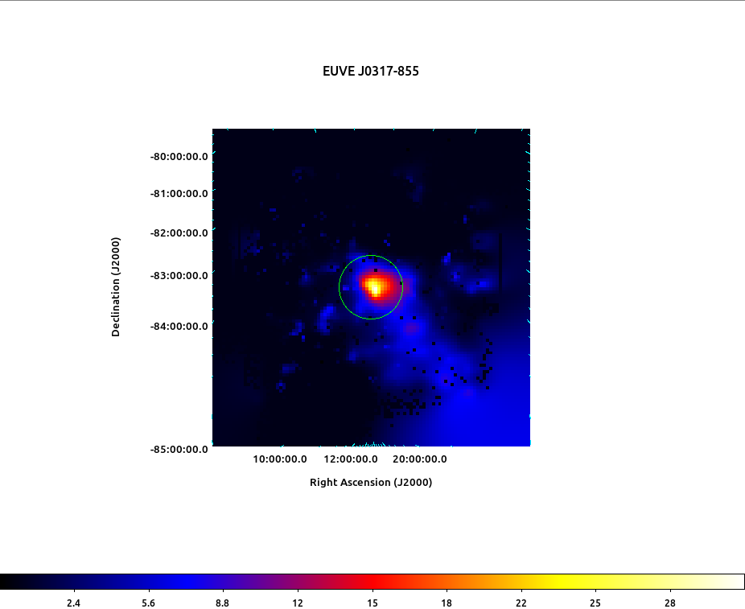
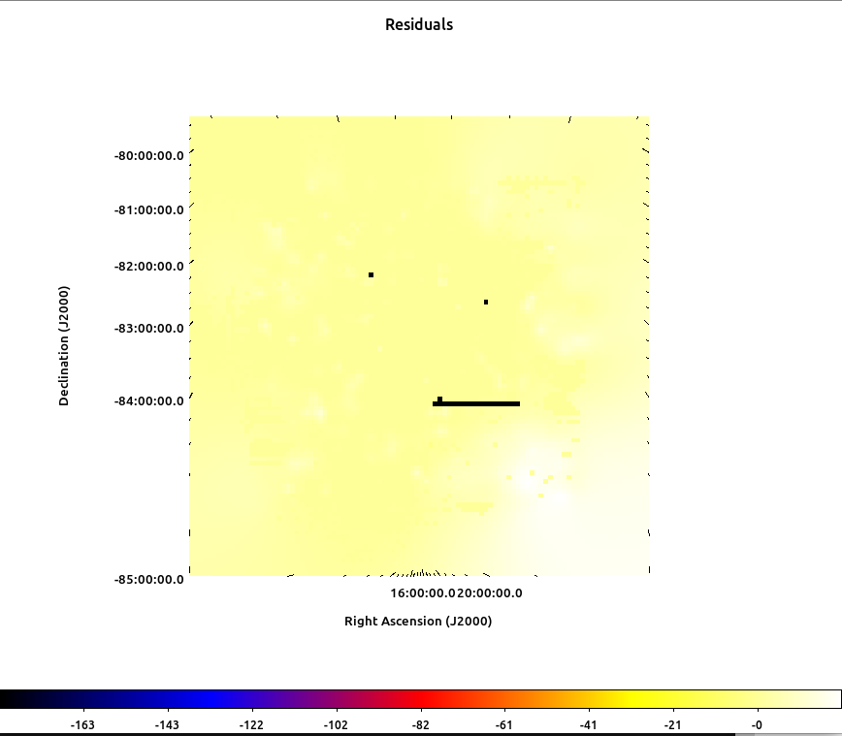
SED of J0317 (0.1-500GeV)
Figure 11: (Left) SED of J0317, (middle) TS Map and right showing the residuals
TS~31 with significance of ~5.6σ
Flux (0.1-500 GeV) = (8.517±0.008)$x{10}^{−10}$ $photons {cm}^{−2}s^{−1}$
Spectral index=-(2.73±0.28)

Slide 17
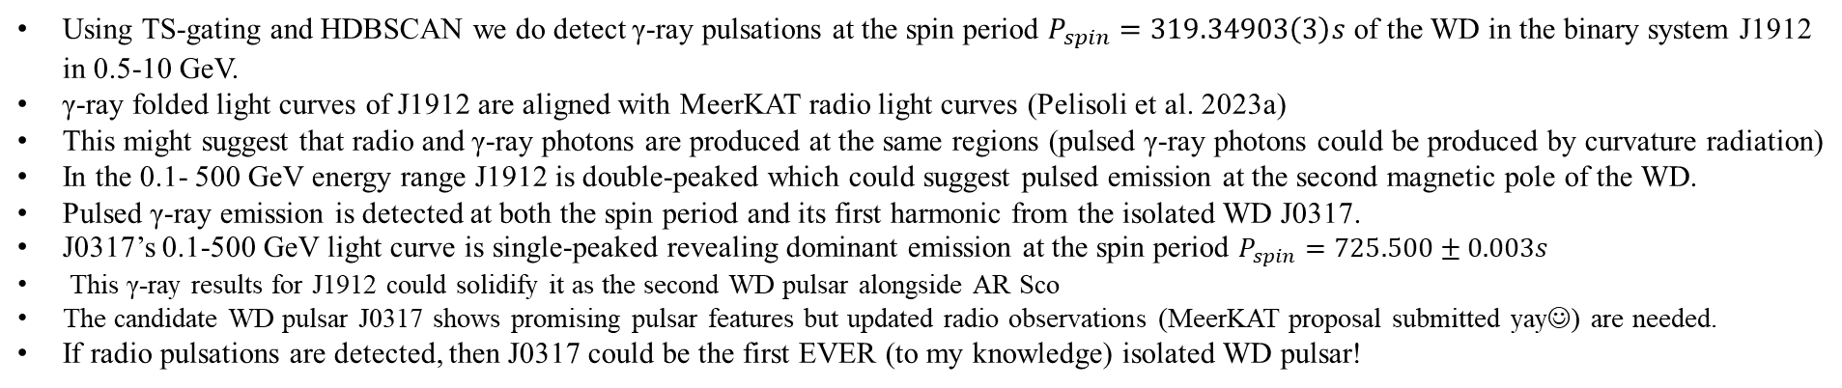
Conclusions
Using TS-gating and HDBSCAN we do detect γ-ray pulsations at the spin period $P_{spin}=319.34903\left(3\right)s$ of the WD in the binary system J1912 in 0.5-10 GeV.
γ-ray folded light curves of J1912 are aligned with MeerKAT radio light curves (Pelisoli et al. 2023a)
This might suggest that radio and γ-ray photons are produced at the same regions (pulsed γ-ray photons could be produced by curvature radiation)
In the 0.1- 500 GeV energy range J1912 is double-peaked which could suggest pulsed emission at the second magnetic pole of the WD.
Pulsed γ-ray emission is detected at both the spin period and its first harmonic from the isolated WD J0317.
J0317’s 0.1-500 GeV light curve is single-peaked revealing dominant emission at the spin period $P_{spin}=725.500±0.003s$
This γ-ray results for J1912 could solidify it as the second WD pulsar alongside AR Sco
The candidate WD pulsar J0317 shows promising pulsar features but updated radio observations (MeerKAT proposal submitted yay☺) are needed.
If radio pulsations are detected, then J0317 could be the first EVER (to my knowledge) isolated WD pulsar!

Slide 18
Thank you!

Slide 19
References
M.A. Barstow, S. Jordan, D. O’Donoghue, M.R. Burleigh, R. Napiwotzki and M.K. Harrop-Allin, RE J0317 – 853: the hottest known highly magnetic DA white dwarf, Monthly Notices of the Royal Astronomical Society 277 (1995) 971
L. Ferrario, S. Vennes, D.T. Wickramasinghe, J.A. Bailey and D.J. Christian, EUVE J0317 — 855: a rapidly rotating, high-field magnetic white dwarf, Monthly Notices of the Royal Astronomical Society 292 (1997) 205.
P.J. Meintjes, S.T. Madzime, Q. Kaplan and H.J. van Heerden, Spun-up rotation-powered magnetized white dwarfs in close binaries as possible gamma-ray sources: Signatures of pulsed modulation from ae aquarii and ar scorpii in fermi-lat data, Galaxies 11 (2023)
Ingrid Pelisoli, TR Marsh, David AH Buckley, I Heywood, Stephen B Potter, AxelSchwope, Jaco Brink, Annie Standke, PA Woudt, SG Parsons, et al. A 5.3-min-period pulsing white dwarf in a binary detected from radio to x-rays. Nature As-tronomy, 7(8):931–942, 2023a. doi: https://doi.org/10.1038/s41550-023-01995-x.
Spencer T. Madzime and Pieter Meintjes. A search for gamma-ray emissionfrom a sample of highly magnetised white dwarfs using Fermi-LAT data. PoS,HEASA2022:055, 2023. doi: 10.22323/1.426.0055.
Ricardo J. G. B. Campello, Davoud Moulavi, and Joerg Sander. Density-based clus-tering based on hierarchical density estimates. In Jian Pei, Vincent S. Tseng, Longbing Cao, Hiroshi Motoda, and Guandong Xu, editors, Advances in Knowl-edge Discovery and Data Mining, pages 160–172, Berlin, Heidelberg, 2013. SpringerBerlin Heidelberg. ISBN 978-3-642-37456-2.
Ingrid Pelisoli, Snehalata Sahu, Maxim Lyutikov, Maxim Barkov, Boris T G¨ansicke,Jaco Brink, David A H Buckley, Stephen B Potter, Axel Schwope, and S HRam´ırez. Unveiling the white dwarf in J191213.72 441045.1 through ultravi-olet observations. Monthly Notices of the Royal Astronomical Society, 527(2):3826–3836, 11 2023b. ISSN 0035-8711. doi: 10.1093/mnras/stad3442.
Schwope, A., Marsh, T. R., Standke, A., Pelisoli, I., Potter, S., Buckley, D., Mun-day, J., and Dhillon, V. X-ray properties of the white dwarf pulsar erassuj191213.9441044. AA, 674:L9, 2023. doi: 10.1051/0004-6361/202346589.
G.B. Hobbs, R.T. Edwards and R.N. Manchester, tempo2, a new pulsar-timing package – I. An overview, Monthly Notices of the Royal Astronomical Society 369 (2006) 655
O.C. de Jager, B.C. Raubenheimer and J.W.H. Swanepoel, A powerful test for weak periodic signals with unknown light curve shape in sparse data., 221 (1989) 180
S. Vennes, G.D. Schmidt, L. Ferrario, D.J. Christian, D.T. Wickramasinghe and A. Kawka, A multiwavelength study of the high-field magnetic white dwarf euve j0317–85.5 (=re j0317–853), The Astrophysical Journal 593 (2003) 1040

Slide 20
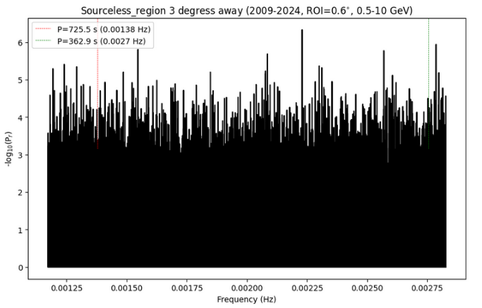
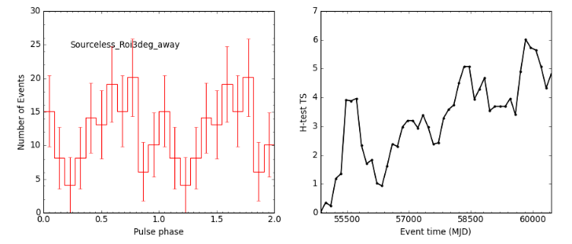
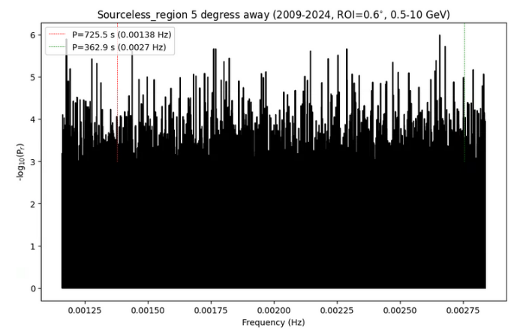
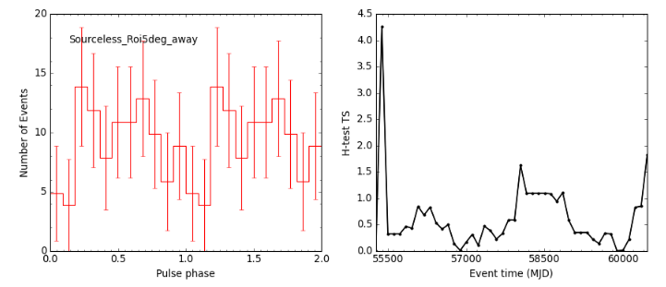
Control Tests for J0317
Figure 12: Rayleigh Periodogram of sourceless region (ROI=3 degrees away) at RA=3:44:29.1403 and DEC=-82:38:51.857, with folded light curve and H-test
Figure 13: Rayleigh Periodogram of sourceless region (ROI=5 degrees away) at RA=1:58:38.6269 and DEC=-81:02:27.438, with folded light curve and H-test

Slide 21
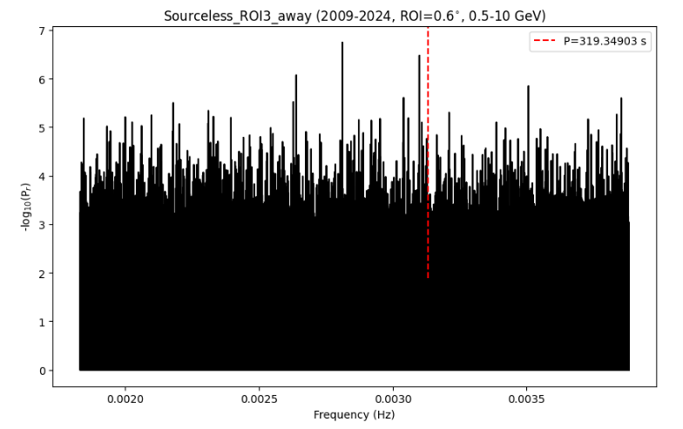
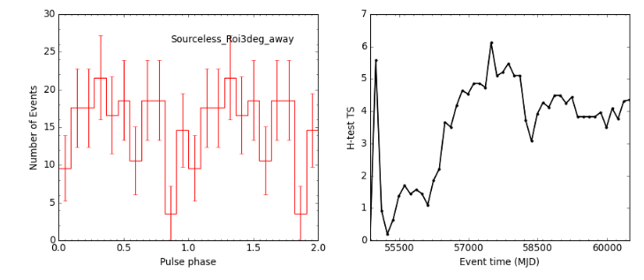
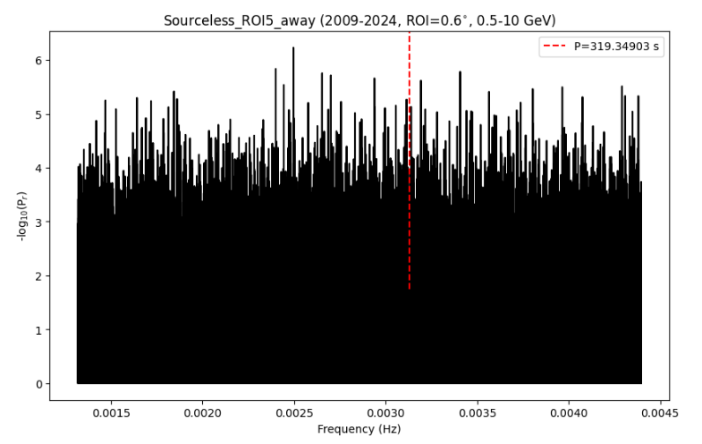
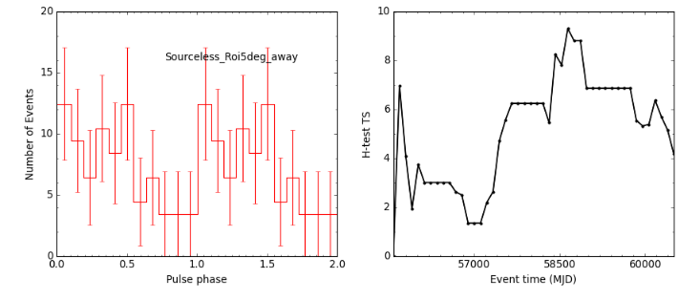
Control Tests for J1912
Figure 14: Rayleigh Periodogram of sourceless region (ROI=3 degrees away) at RA=19:21:57.3063 and DEC=-46:37:36.908, with folded light curve and Htest
Figure 15: Rayleigh Periodogram of sourceless region (ROI=5 degrees away) at RA=19:26:36.4387 and DEC=-48:29:49.663, with folded light curve and H-test

