Slide 1



Slide 2
Blazars
AGNs with jets pointing towards Earth
Emit across the electromagnetic spectrum; significant in gamma rays, neutrinos, cosmic rays
Rapid brightness changes; jets show apparent superluminal motion
Natural labs for particle acceleration and magnetic field studies
Linked to cosmic ray and neutrino sources; e.g., TXS 0506+056
Powered by supermassive black holes; feature accretion disks and jets

Slide 3
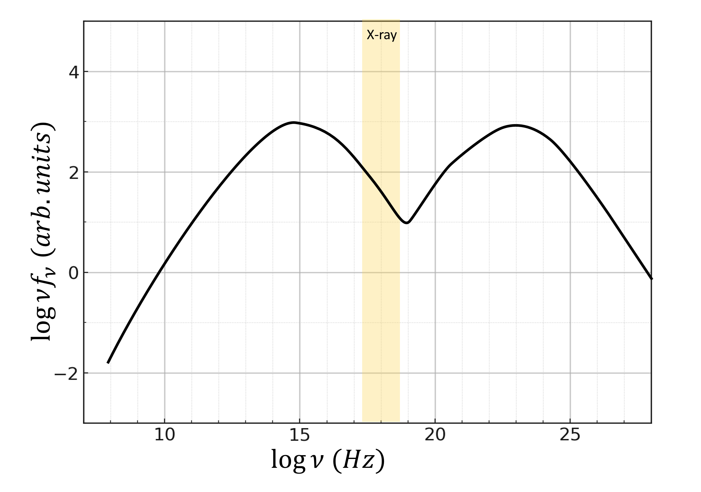
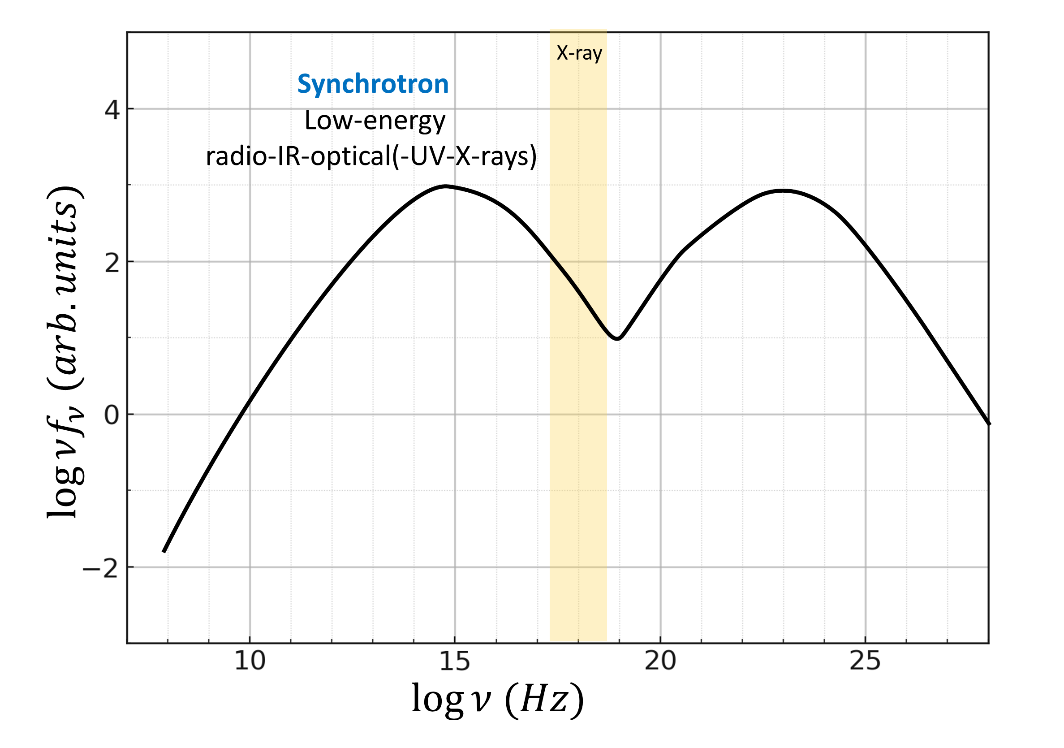
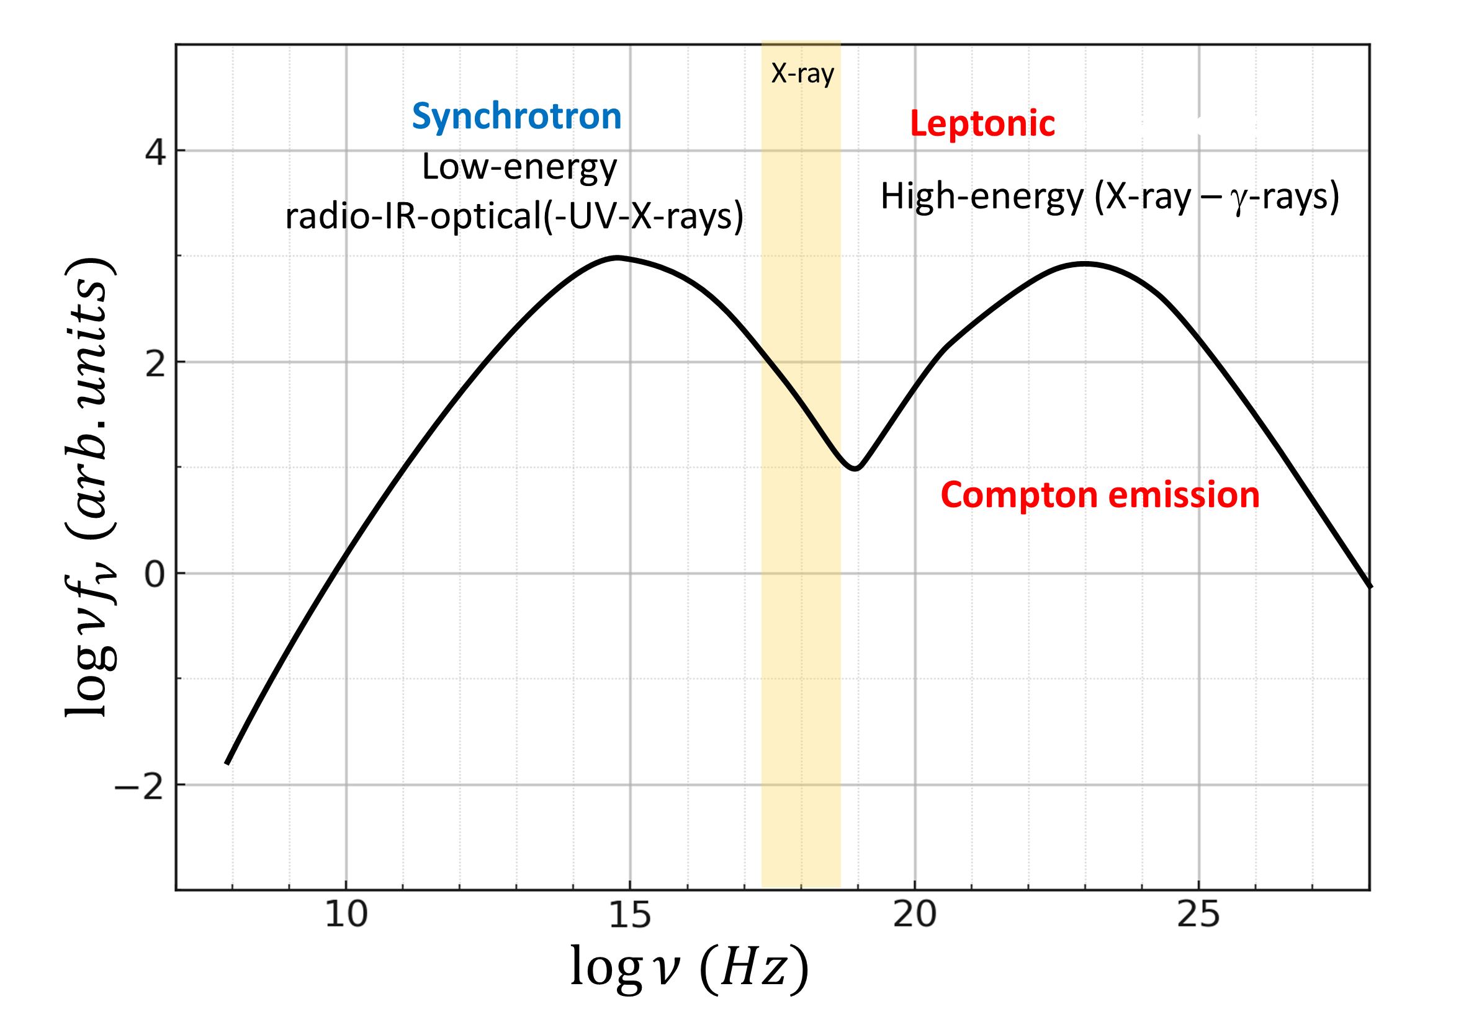
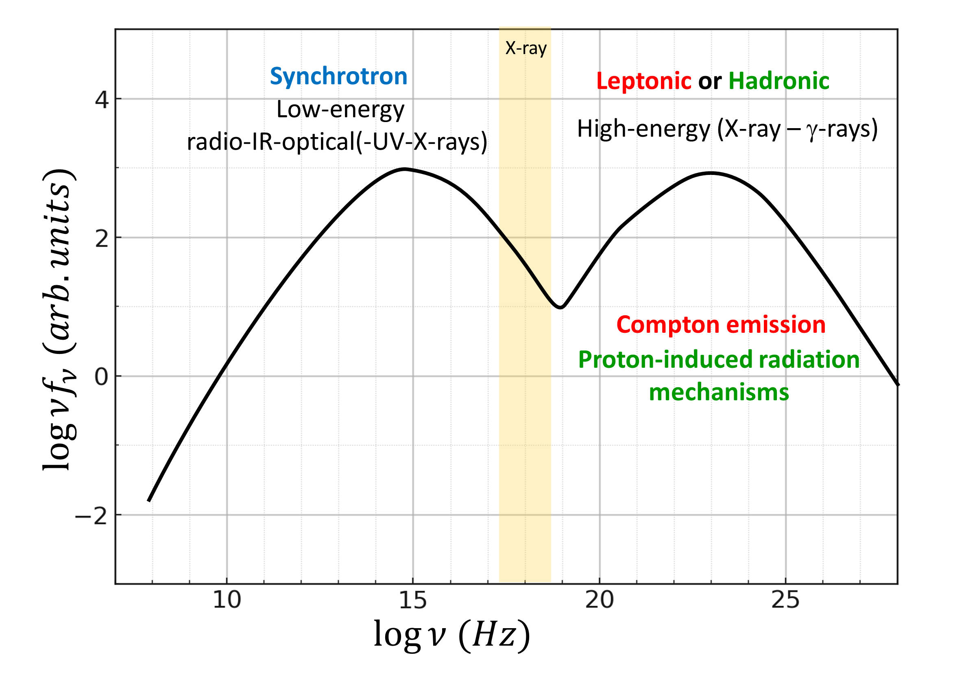
Blazars: Spectral Energy Distributions (SEDs)

Slide 4
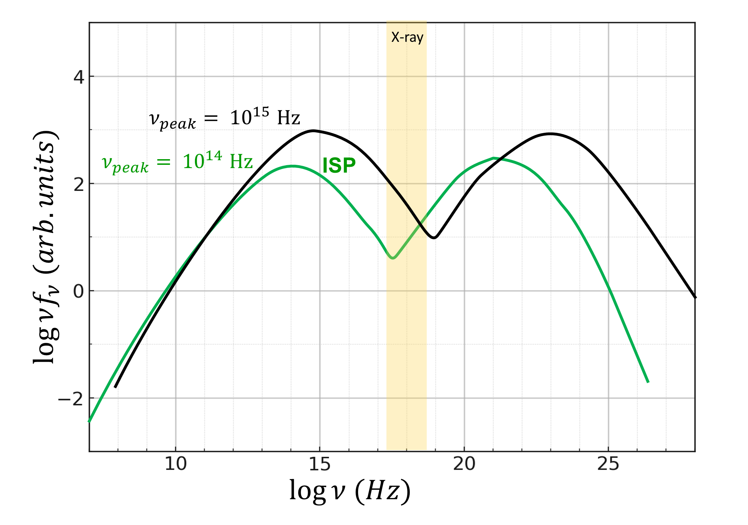
Blazars: Classification Intermediate-synchrotron-peaked (ISP) Blazars

Slide 5
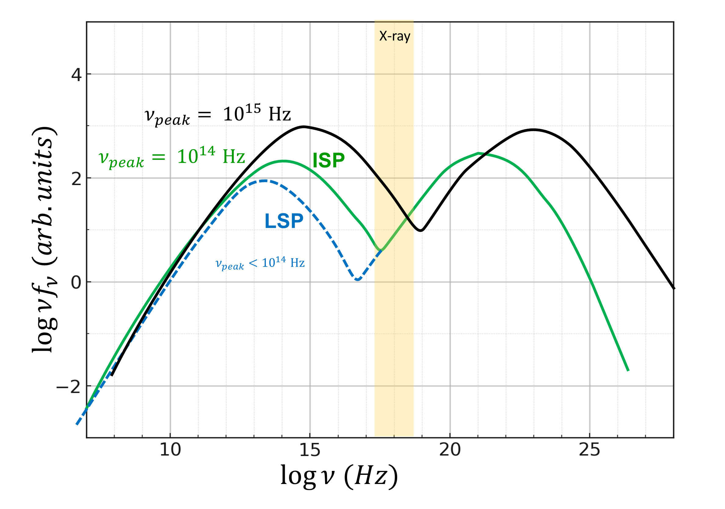
Blazars: Classification Low-synchrotron-peaked (LSP) Blazars

Slide 6
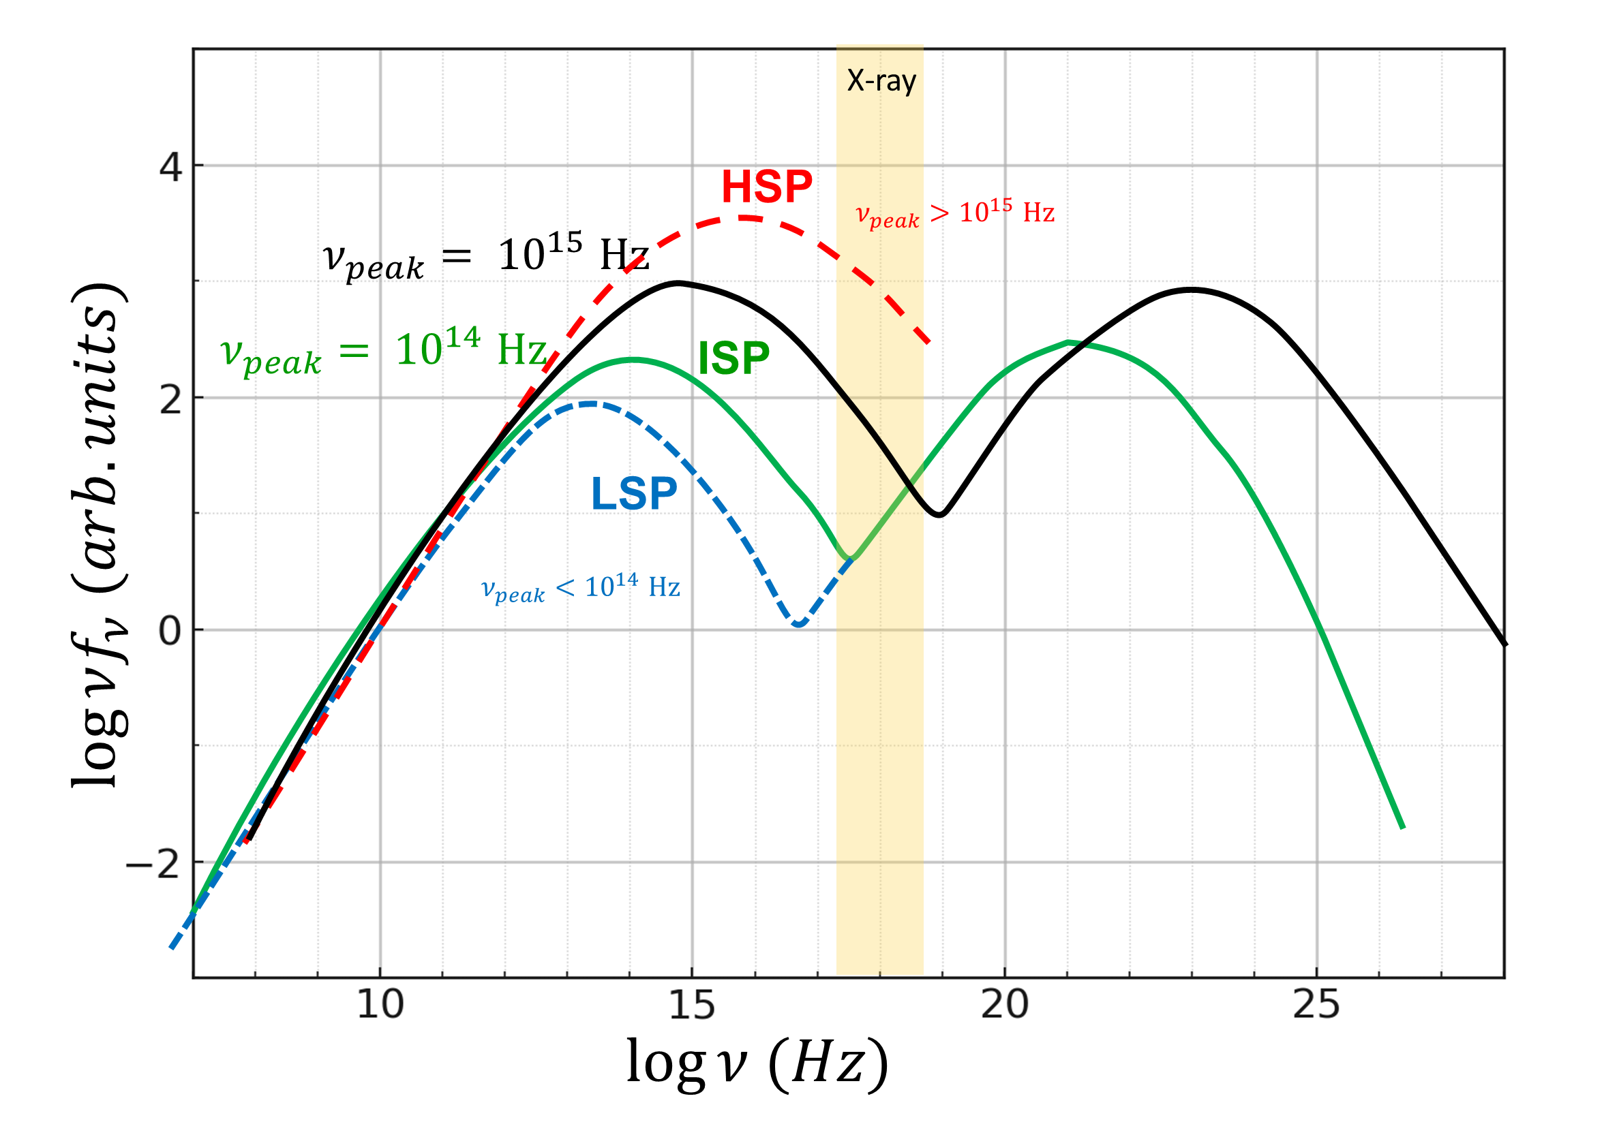
Blazars: Classification High-synchrotron-peaked (HSP) Blazars

Slide 7
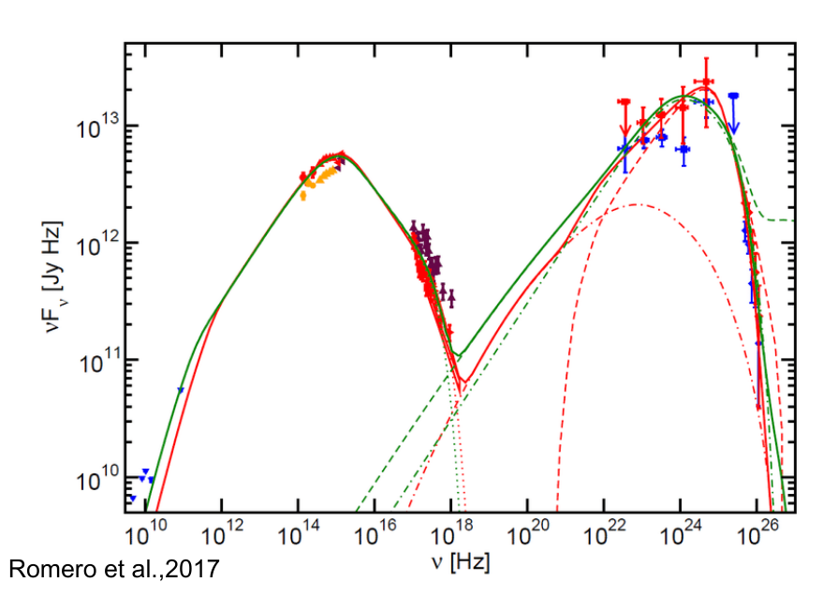
Blazars: Emission Mechanisms High-Energy Component
What are the dominant processes responsible for the high-energy emission in blazars?

Slide 8

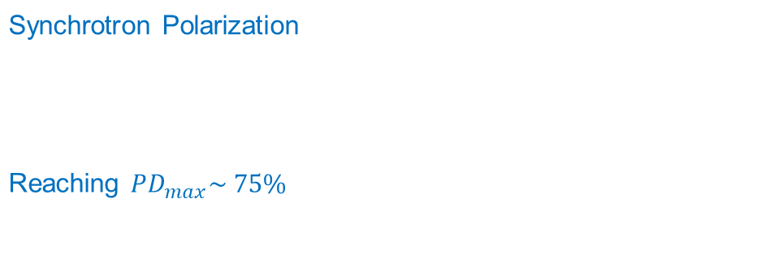
Blazars: Emission Mechanisms
Synchrotron Polarization
For Synchrotron photons scattering off electrons with n_{e} (γ) ~ γ^{-p}
Reaching $PD_{max}\sim 75\%$ In ordered magnetic fields
What are the dominant processes responsible for the high-energy emission in blazars?

Slide 9
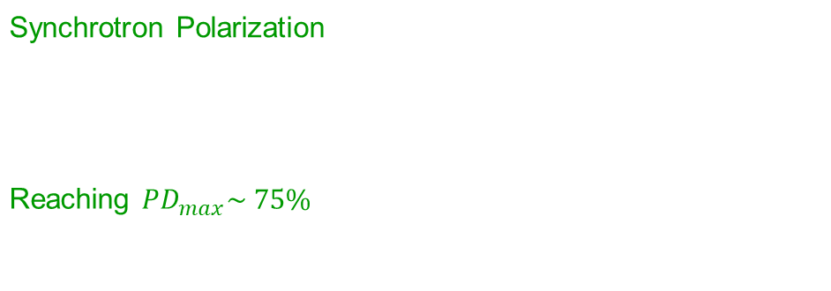
Blazars: Emission Mechanisms High-Energy Component
Synchrotron Polarization
For Synchrotron photons scattering off electrons with n_{e} (γ) ~ γ^{-p}
Reaching $PD_{max}\sim 75\%$ In ordered magnetic fields
What are the dominant processes responsible for the high-energy emission in blazars?

Slide 10
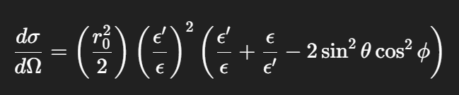
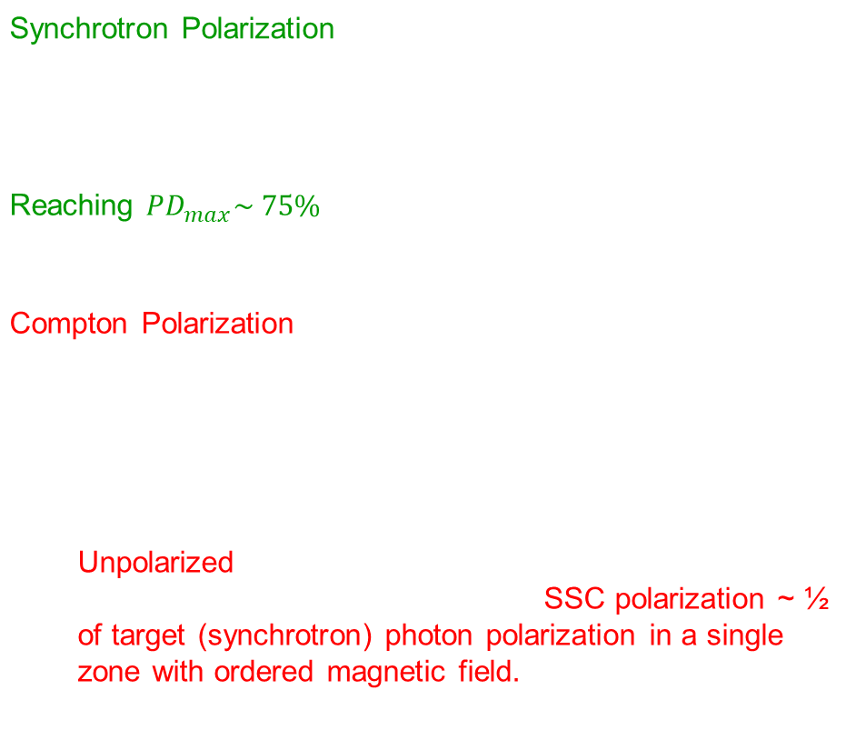
Blazars: Emission Mechanisms High-Energy Component
Synchrotron Polarization
For Synchrotron photons scattering off electrons with n_{e} (γ) ~ γ^{-p}
Reaching $PD_{max}\sim 75\%$ In ordered magnetic fields
Compton Polarization
Preferred polarization direction is preserved.
Unpolarized target photons (EC emission) → Unpolarized Polarized target photons (SSC) → SSC polarization ~ ½ of target (synchrotron) photon polarization in a single zone with ordered magnetic field.
What are the dominant processes responsible for the high-energy emission in blazars?

Slide 11
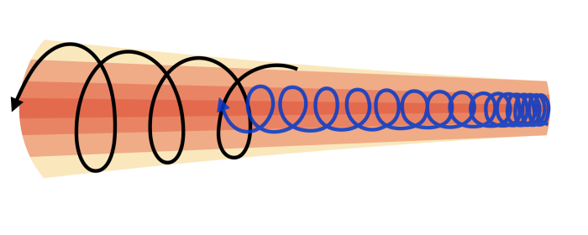
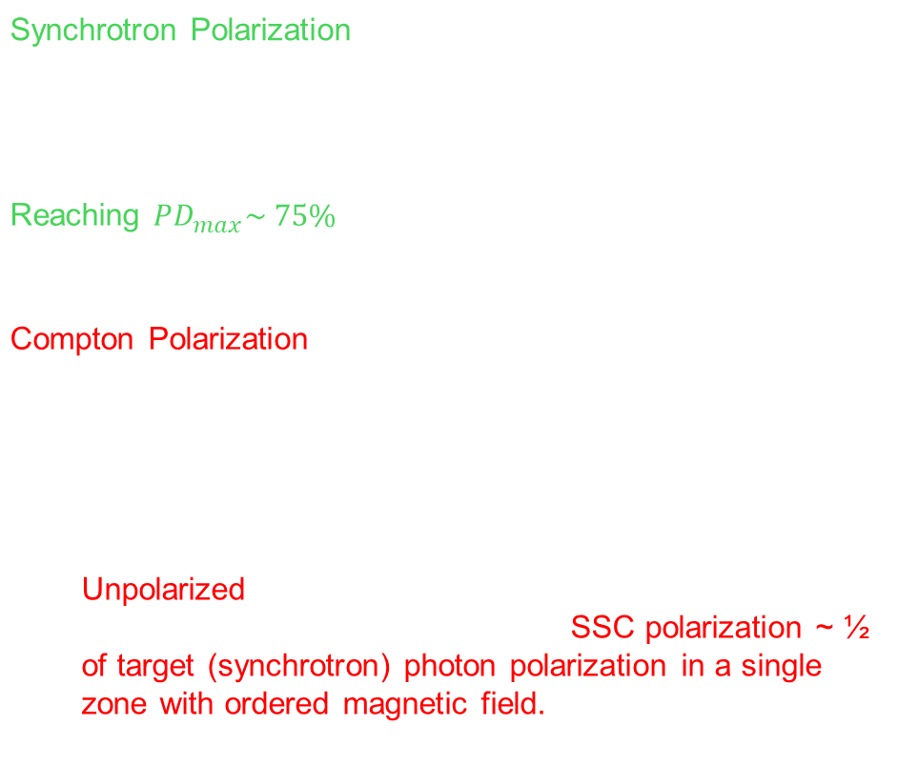
Blazars: Emission Mechanisms High-Energy Component
Synchrotron Polarization
For Synchrotron photons scattering off electrons with n_{e} (γ) ~ γ^{-p}
Reaching $PD_{max}\sim 75\%$ In ordered magnetic fields
Compton Polarization
Preferred polarization direction is preserved.
Unpolarized target photons (EC emission) → Unpolarized Polarized target photons (SSC) → SSC polarization ~ ½ of target (synchrotron) photon polarization in a single zone with ordered magnetic field.
Schematic diagram of double helical magnetic field components inside the jet; from Kim et al., 2023

Slide 12

Blazars: Emission Mechanisms High-Energy Component
Multizone Models
Partially ordered magnetic fields
→ The seed photons arrive from different regions with different magnetic field orientations
Schematic diagram of double helical magnetic field components inside the jet; from Kim et al., 2023
$$ΠSSC=50\%\frac{1}{N^{5/6}}Π_{max}$$
Peirson & Romani 2019;
Zhang et al. 2024

Slide 13


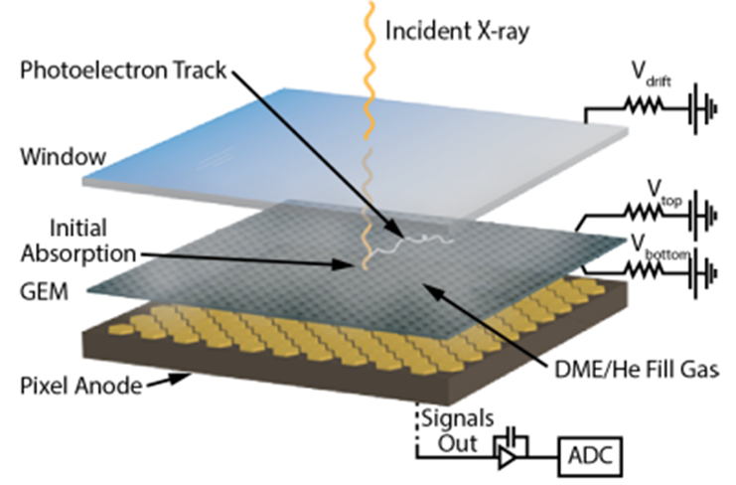
Imaging X-ray Polarimetry Explorer (IXPE)
  Measures the energy, arrival time, and polarization of X-ray photons
  2 - 4 keV range
December 9, 2021
2000
1970
  Black Holes
  Neutron Stars
  Supernova Remnants
  Active Galactic Nuclei and Quasars (Blazars)
  Pulsar Wind Nebulae
1960

Slide 14
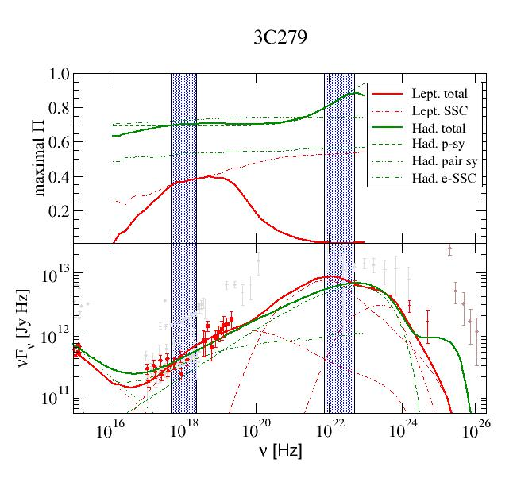
Blazars: Emission Mechanisms High-Energy Component
Expected X-ray and gamma-ray polarization signatures
LSP Blazars
Synchrotron dominated → High polarization degrees, generally increasing with energy. → SSC contribution in X-rays
X-rays are SSC-dominated → Polarization degrees ~ (20 – 40) % γ-rays are EC-dominated. → Negligible polarization Polarization decreases with energy.
Hadronic
Leptonic
Zhang & Bӧttcher, 2013

Slide 15
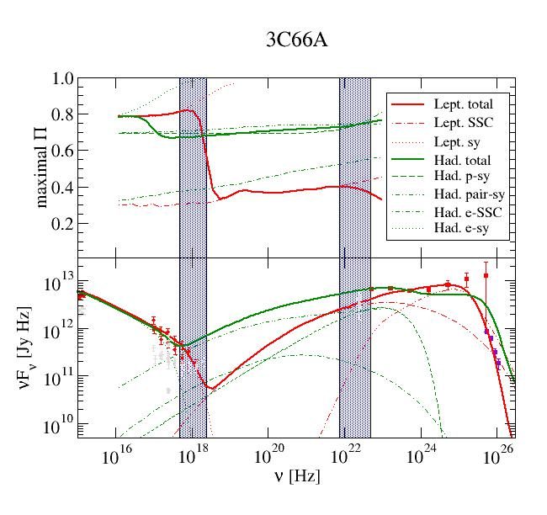
Blazars: Emission Mechanisms High-Energy Component
Expected X-ray and gamma-ray polarization signatures
LSP Blazars | ISP Blazars
Synchrotron dominated → High polarization degrees, generally increasing with energy. → SSC contribution in X-rays | Synchrotron dominated → High polarization degrees, throughout X-rays and γ-rays
X-rays are SSC-dominated → Polarization degrees ~ (20 – 40) % γ-rays are EC-dominated. → Negligible polarization Polarization decreases with energy. | X-rays are Synchrotron-dominated γ-rays are SSC/EC-dominated. → High polarization degrees, rapidly decreasing with energy.
Hadronic
Leptonic
Zhang & Bӧttcher, 2013

Slide 16
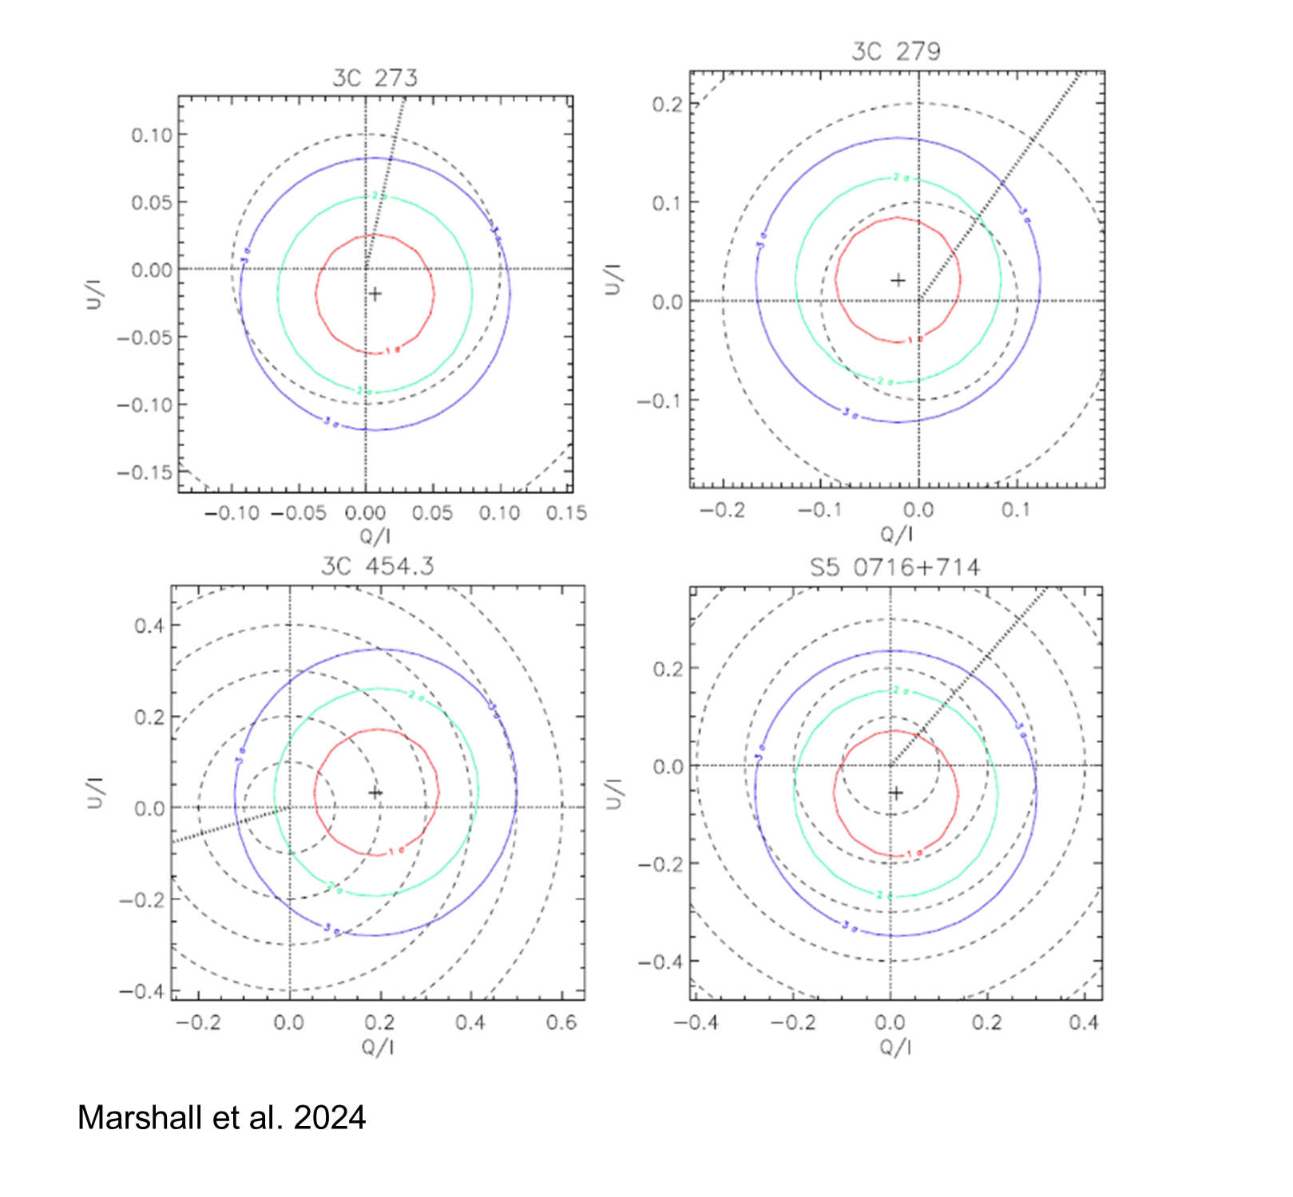
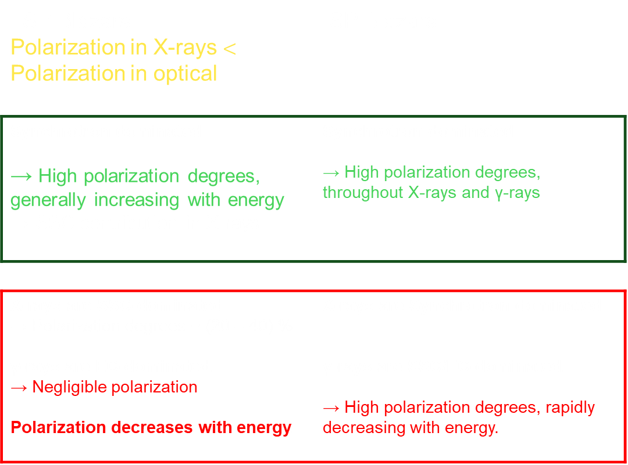
Blazars: Emission Mechanisms High-Energy Component
Results of IXPE Observations
LSP Blazars Polarization in X-rays $<$ Polarization in optical | ISP Blazars
Synchrotron dominated → High polarization degrees, generally increasing with energy. → SSC contribution in X-rays | Synchrotron dominated → High polarization degrees, throughout X-rays and γ-rays
X-rays are SSC-dominated → Polarization degrees ~ (20 – 40) % γ-rays are EC-dominated. → Negligible polarization Polarization decreases with energy. | X-rays are Synchrotron-dominated γ-rays are SSC/EC-dominated. → High polarization degrees, rapidly decreasing with energy.
⇒ Leptonic (SSC/EC) X-ray emission

Slide 17
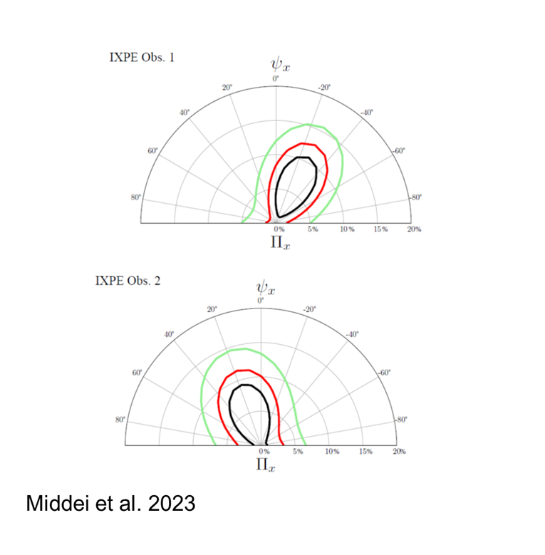
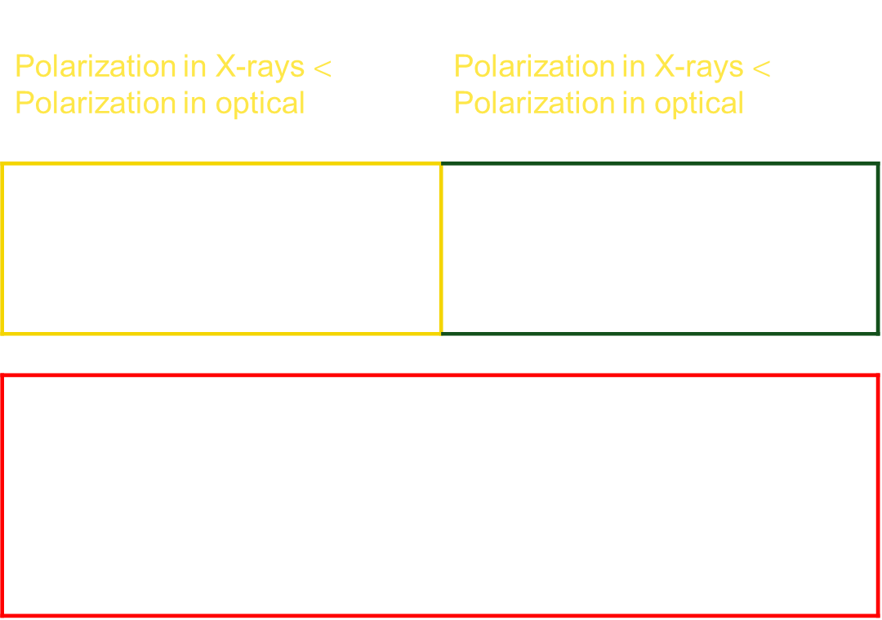
Blazars: Emission Mechanisms High-Energy Component
Results of IXPE Observations
LSP Blazars Polarization in X-rays $<$ Polarization in optical | BL Lacartae Polarization in X-rays $<$ Polarization in optical
 | Synchrotron dominated → High polarization degrees, throughout X-rays and γ-rays
X-rays are SSC-dominated → Polarization degrees ~ (20 – 40) % γ-rays are EC-dominated. → Negligible polarization Polarization decreases with energy. | X-rays are Synchrotron-dominated γ-rays are SSC/EC-dominated. → High polarization degrees, rapidly decreasing with energy.
⇒ Leptonic (SSC/EC) X-ray emission
⇒ Leptonic (SSC) X-ray emission
The IXPE Observations of LBL/IBL Blazars are consistent with the leptonic model predictions

Slide 18
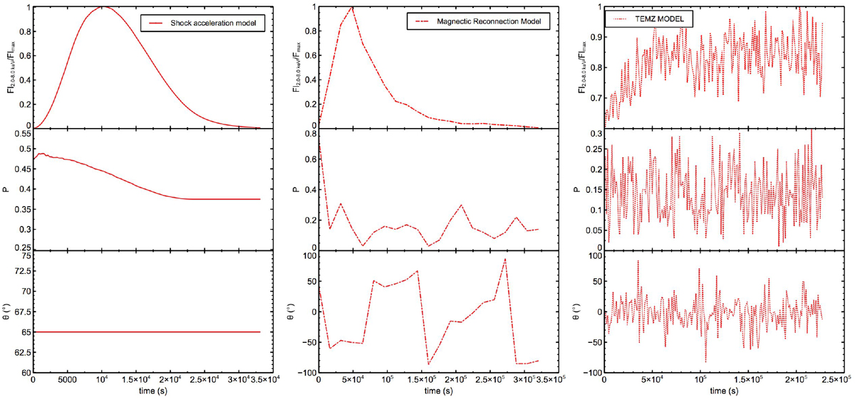
Blazars: Emission Mechanisms & Particle Acceleration
Polarization predictions for the mode of acceleration
Shock Acceleration | Magnetic Reconnection | TEMZ (Turbulence)
Predicts a significant (~40%), quasi-constant polarization degree and constant polarization angle.
Expect a lower polarization degree (below ~20%), with both the polarization degree and angle modulated with time.
Predicts rapid variability in both polarization degree and angle, with turbulence lowering the overall polarization degree.
Fl
Gesu et al., 2022 A&A 662, A83

Slide 19
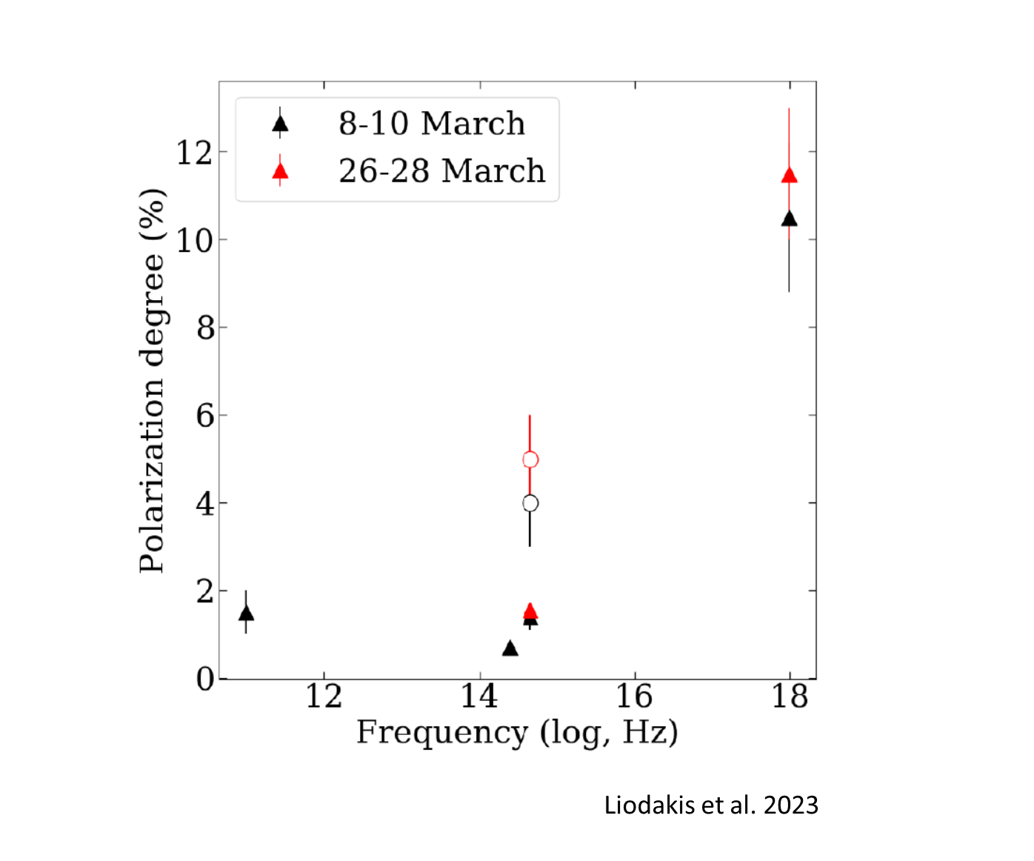
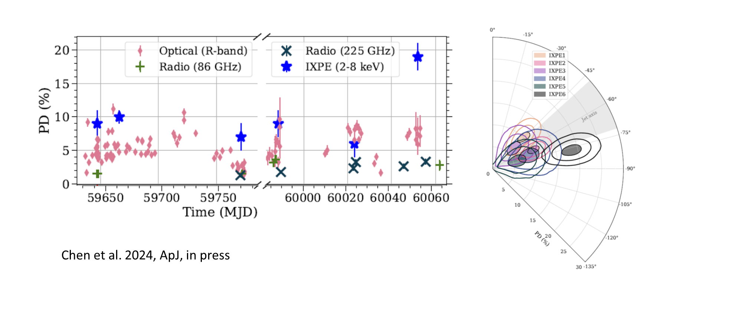
Blazars: Emission Mechanisms & Particle Acceleration
Results of IXPE Observations: HSP Blazars
Fl

Slide 20

Blazars: Emission Mechanisms & Particle Acceleration
Results of IXPE Observations: HSP Blazars
Fl
X-ray polarization degree of 10-11%, about 2 times higher than optical measurements. The polarization angle is consistent with the radio jet direction | $⇒$ X-ray emission dominated by electron synchrotron $⇒$ Support for particle acceleration in a small, localized region with well-ordered magnetic field (e.g., shock).

Slide 21
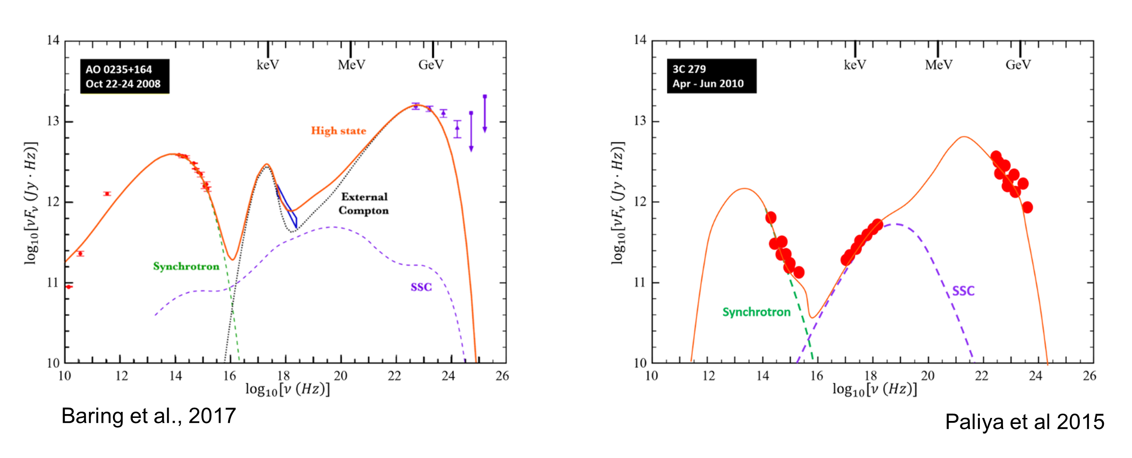
Blazars: Emission Mechanisms Big Blue Bump
Accretion disk + Corona?
→ Unpolarized
Additional synchrotron component?
→ Moderately polarized
Bulk Compton scattering of external radiation field by thermal electrons (Sikora et al. 1994)
→ Potentially highly polarized
In Baring et al. (2017: MNRAS, 464, 4875):
Self-consistent thermal + non-thermal electron distributions from diffusive shock acceleration (Summerlin & Baring 2012)
BBB results from the thermal electrons' Comptonization of the external (dust torus) radiation field.
Tight constraints on plasma parameters (total density, magnetization, …)

Slide 22
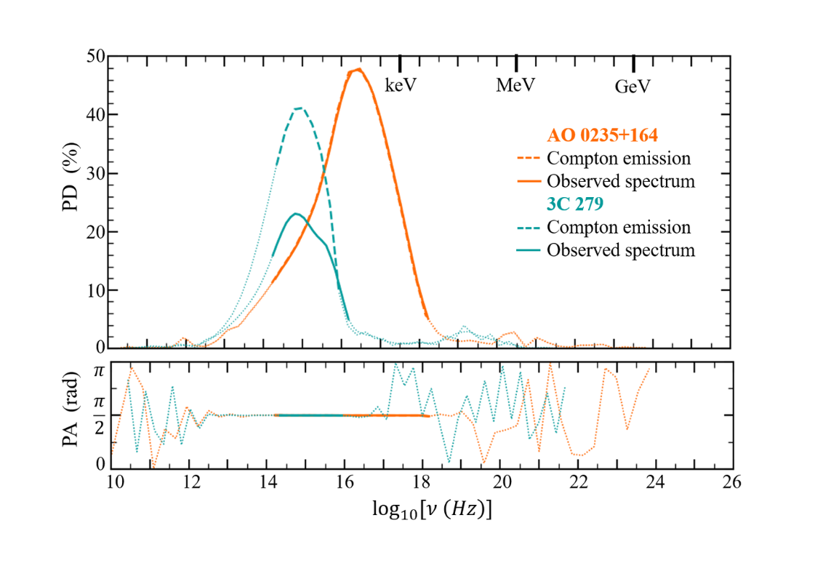
Blazars: Emission Mechanisms Big Blue Bump
IXPE may be able to detect the Compton polarization of the UV/soft X-ray excess in the SEDs of AO 0235+164 and 3C 279
In Baring et al. (2017: MNRAS, 464, 4875):
Self-consistent thermal + non-thermal electron distributions from diffusive shock acceleration (Summerlin & Baring 2012)
BBB results from the thermal electrons' Comptonization of the external (dust torus) radiation field.
Tight constraints on plasma parameters (total density, magnetization, …)

Slide 23
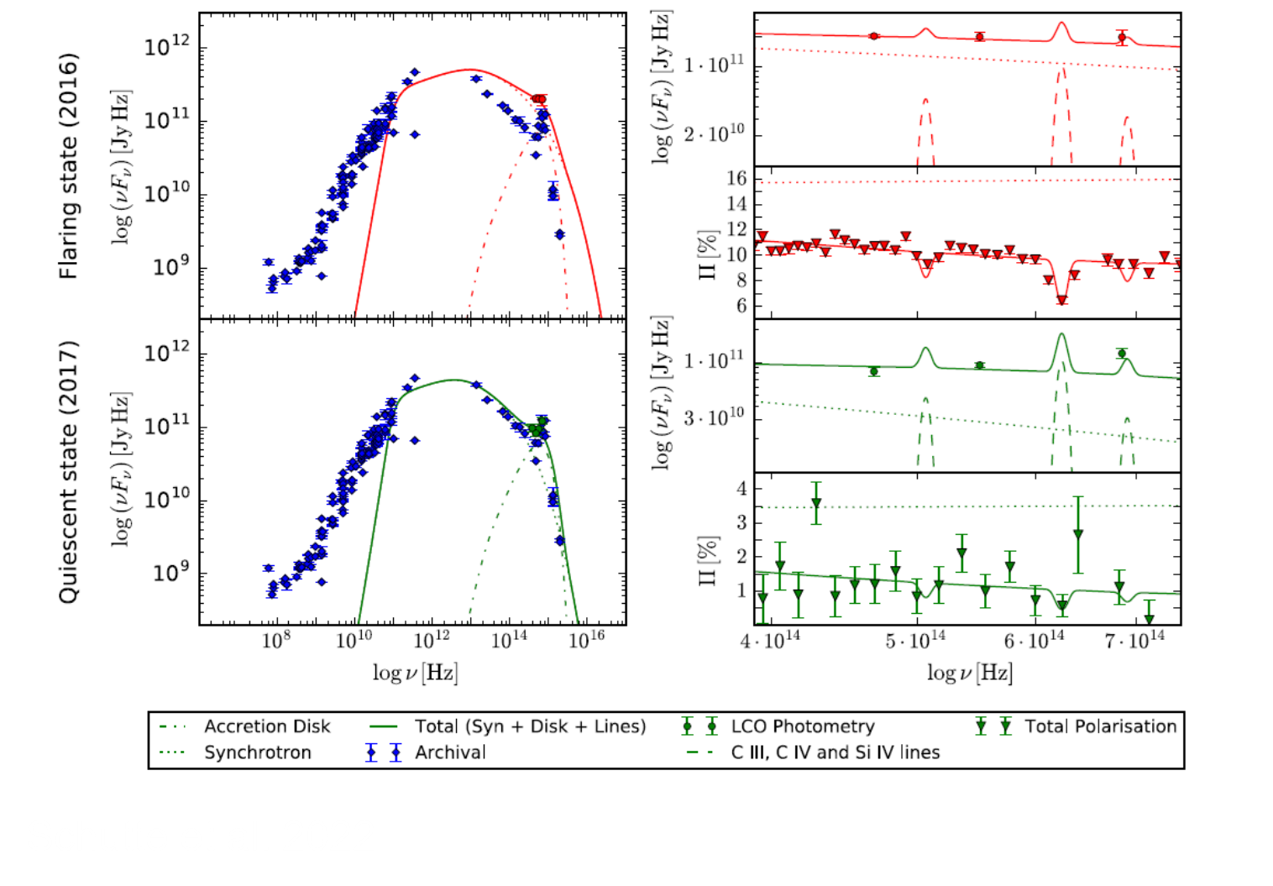
Spectropolarimetry of FSRQ-type blazars
Optical Spectropolarimetry separates jet Synchrotron from accretion-disk emission
→ Constrain Black Hole mass

Slide 24
Spectropolarimetry of FSRQ-type blazars
Optical Spectropolarimetry separates jet Synchrotron from accretion-disk emission
→ Constrain Black Hole mass
The sudden disappearance of the jet synchrotron + Fermi-LAT GeV γ-rays components in July 2021; X-rays and VHE γ-rays almost unchanged
Optical emission consistent with accretion disk only
Strong preference for two-zone model
Aharonian et al. 2023

Slide 25
Summary
XPE has revolutionized high-energy polarimetry, enabling detailed studies of blazar jets and their emission mechanisms.
The findings from IXPE observations of different blazar classes have provided valuable insights into the dominant emission processes in these sources.
Future studies with IXPE and upcoming missions will continue to refine our understanding of blazar jets, their magnetic field configurations, and the physical processes driving their extreme high-energy emission; including different spectral features, such as the Big Blue Bump.
Multizone models incorporating the latest polarization data will be crucial for unraveling the complex interplay of magnetic fields, particle acceleration, and emission mechanisms in blazar jets.

