Slide 1
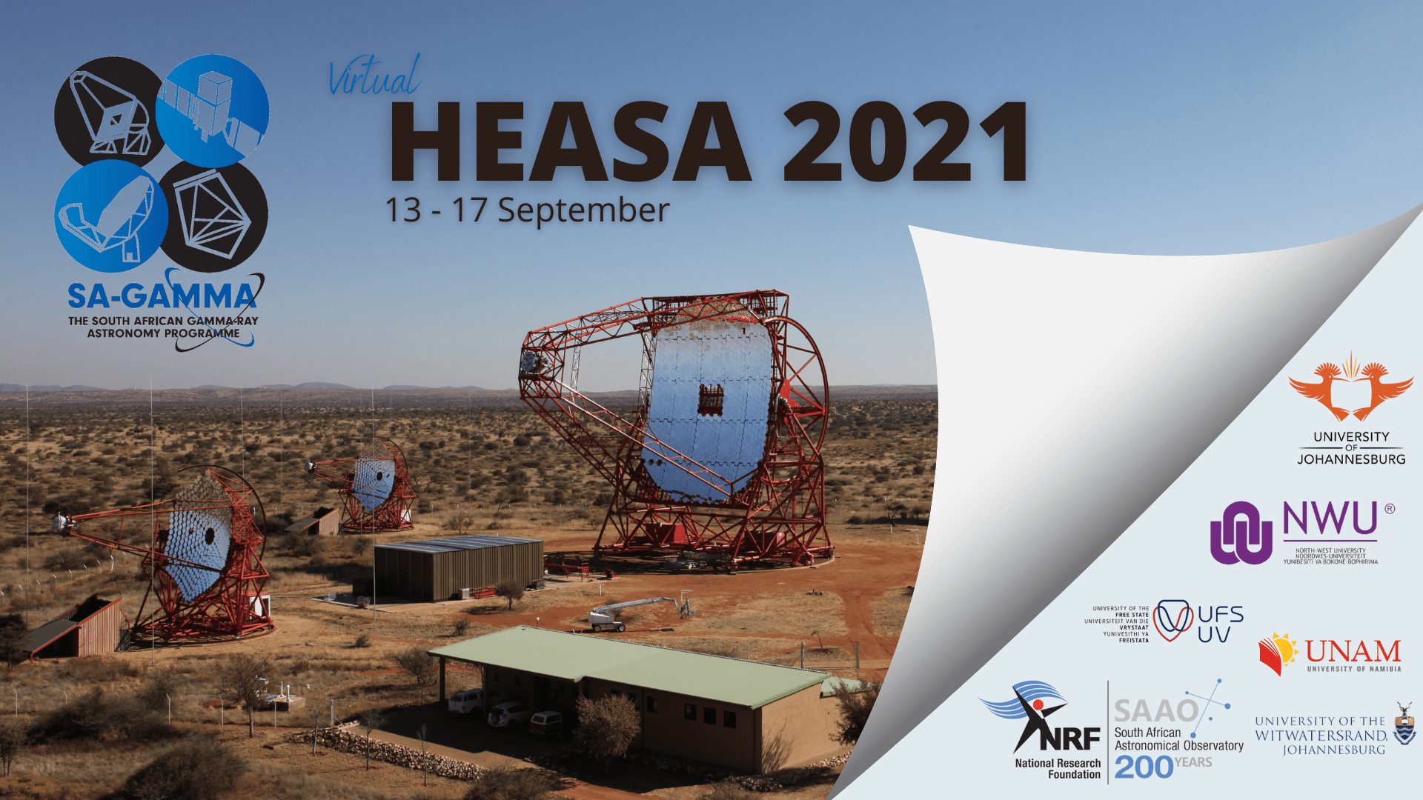
Welcome to
0
Markus Böttcher
North-West University
Potchefstroom, South Africa
Chair of SA-GAMMA

Slide 2
8th edition of “High Energy Astrophysics in Southern Africa”
Largest HEASA conference ever:
115 registered participants
31 international participants (incl. 11 invited speakers)
Originally planned to be held Sept. 2020 in Bloemfontein, but postponed and converted to virtual due to COVID-19.

Slide 3
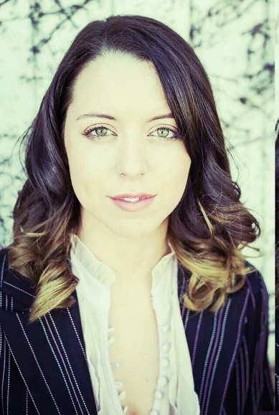
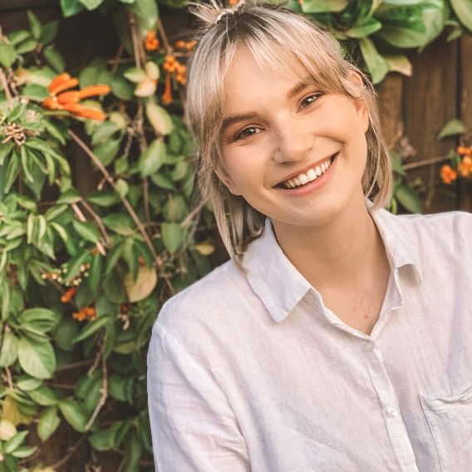
Special thanks for help with the organisation and technical support:
Lenté Dreyer (NWU)
Anna Samara Larmuth (UJ)

Slide 4

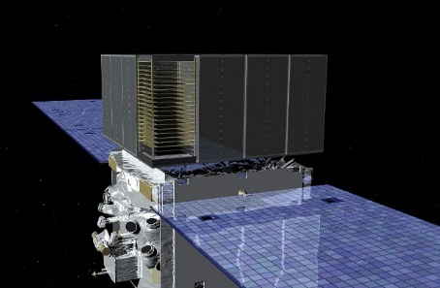
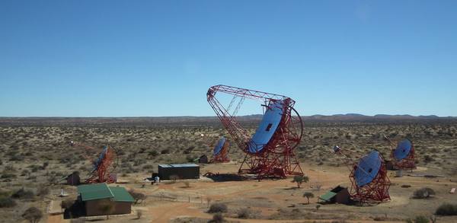
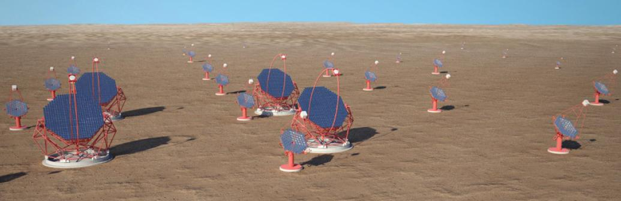
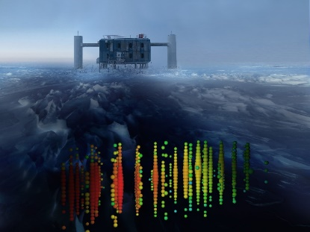
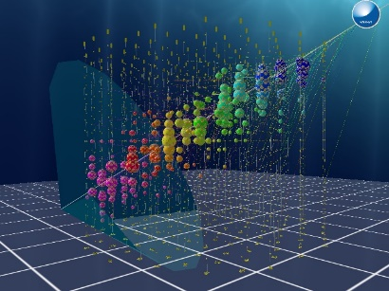


The South African Gamma-Ray Astronomy Programme (SA-GAMMA)
Coordinating research activities and funding
needs for gamma-ray astronomy in South Africa
and Namibia
H.E.S.S.
CTA
Fermi
IceCube, KM3NeT
23 permanent staff scientists,
11 postdocs, 27 Ph.D. students, 35 M.Sc. Students
at 6 institutions:
Fermi
H.E.S.S.
CTA
IceCube
Km3NeT

Slide 5

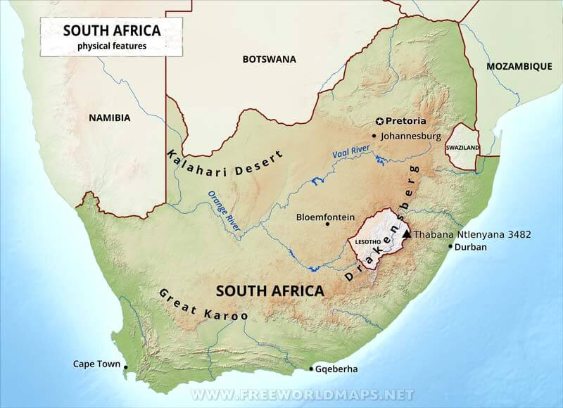





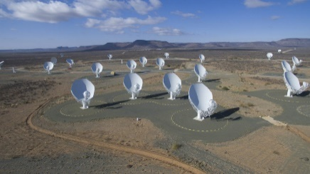

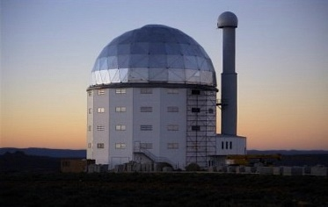

SA-GAMMA Consortium
Windhoek
H.E.S.S.
Potchefstroom
MeerKAT
SALT

Slide 6

SA-GAMMA
Funded by DSI through the NRF at approx. ZAR 4M per year
Thank you!

