Slide 1






Single event effect study on LGAD: Present status and prospects of femtosecond laser studies at ELI
Gordana Lastovicka-Medin
University of Montenegro
Gregor Kramberger
Jozef Stefan Institute
Mateusz Rebarz, Jakob Andreasson, Kamil Kropielniczki
ELI Beamlines
Jiří Kroll, Michal Tomášek, Tomáš Laštovička
Institute of Physics, Academy of Sciences, CZ
Valentina Sola, Nicolo Cartiglia
INFN Torino
PSD12: The 12th International Conference on Position Sensitive Detectors
Sep 12 – 17, 2021 University of Birmingham

Slide 2
Outline
Motivation
Mortality Hypotheses
Fs-Laser induced SEB (motivation/benefits/opportunities)
Results from the Femtosecond Laser Studies of LGAD mortality at ELI Beamlines
  Stability, Instability and irreversible breakdown (HV, Laser power) threshold (TCT-SPA)
  Probing the SEB Sensitive Depth of LGAD (TCT-TPA)
Lessons learnt, steps forward/prospect/upgrades

Slide 3
Quick introduction: LGADs breaking down at high V_{bias}
Destructive breakdowns appear mostly in the test beams (TB) – not observed in the laboratory setups (Sr90, probe stations)
Destructive breakdowns (fatalities) appear at bias voltages that are significantly (50 -100V) lower than those in the lab.
They appear suddenly without a clear warning (increase of leakage current, instability in leakage current, changes in gain.
There are indications that fatalities are beam related and not linked to the environmental conditions;
The tested reasons/hypotheses for these breakdowns:
  Is it the high electrics field in highly irradiated sensors that is the problem?
  Is it the gain of the devices that plays a role? Thickness?
  Is it the irradiations that are the reason, or they merely facilitate the conditions where high bias voltages can be applied?
The main difference between lab (Sr-90 with E_{max}=2.3 MeV) and TB (up to several tens MeV deposits – CMS paper) is the energy of the particles:
  Can huge amount of charge in a single collision cause a conditions that lead to a destructive breakdown?
  Ref/CMS paper: Mika Huhtinen, Highly ionising events in silicon detectors, CMS Note, March 2002

Slide 4
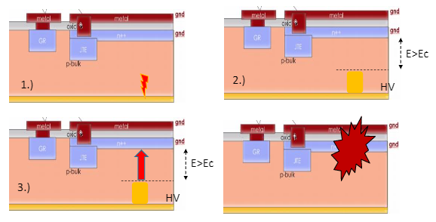
A possible explanation
1.) larger deposition of the charge (fragments producing deposition in few
um as large as 1000 mips- (CMS tracker paper ) in few um (not possible with lab sources)
2.)larger density of carriers leading to collapse of the field (screening prevents
the carriers from being swept away)
3.) once the field collapses the HV is brought closer to the pad which leads to
very high field strength leading to avalanche breakdown and full discharge of sensors and bias capacitor

Slide 5
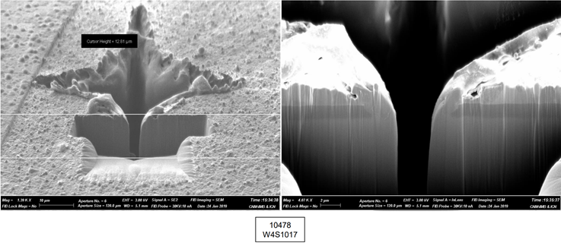
Fatality signature at the beam-tests: CNM LGAD burnout study (2019)
courtesy of CNM (ATLAS TB sensor)
https//agenda.infn.it/event/25712/contributions/129401/attachments/78738/101896/20210203_Lgad_Burn_Issues_v1.pdf

Slide 6
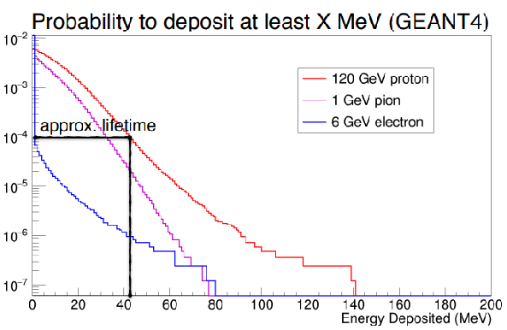
Proposed death mechanism slide courtesy of Ryan Heller
Rare, large ionization event “Highly Ionizing Particle”
  Excess charge leads to highly localized conductive path
  Large current in narrow path→ “Single Event Burnout”
Estimate 40-50 MeV deposit needed
  Rare, but possible in DESY 6 GeV electron beam (has been observed)
  Common at LHC
Some ability to model in TCAD, but not really “predictive” so far
Rayen Hellr (on behalf of CMS) , Studies of LGAD mortality using the Fermilab Test Beam, 48th CERN RD50 Workshop, June 2021

Slide 7
Femtosecond laser induced SEE/SEB event
Hypotheses: If the speed of deposition is similar to MIP then the laser test with extremely short and high laser energy per pulse should lead to LGAD fatalities.
Laser excitation of diodes is always a controlled way to excite those
devices (biased as detectors).
Electrical excitation is not appropriate because the non-intentional avalanches, in short, the single event burnout phenomenology, has to be excited from the bulk if we want to research the mechanisms.
Field edge effects are always important but mainly because the internal electric field is always bigger around edges. Those field edge effects are contemplated during the device design phase or the device would never be biased.
SEB induced by fs-laser using front and backside illumination and probing the SEB sensitive depth in LGAD would bring a new insight, not possible by beam tests.

Slide 8
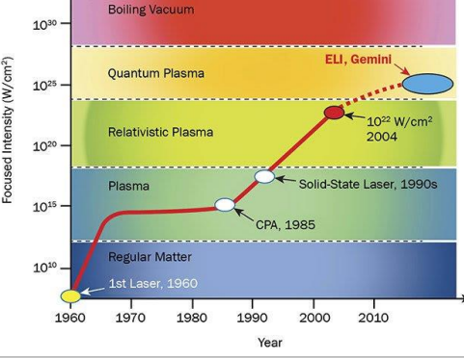

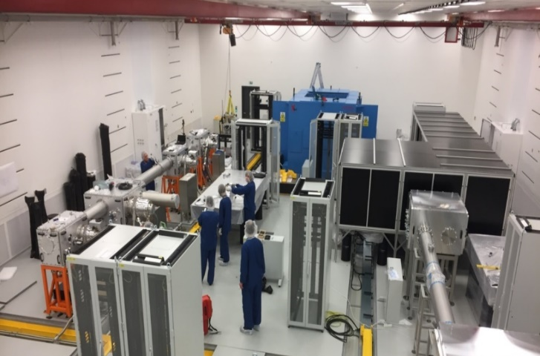
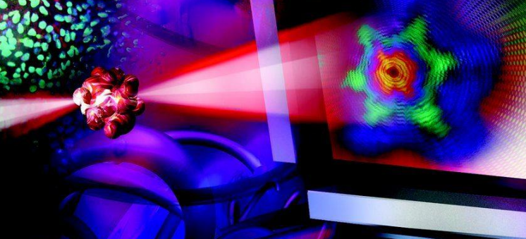
Laser Facility: ELI Beamlines
Czech Republic
Dolní Břežany (on the outskirts of Prague)
www.eli-beams.eu
Experimental hall E1
Research program: Bio and Material Applications
TCT
Project supported by: Advanced research using high intensity laser produced photons and particles (ADONIS) Reg. n.: CZ.02.1.01/0.0/0.0/16_019/0000789

Slide 9
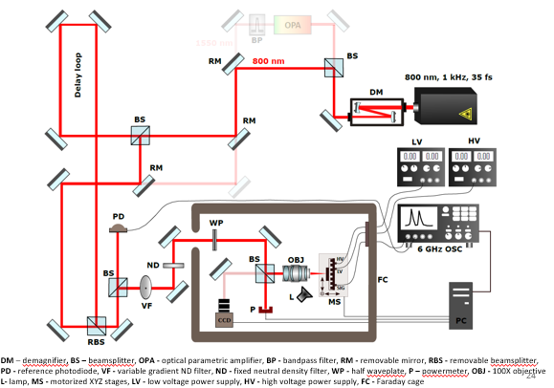
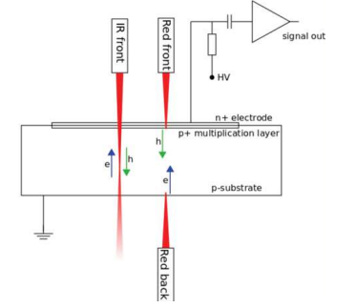
1. LGAD Mortality study with fs- TCT-SPA
Laser conditions:
λ = 800 nm (beam focused in the center of pad)
d = 1.7 μm
w₀= 0.85 um, Z_{R} = 3.31 um
Cooling temperature: -25 °C
Laser power/energy range
1-50 nW (1-50 pJ)
Tests uses 800 nm (27 μm penetration) of 50 fs pulses with pulse of up to a 1 mJ. Pulses are focused to dimensions similar that of mip deposition (1-2 μm cone)
Schematic working principle of front/back TCT illumination of a silicon sensor and the charge carrier generation

Slide 10
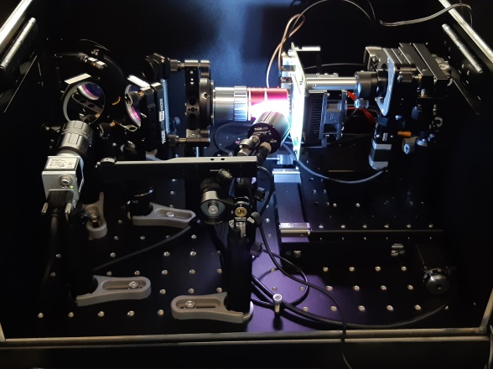
TCT set-up

Slide 11
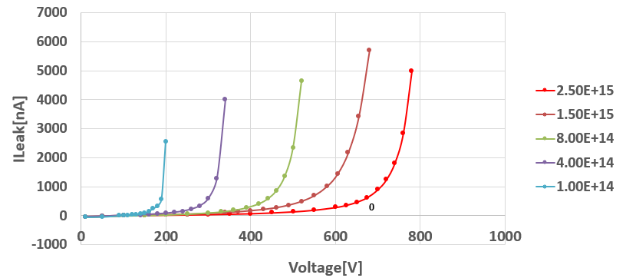
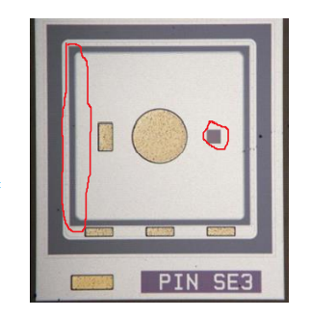
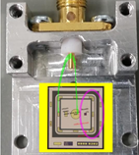
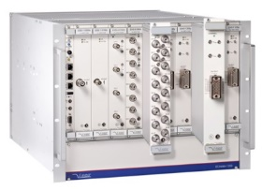
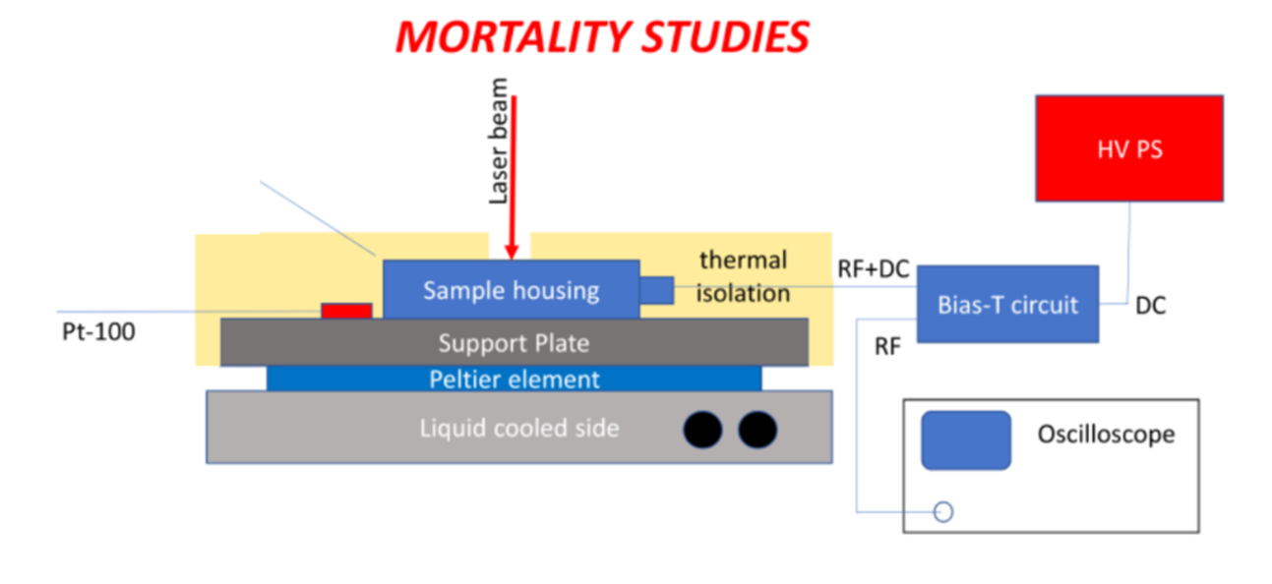
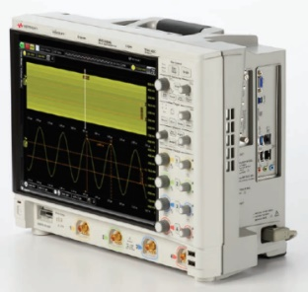
Samples and readout
The samples are from HPK-P2 run, the latest ATLAS/CMS LGAD fabrication (shown in many talk in the workshop)
  W36 (Vgl~51.5 V, Vbd~220 V) (with Boron; no C enrichment)
  I Exp: : (0.4, 0.8, 1.5, 2.5)e15 cm⁻²
  II Exp:: fluences covered are the ones of interest for ATLAS & CMS: 1.5e15, 2.5e15 cm⁻²
Measurements by Sr-90 at JSI
Closed circuit chiller T=-25C
N2 flushed to avoid condensation.
No active amplifier used-we want large signals.
Bias-T used to prevent discharge into oscilloscope
No other bias filtering used
Oscilloscope
HV power supply: EB1200305040000200 (Iseg)
6 GHz (Keysight Infinium)
DSOS604A

Slide 12
Procedure Explained
feseability study
2. systematic study aiming to establish stable, instable and irreversible breakdown (HV, Laser power) threshold
  Starting with low pulse energy 1 pJ the bias was increasing from 100 V to 650 V (later this limit was extended to 670 V) whereas the signal was observed on the oscilloscope (waveforms were recorded) and the leak current was monitored.
  This procedure was repeated for increasing pulse energies with 5 pJ step until 50 pJ; 5 pJ would correspond to 5 M e-h pairs
  For every scan we searched for the first symptoms of instability in the signal. When the signal started slightly “jumping”, we noted the values of energy and bias as "stability threshold“
  After reaching the threshold the bias was further increased (to 670 V) to explore "unstable region" as long as the signal can be safely measured by the scope.
  When the signal was high and significantly deformed the scope was disconnected and only leak current was observed with increasing bias.
  In the end the energy was set at 50 pJ and the bias was increased until the breakdown of the sensor

Slide 13
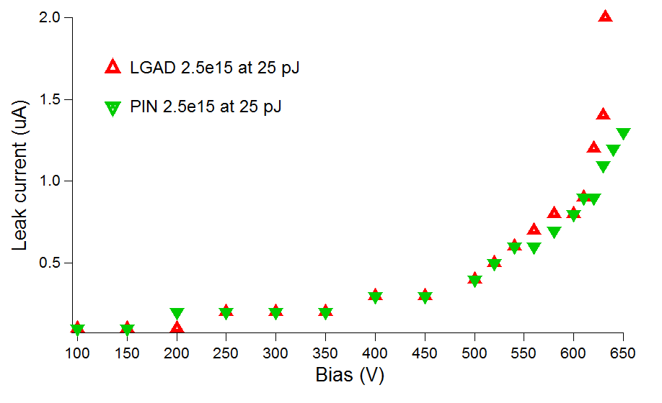
Measurements
Leakage current
The leakage current was recorded for different bias values.
Nearly identical dependency was observed for all the samples at low illumination level. The small differences between LGADs and PINs appears only for higher laser power (see example below).
Above stability threshold the current is jumpy and it's not possible to define the value.

Slide 14
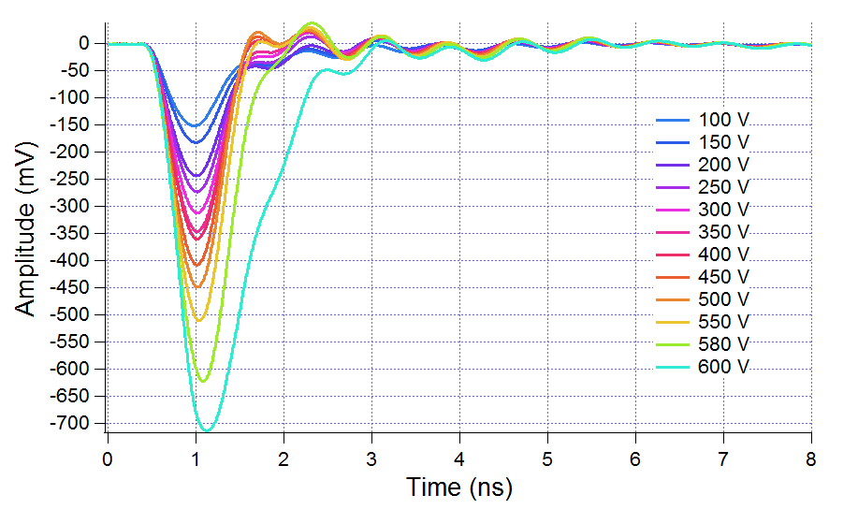
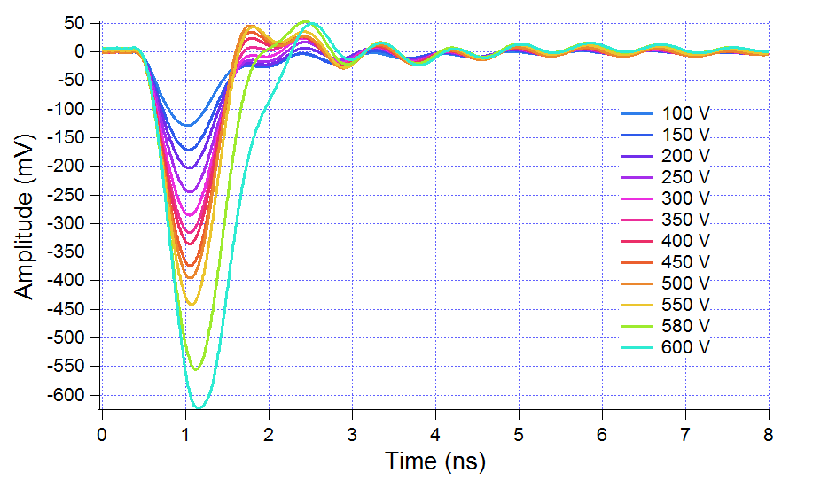
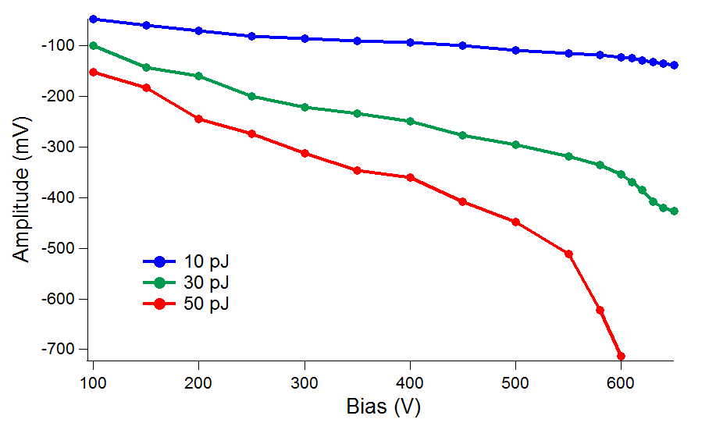
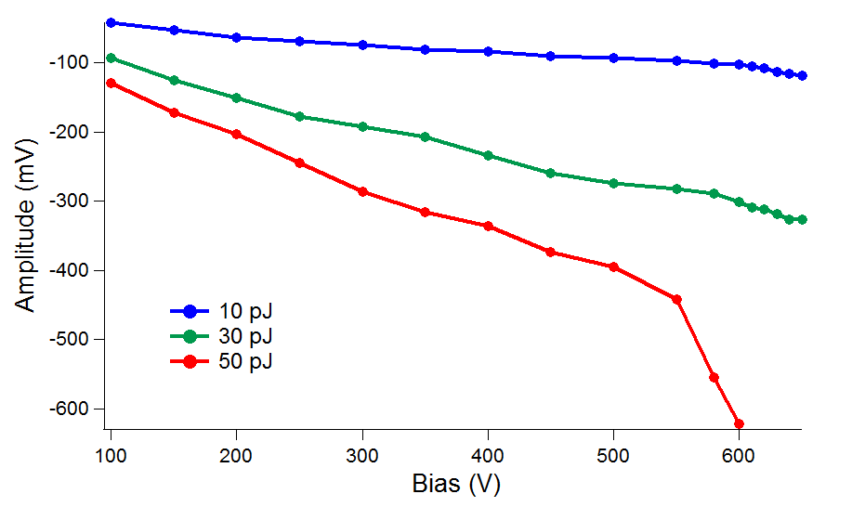
Waveform examples
LGAD 2.5e15 at 50 pJ
PIN 2.5e15 at 50 pJ
No significant different was observed between irradiated LGADs and PINs.

Slide 15
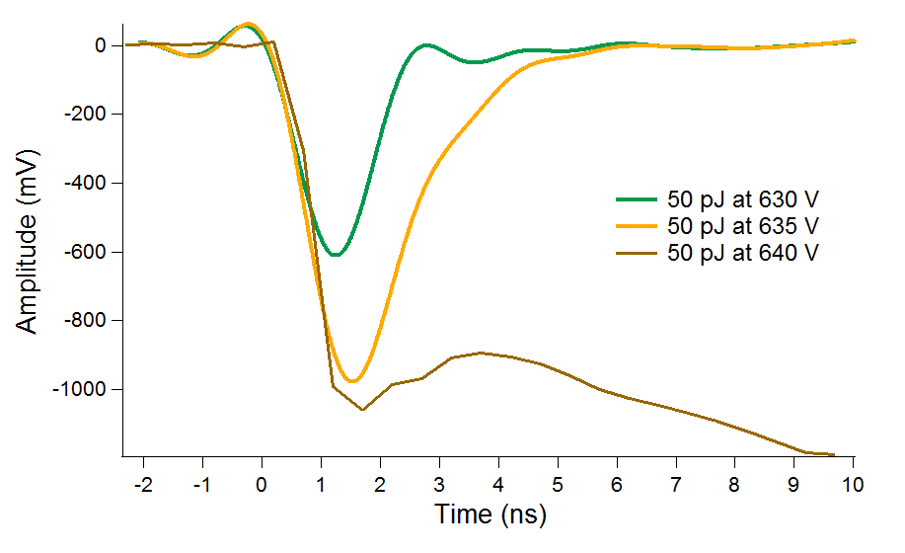
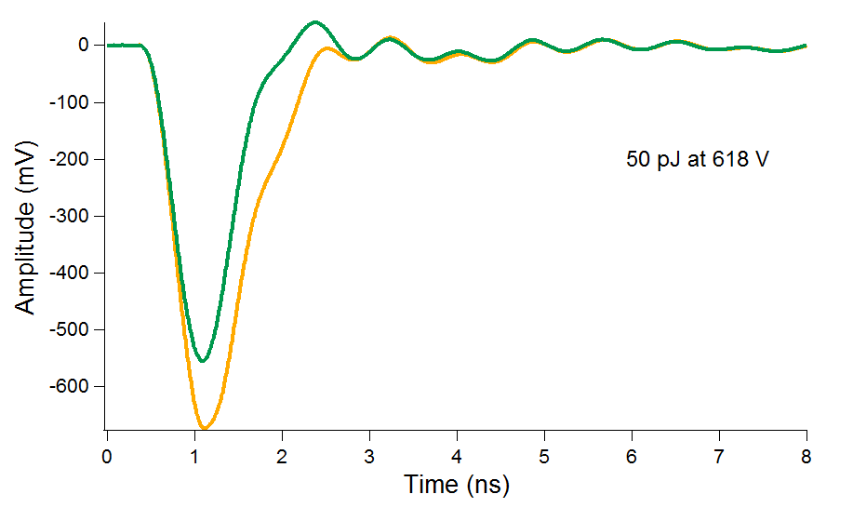
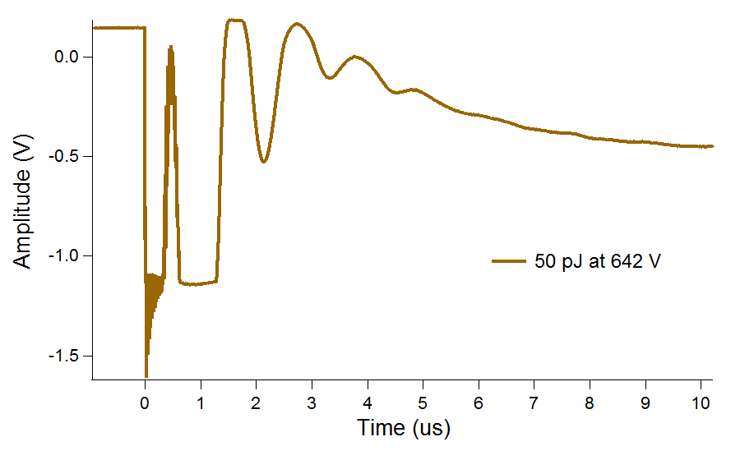
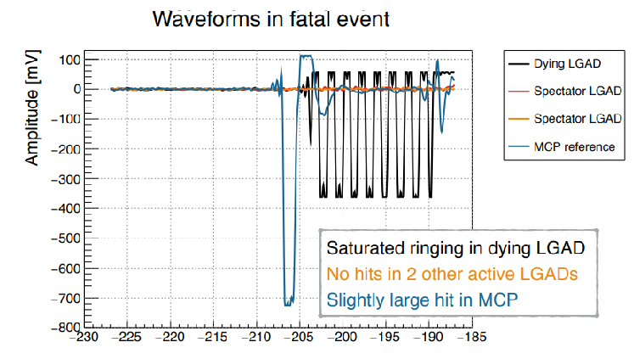
Stable/unstable and irreversible breakdown behaviour: Examples of waveforms
Unstable condition
Stable condition
For comparison:
Fermilab/Example of death event
Next to the irreversible breakdown
Ryan Heller, Studies of LGAD mortality using the Fermilab Test Beam 38th RD50 Workshop

Slide 16
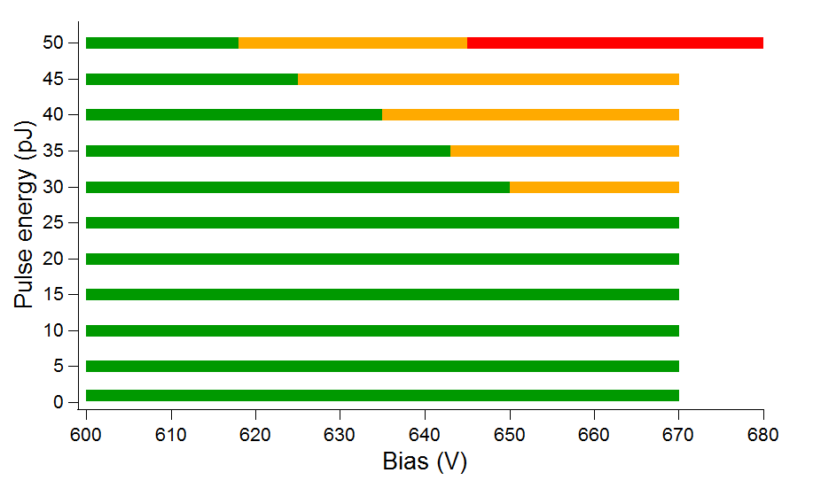
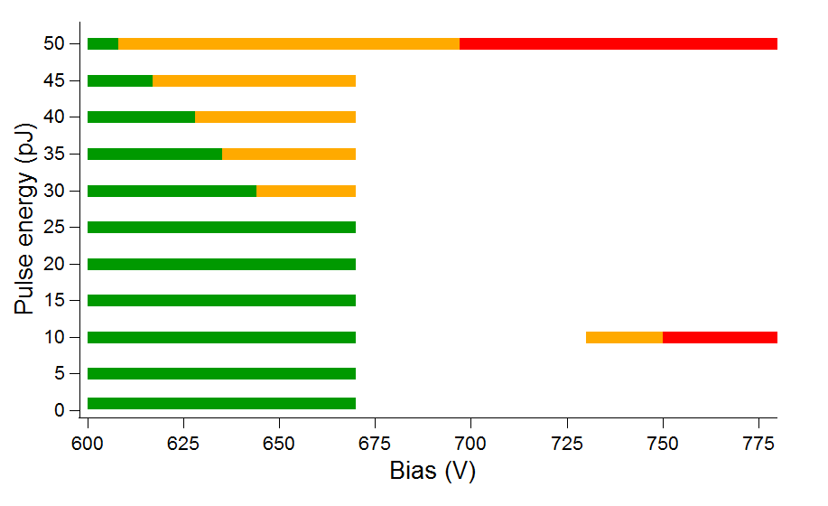
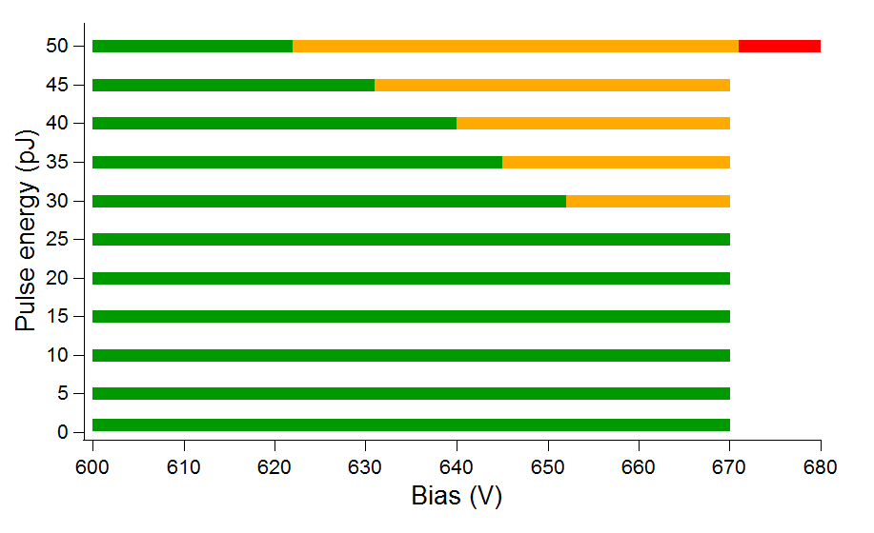
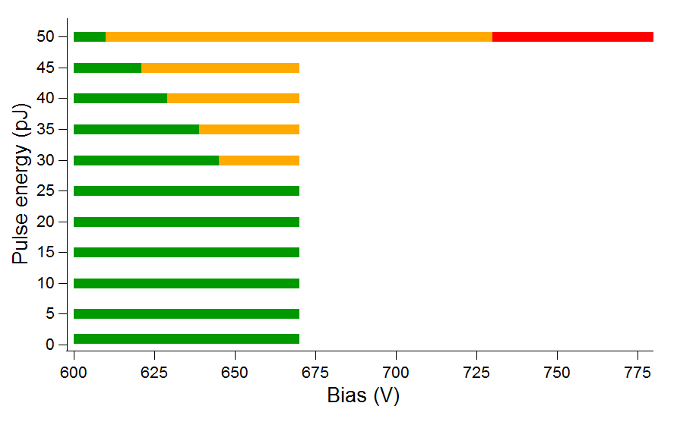
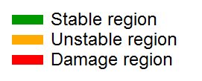
Stable/Instable/and damage damage thresholds
LGAD 1.5e15
LGAD 2.5e15
PIN 1.5e15
PIN 2.5e15
No mitigation needed for 1.5e15 neq/cm2
Implication for proton beams: one proton can cause such huge deposition that breakdown sensor irreversibly.

Slide 17
Summery: Stability and damage thresholds for 1.5e15 and 2.5e15 samples
E (pJ) | W36 LGAD 1.5e15 |  | W36 LGAD 2.5e15 |  | W36 PIN 1.5e15 |  | W36 PIN 2.5e15
 | Stability threshold (V) | Damage threshold (V) | Stability threshold (V) | Damage threshold (V) | Stability threshold (V) | Damage threshold (V) | Stability threshold (V) | Damage threshold (V)
1 | > 670 |  | > 670 |  | > 670 |  | > 670
5 | > 670 |  | > 670 |  | > 670 |  | > 670
10 | > 670 |  | > 670 |  | > 670 |  | > 670
15 | > 670 |  | > 670 |  | > 670 |  | > 670
20 | > 670 |  | > 670 |  | > 670 |  | > 670
25 | > 670 |  | > 670 |  | > 670 |  | > 670
30 | 650 |  | 644 |  | 652 |  | 645
35 | 643 |  | 635 |  | 645 |  | 639
40 | 635 |  | 628 |  | 640 |  | 629
45 | 625 |  | 617 |  | 631 |  | 621
50 | 618 | 645 | 608 | 697 | 622 | 671 | 610 | 730
Bottom line: No death observed in 50 micron sensors with bias < 645 V

Slide 18
2. Mortality study with fs-TCT-TPA
Accurate depth for triggering SEB - particularly the role of charge io determination of the SEB sensitive depth is important for guiding radiation hardness assurance methods. Many heavy-ion accelerator test facilities lack the high energy ions required for penetration deep into the substrate region.
TCT-TPA seems to be promising tool for probing SEB depth in LGAD
Open question:
Does the position of deposition inside LGAD matter? It can be that it is not the same if large amount of charge is released on top or on the bottom of the active layer (a clear case for TPA study, see the next talk)
What is the “threshold for charge deposition” at given HV bias, at different LGAD depths that leads to destruction of the sensor?

Slide 19
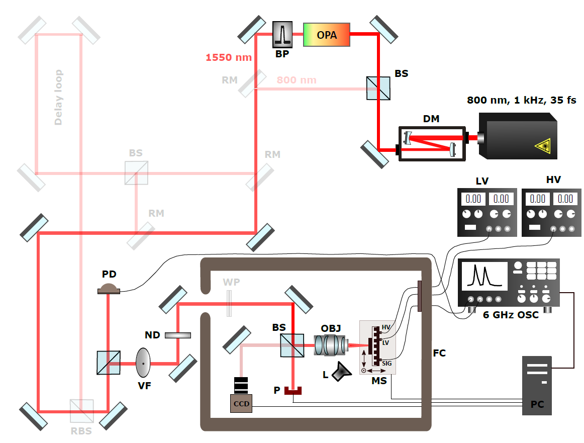
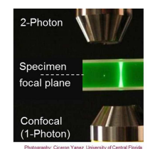
Configuration of TCT-TPA
Probing the SEB Sensitive Depth of LGAD: TCT-TPA
Final parameters
w₀ = 1.52 μm
Z_{R} = 7.74 μm
Challenges: The charge density is proportional to the square of the intensity of the laser beam, but because intensity is proportional to 1/r² (where r is the radial distance from the long axis of the ellipsoidal focal area), the ionized charge density falls off as l /r^{4.}

Slide 20
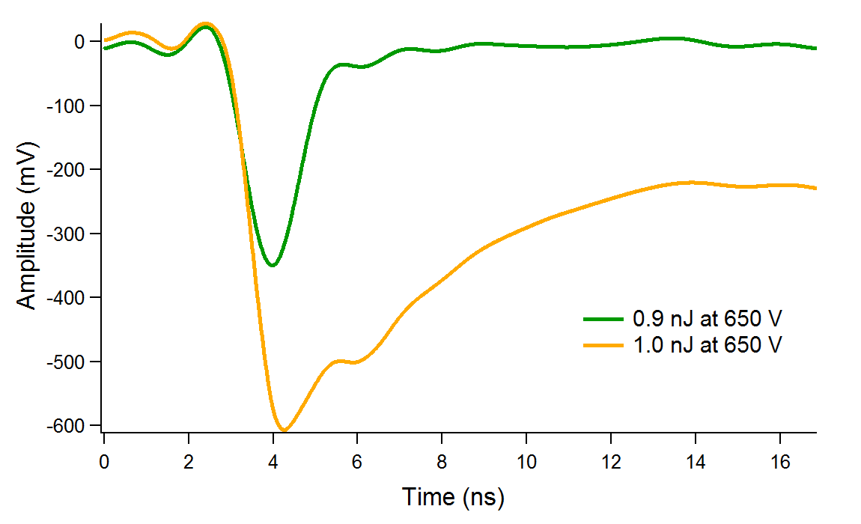
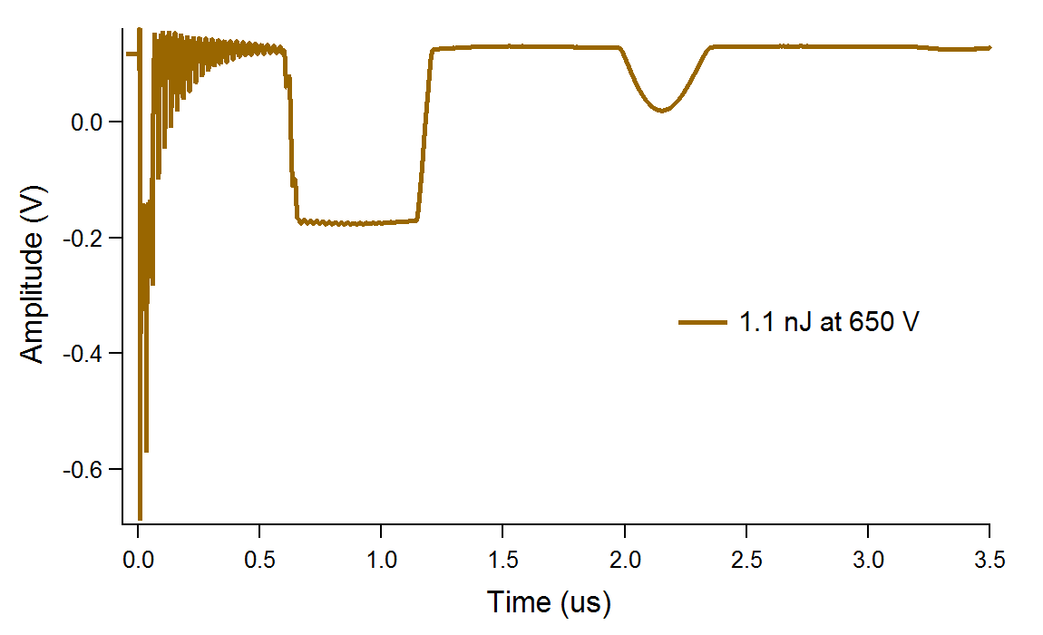
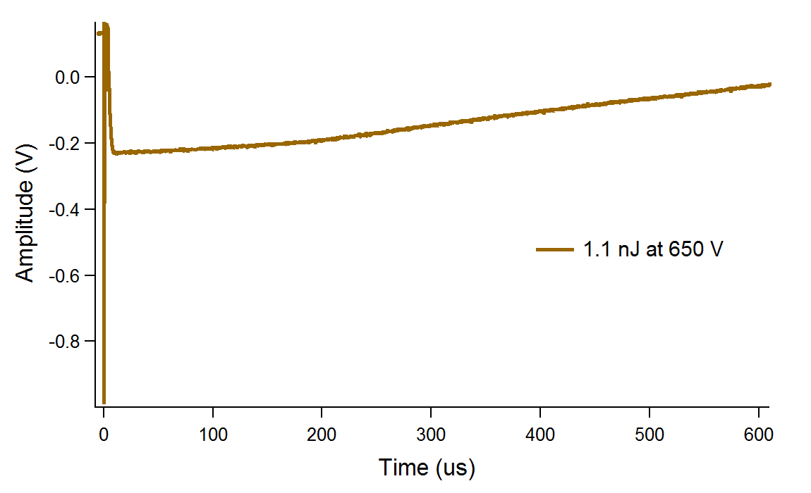
Unstable region
Unstable region corresponds to the power giving significant changes in the signal.
Example of waveforms for LGAD 1.5e15
Above certain threshold the signal is completely deformed and extended to microsecond range. Situation is very similar to SPA case.

Slide 21
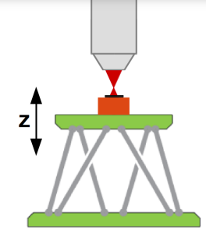
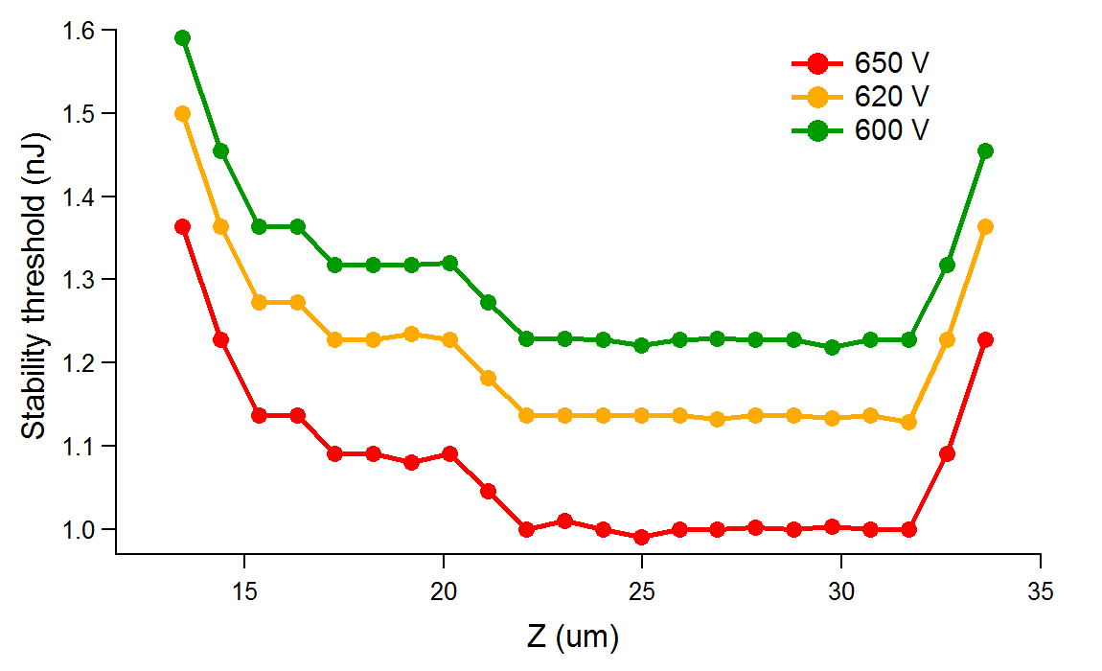
SPA:
Light absorption anywhere along beam
TPA:
No signal, if focal point not inside detector
Stability threshold vs Z
We managed to measure stability threshold for three different values of bias (650 V, 620 V, 600 V) in the most relevant Z range.
Irradiation:
defects in band gap
→ single photon absorption possible
→ TPA measurements need to be corrected
For every Z-position in relevant range the threshold was found. Idea was to see if mortality/stability limits of the device depends on the depth (position where the charge is generated).
We can see that in the range considered as “inside device” corresponding to 20-32 um. the stability is more or less constant
Conclusion: It seems that stability (maybe also mortality) does not change if we generate the charge closer to the front or closer to the back of the device.

Slide 22
Sensor damage inspection under electronic microscope

Slide 23
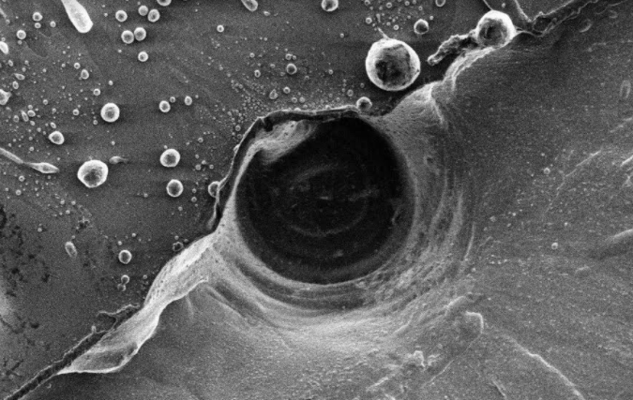
SPA
It seems that all the fatalities occur at the metallization-opening interface!
The “avalanche” seems to be triggered in the centre of opening where the laser hits the sensor, but the damage occurs at the point metal-Si interface, as there is a resistive path at metal-si interface which causes the heating and melting away the silicon. At lower bias voltages these sensors can take huge abuse with highly energetic laser pulses and that doesn’t hurt them. So it must be field related.
The added piece to the puzzle
W36 LGAD 1.5e15 cm⁻² (I exp)
The HV was set to 680 V
After 3 nW illumination at 680 V the sample broke down
(~10 MeV od deposited energy).
No crater fatality signature seen as it was the case in test-beams; this is the most probable because in ELI tests we did not used 10 nF capacitor (set on timing board) so damage happen later. There is no discharge through sensor, and thus no crater rupture.

Slide 24
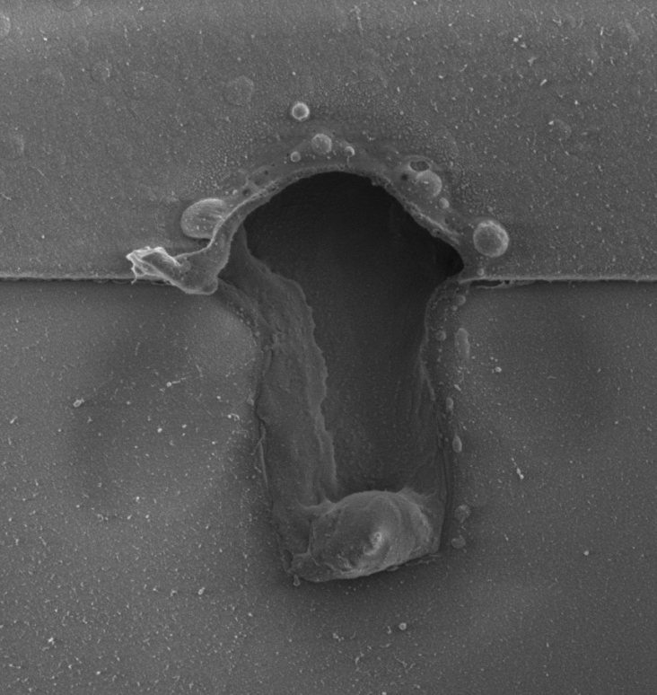
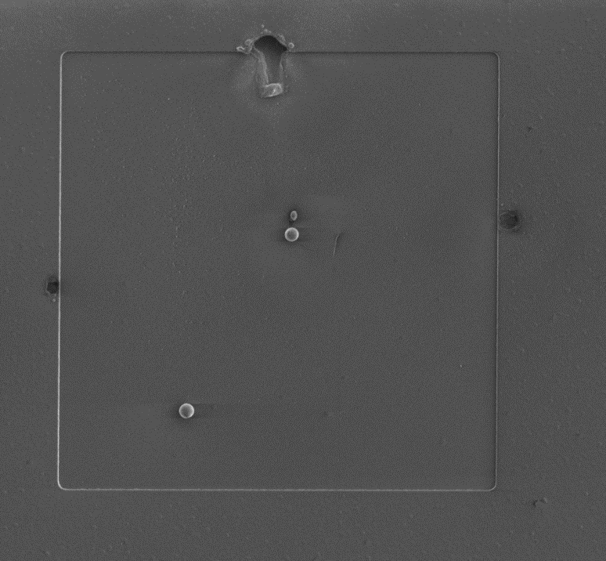
SPA
Damaged by SPA: 50 pJ, 692 V
LGAD 2.5e15

Slide 25
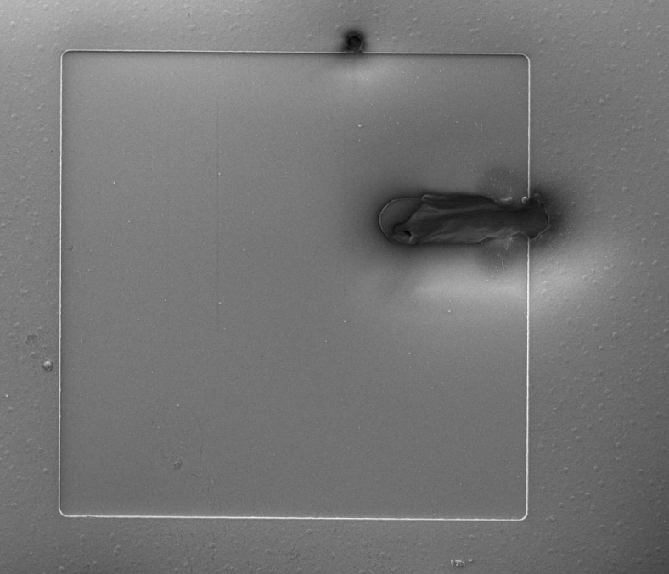
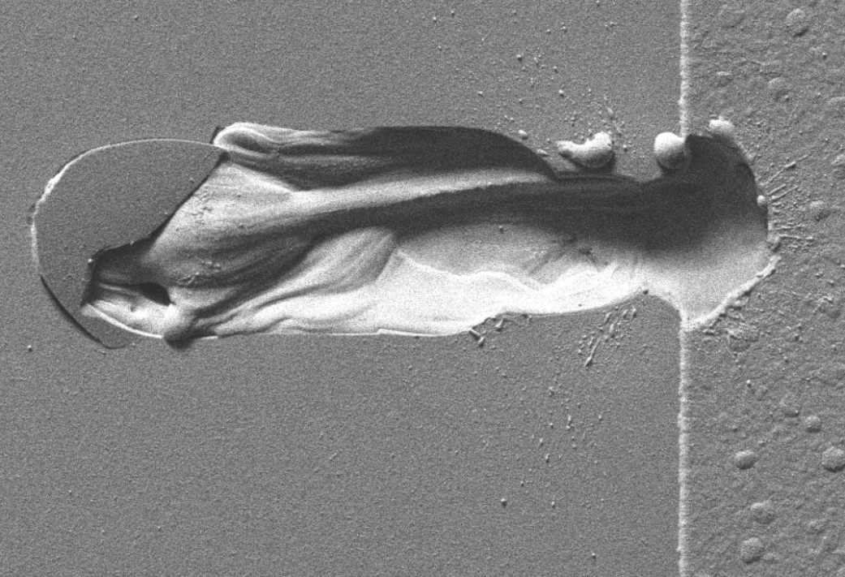
SPA
LGAD 1.5e15
Damaged by SPA: 50 pJ, 625 V

Slide 26
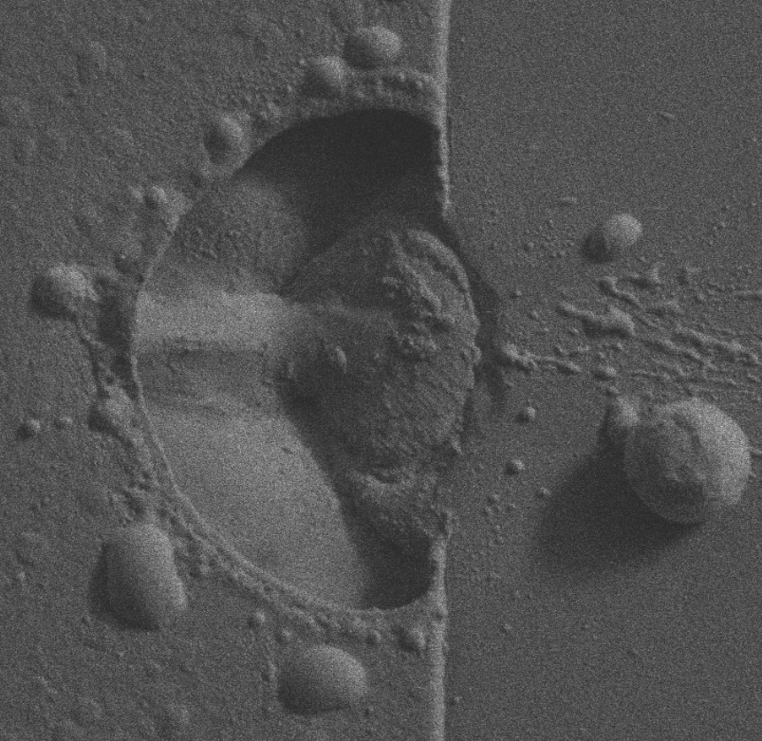
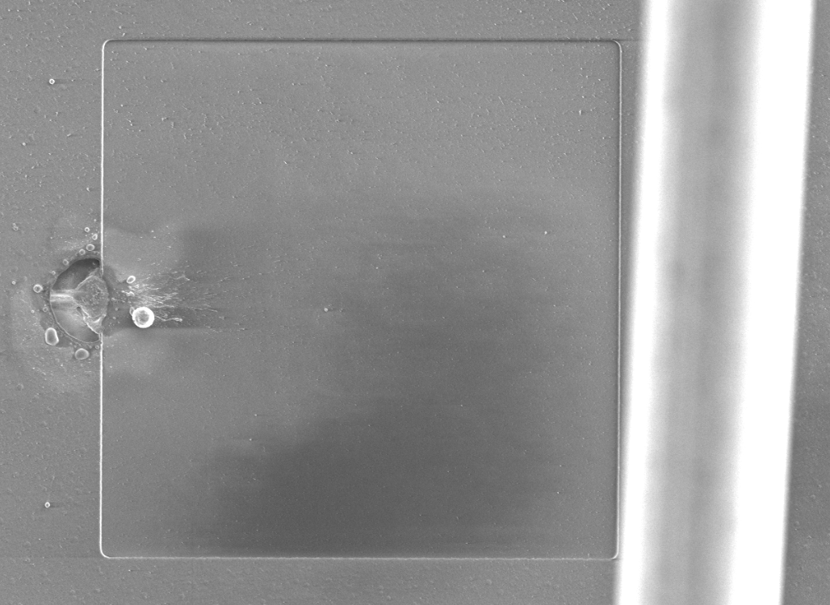
SPA
PIN 2.5e15
Damaged by SPA: 50 pJ, 730 V
Edge effect: metal-semiconductor
The energy for the crater (seen in proton-beam tests) comes from the filtering capacitors.

Slide 27
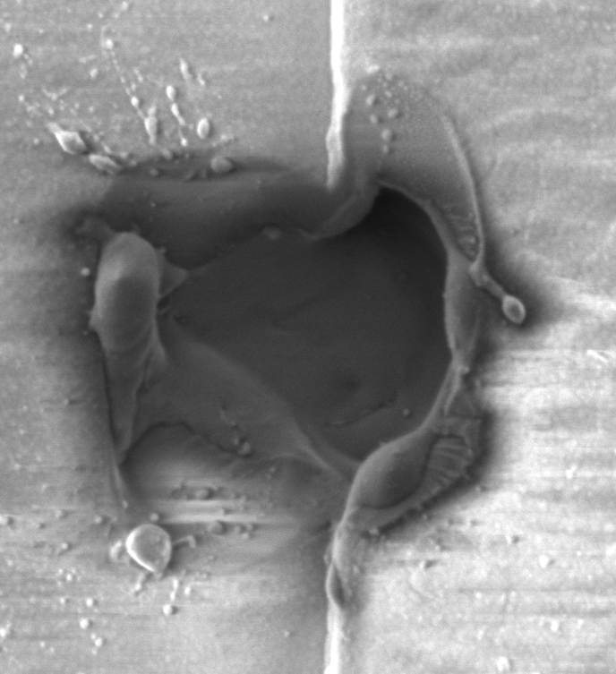
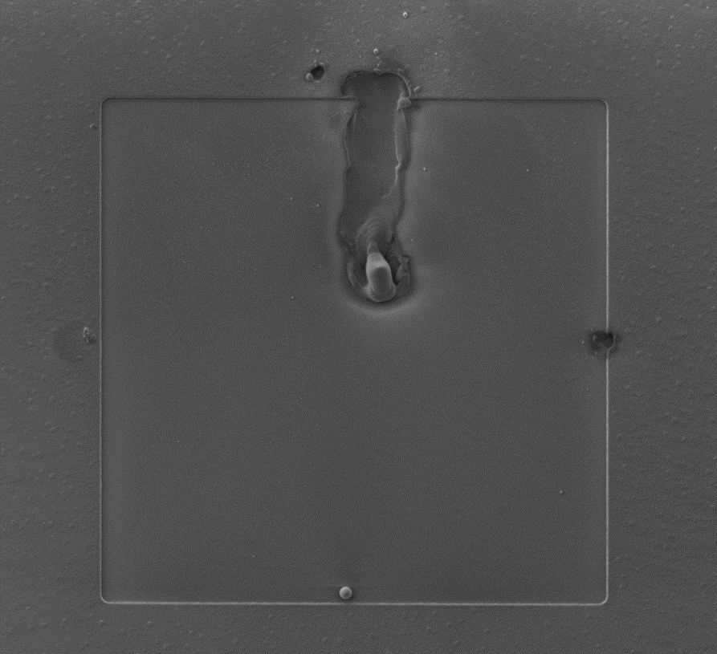
SPA
PIN 1.5e15
Damaged by SPA: 50 pJ, 671 V

Slide 28
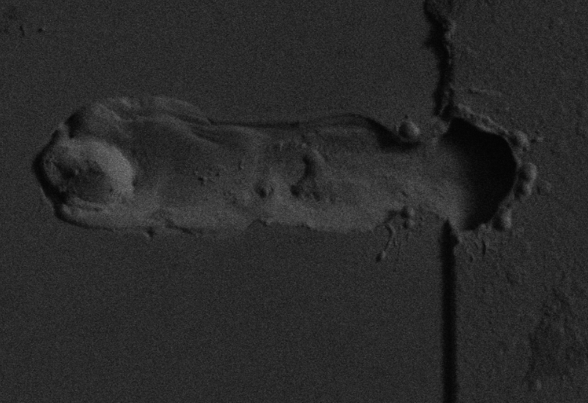
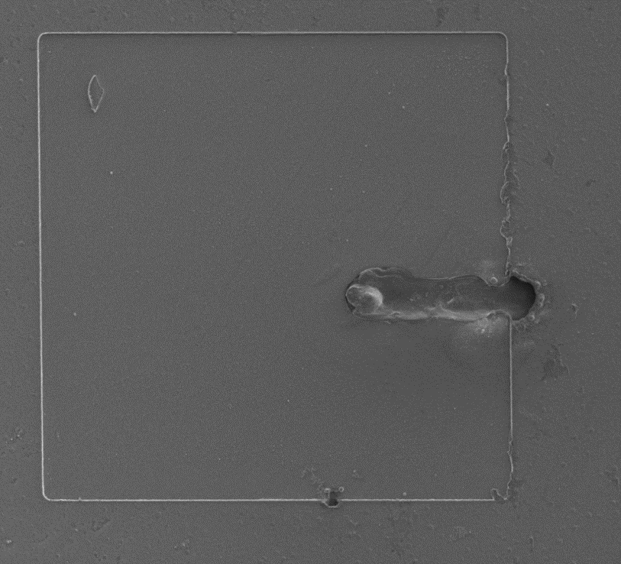
TPA
F LGAD 1.5e15 n_{eq}/cm²
completely damaged by TPA at 3.2 nJ and 600 V
Location and character of damage areas look quite similar to those obtained by SPA breakdowns

Slide 29
Summery: Steps we made
A feasibility study conducted at the laser facility ELI Beamlines confirms that highly energetic fs-laser pulses can produce Single Event Effect and Single Event Burnout (SEB) conditions in irradiated Low Gain Avalanche Detectors (LGADs) and corresponding PIN diodes
Comprehensive and systematic mortality study on LGADs and PINs has been conducted to experimentally set stability, instability, and irreversible damage thresholds (HV bias, laser power) for LGADs and PINs exploiting fs-laser
Destructive and non-destructive measurements using fs-laser have been used to investigate the burnout process. Non-destructive measurements are only able to indicate the onset of avalanche multiplication. On the other hand, destructive measurements are able to provide more detail about the burnout process.
Using TCT-Two Photon Absorption (TPA) to study the mechanism that triggers SEU/SEB condition in LGADs as function of illumination position establishes this technique as a promising tool for the more advanced exploration of SEE not only in LGADs but also in other Si-based sensors.
To achieve these results, a highly flexible, and versatile fs-laser-based TCT experimental setup has been developed at ELI Beamlines, allowing two TCT modalities at the same setup: SPA at 800 nm and TPA at 1550 nm laser wavelength

Slide 30
Advantages: fs- laser tests vs beam tests
Presented work demonstrates that Single Event Burnout event can be systematically studied using fs-laser in a such controlled way that LGAD once brought to the instable condition that is next to the irreversible breakdown but not yet broken, could be returned to the stable operable condition by decreasing HV by a few volts;
This excellent control over the very unstable but not yet irreversible breakdown conditions of LGADs is unique for the presented fs-laser beam tests since such control is not possible to be achieved in proton beams-tests.
As the primary outcome, the presented study sets the reference values for stability, instability, and damaged thresholds mapping this way the safety region and defining the turning point after which irreversible breakdown is unavoidable.

Slide 31
Lessons learnt
ELI Mortality campaigns significantly improved understanding of LGAD’s death mechanism
- it is almost certain that this is not LGAD feature. It is property if silicon at high fields.
  Irreversible breakdowns are unrelated to gain; LGADs and PINs suffer the same.
  Irreversible breakdowns are also radiation damage unrelated and not fluency dependent; there is HV and laser power dependance.
  link to the fluences is only because irradiations enables sensors to be biased at higher HV; (HV >580 V); this leads to the higher el field that LGAD can not sustain.
  the reason for fatalities is the high field (voltage)
  Crater signature not observed in ELI mortality study since capacitor was not mounted to sensors' household (housings provided by IJS).
  Damage appearance preference: at pad edge
We manage successfully to define the stability and damage thresholds for 1.5e15 and 2.5e15n_{eq}/cm² HPK (WF36) samples;
destructive breakdown observed at bais votlages around 650 V at laser energies of 50 pJ; this is in agreement with SEB
Bottom line: 50-micron HPK-WF35 sensors seem quite safe with HV bias < 645 V.
there is no difference between PIN and LGAD and 1.5e15 and 2.5e15.
there are three regions stable – instable – destroyed

Slide 32
Open questions and steps forward
Correlation of the mortality rate with the electric field and deposited energy.
Safe voltage for a given thickness
  Thick sensor vs. thin sensor; maybe thin sensor are more resistant to SEB
Understanding the process
  Is the damage mechanism the same for particles and light (same photos as at observed at ELI observed also at UCSC); HV threshold for irreversible breakdown is lower in beam tests then in laser tests at ELI; Should we compare the total ionization in MeV, or instead the rate of ionization in MeV / fs ?
  The question is it really impossible to break a sensor at 550V, or does the ionization threshold just raise to a huge value like 500 or 1000 MeV? This is hard to answer at the test beam but maybe can be addressed with a scan of the laser power at lower bias (some hint on the next page)..
Mitigation techniques
  Carbon enrichment seems most advanced solution so far
  Is there a room for improvement in the design
    An active quenching strategy is way more evolved, it needs a deep understanding of power microelectronics because the power bursts are too fast (that is the main reason of the fast discharge of any HV capacitor around the detector diode).
    Engeeneing: Low resistivity bulk might act as quenching resistor

Slide 33
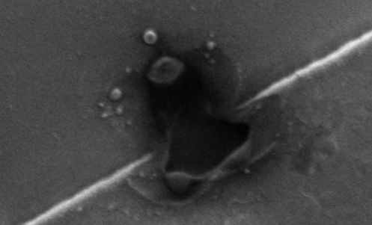
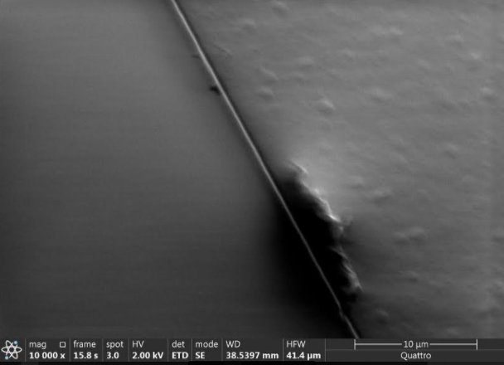
Open question raised: Is it really impossible to break a sensor at 550V, or does the ionization threshold just raise to a huge value like 500 or 1000 MeV?
The HV was increased in steps, and survival of sensor at each step (chosen HV) was tested by increase of laser power till sensor brake down.
TREDI2021 Workshop; G.Medin et al
LGAD WF36
2.5e15 n_{eq}cm⁻²
HV = 450 V, P_{laser} = 6 μW
PIN
1.5e15 n_{eq}cm⁻²
HV = 400 V, P_{laser} = 6 μW

Slide 34
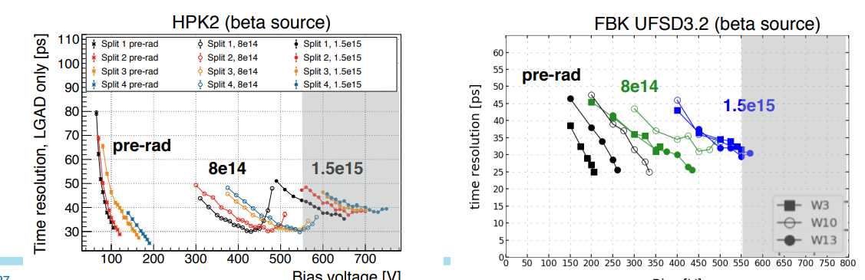

Context for ETL
.
Some FBK wafers deliver required performance < 550V at all ETL fluences.
  Next tests at ELI
(courtesy of Ryan Heller)

Slide 35

Future steps at ELI
 | Wafer # | thickness | GL DEPTH | Dose Pgain | Carbon | Diffusion
 | 1 | 45 | Standard | L | 1*A | L
 | 2 | 44 | Standard | L | 1*A - Spray | L
 | 3 | 45 | Standard | L | 0.8*A | L
 | 4 | 45 | Standard | L | 0.6*A | L
 | 5 | 45 | Standard | L | 0.4*A | L
 | 6 | 25 | Standard | VVL | A | L
 | 7 | 45 | 2 um | L’ | 1*A | L
 | 8 | 55 | 2 um | L’ | 1*A | L
 | 9 | 45 | 2 um | L’ | 0.6*A | L
 | 10 | 45 | 2 um | M’ |  | L
 | 11 | 45 | 2 um | M’ | 1*A | L
 | 12 | 45 | 2 um | M’ | 0.6*A | L
 | 13 | 45 | 2 um | M’ | 1*A | H
 | 14 | 55 | 2 um | M’ | 1*A | H
 | 15 | 45 | 2 um | M’ | 0.6*A | H
 | 16 | 45 | 2 um | H’ |  | H
 | 17 | 45 | 2 um | H’ | 0.8*A | H
 | 18 | 45 | 2 um | H’ | 0.6*A | H
To exploit UFSD3.2 sample
First production of UFSD 45 um, Investigate the Carbon dose range 0.1 – 1.2
Deep implant:
Investigate the feasibility of deep implant B+C, Investigate
https://www.sciencedirect.com/science/article/pii/S0168900218317741
To exploit LGAD’s irreversible breakdown vs. thickness
Performing laser illumination (SPA & TPA) from the LGAD’s back side

Slide 36
Thank you
This work has been performed within the framework of RD50 and partially supported by Ministry of Science in Montenegro within the project “ Improving research infrastructure and measuring techniques for testing of fast "state-of-the-art" LHC-HL time detectors", Contract No. 03/1- 062/20-500/3.
The authors acknowledge the financial support from the Slovenian Research Agency (ARRS J1-6199).
We acknowledge ELI Beamlines in Dolní Břežany, Czech Republic, for providing beamtime and thank the instrument group and facility staff for their assistance. LM2018141, MEYS – Large research infrastructure project ELI Beamlines. This work was supported by the projects Advanced research using high-intensity laser-produced photons and particles (ADONIS) (CZ.02.1.01/0.0/0.0/16_019/0000789),Structural dynamics of biomolecular systems (ELIBIO) (CZ.02.1.01/0.0/0.0/15_003/ 0000447) (both from the European Regional Development Fund and the Ministry of Education,Youth and Sport)

Slide 37
Backup Slides

Slide 38

Correlation between pulse energy and energy deposit

Slide 39




Pulse energy vs. Bias mapping
"safe operation“ region below 50 pJ and 645 V
LGAD 1.5e15
LGAD 2.5e15
PIN 1.5e15
PIN 2.5e15

