Slide 1
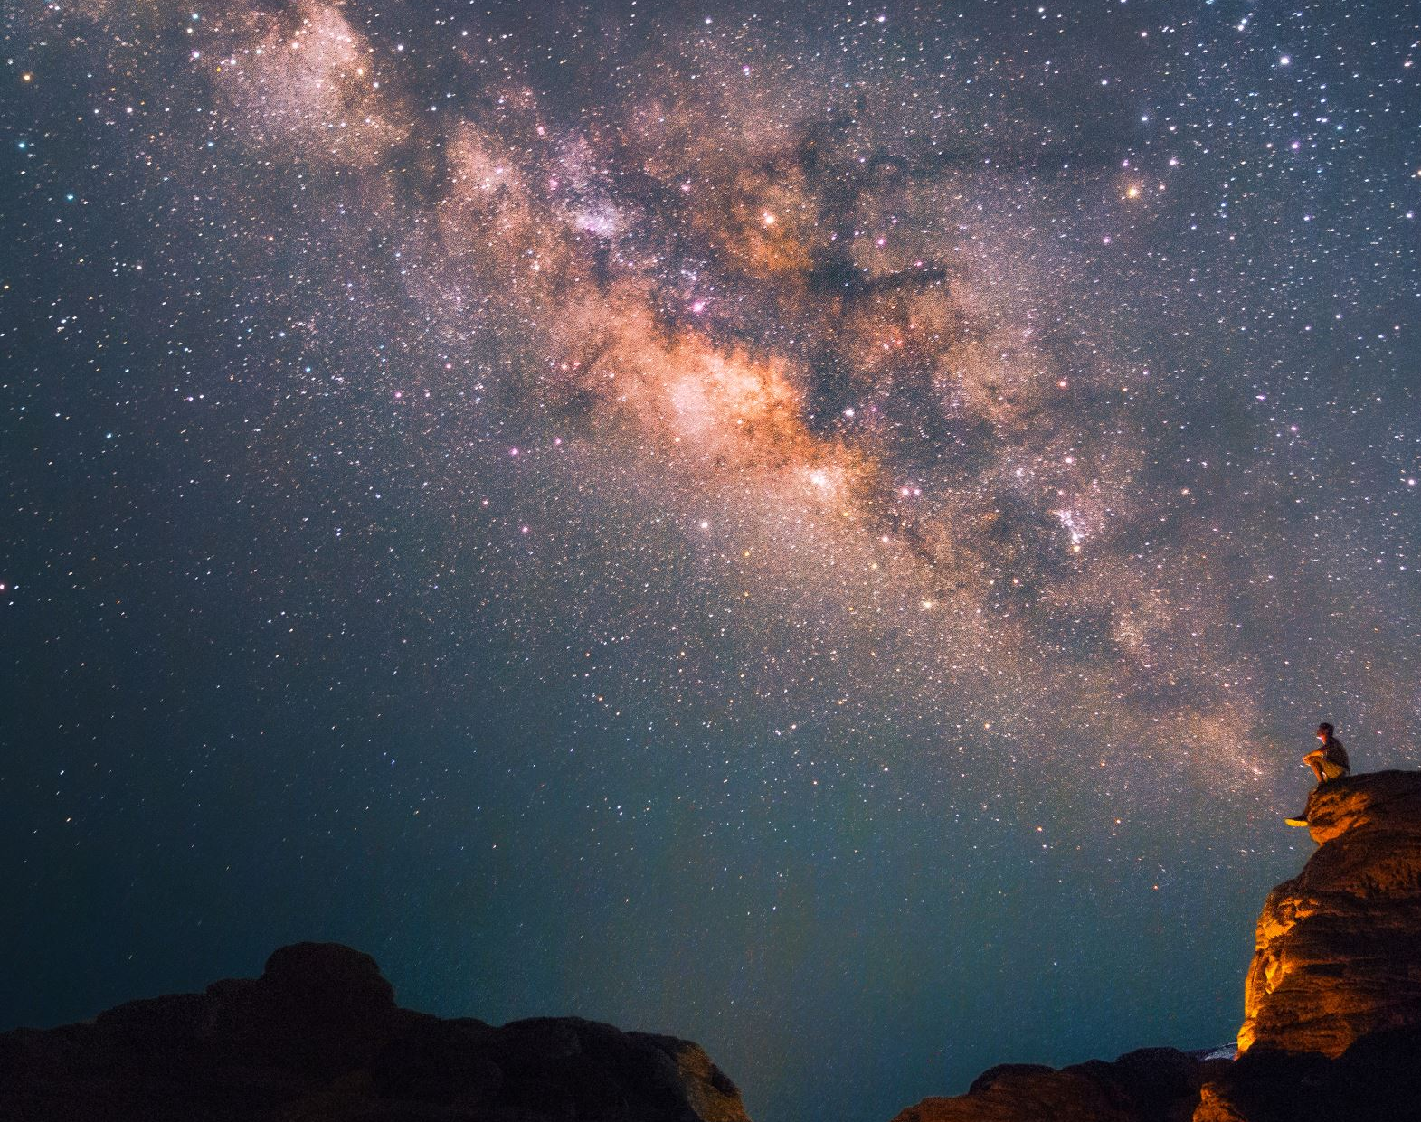

Directional Dark Matter Search with NEWSdm
Andrey ALEXANDROV (on behalf of the NEWSdm collaboration)
I.N.F.N. and University of Naples, Italy
National University of Science and Technology 'MISiS', Moscow, Russia
Lebedev Physical Institute (LPI RAS), Moscow, Russia

Slide 2







NEWSdm COLLABORATION
Nuclear Emulsion WIMP Search directional measurement
81 physicists
23 institutes
ITALY
LNGS, GSSI
INFN: Napoli, Roma, Padova
Univ.: Napoli, Roma, Padova,
Potenza, Benevento
JAPAN
Chiba, Nagoya, Toho, Tsukuba
SOUTH KOREA
Gyeongsang University
RUSSIA
LPI RAS Moscow
JINR Dubna
SINP MSU Moscow
INR RAS Moscow
NUST MISiS Moscow
NRU HSE Moscow
TURKEY
METU Ankara
Website:
news-dm.lngs.infn.it
Letter of intent:
https://arxiv.org/pdf/1604.04199.pdf
2

Slide 3
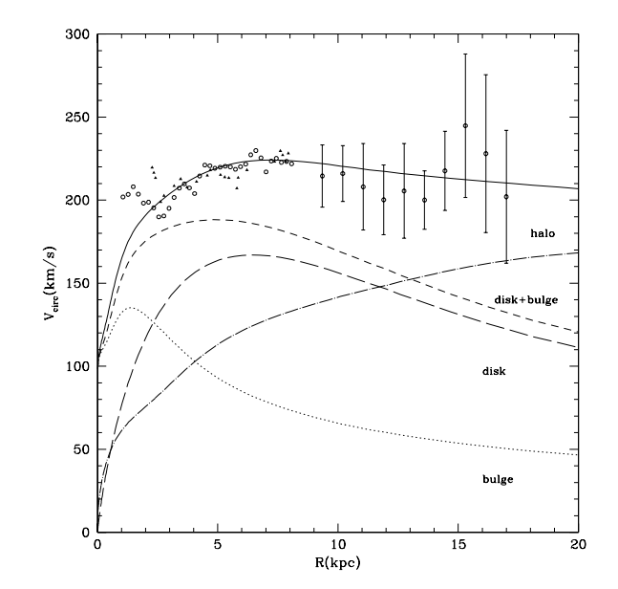
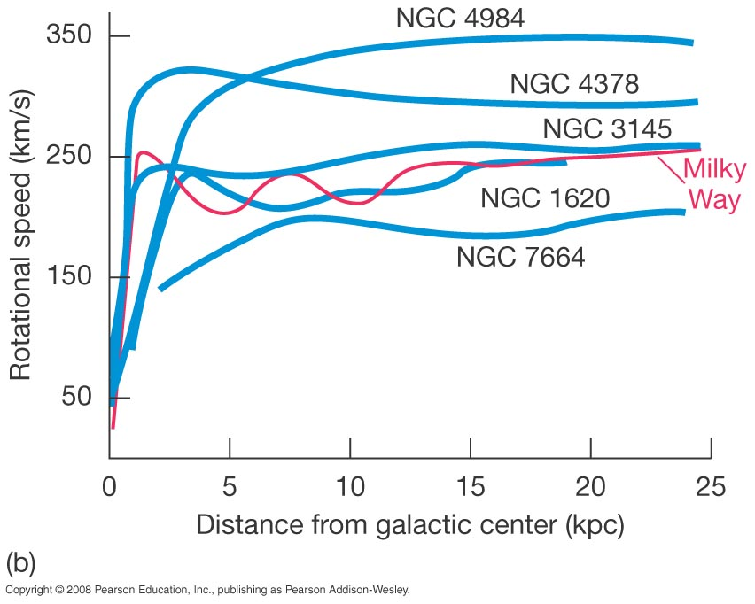
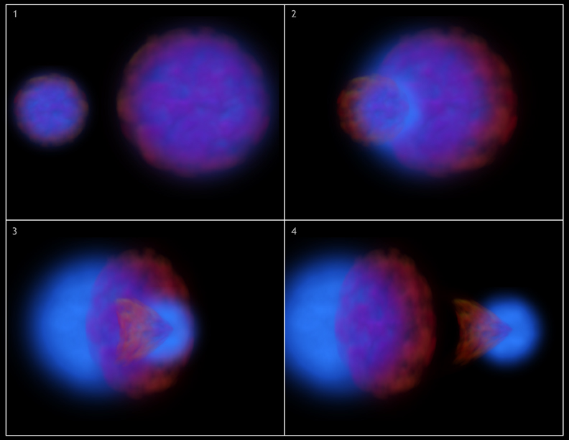
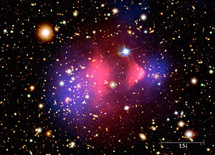
Dark Matter
Dark matter is a hypothetical form of matter thought to account for approximately 85% of the matter in the universe.
Main characteristics:
Stable at the cosmological scale
Electrically neutral but interacts gravitationally and (presumably) weakly
Non-relativistic and heavy
One of possible candidate is WIMP
(Weakly Interacting Massive Particle)
Experimental evidences:
Structures and rotational anomalies of galaxies
Gravitational lensing
Large-scale structures formation
3

Slide 4
WIMP directional detection
Earth@Summer
Nuclear emulsion detector
Direction of solar system
(220km/sec)
Dark matter
wind
WIMP
Target nuclei
Earth@Winter
Strong correlation between the direction of WIMP and scattered nuclei → strong signature and unambiguous proof of the galactic DM origin
Unique possibility to overcome the “neutrino floor”, where coherent neutrino scattering creates an irreducible background
Nuclear Emulsion is a high-density solid-state medium → large mass with a compact detector
4

Slide 5
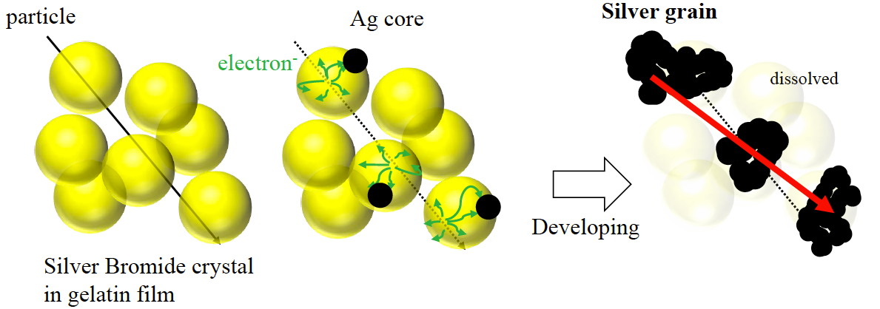

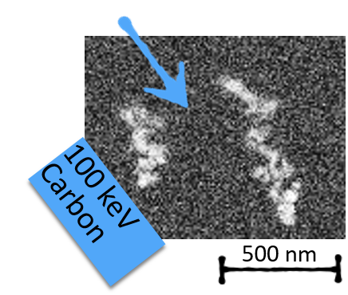
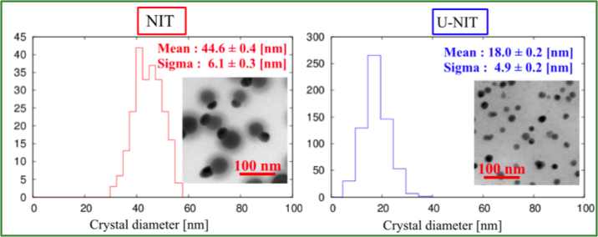
NIT: Nano emulsion Imaging Trackers
A long history, from the discovery of the Pion (1947) to the discovery of ν_{μ}→ ν_{τ} oscillation in appearance mode (OPERA, PRL 115 (2015) 121802)
Nuclear emulsions: AgBr crystals in organic gelatine
Passage of charged particle produce latent image
Chemical treatment make Ag grains visible
New kind of emulsion for DM search
Smaller crystal size
SEM image
5
Granularity = 71 nm
Granularity = 40 nm

Slide 6
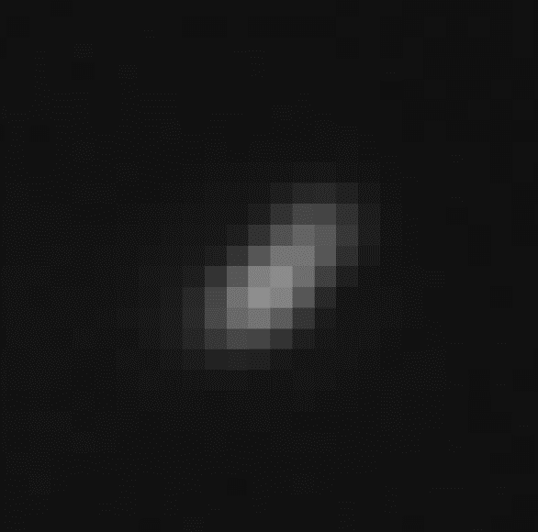
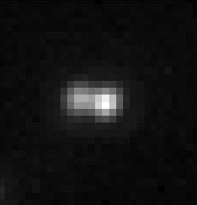
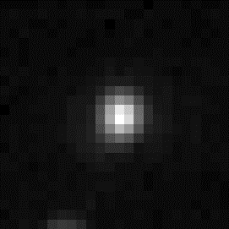
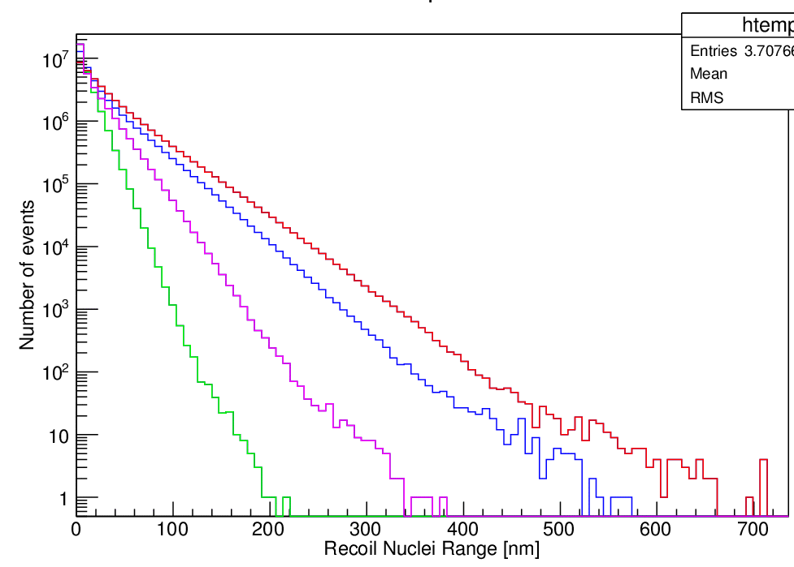
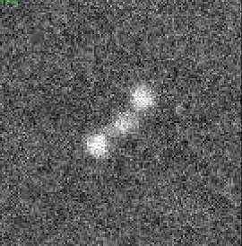
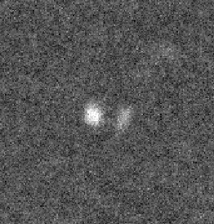
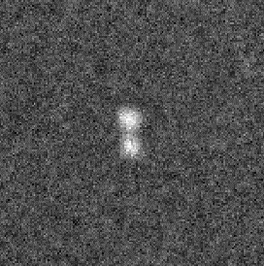
Directional detection challenge
expected recoil length in the nuclear emulsion
Optical
Optical
Optical
U-NIT (40nm)
WIMP mass
― : 100 GeV/c²
― : 50 GeV/c²
― : 20 GeV/c²
― : 10 GeV/c²
NIT (71 nm)
3.2 g/cm³
target : C,N,O, Ag, Br
X-ray
X-ray
X-ray
10 GeV/c²
20 GeV/c²
100 GeV/c²
50 GeV/c²
Track length [nm]
Inaccessible due to diffraction limit
L = 380 nm
L = 265 nm
L = 160 nm
Need super-resolution to measure tracks shorter than 200 nm
6

Slide 7
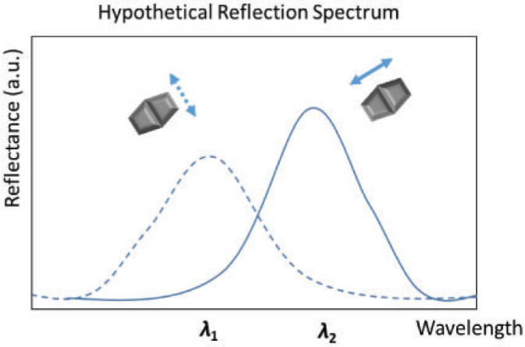
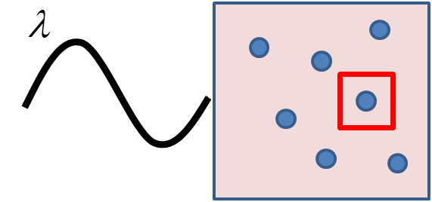

Optical readout beyond the diffraction limit
Super-resolution idea: use the plasmon resonance effect to overcome the diffraction limit:
  generated by a light wave trapped within conductive nanoparticles smaller than the wavelength of light
  resonant frequency strongly depends on the composition, size, geometry, dielectric environment and distance between nanoparticles
  occurs in the visible region for Ag and Au nanoparticles!
  improve resolution by analyzing scattered light polarization and spectrum
λ_{l}
Oscillation of e-cloud
7

Slide 8
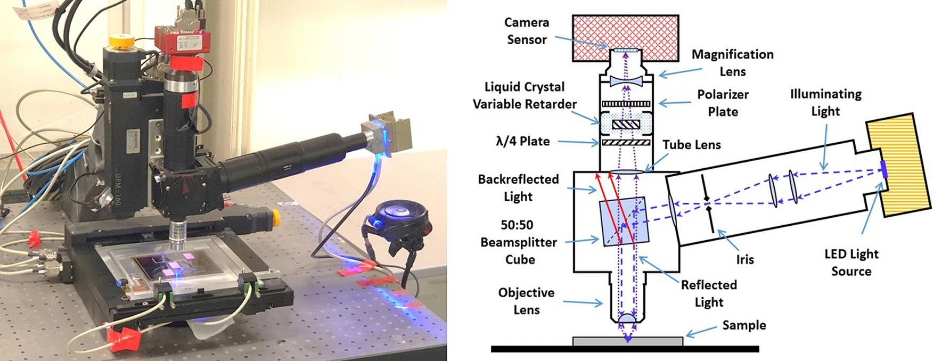
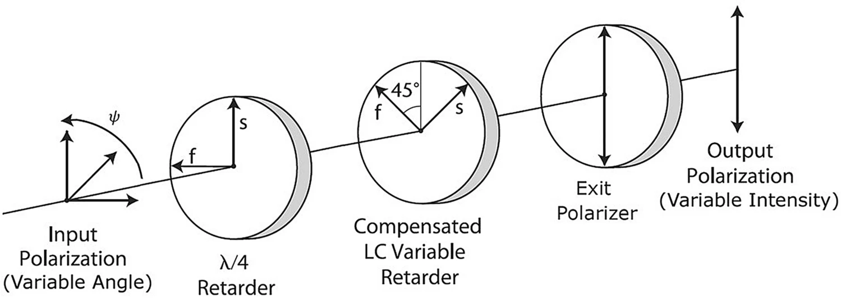
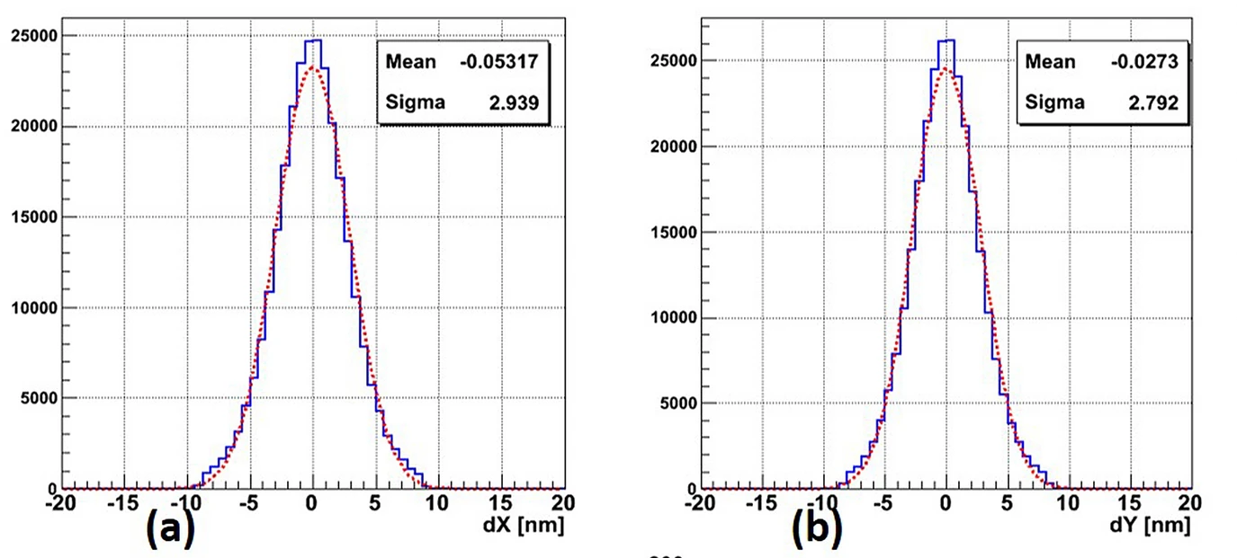
Super-resolution microscope
Sci. Rep. 10 (2020) 18773
Spatial Accuracy = 3 nm
Liquid Crystal Polarization Analyzer
8

Slide 9


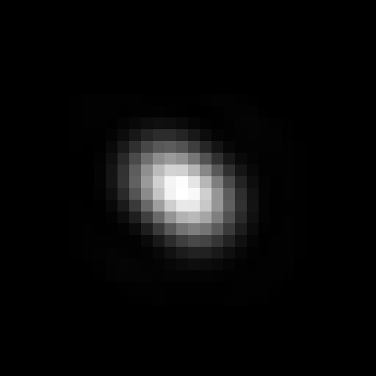



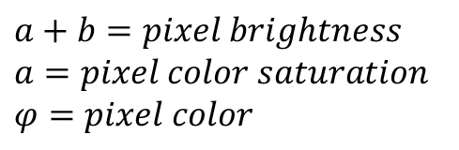


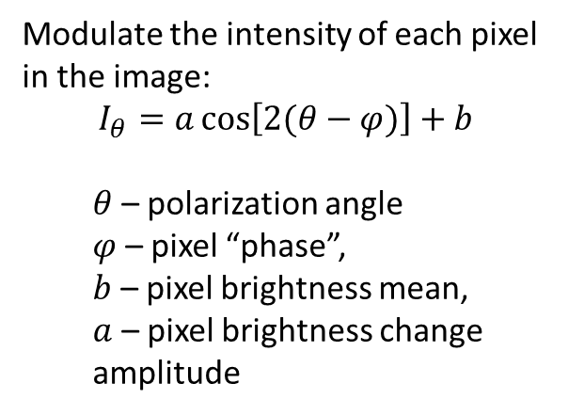
Original scene
(upolarized illumination)
Modulated (rotating polarizations)
Modulate the intensity of each pixel in the image:
$$I_{θ}=a\cos\left[2(θ−φ)\right]+b$$
  $θ$ – polarization angle
  $φ$ – pixel “phase”,
  $b$ – pixel brightness mean,
  $a$ – pixel brightness change amplitude
$$⨂PSF$$
Microscope
Reconstructed scene
0
$$φ$$
180
255
$$a$$
0
Joint Image
Deconvolution
$$a+b=pixel brightness$$
$$a=pixel color saturation$$
$$φ=pixel color$$
9

Slide 10
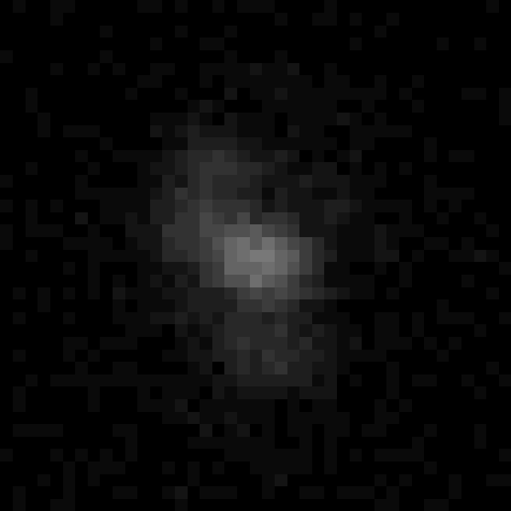

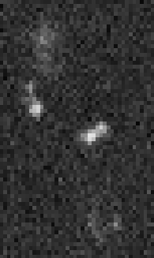
Joint image deconvolution
Sci. Rep. 10 (2020) 18773
Microscopic image (8 polarizations)
Reconstructed image
200 nm
200 nm
SEM image
10

Slide 11
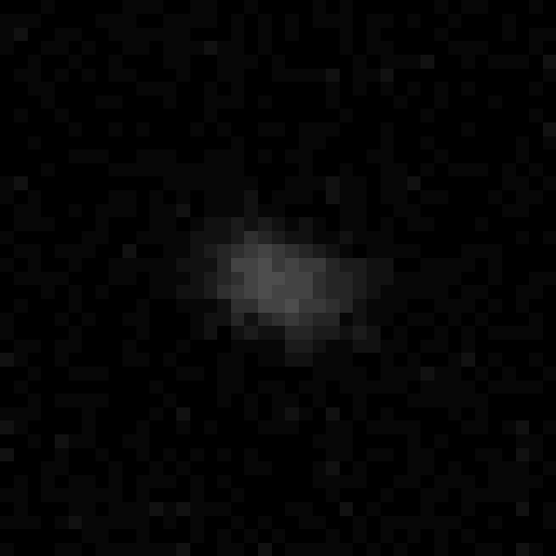

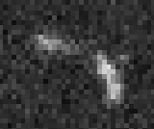
Joint image deconvolution
Sci. Rep. 10 (2020) 18773
Microscopic image (8 polarizations)
Reconstructed image
200 nm
200 nm
Barycenter
Shift = 48 nm
SEM image
11

Slide 12
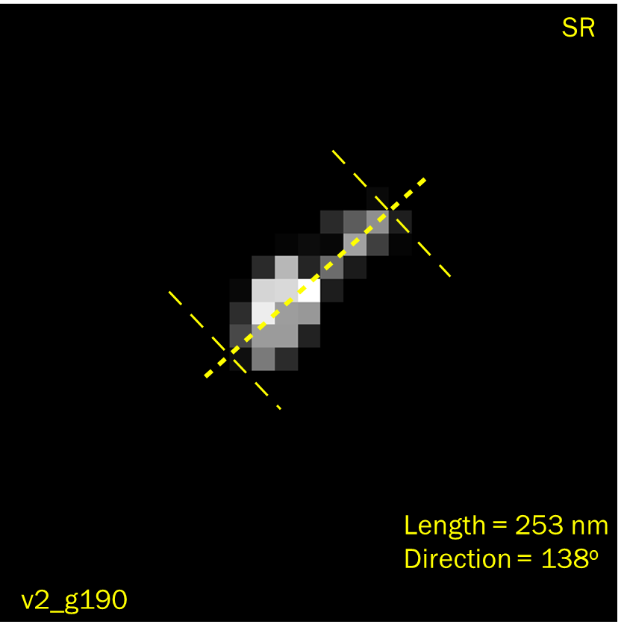
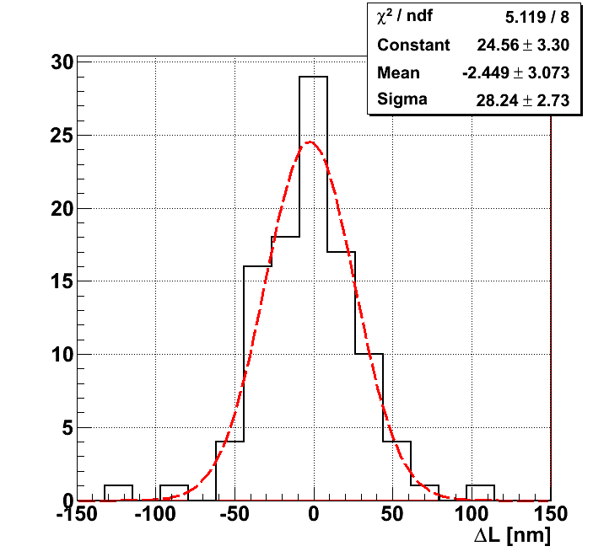
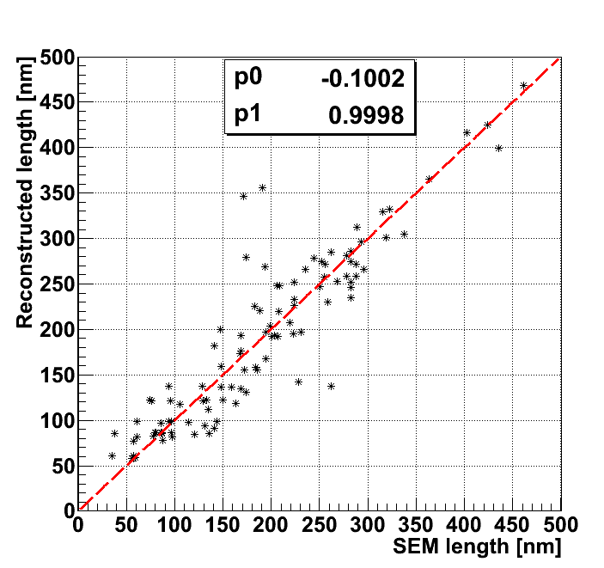
Joint Image Deconvolution
Event Length comparison with SEM
Pearson Coefficient | Matched | Unmatched
Length | 0.912 | -0.009
Width | 0.713 | -0.007
Length accuracy: 28 nm ≈ pixel size (27.5 nm)
Spatial resolution: 80 nm (Nyquist theorem)
12

Slide 13
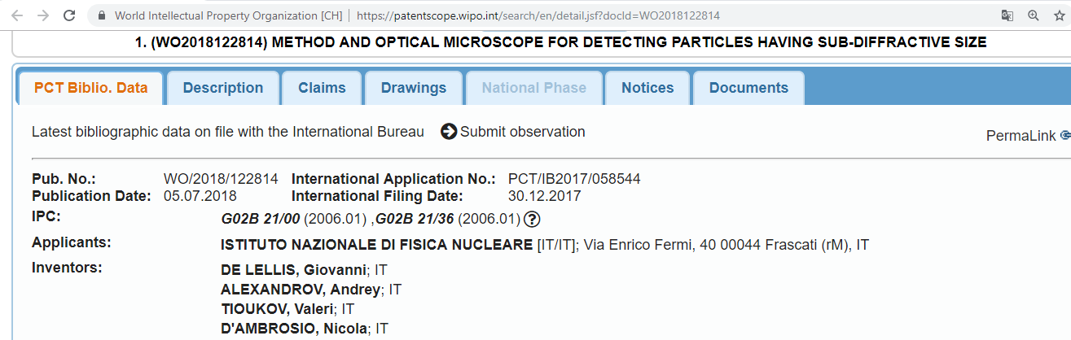
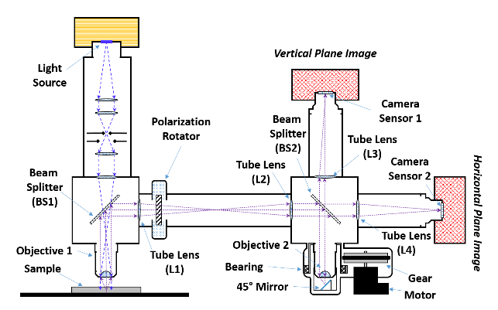
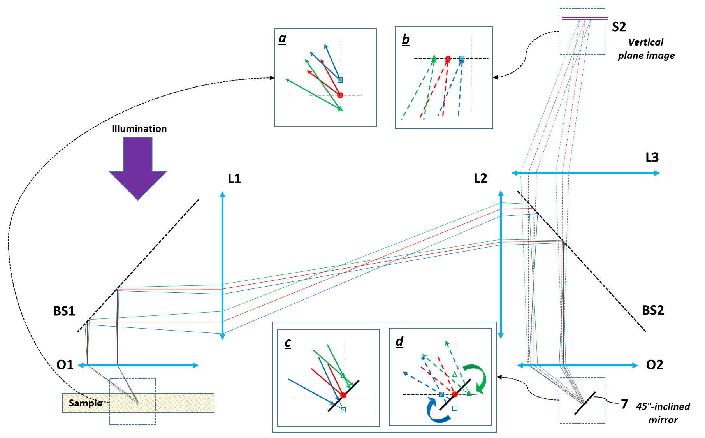
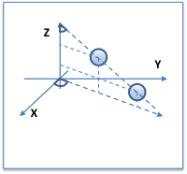
Measurement in 3D
A
Two focal planes:
Horizontal: XY
Vertical: ZA
International Patent No. WO/2018/122814
13

Slide 14
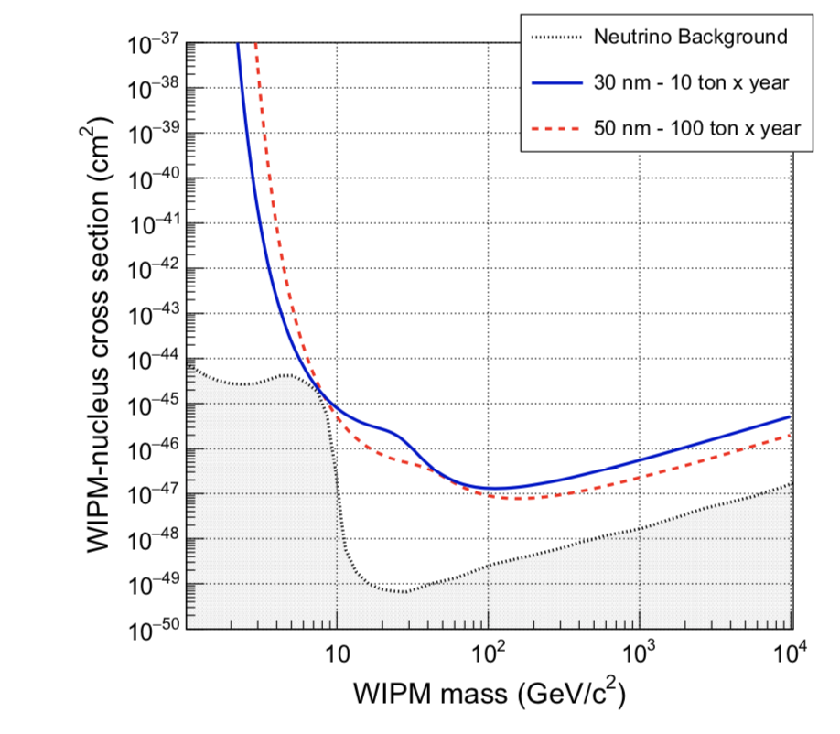
NEWSdm intermediate and final goals
First directional dark matter detector with a 10 kg solid target
Explore the DAMA region with a completely different technique based on the visual observation
of recoil tracks in emulsion
First high-sensitivity spin-independent measurement with a directional approach
First step in the application of the emulsion technology, scalable to larger masses
Longer term: overcome the neutrino floor
90% C.L. upper limits for the NEWSdm detector with an exposure of 10 kg year in the zero-background hypothesis
90% C.L. upper limits for the NEWSdm detector with an exposure of 10 ton year in the zero-background hypothesis
14

Slide 15
THANK YOU FOR ATTENTION!
Andrey ALEXANDROV (on behalf of the NEWSdm collaboration)
andrey.alexandrov@na.infn.it

Slide 16
Backup slides

Slide 17
Importance of the directional detection
PHYSICAL REVIEW D 92 (2015) 063518
10 kg
1 kton
10⁻⁴⁴
direct
10⁻⁴⁸
direct
directional
directional
1
10
Need 3D with sense recognition for best results!
17

Slide 18
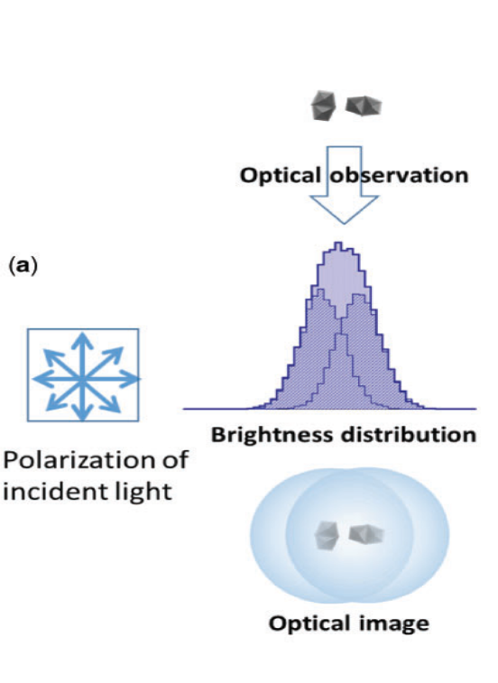
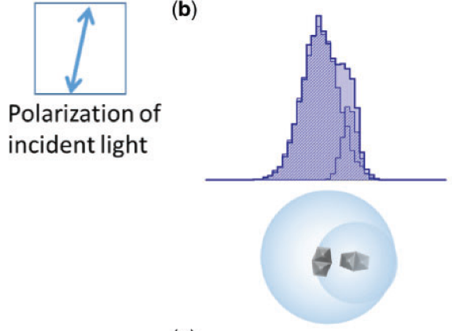
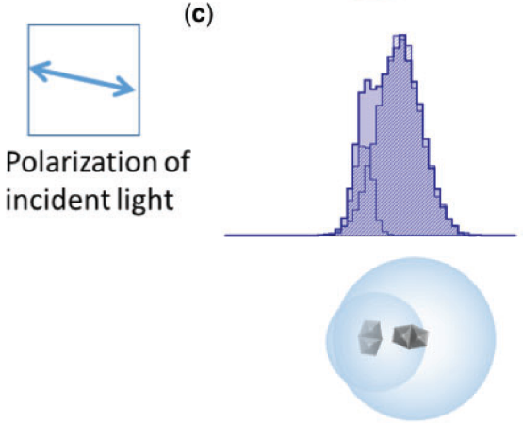
Optical readout beyond the diffraction limit
PTEP, Vol. 2019 Issue 62019, 063H02
18

Slide 19
Directionality preservation of nuclear recoils
Performance in the measurement of the recoil direction and comparison with other techniques
Simulation of nuclear emulsion granularity: volume filled with AgBr crystals described as spheres of diameters 44±7 nm for NIT, 25±4 nm for U-NIT
Evaluation of energy-weighted cosine distribution
Realistic distribution of mean values of weighted-cos𝜗 for NIT and U-NIT, compared with other detectors
A. Alexandrov, G. De Lellis, A. Di Crescenzo, A. Golovatiuk and V. Tioukov, «Directionality preservation of nuclear recoils in an emulsion detector for directional dark matter search» JCAP 04 (2021) 047
19

Slide 20
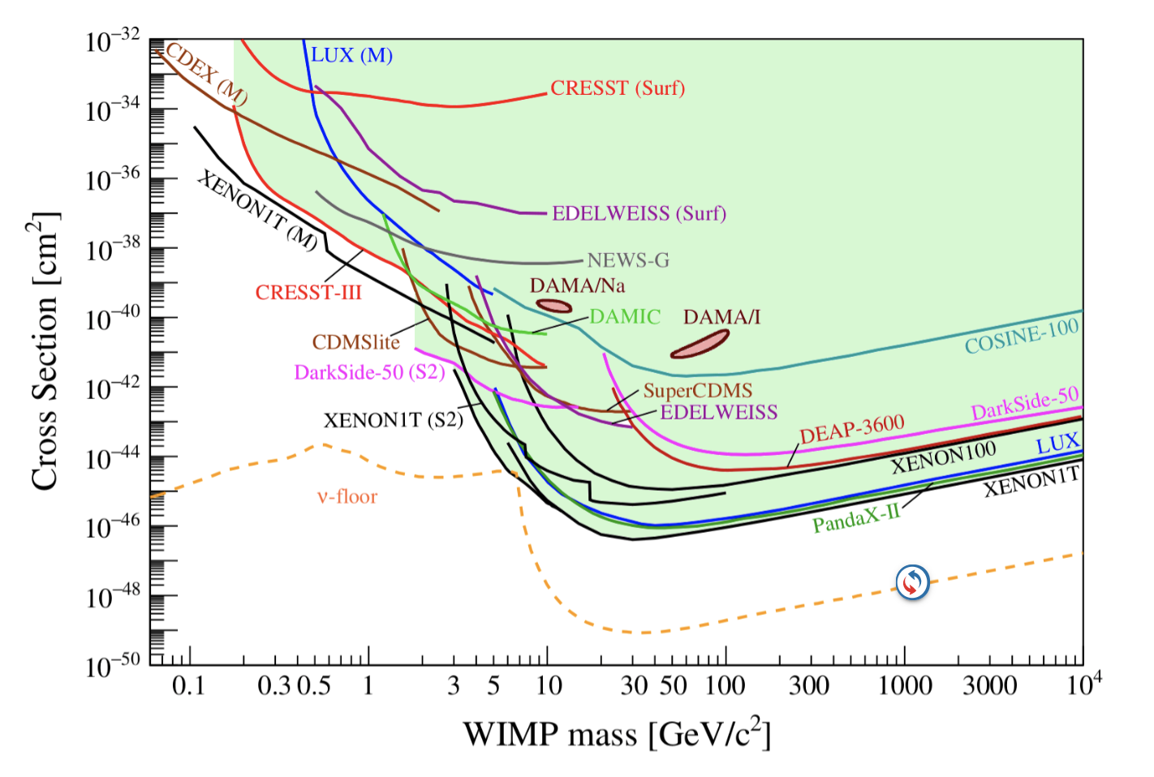
Direct Dark Matter searches
Current status of searches for spin-independent elastic WIMP-nucleus scattering assuming the standard parameters for an isothermal WIMP halo
Direct Detection of Dark Matter – APPEC Committee Report
https://www.appec.org/wp-content/uploads/2021/04/appec_dm_report_2020_ga_approved.pdf
arXiv: 2104.07634
20

Slide 21
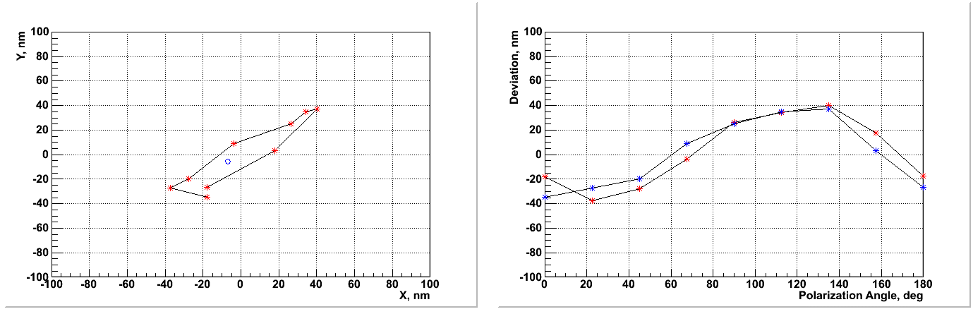
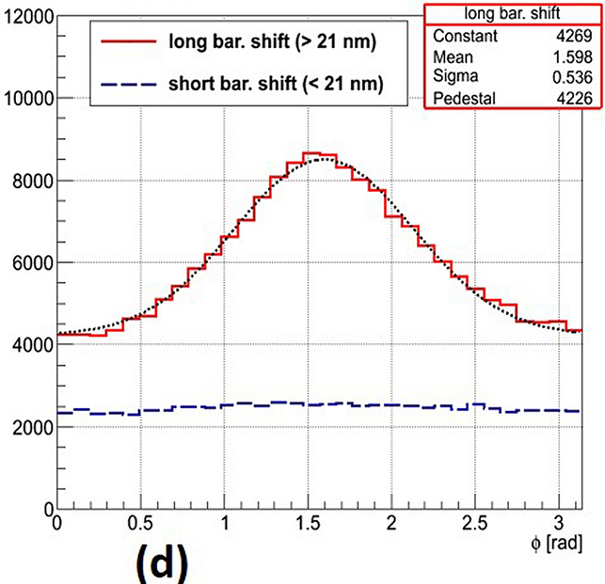
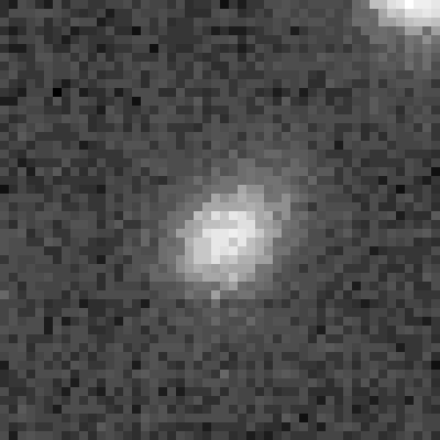
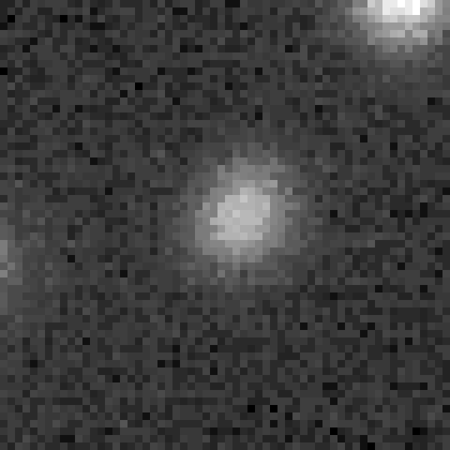
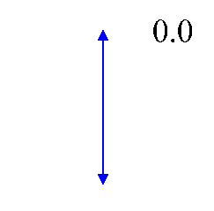
Barycenter shift analysis
NIM A 824 (2016) 600–602
Sci. Rep. 10 (2020) 18773
Rotating polarizer
No polarizer
Beam
Beam
Barycenter shift
BS=100 nm
grain1
grain2
300 nm
200 nm
Beam
1150 nm
1150 nm
Carbon ion 100 keV
Carbon ions 60 keV
21
pol angle

Slide 22
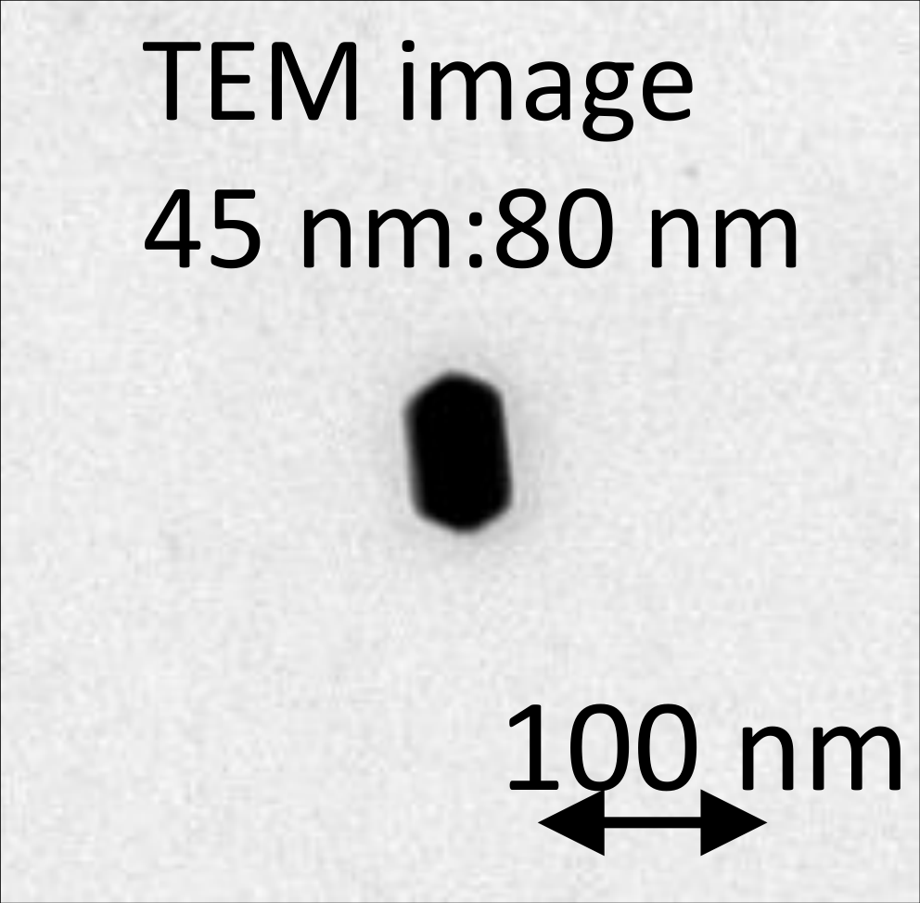
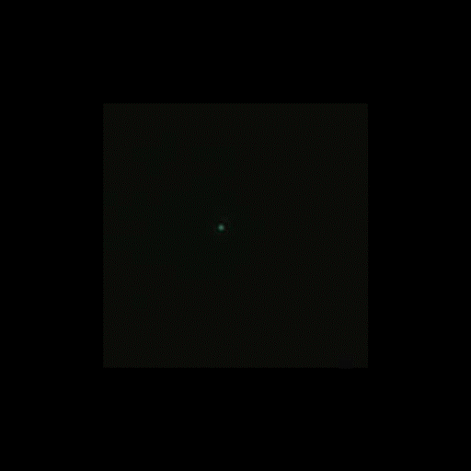
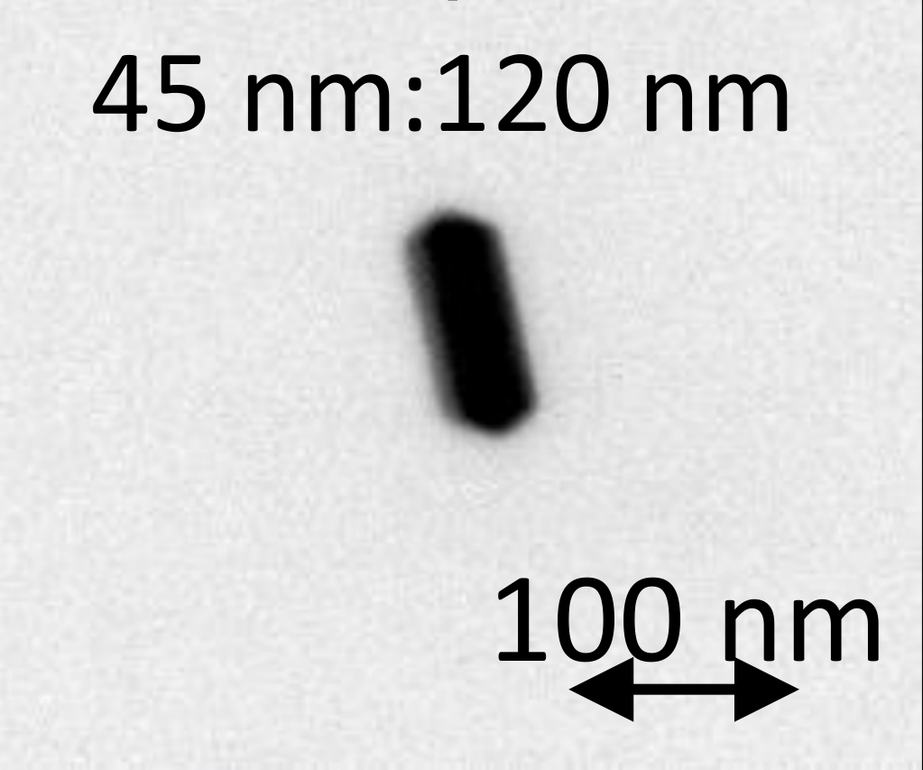
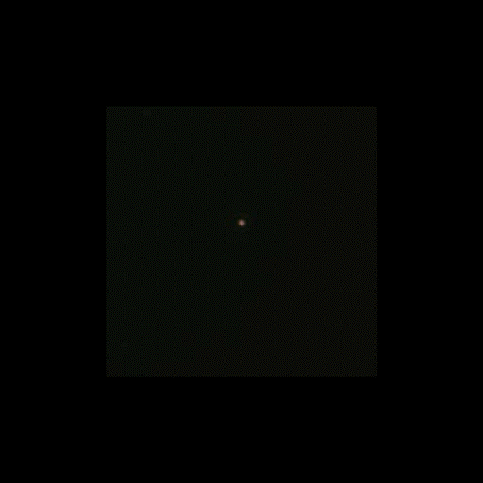

Plasmon resonance wavelength dependency
*polarization rotating
~45 nm : blue
~80 nm : green
100 nm
*polarization rotating
~45 nm : blue
~120 nm :orange
100 nm
22
20 nm
60 nm
100 nm

