Slide 1
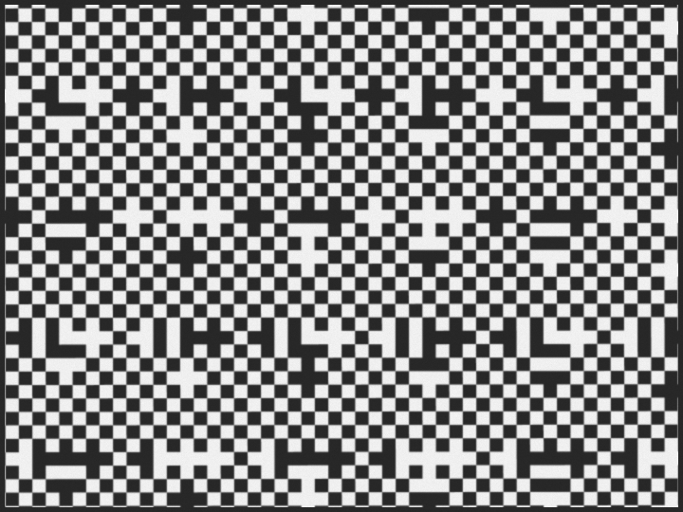
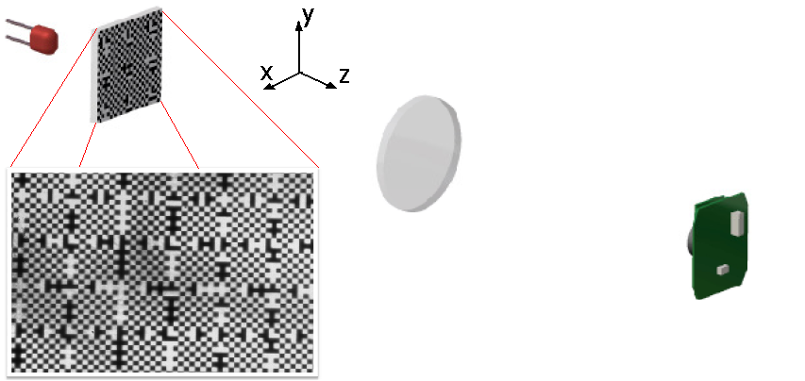

The application of the Rasnik 3-point alignment system
in seismic instrumentation
Harry van der Graaf
Bram Bouwens
Alessandro Bertolini
Joris van Heijningen
Nelson de Gaay Fortman
Lennart Otemann

Slide 2
Muon chamber alignment for the
L3 and ATLAS experiments at CERN
Muon momentum measurement: Radius of Curvature of track in magnetic field
p = 0.2998 x B x R (GeV/c)
sagitta s = L² /8R
For this, the relative position of the central tracking detector with respect to
the two outer chambers must be precisely (of order 10 𝝁m) known
Mechanically this alignment is very hard to obtain, and even harder to maintain
due to environment changes in temperature and on/off magnetic field
Therefore: monitoring of alignment

Slide 3
lens: positive singlet
pixel image sensor
(taken out of 10 € webcam)
A relative shift of a mask, lens or image pixel sensor will cause: an image-shift-on-the-sensor in X
an image-shift-on-the-sensor in y
a change in the image scale S
a rotation of the image around the optical (Z) axis

Slide 4
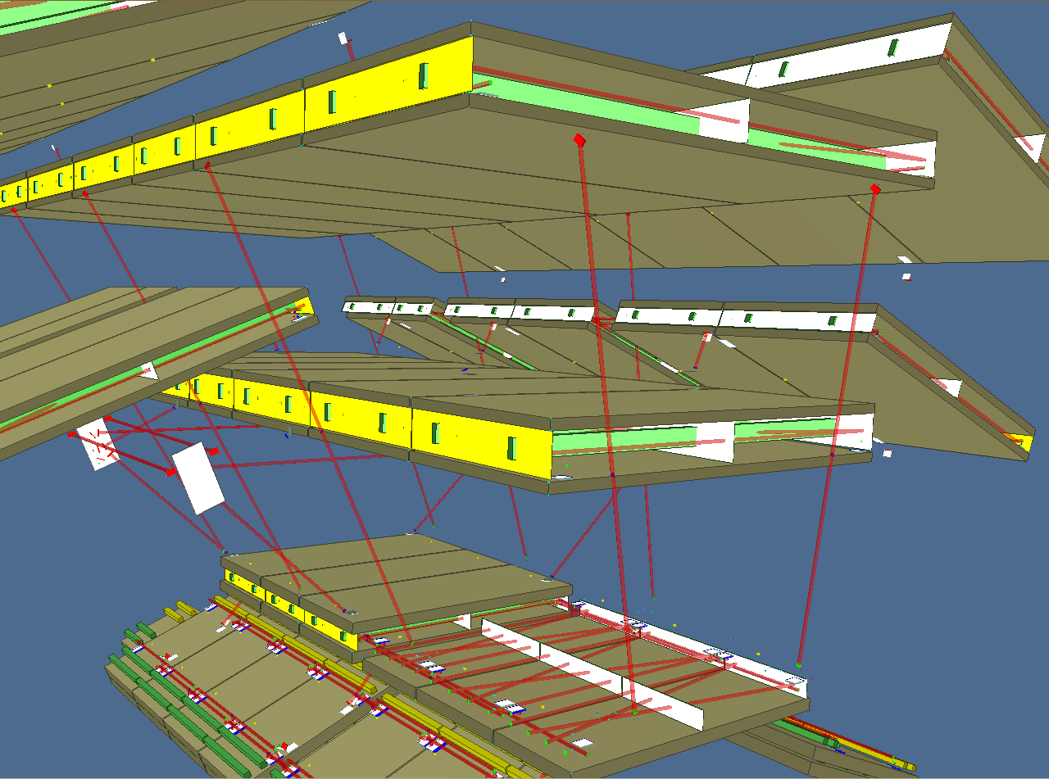

Slide 5
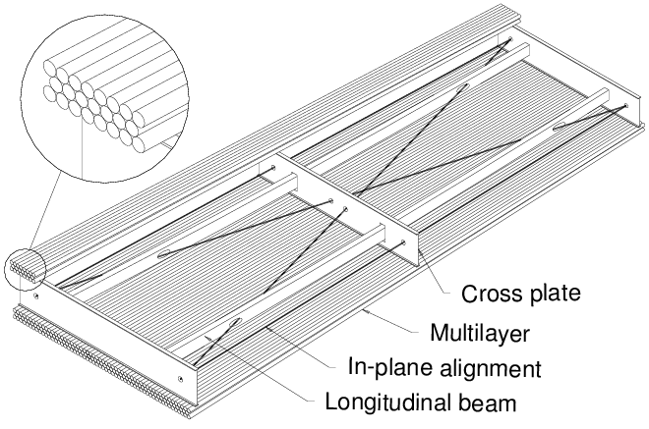
ATLAS Muon chambers:
monitoring sag and torsion
In ATLAS, 8000 Rasnik systems are perfectly operational since 2005

Slide 6
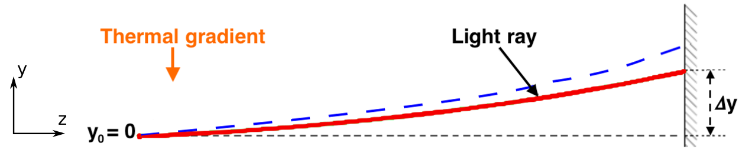
The ATLAS Rasniks (6 m distance between mask and sensor)
showed sub-um precision
In practical systems, the largest error is due to gradients in air density:
So, apply vacuum, or apply shielding of light path

Slide 7
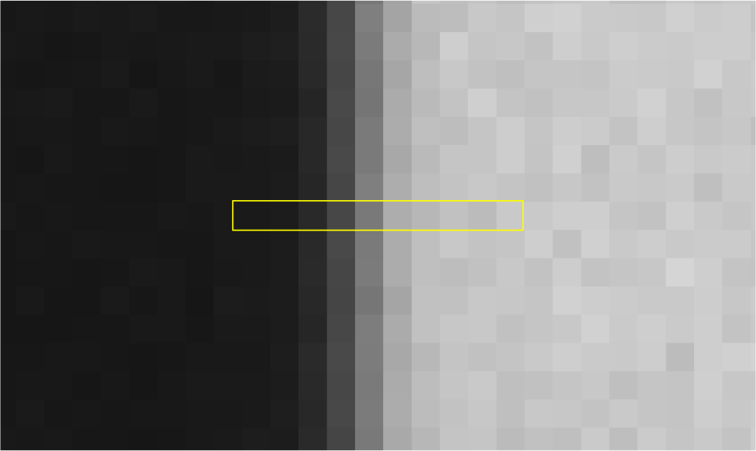
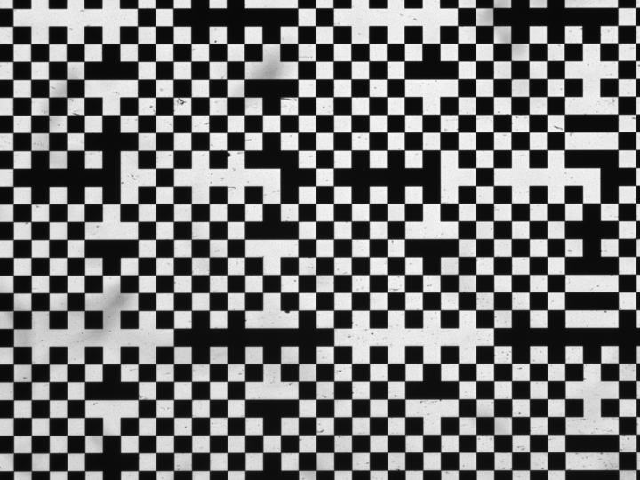
Estimation of precision to be reached:
how well do we measure the image position
on the sensor?
position measurement of
contour (black-white transient)

Slide 8
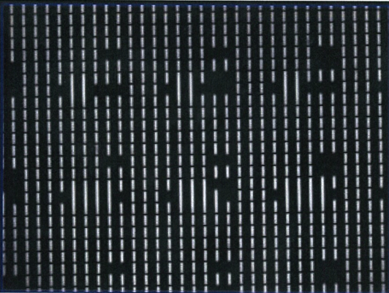
Standard system:
Sensor: 4 mm x 3 mm
pixel size: 10 𝜇m squares
ChessFiels size: 120 𝜇m squares, optimized for diffraction limited image
Total contour length: 150 mm, both vertical and horizontal
Contour position is sampled each 10 𝜇m, so position is measured 15 k times!
Given width of:
Gaussian (diffraction) distribution and
pixel noise
precision of each sample is 0.2 𝜇m
Expected precision for complete image: 0.2 𝜇m / √(15 k) = 1.5 nm
Image differentiated in X
Q(n) = Q(n+1) – Q(n-1)
Pixel noise:
mainly quantum fluctuations of light-on-pixel

Slide 9
Quality of displacement sensor:
spatial resolution
linearity
how many measurements s⁻¹ (resolution ‘power’)

Slide 10
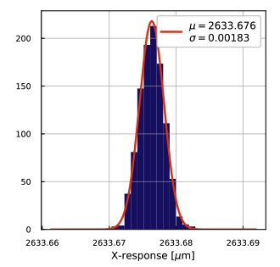
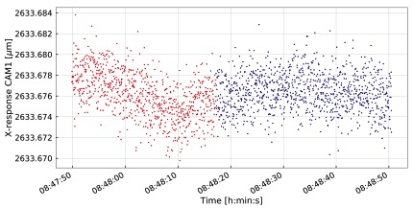

Slide 11
Measurement of spatial resolution
- solid fixation of relative position of mask, objective and sensor
- from multiple images at highest rate
Welch plots, displaying Amplitude Spectral Density (ASD)
includes ‘resolution power’ due to data rate
filters (still present) thermal and mechanical displacements
Welch plot of continues data (275 Hz),
in open air

Slide 12
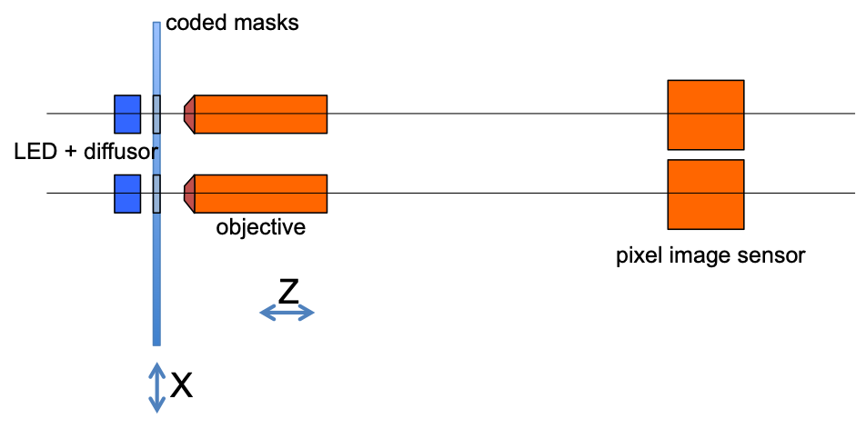
Replace positive lens by microscope objective:
image displacement increased by factor (magnification)
Measurement of spatial resolution and linearity:
take two (differential) Rasnik systems:
both masks are displaced equally by piezo actuator
Linearity: determined by mask precision

Slide 13
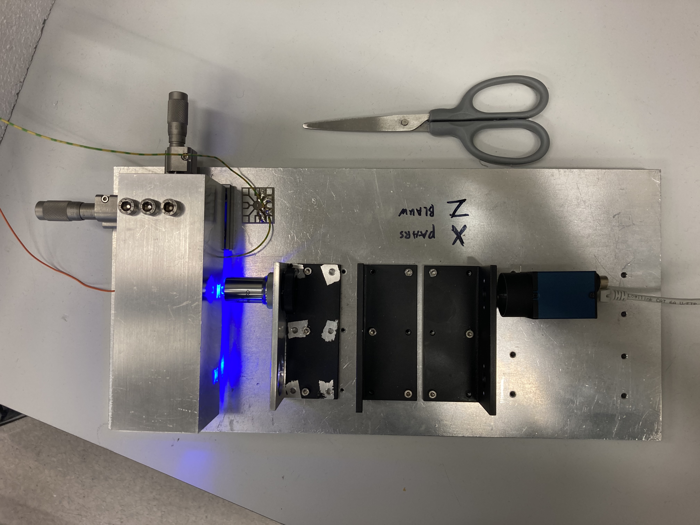
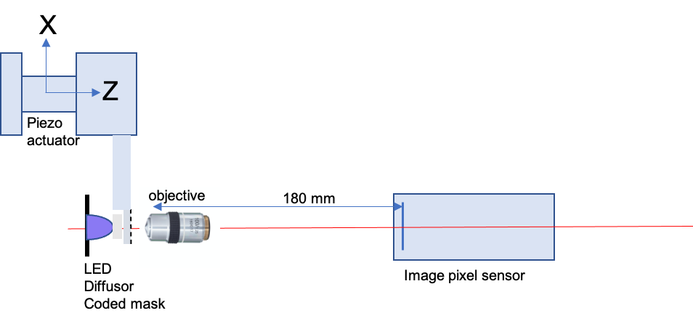
Complete unit was suspended by two
thin wires in vacuum tank

Slide 14
Noise floor level at 7 pm / √ Hz

Slide 15
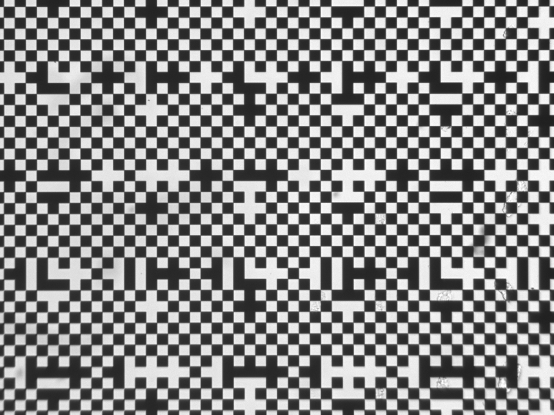
Simulations: revealed non-linearities within a mask period

Slide 16
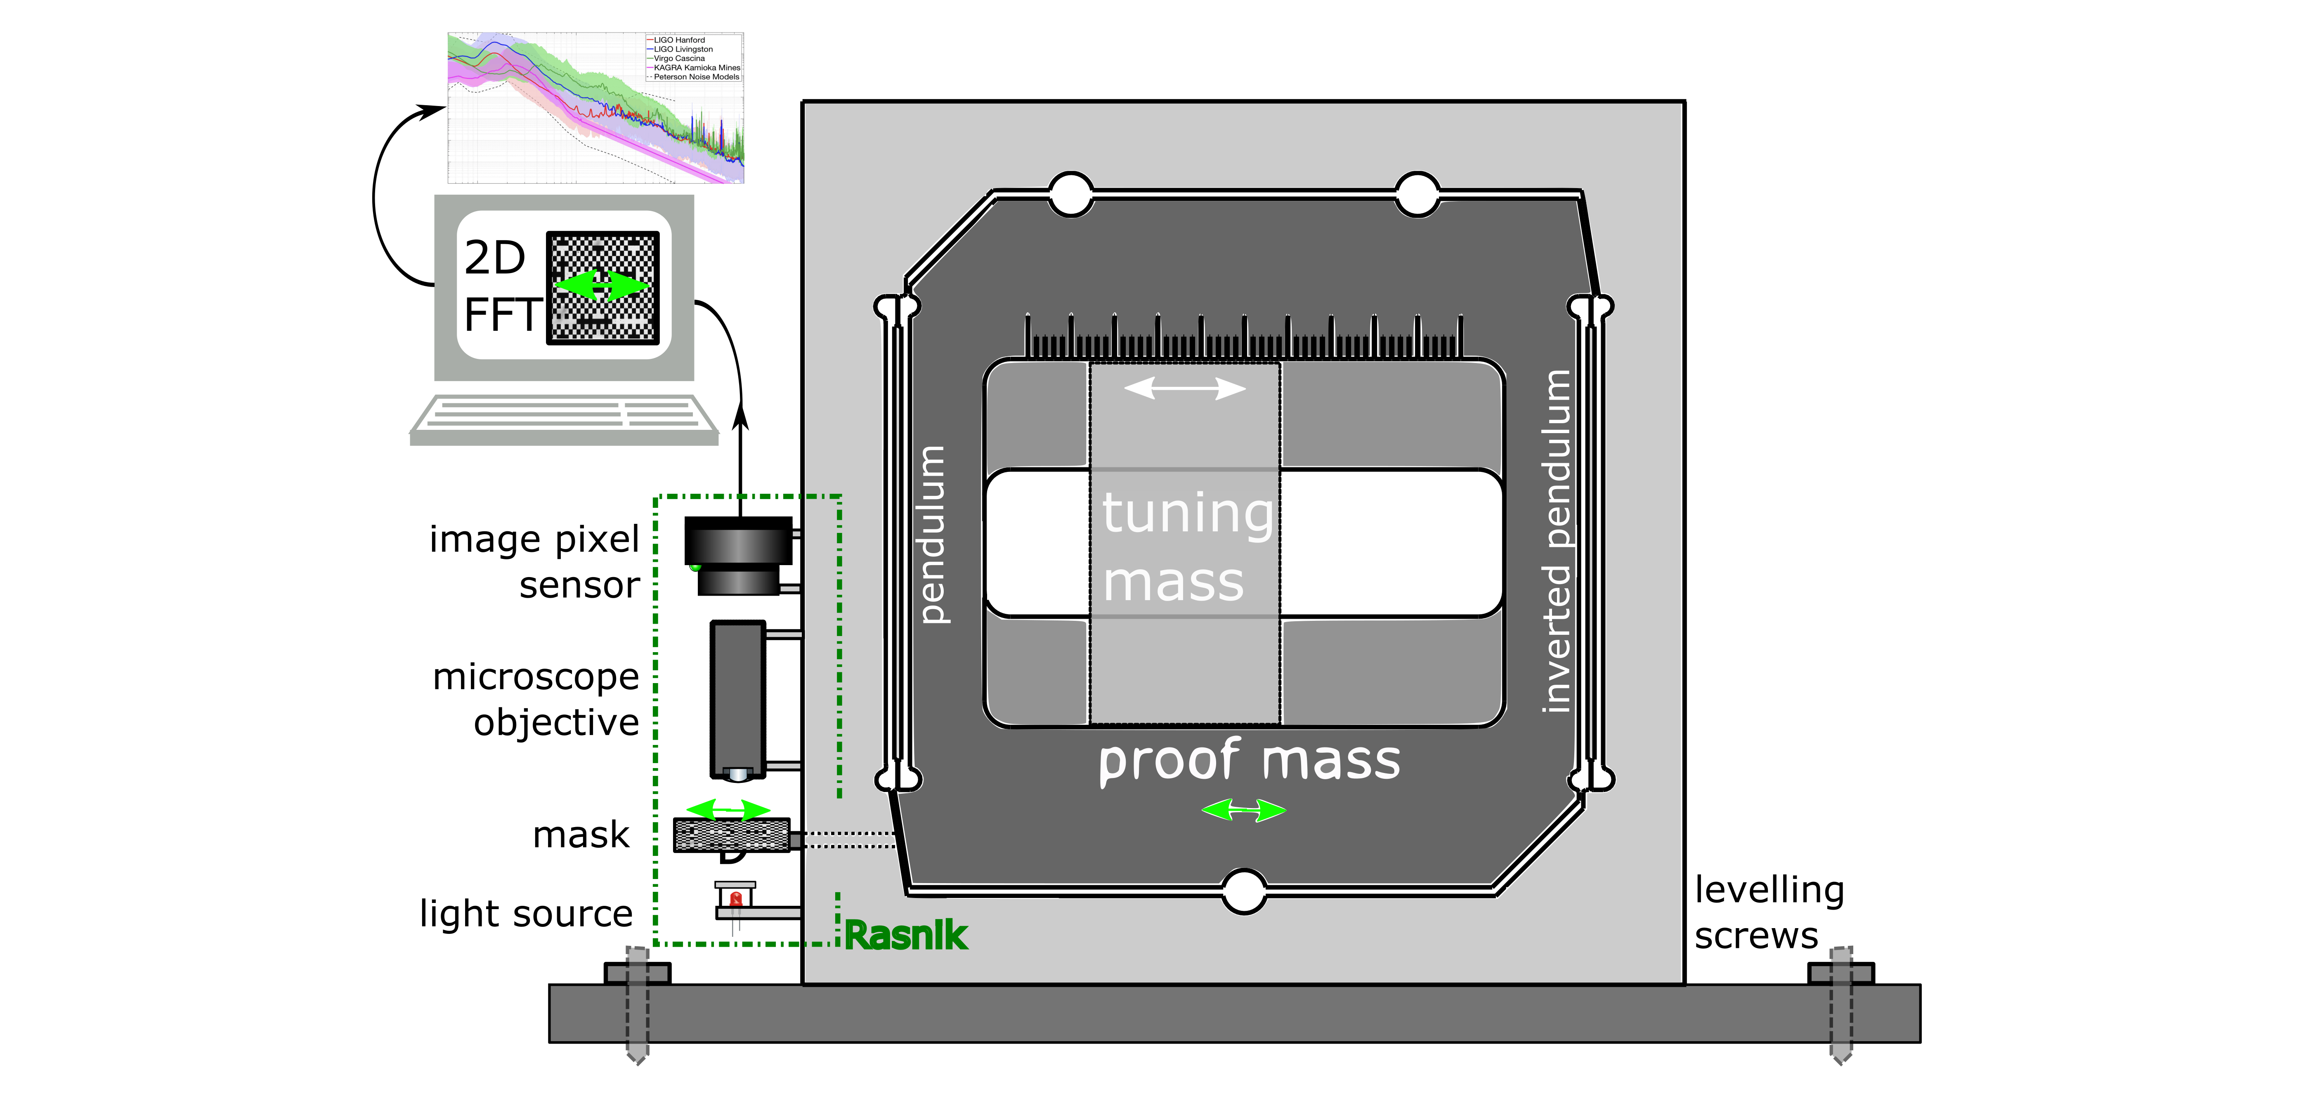
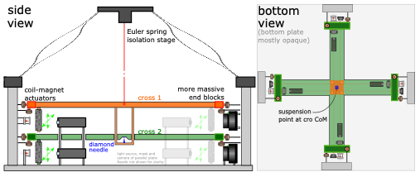
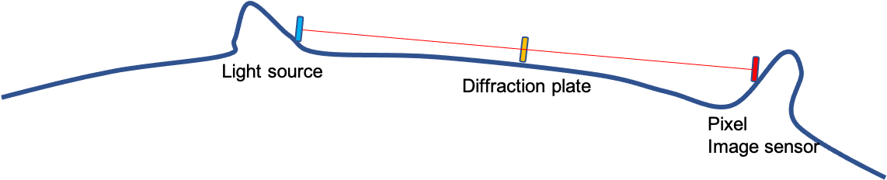
Applications
(inertial) seismic tilt sensor
(inertial) seismic sensor
the Moon as GW test mass

Slide 17
Conclusions
Rasnik measures a 2D displacement in the plane of the mask with respect to the optical axis, perpendicular to the mask plane. The optical axis is defined by the fixed-together lens and optical image sensor unit
systematical linearity error 50 pm or smaller over arbitrarily large dynamic range, in 𝑥 and 𝑦
only one precision element: the coded mask, available at low cost thanks to MEMS and IC industry
no cross coupling between output parameters x, y, S and 𝜃𝑧; perpendicularity between x and y only defined by the mask
no calibration required
straight, analog/digital linear measurement system: no ‘lock’ control and feedback systems required

Slide 18
arbitrarily large range of measurement (determined by mask size)
extremely low 1/ 𝑓 noise, and absence of drift; only 3rd order temperature effects
no special electronics required: a system can be composed of only commercially available CMOS pixel image sensors, CPUs and USB or Ethernet3 networking, and COTS optical components
(very) low cost: 300 - 3000 € excl. network and CPUs
light pressure onto the mask acts perpendicular to the directions of interest
system can operate in air, or in vacuum, and in cryogenic environments if case-specific precautions are taken.
The proven spatial resolution in 𝑥 and 𝑦 of Rasnik: 7 pm/ √Hz
is not as good as can be obtained with interferometers 4 fm/ √ Hz,
and SQUIDs 0.1 to 3 fm/ √ Hz

